Slide 1

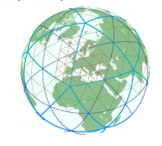
Precipitation
peak values overestimation
Average and area underestimation
Yoav Levi
WG5 21.1.2025

Slide 2

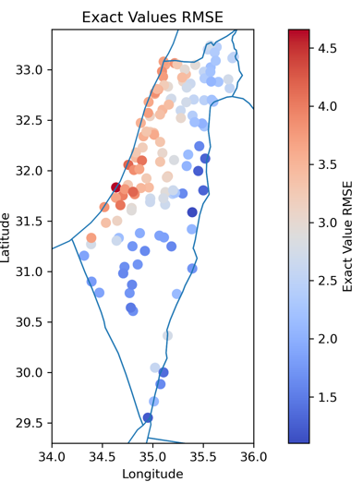
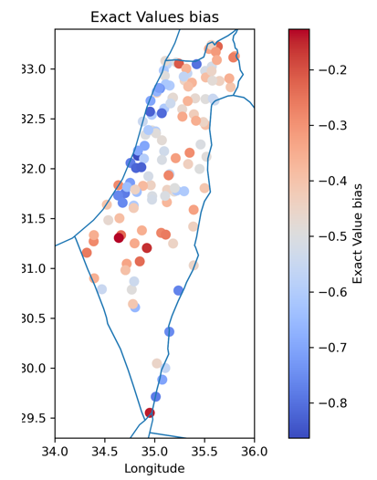
ICON precipitation verification
4 years hourly data vs. 135 rain gauges
ICON climatology on a smaller domain, 00Z runs using 6-30 hour lead time for 2019-2022
Similar results for the median and average from 27.5x27.5 km area around each rain gauge
ICON has a negative overall bias.
Near the coast larger biases and RMSE.
Nearest point RMSE
Nearest point bias
COSMO GM 2024, Offenbach

Slide 3
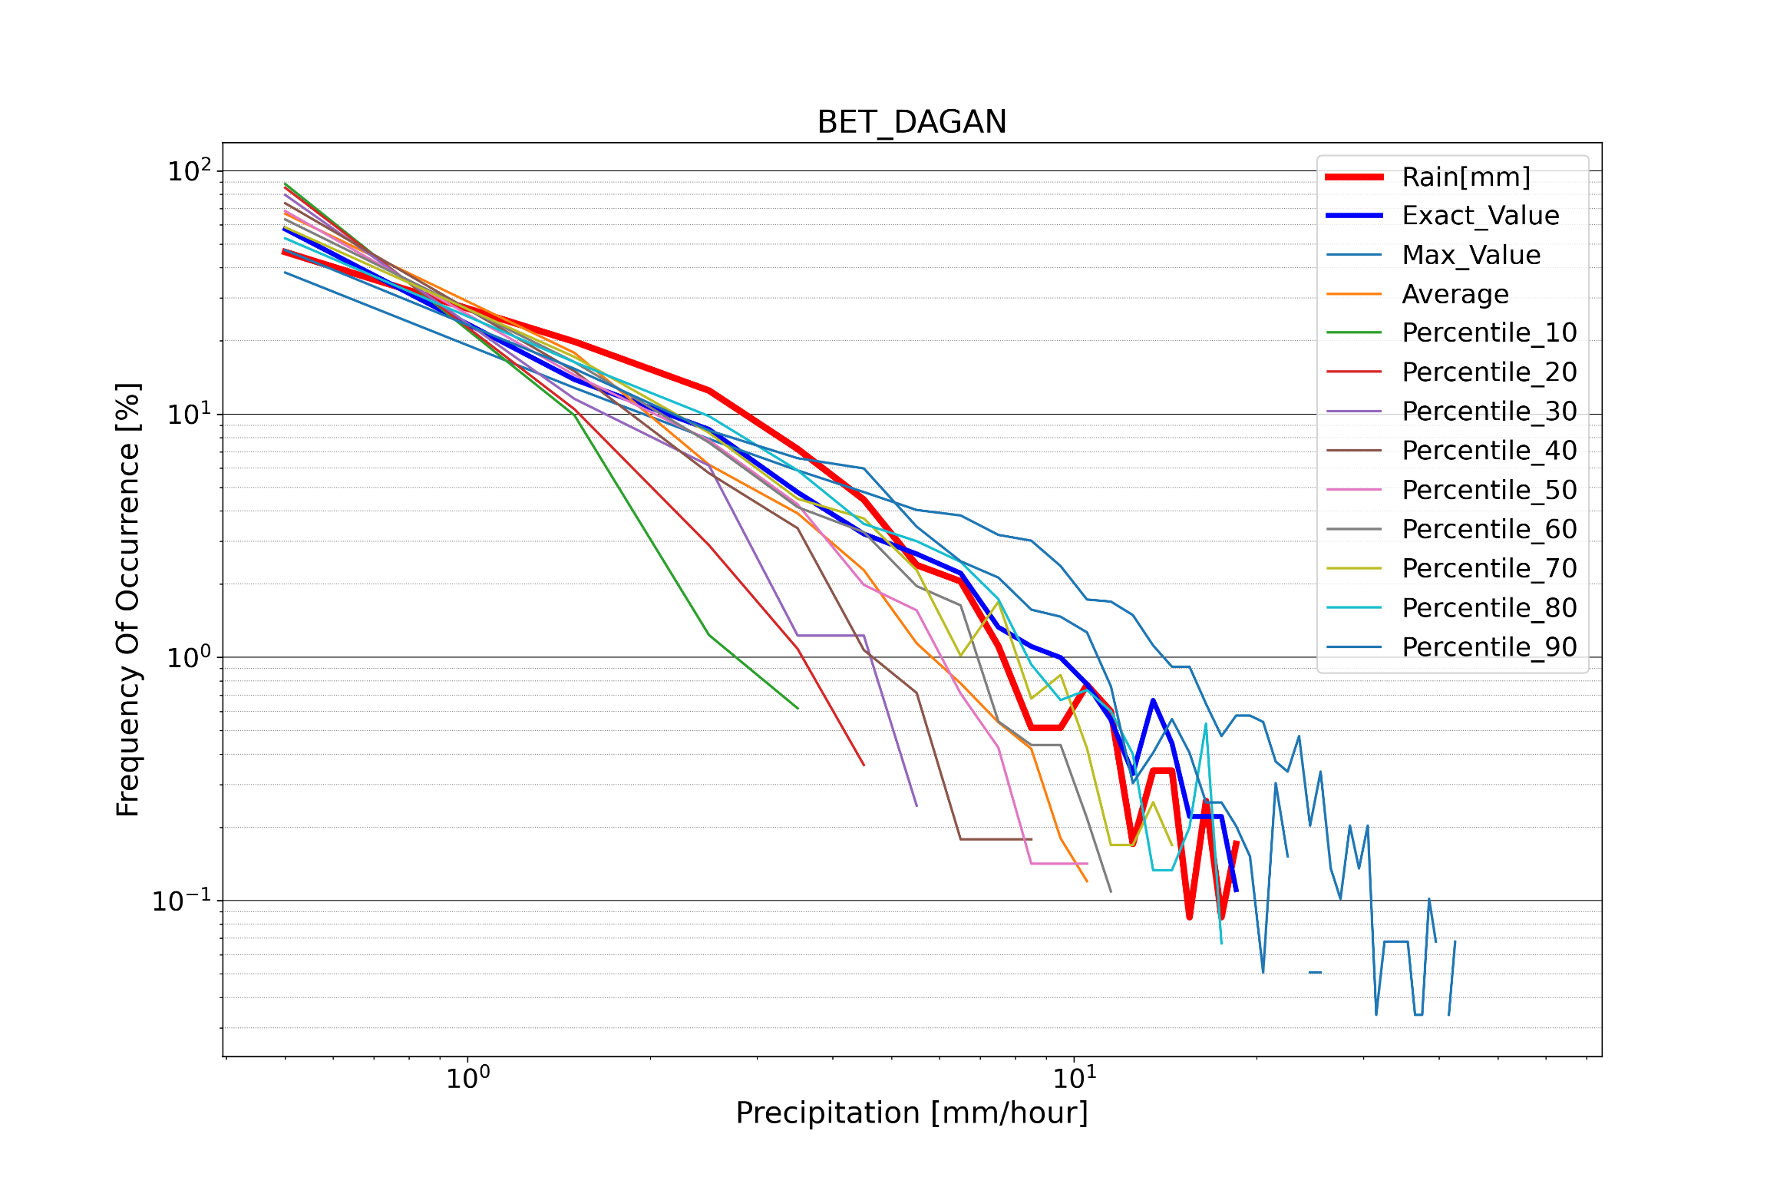
Precip. Distribution
27.5x27.5 km around Bet Dagan gauge
Obs
~ 4-5 mm/hour
Nearest point
Missing rains
max
nearest
90%
Obs
80%
COSMO GM 2024, Offenbach

Slide 4
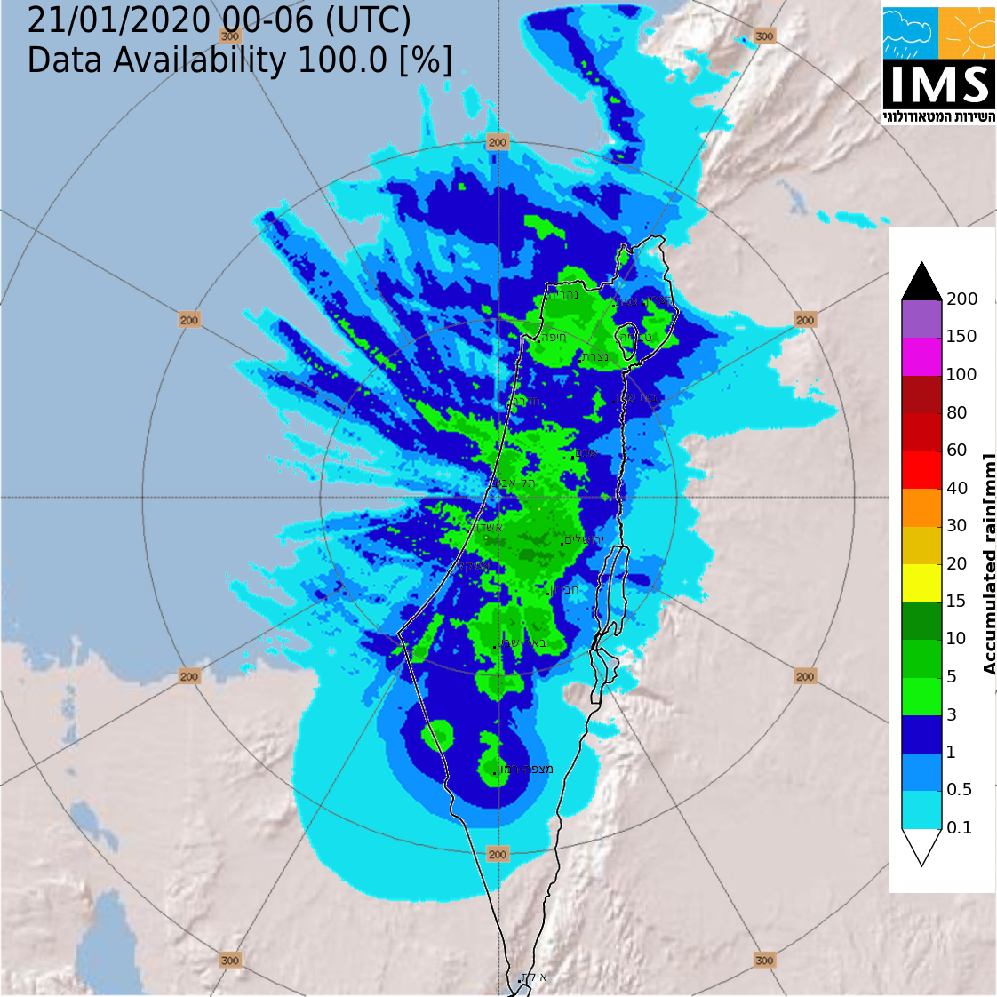
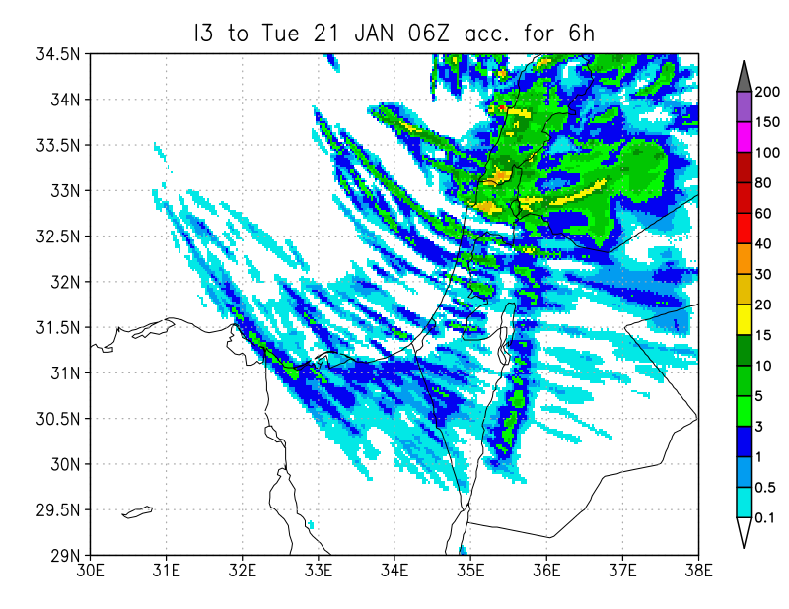
Although max values are in good agreement
there are may white areas in the ICON forecast
ICON forecast
Radar + rain gauge
COSMO GM 2024, Offenbach

Slide 5
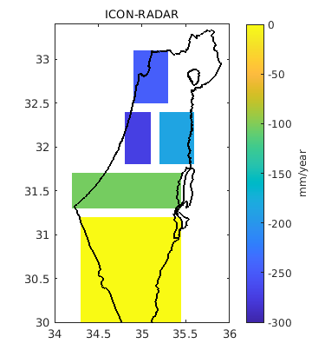
ICON-CLM
ICON-CLM (2.5 km) also indicates a negative bias.
How to fill the precipitation gap between convective cells and enhance the lower precipitation rates?
COSMO GM 2024, Offenbach

Slide 6
ICON
Modifications of the (1Mom) graupel scheme and the saturation adjustment to improve the precipitation characteristics in ICON-D2
Günther Zängl, Alberto de Lozar, Axel Seifert
routine meeting, 26.11.24
Notes:
6

Slide 7
Measures
Modification of the saturation adjustment (satad), which allows a supersaturation of up to 0.005*w in updrafts (i.e. 5% at 10 m/s). This is additionally limited to limfac*QC/QV so that cloud formation also starts at the saturation point in updrafts:
tune_supsat_limfac = 2.0
Corresponding adjustment in the LHN (controlled by the same switch; important!)
Variable ‘rain_n0_factor’ with transition range between 1 and 3 g/kg (QR)
lvariable_rain_n0 = .true. (namelist parameter)
Halving the snow-sleet conversion term by rimming
tune_zcsg = 0.25 (default 0.5)
Consideration of the T-dependence of the phase transformation heats in microphysics
ithermo_water = 1 (in RUC operational) (namelist parameter)
Halving the subscale term for CLC diagnostics in ice clouds
tune_sgsclifac = 0.5 (in RUC und ICON-global 0; no impact on precipitation)

Slide 8
IMS experiment
Compare org configuration at IMS to the new configuration with:
At granules/microphysics_1mom_schemes/gscp_graupel.f90 lines 622 & 646:
lvariable_rain_n0 = .true. (namelist parameter) -->
log_n0fac = LOG(MIN(0.005_wp,MAX(64.0_wp,(10.e2_wp*qr(iv,k))**2)))
  rain_n0_factor = 64
tune_supsat_limfac = 2.0 Limit supersaturation in saturation adjustment
tune_zcsg = 0.25
ithermo_water = 1 (in RUC operational) (namelist parameter)
tune_v0_snow = 20

Slide 9
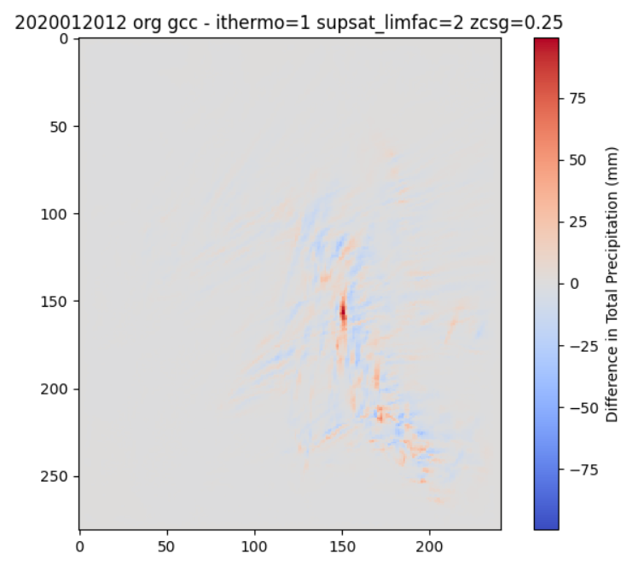
Tot_perc sum for 48 hours
20.01.2020 12Z to
22.01.2020 12Z

Slide 10
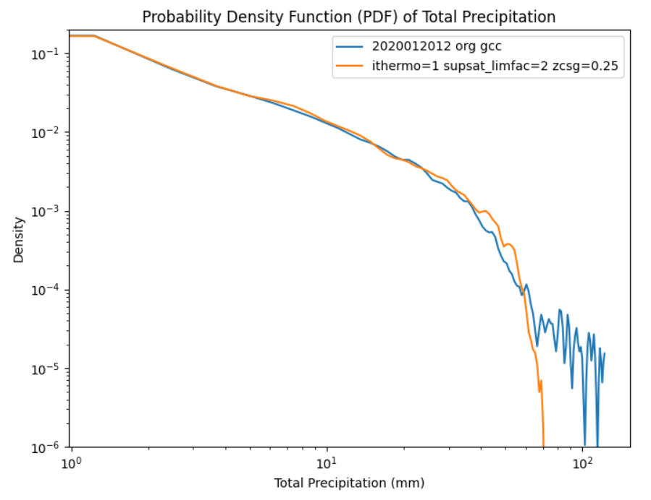

Slide 11
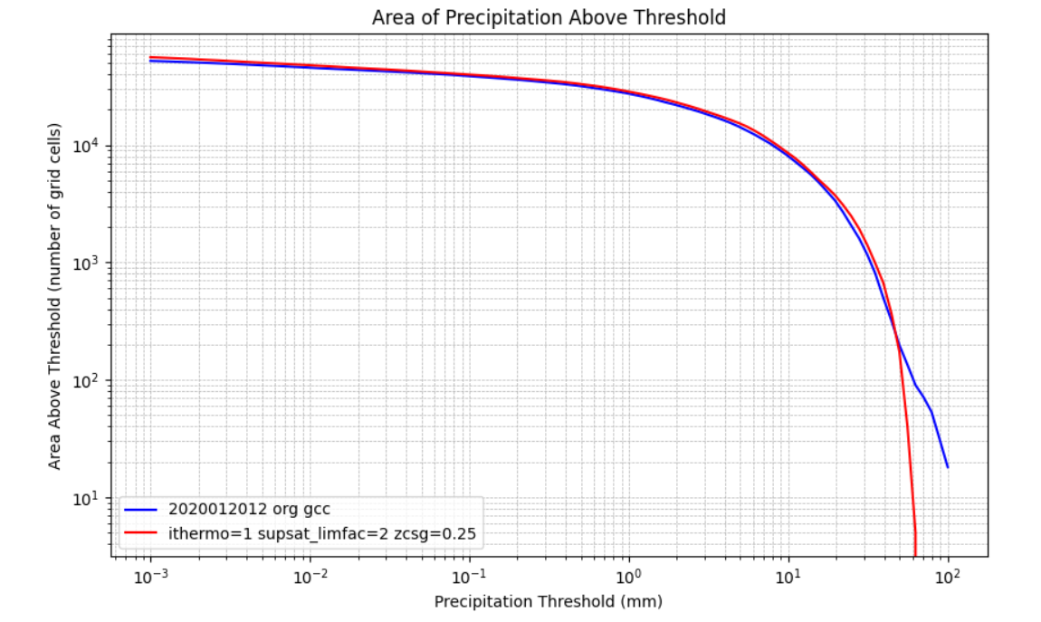
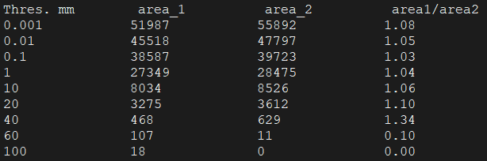
The new tuning reduced the maximum value by 44% increased the average precip. by 6.4% and increased the precip. area in all thresholds less up to 40 mm.

Slide 12
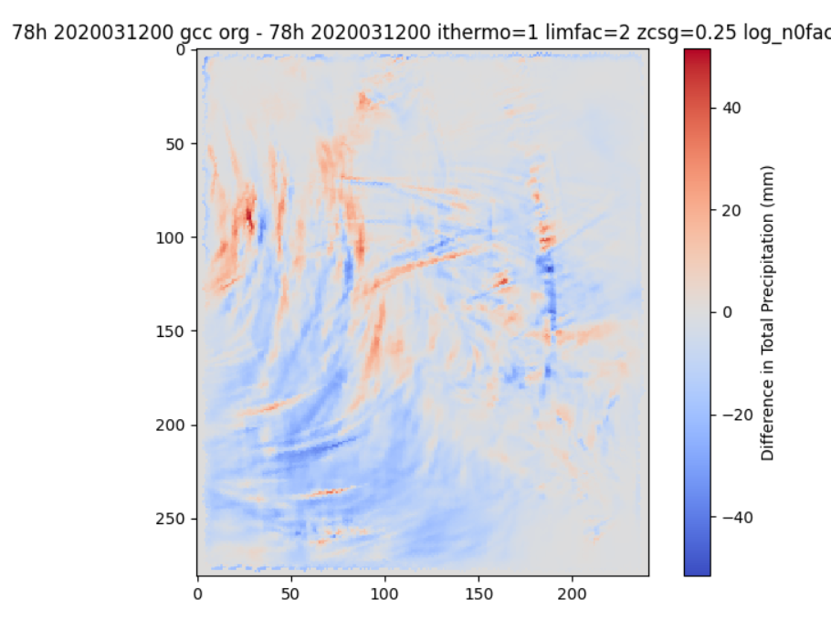

Slide 13
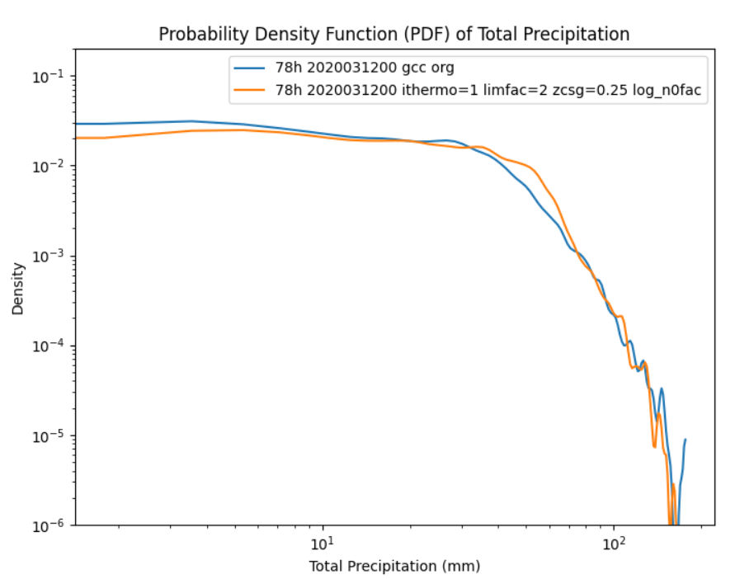

Slide 14
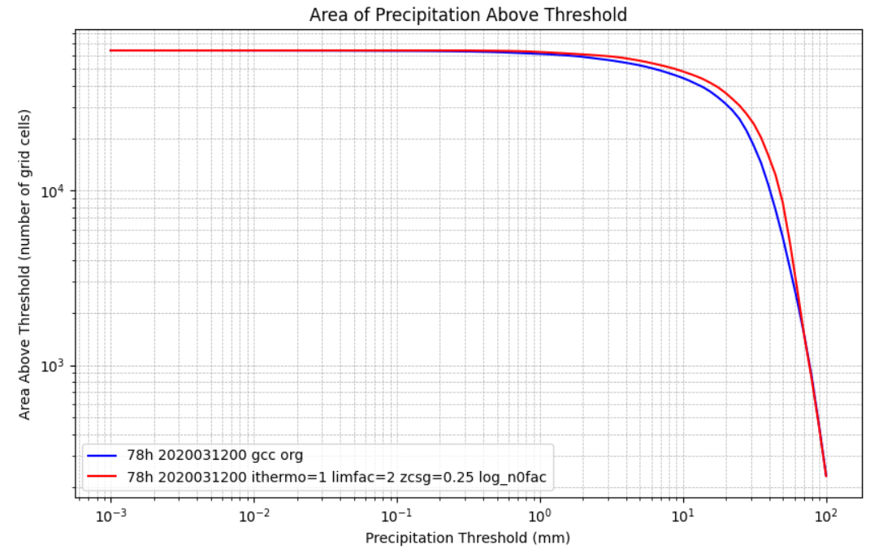
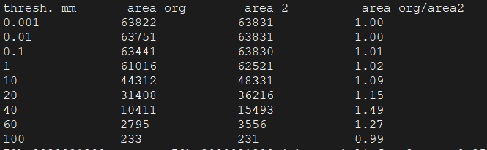
The new tuning reduced the maximum value by 9% increased the average precip. by 17% and increased the precip. area for all thresholds less up to 60 mm

Slide 15
Summary
The 2 cases indicate that the new tuning does the trick
Improvement of the intercept parameter N0 tuning
More verification should be done.
COSMO GM 2024, Offenbach

