Slide 1
Use of extended Mode-S aircraft data
in ICON-D2
Christoph Schraff, Hendrik Reich
Elisabeth Bauernschubert, Harald Anlauf, Klaus Stephan, et al.
Deutscher Wetterdienst, Offenbach, Germany
obtained / derived from
air traffic control surveillance
(horiz.) wind vector + temperature data
(temperature derived from Mach number → larger obs error)
finally collected + processed + quality controlled by KNMI
(EMADDC = “European Meteorological Aircraft Derived Data Centre” → http://emaddc.com)
(from www.emaddc.com/publications++presentations)

Slide 2
New, extended Mode-S aircraft data product
Mode-S v1.6 used operationally since 2017: NOT available after end March 2022
(QC + BC not updated any more by KNMI, quality potentially degraded continuously)
new all-stream EMADDC v2.2 (available since Oct. 2021)
more dense, expanded area → > 100 times more Mode-S data
improved quality control
new Mode-S (v2.2)
traditional
Mode-S (v1.6)
1 Oct. 2021
0 – 1 UTC
zonal wind (FG)

Slide 3
New, extended Mode-S aircraft data product
new all-stream EMADDC : ~ 45 / 25 million wind / temperature obs per day
number of
derived obs
in [0.5x0.5]°
20 – 26
Sept. 2021
different ‘streams’
(Mode-S EHS
data providers)
(from www.emaddc.com/publications++presentations)

Slide 4
New, extended Mode-S aircraft data product:
Technical issues
Mode-S available as multi-BUFR messages (up to 100) – within 1 multi-BUFR:
all aircraft reports valid for same minute, but distributed widely in vertical + horizontal
SKY / GloBUS: multi-BUFR split up
into blocks of 10 x 10 deg.
→ need to read all blocks that overlap with
ICON-D2 domain (40N – 60N, 10W – 20E)
→ huge amount of reports
(> 1 million per DA cycle at daytime)
→ required time for 1-hr ICON-D2 first guess run:
1 min → 5 min ! (in BACY)

Slide 5
New, extended Mode-S aircraft data:
Technical issues
to make it affordable:
→ increased parallelization:
– data base retrieve, conversion BUFR → NetCDF (cdfin)
– parallelized reading of cdfin-files by ‘unified’ DACE obs operators for obs type AIREP
(cdfin files read by as many PE’s in parallel, additionally parallel read of each cdfin)
→ pre-thinning: as early as possible in DA process (i.e. after reading obs in ICON)
→ # reports reduced by factor > 30 for further processing ( )
(obs operators applied for model equivalents, written to feedback files,
read by LETKF, available for verification (!))
→ extra wall clock time used: ~ 45 – 60 sec. for 3-hr DA block in operational setup ☺
box size:
10 hPa, 40 km

Slide 6
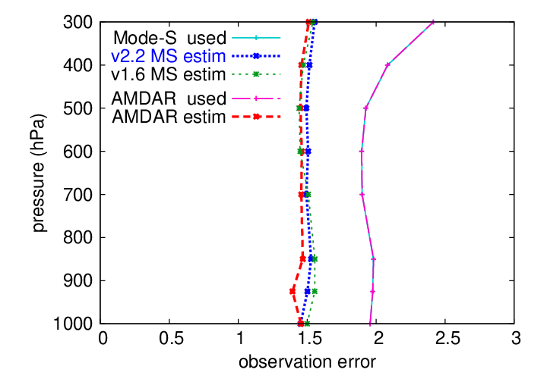
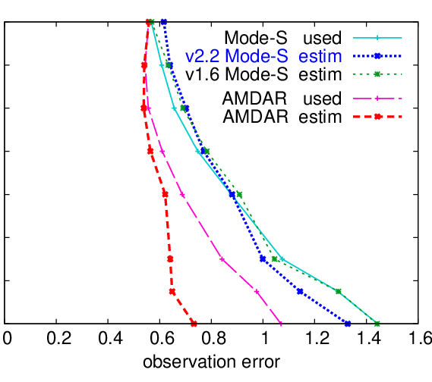
New, extended Mode-S aircraft data product:
Data quality
observation error ‘estimation’ by Desroziers statistics
wind
temperature
wind obs error similar to old Mode-S, AMDAR
temperature obs error: slightly smaller than old Mode-S, still much larger than AMDAR
potential for improvement by optimizing obs errors used in LETKF

Slide 7
New, extended Mode-S aircraft data:
Thinning / experiments
thinning box sizes:
Exp. | AMDAR (wind, T, (RH)) | Mode-S (wind, T – horiz. 40 km)
REF (rout) | 5 hPa, ~ 80 km | v1.6 50 hPa
NEW | 10 hPa, 40 km, pref | v2.2 50 hPa
NEW_2 | sfc. – 600 hPa: 5 hPa, 20 km, pref 600 – 100 hPa: 10 hPa, 40 km, pref (amount of active data similar as in REF) | v2.2, sfc. – 840 hPa: 10 hPa, pref v2.2, 840 – 700 hPa: 20 hPa, pref v2.2, 700 – 100 hPa: 50 hPa, pref
thinning preferences:
standard: 1. status (active), 2. time (dist. to analysis), 3. data (number of obs)
“pref” : 1. status (active), 2. data (number of obs), 3. time (distance to analysis)
→ with “pref”: more temperature obs, possibly further in the past
NEW vs. REF : new Mode-S obs, DACE obs operators, similar thinning
NEW_2 vs. NEW: less thinning in lower troposphere
BACY experiment period: 1 – 20 Oct. 2021

Slide 8
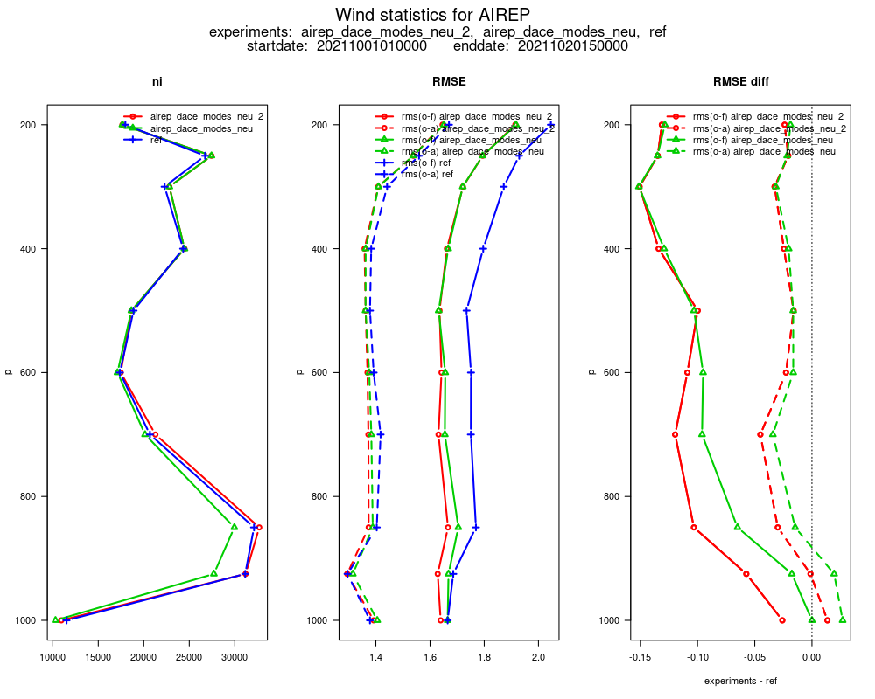
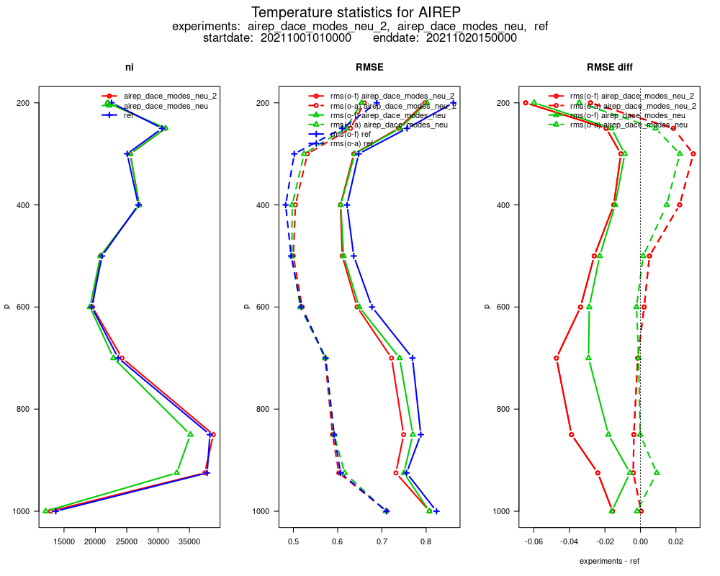
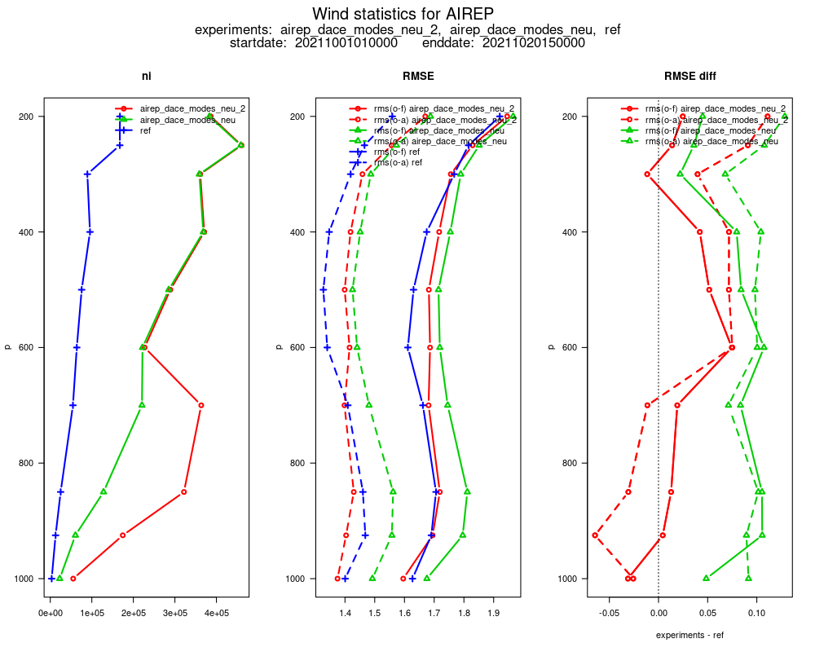
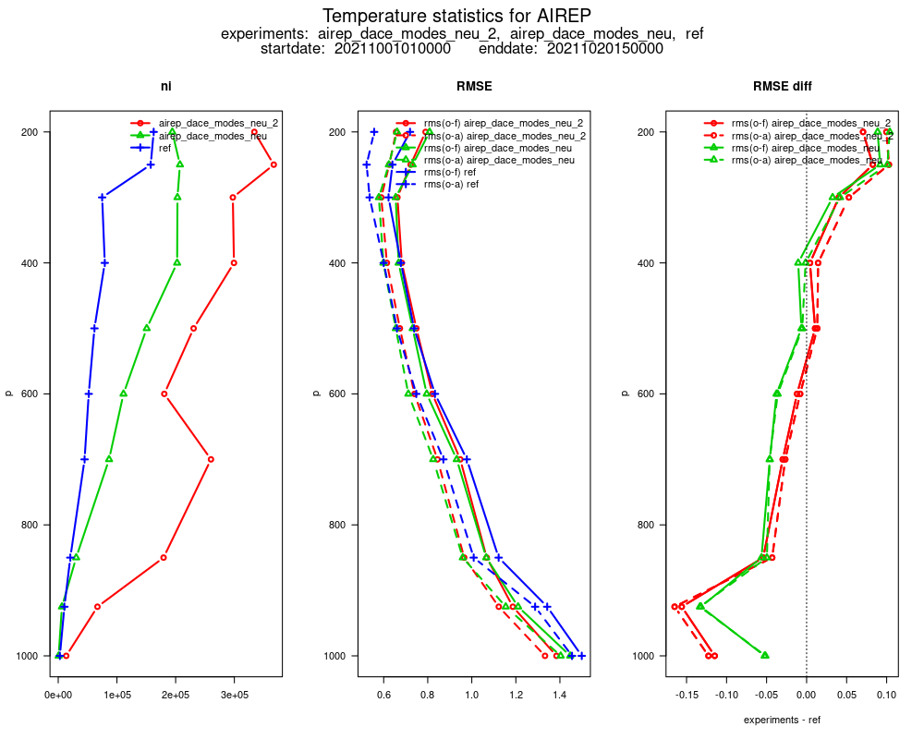
New, extended Mode-S aircraft data:
Number of active observations
AMDAR wind
AMDAR temperature
Mode-S wind
Mode-S temperature
REF
NEW
NEW_2
30’000
30’000
30’000
30’000
AMDAR: similar number of obs in NEW_2 and REF
Mode-S (NEW vs. REF): far more wind obs, no more T obs at low levels! …from larger area!
NEW_2 (vs. NEW): more Mode-S obs at lower levels, more T obs at all levels due to “pref”
(in same horizontal areas!)

Slide 9
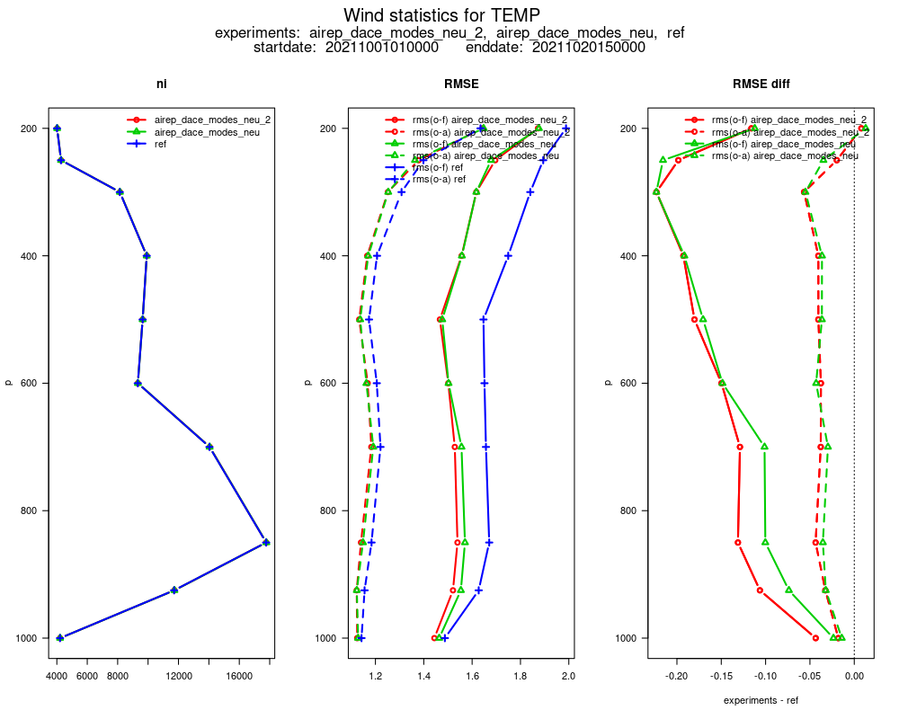
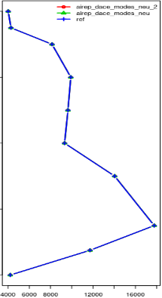
New Mode-S aircraft data:
First guess wind RMSE
AMDAR
Mode-S
Wind
RMSE
radiosondes
RMSE diff to REF
REF
NEW
NEW_2
# obs
vs. AMDAR: large error reduction (~ 7 %), particularly NEW_2 (similar obs as REF)
vs. Mode-S: larger RMSE, but verifying obs set very different, covering different areas!
vs. radiosonde: error reduction 7 – 10 % ! NEW_2 better than NEW

Slide 10
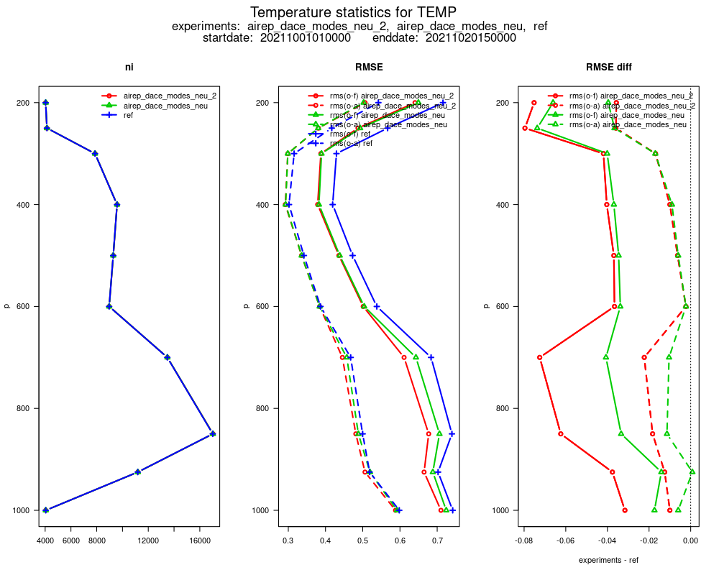
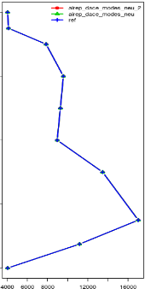
New Mode-S aircraft data:
First guess temperature RMSE
AMDAR
Mode-S
T
RMSE
radiosondes
RMSE diff to REF
REF
NEW
NEW_2
# obs
vs. AMDAR, Mode-S: clear error reduction
vs. radiosonde: error reduction 5 – 10 % ! NEW_2 better than NEW

Slide 11
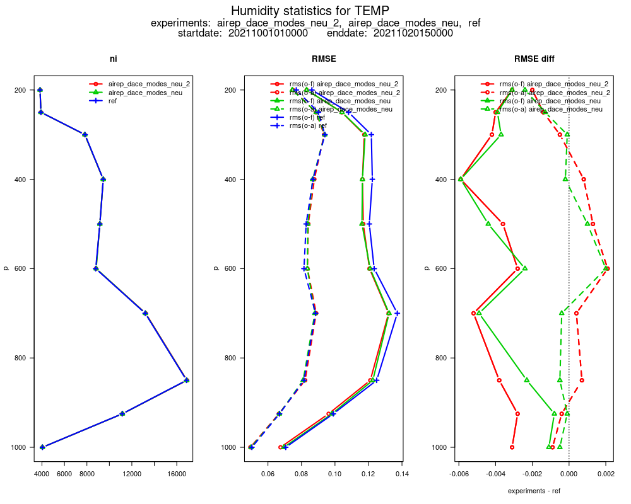
New Mode-S aircraft data:
First guess humidity RMSE
RH
RMSE
radiosondes
RMSE diff to REF
REF
NEW
NEW_2
vs. radiosonde: error reduction 2.5 – 5 % !
NEW_2 slightly better than NEW at low levels

Slide 12
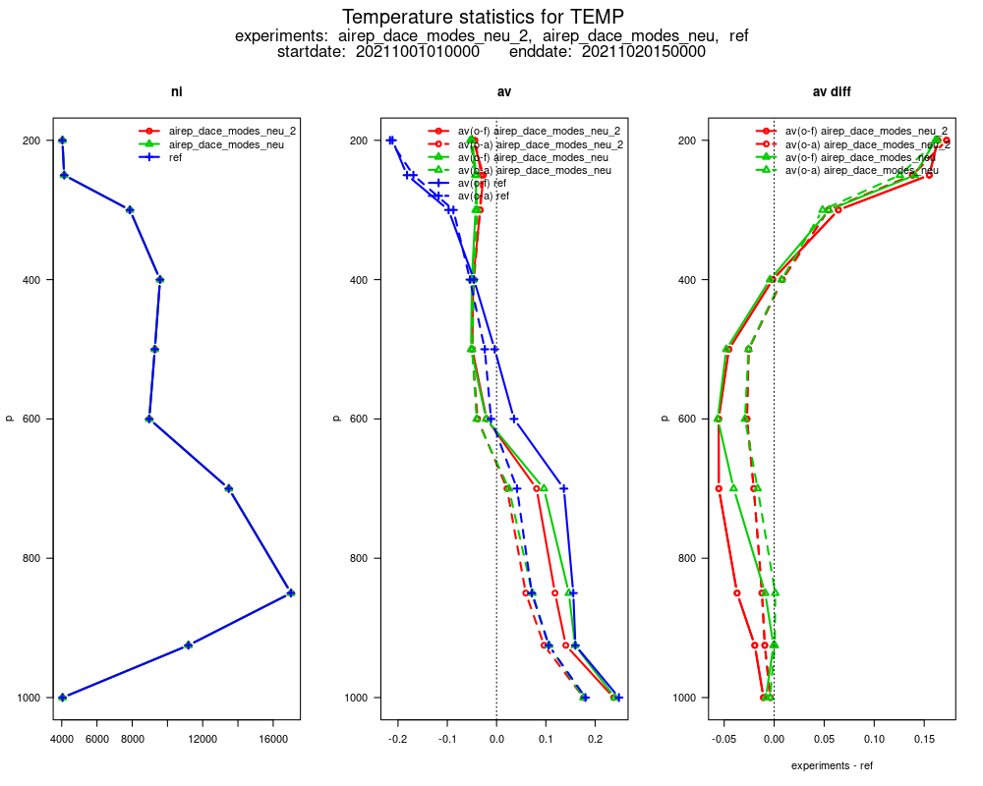
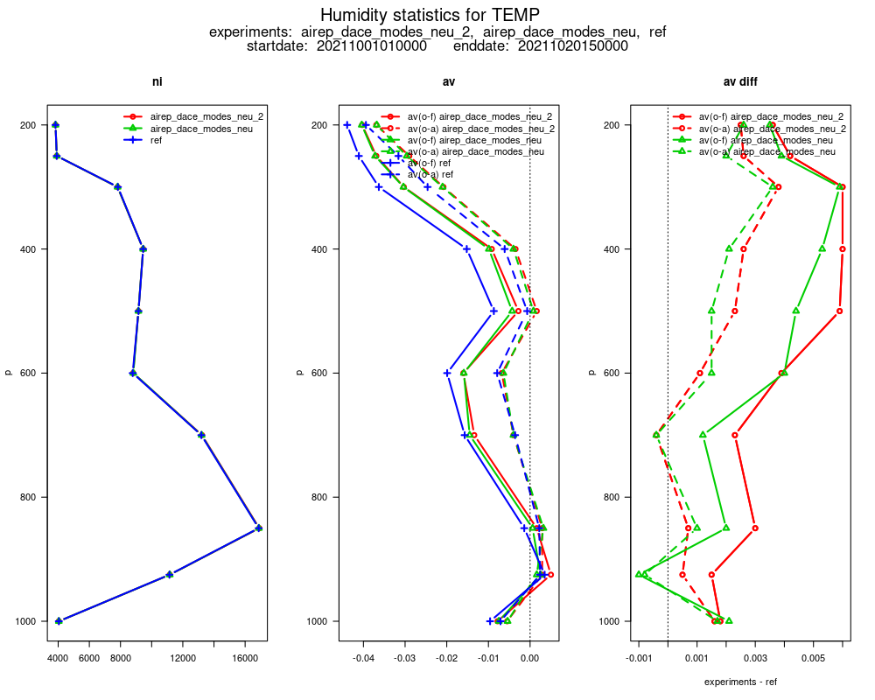
New Mode-S aircraft data:
First guess biases
radiosondes
temperature bias
RH bias
REF
NEW
NEW_2
vs. radiosonde: also temperature + humidity (cold + wet) biases reduced

Slide 13
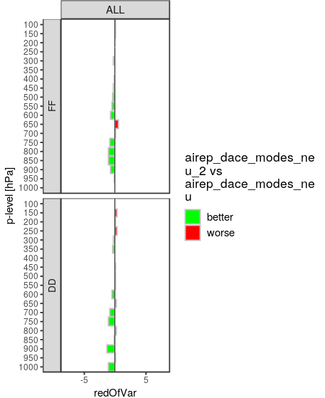
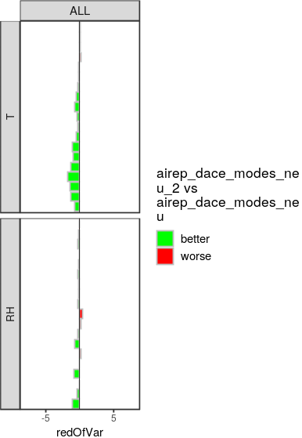
New Mode-S aircraft data:
Verification of deterministic forecasts
Radiosonde
verification
NEW_2 vs. NEW
reduced thinning (NEW_2 vs. NEW):
beneficial in radiosonde verif.
neutral in Synop verif.

Slide 14
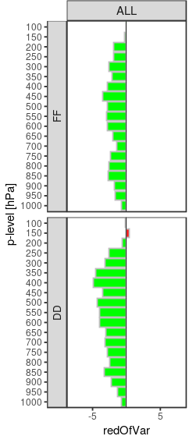
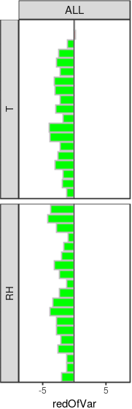
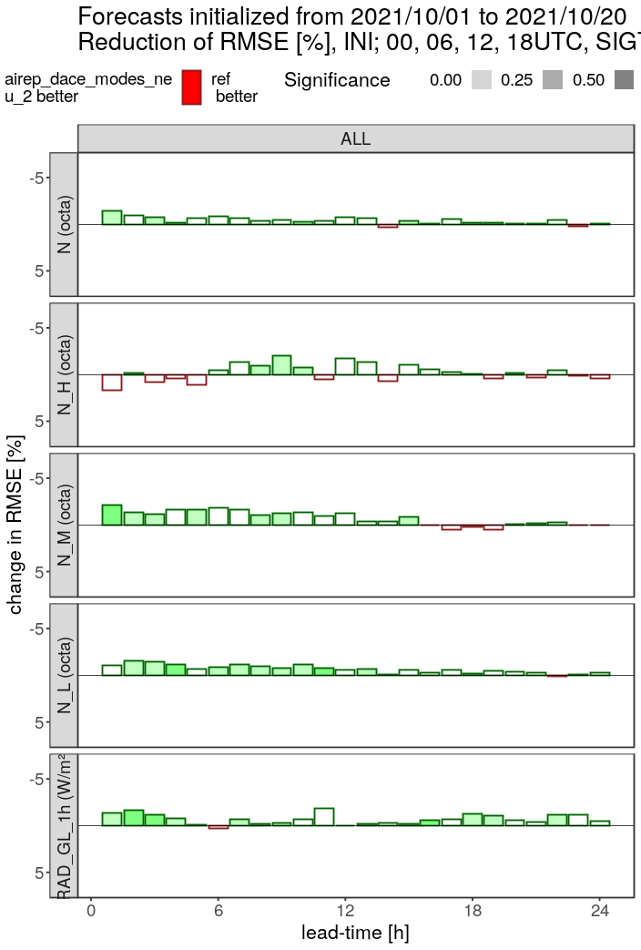
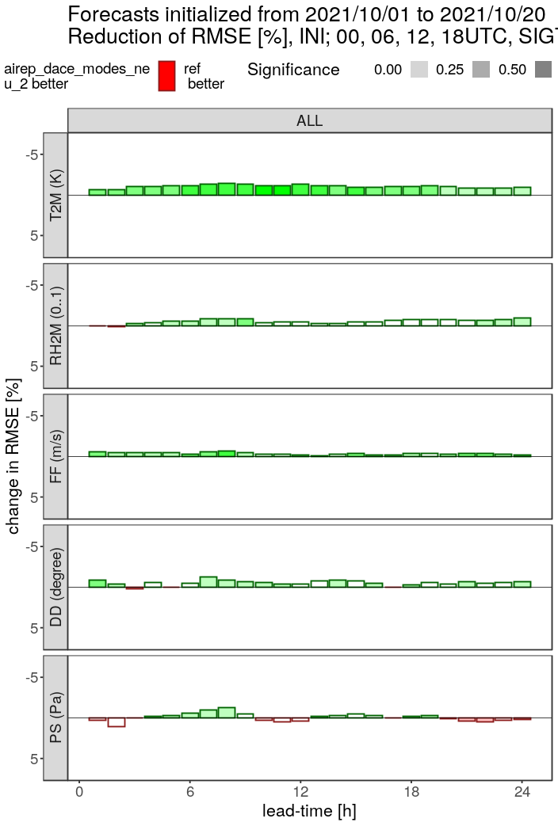
New Mode-S aircraft data:
Forecast verification: NEW_2 vs. REF
Synop
verification
Radiosonde
verification
NEW_2 vs.
REF
total cloud
high cloud
mid-level cloud
low cloud
global radiation
T2M
RH2M
wind speed
wind direction
surface pressure

Slide 15

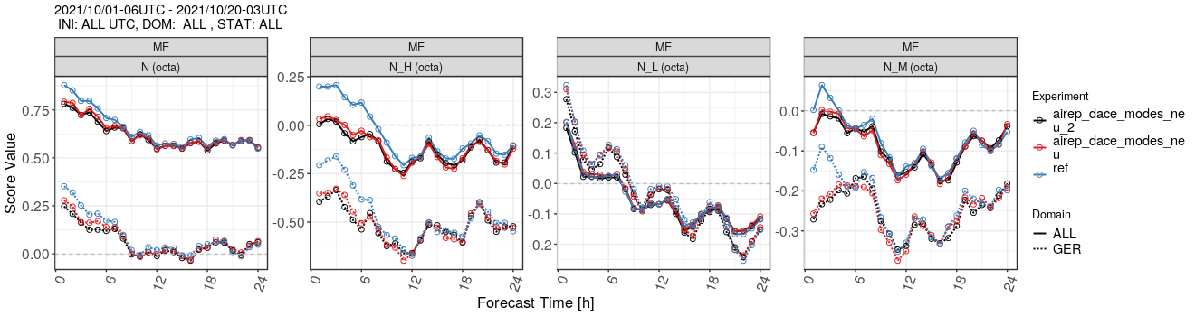
New Mode-S aircraft data:
Forecast verification: cloud biases
Synop
verification
REF
NEW NEW_2
less spin-down for cloud (and slightly for T2M, RH2M, Td2M)
upper-level moist bias slightly decreased (not shown)

Slide 16
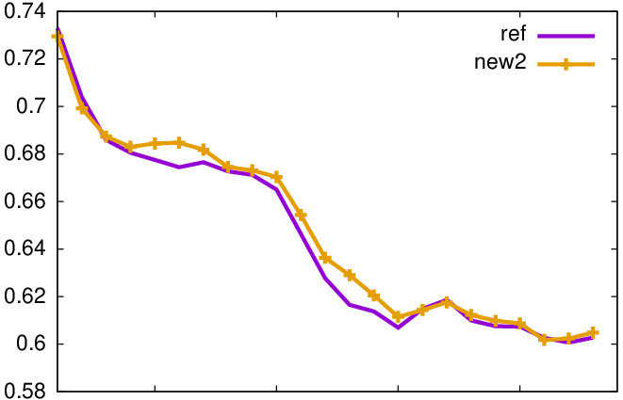
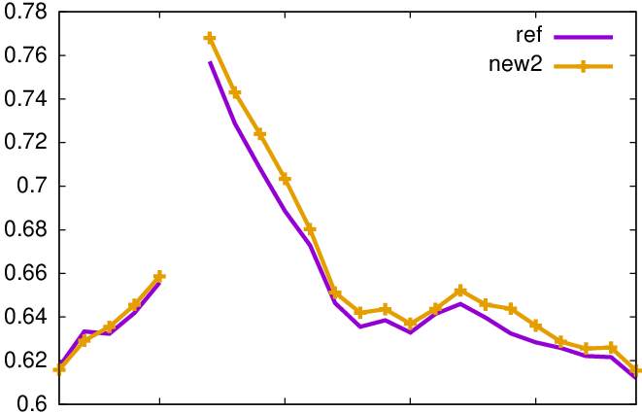
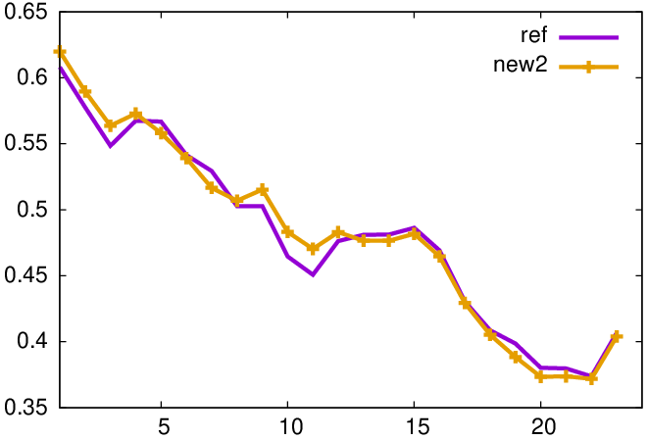
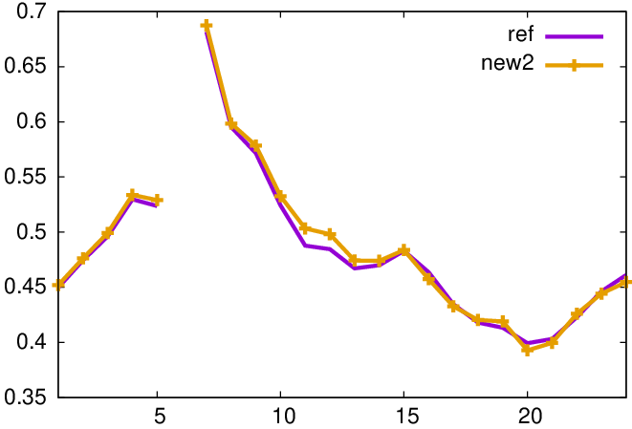
New Mode-S aircraft data:
Forecast verification: radar-derived precip
FSS
11 g.p.
23 km
0-UTC runs
6-UTC runs
REF
NEW_2
0.1
mm/h
1
mm/h

Slide 17
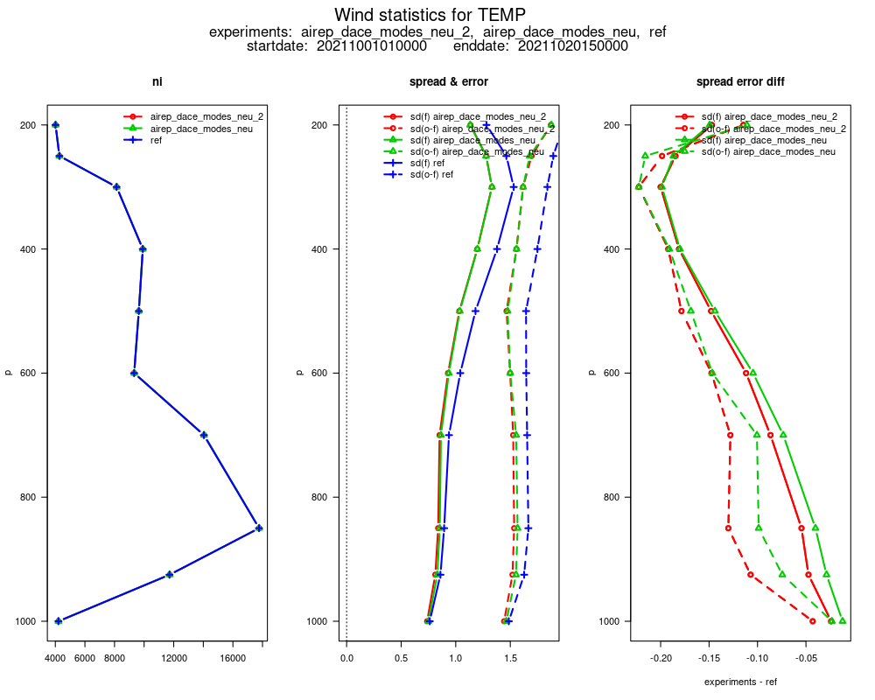
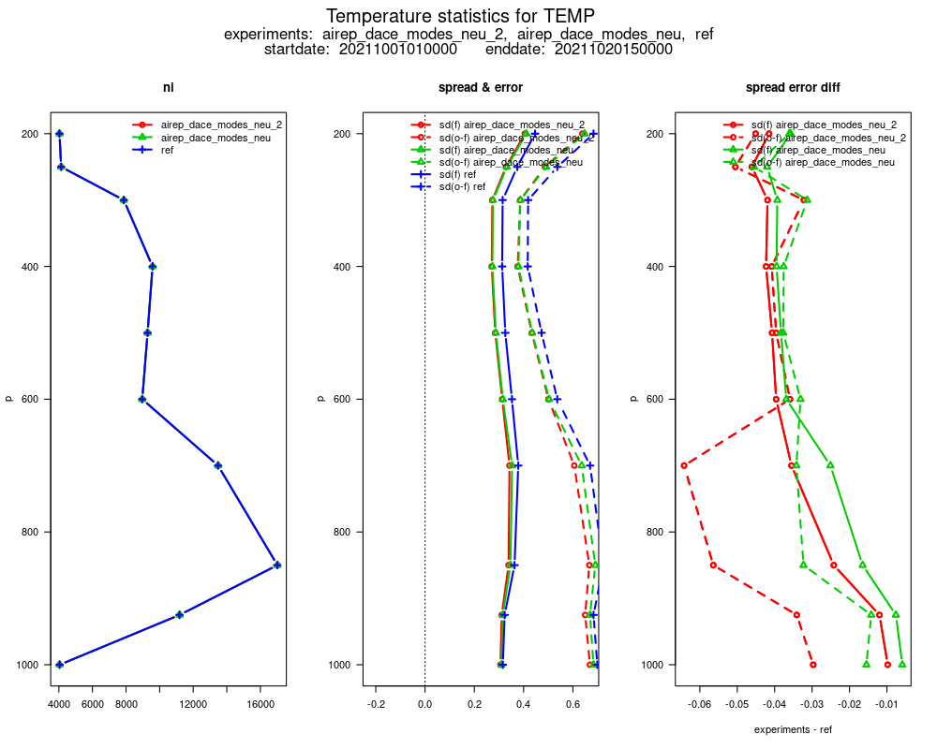
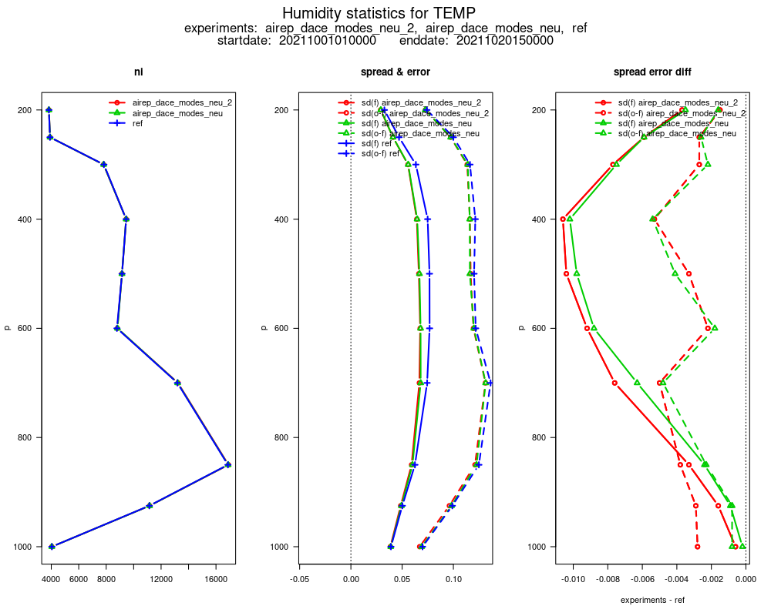
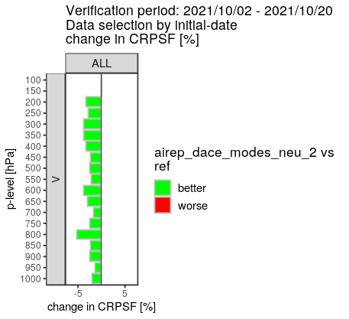
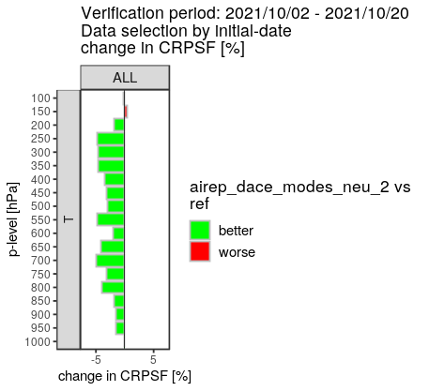
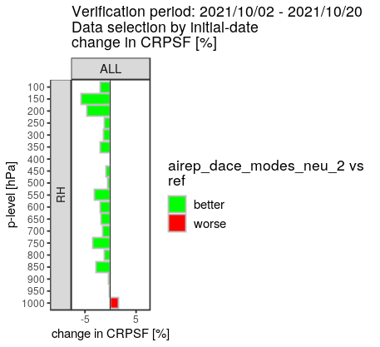
New Mode-S aircraft data:
Ensemble spread , EPS
first guess spread / RMSE vs. radiosondes
wind
temperature
relative humidity
REF
NEW
NEW_2
spread
rmse
spread / rmse ratio slightly (wind, T) / clearly (humidity) reduced only above 750 hPa
CRPS reduced in EPS forecasts

Slide 18
New Mode-S aircraft data:
Conclusion
overall positive impact by reduced thinning (NEW_2), without computational costs
clear positive impact (in October period) from new EMADDC v2.2 Mode-S data,
particularly upper-air, but also for surface and weather parameters
in parallel suite since 16 Feb. 2022
→ new Mode-S: larger latency for 15-min data batches (~15 min → ~34 min)
→ with data cut-off time of ~ 27 min for ICON-D2, latest 15 min of new Mode-S obs
(i.e. obs closest to time-critical analysis time) not available for analysis
→ positive impact weaker than in exp., but largely confirmed in TEMP verif., except:
→ T2m reduced by 0.03 K (→ cold bias increased in stormy period (1st week))
after operational introduction (23 March 2022), next summer:
assess impact in summer, possibly re-tune (thinning, obs errors, …)
experiments for use in global DA / ICON start soon (Alexander Cress)
(Mode-S so far not used in global EnVar since only available over Europe (DE, NL, BE))

