Slide 1
Temporal and spatial variability in observation error and ensemble spread
ICCARUS KENDA meeting
11th of March 2022
Klaus Stephan

Slide 2
Baseline
At DWD following observations are assimilated operationally
  TEMP (RH, T, WIND)
  AIREP (RH, T, WIND)
  PILOT (WIND)
  RADAR (Reflectivity, Radialwind)
  SYNOP (P, T, RH, WIND)
  DRIBU (P)
For all this observation we need to specify an observation error

Slide 3
Baseline
Observation error may contain lots of sources:
  Measuring error
  Representative error (space, time, inconsistent to model understanding)
  Random error
  Residuals
The chosen values of observation error decide about the weight of such observation within assimilation. There certainly will be an correspondences to ensemble spread and the errors of ANAlysis and FirstGuess.
Deroziers method is widely used to estimate the errors, but how variable is it with respect to time, numbers of observations and model configuration?

Slide 4
Let’s do data munching
ICON-D2 is running now over one year, preparing
  an analysis with long cut off every hour
  an analysis with short cut off every hour
  lots of information and output is stored in data base
For the subsequent results I used (only):
  all ekf files of long cut off analysis cycle from 15.02.21 until 14.02.22
  all ekf files of short cut off analysis cycle from 06.06.21 until 31.08.21
  all ekf files of short cut off analysis RUC cycle from 06.06.21 until 31.08.21

Slide 5
running obserrstat for all, for every hour, for seasons MAM,JJA,SON,DJF taking only “ACTIVE” observations into account
  obserrstat give lot’s of values: I concentrate mainly on
    observation numbers
    spread
    estimated observation error
    for WIND (3 different observation systems) and RADAR
  Lets start with a short look into obserrstat output variables:

Slide 6
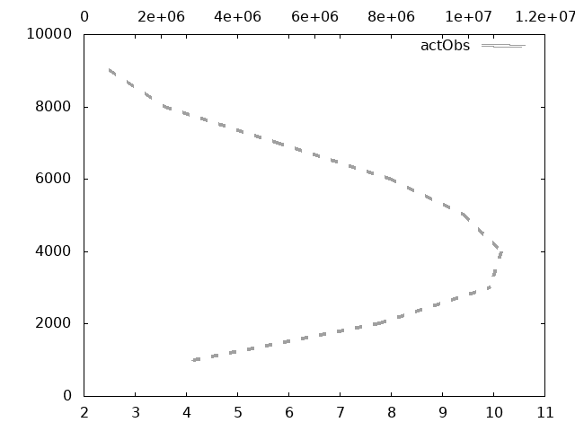
Radar Reflectivity over the last year
Top
Height [ m or hPa)
Bottom
Quantities in units of observable

Slide 7
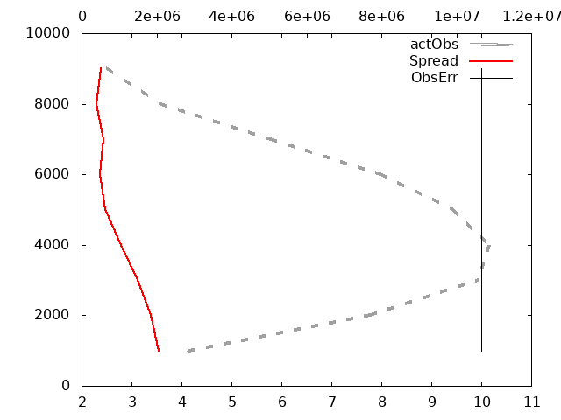
Radar Reflectivity over the last year

Slide 8
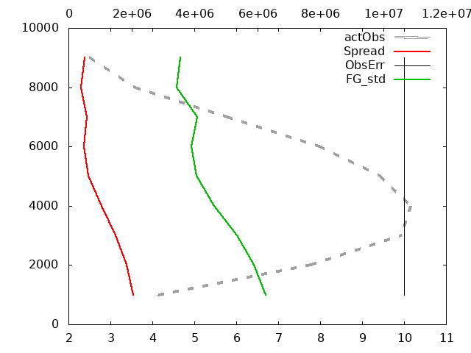
Radar Reflectivity over the last year

Slide 9
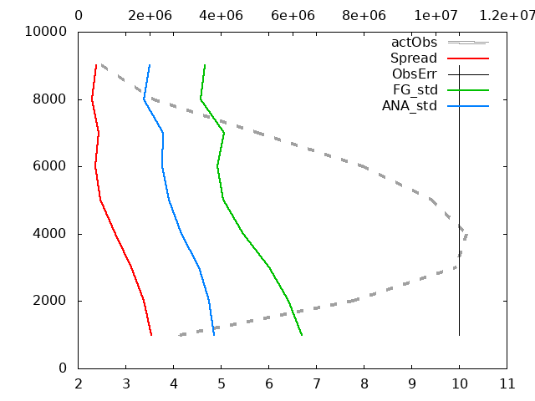
Radar Reflectivity over the last year

Slide 10
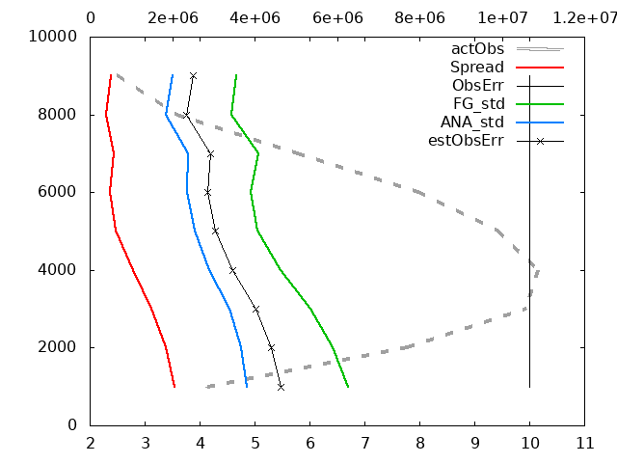
Radar Reflectivity over the last year

Slide 11
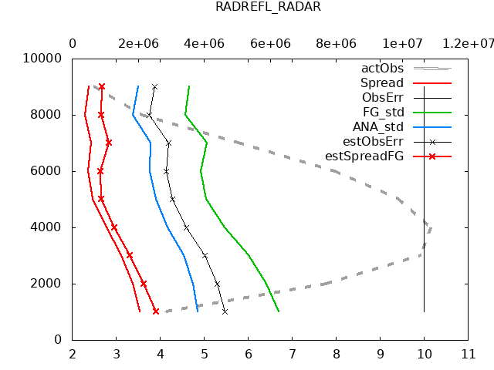
Radar Radialwind over the last year
(Obserr=const)
ANAstd < FGstd
ANAstd<estOE<FGstd
(Spread < estSpread)
no dependency to actOBS
All lines with similar shape

Slide 12
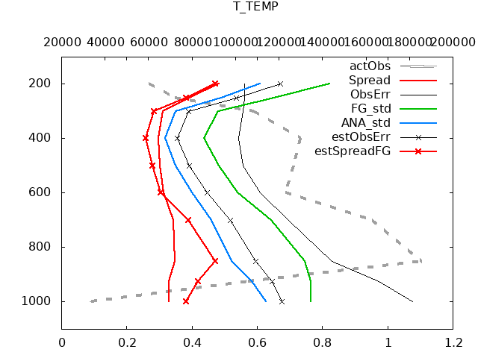
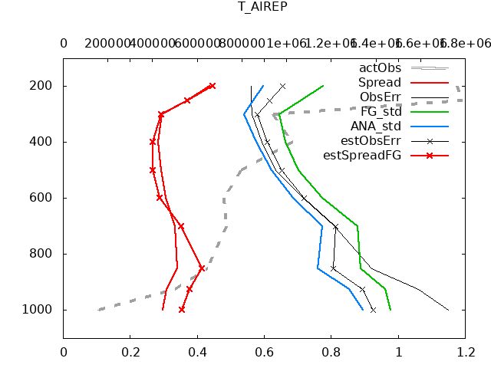
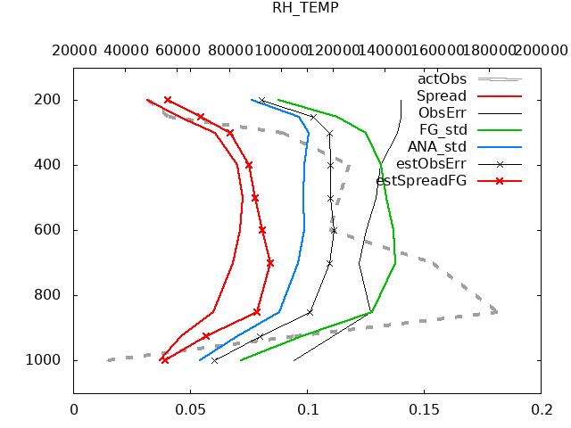
T_TEMP
T_AIREP
RH_TEMP
ANAstd < FGstd
ANAstd<estOE≤OE<FGstd
Spread ~ estSpread
T_TEMP best fitted OBS!

Slide 13
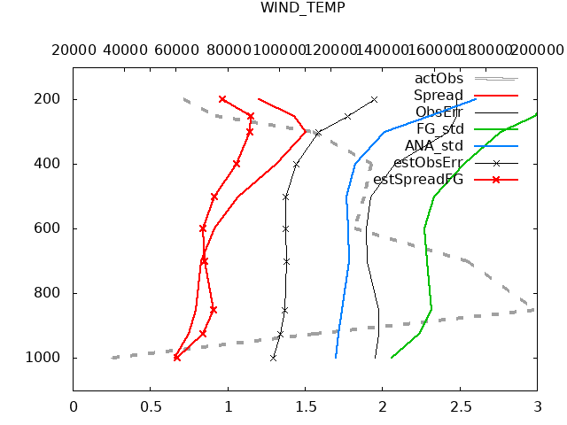
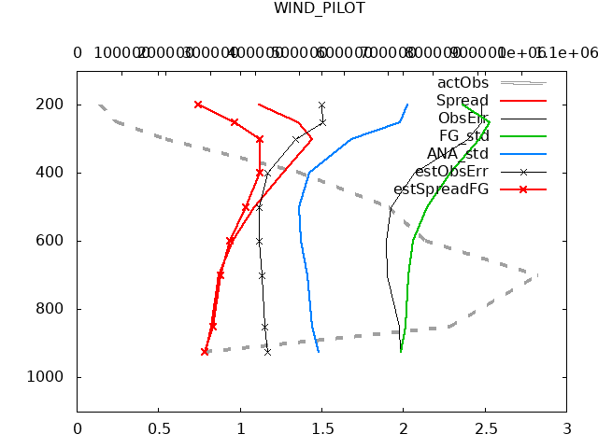
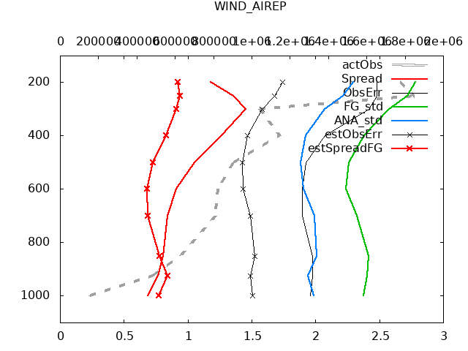
WIND_TEMP
WIND_PILOT
WIND_AIREP
ANAstd < FGstd
estOE<ANAstd≤OE<FGstd
Spread ~ estSpread
OE much to large?

Slide 14
How variable is that statistic in time?

Slide 15
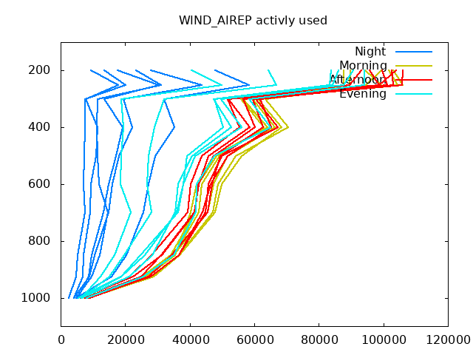
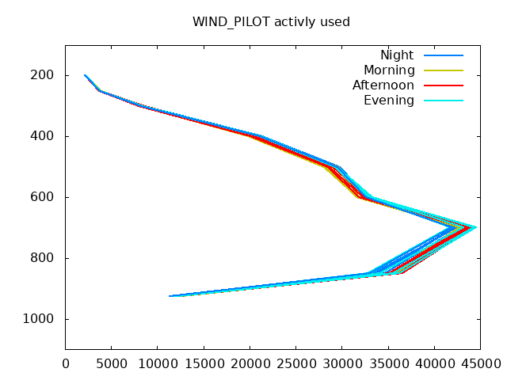
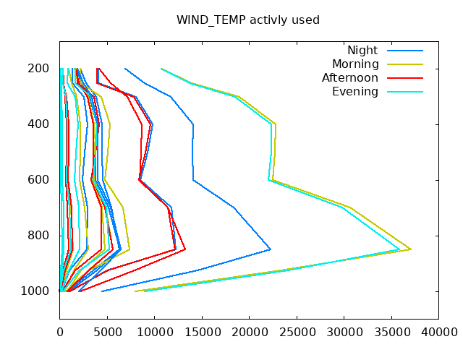
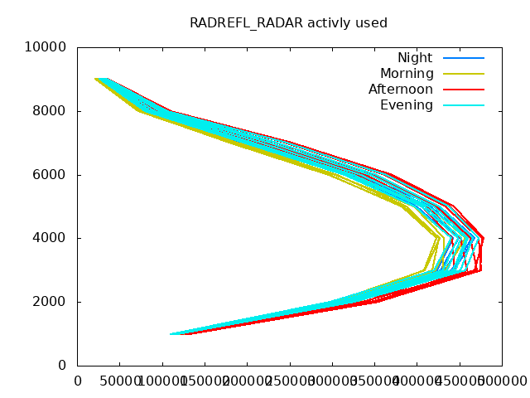
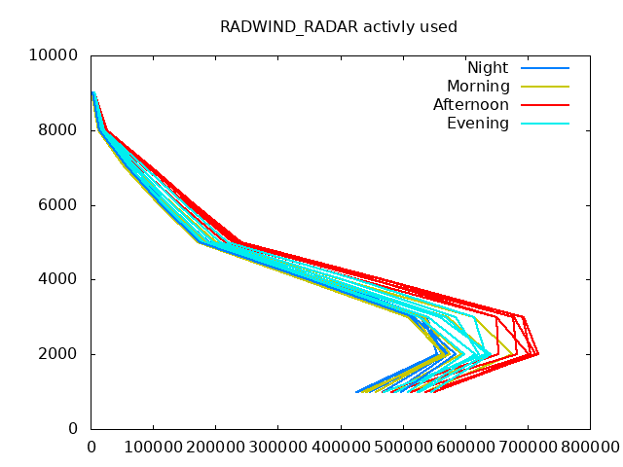
Actively used observations
WIND_AIREP
WIND_PILOT
WIND_TEMP
REFL_RADAR
WIND_RADAR
Night Morning Afternoon Evening
Well know features for TEMP and AIREP
Less obs for PILOT and RADWIND at night
Most obs for Radar at afternoon

Slide 16
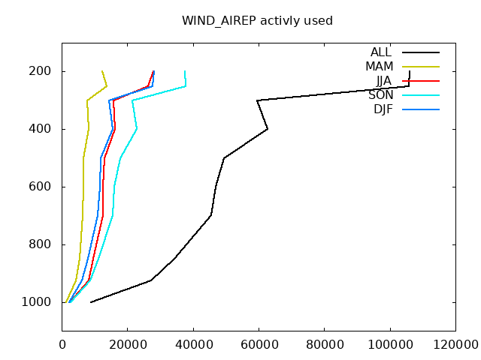
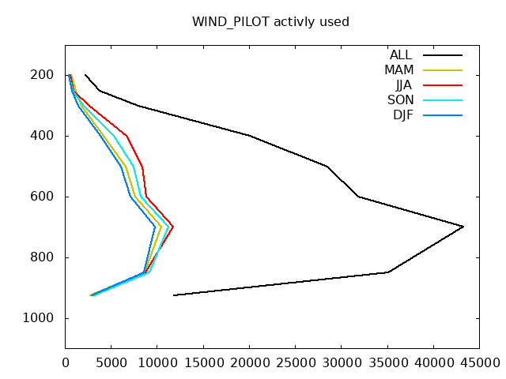
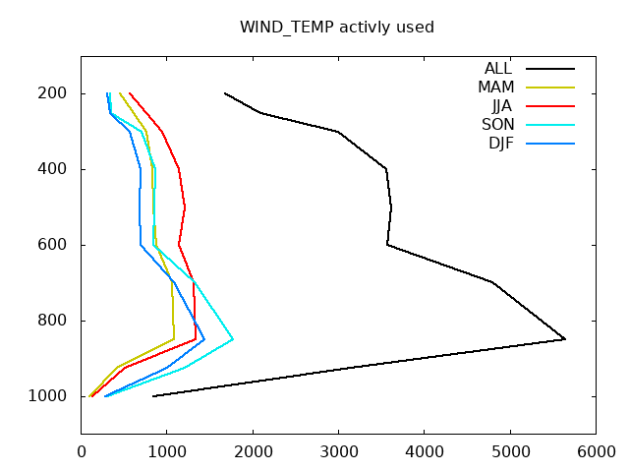
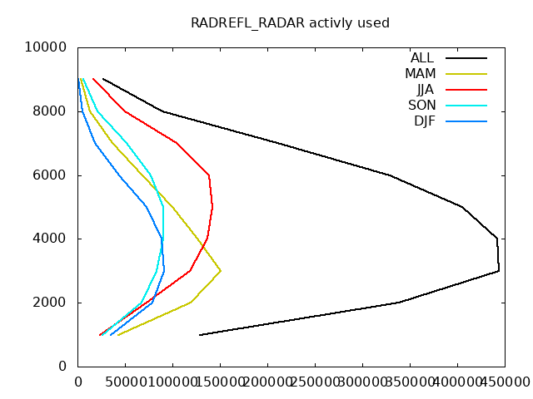
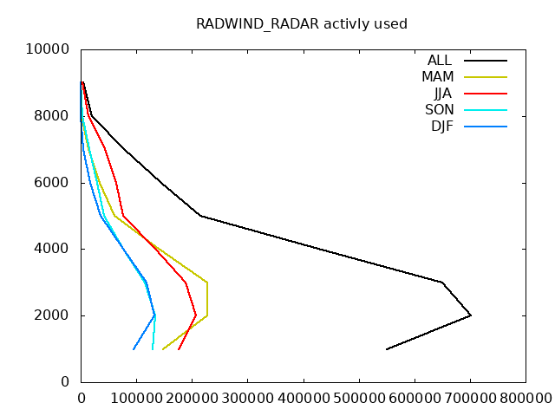
Actively used observations at 12 UTC
WIND_AIREP
WIND_PILOT
WIND_TEMP
REFL_RADAR
WIND_RADAR
DJF MAM JJA SON ALL
COVID effects on AIREP?
Less obs for PILOT and RADWIND at night
Most obs in JJA, less in DJF

Slide 17
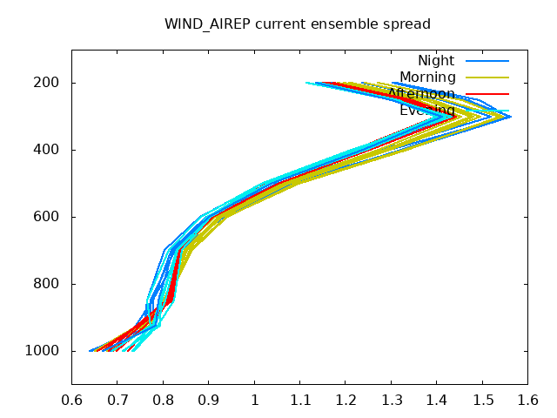
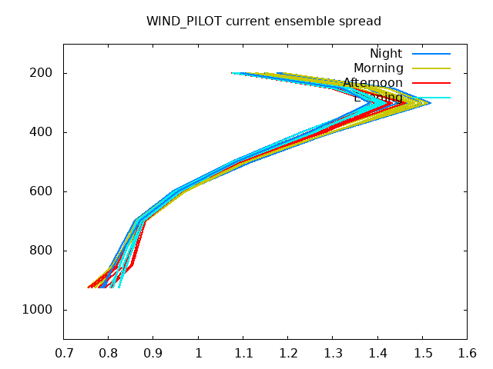
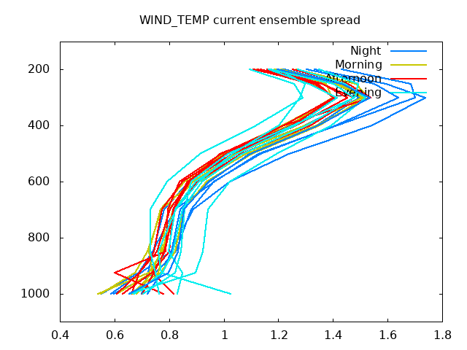
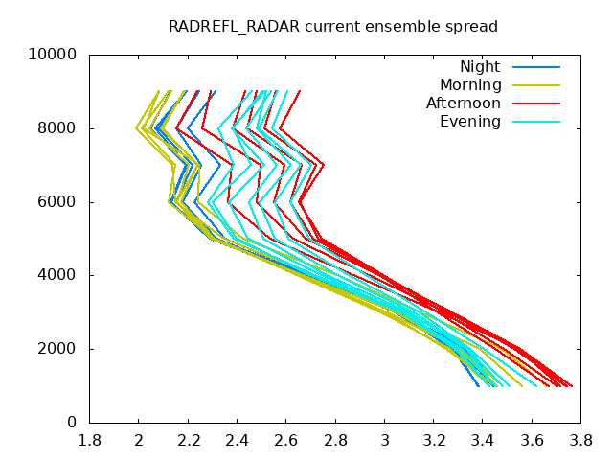
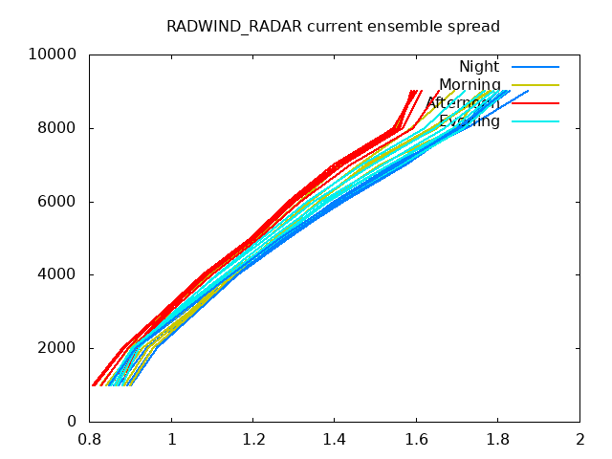
Spread
WIND_AIREP
WIND_PILOT
WIND_TEMP
REFL_RADAR
WIND_RADAR
Night Morning Afternoon Evening
Somehow contradicting:
Less spread at night for AIREP and PILOT but most for TEMP and RADWIND
Most spread in REFL afternoon

Slide 18
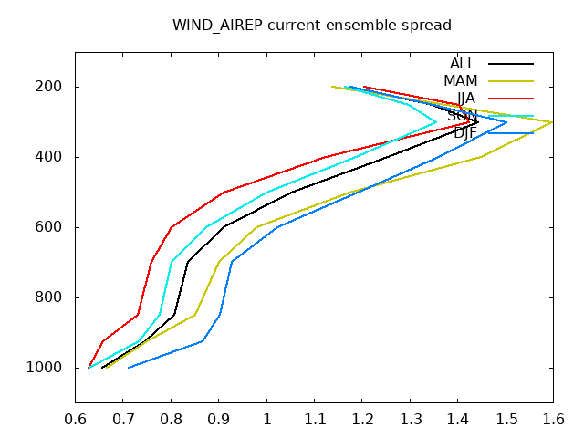
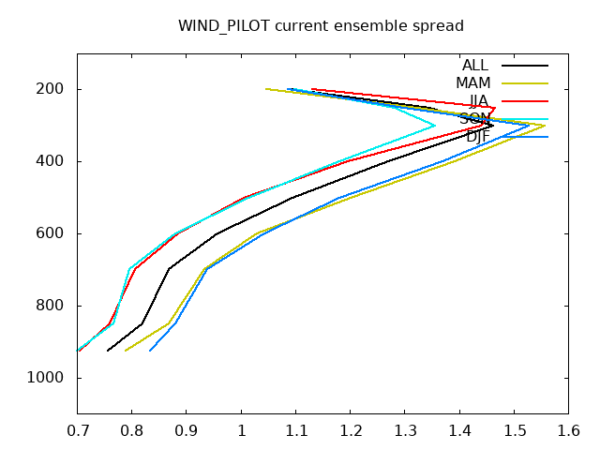
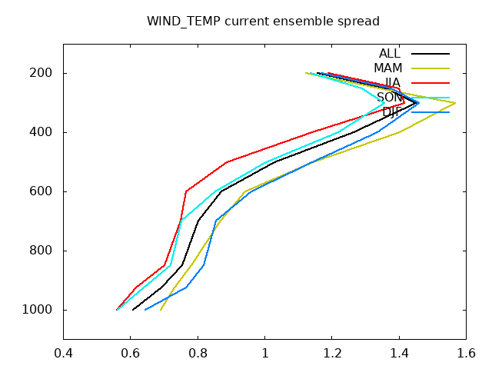
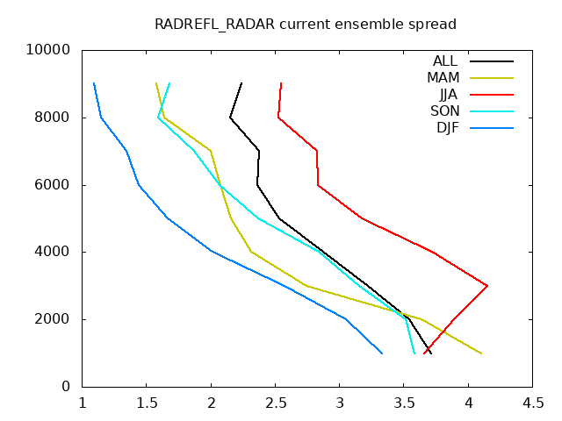
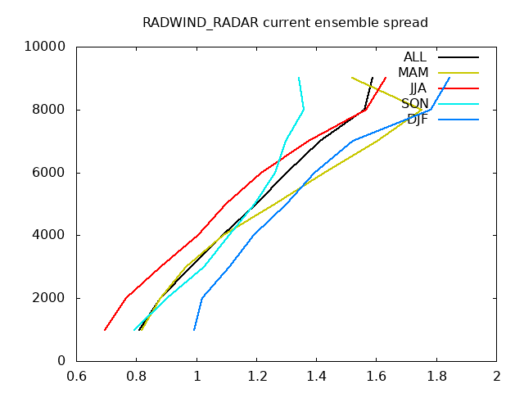
Spread at 12 UTC
WIND_AIREP
WIND_PILOT
WIND_TEMP
REFL_RADAR
WIND_RADAR
DJF MAM JJA SON ALL
More spread in DJF and MAM, less in
JJA and SON for WINDs
For REFL most in JJA

Slide 19
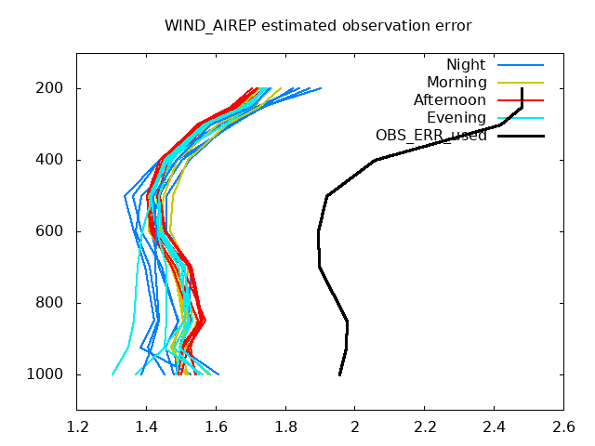
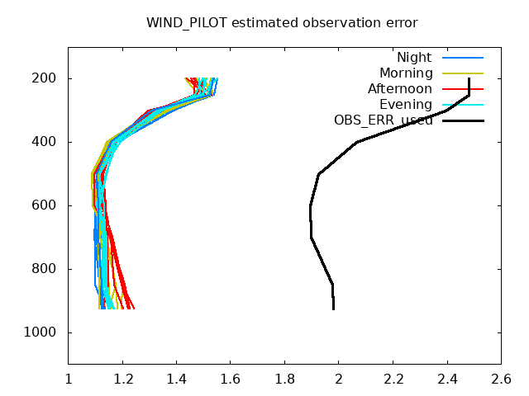
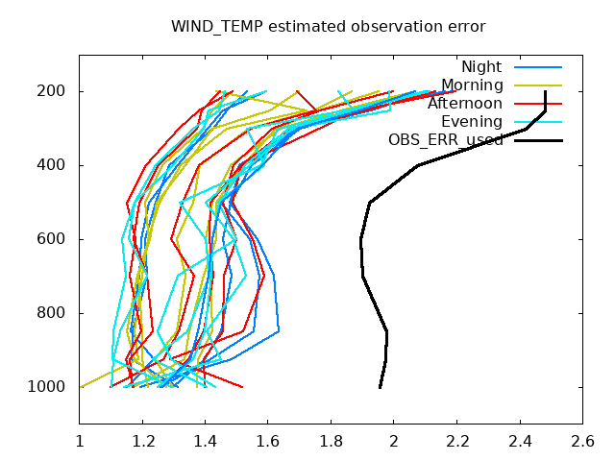
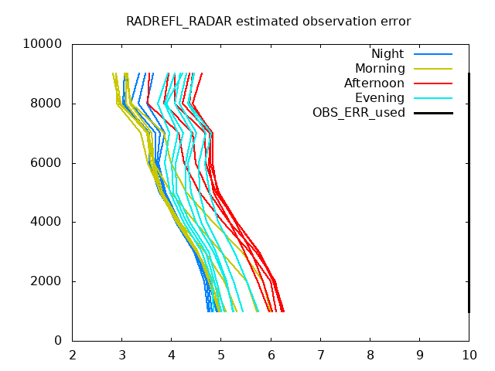
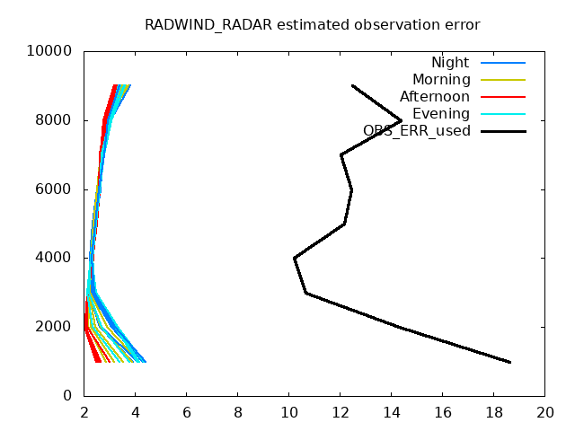
Estimated Observation Error
WIND_AIREP
WIND_PILOT
WIND_TEMP
REFL_RADAR
WIND_RADAR
Night Morning Afternoon Evening
Stable for PILOT
Variable for REFL and TEMP (RADWIND near ground) somehow in accordance to spread variability.
Maybe to less obs for TEMP?

Slide 20
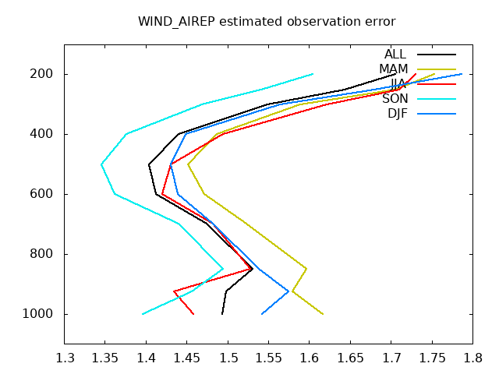
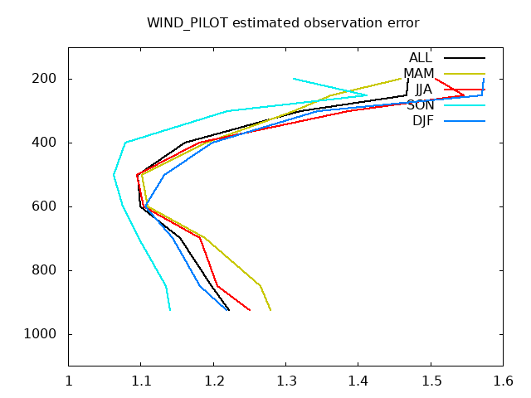
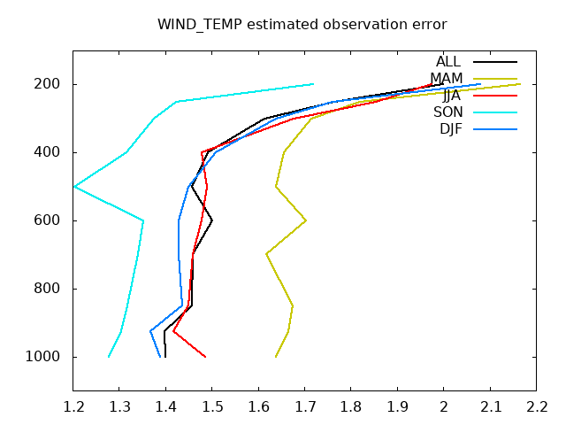
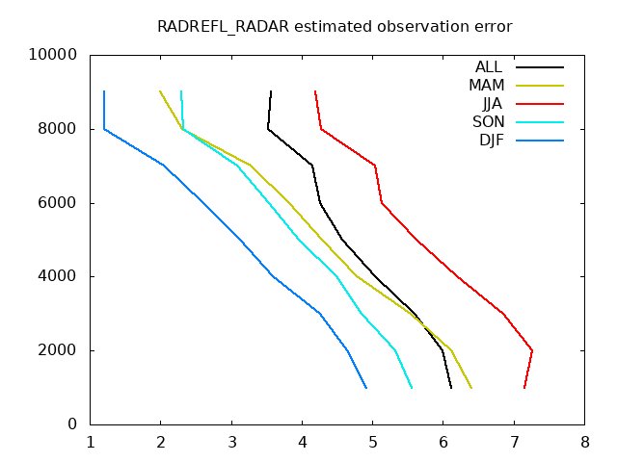
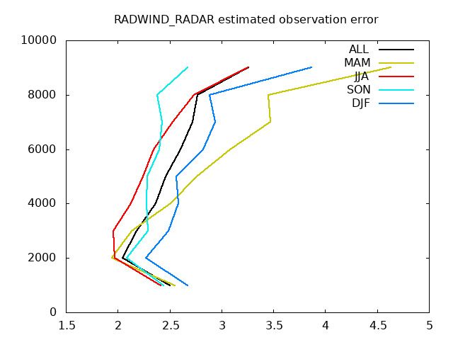
Estimated Observation Error at 12 UTC
WIND_AIREP
WIND_PILOT
WIND_TEMP
REFL_RADAR
WIND_RADAR
DJF MAM JJA SON ALL
Clearly variable with seasons

Slide 21
How sensitive is that to numbers of observation
(land cut of against short cut off) and model configuration
(Routine against Rapid Update Cycle (hourly + 2MOM)?

Slide 22
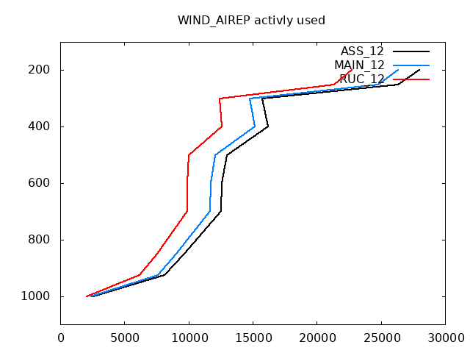
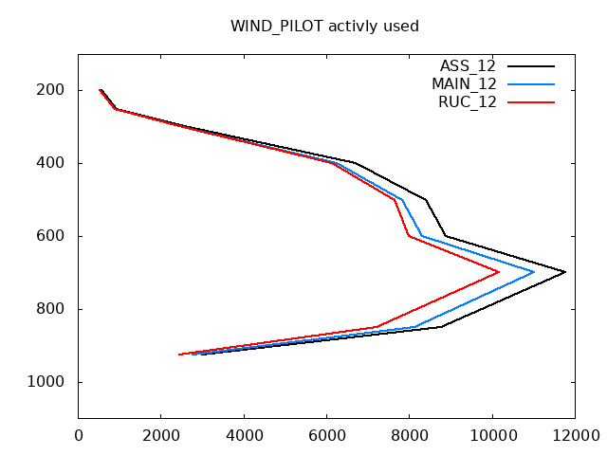
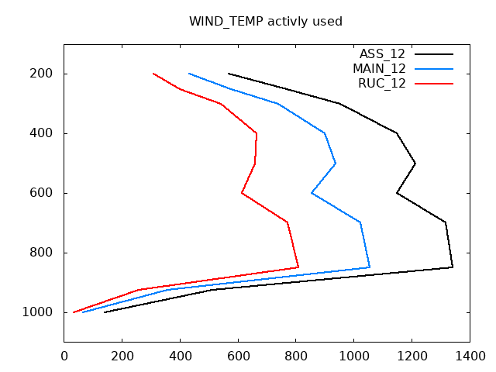
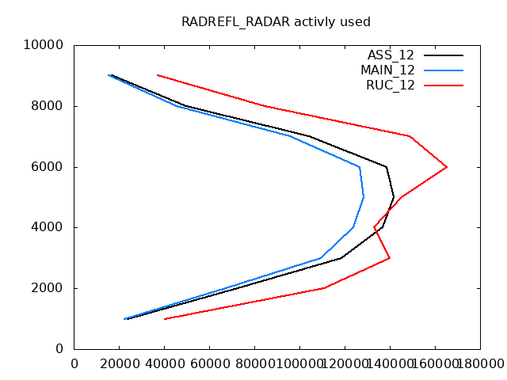
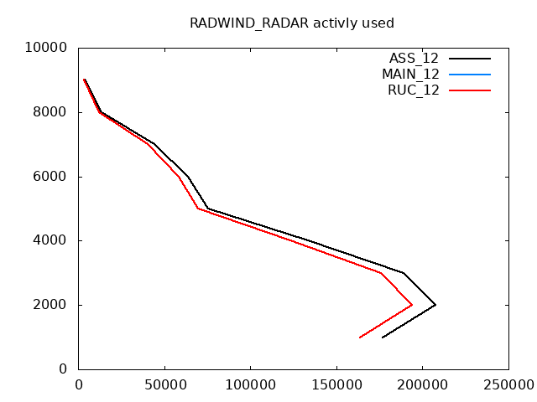
Actively used observations at 12 UTC in JJA
WIND_AIREP
WIND_PILOT
WIND_TEMP
REFL_RADAR
WIND_RADAR
RUC scutoff lcutoff
Mostly dependent on cut off time but for REFL also befenefit due to 2MOM

Slide 23
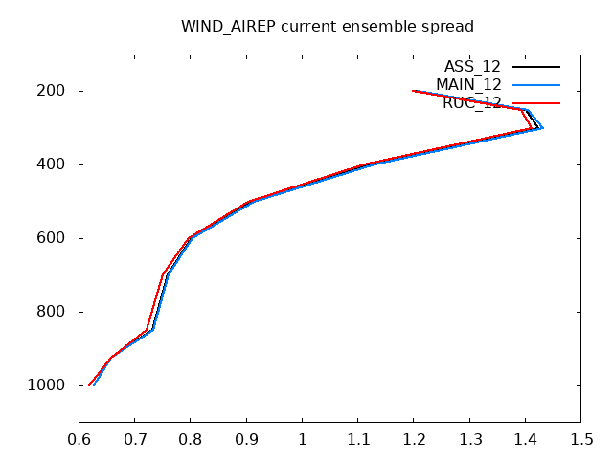
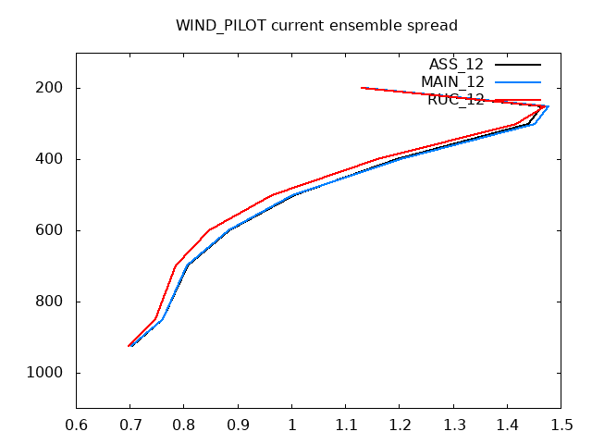
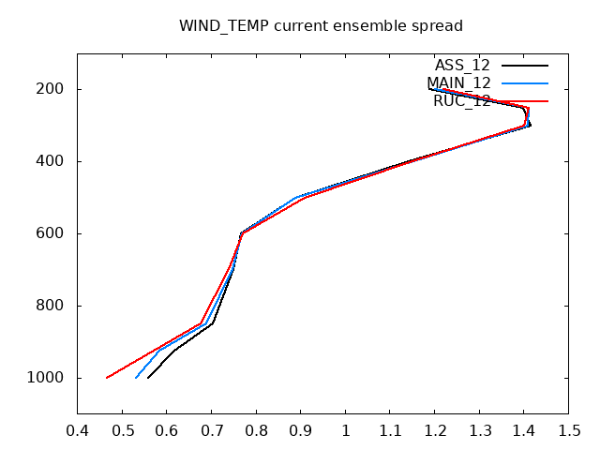


Spread at 12 UTC in Summer (JJA)
WIND_AIREP
WIND_PILOT
WIND_TEMP
REFL_RADAR
WIND_RADAR
RUC scutoff lcutoff
Not much influence on spread

Slide 24





Estimated Observation Error 12 UTC JJA
WIND_AIREP
WIND_PILOT
WIND_TEMP
REFL_RADAR
WIND_RADAR
RUC scutoff lcutoff
Estimated errors tends to be smaller for RUC, esp. in REFL

Slide 25
Conclusion
Evaluation the treasure of operational data can give us more understanding of our system.
I only concentrated on ekf files evaluated with obserrstat. There is lot more to analyse within database.
Deroziers error estimation is cleary variable in time, esp. shows a seasonal variability and seems to be less sensitive to model configurations
The profile of estimated errors shows strong similarities with the profiles of standard deviation. This might promote the idea of setting observation errors dependent of OBS minus FG.
What tell us the estimated spread? Is a discrepancy to actual spread a hint for badly tuned spread?
Estimated analysis spread is much lower the FG spread. Do we apply to less inflation?

Slide 26
To Do
Check obs errors for all wind observations, including 10m winds
  Could we use more 10m winds, also above 100m AMSL?
Check influence of inflation technics. Spread of analysis is still much less than spread of FG (not for all variable, i.e. QC)
  Applying ensemble perturbations for LHN
Do we need bias correction for surface pressure and also for some single stations (radio sonde in Trappes, nocturnal T bias of AMDAR (type 145))
  Does surface pressure leads to unwanted increments in upperair temperature?
Reduction of influence of 2m T+RH at coastal stations.
Investigation of change in resolution in ICON model. This might effect also setting of observation errors
When incorporation of new observation systems, please also check estimated observation error for current observation systems

