Slide 1
COSMO-1E and COSMO-2E: Status Report
Yves Karrer, André Walser, and Marco Arpagaus
MeteoSwiss

Slide 2
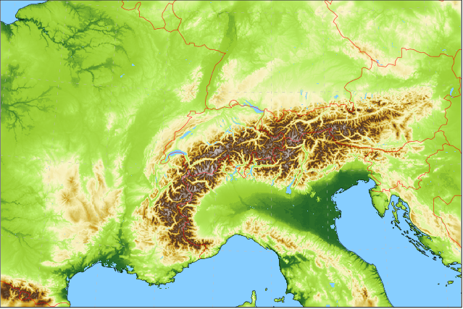
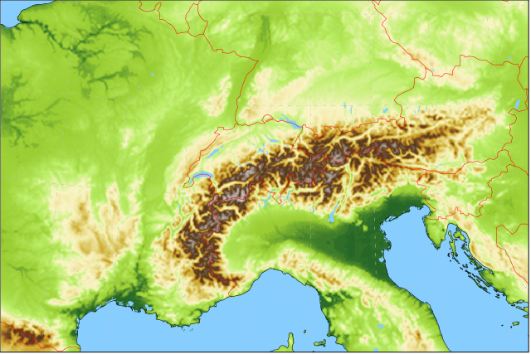
ModInterim project
Lateral boundary conditions: IFS HRES / ENS 0.1° / 0.2° 4x per day
Ensemble Data Assimilation cycle KENDA-1: 40 members @ 1.1km grid size
COSMO-1E: 33 hour forecasts, 8x per day 1.1km grid size (convection permitting) 11 ensemble members
COSMO-2E: 5 day forecasts, 4x per day 2.2km grid size (convection permitting) 21 ensemble members

Slide 3
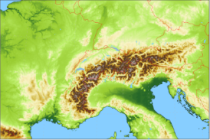
COSMO-2E setup (close to COSMO-E)
21 members (control and 20 perturbed runs)
2.2 km horizontal mesh-size, 60 vertical levels
4 forecasts per day up to +120h
initial condition (perturbations): KENDA-1 assimilation cycle (→upscaled)
KENDA deterministic run for control
KENDA members 1-20 (out of 40)
lateral boundary condition (perturbations): ECMWF (6h older LBCs)
ENS control for control
ENS members selected by member selection based on clustering
model uncertainty: SPPT (range_rn=0.8)

Slide 4
COSMO-1E setup
11 members (control and 10 perturbed runs)
1.1 km horizontal mesh-size, 80 vertical levels
8 forecasts per day up to +33h (03 UTC +45h)
initial condition (perturbations): KENDA-1 assimilation cycle
KENDA deterministic run for control
KENDA members 1-10 (out of 40)
lateral boundary condition (perturbations): ECMWF (6h older LBCs)
HRES control for control
ENS members selected by member selection based on clustering
model uncertainty: SPPT (range_rn=0.6)

Slide 5
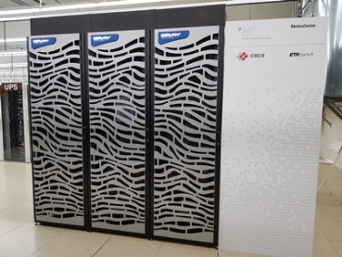
New HPC system Pigne d’Arolla
Cray CS-Storm with 3 racks with two logical partitions (production and R&D)
nodes swappable between partitions
18 GPU nodes in total with
8 NVIDIA V100 GPUs
2 Intel Skylake (8-core, 3.2GHz) CPUs
COSMO-1E and COSMO-2E require 11 GPU nodes
COSMO-1E: 1 member per node
COSMO-2E: 2 members per node

Slide 6
ModInterim project status
pre-operational since a few days
COSMO 5.06, single precision (also in KENDA-1)
collecting data for verification
elapsed times:
KENDA-1 1h cycle: 20 min (LETKF ~7 min)
COSMO-1E +33h: 50 min (COSMO members without pollen)
COSMO-2E: +120h: 40 min (COSMO members without pollen)

Slide 7
Preliminary verification results
Comparison of COSMO-1E against COSMO-2E (01.01.2020-18.02.2020)
Parameter | Spread / Error | Outliers | RPSS | BSS (several thresh.) | Rel. Dia. (several thresh. and lead times)
Precipitation | Similar | Slightly worse | Slightly better | Slightly better for high threshold | Similar
Cloud amount | Slightly better | Slightly worse | Slightly worse | Slightly worse for high threshold | Slightly worse for high threshold
Temperature | Slightly better | Slightly worse | Slightly better | Slightly better | Similar
Dewpoint | Better | Slightly worse | Better | Better | Slightly better for low threshold
Wind speed | Better | Similar | Better | Better | Slightly better for lower thresholds
Gusts | Slightly better | Slightly worse | Better | Better | Better for low, worse for higher thresholds
Pressure | Much better

Slide 8
WG7 activities
Model perturbation setup for COSMO-1E
Testing lateral boundary conditions from ICON-EU for COSMO-1E

Slide 9
Is SPPT really the best available model perturbation method for COSMO-1E?

Slide 10
Experimental setup for 3 convective case studies
COSMO-1E with 21 members
ICs: COSMO-1 analyses
LBCs: IFS control and 1-20 (or «best member»)
model perturbations:
no
SPPT (range_rn=0.6 / 0.8)
Parameter perturbations (PP) of COSMO-D2-EPS

Slide 11
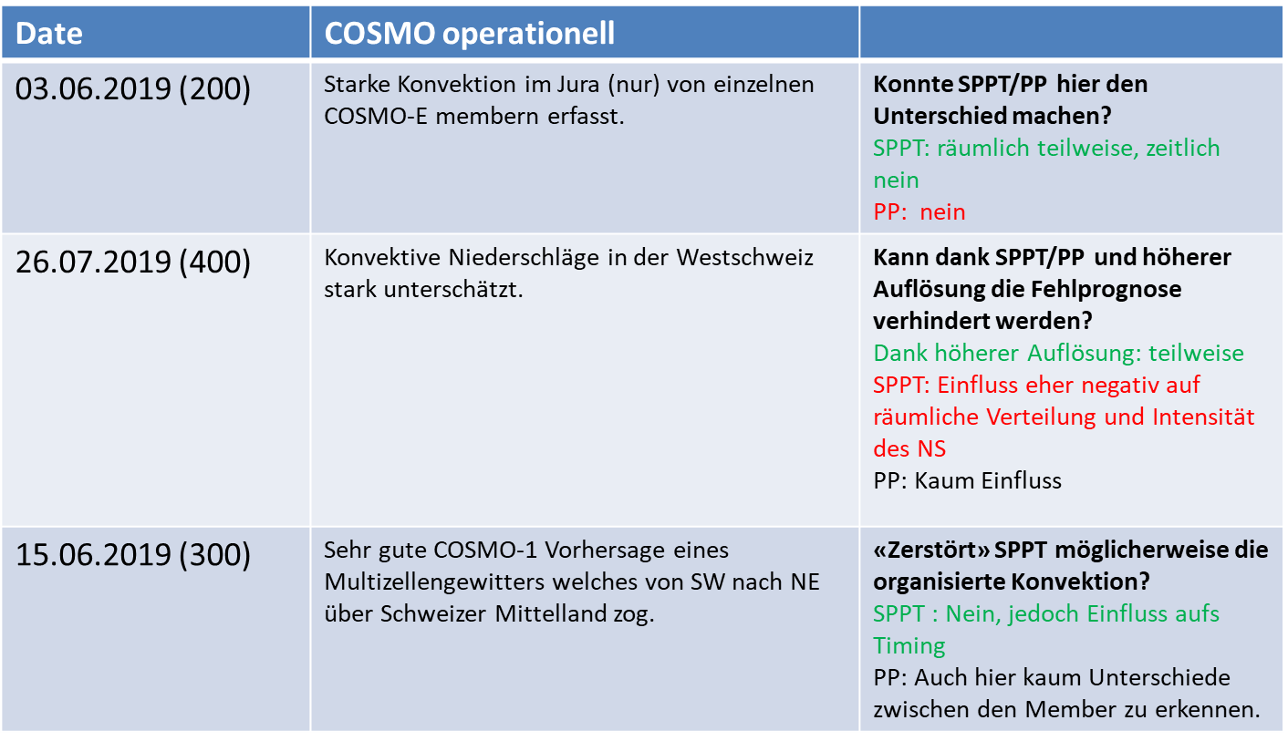
Summary case studies
Conclusions:
SPPT increases variability stronger than PP
Impact for SPPT beneficial in 2 out 3 cases

Slide 12
Which SPPT setup should we chose for COSMO-1E?

Slide 13
Experimental setup for 2 summer weeks
COSMO-1E experiments
Summer period: 18.08.19 – 31.08.19
Initial conditions: KENDA-1
Leadtime: +36h
601 : SPPT 0.6 2 x day (00z, 12z) → as in the (pre-)pre-operational COSMO-1E
603 : SPPT 0.8 2 x day (00z, 12z) → as in COSMO-E / COSMO-2E
602 : no SPPT 1 x day (00z)

Slide 14
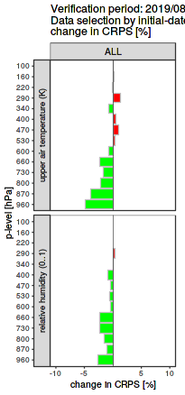
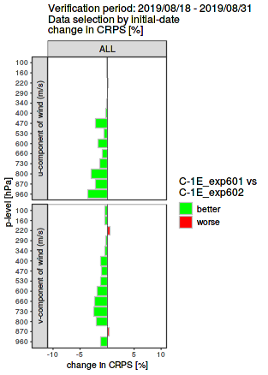
CRPS: SPPT 0.6 vs no SPPT

Slide 15
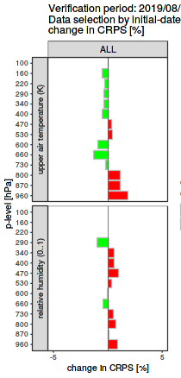
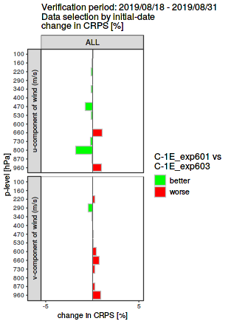
CRPS: SPPT 0.6 vs SPPT 0.8

Slide 16
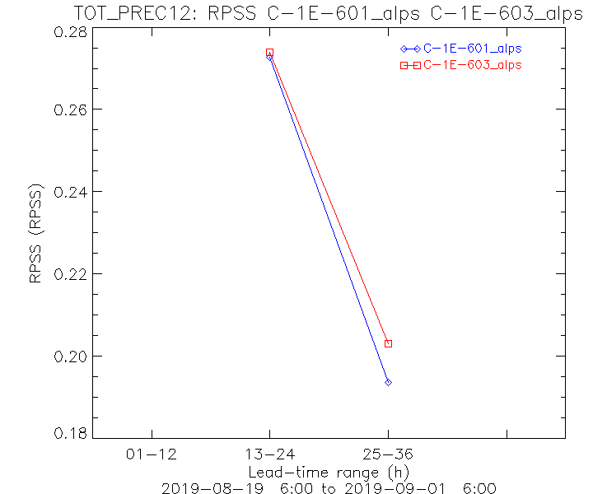
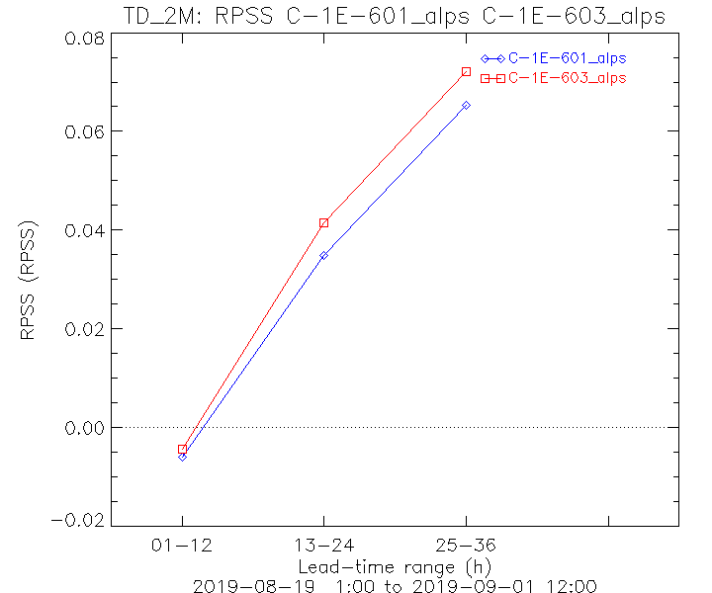
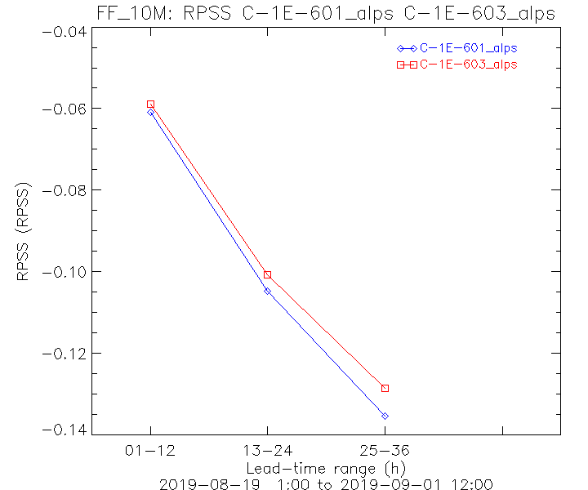
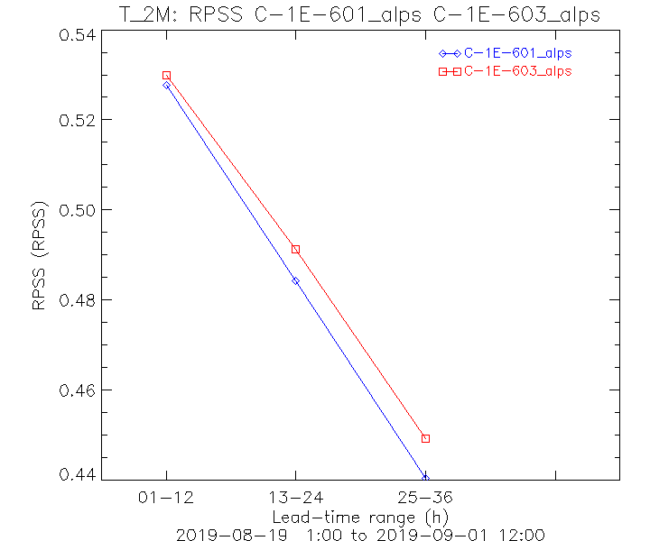
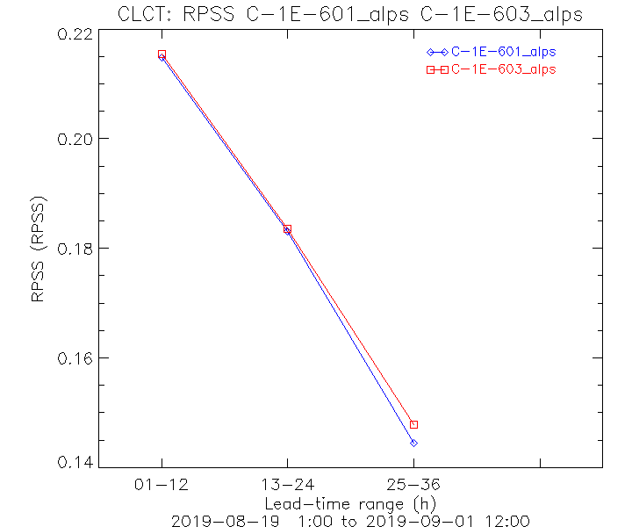
RPSS
0.8 SPPT | 603
0.6 SPPT | 601

Slide 17
Issues due to SPPT
Simulation | Setting | Crashes | Number of members with targeted diffusion warnings
 |  |  | > 100 | > 1000
601 | SPPT 0.6 | 0 | 8 | 2
602 | No SPPT | 0 | 1 | 0
603 | SPPT 0.8 | 0 | 64 | 20

Slide 18
Summary SPPT experiments
Negligible differences in terms of ME, MAE, RMSE
More spread with SPPT 0.8 and thus slightly better CRPS / RPSS
Pro 0.8:
overall slightly better scores for most parameters
Pro 0.6:
significantly less "cold pool diffusion warnings"

Slide 19
Would ICON lateral boundary conditions be beneficial for COSMO-1E

Slide 20
Experimental setup for 1 month
COSMO-1E experiments
Period: 19.09.19 – 13.10.19
28 runs (1 per day)
Initial time: 06z
Leadtime: 0-24h
Initial conditions: COSMO-1 analysis
LBC (all 00z):
101: IFS m0-10 → m0 unperturbed
102: ICON-EU m1-11

Slide 21
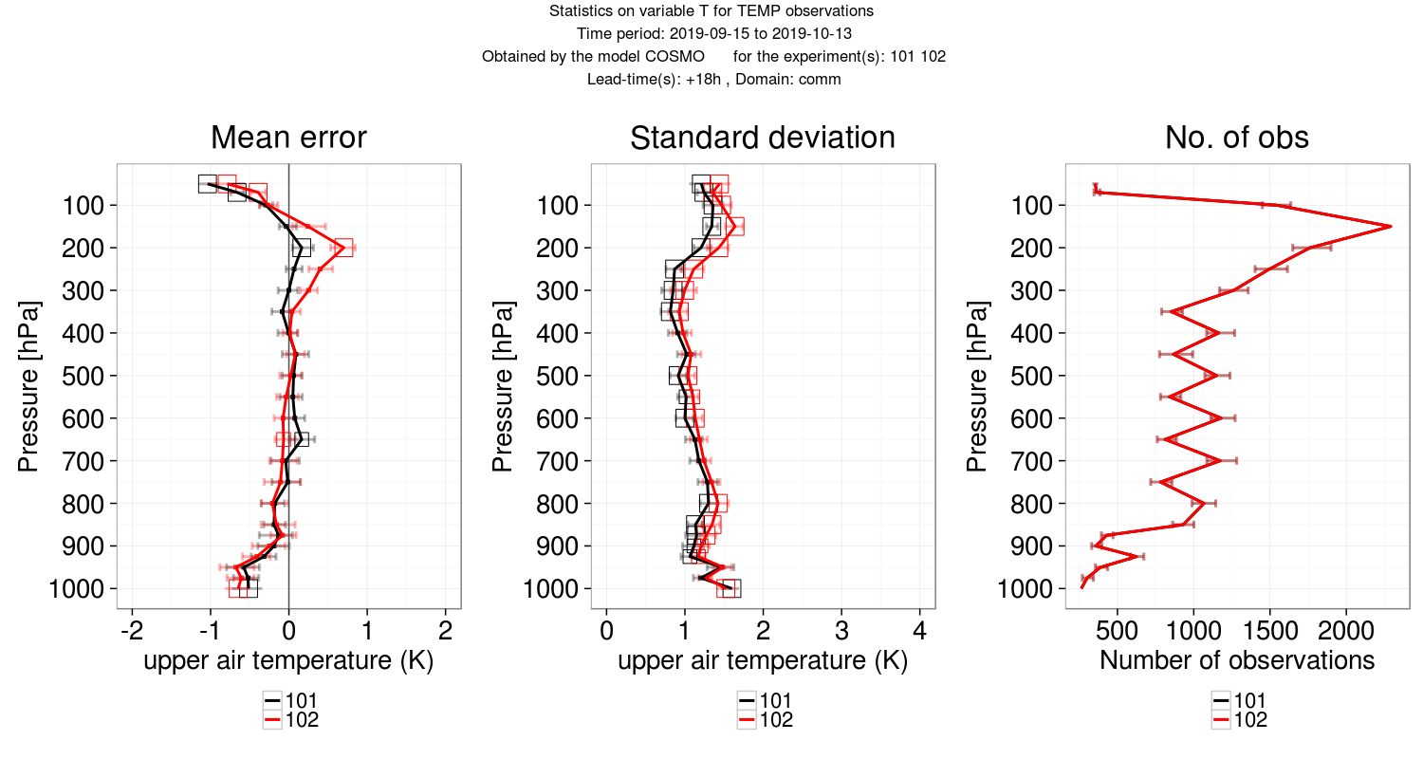
Upper air: Temperature (deterministic) IFS (m01) vs ICON (m11)
102: ICON LBC
101: IFS LBC
Notes:
Hier vorher mit IFS 000 verglichen: 2. Grund wieso ICON als schlechter erachtet haben

Slide 22
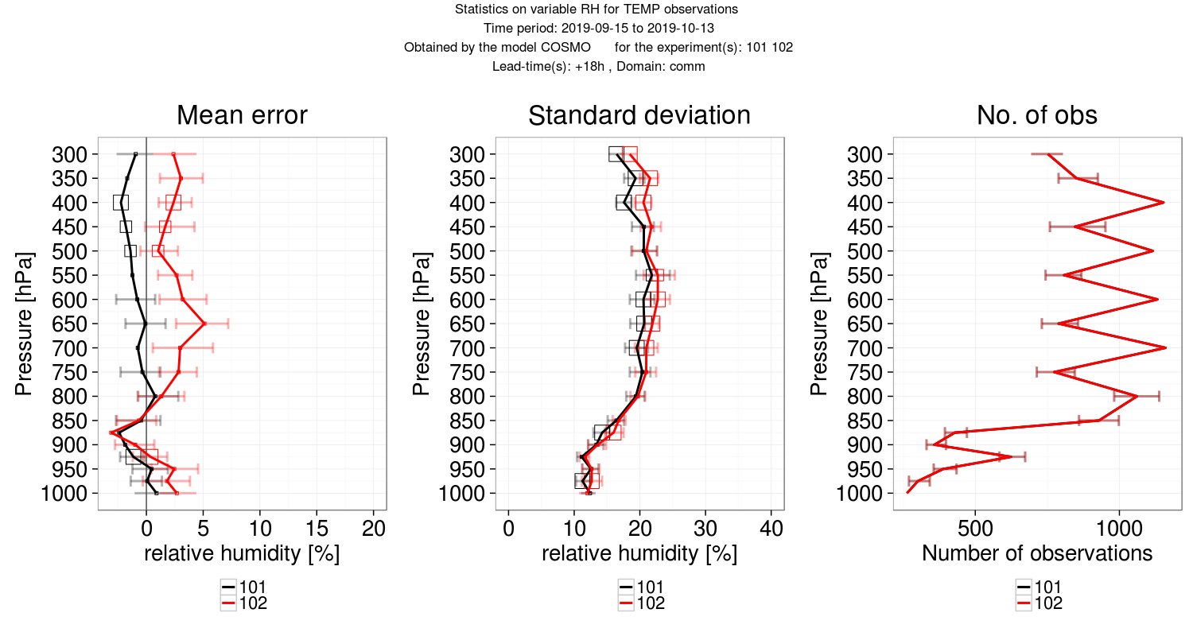
Upper air: relative humidity (deterministic) IFS (m01) vs ICON (m11)
102: ICON LBC
101: IFS LBC

Slide 23
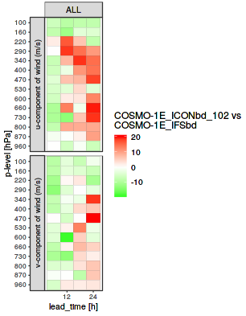
Upper Air: CRPS difference (%)

Slide 24
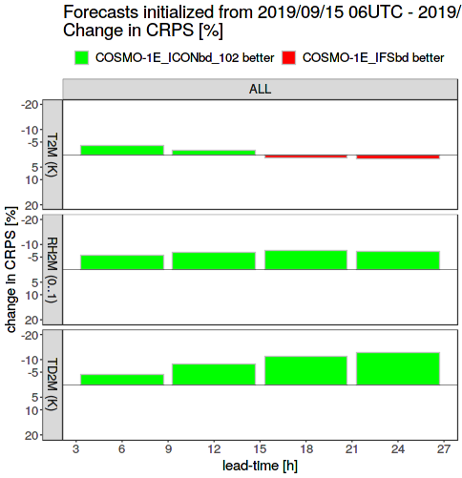
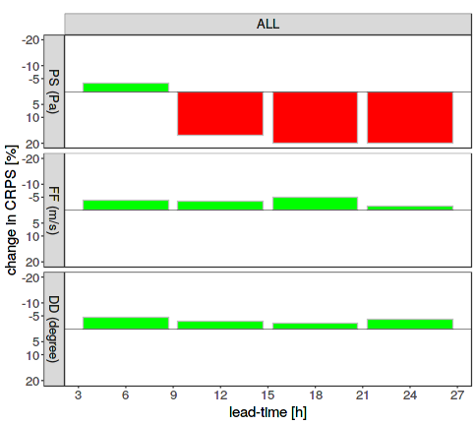
Summary: CRPS difference
temperature
rel. humidity
dewpoint
pressure
wind speed
wind direction

Slide 25
Summary – deterministic verification pro / cons
Surface:
mean absolute error in surface pressure
Upper Air:
(positive) humidity bias
(positive) temperature bias at upper levels
larger standard deviation for all 3 variables

Slide 26
Summary – ensemble verification pro / cons
Generally: more spread
Surface verification (CRPS):
+ humidity
+ wind
- surface pressure
Upper air (CRPS):
temperature (upper levels)
wind
+ humidity

Slide 27
Conclusion / Outlook
With ICON LBCs, error is generally larger
However, ensemble verification for surface in favour of ICON LBCs
To what extend would IC perturbations and member selection for LBCs change these results?
New experiments run but they aren’t analysed yet
→ In summary, there is no need to rapidly switch to ICON LBCs for COSMO-1E

Slide 28
ModInterim: next steps

