Slide 1
Change of methodology in LHN for ILAM at DWD
ICCARUS KENDA meeting
11th of March 2022
Klaus Stephan

Slide 2
Baseline
LHN normaly stands for Latent Heat Nudging
Take model latent heating profile at every model grid point and calculate increment in T by scaling the profile with the ratio of observed over simulated precipitation rate.
Basic assumption is a correlation between latent heat release and precipitation.
This works very well in the last years in COSMO when additionally an increment in QV is applied, to remain relative humidity constant (lhn_hum_adj=.true.)

Slide 3
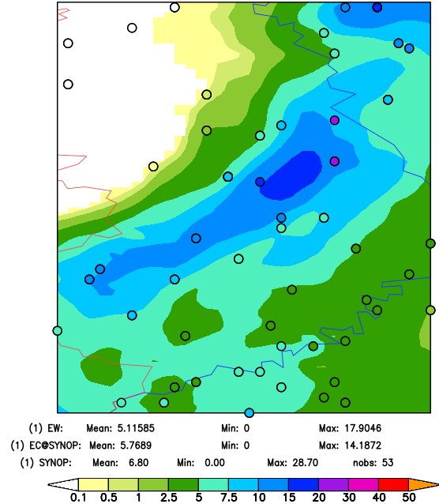
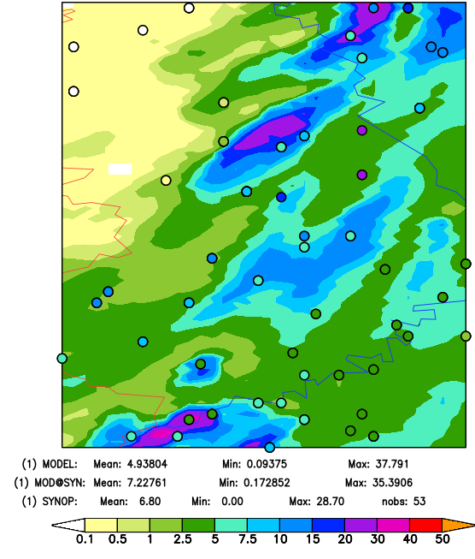
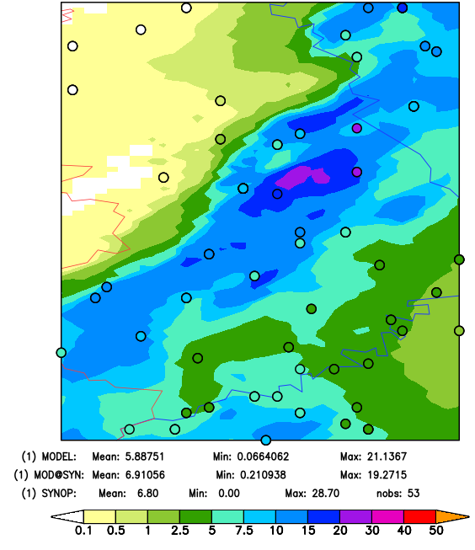
Bug fixing and retuning
As a matter of fact, there was a bug in model internal bright band detection, we strongly need (and apply at least at DWD), applying it in warm seasons
Many of observation grid points showing high precipitation (i.e. in showers or thunderstorms) were rejected by bright band detection, as we found for instant in flash flood event 14th of July 2021, shown is 16 UTC (1 hourly forecast)
OBS
OLD
NEW

Slide 4
Retuning
Fixing the bug needs to retune the LHN setting. This can be done also with the baseline methodology. BUT trying to couple LHN with 2MomentPhysics we found, that using a new methodology shows good results. The same method was also shown best results when trying to apply LHN at ICON-EU (convection parameterization!)
What is the new idea: run the same procedure as in baseline, but set T increment to zero at the end of LHN scheme. Only QV increments are applied.
Please note: different code in ICON and in COSMO concerning SATAD: It is always called after LHN in ICON but in COSMO only when lhn_hum_adj =.false.

Slide 5
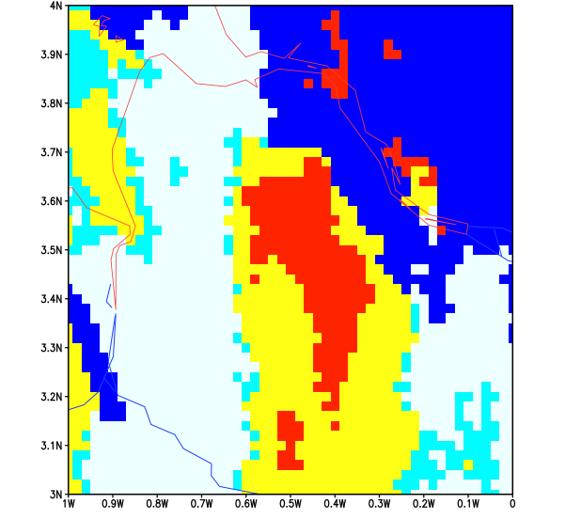
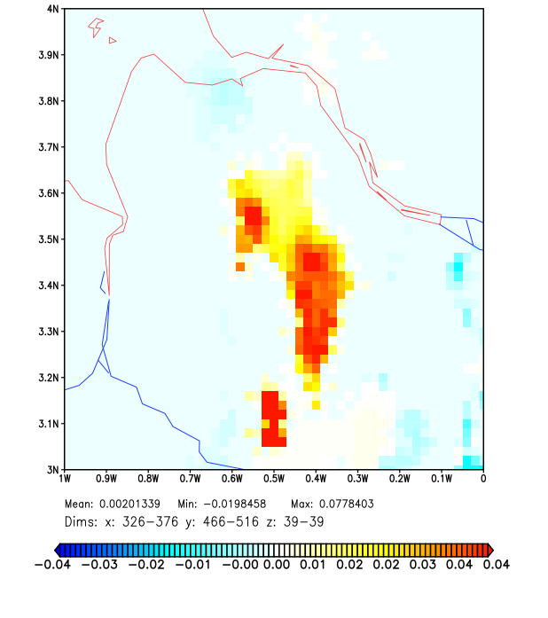
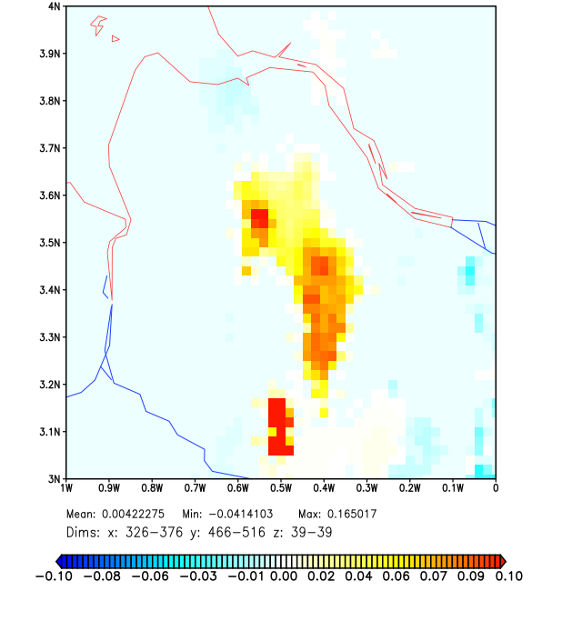
T tendency by LHN
in K
QV increment by LHN
in g/kg
Treating by LHN
no data
tiny cooling/
heating
cooling
warming
“artif” warming

Slide 6
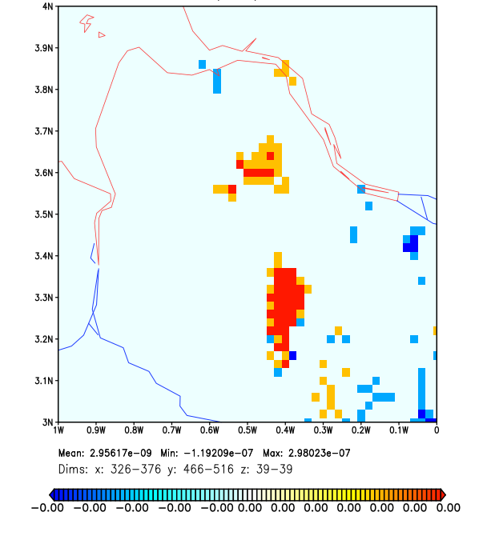
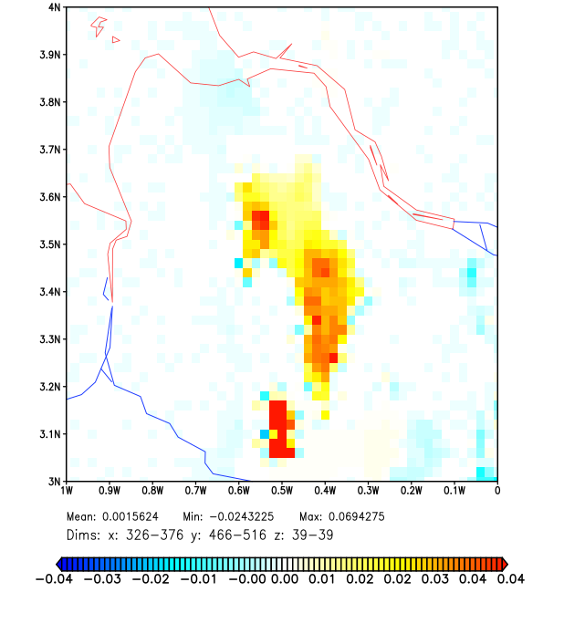
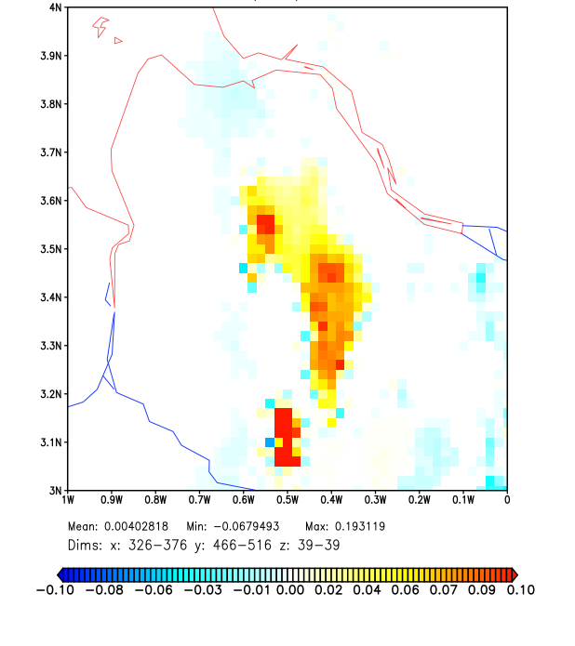
Change of QC with LHN
in kg/kg
Change of T with LHN
in K
Change of QV with LHN
in g/kg
Changes by LHN after applying both increments

Slide 7
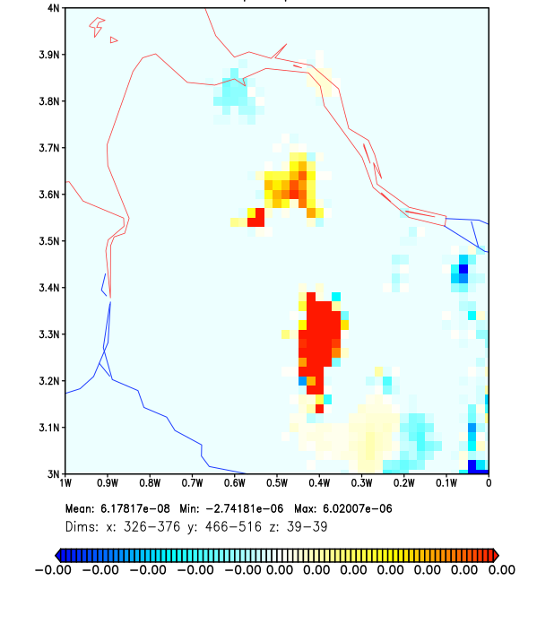
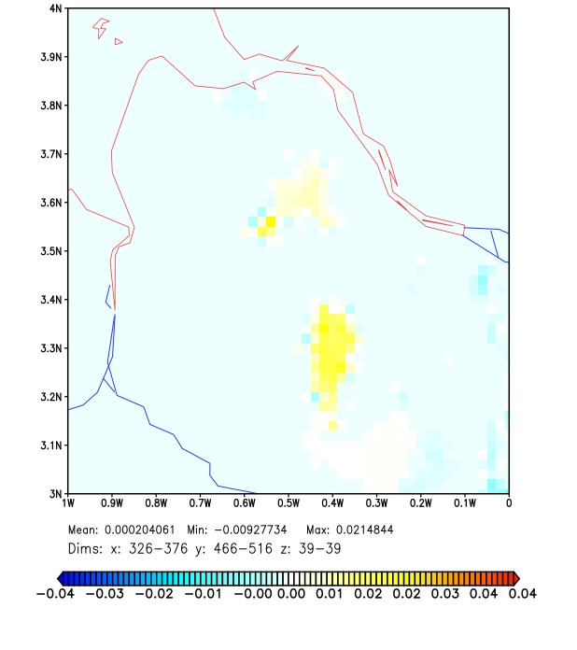
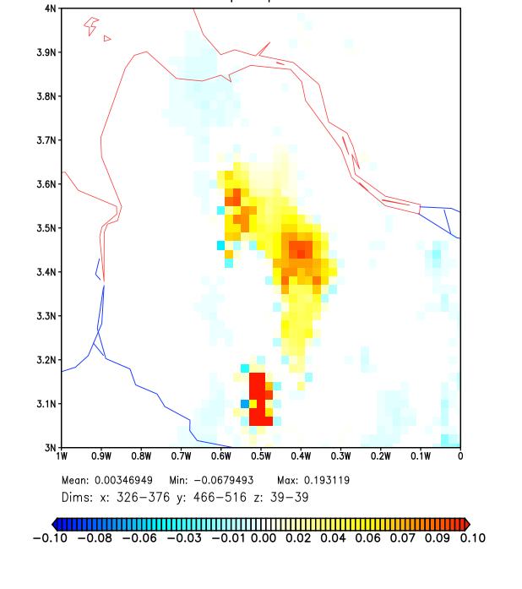
Change of QC with LHN
in kg/kg
Change of T with LHN
in K
Change of QV with LHN
in g/kg
Changes by LHN after applying only QV increments

Slide 8
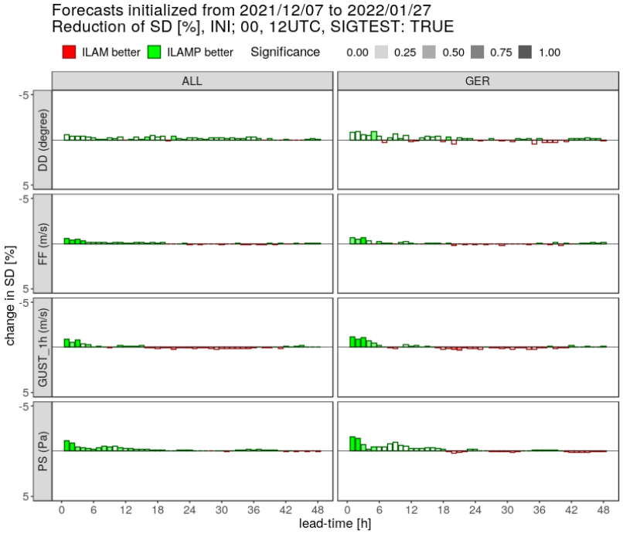
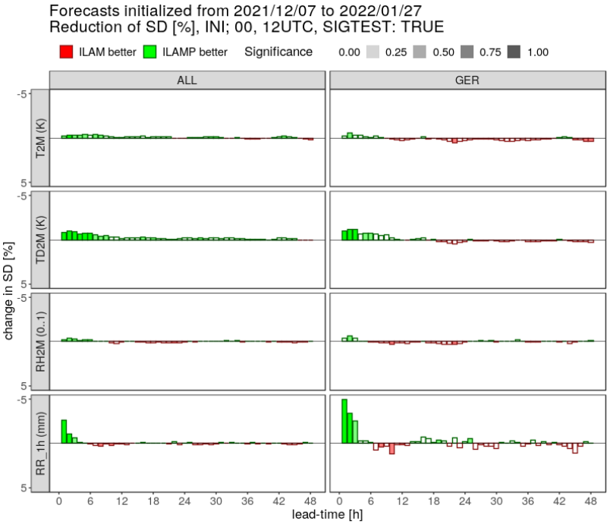
Conclusion
Applying QV increments only, will lead to similar results, when allowing a bit stronger forcing. So far no direct comparison was done, but several test with bug fix and retuning against operational baseline. Especially in winter, when bug fix will play a minor role, improvements against SYNOP are found.
T
WIND
RH
PMSL
RR

