Slide 1
Ground-based microwave radiometer assimilation in KENDA/COSMO
Claire Merker ª, Jasmin Vural ^{b}, Daniel Leuenberger ª, Maxime Hervo ª, Alexander Haefele ª
ª MeteoSchweiz, ^{b} Deutscher Wetterdienst

Slide 2
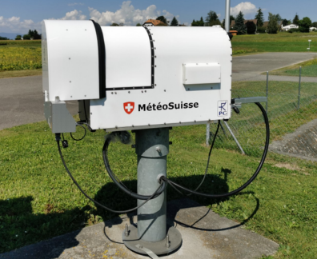
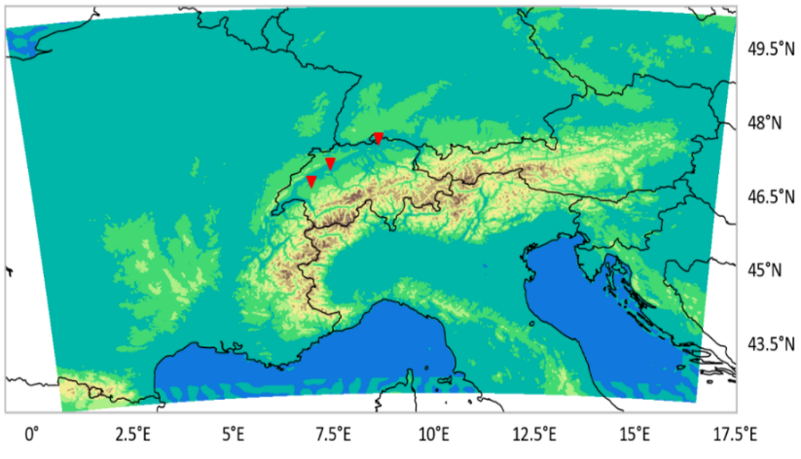
Ground-based microwave radiometer (MWR)
Brightness temperature in 14 channels
between 22 and 58 GHz
1-7: humidity sensitive
8-14: temperature sensitive
Direct assimilation of brightness temperature
Observation operator: RTTOV-gb (de Angelis et al. 2016)

Slide 3
Comparison in obs. space
DA method | LETKF/KENDA with 40+1 members
Model | COSMO 2.2km
Observations | HATPRO in Payerne and Grenchen, TEMPRO in Schaffhausen Zenith scan only, channels 8-9 excluded (data quality issues)
Temporal resolution | 60 minutes for data assimilation
Observation errors | Instrument error + standard deviation of O-B statistics
Vertical localisation | Exp 344: no vertical localisation Exp 345: vertical localisation from RTTOV-gb Jacobians
Bias correction | Static, derived from O-B statistics
Cloudy observations | Active for channels 2, 3, 7, 10-14
Time period | 01.09.2021-10.09.2021

Slide 4
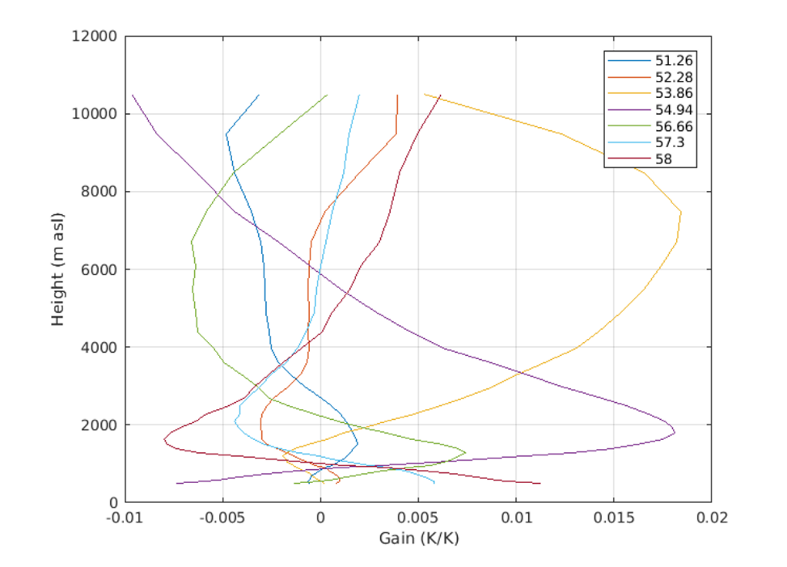
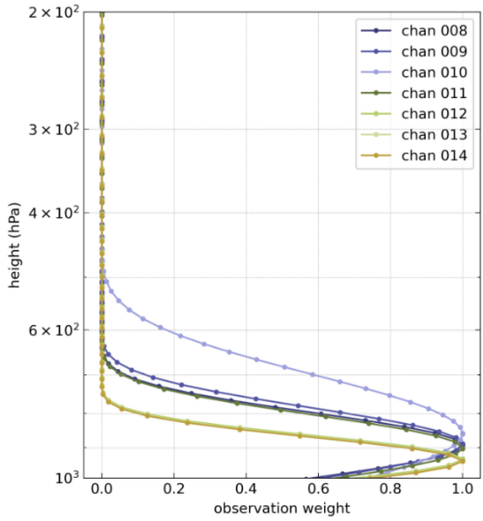
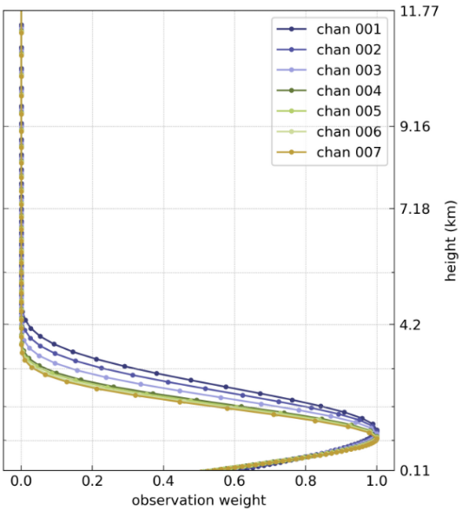
G2 retrieval gain vs. MWR vert. localisation
change on the atm. temperature for a change of 0.01K in brightness temperature (zenith only)
“more opaque (higher frequency): impact is lower in altitude”
based on RTTOV-gb Jacobians and profiles of temperature and humidity
channels 8-14
channels 1-7

Slide 5
Comparison in observation space linear analysis and observations, Payerne
2.2km REF
with vert. loc.
without vert. loc.
observations
Experiments with MWR assimilation closer to observations

Slide 6
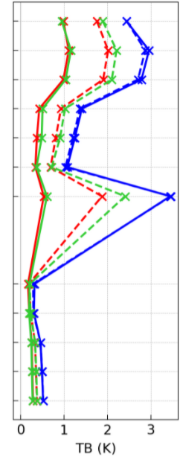
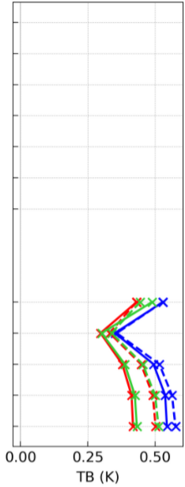
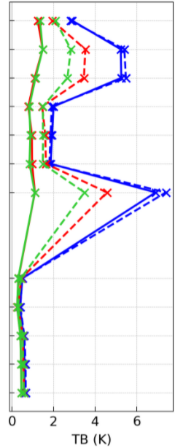
Comparison in observation space RMSE of O-B, O-A
2.2km REF
with vert. loc.
without vert. loc.
Payerne
Schaffhausen
Grenchen
analysis
first guess
Improvement in analysis compared to first guess in experiments
In Payerne and Schaffhausen, results are best for the experiment without localisation

Slide 7
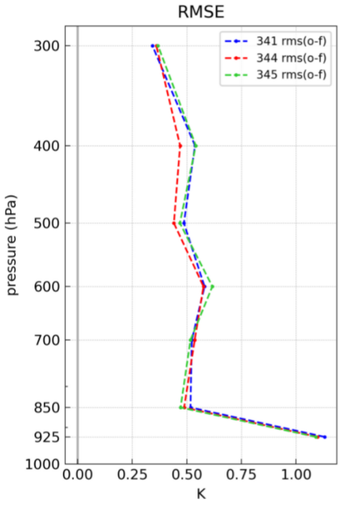
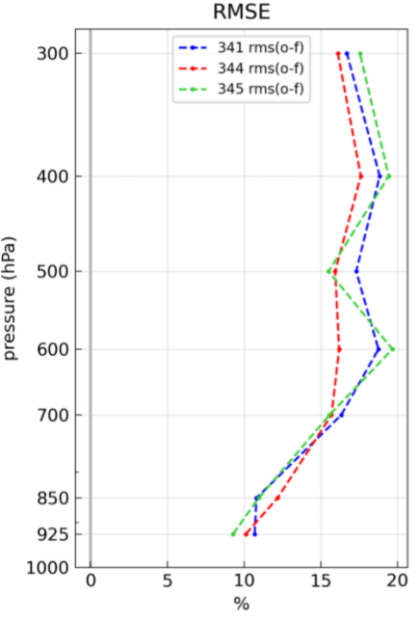
Upper air comparison to soundings RMSE of O-B, Payerne
2.2km REF
with vert. loc.
without vert. loc.
Temperature
Relative humidity
Upper air improvement visible for experiment without vertical localization
Experiment with vertical localisation does not allow increments above approx. 500hPa (channels 7-14)

Slide 8
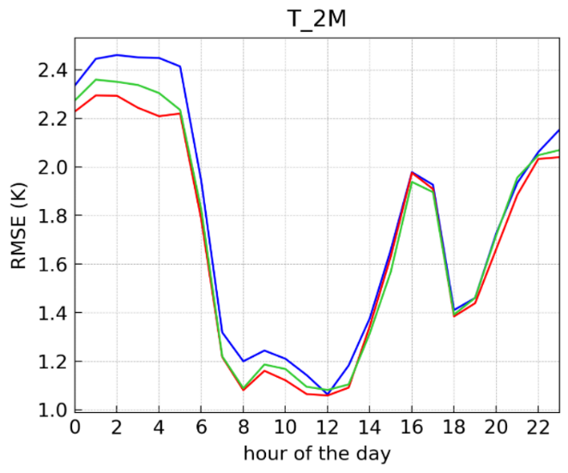
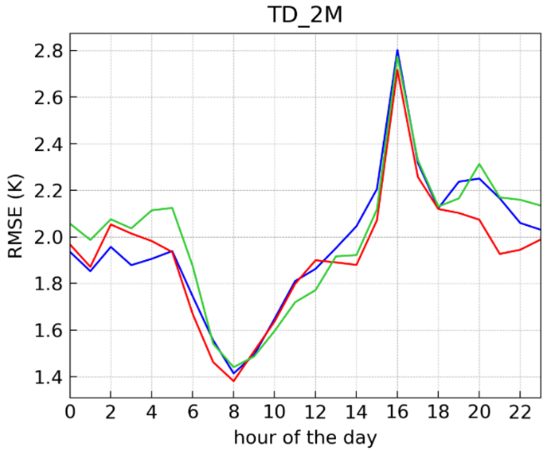
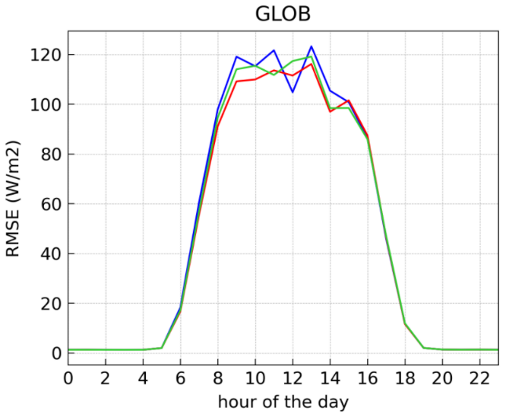
Surface verification, first guess det. diurnal cycle, RMSE (Swiss Plateau)
2.2km REF
with vert. loc.
without vert. loc.
Improvement in 2m temperature compared to reference, even better without vertical localisation
Deterioration in 2m dew point temperature in second half of the night mitigated without vertical localization, improvement in first halt of the night
No significant change in global radiation

Slide 9
Further experiments:
No vertical localisation
+ 3 scans (30°, 19.2°, 5.4°)
+ 3 scans (30°, 19.2°, 5.4°) but only channels 2, 7, 11, 14

Slide 10
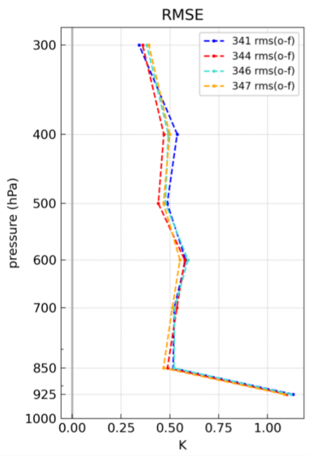
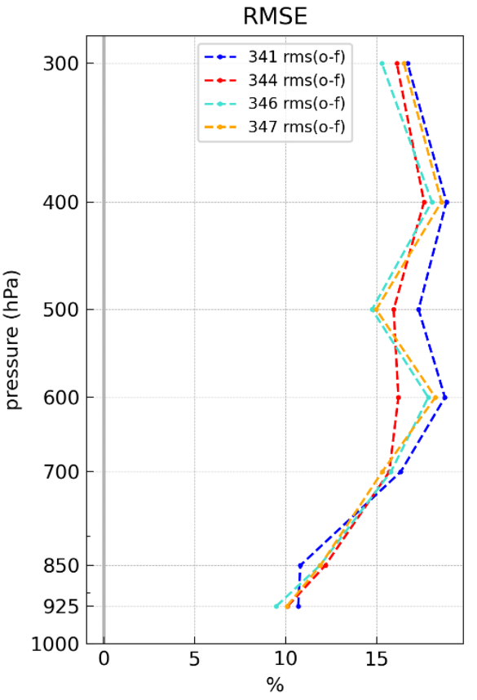
Upper air comparison to soundings RMSE of O-B, Payerne
2.2km REF
without vert. loc.
+ 3 scans
+ 3 scans, only 4 channels
Temperature
Relative humidity
Adding more scans and keeping all channels does not improve results, not even temperature in this case

Slide 11
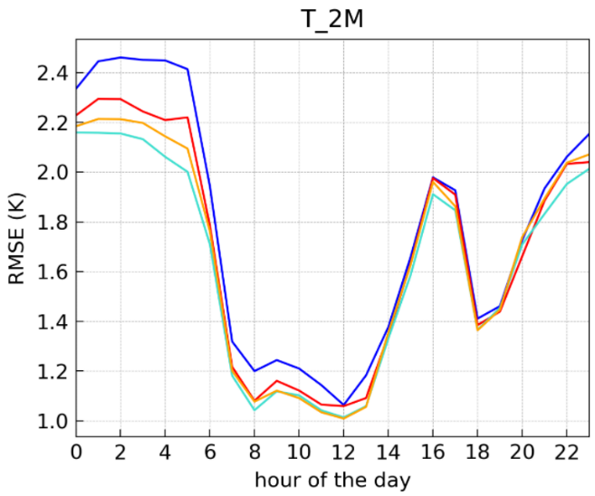
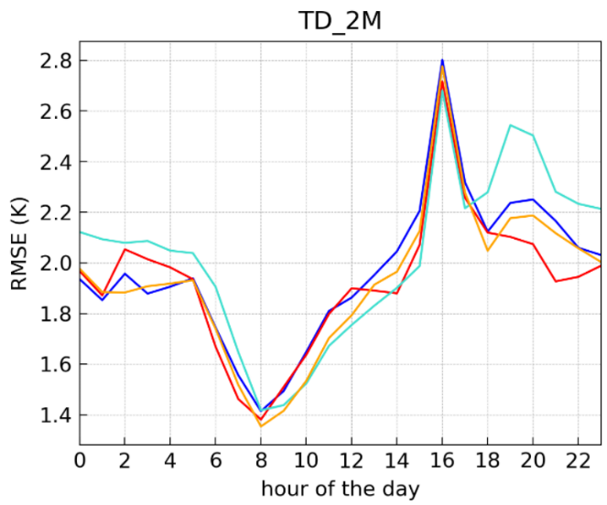
Surface verification, first guess det. diurnal cycle, RMSE (Swiss Plateau)
2.2km REF
without vert. loc.
+ 3 scans
+ 3 scans, only 4 channels
Improvement in 2m temperature when adding more information…
…but deterioration in humidity (not so much when reducing the number of channels)
Overfitting in temperature? Too much correlated information with too small observation error?

Slide 12
Summary

Slide 13
Summary and next steps
Promising results
good impact on brightness temperature
slight positive impact on upper air/2m temperature and humidity in first guess
Go on with setup without vertical localization and zenith scan only
Further experiments
COSMO 1.1km
longer time period + forecasts
include adaptive bias correction

