Slide 1
PP CITTA: status at IMS
Pavel Khain, Ron Drori, Yoav Levi
WG meeting, Feb 2023

Slide 2
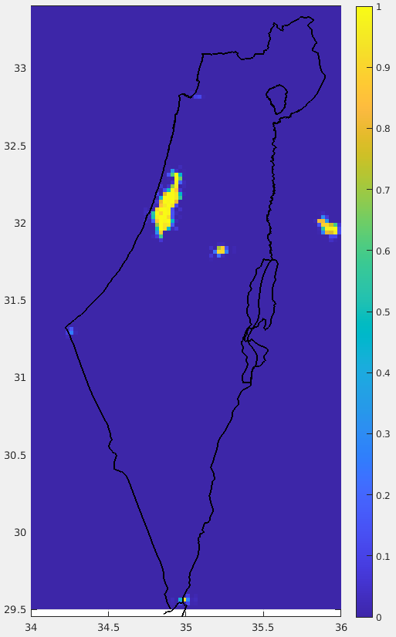
ICON-IL domain (2.5km) driven by IFS
FR_PAVED GlobCover
sea
land
Tel Aviv
Jerusalem
Strong underestimation

Slide 3
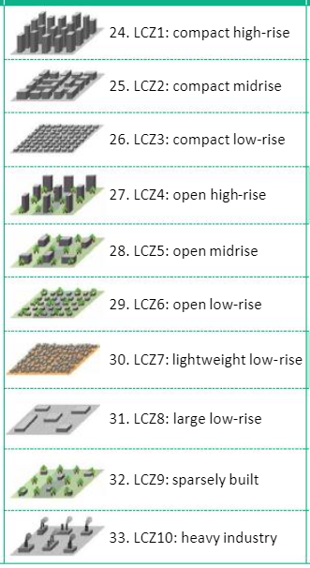
FR_PAVED NEW
Carmela Apreda (CMCC)
sea
ECOCLIMAP-SG (300m resolution)
Roni Drori (IMS)
Urban classes 24-33
↓
GlobCover class 19
on triangular grid
Classes 27, 28, 29, 32 are partially urban. Taking them as 1 leads to overestimation in Urban fraction

Slide 4
8 days experiment: 7/2/2023-14/2/2023 00 UTC + 78h on ATOS@ECMWF
Experiment | lterra_urb | lurbalb | lurbahf
ref | False | False | False
urb₀ | True | False | False
urb₁ | True | True | True
use urban albedo and emissivity
use urban anthropogenic heat flux
lterra_urb ! activate urban model TERRA_URB (modified heat capacity and thermal conductivity)
lurbalb ! use urban albedo and emissivity
lurbahf ! use urban anthropogenic heat flux
itype_kbmo=2 ! type of bluff-body thermal roughness length parameterization (2: Brutsaert Kanda)
itype_eisa=3 ! type of evaporation from impervious surface area. Commented in the code ?!

Slide 5
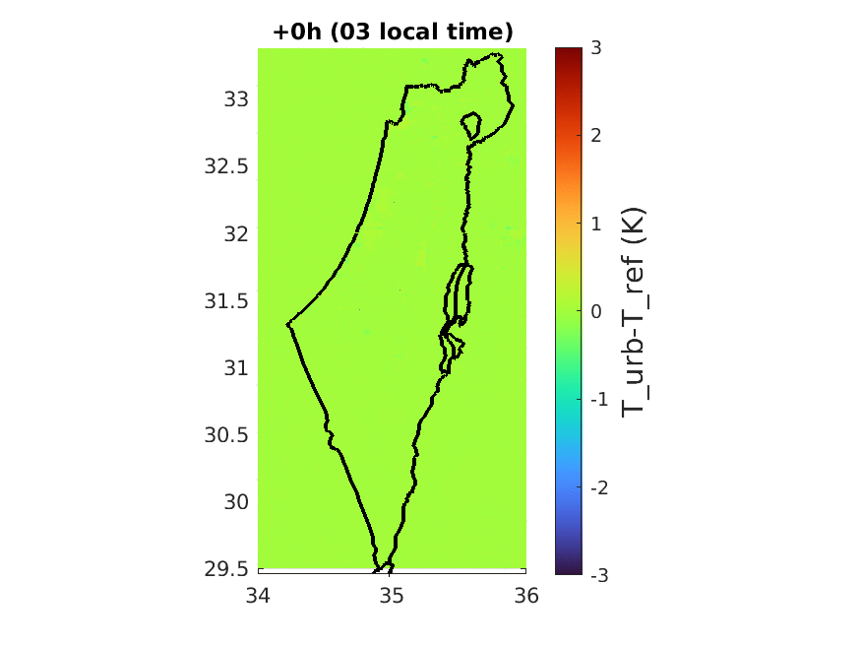
sea
land
urb₁-ref
land

Slide 6
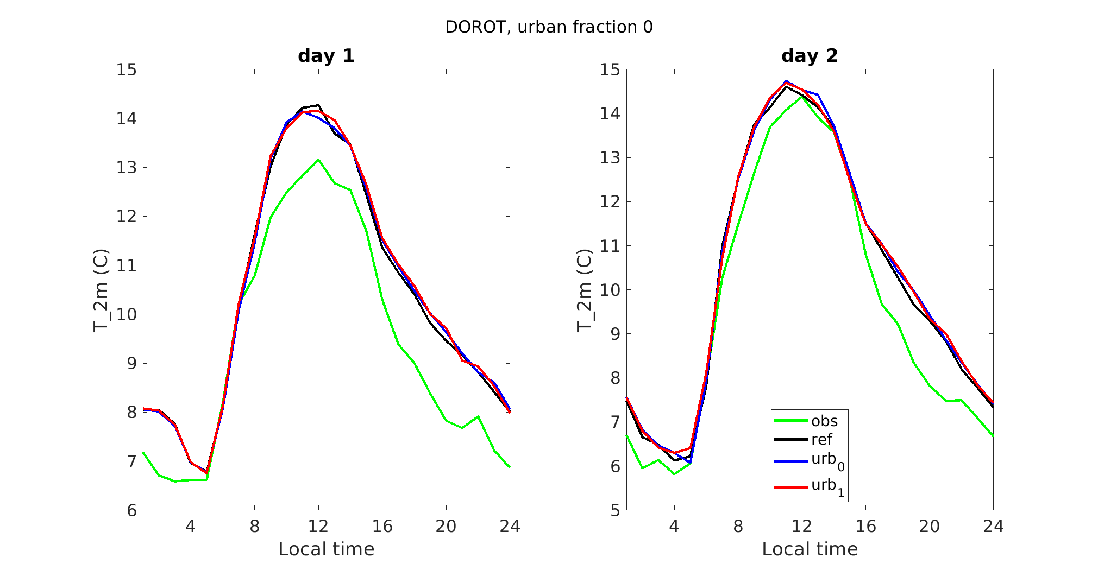

Slide 7
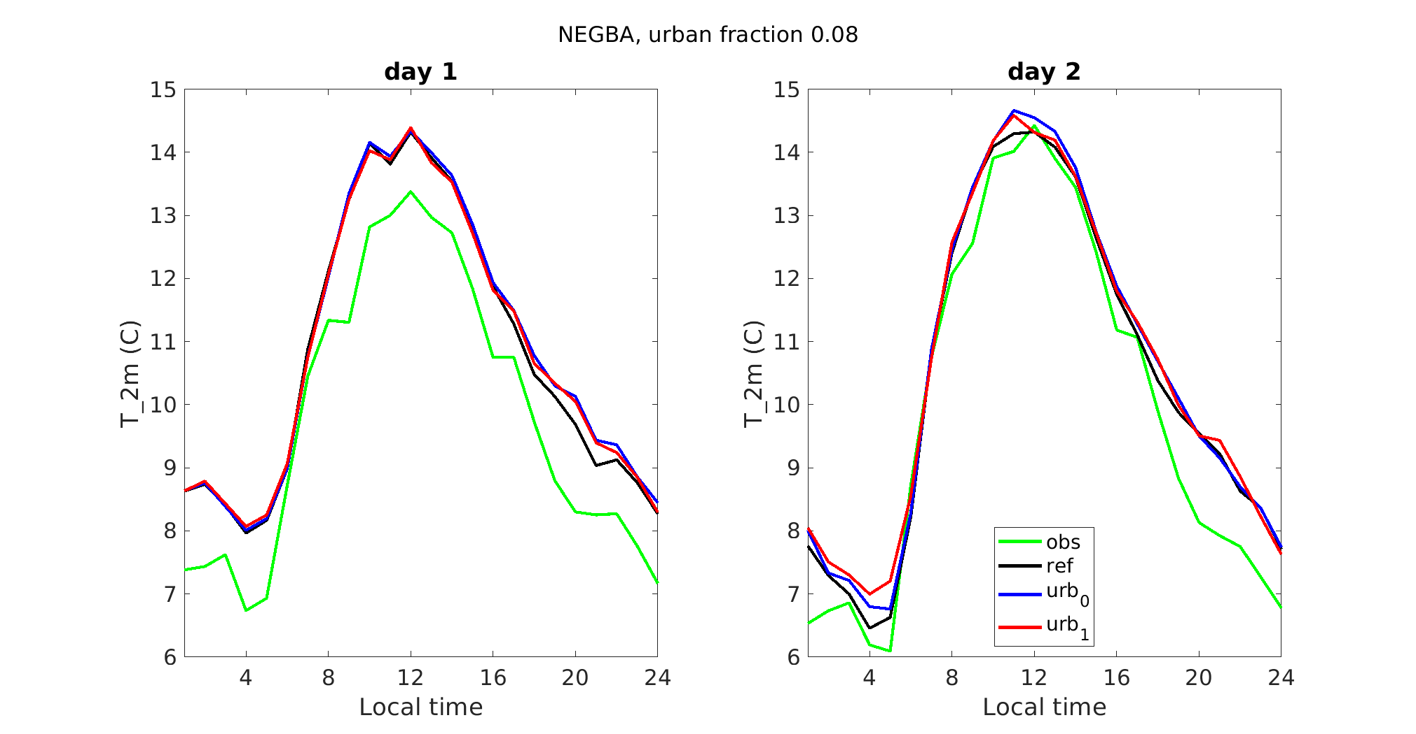

Slide 8
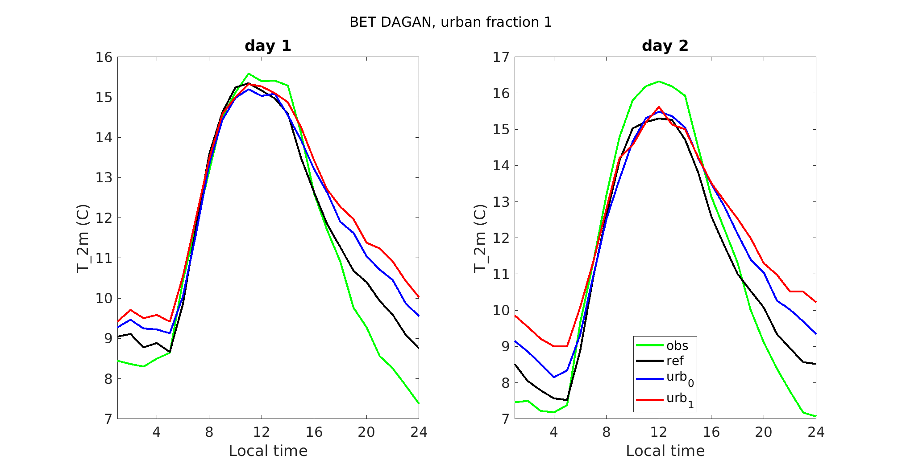

Slide 9
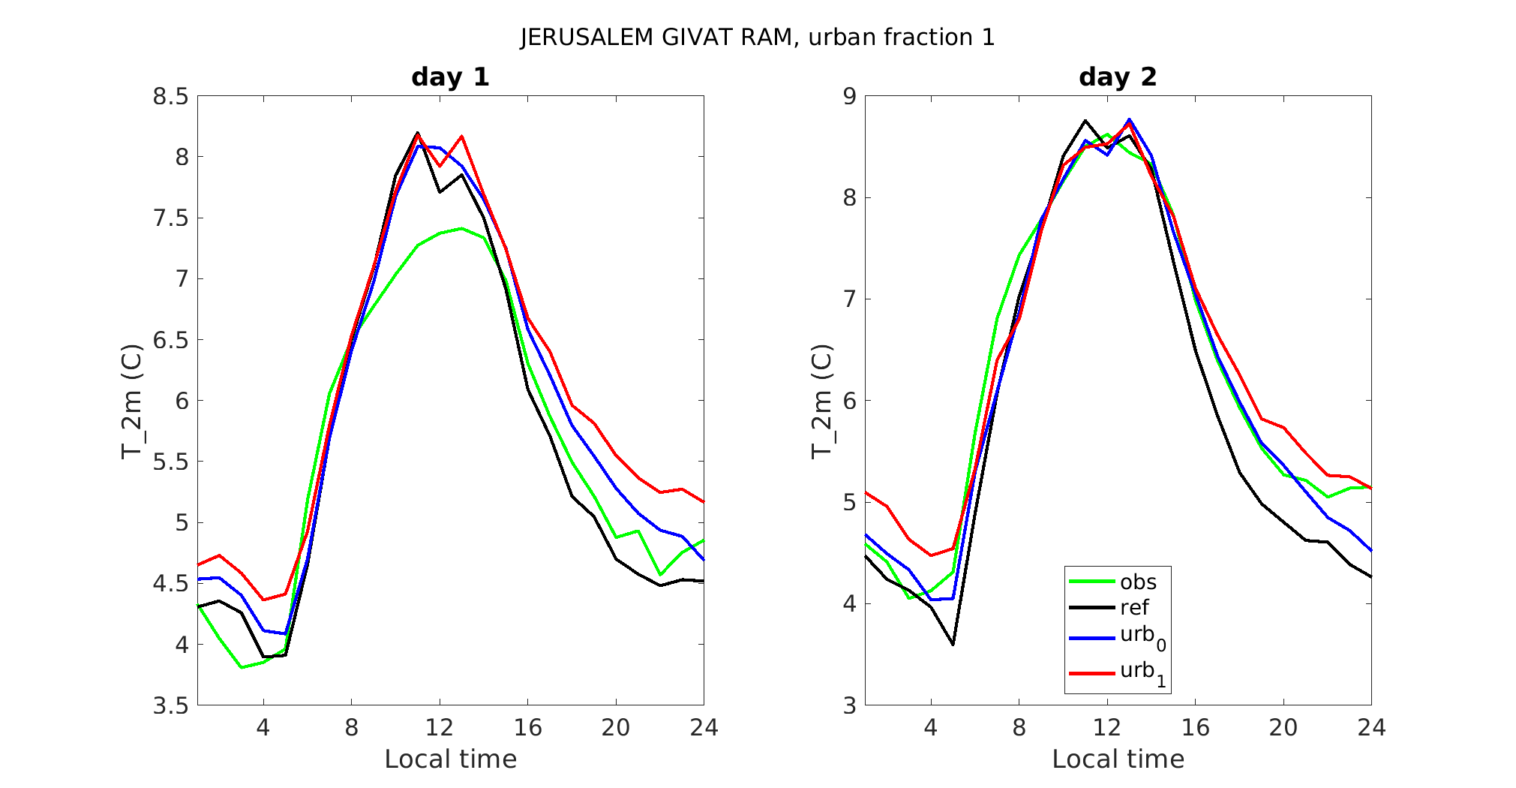

Slide 10
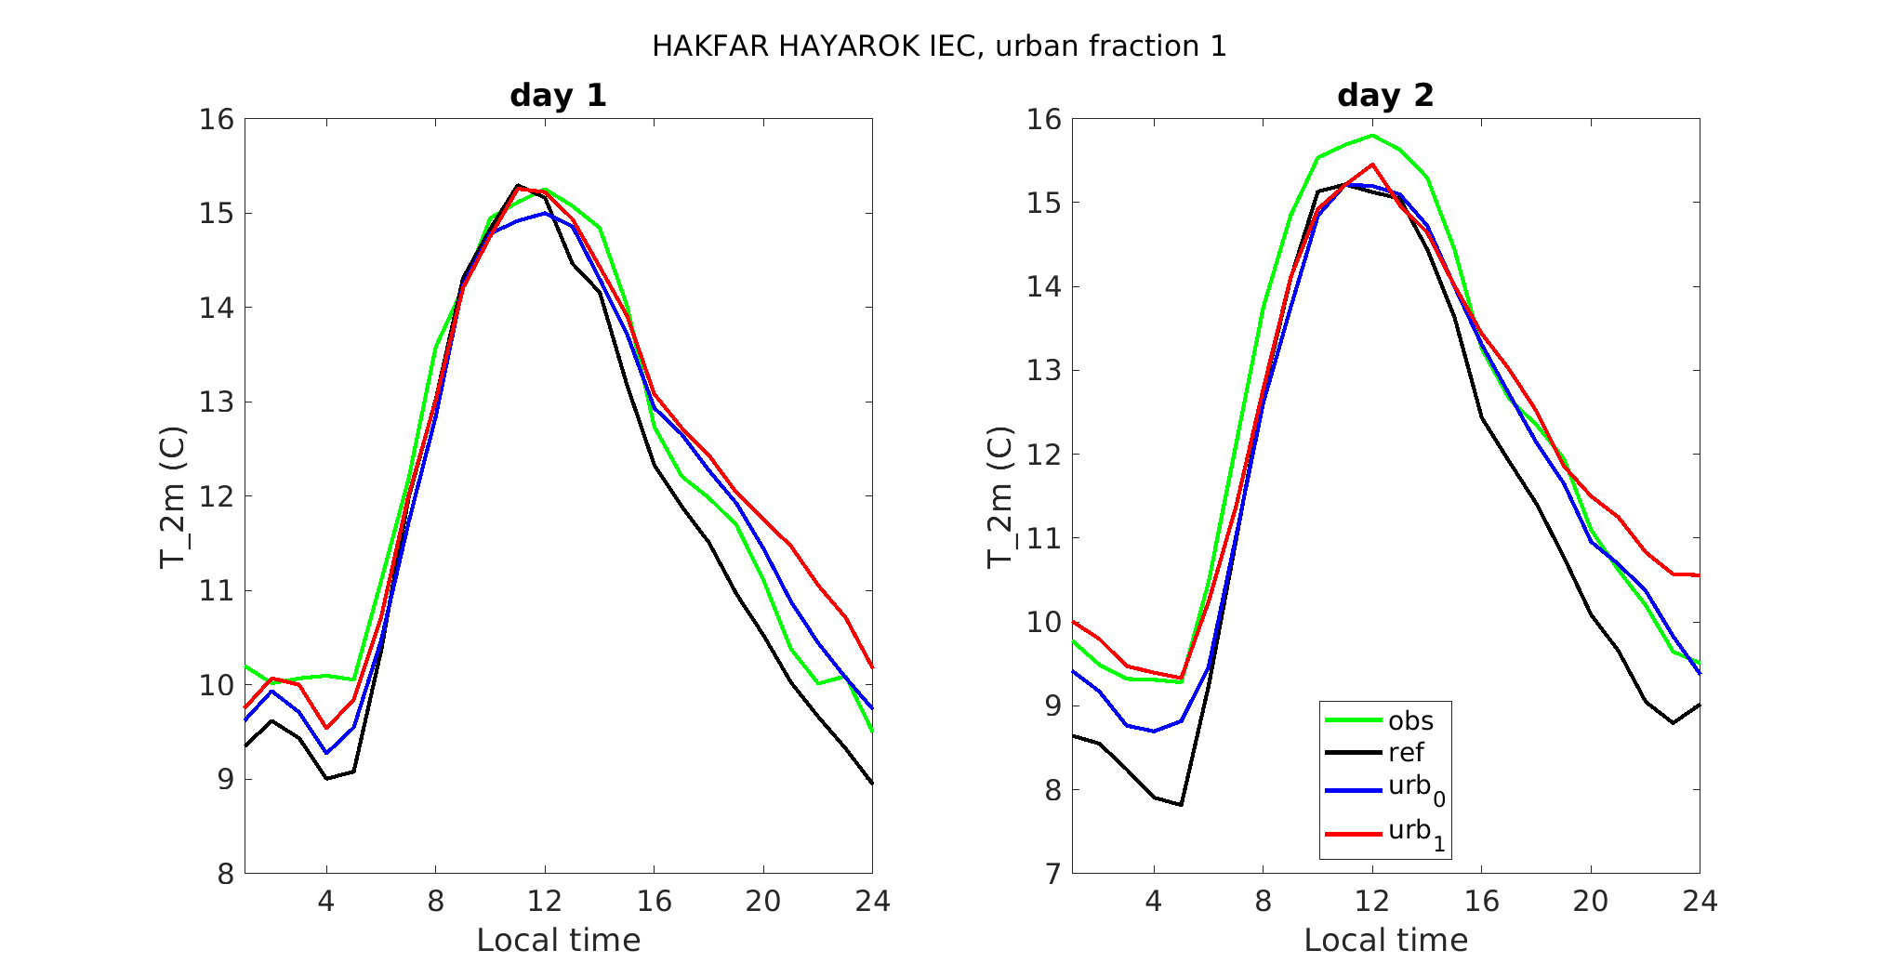

Slide 11
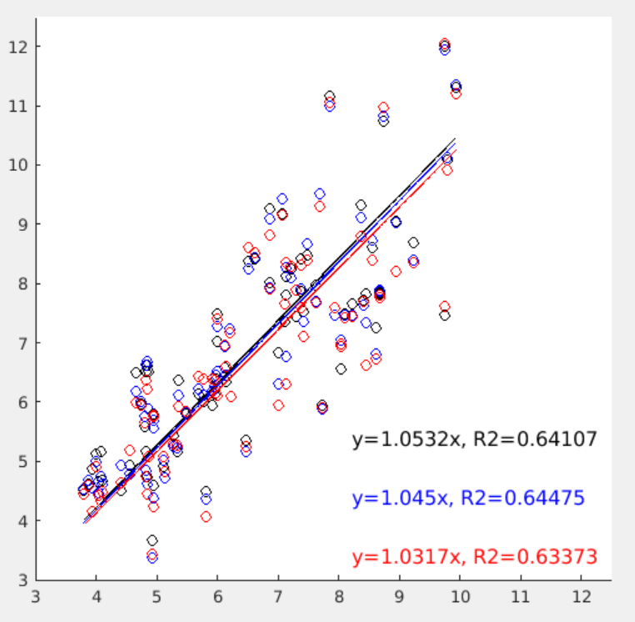
Mean diurnal amplitude ∆T during 8 days experiment: simulated vs observed
Each circle represents one station
As expected ∆T is lower when the urban effect is taken into account
∆T in model and observations approaches 1:1 line
Simulated ∆T (ºC)
ref
urb₀
urb₁
Observed ∆T (ºC)

Slide 12
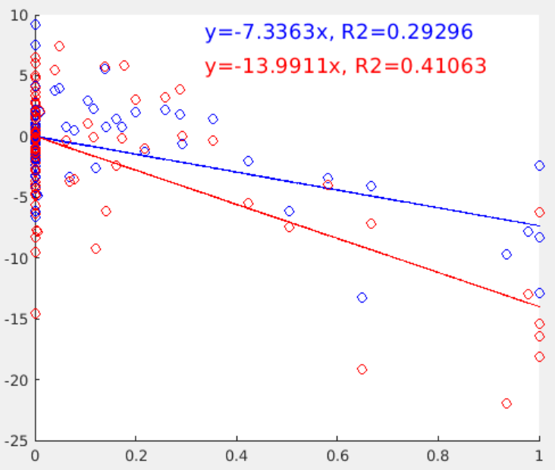
Mean diurnal amplitude ∆T during 8 days experiment: simulated effect vs urban fraction
Each circle represents one station
The simulated effect is estimated in percent (%) by:
urb₀ ∆T is reduced by ~7%
urb₁ ∆T is reduced by ~14%
$$100\frac{\text{∆}\text{T}\text{(}\text{urb}\text{0}\text{)−}\text{∆}\text{T}\text{(}\text{ref}\text{)}}{\text{∆}\text{T}\text{(}\text{ref}\text{)}}$$
$$100\frac{\text{∆}\text{T}\text{(}\text{urb}\text{1}\text{)−}\text{∆}\text{T}\text{(}\text{ref}\text{)}}{\text{∆}\text{T}\text{(}\text{ref}\text{)}}$$
$100\frac{\text{∆}\text{T}\text{(}\text{urb}\text{)−}\text{∆}\text{T}\text{(}\text{ref}\text{)}}{\text{∆}\text{T}\text{(}\text{ref}\text{)}}$ (%)
$$100\frac{\text{∆}\text{T}\text{(}\text{urb}\text{)−}\text{∆}\text{T}\text{(}\text{ref}\text{)}}{\text{∆}\text{T}\text{(}\text{ref}\text{)}}$$
Urban fraction [0-1]

Slide 13
Conclusions
8 days experiment was performed over the Eastern Mediterranean with 2 versions of the urban scheme
The urban scheme shows promising results
By transferring classes 24-33 of ECOCLIMAP-SG to GlobCover class 19, the urban cover is improved significantly, but is overestimated
Plan: Further improve the land use map, including the urban class (19) using 10m satellite data: The European Space Agency (ESA) WorldCover 10 m 2021 product https://esa-worldcover.org/en
Use ECOCLIMAP-SG from EXTPAR when available
Thanks a lot to Carmela and Jan-Peter!

