Slide 1
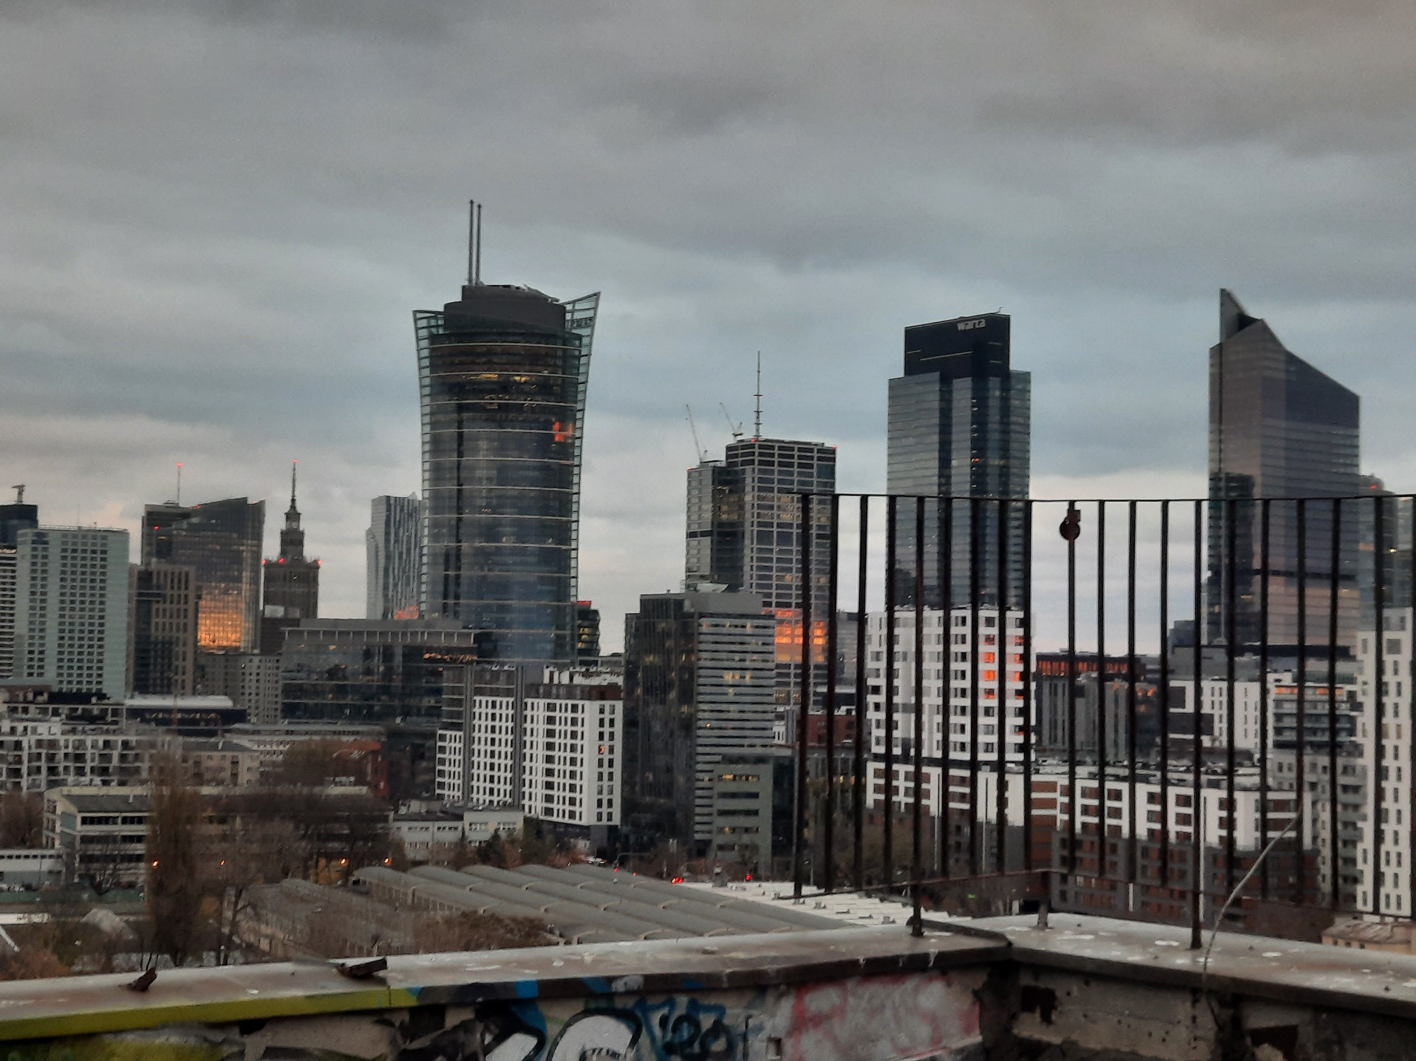

PP-CITTÀ – update on the work in EXTPAR
Andrzej Wyszogrodzki, Adam Jaczewski
Centre of Numerical Weather Prediction
22/02/2023, COSMO PP CITTA' meeting
photo by: Gabriel Jaczewski

Slide 2

Existing approach to landcover data in EXTPAR module
extpar_landuse_to_buffer.f90 is responsible for the aggregation of the landuse data to the targer grid
Raw data | No. of classes | Integer | Setting | module calling
GLOBCOVER 2009 | 23 | 1 | operational settings | mo_globcover_lookup.f90
 |  | 2 | experimental settings
GLC2000 | 23 | 1 | operational settings of GME | mo_glc2000_lookup.f90
 |  | 2 | operational settings of COSMO
 |  | 3 | experimental settings
GLCC | 24 | 1 | operational settings of GME | mo_glcc_lookup.f90
 |  | 2 | operational settings of COSMO
 |  | 3 | experimental settings
Ecoclimap | 218 | n.a. | ecoclimap lookup.TAB | mo_ecoclimap_lookup.f90
ESA CCI-LC | 23 | 1 | experimental settings | mo_ecci_lookup_tables.f90
Notes:
Currently, 5 alternative landuse datasets can be used.
The datasets differ in number and kinds of classes.
Main program is responsible for the aggregation of the landuse data to the targer grid.
The separate fortran module is used for each dataset.

Slide 3
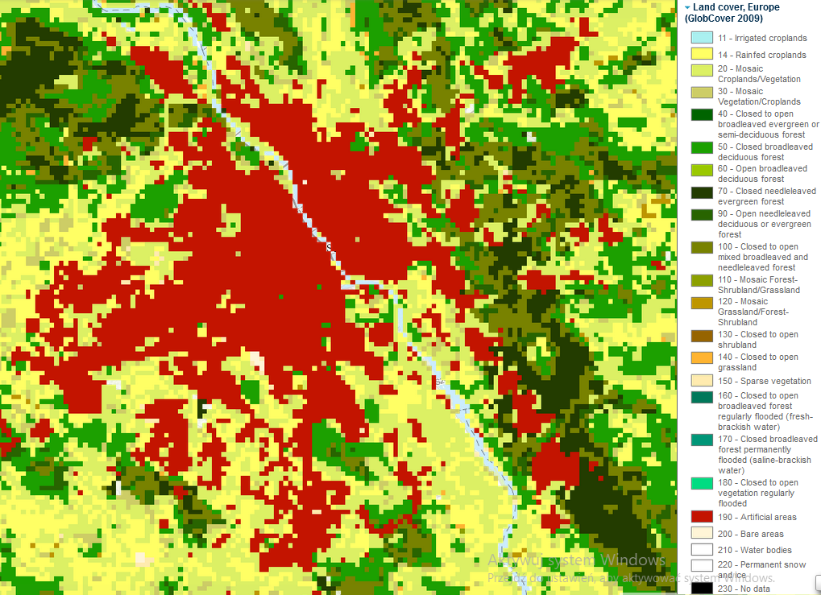
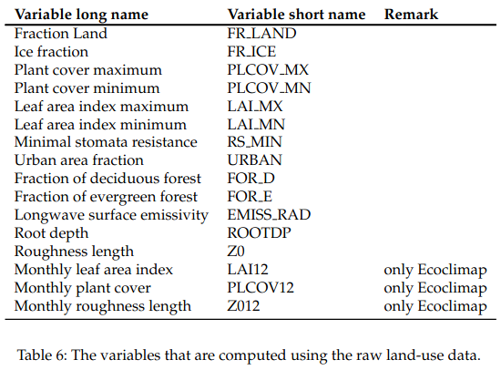
Existing approach to landuse data in EXTPAR module
External Parameters in EXTPAR v5_6
The raw landuse data are necessary to generate fields of surface properties on target grid.
lookup table
Warsaw (GlobCover 2009)
lookup table is fed with the land use class which gives a value for all the target fields

Slide 4
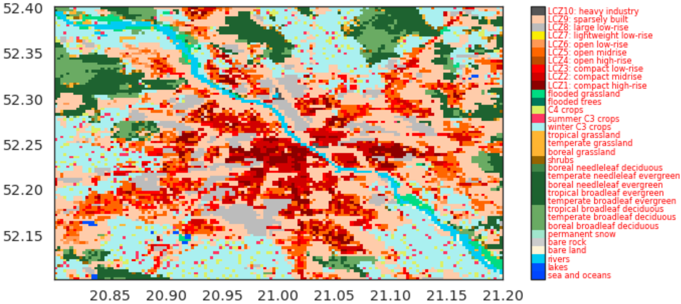
ECOCLIMAP-SG vs Globcover 2009 for Warsaw
(GlobCover 2009), 23 classes
class 19 - artificial surfaces
(ECOCLIMAP-SG),33 classes,
10 LCZ urban classs
homogeneity decreased in ECOCLIMAP-SG

Slide 5
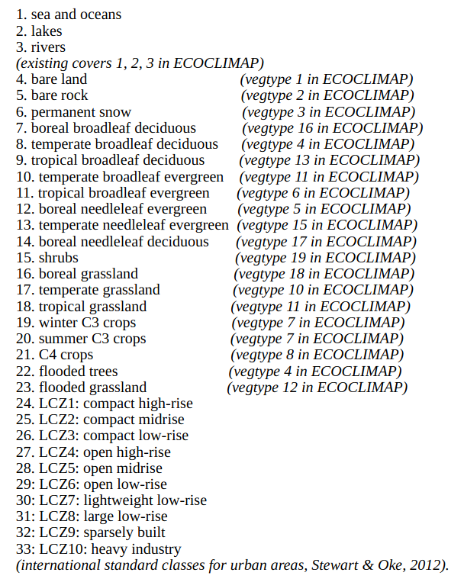
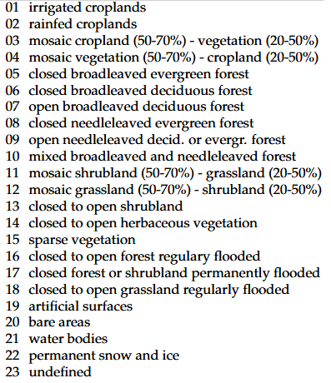
Land cover classes in ECOCLIMAP-SG and GLOBCOVER 2009
ECOCLIMAP-SG
GLOBCOVER 2009
vegetation types
(open, closed, mosaic, mixed)
vegetation types
(boreal, temperate,
tropical)
urban types
Different aggregation rules to derive surface parameters
Notes:
By contrast, existing datasets allowed for mixed surfaces.

Slide 6
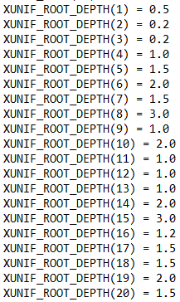
ECOCLIMAP-SG vs Globcover 2009
ECOCLIMAP-SG | GLOBCOVER 2009
1. sea and oceans 2. lakes 3. rivers | 21 water bodies
4. bare land 5. bare rock | 20 bare areas
6. permanent snow | 22 permanent snow and ice
7. boreal broadleaf deciduous 8. temperate broadleaf deciduous 9. tropical broadleaf deciduous | 06 closed broadleaved deciduous forest 07 open broadleaved deciduous forest
10. temperate broadleaf evergreen 11. tropical broadleaf evergreen | 05 closed broadleaved evergreen forest
12. boreal needleleaf evergreen 13. temperate needleleaf evergreen | 08 closed needleleaved evergreen forest
14. boreal needleleaf deciduous | 09 open needleleaved decid. or evergr. forest
15. shrubs | 13 closed to open shrubland
16. boreal grassland 17. temperate grassland 18. tropical grassland | 14 closed to open herbaceous vegetation
19. winter C3 crops 20. summer C3 crops 21. C4 crops | 02 rainfed croplands
22. flooded trees | 16 closed to open forest regulary flooded
23. flooded grassland | 18 closed to open grassland regularly flooded
NAM_DATA_ISBA for SURFEX V8.1
Notes:
As the first guess the new lookup tables could be fed from these Globcover classes.

Slide 7
Final lookup tables

Slide 8
Urban lookup tables
constant LCZ paramaters OK without TERRA URB, othervise we need variablility

Slide 9
Urban lookup tables – artificial surface
 | GLOBCOVER2009 | GLC2000 | GLCC
Plant cover max | 0.2 | 0.2 | 0.2
Plant cover min | 0.02 | 0.1 | 0.05
Leaf area index maximum | 1.6 | 1 | 1
Leaf area index minimum | 0.1 | 0.1 | 0.1
Minimal stomata resistance | 120 | 150 | 150
Urban fraction | 1 | 1 | 1
Longwave surface emissivity | 0.96 | 0.96 | 0.96
Root depth | 0.6 | 0.6 | 0.6
Roughness length | 1 | 1 | 1
… they should differ between LCZ and different cities
Notes:
.

Slide 10
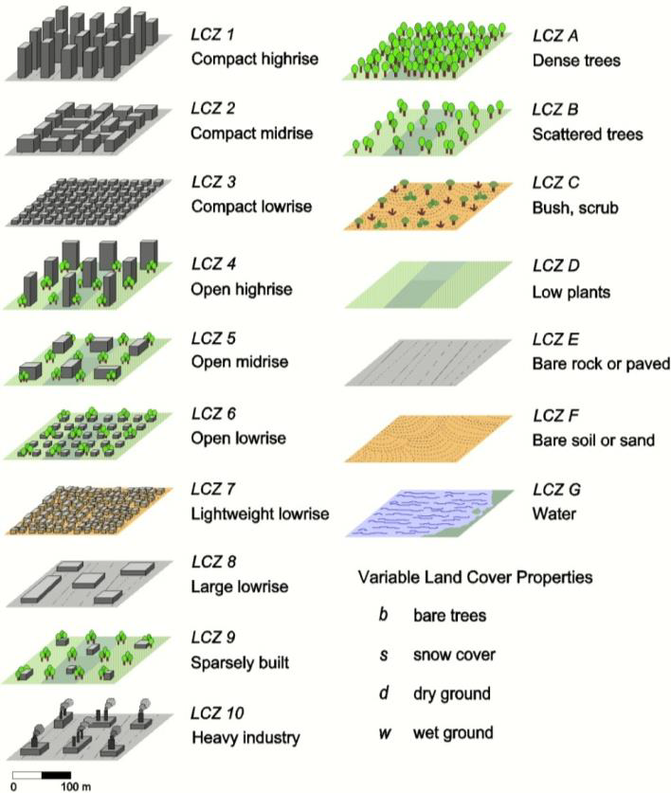
What about Local Climate Zones?
LCZ description (Stewart and Oke 2012)
24. LCZ1: compact high-rise
25. LCZ2: compact midrise
26. LCZ3: compact low-rise
27. LCZ4: open high-rise
28. LCZ5: open midrise
29: LCZ6: open low-rise
30: LCZ7: lightweight low-rise
31: LCZ8: large low-rise
32: LCZ9: sparsely built
33: LCZ10: heavy industry
Notes:
But there are new classes, Local Climate Zones.

Slide 11
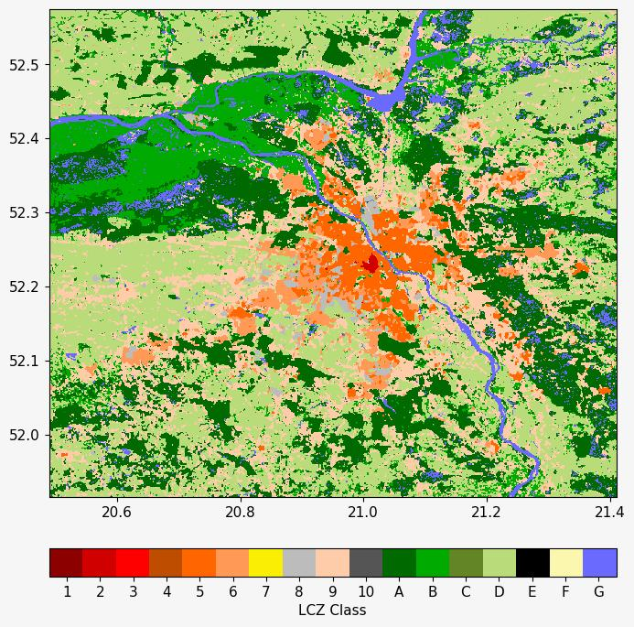
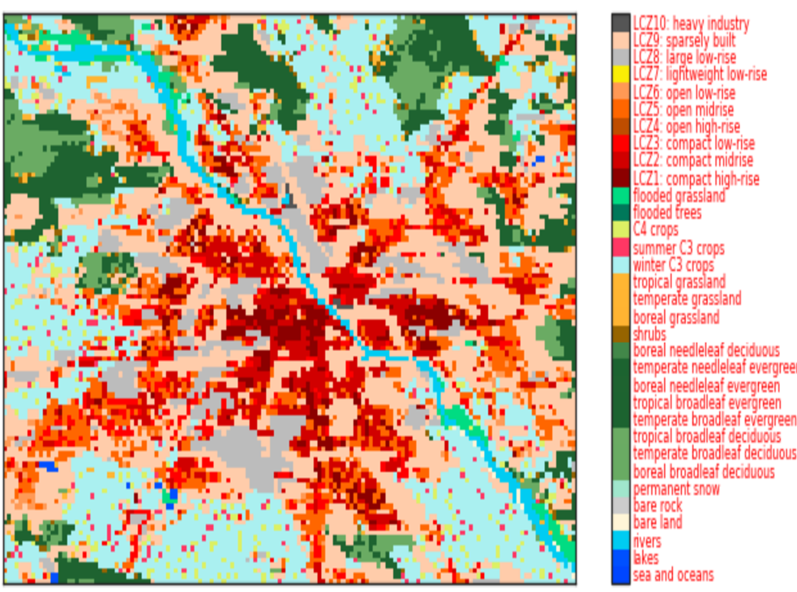
What about Local Climate Zones?
WUDAPT Vector based LCZ map (https://lcz-generator.rub.de)
ECOCLIMAP-SG

Slide 12
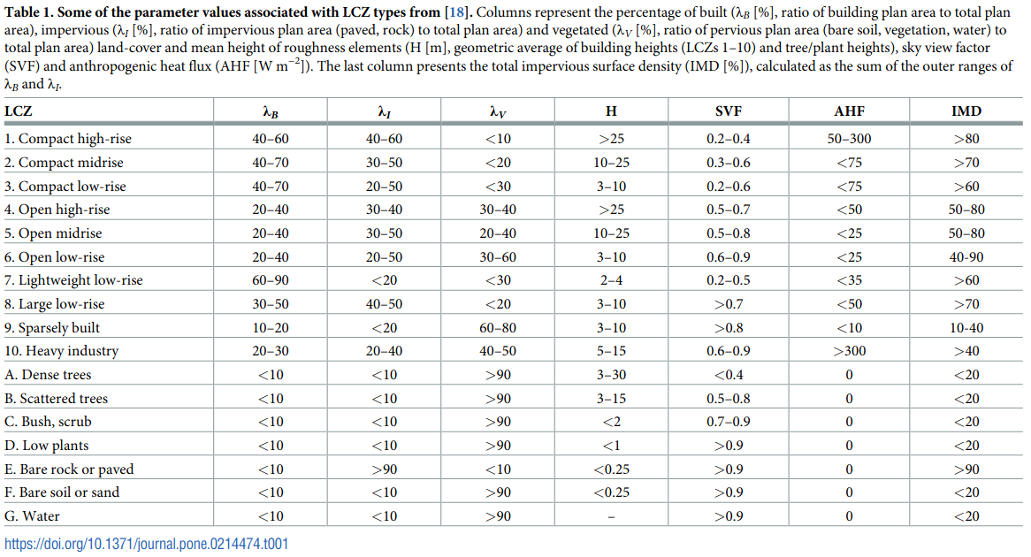
Existing data for lookup tables
Demuzere, M., Bechtel, B., Middel, A., Mills, G., 2019. Mapping Europe into local climate zones. PLOS ONE 14, e0214474. https://doi.org/10.1371/journal.pone.0214474
Notes:
Some values have been compiled by Demuzere et al. Based on WUDAPT data.

Slide 13
Existing data for lookup tables
Demuzere, M., Bechtel, B., Middel, A., Mills, G., 2019. Mapping Europe into local climate zones. PLOS ONE 14, e0214474. https://doi.org/10.1371/journal.pone.0214474
The data can be improved by incorporating ISA field from CLMS-IMD dataset
Notes:
Some of the parameter values can be improved.
For example, for sealed surface, pan-european product can be used.

Slide 14
Final urban lookup tables for LCZ
Integrate global LCZ information / long term
PROBLEM 1: large range of parameter variability for different cities
PROBLEM 2: how to transform these parameters into TERRA-URB in COSMO and ICON?

Slide 15
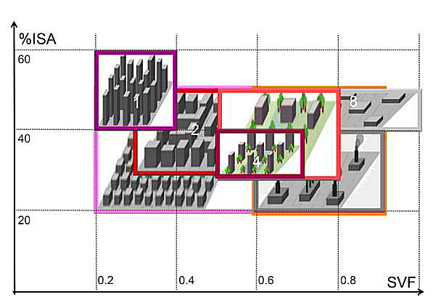
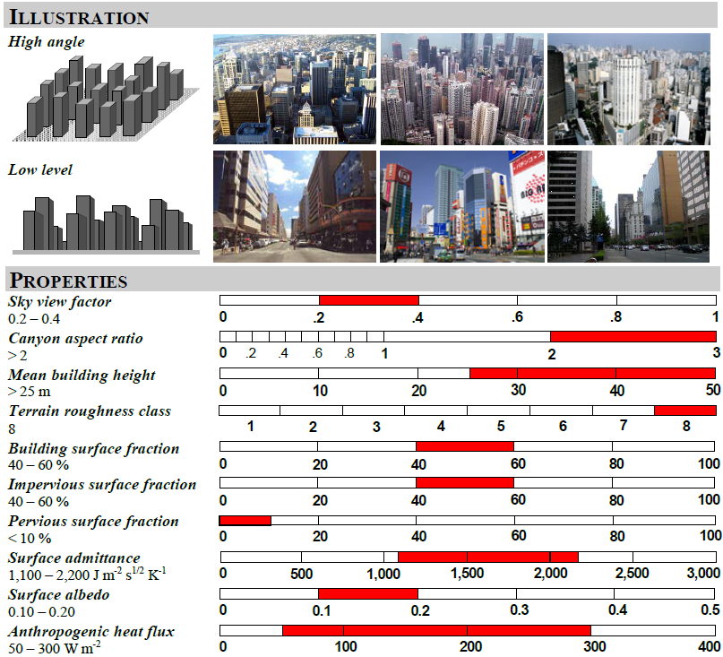
Final urban lookup tables for LCZ
PROBLEM 1: large range of parameter variability for different cities
range of values
reduces the number of standard classes
simplify classification process no need for exact measurements

Slide 16
EXTPAR recoding – task for COSMO finished
extpar_consistency_check.f90
extpar_landuse_to_buffer.f90
mo_landuse_routines.f90
mo_landuse_tg_fields.f90
INTEGER(KIND=i4), PARAMETER :: i_lu_globcover = 1, & !< id for landuse data set Globcover 2009
& i_lu_glc2000 = 2, & !< id for landuse data set GLC2000
& i_lu_glcc = 3, & !< id for landuse data set GLCC
& i_lu_ecoclimap = 4, & !< id for landuse data set ecoclimap
& i_lu_ecci, = 5, & !< id for landuse data set ESA CCI
& i_lu_ecosg = 6 !< id for landuse data set Ecoclimap-SG
get_dimension_ecosg_data, get_lonlat_ecosg_data, agg_ecosg_data_to_target_grid
mo_landuse_output_nc
CASE (i_lu_ecoclimap) CALL get_name_ecoclimap_lookup_tables(….)
CASE (i_lu_globcover) CALL get_name_globcover_lookup_tables(....)
CASE (i_lu_glc2000) CALL get_name_glc2000_lookup_tables(…..)
CASE (i_lu_glcc) CALL get_name_glcc_lookup_tables(…..)
CASE (i_lu_ecosg) CALL get_name_ecosg_lookup_tables(…..)
mo_ecosg_lookup_tables.f90, mo_ecosg_data.f90
Notes:
.

Slide 17
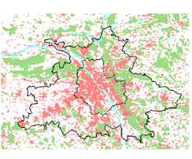
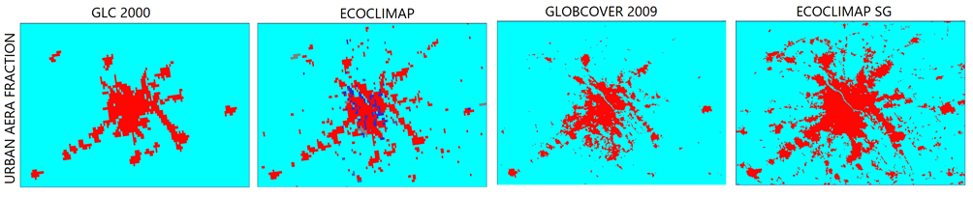
EXTPAR - typical results, urban fraction coverage
Comparison of urban fraction for Warsaw area
Main differences between data sets:
area coverage / size
accuracy
granularity / level of coarsening
Key factors for differences:
natural growth/changes of urban areas in time
dataset age
accuracy of measurements
postprocessing methodology
Notes:
.

Slide 18
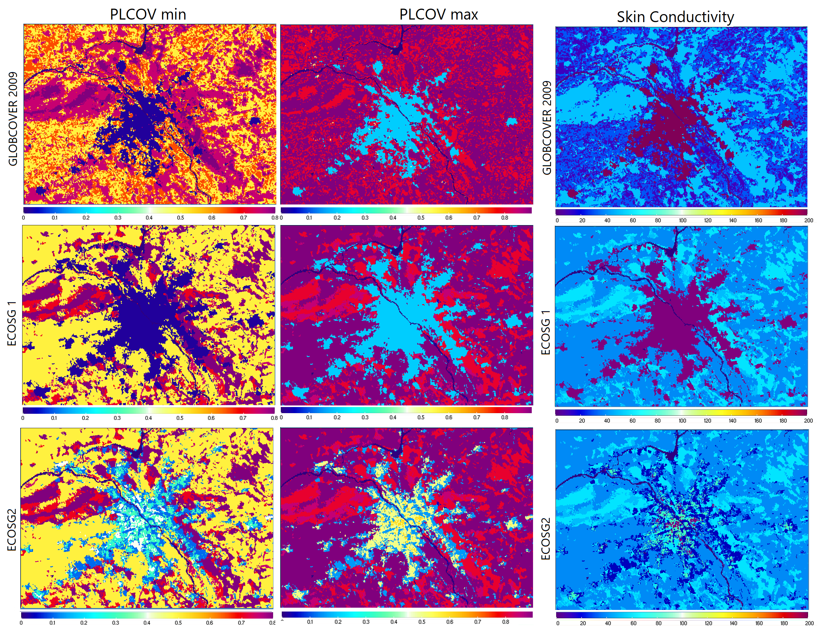
EXTPAR - ECOCLIMAP-SG vs GLOBCOVER2009
Key differences/features:
different LU classifications outside urban zones resulting in different range of values for parameters even in rural areas
different size of urban area coverage and granularity
nonhomogeneous parameter distribution and values inside urban zones for lookup tables accounting for LCZ
Notes:
.

Slide 19

Thank you
Andrzej Wyszogrodzki
CMM IMGW
22/02/2023, COSMO PP CITTA meeting

