Slide 1



Implementation of the urban albedo and anthropogenic heat flux of TERRA_URB in ICON: Preliminary results over Italy
A. Campanale, M. Adinolfi, M. Raffa, P. Mercogliano, J.-P. Schulz
PP CITTA’ Plenary Meeting, 22 February 2023

Slide 2

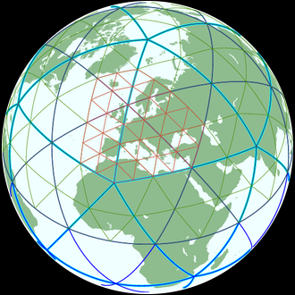
Implementation of TERRA_URB in ICON:
PP CITY PRIORITY PROJECT:
Implementation of TERRA_URB in ICON
Working group 1:
Porting of TERRA_URB in ICON
Working group 2:
New EXTPAR for ICON
TERRA_URB is able to reproduce the key urban meteorological features in the COSMO model.
EXTPAR dataset for TERRA_URB is outdated and should be replaced.
In the framework of the transition from COSMO to ICON, TERRA_URB needs to be implemented in ICON.
A new, improved and without inconsistency for the urban canopy, ECOCLIMAP-SG, needs to be implemented in TERRA_URB
TERRA_URB in ICON

Slide 3

WG1: Porting of TERRA_URB in ICON
WG1: PORTING of TERRA_URB in ICON par for par
Compiling and testing: experiments over Italy domain (2km res.)
Step1: lterra_urb master switch, including thermal effects in land surface
Step2: itype_kbmo type of turbulence (Brutsart-Kanda model)
…
Step3: lurbalb master switch, including urban albedo effects
…
Step4: lurbahf master switch, including anthropogenic effects
… in the future
Porting of urban
emissivity and soil evaporation
Coupling with the new dataset ECOCLIMAP-SG

Slide 4
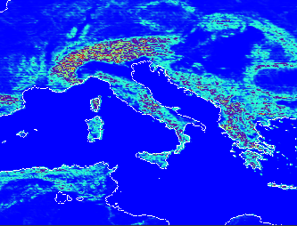
WG1: Porting of TERRA_URB in ICON
Urban Albedo validation: model setup
Model: ICON-nwp
Resolution: 2km (0.018°) over Italy-LAM domain
Period 1: 16 August 2020 (00 UTC) to 20 August 2020 (24 UTC) 5 Days simulation
Period 2: 16 August 2020 (00 UTC) to 30 August 2020 (24 UTC) 14 Days simulation
Forcing data: ECMWF IFS analyses at 6hr
Main namelist switch: lurbalb=TRUE Urban Albedo activated
lurbalb=FALSE Urban Albedo deactivated
Downscaling from 8,5km to ~2km
IFS grid
ICON grid

Slide 5
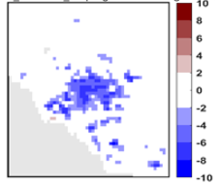
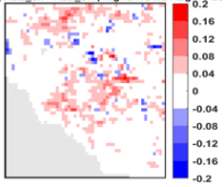
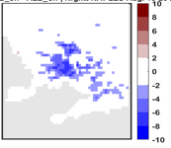
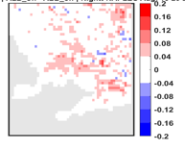
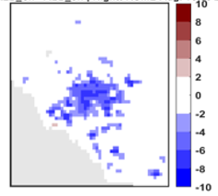
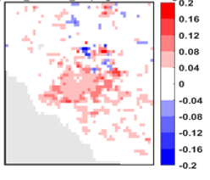
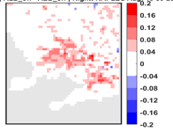
WG1: Porting of TERRA_URB in ICON
Resolution: 2km (0.018°) over Italy domain
Period 1: 16 August 2020 to 20 August 2020
Period 2: 16 August 2020 to 30 August 2020
lurbalb = TRUE (ALB_ON)
lurbalb = FALSE (ALB_OFF)
Albedo validation: results
Albedo maps vs t_2m maps during Nighttime
ROME box Nighttime: 5 simulated days
NAPLES box Nighttime: 5 simulated days
Albdif [%] | ALB_on - ALB_off | ROME
T_2m [°C] | ALB_on - ALB_off | Nightt. ROME
Albdif [%] | ALB_on - ALB_off | NAPLES
T_2m [°C] | ALB_on - ALB_off | Nightt. NAPLES
vs
vs
ROME box Nighttime: 14 simulated days
NAPLES box Nighttime: 14 simulated days
Albdif [%] | ALB_on - ALB_off | ROME
T_2m [°C] | ALB_on - ALB_off | Nightt. ROME
Albdif [%] | ALB_on - ALB_off | NAPLES
T_2m [°C] | ALB_on - ALB_off | Nightt. NAPLES
vs
vs

Slide 6
WG1: Porting of TERRA_URB in ICON
AHF validation: model setup
Model: ICON-nwp
Resolution: 2km (0.018°) over Italy-LAM domain
Period 1: 16 August 2020 (00 UTC) to 20 August 2020 (24 UTC) 5 Days simulation
Forcing data: ECMWF IFS analyses at 6hr
Main namelist switch: lurbahf=TRUE AHF activated
lurbahf=FALSE AHF deactivated
lterraurb=FALSE TERRA_URB Deactivated
Downscaling from 8,5km to ~2km
IFS grid
ICON grid

Slide 7
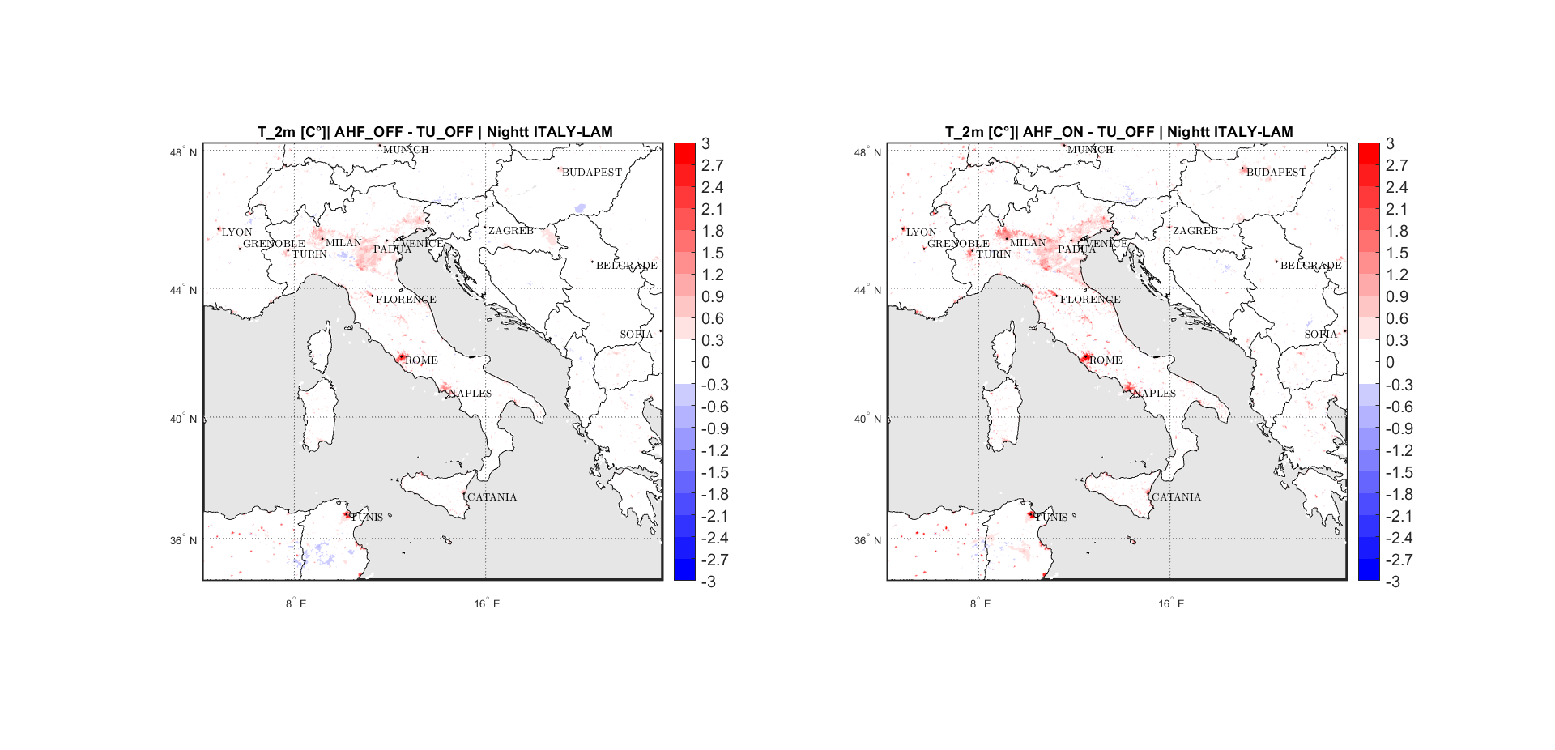
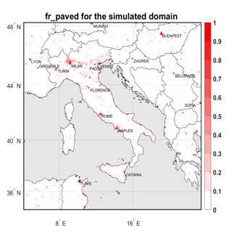
WG1: Porting of TERRA_URB in ICON
Resolution: 2km (0.018°) over Italy domain
Period: 16 August 2020 (00 UTC) to 20 September 2020 (24 UTC)
Forcing data: ECMWF IFS analyses at 6hr
lurbahf = TRUE (AHF_ON)
lurbanh = FALSE (AHF_OFF)
reference case = terra_urb_off (TU_OFF)
AHF validation: results
Fr_paved vs T_2m differences maps during Nighttime
vs
vs

Slide 8
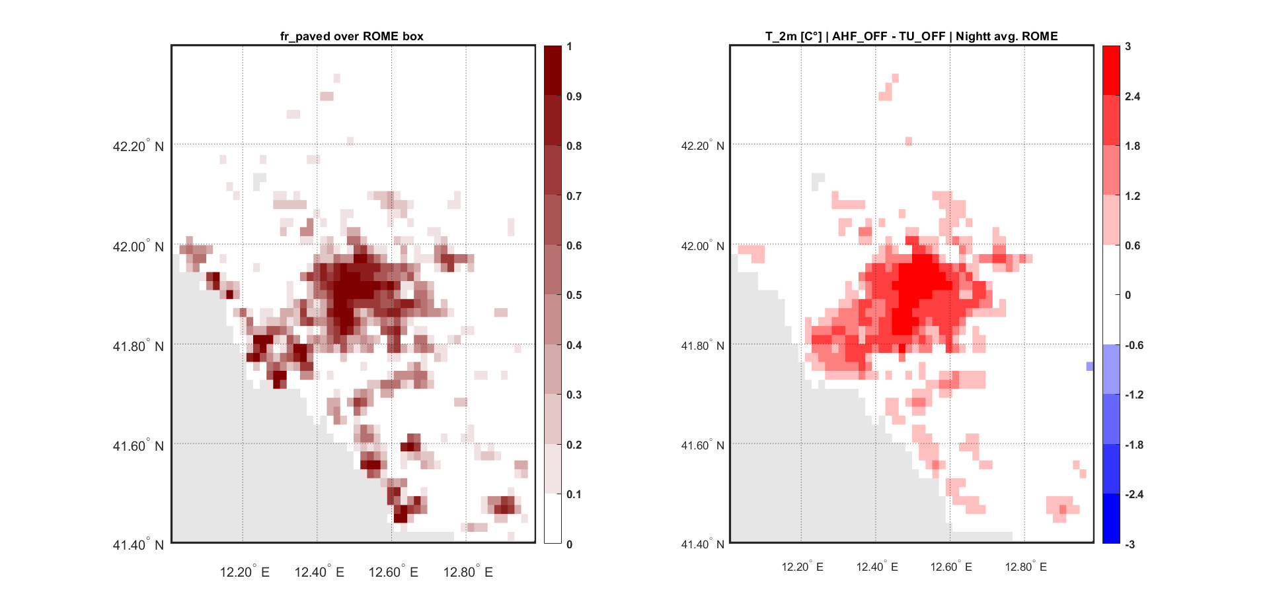
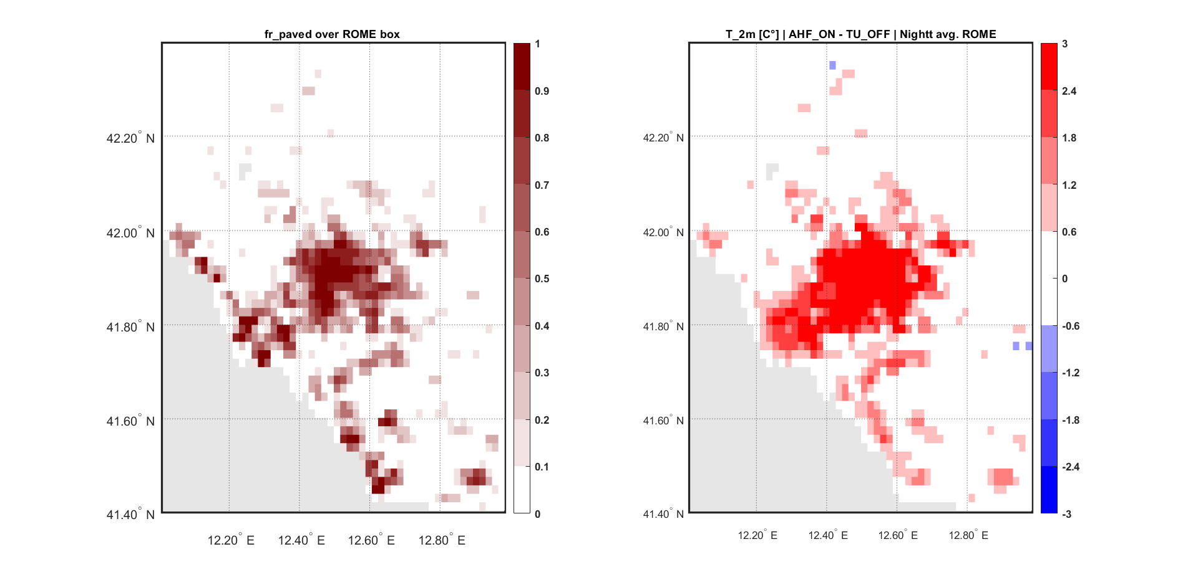
WG1: Porting of TERRA_URB in ICON
Resolution: 2km (0.018°) over Italy domain
Period: 16 August 2020 (00 UTC) to 20 September 2020 (24 UTC)
Forcing data: ECMWF IFS analyses at 6hr
lurbahf = TRUE (AHF_ON)
lurbanh = FALSE (AHF_OFF)
reference case = terra_urb_off (TU_OFF)
AHF validation: results
Fr_paved vs T_2m differences over ROME
Without AHF
With AHF
vs
vs
vs

Slide 9
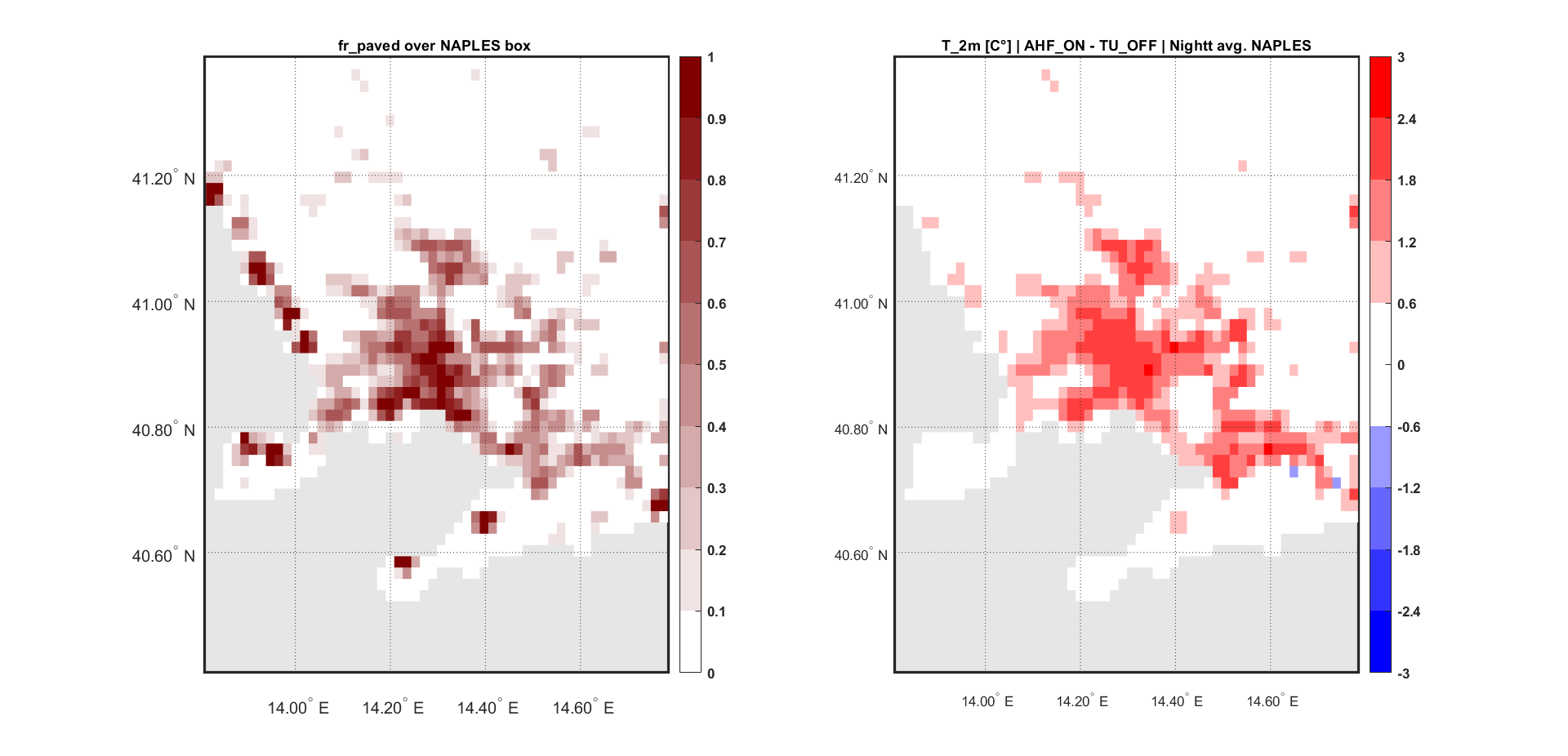
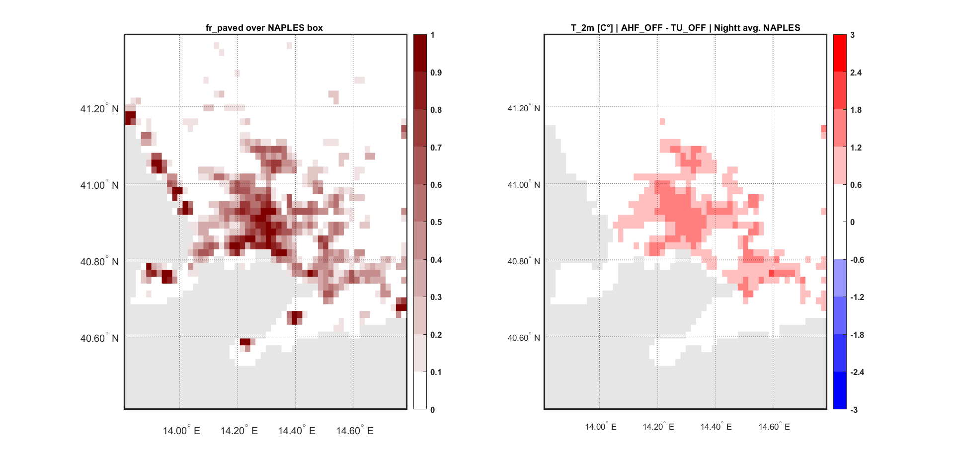
WG1: Porting of TERRA_URB in ICON
Resolution: 2km (0.018°) over Italy domain
Period: 16 August 2020 (00 UTC) to 20 September 2020 (24 UTC)
Forcing data: ECMWF IFS analyses at 6hr
lurbahf = TRUE (AHF_ON)
lurbanh = FALSE (AHF_OFF)
reference case= terra_urb_off (TU_OFF)
AHF validation: results
Fr_paved vs T_2m differences over NAPLES
Without AHF
With AHF
vs
vs

Slide 10


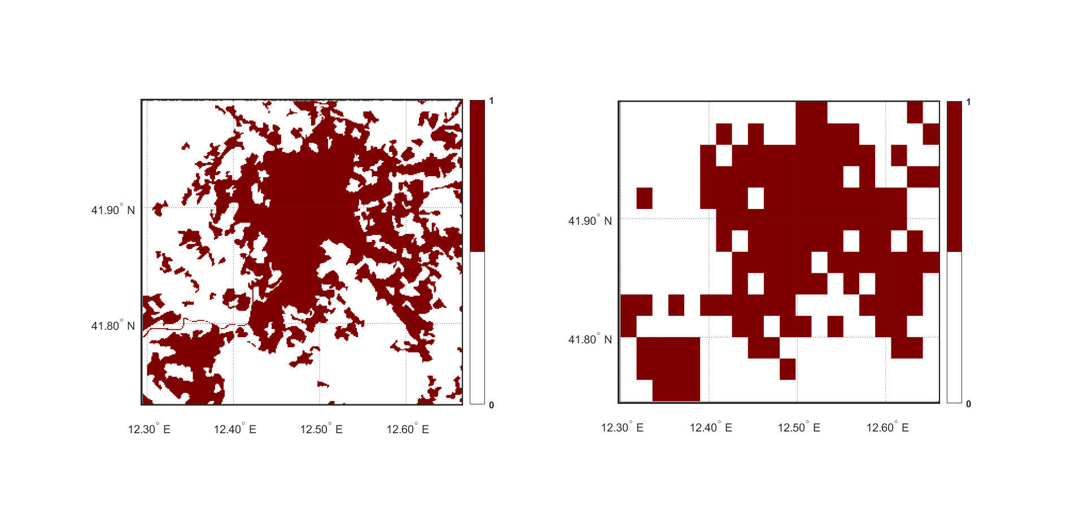
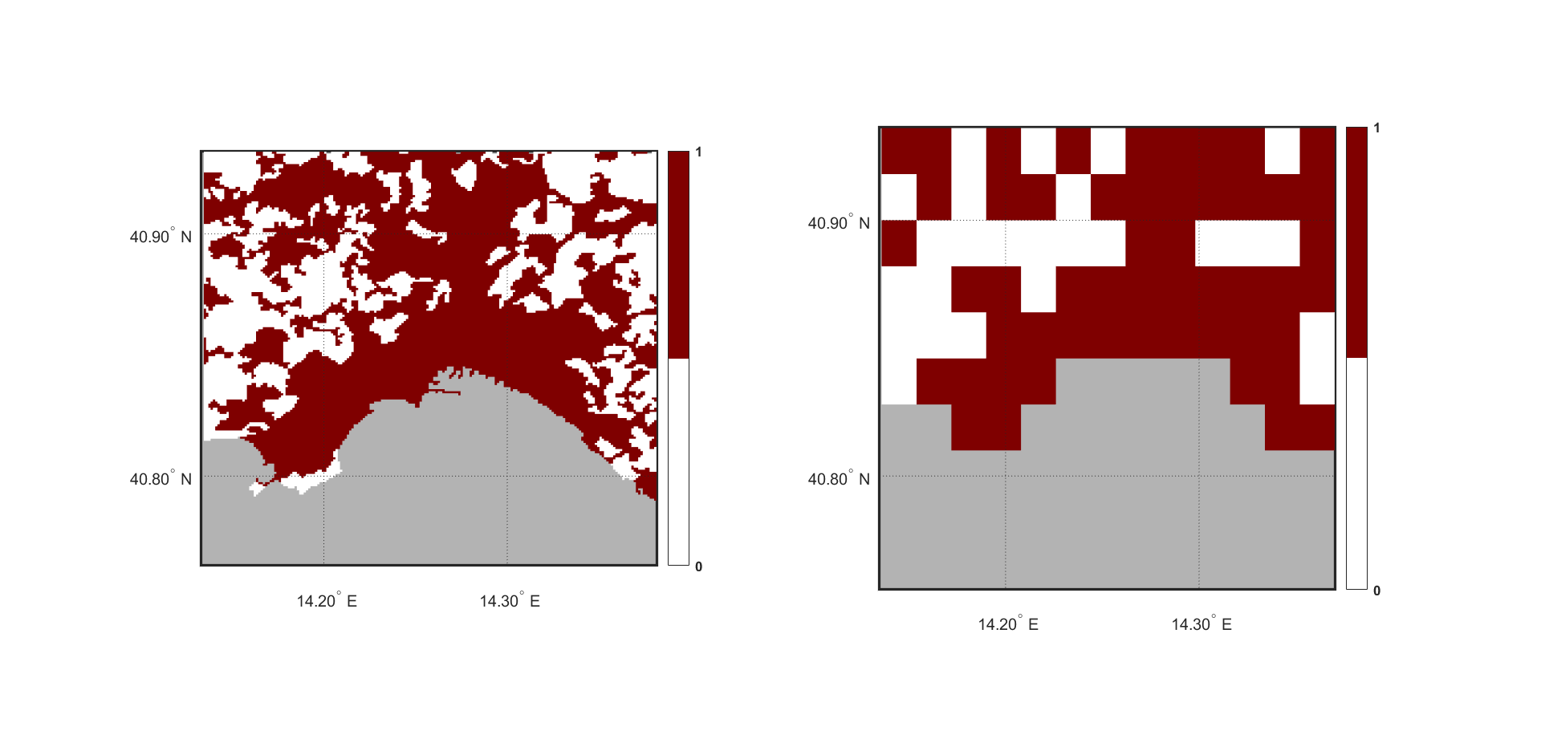
WG1: Porting of TERRA_URB in ICON
Validation with UrbClim reanalysis dataset
Dataset main Features
Domain: 100 European cities
Spatial Resolution: 100m x 100m
Temporal Coverage: 2008-2017
Temporal Resolution: 1 hour
Data Type: Gridded
Variables: t_2m (K), Wind Speed (m/s), Relative
humidity (%), Specific humidity (kg/kg),
urban-rural mask, land-sea mask
DOI: 10.24381/cds.c6459d3a
For the UrbClim dataset, the ERA5 reanalysis large-scale weather conditions are downscaled to urban agglomeration-scale.
The dataset was produced by VITO
(Flemish Institute of Technological Research) on behalf of the Copernicus Climate Change Service.
Urban Rural Mask used for UHI calculation
ROME UrbClim (100m res)
NAPLES UrbClim (100m res)
ROME ICON exp. (2km res)
NAPLES ICON exp. (2km res)
Remap
Remap

Slide 11
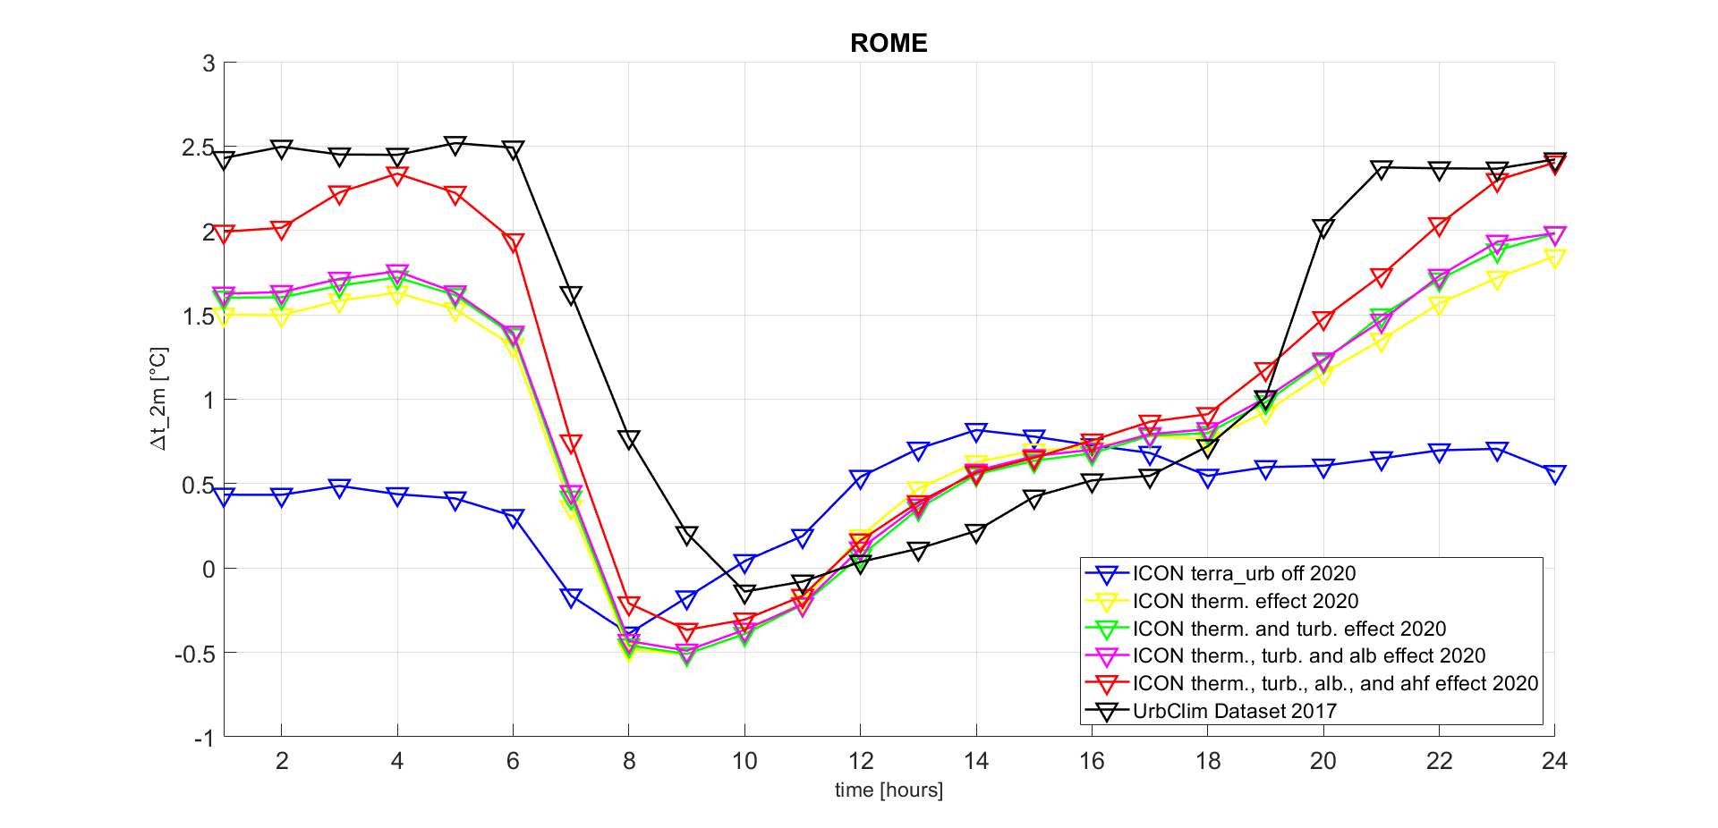
WG1: Porting of TERRA_URB in ICON
ICON + TERRA-URB UHI vs UrbClim UHI:
Effect of different implementations

Slide 12
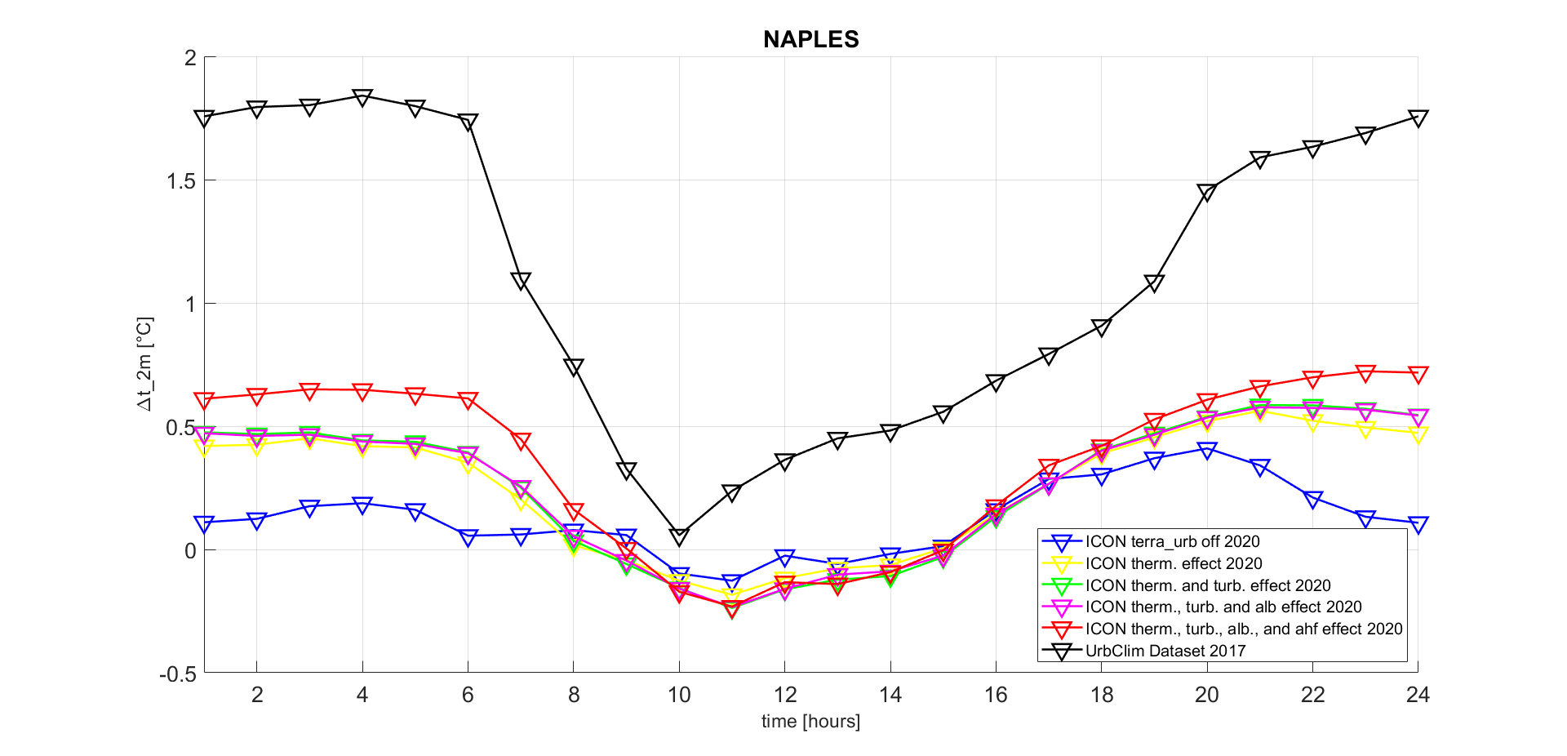
WG1: Porting of TERRA_URB in ICON
ICON + TERRA-URB UHI vs UrbClim UHI:
Effect of different implementations

Slide 13
WG1: Porting of TERRA_URB in ICON
Conlusions
Urban albedo and anthropogenic effects have been ported in ICON-TERRA_URB and experiments have been carried out to validate them
By activating lurbalb, differences, in terms of albedo, are observed near urban centers, as expected, and differences, in terms of temperature (with a magnitudo about 0.2 °C and higher during nighttime), are observed in agreement with albedo spatial patterns.
The albedo maps of temperature differences are «noisy» but the situation seems to improve with longer simulation (the noise seems to be comparable to the signal).
By activating lurbahf, very strong temperature differences are observed near urban centers (with a magnitudo even higher then 2°C and a nighttime warmer then daytime)
The simulated UHIs have been compared to UrbClim dataset UHIs, confirming the added value of Terra_Urb to ICON-LAM
At this stage of implementation, TERRA_ URB seem to provide very promising results!

Slide 14
WG1: Porting of TERRA_URB in ICON
Further developments and suggestions
Current results are very good, but they can be improved with proper experiments that should be defined (e.g. period included in the UrbClim temporal coverage or spatial resolution lower then 2km), other then the completion of the entire implementation of TERRA_URB in ICON.
UrbClim dataset offers the possibility to see differnt climate variables of several European cities (with different urban morphology and climatic conditions) that could be tested.
Common namelist or configuration should be defined in order to perform similar experiments

