Slide 1
preliminary tests with terra urb at very high resolution over southerN italy
Davide Cinquegrana, Edoardo Bucchignani
CIRA – Italian Aerospace Research Center, Capua CE Italy
{d.cinquegrana, e.bucchignani}@cira.it
COSMO PP CITTA‘ Meeting 22 February 2023 - webex

Slide 2
Numerical settings
Parameterization schemes
Shallow convection parameterization is active
Deep and mid-level convection are switched off
Single moment cloud microphysics
Diagnostic Kohler cloud cover
1 day run in forecast mode:
Start date: 2019-07-01
IC: IFS Analysis @ 00:00
BCs reads @ IFS forecast every 3h
Timestep size= 6 s
itype_kbmo = 2
lterra_urb =
lterra-> .true. Vs .false. Vs.
albedo.and.Ahf -> .true. vs .false.
Domains
«DOMFine» @ 0.6 Km (R02B12)
Results:
ΔT2m(True - False) field
Local T2m(t) and rel.hum as function of fr_paved

Slide 3
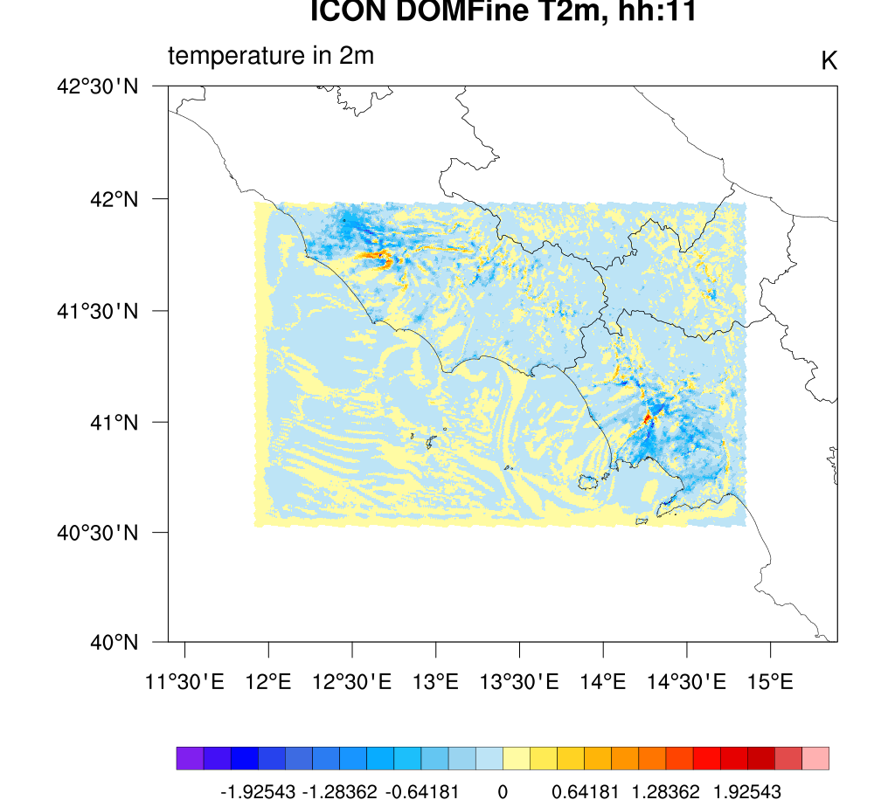
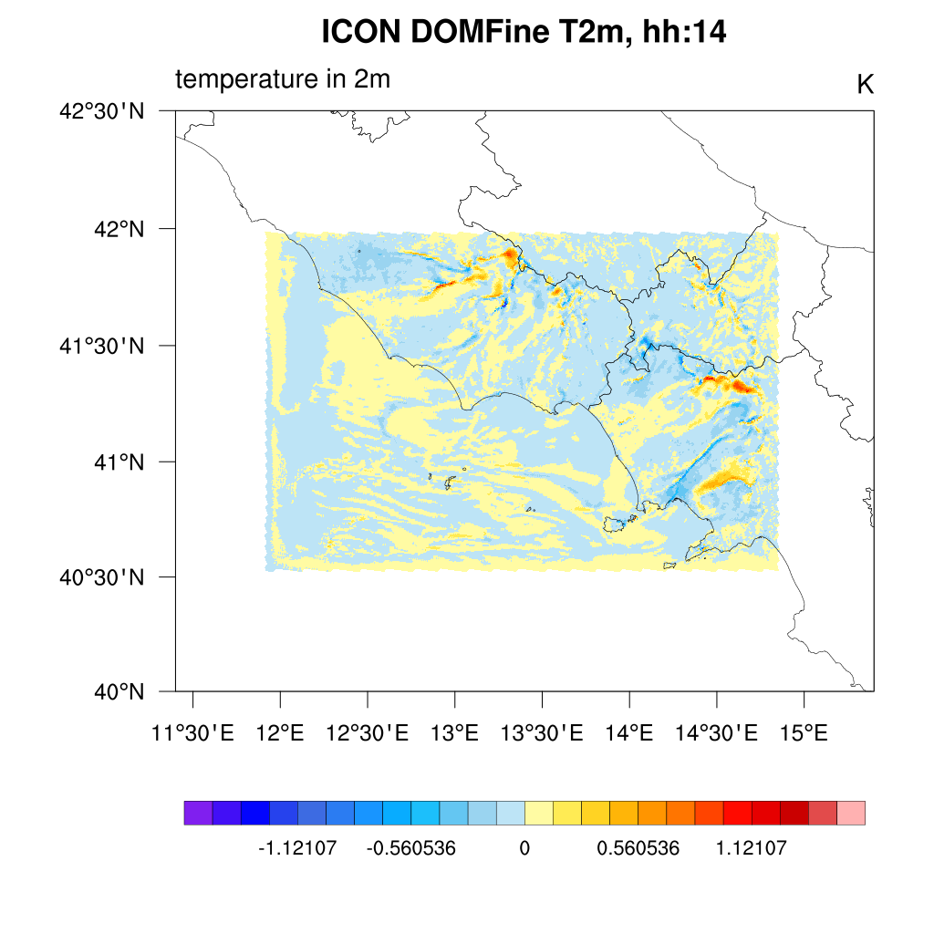
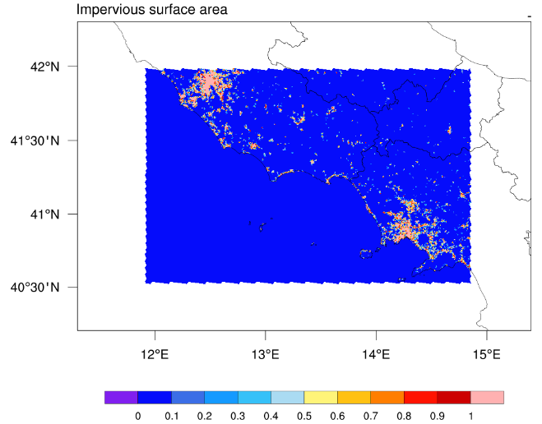
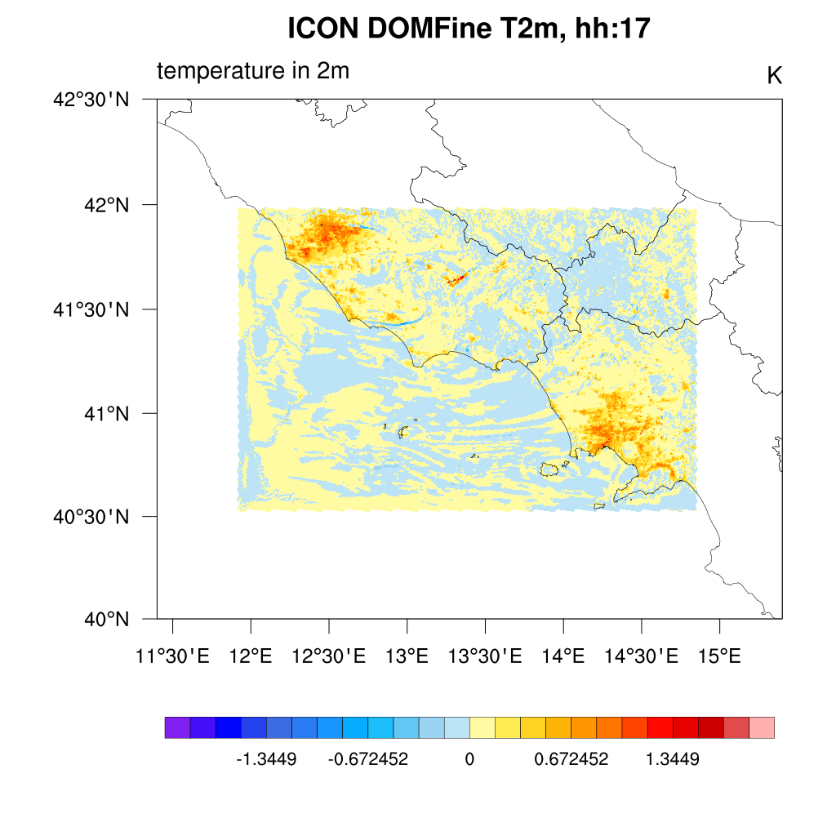
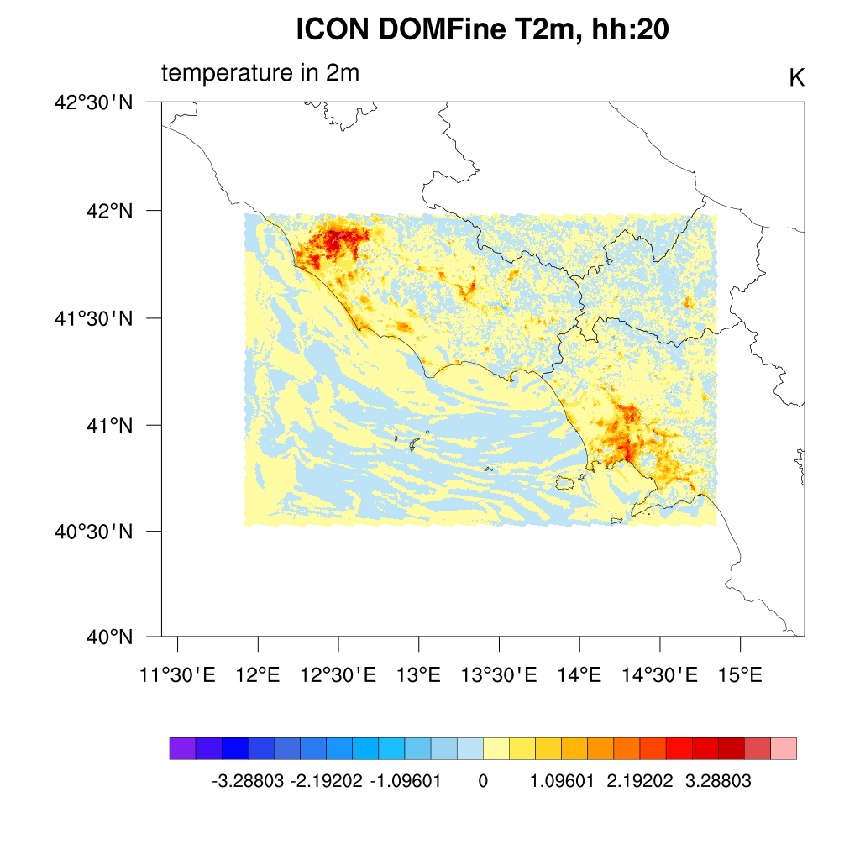
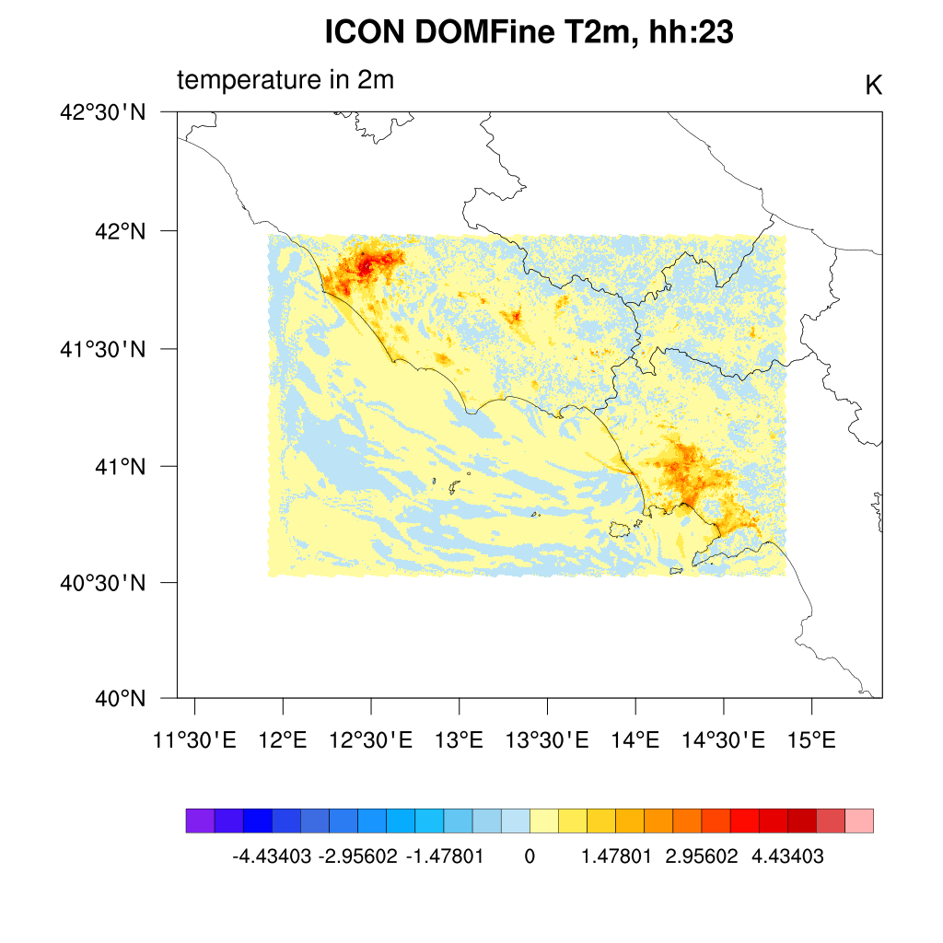
Results – 0.6 km res.
ΔT2m(True - False): map field

Slide 4
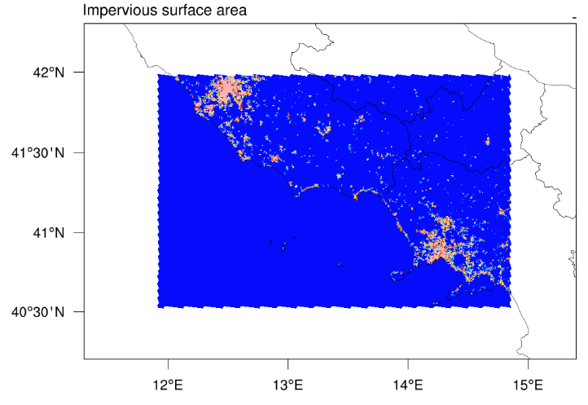
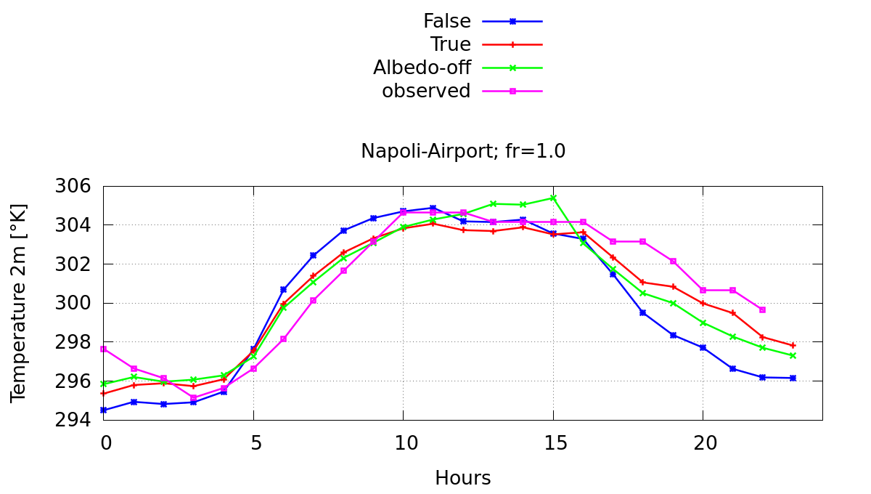
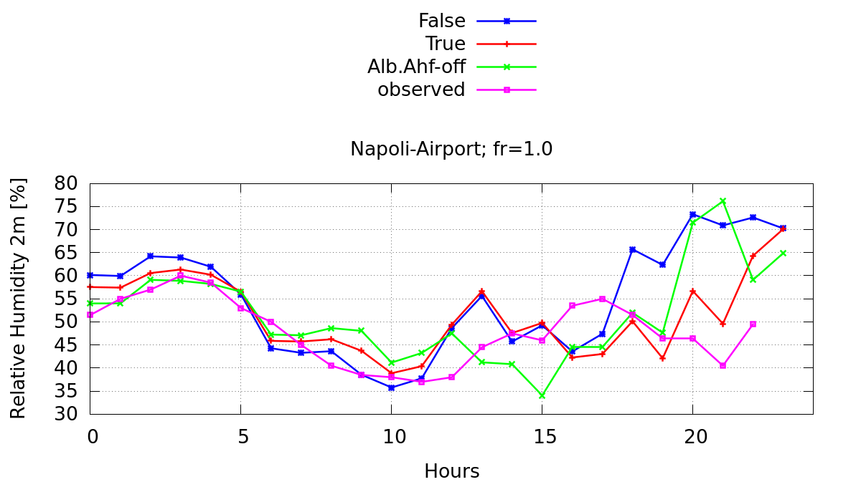
Results – 0.6 km res.
Local results: Capodichino Airport
Comparison of T2m and rel. Hum. [%] with:
Terra_urb -> true (red)
albedo&Ahf -> false (green)
Terra_urb -> false (blue)
Observed -> data (magenta)
T2m on 2019-07-01:
Relative humidity [%] 2019-07-01 :

Slide 5
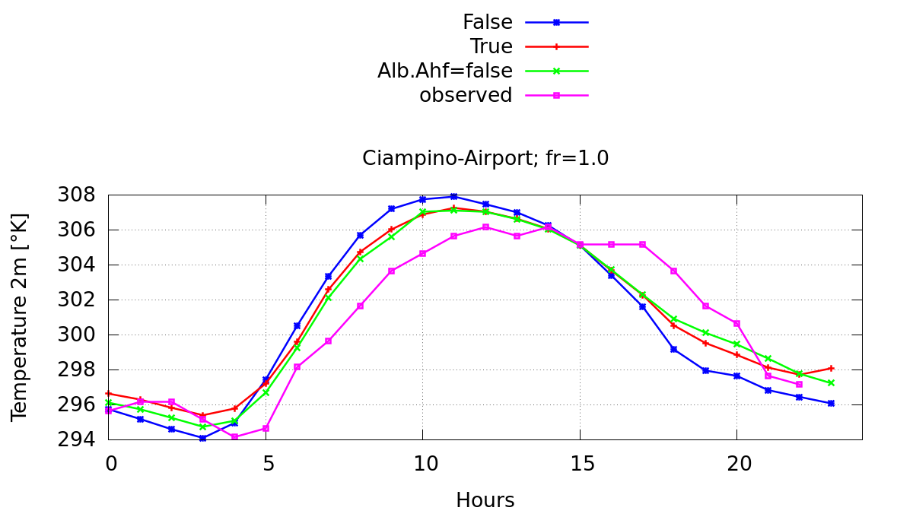
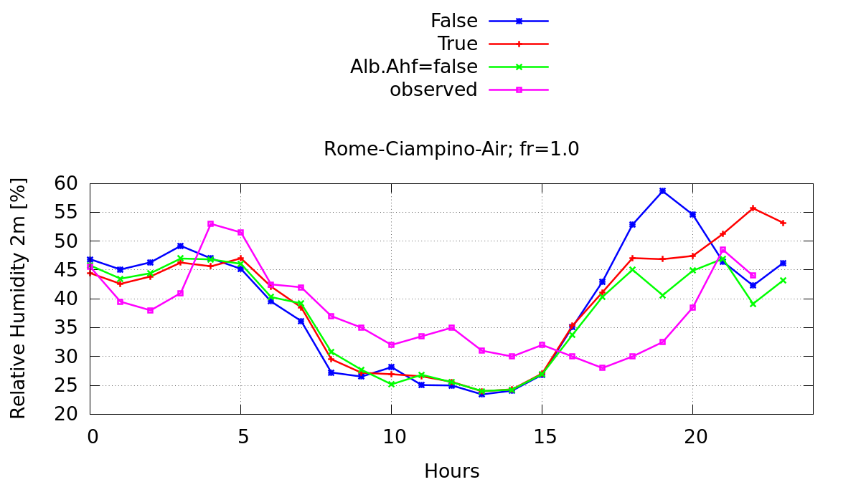
Results – 0.6 km res.
Local results: Rome-Ciampino Airport:
Comparison of T2m and rel. Hum. [%] with:
Terra_urb -> true (red)
albedo&Ahf -> false (green)
Terra_urb -> false (blue)
Observed -> data (magenta)
T2m on 2019-07-01:
Relative humidity [%] 2019-07-01 :

Slide 6
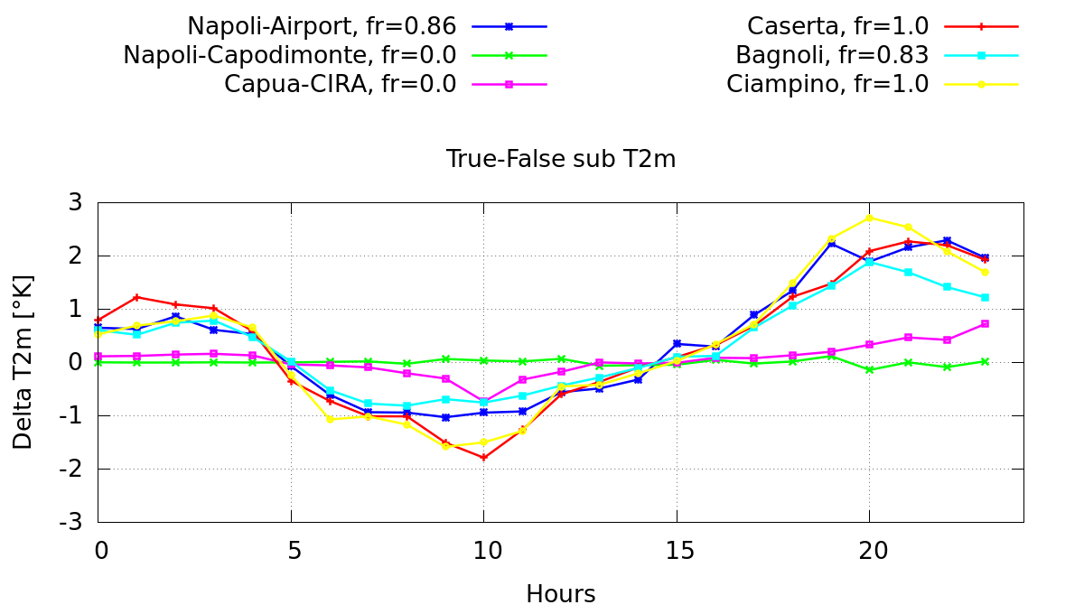
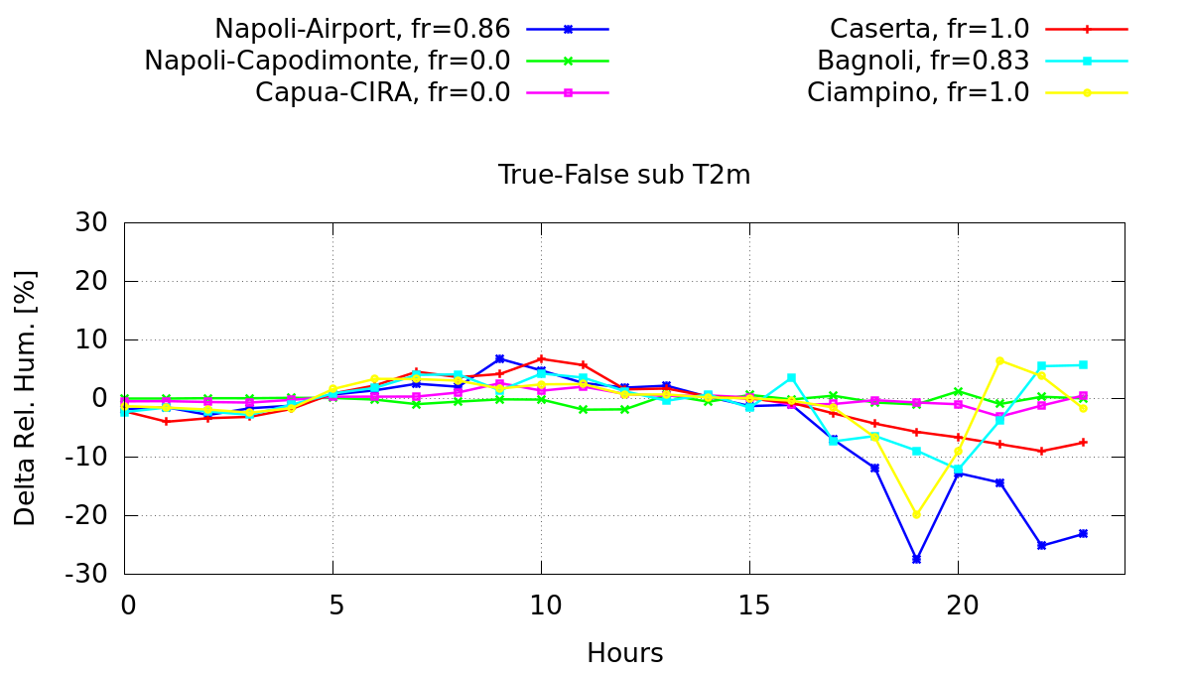
Results – 0.6 km res.
ΔT2m(True - False): Local results

Slide 7
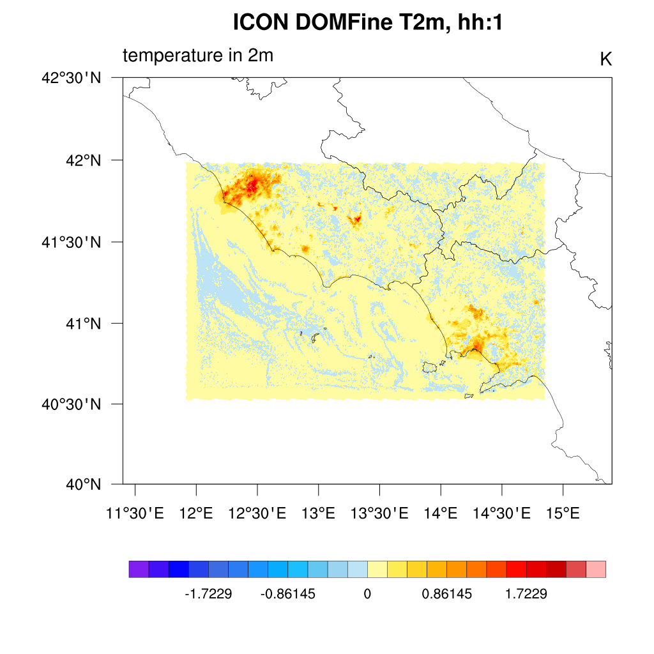
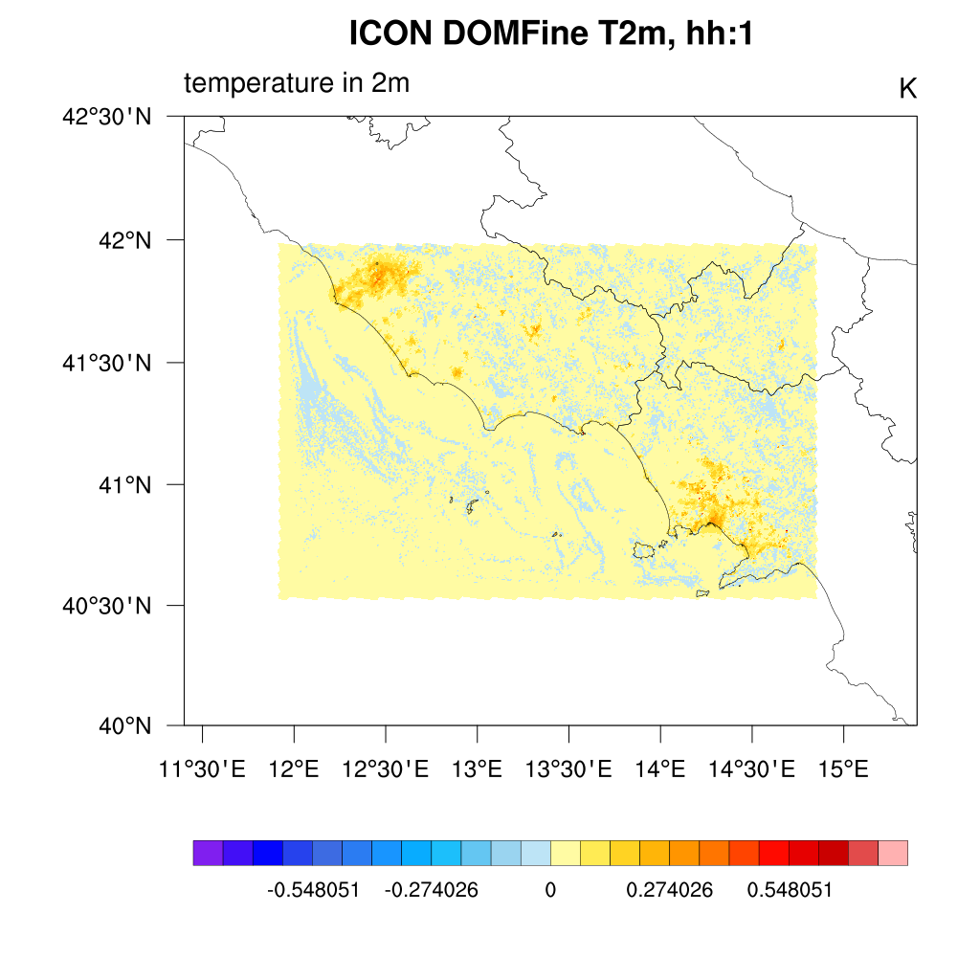
Albedo and Anthropogenic heat f. effects
ΔT2m(True - False):
ΔT2m(True – Alb.Ahf.false):
Notes:
On the left the

Slide 8
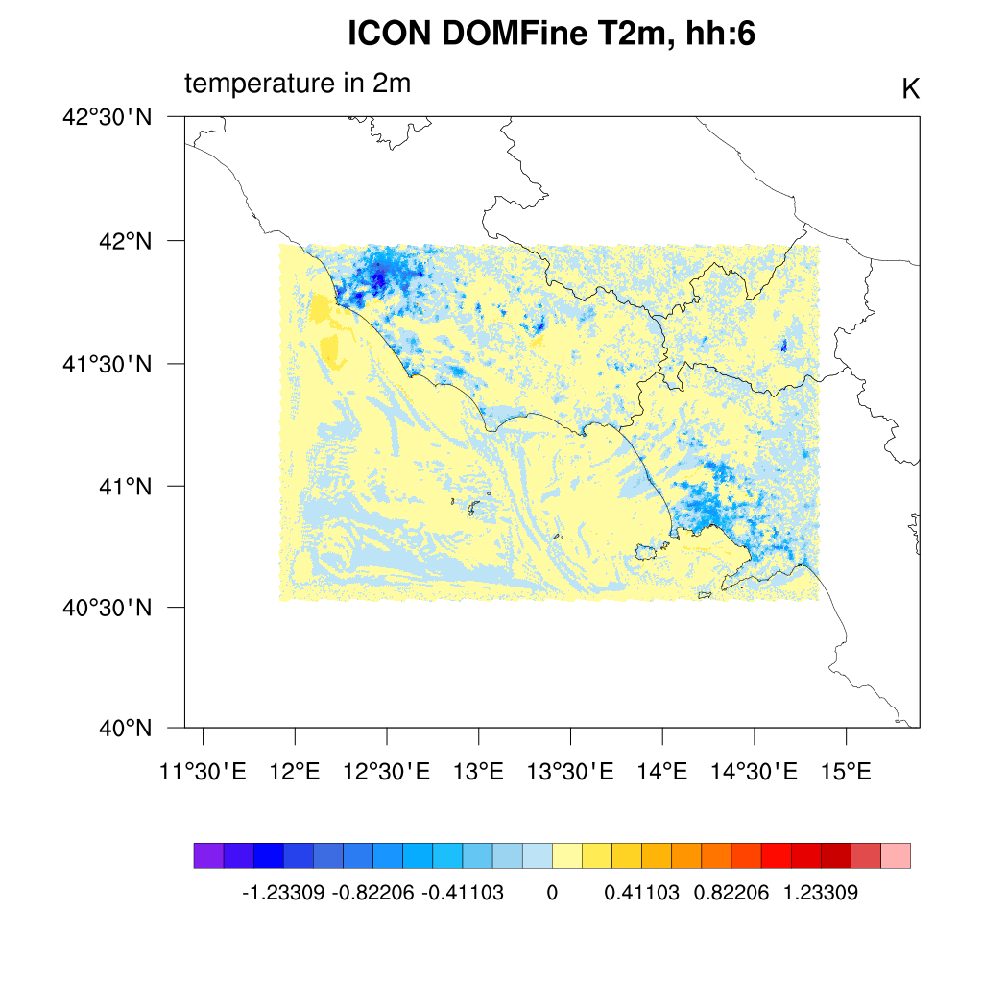
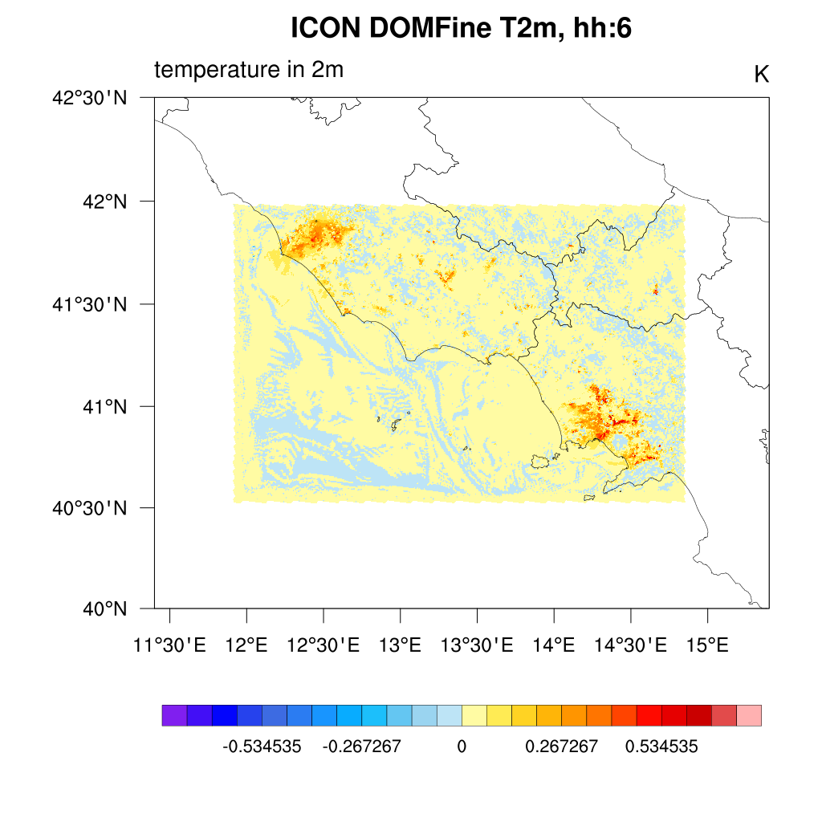
Albedo and Anthropogenic heat f. effects
ΔT2m(True - False):
ΔT2m(True – Alb.Ahf.false):

Slide 9
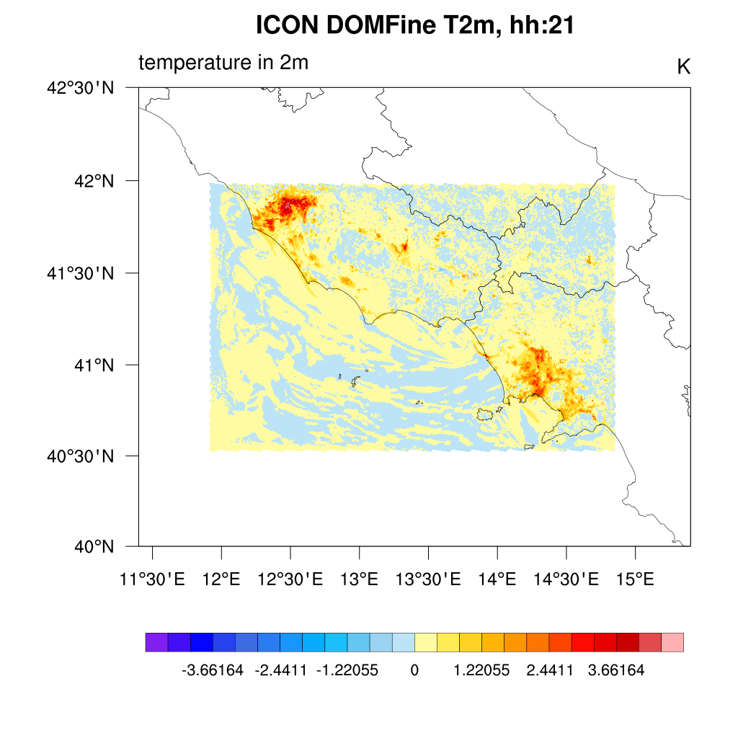
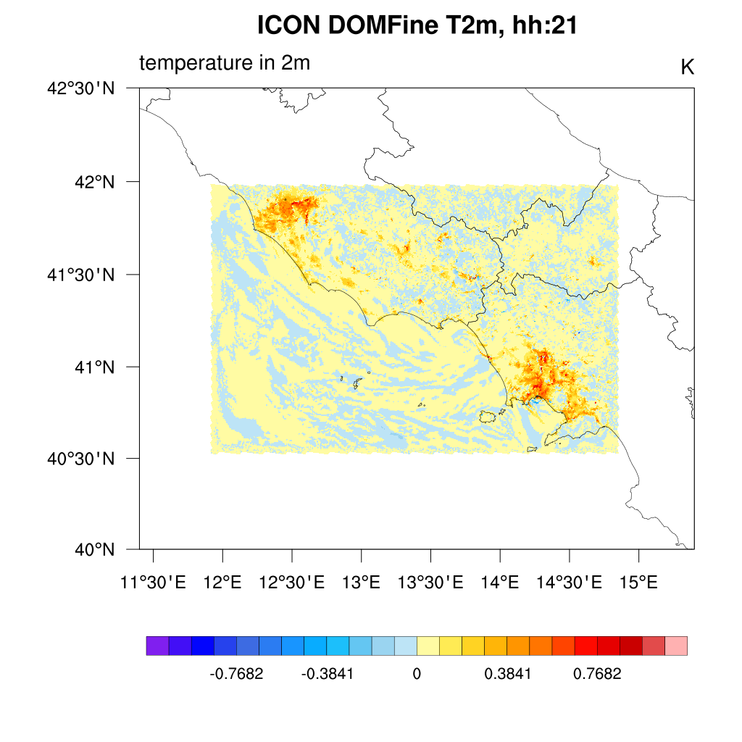
Albedo and Anthropogenic heat f. effects
ΔT2m(True - False):
ΔT2m(True – Alb.Ahf.false):

Slide 10
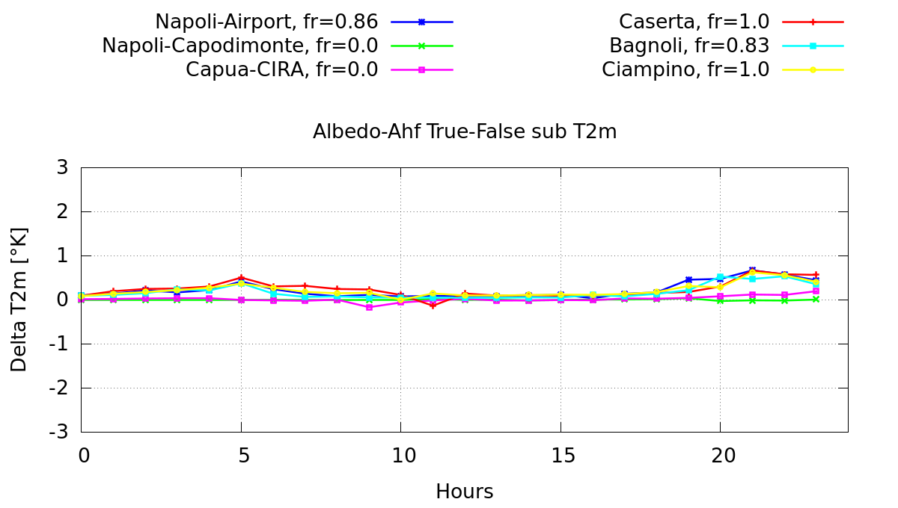
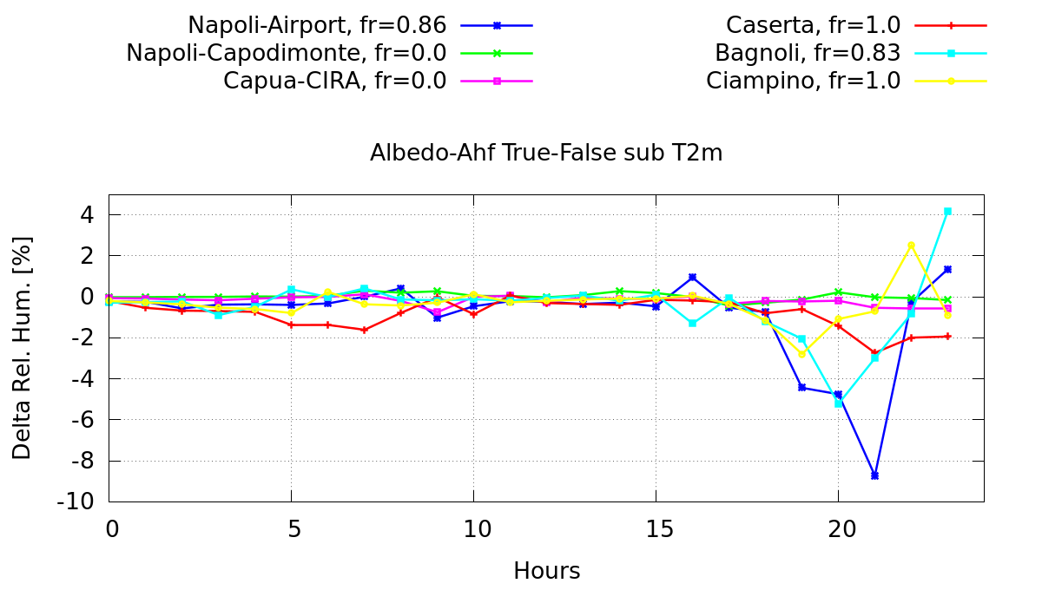
Albedo and Anthropogenic heat f. effects
ΔT2m(True – Alb.Ahf.false): local results
Albedo with Ant. Heat f. contributes up to 0.6 K increase in urban environment

Slide 11
Comments and way forward
Preliminary analysis with ICON –Terra_urb performed over southern Italy
The new uploaded Terra_urb release was checked
Only 1-day simulation, considered during a very hot week in July 2019
A first test with grid resolution of about 600mt
Next steps:
Longer simulations
Further statistics based on wider area rural/urban

Slide 12
Thank you for your attention!

