Slide 1
PP Citta: very preliminary results
Pavel Khain, Leenes Uzan, Alon Shtivelman, Yoav Levi
Citta meeting, 7/7/2022

Slide 2
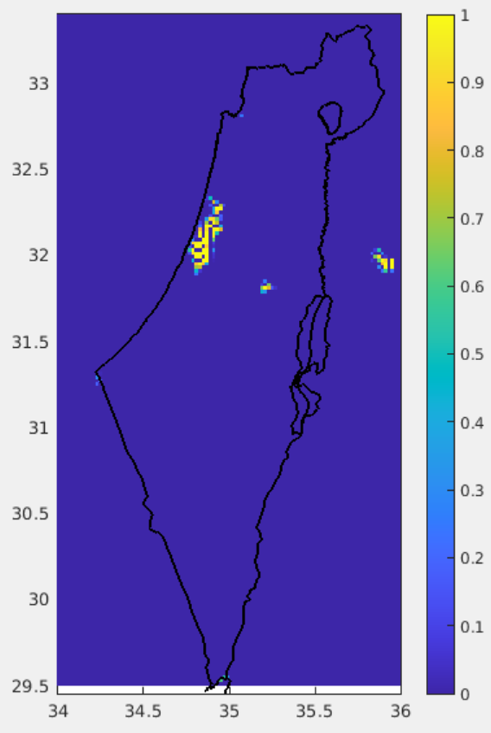
URBAN (ISA) field
ICON-IL domain (2.5km) driven by IFS
sea
land
Tel Aviv
Jerusalem
3 days experiment: 25/1/2022 00 UTC + 78h on ATOS@ECMWF
Cyclone coming from west, causing significant precipitation and ~15-20 cm in Jerusalem area (800m)

Slide 3
Animation
T_2m effect (URB_ON-URB_OFF)
sea
land
Tel Aviv
Jerusalem
dessert
T_2M (C)

Slide 4
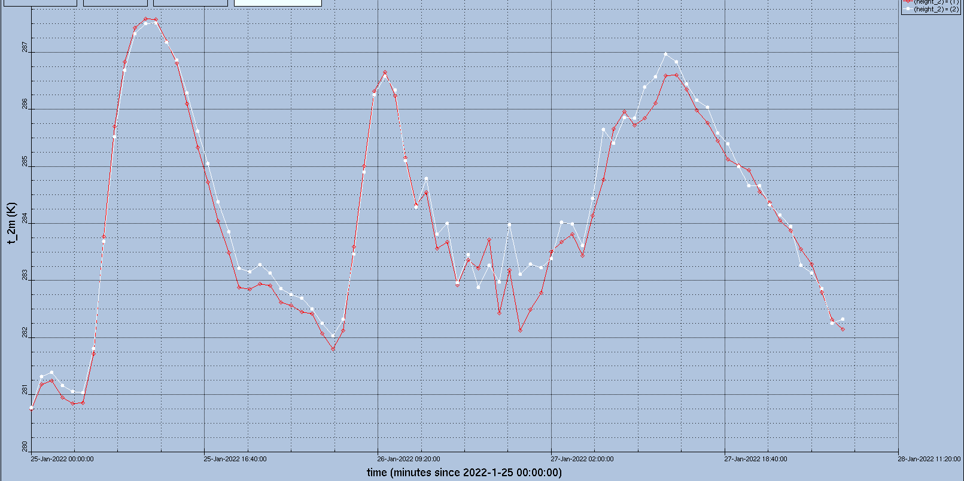
Mean T_2m over Tel-Aviv area (34.725-34.9E,31.95-32.325N)
URB ON
URB OFF

Slide 5
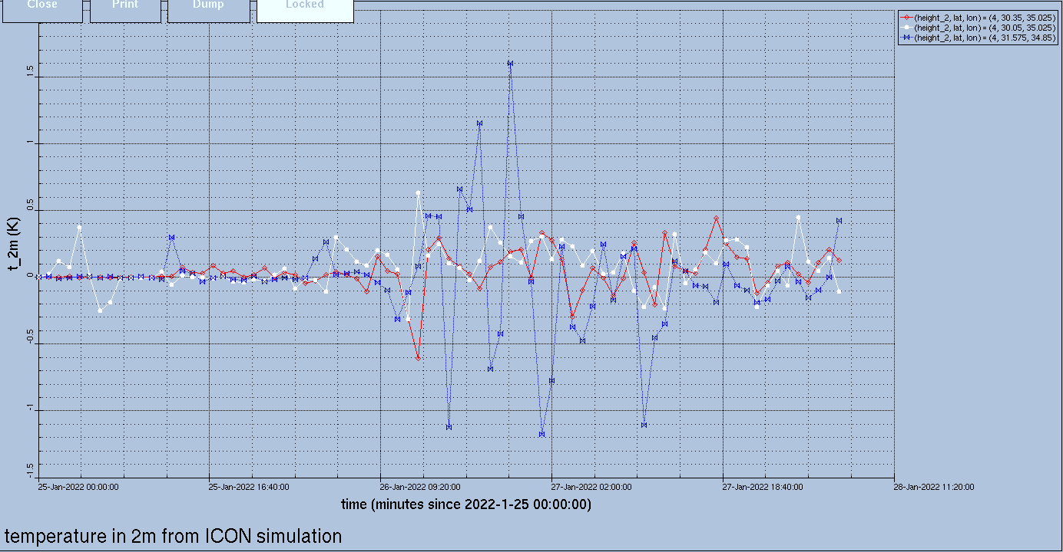
T_2m effect (URB_ON-URB_OFF) at rural areas

Slide 6
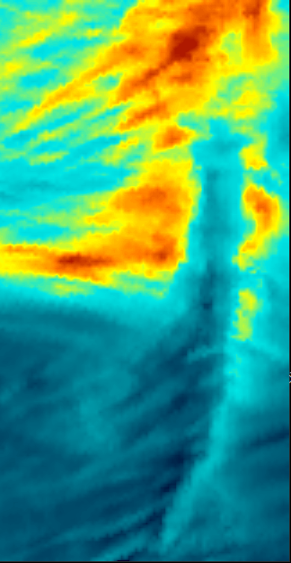
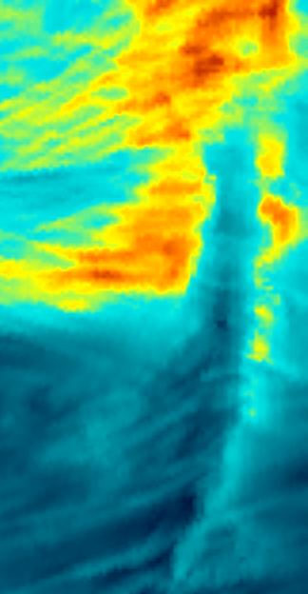
URBAN scheme effect on precipitation
URB off
URB on
sea
sea
land
land
Tel Aviv
Tel Aviv
Jerusalem
Jerusalem
dessert
dessert
mm/78h

Slide 7
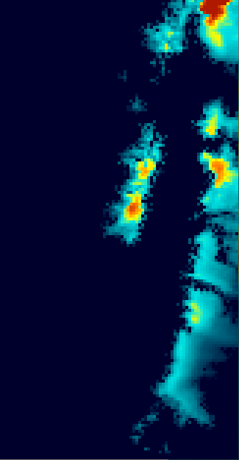
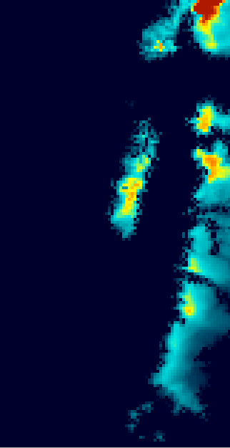
URBAN scheme effect on snow depth
URB off
URB on
sea
sea
land
land
Tel Aviv
Tel Aviv
Jerusalem
Jerusalem
dessert
dessert
(m)

Slide 8
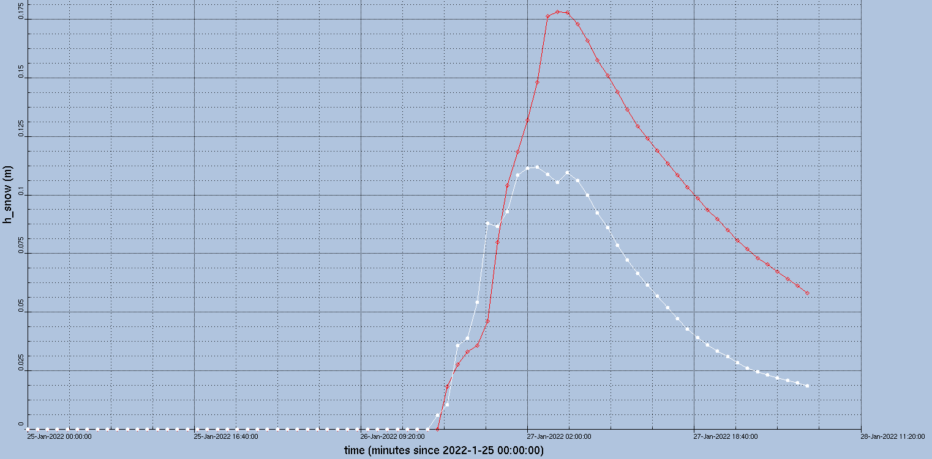
Snow depth in Jerusalem (31.925N/35.225E)
URB OFF
URB ON

Slide 9
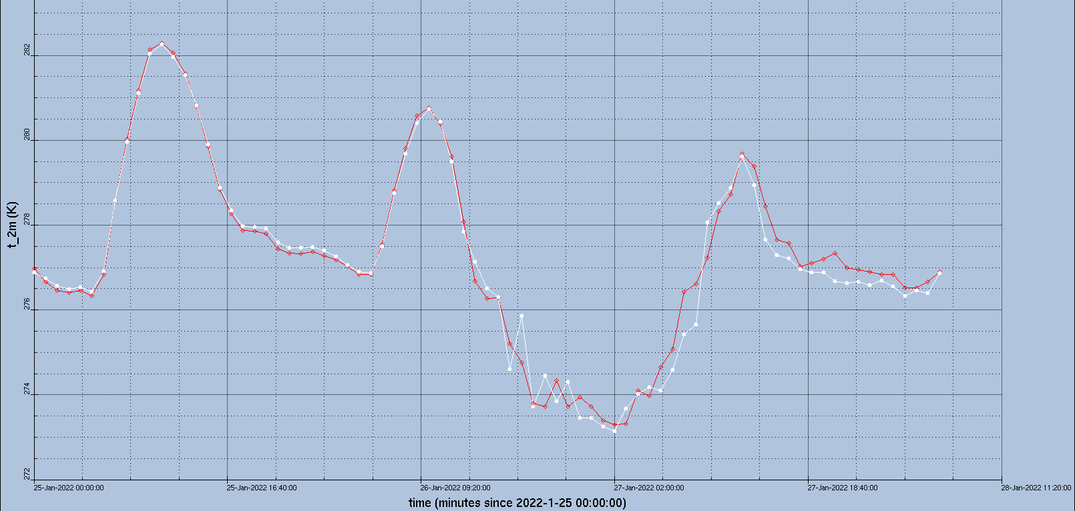
Mean T_2m over Jerusalem city (35.18-35.25E,31.73-31.81N)
URB OFF
URB ON

Slide 10
Preliminary conclusions
3 days experiment was performed over the Eastern Mediterranean with the urban scheme on and off
Not classical synoptic situation for testing the urban scheme: cyclone, strong western winds
However, the Tel-Aviv area is indeed warmer at nights (for urban scheme on). Good.
Jerusalem does not seem to be warmer at nights (for urban scheme on). Still the accumulated snow is lower! Probably just a coincidence.
First thing to do: check the ISA (URBAN) field over Israel

