Slide 1
Unified Microphysics
Carmen Köhler, Uli Schättler, Uli Blahak, Xavier Lapillone, Oliver Fuhrer, Günther Zängl, Felix Köhler

Slide 2



Model Changes
Cloud Ice Sedimentation
Sticking Efficiency
Supercooled Liquid Water
Reduced Rain Rate

Slide 3
Explanation of the following plots
DWD standard verification shows
  Row 1: FBI / PEC for Cloud Cover (total, low, medium, high)
  Row 2: BIAS / RMSE for temperature, dew point temperature, Tmin, Tmax
  Row 3: BIAS / RMSE for pressure, wind speed and direction
  Row 4: ETS / FAR / POD for wind gusts
  Row 5: FBI / TSS for precipitation threshhold
Experiment is shown in red, reference experiment is shown in blue
Results are neutral to positive!

Slide 4
COSMO-EU Tests 2013
Done by Felix Köhler based on COSMO-Model 4.26

Slide 5
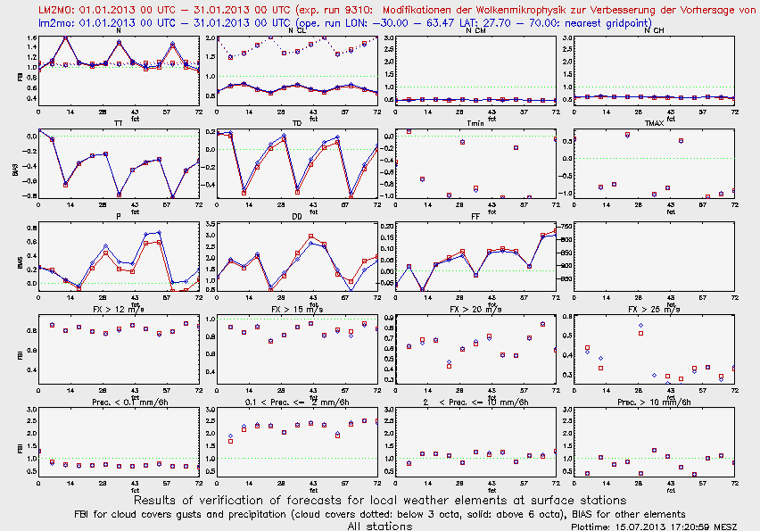
Standard Verification COSMO-EU January 2013

Slide 6
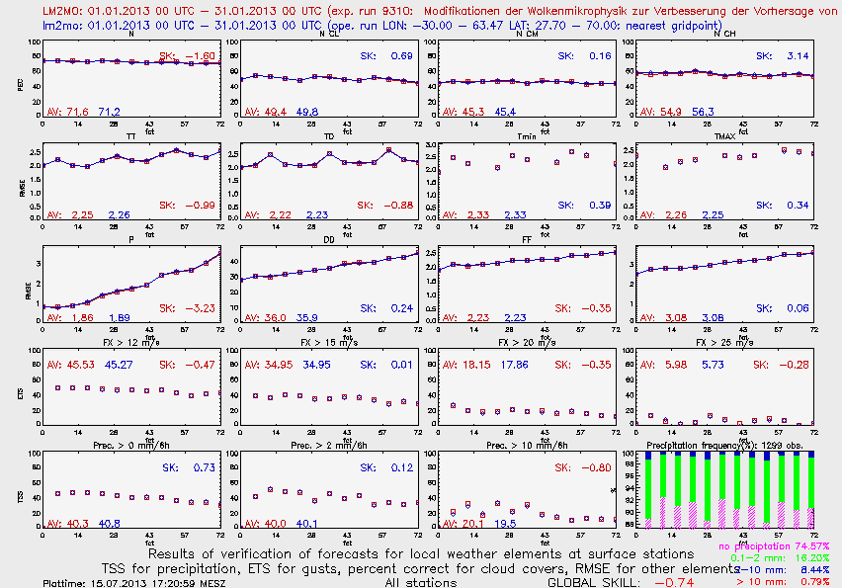
Standard Verification COSMO-EU January 2013

Slide 7
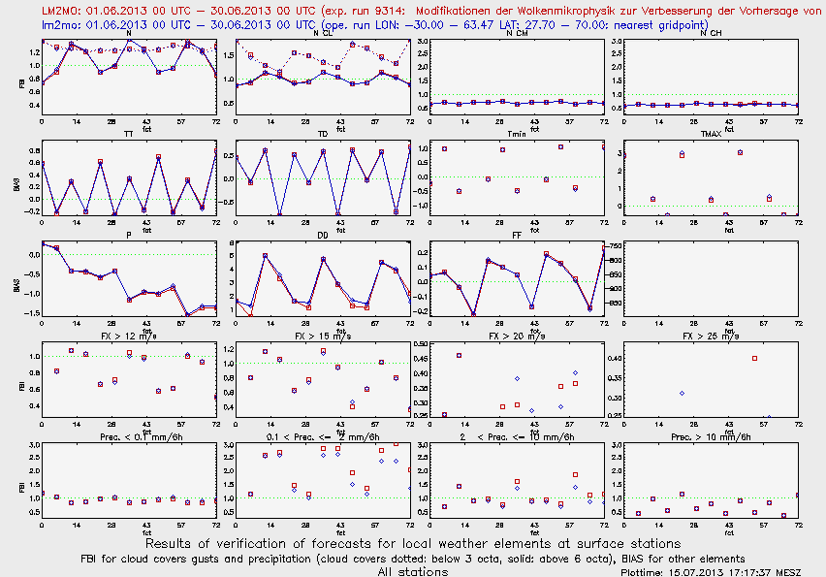
Standard Verification COSMO-EU June 2013

Slide 8
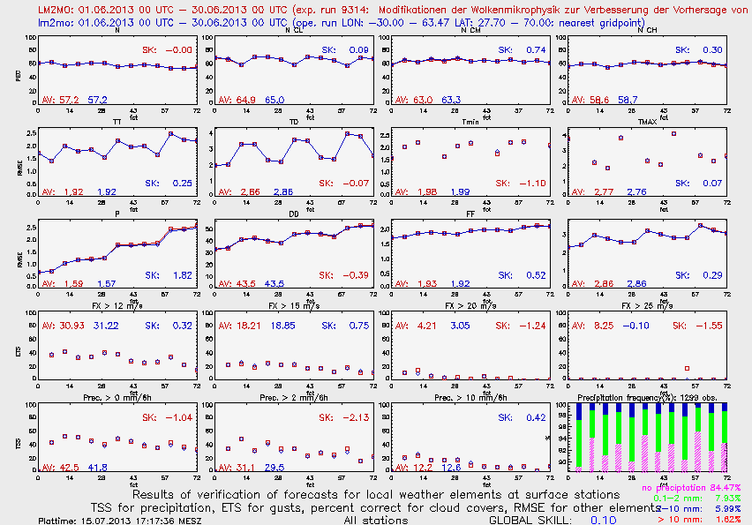
Standard Verification COSMO-EU June 2013

Slide 9
COSMO-EU Tests 2014
(only for 24 hours)
Done by Carmen Köhler based on COSMO-Model 5.0.2
Only 24 hours to provide boundaries for COSMO-DE

Slide 10
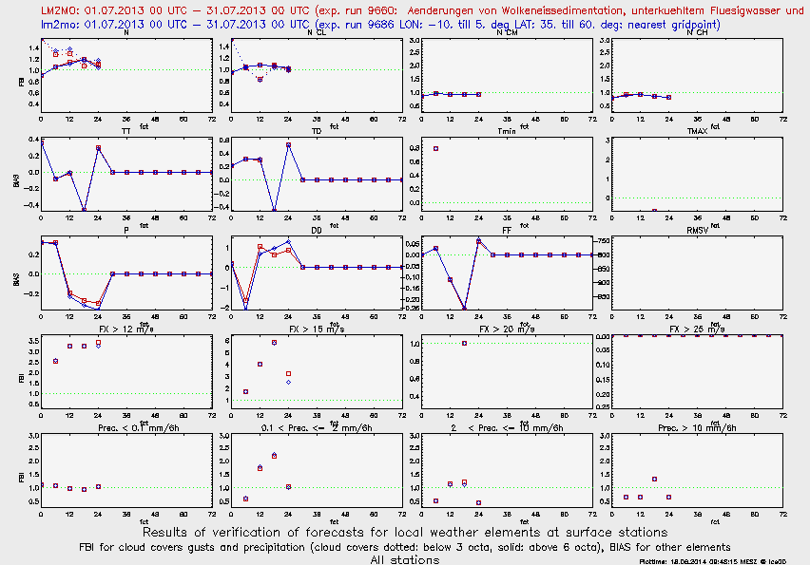
Standard Verification COSMO-EU July 2013

Slide 11
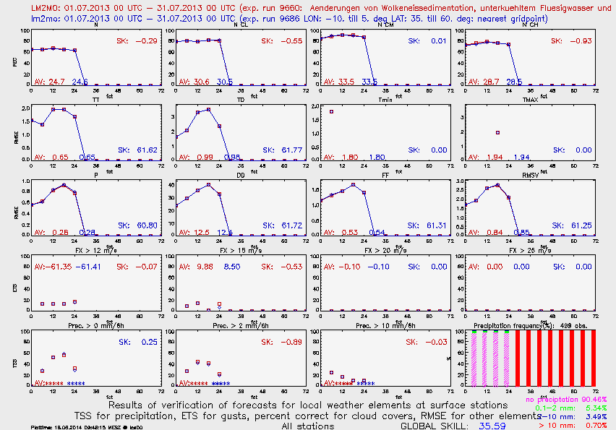
Standard Verification COSMO-EU July 2013

Slide 12
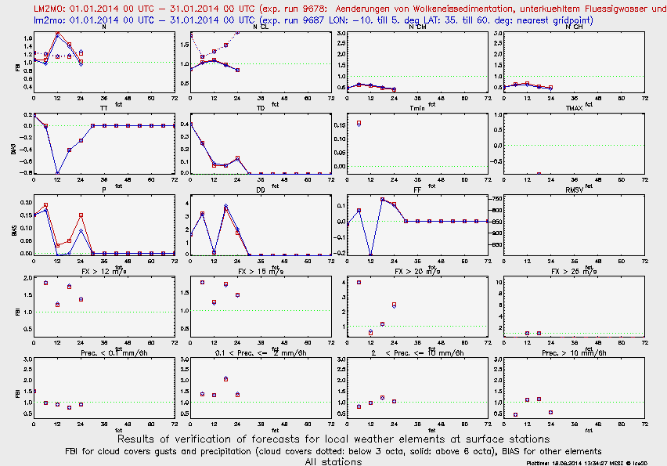
Standard Verification COSMO-EU January 2014

Slide 13
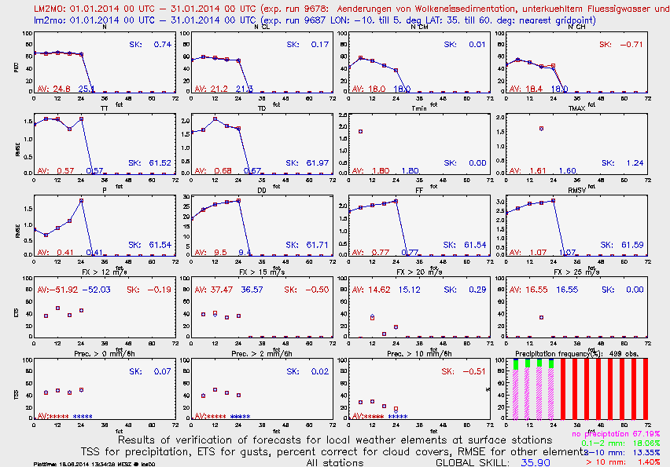
Standard Verification COSMO-EU January 2014

Slide 14
COSMO-DE Tests 2014
Done by Carmen Köhler based on COSMO-Model 5.0.2

Slide 15
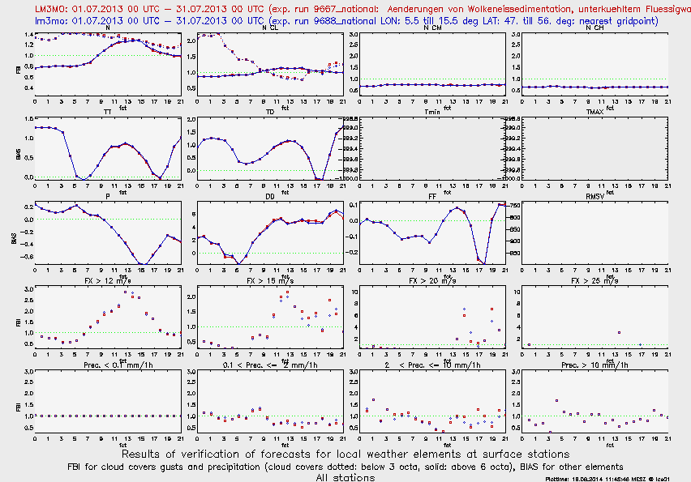
Standard Verification COSMO-DE July 2013

Slide 16
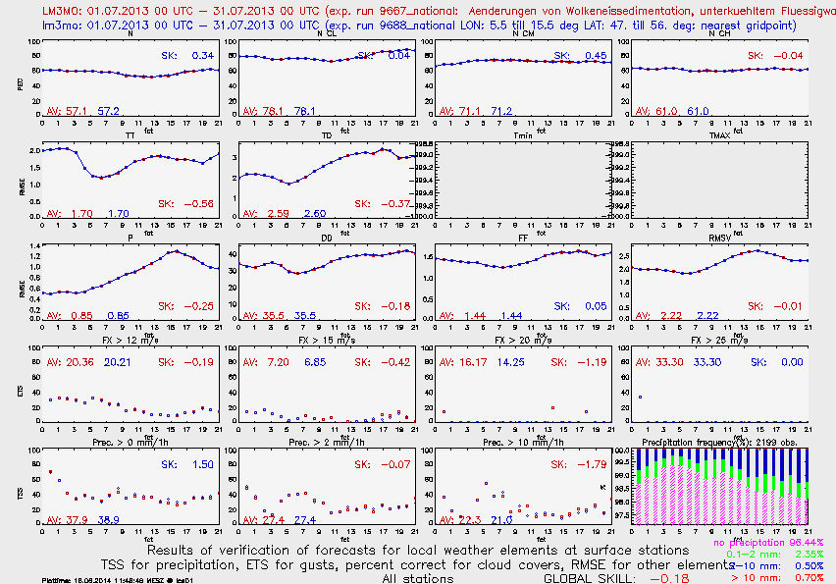
Standard Verification COSMO-DE July 2013

Slide 17
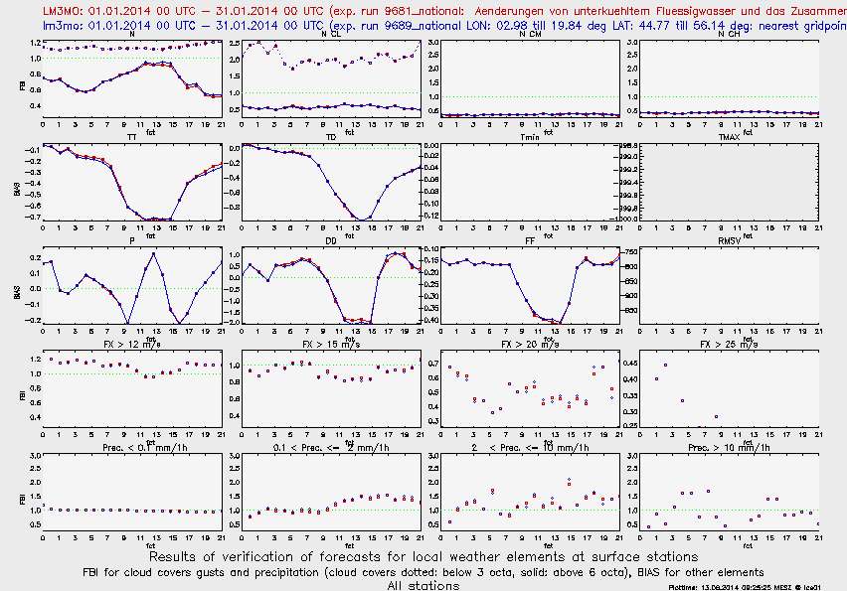
Standard Verification COSMO-DE January 2014

Slide 18
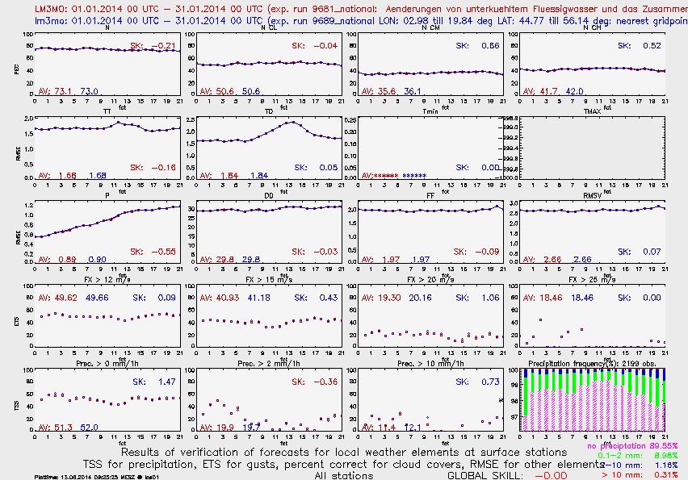
Standard Verification COSMO-DE January 2014

Slide 19
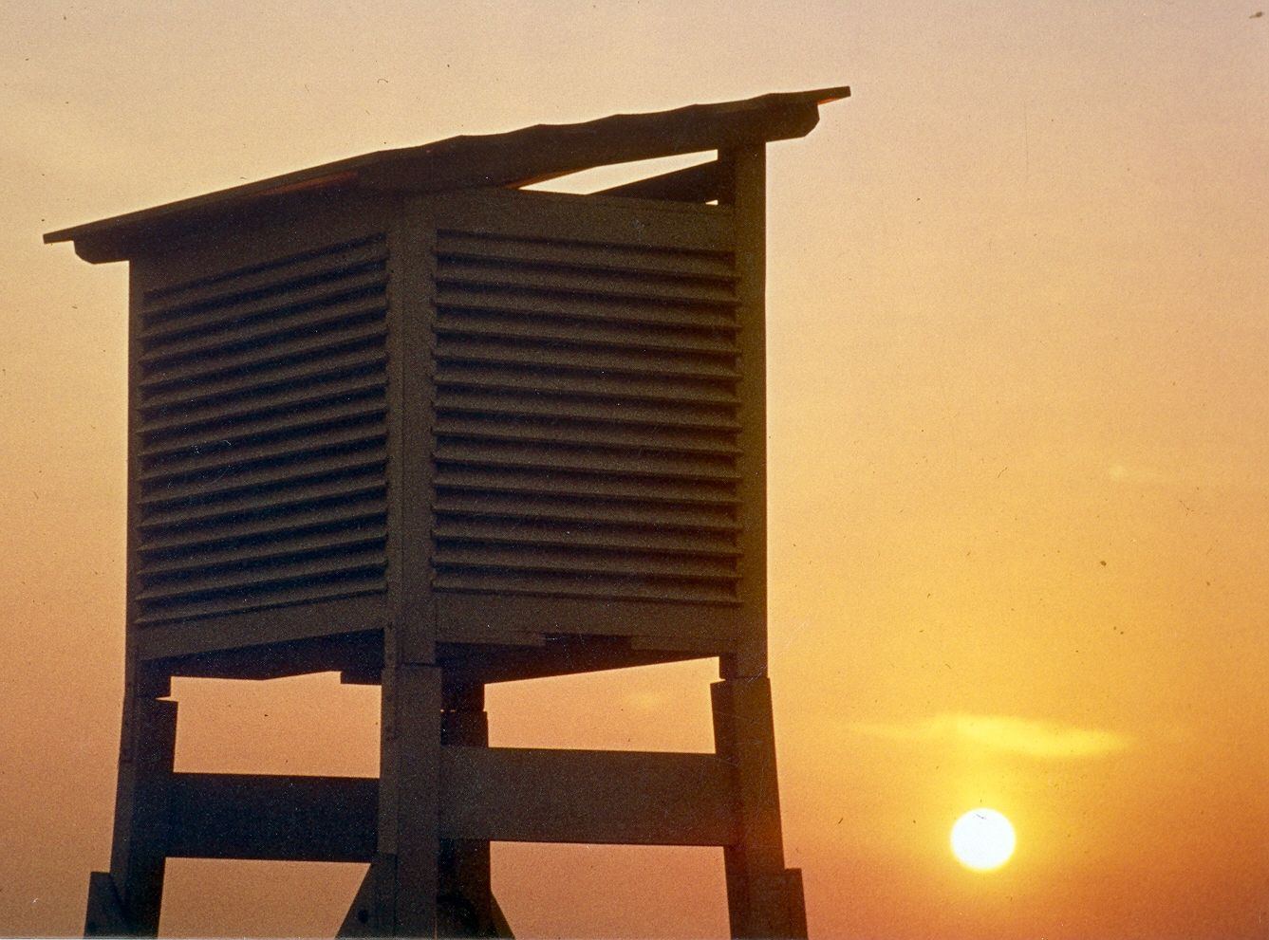
Thank you
very much
for your
attention
10.09.2012
COSMO General Meeting 2012
19

