Slide 1

WG VA: Verification and Applications Activities
Amalia Iriza-Burca (NMA)
Andrzej Mazur (IMGW-PIB)
Contributors: F. Fundel (DWD), F. Gofa (HNMS), N. Vela (ARPA-PT), I. S. Gabrian (NMA), S. Dinicila (NMA), D. Boucouvala (HNMS), N. Zaccariello & F. Batignani & R. Golino (CNMCA), A. Surowiecki (IMGW-PIB), A. Pauling & P. Kaufmann (MCH), P. Khain (IMS), M. S. Tesini & T. Gastaldo (ARPAE), M. Bogdan (NMA), ...
WG V/A Report, COSMO GM, Rome, 14-18.09.2026
Notes:
1
1

Slide 2
Thank you to Flora for all the hard work, support and dedication during these 13 years as WGc
I am confident for a great collaboration also from now on.
WG V/A Report, COSMO GM, Rome, 14-18.09.2026
Notes:
2
2

Slide 3
Software
1.1 FFV2
1.2 VAST
Repository and Documentation
CP Activities
3.1 Verification on Common Areas – DET
3.2 Fuzzy verification
3.3 News about EPS verification
PP APOCS
Workshop on model errors
Discussions in Parallel Session
Next steps
WG V/A Report, COSMO GM, Rome, 14-18.09.2026
Notes:
3
3

Slide 4
1. Verification Software
1.1 FFV2 (F. Fundel, DWD)
Transition from qs to qs2
qs as score file format was introduced for data loading performance reasons
qs is no longer supported with R >= 4.6
qs2 - same functionality, not backwards compatible
A current versions of FFV2 and shiny apps support both, qs and qs2
A FFV2 version no longer depending on qs is ready
  Git tag 1.5.0
A simple R script to convert qs files to qs2 can be provided
Shiny apps can be adopted easily by commenting out the import of the qs package
Rdata still is supported
Smaller changes
Verification of RHi (rel. humidity over ice) - calculated within FFV2 if T and RH exist (EPS, TEMP & AIREP)
Upper-air verification with binned vertical levels optionally allows to include data outside the bins
Verification against analysis at observation location - for station based scores
Verification of mslp

Slide 5
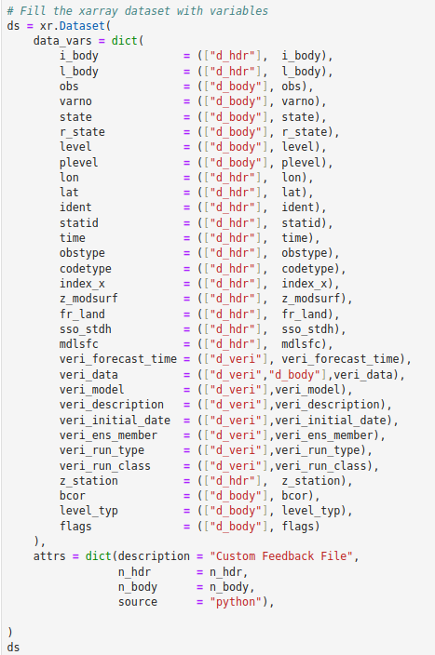
1. Verification Software
1.1 FFV2 (F. Fundel, DWD)
FFV2
Alternative for new observation/forecast data
FFV2 requires feedback files
Recommended way is to use MEC for production
New types of observations and/or forecasts are not easily implementable in MEC
Different approaches at DWD for easy production of feedback files without MEC
Most simple approach is based on pythons xarray
Jupyter notebook can be provided as template
Procedure
Load observations
Load predictions
Interpolate prediction to observation location
Write an xarray dataset with additional attributes (lon, lat, statid, …)
Save as netCDF
(Subproblem: filling existing feedback file with new forecasts)

Slide 6
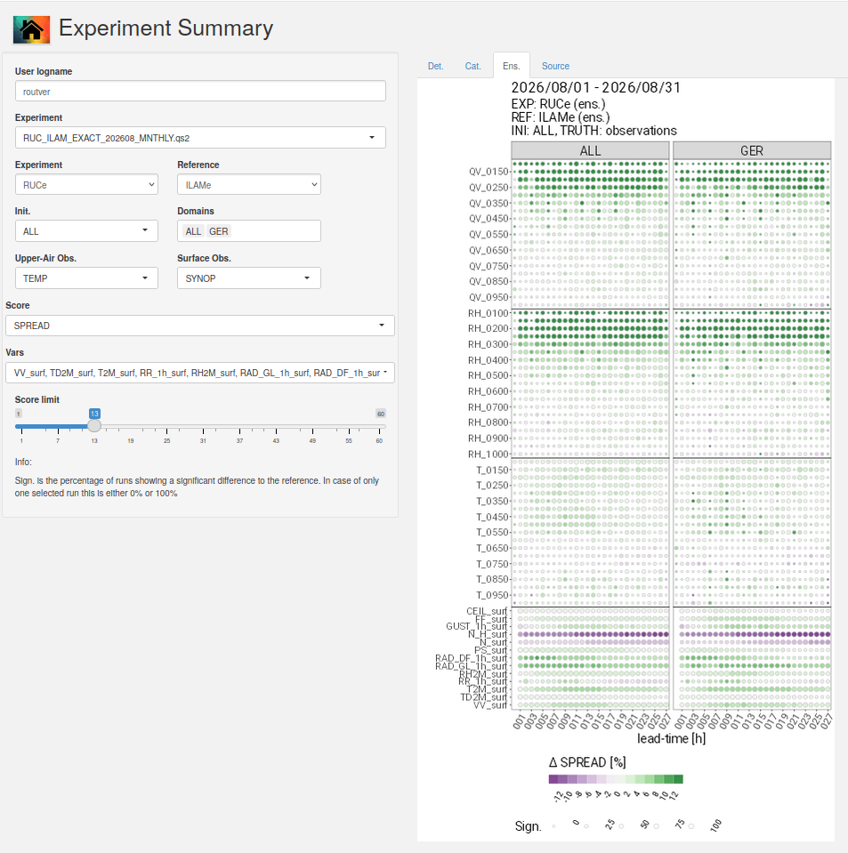
1. Verification Software
1.1 FFV2 (F. Fundel, DWD)
New Scores
SDF (Standard deviation of forecasts), SDO (Standard deviation of observations)
SDF/SDO (Activity ratio) , IE Information error (error in direction of observations vector)
NE Noise error (error orthogonal to observation vector)
R_agg Correlation coefficient (cosine of angle between obs. And forecast vector; r^2)
Shiny Apps
Score Card App
Work with .qs .qs2 and .Rdata score files
Revised categorical upper air score app
New ScoreCard app
  Shows upper air and surface scores at once
  Det. and EPS

Slide 7
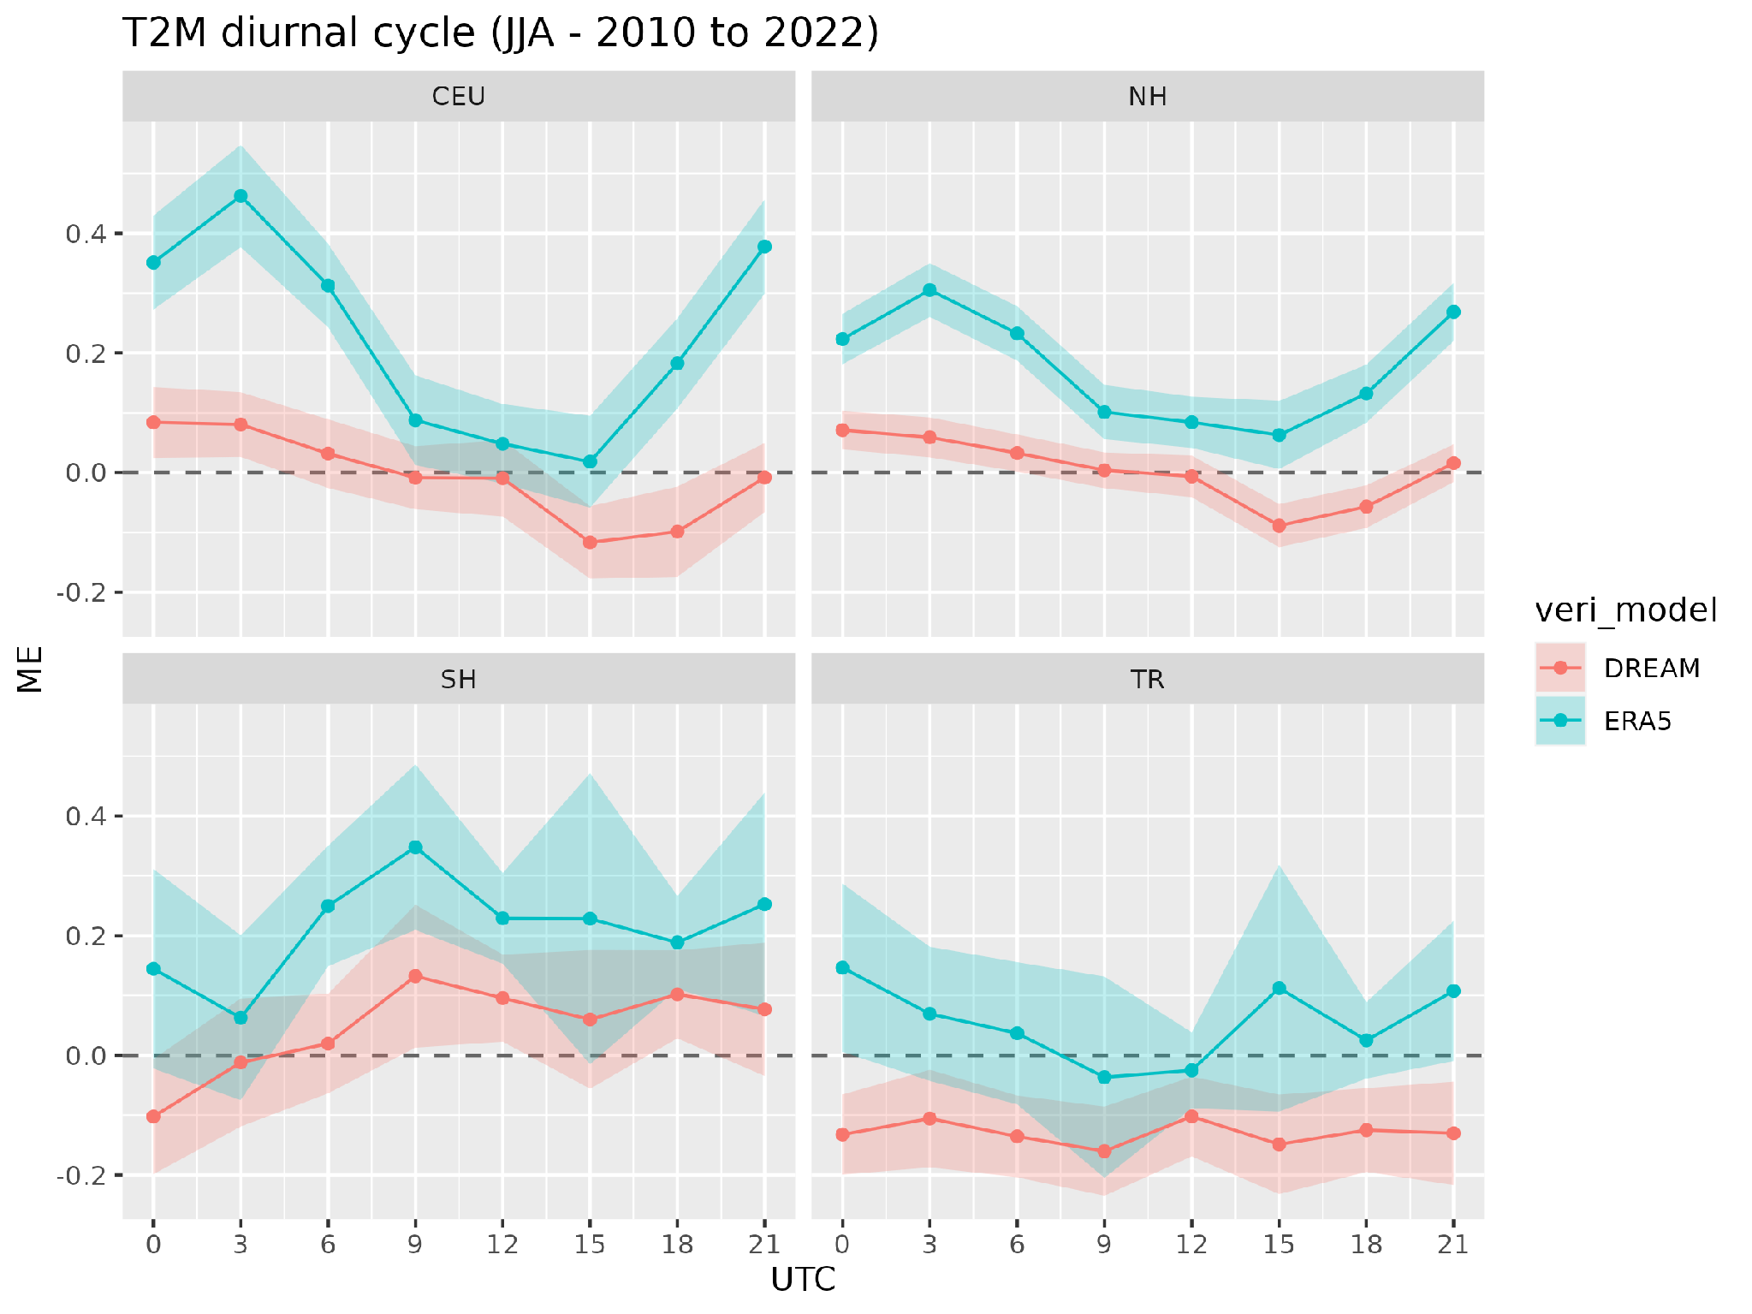
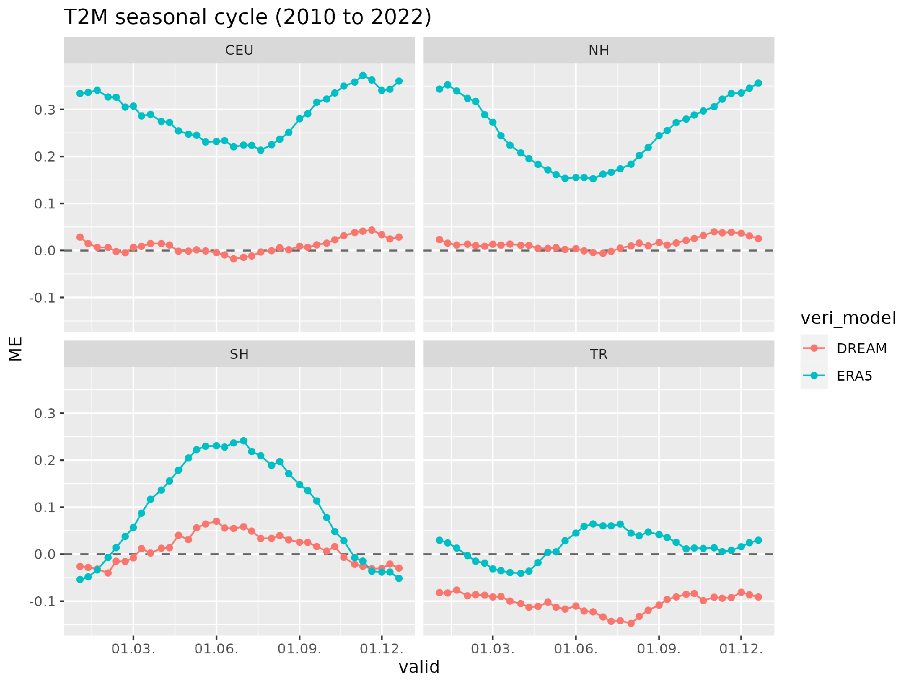
Other Topics
F. Fundel, DWD
Reanalysis
DREAM
  ICON, deterministic, 13km + 7km EU nest
  2010 - current
FORCE
  ICON-D2, deterministic, 2km
  2016-2025
DREAM vs. ERA5
Err. In daily cycle lower than in ERA5
Closer to observations
Colder in the tropics
Plots by Sabrina Wahl

Slide 8
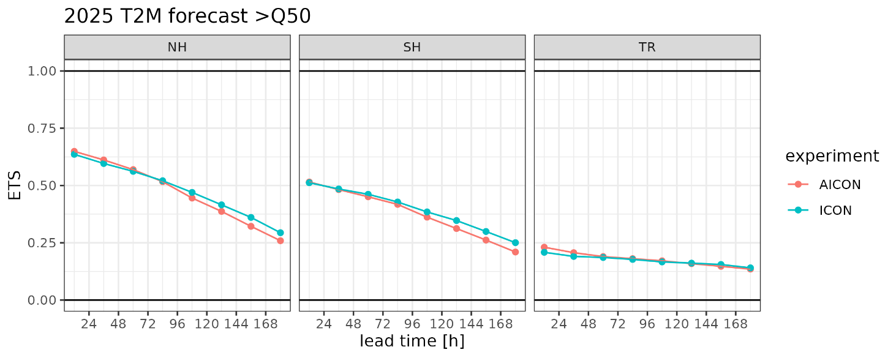
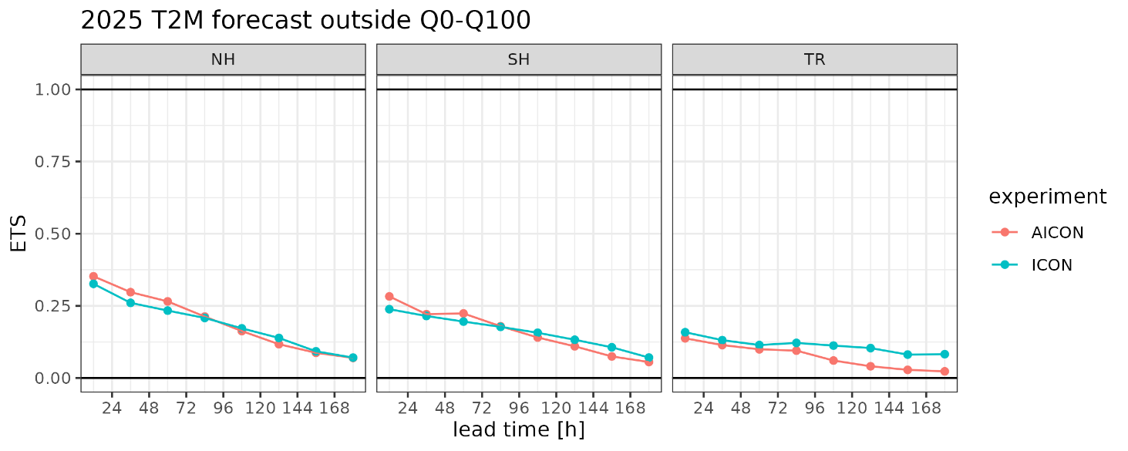
F. Fundel, DWD
Fill contingency table for all events outside Q0 and Q100
How good is ICON/AICON in forecasting extreme (2010-2022) events?

Slide 9
1. Verification Software
1.1 FFV2 container (A. Iriza-Burca & R. Dobre, NMA)
Summary of What was done
created a Makefile that helps package the Met R library into a Linux Container
the build process depends on Met R source files, Podman and Apptainer
Apptainer is the only container runtime required to run the container once is built (it has to be available on the HPC platform)
Creating the container
Clone the repo from https://github.com/dobrerazvan/met-container
run `make sif` - builds the container on your local machine. Alternatively you can download prebuilt containers from TBD
Using the container
Running R
apptainer exec <sif_file> R
Running demo files
apptainer exec <sif_file> scores_by_date|aggregate|scores_by_station <params>
58th COSMO General Meeting, Rome, 14-18.09.2026
Notes:
5
5

Slide 10
1. Verification Software
1.1 FFV2 container (A. Iriza-Burca & R. Dobre, NMA)
Use cases and arguments:
Use case Arguments (after use case)
scores_by_date namelist OBSTYPE FCST_TYPE no_cores
aggregate namelist OBSTYPE FCST_TYPE no_cores
scores_by_station namelist OBSTYPE FCST_TYPE PARAM_CATEG no_cores
basically, same as when running the original FFV2 sources
See wrapper usage (& use-case names) without running a job:
```bash
apptainer run r-rocky9-ffv2-<TAG>.sif
```
58th COSMO General Meeting, Rome, 14-18.09.2026
Notes:
8
8

Slide 11
1. Verification Software
1.2 VAST (Naima Vela, Arpa Piemonte)
VAST (Versus Additional Statistical Techniques)
software not modified recently
no plans to upgrade it in the near future
will be maintained
software package in Bash, Fortran 90 and R
verify the dichotomic parameters with a multi intensity/ multi scale spatial verification approach.
Categorical scores calculated through different upscaling approaches (normal upscale, yes/no, minimum coverage, fuzzy logic, etc.).
Non categorical scores also included (FSS, BSS and ETSr).
WG V/A Report, COSMO GM, Rome, 14-18.09.2026
Notes:
9
9

Slide 12
2. Repository and Documentation for WG VA
NEW
Repository for the documentation and templates regarding the installation and usage of the MEC-FFV2 (formerly RFDBK) is now hosted on the dkrz git/ PP CARMENs project.
New security rules / restricted access to the FTP server that hosts CP data transfer
3. CP Activities
Summary of 2025/2026
CP scores uploaded to the COSMO shiny server (deterministic & Fuzzy), up to MAM26.
Some delays due to missing data and lack of human resources.
Issue (valid for DET & Fuzzy) - delay in providing data
WG V/A Report, COSMO GM, Rome, 14-18.09.2026
Notes:
10
10

Slide 13
CP Activities Update
Specifications
Files submission (seasonal or monthly basis): All files to be uploaded on seasonal/monthly/daily basis on the NMA ftp server
  OBS_NC: netcdf observations
  PRECI-GRIB: 3h precipitation GRIB files (for spatial verification)
  CARMA (Forecast files): MEC derived files
Observations (SYNOP and TEMP) in netcdf format available on NMA ftp server daily
  Also available on the ATOS HPC for those who require it
COSMO-LEPS control files are processed (MEC) at Atos HPC on a monthly basis
Cleanup of past years files is necessary in COSMO shiny server (folders, content not visible unless moved)
WG V/A Report, COSMO GM, Rome, 14-18.09.2026
Notes:
12
12

Slide 14
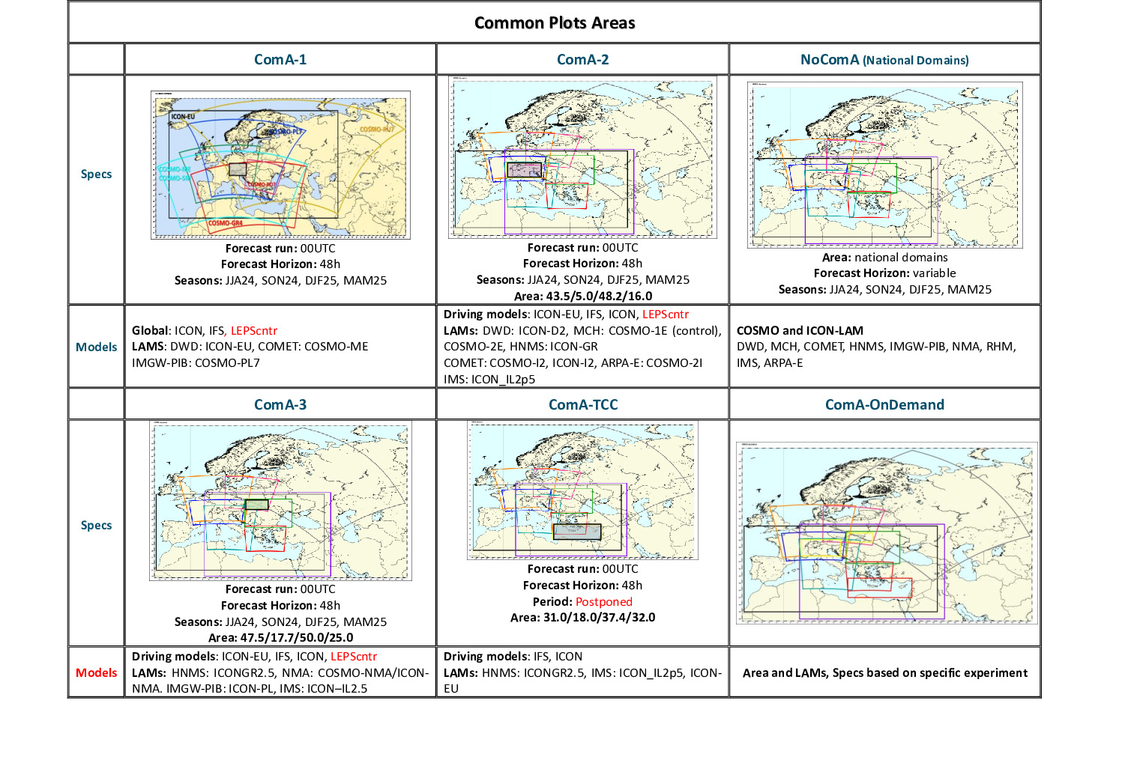
3.1 CP Activities Update
WG V/A Report, COSMO GM, Rome, 14-18.09.2026
Notes:
13
13

Slide 15
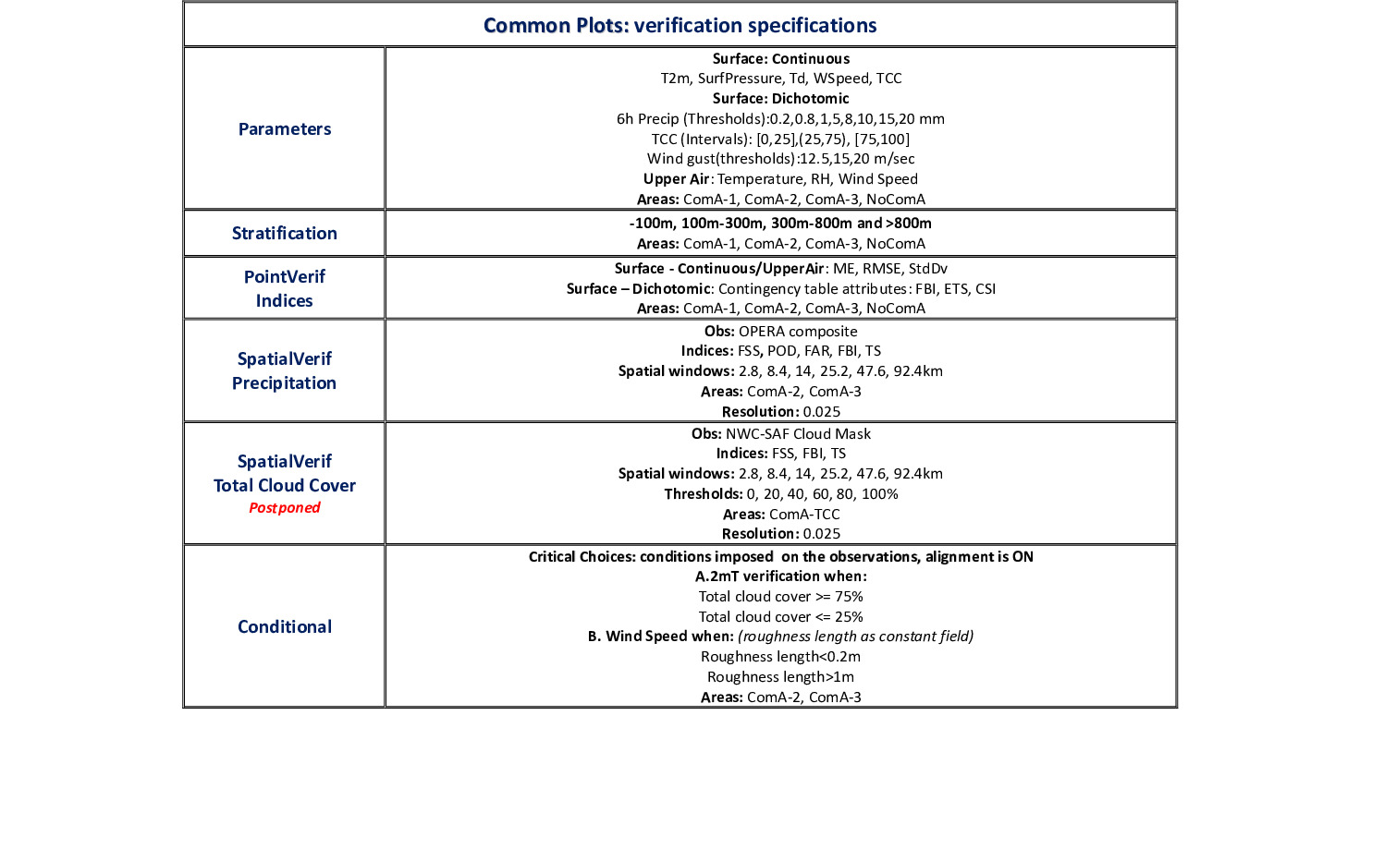
3. CP Activities Update
WG V/A Report, COSMO GM, Rome, 14-18.09.2026
Notes:
14
14

Slide 16
CP Activities Update
COARSE
FINE
EPS
Operational models:
DWD: ICON-GLOBAL(0.117), ICON-EU (0.0625), ICON-D2 (0.02), ICON-D2-EPS (0.02)
COMET: ICON-IT (0.02)
IMGW-PIB: COSMO-PL7 (0.0625), COSMO-CE-PL2k8 (0.025), ICON-PL (0.025), COSMO-PL2k8TLE-eps (0.025)
HNMS: ICON-GR (0.025)
MCH: ICON-1E (0.01), ICON-2E (0.02)
IMS: ICON-IL (0.025)
NMA: COSMO-RO7 (0.0625), ICON-RO2p8 (0.025)
ARPAE-SIMC: COSMO-2I-EPS (0.02), ICON-2I (0.02)
Additionally: COSMO-LEPS and IFS (missing this year)
Driving models: ICON-GLOBAL (0.117), ICON-EU (0.0625) and IFS
Ending: COSMO-ME (0.045), COSMO-IT(0.02) (DJF26)
WG V/A Report, COSMO GM, Rome, 14-18.09.2026
Notes:
15
15

Slide 17
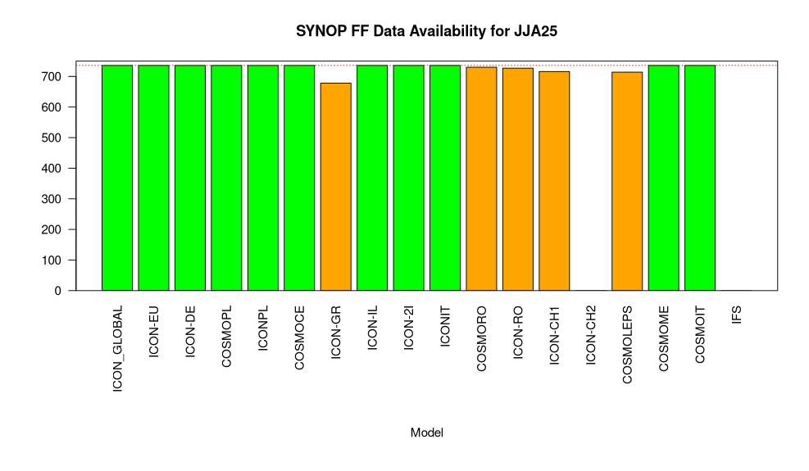
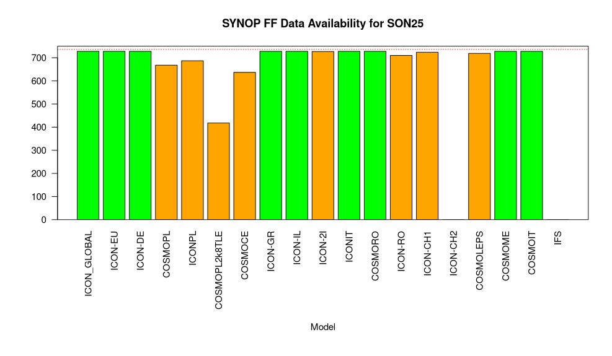
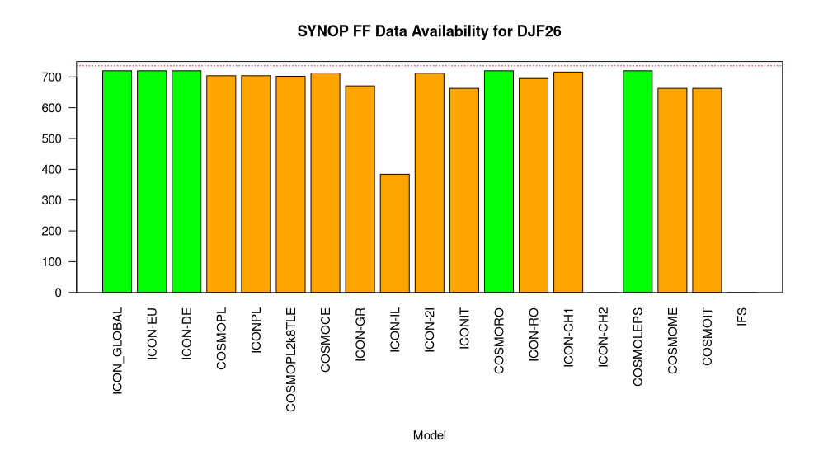
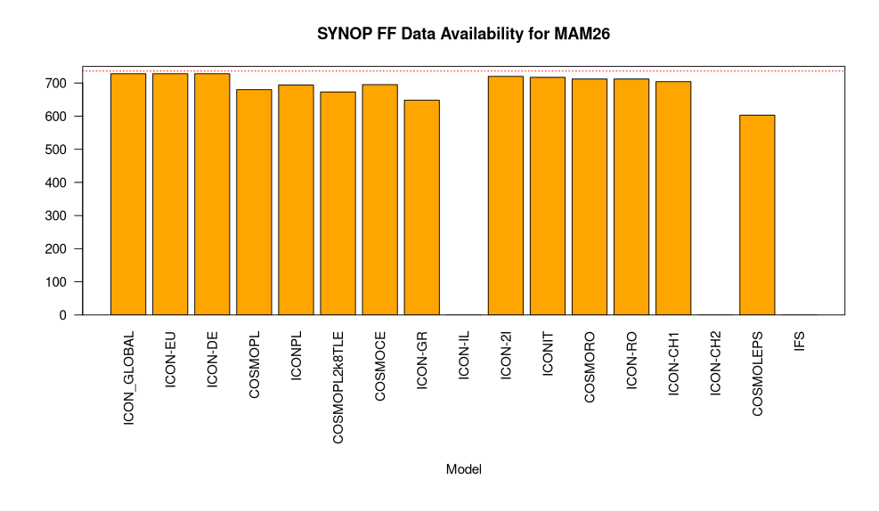
CP data Availability
WG V/A Report, COSMO GM, Rome, 14-18.09.2026

Slide 18
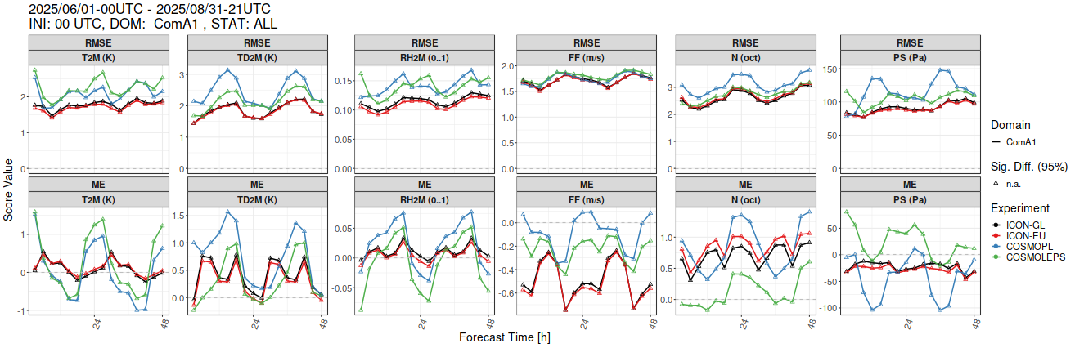
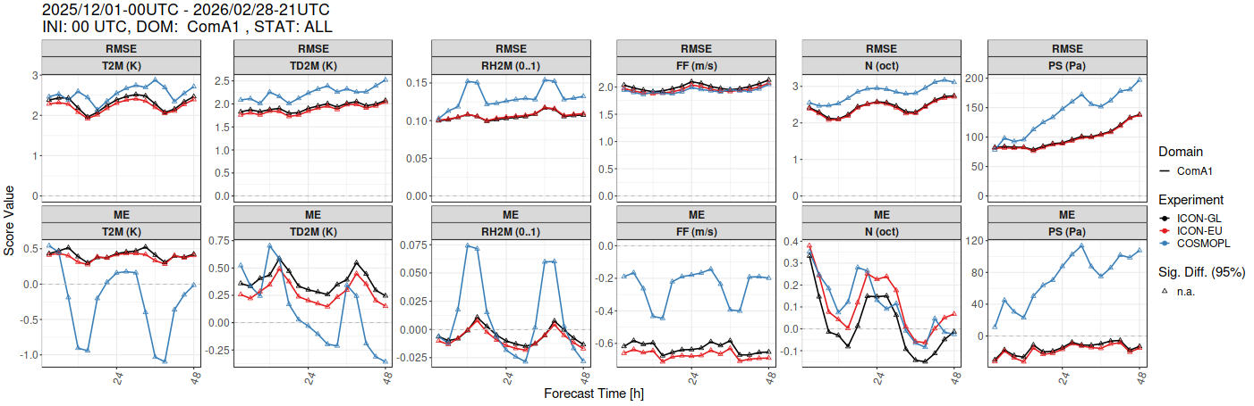
Common Area 1 (ComA1)
Summer 25
Winter 25/26
WG V/A Report, COSMO GM, Rome, 14-18.09.2026

Slide 19
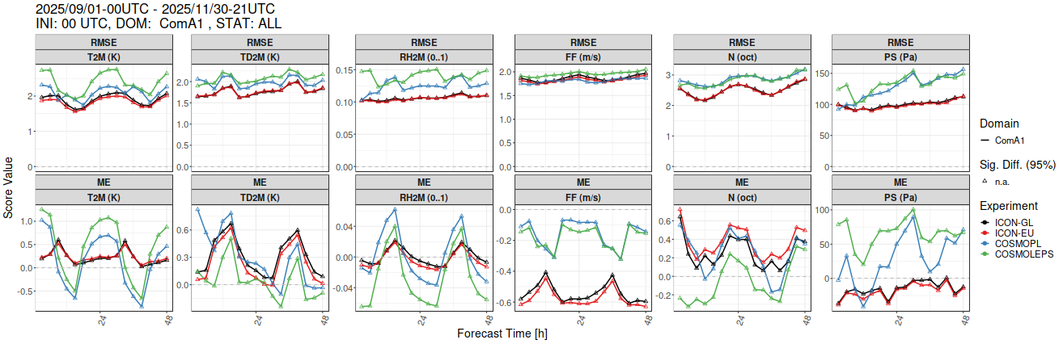
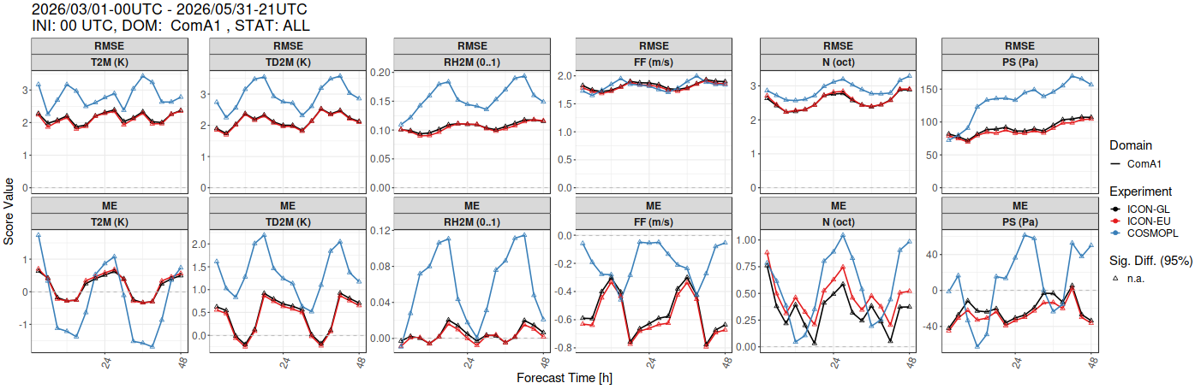
Common Area 1 (ComA1)
Autumn 25
Spring 26
WG V/A Report, COSMO GM, Rome, 14-18.09.2026

Slide 20
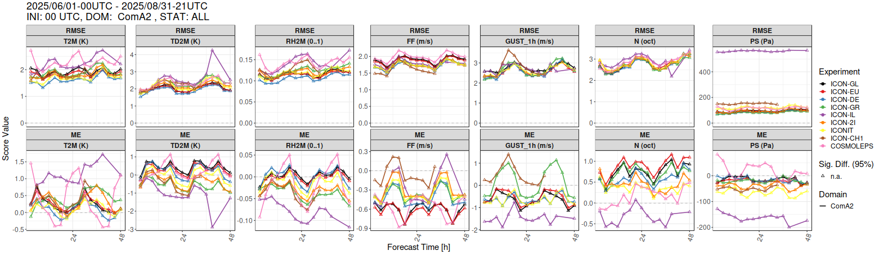
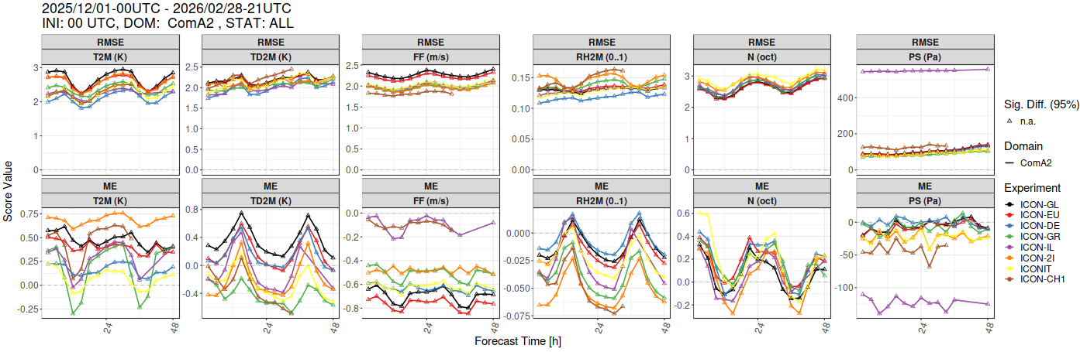
Common Area 2 (ComA2)
Summer 25
Winter 25/26
WG V/A Report, COSMO GM, Rome, 14-18.09.2026

Slide 21
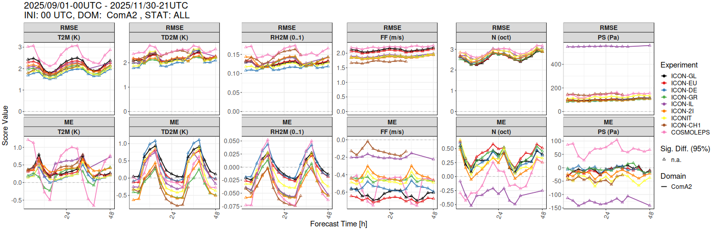
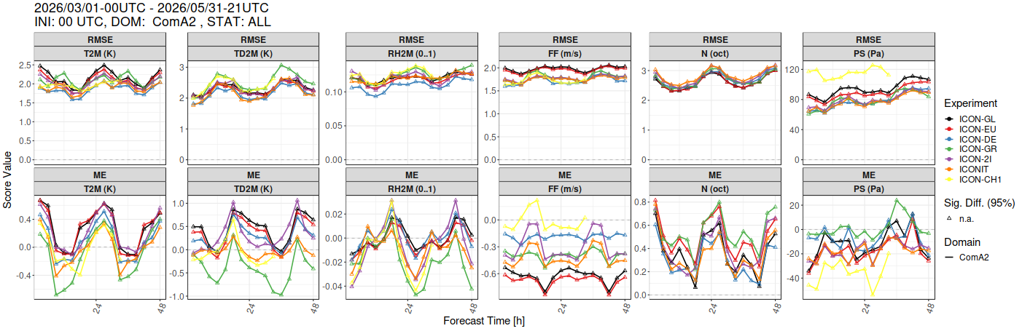
Common Area 2 (ComA2)
Autumn 25
Spring 26
WG V/A Report, COSMO GM, Rome, 14-18.09.2026

Slide 22
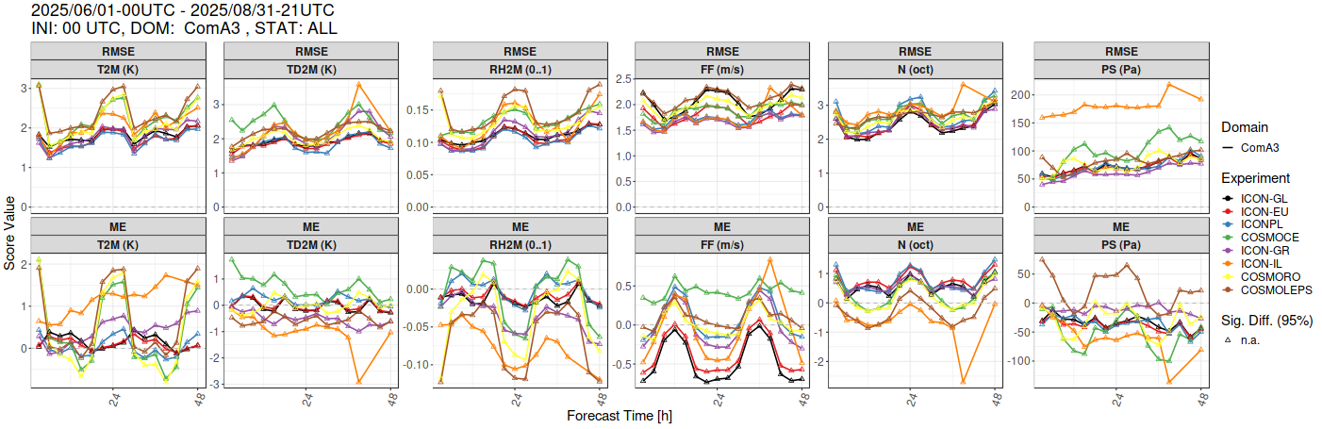
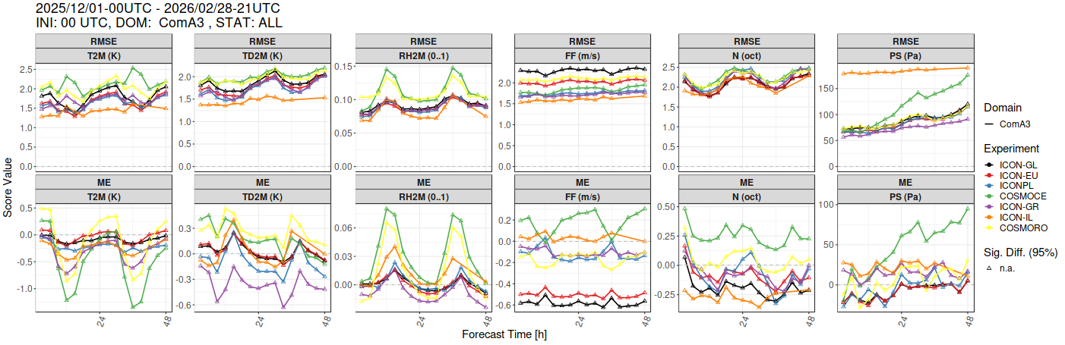
Common Area 3 (ComA3)
Summer 25
Winter 25/26
WG V/A Report, COSMO GM, Rome, 14-18.09.2026

Slide 23
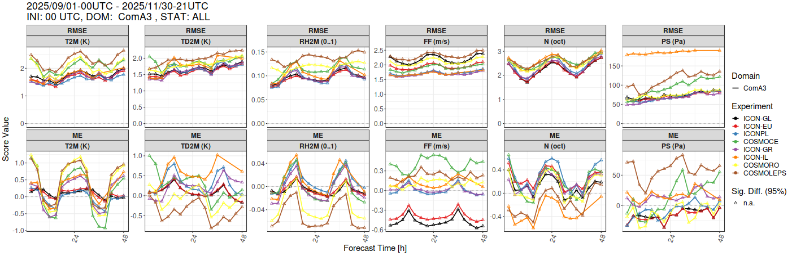
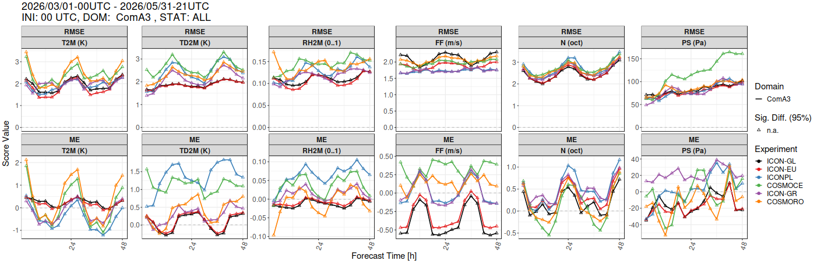
Common Area 3 (ComA3)
Autumn 25
Spring 26
WG V/A Report, COSMO GM, Rome, 14-18.09.2026

Slide 24
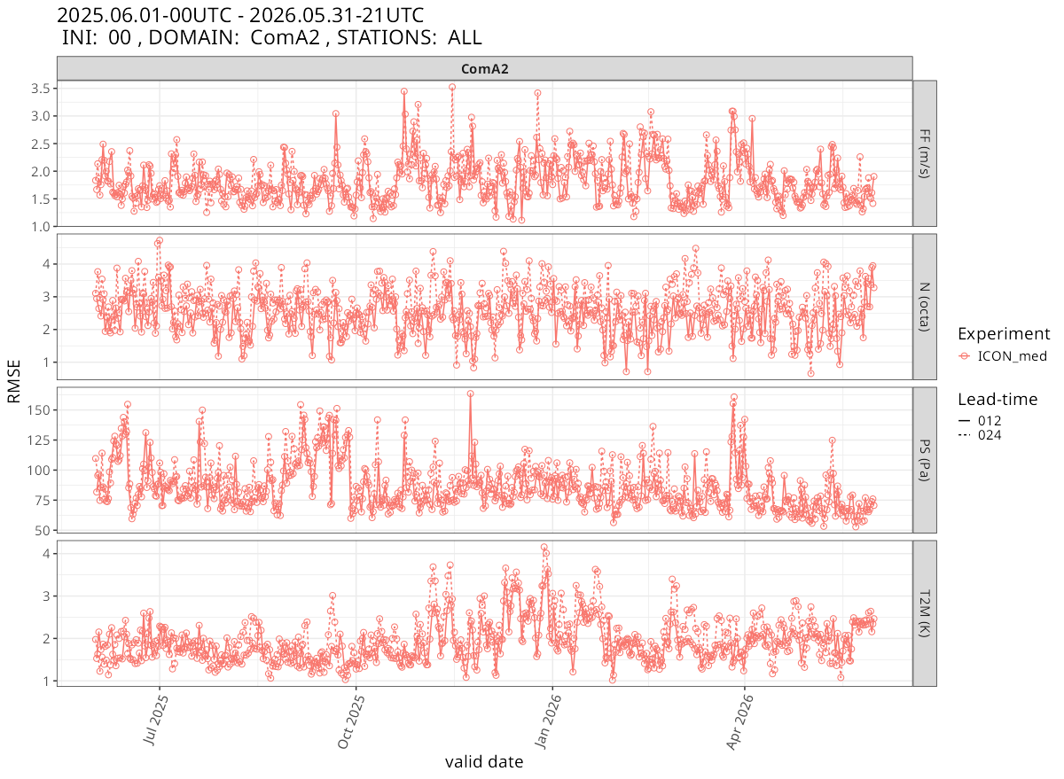
Common Area 2 (ComA2)
Overall model average
WG V/A Report, COSMO GM, Rome, 14-18.09.2026

Slide 25
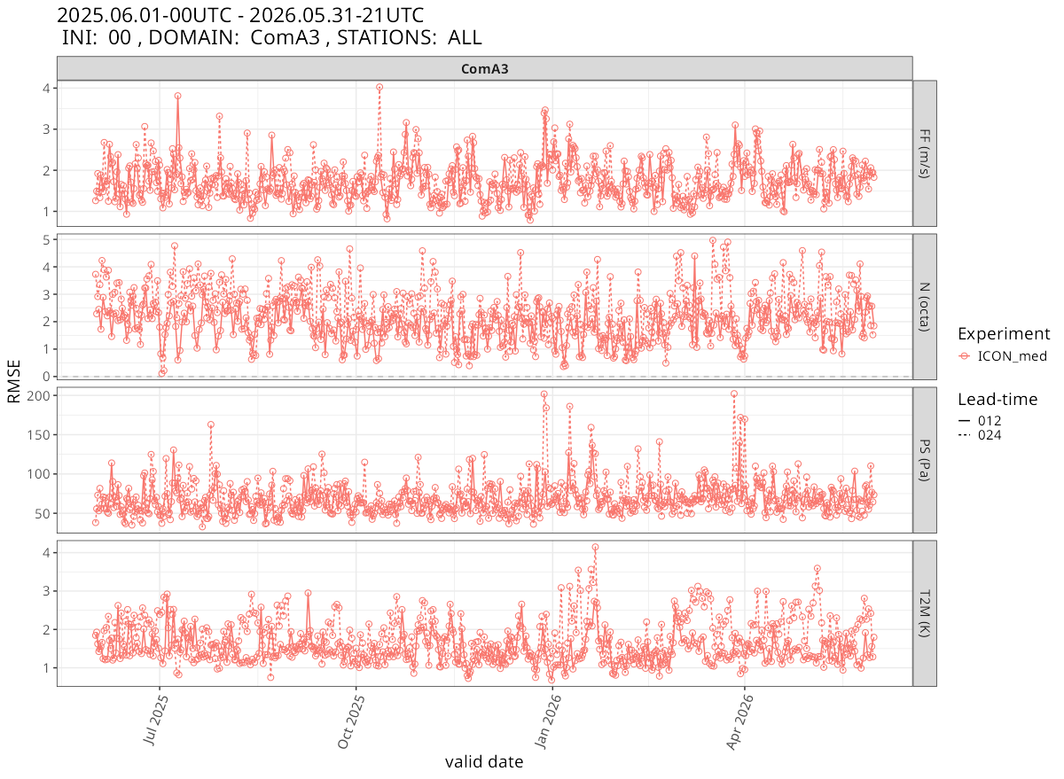
Common Area 2 (ComA2)
Overall model average
WG V/A Report, COSMO GM, Rome, 14-18.09.2026

Slide 26
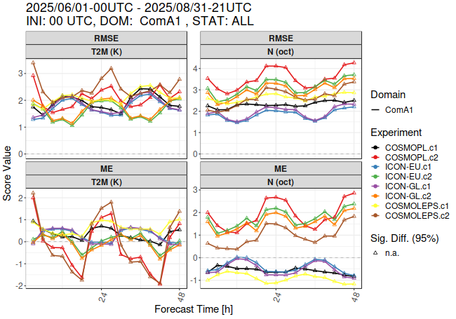
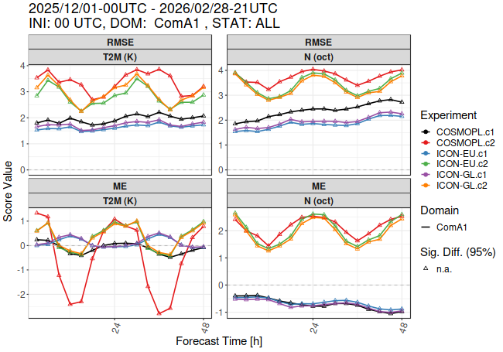
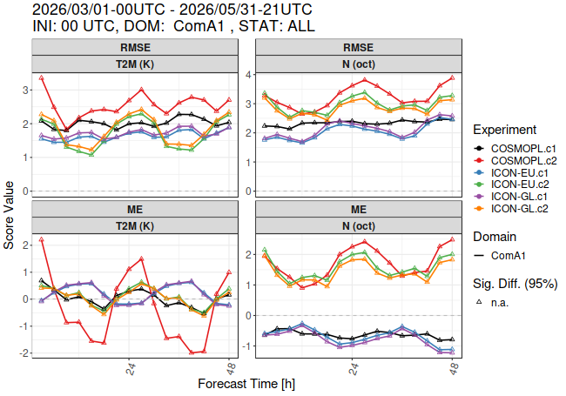
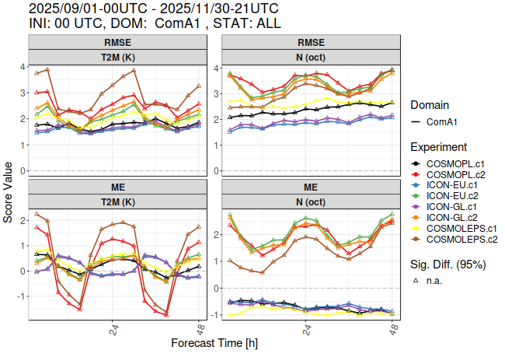
Common Area 1 (ComA1)
Conditional Verification
Summer 25
Winter 25/26
Spring 26
Autumn
C2
WG V/A Parallel Session, COSMO GM, Rome, 14-18.09.2026

Slide 27
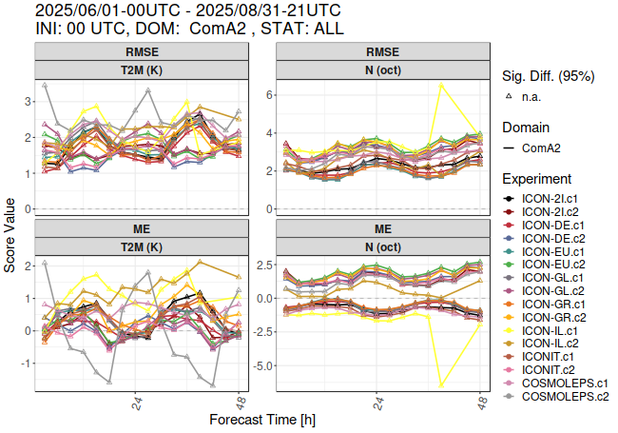
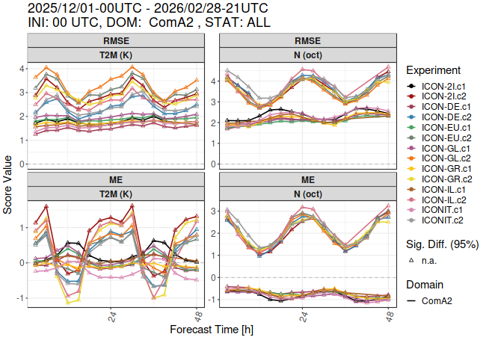
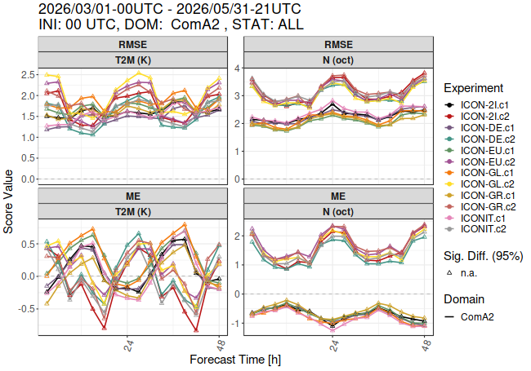
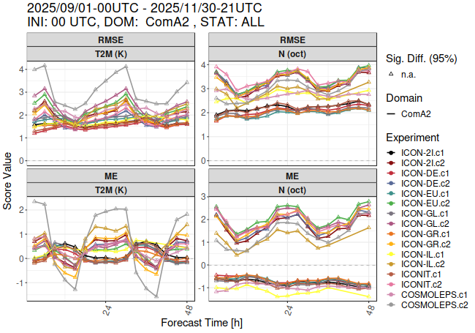
Common Area 2 (ComA2)
Conditional Verification
Summer 25
Winter 25/26
Spring 26
Autumn 25
WG V/A Parallel Session, COSMO GM, Rome, 14-18.09.2026

Slide 28
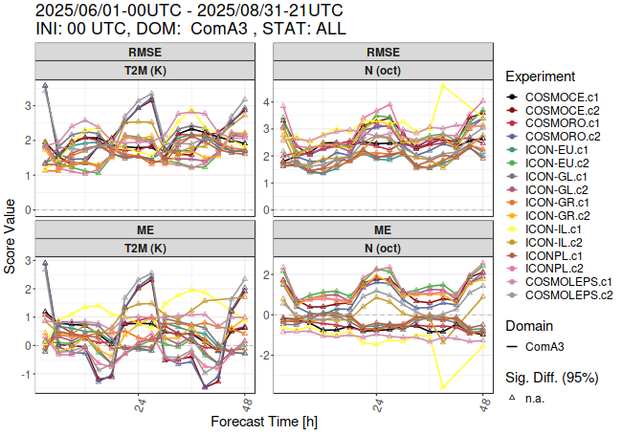
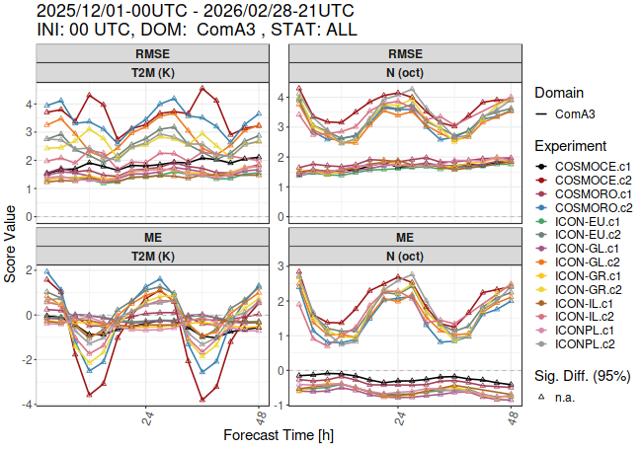
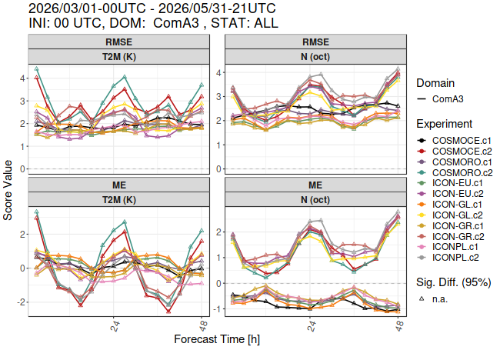
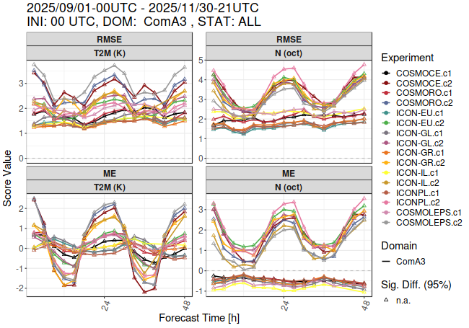
Common Area 3 (ComA3)
Conditional Verification
Summer 25
Winter 25/26
Autumn 25
Spring 26
WG V/A Parallel Session, COSMO GM, Rome, 14-18.09.2026

Slide 29
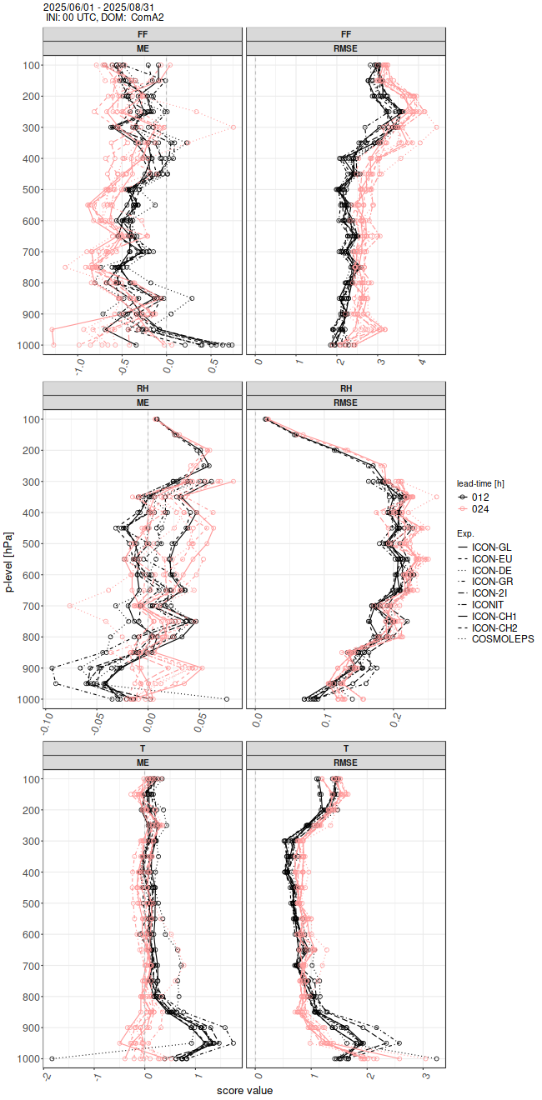
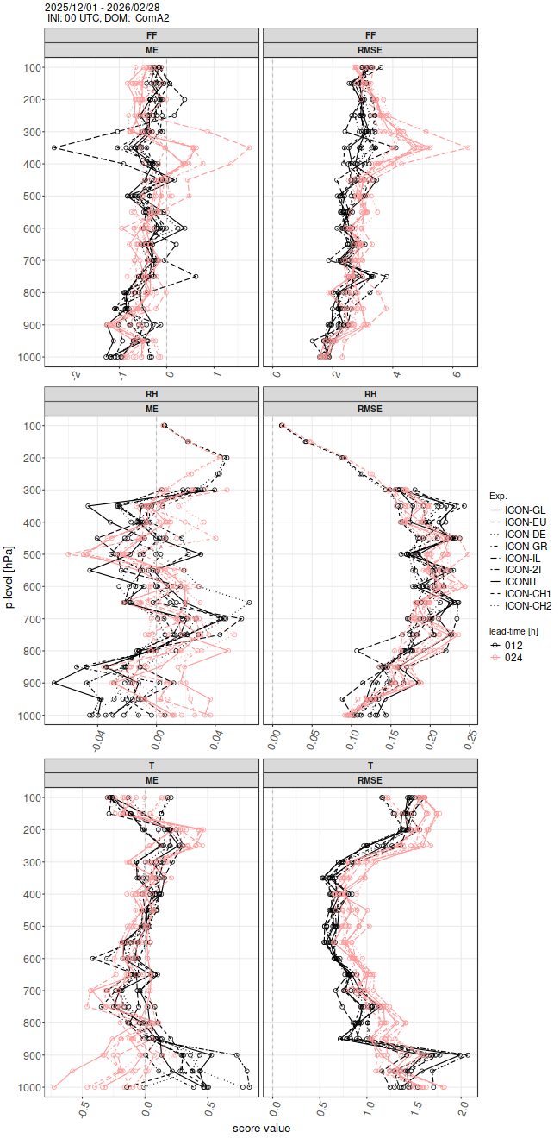
Common Area 2 (ComA2)
Upper Air Verification
Summer 25
Winter 25/26
WG V/A Report, COSMO GM, Rome, 14-18.09.2026

Slide 30
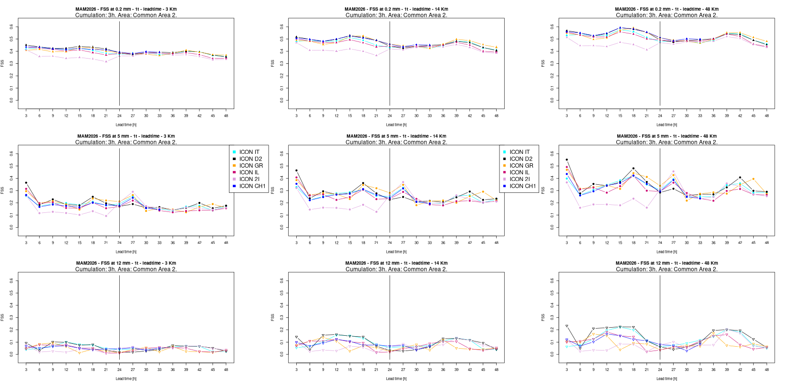
N. Vela, Arpa-PT
Fuzzy Verification: Motivation and Objectives
Multi-scale evaluation
Beyond the double penalty
High-resolution precipitation forecasts must be verified across scales to assess useful performance.
Traditional point-by-point scores penalise realistic but slightly displaced forecasts.
A fuzzy, neighbourhood approach
Objective
Forecasts are evaluated over a range of spatial scales and precipitation thresholds.
Compare multiple NWP models over two common verification areas, across four seasons.
Example plot
MAM 2026
Area 2
FSS
15th September 2026
34

Slide 31
Verification Set-up
N. Vela, Arpa-PT
MODELS
SCORES AND METHODS
Common Area 2
FSS · ETS · FBI
1 TIMESTEP · 3 TIMESTEPS
D0 · D1
3H CUMULATION
ICON D2 · ICON CH1 · ICON GR · COSMO IT · ICON IT · ICON IL · ICON 2I
Common Area 3
ICON GR · ICON PL · COSMO CE PL · ICON IL · ICON RO
OBSERVATIONS & RESOLUTION
OPERA database (EUMETNET)
0.025° lat-lon grid · Period: JJA 2025, SON 2025, DJF 2026, MAM 2026

Slide 32
N. Vela, Arpa-PT
Seasonal Synthesis for Common Areas
FSS and ETS behave very similarly across all seasons, confirming the robustness of the approach
Diurnal cycle is weakest in summer (JJA) and most evident in winter/spring (DJF, MAM)
2
1
2
Model agreement is high at coarse/medium scales; divergence may appear at fine scales and short lead times
FBI shows the largest seasonal variability, particularly at medium-to-high thresholds
3
4
1
FSS and ETS again track each other closely across all seasons
Model spread is consistently larger than in Common Area 2, in every season
3
2
Diurnal cycle is present but more irregular, with the clearest signal in winter and spring
FBI remains the most season-sensitive score, with occasional strong night-time overestimation
3
4
15th September 2026
36

Slide 33
N. Vela, Arpa-PT
Conclusions
1
The fuzzy verification framework provides a robust, scale- and threshold- dependent assessment
2
All models show a small decrease in skill with lead time
3
Pronounced diurnal cycles are more visible in winter/spring
4
Frequency bias is the main discriminator between models, more than spatial-accuracy scores
5
Common Area 3 is consistently more challenging to forecast than Common Area 2 for all models
6
Results support continued multi-model, multi-scale verification to guide future model development
15th September 2026
37

Slide 34
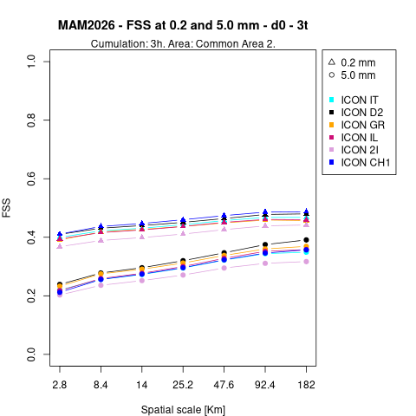
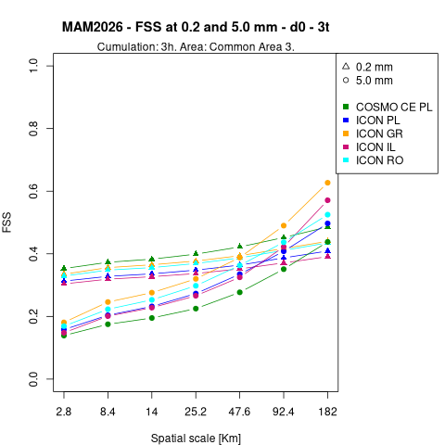
N. Vela, Arpa-PT
New Feature: Verification based on Lead - Time
More detailed analysis will be included in the Verification Report
3-Timestep Verification Overview
A systematic evaluation of spatial forecast skill across meteorological models, thresholds, seasons, and regions, extending the analysis to a three-timestep (3x3h) cumulation across four seasons and two common verification areas.

Slide 35
CP Activities
Guidelines for 2026/2027
To be designed by the end of SON26.
No major changes in structure and requirements expected.
Pending Issues:
  A slight revision of score file naming convention is necessary, as they have become complicated due to the number of models involved
  Include the EPS activity on a regular basis
        can provide additional insights
  Update the status of the models used for verification.
Verification Report: a short summary to be published as a Technical Report
WG V/A Report, COSMO GM, Rome, 14-18.09.2026
Notes:
38
38

Slide 36
CP Activities - EPS
Data availability:
  JJA25: DWD and MCH
  Starting from SON25 also COSMOPL2K8TLE
  Good starting point
  Intent: include the EPS in the CP activity on a regular basis for 2026/2027
  ICON-2I o be included soon - tests already performed
  ICON-IT - production of FF is planned
AOB CP Activity
CP analysis requires further attention to identify systematic errors
Thanks to T. Andreadis (HNMS) for help with the updates to the verification pages
Thanks to everyone!
WG V/A Report, COSMO GM, Rome, 14-18.09.2026
Notes:
40
40

Slide 37
4. PP APOCS (PL. A. Surowiecki, IMGW-PIB)
Application of Personal weather station and Opportunistic sensor data CrowdSourcing
Start: April 2025 - Scheduled end: August 2027
Dedicated parallel session during COSMO GM26
Task 1
Subtask 1.1: Partially delayed
Some participants have not provided more detailed information regarding the results of surveys.
MeteoNetwork / NetAtmo networks subject to legal constraints which prevent use of real-time data from their sensors for purposes other than personal use, with some exceptions.
Can be efficiently used a posteriori for research & verification (e.g. development of QC algorithms).
Subtask 1.2: Completed: required parsers fully operational
Subtask 1.3: Nearly complete (~90%)
APRS path and the Ecowitt HTTPS interface operational in the production environment, HTTP version to be implemented.
Subtask 1.4: On-going (~60%)
PWS database and basic version of website for sharing and visualizing collected data developed.
Quality control of measurement data implemented.
Next step: expanding & improving the system’s functionality.
WG V/A Report, COSMO GM, Rome, 14-18.09.2026
Notes:
41
41

Slide 38
4. PP APOCS (PL. A. Surowiecki, IMGW-PIB)
Application of Personal weather station and Opportunistic sensor data CrowdSourcing
Task 2
Subtask 2.1: Delayed (nearing completion)
Substantial progress in adapting the RainGuageQC system to CML-based precipitation data.
Depends on the successful finalization of the purchase of real-time access to that data (Task 1).
Subtask 2.2: On-going
Considerable progress achieved also prior to the official start time of the substask
Data extraction procedure for Meteonetwork developed and refined using the Meteohub portal.
Data retrieval via the REST API relatively slow => use of these data in real time is not currently
Feasible & application is limited to research and retrospective verification.
Test period mid-September to mid-October 2025 selected for QC procedures for hourly and daily precipitation (using Titan libraries)
Results highly preliminary, presented during the parallel session at the 2026 General Meeting.
Subtask 2.3: Nearly complete
A newly independent Spatial Consistency Test (SCT) code developed in R, to enable detailed analysis of its effects and behavior, and is included in Titan lib.
Additionally, a new QC procedure has been developed in Python for NetAtmo data.
Next step: compare various QC techniques (Titan lib, the SCT R code and the Python QC procedure) using data from the non-official Meteonetwork and Netatmo networks.
WG V/A Report, COSMO GM, Rome, 14-18.09.2026
Notes:
42
42

Slide 39
4. PP APOCS (PL. A. Surowiecki, IMGW-PIB)
Application of Personal weather station and Opportunistic sensor data CrowdSourcing
Task 3
Subtask 3.1: Completed
Results presented at the COSMO GM 2026 (PP APOCS parallel session)
A required final report has not been yet submitted.
Subtask 3.2: Completed
Results presented at the COSMO GM 2026 (PP APOCS parallel session)
A required final report has not been yet submitted.
Task 4
Subtask 4.1: Completed
Work on seamlessly merging all input data completed.
Improved RainGRS+ software for generating precipitation fields implemented for operational use.
Methodology presented at the COSMO GM 2026 (PP APOCS parallel session)
Further use of non-conventional surface observations.
A required final report has not been yet submitted.
Subtask 4.2 No progress reported yet.
Scheduled to be completed in December 2026.
WG V/A Report, COSMO GM, Rome, 14-18.09.2026
Notes:
43
43

Slide 40
4. PP APOCS (PL. A. Surowiecki, IMGW-PIB)
Application of Personal weather station and Opportunistic sensor data CrowdSourcing
Task 4 (continued)
Subtask 4.3: Delayed (use of PWS measurements for verification still in progress)
New operational ICON-LAM forecast (1km, with 2-moment microphysics) is operationally verified against synoptic stations and RainGRS precipitation data.
  Model forecasts quasi-routinely verified against data from urban weather stations Warsaw.
  Other settings for the ICON-LAM model (2.5 km) also tested.
Output data for specific cases (intense deep moist convection) archived for further verification which will also use PWS data.
QC NetAtmo temperature and humidity data used to investigate UHI effect in Turin
  Comparison of results also with the official meteorological network
  Also used to validate ICON+TERRA_URB model simulations over Turin.
Subtask 4.4: On-going
COSMO_RUC added to the common verification system (IMGW) for routine SAL spatial verifications using precipitation data from the RainGRS.
  further testing with data from RanGRS+ version udpated with PWS data (part of Subtask 4.1)
New converters RainGRS -&gt; COSMO GRIB created for LHN assimilation
Collection of precipitation cases from 2026 convective season for testing purposes.
Subtask 4.5: Completed
Observational PWS data (MeteoNetwork) fed into data assimilation in ICON-IT operational chain.
In the future, further use of non-conventional surface observations.
A required final report has not been yet submitted.
WG V/A Report, COSMO GM, Rome, 14-18.09.2026
Notes:
44
44

Slide 41
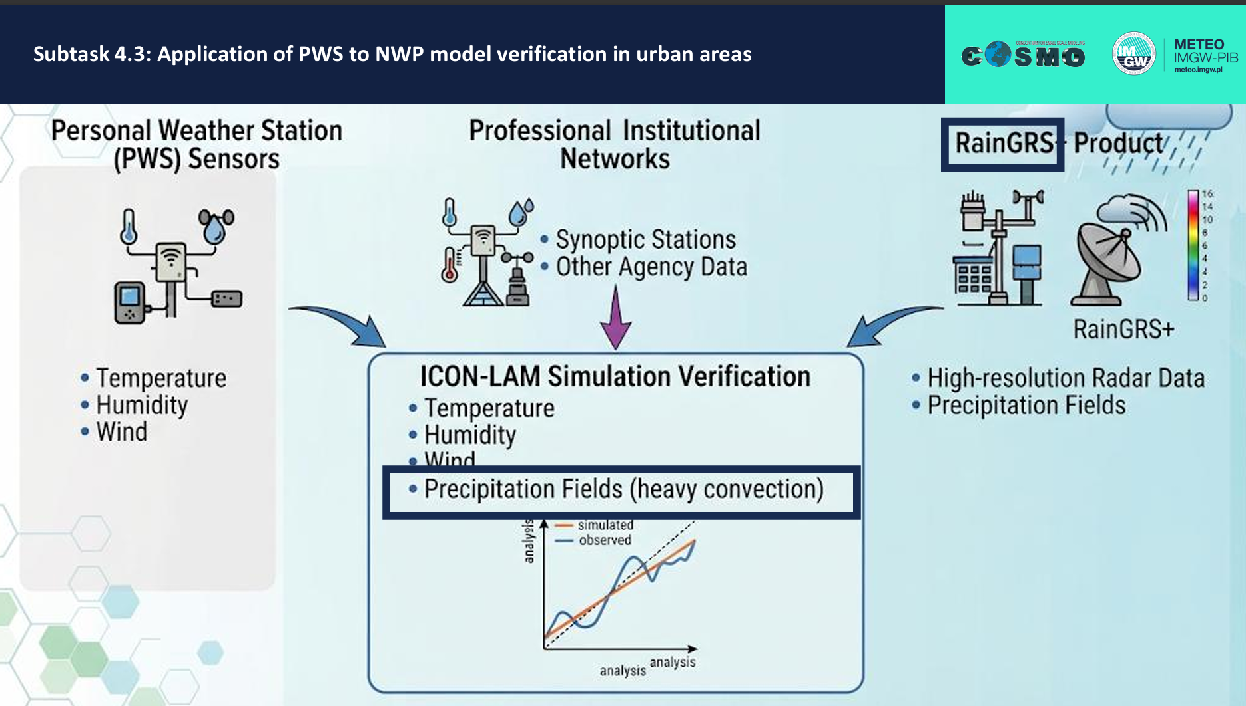
4. PP APOCS (PL. A. Surowiecki, IMGW-PIB)
Application of Personal weather station and Opportunistic sensor data CrowdSourcing

Slide 42
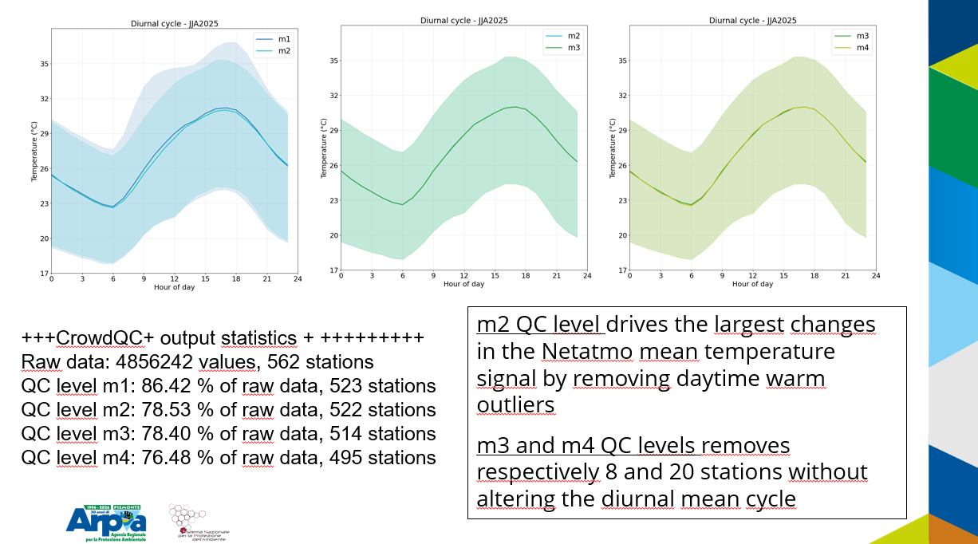
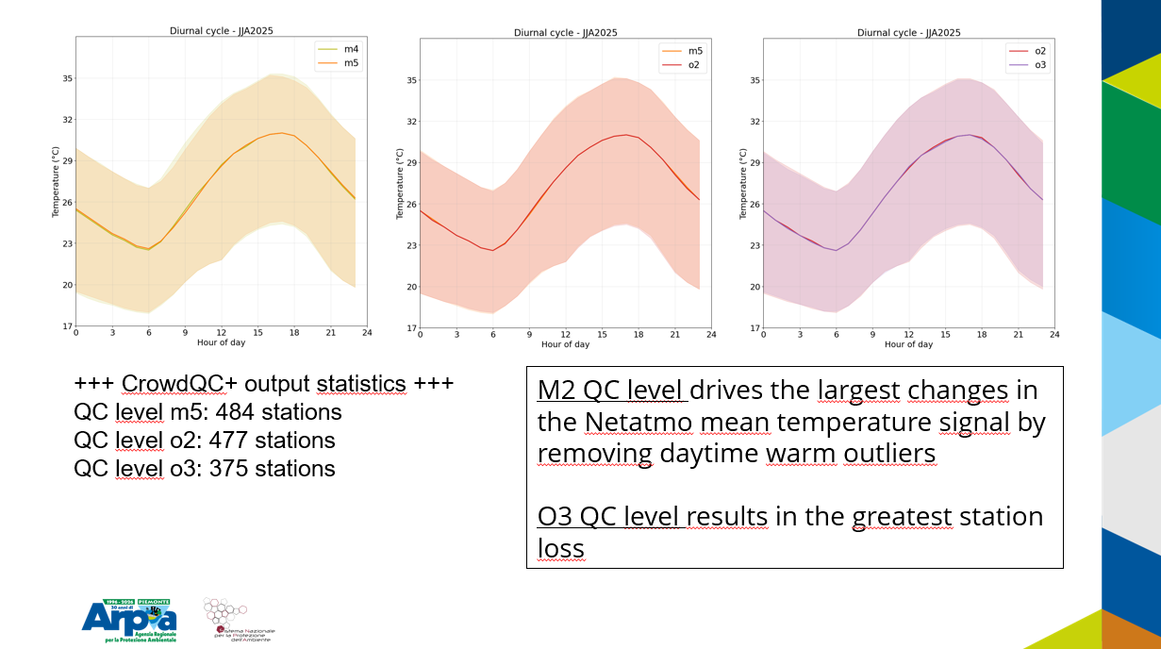
4. PP APOCS (PL. A. Surowiecki, IMGW-PIB)
Application of Personal weather station and Opportunistic sensor data CrowdSourcing
Conclusions after the dedicated session:
all data quality procedures developed and refined in the frame of the project to be documented
placed in designted place of PP APOCS website, where the PWS data collected in the database will be made available
Suggestion: prepare recommendations regarding data quality controls methods used, developed and improved as a part of the project
include all guidelines for applying specific set of QC procedures depending on the type of data

Slide 43
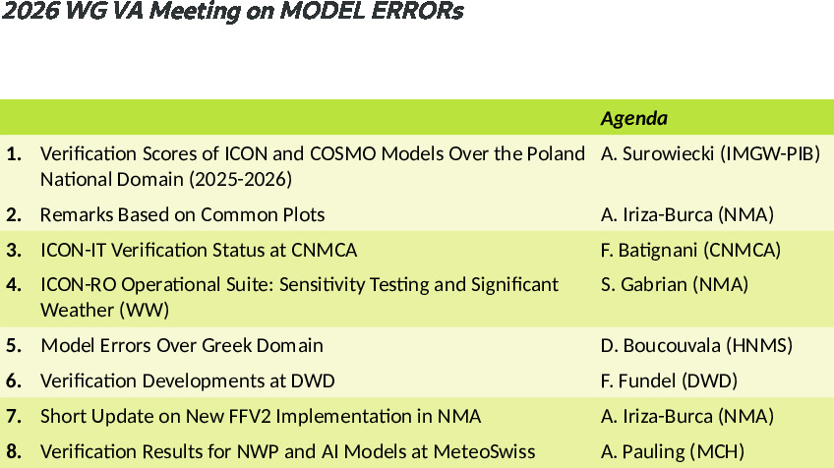
5. WG V/A Workshop on Model Errors
2026 WG VA Meeting on MODEL ERRORs: 17th June
Presentations uploaded on the COSMO repository
The event page with the available presentations will be created soon
WG V/A Report, COSMO GM, Rome, 14-18.09.2026
Notes:
45
45

Slide 44
5. WG V/A Workshop on Model Errors
Verification scores of ICONPL and COSMOCEPL Models over
Poland National Domain(2025-2026)
(A. Surowiecki, IMGW-PIB)
  Upgrade of the COSMO verification software at IMGW-PIB
  The latest version of FFV2 was succesfully implemented in the operational verification of COSMO and ICON models running at IMGW-PIB
  Launched FFV2 on new HPC system
  The verification process for output data from the national domain NWP models fully automated since autumn 2025
  Produce verification scores for COSMO 2k8 Time Lagged Ensembles
  Currently, verification covers only 00Z model runs.
WG V/A Report, COSMO GM, Rome, 14-18.09.2026
Notes:
46
46

Slide 45
5. WG V/A Workshop on Model Errors
ICON-IT verification @CNMCA (F. Batignani, CNMCA)
Confirmed overall better performance for ICON-IT compared with COSMO-IT, COSMO-ME.
Surface: WS10m negative bias for ICON, more pronounced during night hours. ICON-COSMO: very similar behavior for RMSE.
Upper: general better results for ICON (MAE, RMSE) for medium/lower troposphere; underestimation tendency for WS10m, reduced in the last two quarters.
Precipitation: overforecasting tendency, for lower thresholds.
WG V/A Report, COSMO GM, Rome, 14-18.09.2026
Notes:
47
47

Slide 46
5. WG V/A Workshop on Model Errors
ICON-RO Operational Suite: Sensitivity Testing and Significant Weather
(I. S. Gabrian, NMA)
Status: new operational configuration: Currently based on v2025.04
Watch: midday bias: Wind, low cloud and humidity remain the main sensitivity signal.
Verify: WW events (dedicated parameter from ICON) Precipitation and snow are useful; showers/thunder remain weak.
Future: Keep continuous, categorical and WW monitoring as routine control.
WG V/A Report, COSMO GM, Rome, 14-18.09.2026
Notes:
48
48

Slide 47
5. WG V/A Workshop on Model Errors
Verification Model errors over Greek Domain 2025-2026
(ICON-GR 2.6.5/ ECMWF-IFS)
(D. Boucouvala, HNMS)
  2m Temperature overestimation at night.
  2m Td different patterns for every season (-most important summertime underestimation)
  TCC is overestimated in contrast to IFS underestimation. RMSE better for IFS in JJA.
  MSLP similar patterns both models with RMSE increasing with forecast time.
  10m WS is mostly underestimated with better RMSE for ICON-GR.
  6 h precipitation patterns differ mainly for low thresholds with IFS
WG V/A Report, COSMO GM, Rome, 14-18.09.2026
Notes:
49
49

Slide 48
5. WG V/A Workshop on Model Errors
AI Model Verification at DWD (F. Fundel, DWD)
More and more AI models go into production
  At DWD AICON 2025/09, AICON-EU 2026/06, AICON-LAM 2027
Characteristics of these models need to be explored
  Standard verification
  Unphysical behaviour
    Artefacts & Inconsistencies
  Extremes
  Properties change with forecast lead time
    Loss of activity
Build trust
  Integrate users (forecasters) in development & operationalization
Forecaster evaluation (since 2025/09)
Focus on wind, precip and T_2M & single events
Comparison to ICON, IFS, AIFS, GFS AICON of equal performance
WG V/A Report, COSMO GM, Rome, 14-18.09.2026
Notes:
50
50

Slide 49
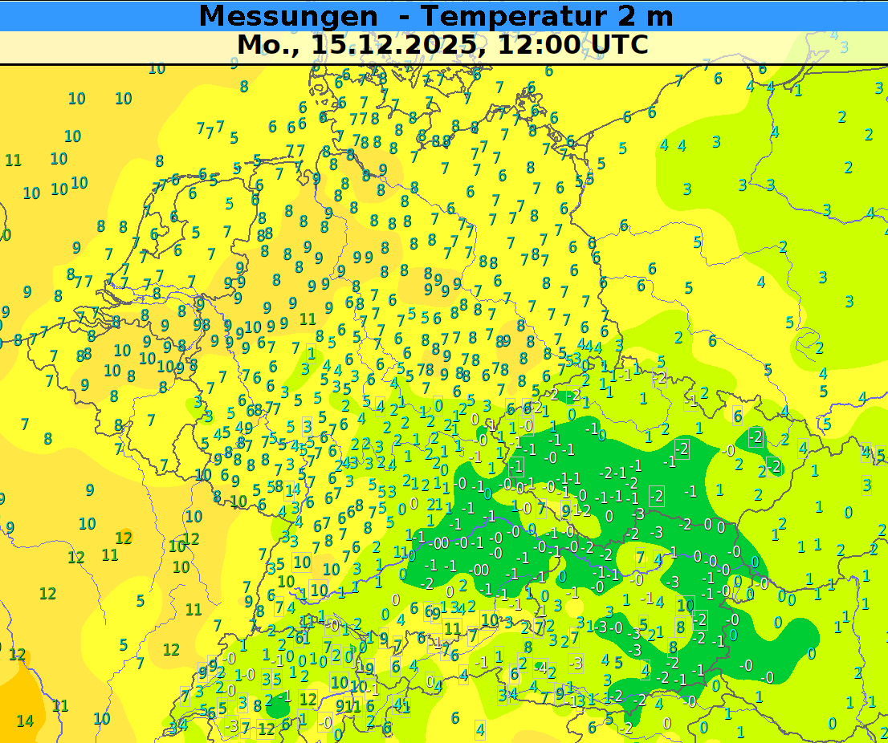
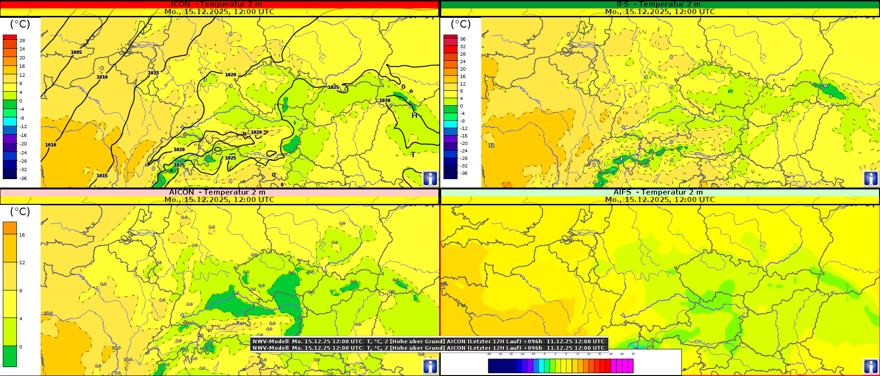
5. WG V/A Workshop on Model Errors
AI Model Verification at DWD
(F. Fundel, DWD)
51
WG V/A Report, COSMO GM, Rome, 14-18.09.2026
Notes:
51
51

Slide 50


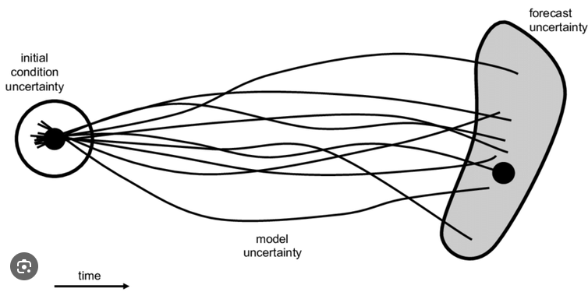
COSMO-LEPS Ensemble verification scores
6. Discussions in the Parallel Session
SON25-MAM26
Dimitra Boucouvala
SON25-MAM26
Dimitra Boucouvala

Slide 51



2m temperature
SON 25
DJF 26
MAM 26
Worse scores at night and MAM season
6. Discussions in the Parallel Session
Notes:
CRPS (Continuous ranked probability score) and spread skill ratio for the 3 seasons. The CRPS is higher at night (EPS more difficult to predict minimum values ) and the same time it becomes underdispersive

Slide 52


2m temperature (CRPS time series)
DJF 26
Night
Day
6. Discussions in the Parallel Session
Better score in the day and February
Notes:
These graphs of CRPS are for the whole season of winter 26 and February was the better score for day and night

Slide 53

CRPS spatial variability map T2m (DJF26-36h)-Geographical Plots
6. Discussions in the Parallel Session
Notes:
You can view the errors spatial variability

Slide 54
6. Discussions in the Parallel Session
Status of verifications at CNMCA.
Case studies of interest
Rome, 15th September 2026 LT. Raffaele GOLINO

Slide 55
6. Discussions in the Parallel Session
ICON-IT ITAF operational setup
Ensemble Data Assimilation:
Observations
RAOB, PILOT, SYNOP, SHIP, BUOY, Wind Profilers, Radars, AMDAR-AIREP, Mode-S, Meteosat AMV, sfc non-conventional, Metop scatt. winds, NOAA/Metop AMSUA/MHS and NPP ATMS radiances
1h cycle
2.2 km
65 v.l.
40+1 m.
1h
LETKF
Boundary Conditions
(CTRL, ENS)
Ensemble
Analysis
Deterministic
Analysis
2.2 km
65 v.l.
ICON-IT EPS
00-06-12-18 UTC runs up to 48h
MEC-RFDBK
2.2 km
65 v.l.
20 m.
00-12 UTC runs up to 48h
ICON-IT
NETTUNO-IT 1‘, 30 freq., 36 dir.
00-12 UTC up to 48h
Ensemble Prediction System
Local Area Model
COSMO GM-2026, 14-18 September 2026 Rome, Italy
Notes:
Looking directly at our operational setup, our deterministic chain is based on ICON-IT at a 2.2 km horizontal resolution with 65 vertical levels. The core of our local area system relies on a 1-hour LETKF assimilation cycle operating on an ensemble of 40 members plus 1 control. This hourly update strategy allows us to continuously integrate a massive stream of both conventional and non-conventional observations.
We regularly assimilate ground-based data from SYNOP, SHIP, and BUOY stations, radiosondes, wind profilers, radars, and aircraft sensors such as AMDAR, AIREP, and Mode-S, alongside complex satellite datasets. These include radiances from AMSU-A and MHS instruments aboard NOAA and Metop satellites, ATMS radiances from NPP, and scatterometer winds from Metop. This comprehensive assimilation effort ensures a highly coherent initial state for our hourly forecasts."
"Alongside the deterministic run, CNMCA operates the probabilistic ICON-IT EPS system, configured at the same 2.2 km resolution and 65 vertical levels across 20 ensemble members. This allows us to deliver high-precision probabilistic guidance over our national territory.
To complete our operational suite for marine applications, the chain incorporates the NETTUNO-IT wave model. Operating at a spatial resolution of 1 arc-minute, it is discretized into 30 frequencies and 36 spatial directions. Main runs are executed regularly at 00:00 and 12:00 UTC, extending forecasts up to 48 hours. The system also leverages the MEC-RFDBK feedback mechanism to continuously monitor sea-state forecast quality."

Slide 56




6. Discussions in the Parallel Session
ME, MAE, RMSE
ICON-IT verification SON 2025 – JJA 2026
SON 25
DJF 26
T, upper,+48h
MAM26
JJA26
COSMO GM-2026, 14-18 September 2026 Rome, Italy
Notes:
We have examined upper parameters, looking at scores ME, MAE, RMSE and their trends with the vertical levels; we compare icon-it /orange) and cosmo-it (green), and also the implementation of
Cosmo on mediterranean domain, 5km res (blue), using soundings on the italian area.
T, +48h.
We observe a pretty similar behavior for icon-it and cosmo-it above the medium troposphere, while below icon-it is generally better,with an underestimation tendency for lower levels, close to grounds.

Slide 57
6. Discussions in the Parallel Session
Conclusions and remarks
Confirmed overall better performances for ICON-IT compared with COSMO-IT, COSMO-ME(both decommissioned).
Surface: WS10m negative bias for ICON, more pronounced during night hours
Upper: general better results for ICON (MAE, RMSE) for medium/lower troposphere; underestimation tendency for WS10m, reduced in the last two quarters.
Precipitation: overforecasting tendency, for lower thresholds.
Operational run (lgrayzone_deepconv=T) missed or underestimated several severe convective events during summer 2026 (e.g., Emilia Romagna on 15 July, Northern Campania, Lazio, Liguria, and Tuscany)

Slide 58
ICON verification using rain gauge data corrected according to SPICE experiment recommendations
6. Discussions in the Parallel Session
COSMO GM 2026
WG VA Parallel Session
CASD, Rome, 14 September 2026

Slide 59
Conclusions
6. Discussions in the Parallel Session
Corrected measurements reduce model bias
Standard deviation and RMSE are both increased
Measurements get large corrections at wind exposed stations, thereby increasing measurement variability
Transfer functions are rough approximations with a high degree of uncertainty
The use of corrected measurements is not beneficial for the verification, the large increase of the standard deviation largely outweighs the reduction of the bias

Slide 60

WINDMIL-AI: research to pre-production, I. S. Gabrian, NMA
6. Discussions in the Parallel Session
ROMANIAN 0–6-HOUR FORECASTING
WINDMIL-AI: research to pre-production
26 August 2026 · 17–20 UTC | ★ Predeal: 36.8 mm observed in 3 h
Main product · A working ML decision-support prototype for remote-sensing data-mining an d meteorologist-readable decision support
01
WG V/A Report, COSMO GM, Rome, 14-18.09.2026
Notes:
Good morning. I am Ioan Stefan Gabrian from NMA Romania. WINDMIL-AI connects national observations, locally trained AI models, operational products and verification. Start with a real example: the 26 August 17–20 UTC rainfall. These are radar estimates, a forecast initialized at 17 UTC, and station totals for the same three-hour window. The star is Predeal. This is a representative product and intensity challenge, not a showcase claim of perfect prediction. The deck covers all documented research strands, with emphasis on what now runs in pre-production.
Evidence:
/home/stefan/WINDMIL-AI/outputs/intense_event_daily_gallery/metadata/intense_event_20260826.json

Slide 61
WINDMIL-AI: research to pre-production, I. S. Gabrian, NMA
MODEL DEVELOPMENT · TRAINED CONFIGURATIONS AND RETAINED CAPABILITIES
From image-based learning to a hybrid weather nowcaster
1 · U-Net
2 · Graph models
3 · TAU-AFNO
Image-to-image encoder–decoder
GraphCast-style · Anemoi-aligned
Temporal Attention Unit +
Adaptive Fourier Neural Operator
32 → 48 → 64 base channels
BC64 pre-production model
H256 · 8 processor layers
H384 · 12 processor layers
H1024 · 12 TAU blocks
16 AFNO blocks
Per block: 16 × 64 channels
Multiscale image patterns
History represented as channels
Graph-based spatial relationships
Neighbour-to-neighbour messages
Explicit temporal attention
Domain-wide Fourier mixing
Overfitting informed selection;
epoch 34 retained for TP.
Complementary TP / WW results
Both retained with U-Net
in a lead-dependent ensemble.
Hybrid nowcaster proposed
Epochs 4 / 9 / 16 retained
TP · WW · P10 / P50 / P90
Shared forecast design: 7 history frames · 138 × 288 grid · 13 direct leads from 0 to 6 hours
Research outcome: temporal attention + global Fourier mixing + local detail in one hybrid nowcaster.
WINDMIL-AI · NMA Romania | COSMO GM 2026
05
Notes:
Research sequence requested by Ioan-Stefan Gabrian: start with an image-based U-Net, investigate GraphCast-style regional graph architectures, then propose the TAU-AFNO hybrid after mixed, complementary results. This is an architectural development story, not a controlled model-ranking claim.
U-Net: image-to-image convolutional encoder-decoder with multiscale features and history stacked into channels. Generator-style describes field generation, not adversarial or diffusion training. The first project report records base-width exploration from 32 to 48 to 64; the inspected retained checkpoint is BC64, epoch 34. The researcher describes training into overfitting; the stored comparator reaches epoch 49 with validation loss 1.2478887, above its best 1.2273240. Project documentation states that epoch 34 had the lowest stored TP validation loss among available U-Net checkpoints, whereas epoch 30 was marginally better on the joint objective. Thus the selected intermediate checkpoint is tied to its precipitation role rather than the last epoch.
Graph experiments: H256 with 8 processor layers and message width 512; H384 with 12 processor layers and message width 768. H denotes hidden feature width, not forecast hours. The published checkpoints inspected are both epoch 11; the historical training report reaches H384 epoch 13, so trained and published checkpoint ages are explicitly distinguished. These models operate on a full 138-by-288 regional graph, token stride 1, with directed eight-neighbour connectivity. They use a local PyTorch encoder-processor-decoder following GraphCast-style design and Anemoi conventions. They are not the original global GraphCast and do not require the external Anemoi runtime. Historical event tests found complementary TP and WW behaviour, motivating the retained lead-dependent U-Net/graph ensemble; the single historical event is not reintroduced as a case slide or part of the frozen full-period verification. Graph geometry means connectivity and spatial interaction, not a claim that this implementation explicitly encodes storm-object geometry.
TAU-AFNO: Temporal Attention Unit plus Adaptive Fourier Neural Operator. H1024 means 1,024 latent features. There are 12 sequential TAU blocks and 16 sequential AFNO blocks. Inside each AFNO block, the 1,024 channels are divided into 16 groups of 64 for block-diagonal spectral transformations; 16-by-64 is channel grouping, not 64 AFNO layers or 16 independently trained models. Attention is applied across seven historical times at each latent location; Fourier mixing acts across the full latent spatial domain. Local convolutional detail, a sparse-observation residual and bounded advection complete the hybrid. The report records 204,387,466 parameters. The direct outputs include TP, rain/exceedance probabilities, P10/P50/P90 and WW. The pre-production archive retains epoch 4 and observation-priority-v2 epochs 9 and 16 as separate products. Calibrated epoch-16 output is an additional postprocessing product, not another trained neural architecture. Training runs used seven half-hour histories and 13 direct leads to six hours.
The former slide-5 baseline remains relevant to why station-priority supervision was adopted. Its full text and evidence are preserved in model_evolution_replaced_slide5.json, and its notes follow here without repeating its statistical graphic in the main narrative:
The corrected baseline contains every hour of 2023. It is corrected downscaled ERA5/ICON-derived reanalysis, not an AI prediction. On the strict regional SYNOP sample, the hourly mean is 0.075 mm against 0.197 mm observed. At 10 mm in one hour it produces 371 events versus 3,051 observed: frequency bias 0.122. The seven-group weather accuracy of 0.812 conceals a macro-F1 of 0.316. This motivated observation-priority TP and WW losses and a station residual path. Do not compare these baseline scores directly with 2026 AI scores: years and samples differ. The baseline includes neighbouring stations inside the regional domain; it is not a Romanian-only statistic.
Evidence:
/home/stefan/WINDMIL-AI/reports/REANALYSIS_VS_SYNOP_2023_CORRECTED_RESULTS/REANALYSIS_VS_SYNOP_2023_REPORT.md
Evidence:
/home/stefan/WINDMIL-AI/presentations/windmil_ai_cosmo_2026_selected_insights/evidence/model_evolution_project_documentation.md
/home/stefan/WINDMIL-AI/presentations/windmil_ai_cosmo_2026_selected_insights/evidence/model_evolution_training_comparator.csv
/home/stefan/WINDMIL-AI/presentations/windmil_ai_cosmo_2026_selected_insights/evidence/model_evolution_tau_h1024.yaml
/home/stefan/WINDMIL-AI/presentations/windmil_ai_cosmo_2026_selected_insights/evidence/model_evolution_graph_h256.yaml
/home/stefan/WINDMIL-AI/presentations/windmil_ai_cosmo_2026_selected_insights/evidence/model_evolution_tau_architecture.py
/home/stefan/WINDMIL-AI/presentations/windmil_ai_cosmo_2026_selected_insights/evidence/model_evolution_evidence.json
/home/stefan/WINDMIL-AI/presentations/windmil_ai_cosmo_2026_selected_insights/evidence/model_evolution_replaced_slide5.json
/home/stefan/WINDMIL-AI/presentations/windmil_ai_cosmo_2026_selected_insights/evidence/021_windmil_ai_first_project_report.md
/home/stefan/WINDMIL-AI/presentations/windmil_ai_cosmo_2026_selected_insights/evidence/016_TAU_AFNO_MODEL_SKILL_INTERPRETATION.md

Slide 62
WINDMIL-AI: research to pre-production, I. S. Gabrian, NMA
OBSERVATION RESEARCH → RETAINED IMPLEMENTATION
Time-correct observations are part of the model
BUFR / SYNOP
Radar + FCI
Retained result
All station subsets
Field-wise corrections
Exact accumulation windows
Seven aligned history times
Radar geometry diagnostics
Explicit missing-data masks
156 stations in all 7 frames
30 July structural audit
Radar QC kept in shadow
A forecast history must represent what was available at its own initialization time.
WINDMIL-AI · NMA Romania | COSMO GM 2026
06
Notes:
The initial decoder could lose stations by handling only one BUFR subset. The corrected implementation decodes all subsets, respects period units and merges original reports, corrections and retransmissions field by field. At half-hours, rolling hourly precipitation requires all six ten-minute contributions. In the 30 July audit, 156 stations appeared in every one of the seven frames, with 157–163 reports per frame. All rainfall was zero in that structural audit: this demonstrates coverage, not wet-event skill. Radar work separately diagnosed range geometry and point spikes; additional radar masks remain shadow diagnostics. Radar volumes provide DBZH only in the supplied files, so no dual-polarization classification is claimed.
Evidence:
/home/stefan/WINDMIL-AI/reports/bufr_implementation_report_20260730/REPORT.md
/home/stefan/WINDMIL-AI/RADAR_QC_SHADOW.md
/home/stefan/WINDMIL-AI/PROJECT_DOCUMENTATION.md

Slide 63
6. Discussions in the Parallel Session
TAU-AFNO learns temporal and domain-wide structure
Six neural members run in one pre-production chain
Observations
Graph + U-Net
Published guidance
BUFR / SYNOP
3-D radar
FCI + static fields
3 members → lead-weighted ensemble
Raw + calibrated products
1 h / 3 h TP and WW
TP P10 / P50 / P90
TAU-AFNO
Epochs 4 / 9 / 16 kept separately
Raw forecasts, calibrated candidates and verification records retain separate identities.
WINDMIL-AI · NMA Romania | COSMO GM 2026
11
Notes:
The frozen 9 September 09 UTC run is complete. It contains two graph members, U-Net epoch 34 and TAU epochs 4, 9 and 16. The main ensemble remains the lead-weighted graph/U-Net blend. It publishes both raw and calibrated outputs. TAU remains a separate product family; epoch-16 event calibration is also applied under its own candidate identity. This updates the July documentation, which still described calibration as shadow-only. Future observations are collected for verification and postprocessing after issue time; this is not hourly retraining of neural weights. The live TAU summary explicitly reports missing TP/WW and WKL context channels as zero-filled. That training-to-serving difference is a concrete development target.
Evidence:
/home/stefan/WINDMIL-AI/outputs/run_20260909_0900/run_state.json
/home/stefan/WINDMIL-AI/outputs/latest_forecast.json
/home/stefan/WINDMIL-AI/outputs/run_20260909_0900/forecast/tau_afno_h1024_synop_obs_priority_v2_epoch16/tau_afno_h1024_synop_obs_priority_v2_epoch16_run_summary.json
Native TP P10/P50/P90 are direct quantile heads (10th/50th/90th percentile), separate from the primary TP forecast and calibrated weather-type layer. The Predeal illustration on slide 12 explains their use. The hourly uncertainty dashboard also plots P90−P10 spread. Quantile reliability remains to be verified; 3h totals do not imply available 3h quantiles.

Slide 64

WINDMIL-AI: research to pre-production, I. S. Gabrian, NMA
FULL ARCHIVE · NEAREST NEIGHBOUR (NN) · RETROSPECTIVE
Three-hour WW verification at the nearest grid cell
WINDMIL-AI · NMA Romania | COSMO GM 2026
22
WG V/A Report, COSMO GM, Rome, 14-18.09.2026
Notes:
Most significant actual WW code across exact +1,+2,+3h, separately for observations, raw e16, calibrated e16 and U-Net/GraphCast H384/H256 ensemble. 800 initializations and 124,127 complete station windows are common to all three forecasts. Observed n, hits, misses and forecast counts are shown. Forecasts=hits+false alarms; undefined rates are N/A. No spatial neighbourhood relaxation is applied; nearest-grid distance is limited to 20km. Four categories are hidden by request but retained in the score table.
Full frozen epoch-16 archive: 806 initializations from 3 August 2026 09 UTC to 9 September 2026 10 UTC. Nine June 30 runs remain excluded by request. Not an assertion that every hour has a forecast or that new September 10 outputs were included. All-period calibration scores are retrospective because development dates overlap. Separate post-fit results are preserved. Missing observations are never replaced with zero; per-lead and threshold samples vary with availability. Repeated station/window pairs are not independent storms.
Evidence:
/home/stefan/WINDMIL-AI/presentations/windmil_ai_cosmo_2026_selected_insights/evidence/first3h_max_ww_scores.csv
/home/stefan/WINDMIL-AI/presentations/windmil_ai_cosmo_2026_selected_insights/evidence/first3h_max_ww_pairs.parquet
/home/stefan/WINDMIL-AI/presentations/windmil_ai_cosmo_2026_selected_insights/evidence/first3h_max_ww_method.json
Readability revision: aligned model rows with equal 0–100% bar tracks; POD and FAR values, hits, misses and forecast counts are retained for all six previously displayed categories. Metrics are unchanged. POD = hits / observed events; FAR = false alarms / forecast events; forecasts = hits + false alarms. N/A in the displayed FAR column means no forecast events. The counts refer to matched station–initialization windows, not independent storms. The separate colour/style treatment does not change the underlying verification.

Slide 65

WINDMIL-AI: research to pre-production, I. S. Gabrian, NMA
FULL ARCHIVE · 3 AUG–9 SEP 2026 · RETROSPECTIVE
Heavy-rain calibration gains remain limited
Calibrated ≥5 mm / 1 h: 12.8% detected · 77.2% false-alarm ratio · CSI 0.089.
WINDMIL-AI · NMA Romania | COSMO GM 2026
23
WG V/A Report, COSMO GM, Rome, 14-18.09.2026
Notes:
Full-period threshold scores pool integer +1–6h for 1h TP and +3–6h for 3h TP. n below thresholds is observed-event station/forecast pairs, not independent storms. Strong-threshold CSI improves modestly for some thresholds, but the high-tail-preserving layer does not provide a general amount-error improvement. Inspect matched RMSE alongside these categorical scores.
Full frozen epoch-16 archive: 806 initializations from 3 August 2026 09 UTC to 9 September 2026 10 UTC. Nine June 30 runs remain excluded by request. Not an assertion that every hour has a forecast or that new September 10 outputs were included. All-period calibration scores are retrospective because development dates overlap. Separate post-fit results are preserved. Missing observations are never replaced with zero; per-lead and threshold samples vary with availability. Repeated station/window pairs are not independent storms.
Evidence:
/home/stefan/WINDMIL-AI/reports/tau_epoch16_calibrated_replay_20260909/tables/retrospective_all/station_threshold_overall.csv
/home/stefan/WINDMIL-AI/reports/tau_epoch16_calibrated_replay_20260909/tables/retrospective_all/matched_rmse_by_lead.csv

Slide 66


6. Discussions in the Parallel Session
Model Verification at ARPAE
01
Status of FFV2-based verification at ARPAE
Deterministic and ensemble systems
Authors
Thomas Gastaldo, Davide Cesari, Alessandro Frigato, Maria Stefania Tesini
02
Spatial verification of precipitation
Methods and applications using FSS and User-Oriented Approaches
Authors
Leonardo Beltrami, Maria Stefania Tesini
COSMO General Meeting, September 14th-18th 2026, Rome

Slide 67

6. Discussions in the Parallel Session
Impact of T2m Overestimation on Heat Warnings
During last summer’s extreme heat events, Tmax overestimation appeared to increase at the highest temperatures. This is one of the aspects we plan to investigate further in the coming months using conditional verification
OBS
IFS
Valid for 27 June 2026
Forecast issued on
27 June — Day 1
ICON-2I
ICON-2I_BK

Slide 68
6. Discussions in the Parallel Session
ICON-2I EPS - Verification next steps:
Operational:
  Verification and spatial verification to better represent model uncertainty in extreme weather, convection
  Implement a verification setup with same lead Times to compare ICON-2I to IFS
Research [PP KAOS]
  Task 3.1 : Cosmo software to verify ICON-LEPS, to be implemented
  Task 3.2 : Spatial verification and diagnostics for EPSs, specific focus on precipitation
Both points overlap with WGs VA, EPS, PHY

Slide 69




6. Discussions in the Parallel Session
Precipitation - User oriented verification
The verification is performed at the scale of Civil Protection warning areas, using representative values derived from observations and model grid points.
Dataset
Regional & National Networks from DPCN: High-resolution rain-gauge networks
Radar Composite: Gauge-adjusted national radar composite for 3-h precipitation.
Scores are computed for Italy as a whole and separately for Northern and Southern Italy, based on Civil Protection warning areas.
This allows model performance to be assessed under different geographical and meteorological regimes.

Slide 70

Takeaways from Parallel Session
Plan for more time for the parallel session
Continue discussions regarding ICON-LEPS
(great collaboration with WG ENS )
Discussions regarding the IFS inclusion in the CP activities
People are already performing many tasks/studies with regards to verification of AI models
Perhaps a follow-up meeting to discuss related AI activities might be fruitful, complementary to the Workshop on Model Errors
WG V/A Report, COSMO GM, Rome, 14-18.09.2026
Notes:
56
56

Slide 71
6. Discussions in the Parallel Session
Meteorological support for non-engine aircraft users
based on numerical forecasts, with particular emphasis
on the description of convection on a local and regional scale
Andrzej Mazur
LMM ZPN-COSMO IMGW-PIB

Slide 72
6. Discussions in the Parallel Session
Basics
The theoretical foundations were developed, applied, and verified in work conducted using COSMO mesoscale models with resolutions of 14 and 7 km.
The work is being conducted in three directions:
description of air movement on a regional (national) scale (e.g. for aerostats),
depiction of convection and the resulting information (favorable/unfavorable conditions for general aviation’ participants), and
reporting of local meteorological conditions relevant to gliders’ users.

Slide 73
6. Discussions in the Parallel Session
Summary
Support for unpowered aircraft users should operate from a regional scale (national, at low spatial resolutions) to a local scale (at resolutions of the order of a kilometer). Therefore, work is underway to transfer the schemas to the ICON domain at a resolution of 1 km.
The vertical scale of the aforementioned issues reaches several kilometers above sea level. High accuracy (horizontal resolution) is more important than extension above the lower troposphere.
Forecasts of air movement, the occurrence of convective phenomena, as well as favorable and unfavorable conditions for "general" aviation are crucial.
We can obtain all of this from our numerical models – indirectly (through post-processing) or directly from the model results.

Slide 74

7. Next Steps
Applications
Article from PP EGALITE published
New potential area of research - Work on general aviation
Possible formulation of a new PP/PT on this subject.
Verification
Verification Report (2025/2026)
Guidelines (2026/2027)
Test New features of MEC/FFV2
Follow-up on container implementation
Workshop on Model Errors 2027
Further discussion on AI-related tasks for Verification and Applications
Follow Verification Activities Opportunities
WG V/A Report, COSMO GM, Rome, 14-18.09.2026
Notes:
56
56

Slide 75
Thank you for your attention!
WG V/A Report, COSMO GM, Rome, 14-18.09.2026

