Slide 1




National Report - ITALY
Rome, 16th September 2026
Lt.Col. Antonio VOCINO
Maj. Francesco BATIGNANI

Slide 2


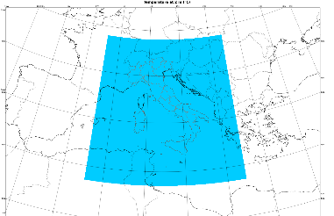



ICON-IT ITAF operational setup
Ensemble Data Assimilation:
Observations
RAOB, PILOT, SYNOP, SHIP, BUOY, Wind Profilers, Radars, AMDAR-AIREP, Mode-S, Meteosat AMV, non-conventional sfc obs, Metop scatt. winds, NOAA/Metop AMSUA/MHS and NPP ATMS radiances
1h cycle
2.2 km
65 v.l.
40+1 m.
1h
LETKF
LHN algorithm
Boundary Conditions
(CTRL, ENS)
Ensemble
Analysis
Deterministic
Analysis
COSMO GM-2026, 14-18 September 2026 Rome, Italy

Slide 3
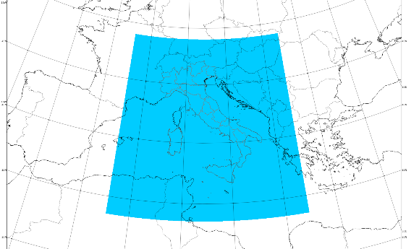
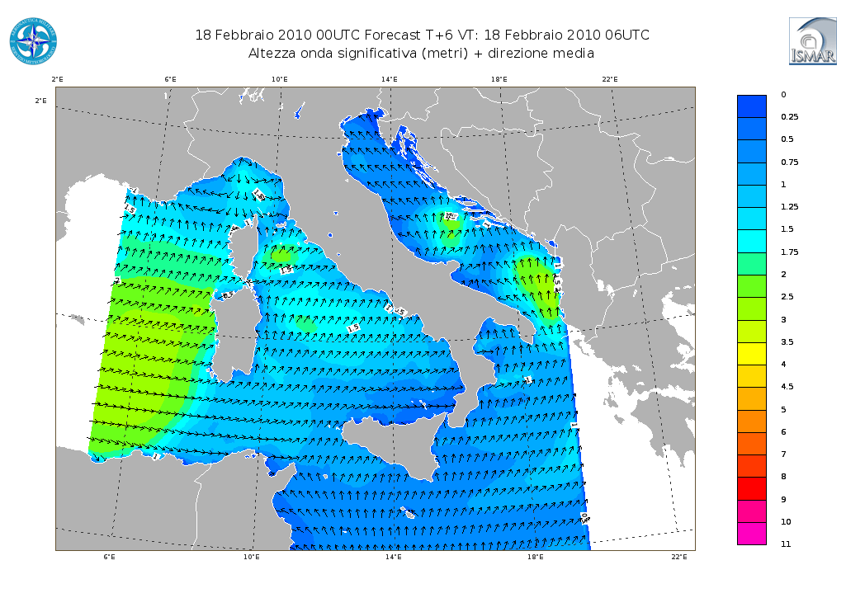
ICON-IT ITAF operational setup
Ensemble Data Assimilation:
Observations
RAOB, PILOT, SYNOP, SHIP, BUOY, Wind Profilers, Radars, AMDAR-AIREP, Mode-S, Meteosat AMV, non-conventional sfc obs, Metop scatt. winds, NOAA/Metop AMSUA/MHS and NPP ATMS radiances
1h cycle
2.2 km
65 v.l.
40+1 m.
1h
LETKF
LHN algorithm
Boundary Conditions
(CTRL, ENS)
Ensemble
Analysis
Deterministic
Analysis
2.2 km
65 v.l.
00-06-12-18 UTC runs up to 48h
explicit convection
ICON-IT
NETTUNO-IT 1‘, 30 freq., 36 dir.
00-12 UTC up to 48h
Local Area Model
COSMO GM-2026, 14-18 September 2026 Rome, Italy

Slide 4
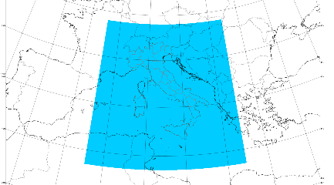
ICON-IT ITAF operational setup
Ensemble Data Assimilation:
Observations
RAOB, PILOT, SYNOP, SHIP, BUOY, Wind Profilers, Radars, AMDAR-AIREP, Mode-S, Meteosat AMV, non-conventional sfc obs, Metop scatt. winds, NOAA/Metop AMSUA/MHS and NPP ATMS radiances
1h cycle
2.2 km
65 v.l.
40+1 m.
1h
LETKF
LHN algorithm
Boundary Conditions
(CTRL, ENS)
Ensemble
Analysis
Deterministic
Analysis
ECMWF
ATOS platform
(ICON-IT DET/EPS also on local HPC)
2.2 km
65 v.l.
ICON-IT EPS
00-06-12-18 UTC runs up to 48h
2.2 km
65 v.l.
20 m.
00-12 UTC runs up to 48h
explicit convection
ICON-IT
NETTUNO-IT 1‘, 30 freq., 36 dir.
00-12 UTC up to 48h
Ensemble Prediction System
Local Area Model
COSMO GM-2026, 14-18 September 2026 Rome, Italy

Slide 5
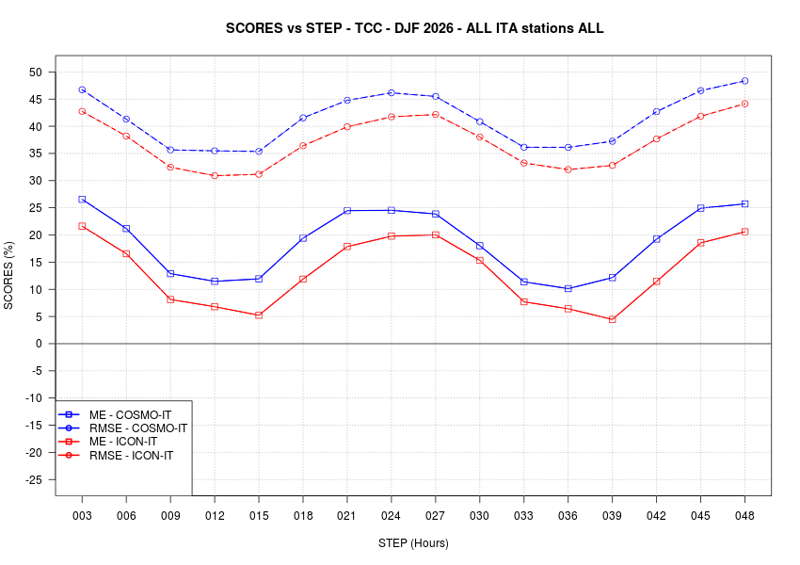
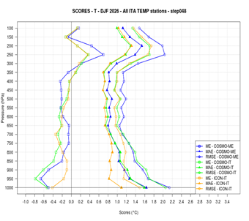
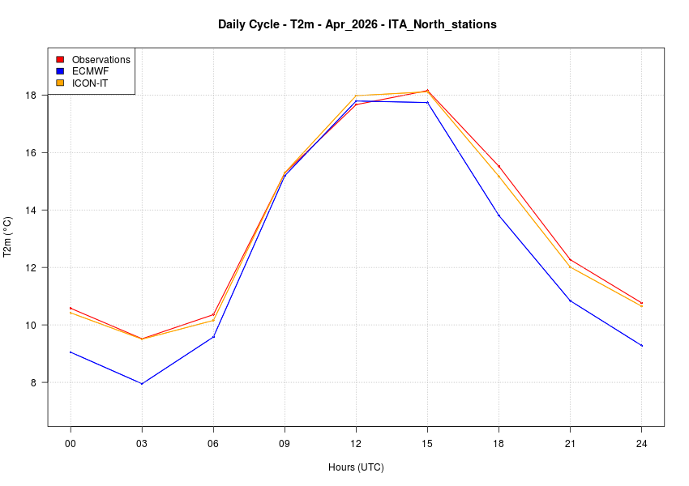
ICON verification and open issues
Feedback from CNMCA operational forecasters /
periodic objective verifications:
In general well satisfied from ICON-IT performances during the year (Clouds, Precipitations, Temperature, etc.)
COSMO GM-2026, 14-18 September 2026 Rome, Italy

Slide 6
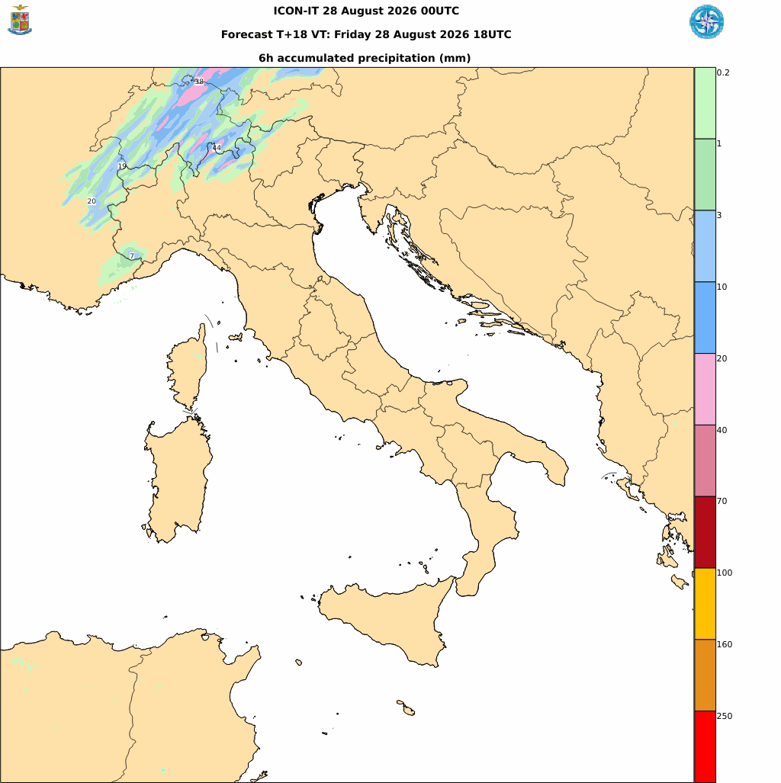
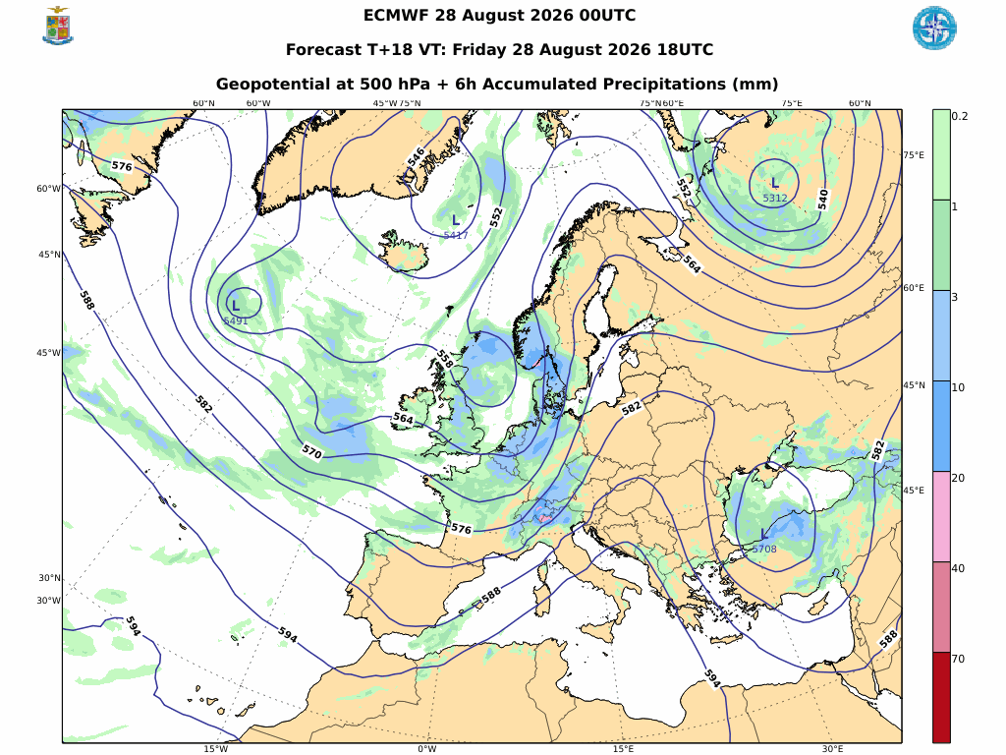
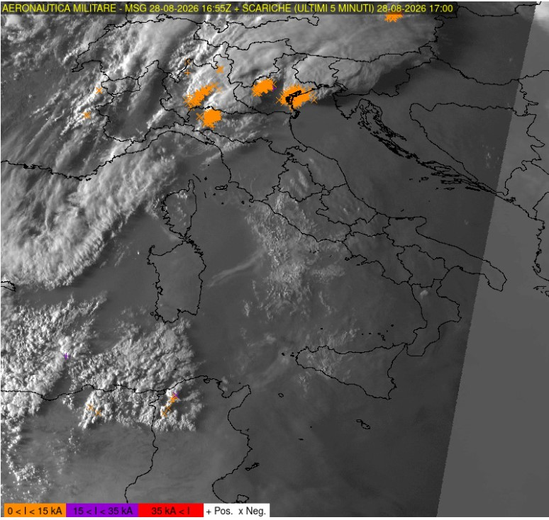
ICON verification and open issues
ICON-IT showed some missing cases of convective
systems, with intense precipitation observed (Summer 26)
28/08/2026 – North Italy (Cremona)
Gray zone active
COSMO GM-2026, 14-18 September 2026 Rome, Italy

Slide 7
ICON verification and open issues
ICON-IT showed some missing cases of convective
systems, with intense precipitation observed (Summer 26)
It seems to be not related with BC data, using only the shallow convection scheme brings sometimes improvements, but in a very limited range of cases -> need further investigation
28/08/2026 – North Italy (Cremona)
Gray zone active
COSMO GM-2026, 14-18 September 2026 Rome, Italy

Slide 8
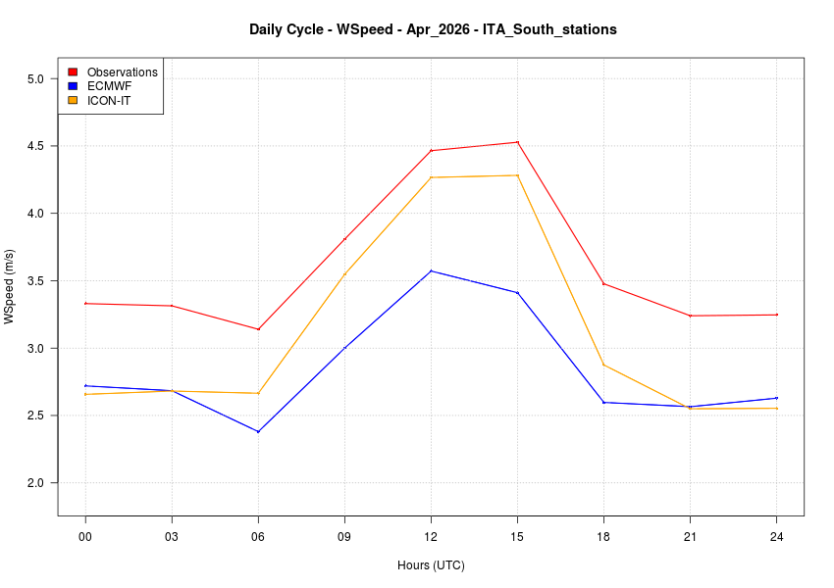
ICON verification and open issues
Good overall performances for ICON model
ICON-IT seems to underestimate WS10m, especially during night hours
Daily cycle WS 10m
OBS (red)
ICON (orange) vs IFS model (blue)
APRIL 2026 (but it appears to be systematic over different seasons)
COSMO GM-2026, 14-18 September 2026 Rome, Italy

Slide 9
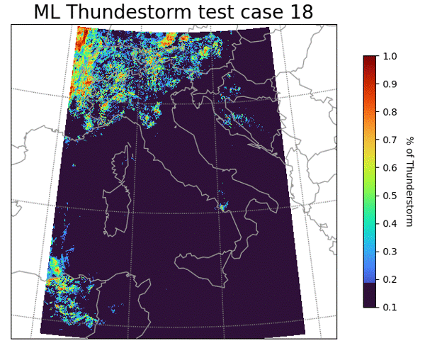


AI/ML applications
EUMETNET - SRNWP-EPS project
Adverse weather conditions forecasting
TS, FOG
Objective: use AI and ML techniques, (with incremental training) to enhance early detection of significant/extreme weather events, like TS and FOG.
First approach: a decision tree and XGBoost model with Numerical Weather Prediction data
Future approach: Graph Neural Networks use
ITAF EUMETNET coordinator:
LT. Col. Francesca MARCUCCI
CNMCA coordinator:
LT Raffaele GOLINO
COSMO GM-2026, 14-18 September 2026 Rome, Italy

Slide 10
Future plans
- Data Assimilation system improvements ( further use of non conventional obs, GPS obs, strong interest in testing DA including geostationary sat data …)
- AI/ML for post processing purposes
- Tests for ICON @ 1km/500m (Italian area)
- ITAF computational capabilities slight increment
COSMO GM-2026, 14-18 September 2026 Rome, Italy

Slide 11
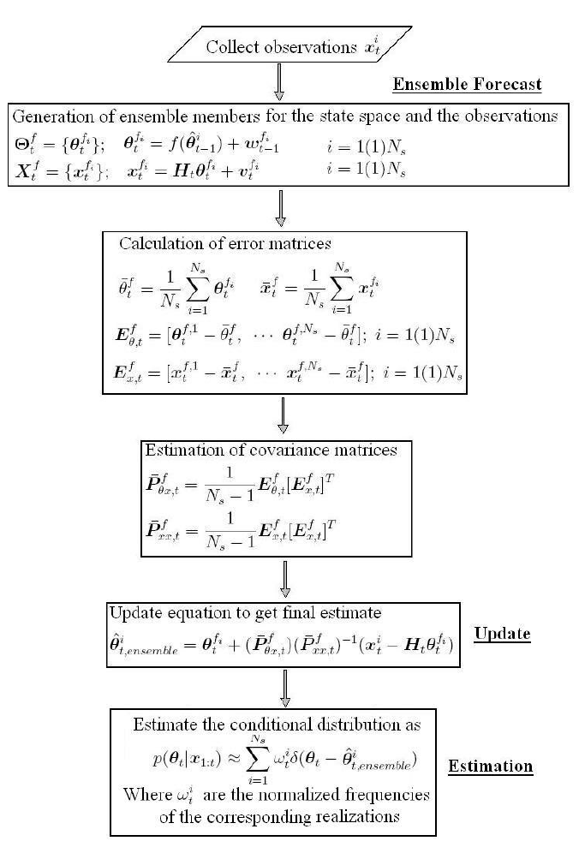
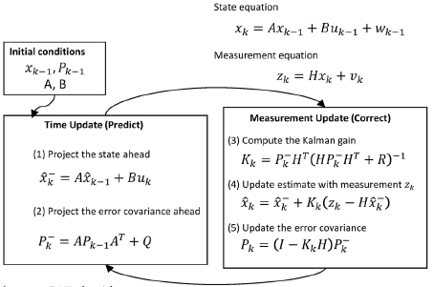
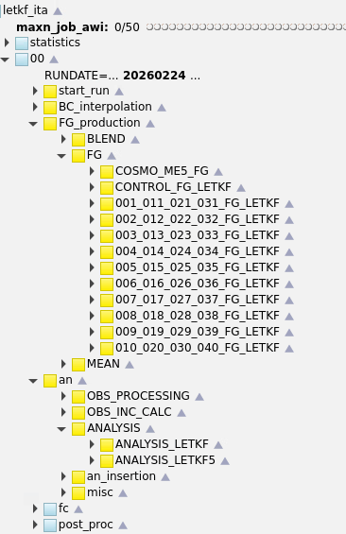
LETKF @ ITAF Met Service
SPECIAL SLIDE
15 YEARS from the first LETKF DA operational chain @ Italian Air Force Met Service
COSMO GM-2026, 14-18 September 2026 Rome, Italy

Slide 12

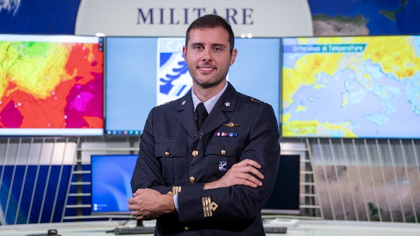
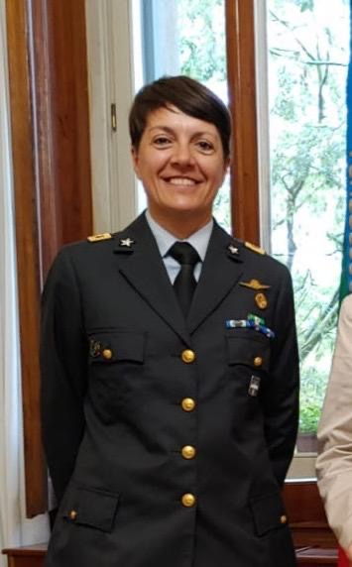
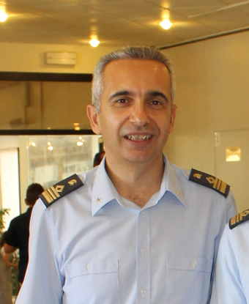
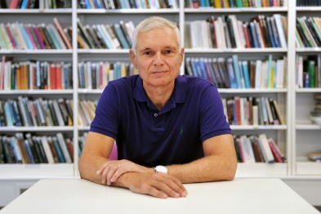
LETKF @ ITAF Met Service
SPECIAL SLIDE
15 YEARS from the first LETKF DA operational chain @ Italian Air Force Met Service
MANY THANKS TO:
COSMO GM-2026, 14-18 September 2026 Rome, Italy

Slide 13
National Report - ITALY
News about
  Operations
  Research and development
  Scientific collaborations
Insight into
  Way ahead of the national partnership
  Commitment in COSMO activities
the “Italian COSMO family”
COSMO 28th General Meeting – Rome, 14-18 September 2026

Slide 14
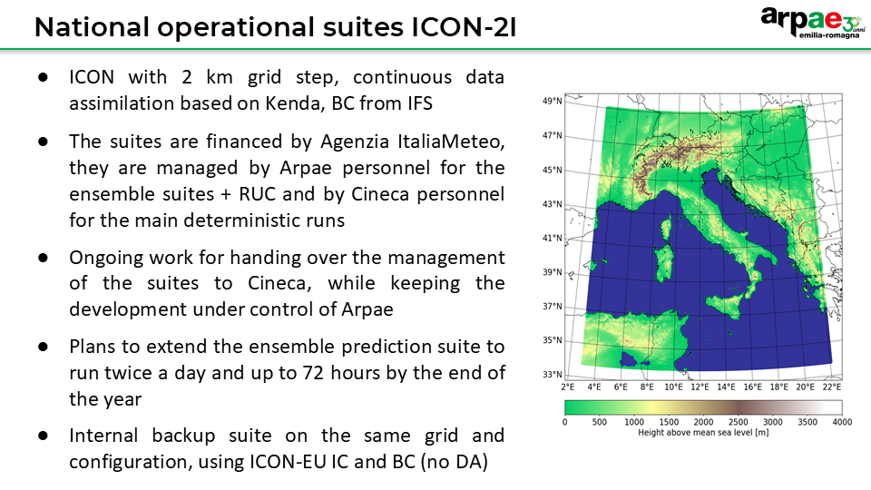
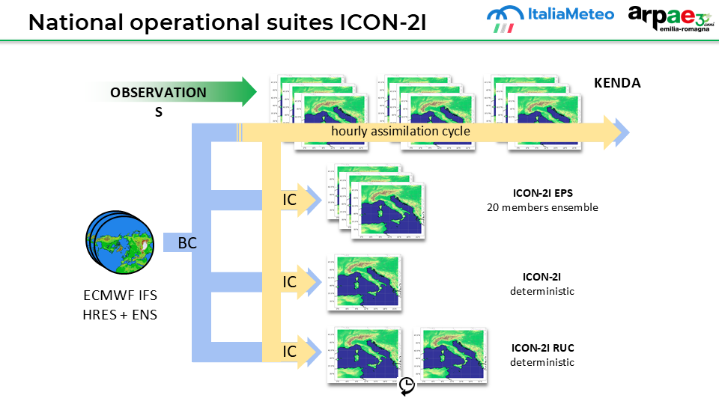
COSMO 28th General Meeting – Rome, 14-18 September 2026

Slide 15
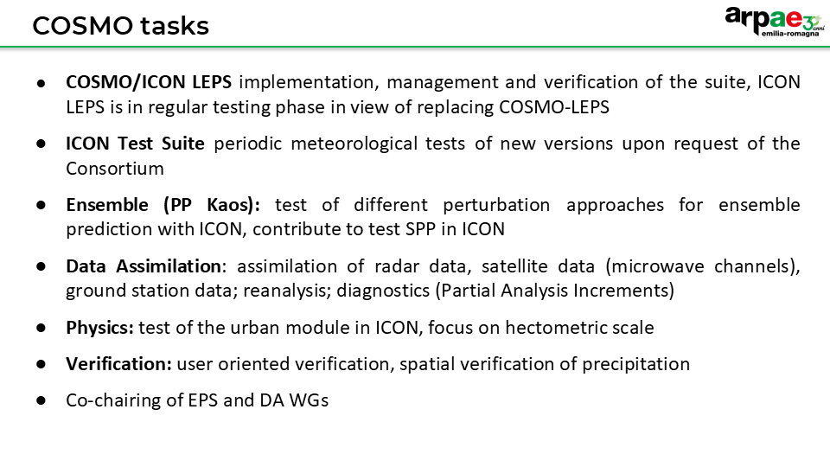
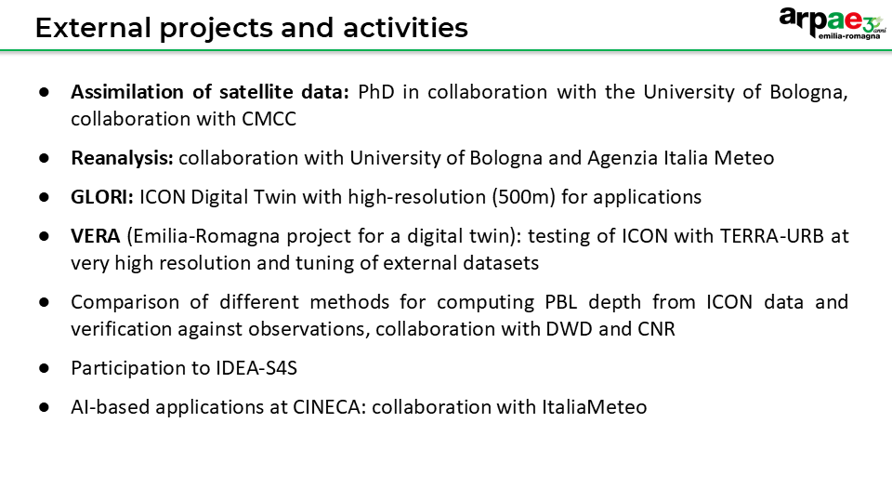
COSMO 28th General Meeting – Rome, 14-18 September 2026

Slide 16
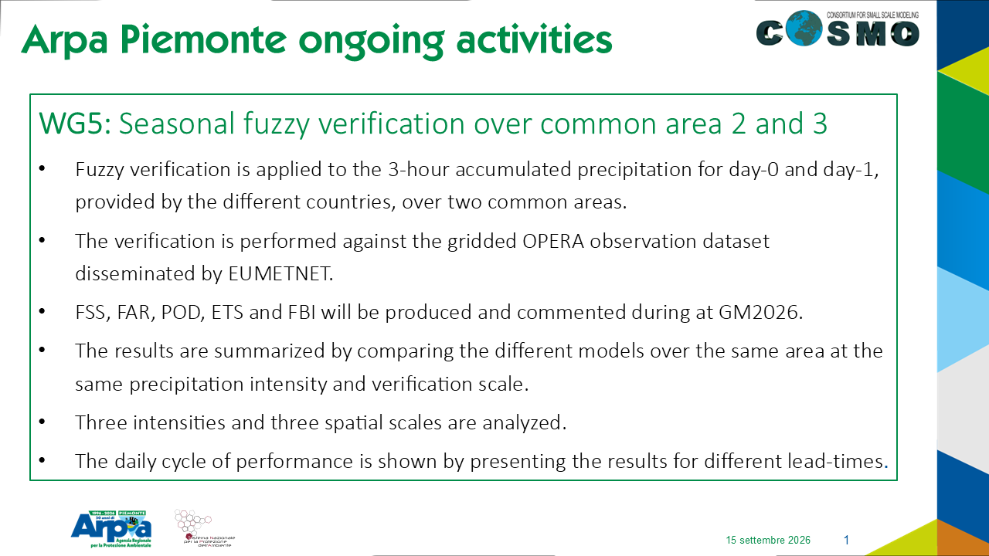
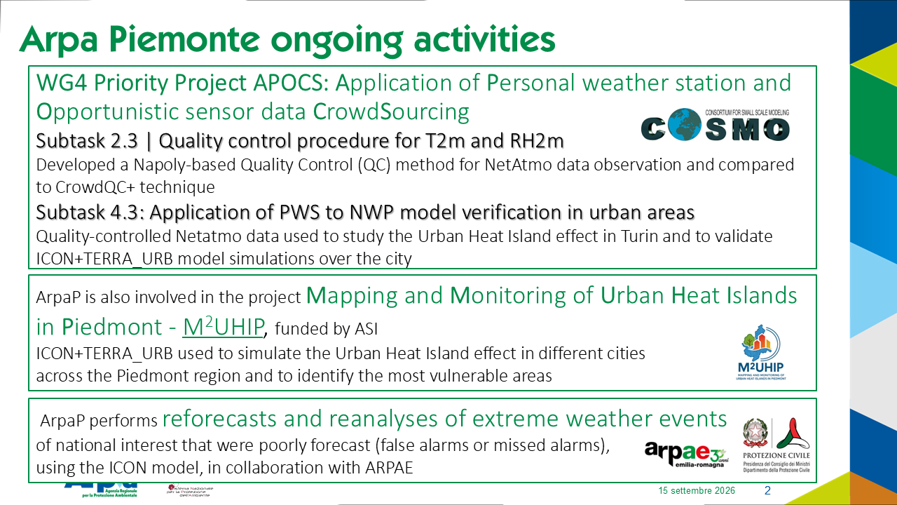
COSMO 28th General Meeting – Rome, 14-18 September 2026

Slide 17
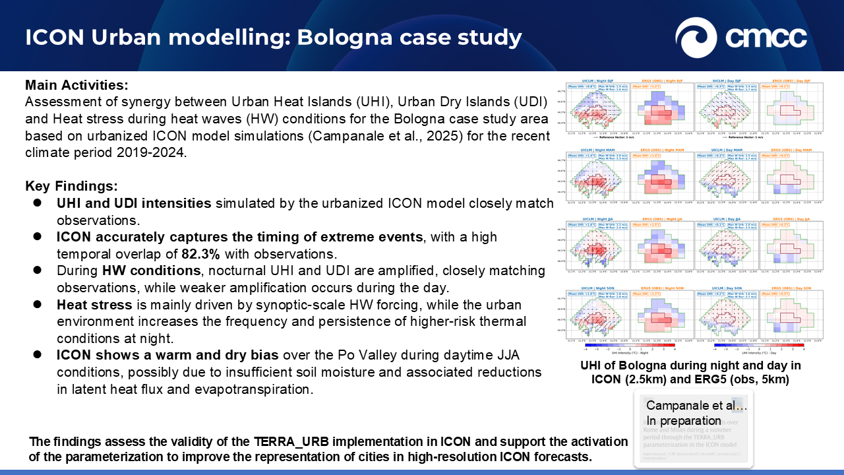
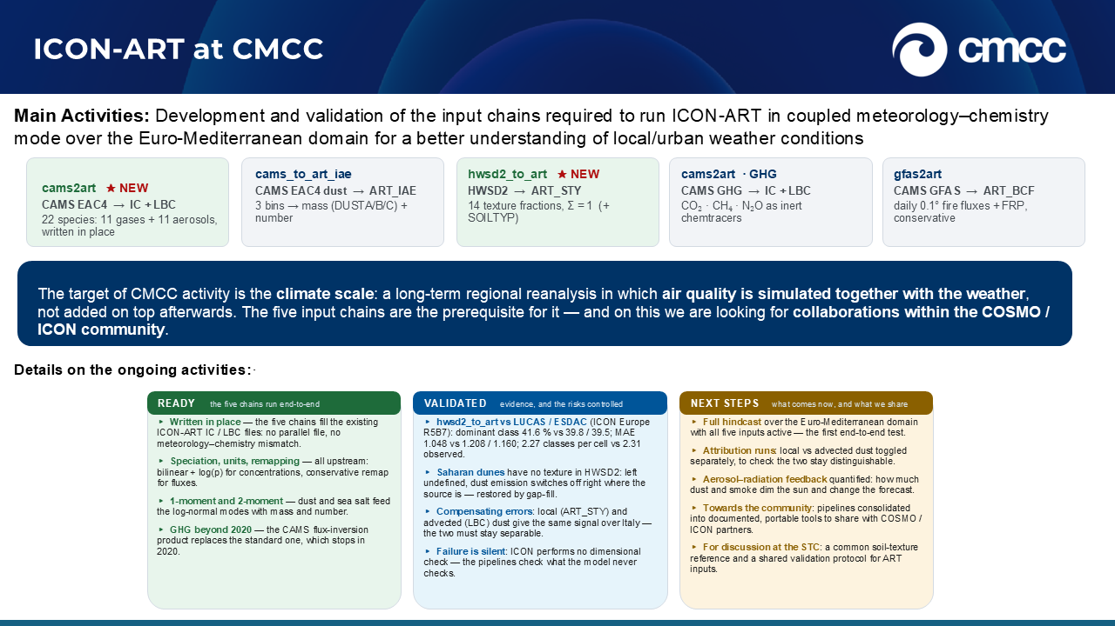
COSMO 28th General Meeting – Rome, 14-18 September 2026

Slide 18
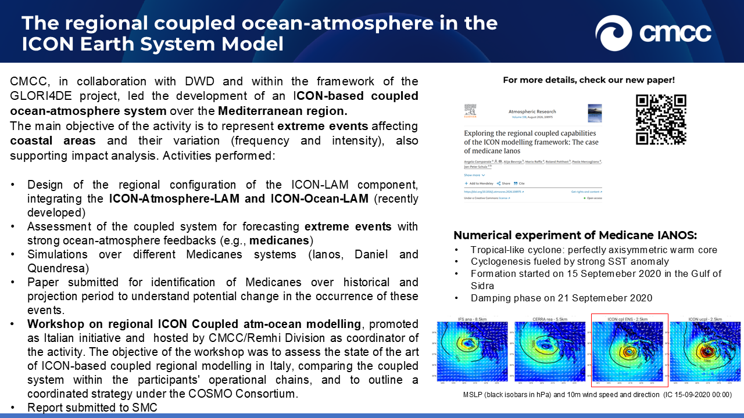
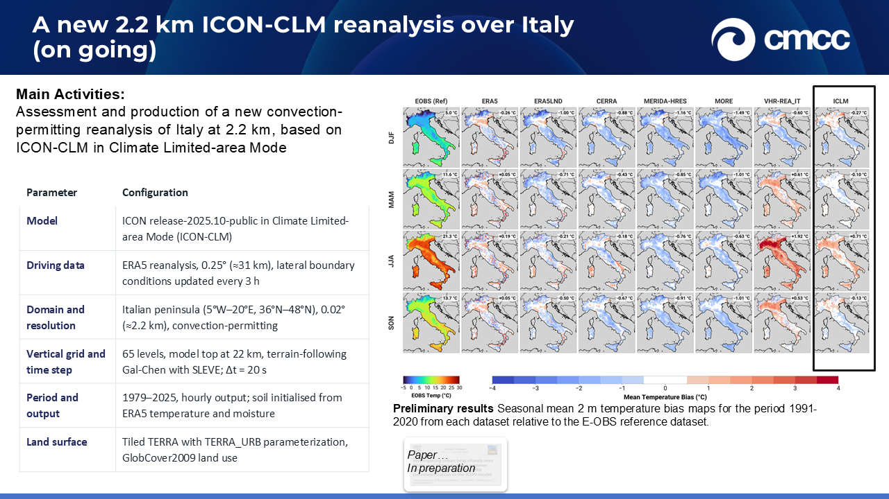
COSMO 28th General Meeting – Rome, 14-18 September 2026

Slide 19
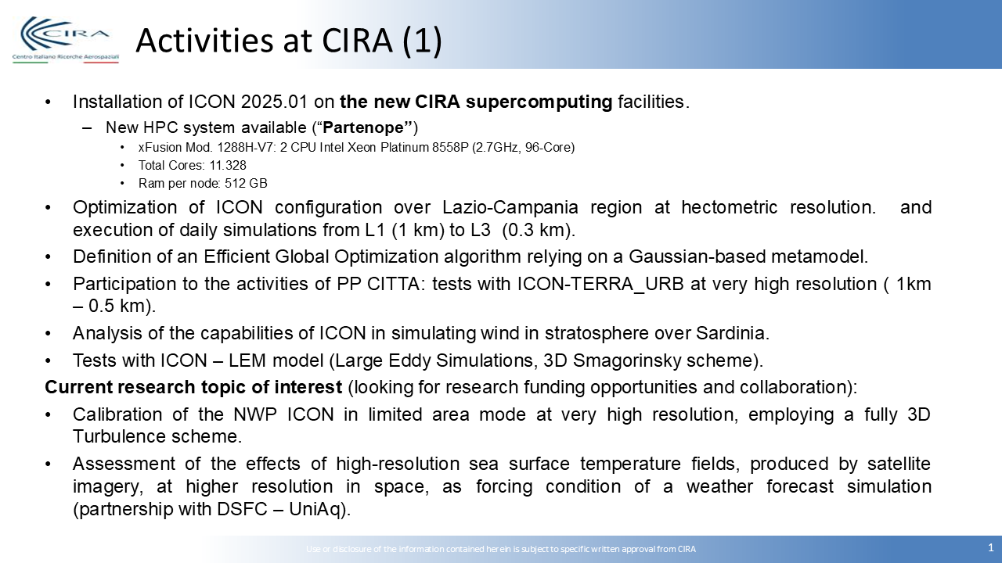
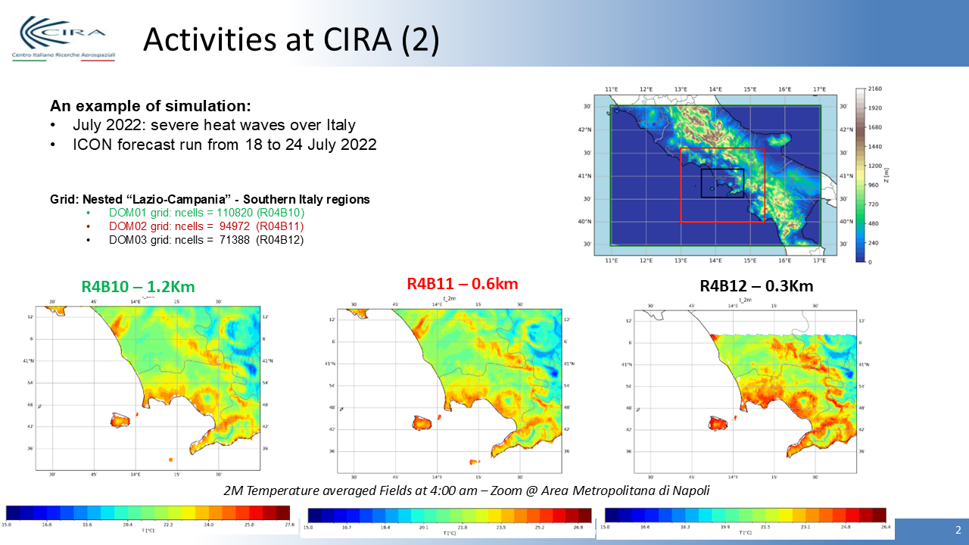
Cinquegrana D., Bucchignani E., Montesarchio M., Zollo A.L., The impact of grid resolution, turbulence schemes and soil initialization over performances of ICON model with TERRA-URB at hectometric scale. Meteorol. Atmos. Phys. 2026, 138, 3. https://doi.org/10.1007/s00703-025-01103-w
Cinquegrana D., Bucchignani E. Machine Learning as a Lens on NWP ICON Configurations Validation over Southern Italy in Winter 2022–2023—Part I: Empirical Orthogonal Functions. Atmosphere 2026, 17, 132. https://doi.org/10.3390/atmos17020132
‘Highly Resolved Numerical Models in Regional Weather Forecasting’, a Joint Special Issue of Atmosphere (ISSN 2073-4433) and Meteorology (ISSN 2674-0494). Guest Editors: D. Cinquegrana, A. Ricchi, E. Bucchignani.
COSMO 28th General Meeting – Rome, 14-18 September 2026

Slide 20
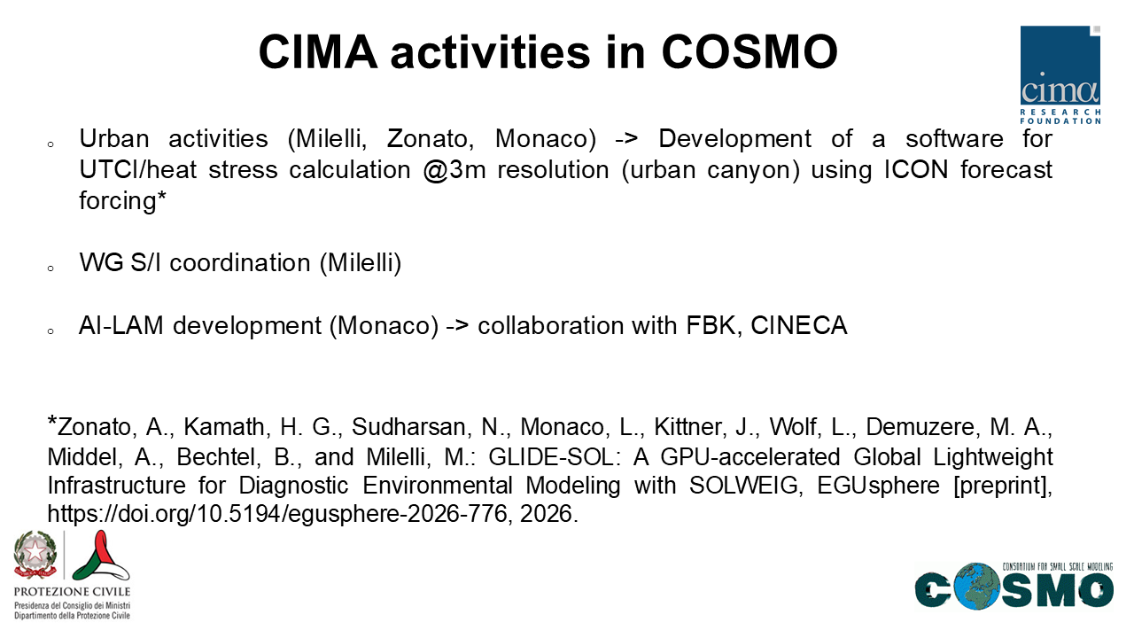
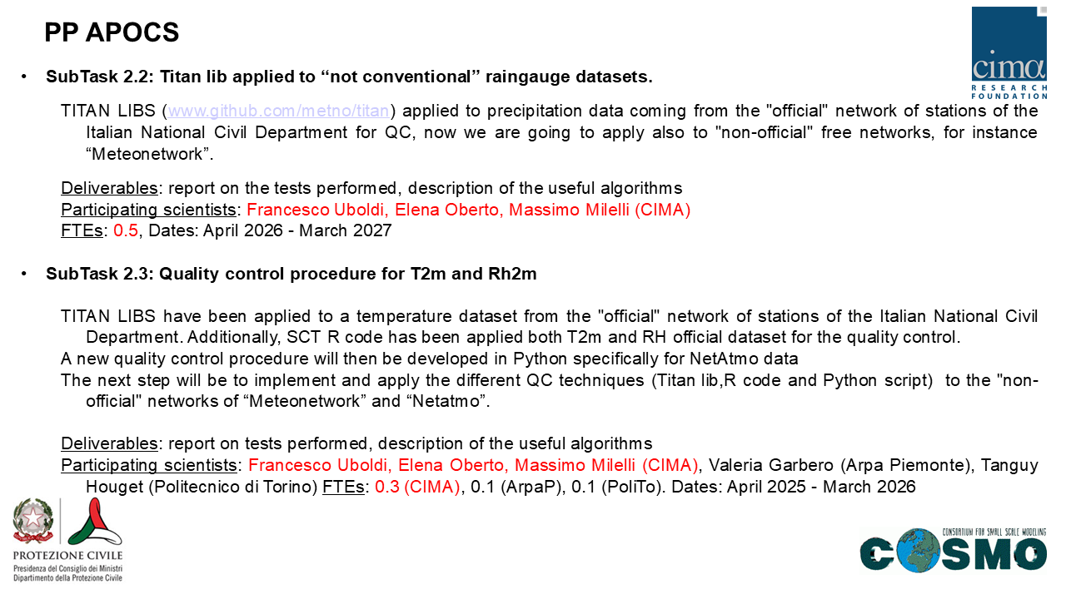
COSMO 28th General Meeting – Rome, 14-18 September 2026

Slide 21
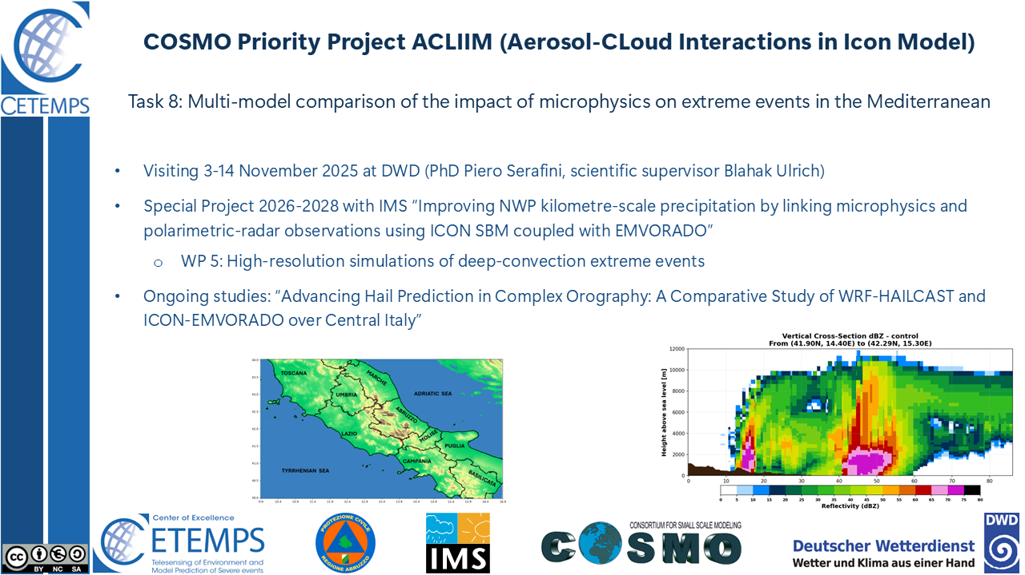
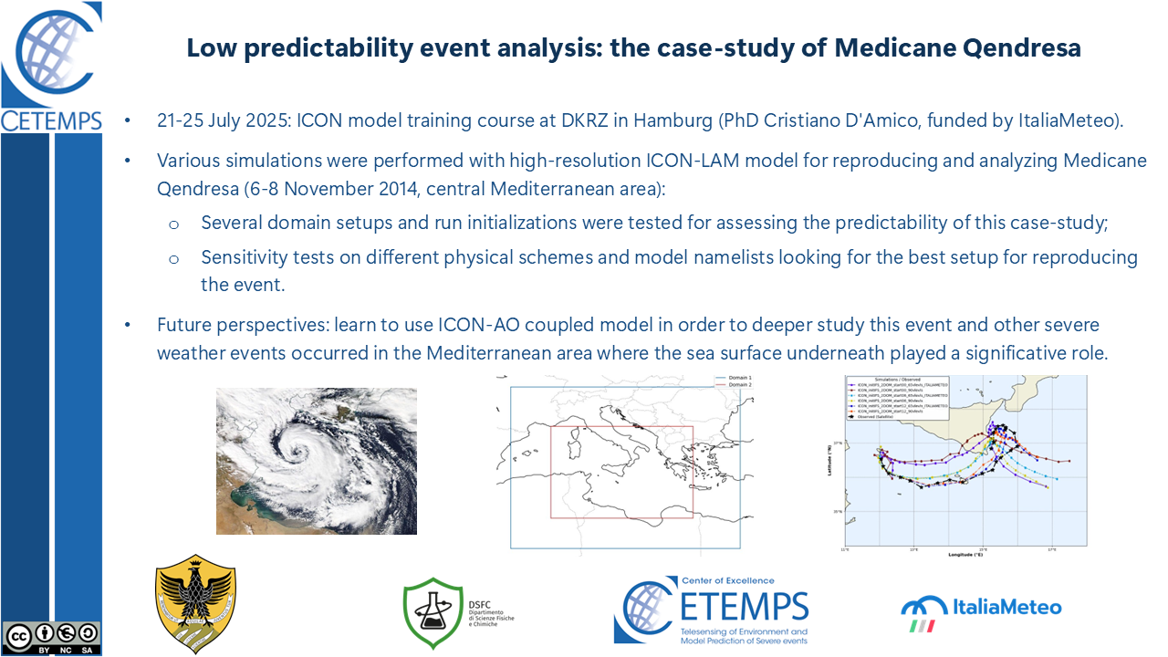
COSMO 28th General Meeting – Rome, 14-18 September 2026

Slide 22
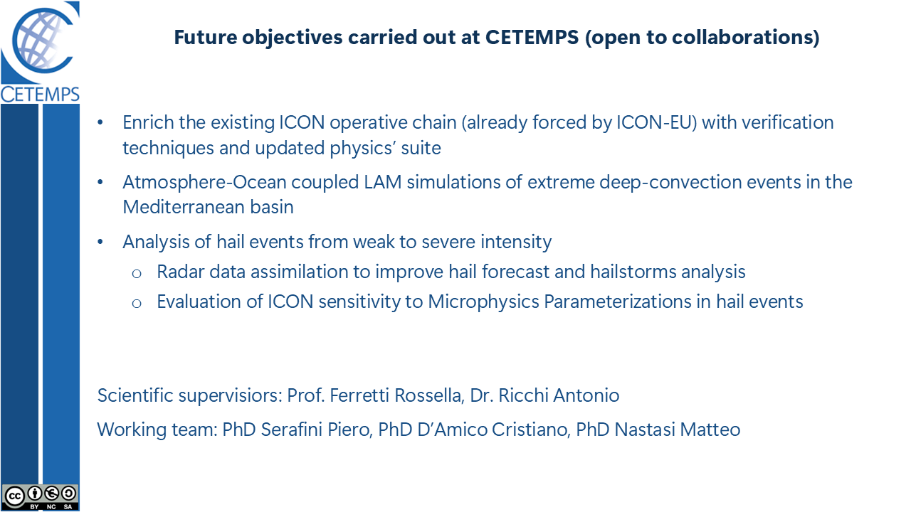
COSMO 28th General Meeting – Rome, 14-18 September 2026

Slide 23
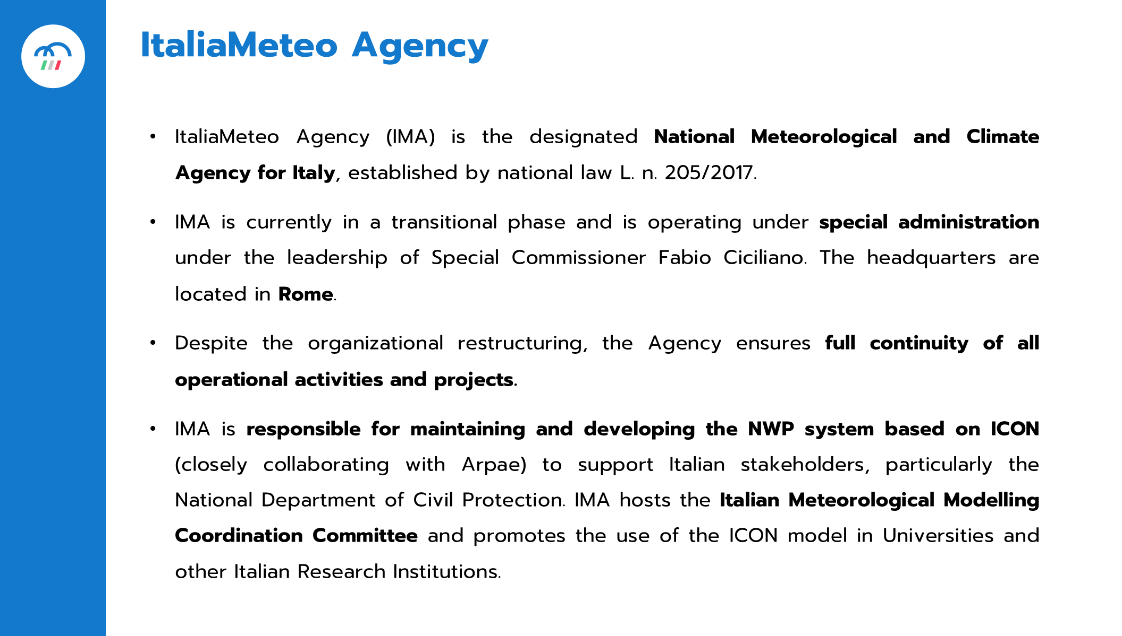
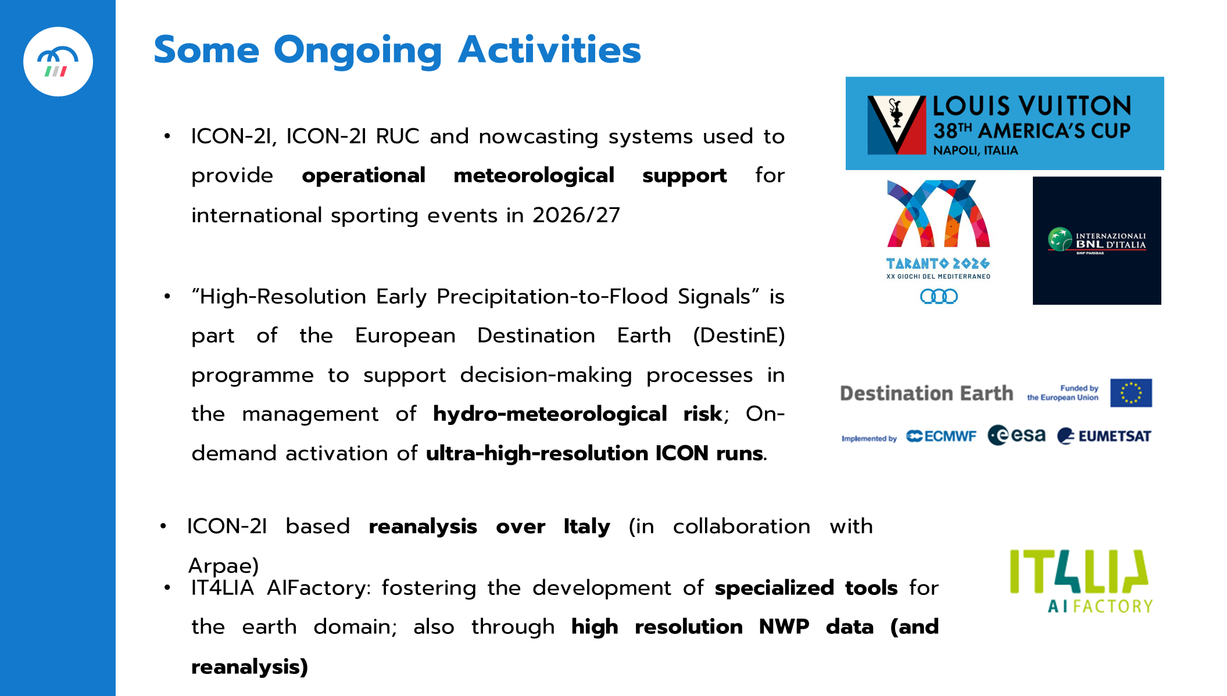
COSMO 28th General Meeting – Rome, 14-18 September 2026

Slide 24
The way ahead
Fostering the COSMO narrative for the benefit of the Italian NWP community
Strengthening the national partnership
  +synergies +communication +coordination
  -duplications -autarchy -dispersion
Alignment with the COSMO strategy
  feeding the Working Groups
  bringing COSMO activities «at home»
  open-science and open-mind
COORDINATION
COOPERATION
COURAGE
Thank you
COSMO 28th General Meeting – Rome, 14-18 September 2026

