Slide 1

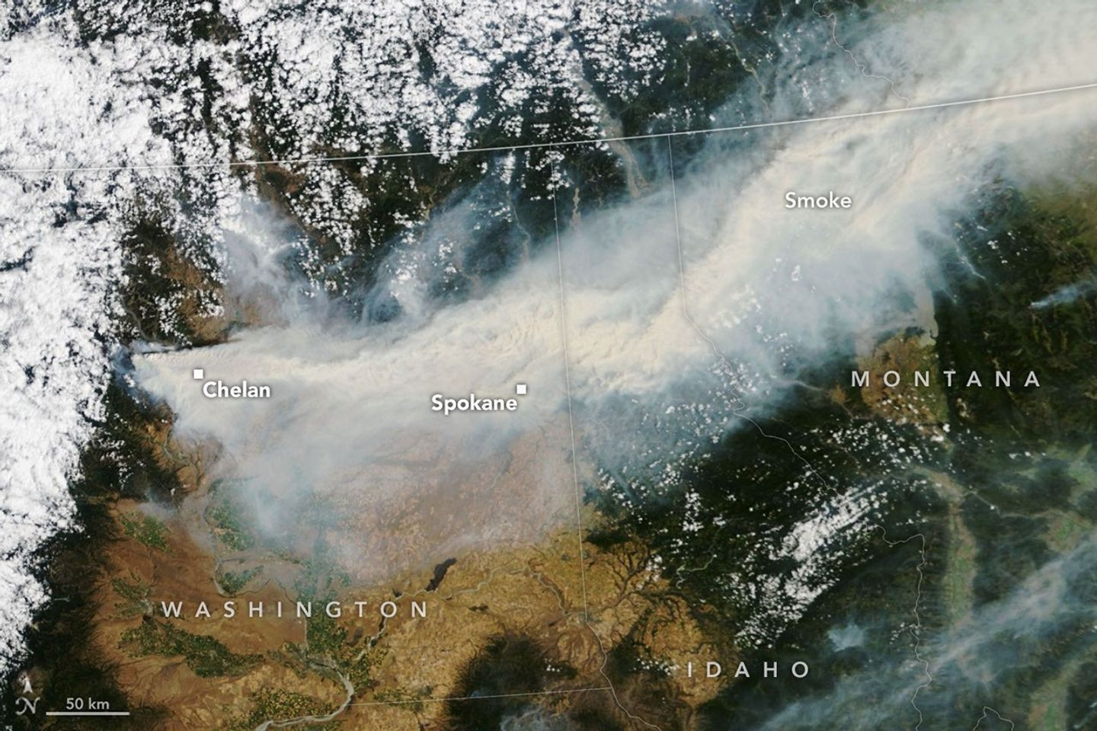
WG PHYS - Upper Air
בס"ד
NASA
Harel Muskatel (IMS)
28th COSMO General Meeting, September 17, 2026

Slide 2
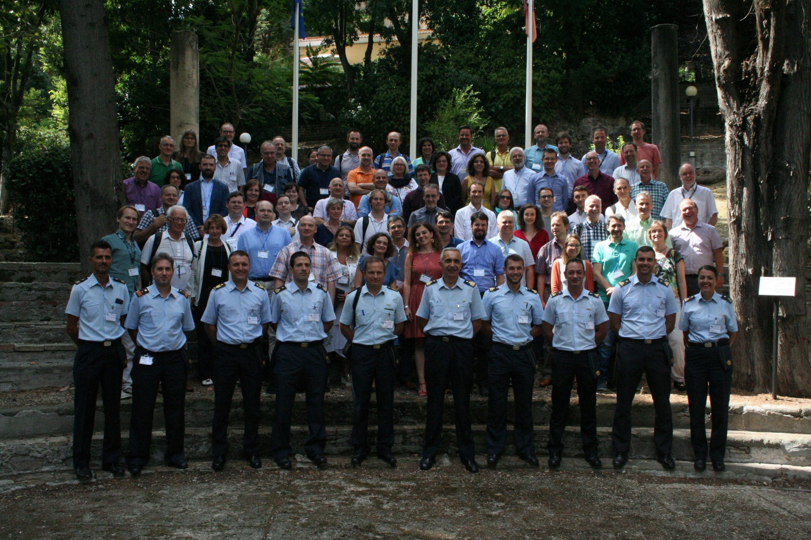

Slide 3

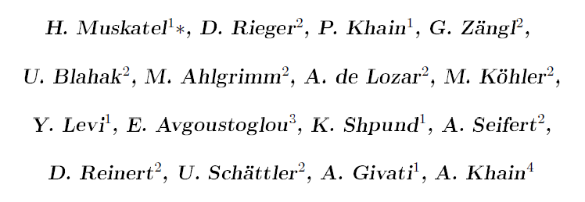
CAIIR Priority Project
Achievements:
New ice particle optical properties (Muskatel et al. 2021)
CAMS aerosols climatology
CAMS forecasted aerosols
New ice nucleation scheme (deMott 2015)
Spectral bin microphysics scheme
New 2D aerosols scheme

Slide 4
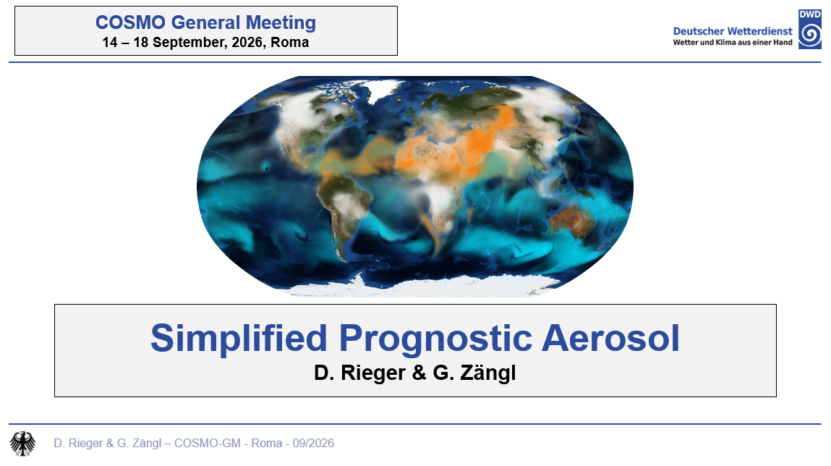

Slide 5
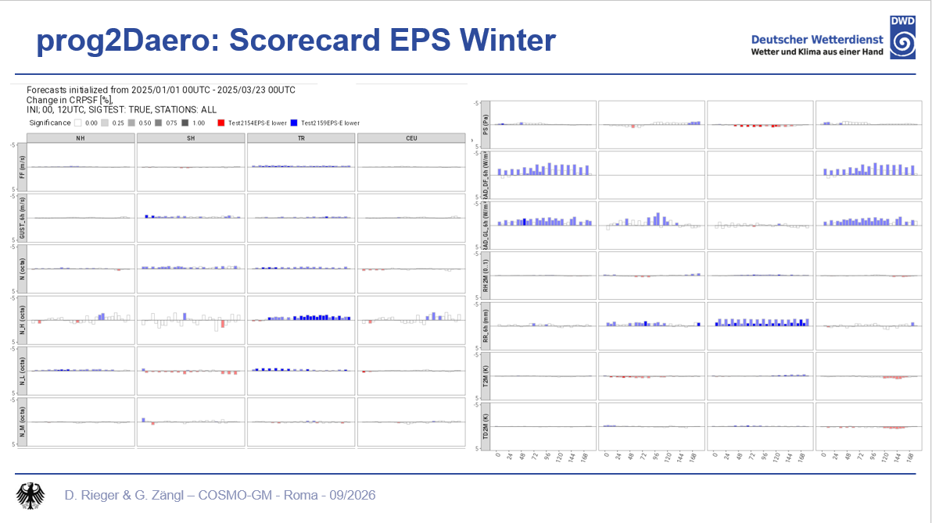

Slide 6
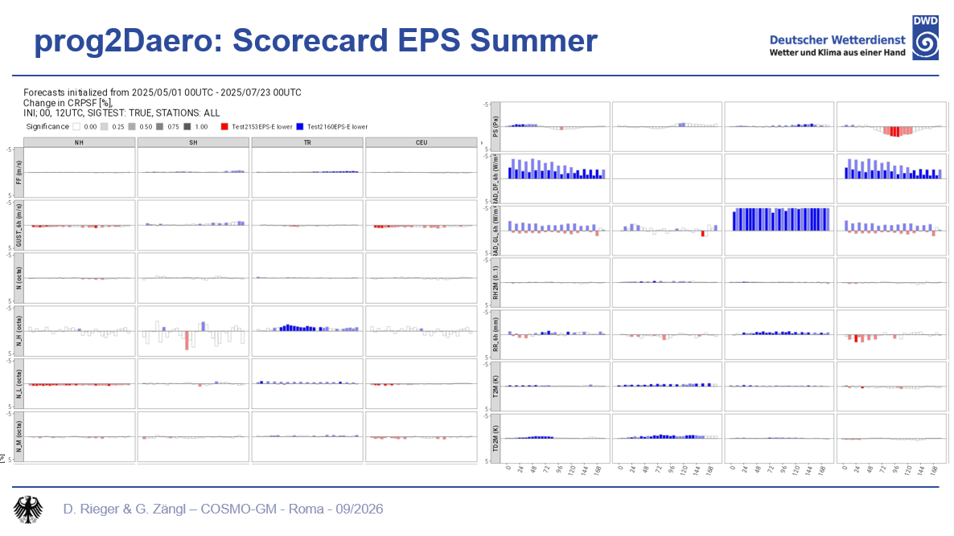

Slide 7
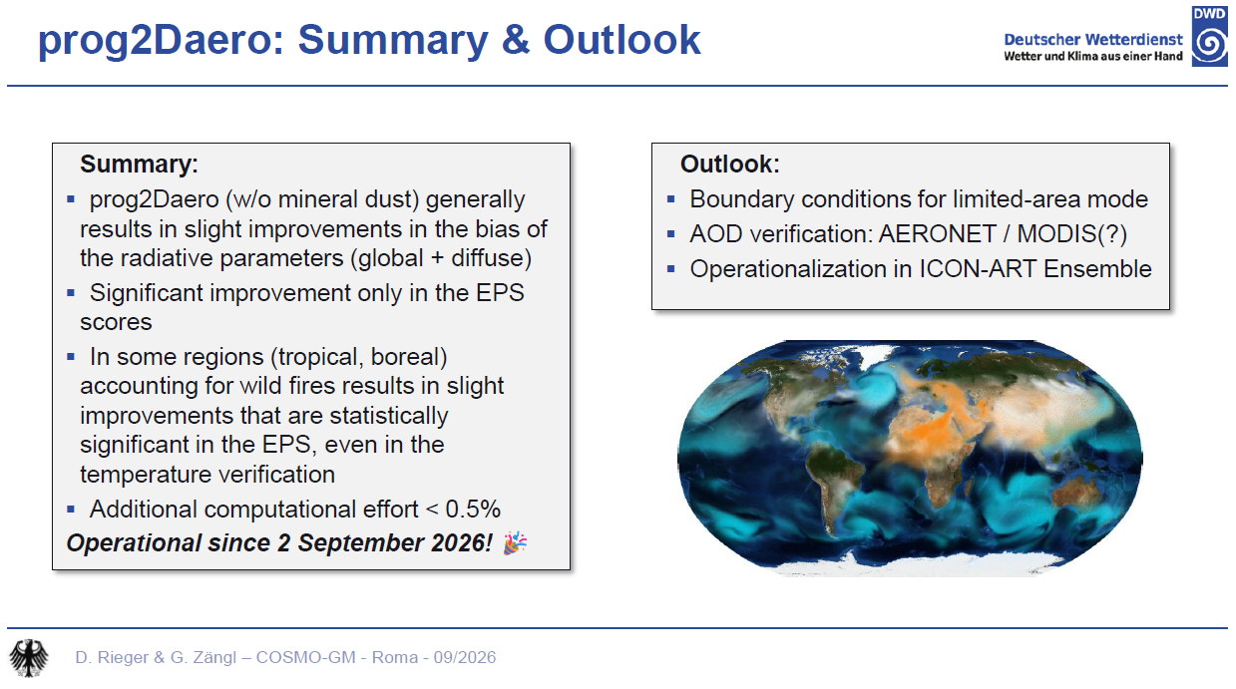

Slide 8


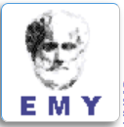

Aerosol-CLoud Interactions in ICON Model:
ACLIIM Priority Project
September 2024 - August 2027
Total planed FTEs : 6.1
Participants:
Harel Muskatel (IMS)
Pavel Khain (IMS)
Euripides Avgoustoglou (HNMS)
Daniel Rieger (DWD)
Alberto de Lozar (DWD)
Piero Serafini (CETEMPS)

Slide 9
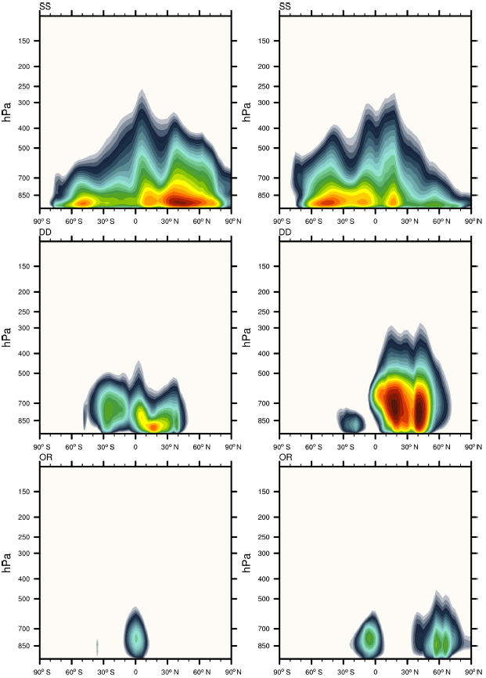
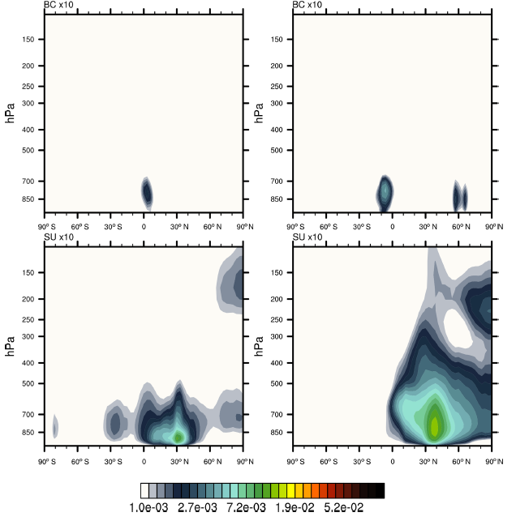
CAMS climatology - Zonal-mean layer-integrated mass profiles
Jan
Jul
SS
Jan
Jul
BC
DU
SU
OM
gr/m²
Bozzo et al. 2020

Slide 10
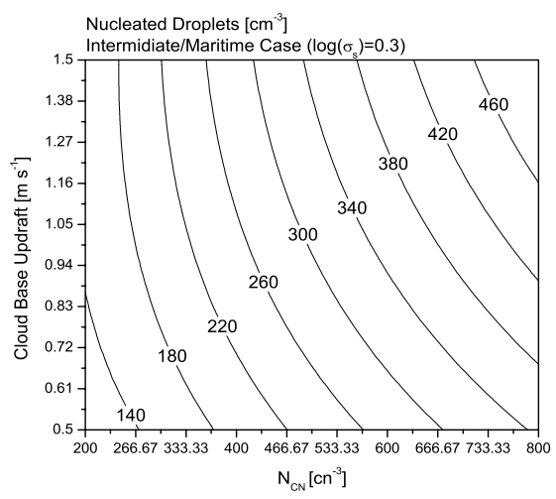

Segal & Khain cloud droplets activation scheme
  Calculation of CDNC from N_{CN} is estimated from Segal & Khain (2006)
  4D look-up table:
$$CDNC=f(n_{cn}, log(σ),r_{mod}{,w}_{CB})$$
Tegen CAMS climatology CAMS forecasted
Segal & Khain (2006)

Slide 11
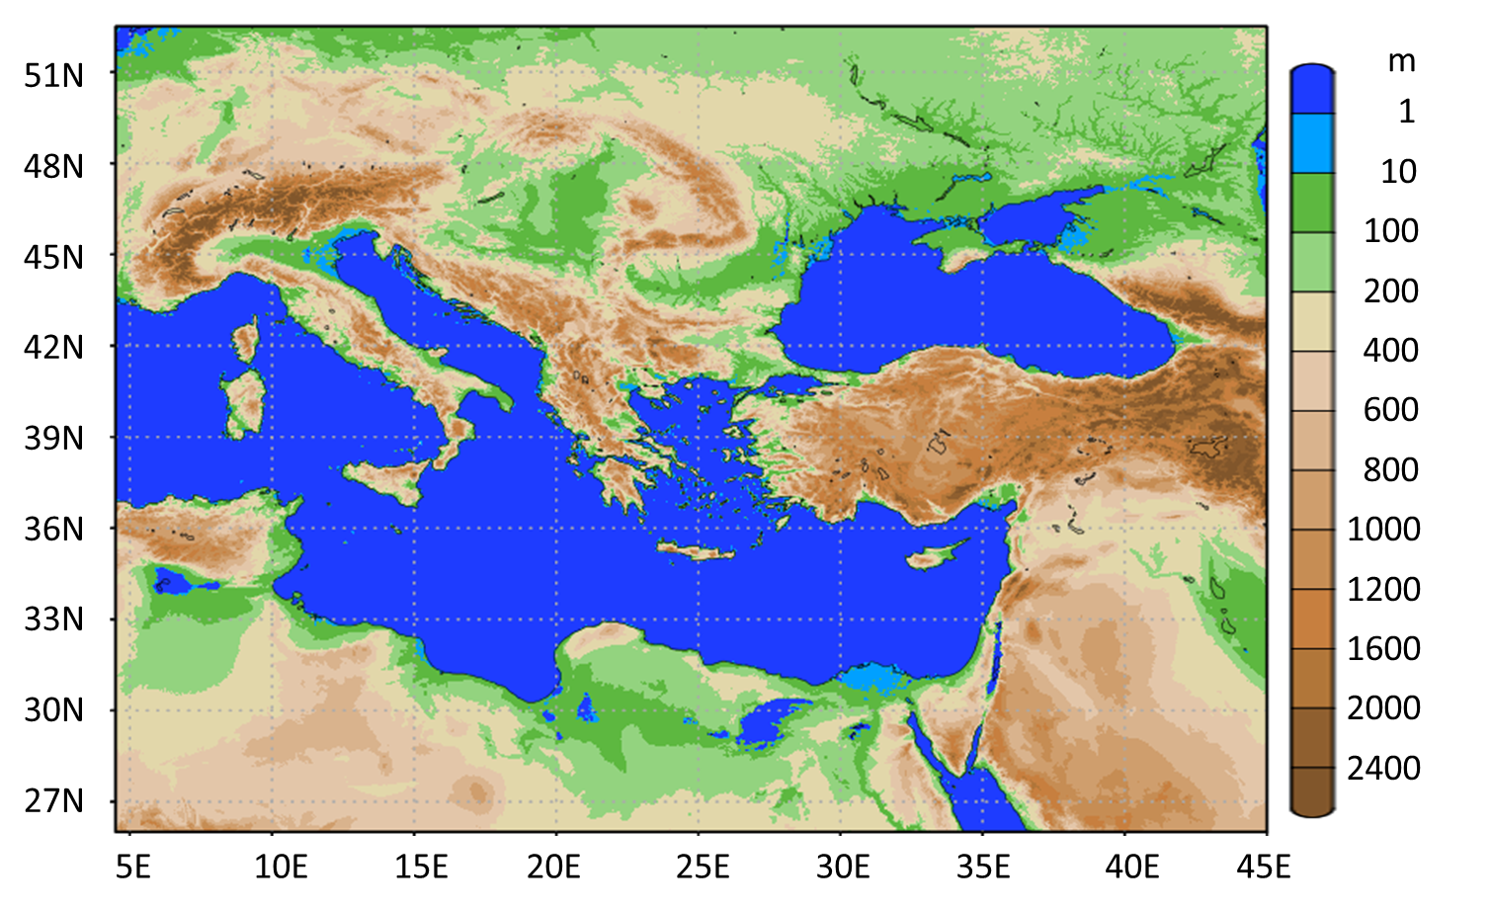
Test case – storm “Daniel”
Southeast Europe Domain (SEE)

Slide 12
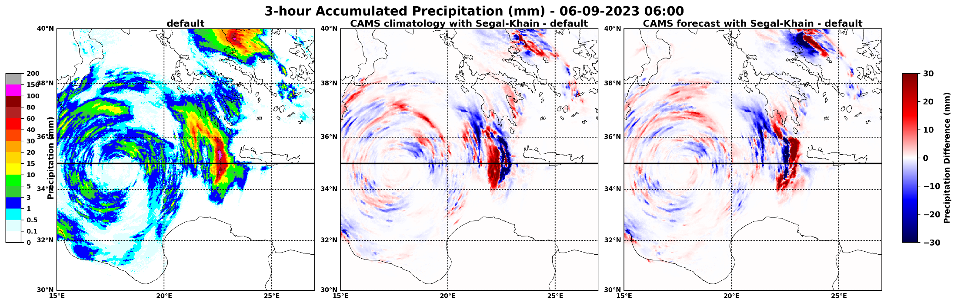
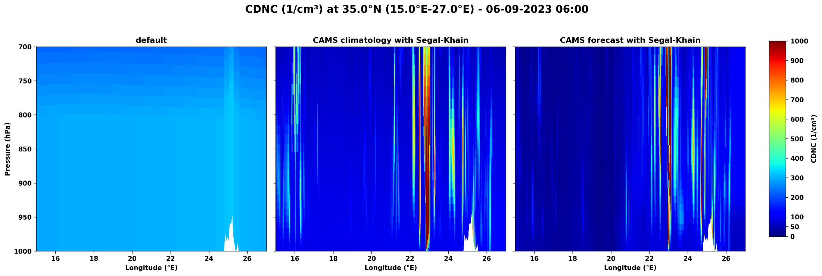
Snapshot analysis

Slide 13


A Deep Learning Emulator for pyrcel-Based Cloud Droplet Number
Concentration in ICON
בס"ד
ACLIIM
Harel Muskatel (IMS), Daniel Rothenberg (Brightband), Mareike Burba (DWD) and Axel Seifert (DWD)
ICCARUS, March 17, 2026

Slide 14
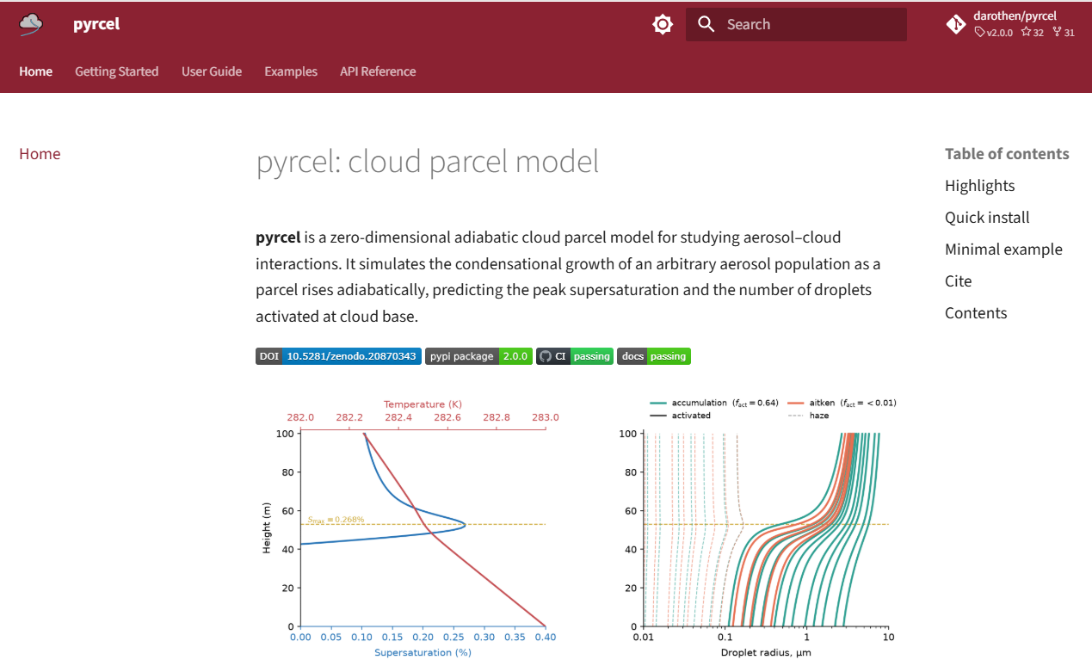

Slide 15
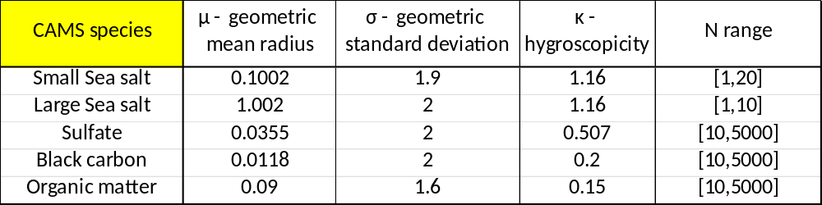
pyrcel: a Cloud Parcel Model
Adiabatic parcel model (Rothenberg & Wang, 2016) simulating cloud droplet formation and growth via condensation
Solves a coupled ODE system (temperature, water vapor, liquid water, supersaturation, and pressure) to predicts droplet activation by tracking supersaturation evolution as a balance between condensational heating and adiabatic cooling
Uses κ-Köhler theory to represent aerosol hygroscopicity with a single parameter
Supports arbitrary aerosol populations — any combination of size, number concentration, and hygroscopicity (internal/external mixtures)
Aerosol size distributions discretized from lognormal modes into sectional bins
    output: CDNC and S_{max}

Slide 16
pyrcel Data Base
T₀ → [ 237.0 K , 318.0 K ]
w → [ 0.02 m/s , 5.0 m/s ]
Small Sea salt N₁ → [ 5 , 20 ] Liu et al. 2012
Large Sea salt N₂ → [ 2 , 10 ] Liu et al. 2012
Sulfate N₃ → [ 10 , 5000 ] Kim et al. 2008
Black Carbon N₄ → [ 10 , 5000 ] Kim et al. 2008
Organic Matter N₅ → [ 10 , 5000 ] Kim et al. 2008
P₀ = 850 hPa
S₀ = 0.0
Total: 10.3 Million model runs

Slide 17
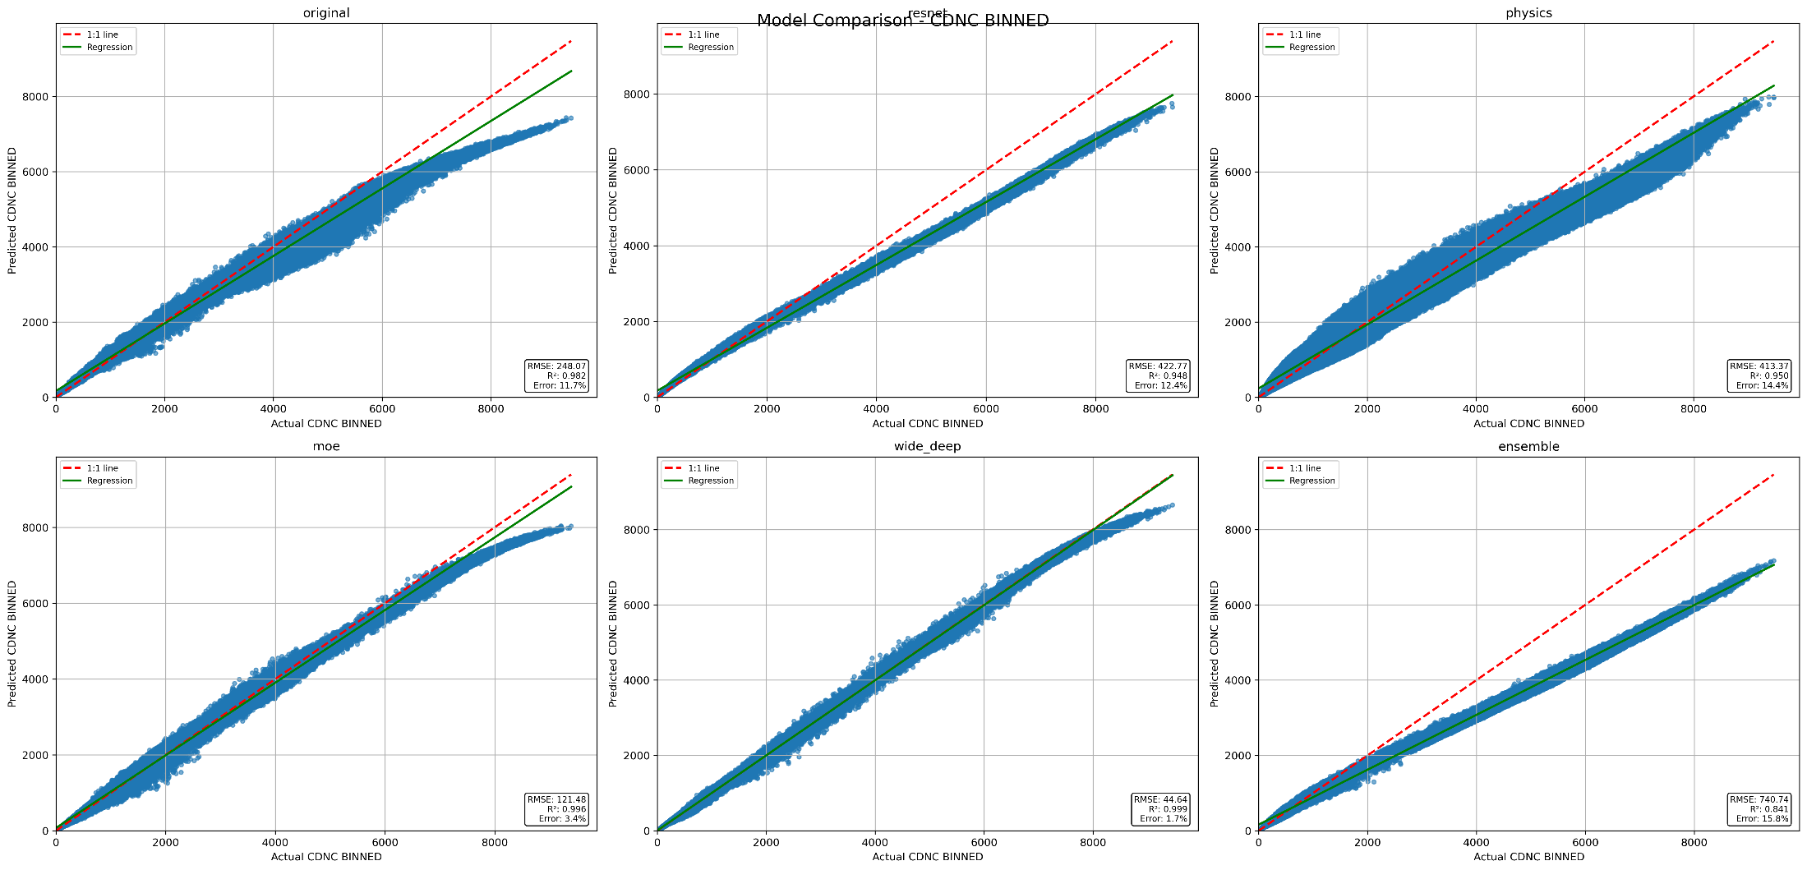
AI-pyrcel Emulator - Model Architectures
Bottleneck
resnet
Physics informed
11.7%
12.4%
14.4%
3.4%
1.4%
15.8%
moe
Wide & deep
endemble

Slide 18
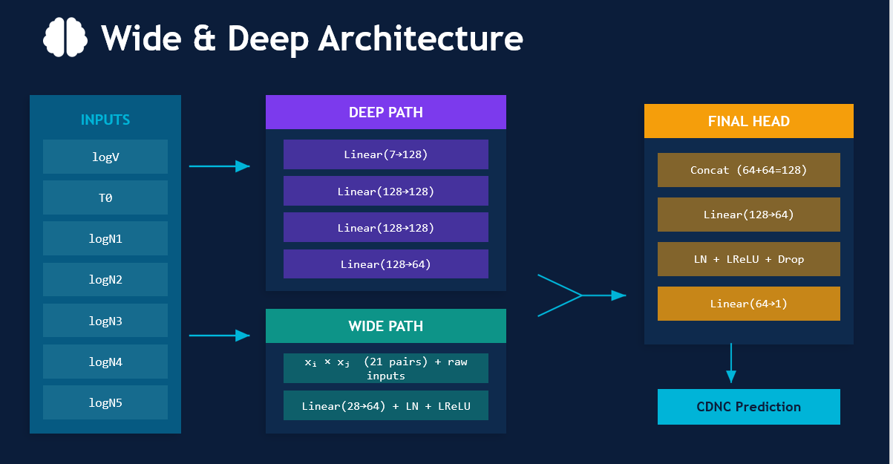
AI-pyrcel Emulator

Slide 19
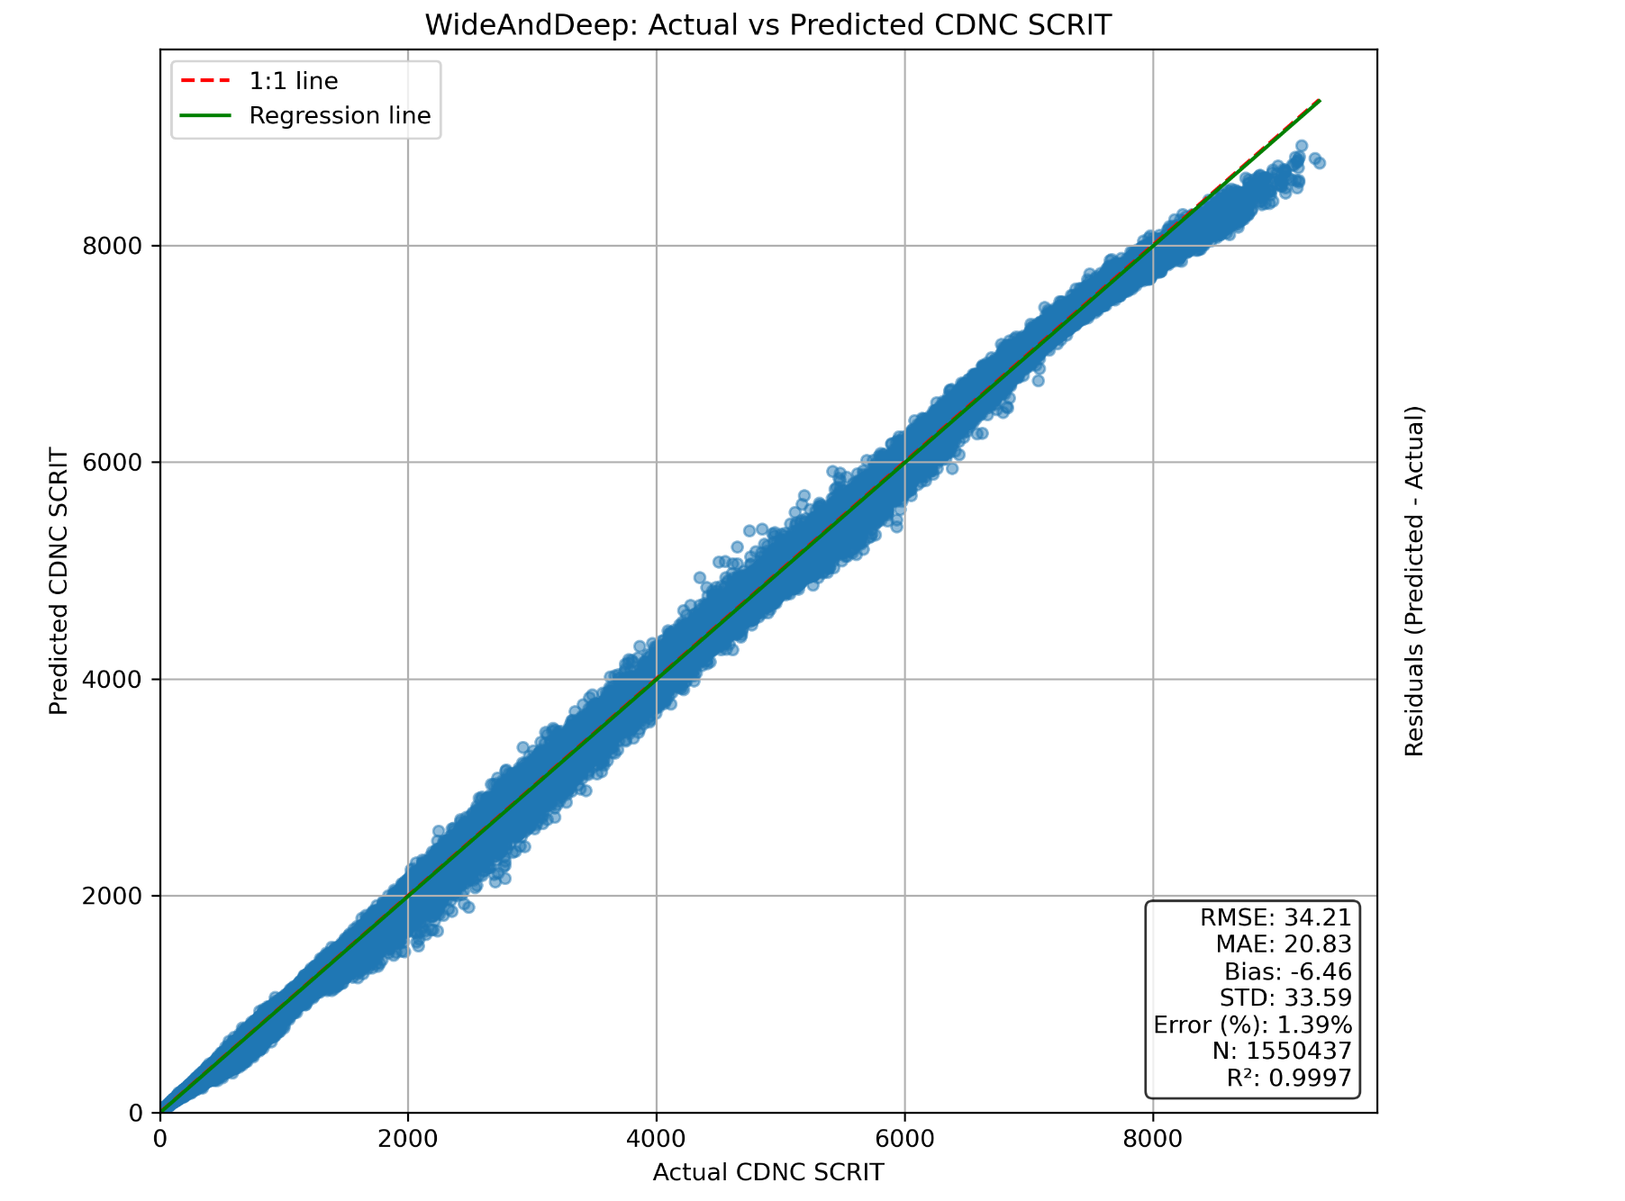
Wide and Deep architecture - inference
Mean Error = 1.4%

Slide 20
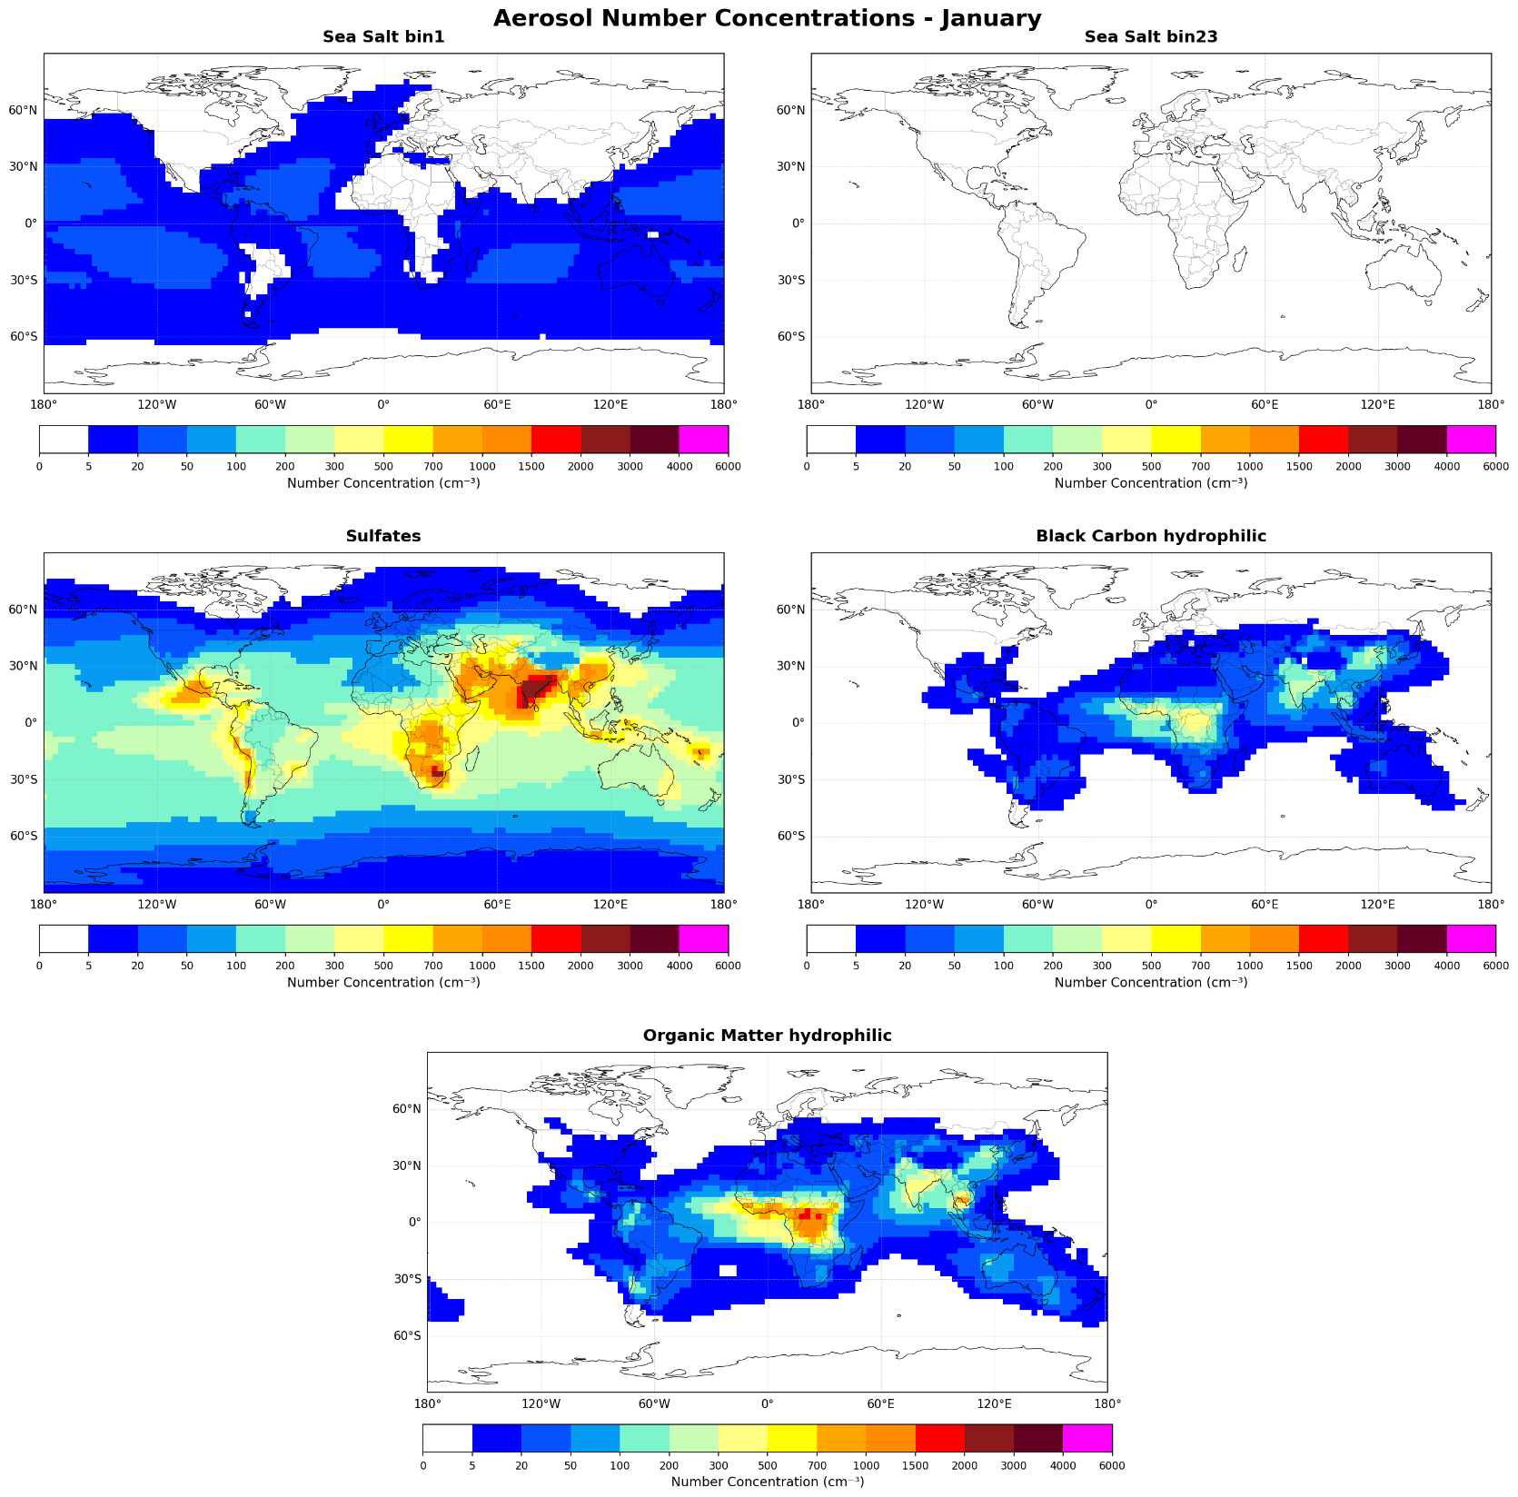
CAMS climatology – Number Concentrations at 850 hPa
SS small
SS big
SU
BC∙ (1/50)
January
OM

Slide 21
pyrcel-CAMS-AI-emulator 5D CDNC climatology
Vs.
MODIS 2D CDNC climatology

Slide 22
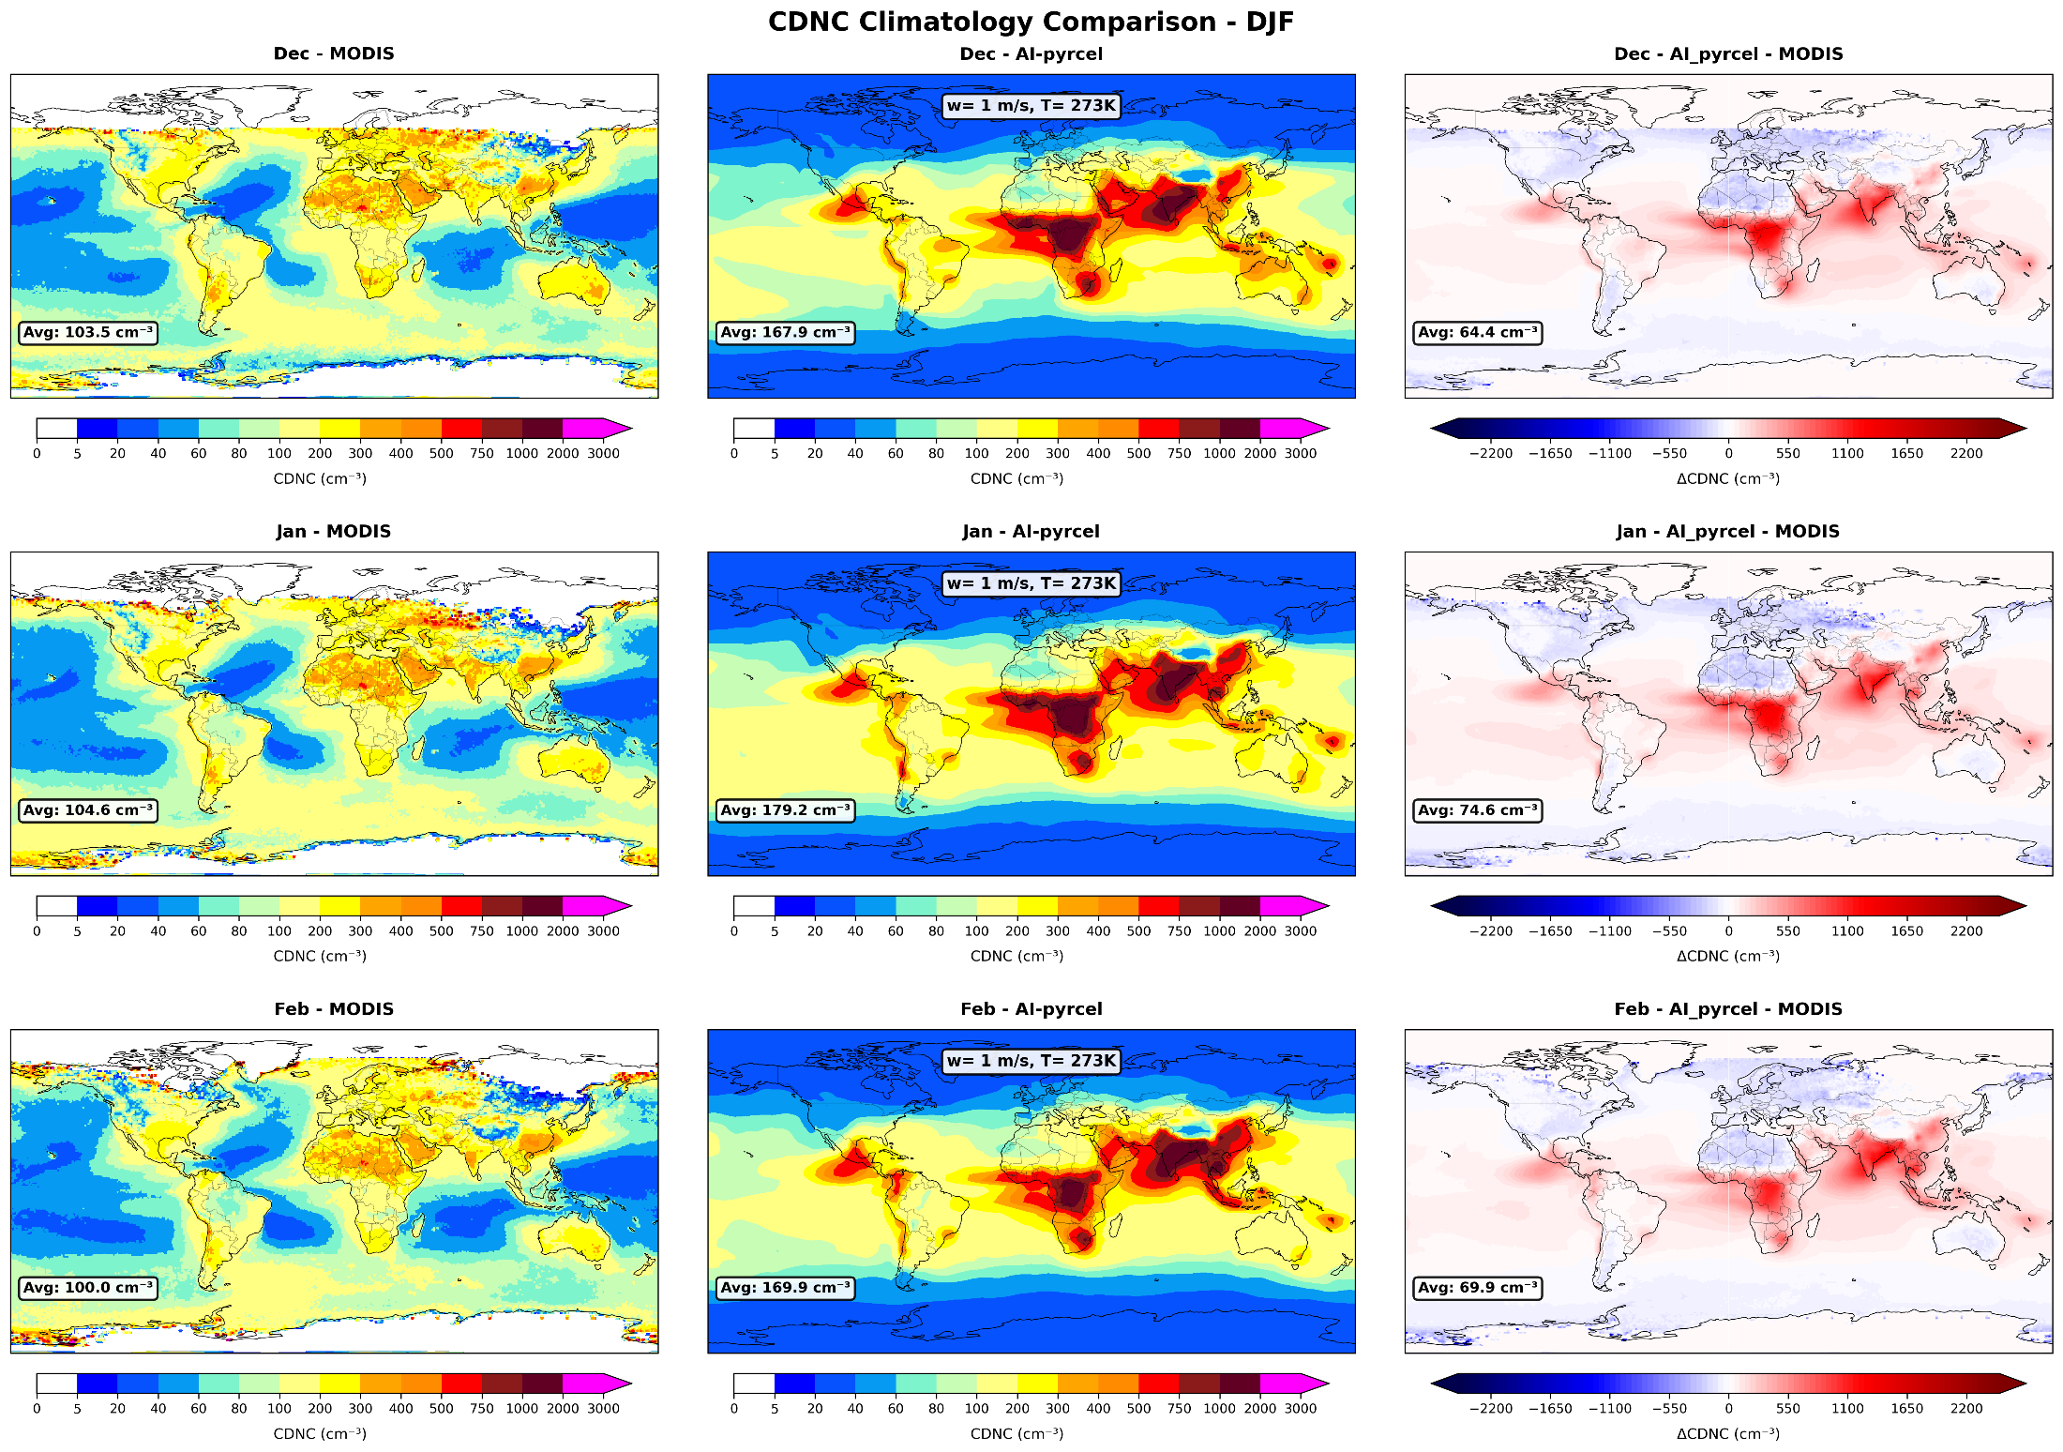
w = 1 m/s , T=273K

Slide 23
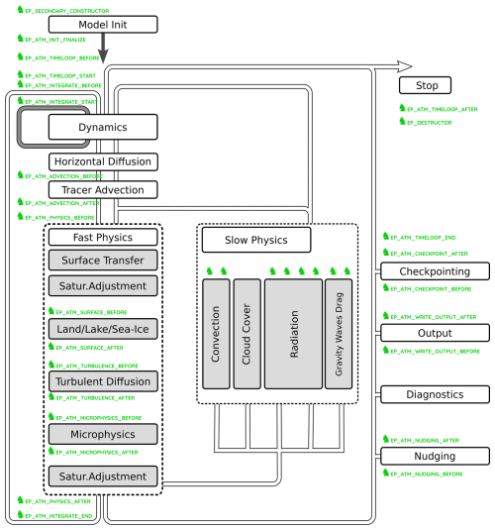
Running AI-pyrcel in ICON using ComIn interface
Thanks to Mareike Burba
AI-pyrcel plug-in
AI-pyrcel plug-in
Hartung, K., et al, 2025.

Slide 24
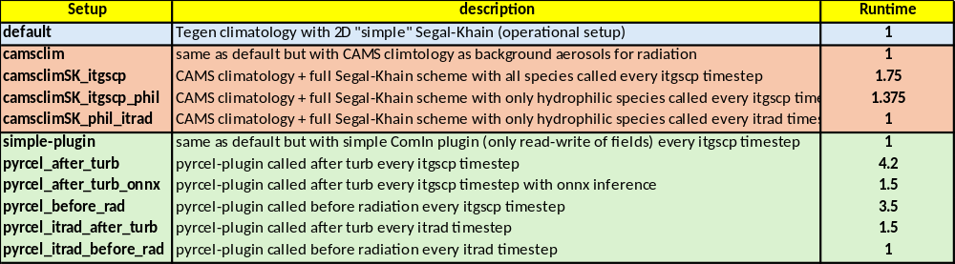
Running AI-pyrcel in ICON using ComIn
ONNX - Open Neural Network Exchange: standard file format for describing a trained neural network
Thanks: Florian Prill, Ronald Wirth, Nils-Arne Dreier

Slide 25

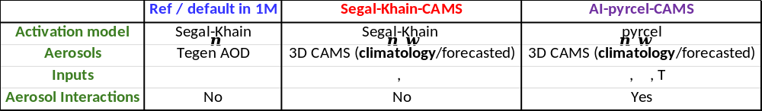
Test case – Daniel storm Model Setup

Slide 26
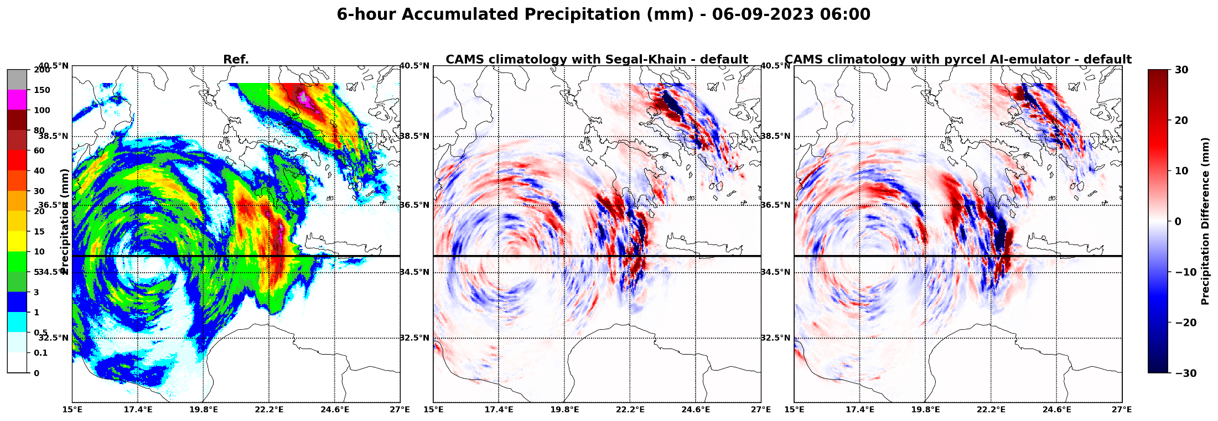
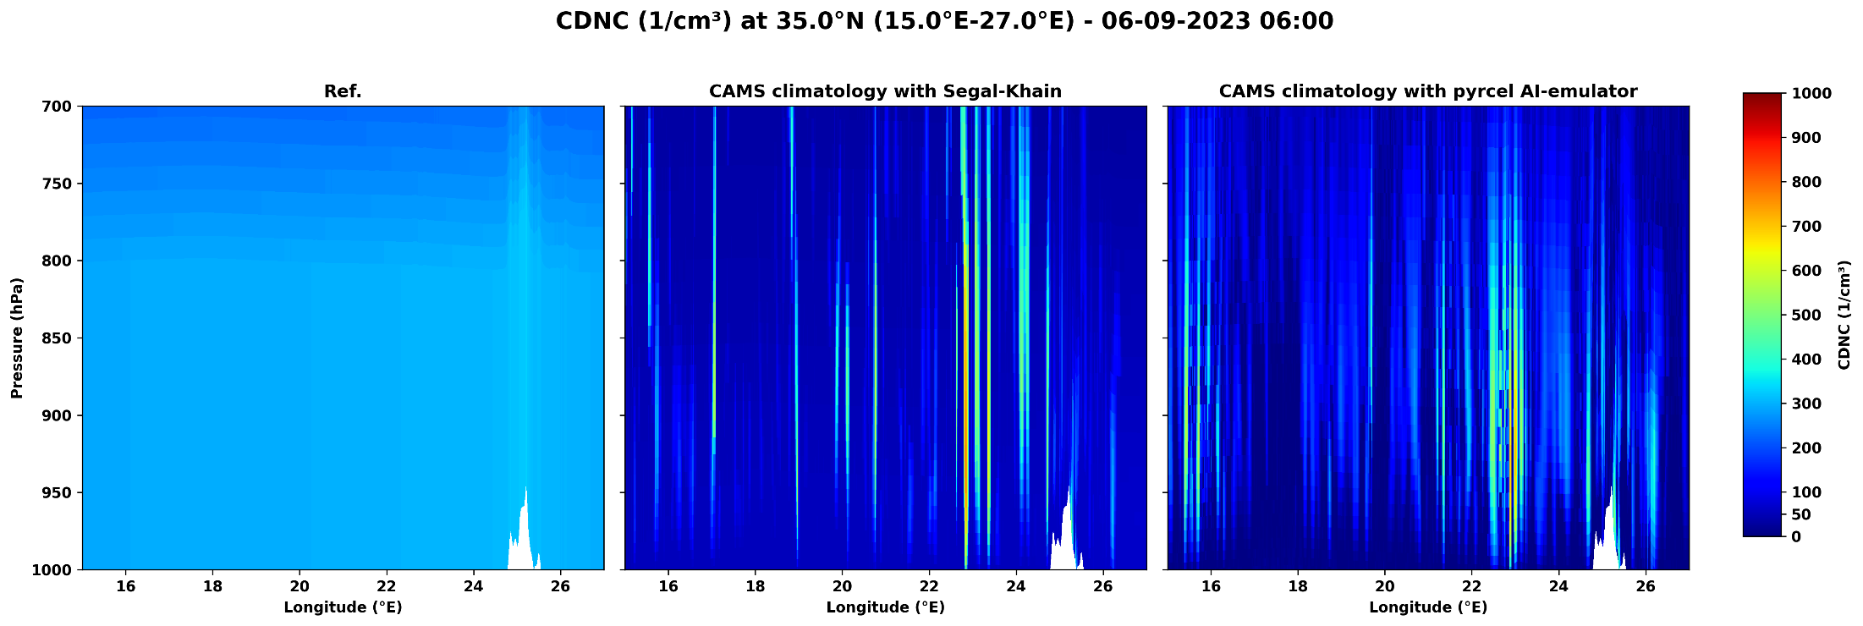
Snapshot analysis

Slide 27



DESIGNATION OF THE TESTED AEROSOL CLIMATOLOGIES
Default (DEF): Reference setup with Tegen aerosol climatology.
DeMott (DM): DeMott 2015 ice nucleation scheme is used.
IceOpt (ICE): New ice optical properties after Muskatel et al. (2020) including large hydrometeors in ecRAD.
Camsclim (CC): CAMS (Copernicus Atmosphere Monitoring Service) climatology used (instead of Tegen).
camsforc (CF): CAMS forecasted aerosols used (instead of Tegen).
camsclimSK (CCSK): CAMS climatology using Segal & Khain aerosol activation parameterization.
camsforcSK (CFSK): CAMS forecasted aerosols using Segal & Khain aerosol activation parameterization.
pyrcel_onnx_rev (PO): AI-emulator of the pyrcel model.
pyrcel_camsforc (PCF): AI-emulator of the pyrcel model using CAMS forecasted aerosols.
Euripides Avgoustoglou, Hellenic National Meteotological Service, 28th COSMO GM , Rome-Italy, September 13-18, 2026
05

Slide 28
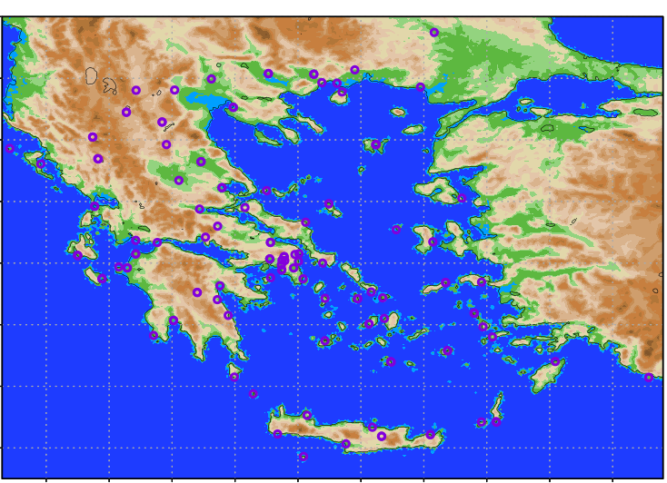
HNMS Station Positions
In the present work we are focused on a 48 ICON Model run starting at 20230905 00UTC
Euripides Avgoustoglou, Hellenic National Meteotological Service, 28th COSMO GM , Rome-Italy, September 13-18, 2026
08

Slide 29
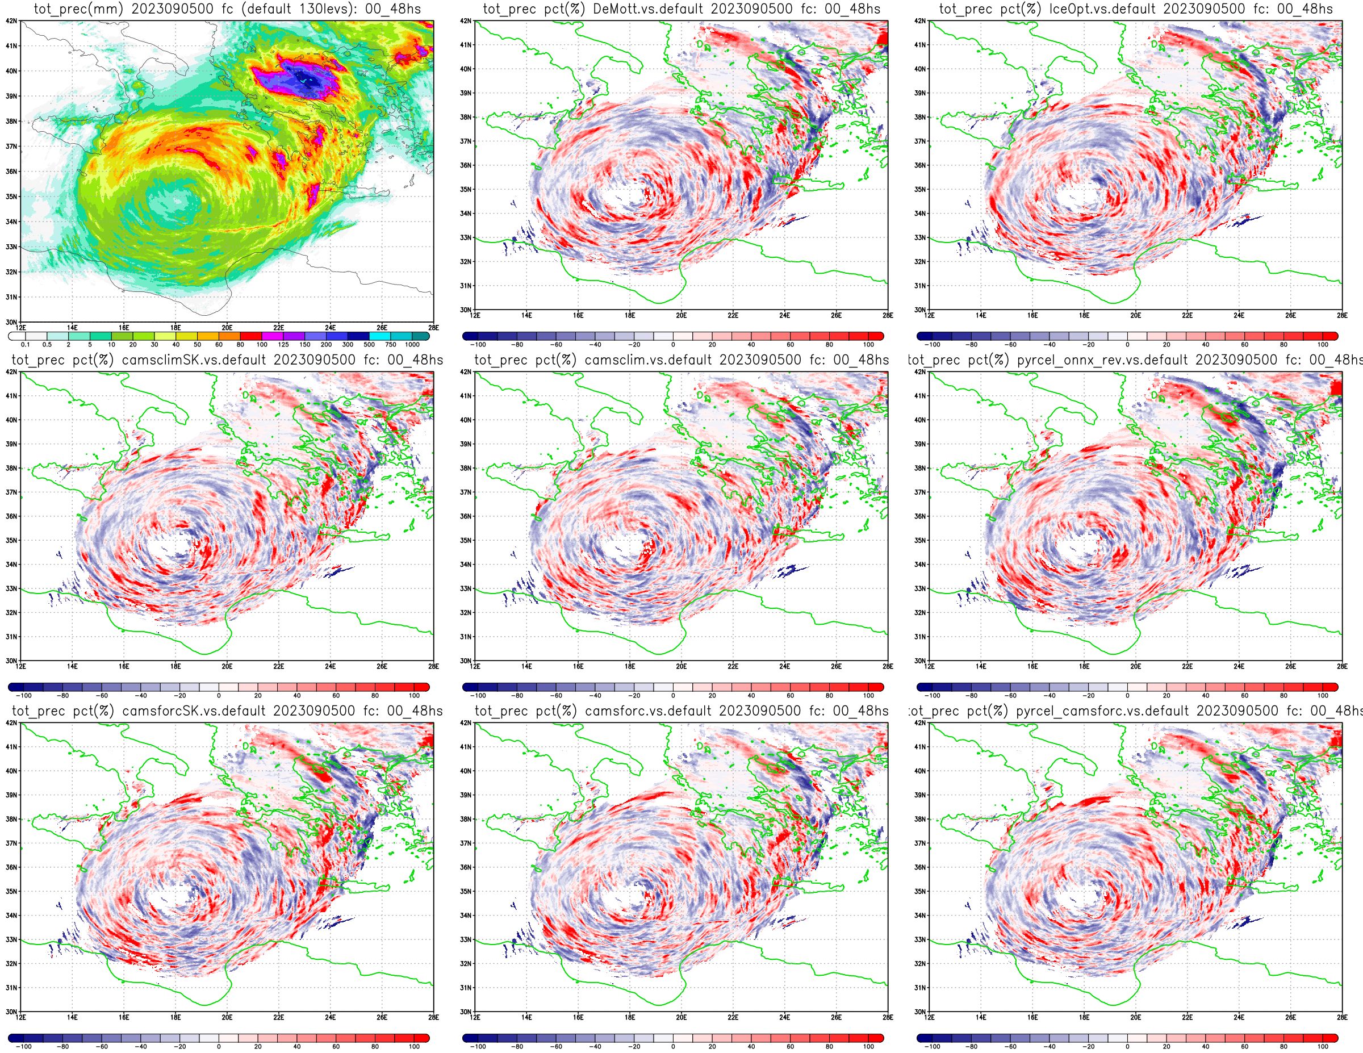
Euripides Avgoustoglou, Hellenic National Meteotological Service, 28th COSMO GM , Rome-Italy, September 13-18, 2026
12a

Slide 30
Key Findings – Precipitation Sensitivity against Observations (mm)
Configuration | Best level | Error
Default | 130L | 16.8
DeMott | 100L | 30.9
IceOpt | 100L | 13.5
CAMS configurations | 130L | 5.2-17.2
Pyrcel configurations | 65L | 3.4-4.2
Observed total precipitation: 868.9
Best agreement with observations
pyrcel_onnx_rev – 65L: 865.5 → error 3.4 (0.39%)
pyrcel_camsforc – 65L: 873.1 → error 4.2 (0.48%)
camsclimSK – 130L: 863.7 → error 5.2 (0.59%)
camsclim – 130L: 875.4 → error 6.5 (0.75%)
The optimal resolution is configuration-dependent, likely reflecting interactions between vertical resolution and the representation of cloud microphysics, convection, and aerosol/forcing inputs.
Euripides Avgoustoglou, Hellenic National Meteotological Service, 28th COSMO GM , Rome-Italy, September 13-18, 2026
18

Slide 31
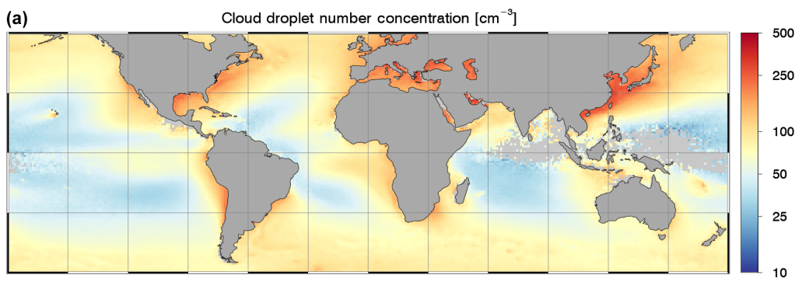
Comparisons to other datasets
1. MODIS climatology (done)
2. MODIS daily values 2000-2020 (Gryspeerdt et al., 2022)
Bennartz, R; Rausch, J (2017). ATMOSPHERIC CHEMISTRY AND PHYSICS, 17(16), 9815-9836.

Slide 32
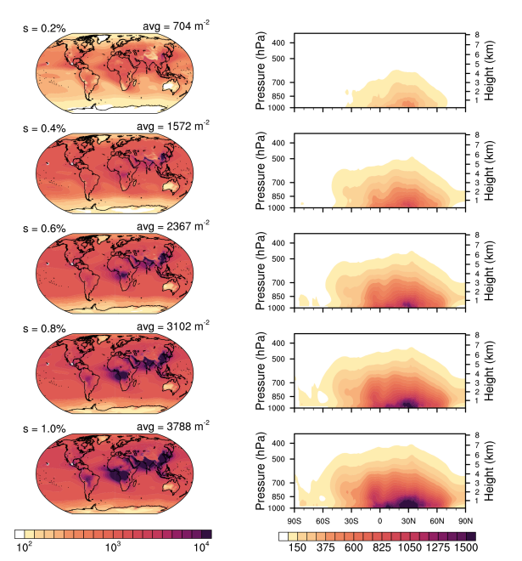
Comparisons to other datasets
3. CAMS reanalysis daily values 2003-2021 (Block et al., 2024)

Slide 33
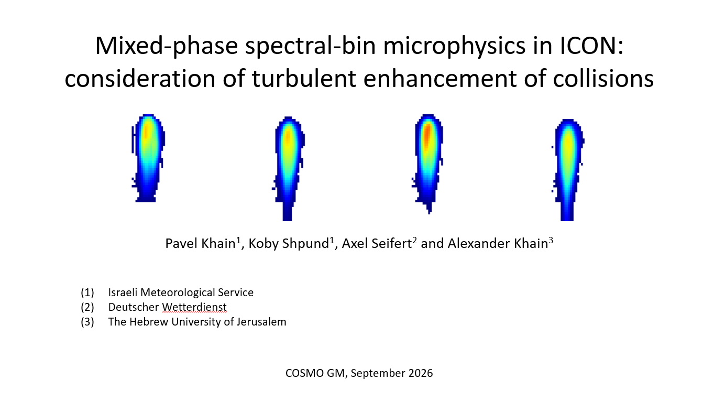
Spectral Bin Microphysics in ICON – Pavel Khain

Slide 34
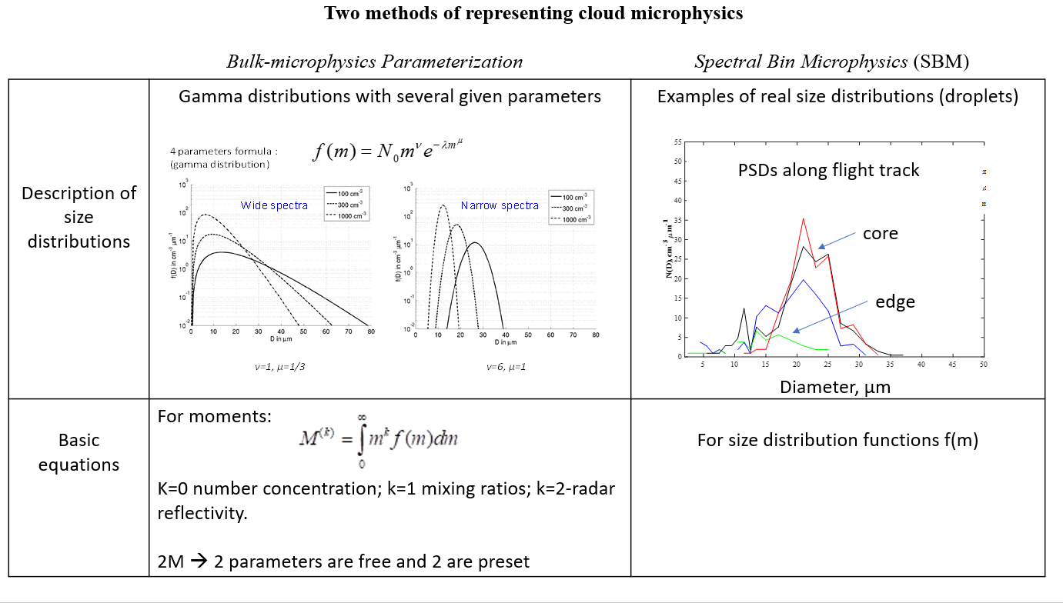

Slide 35
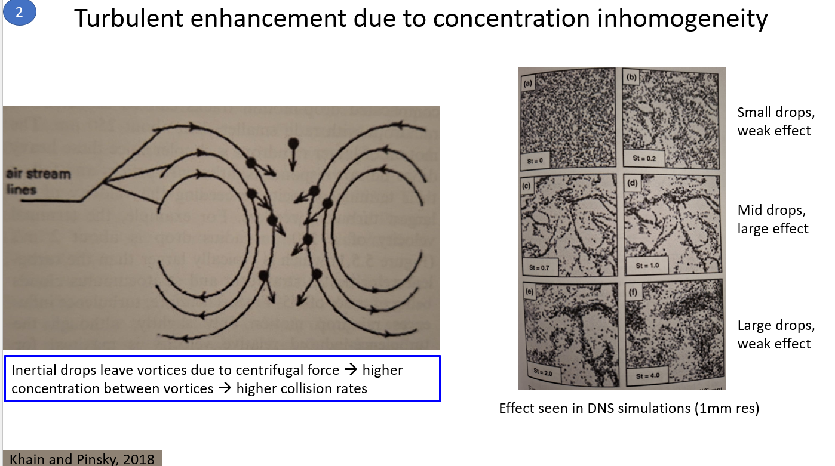

Slide 36
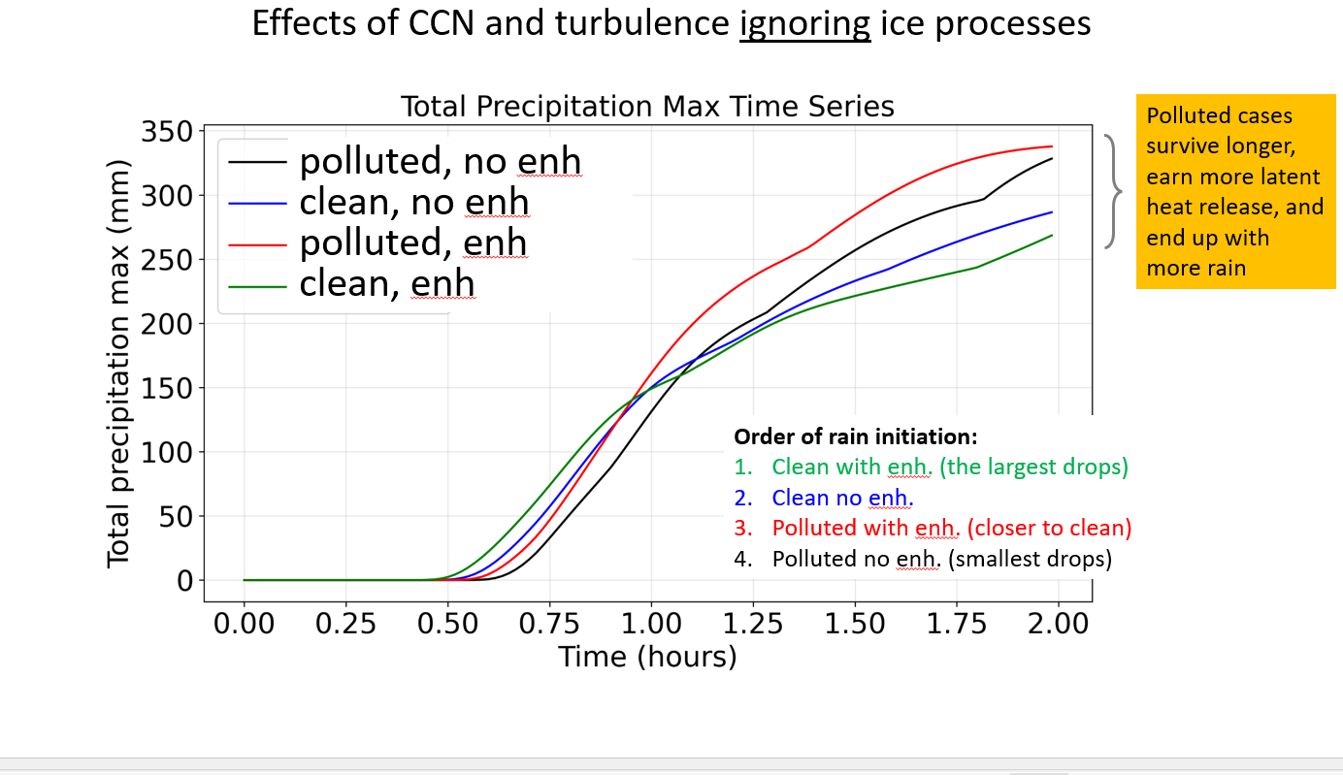

Slide 37
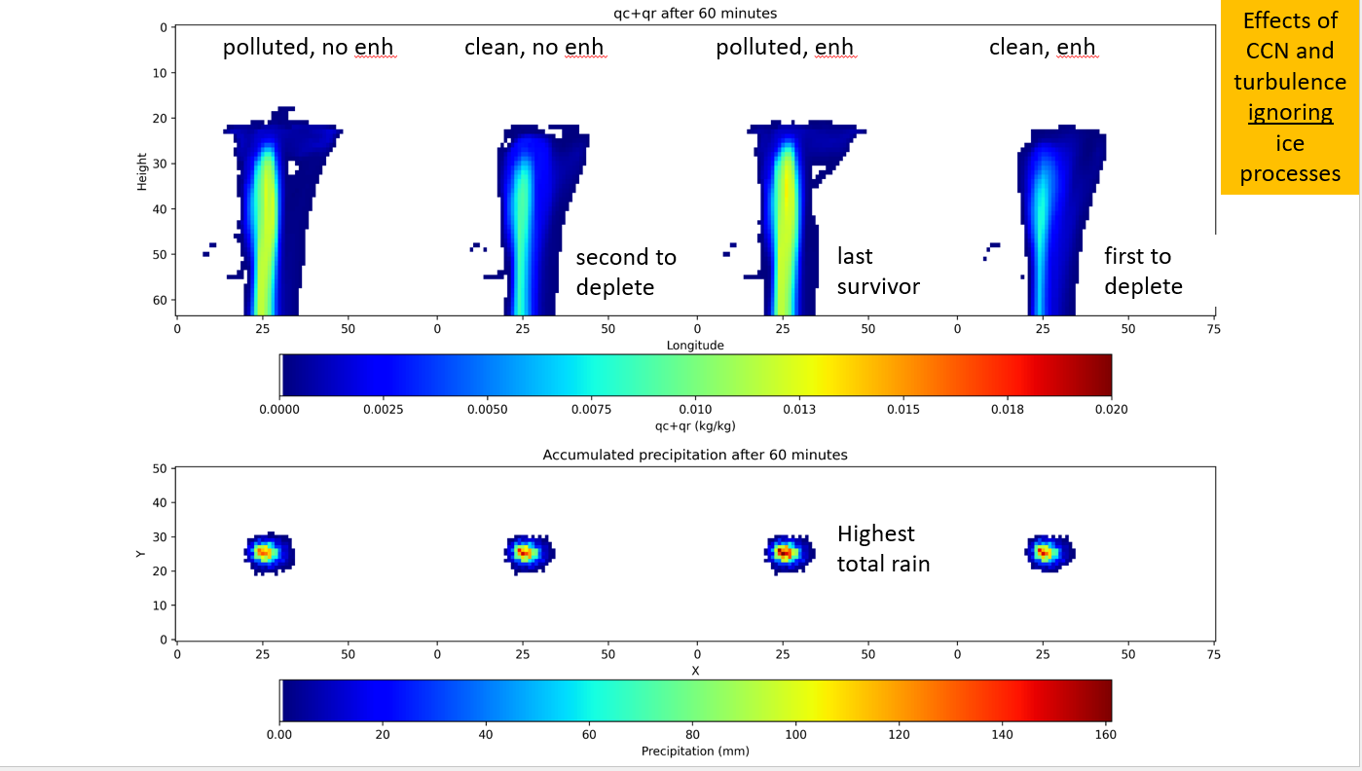

Slide 38
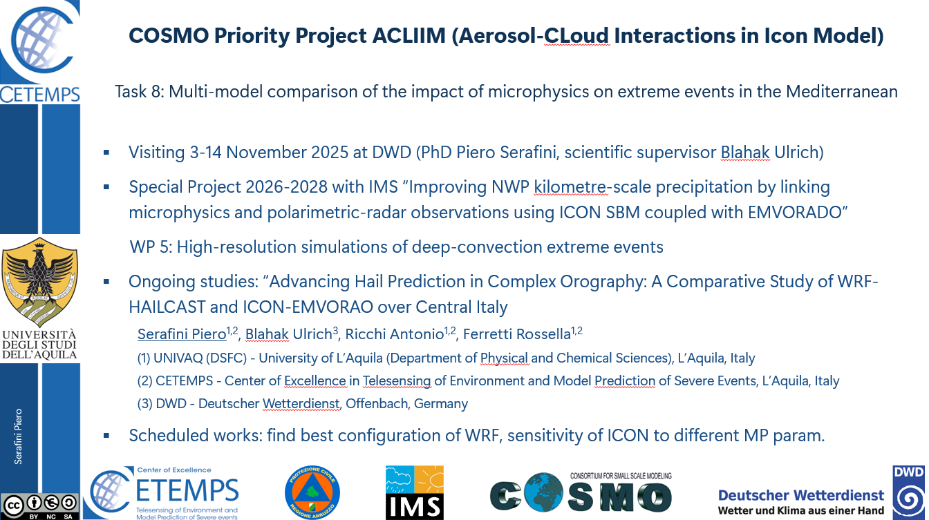

Slide 39
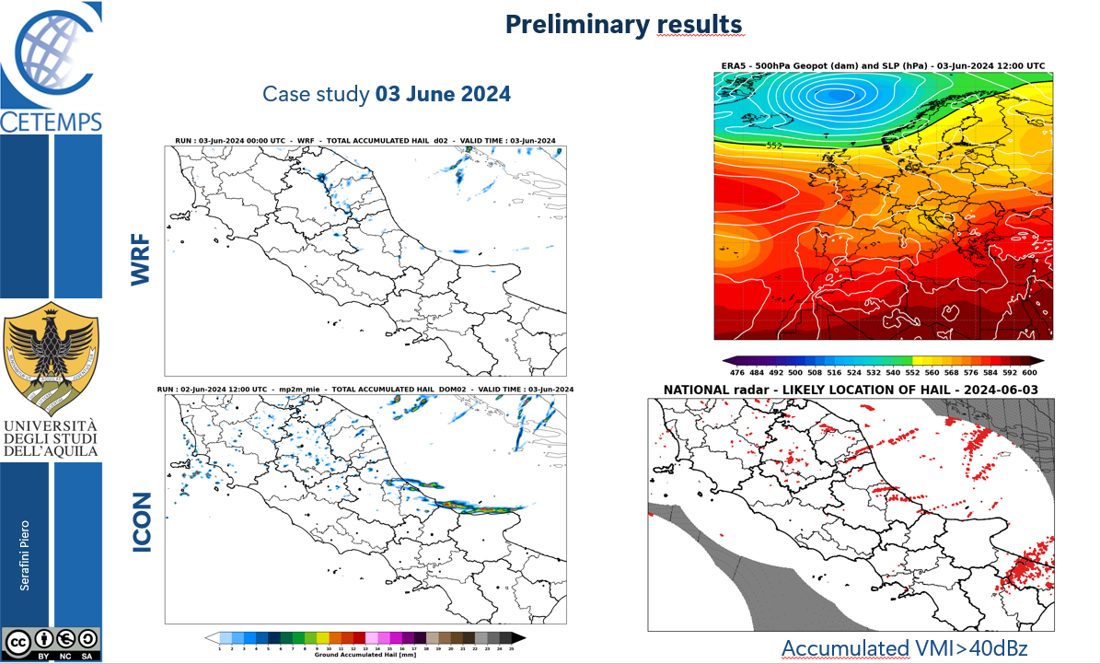

Slide 40
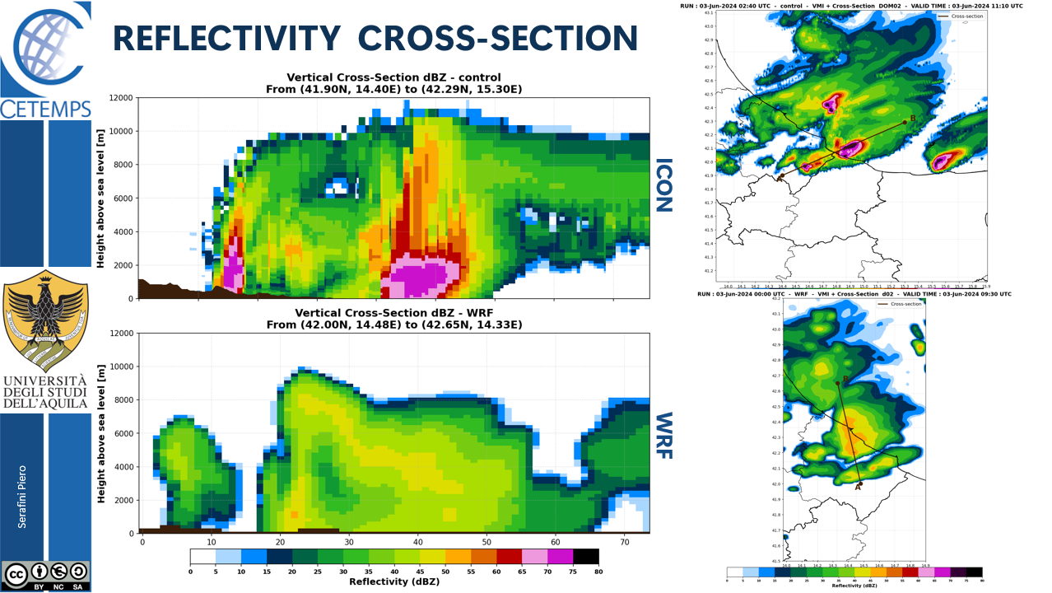

Slide 41



COSMO Priority Task: an update
Mediterranean Precipitation Improvement using EMVORADO
(MED-PRECIP-EM)
Jacob (Koby) Shpund, Jana Mendrok, Pavel Khain, Uli Blahak, Amir Givati and Axel Seifert
(1) Israel Meterological Service (IMS)
(2) Deutscher Wetterdiens (DWD)

Slide 42
MED-PRECIP-EM: motivation & current tasks
Synergy between radar observations and state-of-the-art microphysical schemes → better understanding of mixed-phase processes → enabling improved representation and calibration of precipitation in NWP
Validate & constraint ICON using radar forward operator (EMVORADO) coupled with the Spectral-Bin Microphysical (SBM*) scheme
  Ongoing:
  Subtask 2.0: Advancing current ICON-SBM mixed-phase version to meet the full hydrometeor topology of EMVORDO (e.g., rimed/melted mass fraction and explicit melting)
  Subtask 2.1: Coupling the EMVORADO forward operator module to recently developed ICON-SBM alongside the 1M and 2M schemes. Debugging and assuring EMVORADO’s look-up tables and hydrometeors topology are fully functional and consistent with the SBM microphysical scheme
  Subtask 2.2: Using idealized simulations of deep convection to assure the coupling works flawlessly, emphasizing on each polarimetric synthetic variable to act within expected range
  Next step:
  Subtask 3.1: Identifying and simulating selected Mediterranean precipitation regimes during autumn and winter (Cyprus Lows, Cold Fronts, Cuttoff Lows). Comprehensively compare with 3D radar observations and distrometers, in particular over Israel
  Subtask 3.2: For each microphysical scheme, map the phase space of relevant microphysical process rates and discuss the differences in terms of deficiencies compared to observed radar signatures

Slide 43
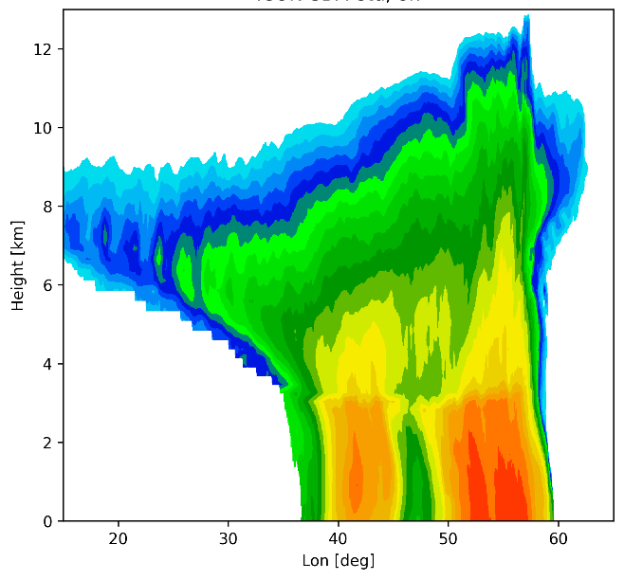
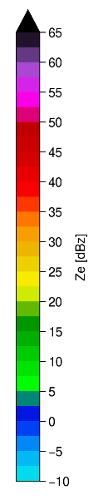
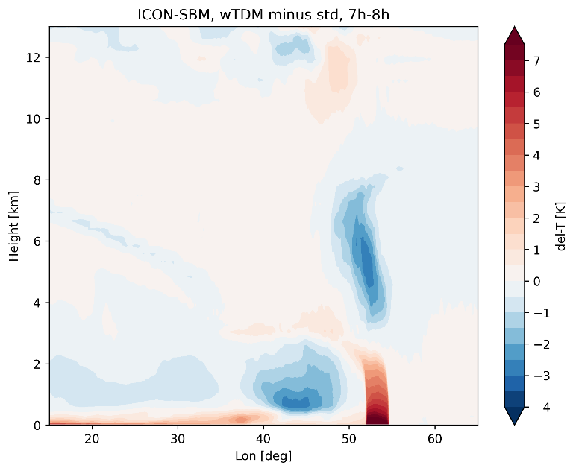

MED-PRECIP-EM: ongoing results
ICON-SBM-std
An idealized 3D squall-line is being used to evaluate the ICON-SBM dev work
The latest development includes the Time-Dependent-Melting (TDM) scheme, which caries liquid water mass on frozen hydrometeors to represent the melting process more accurately
The enhanced stratiform bright-band reflectivity is evident (even) in the Rayleigh regime, arising from the excess of large drop in the presence of ice produced during melting
The differences in microphysical process rates leads to 4 distinct regions of heating/cooling
ICON-SBM-wTDM

Slide 44
ICON-ART-Dust-IMS
First operational dust model in IMS
Thanks: Jochen Förstner, Sascha Brand, Uli Schaettler, Detlev Majewski

Slide 45
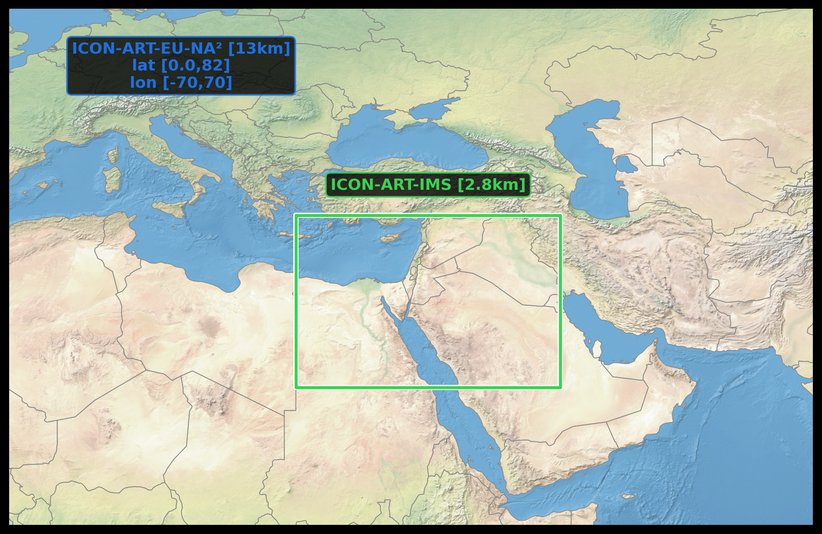
Model domain

Slide 46
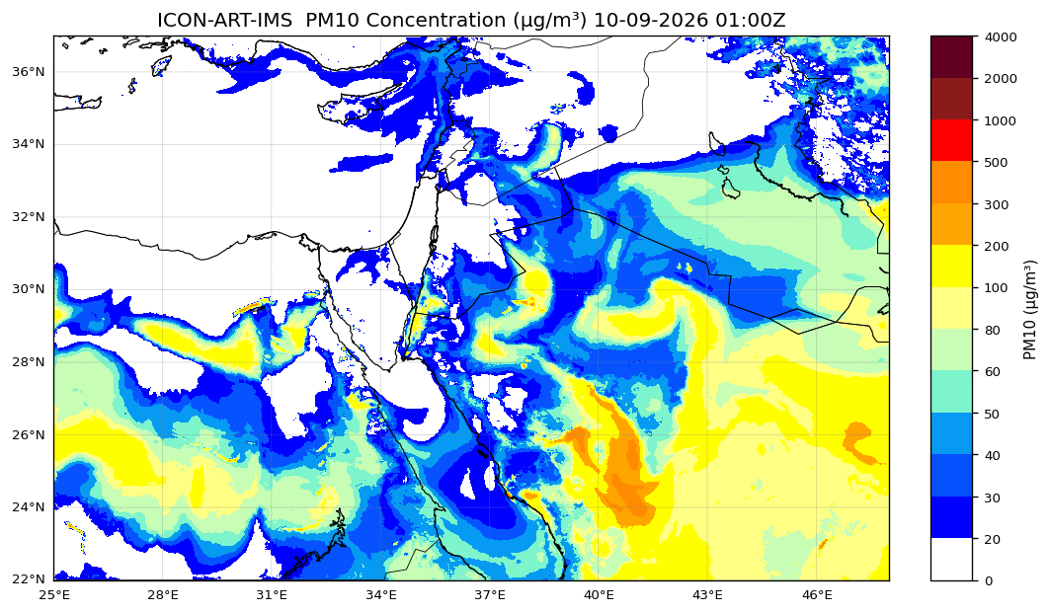
Example

Slide 47
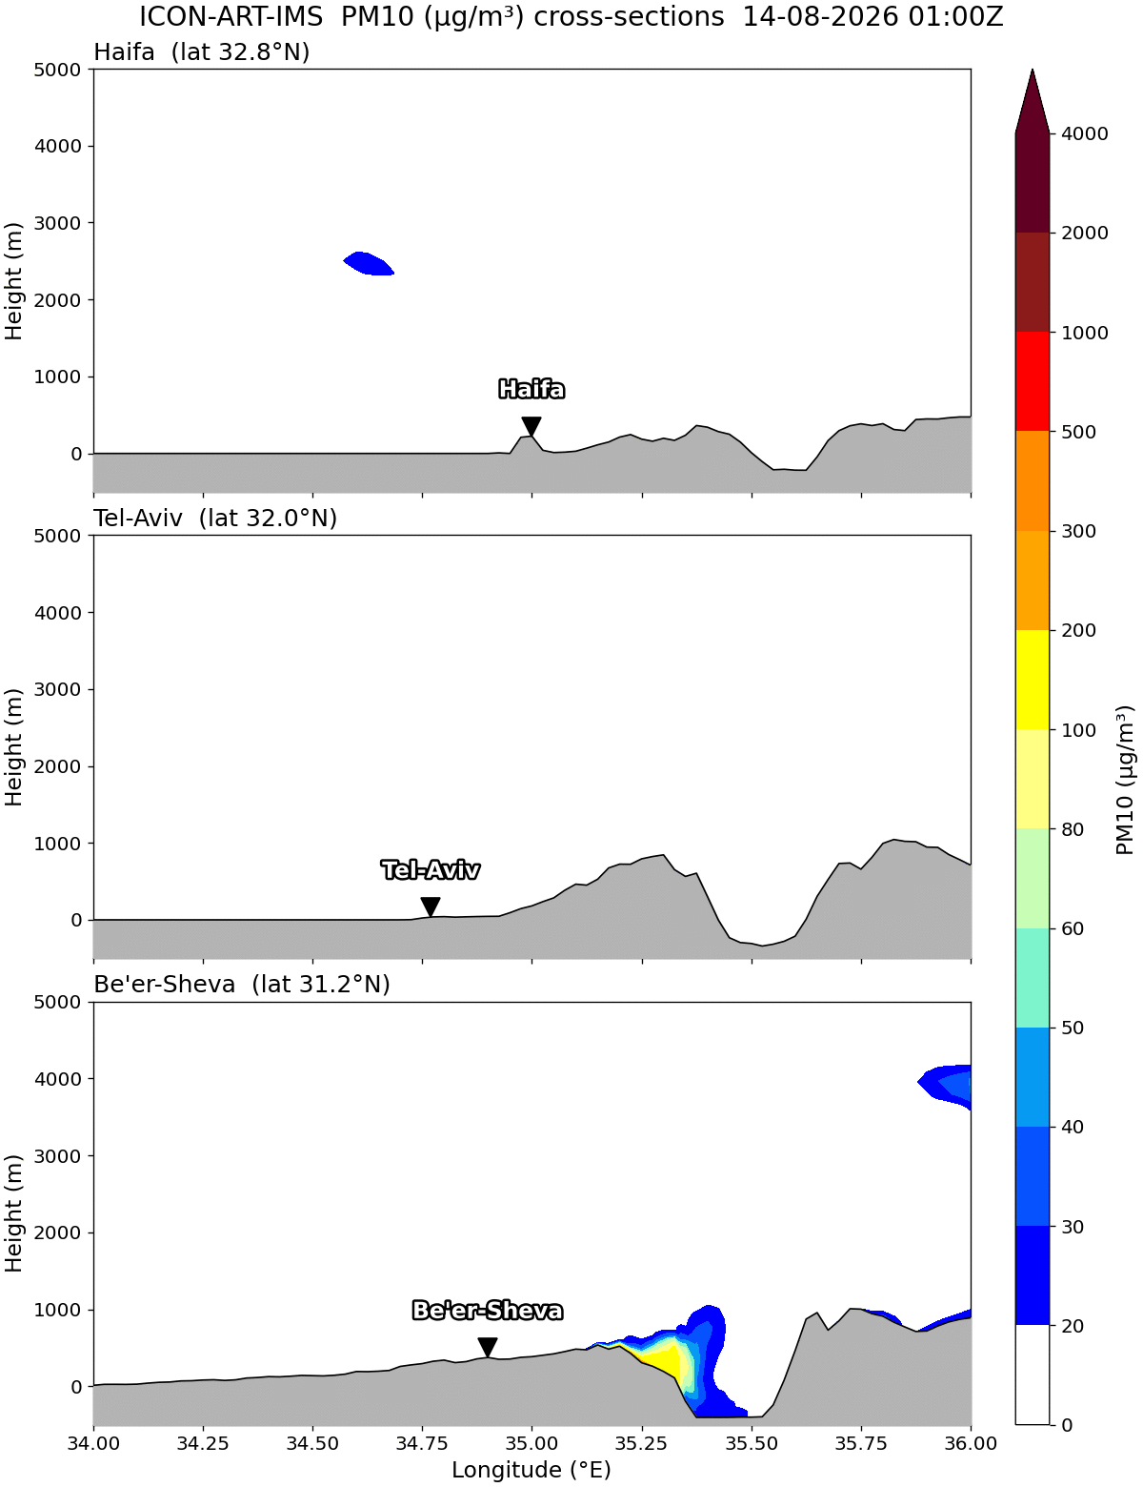
PM10 profiles

Slide 48
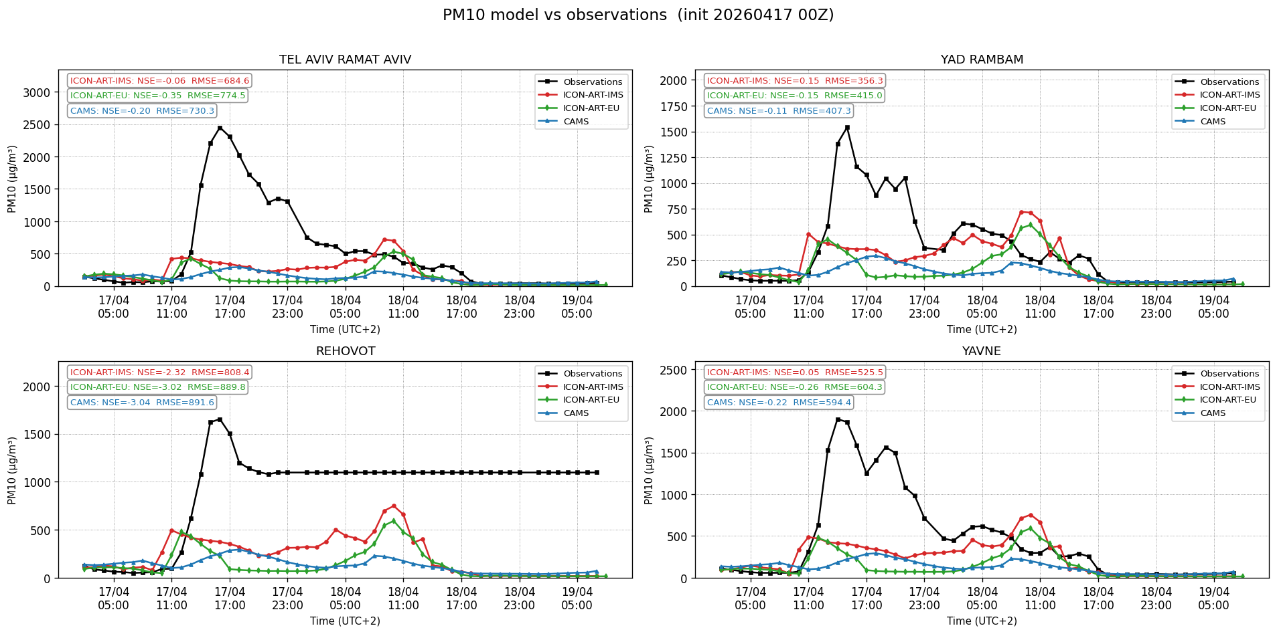
Ground base PM10 Verifications
17/04/2026 – 00Z RUN

Slide 49
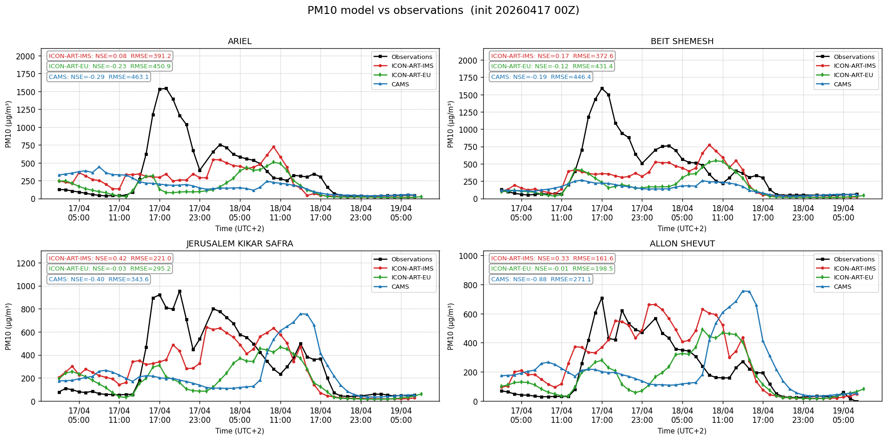
Ground base PM10 Verifications
17/04/2026 – 00Z RUN

Slide 50
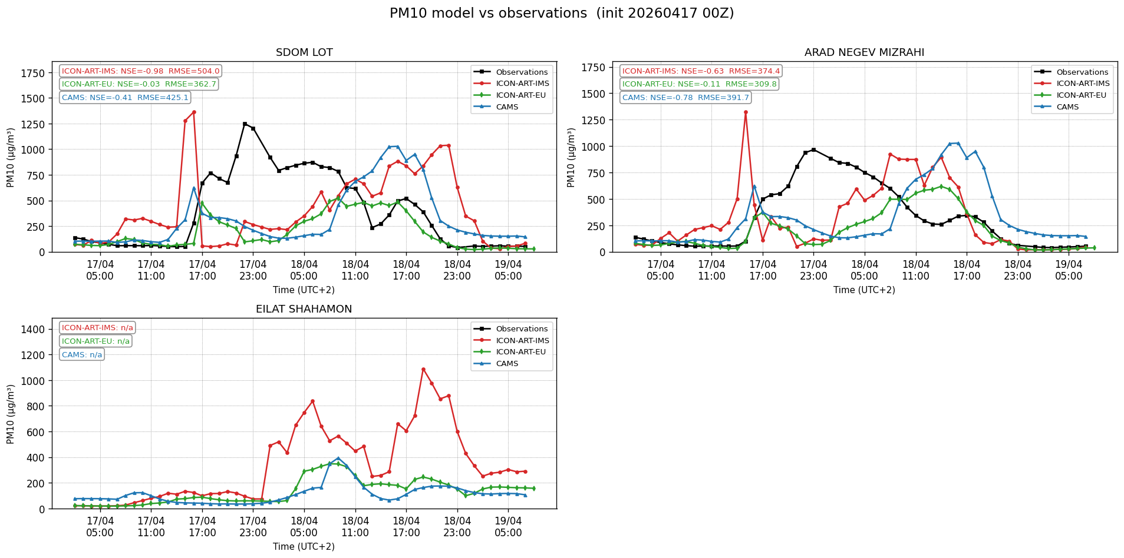
Ground base PM10 Verifications
17/04/2026 – 00Z RUN

Slide 51
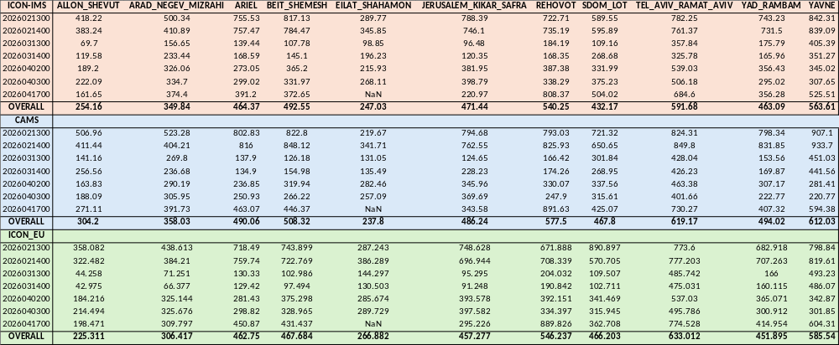
Ground base PM10 Verifications
==== Overall metrics (all dates, all stations) ====
ICON-ART-IMS : RMSE=458.61 bias=-194.76 (n=3909)
ICON-ART-EU : RMSE=461.45 bias=-240.96 (n=3909)
CAMS : RMSE=485.70 bias=-198.41 (n=3909)

Slide 52
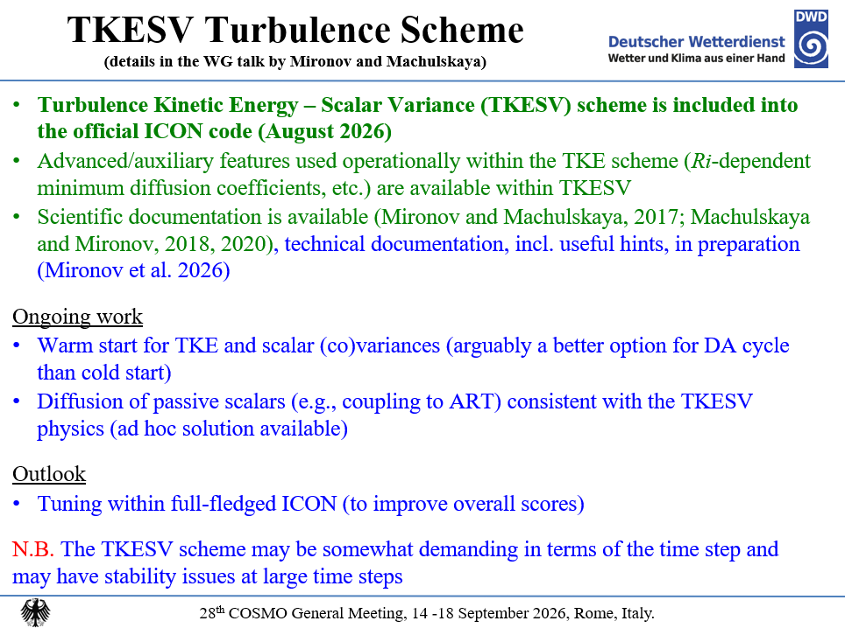

Slide 53
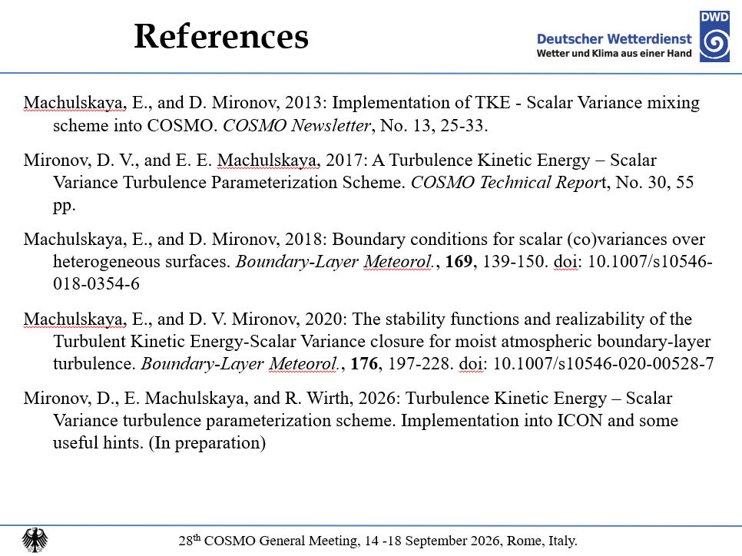

Slide 54


