Slide 1

Andrzej Mazur (on behalf of Andrzej Wyszogrodzki)
COSMO General Meeting 2026
NWP/HPC @ IMGW-PIB
status and plans

Slide 2
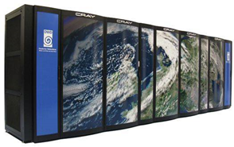
HPC for 2025+
World Bank PODPOW project (10+ mln EURO) run from 2025+
2 IMGW-PIB locations:
Warsaw 1Pf CPU (Dell PowerEdge R660 / Intel® Xeon® Platinum 8480+ 2.0G)
180 nodes x 2 CPU x 56 cores = 20160 cores, 512GB RAM/node
Krakow 0.75 Pf GPU (3 nodes of Dell PowerEdge XE9680)
3 x 2 x Intel® Xeon® Platinum 8468 2.1G, x 48 cores = 288 CPU corers
3 nodes x 8 cards NVIDIA HGX H100 8-GPU = 24 GPU cards
1024 Gb RAM/node
0.25 Pf CPU (Dell PowerEdge R660 , Intel Xeon Platinium 8480+ 2.0G)
45 nodes x 2 CPU x 56 cores = 5040 cores, 512GB RAM/node
Storage: 2x 4 PB datastore
GPU possible applications: COSMO/ICON, hydro models,
ALADIN/Destination Earth

Slide 3
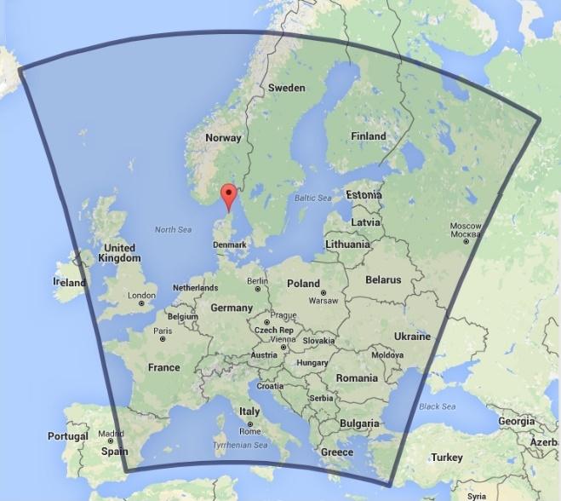
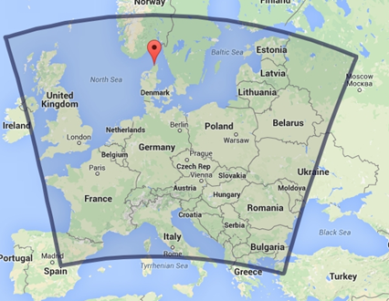
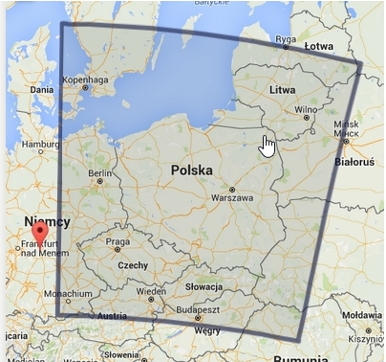
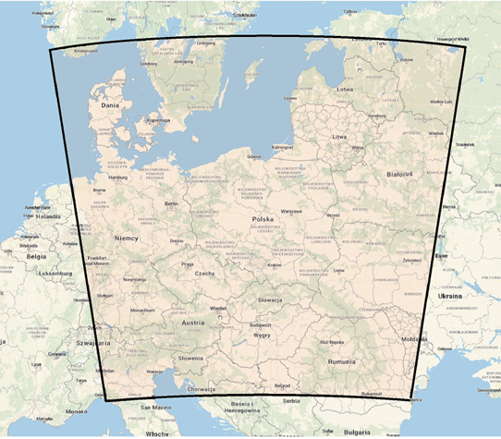
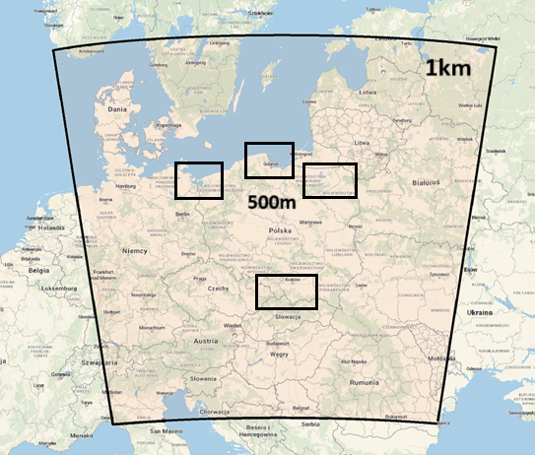
2026 NWP operational deterministic models
COSMO 14k0
COSMO 7k0
COSMO 2k8
ICON-LAM 2k5
Model Version | COSMO14k 5.05 | COSMO 7k V 6.01 | COSMO 2k8 V 6.01 | ICON-LAM (2024.03)
Grid spacing | 14km | 7km | 2.8km | R2B10,2.5k
Grid size [NxMxL] |  | 415x445x51 | 380x405 x 41 | 294638 x 65
Integration time [sec] | 55 | 40 | 15 | 24
Forecast length [hours] | 78 | 96 | 60 | 48
Forcst time start [UTC] | 00,06,12,18 | 00,06,12,18 | 00,06,12,18 | 00,06,12,18
IC/BC / update time [h] | ICON / 3h | ICON / 3h | COSMO7k0/1h | ICON / 3h
R2B10, ~2.5km
14 x 14 deg domain,
294636 elements
rotated north pole: -170,0,0
65 levels, dt=24s
48 hour forecast
4x/day (00, 06, 12, 18 UTC)
Changes planned
Increase resolution to ~1km (it is running, tho’ not operationally yet)
Nested subdomains at hectometric scale (500m and below)
ECOCLIMAP-SG + TERRA_URB

Slide 4
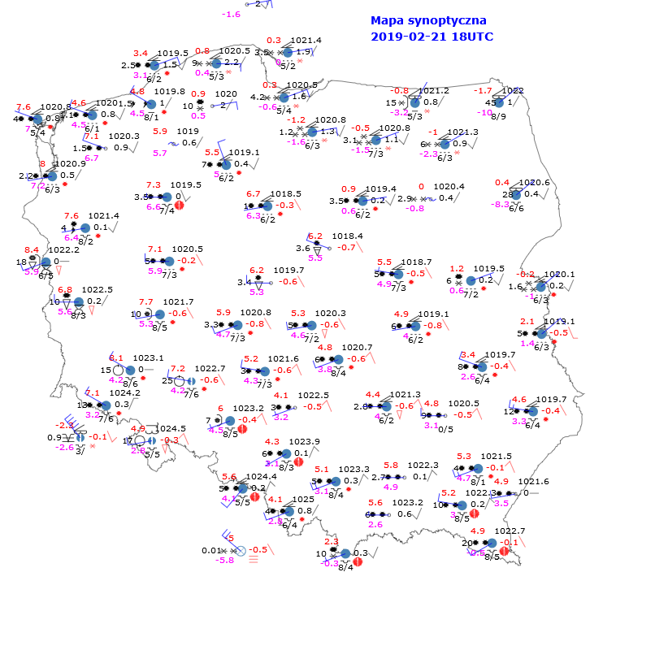
ICON-LAM vs COSMO
ICON-PL
(dated 2024.03, 2.5km, includes cp/cv bug fix, the RRTM radiation scheme)
COSMO-CE-PL
(v. 6.01, 2.8km)
Verification using MEC/Rfdbk (← CARMENs)
Comparison with the Polish SYNOP (Poland domain),
TEMP stations (Poland stations)
ICON-PL overall performs better than COSMO-CE-PL for most of surface and upper air parameters
Exceptions (still under investigation…):
There is a systematic difference in wind speed and wind direction biases between ICON-PL and COSMO-CE-PL
ICON-PL produces more rain than COSMO-CE-PL during convective seasons
ICON-PL is generally less accurate than COSMO-CE-PL at the top of the atmosphere for all analyzed parameters
Notes:
4

Slide 5
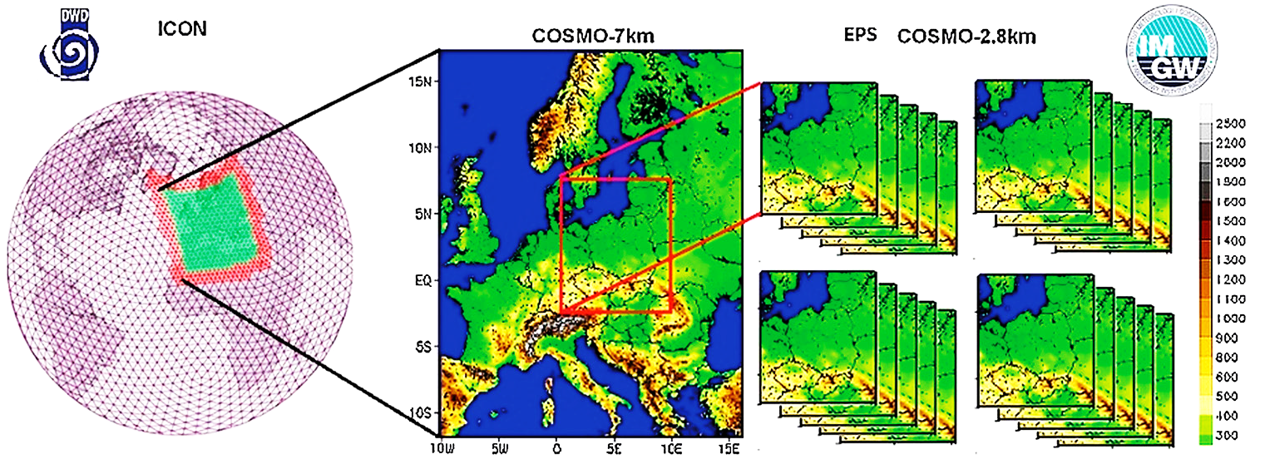
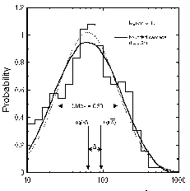
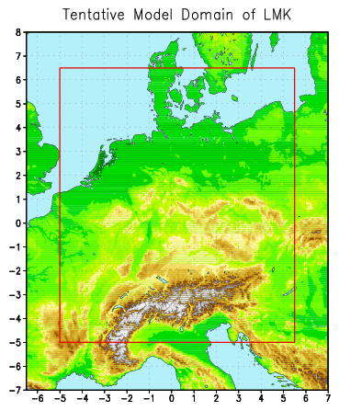
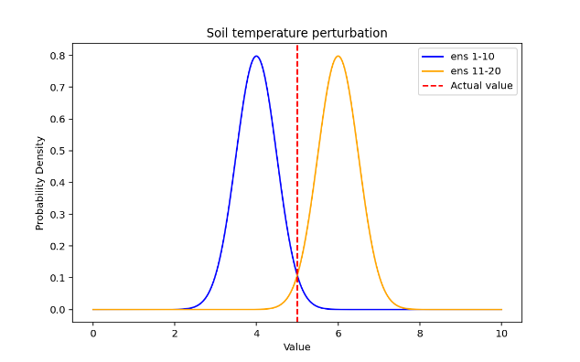
TLE ensemble system 2025+
TIME LAGGED EPS / COSMO 2k8 (20 members)
products
verification
statistical postprocessing
ICON -> COSMO 7km
PERTURBATIONS:
C-Soil, T_SO
IC/BC
Soil physics
Changes planned
COSMO -> ICON-LAM transition
Perturbation setup -> increase spread

Slide 6
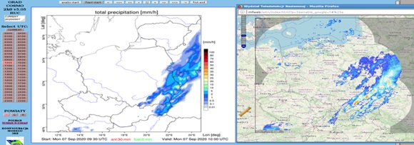
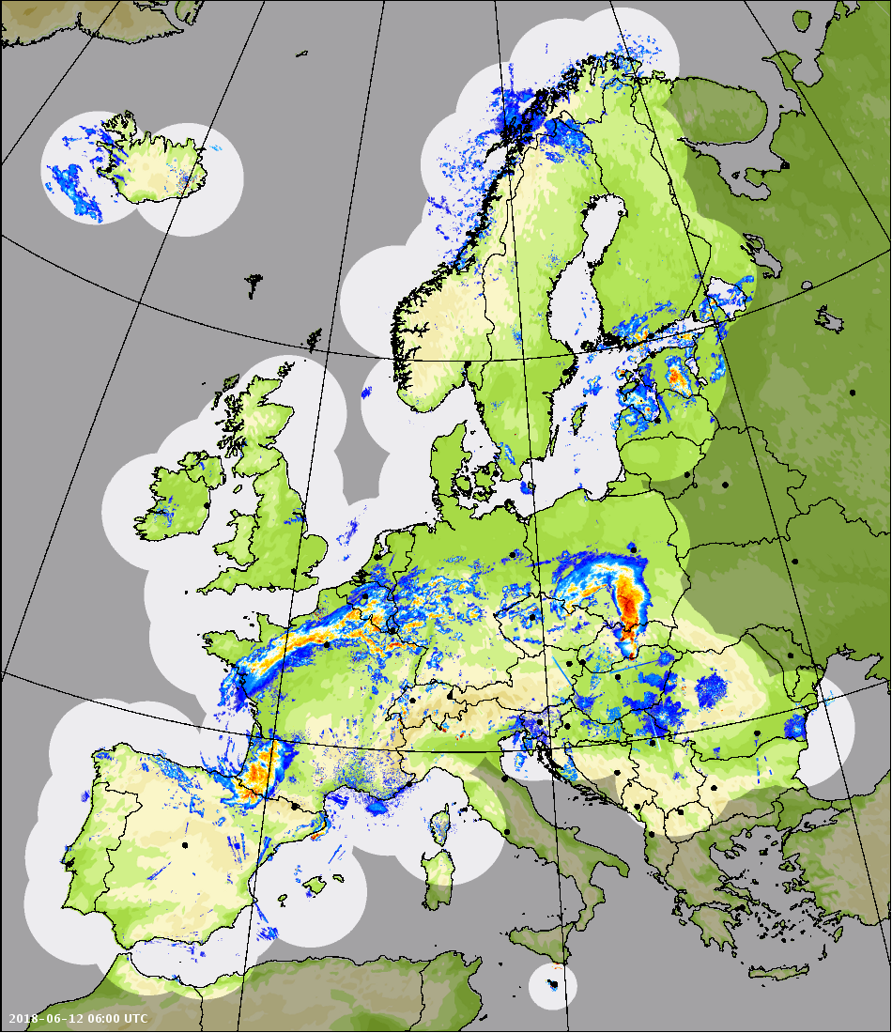
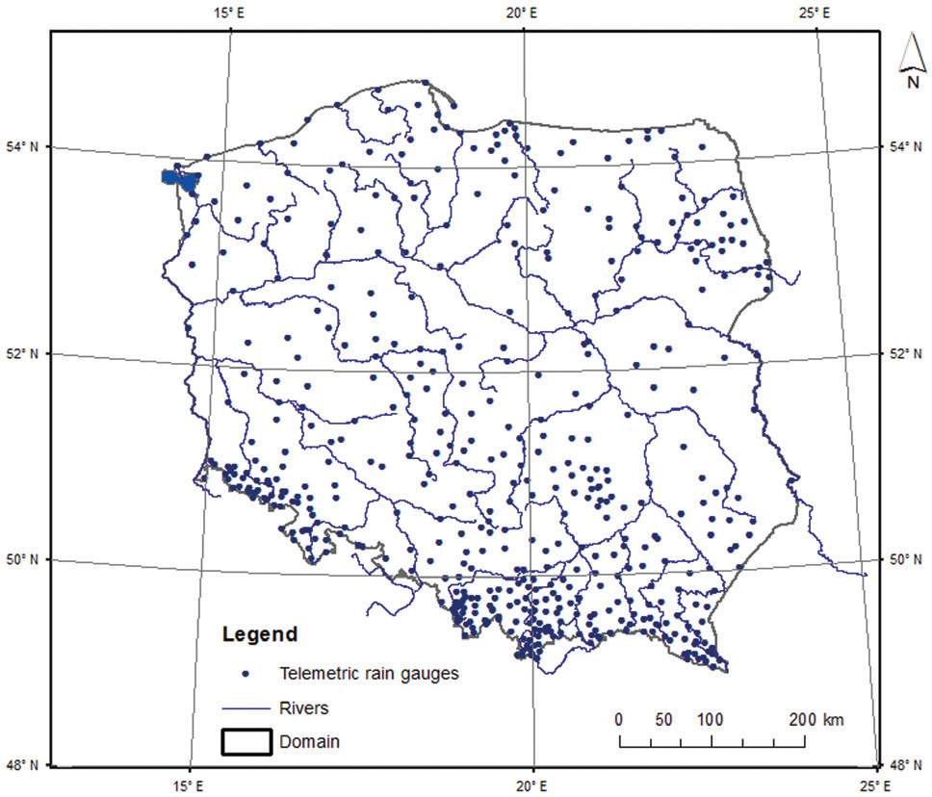
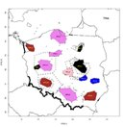
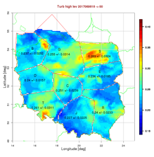
RUC - Rapid Update Cycle
COSMO 2.8km
1h analysis
3h forecast
30 min update (48/day)
assimilation:
Opera radar SRI, AMDAR and telemetric 380 stations
Applications:
aviation,
nowcasting
flash flood
Control FIR zones
  Changes/additions (as planned):
  Opera (15 min) → RainGRS+ (5/10 min)
  2-moment microphysics (graupel and hail) – to be running operationally soon
Turbulence, icing, visibility, convective parameters

Slide 7
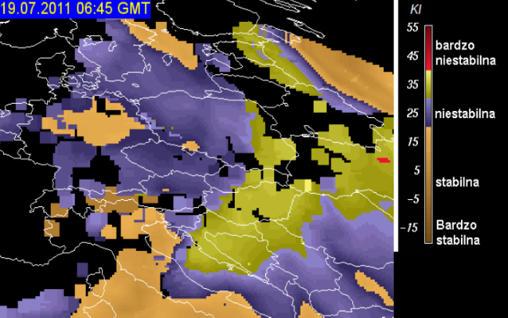
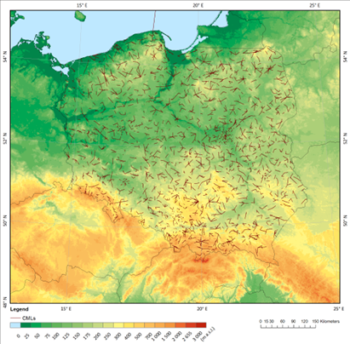
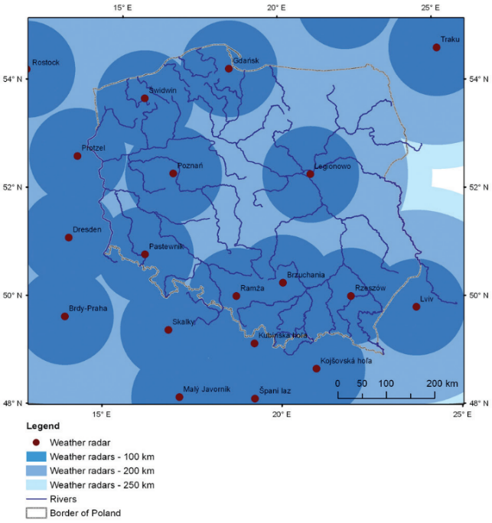
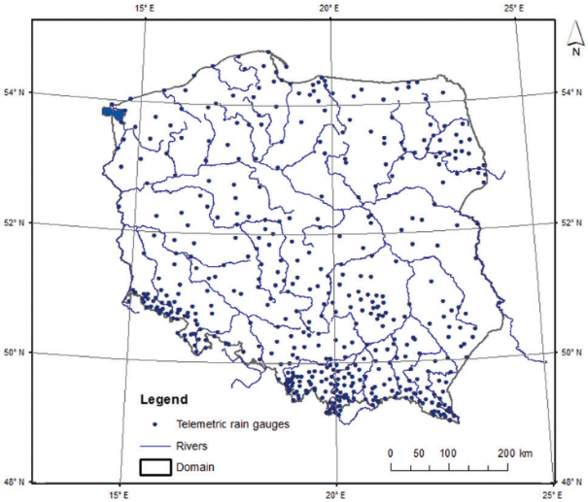
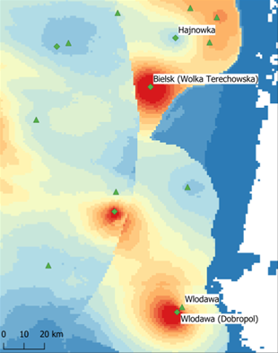
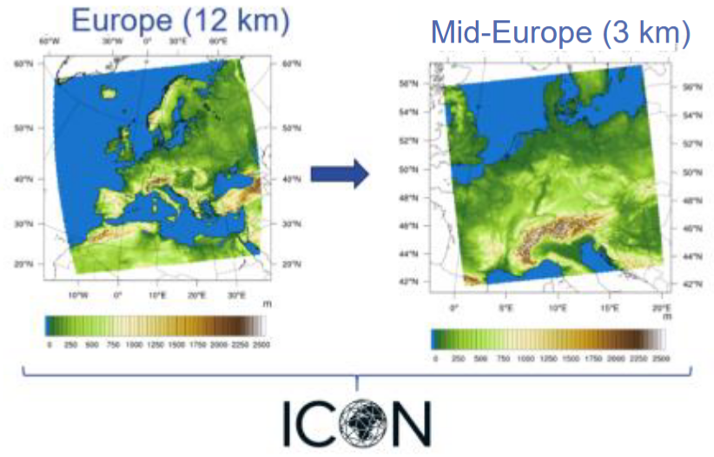
RUC - Rapid Update Cycle
METEOSAT SATELLITES
RainGRS composites
multi-source GRS precipitation fields
data quality control,
weighted processing of precipitation inputs
RainGRS+OPERA, PWS^{*)}, CML^{**)}
Doppler /dual-polarized radar data: Poland (8) + Lithuania (2), Ukraine (1), Slovakia (4), Czech Republic (2), Germany (4)
NETWORK OF TELEMETRIC RAIN GAUGE STATIONS (491)
POLRAD + OPERA
POLRAD+ NETWORK
^{*)} Personal Weather Stations
^{**)} Commercial Microwave Links – point-to-point radio connections between cellular base stations that double as high-resolution environmental sensors.

Slide 8
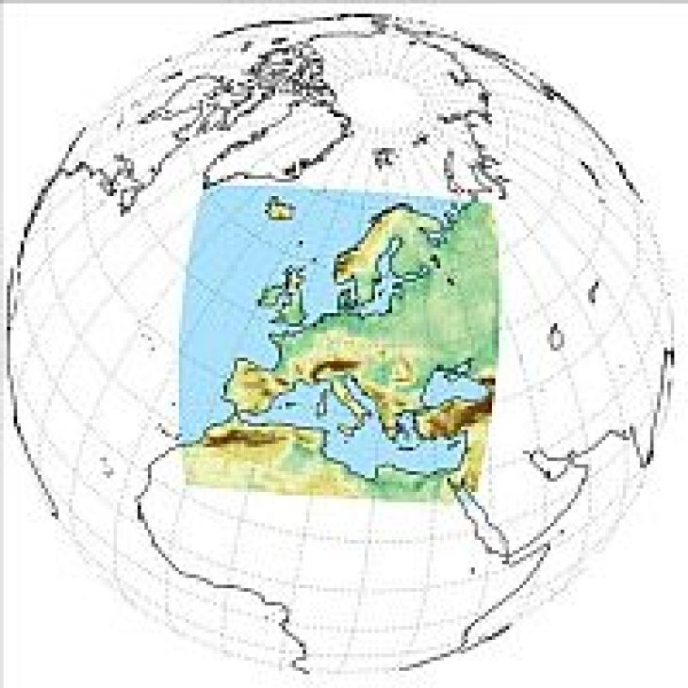
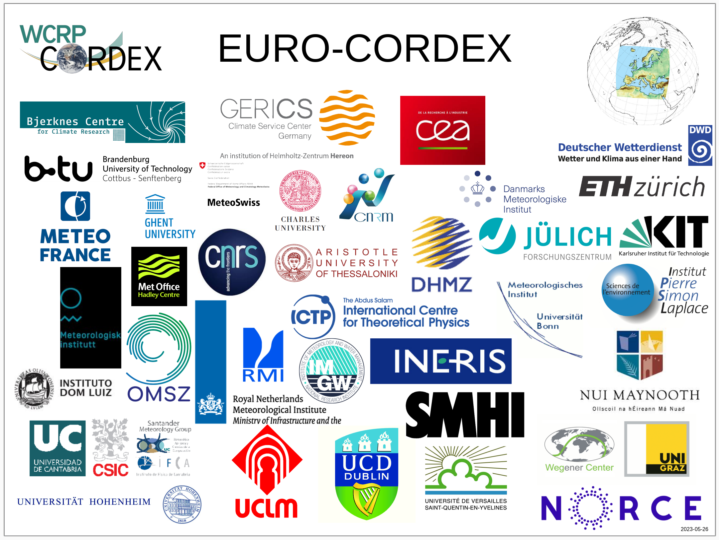
Regional climate simulations with ICON-CLM
Contribution to EURO-CORDEX
CMIP6 GCM: NorESM2-MM
Scenarios: SSP126, SSP370
UDAG project (Updating the Data basis for Adaptation to climate change in Germany) – tune ICON-CLM at 3 km on DKRZ
Configuration Optimization of ICON-CLM 12km over Europe and 3km over Germany using a Linear Meta MOdel (LiMMo)

Slide 9
COSMO sci. projects 2025/2026
PP APOCS (Application of Personal Weather Station and Opportunistic Sensor Data CrowdSourcing) running
PP KAOS (Addressing the complexity in the weather forecast) running
PP PROPHECY ( PRObabilistic Prediction at High-resolution with EnhanCed perturbation strategY) → finished.
PP CITTA (City Induced Temperature change Through A’dvanced modelling) → finished
PT EGALITE (Early warninG and AnaLysIs SysTEm for release and dispersion of contaminants) → finished (publication prepared and submitted).
PP CARMENs (Cosmo Application of Rfdbk/MEC on ENS) → finished

Slide 10
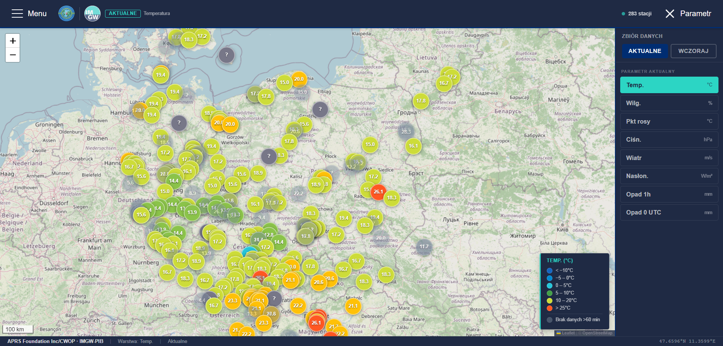
PP APOCS (Application of Personal Weather Station and Opportunistic Sensor Data CrowdSourcing)
280+
500 km
active PWS stations
radius · 52°N / 19°E

Slide 11
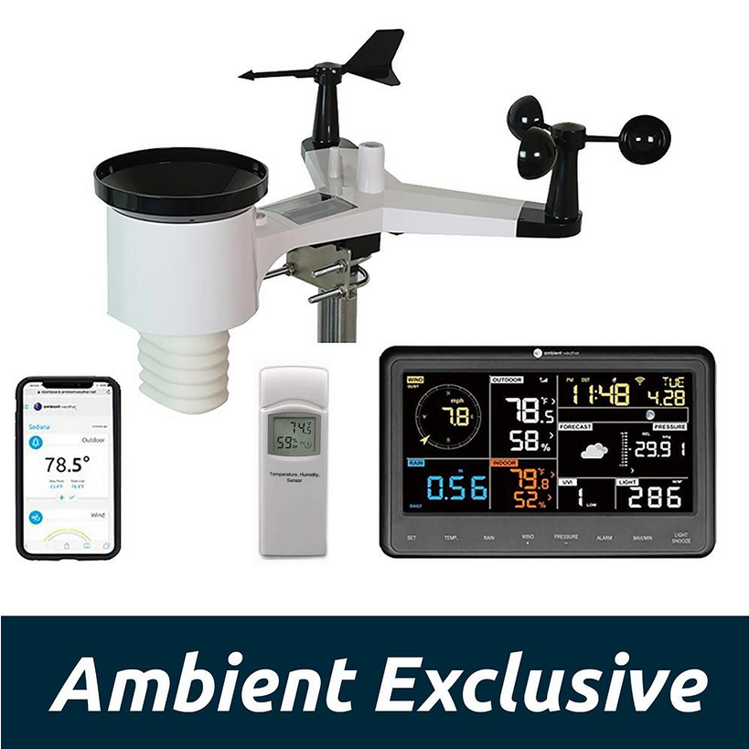
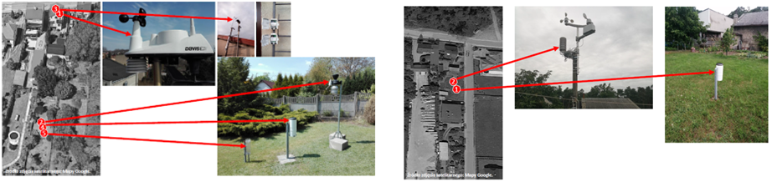
PP APOCS – Task 1: Development of COSMO PWS database
The first tests with employee devices and the test database (approx .40 stations)
Include a larger number of stations for internal tests
Add participants from COSMO partners and other collaborating institutions.
Include data QC software and web based GUI with visualization

Slide 12
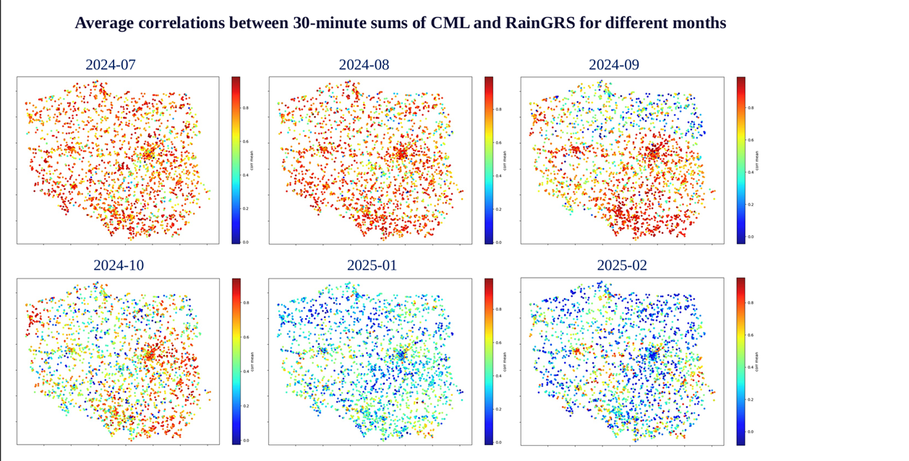
PP APOCS – Task 2.1: Adaptation of the RainGaugeQC system
to CML-based precipitation data)

Slide 13
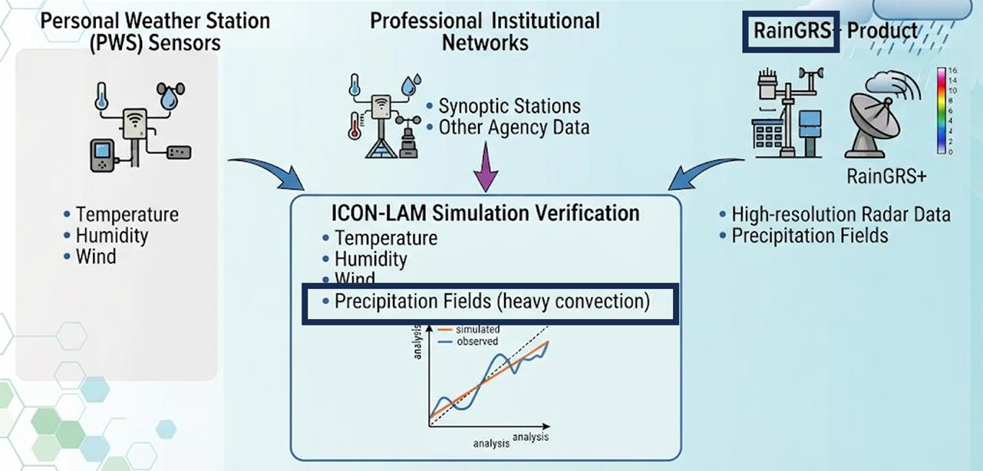
PP APOCS – Task 4.3: Application of PWS
to NWP model verification in urban areas

Slide 14
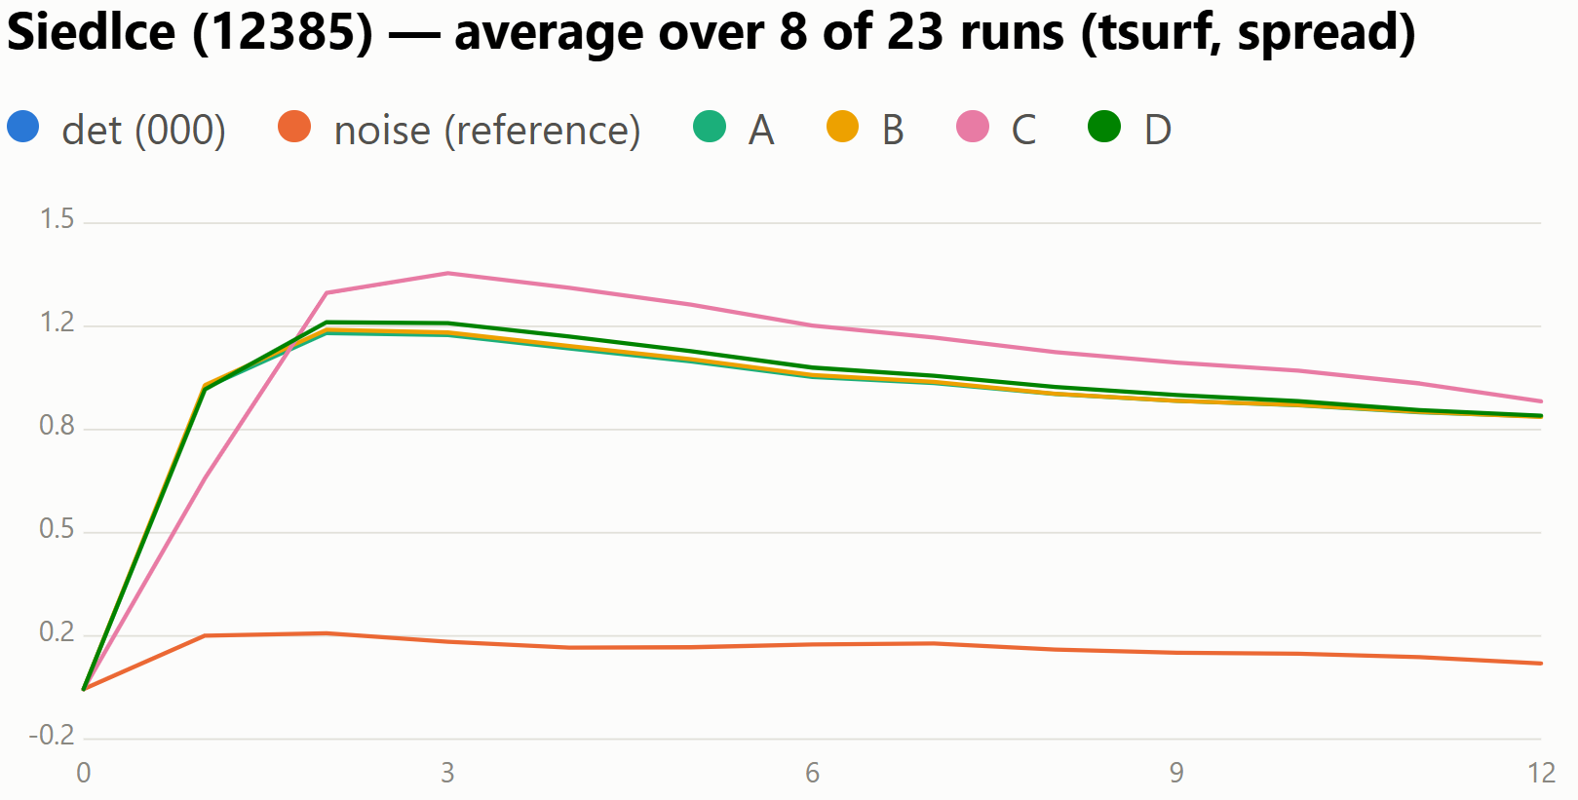
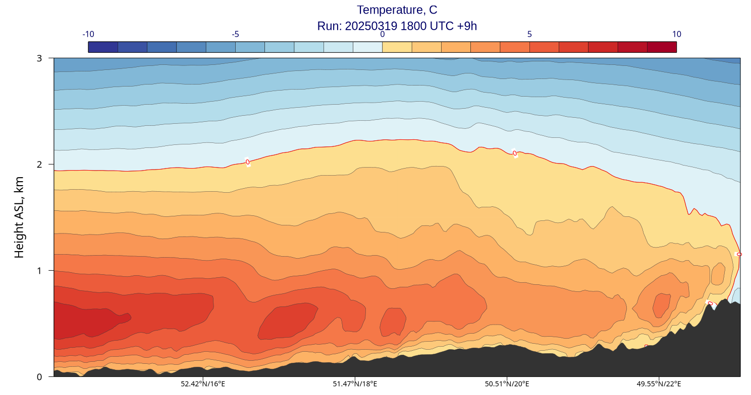
PP KAOS: perturbation of the soil variables
as a part of PP KAOS, we are working on the development of a new scheme for introducing soil temperature perturbations
the scheme has been implemented and tested in ICON on a number of test cases with inversion favorable conditions
we are planning to add and test more soil-related variables
Example: aggregated spread for Siedlce station.
Temperature shift as a function of soil depth, based on Tsyrulnikov et al. (2023).
The soil temperature perturbation scheme is tested on the test cases with inversion favorable conditions.

Slide 15
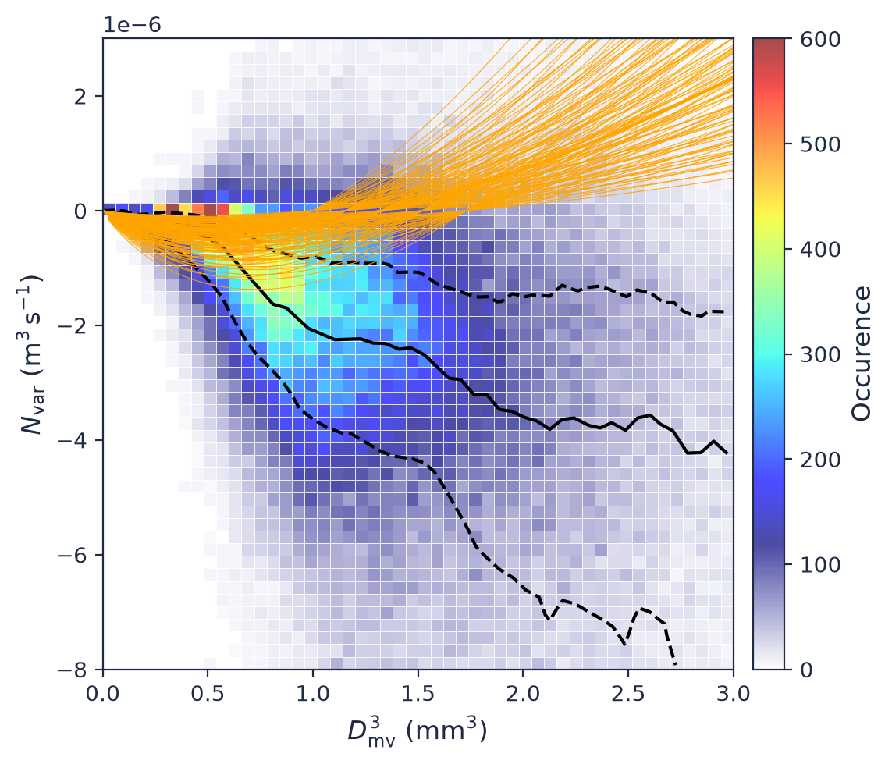
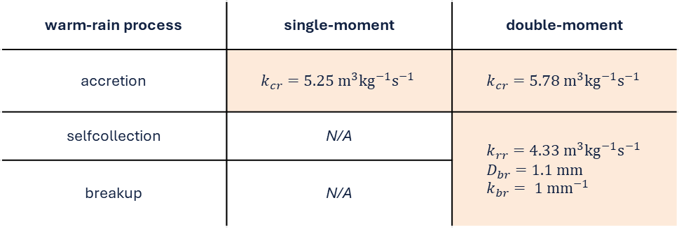
PP KAOS: cloud microphysics parameters for SPP development
as a part of PP KAOS, we are working on the development of the SPP method in ICON
recently, we have derived perturbation ranges for several parameters related to single- and double-moment cloud microphysics
we are planning to test them in an ensemble setup
warm-rain process | single-moment | double-moment
accretion | $$k_{cr}=5.25{ m}^{3}kg^{−1}s^{−1}$$ | $$k_{cr}=5.78{ m}^{3}kg^{−1}s^{−1}$$
selfcollection | N/A | $$k_{rr}=4.33{ m}^{3}kg^{−1}s^{−1} \\ D_{br}=1.1 mm \\ k_{br}= 1 {mm}^{−1}$$
breakup | N/A
Reproduction of Figure 10. from Niquet et al. (2024), used to derive perturbation ranges
for $k_{rr}$, $D_{br}$ and $k_{br}$ parameters.
Reproduction of Figure 9. from Long (1974), used to derive perturbation ranges for $k_{cr}$ parameter.

Slide 16
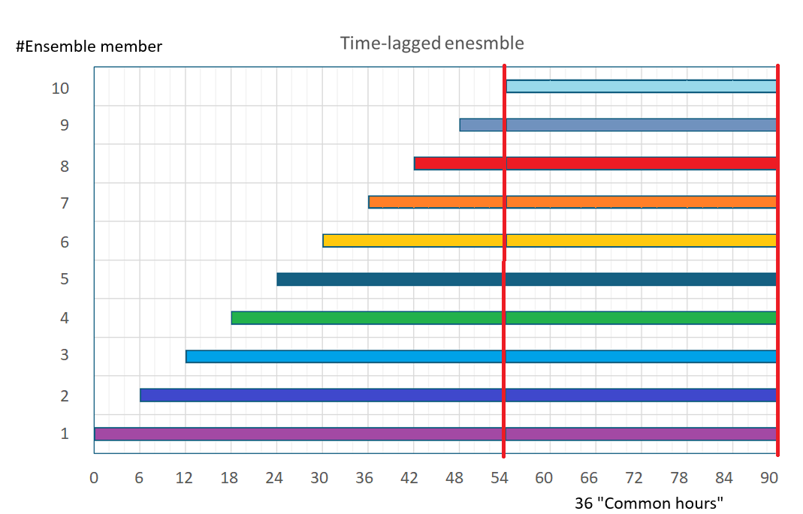
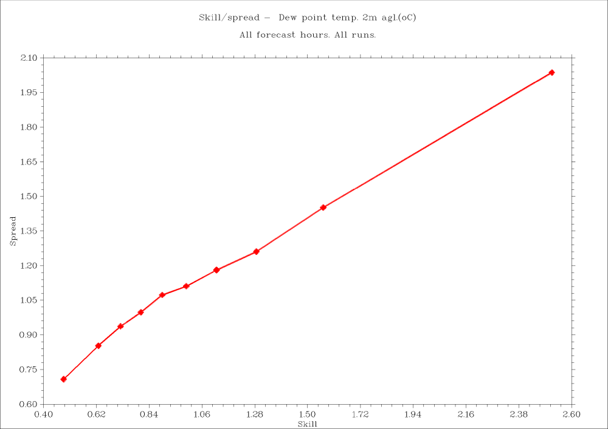
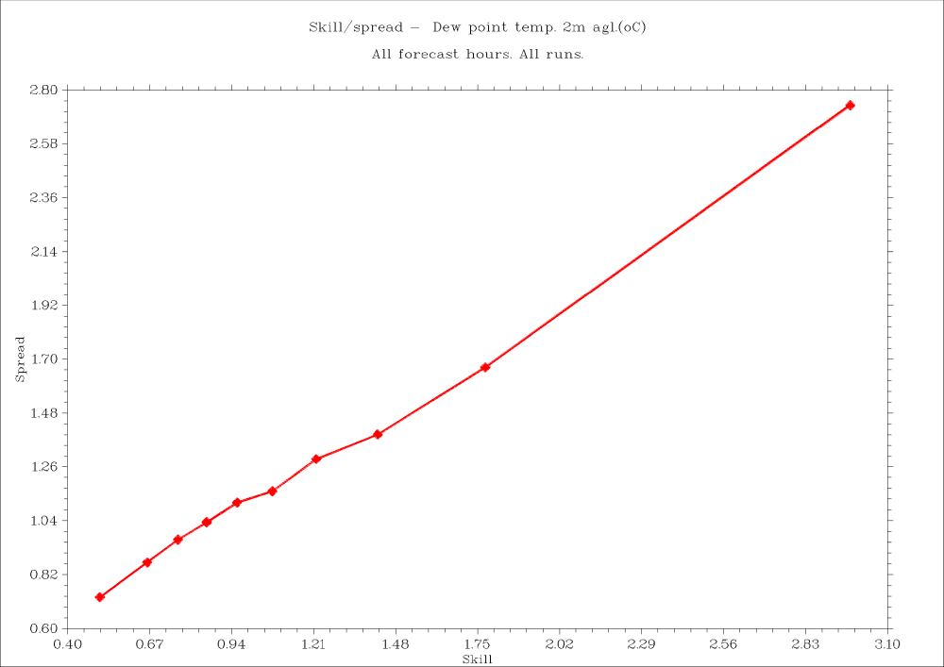
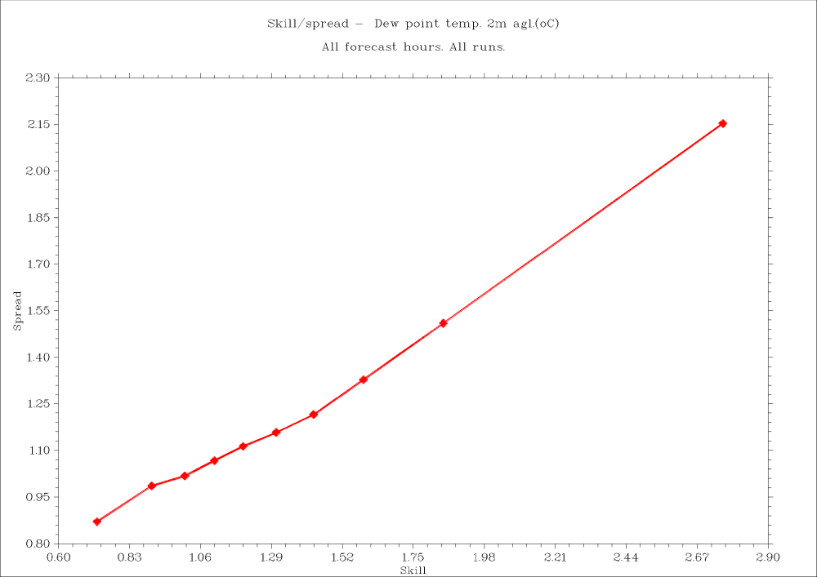
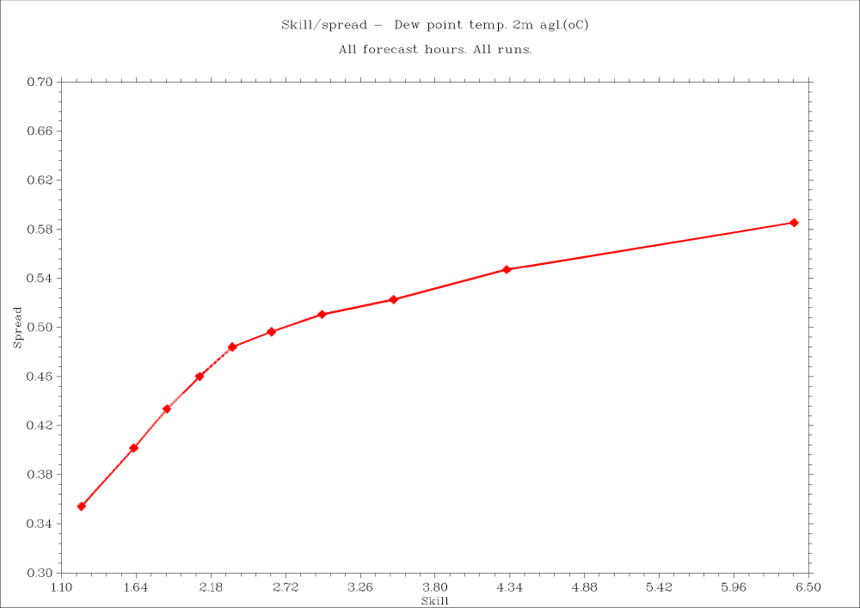

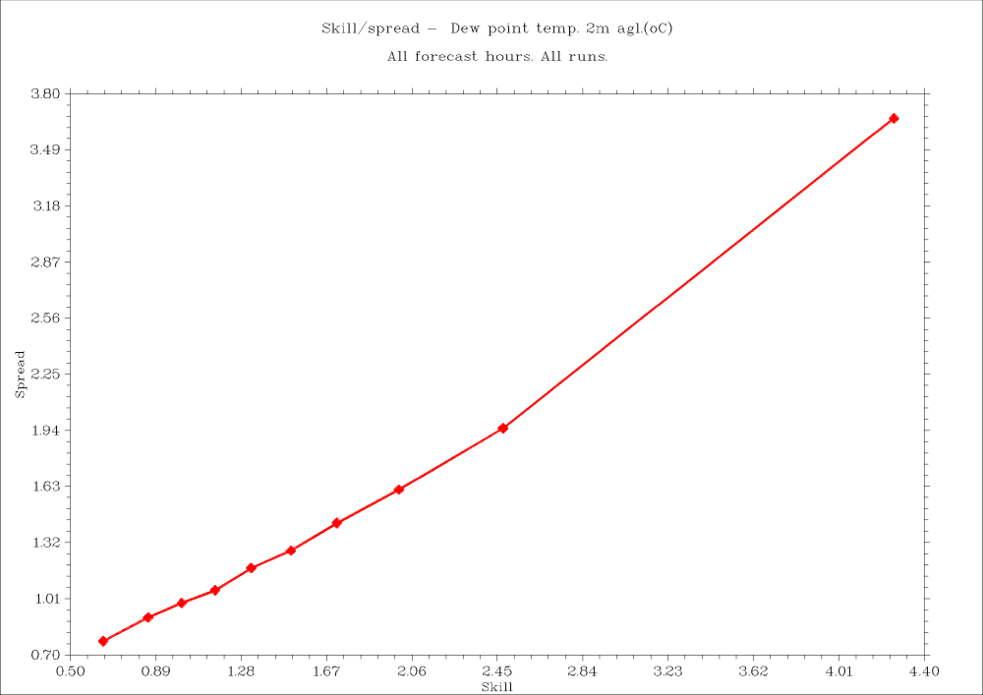
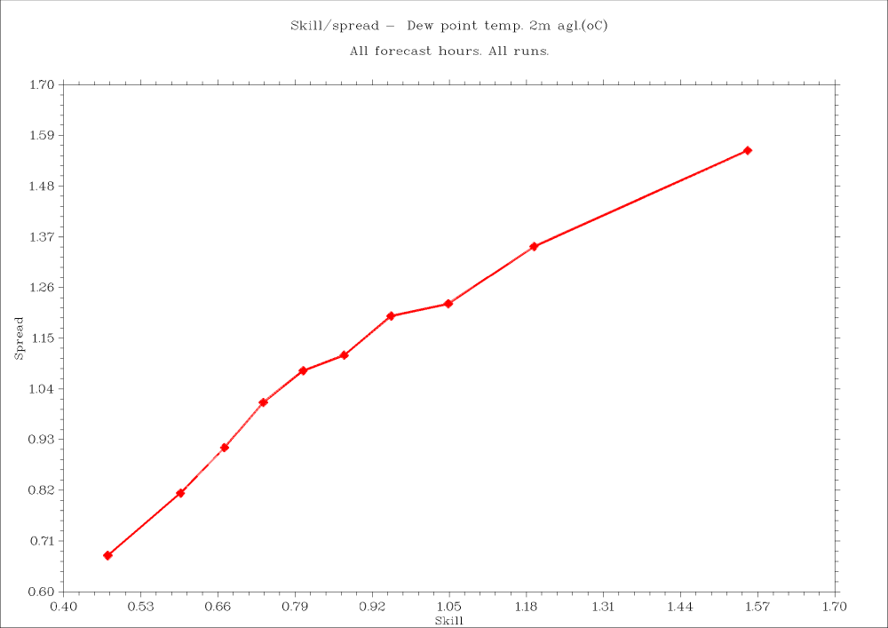
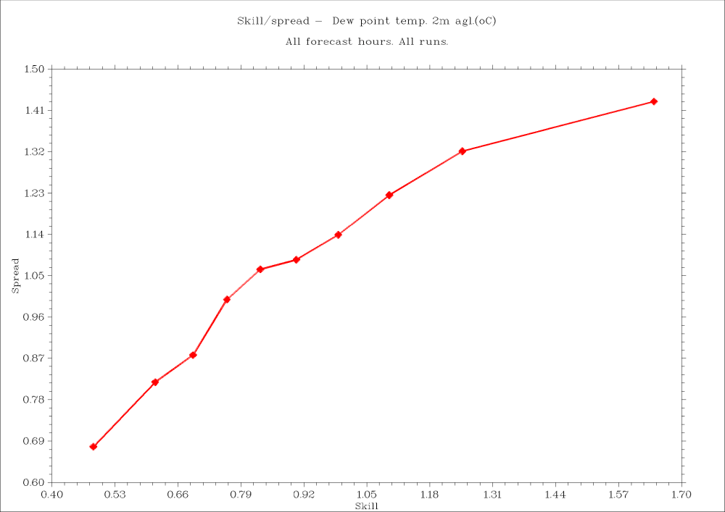
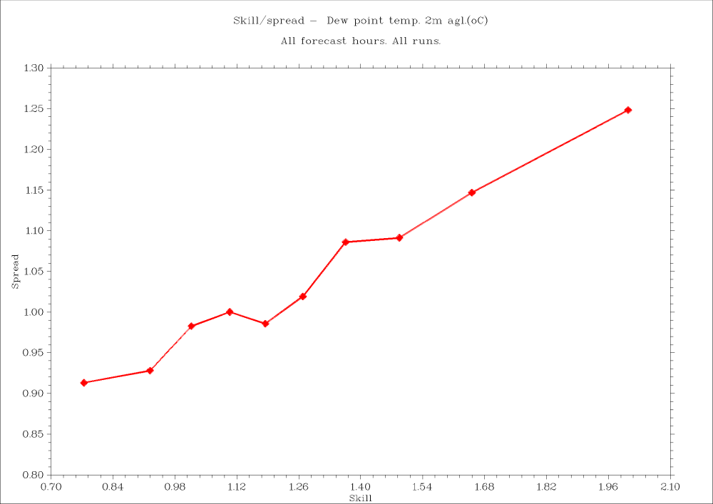
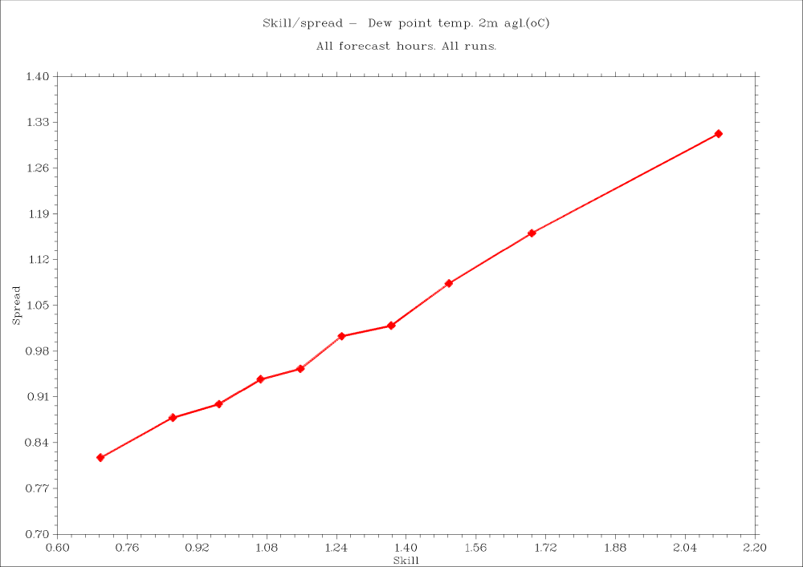
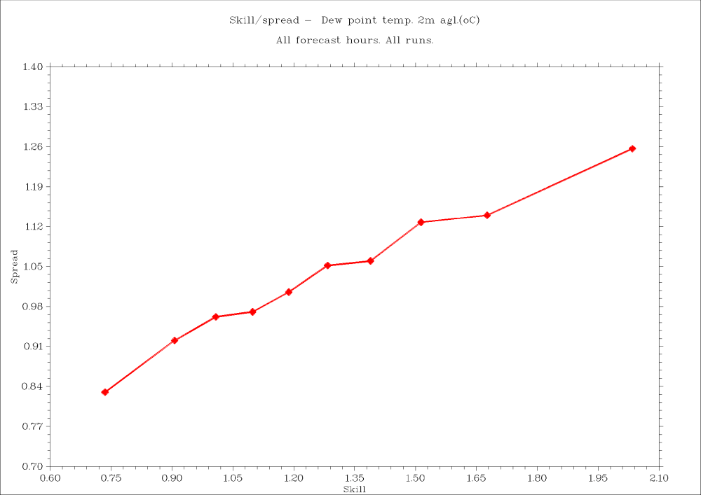
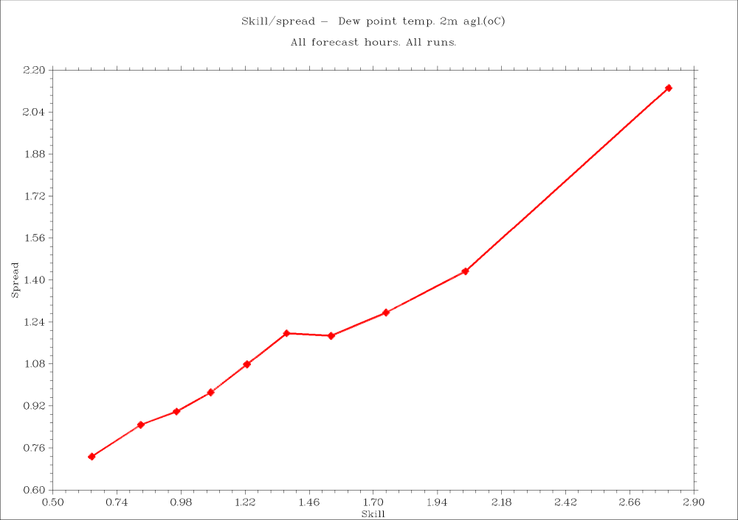
PP KAOS: Time-Lagging Ensembles
To reduce computational cost: skip the MVE part, stick with TLE → the number of elements = 10. An appropriate "base" models (deterministic, but with a sufficiently long forecasting period; 90 hours). Remember the previous forecasts…
youngest
oldest
Standard mean Weighted mean Standard regression Weighted mean Weighted mean ANN-based mean
(regression+geo.coords) (regression+orography)
Spread-Skill charts; TD2M, ”Super(TL)ensemble”, 50 members
Spread-Skill charts; TD2M, ”Super(TL)ensemble”, 60 members

Slide 17
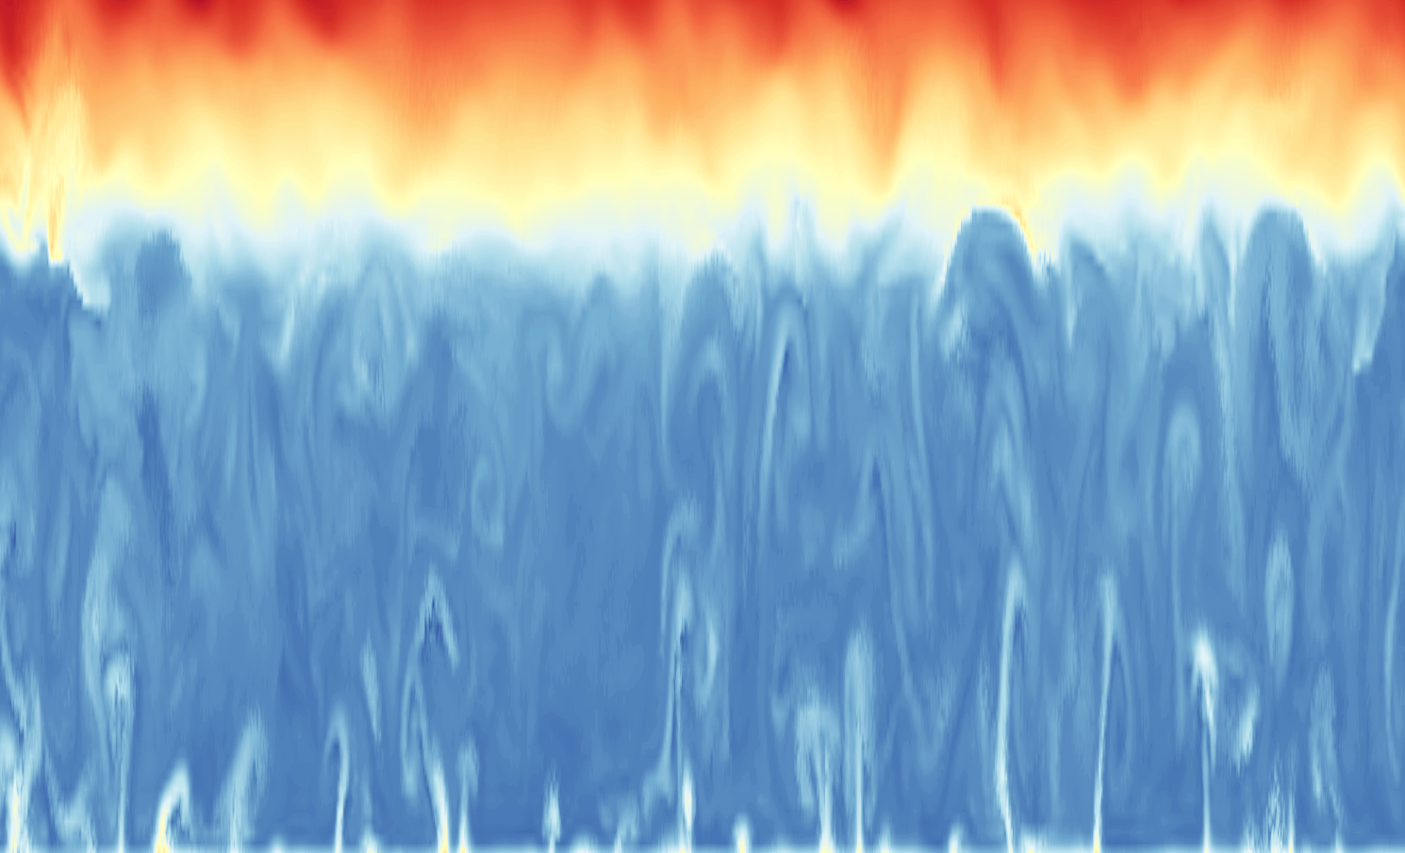
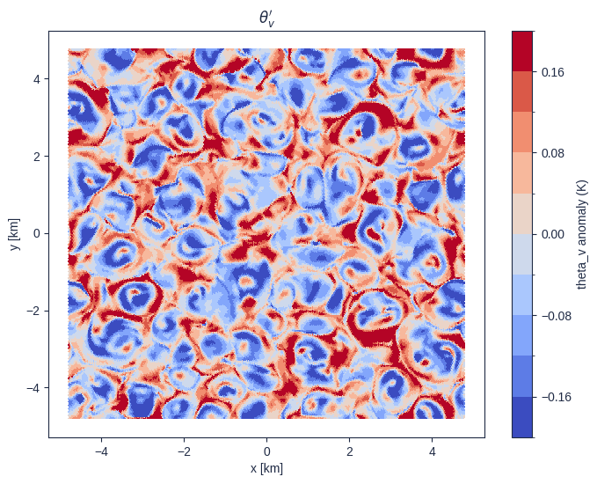
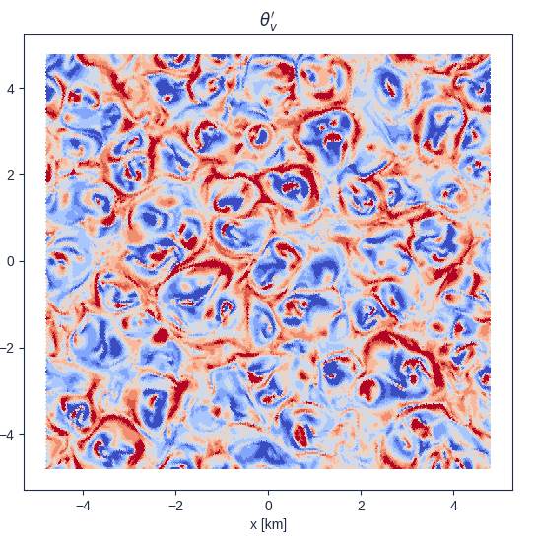




Dry Convective Boundary Layer Revisited Mixed Layer Scaling
G.Cegielski, G.Zakrzewski, A.Wyszogrodzki, A.Jaczewski, W.Interewicz
$$Q_{top}=0$$
Configurations
$$Q_{s}=0.025, 0.05,…,0.4\left[\frac{K⋅m}{s}\right]$$
Varying surface heat flux
Varying resolution
Closure model: LES (Smagorinsky) vs. NWP (Raschendorfer)
$$Δl=12.5m, 25m…200m$$
peiodic
peiodic
$$Q_{s}$$
CASE STUDY: Dry Convective Boundary Layer (DCBL)
LES
Raschendorfer

Slide 18
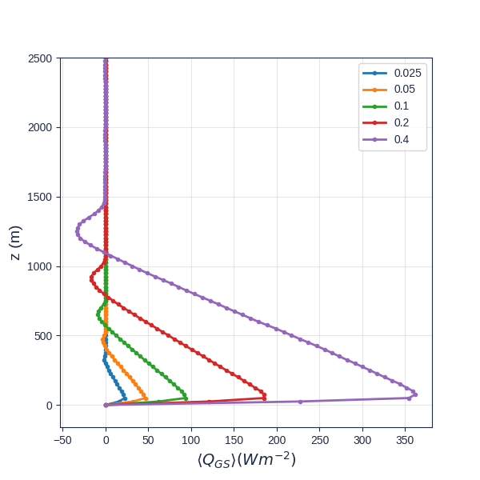
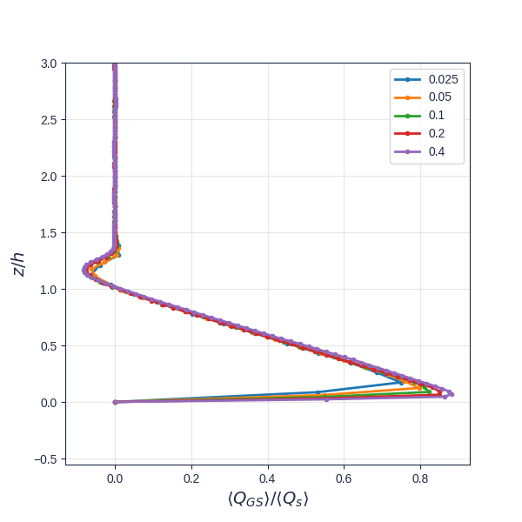








LES RESULTS: PROFILE SCALING W. DIFFERENT SCALES
IMPACT OF RESOLUTION AND TURBULENCE MODEL
$${\left\langle w^{′}θ^{′}\right\rangle }_{s}$$
$$h_{m}≔\frac{Δ_{m}θ}{Γ}\left(1+\sqrt{1+\frac{2{\left\langle w^{′}θ^{′}\right\rangle }_{s}Γt}{{\left(Δ_{m}θ\right)}^{2}}}\right)$$
$$z_{enc}≔\left[2\frac{B_{s}}{N^{2}}\left(1+\frac{1}{Re_{0}}\right){\left(t−t_{0}\right)}^{1/2}\right]$$
Scaled Resolved
Turbulent Heat Flux: Varying BC
$${\left\langle Q\right\rangle }_{s}={\left\langle w^{′}θ^{′}\right\rangle }_{s}{\left\langle ρ\right\rangle }_{s}c_{p}$$
Buoyancy and Buoyancy Flux
Buoyancy Variance and Eddy Viscosity

Slide 19






Planned (other) activities (applications)
Support for General Aviation, i.a. non-engine aircraft users based on numerical forecasts, with particular emphasis on the description of convection on a local/regional scale
Notes:
19

