Slide 1
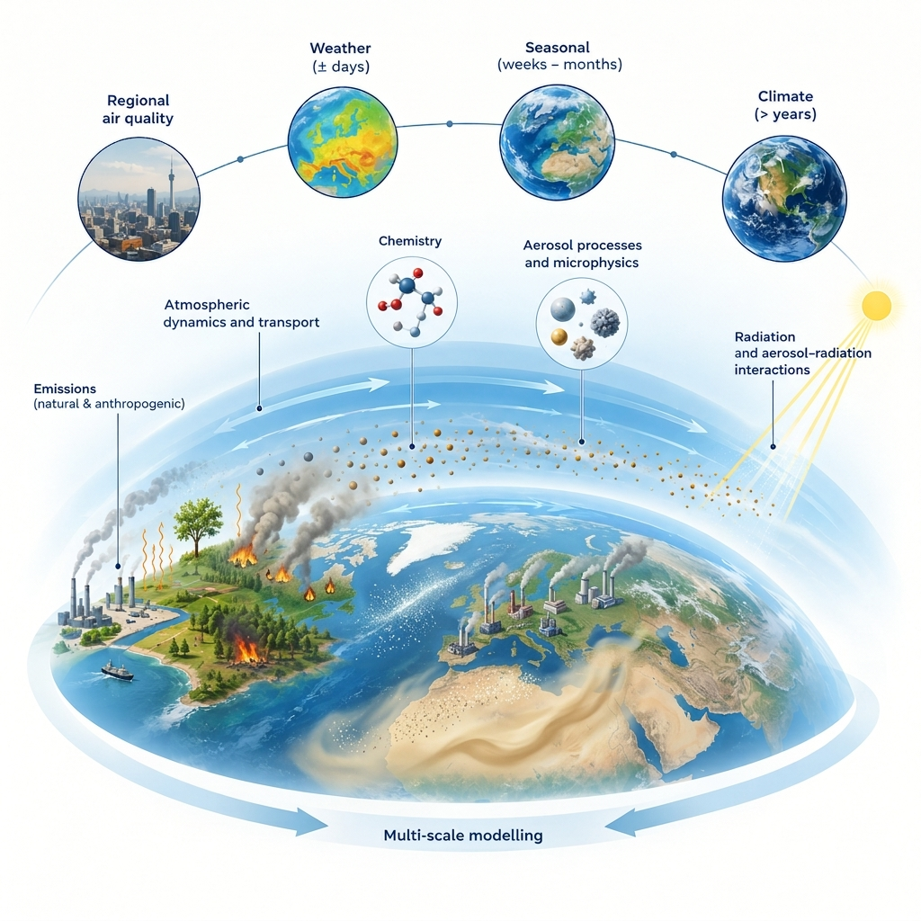

ICON-ART
Status & Highlights
Presented by: Ali Hoshyaripour
Contributions by S. Werchner, J. Förstner, P. Sreshtha et al.
COSMO GM, Rome, September 2026

Slide 2
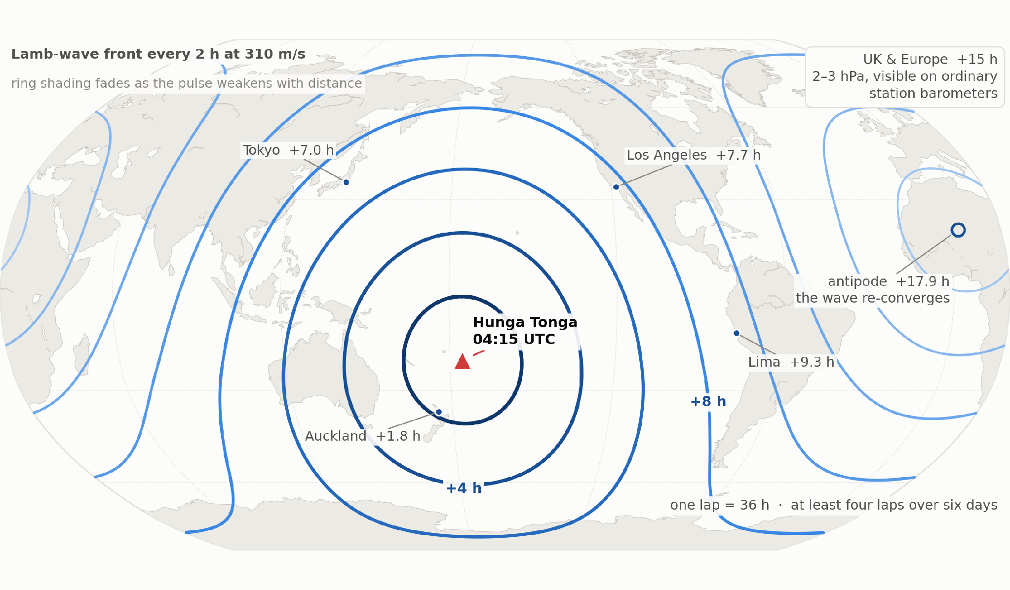
Why Hunga Tonga eruption matters to us
A once-in-a-century event. One impulse at a known place and time every barometer on Earth recorded the answer.
≥ 4
laps of the globe in six days
Lamb wave at 310 m/s, one lap every 36 h — last seen after Krakatoa, 1883
57 km
plume top, into the mesosphere
Highest ever observed. Pinatubo 1991 reached 40 km
+10%
more water in the stratosphere
146 Tg injected, ~4× Pinatubo — a climate signal lasting years
A source at a known place, time and amplitude is a free end-to-end test of the whole chain — station barometers, data assimilation, and whether an operational model can carry a 310 m/s wave across the globe at all.
Notes:
Hunga Tonga-Hunga Ha'apai, 15 January 2022, 04:15 UTC.
The pitch: this is the closest thing atmospheric science will ever get to a controlled experiment on the whole atmosphere. A near-instantaneous impulse at a precisely known place and time, and a planet already covered in barometers.
The map: Lamb-wave fronts every two hours at 310 m/s. Auckland felt it in under two hours, Tokyo in seven, Europe in fifteen at 2-3 hPa - well inside the range of an ordinary station barometer. The wave re-converged at the antipode in Algeria at +17.9 h and went on to lap the planet at least four times over six days.
The trace, bottom right: routine 10-minute AWS data from Nuku'alofa, 70 km from the vent. A 16 hPa rise in twenty minutes. Nothing special about the instrument - this is an ordinary synoptic station.
Why it matters operationally:
- End-to-end validation. Known source, known time, known waveform propagating at a known speed. You can check timing and amplitude right across your network.
- Model verification. Most operational NWP configurations at the time could not carry this wave properly - it is a hard test of the dynamical core and of how the model handles fast acoustic-gravity modes.
- The pressure forcing generated a genuine meteotsunami that arrived at many coasts ahead of the seismic sea wave. Warning systems had no framework for an atmospherically forced tsunami.
- 146 Tg of water into the stratosphere is a multi-year radiative signal that still shows up in reanalyses.
The last comparable event was Krakatoa in 1883, when we had a few hundred barographs and no satellites.

Slide 3
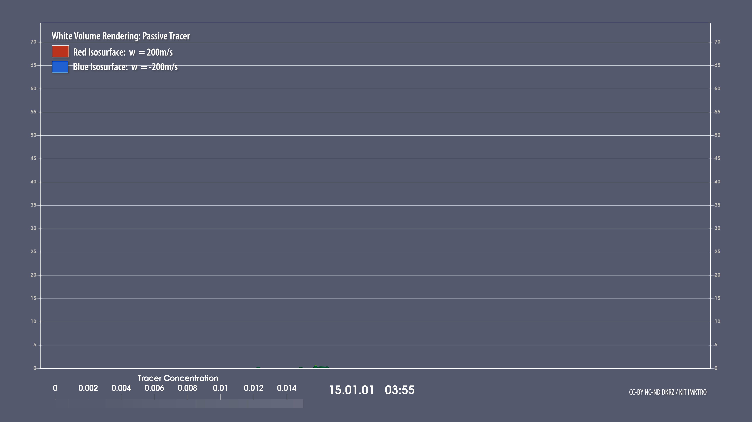
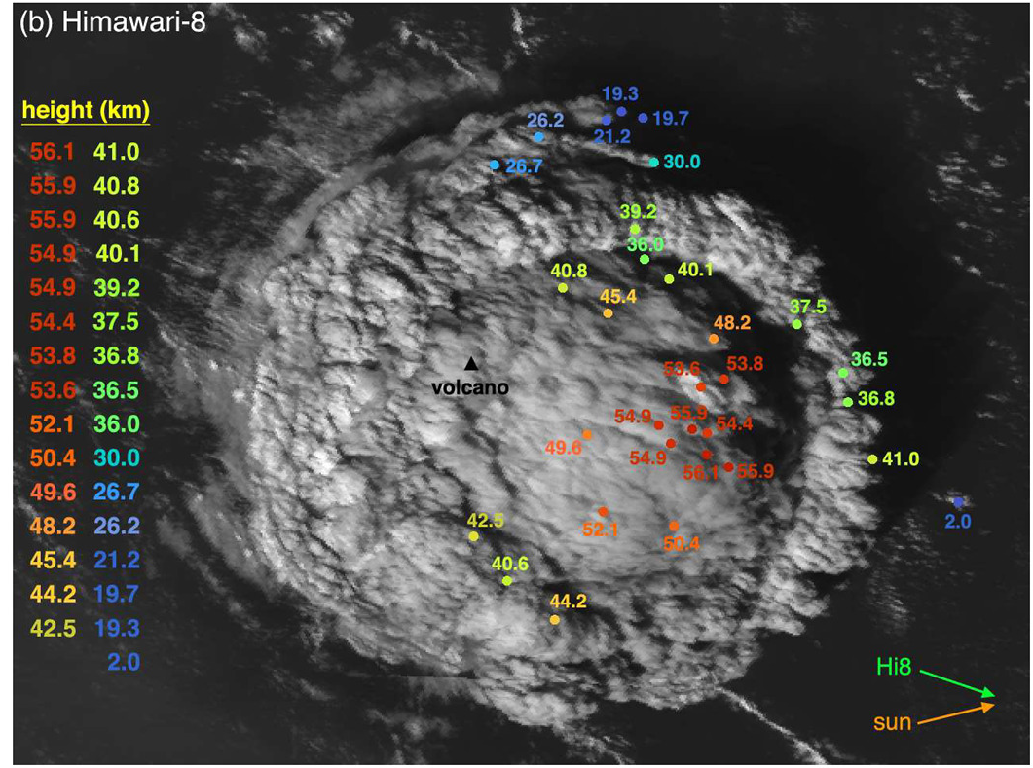
Submarine eruption of Hunga 15.01.2022
ICON-ART simulations reproduce the observed plume structure
Simon Proud / STFC RAL Space
Large-eddy simulation coupled to radiation and dynamics
We show that moist convective instability (driven by the ocean water) plays a key role in driving the plume to high altitudes.
Estimated heights (Carr et al, 2022)
Bruckert et al. (2026) in review

Slide 4
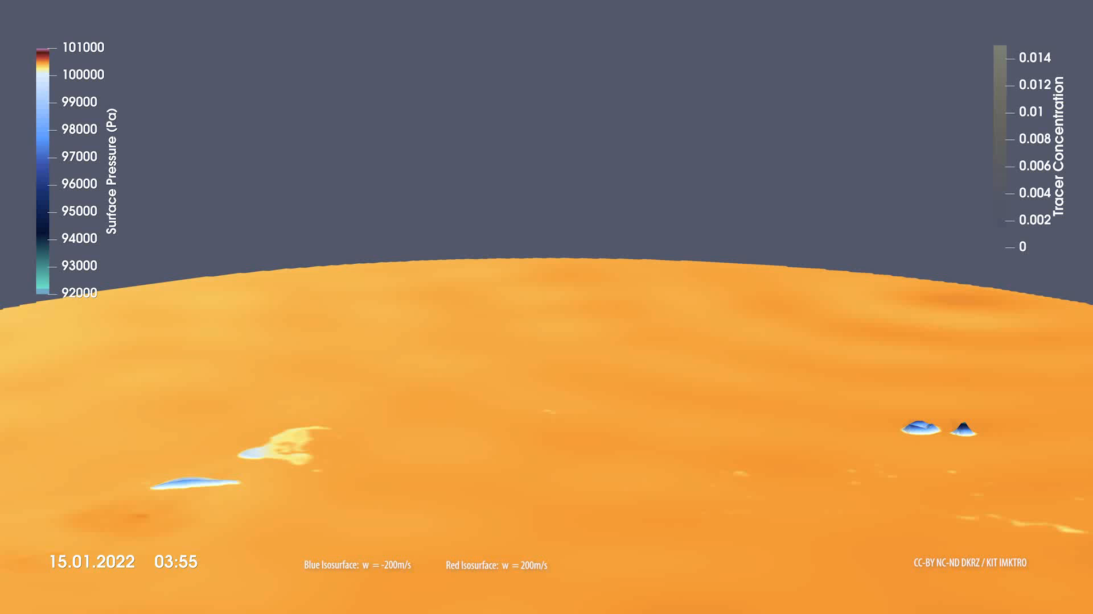
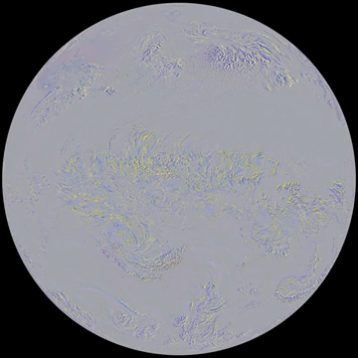
What about waves?
Gravity and Lamb waves are reproduced in the simulation
Simon Proud / STFC RAL Space

Slide 5

Aerosol-Cloud Interactions in ART
Towards consistent treatment of ACI
Dusty-cirrus parameterization
ART and 2-mom scheme
  CCN based on ARG → 2026.10
  IN based on INAS
  Talk by J. Förstner RCAC WG
ART and 1-mom scheme
  IN based on INAS
ICON
ART
2-mom microphysics
Aerosol processes and activation
Rest of the physics
Duplicated 2-mom microphysics
ICON
ART
2-mom microphysics
Aerosol processes and activation
Rest of the physics
Duplicated 2-mom microphysics

Slide 6
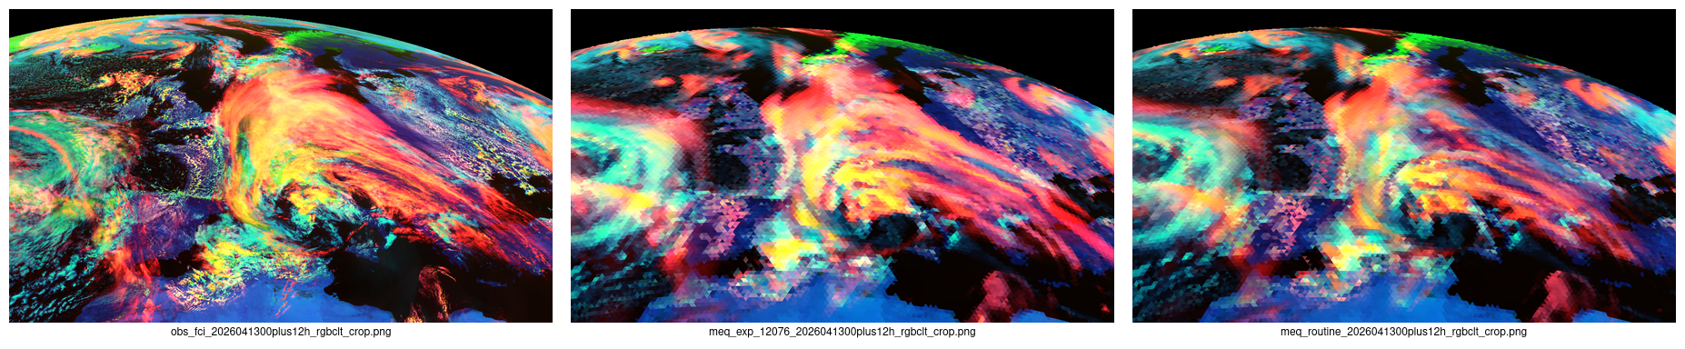
13 April 2026 12 UTC – cloud type
More red and yellow – that's good!
MTG-I FCI (Flexible Combined Imager) ICON-ART exp_12076 ICON-ART Routine
Jochen Förstner et al.

Slide 7
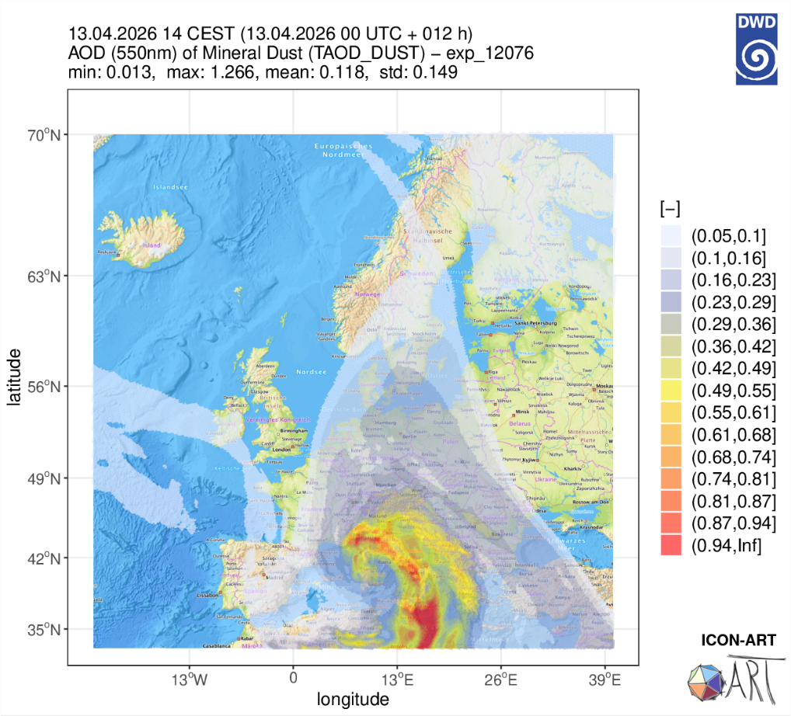
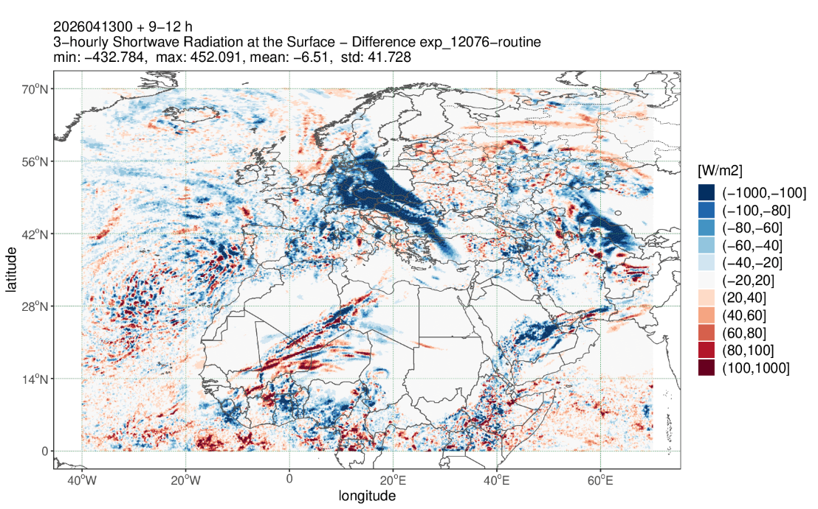
„Dusty Cirrus“ on 13 April 2026
Difference in 3-hourly shortwave radiation at the surface (exp_12076 – ICON-ART Routine)
Jochen Förstner et al.

Slide 8
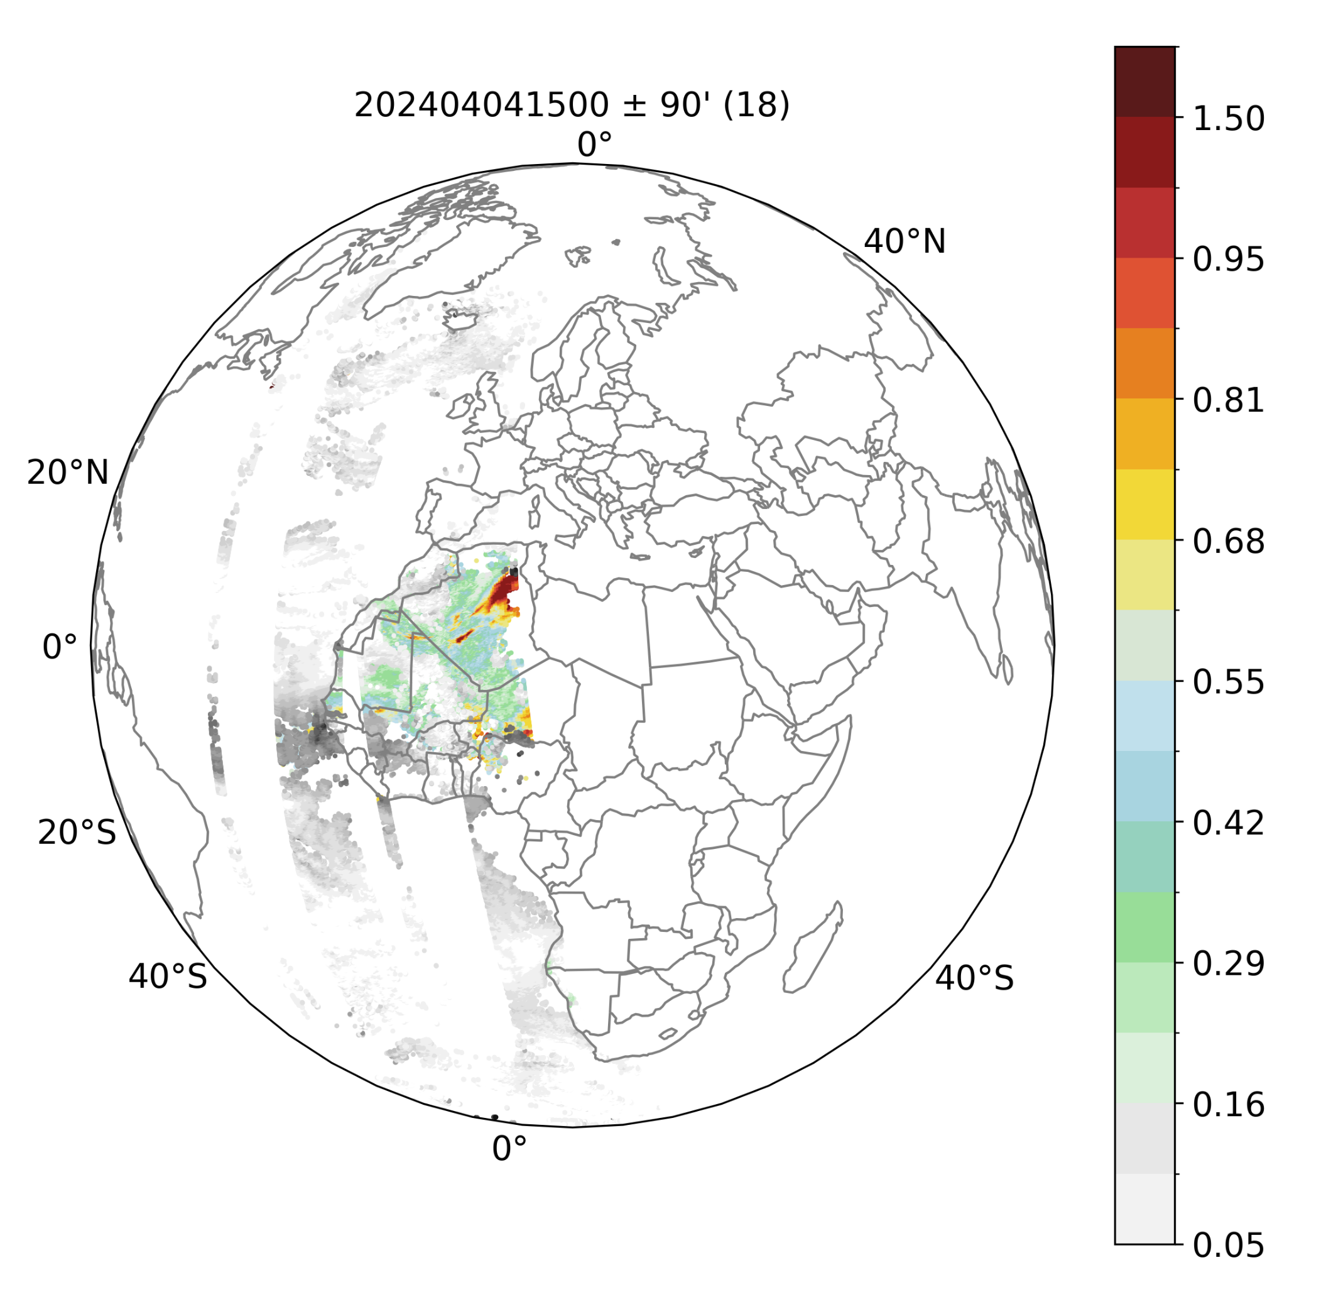

Energy Applications in GLORI
Objective:
“Develop Global-to-Regional high resolution configuration setup for predictions of selected atmospheric composition elements such as mineral dust and pollen.”
Hypothesis:
“Added value of LAM high resolution runs is strongly impacted by lateral boundary conditions (LBCs). Assimilation of satellite dust AOD (Aerosol Optical Depth) can improve the LBCs for LAM domains over Europe leading to better radiation and PV forecasts in dusty days.”
Dusty pixels from Level 2 MODIS Collection 6.1 product (AQUA and TERRA). The dusty pixels are passed onto the Raw Observeation Files (ROFs) for assimilation.
P. Sreshtha et al.

Slide 9
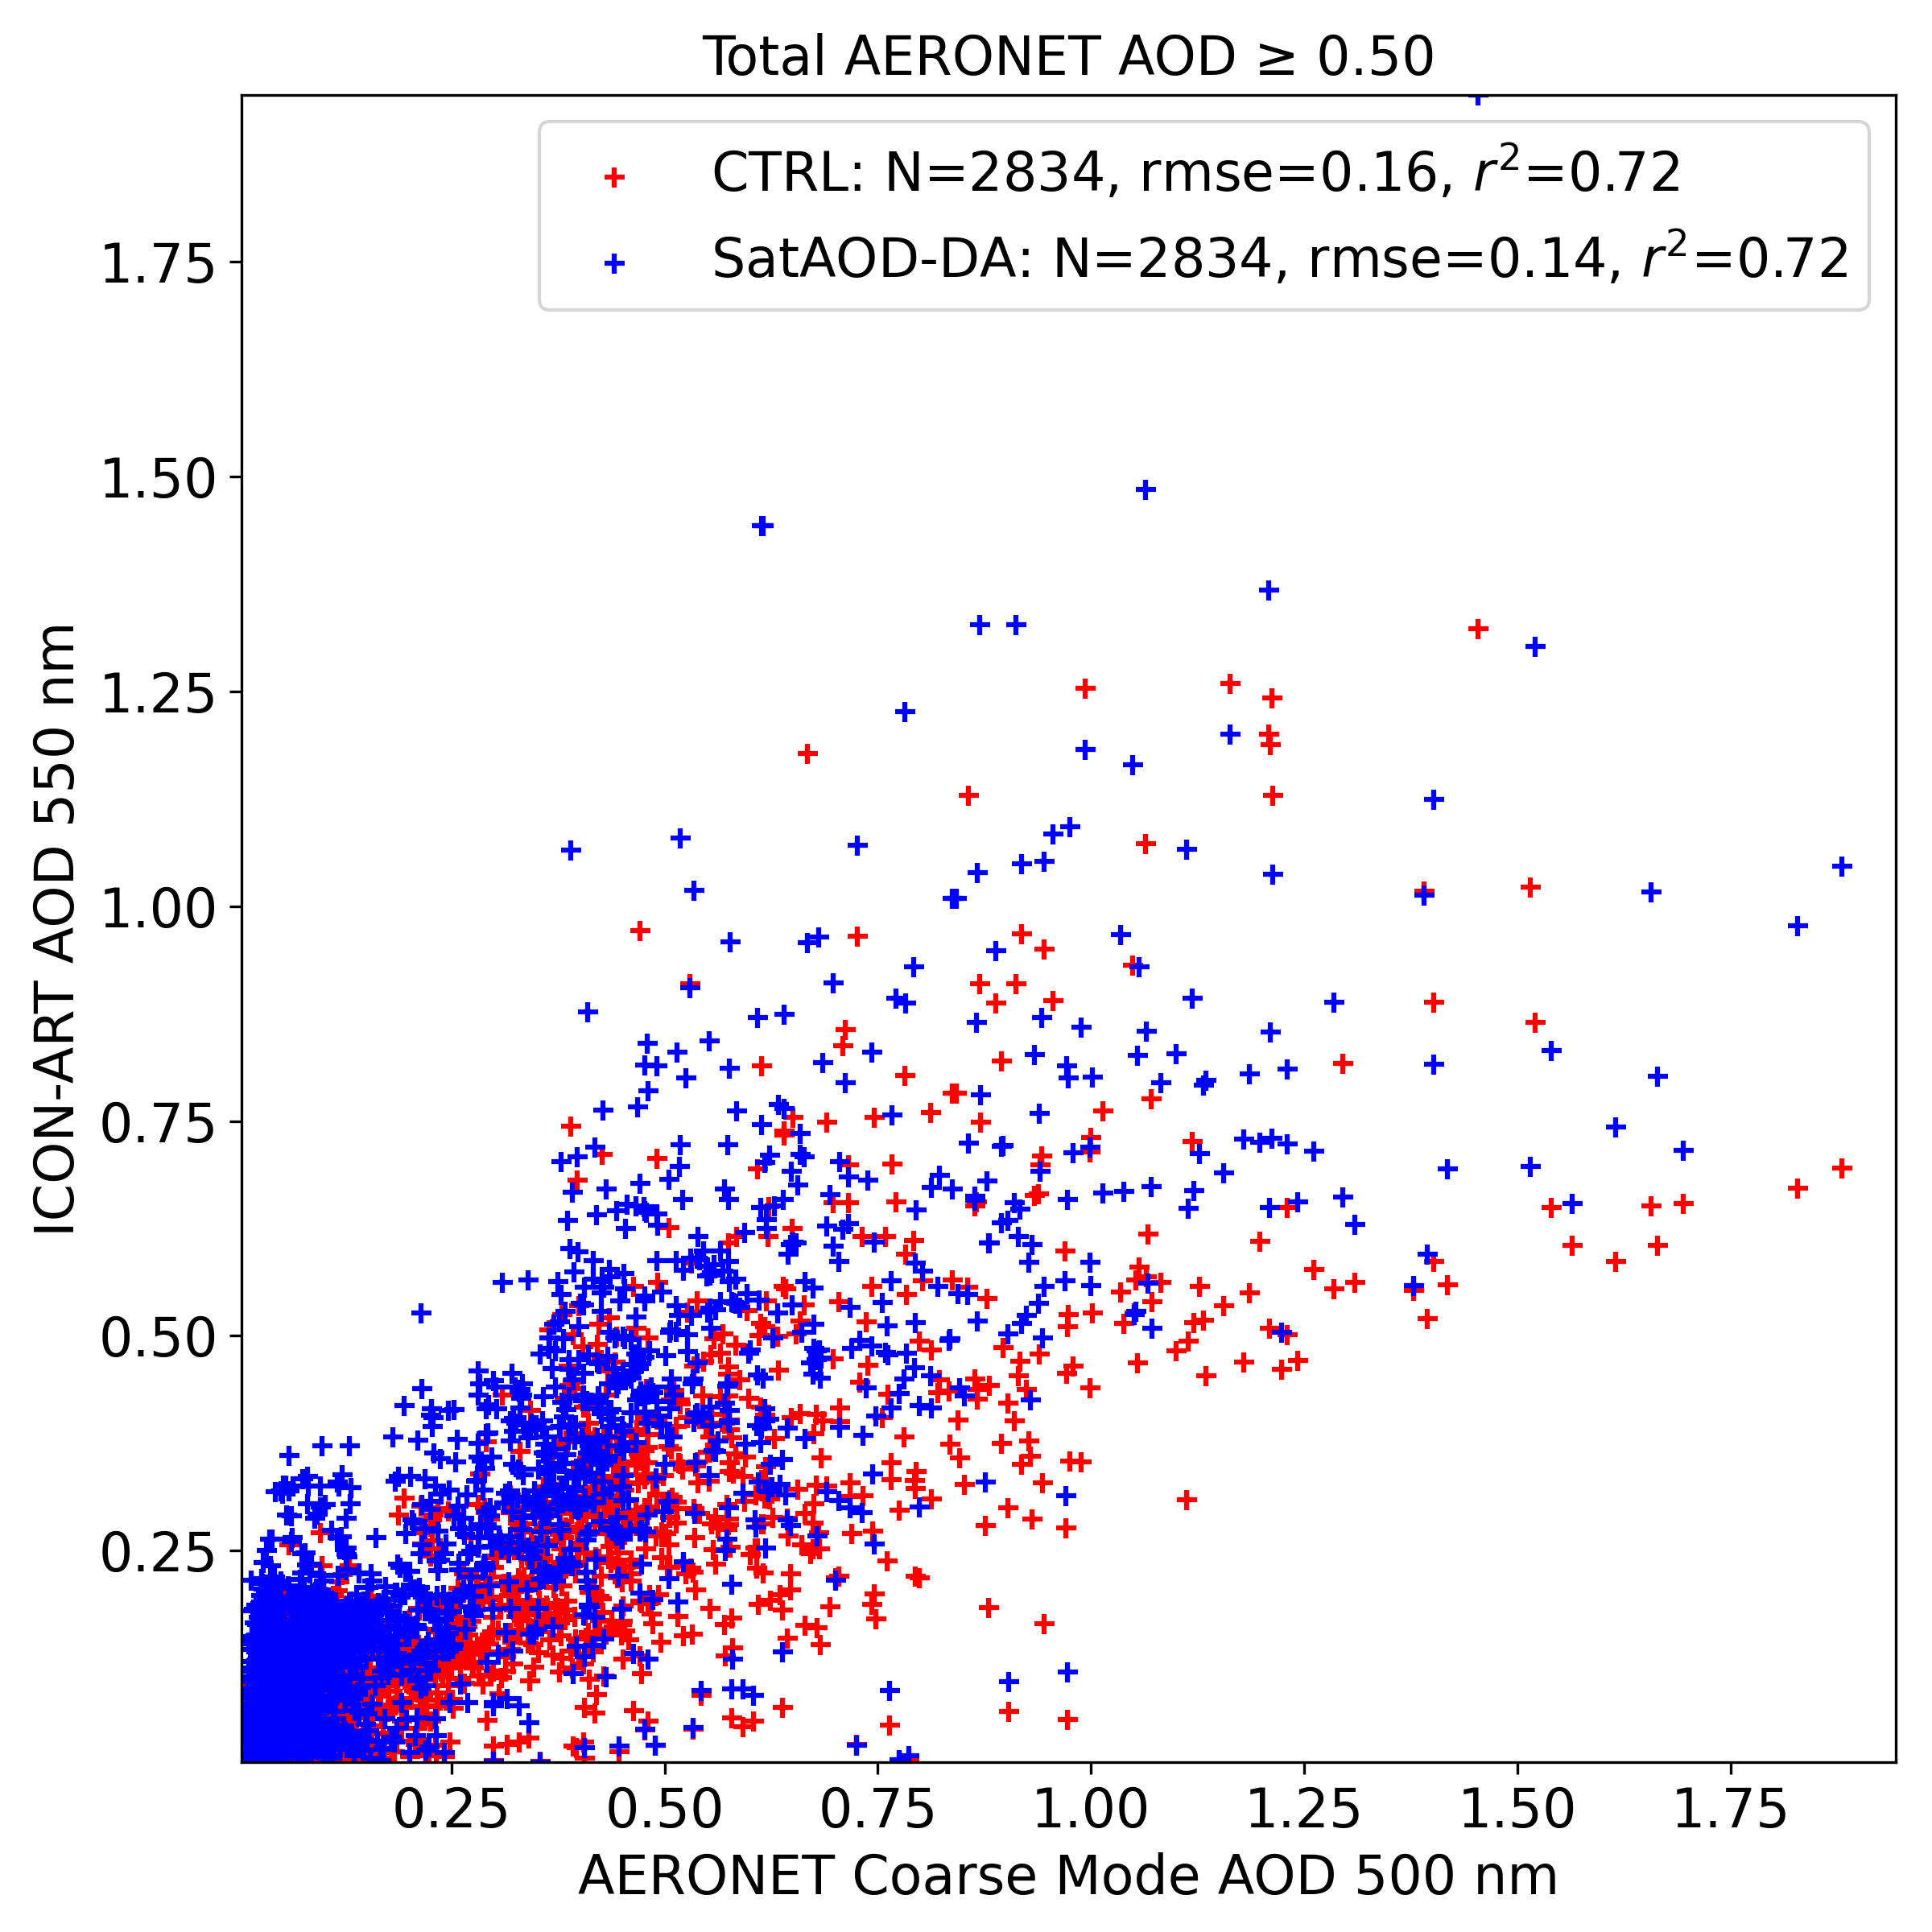
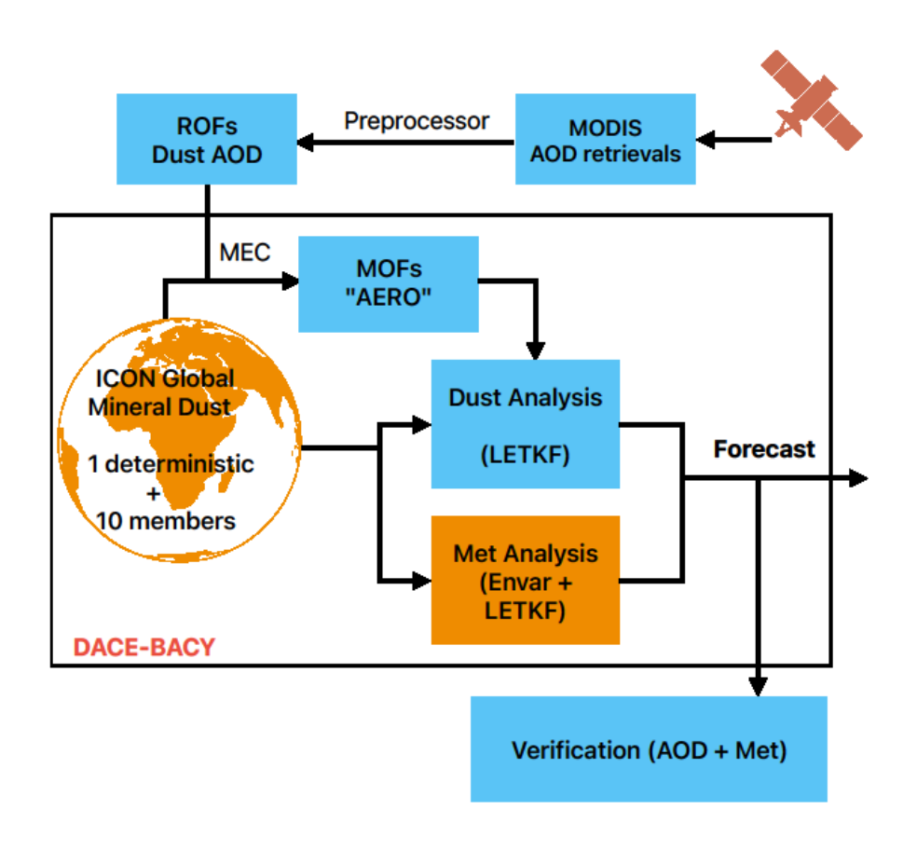
Satellite dust AOD assimilation
Preliminary results show improvment in the AOD forecast
R03B06 Global Domain
CTRL – Met
SatAOD-DA – Dust + Met
(3 hourly Ass. Cycle)
Energy system modeling is ongoing …
Preliminary results from evaluation of CTRL and SatAOD-DA runs with global AERONET observations (Feb-Mar 2024)
P. Sreshtha et al.

Slide 10
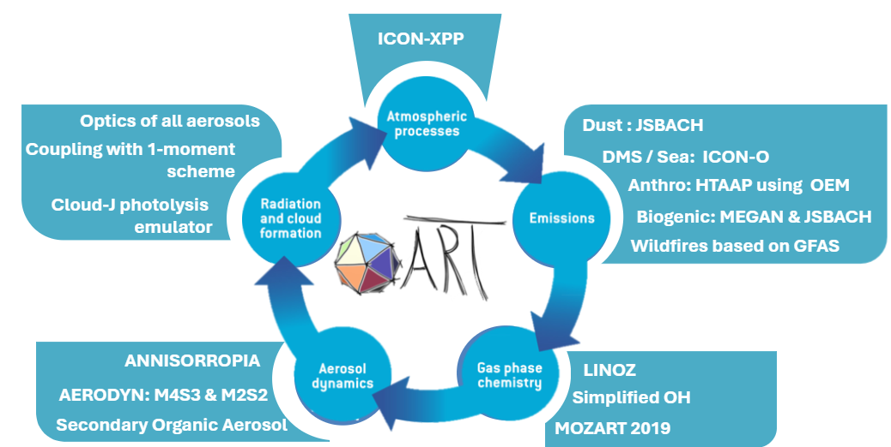
Targeted SmART configuration
Making ART usable for coupled atm-land-ocean applications

Slide 11
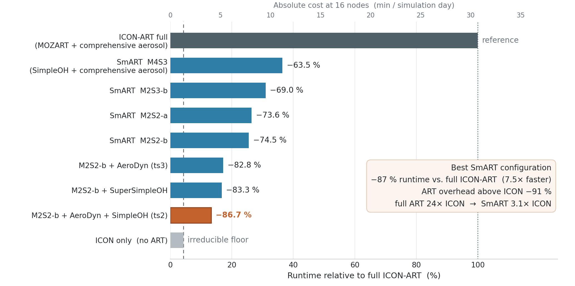
Cumulative efficiency gain of SmART over ART
Optimized part
Chemistry
Aerosol
Calls
Red. Grid?
We are not done yet!

Slide 12
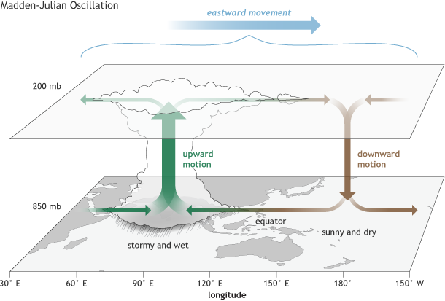
Madden-Julian Oscillation and aerosols
MJO: dominant 30–90-day tropical variability, with eastward-propagating convection
MJO development couples convection, moisture, radiation and circulation
Aerosols alter radiation and cloud processes, potentially affecting convective development and propagation
Prognostic aerosols capture evolving aerosol–meteorology feedbacks
Source: https://cpo.noaa.gov/

Slide 13
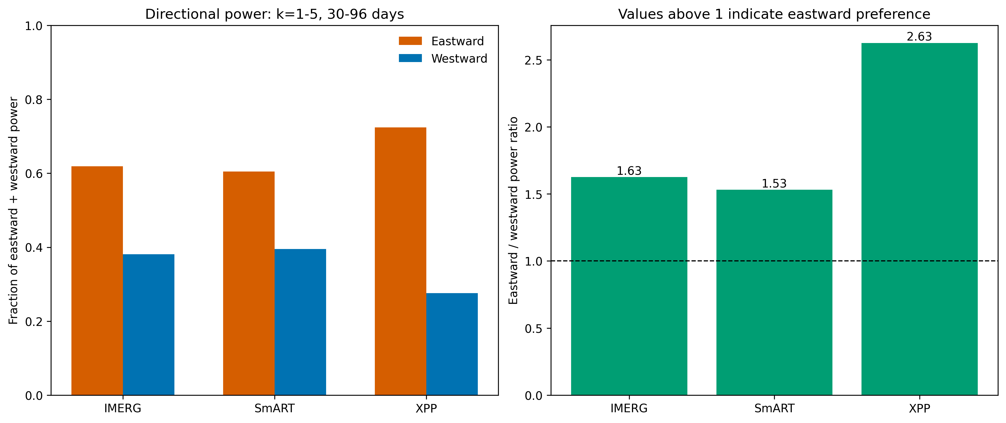
SmART more realistically reproduces the observed MJO-like spectral signature than XPP
Precipitation variability at k = 1–5 and periods of 30–96 days
East / west power
1.63 IMERG
1.53 SmART
2.63 XPP
XPP power ratio is too high. SmART is closer to observation
Evidence of MJO-like precipitation behaviour; propagation and amplitude still need validation.
1 / 2

Slide 14
ML compression for tracer advection
Problem: Advection cost grows linearly with the number of tracers.
Idea: Advect r latent tracers instead of m (r < m), keep the dynamical core unchanged.
m tracers
V
Encode
compress
Advect r < m
latent tracers
Decode
reconstruct
m tracers
V̂ ≈ V
Linear: NMF “superspecies”
Non-linear: Autoencoder
V ≈ W·H; projection B before, reconstruction W after advection
Non-negative, additive combinations of species
LOTOS-EUROS (Sturm et al., 2023): up to 75% compression, < 5% error, 30–50% faster advection
Neural encoder/decoder learns non-linear links between species
Softplus outputs keep latent and reconstructed tracers non-negative
Multi-head decoder: magnitude × non-zero mask; ICON-ART test 6 → 3 tracers
Requirements: no negative tracers · stable when applied every time step · mass conservation handled separately

Slide 15
Can we use these methods in ICON?
Probably yes, but not yet!
  Total time taken
      Full model: 41.92s
      Reduced order: 33.32s
      Saving: 21%
  Expected, as ICON advect 5-7 hydrometeors + 6 dust species → 25% saving if ART species halfed
  8% used for ComIn call back
TRACER FROM ICON ONLY
Tai Pak

Slide 16
What’s failing now?
Decoder
      Physical admissible → Non-negative, mass conserving by design
      Single pass reconstruction produces high quality output at mid ranges, failing at extreme values
      Unstable over iterations
      Next steps:
      Rethink the ML tools and methods
      Adopt advection for gases and aerosols
Advection
Softplus (Non-zero)
X
Sigmoid
(classifier)
Tai Pak

Slide 17
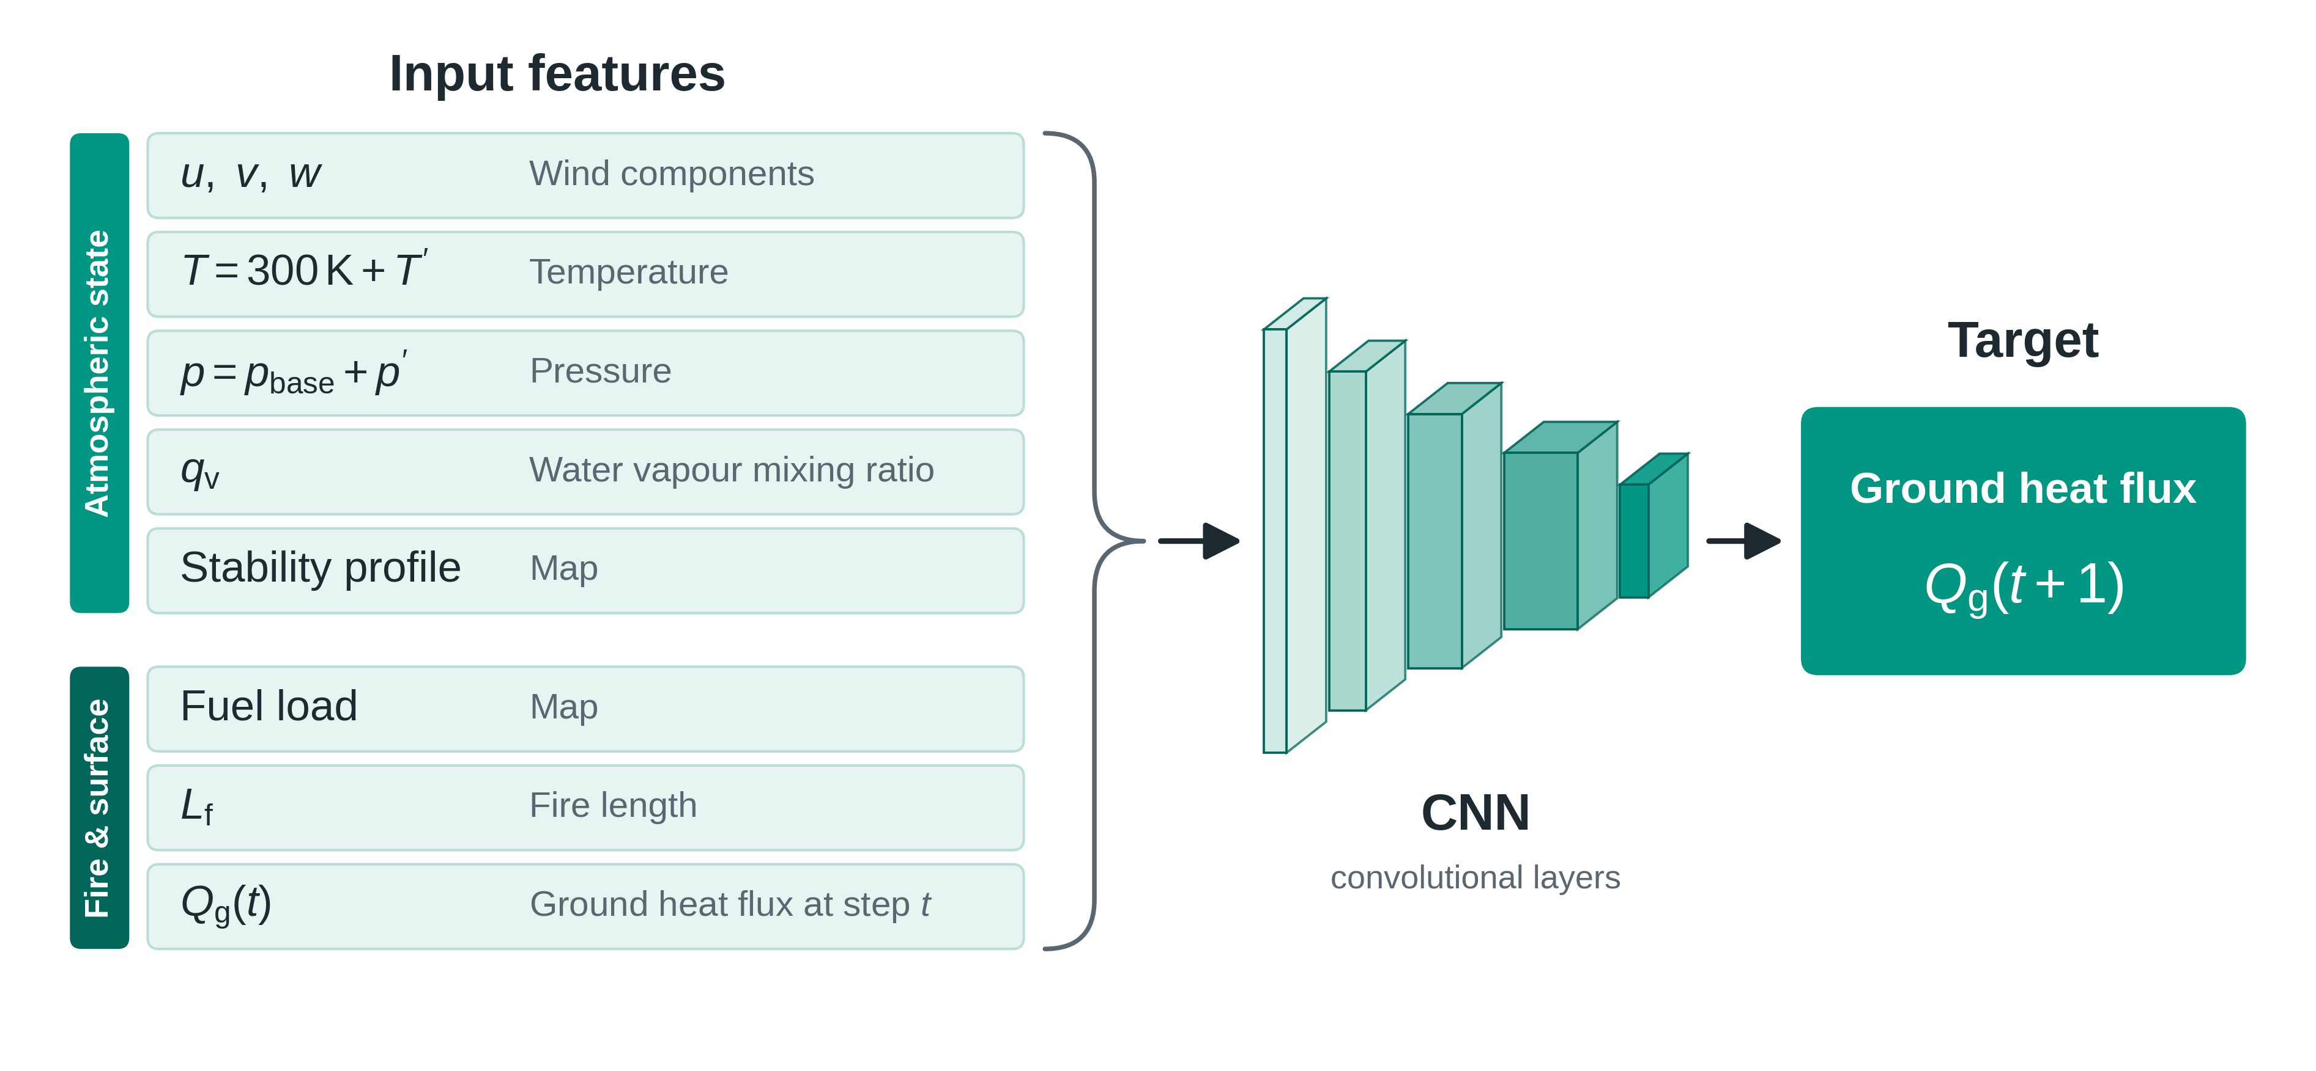
Wildfires are becoming more frequent and intense
There are fire dynamics models, NWP and dispersion models but not fully coupled in a unified framework.
Currently, it is not feasible to simulate fire-atmosphere interactions.
ML methods are viable options to fill this gap
Training data from LES simulations with WRF-SFIRE by Moisseeva and Stull (2021).
Moradpour et al., 2026

Slide 18
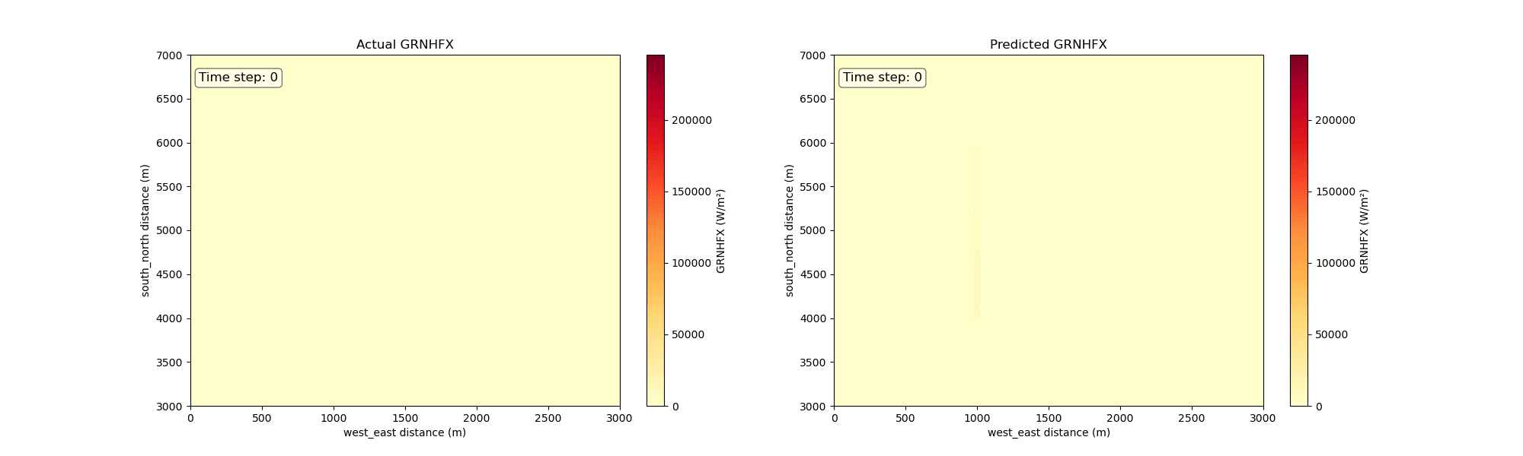
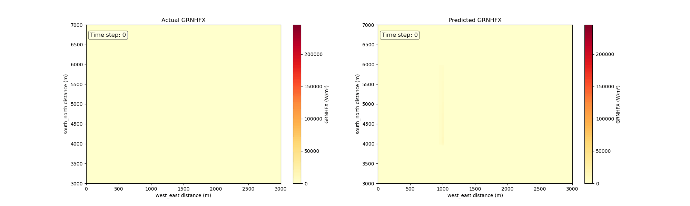
Wildfire dynamics: ground heat flux one example from W5F4R1: intense hyperbolic distribution
Moradpour et al., 2026

Slide 19
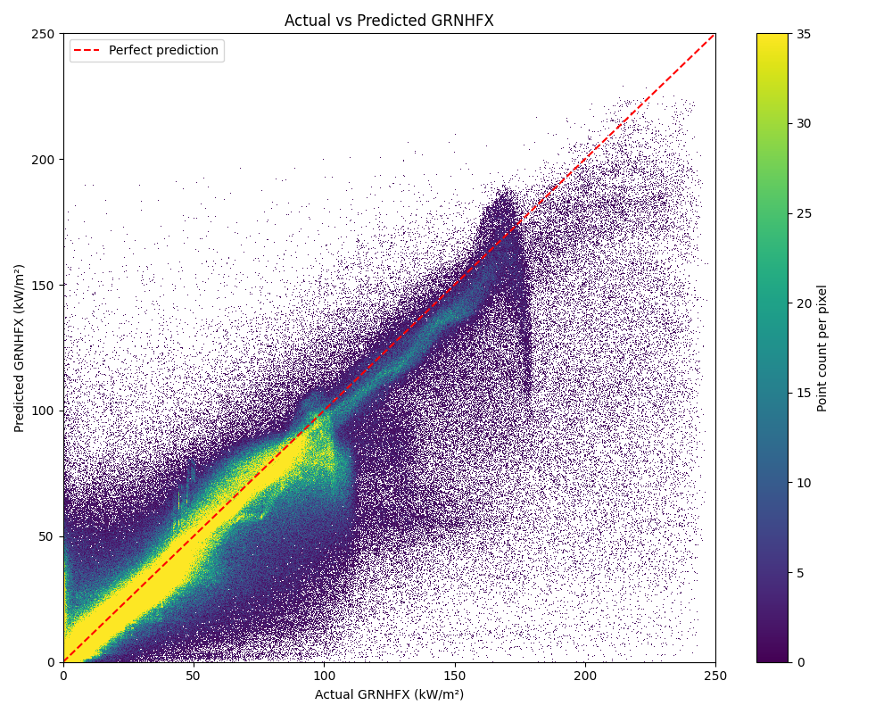
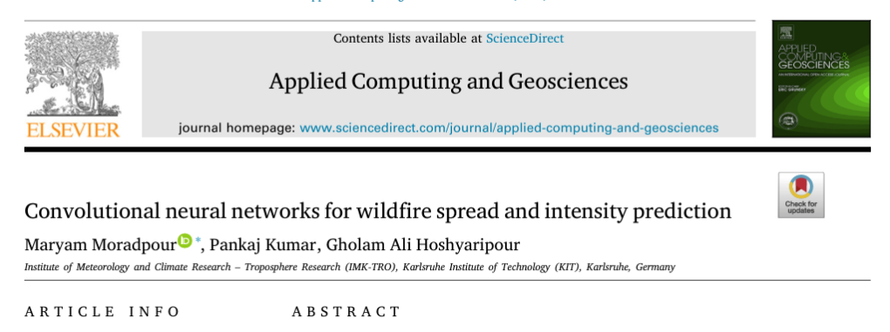
Validation
The model does a good job in predictions.
Paper published
DFG proposal for further development and implementation in ART
Including storyline simulations
Moradpour et al., 2026

Slide 20



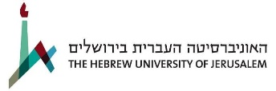
OpenICON – Project Overview
Current drawbacks in ICON
Entangled structure
Full-stack understanding
Conflict potential
Whole-code execution only
Method
Modularize ICON
Introduce interfaces
Benefits
Separation of concerns
Independent flexible development workflow
Fine grained testing
Interoperability
Portability
OpenICON-Team: M. Zacharuk, E. Metzner, A. de Lozar,
D. Rieger, S. Reznik, R. Potthast, G.A. Hoshyaripour

Slide 21
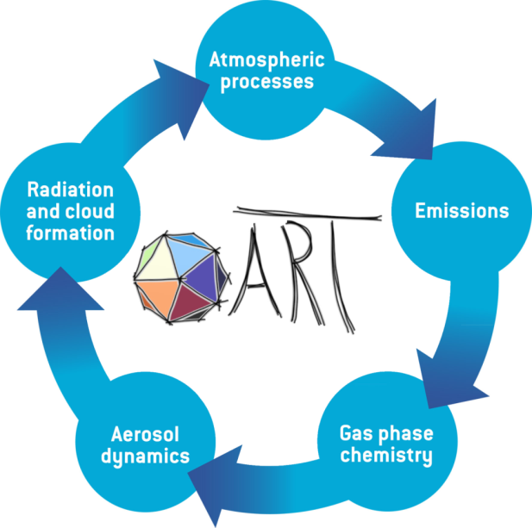
OSR 2026.04 and OSR 2026.10
  Dust & biogenic coupled to JSBACH
  Sea Salt & DMS coupled to ICON-O
  OEM made GPU-ready
  Lumped BVOC tracers
  AI-based opitcs MieAI
  Updates in dusty cirrus
  New CCN activation
  OpenACC port of DUSTRAD experiment
  Fixes in CloudJ
  EUV photoionization and dissociation

