Slide 1
WG DA
Christoph Schraff et al.
Activities at MeteoSwiss, CNMCA, ARPAE, CMCC
Satellite DA: only overview
Partial Analysis Increments (ARPAE)
DA of wind lidar and DIAL … and verification pitfalls
New snow analysis
Re-analysis
AI-Var (1 slide)

Slide 2
WG DA
DE
Disclaimer:
new PP KENDAexodus, which will consist of
  a (very) small algorithmic part (refinements of LETKF)
  a major part on observations, in particular satellite data
  (but excludes AI-emulators of DA itself)
  PP plan not yet finished (autumn hopefully)
(successful) visit of Koby Shpund in July to prepare implementation of KENDA at ATOS for IMS
IT

Slide 3
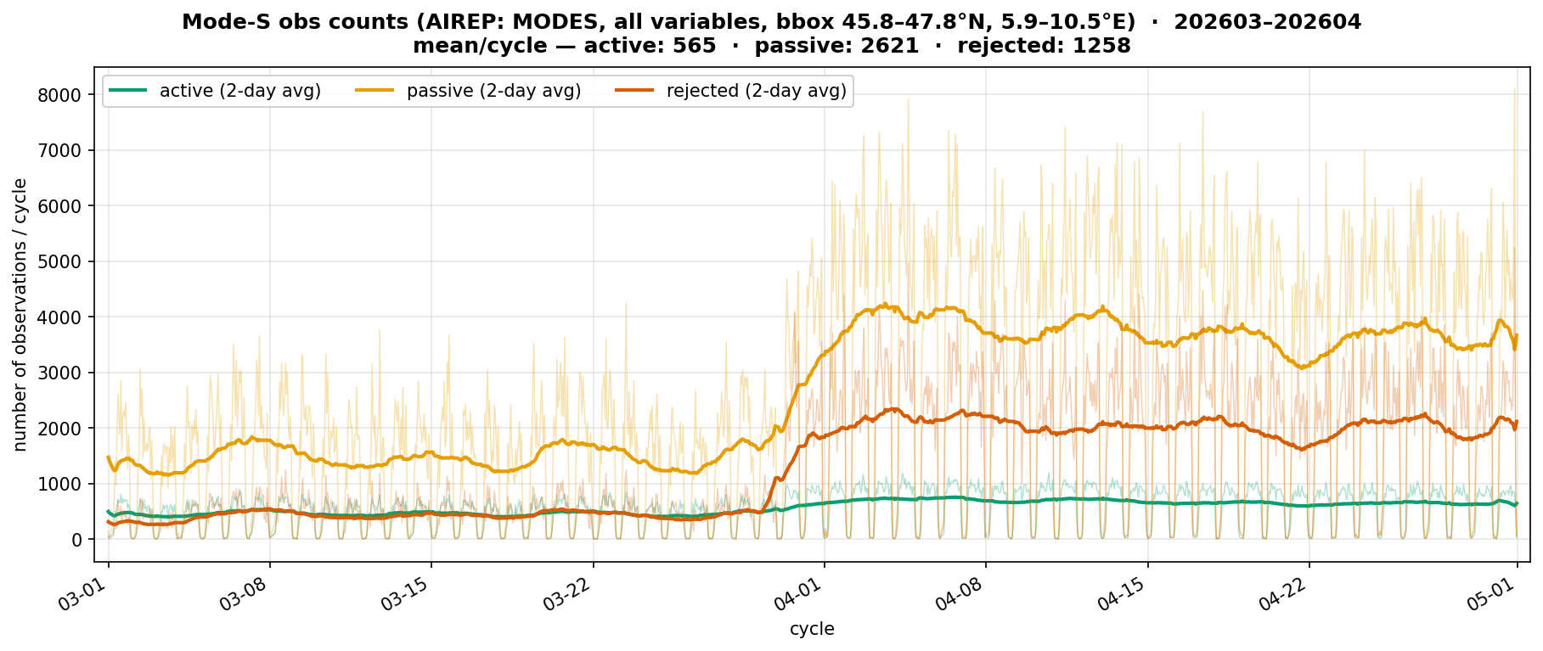
Operational Changes to KENDA-CH1
DA activities: Daniel Leuenberger, Alina Yapparova, Julien Delbeke, Claire Merker, Marco Arpagaus
2026-03-31: Swiss MODE-S receivers
Number of MODE-S obs over Switzerland
2026-03-31
2026-08-12: Introduction of APT
COSMO GM 2026, Rome, Daniel Leuenberger et al.

Slide 4
Adaptive Parameter Tuning Setup
tuned parameters using T2m and RH2m obs increments
  Evapotranspiration
  Heat conductivity and capacity
  Land and snow albedo
  Near-surface minimum diffusion
  Soil moisture
surface friction tuning has not yet worked satisfactorily in complex terrain and is thus currently not used
wind assimilation still restricted to stations below 100masl
e-suites for 6-week Summer and 2-week Winter periods
COSMO GM 2026, Rome, Daniel Leuenberger et al.

Slide 5
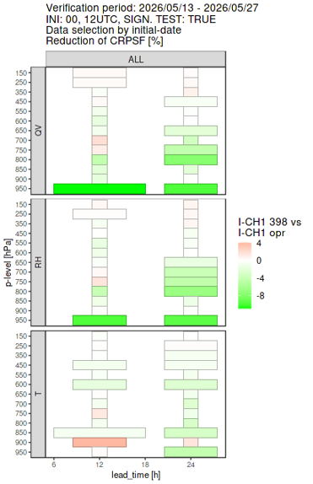
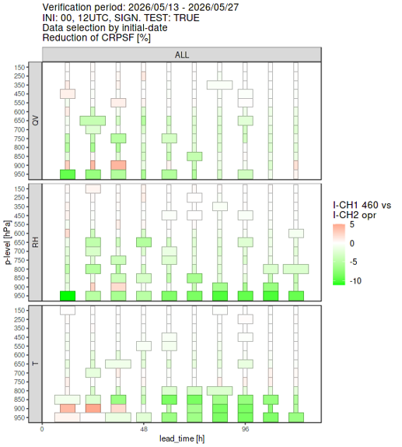
Adaptive Parameter Tuning Results
ICON-CH1-EPS
ICON-CH2-EPS
Summer
COSMO GM 2026, Rome, Daniel Leuenberger et al.

Slide 6
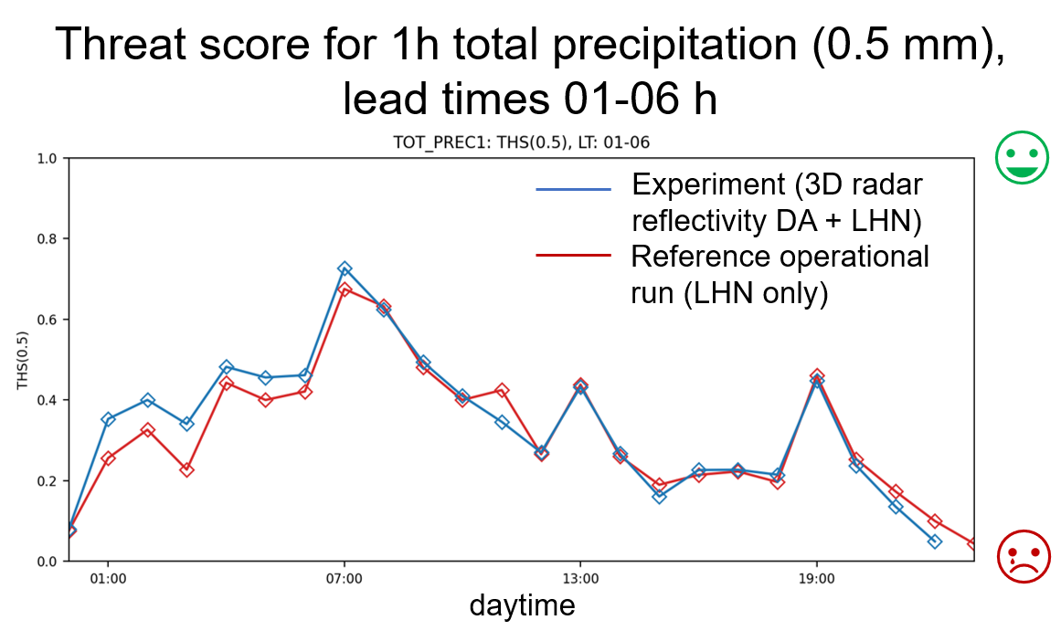
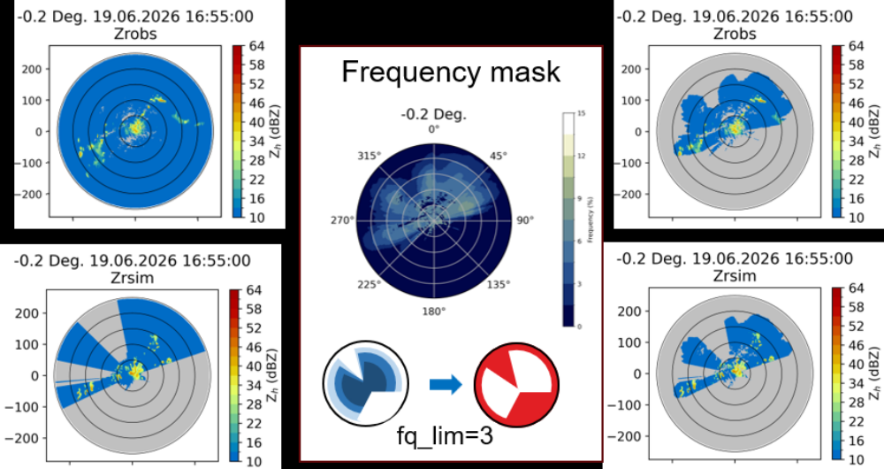
Conclusions on DA of 3D Radar reflectivity
small but consistent improvement in many scores for total precipitation in summer convective period
reduction of excess light rain
improvement apparent for short lead times (≤ +6 h)
minor impact in winter period
no degradation in other parameters or scores
LHN still needed
pre-processing of reflectivity observations with quality flags from frequency maps implemented in EMVORADO (in master) → available to everyone
3D radar DA
opr

Slide 7
Plans for next year
Radar Data Assimilation
  Bring 3D radar reflectivity data assimilation to operations
Continue APT tests with newest APT version
  Add wind (not yet included)
  Revisit setup for ICON-CH2-EPS
Prepare for the reanalysis of the TEAMx EOP’s (GREAT)
  Port KENDA-CH1 to a new (elastic) platform
  Do KENDA-CH1 experiments with additional datasets
Train ML models with observations
  Upgrade REA-L-CH1 (2005-2024) to version 2 (details to be defined)
COSMO GM 2026, Rome, Daniel Leuenberger et al.

Slide 8



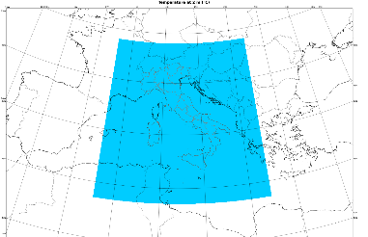


ICON-IT ITAF operational setup
RAOB, PILOT, SYNOP, SHIP, BUOY, Wind Profilers, Radars, AMDAR-AIREP, Mode-S, Meteosat AMV, non-conventional sfc obs, Metop scatt. winds, NOAA/Metop AMSUA/MHS and NPP ATMS radiances.
Observations
Latent Heat Nudging
implemented last july
Boundary Conditions
(CTRL, ENS)
Ensemble Data Assimilation:
1h cycle
2.2 km
65 v.l.
40+1 members
1h
LETKF
COSMO GM 2026, 14-18 September 2026 Rome, Italy

Slide 9
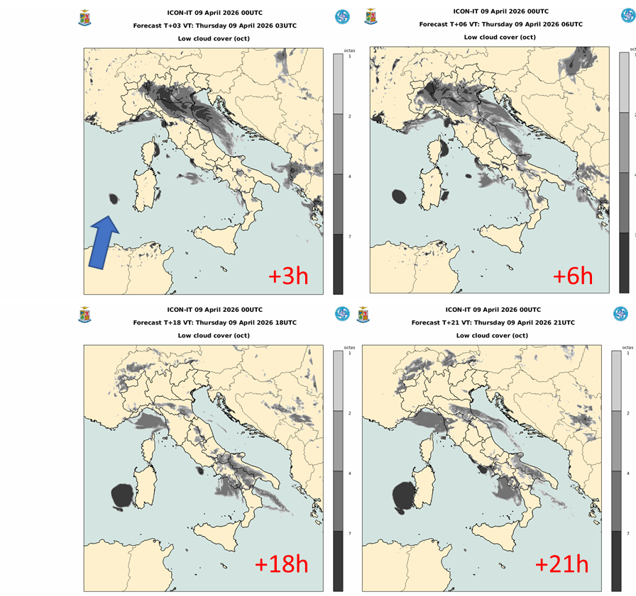
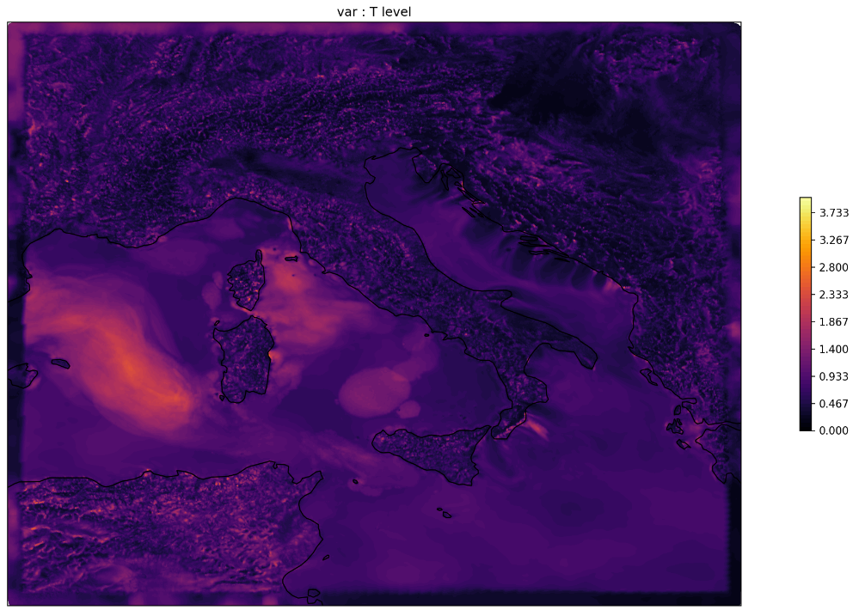
Problem: Artificial low clouds generation
large temperature spread at lowest model level:
up to 3 K in area where low cloud appears
→ look at spread of SST?
COSMO GM 2026, 14-18 September 2026 Rome, Italy

Slide 10
Future plans
Assimilation of GPS observations
Further use of non conventional observations
Interest in testing/implementation of geostationary satellite data assimilation
COSMO GM 2026, 14-18 September 2026 Rome, Italy

Slide 11


Data Assimilation at Arpae:
recent updates
Thomas Gastaldo, Virginia Poli, Marcello Grenzi, Antonio Giordani,
Ludovico Mattavelli, Davide Cesari, Chiara Marsigli
Plans:
DA of Synop- T2M/RH2M: re-run experiments with soil moisture nudging
DA of radar data: adapt to renewal of Italian network; extend to OPERA data

Slide 12
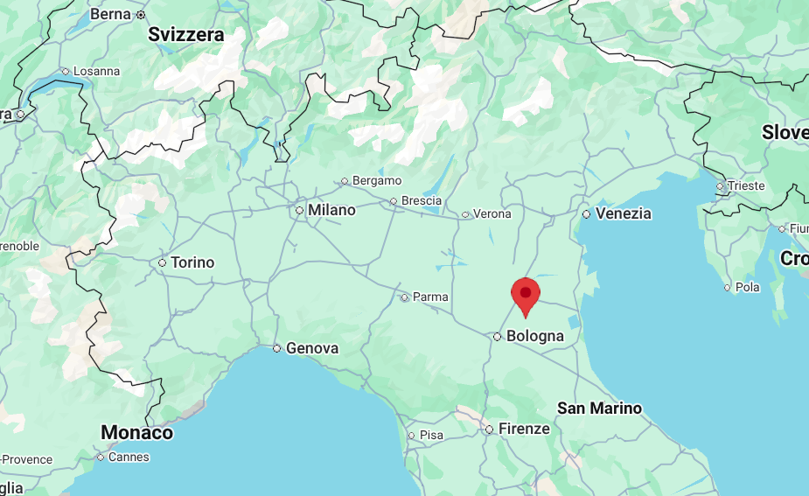
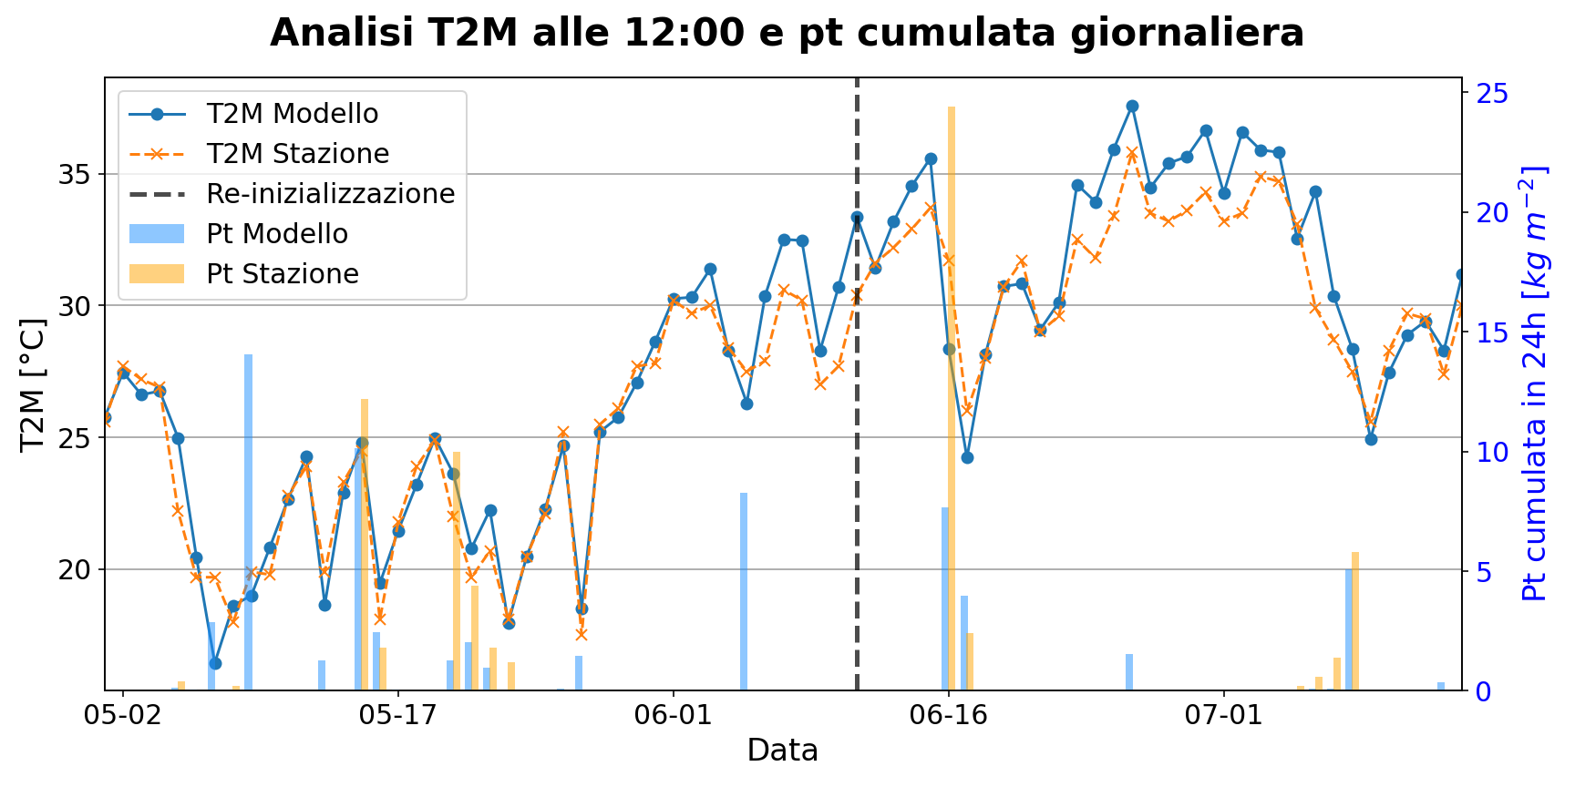
Soil moisture (SM) nudging: motivation
ICON-2I overestimates maximum T2M in summer
good agreement during/after rainy days; increasing T2M overestimation at persistent stable anticyclonic conditions
+12 h forecasts , San Pietro Capofiume
T2M at 12 UTC + daily precipitation
T2M ICON-2I
T2M observed
ICON-2I soil re-initialization
Prec.ICON-2I
Prec. observed
Implementation as at DWD:
SM ‘nudging’
(50% weighting)
1 x / day (03 UTC)
towards
ICON-EU soil moisture

Slide 13
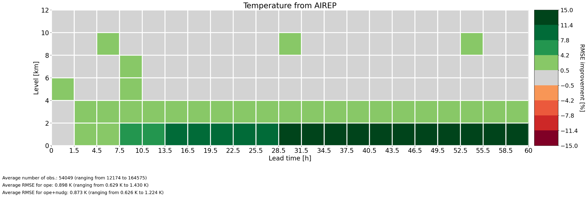
SM nudging: upper-air temperature (RMSE)
Plot difference: RMSE(ope) - RMSE(ope+nudg).
Positive values (green) → ope+nudg better than ope

Slide 14
SM nudging: conclusions
Implementation of soil moisture nudging:
Synop: T2M, TD2M, PS strongly improved, 10-m wind speed neutral
upper-air: T, RH, wind improved, in particular below 2 – 4 km.
slightly improves precipitation.
soil moisture nudging operational since 17/06/2026
to overcome the issue of overestimation of maximum temperatures during summer
However, experiments are running to evaluate impact on other seasons

Slide 15



Data Assimilation activities at CMCC/REMHI: current developments and ongoing work - RECAP FOR PLENARY
Francesca Vittorioso, Alessandro Sebastianelli, Mario Raffa, Oliver Carlo, Gabriella Ceci, Ilenia Manco, Otavio Feitosa, Paola Mercogliano
francesca.vittorioso@cmcc.it; alessandro.sebastianelli@cmcc.it
CMCC — Institute for Climate Resilience
www.cmcc.it

Slide 16



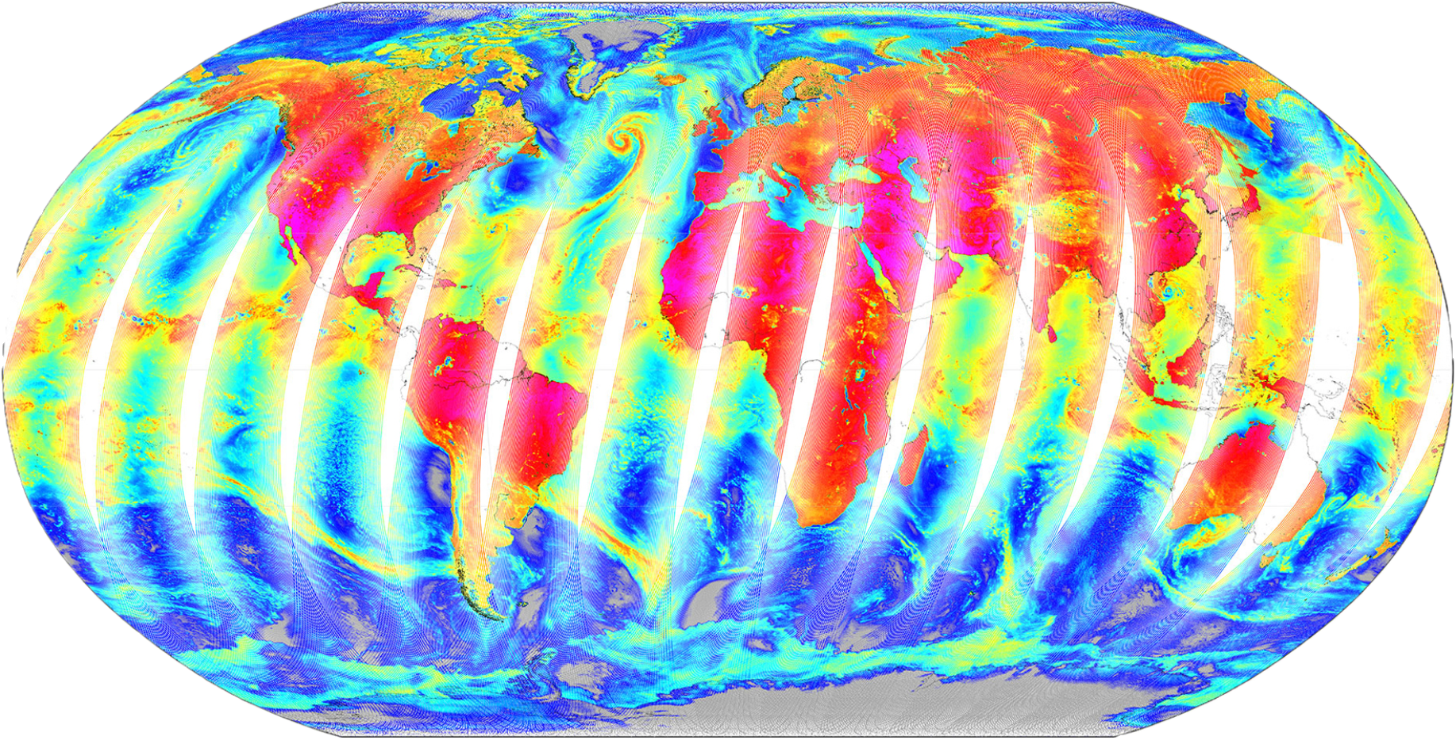

Data Assimilation in ICON - ongoing activities
Model & Assimilation set-up
ICON over Italy: 2.2 km resolution, L65, ERA5 LBC
Initial conditions: LETKF / KENDA
20 ensemble members (under testing — is it enough for long periods at high resolution?)
3h assimilation cycle
DATA
In progress
Next step
Exploring
1
2
3
MHS
Microwave Humidity Sounder
SEVIR-MSG/ FCI-MTG
Geostationary Imagers (VIS-IR)
CONVENTIONAL DATA (STNOP+..)
Collaboration
ARPAE: active joint work on part of the scientific chain (See T. Gastaldo - ARPAE results for ICON-2I MHS data assimilation for operational)
DWD: independent development with regular exchange of results
Plan to run similar implementation on CMCC HPC for CMCC/REMHI-focused research activities
(e.g. re-analysis and analysis of extreme events).
Preparation of the HPC env was necessary to run the experiments:
Technical pipeline
Pre-processing
HPC environment set-up
Workflow deployment
Ready to run

Slide 17
Machine Learning Approach
End-to-end framework
Modular design: usable with ICON, COSMO and WRF with proper pre-processing (a model-based retrain is needed for each).
Custom U-Net architecture that accommodates heterogeneous inputs via multi-branching — currently configured with an NWP branch and an EO branch.
Data sources
NWP
ICON / WRF / COSMO
Earth Obs
MSG-SEVIRI
Ground Stations
NOAA ISD
Future directions
CURRENT RESULTS
Initial tests on T2M (configurable to other variables).
Three model variants tested and evaluated against station observations, with encouraging performance.
Next important step: moving to a multivariate approach.
Multivariate NWP input (e.g. T2M + humidity)
Add auxiliary data (e.g. day-of-year/time encoding)
Physics-aware loss (orography, seasonal weighting, DA-oriented)
Attention mechanism on the U-Net bottleneck (adaptive EO/NWP weighting)
Test resilience to missing input sources
Add further sources to be assimilated
Expand the training period
Run a proper hyperparameter search
Draft a paper

Slide 18
Overview on activities / plans for satellite DA in KENDA
all-sky MTG FCI IR-WV + VIS data (to replace operational SEVIRI) → cloud information
  → 50-day impact experiment: underestimation of precipitation slightly improved
DE
all-sky MTG FCI NIR data → info on cloud + IWV (→ low-level humidity)
  project planned at LMU Munich HErZ
MW channels from polar-orbiting satellites → (non-rainy) (temperature +) humidity profile information
(Arctic Weather Satellite (AWS), future EPS Sterna; EPS-SG/MWS (Europe), JPSS/ATMS (USA), FY3/MWHS (China))
  DA run technically at DWD, next: monitoring
  ARPAE: extreme flood event case strongly improved; first impact experiments over ~ 16 days, results ~ neutral
IT

Slide 19
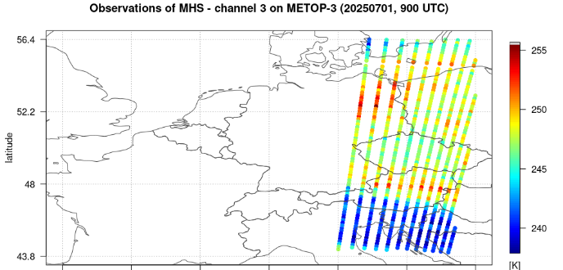
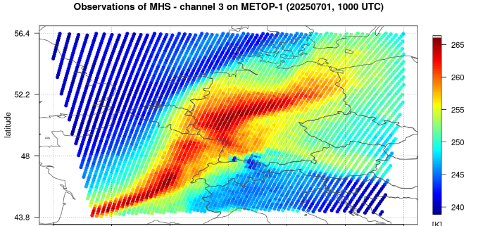
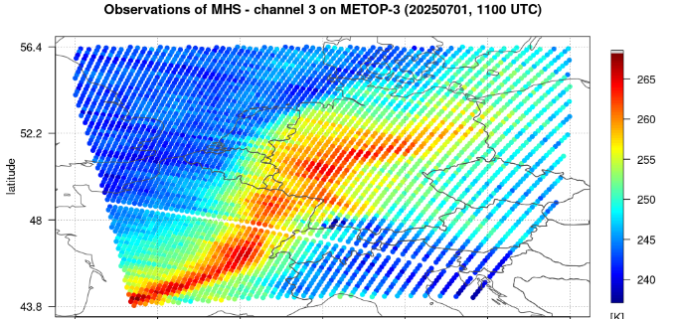
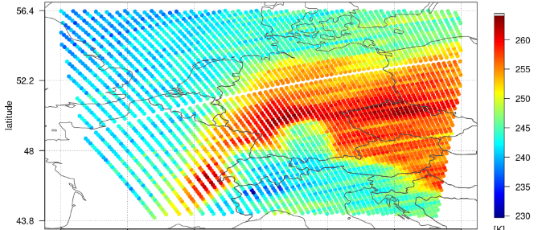
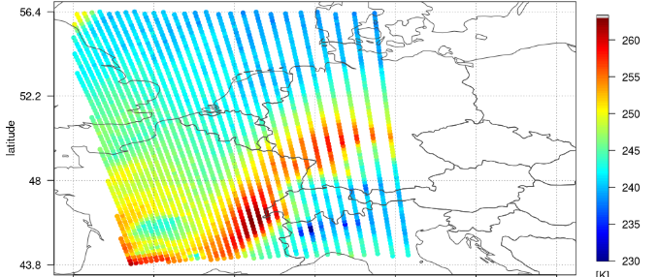
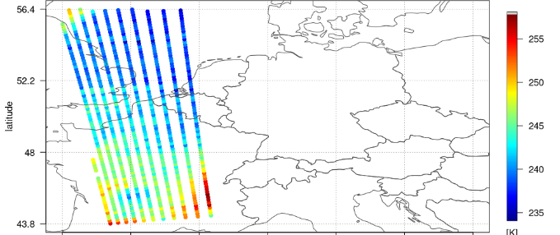
All-sky MW humidity channels from polar-orbiting satellites.
Annika Schomburg
Goal: all-sky assimilation of microwave humidity information (possibly also temperature)
start with clear-sky DA of MHS (on Metop-B, Metop-C) & ATMS (on Suomi-NPP, NOAA-20, NOAA-21)
DA runs technically, adaptations needed for bias correction
Next: MHS + ATMS: monitoring, DA experiments (incl. bias correction) (‚clear-sky‘ as long as RTTOV-14 not ready
at DWD
Coverage by MHS (morning (09, 10, 11 UTC upper row) and evening overpass (20, 21, 22 UTC))
19

Slide 20
Overview on activities / plans for satellite DA in KENDA
all-sky MTG FCI IR-WV + VIS data (to replace operational SEVIRI) → cloud information
  → 50-day impact experiment: underestimation of precipitation slightly improved
DE
all-sky MTG FCI NIR data → info on cloud + IWV (→ low-level humidity)
  project planned at LMU Munich HErZ
MW channels from polar-orbiting satellites → (non-rainy) (temperature +) humidity profile information
(Arctic Weather Satellite (AWS), future EPS Sterna; EPS-SG/MWS (Europe), JPSS/ATMS (USA), FY3/MWHS (China))
  DA run technically at DWD, next: monitoring
  ARPAE: extreme flood event case strongly improved; first impact experiments over ~ 16 days, results ~ neutral
Hyperspectral IR sounders: focus on clear-sky DA for temperature + humidity profile information
  IASI-(NG) (polar-orbiting sat.) (ARPAE; DWD for global system)
  MTG IRS
IT

Slide 21
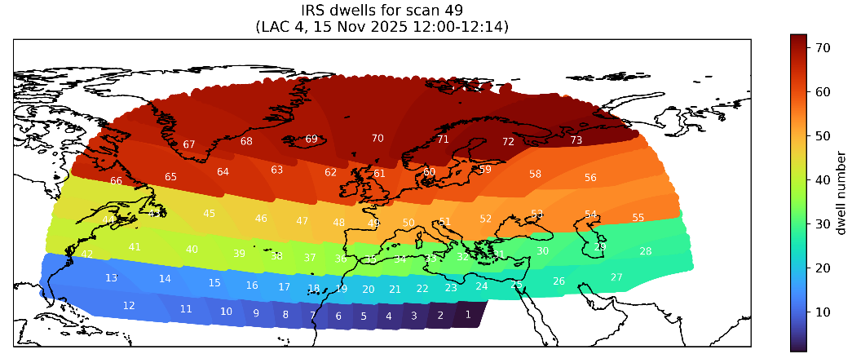
MTG IRS (hyperspectral IR sounder)
Thomas Deppisch, Mahdiyeh Mousavi, Robin Faulwetter, Anne Rojahn, Olaf Stiller,
Christina Köpken-Watts
IRS real data in DWD data base since 03 Aug. 2026; use obs available at t_{ana} – 20 min over ICON-D2 domain
IRS load tests (all available 70000 fovs, 120 ch., MM)
cost increase: − ICON: 1-h FG run: + 65 %
  − LETKF: + 100 %
  → cost optimization needed (parallelized obs reading?)
70’000 fovs
over ICON-D2
from 6 “dwells”
satellite pre-processing sat_pp is adjusted (RF, AR)
  → pre-thinning
refinement of cloud detection for real-data (incl. model top extension),
(restrictive?) channel selection,
specification of inter-channel observation error cross covariances (OS, MM)

Slide 22


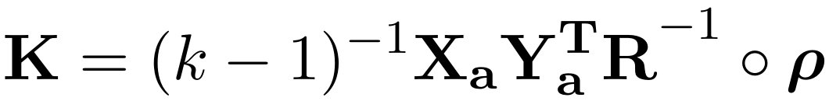
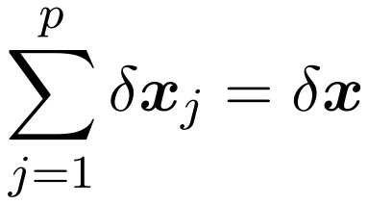
Partial Analysis Increments (PAI): original formulation
Algorithm developed by Diefenbach et al., 2023. Estimates the 3D analysis increment δx_{j} attributed to each j^{th}-observation, using the Kalman gain (K) based on ensemble analysis perturbations.
Where Xa, Ya are the ensemble analysis perturbations in model and observation space, R the observation error covariance, ρ the localization matrix, k the number of ensemble members.​
computable from standard LETKF output​ of KENDA!
avoids expensive single-observation experiments​
can help to detect detrimental observation influence (e.g. due to ‘incorrect’ localization settings)
can help to optimize (e.g. vertical) localization & guide modifications to assimilation settings

Slide 23

PAI: updates
​Original PAI formulation does not take into account two important components of the DA cycle:​
Covariance inflation
Localization contribution on Ya matrix
This implies the sum of PAI contributions can deviate from the total LETKF increment:
We have implemented a mathematically consistent correction of PAI to account for RTPS covariance inflation and localization​ effects
This improves the agreement with total LETKF increment δx by more than 10% for most prognostic variables (T, u, v, qr, p).​ See more details in presentation “Partial Analysis Increments: Theoretical Advances and Case Study Applications” during WG-DA by Poli & Grenzi.

Slide 24
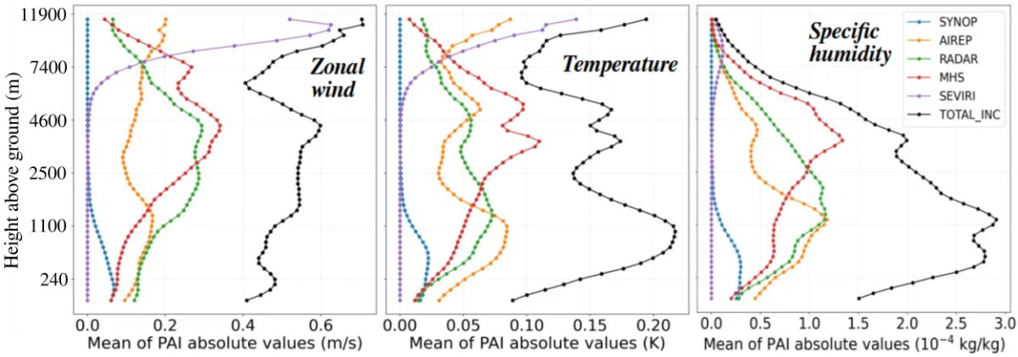
PAI: Relative impact at different altitudes
PAI results for the analysis used as initial condition of the ICON-2I forecast. Severe convection case study ​(15/09/2022 00UTC, Central Italy). Assimilating MHS & SEVIRI satellites, radar & conventional data
SEVIRI dominating high troposphere​
MHS dominating mid troposphere​
RADAR and conventional dominating low troposphere​
Complementary contribution coming from infrared and microwaves
Plan: test PAI on multiple case studies; tests for optimising localization

Slide 25
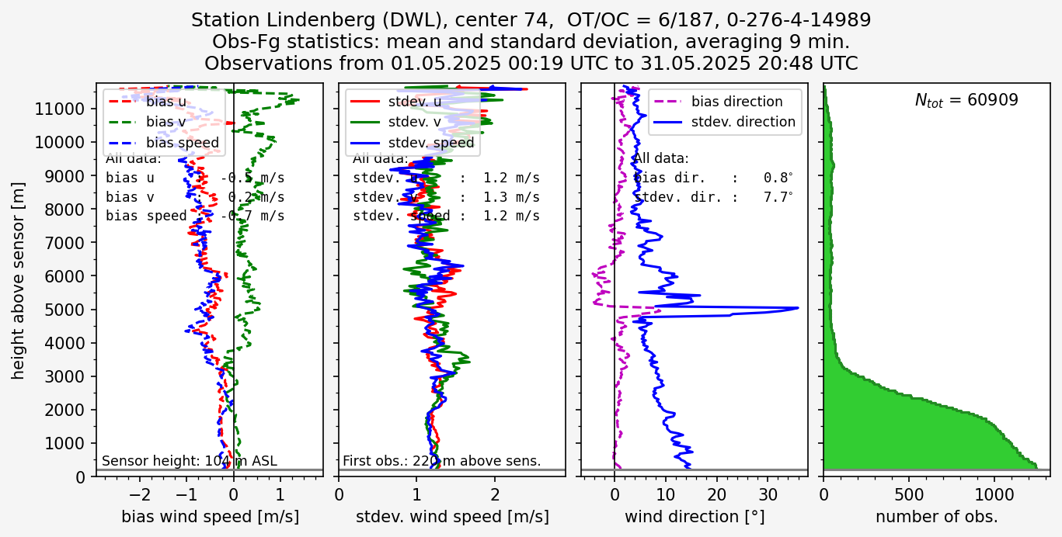
PBL profiler obs: Doppler wind lidar
Michael Bender
monitoring May 2025 (here: Lindenberg):
most obs
below 2 – 3 km
low biases
(low levels)
very low stdev

Slide 26
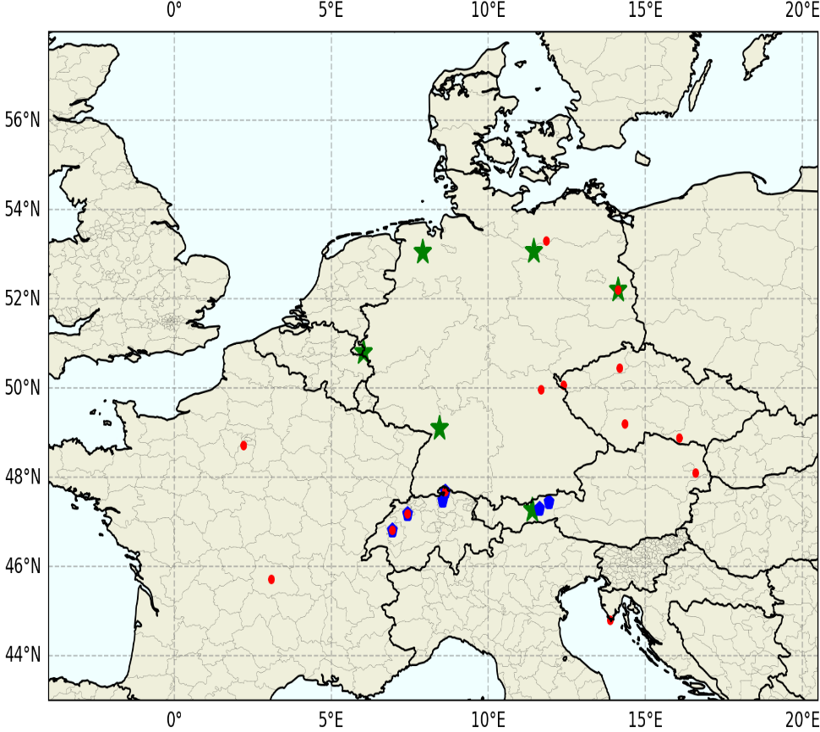
PBL profiler obs: Doppler wind lidar
Michael Bender
⬇ DWL assimilated
DWL passive
Wind Profiler
 W-Prof passive
incl. ACTRIS DWL stations

Slide 27
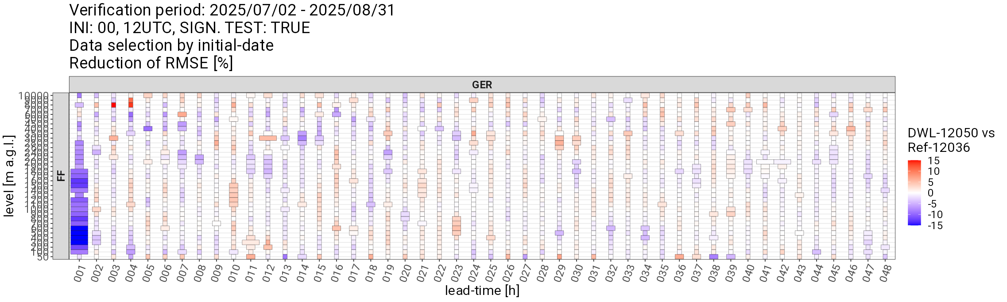
PBL profiler obs: Doppler wind lidar
Michael Bender, Klaus Stephan
NUMEX impact experiment for July 2025:
strong local positive impact on wind at +1h,
very rapidly decreasing to ~zero after 4 h (short-lived)
all wind lidar data (available ~ every 10 min)
assimilated in 1-hourly KENDA,
and used in MEC verification !
i.e. score at 1-hr lead time is in fact a mixture
of 10’, 20’, 30’, 40’, 50’, 60’ lead times! (pitfall!)
weak negative impact on low-level T, RH
new experiment: active assimilation
of only 1 profile per hour near analysis time:
  no negative impact on T, RH any more
  ~ no positive impact on wind (?!)
  ~ no positive impact of exp 12050 when
  verifying against reduced set of obs (!!?)
against
lidar + profiler wind speed
(box width
is related to
statistical
significance)
  however: inconsistencies in the verification results
  first need to understand the experiments / verification / results

Slide 28
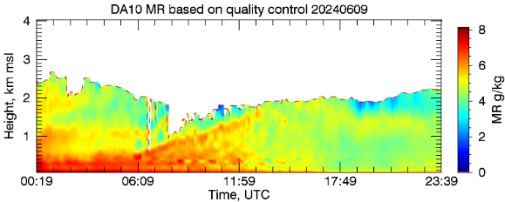
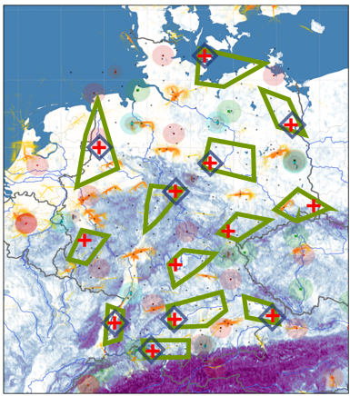
PBL profiler obs: DIAL (Differential Absorption Lidar)
Jens Pruschke
DIAL → vertical profiles of water vapour mixing ratio (MXR)
in lowest 2 – 4 km (or up to low cloud base),
resolution 10 m (30 m?), every 20 min
DWD plans to buy ~ 13 DIAL instruments
for locations across Germany (as for DWL)
+
DIAL
1 testbed DIAL (Vaisala DL10) at Lindenberg observatory
Impact experiment July 2025:
positive impact on humidity in FG (large vs. DIAL mixing ratio
small vs. Lindenberg radiosonde RH)

Slide 29
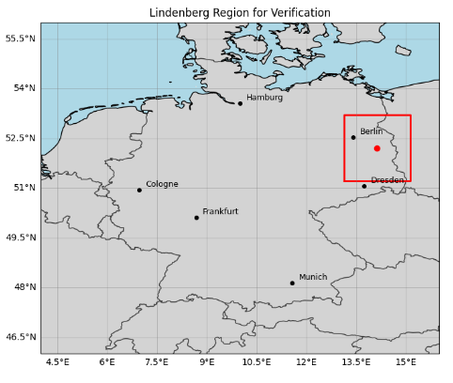
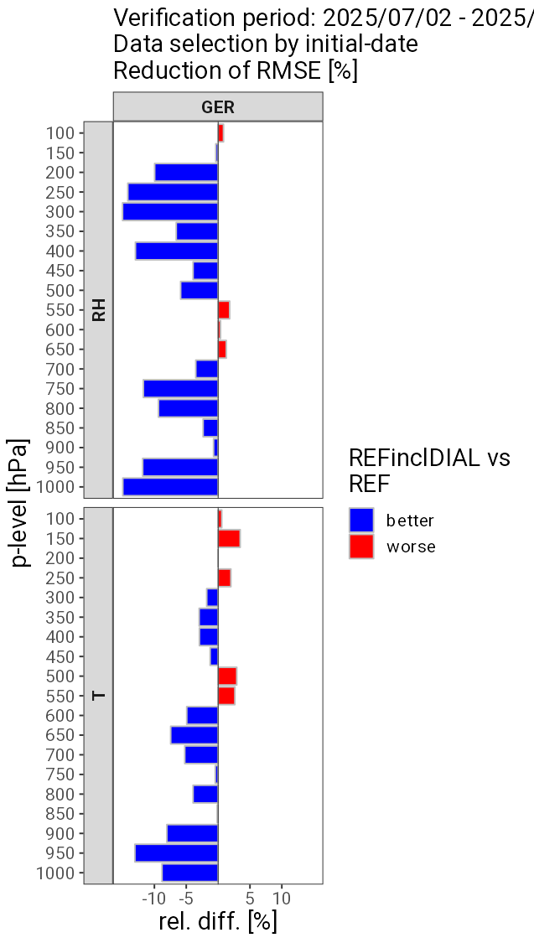
PBL profiler obs: DIAL (Differential Absorption Lidar)
Jens Pruschke
Forecast verification vs. radiosonde (restricted area around Lindenberg
(~ 100 km radius))
for July 2025
Lindenberg
verification over a small region
(+/-1° in Lat/Lon)
forecast runs every 6 h
RMSE averaged over lead times ≤ 6 h:
~ 30% +2h , ~ 70% +5h (Lindenberg radiosonde 6-hrly)
strong error reduction in relative humidity & temperature
(but not statistically significant in available scores)
→ time series: improvement only from single forecasts;
at each level another forecast with reduced RMSE
→ results look great but are rather inconclusive ! (pitfall)
(noise rather than signal ?!)
Notes:
Typisches Felix-Tool verwendet. Gebiet wie bei FG Verifikation eingeschränkt. Daher lead-times für diesen Plot auch nicht bis 24h berücksichtigt (aber berechnet)
Negative Einflüsse noch unklar. Echte Signifikanz nur zum Teil gegeben.
Winterperiode noch im Bearbeitung.

Slide 30
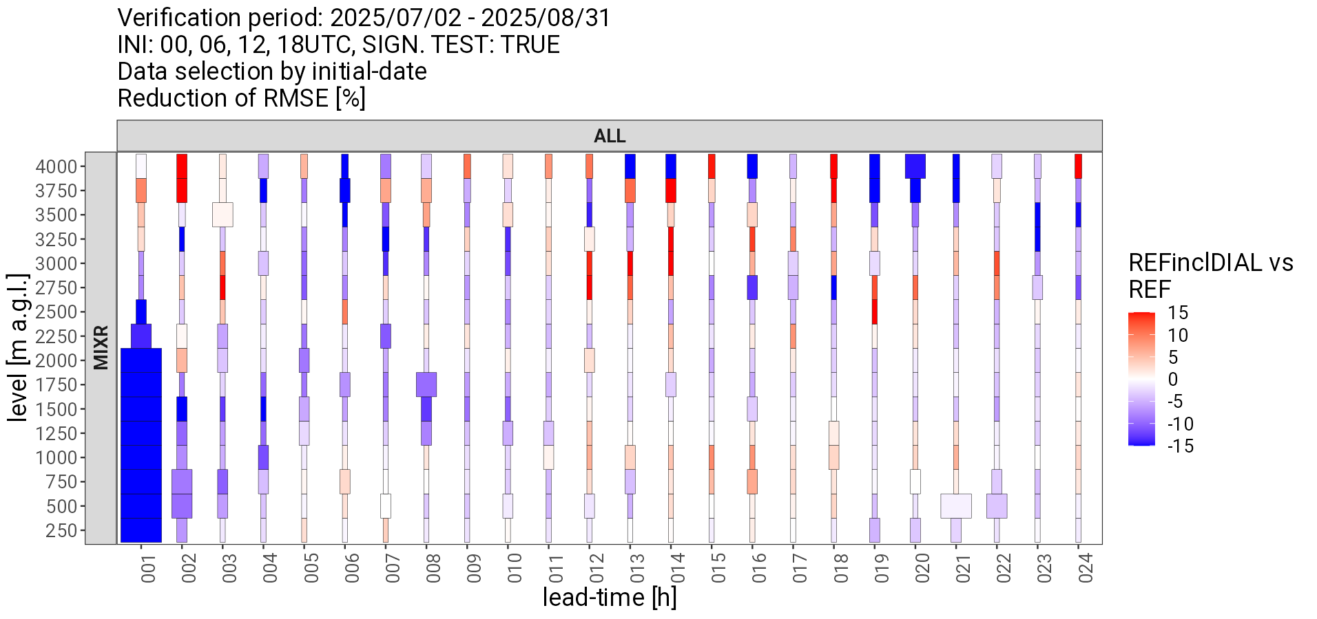
PBL profiler obs: DIAL (Differential Absorption Lidar)
Jens Pruschke
NUMEX experiment for new 2-month period: July + August 2025
against DIAL mixing ratio
first hour: mixture of 20’, 40’, 60’ lead times
still some positive impact up to 8 – 11 h
Notes:
Typisches Felix-Tool verwendet. Gebiet wie bei FG Verifikation eingeschränkt. Daher lead-times für diesen Plot auch nicht bis 24h berücksichtigt (aber berechnet)
Negative Einflüsse noch unklar. Echte Signifikanz nur zum Teil gegeben.
Winterperiode noch im Bearbeitung.

Slide 31
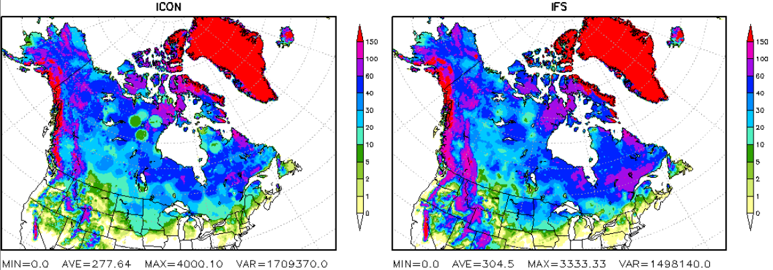
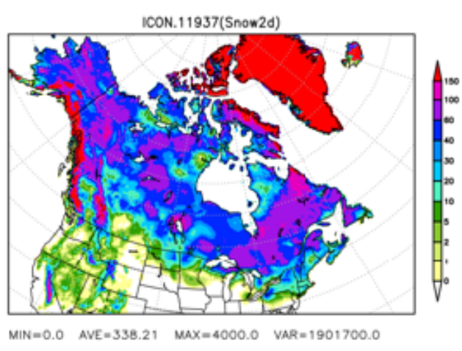
Why a new snow analysis ?
T. Hüther, G. Geppert, M. Lange, R. Williams et al.
Operational:
Cressman Analysis
with successive correction methods due to the lack of true spatial covariance matrix (B)
Pre-operational (last winter):
2D-Var
using isotropic horizontal B-matrix
with vertical displacement penalty,
but terrain blind
FE1 – plot catalogue – Helmut Frank
code not compliant with
“DACE requirements,
did not allow for developing MEC with consistent obs operator
T. Hüther, G. Geppert, M. Lange, R. Williams et al.
Notes:
Monthly updates planned to be available with 5 days delay to realtime

Slide 32
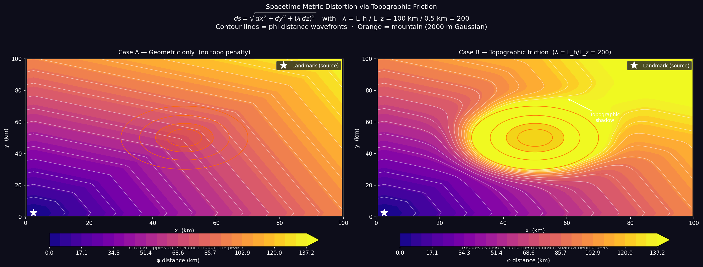
New snow analysis: topography penalty
Richard Williams
uses: ”Curving spacetime”
(i.e. going across mountains takes effort)
Diffusive B-matrix:
new snow analysis
embeds a 2D-Var analysis
in higher-dimensional space
using conductance to dictate
the B-matrix influence
barriers (e.g. water, ocean) and orography (e.g. mountain ridges) can now be seen
at very negligible cost
Notes:
Monthly updates planned to be available with 5 days delay to realtime

Slide 33
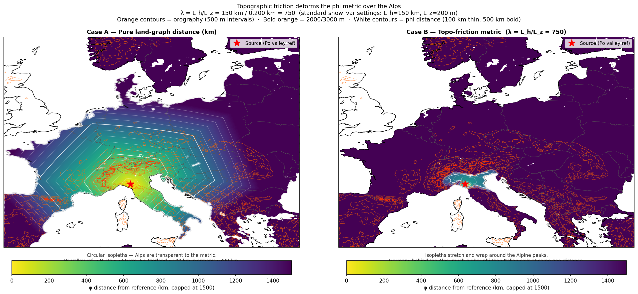
New snow analysis: topography penalty
Richard Williams
Richard Williams
Notes:
Monthly updates planned to be available with 5 days delay to realtime

Slide 34
New snow analysis: stability tests using ICON-DREAM
Arianna Valmassoi, Richard Williams
offline stability tests by applying new snow analysis to 16 years of first guesses from ICON-DREAM
(Arianna Valmossoi)
→ blacklisting is the main issue;
buddy checks introduced, tests with more observation (e.g. Snotel)
being tested now in NUMEX experiment (for the global system)
new code is ‘hard-coded’ for snow analysis exclusively (not in DACE)
Notes:
Monthly updates planned to be available with 5 days delay to realtime

Slide 35
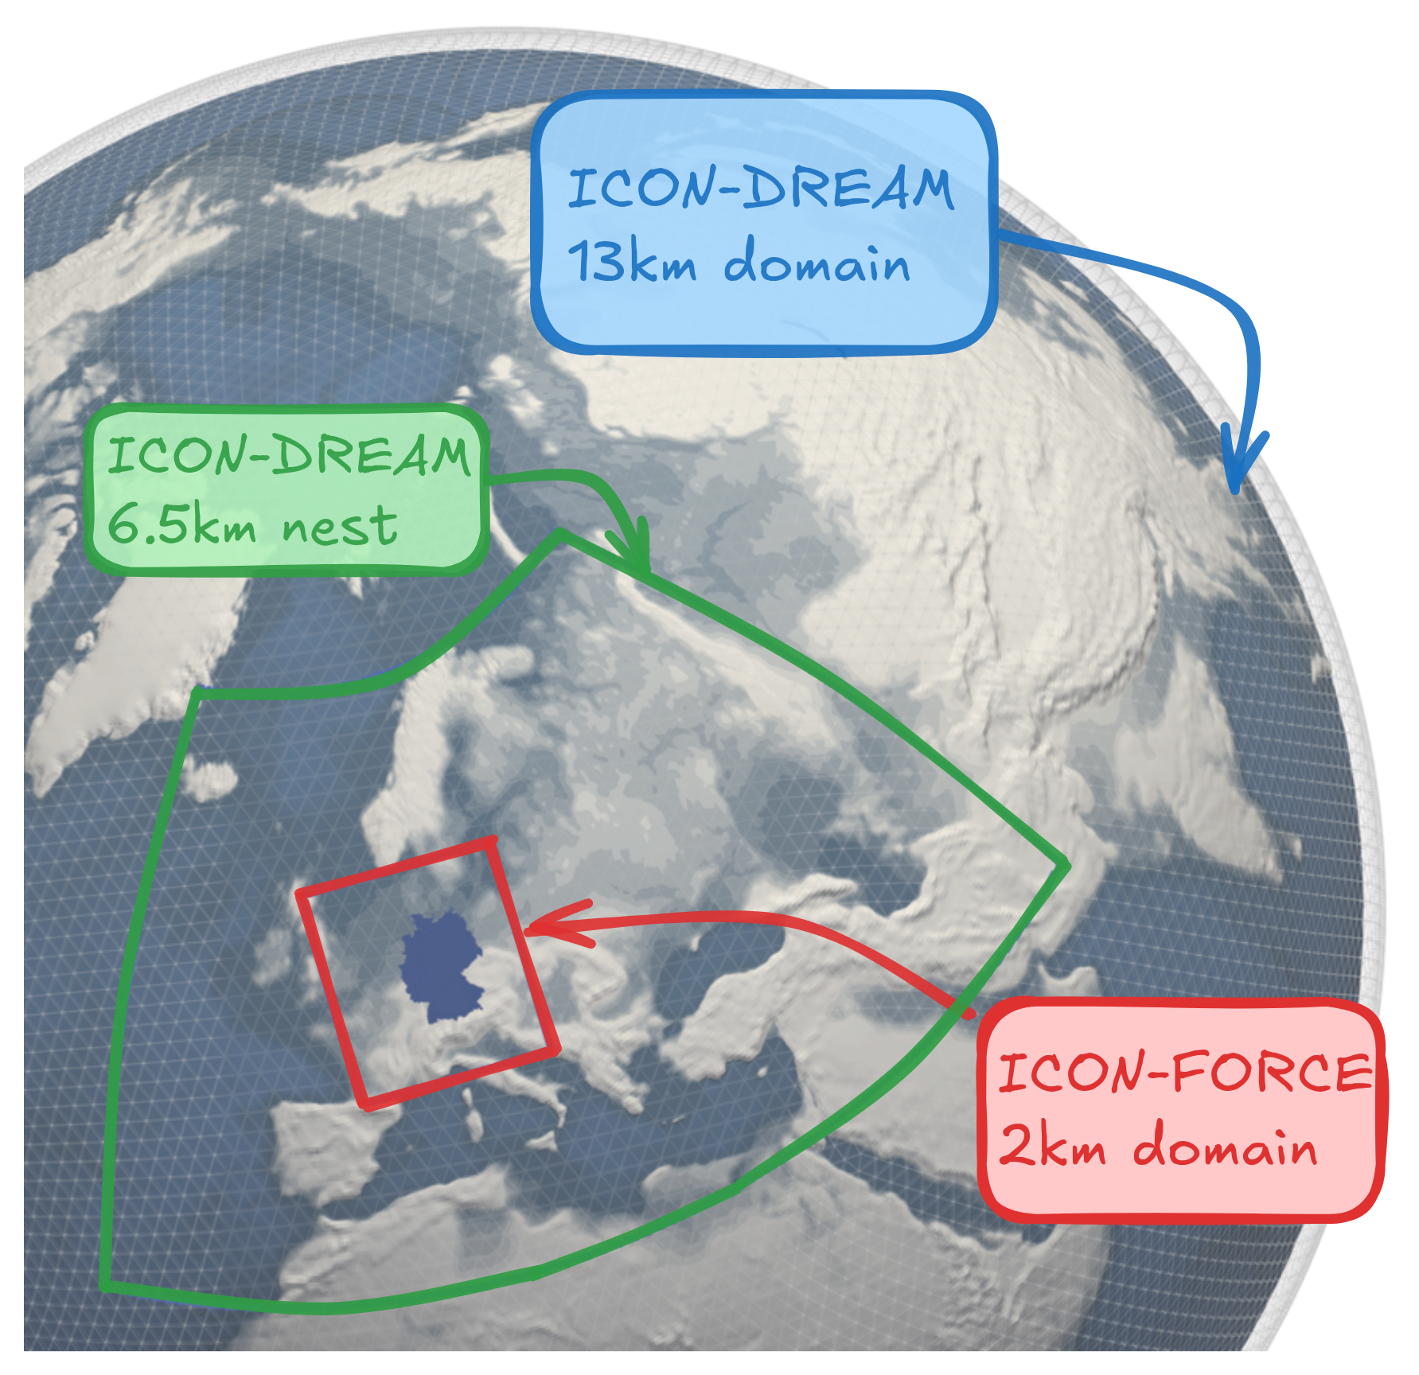
ICON-DREAM: Dual resolution Reanalysis for Emulators, Applications and Monitoring
Re-analysis
Arianna Valmassoi a.o.
2010 – 2025, 20 ensemble members; DOI: 10.5676/dwd/icon-dream_v1
subset of variables is available in opendata
ICON-DREAM v2 developments:
− extended period 1982 – current
− new features:
    include radiances assimilation: AMSU-A/B, MHS, ATMS, HIRS, MSU (thanks to Bill Bell)
    if available, use new Climate Data Records (CDR)
    i.e. reprocessed observations
    improve ensemble representation

Slide 36

ICON-FORCE: Fine-scale Observation-based Reanalysis for Central Europe
Re-analysis
Arianna Valmassoi a.o.
2 km resolution, deterministic + 20 ensemble members
observations used: same as ILAM-D2 / RUC, but no time cutoff; reprocessed LHN input
ICON configuration: SINFONY physics, i.e. 2-moment microphysics
IC / LBC: ICON-DREAM; available 2019 – 2025 (2016 – 2018 planned)
ICON-FORCE-c: Fine-scale Observation-based Reanalysis for Central Europe - conventional

Slide 37
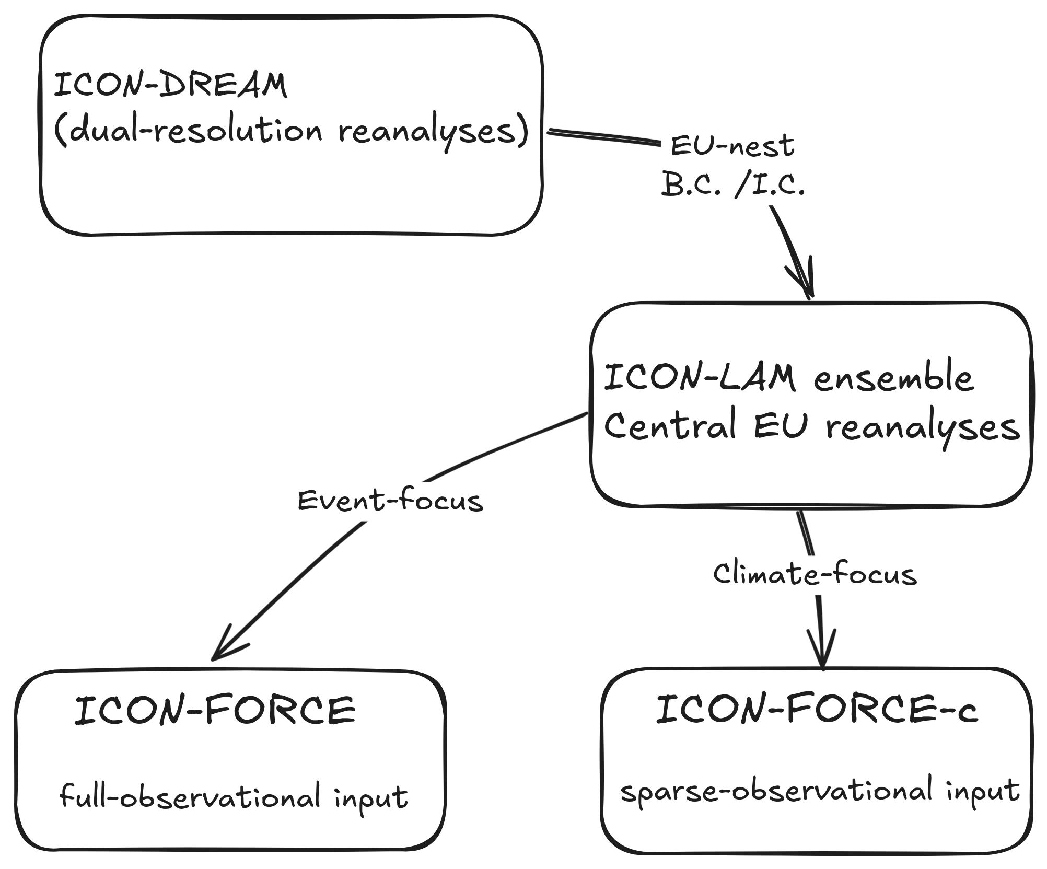
Re-analysis
Arianna Valmassoi, Alexander Kelbch a.o.
Why splitting the regional reanalyses?
ICON-FORCE: Aims for best possible representation of atmospheric state!
Full observational input including 3-D radar scans, LHN, MODE-S, SEVIRI
ICON-FORCE-c: Aims for max. consistency regarding the observational input! (sparse: only conventional observations are assimilated!)
Designed for climate monitoring and related applications.
A. Valmassoi et al., A. Kelbch et al.

Slide 38
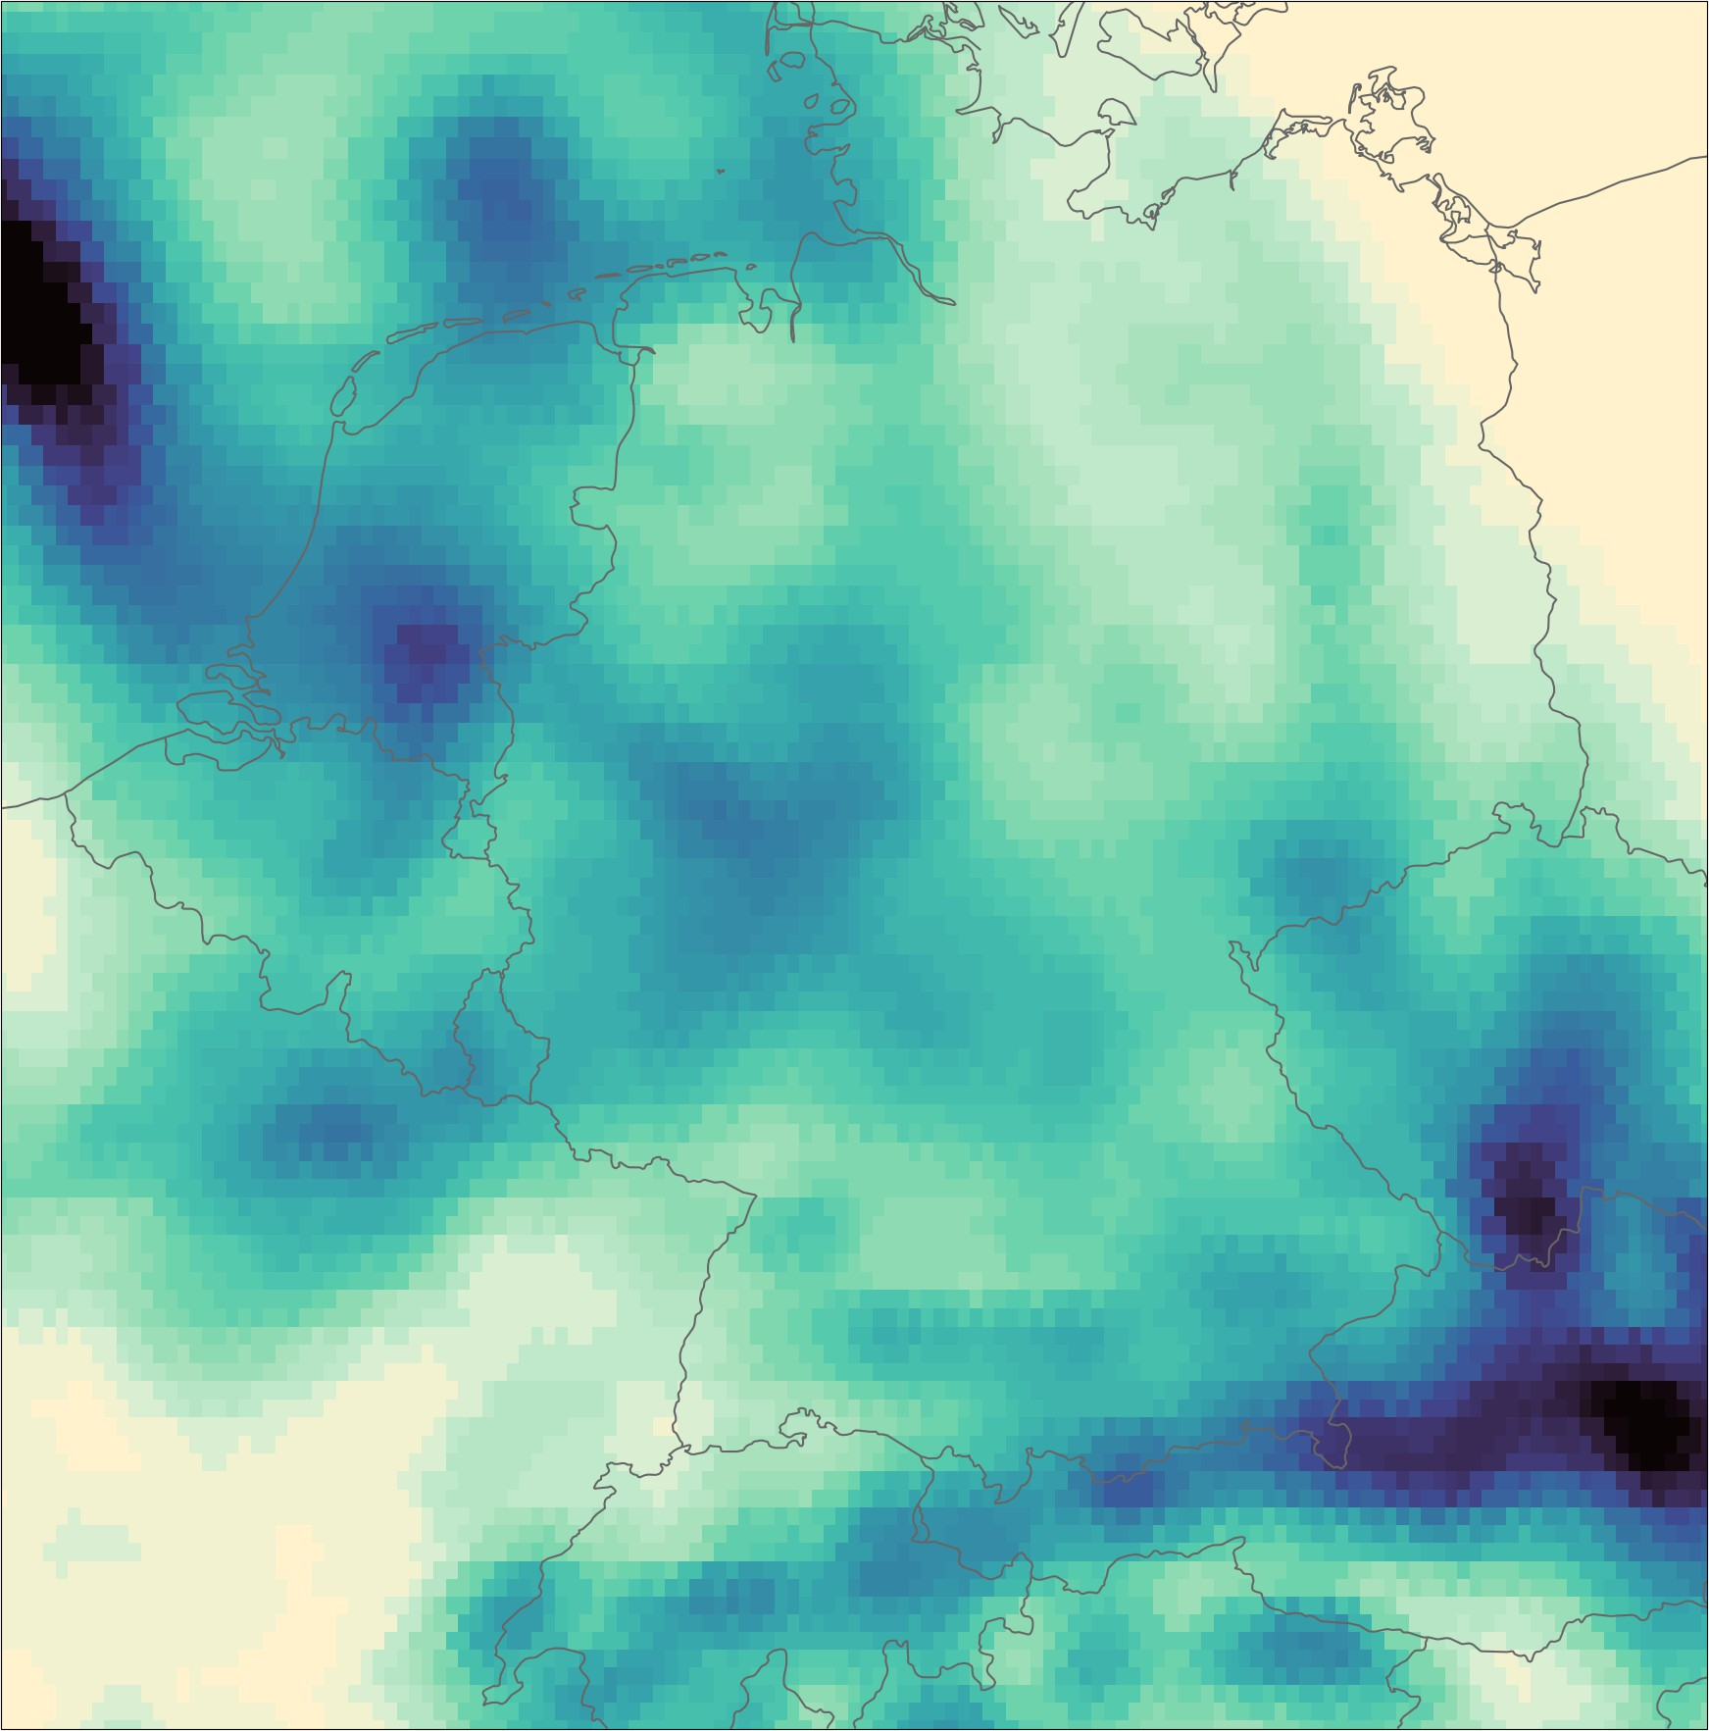
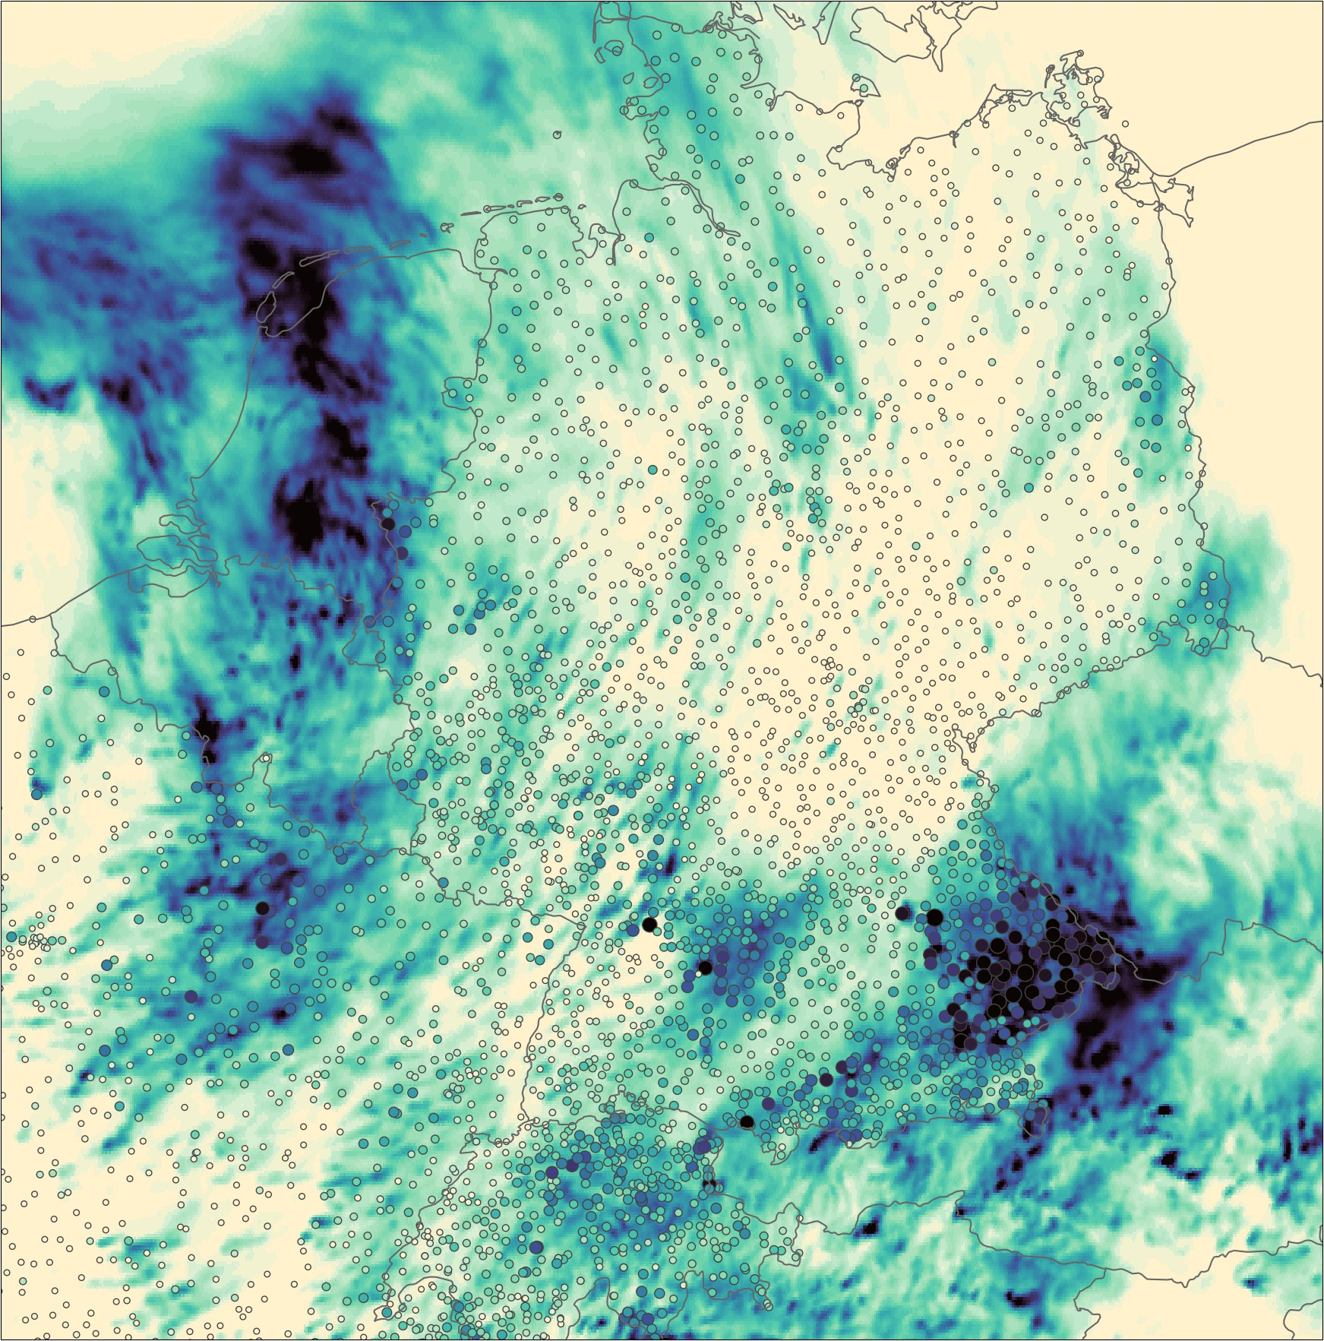
precipitation daily sum: 05.06.2022 (ICON-FORCE)
Re-analysis
Arianna Valmassoi a.o.
Qualitative comparison with DWD-CDC
stations
ERA5
ICON-FORCE

Slide 39
Re-analysis.
highlights DWD:
  initialized analyses from all ICON reanalyses outperform ERA5 wrt. surface scores (vs. assimilated Synop obs)
  ICON-DREAM (global) used for many external applications (e.g. private renewable energy sector)
  great interest for FORCE (ICON-D2) (e.g. hydrology)
DE
continued collaboration at DWD, MeteoSwiss, ARPAE on (facilitating) production of regional reanalyses (sharing knowledge, historic and non-GTS observations, observation pre-processing, etc.),
coordinated by Arianna Valmassoi
currently a problem: easily accessible location to share large data sets between partners,
i.e. LBC/IC from DREAM for ARPA and from FORCE for Meteo-Swiss
(ATOS? → storage quota?)
IT

Slide 40
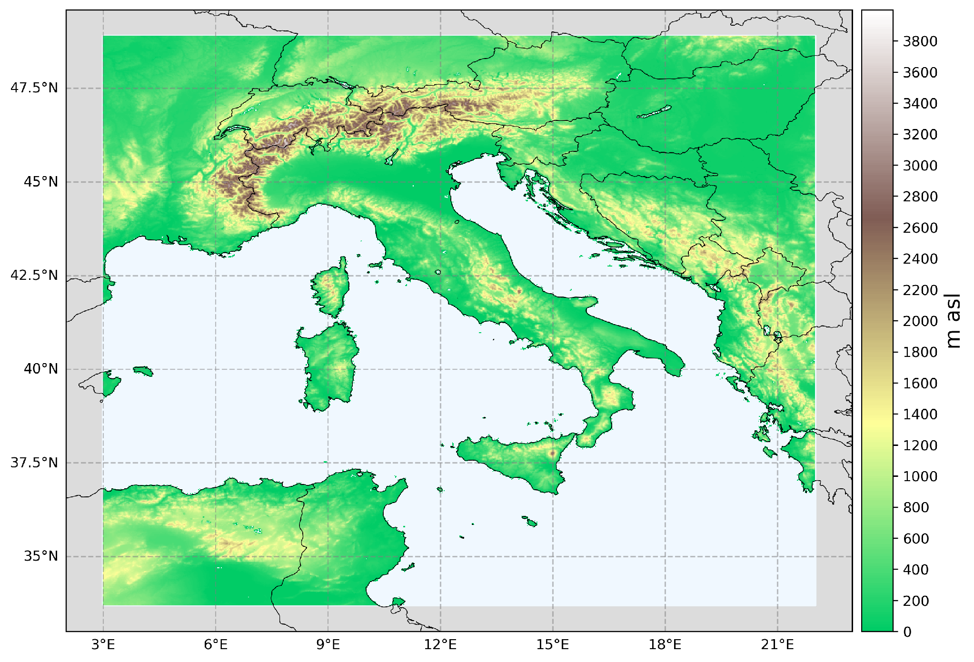
ITINERE
ITalian Icon-based Near-real time Ensemble Reanalysis (in collab. w. Antonio Giordani, Unibo)
Technical setup:
Built upon operational config. of ICON-2I model:
Horizontal resolution ~2.2km, L65, model top at 22km
Temporal range: 2010 – 2025, with near-real time extension
Ensemble members: 20+1
LBC: ICON-DREAM EU nest (det. 6.5km + 20-memb. ens. 20km)
DA: LETKF of conventional observations (SYNOP, TEMP, AIREP) + LHN of radar-estimated rainfall, daily SST + SMA & 3-h SNW analyses.
Possibly additional assimilation of T2m and satellite data (SEVIRI)(?)
1st test: 8 days Marche flood event: ITINERE closer to 24-h precip obs than ICON-DREAM, ICON-2I ope,
        IFS ope & all 5 Italian regional reanalysis recently produced!
next: add soil moisture nudging, SST + snow analsis, TERRA-URB
start production of first 5-year stream by end of 2026 (ecFlow suite on ATOS, Special Project SPITGIOR (2026-2028))

Slide 41
REA-L-CH1
V1: − deterministic downscaler from ERA5 to 1 km, except for applying LHN
− stakeholders: wind energy sector for wind climatology; ML
− 2005 – 2024, open access hopefully soonish (early 2027?)
V2 plans: − add TERRA-URB
− add EUCOM / OPERA for LHN (2016 ff)
− add multi-layer snow model NIX
− assess quality of new 2d-Var snow analysis
− use APT climatology (?)
− use ERA6 (instead of ERA5; promised for end of 2027) as LBC
− start production towards end of 2027
COSMO GM 2026, Rome, Daniel Leuenberger et al.

Slide 42
AI-Var
DE
so far: global T2M analysis, DA of upper air observations for smaller domains
for global 3D atmospheric DA at analysis resolution: parallelization required,
however ‘old’ code could not parallelize
→ new AI-Var code written (Richard Williams → snow analysis, therefore limited resources in AI-VAr)
with parallel data structures, allowing for parallelized B-matrix (in Python)
in 2027, significantly more resources will be available
IT

