Slide 1
Operational NWP and projects at MeteoSwiss
Oliver Fuhrer
COSMO General Meeting 2026, 17.9.2026

Slide 2
Operational NWP System

Slide 3

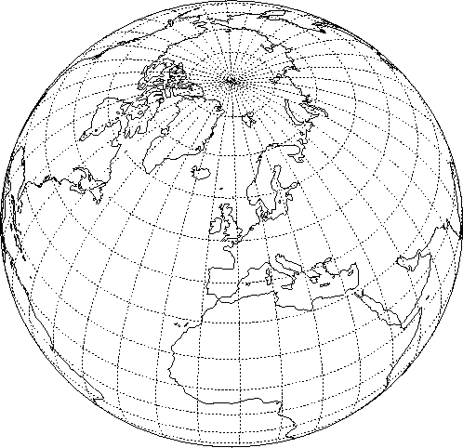
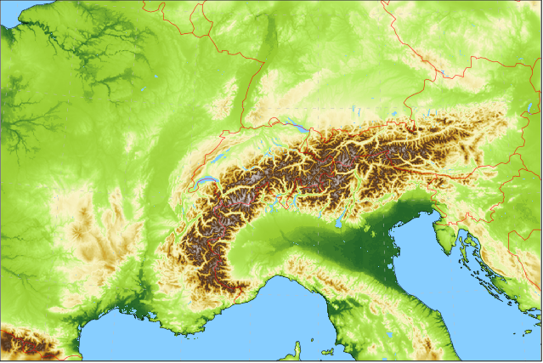
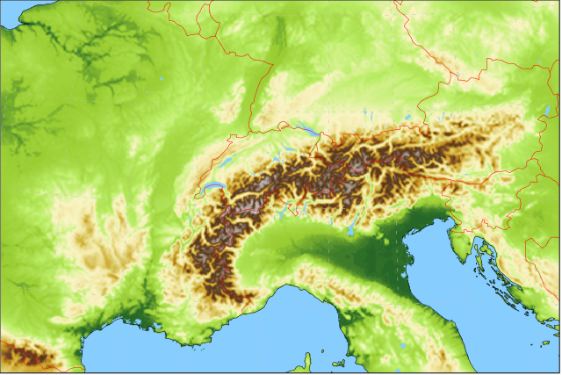
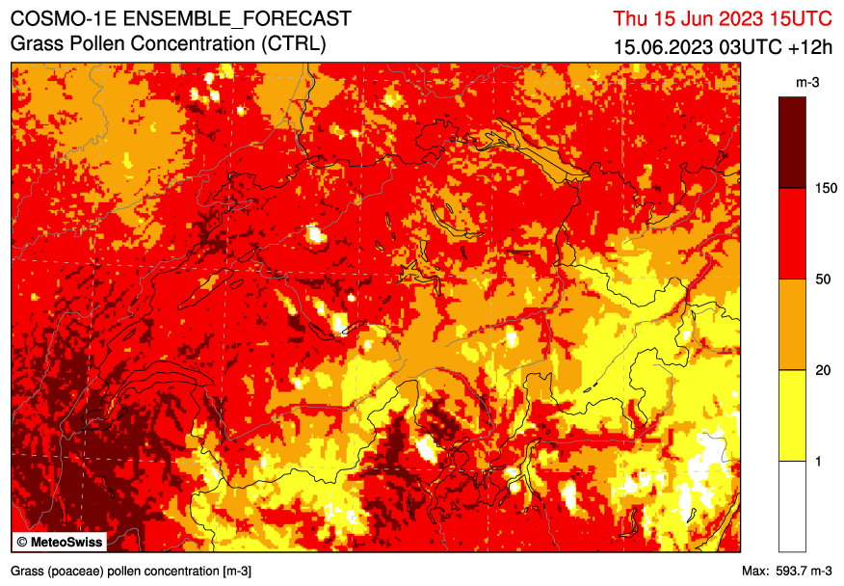
Forecasting System based on
Ensemble Data Assimilation: KENDA-CH1 with LETKF
40+1 members at 1.0 km grid size with ICON-CH1 setup (SPPT)
hourly cycling
Lateral boundary conditions: IFS ENS
9 (18) km
4x per day
ICON-CH1-EPS: 33 hour forecasts, 8x per day
1.0 km grid size (R19B08), 80L
11 ensemble members
ICON-CH2-EPS: 5 day forecasts, 4x per day
2.1 km grid size (R19B07), 80L
21 ensemble members
DWD

Slide 4
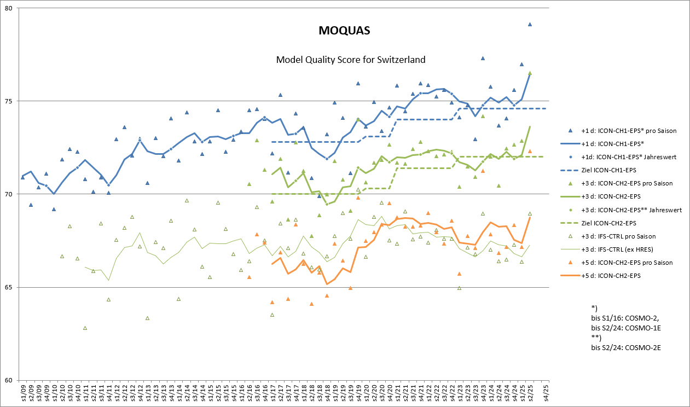
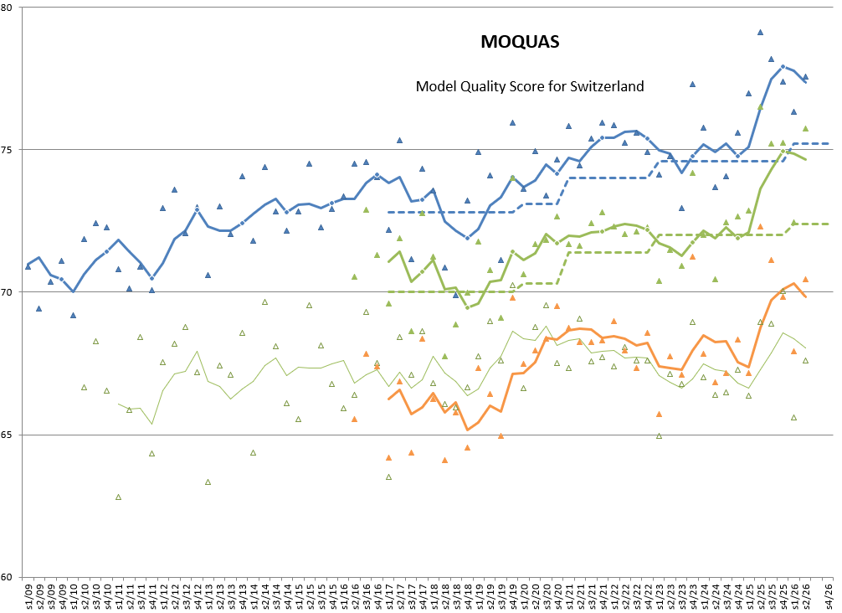
Headline Score
30% precipitation
30% temperature
30% cloud cover
10% wind speed

Slide 5
Operational Changes
Microphysics tuning
Updraft-dependent supersaturation
rain DSD(qᵣ)
reduced riming and snow fall speed
Terrain effects
Slope/shading corrections and reduced mixing improve valley T/RH
KENDA
Revised RH and surface-station handling
Adaptive Parameter Tuning (APT)
Filtered analysis increments tune surface parameters and reduce T_{2m} / RH_{2m} biases
Ensemble perturbations
SST, soil T and moisture perturbations improve surface spread
External parameters
Remapping fix removes radiation block patterns
Catchment-scale precipitation overestimation remains an open issue.
Notes:
Scope: ICON-CH1-EPS, ICON-CH2-EPS and KENDA-CH1. Status 16 September 2026.
24 March 2026: KENDA 10 UTC, forecasts 12 UTC. ICON icon-2024.10-mch-1.0, DACE 2.23. Supersaturation allowed at 1% per 2 m/s updraft, constrained by QC/QV. Rain DSD depends on QR. Snow-to-graupel riming efficiency reduced and terminal snow fall velocity reduced. Orographic shading changes DURSUN. New _OS output fields retain horizontal-plane radiation with shading. Surface humidity observations above 96% no longer forced to saturation. Correct pressure assignment for stations without pressure observations. Exclude SYNOP above 3000 m and sub-hourly SYNOP. Some deterioration of intense winter precipitation and mountain cold/moist bias. Technical changes: CSCS stack v8, emme to inn, CUDA graphs in forecast models, LV03/LV95 interpolation fix.
12 August 2026: KENDA 10 UTC, forecasts 12 UTC. ICON icon-2025.10-mch-1.0, DACE 2.27. APT gains largest in KENDA, smaller in CH1, smallest in CH2. Slight degradation of dewpoint STDE. Little impact on precipitation/wind/cloudiness. Additional stratocumulus and interception-store tuning, AMDAR thinning and DA configuration alignment with DWD.
Sources:
2025-11-12 ICON-Info.pdf, pp. 4–6, 9.
2026-07-28 ICON-Info.pdf, pp. 4–5.
https://meteoswiss.atlassian.net/wiki/spaces/NO/pages/368345922
https://meteoswiss.atlassian.net/wiki/spaces/NO/pages/737739230
https://meteoswiss.atlassian.net/wiki/spaces/NO/pages/1992359988

Slide 6
Next release: Autumn 2026
Subgrid radiation–topography
Refined horizon / shading treatment and new EXTPAR fields
3D radar reflectivity DA
KENDA + EMVORADO, targeting end-2026
TERRA-URB
Urban surface scheme with anthropogenic heat and GLOBCOVER
APT
Revised internal soil-moisture adjustment
Wind and turbulence
Revised gust diagnostic, SSO drag, horizontal shear and Rayleigh damping
Precipitation type
New diagnostic for precipitation phase (PTYPE)
Further physics updates
Day/night visibility, trace gases, snow settings and dissipative heating
Parallel testing ongoing, final release approval pending.
Notes:
Status: 16 September 2026. Intended autumn release package, not a formally approved deployment commitment. Detailed release planning updated 10 September has empty Next Deployment and QRM-approved parallel phase tables. KENDA suite 857 started 13 August, added single-precision ecRad and revised APT-SMA on 25 August, TERRA-URB on 1 September, restarted 10 September.
Technical settings: a_hshr 2.0 to 1.25 in all systems. imode_snowsmot 1 to 2. Updated CO2, CH4, N2O and CFC concentrations. Rayleigh coefficient 5 to 8 in KENDA/CH1. SSO tune_gfrcrit 0.333 to 0.5 in KENDA/CH1, tune_gkwake 0.25 to 0.1 in CH2. itune_vis_diag 1 to 2. Gust diagnostic itune_gust_diag=4, tune_gustlim_agl=1500, ff10m_interval=600, tune_gustlim_fac=1.5 (CH1), 1.75 (CH2). itype_dissip_heat=2. TERRA-URB currently uses climatological T2m for anthropogenic heat.
PTYPE uses the Bourgouin/Firdewsa method as named in the release-planning record.
Additional planned platform work: ecCodes 2.47, libaec 1.1.7, eccodes-cosmo-resources 2.47.0.2, refreshed stack and separate ICON uenv. These are coordination inputs, not confirmed deployment approvals.
Sources:
https://meteoswiss.atlassian.net/wiki/spaces/APN/pages/235209143
https://meteoswiss.atlassian.net/wiki/spaces/NO/pages/1747157144

Slide 7
Plans
Integration candidates
NIX multilayer snow
Late 2026 / early 2027, subject to coupled KENDA–forecast tests
Efficiency
Single-precision ecRad and CUDA graphs in KENDA
Research directions
Precipitation and uncertainty
Reduce wet bias and reassess SPPT perturbations
Observations and land surface
Extend LHN beyond Switzerland, revisit Mode-S and snow analysis
Other directions
Wind-based APT, improved external parameters, prognostic aerosols
Notes:
Status: 16 September 2026. These items are not confirmed contents of the core autumn package. Some may still enter a late-2026 release.
Subgrid radiation-topography corrections are distinct from the grid-scale slope/shading corrections operational since March. Improvements expected particularly for valley radiation, sunshine and near-surface temperature. Latest coordination note flags ICON/EXTPAR code availability as unresolved on 26 August.
3D radar reflectivity DA has an explicit end-2026 objective, with parallel suite 315 running and suite 830 (August operational baseline plus radar DA) in preparation as of 11 September. The goal is assimilation, not synthetic radar products in operational forecasts.
NIX: multilayer snow scheme targeting improved snow evolution and spring melt. Requires full cycling and forecast tests. APT coupling had implementations marked untested on 1 September.
Longer term: SPPT tests exclude rain, snow and graupel tendencies. No deployment commitment. EUCOM/OPERA LHN intended to extend radar constraints beyond Switzerland. Mode-S tuning motivated by increased data volume. New snow analysis conditional on benefit beyond NIX. Improved topography/SSO fields, land cover and soil properties need assessment. Wind-based APT depends on better SSO external parameters. CAMS mineral dust and other aerosol tracers remain development priorities.
Sources:
https://meteoswiss.atlassian.net/wiki/spaces/NO/pages/1747157144
https://meteoswiss.atlassian.net/wiki/spaces/APN/pages/1752498628
https://meteoswiss.atlassian.net/wiki/spaces/APN/pages/1305412036
https://meteoswiss.atlassian.net/wiki/spaces/APN/pages/318571144
https://meteoswiss.atlassian.net/wiki/spaces/APN/pages/263458147
https://meteoswiss.atlassian.net/wiki/spaces/APN/pages/902629288
https://meteoswiss.atlassian.net/wiki/spaces/APN/pages/1968898109

Slide 8
Infrastructure

Slide 9

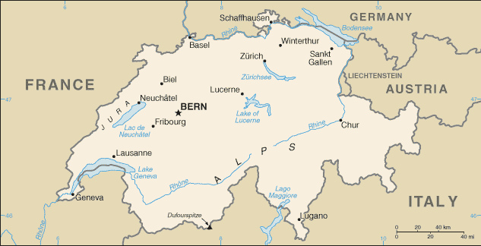
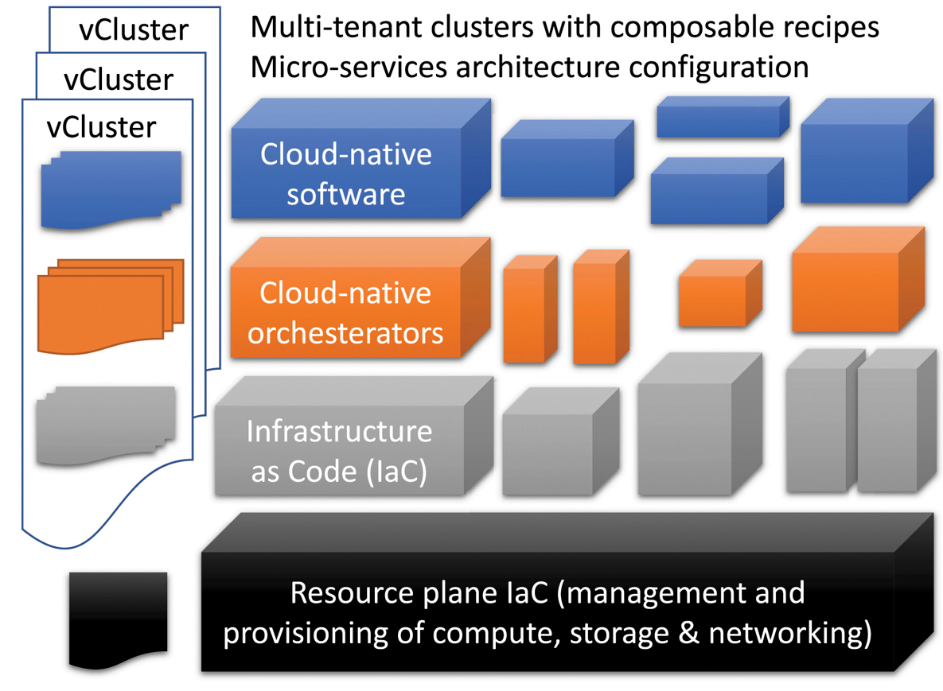
HPC Systeme ICON-22
Use of HPC Services on ALPS @ CSCS
Versatile clusters (IaC)
Elasticity
2 locations: Lugano and Lausanne
Annual service costs
Production: vCluster tasna
44 GPU nodes
4 x NVIDIA A100 96 GB GPUs
1 x AMD EPYC 7713 512 GB CPU
18 CPU nodes
2 x AMD EPYC 7713/7742 512 GB CPUs
Failover and R&D: vCluster balfrin
30 – 54 GPU nodes
18 – 24 CPU nodes

Slide 10
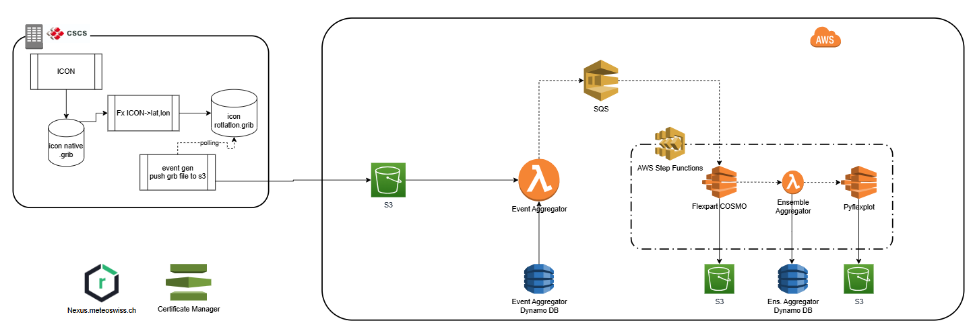
Dispersion simulation on AWS
Dispersion modeling (flexpart, lagranto) running quasi-operationally on AWS
Decomissioning of CSCS deployment in 2027.

Slide 11
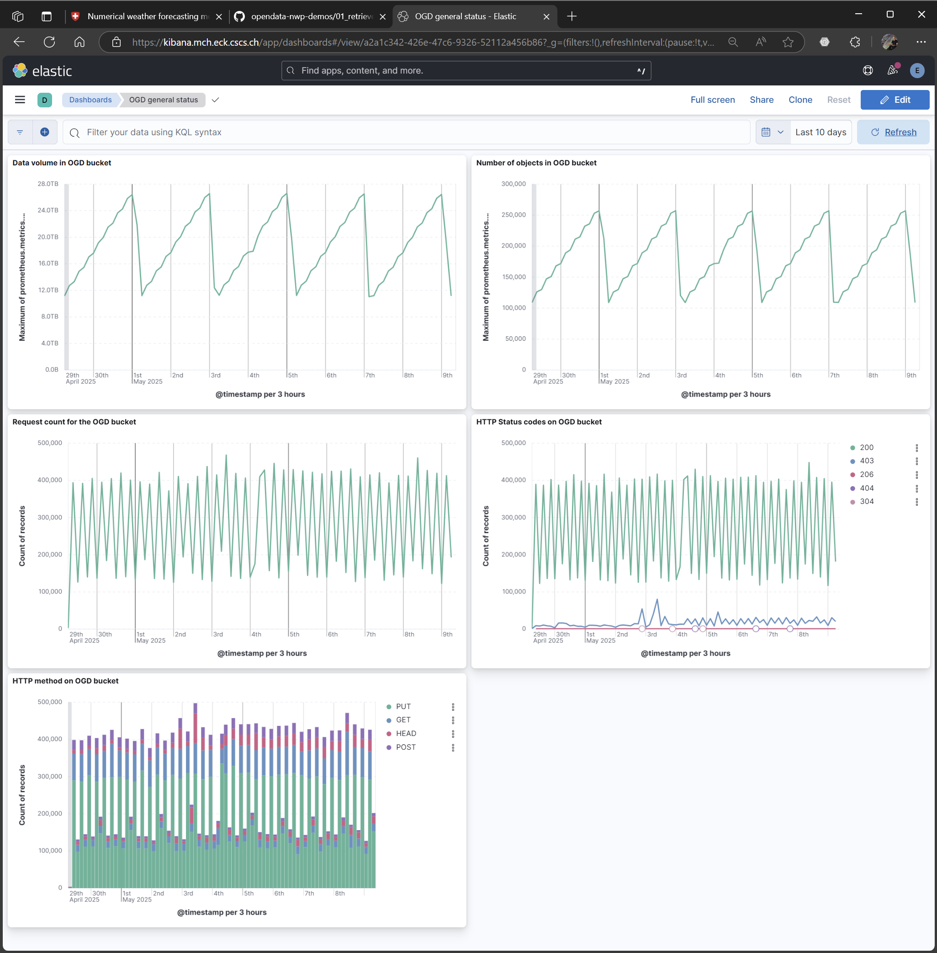
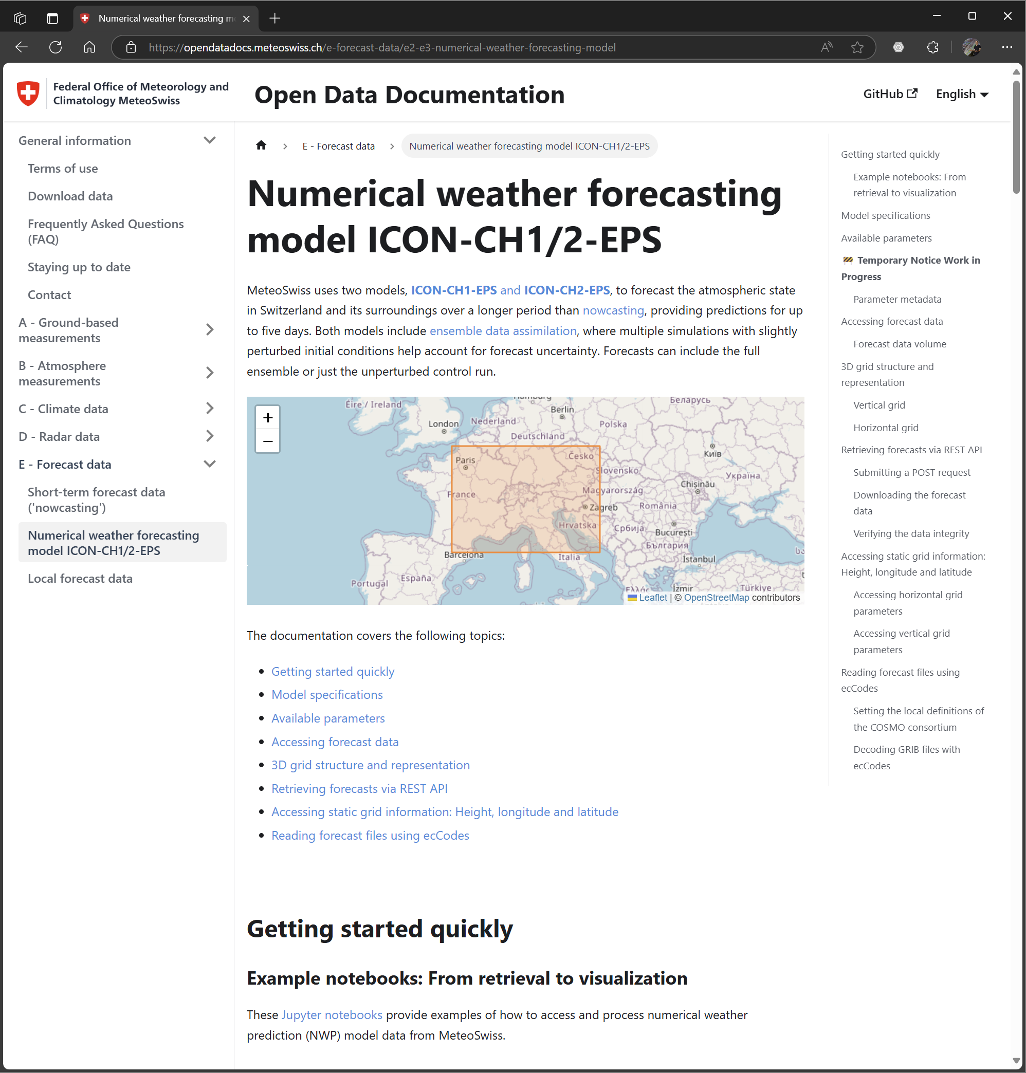
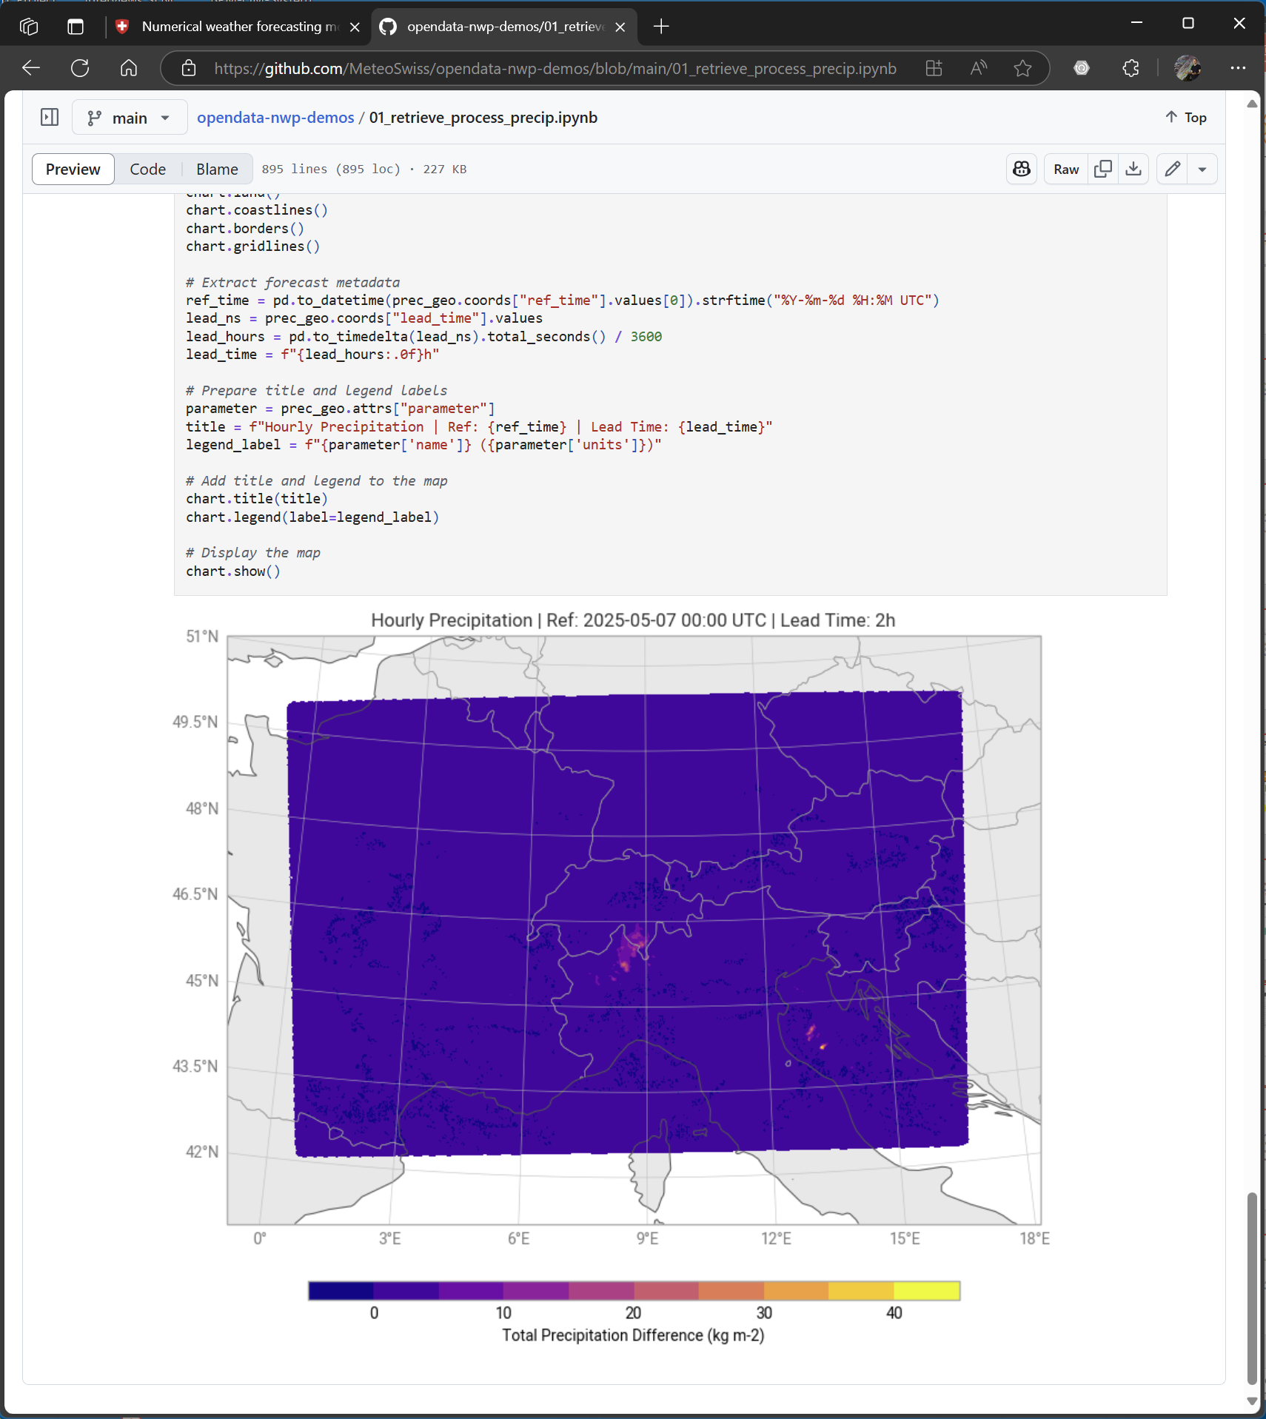
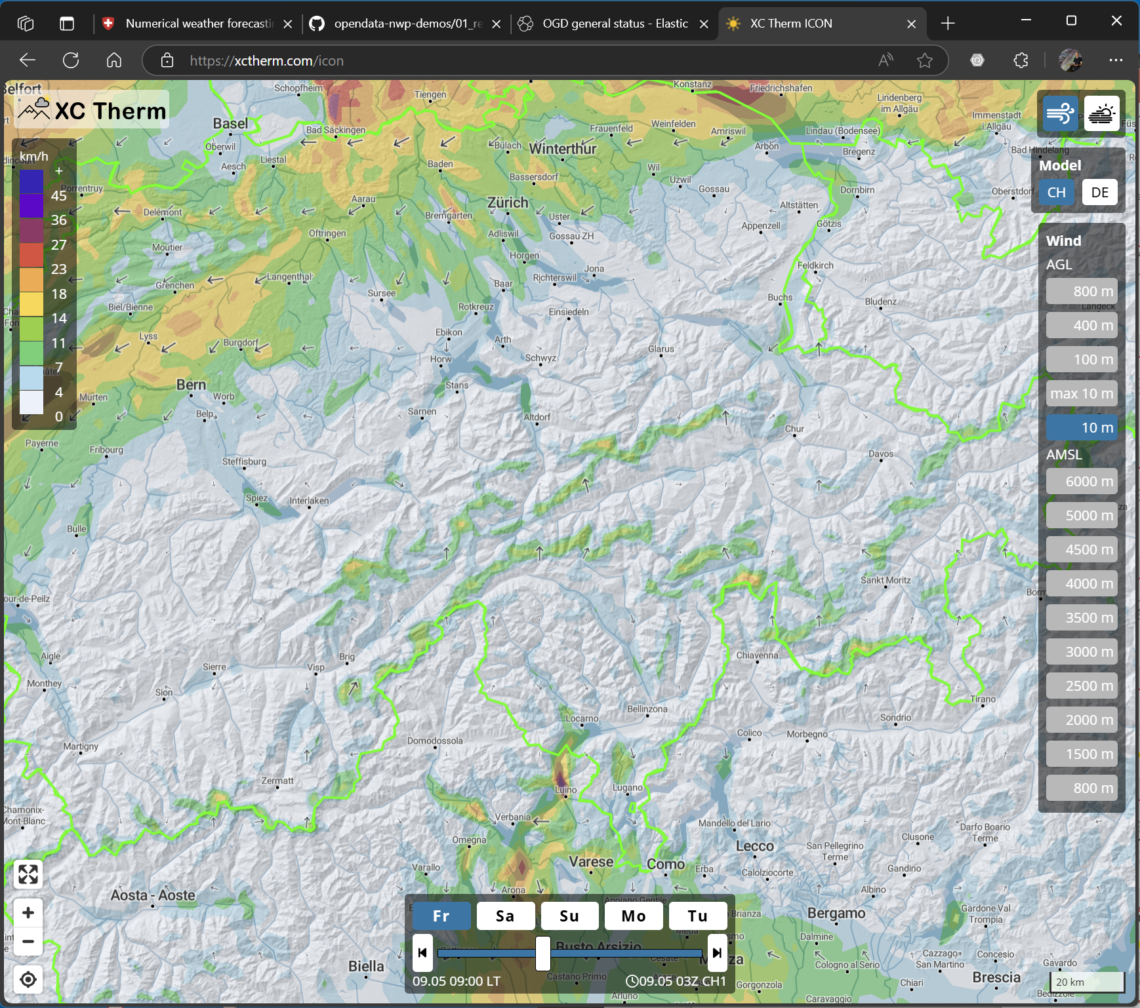
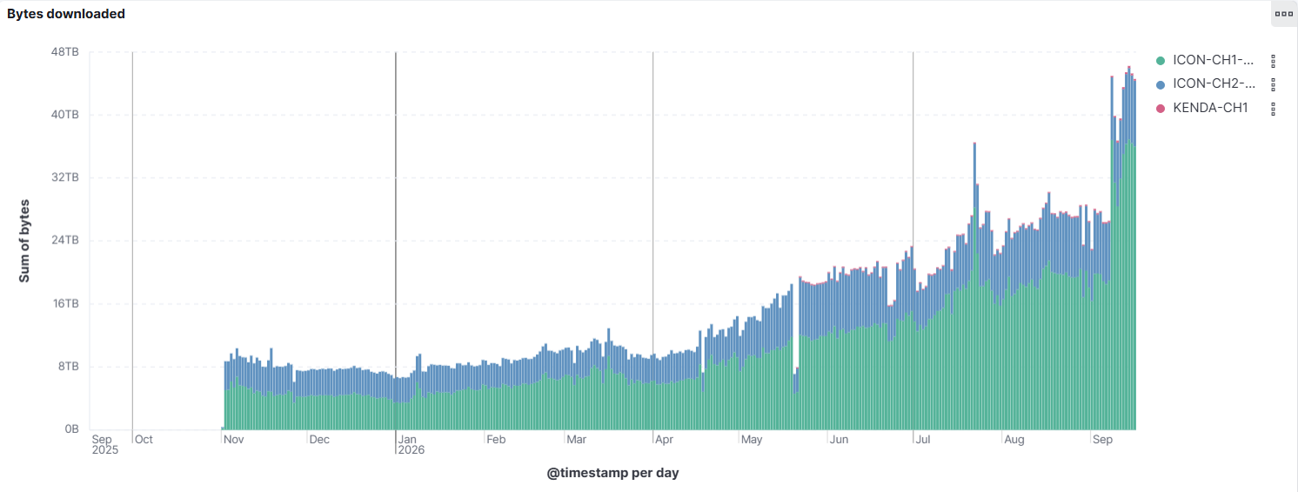
Open-data
Public launch May 22, 2025!
Todo : oli

Slide 12

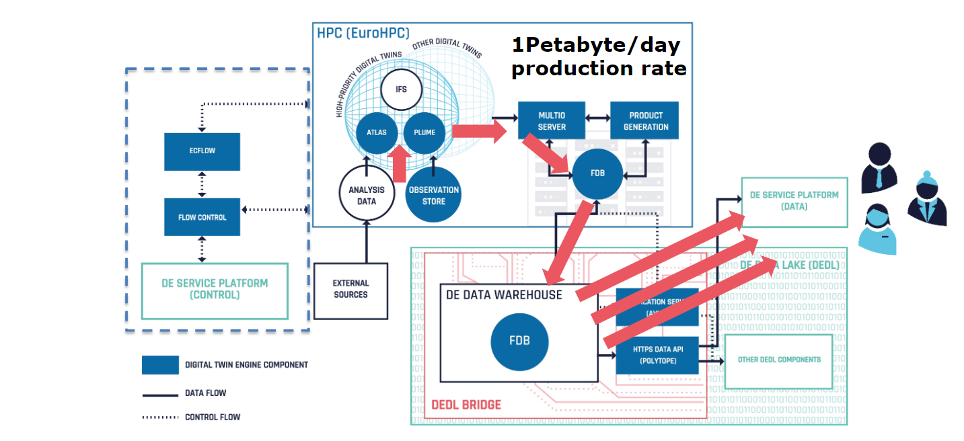


Implementing DestinE Data-bridge
Pre-operational deployment of FDB / Polytope allows for semantic data access, feature extraction, and OGC-compliant EDR API
FDB: a high-performance NWP specific object store.
earthkit
Polytope: serving FDB data through HTTP APIs and efficient feature extraction
Earthkit: bringing NWP (GRIB) data into python

Slide 13


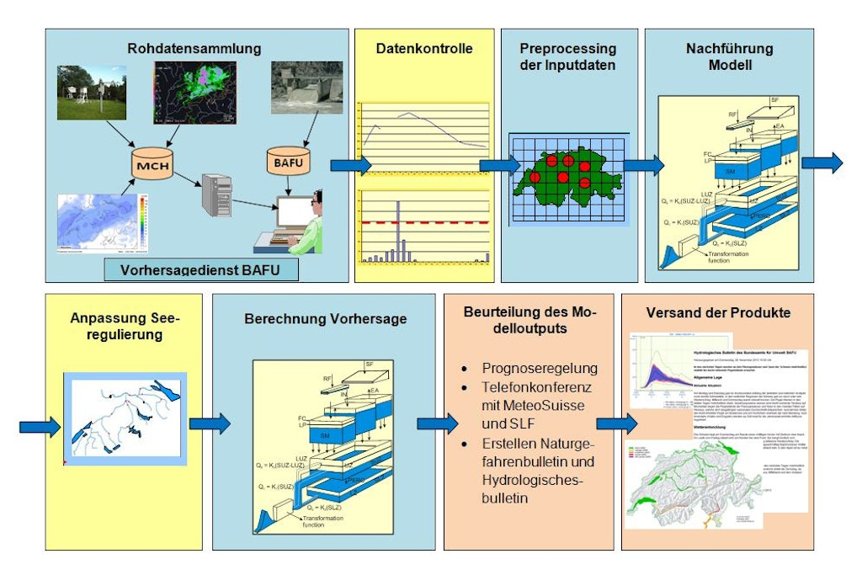
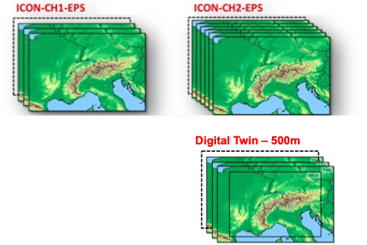


Global to Regional ICON Alpine Twin
Discharge Forecasts
NWP Model
Hydrological Model
WaSiM
Comparison:
Between experiments
With observations (discharge and weather variables)
With “historical forecast”
Operational
GIN: Gemeinsame Informationsplattform Naturgefahren
Spatial resolution
Lead time
Number of ens. members
PREVAH
We can evaluate the impact of changes on flood forecasting end-to-end

Slide 14
Data-driven forecasting

Slide 15


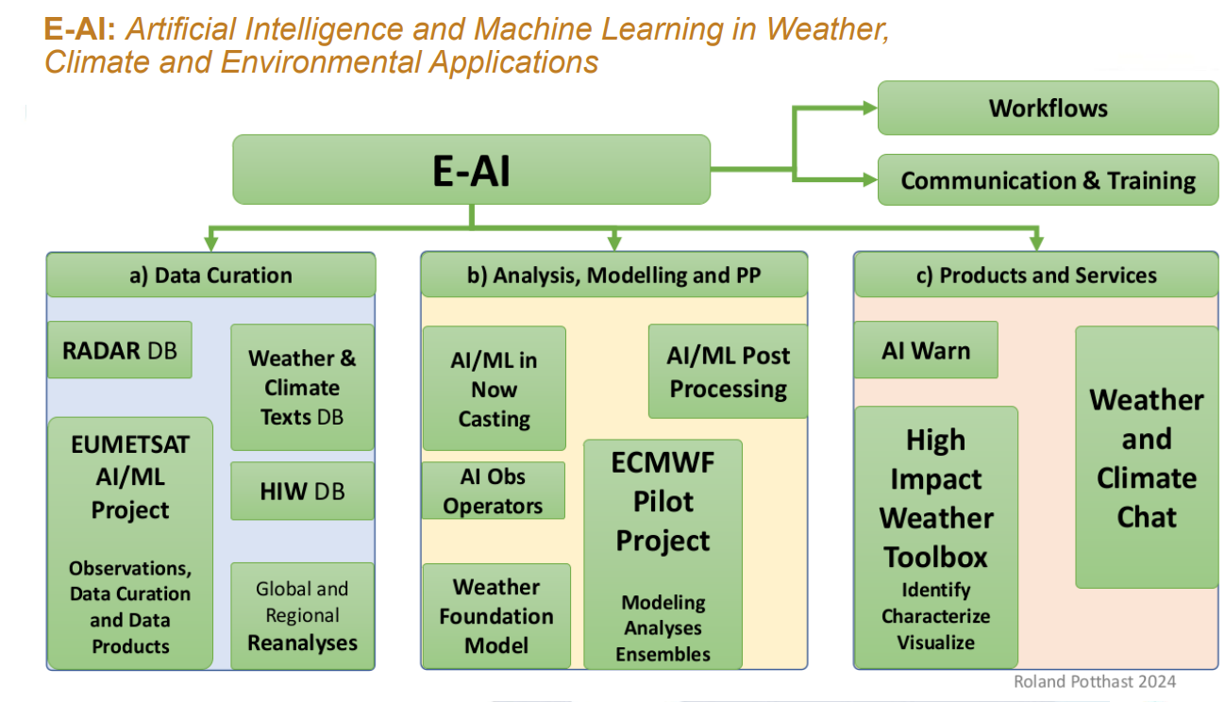
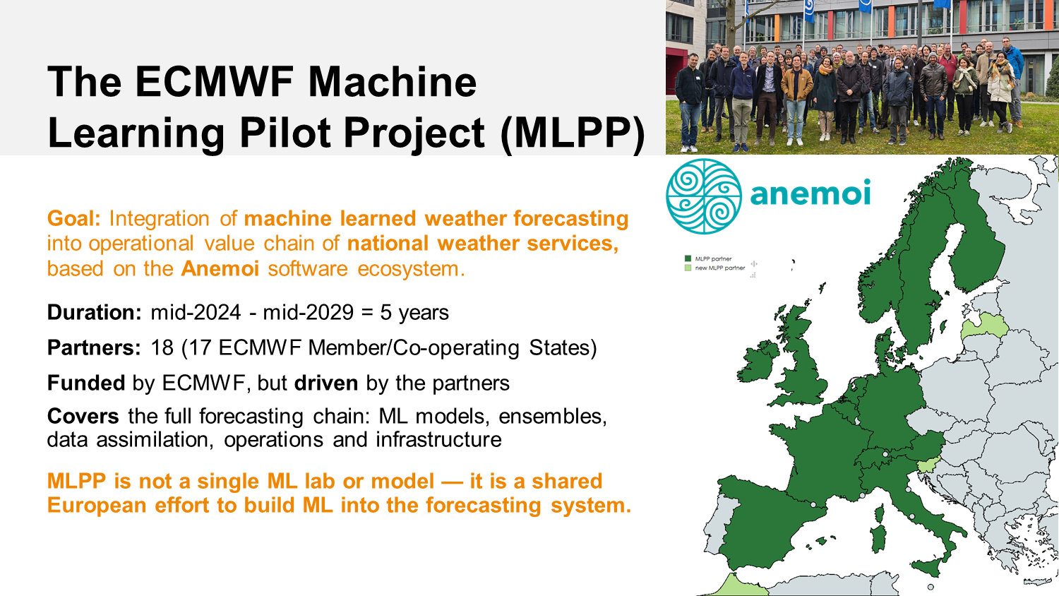
International Collaboration

Slide 16
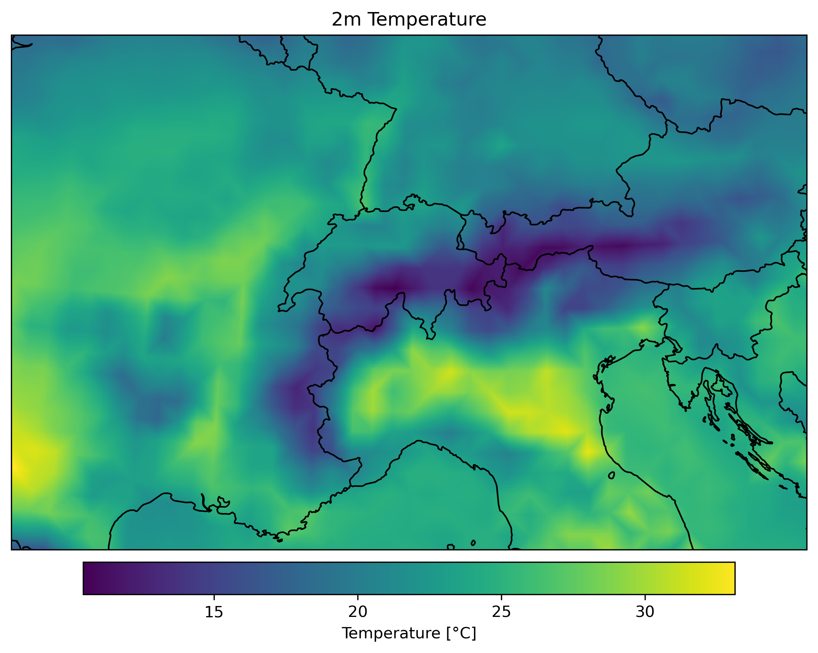
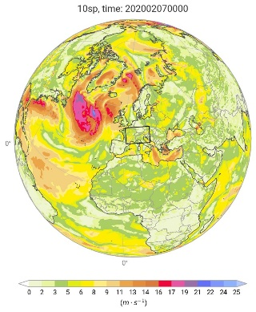

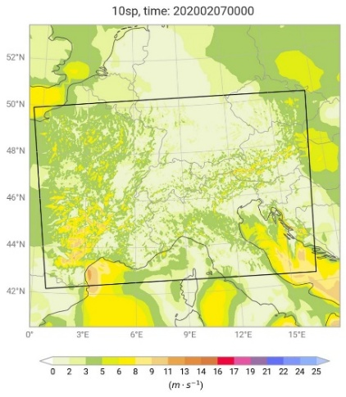
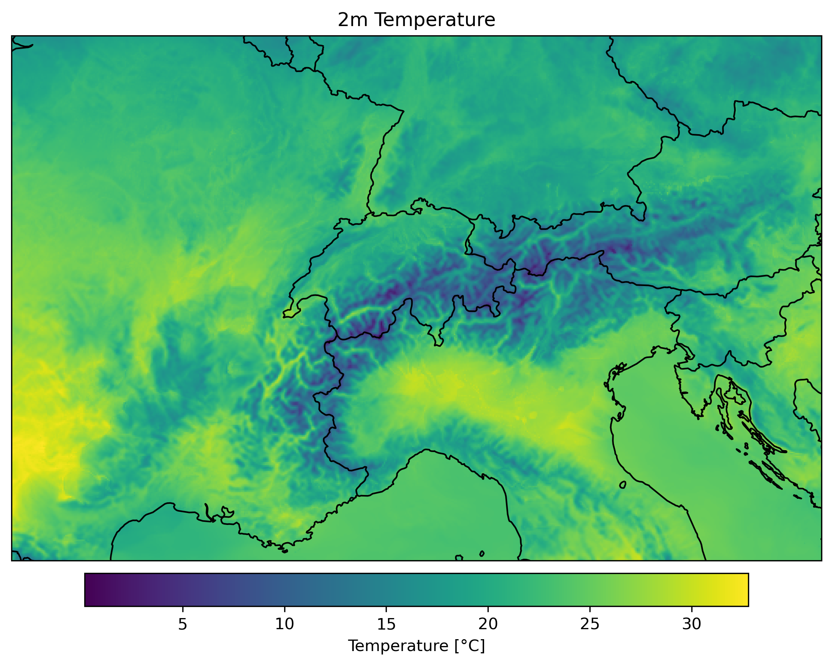
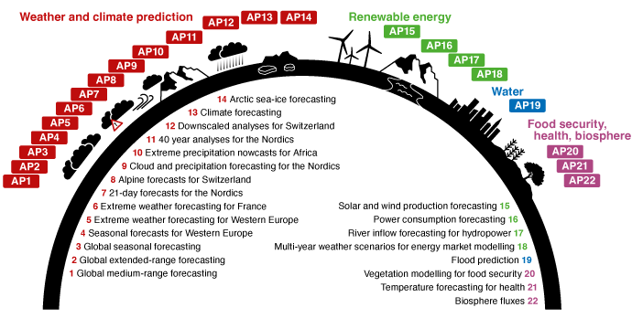
Data-driven forecasting at MeteoSwiss
Generative downscaling
(CorrDiff, NVIDIA)
Auto-regressive forecasting (GNNs, Anemoi)
Foundation model (WeatherGenerator)
ERA5
ICON-CH1

Slide 17
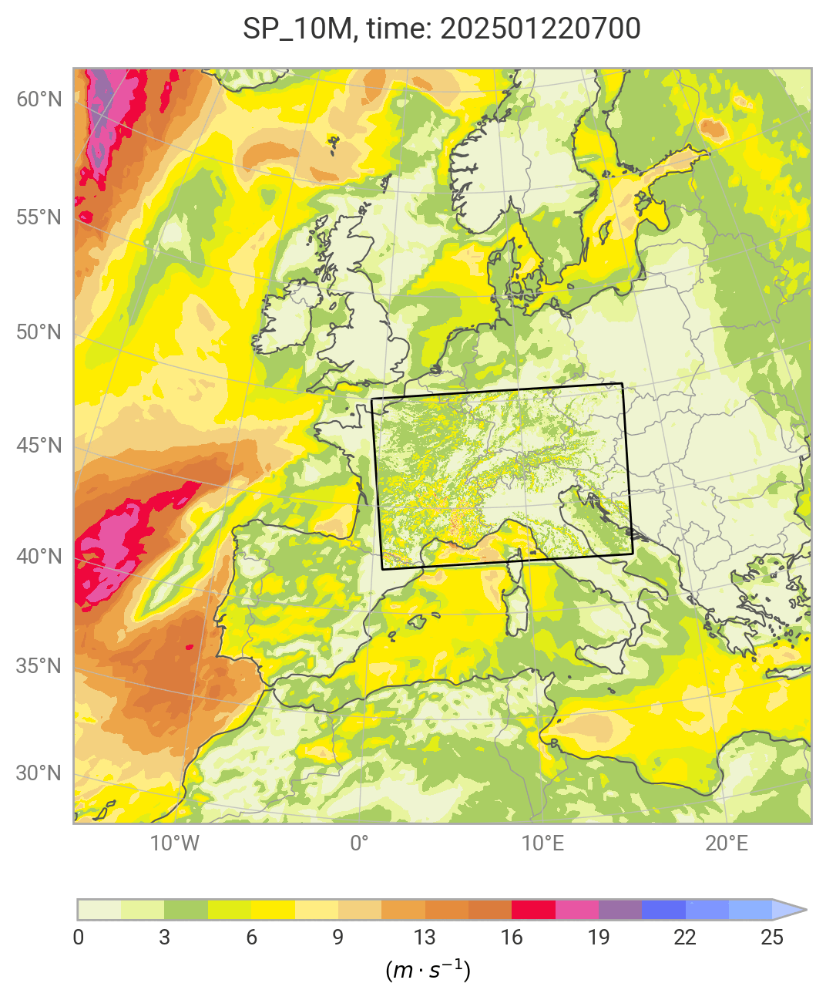
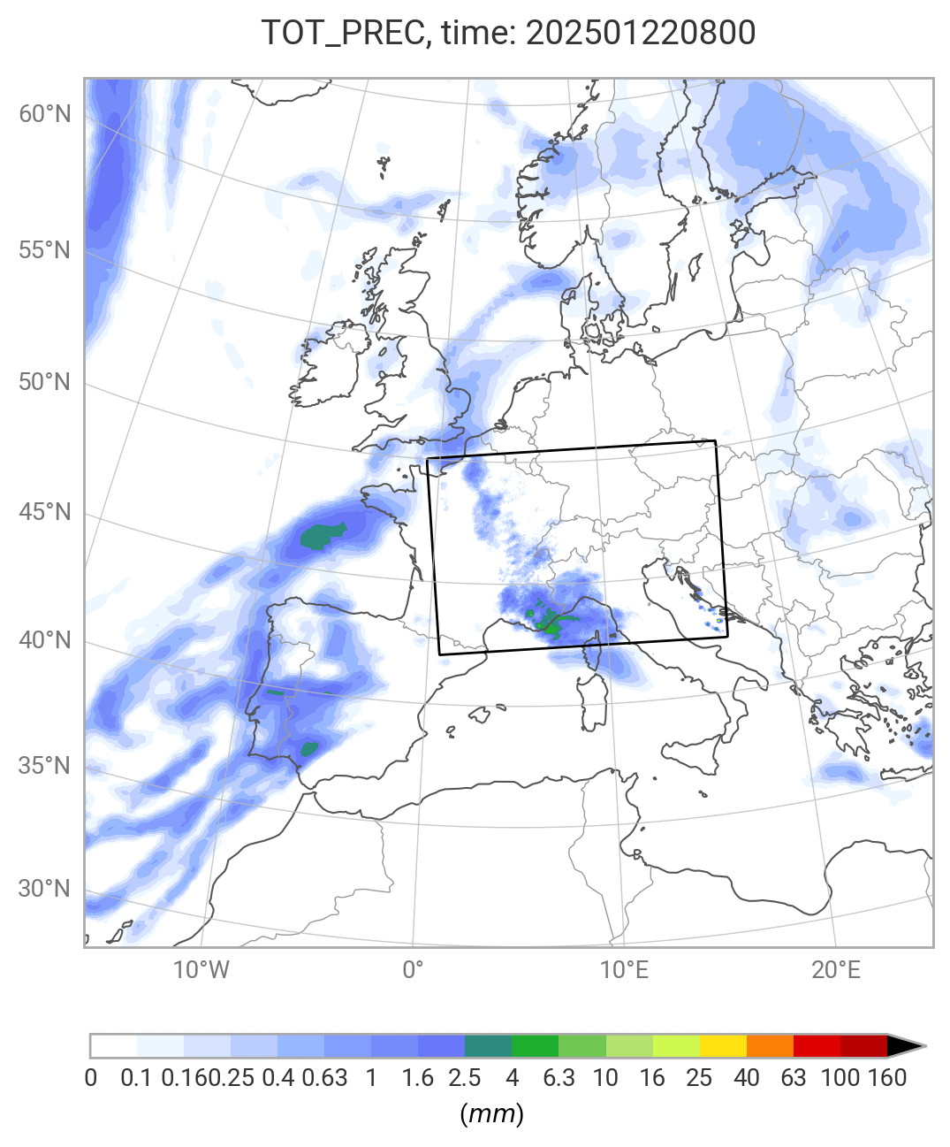
Varda-single in action

Slide 18
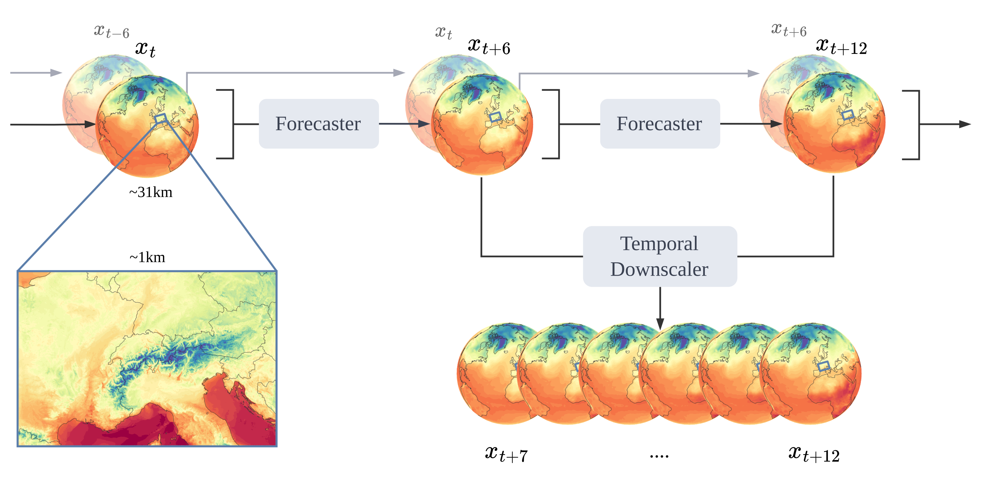
Varda: Model architecture

Slide 19
Varda: Training Curiculum
Stage | Global (Stage B) | Stretched Grid (Stage C) | Rollout (Stage D) | Operational (Stage E)
Type | Pre-training | Fine-tuning | Post-training | Post-training
Global | ERA5 n320 | ERA5 n320 | ERA5 n320 | IFS n320
Regional |  | REA-L-CH1 | REA-L-CH1 | KENDA-CH1
Steps | 50k | 100k | 8k | 1k
Train | 1979-2023 | 2005-2023 | 2005-2023 | 2024
Val | 2024 | 2024 | 2024 | 2025
Test |  |  |  | 2026

Slide 20
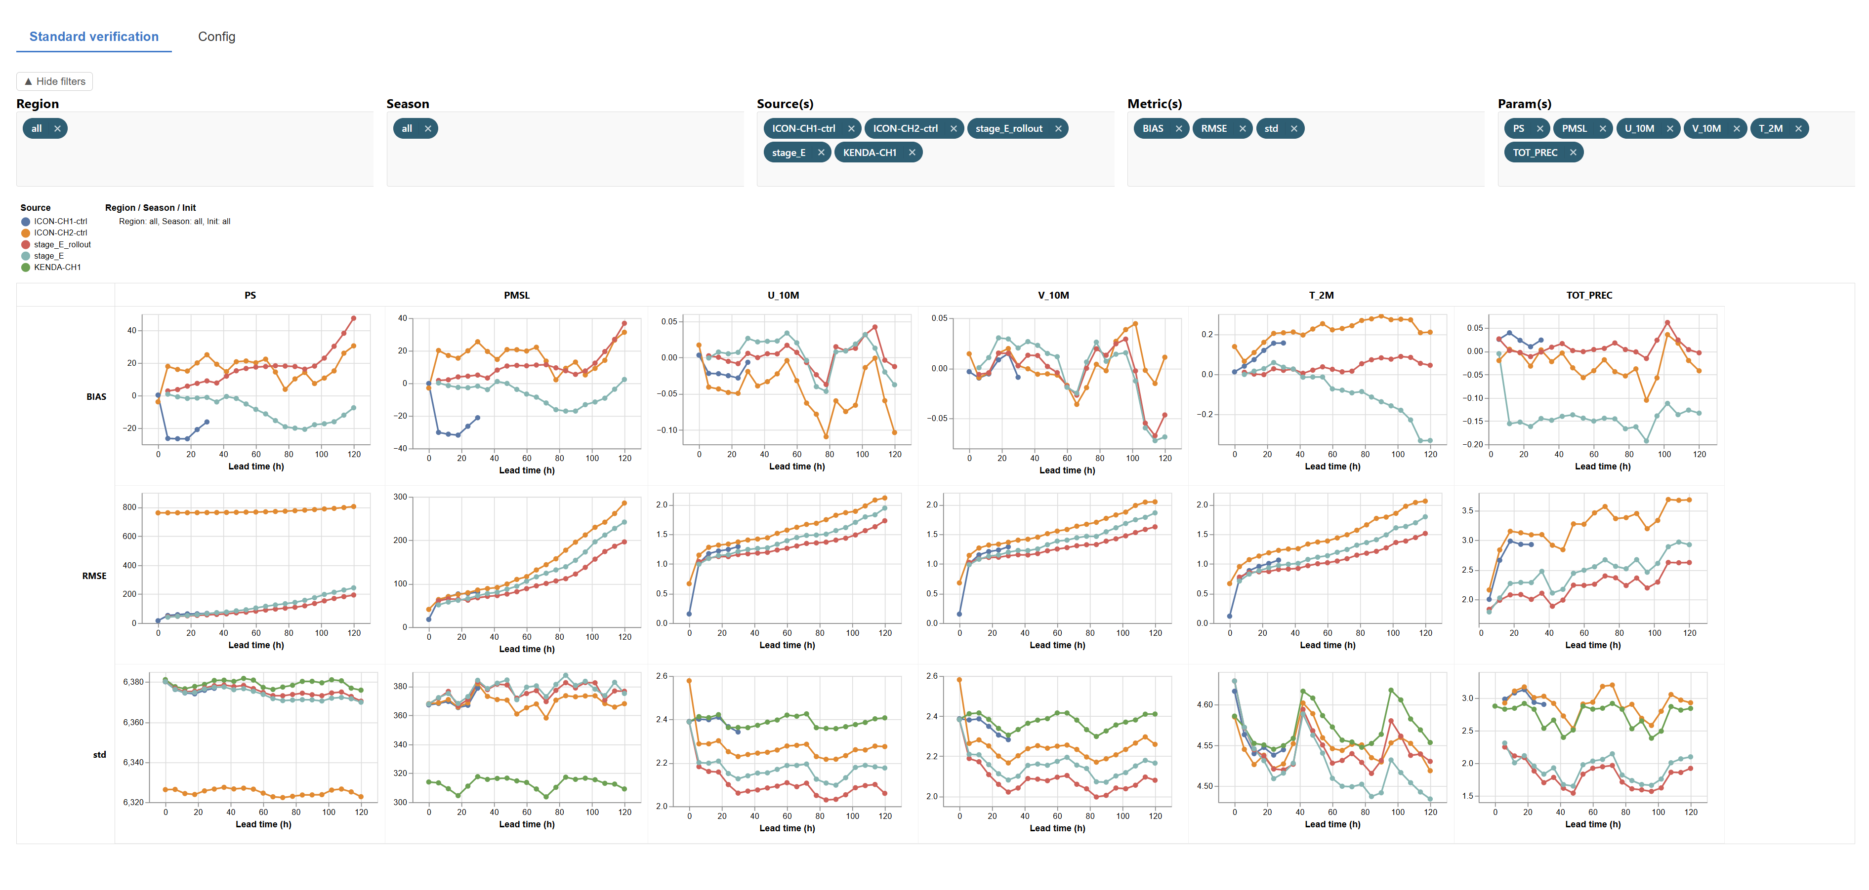
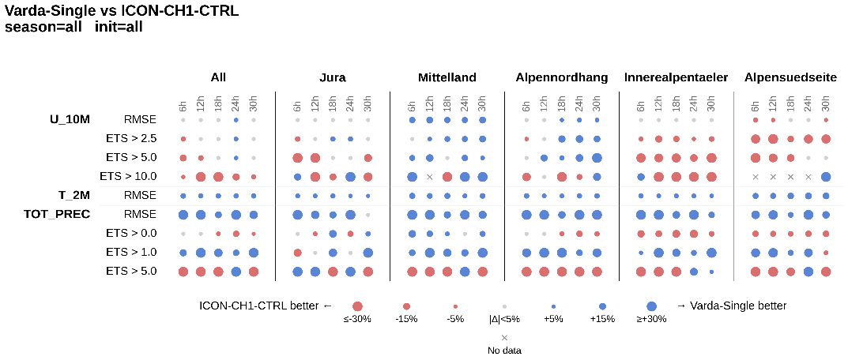
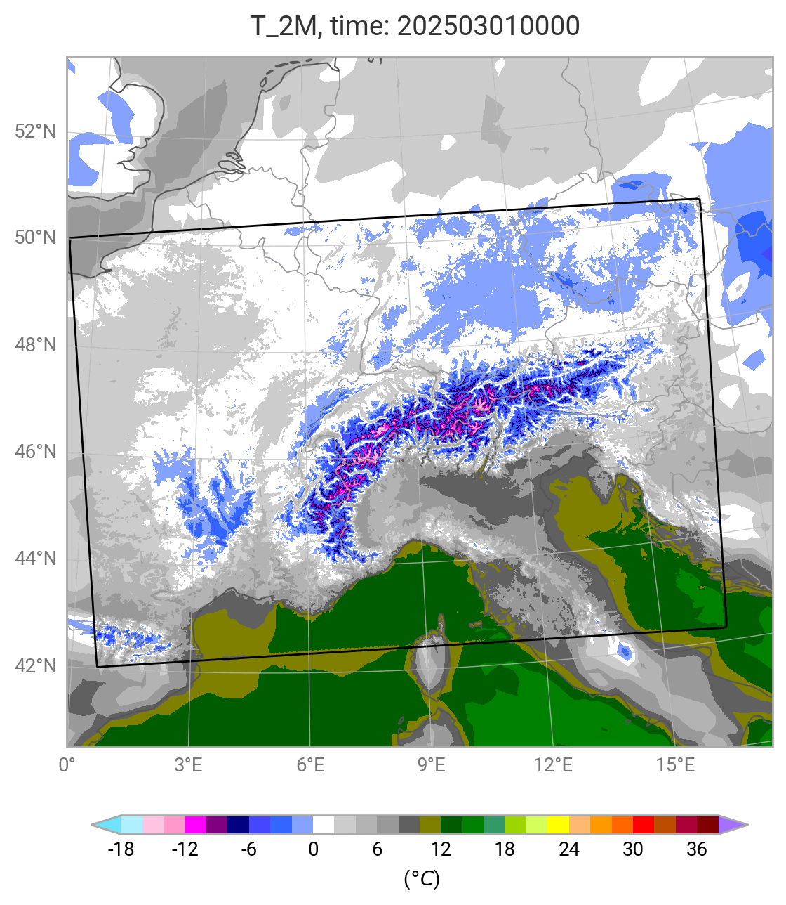
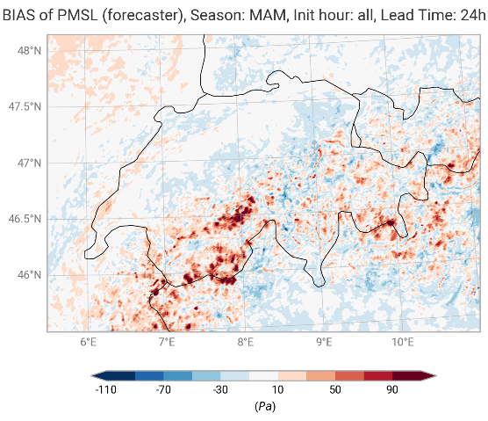
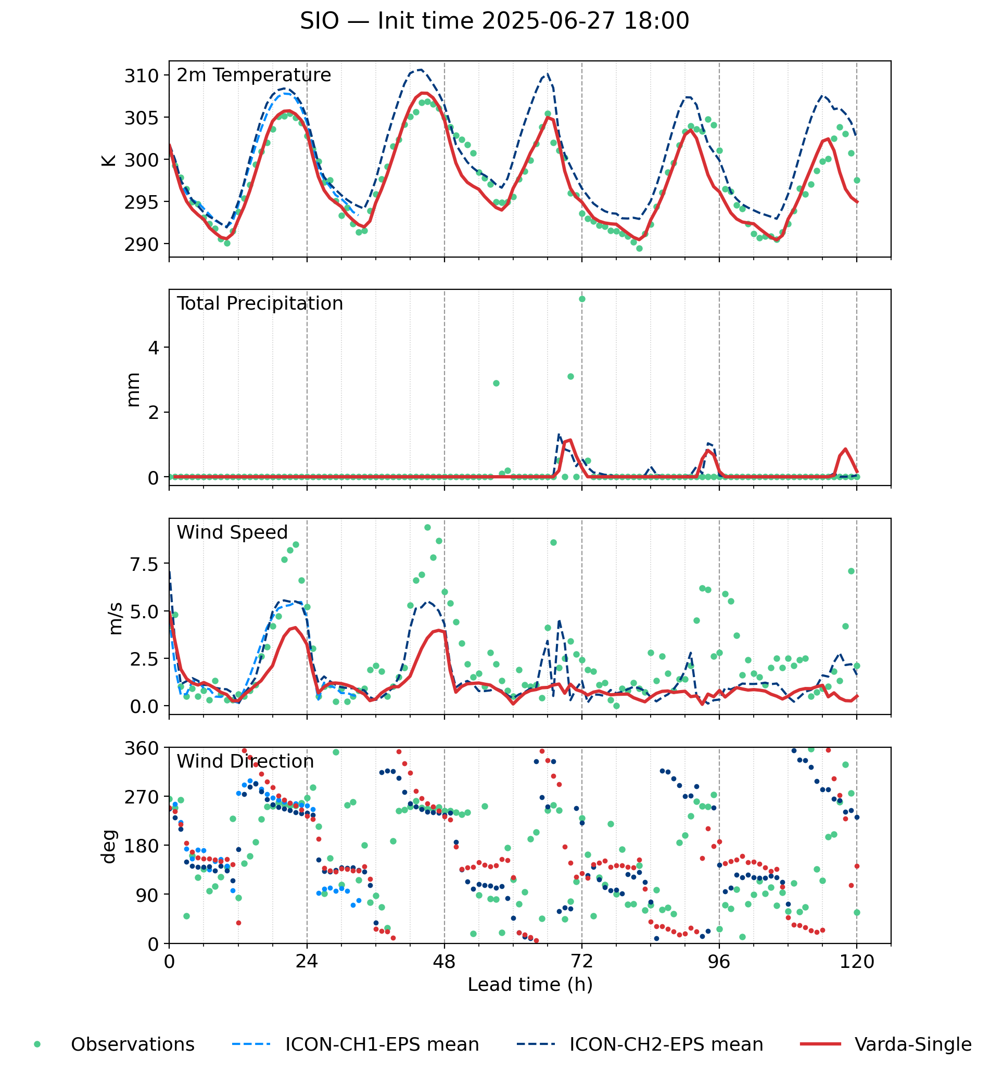
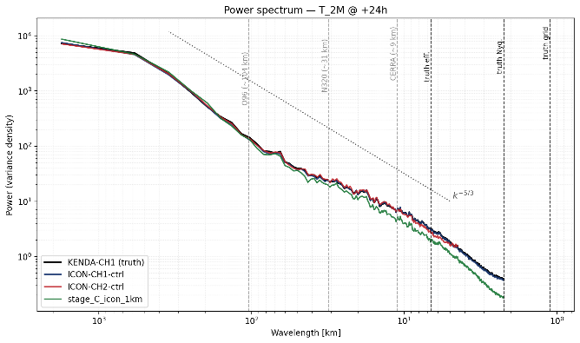

Slide 21
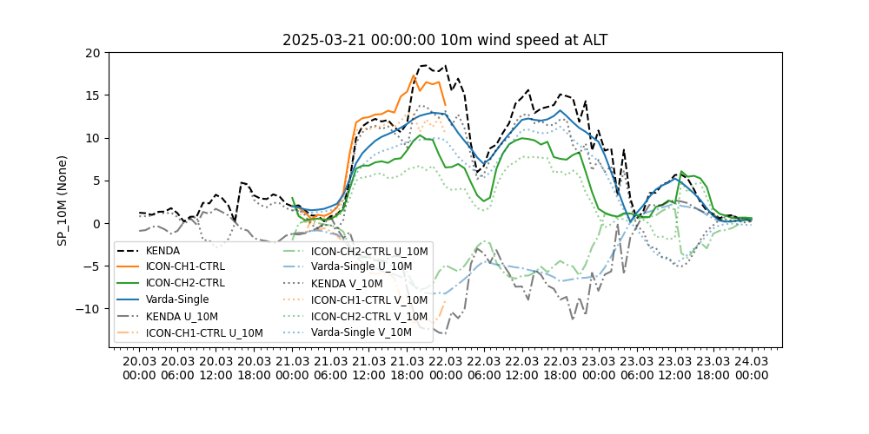
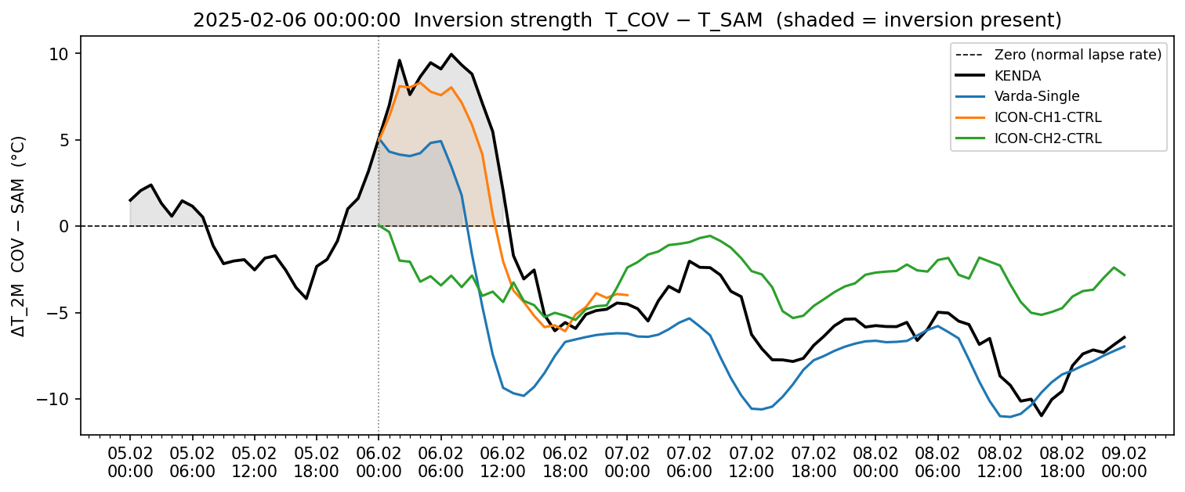
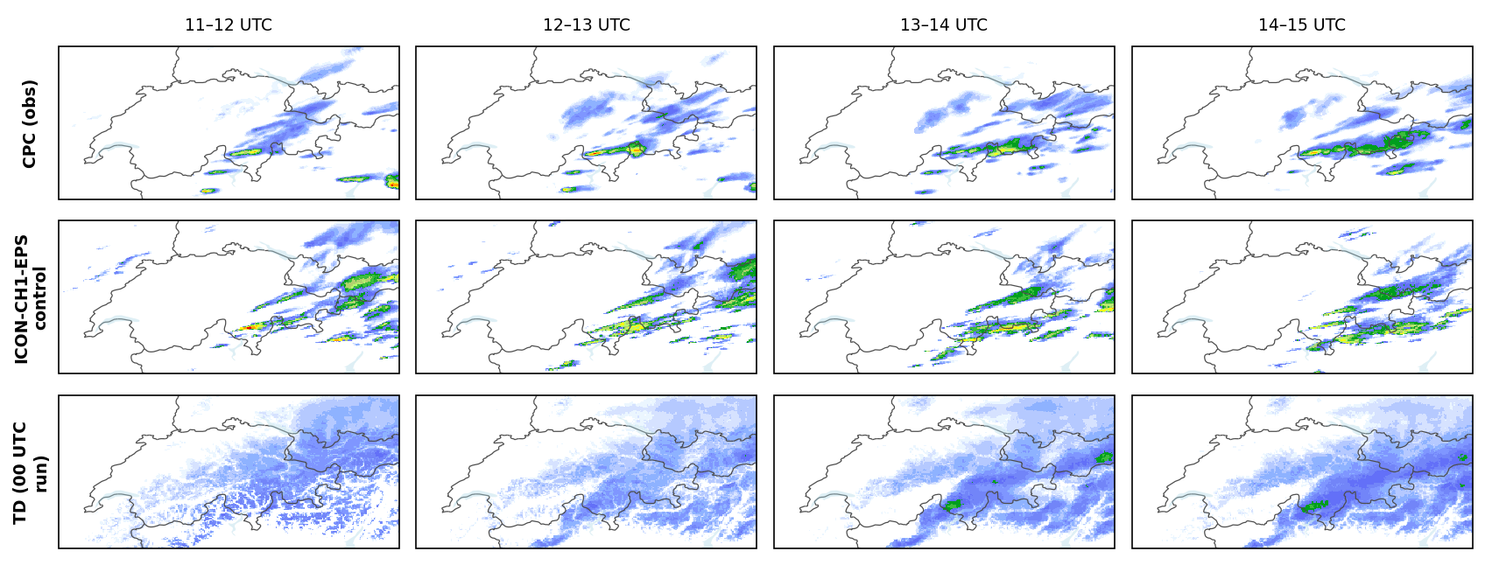
Metrics are good, but we need more...
diagnostics
case studies
falsification tools
expert judgement

