Slide 1

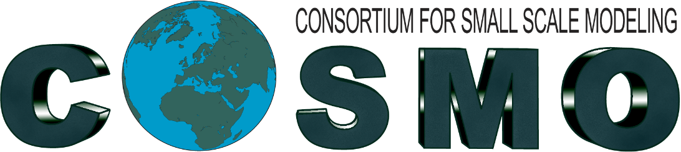
Fuzzy Verification on Common Areas
Naima Vela
Dipartimento Territoriale di Torino, SC.05 Dipartimento Rischi Naturali e Ambientali – Arpa Piemonte
Rome, 15th September 2026

Slide 2
Outline
1
Motivation and objectives
2
Verification set-up: models, observations, period
3
Fuzzy verification methodology
4
Results for Common Area 2
5
Results for Common Area 3
6
Cross-area comparison and conclusions
7
3-timestep FSS verification overview

Slide 3
Motivation and Objectives
Multi-scale evaluation
Beyond the double penalty
High-resolution precipitation forecasts must be verified across scales to assess useful performance.
Traditional point-by-point scores penalise realistic but slightly displaced forecasts.
A fuzzy, neighbourhood approach
Objective
Forecasts are evaluated over a range of spatial scales and precipitation thresholds.
Compare multiple NWP models over two common verification areas, across four seasons.

Slide 4
Verification Set-up
MODELS
SCORES AND METHODS
Common Area 2
FSS · ETS · FBI
1 TIMESTEP · 3 TIMESTEPS
D0 · D1
3H CUMULATION
ICON D2 · ICON CH1 · ICON GR · COSMO IT · ICON IT · ICON IL · ICON 2I
Common Area 3
ICON GR · ICON PL · COSMO CE PL · ICON IL · ICON RO
OBSERVATIONS & RESOLUTION
OPERA database (EUMETNET)
0.025° lat-lon grid · Period: JJA 2025, SON 2025, DJF 2026, MAM 2026

Slide 5
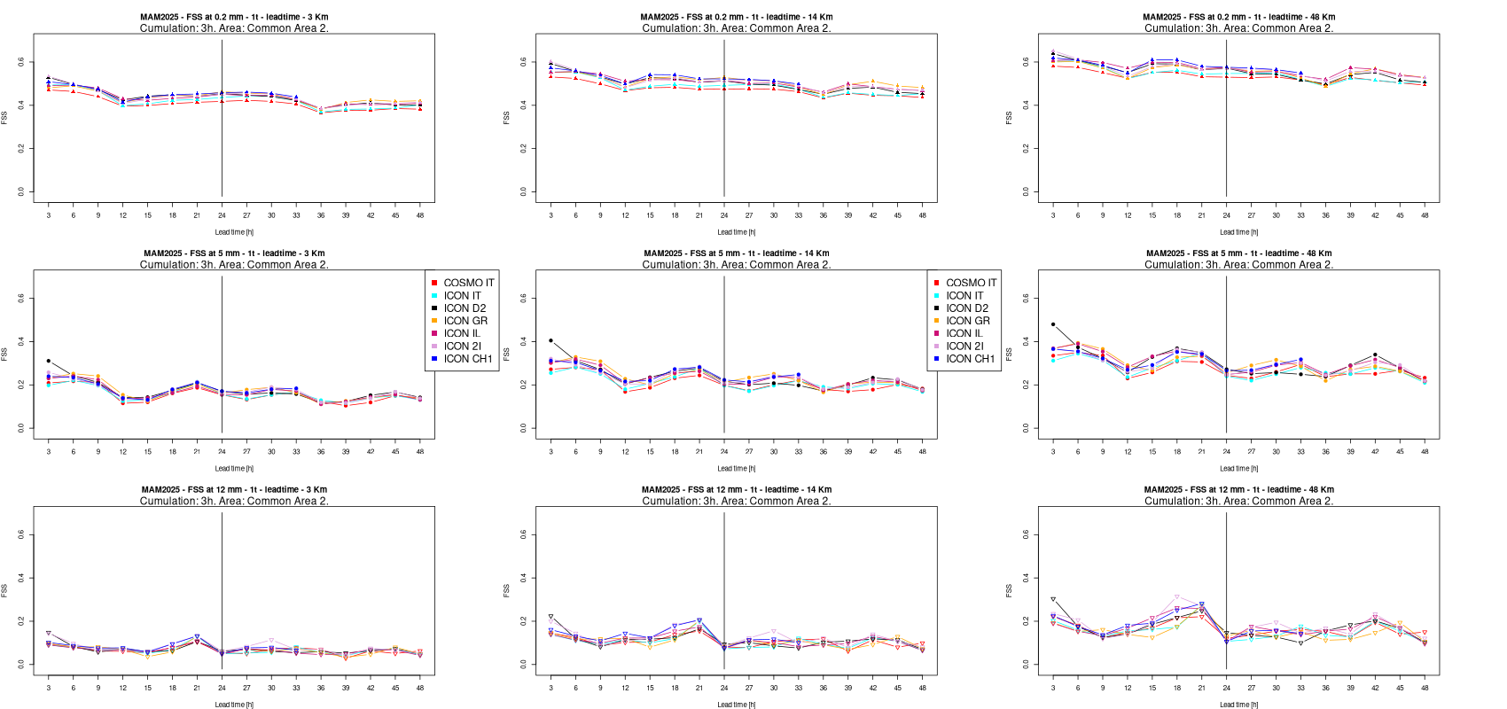
Reading the Lead-Time Plots
Each panel shows verification scores as a function of forecast lead time (3–48 h)
Columns correspond to spatial scales: 3 km, 14 km, 48 km
Rows correspond to precipitation thresholds: 0.2 mm, 5.0 mm, 12.0 mm (3 hour cumulation)
Colors identify the different NWP models compared

Slide 6
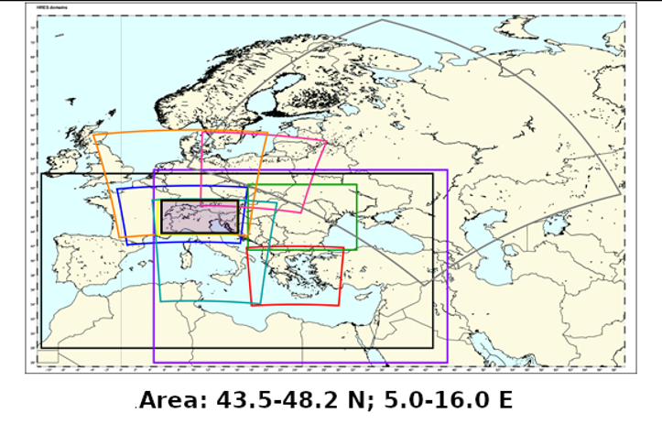
Common Area 2

Slide 7
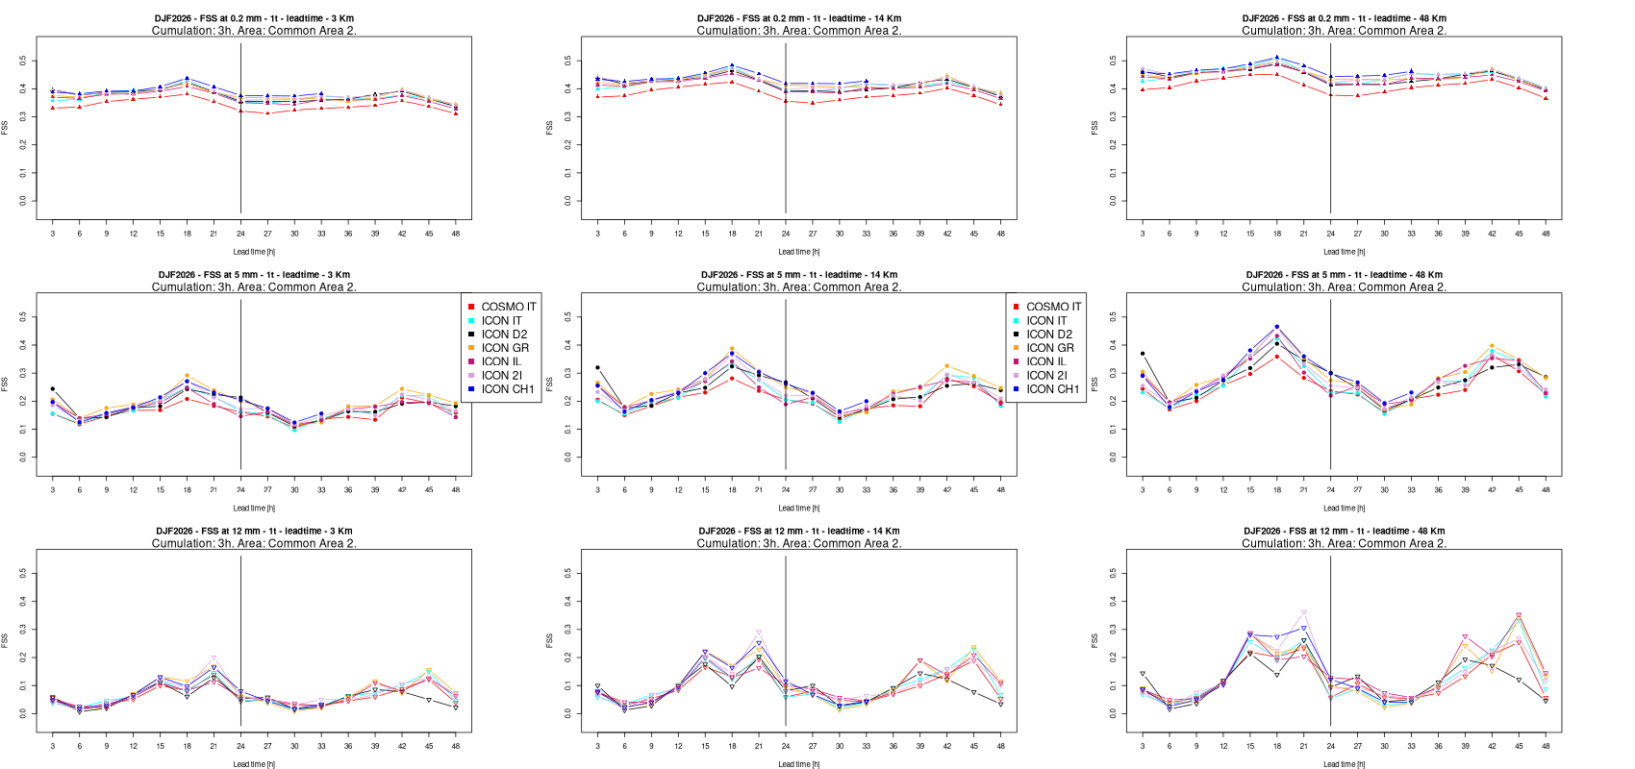
Common Area 2 – Spatial Accuracy (FSS)
DJF 2026
Skill decreases moderately with increasing lead time, in all seasons
A diurnal cycle is present, more evident for larger verification areas and in winter/spring
Models perform very similarly up to medium spatial scales/thresholds
Largest inter-model differences occur at the first forecast timestep and at fine scales

Slide 8
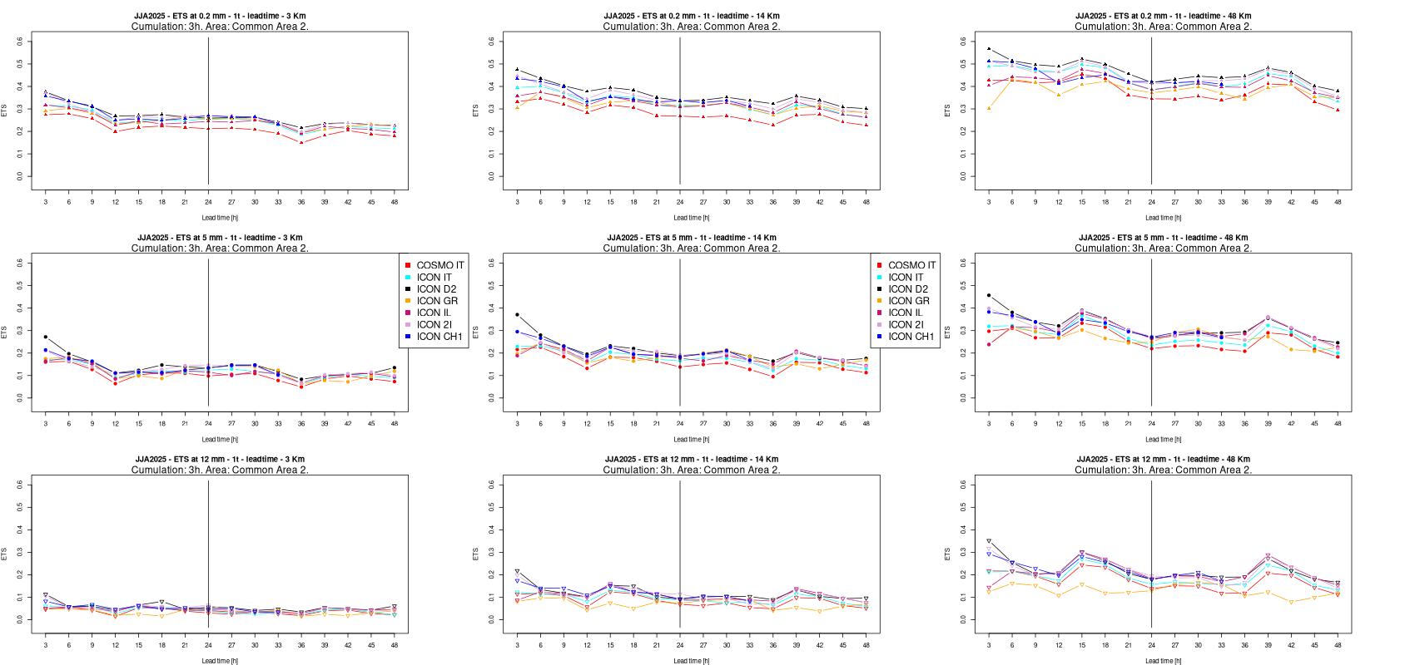
Common Area 2 – Equitable Threat Score
JJA 2025
ETS results are extremely similar to FSS, confirming consistent model behaviour across scores
Small, steady degradation of skill with increasing lead time
A modest diurnal cycle is visible, more pronounced for larger verification areas
All models converge at high thresholds/fine scales
Wider spread for first timestep

Slide 9
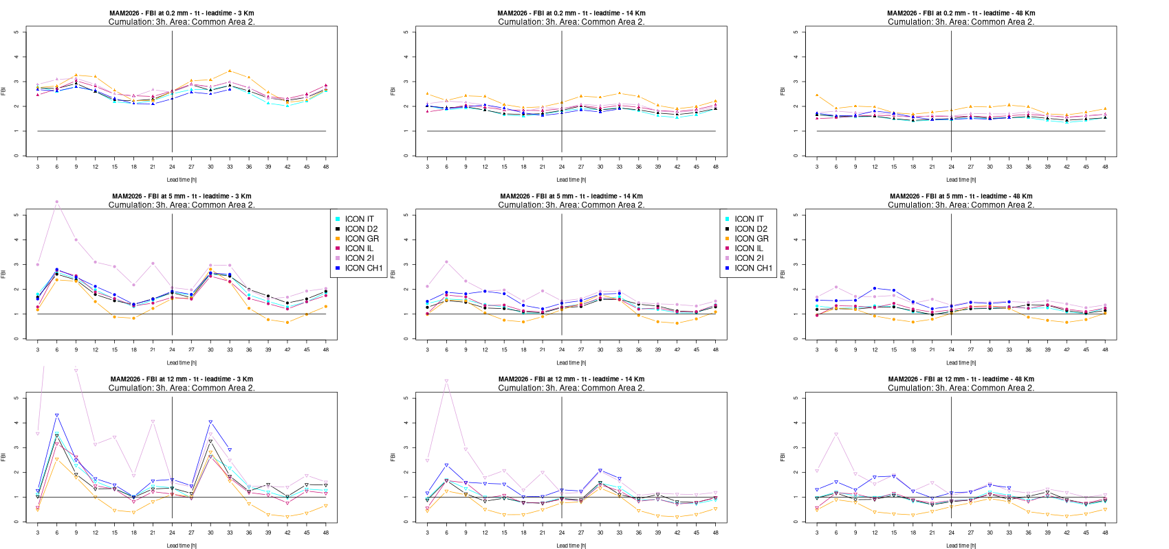
Common Area 2 – Frequency Bias (FBI)
MAM 2026
Overall tendency towards overestimation, generally stronger at low thresholds and during daytime, with JJA being the exception, showing more underestimation
Clear diurnal cycle, with larger biases at medium-high thresholds in winter and spring
Model spread is wider than for FSS/ETS, reflecting model-specific behaviour
Scores become noisier at the highest precipitation threshold
Large overestimation for ICON 2I during first day starting at medium scales

Slide 10
Common Area 2 – Seasonal Synthesis
1
2
FSS and ETS behave very similarly across all seasons, confirming the robustness of the approach
Diurnal cycle is weakest in summer (JJA) and most evident in winter/spring (DJF, MAM)
3
4
Model agreement is high at coarse/medium scales; divergence may appear at fine scales and short lead times
FBI shows the largest seasonal variability, particularly at medium-to-high thresholds

Slide 11
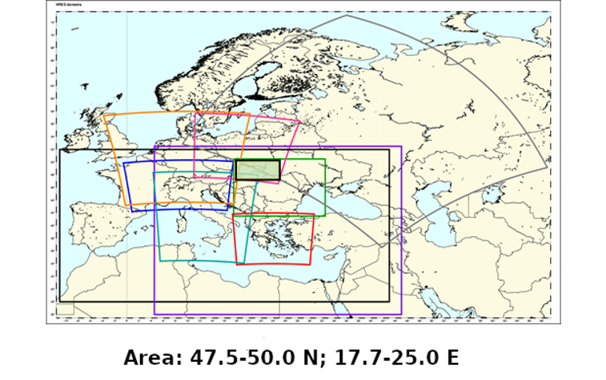
Common Area 3

Slide 12
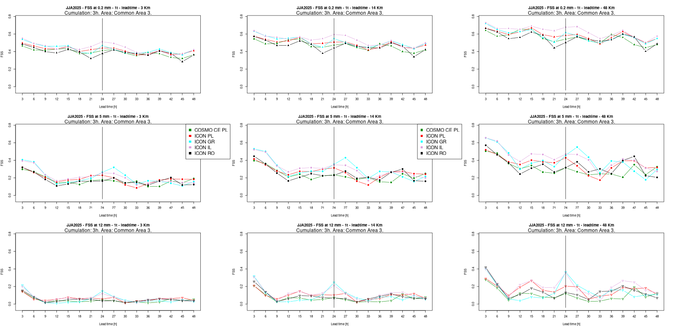
Common Area 3 – Spatial Accuracy (FSS)
JJA 2025
Models show larger spread than in Common Area 2, while following similar seasonal cycles
Scores drop sharply at the highest threshold, often approaching zero
Diurnal cycle is visible in most seasons, more evident for medium thresholds
Some models (e.g. ICON GR) diverge more clearly from the ensemble at fine scales

Slide 13
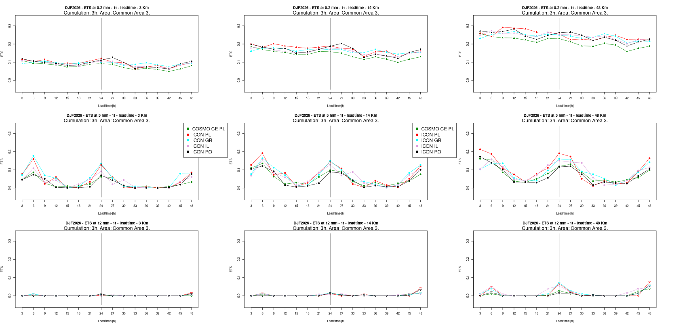
Common Area 3 – Equitable Threat Score
DJF 2026
ETS confirms the FSS picture, with generally larger model spread than in Common Area 2
Skill drops sharply at the highest threshold, close to the detection limit
Diurnal cycle is present but less regular across seasons than in Common Area 2
Model agreement remains good at coarse and medium spatial scales

Slide 14
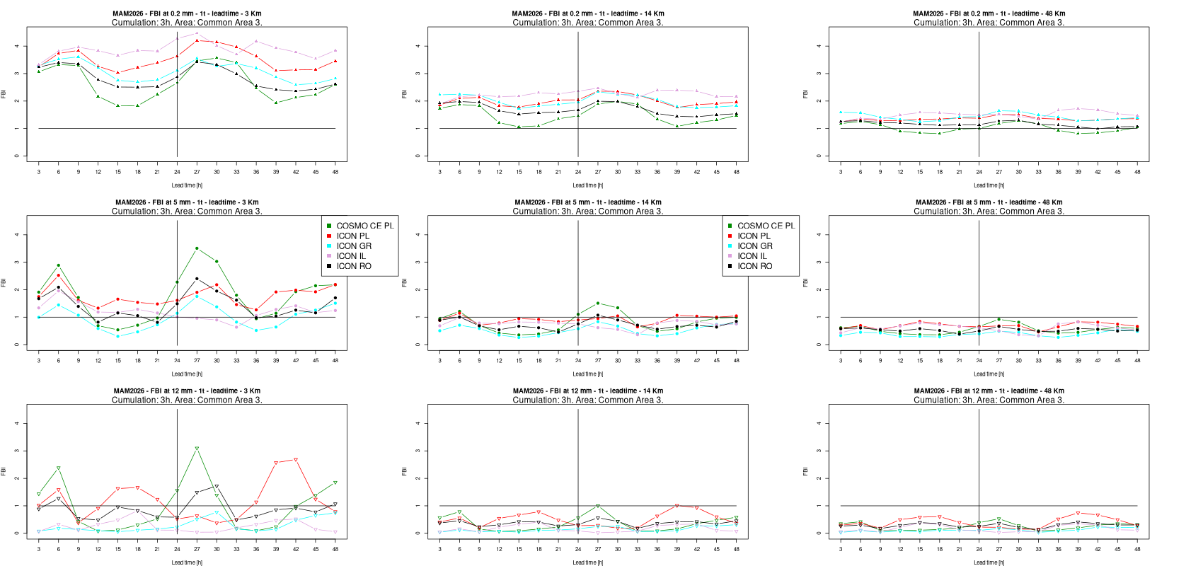
Common Area 3 – Frequency Bias (FBI)
MAM 2026
Overestimation prevails at low-to-medium thresholds; underestimation appears at higher thresholds/larger scales
Diurnal cycle is less regular than in Common Area 2, with occasional strong night-time overestimation
Verification is noisier for small scale / high threshold combinations, reflecting fewer extreme-event samples
Model behaviour is less homogeneous than in Common Area 2

Slide 15
Common Area 3 – Seasonal Synthesis
1
2
FSS and ETS again track each other closely across all seasons
Model spread is consistently larger than in Common Area 2, in every season
3
4
Diurnal cycle is present but more irregular, with the clearest signal in winter and spring
FBI remains the most season-sensitive score, with occasional strong night-time overestimation

Slide 16
Cross-Area Comparison
Consistency
Both areas show comparable seasonal and diurnal patterns, but Common Area 3 shows greater model spread and noise
Skill degradation
Skill scores (FSS, ETS) degrade similarly with lead time in both areas
Key discriminator
Frequency bias is the most sensitive indicator of inter-model and inter-area differences
Model ranking
Overall model ranking is broadly consistent between the two common areas

Slide 17
Conclusions
1
The fuzzy verification framework provides a robust, scale- and threshold-dependent assessment
2
All models show a small decrease in skill with lead time
3
Pronounced diurnal cycles are more visible in winter/spring
4
Frequency bias is the main discriminator between models, more than spatial-accuracy scores
5
Common Area 3 is consistently more challenging to forecast than Common Area 2 for all models
6
Results support continued multi-model, multi-scale verification to guide future model development
Suggestion for next year: Show FAR (False Alarm Ratio) instead of ETS to identify new patterns

Slide 18
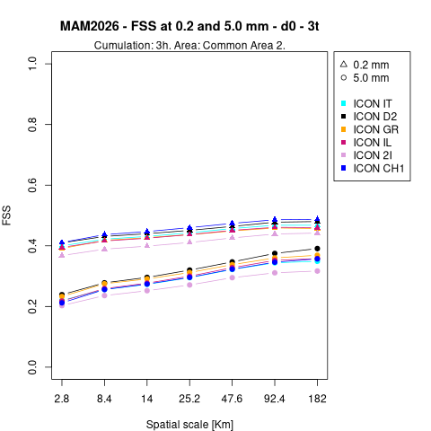
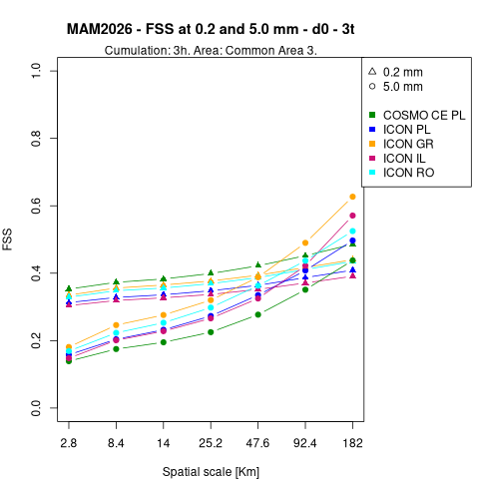
Fractions Skill Score Analysis:
3-Timestep Verification Overview
3-Timestep Verification Overview
A systematic evaluation of spatial forecast skill across meteorological models, thresholds, seasons, and regions, extending the analysis to a three-timestep (3x3h) cumulation across four seasons and two common verification areas.

Slide 19
Common Features Across All Models
Three universal patterns emerge consistently across all evaluated models, overall independent of region or season.
Upscaling Effect
Threshold Sensitivity
Scale-Dependent Convergence
FSS increases consistently with spatial scale — from 2.8 km to 182 km — as forecast skill improves when averaging over larger neighbourhoods. This is a well-established property of neighbourhood-based verification.
Light precipitation (0.2 mm/3h) is systematically* easier to forecast than intense rainfall (5 mm/3h), with the performance gap most pronounced at small spatial scales.
* With the exception of larger scales in Common Area 3
The performance gap between thresholds narrows significantly at larger scales, indicating that threshold difficulty is primarily a small-scale forecasting challenge rather than a structural model deficiency.

Slide 20
Seasonal Predictability and Regional Variations
Seasonal cycles and area-specific dynamics shape both the overall skill level and the spread among models.
1
Seasonal Ranking
Summer (JJA 2025) yields the best overall skill, with FSS values reaching approximately 0.6–0.75 at large scales. Winter (DJF 2026) performs worst, with FSS values mostly remaining below 0.4, reflecting the inherently lower predictability of cold-season precipitation systems.
2
Area 2 vs. Area 3
Area 2 models cluster tightly with one consistent underperformer, suggesting a relatively homogeneous model response. Area 3 exhibits larger inter-model spread and more clearly defined top and bottom performers across seasons.
3
Winter Anomaly in Area 3
In DJF 2026, models split into two distinct groups: ICON PL and ICON GR reach approximately 0.45–0.52, while remaining models cluster near 0.2–0.25. This bifurcation suggests area-dependent winter skill variation driven by model configuration or domain-specific dynamics.

Slide 21
Model-Specific Performance Rankings
Across all regions and seasons, a consistent model hierarchy emerges, with notable divergence in spring and winter conditions.
Strongest Performers
Weakest Performers
Overall Ranking
ICON IL and ICON GR demonstrate consistently high skill across the evaluation period. ICON IL is the most reliable model in Area 3 across multiple seasons, establishing it as the benchmark reference for this domain.
COSMO variants (IT/CE PL) rank lowest in nearly every panel and season. Performance gaps are particularly extreme in spring (MAM 2026) over Area 3, where the spread between top and bottom models is at its widest.
ICON IL / ICON GR lead the hierarchy, followed by mid-tier models, with COSMO variants at the bottom. Performance stability varies substantially by region and season, underscoring the importance of domain-specific model evaluation.
Key takeaway: The ICON family consistently outperforms COSMO variants across all evaluated conditions, with the performance gap widening under challenging small-scale and high-threshold scenarios.

Slide 22
Thank You for Your Attention
Naima Vela – naima.vela@arpa.piemonte.it
Dipartimento Territoriale di Torino, SC.05 Dipartimento Rischi Naturali e Ambientali – Arpa Piemonte
Questions & Discussion

