Slide 1
ICON verification using rain gauge data corrected according to SPICE experiment recommendations
COSMO GM 2026
WG VA Parallel Session
CASD, Rome, 14 September 2026

Slide 2
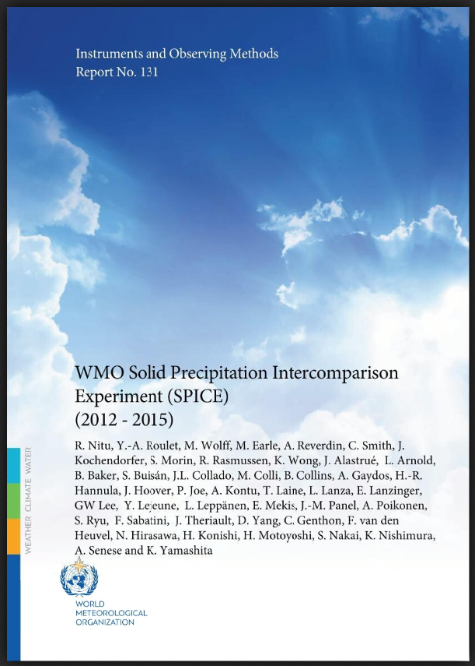
SPICE

Slide 3
Management Summary of Instruments and Observing Methods Report No. 131
The Solid Precipitation Intercomparison Experiment (SPICE) was conducted as an internationally coordinated project, initiated and guided by the Commission for Instruments and Methods of Observation (CIMO) of the World Meteorological Organization (WMO). The SPICE field experiments took place between 2013 and 2015, with a preparatory stage during the winter of 2012/13. SPICE was carried out as a major international effort, and has been remarkable for the diversity of organizations which hosted SPICE tests, contributed with instruments, and were engaged in the data analysis and the derivation of results. In addition to National Meteorological and Hydrological Services, research organizations, academia, and the private sector played active roles and made unique contributions. Field experiments were conducted at twenty sites located in fifteen countries, on all continents except Africa and Antarctica, as outlined in Section 2 of this report. The instrument manufacturing community made a significant contribution to SPICE, as more than twenty instrument manufacturers provided instruments measuring precipitation amount, snow depth, and snow water equivalent. Each instrument model was tested on one or more sites in different climate regimes and over a large range of environmental conditions, providing a solid foundation for the results presented in this report.

Slide 4
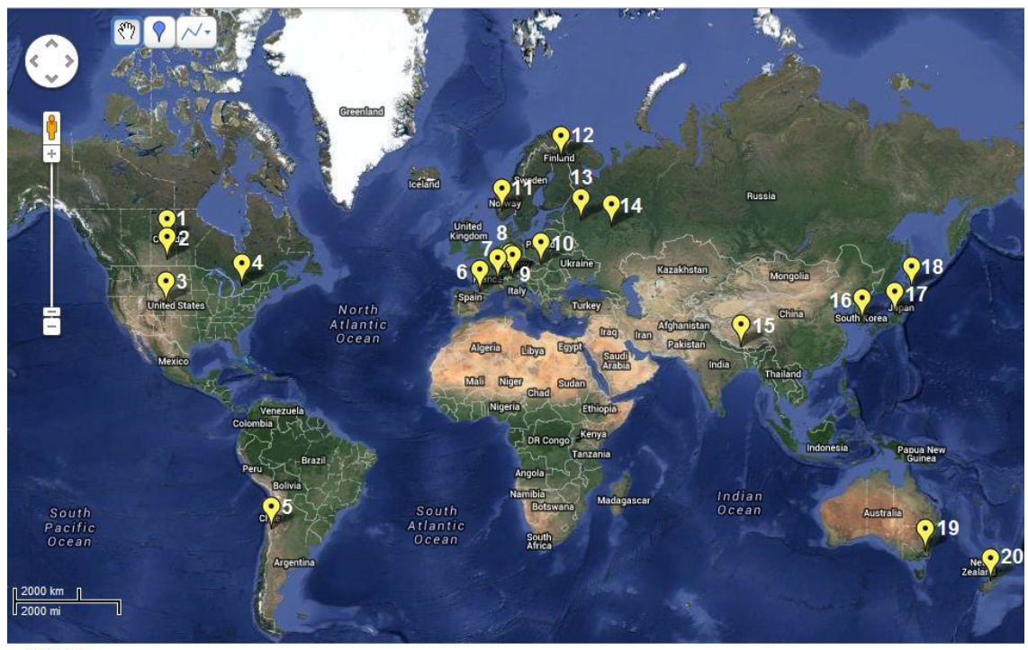
SPICE Participating Sites
WMO Solid Precipitation Intercomparison Experiment (SPICE) (2012 - 2015), Instruments and Observing Methods Report No. 131

Slide 5
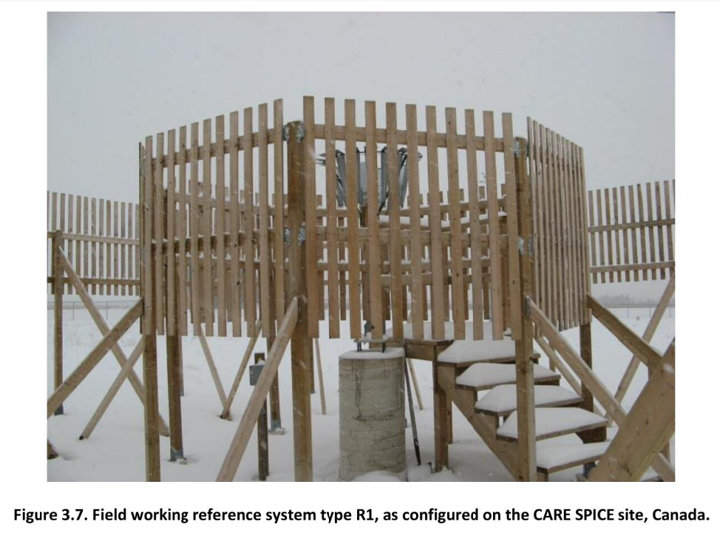
Double Fence Reference Measurements
WMO Solid Precipitation Intercomparison Experiment (SPICE) (2012 - 2015), Instruments and Observing Methods Report No. 131

Slide 6
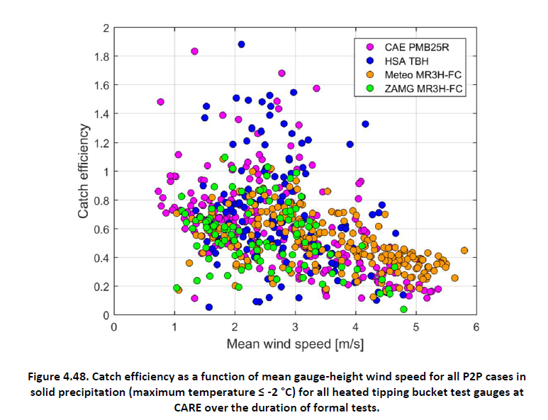
Catch Efficiency vs Wind Speed
Catch efficiency (CE): fraction of precipitation measured by the rain gauge relative to the precipitation deposited on the ground
WMO Solid Precipitation Intercomparison Experiment (SPICE) (2012 - 2015), Instruments and Observing Methods Report No. 131

Slide 7
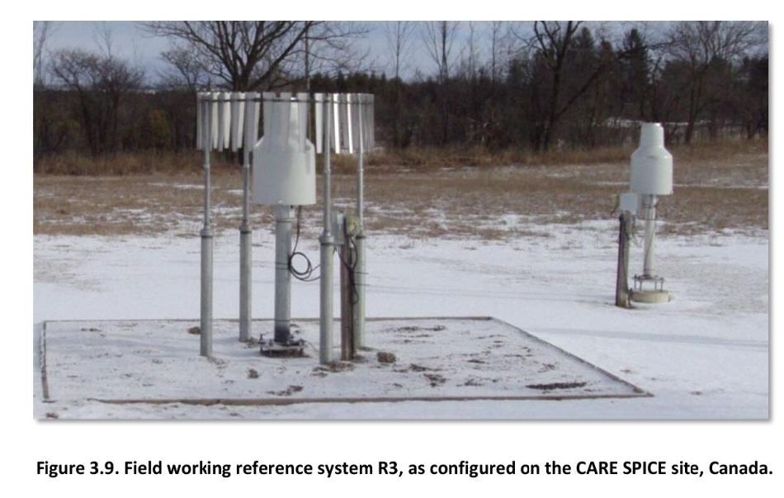
Single Alter Wind Shield
Rain gauge with single Alter shield (SA)
unshielded gauge (UN)
WMO Solid Precipitation Intercomparison Experiment (SPICE) (2012 - 2015), Instruments and Observing Methods Report No. 131

Slide 8
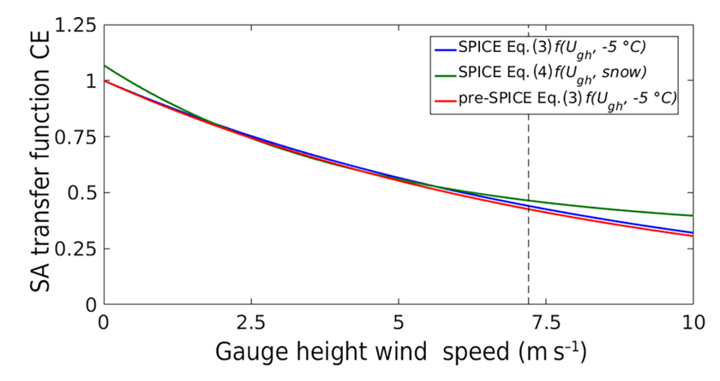

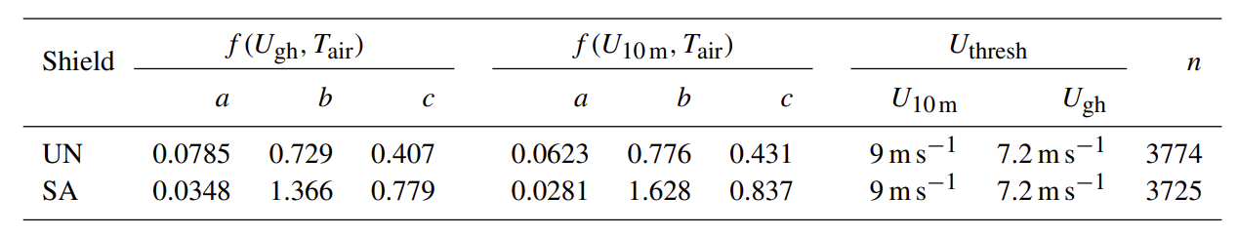
Transfer Function
Correction of precipitation measurement:
P_{corrected} = P_{uncorrected} / CE
T_{air} = Air temperature in °C
U_{gh} = wind velocity at gauge height
U_{10m} = wind velocity at 10 m above ground
U_{thresh} = upper wind-speed limit
After Kochendorfer et al., 2017a

Slide 9
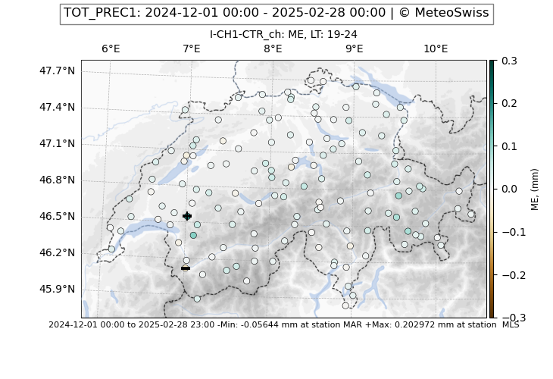
ICON-CH1-EPS Precipitation Bias
Winter 2024/25
Positive model bias, especially over high topography (mountain peaks)
Result of reduced catch efficiency of rain gauges for snow in windy conditions?
→ Redo verification with corrected data
Using original meas.

Slide 10
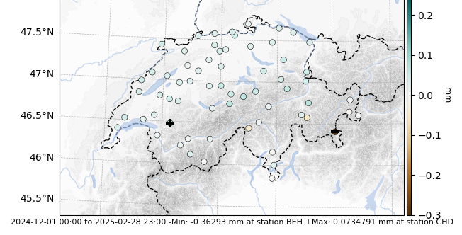
Bias Against Corrected Measurements
Using SPICE corrected meas.
Reduced bias at some stations (see later)
Large dry bias at station Bernina Hospiz (BEH)
BEH

Slide 11
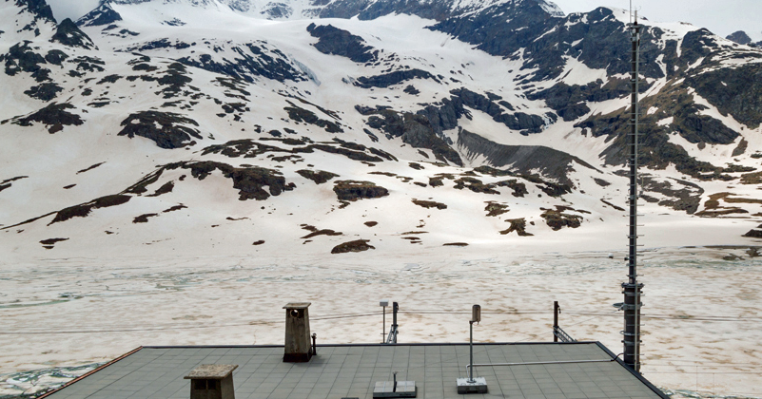
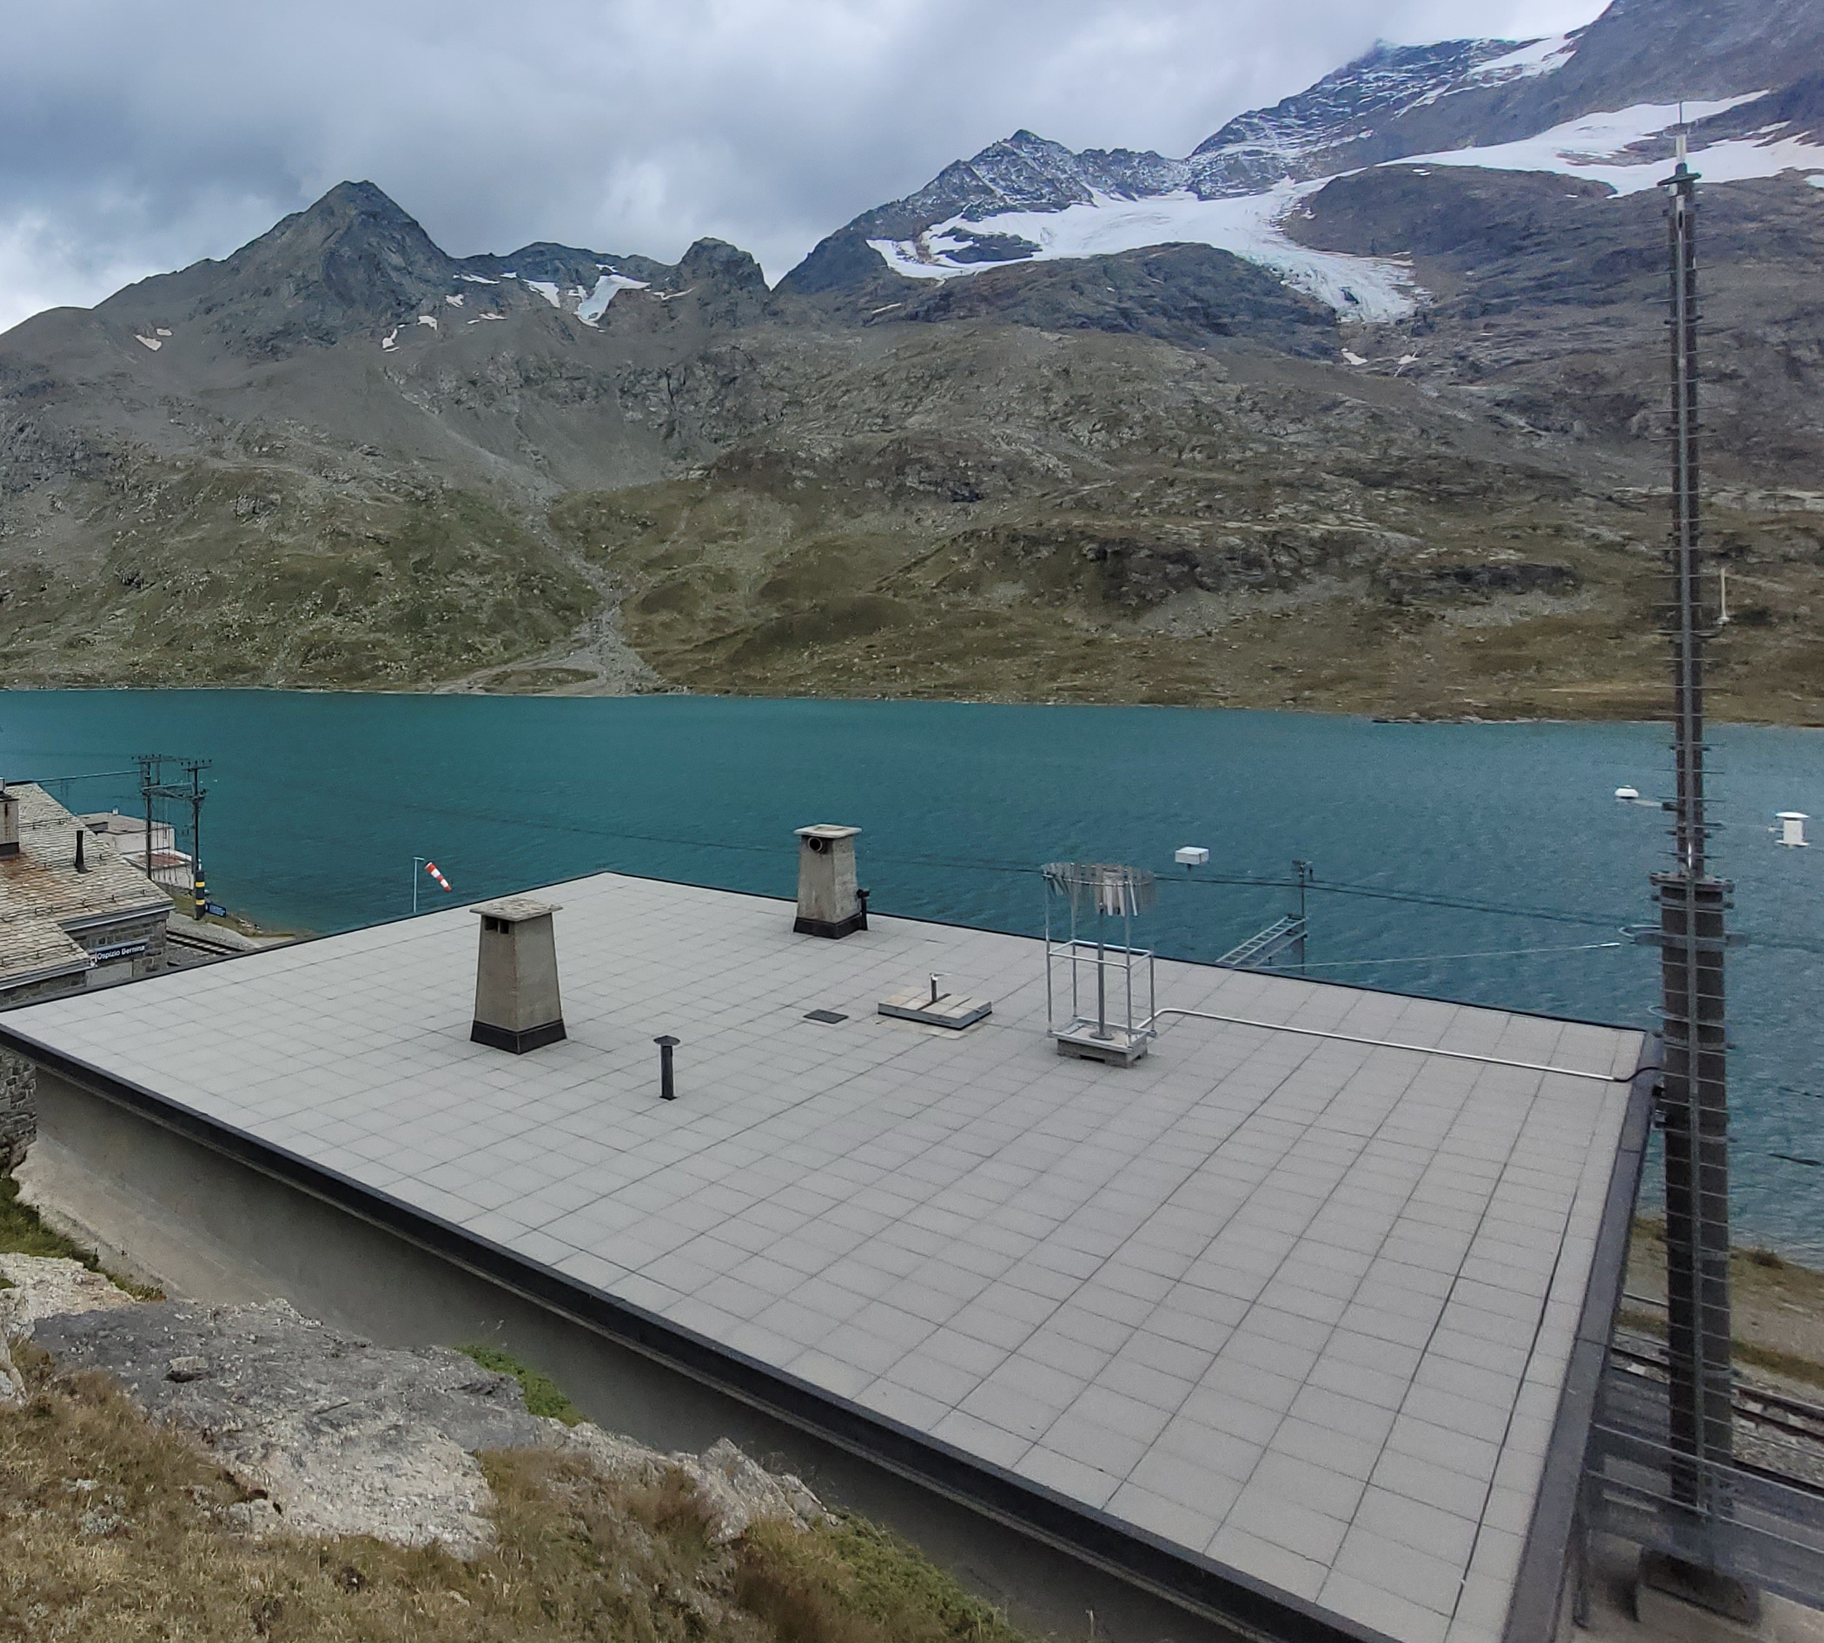
Station Bernina Hospice (BEH)
Before 11 September 2024
Single Alter windshield has been installed but correction for unshielded station has still been applied in winter 2024/25
→ over-correction, measurements too high
After 11 September 2024

Slide 12
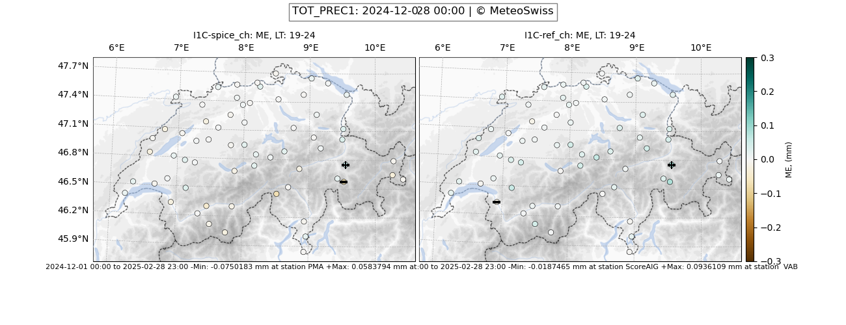
Verification Comparison Winter 2024/25
(after exclusion of BEH)
Higher measurements → less overprediction of model, smaller positive bias (e.g. VAB)
Few stations with even negative bias, model underestimates (e.g. ROE, PMA)
Bias vs original meas.
Bias vs corrected meas.
VAB
VAB
ROE
PMA
PMA
ROE

Slide 13
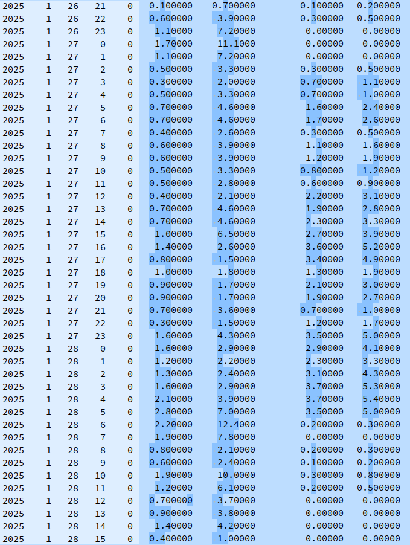
Values [mm h⁻¹]
Yr. Mon. Day Hr. Min. PMA orig PMA corr. ROE orig. ROE corr.
~ x1.5
Piz Martegnas (PMA) is a mountain peak station with strong winds
→ very large corrections
Robièi (ROE) and Valbella (VAB, not shown here but similar to ROE) are valley floor stations with much less strong winds
~ x6

Slide 14
Bias and Std Dev of Selected Stations
Winter 2024/25
Name | Bias orig [mm h⁻¹] | Bias corr [mm h⁻¹] | Std Dev orig [mm h⁻¹] | Std Dev corr [mm h⁻¹] | Mean wind speed [m s⁻¹]
Piz Martegnas PMA (peak) | 0.067 | -0.089 ☹ | 0.33 | 0.81 ☹ | 6.1
Robièi ROE (valley, large change) | 0.017 | -0.083 ☹ | 0.31 | 0.45 ☹ | 2.2
Valbella VAB (valley) | 0.082 | 0.047 ☺ | 0.31 | 0.45 ☹ | 3.6
N = 2160 (3 months * 720 h)

Slide 15
Bias and Std Dev All Swiss Stations
Season | Bias orig [mm h⁻¹] | Bias corr [mm h⁻¹] | Std Dev orig [mm h⁻¹] | Std Dev corr [mm h⁻¹] | RMSE orig | RMSE corr
DJF 2024/25 | 0.0163 | -0.0037 ☺ | 0.333 | 0.395 ☹ | 0.334 | 0.395 ☹
DJF 2025/26 | 0.0208 | 0.0052 ☺ | 0.278 | 0.323 ☹ | 0.279 | 0.324 ☹
N = 138240 (3 months * 720 h * 64 stations)

Slide 16
Conclusions
Corrected measurements reduce model bias
Standard deviation and RMSE are both increased
Measurements get large corrections at wind exposed stations, thereby increasing measurement variability
Transfer functions are rough approximations with a high degree of uncertainty
The use of corrected measurements is not beneficial for the verification, the large increase of the standard deviation largely outweighs the reduction of the bias

Slide 18
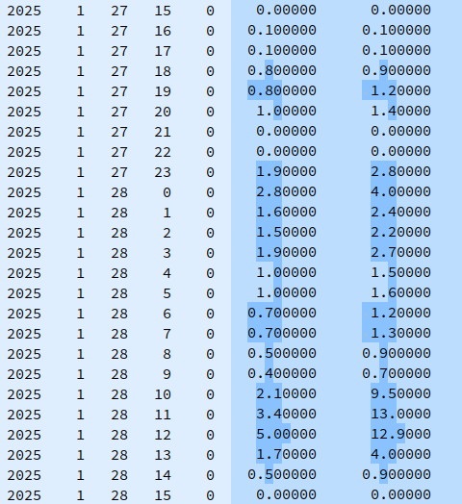
Values Valbella (VAB) [mm h⁻¹]
Year Month Day Hour Min. VAB orig. VAB corr.
Valbella (VAB) is located at the floor station with less strong winds
x1.5

Slide 19
Bias and Std Dev of Seasons
Season | Bias orig [mm month⁻¹] | Bias corr [mm month⁻¹] | Std Dev orig [mm h⁻¹] | Std Dev corr [mm h⁻¹] | RMSE Orig [mm h⁻¹] | RMSE Corr [mm h⁻¹]
DJF 2024/25 | 11.7 | -2.7 | 0.333 | 0.395 | 0.334 | 0.395
DJF 2025/26 | 15.0 | 3.7 | 0.278 | 0.323 | 0.279 | 0.324
N = 138240 (3 months * 720 h * 64 stations)

Slide 20
SPICE@applied MeteoSwiss Documents
Jira Data Board https://meteoswiss.atlassian.net/browse/DB-9?atlOrigin=eyJpIjoiNGJmMjczM2ZmM2ExNGVlNjhmOWIxZTE5MTg3OGY0MWEiLCJwIjoiaiJ9
Confluence https://meteoswiss.atlassian.net/wiki/x/C4Cj

Slide 21
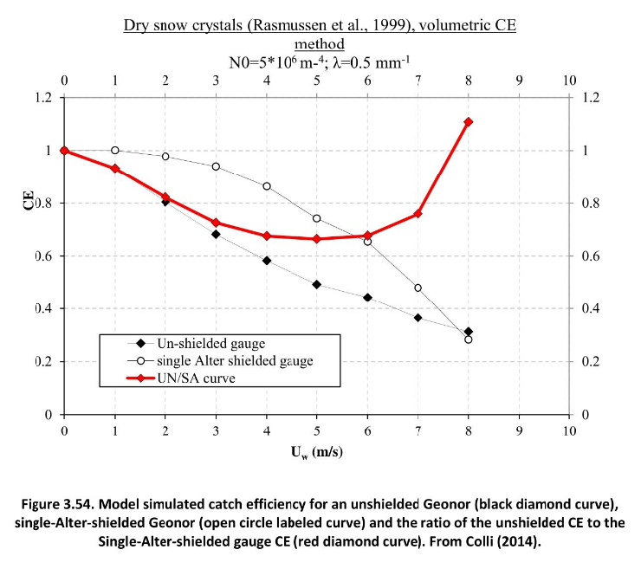
Catch Efficiency vs Wind Speed
WMO Solid Precipitation Intercomparison Experiment (SPICE) (2012 - 2015), Instruments and Observing Methods Report No. 131

Slide 22
Bias and Std Dev of Selected Stations
Name | Bias orig [mm month⁻¹] | Bias corr [mm month⁻¹] | Std Dev orig [mm h⁻¹] | Std Dev corr [mm h⁻¹]
Piz Martegnas PMA | 48 | -64 | 0.33 | 0.81
Robièi ROE | 12 | -60 | 0.31 | 0.45
Valbella VAB | 59 | 34 | 0.31 | 0.45
N = 2160 (3 month * 720 h)

Slide 23
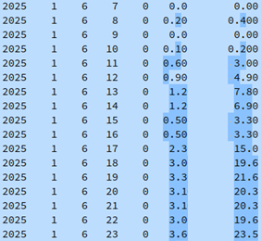
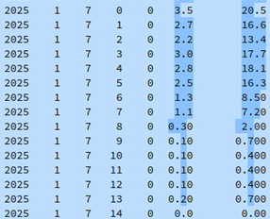
Precipitation Bernina H. (BEH) [mm h⁻¹]
Original Corrected
Original Corrected
The Bernina Hospice is located at a high mountain pass — the Bernina Pass — where strong winds and cold temperatures prevail
x6
x6

Slide 24
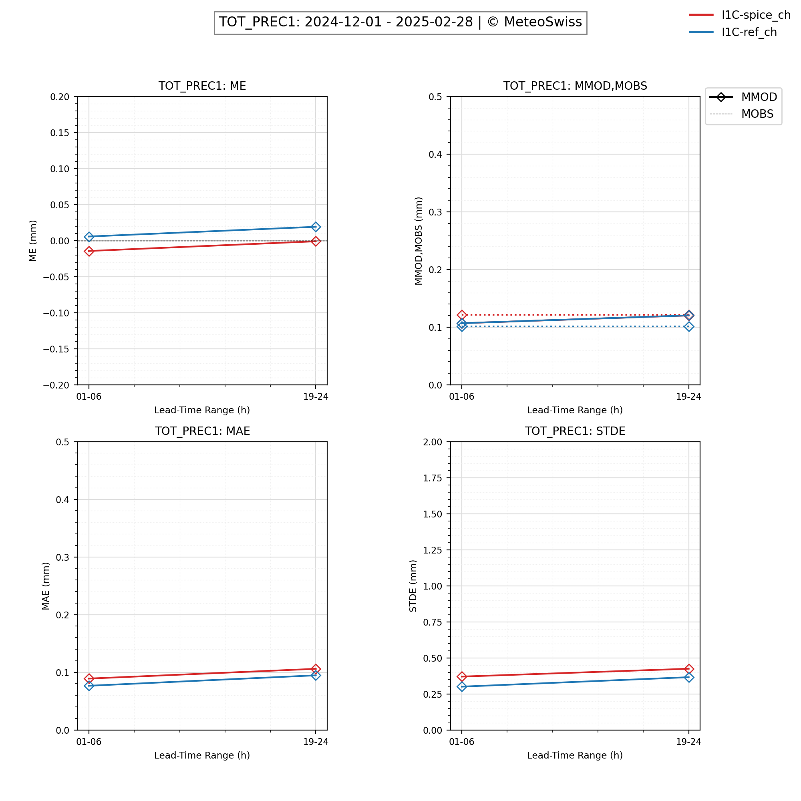
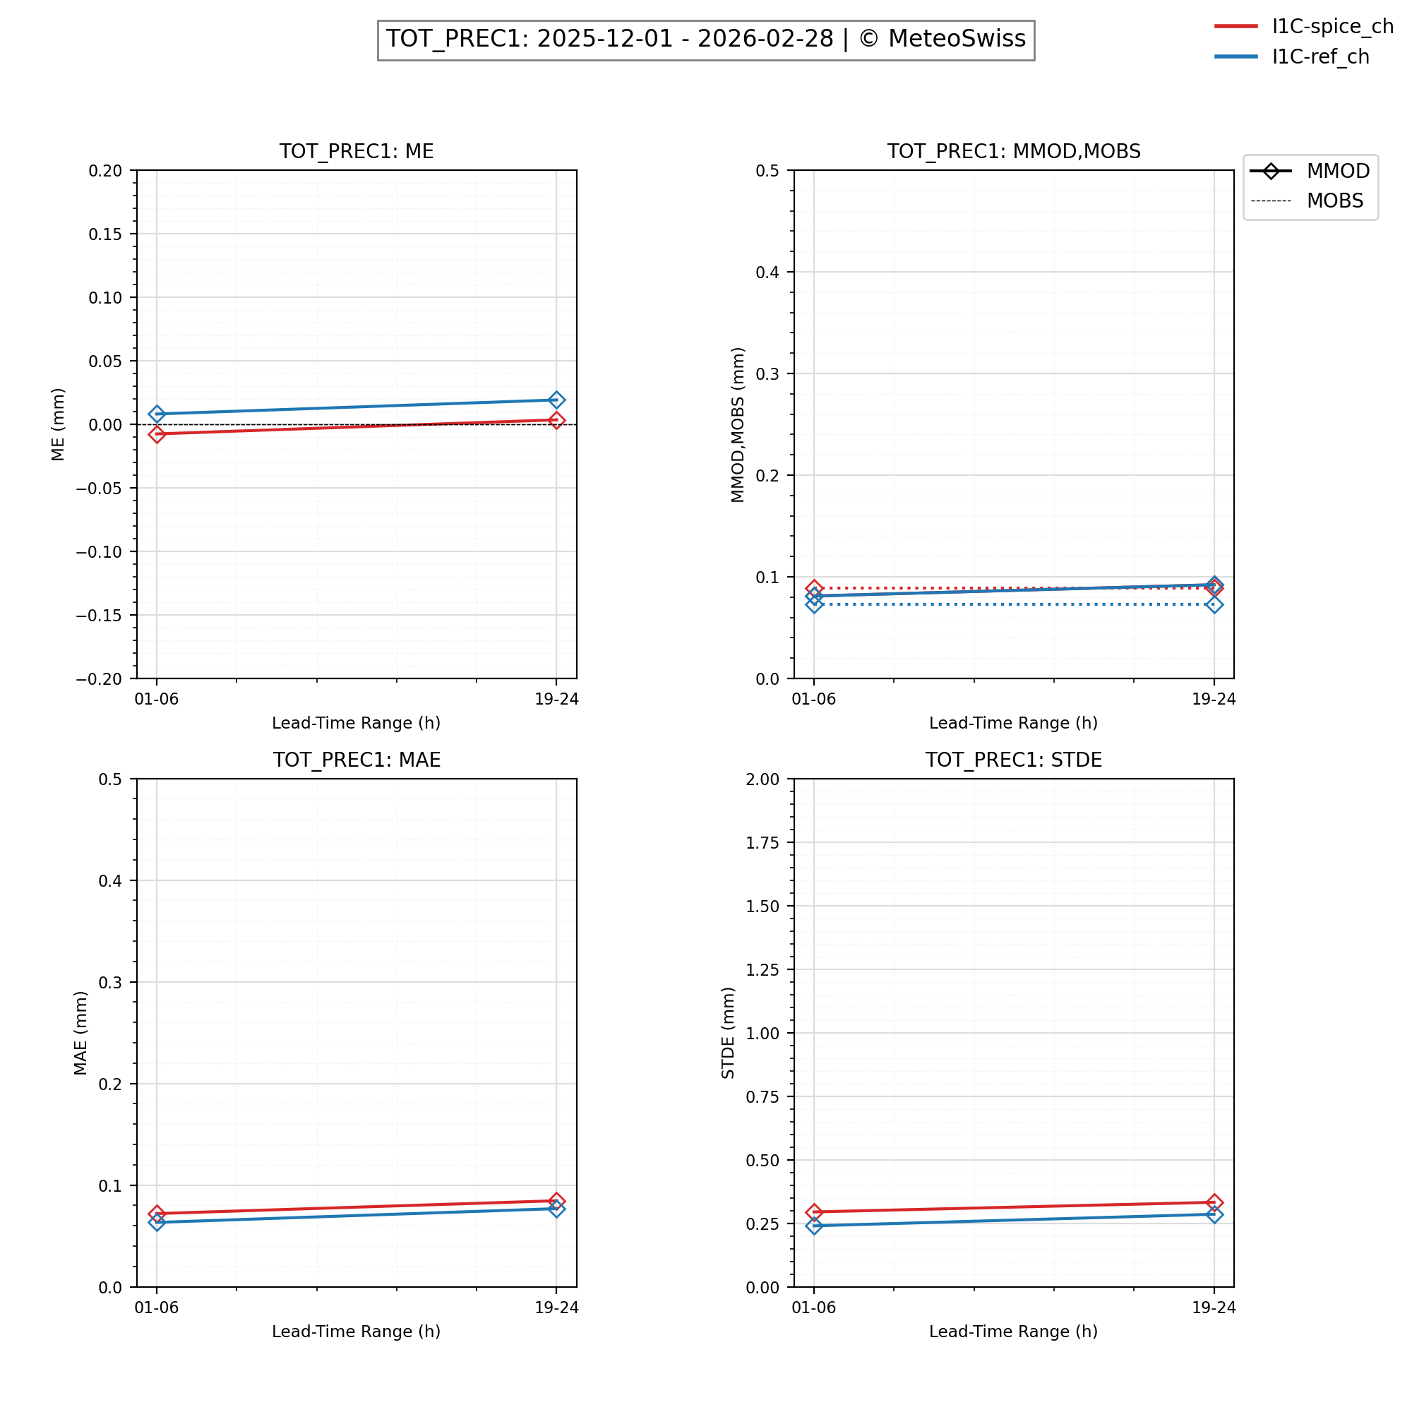
Verification Results
Winter 2024/25
Winter 2025/26
Bias
Mod./Meas.
Bias
Mod./Meas.
MAE
STDE
MAE
STDE

