Slide 1
Meteorological support for non-engine aircraft users
based on numerical forecasts, with particular emphasis
on the description of convection on a local and regional scale
Andrzej Mazur
LMM ZPN-COSMO IMGW-PIB

Slide 2
Contents
Basics
What’s needed and what’s sufficient – products
Summary

Slide 3
Basics
The theoretical foundations were developed, applied, and verified in work conducted using COSMO mesoscale models with resolutions of 14 and 7 km.
The work is being conducted in three directions:
description of air movement on a regional (national) scale (e.g. for aerostats),
depiction of convection and the resulting information (favorable/unfavorable conditions for general aviation’ participants), and
reporting of local meteorological conditions relevant to gliders’ users.

Slide 4
What’s needed and what’s sufficient – products
The quantities relevant to the problem, formulated first, are the wind speed fields (horizontal and vertical) at the model levels. This is obvious (simple?) because these quantities are directly available from the models.
The basic products, which have been used from the outset not only for non-engine aeronautics but for the entire field of "general aviation" are trajectory forecasts (air mass movement) originating from points – given airports – at selected pressure levels.
The generation of such products began with calculations for the COSMO model results at a resolution of 7 km (next slide). Currently, operational results are available based on the results of the COSMO 2.8 model. Further work is underway to transfer the calculations to the results of the ICON 2.5 model and – in the future – to the ICON 1.0 km model.

Slide 5
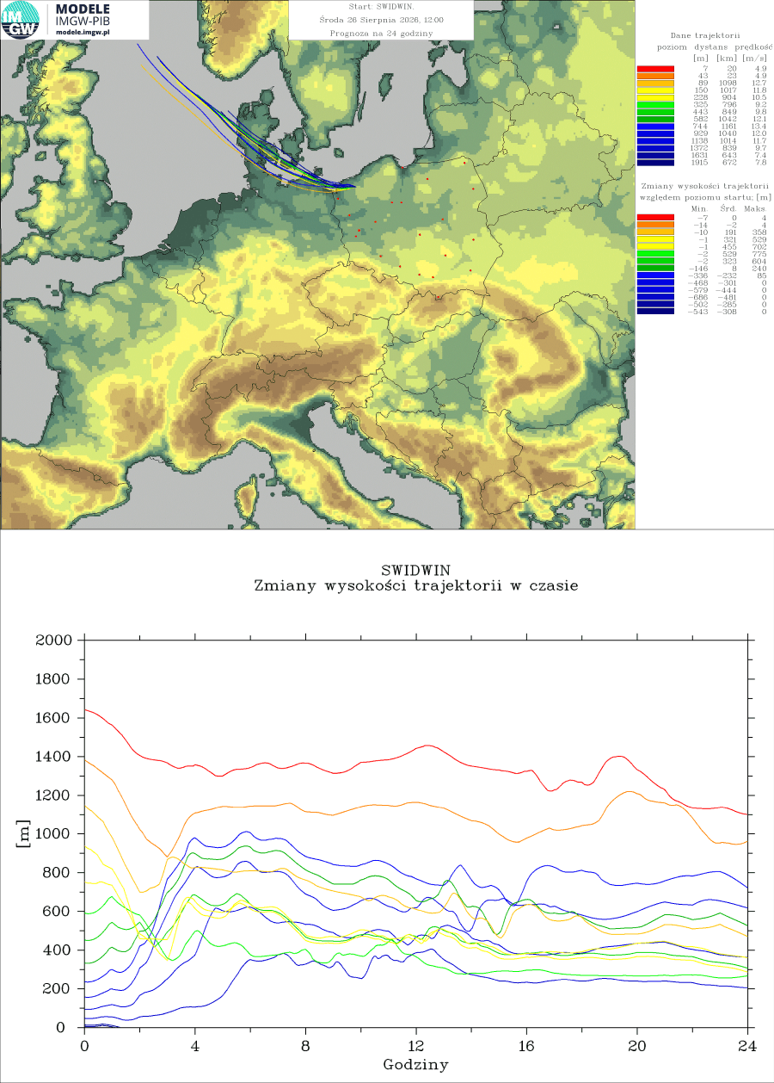


Sample trajectories from selected airports – COSMO 7km

Slide 6
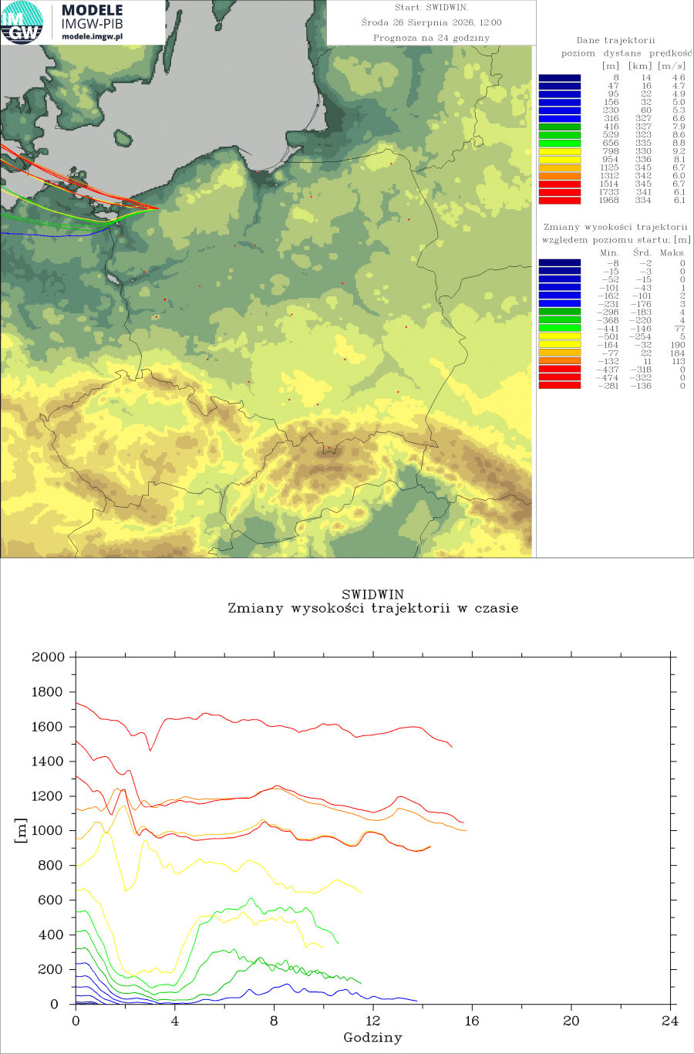
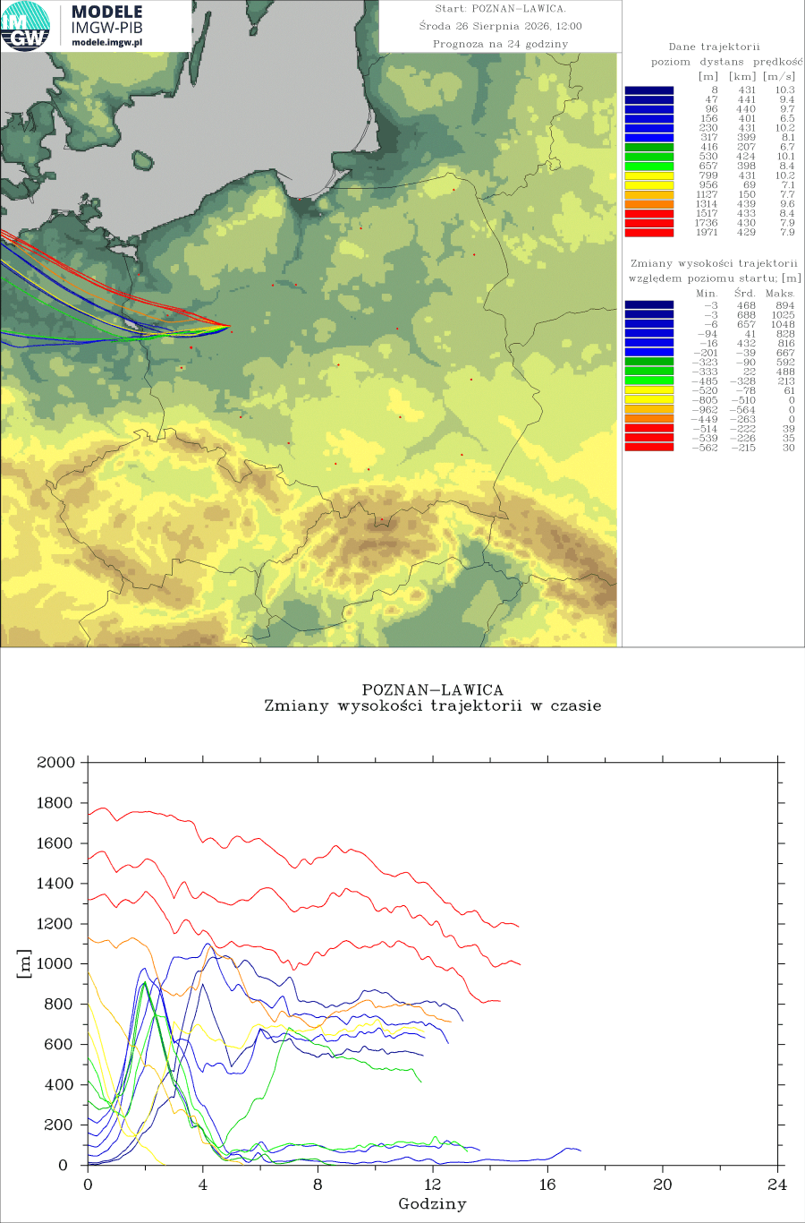
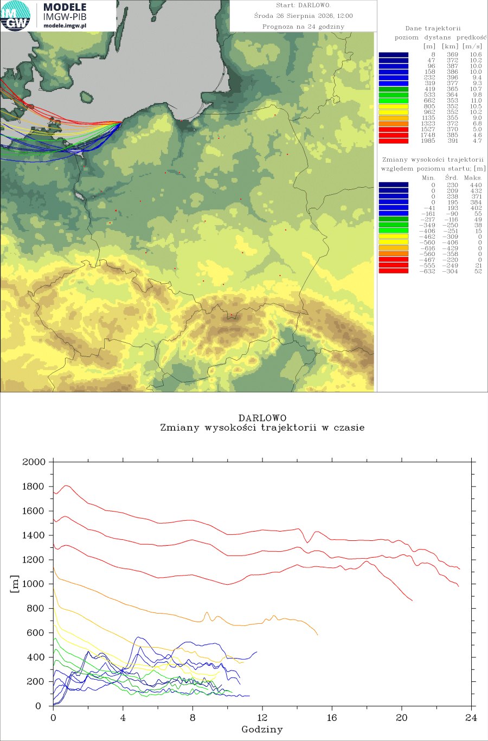
Sample trajectories from selected airports – COSMO 2.8km

Slide 7
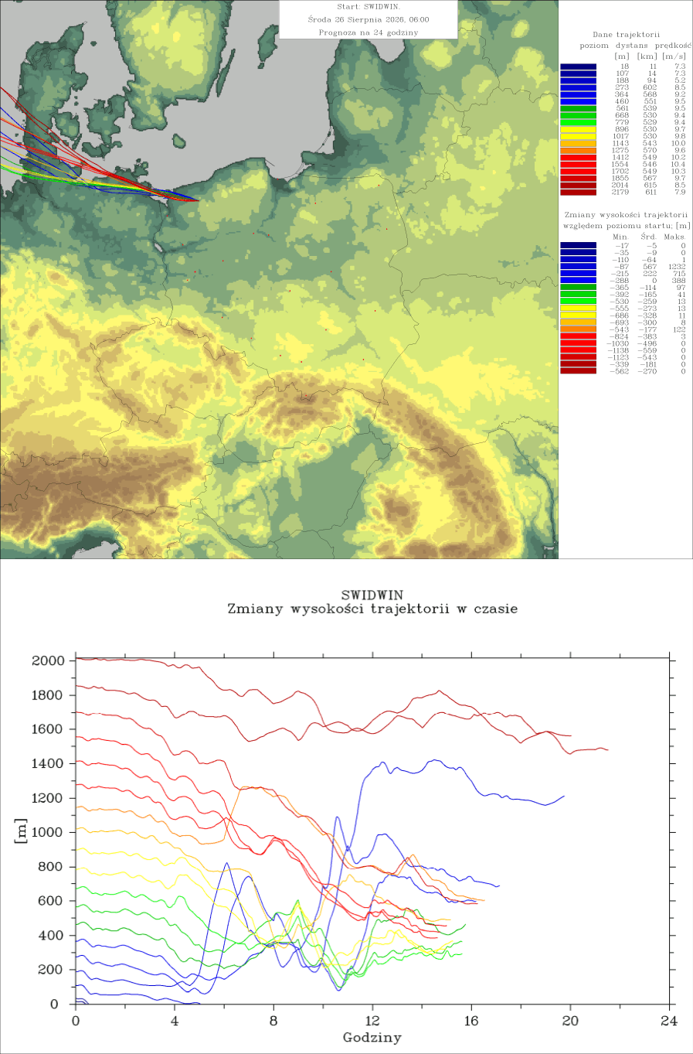


Sample trajectories from selected airports – ICON 2.5km

Slide 8
What’s needed and what’s sufficient – products
The second area of ​​activity was the description of convection, with particular emphasis on the needs of glider pilots. The basic fields used in describing convection include storm relative helicity, wind shear (standard and density-weighted), vorticity, and convective indices such as CAPE (note: for consistency with previous work, this is not a field calculated directly in the model, but from other model fields), lightning frequency, parameterized by the CAPE value – for comparison with the LPI calculated from the model, and DCAPE (downdraft CAPE), which allows for estimating the downdraft velocity.
In addition, standard convective indices (Total Totals, k-index, Showalter Index, Lifted Index; similarly to CAPE, these are values ​​calculated from other model fields, not directly), are calculated, which – alongside values ​​of the SWISS-00/SWISS-12 indices – are intended to determine the likelihood of thunderstorms.
Additional values ​​important for unmanned aircraft are the values ​​of updrafts and downdrafts, calculated from CAPE and DCAPE, respectively.
As before, further work is underway to transfer the calculations to the COSMO 2.8, ICON 2.5, and – in the future – the ICON 1.0 km model.

Slide 9
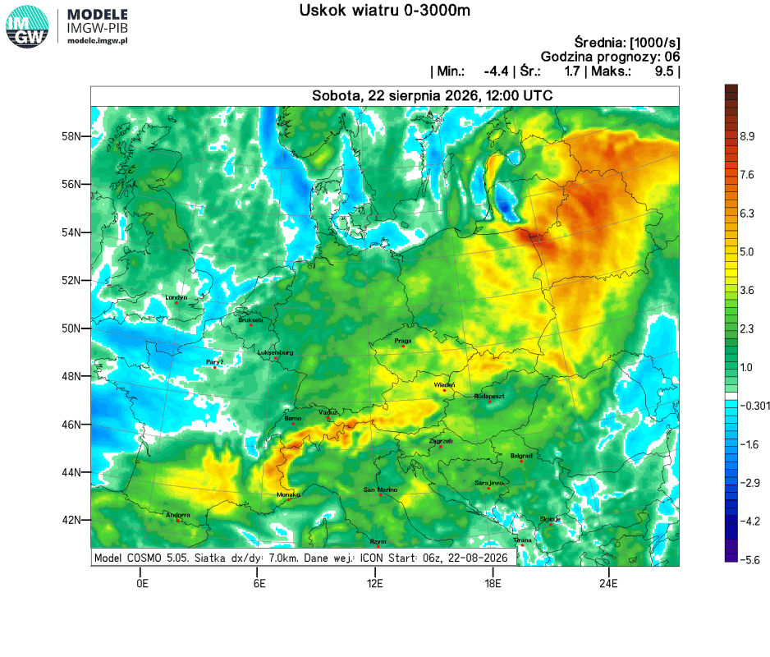
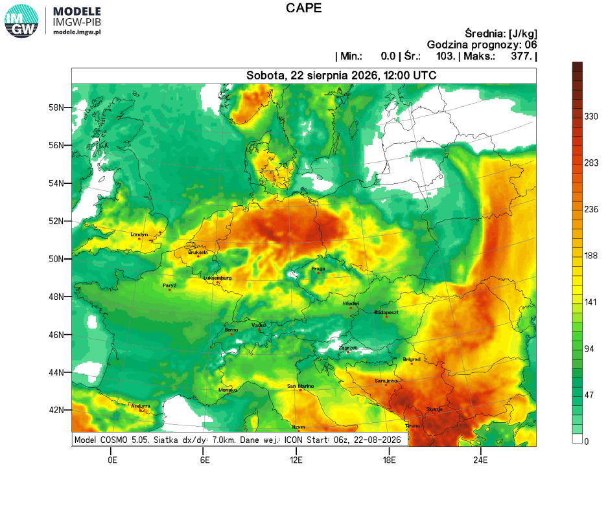
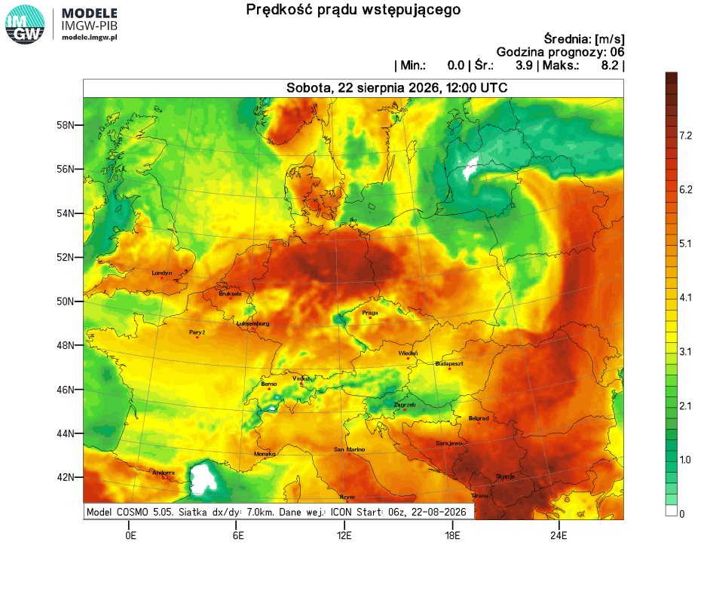
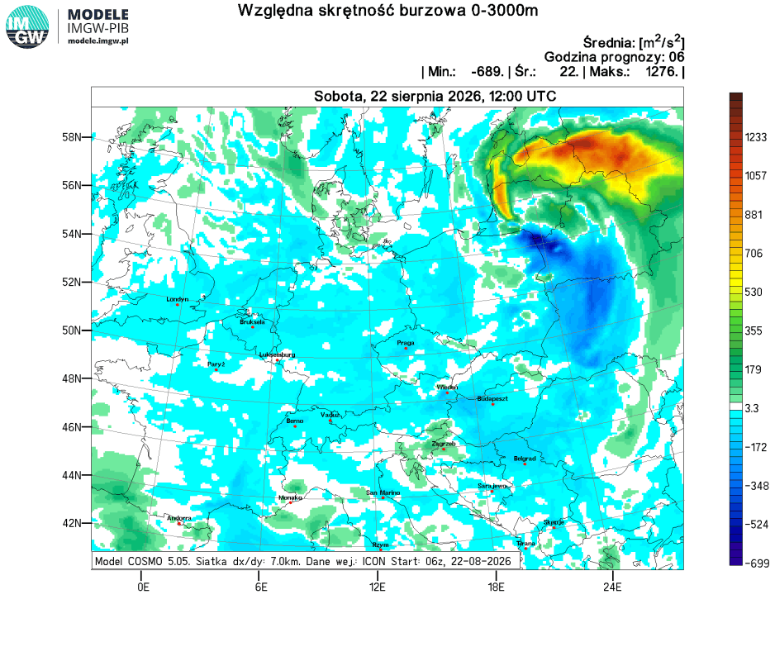
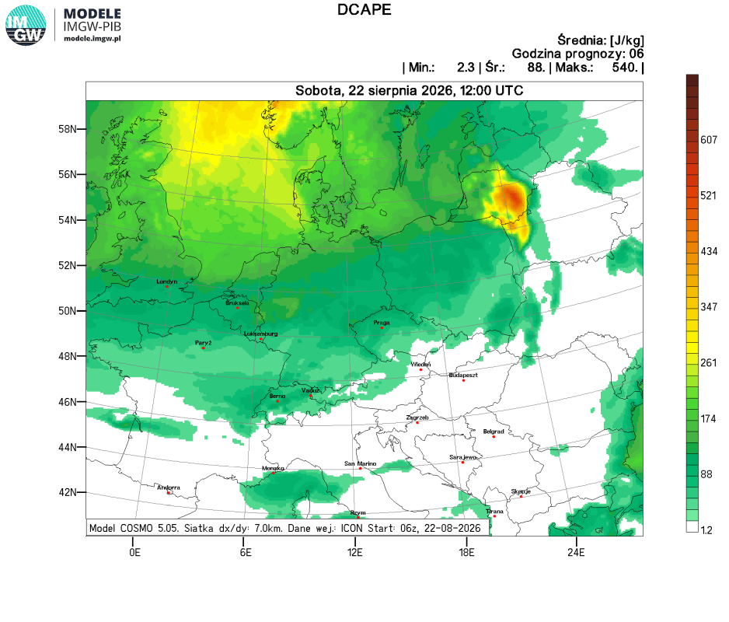
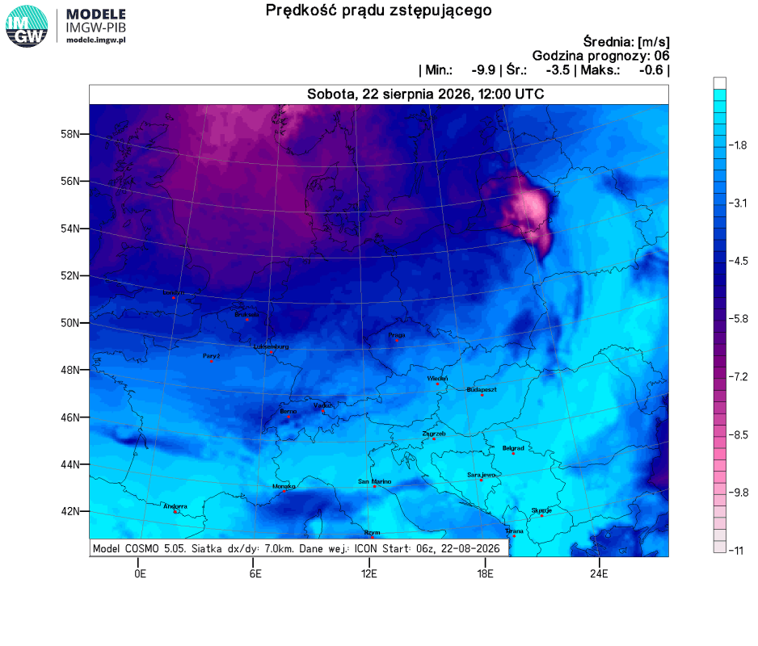
Analiza konwekcyjna
Co potrzeba i wystarcza – produkty
COSMO 7.0 km

Slide 10
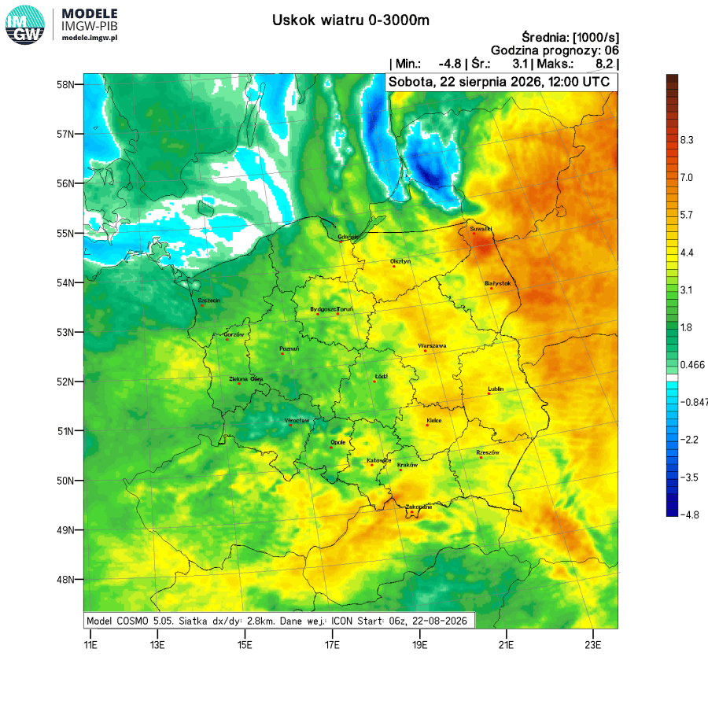
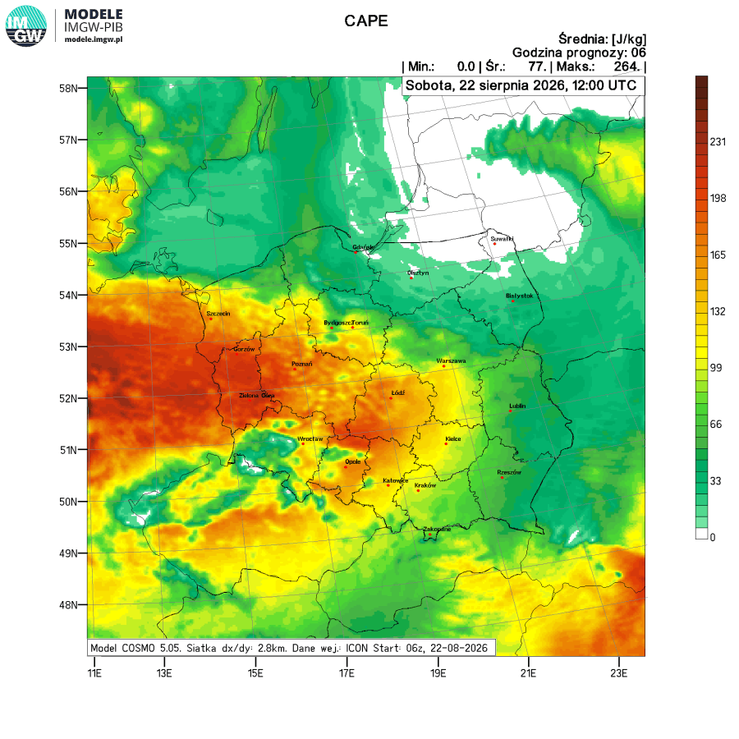
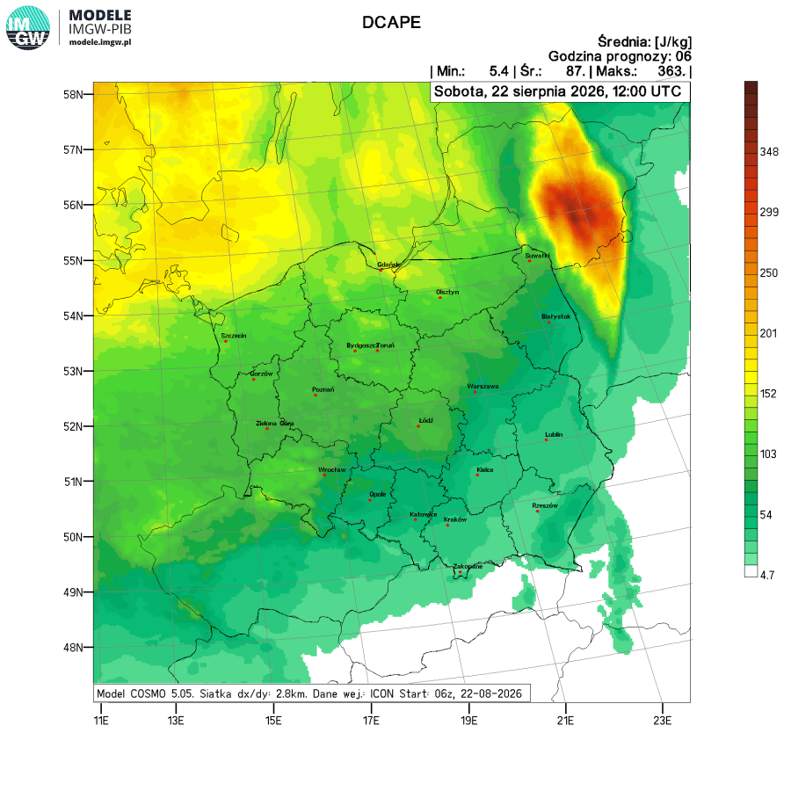
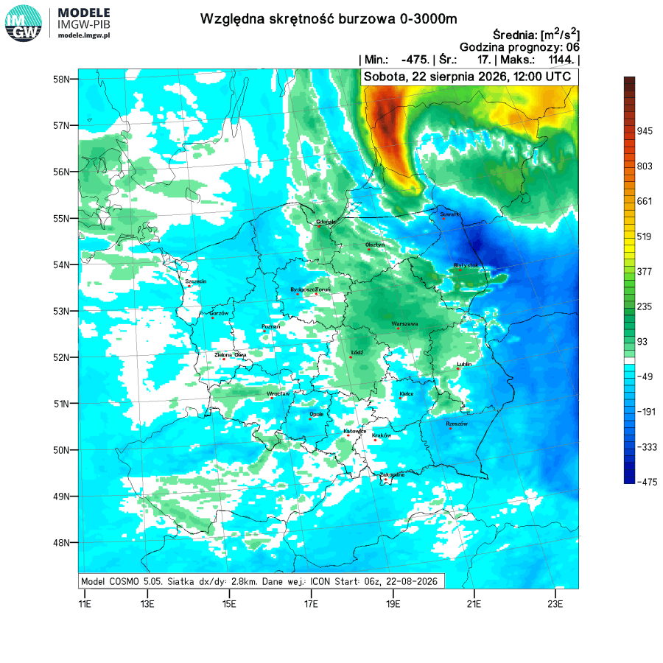
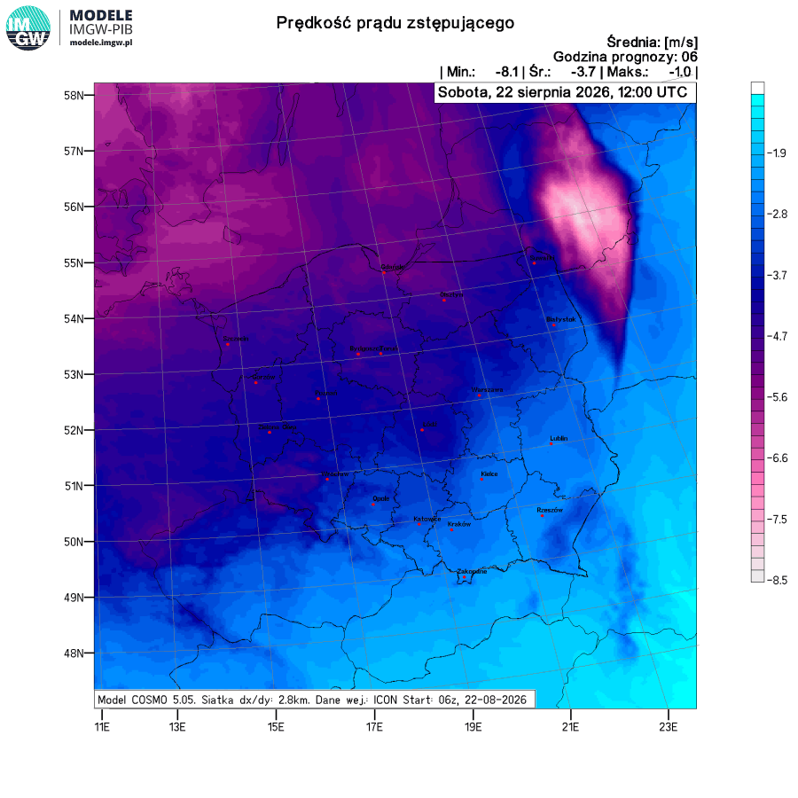
Analiza konwekcyjna
Co potrzeba i wystarcza – produkty
COSMO 2.8 km

Slide 11
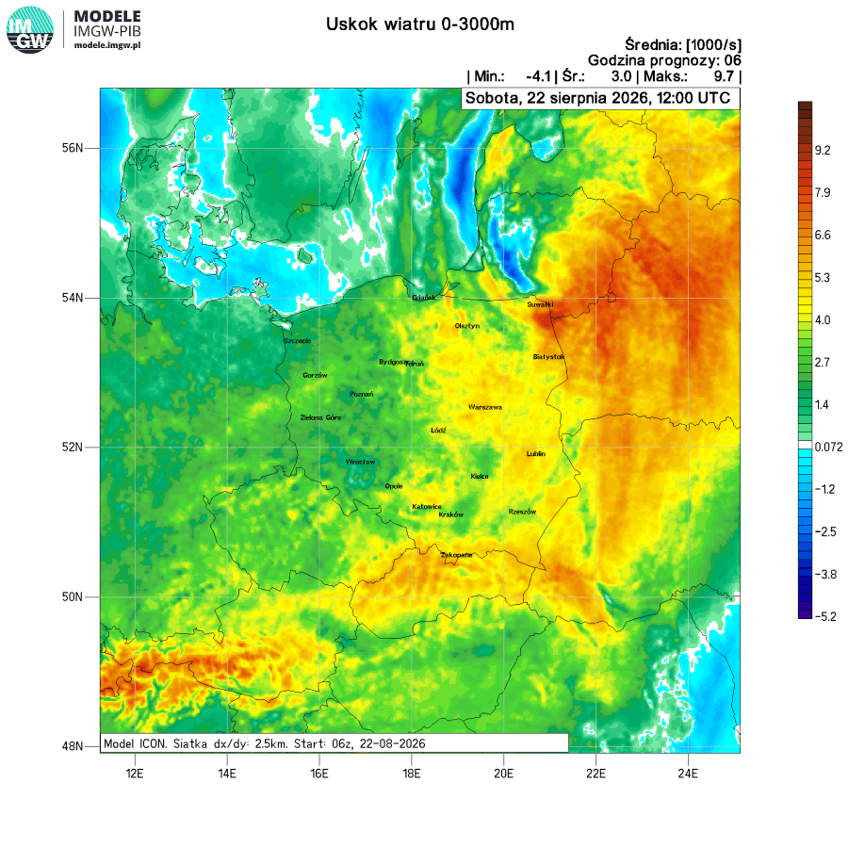
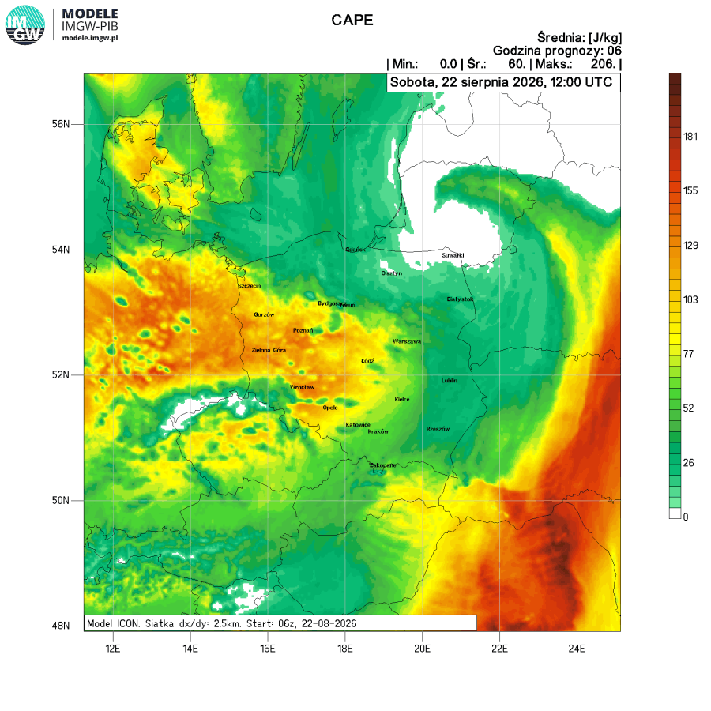
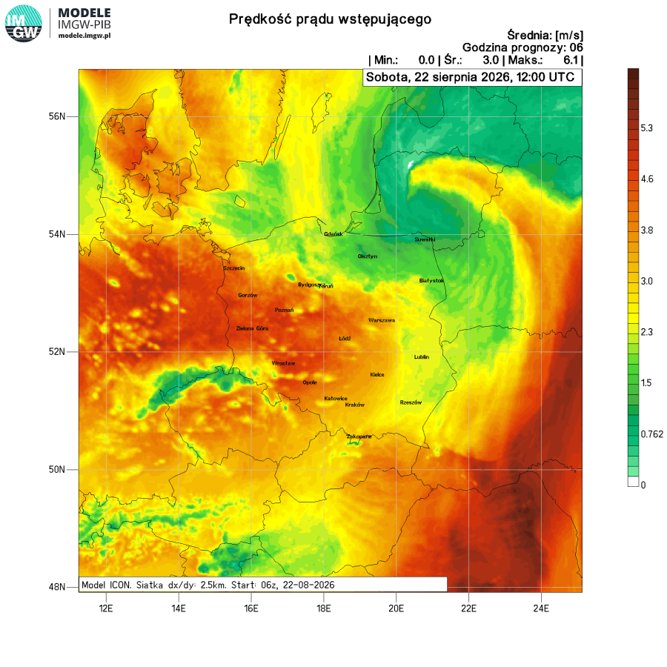
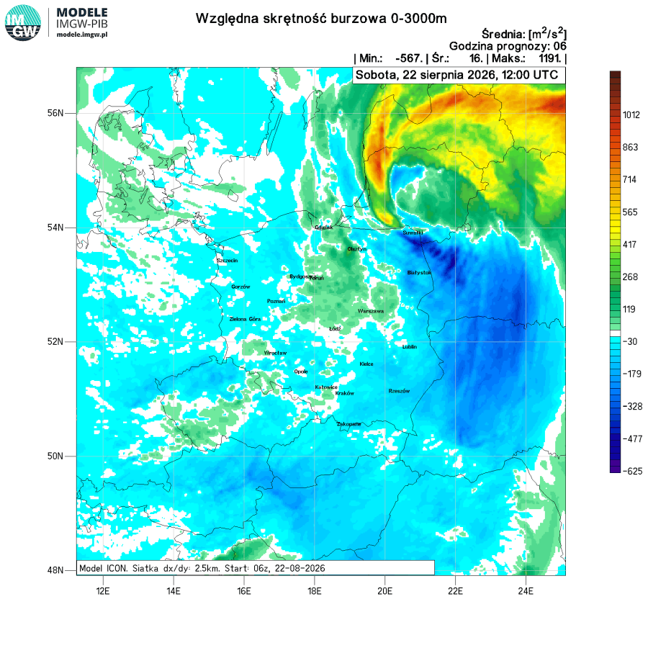
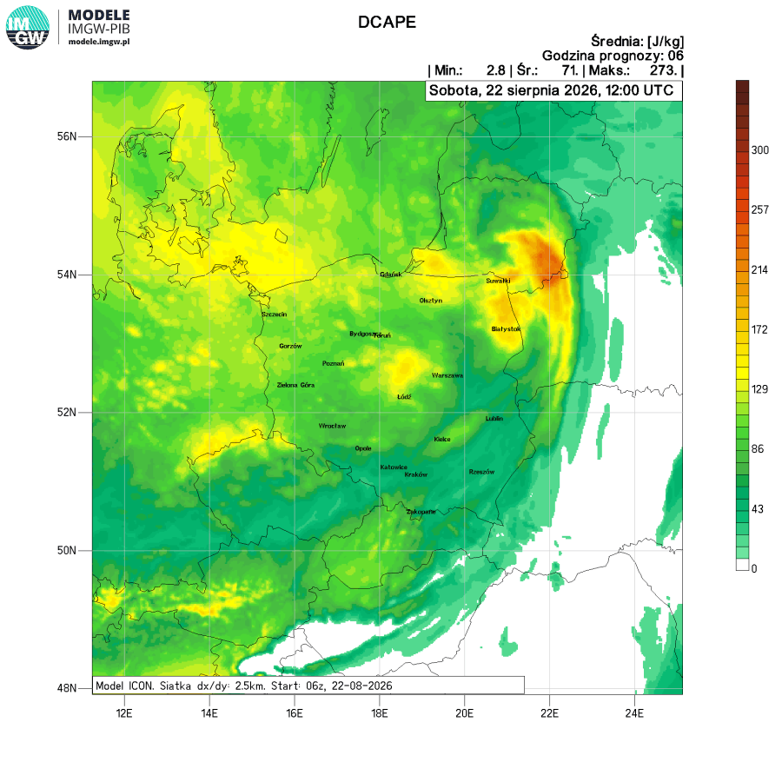
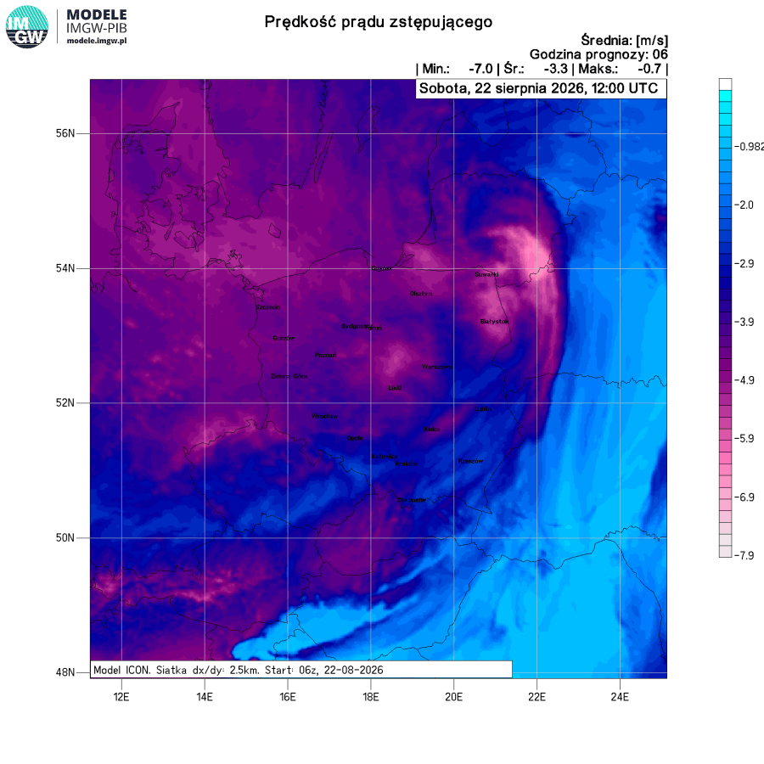
Analiza konwekcyjna
Co potrzeba i wystarcza – produkty
ICON 2.5 km

Slide 12
Definition of indices:
TT = T_{850hPa} + Td_{850hPa} – 2 · T_{500hPa} (Total Totals Index)
The higher positive value, the higher probability of a storm occurrence
K = T_{850hPa} + Td_{850hPa} – T_{500hPa} – (T_{700hPa} – Td_{700hPa}) (K-Index)
The higher positive value, the higher probability of a storm and heavy precipitation
SI = T_{500hPa} – T_{p500hPa}; (Showalter Index for a parcel lifted adiabatically from a level of 850 hPa)
The lower negative value, the higher probability of an instability
SLI = T_{500hPa} – T_{p500hPa}; (Surface Lifted Index for a parcel lifted adiabatically from a ground surface)
The lower negative value, the higher probability/intensity of an instability
SWISS00 = SI + 0.4 · WSH(6000 – 3000) + 0.1 · (T_{600hPa} – Td_{600hPa}) (Severe Weather Index 00)
Value less than 5.1 means "likely thunderstorms".
SWISS12 = SLI – 0.3 · WSH(3000 – 0) + 0.3 · (T_{650hPa} – Td_{650hPa}) (Severe Weather Index 12)
Value less than 0.6 means "likely thunderstorms".
WSH(x-y) – wind shear between levels x and y (m agl.)

Slide 13
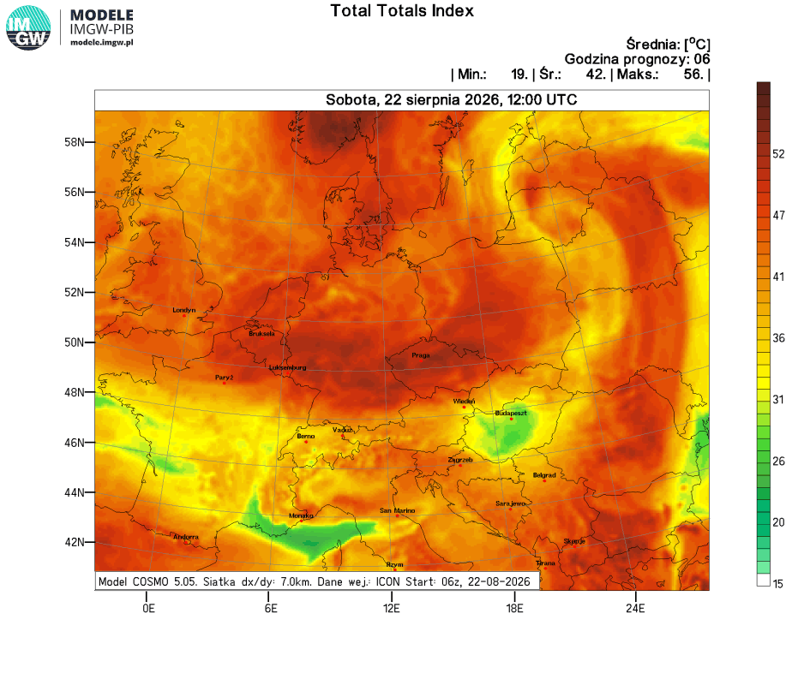
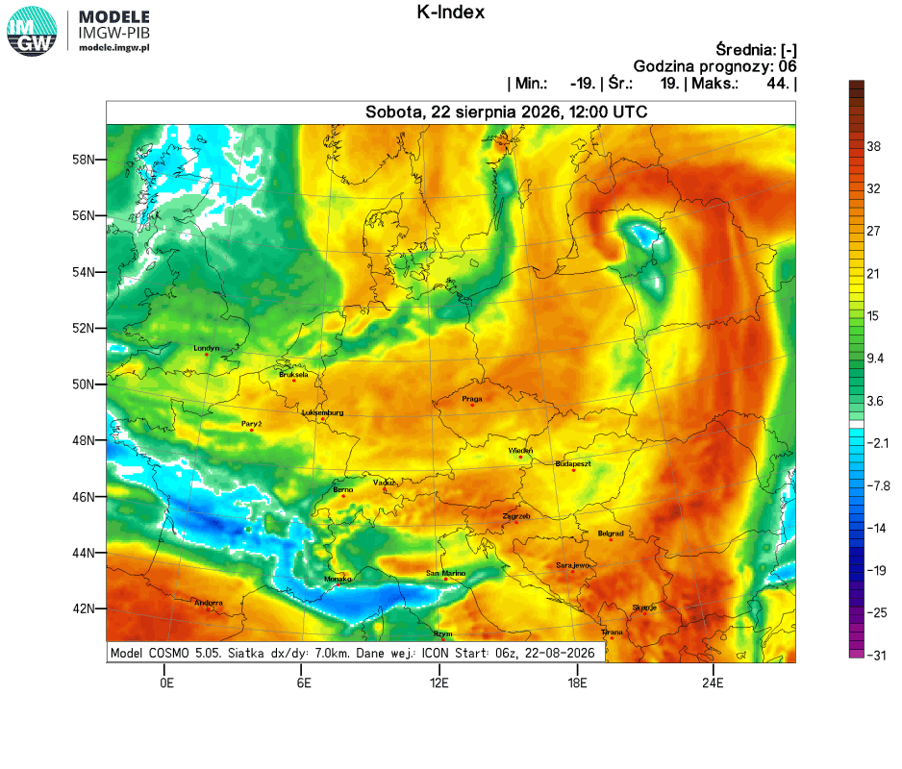
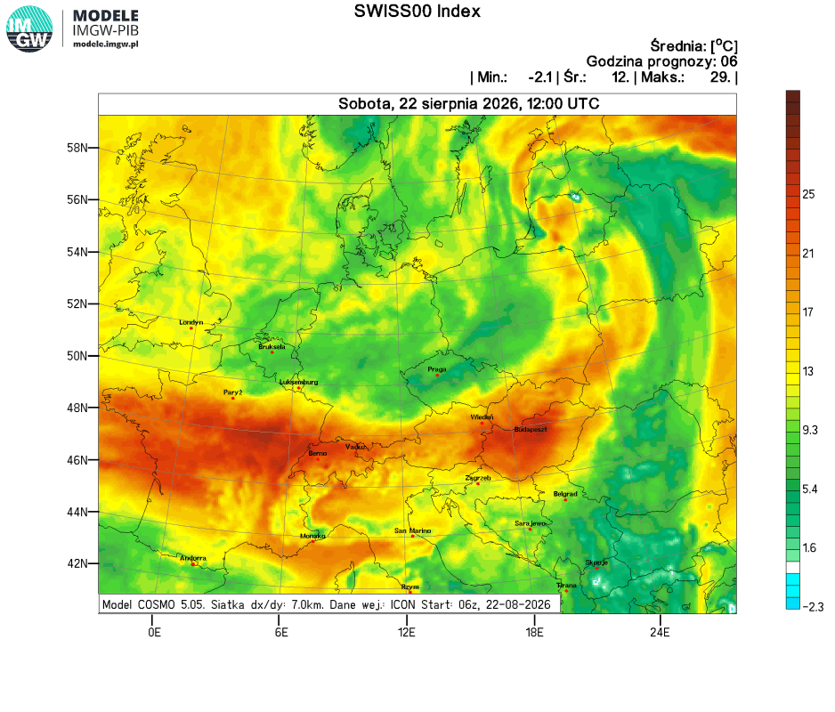
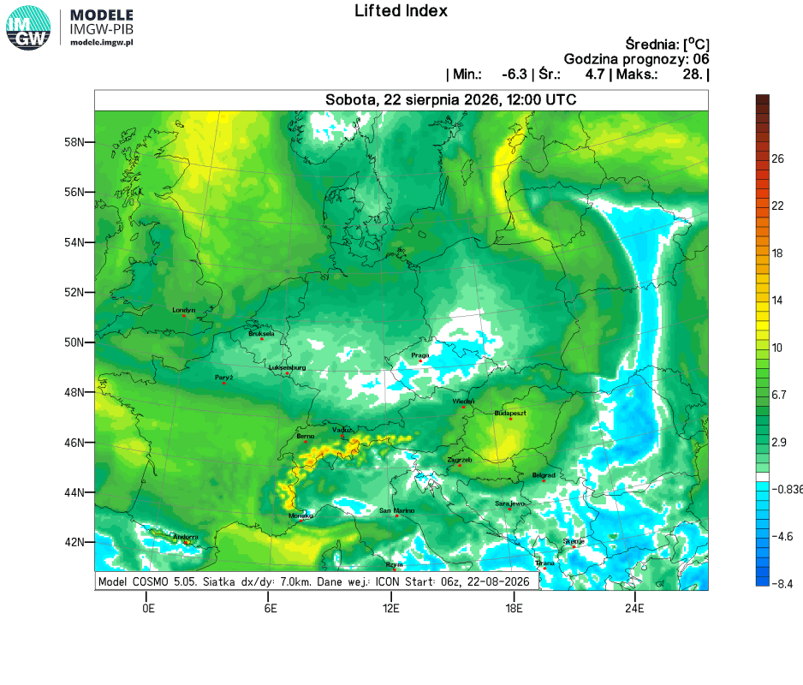
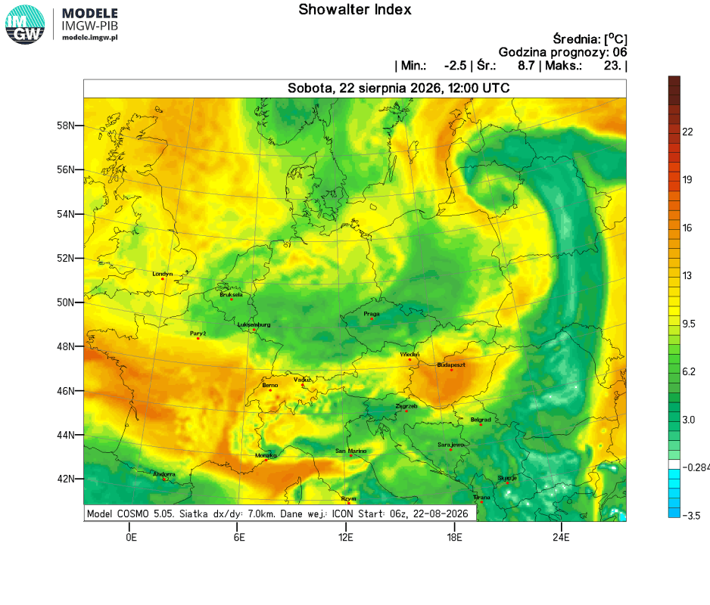
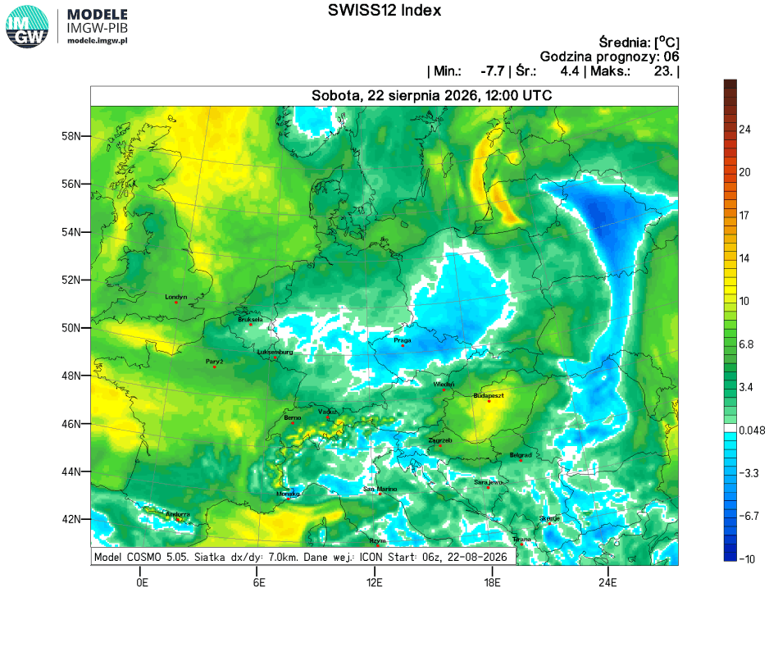
Analiza konwekcyjna
Co potrzeba i wystarcza – produkty
COSMO 7.0 km

Slide 14
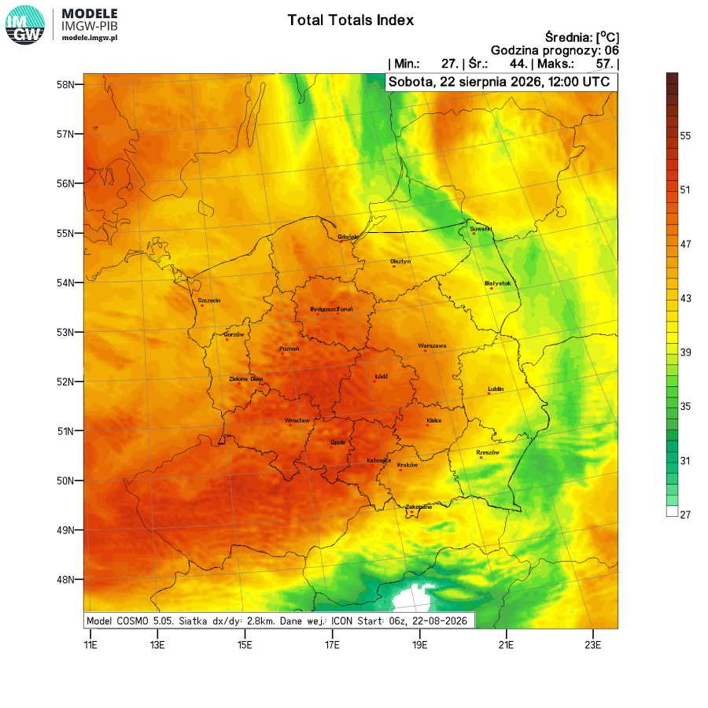
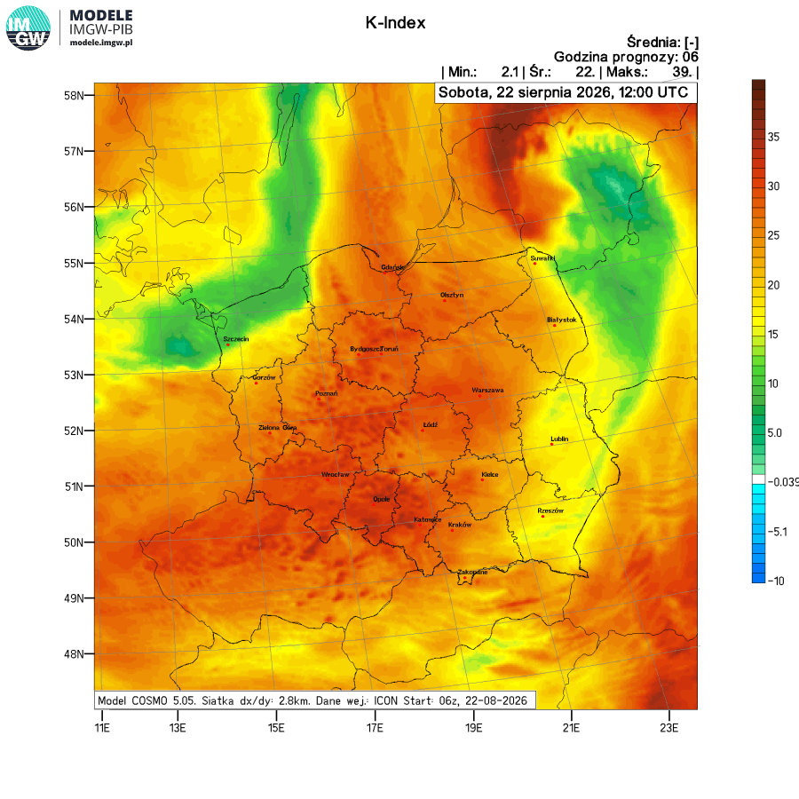
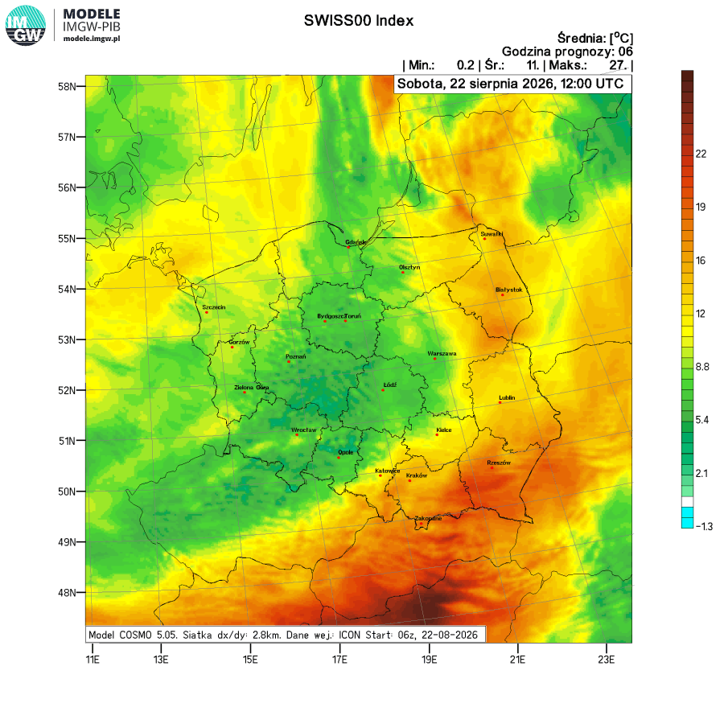
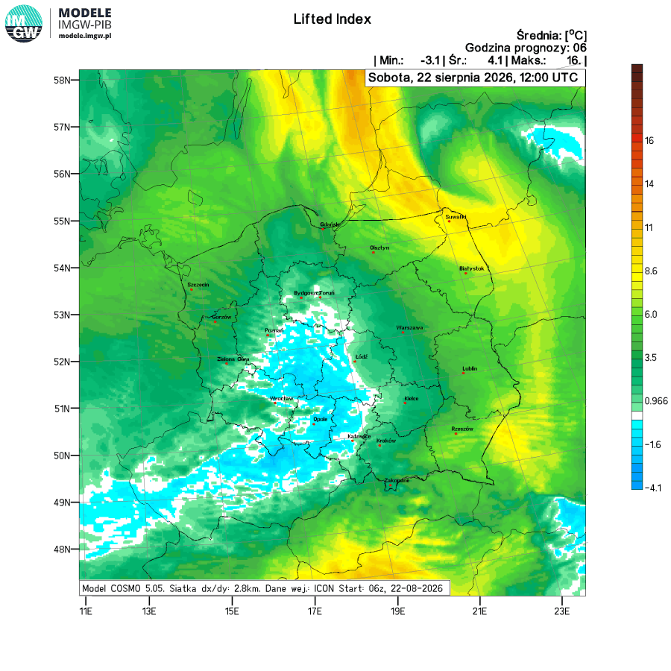
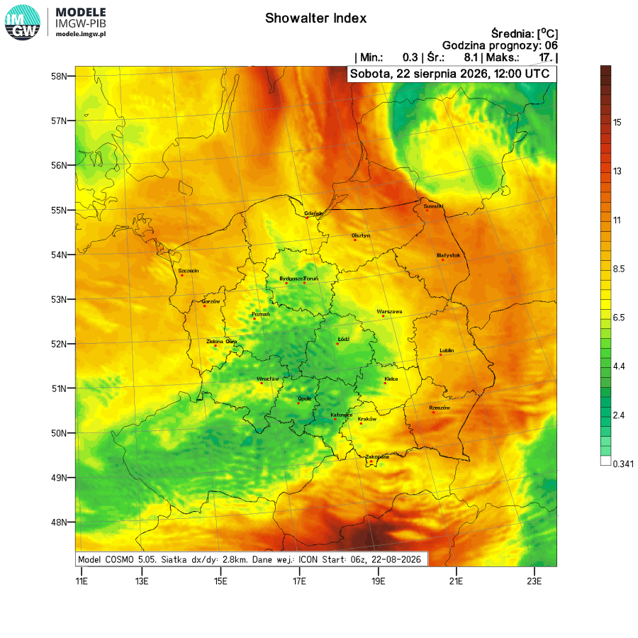
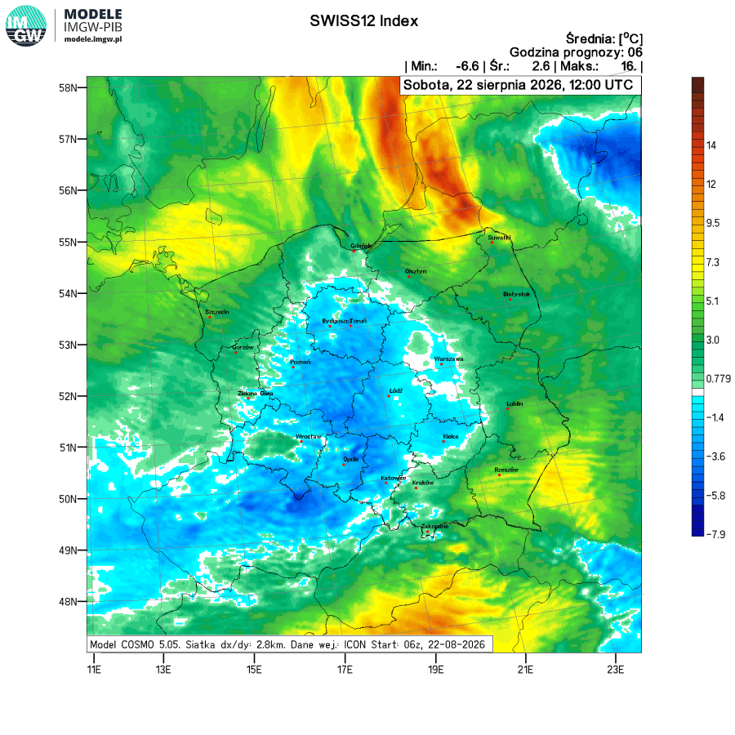
Analiza konwekcyjna
Co potrzeba i wystarcza – produkty
COSMO 2.8 km

Slide 15
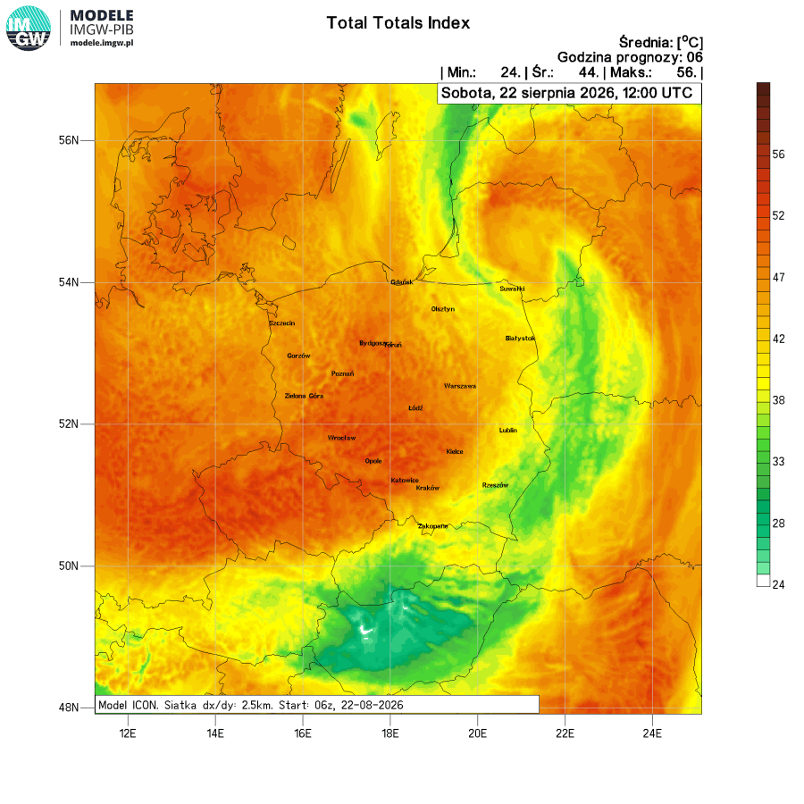
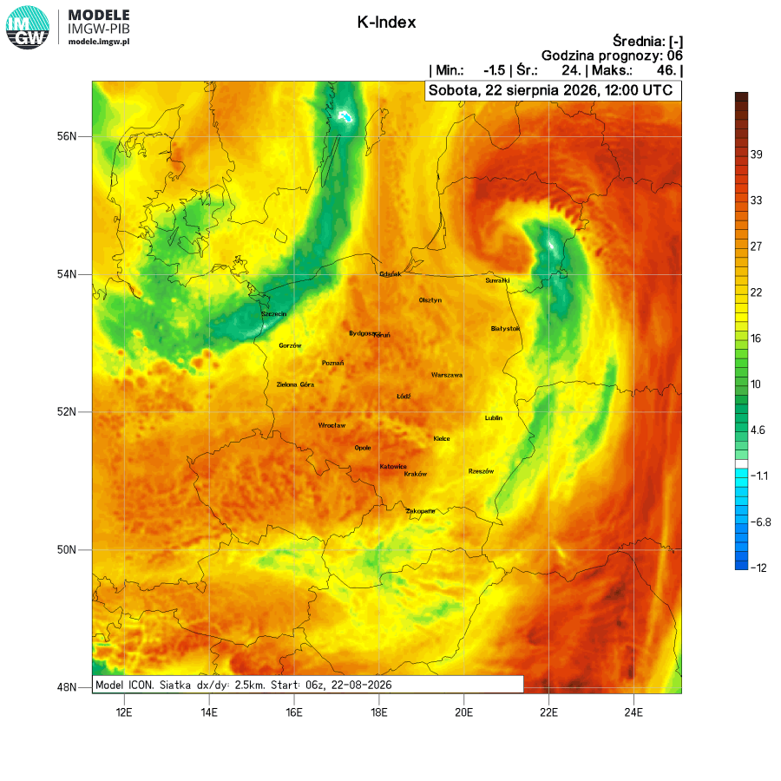
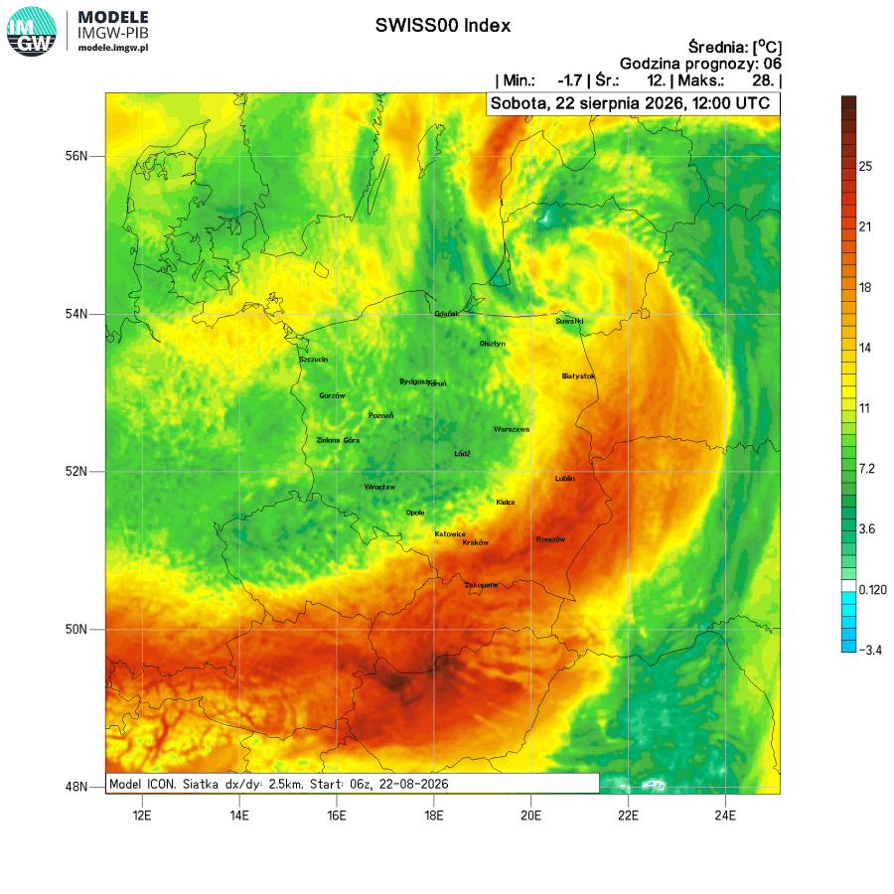
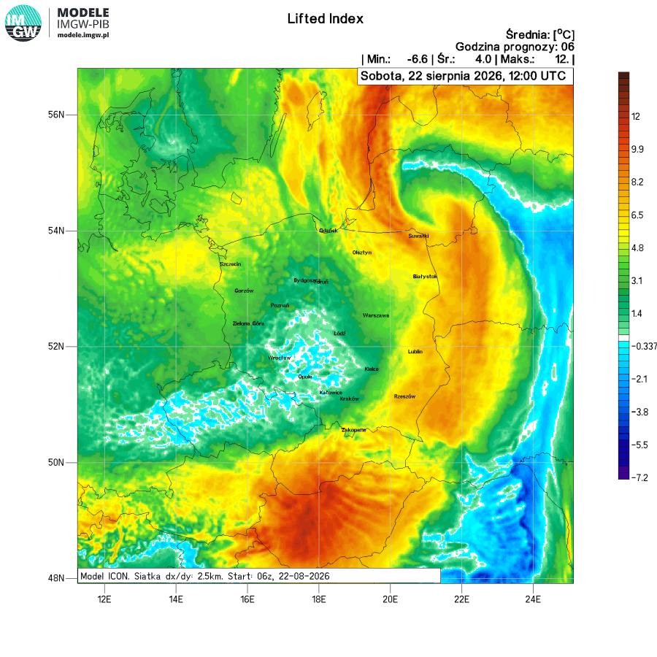
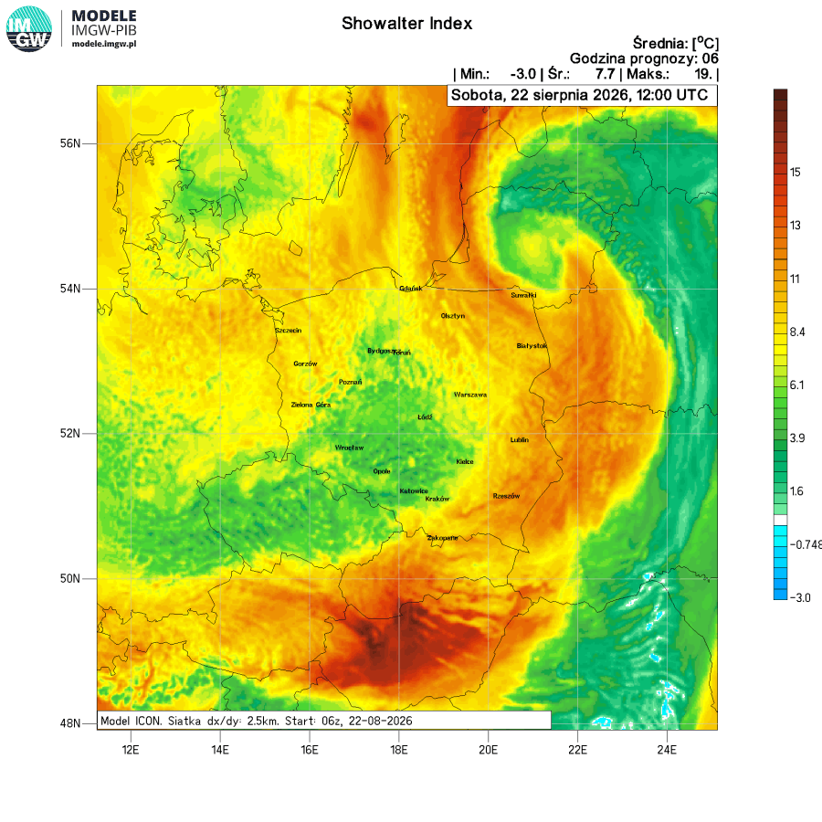
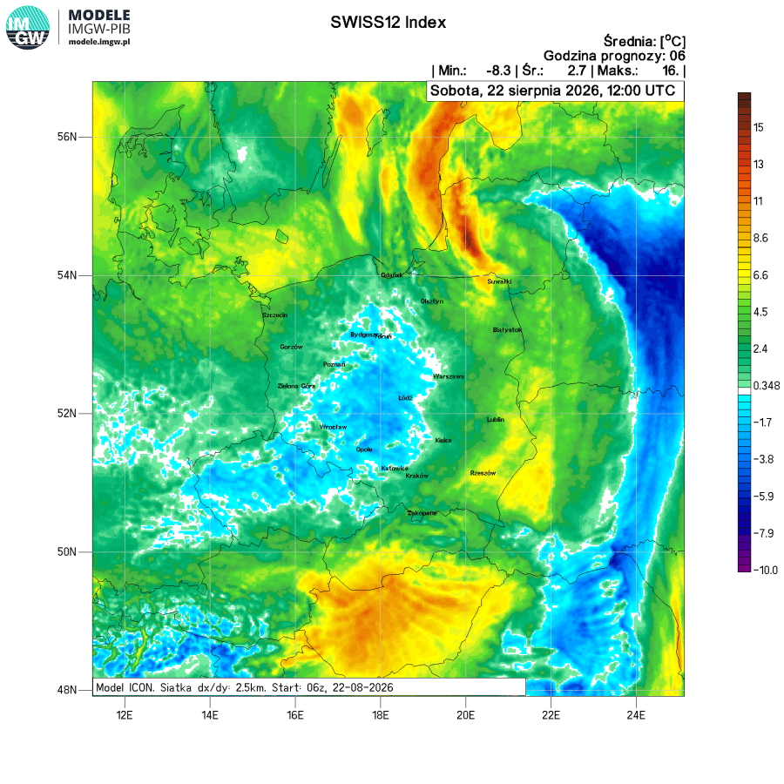
Analiza konwekcyjna
Co potrzeba i wystarcza – produkty
ICON 2.5 km

Slide 16
What’s needed and what’s sufficient – products
Finally, the local-scale description of meteorological conditions relevant to glider users.
As mentioned, all local information about convective conditions, CAPE/DCAPE, is crucial for glider pilots, allowing for the estimation of updraft/downdraft speeds, and vertical profile/wind evolution in time.
The calculation of standard convective indices (TT, K-index, SI, LI, etc.) and other quantities derived from the model, used to determine the probability of storm phenomena, remains in effect.
Further work is underway to transfer the calculations to increasingly higher-resolution model results.
In the near future, this will be applied to the ICON 1.0 km model.

Slide 17

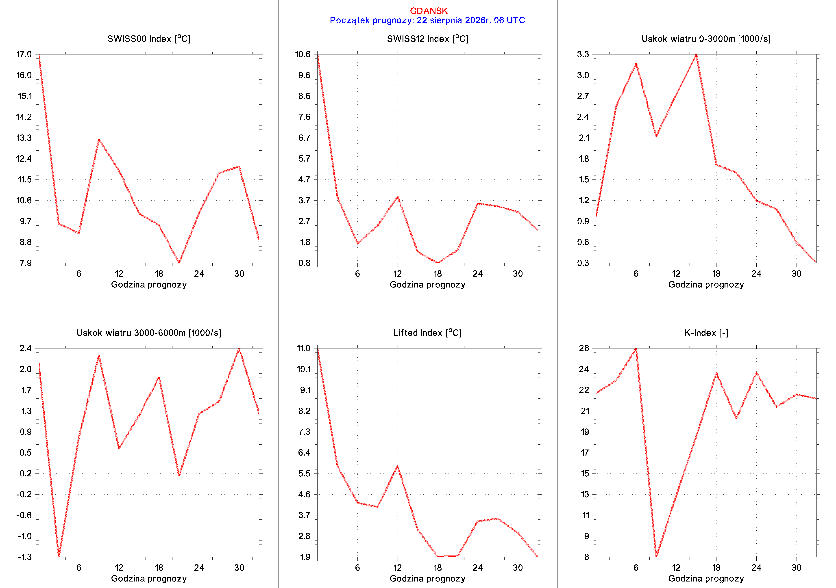
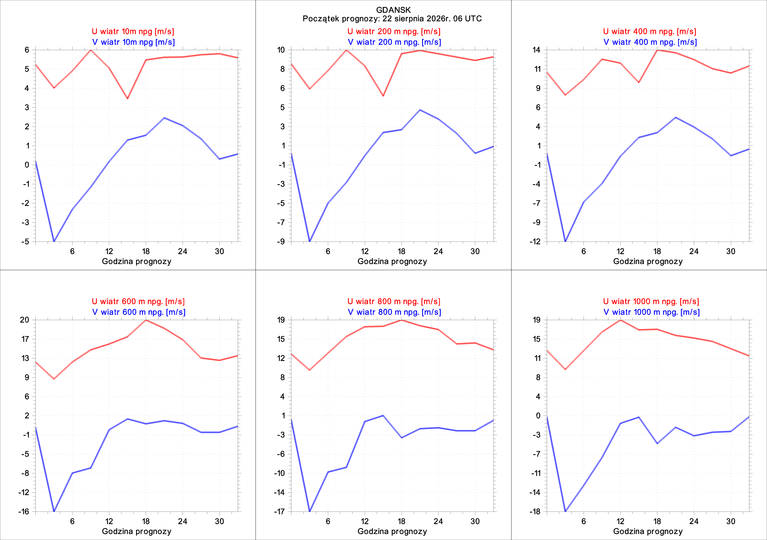
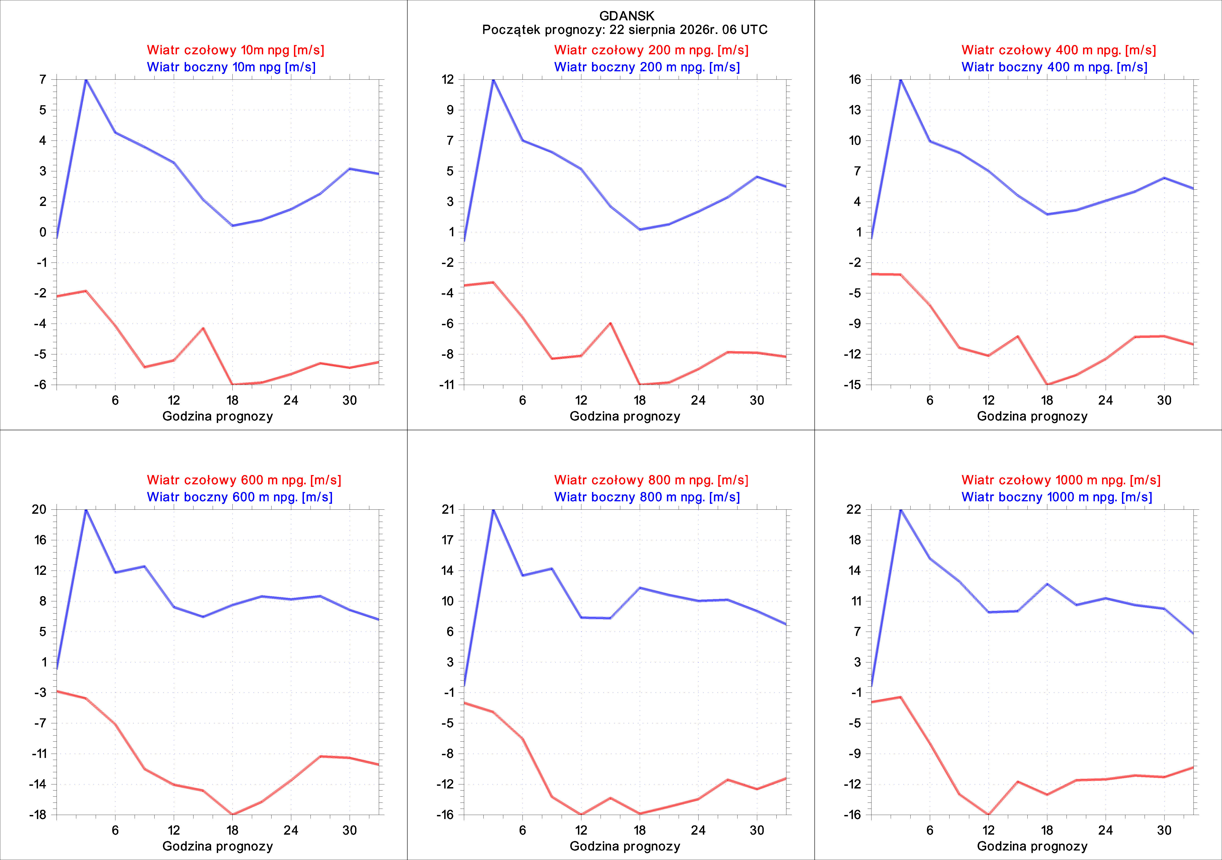
Meteograms of selected convective indices
Meteorological conditions in a local scale
Meteograms of wind components at selected altitudes in N-S/W-E direction
Meteograms of wind components rotated to the runway axis at selected altitudes
COSMO 7.0 km
Gdańsk

Slide 18
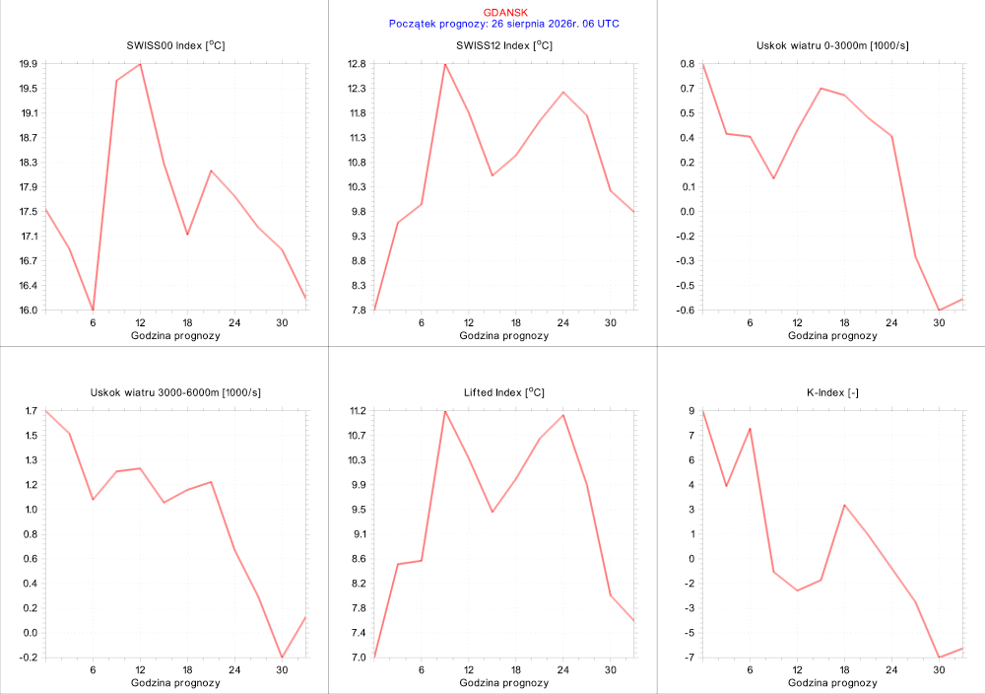
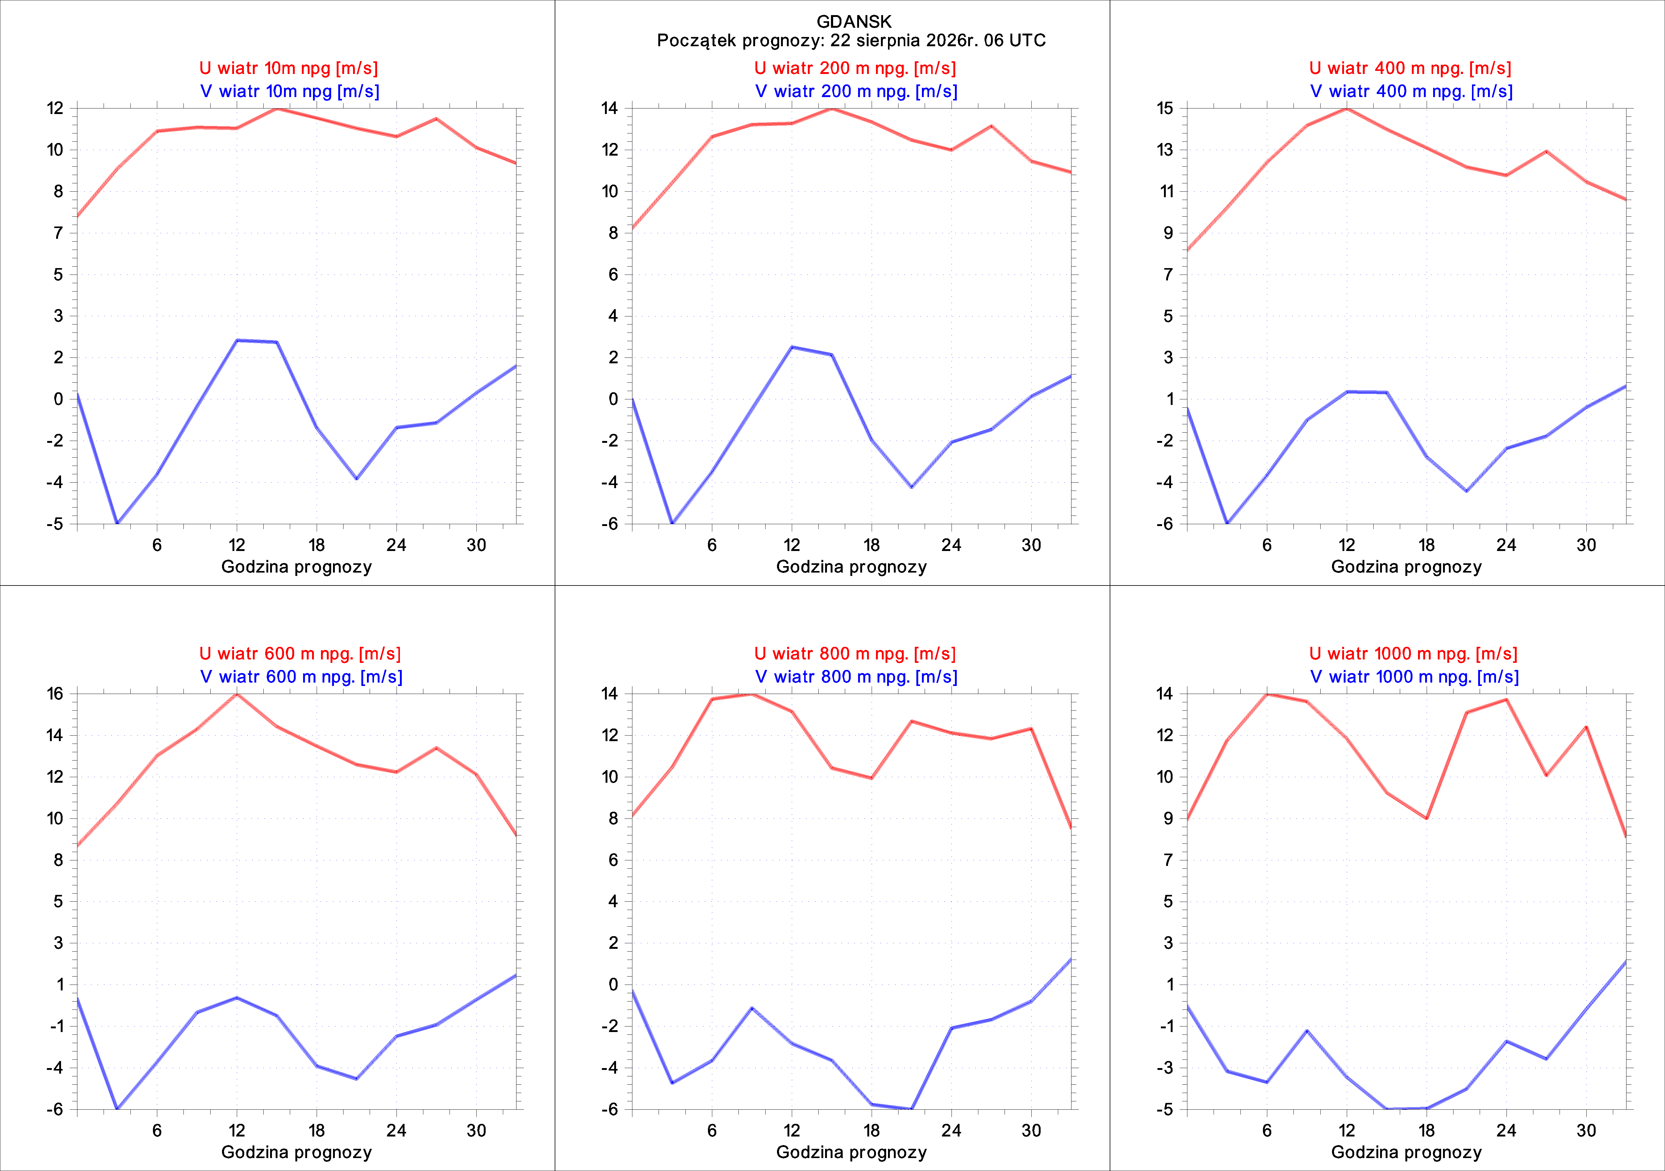
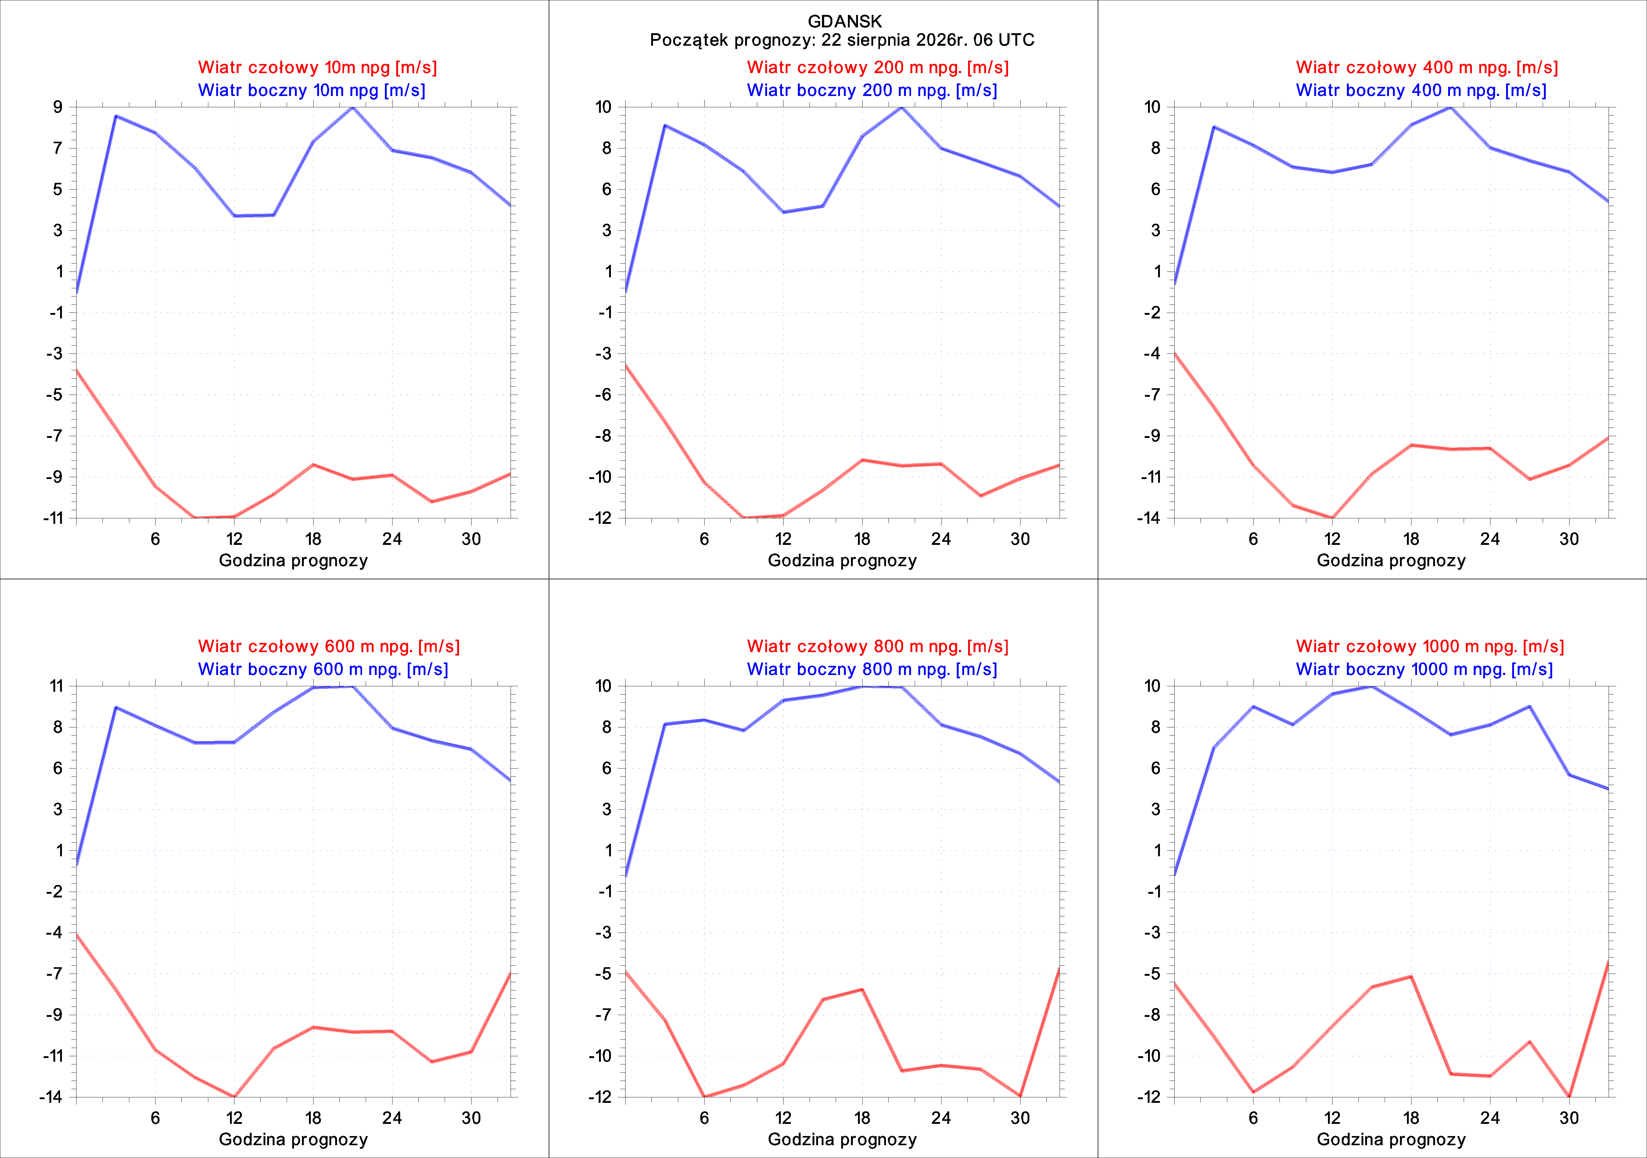
Meteograms of selected convective indices
Meteorological conditions in a local scale
Meteograms of wind components at selected altitudes in N-S/W-E direction
Meteograms of wind components rotated to the runway axis at selected altitudes
COSMO 2.8km
Gdańsk

Slide 19
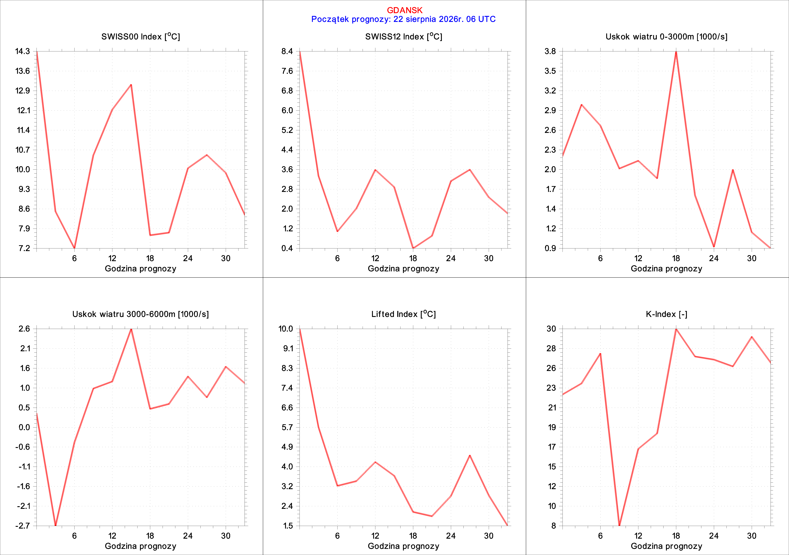
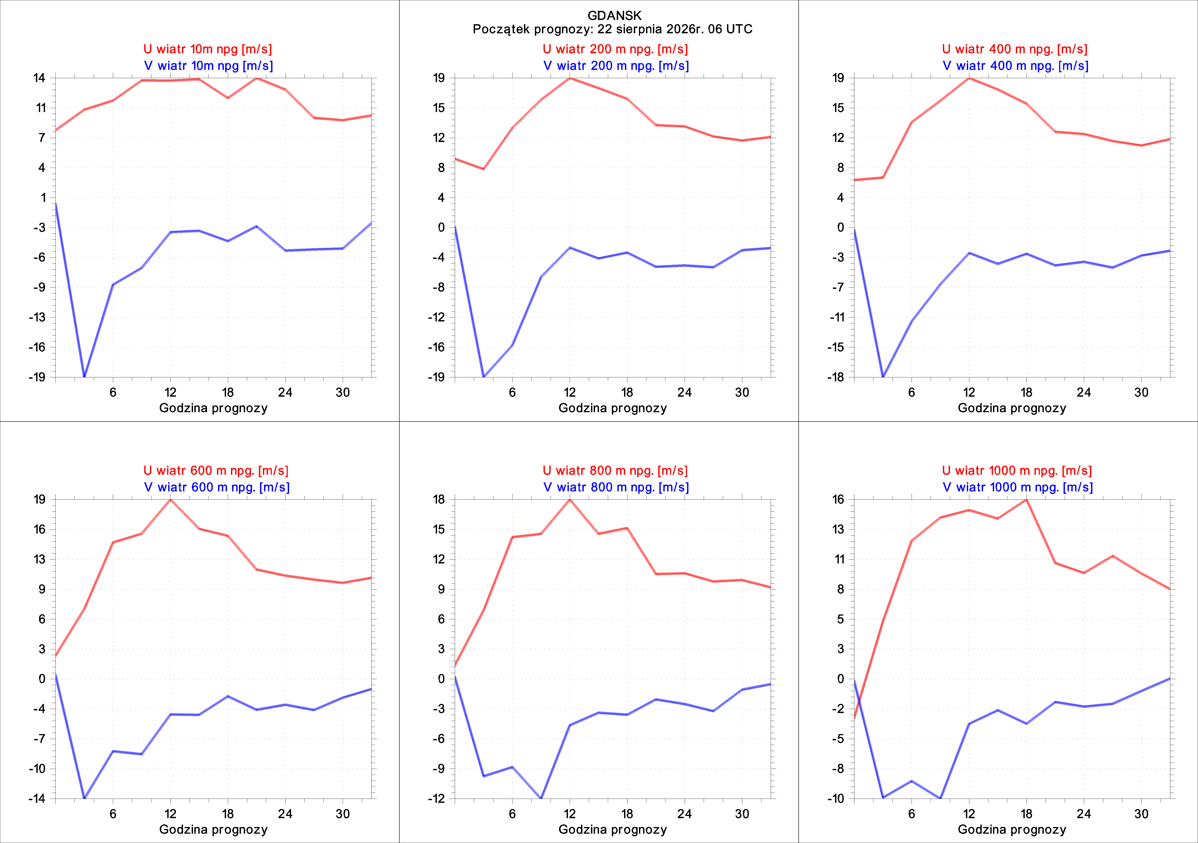
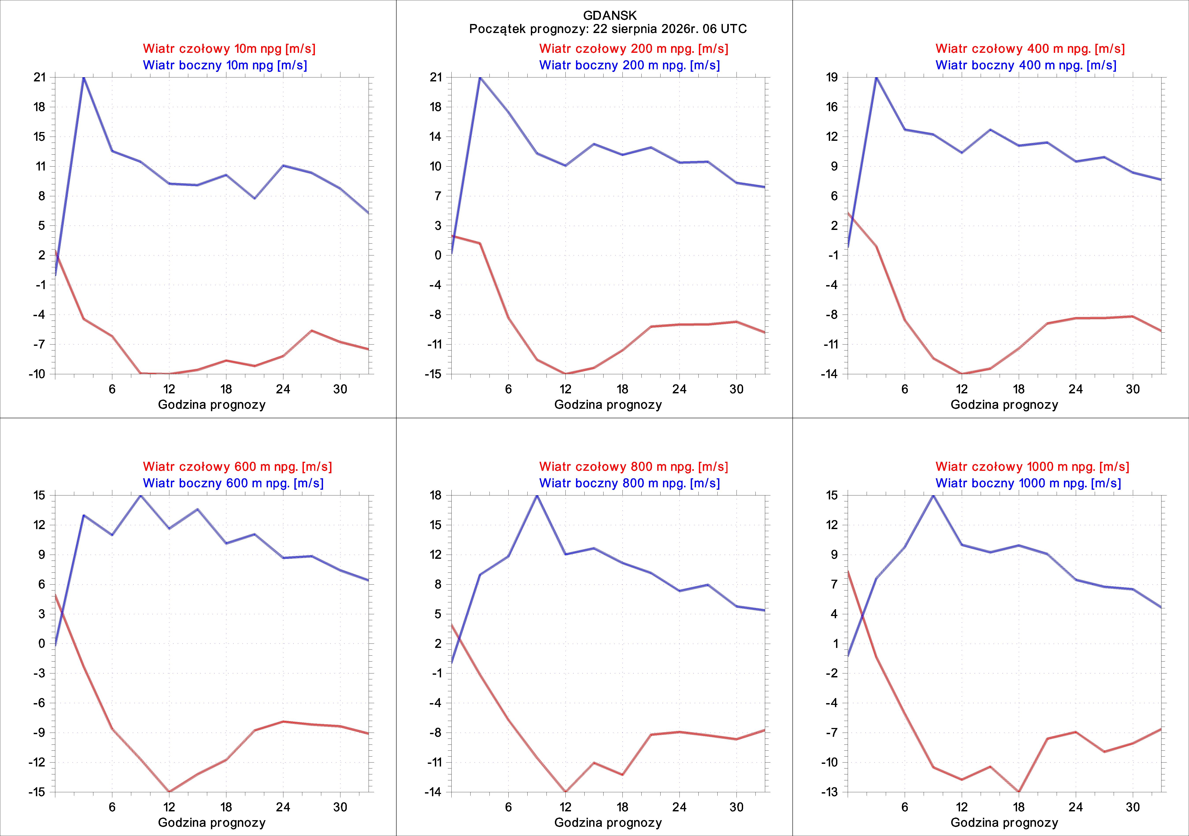
Meteograms of selected convective indices
Meteorological conditions in a local scale
Meteograms of wind components at selected altitudes in N-S/W-E direction
Meteograms of wind components rotated to the runway axis at selected altitudes
ICON 2.5 km
Gdańsk

Slide 20
Summary
Support for unpowered aircraft users should operate from a regional scale (national, at low spatial resolutions) to a local scale (at resolutions of the order of a kilometer). Therefore, work is underway to transfer the schemas to the ICON domain at a resolution of 1 km.
The vertical scale of the aforementioned issues reaches several kilometers above sea level. High accuracy (horizontal resolution) is more important than extension above the lower troposphere.
Forecasts of air movement, the occurrence of convective phenomena, as well as favorable and unfavorable conditions for "general" aviation are crucial.
We can obtain all of this from our numerical models – indirectly (through post-processing) or directly from the model results.
Thank you for your attention

