Slide 1
Verification of Operational EPS (TLE/TLE-MV) implementations
in IMGW-PIB
Andrzej Mazur, Artur Surowiecki, Tatiana Tabalchuk
LMM ZPN-COSMO IMGW-PIB

Slide 2
Contents
Concept and implementation of (TLE) ensembles, methods of description, and examples of results
Post-processing and verification – variants and alternatives
Summary

Slide 3
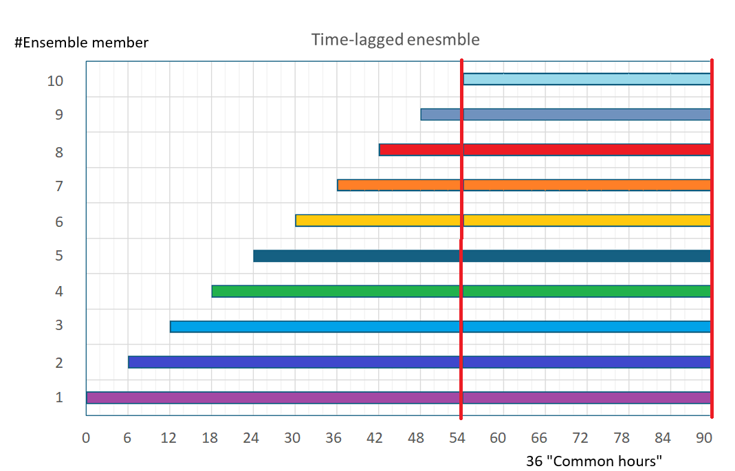
Concept and implementation
To reduce computational cost, we omit the MVE part and stick with TLE and the number of elements (to 10).
Let's choose appropriate "base" models (deterministic, but with a sufficiently long forecasting period; 90 hours).
All we have to do – remember the previous forecasts... and here comes an ensemble.
The only yet crucial question is whether such EPS is correctly defined/valuable from a forecasting perspective...
youngest
oldest
VERIFIED: This time delay scheme does generate the desired forecast spread.

Slide 4
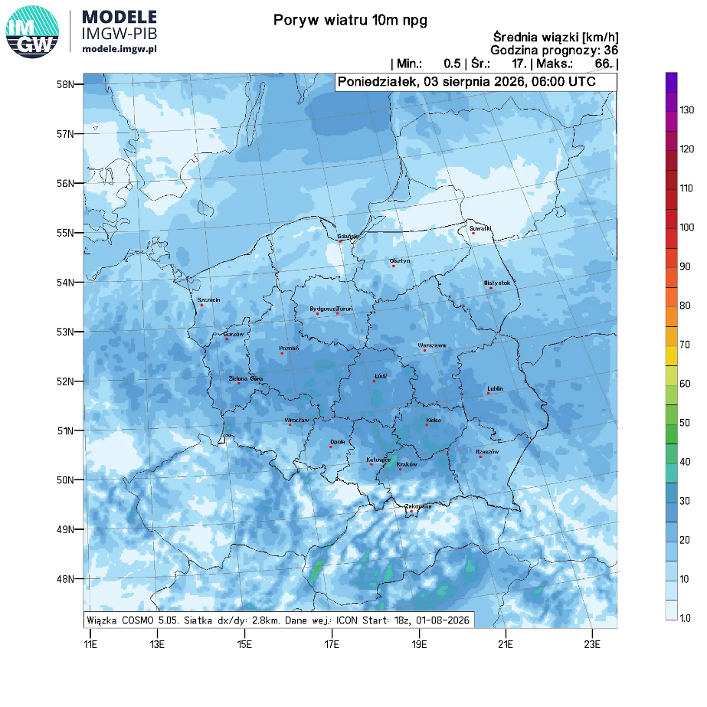
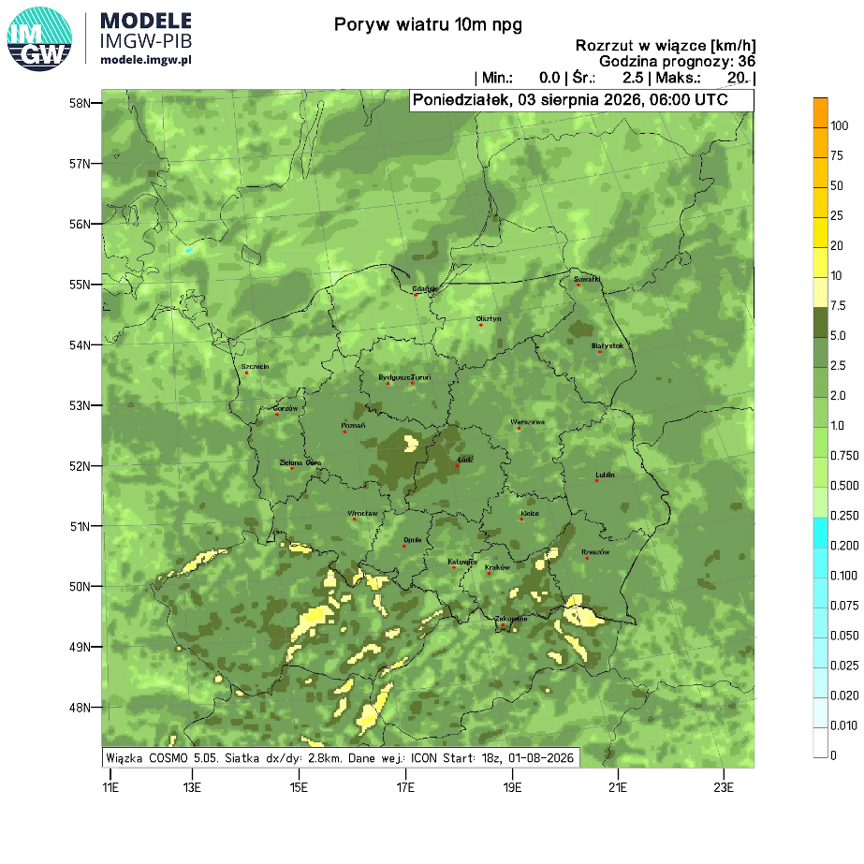
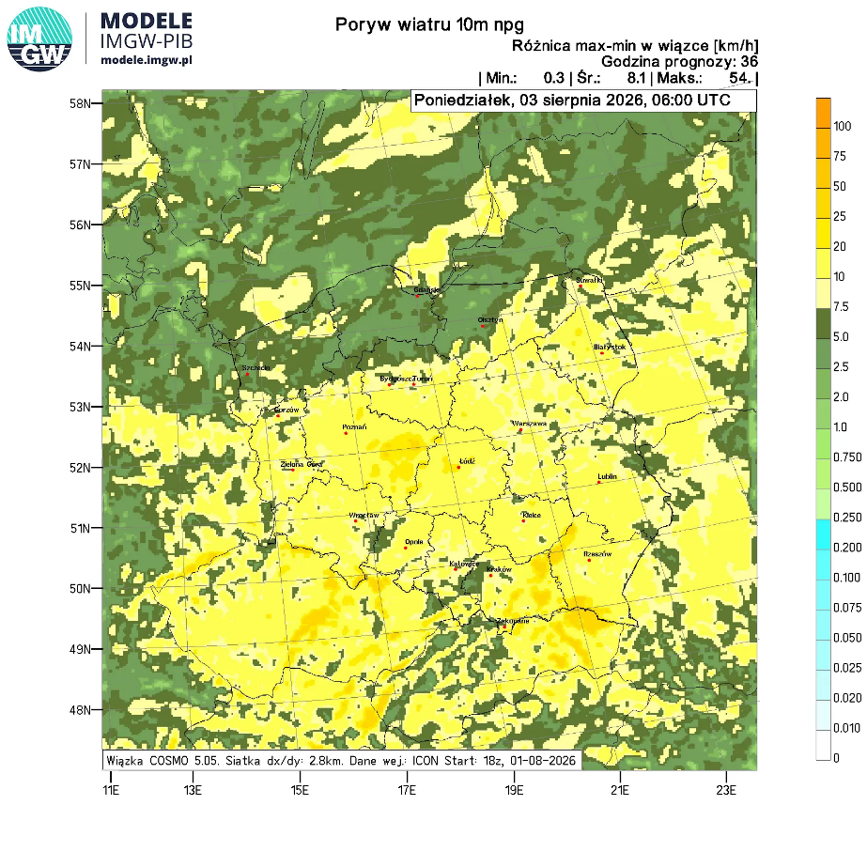
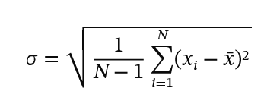
Methods of description/verification of EPS results
Maps: mean values, spread, max-min difference, skill
Reminder:
mean means ensemble mean,
spread – standard deviation of forecasts from the mean EPS value,
skill – bias, |obs.-fcst.|; for EPS – |obs. – mean fcst.| - key value in terms of verification

Slide 5
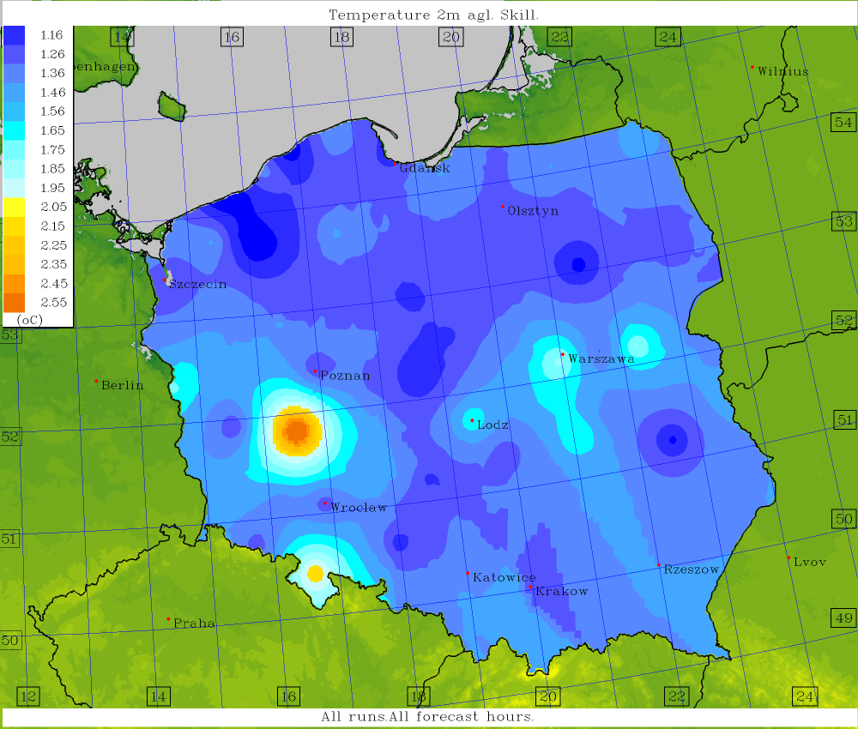
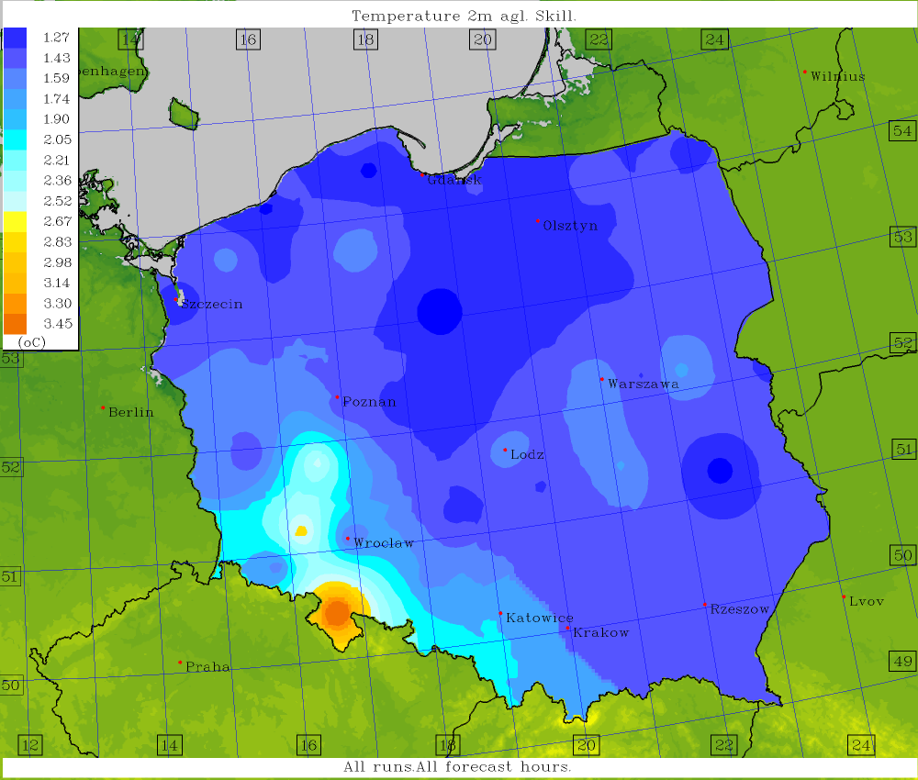
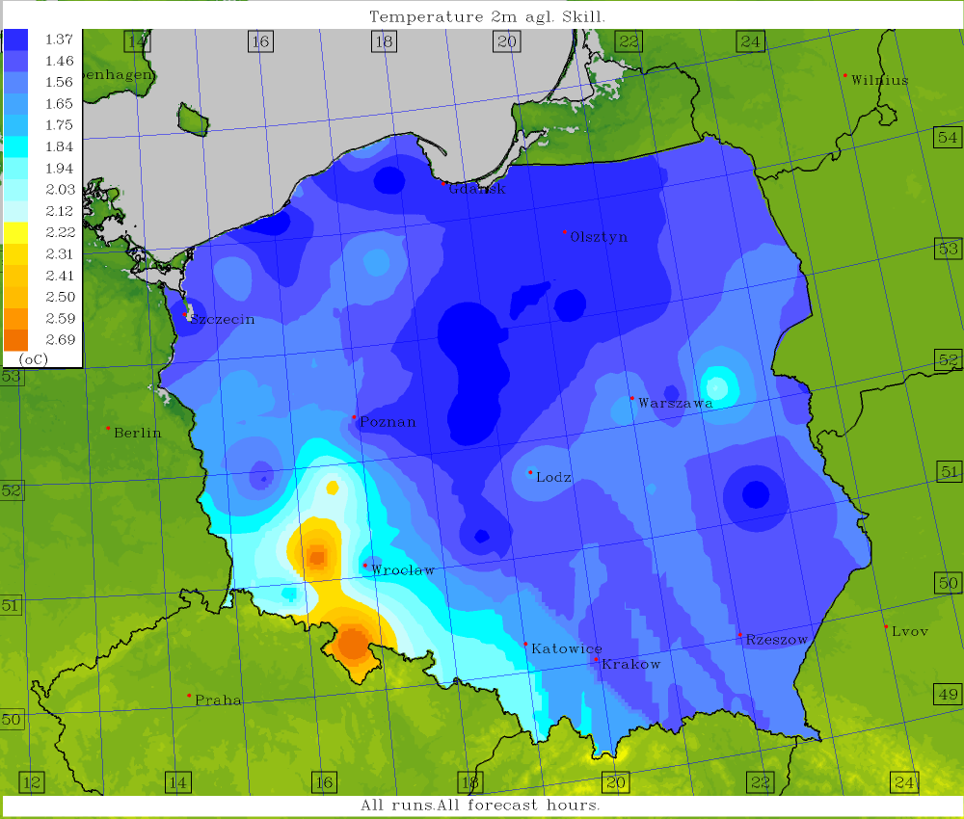
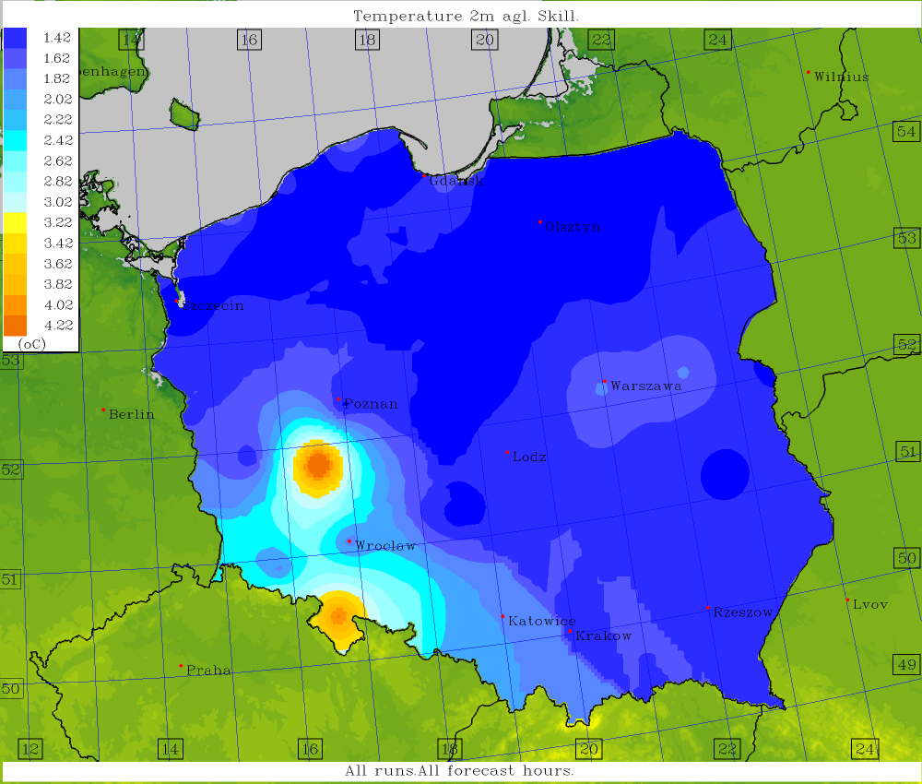
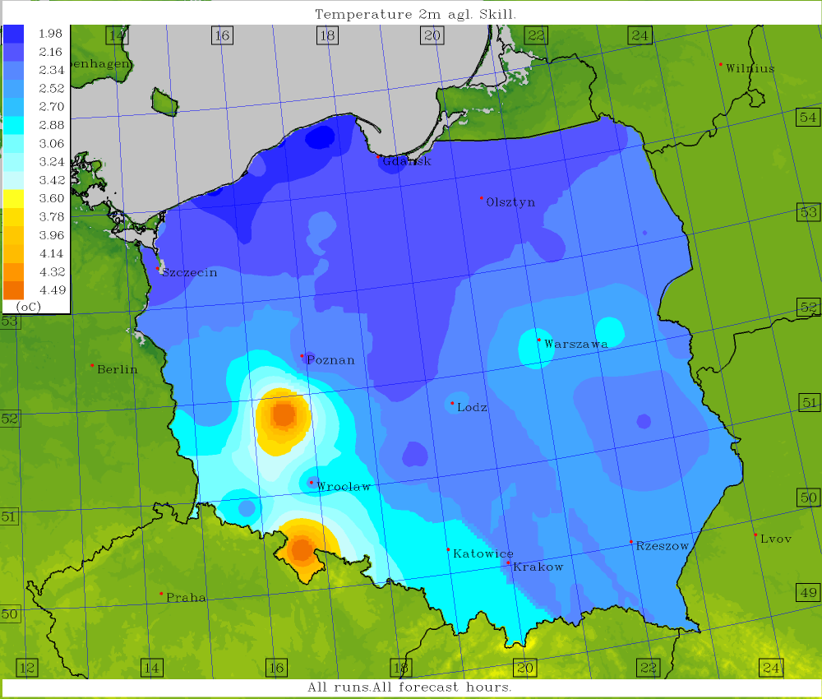
T2M ICON 2.5
T2M COSMO 2.8
T2M COSMO 7.0
Ensemble skill; COSMO 2.8 – TLE-MVE, others – TLE.
T2M GFS
T2M ICON-EU

Slide 6
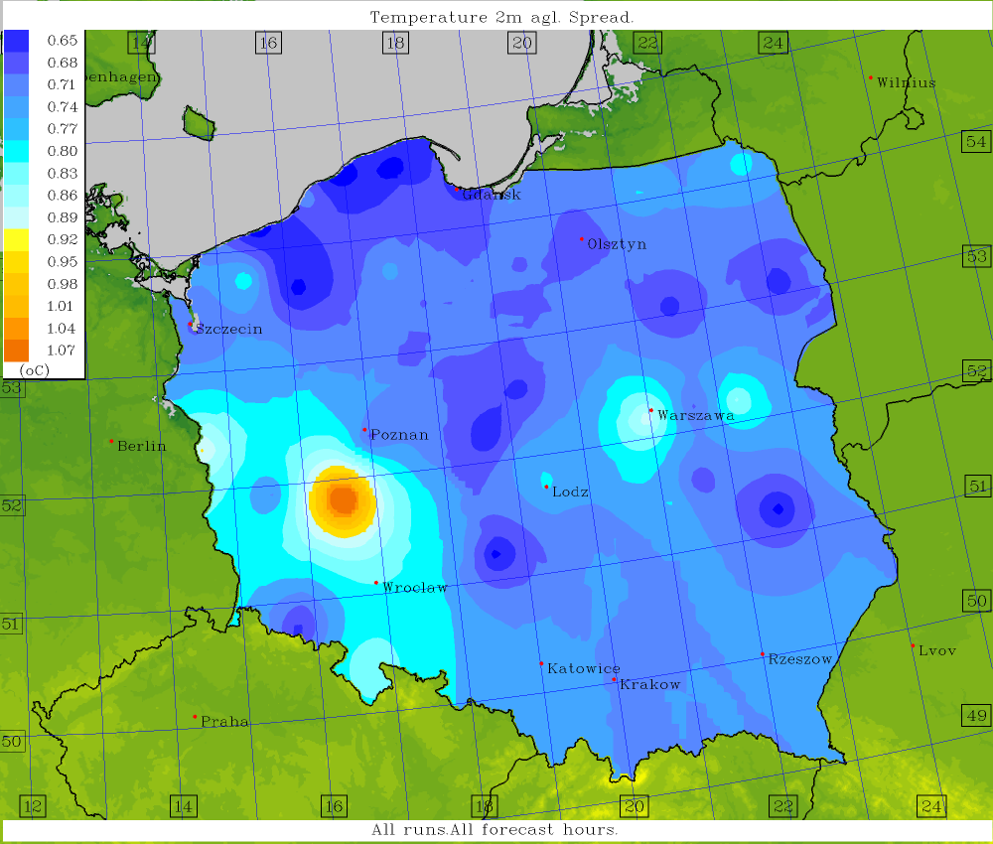
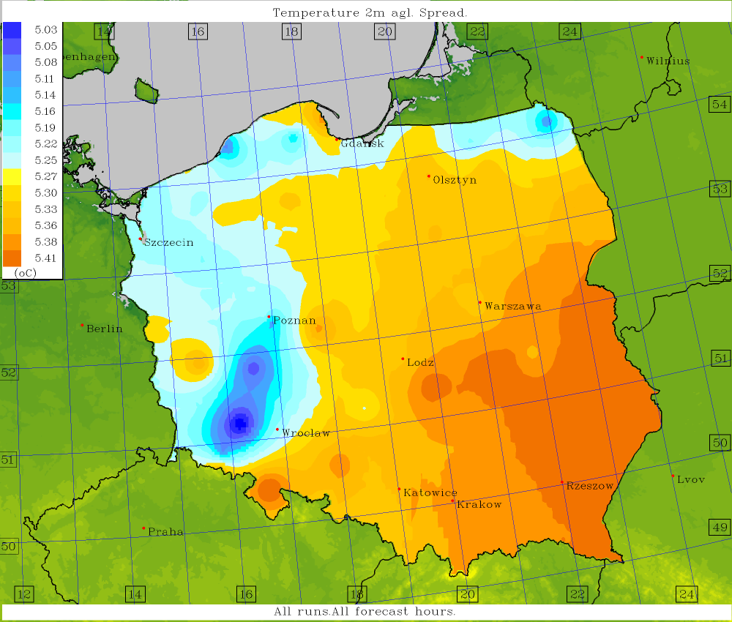
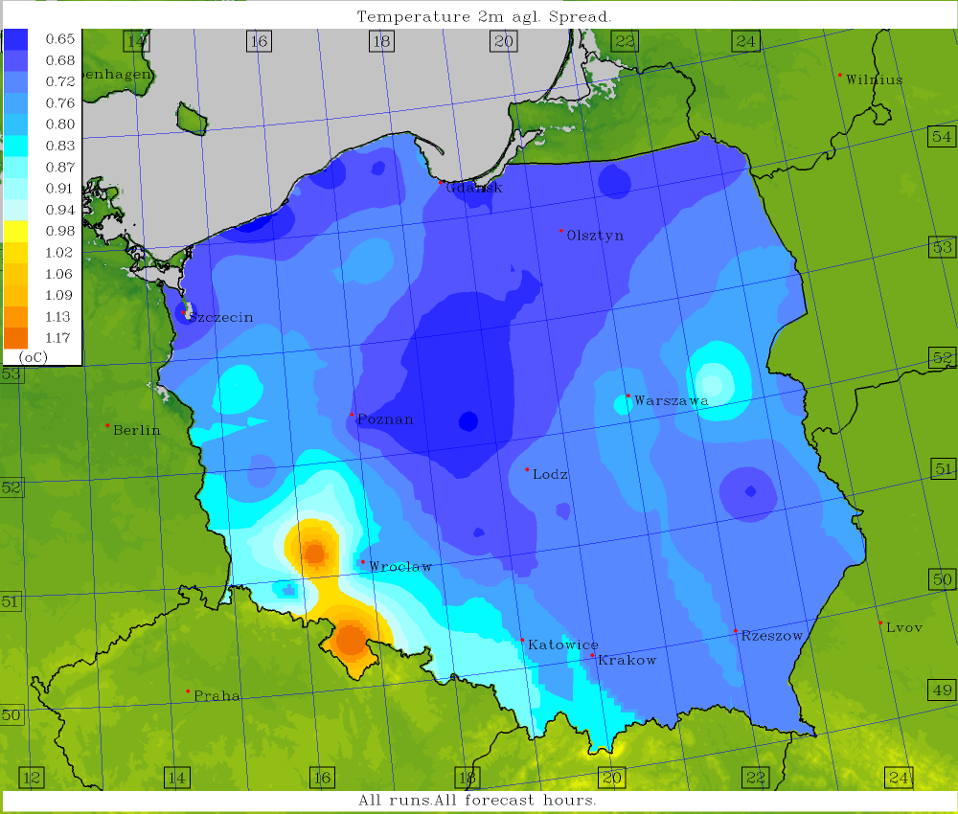
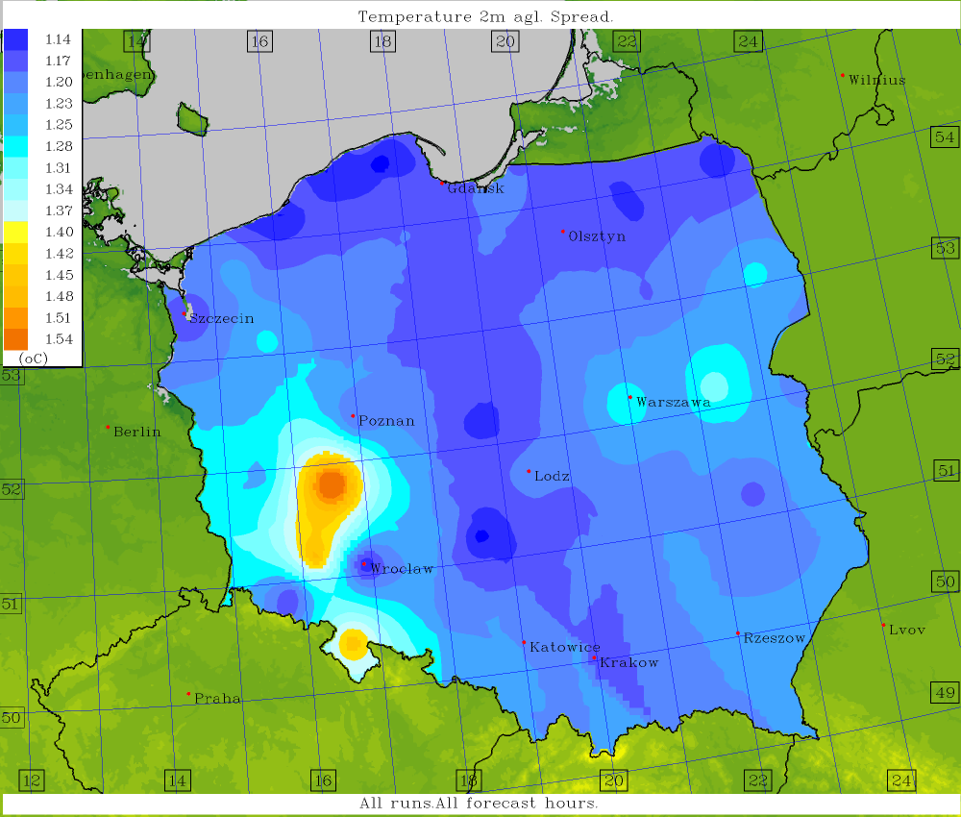
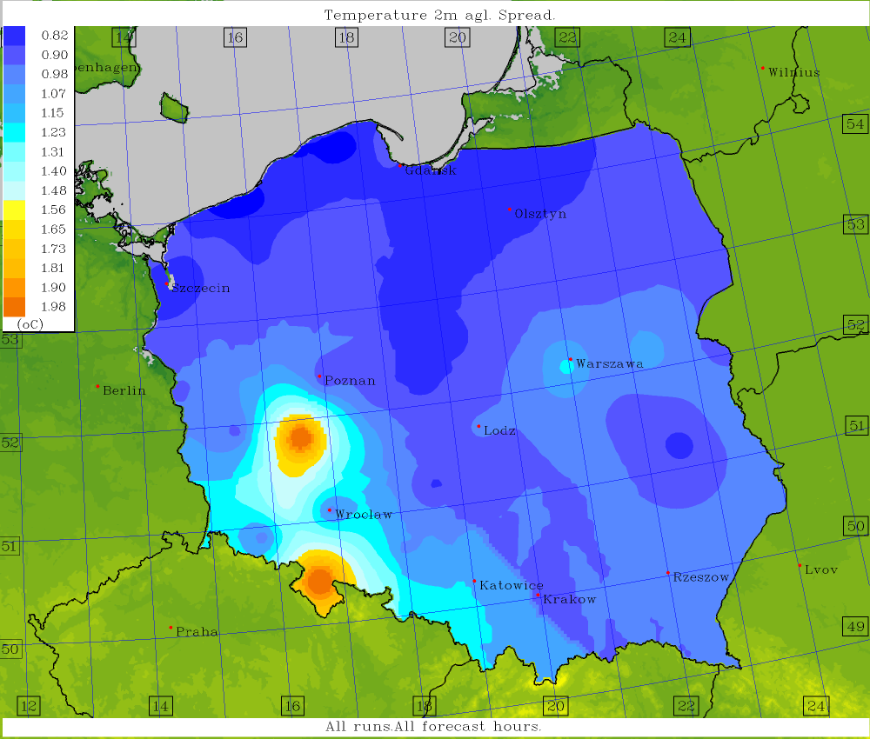
T2M ICON 2.5
T2M COSMO 2.8
T2M COSMO 7.0
Ensemble spread; COSMO 2.8 – TLE-MVE, others – TLE.
T2M GFS
T2M ICON-EU

Slide 7
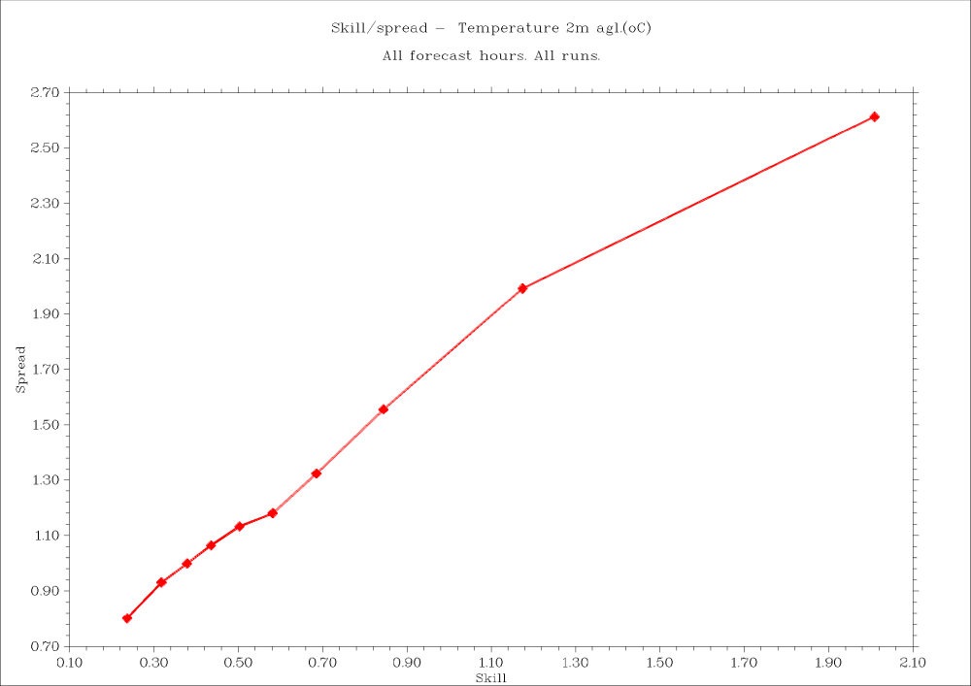
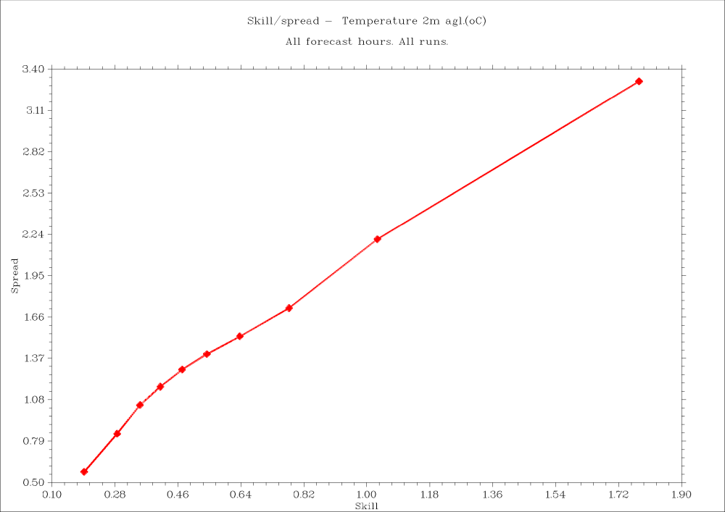
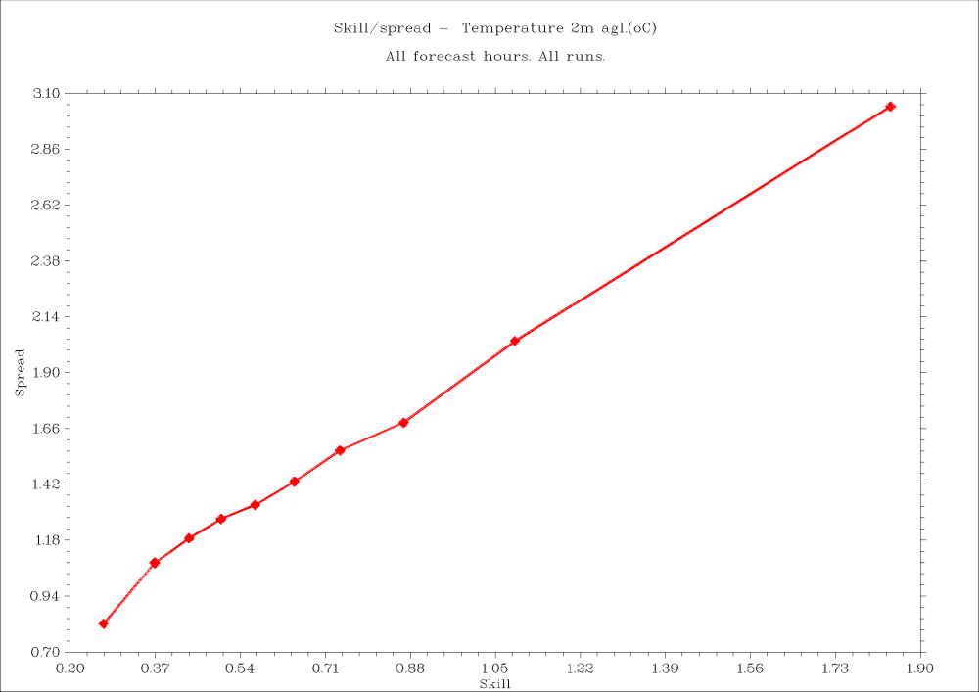
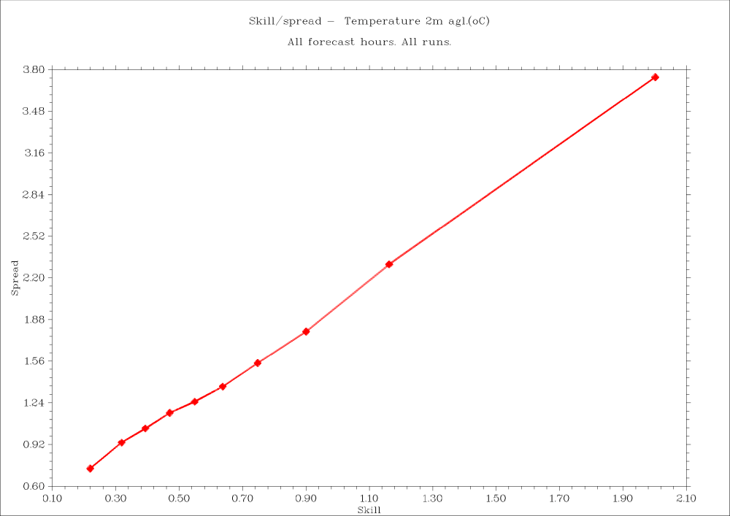
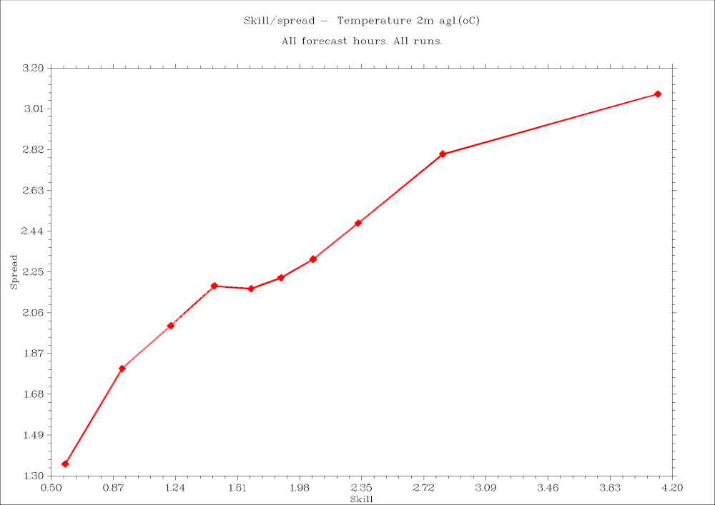
The Spread-Skill chart determines what fraction of the spread value a given skill has (or vice versa). Ideally, it should be a straight line, with the x-axis and y-axis being equal in length.
T2M ICON 2.5
T2M COSMO 2.8
T2M COSMO 7.0
T2M GFS
T2M ICON-EU
Spread-Skill charts; COSMO 2.8 – TLE-MVE, others – TLE.

Slide 8
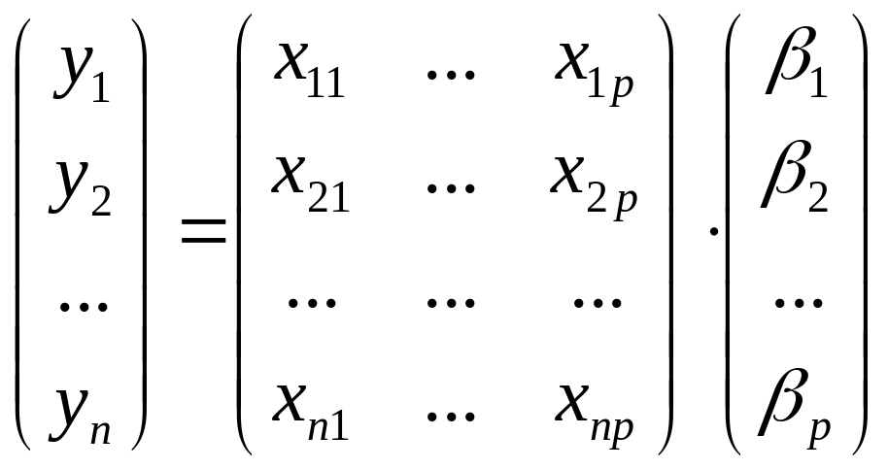
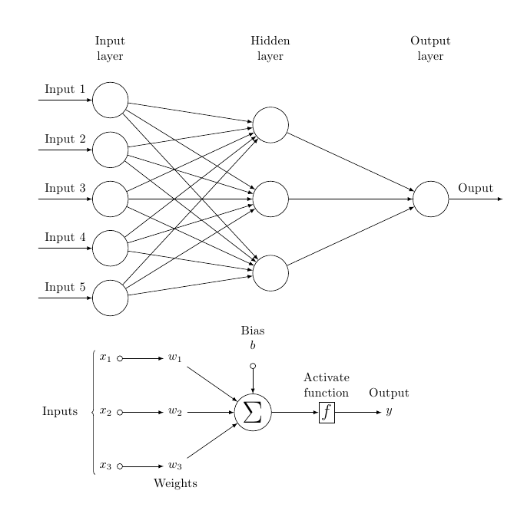
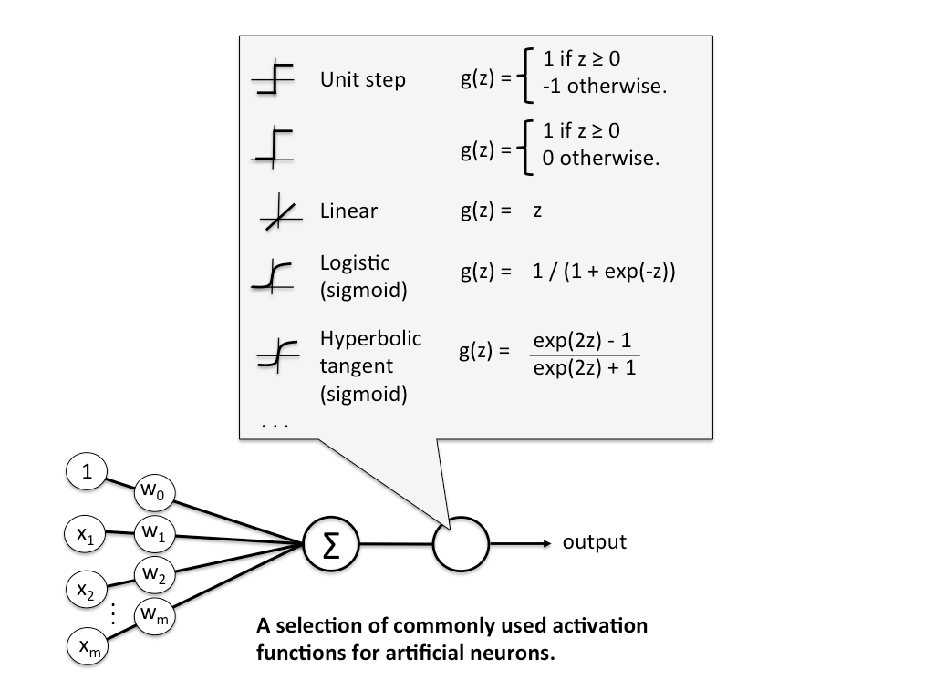
Post-processing and verification – variants and alternatives
Weighted ensemble mean (linear regression)
y – corrected (calibrated) forecasts – new ensemble means
X – matrix of Direct Model Output and parameters,
β – weights – computed with linear regression
x_{ij} = x, [λ,φ,h]
x – T2M, U10M, TD2M, PS
λ,φ – geographical coordinates, h – orography
ANN – an alternative for linear regression
Setup:
23/22/20 neurons in an input layer – h + λ,φ + 20 members (for TLE 13/12/10, respectively)
5 neurons in a single hidden layer
Each element is treated independently (T2m, U10M, PSfc…).
Activation function – hyperbolic tangent.
Training – back-prop method.
Optymalization using gradient descent method.
8

Slide 9
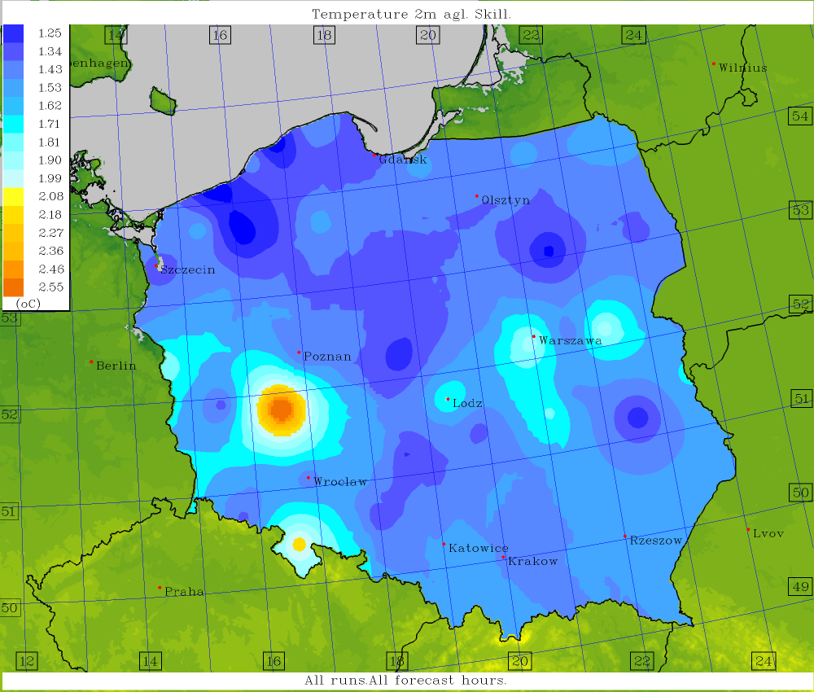
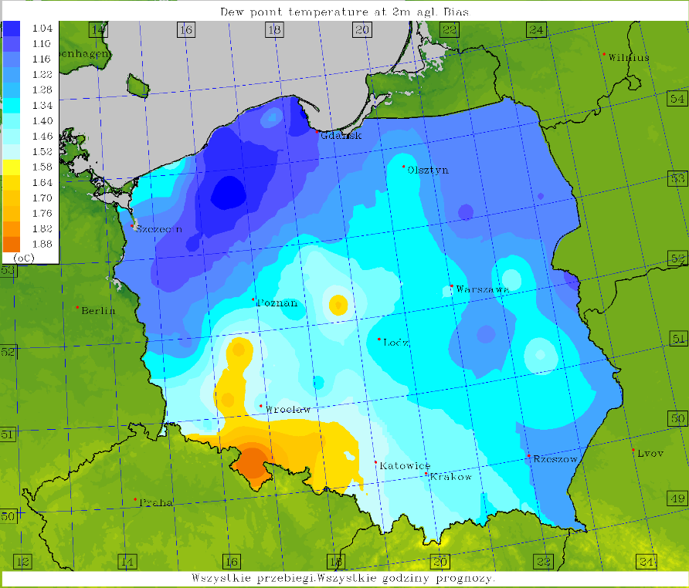
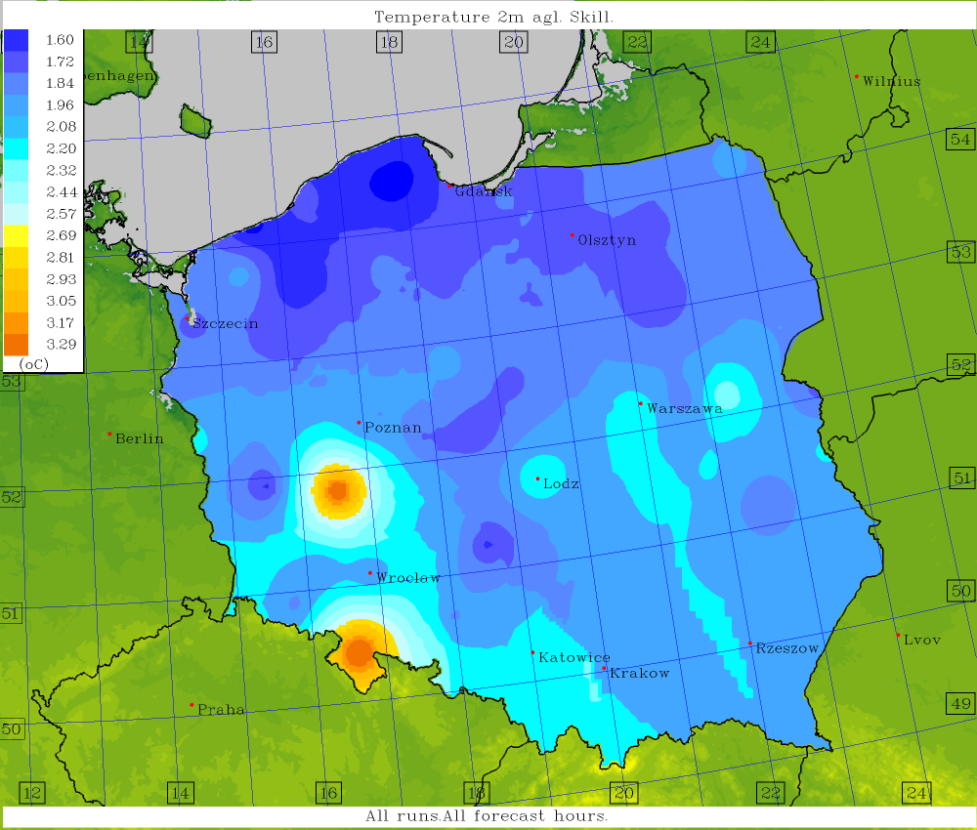
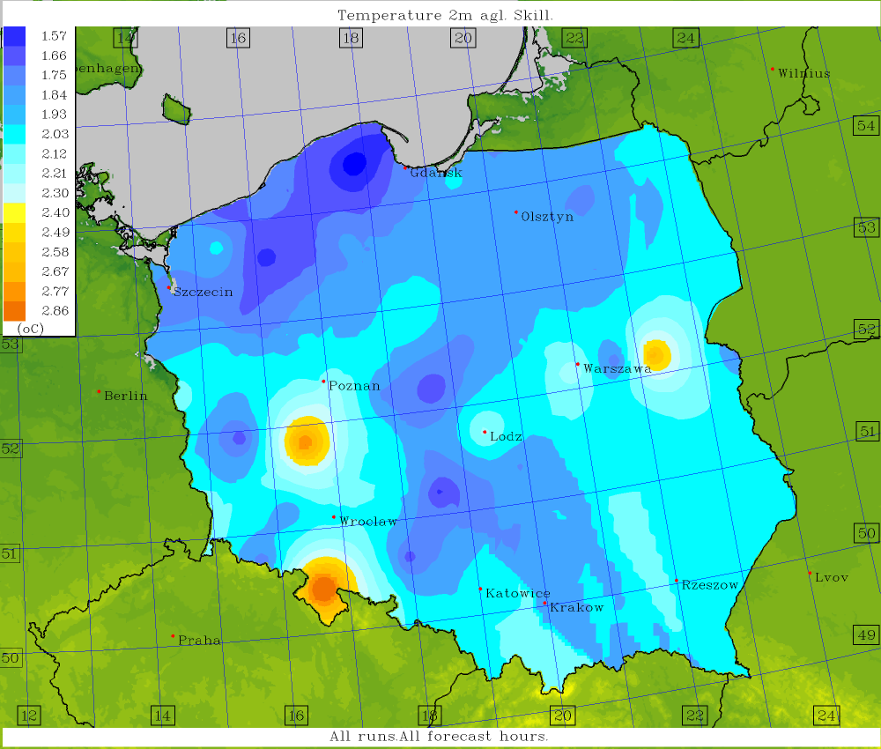
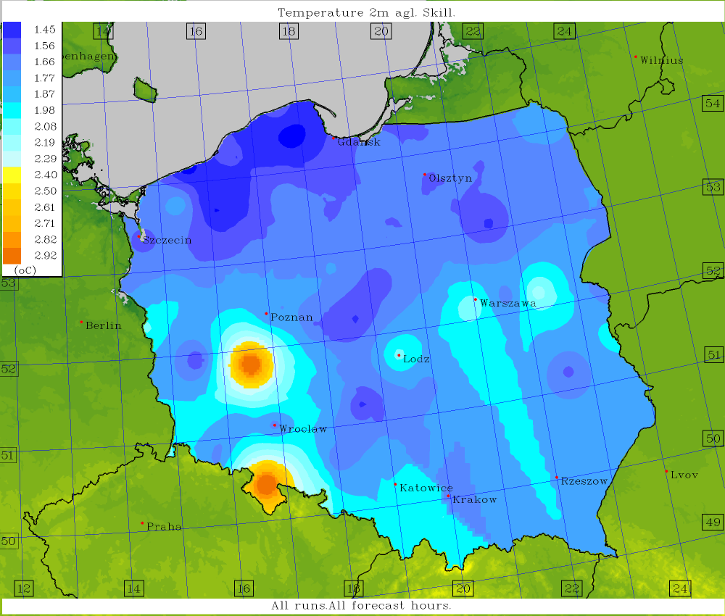
Skills vs. ensemble means, results of postprocessing; T2M, ICON 2.5km
Standard mean Weighted mean Standard regression
Weighted mean (regression+geo.coords) Weighted mean (regression+orography) ANN-based mean

Slide 10
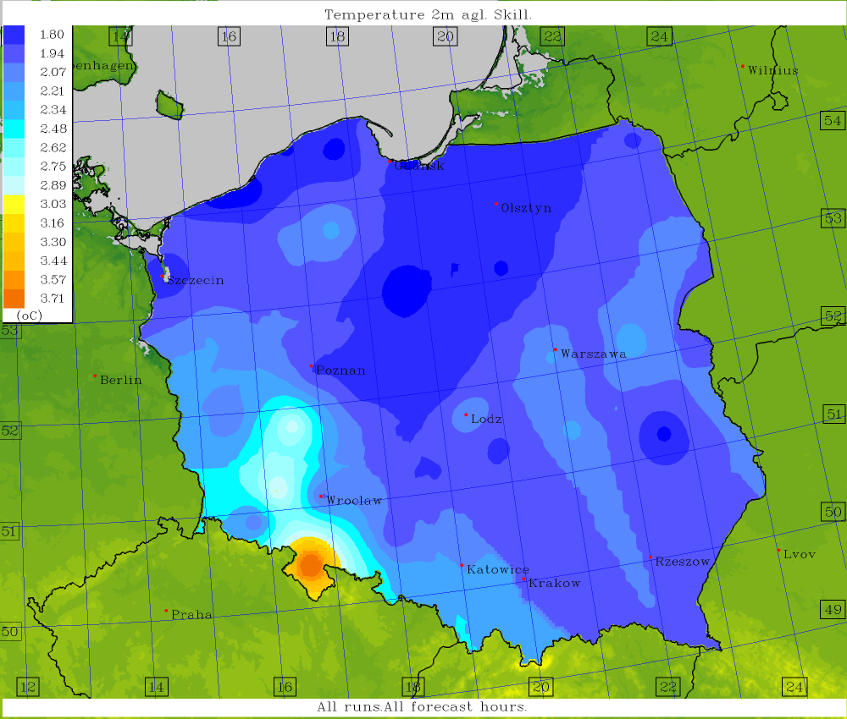
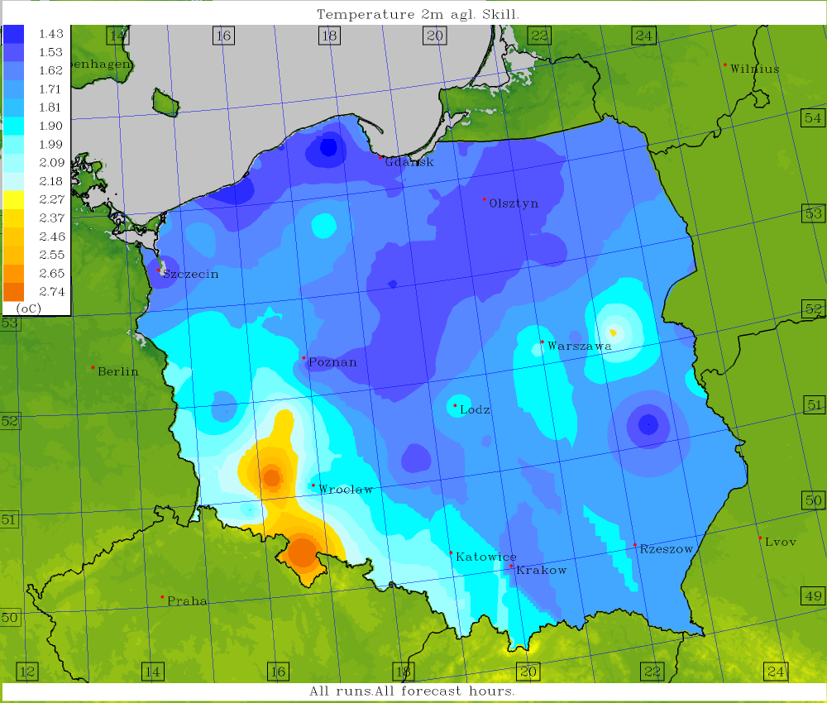
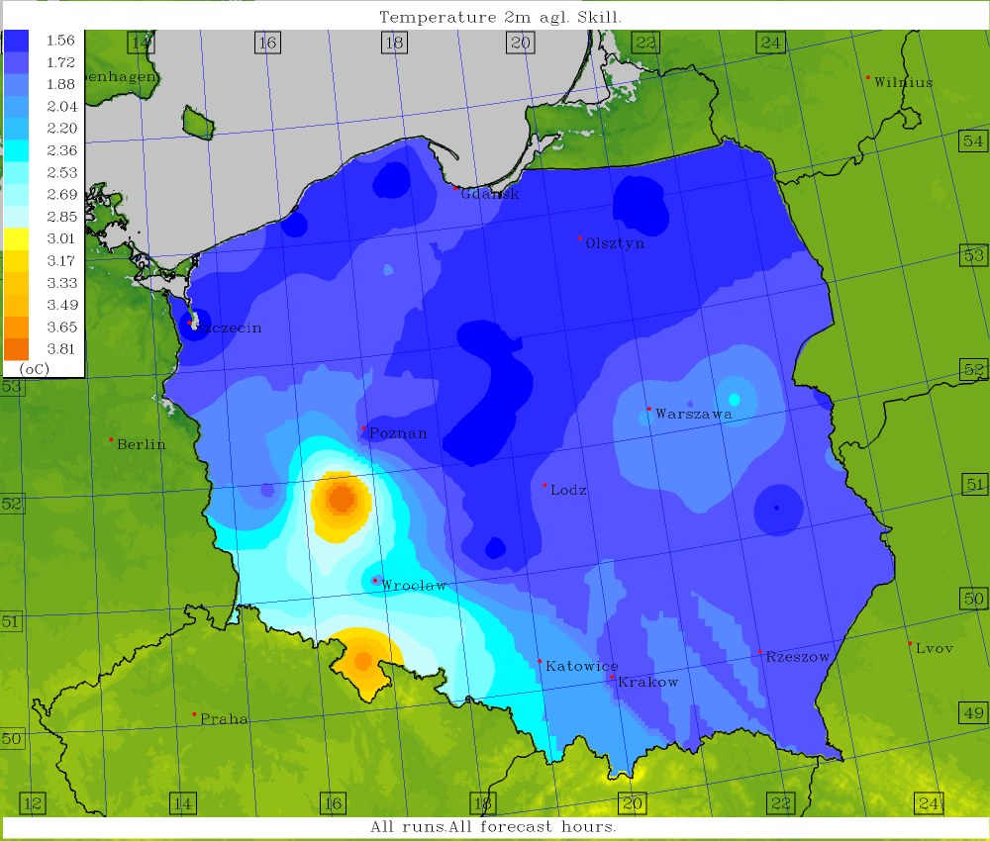
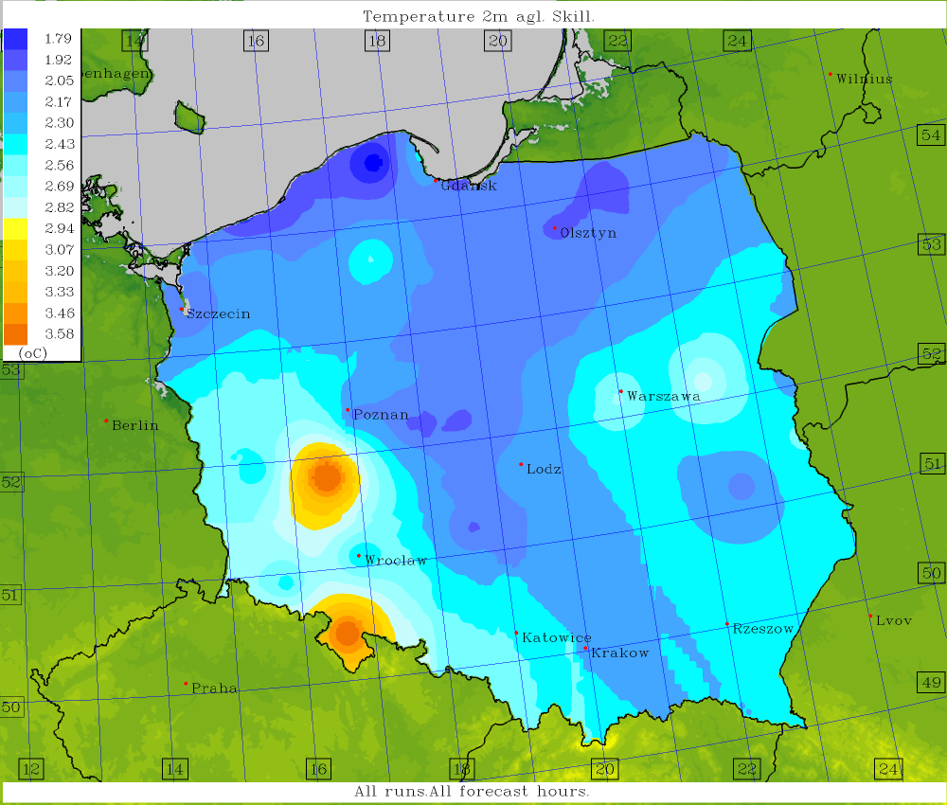
T2M ICON 2.5
T2M COSMO 2.8
T2M COSMO 7.0
Skills vs. ANN-based ensemble means; COSMO 2.8 – TLE-MVE, others – TLE.
T2M GFS
T2M ICON-EU

Slide 11
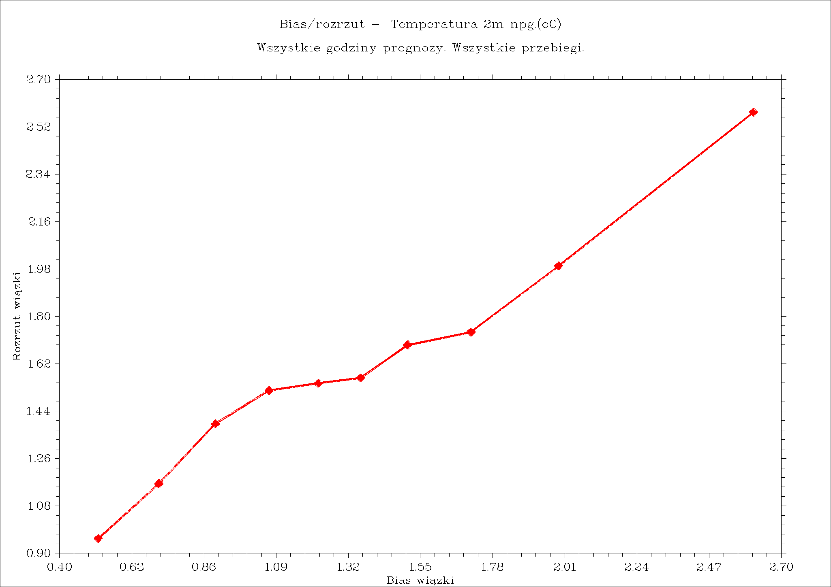
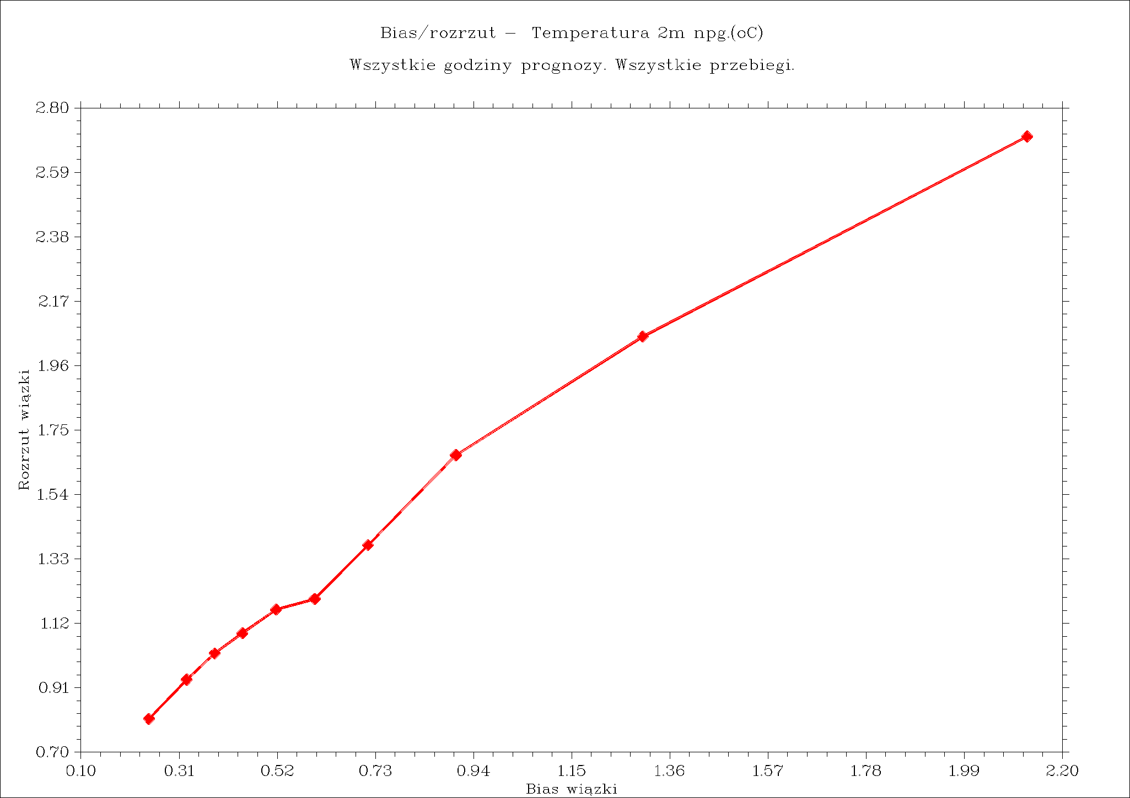
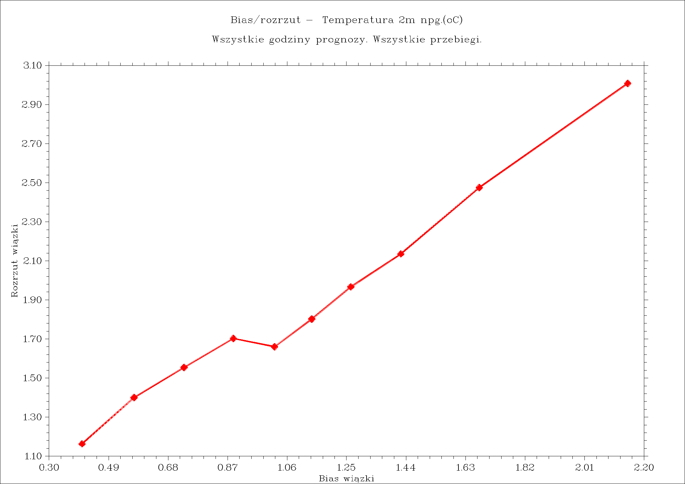

Standard mean
Weighted mean
T2M ICON 2.5
Standard regression mean
ANN-based mean

Slide 12
Summary
It is a truism that the closer the ensemble average comes to the observed values, the closer we are to reality.
The most complex averaging techniques are not always the most accurate, but ANN appears to be a step in the right direction.
Training on historical measured values ​​and testing/validating/verifying against current ones – that is how the setup should be configured.
Thank yor for your attention
#StandWithUkraine

