Slide 1


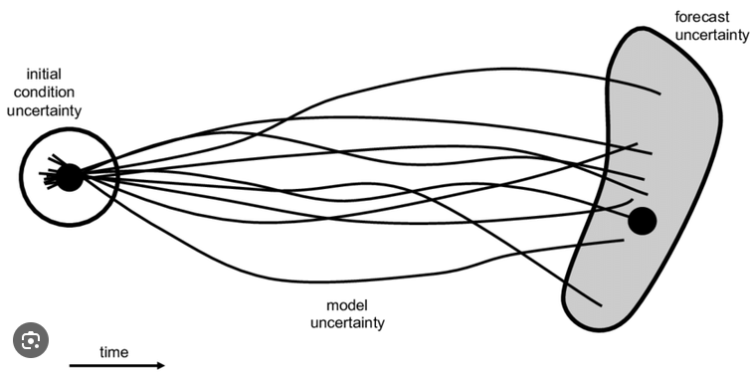
COSMO-LEPS Ensemble verification scores
SON25-MAM26
Dimitra Boucouvala

Slide 2
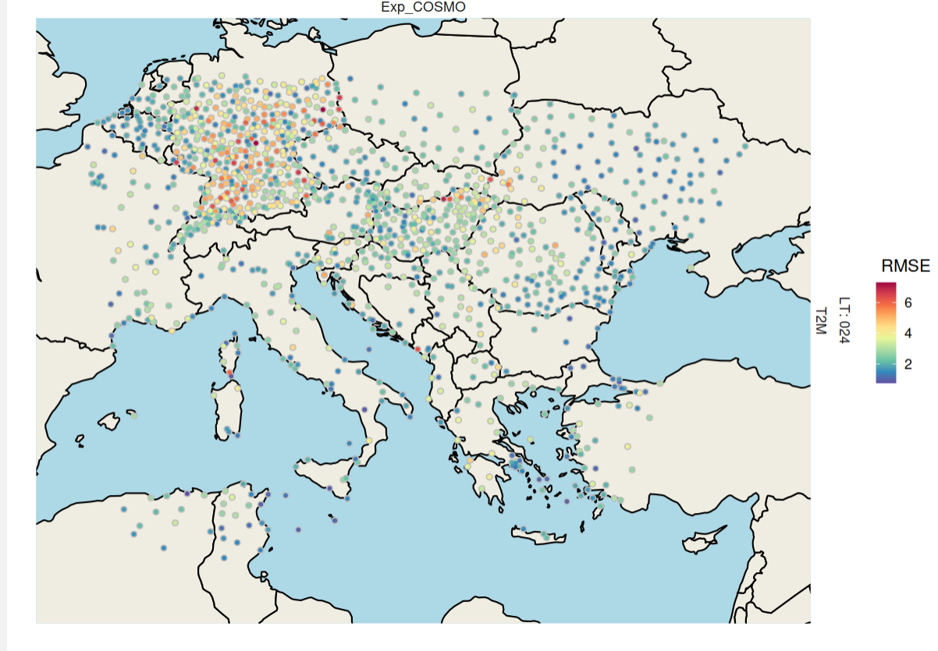
COSMO-LEPS ensemble verification (20 members) started in SON25 (7 km resolution) over European domain with MEC /FFV2 software (in ATOS machine)
Notes:
Cosmo leps verification is performed over this domain with 20 members and 7km resolution using MARS and FFV2 and it runs on atos machines

Slide 3
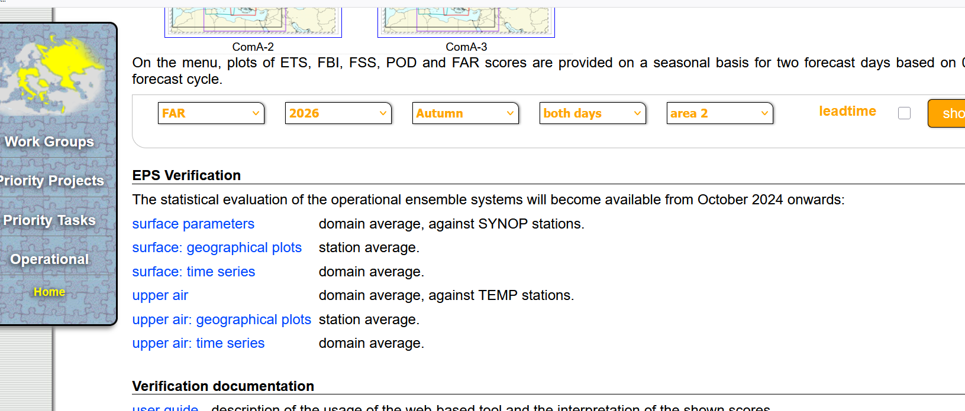
https://www.cosmo-model.org/content/tasks/verification/default.htm
Notes:
This is the website where you can view the scores by clicking on ‘surface parameters’ geographical plots or time series

Slide 4
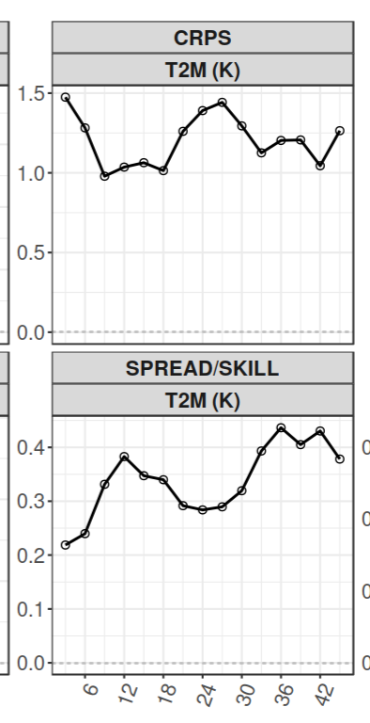
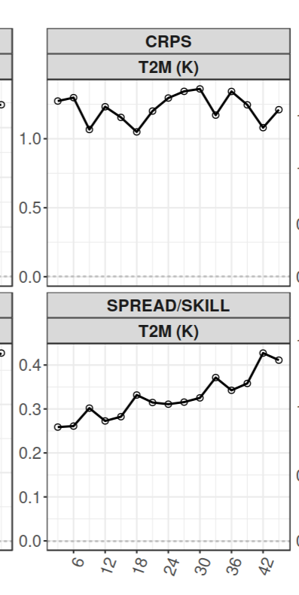
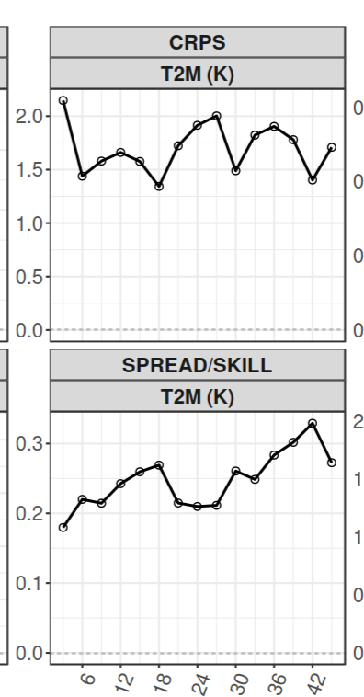
2m temperature
SON 25
DJF 26
MAM 26
Worse scores at night and MAM season
Notes:
CRPS (Continuous ranked probability score) and spread skill ratio for the 3 seasons. The CRPS is higher at night (EPS more difficult to predict minimum values ) and the same time it becomes underdispersive

Slide 5
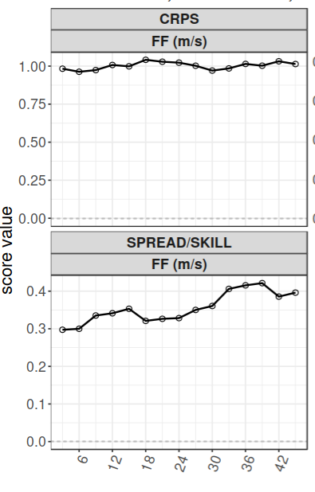
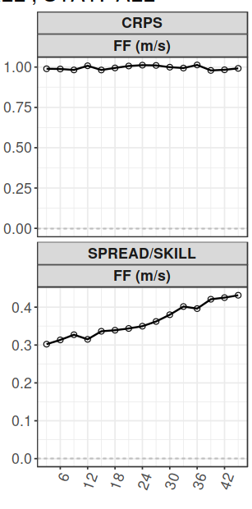
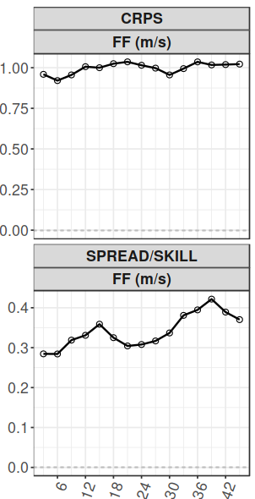
10m Wind Speed
SON 25
DJF 26
MAM 26
Similar error for all seasons
Notes:
The error is similar all 3 seasons . Diurnal difference only for spread/skill (worse values at night)

Slide 6
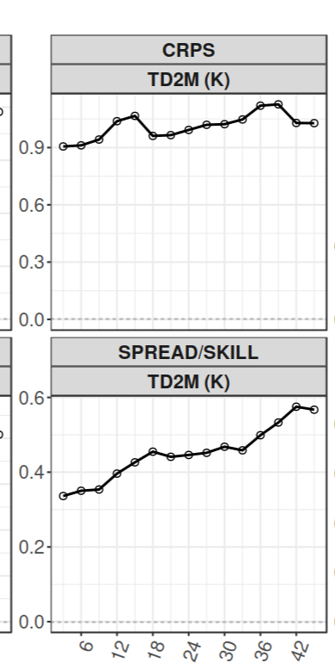
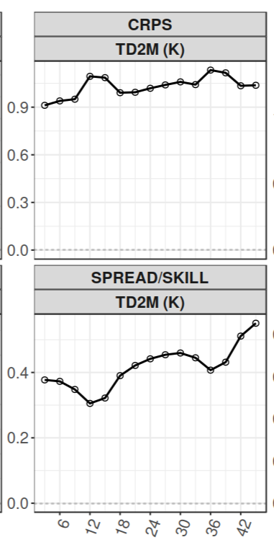
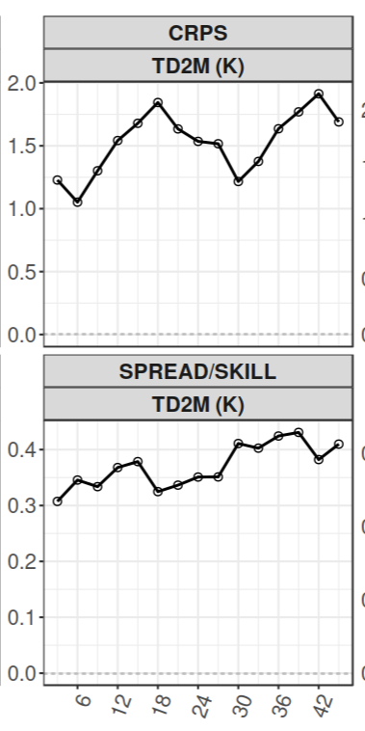
2m Dew point Temperature
SON 25
DJF 26
MAM 26
Worse scores in the day and MAM season
Notes:
In Td2m the errors are higher in the day as it is shown on CRPS and spread/skill graphs

Slide 7
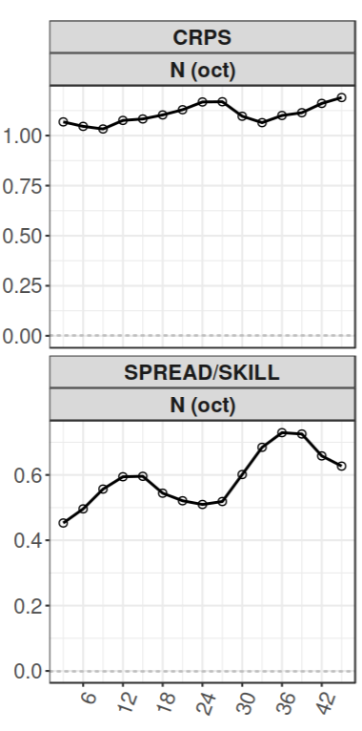
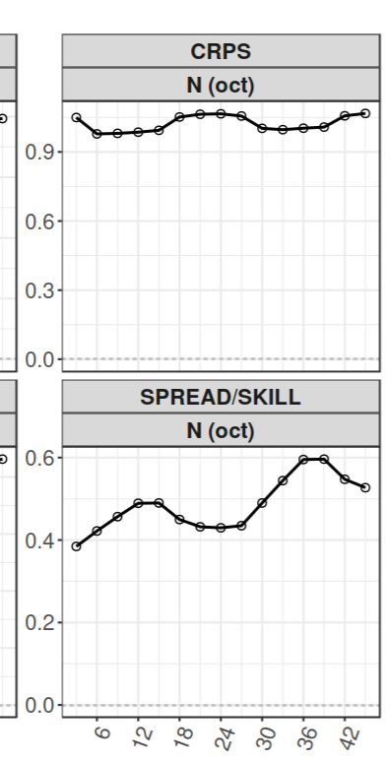
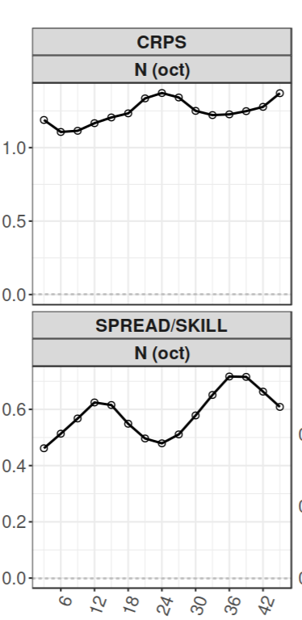
Total Cloud Cover
SON 25
DJF 26
MAM 26
Worse scores at night and MAM season
Notes:
Scores worse at night

Slide 8
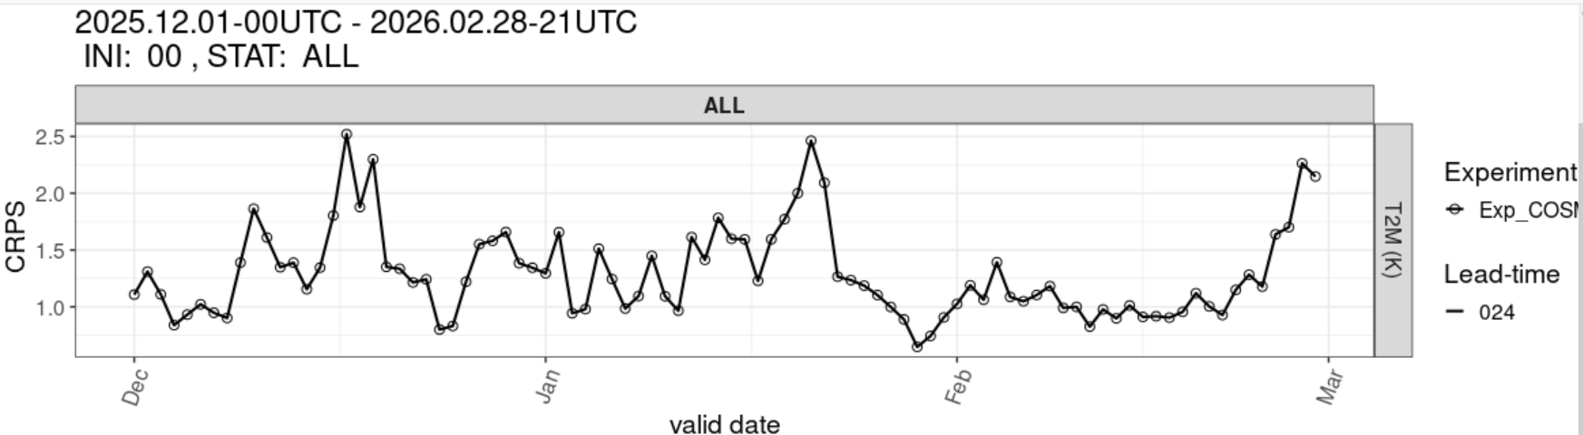
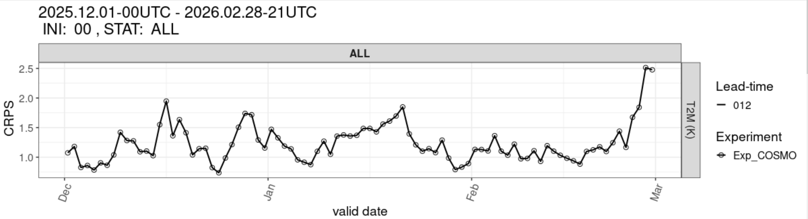
2m temperature (CRPS time series)
DJF 26
Night
Day
Better score in the day and February
Notes:
These graphs of CRPS are for the whole season of winter 26 and February was the better score for day and night

Slide 9
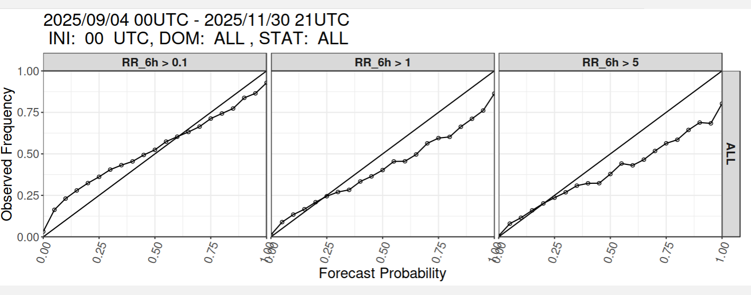
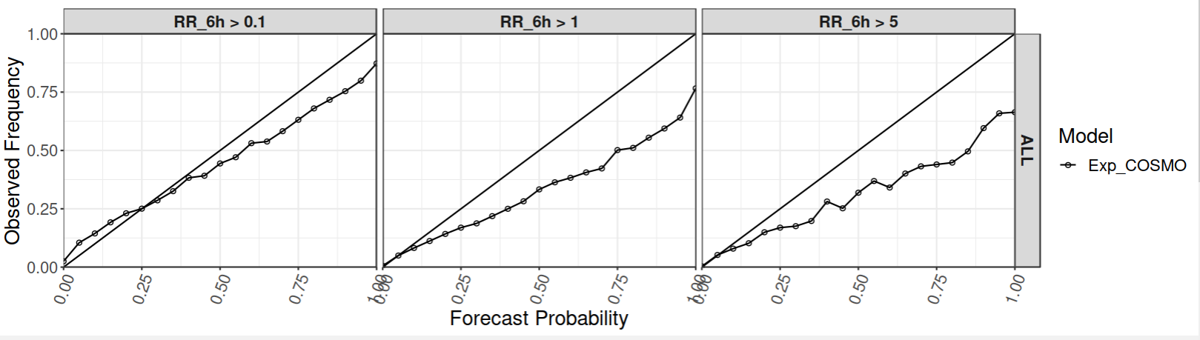
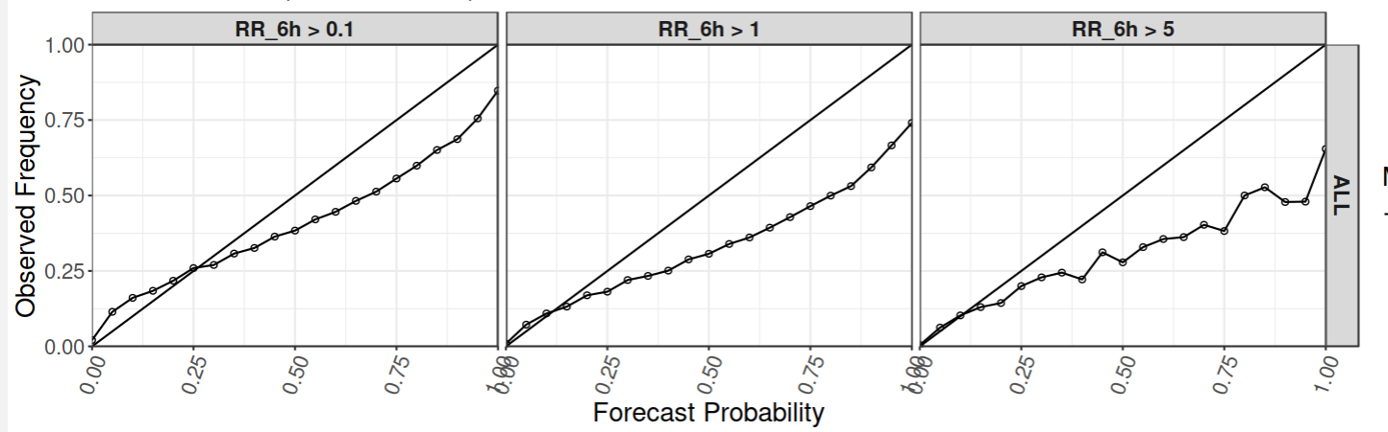
Reliability Diagrams 6h precipitation
(0.1, 1, 5mm thresholds)
SON 25
DJF 26
MAM 26
Overforecast in higher thresholds
Notes:
Overall, the forecasts show reasonable reliability for the lower rainfall threshold. As the rainfall threshold increases, the reliability decreases, with a tendency to overpredict the probability of more intense rainfall events. The larger deviations from the diagonal at higher thresholds may also be associated with the smaller sample size of these relatively rare events.” the score is worse in MAM

Slide 10
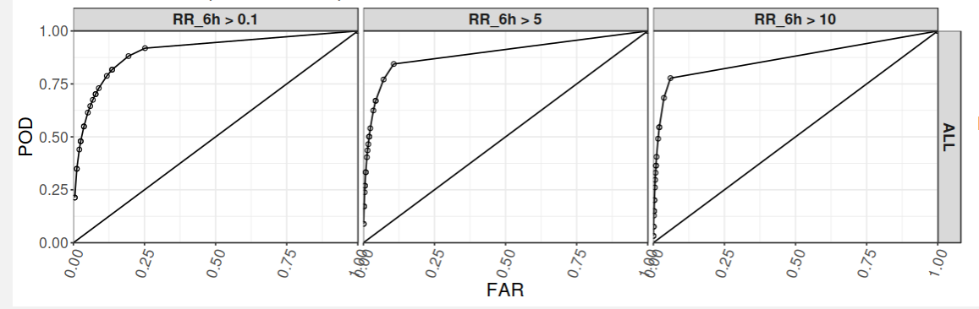
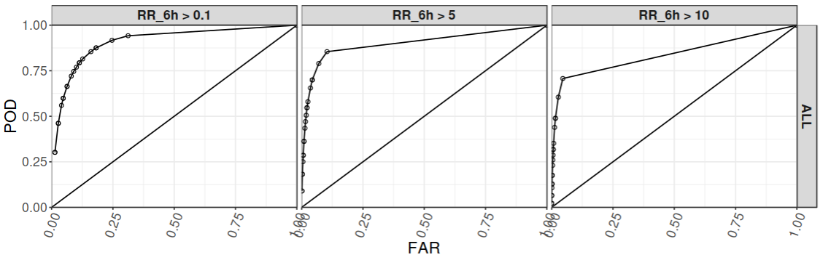

ROC Area 6h precipitation (0.1, 5, 10mm threshold)
SON 25
DJF 26
MAM 26
Notes:
Overall, the system shows good skill in detecting rainfall events. The ROC-AUC decreases as the rainfall threshold increases, indicating lower overall discrimination for more intense rainfall. However, these higher thresholds represent rarer events with fewer samples, so the decrease in AUC should be interpreted with caution.

Slide 11
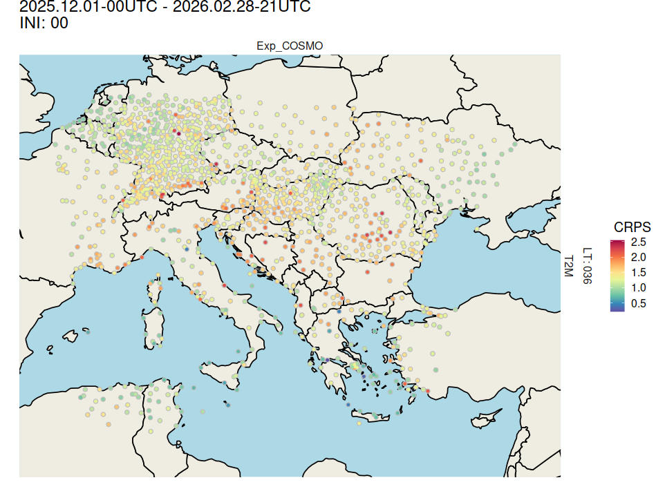
CRPS spatial variability map T2m (DJF26-36h)-Geographical Plots
Notes:
You can view the errors spatial variability

Slide 12
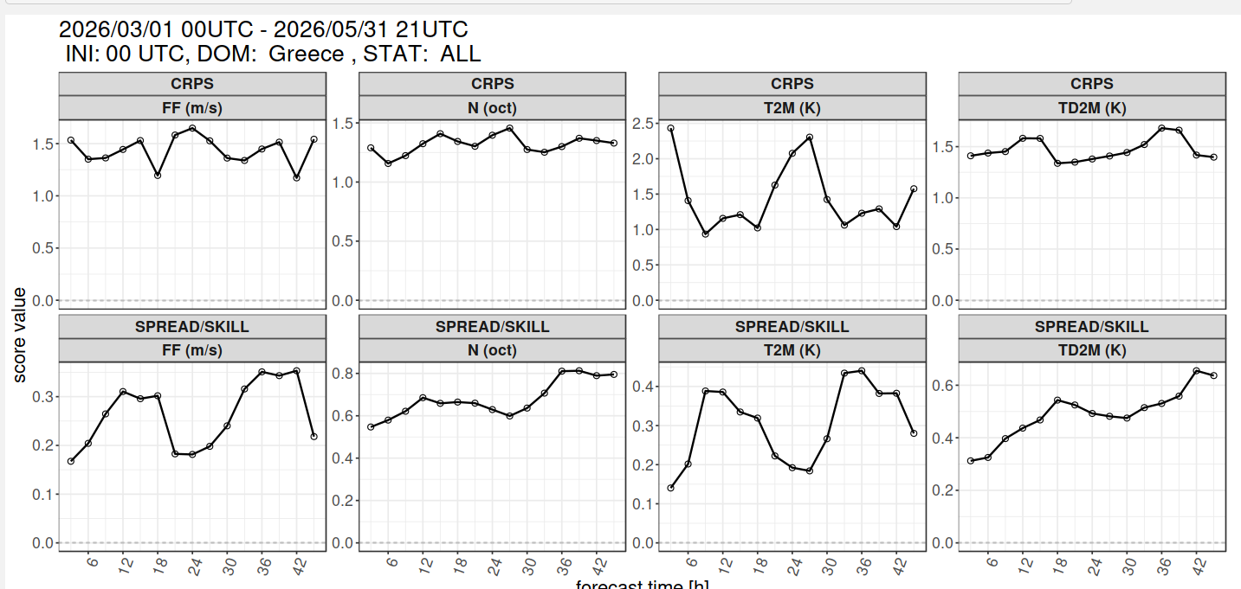
Scores over Greek Domain
Tendency similar to the whole area but errors slightly higher
Notes:
Scores are also produced over Greek domain. The tendency is the same as the big domain but the errors are slightly higher

Slide 13
Conclusions-Next steps
Some COSMO-LEPS ensemble scores are presented.
Scores are generally worse in MAM season and night
Wind speed scores similar for 3 seasons.
JJA26 season will be added soon
Common Area plots can also be produced.
COSMO-LEPS will be replaced by ICON-LEPS ?
Thank you !

