Slide 1
FFV2 Update
Felix Fundel
Deutscher Wetterdienst
Referat FE 12
Frankfurter Straße 135
63067 Offenbach am Main
E-Mail: Felix.Fundel@dwd.de
Tel.: +49 (0) 69 / 80 62 -2422

Slide 2
General Info
MEC, FFV2 and Shiny Apps on dkrz DACE gitlab
https://gitlab.dkrz.de/dace/feedback_file_verification
All COSMO partners should have access

Slide 3
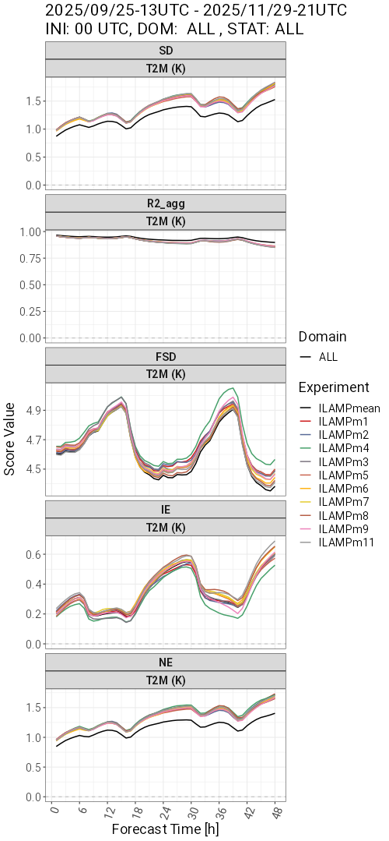
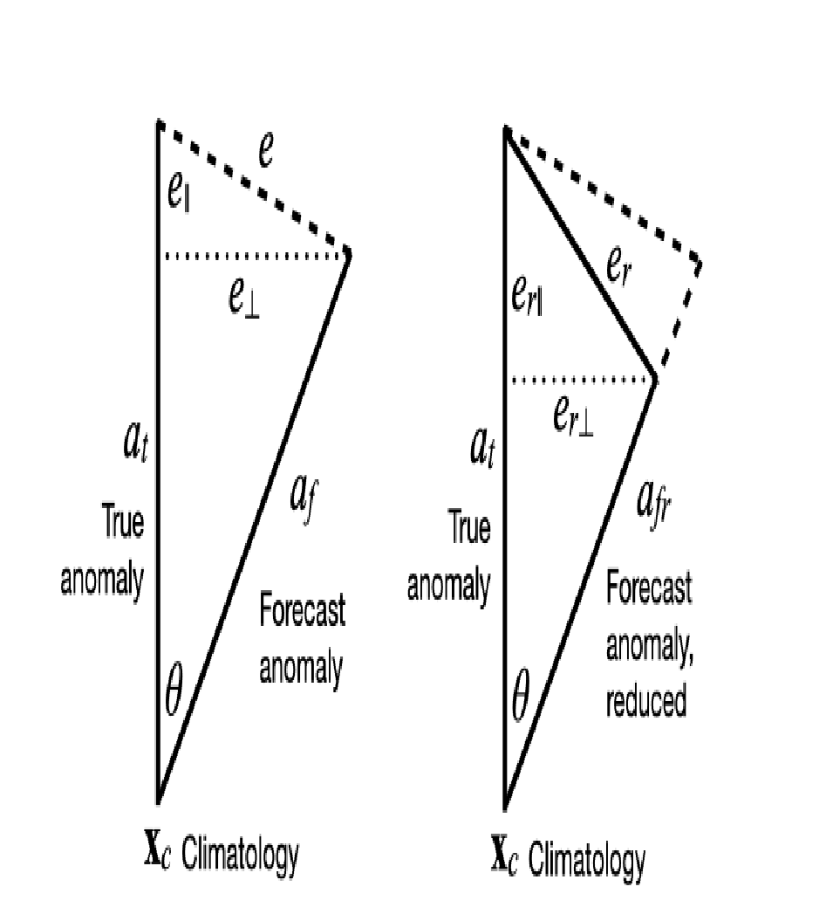
FFV2
New Scores
SDF
  Standard deviation of forecasts
  Measure for forecast activity
  Calculated by FFV2
SDO
  Standard deviation of observations
  Measure of observed activity
  Calculated by FFV2
SDF/SDO
  Activity ratio
  Calculated within shiny app
IE
  Information error (error in direction of observations vector)
  Calculated within shiny app
NE
  Noise error (error orthogonal to observation vector)
  Calculated within shiny app
R_agg
  Correlation coefficient (cosine of angle between obs. And forecast vector; r^2)
  Calculated within shiny app
Massimo Bonavita and Alan J. Geer, ECMWF Tech. Memo 927

Slide 4
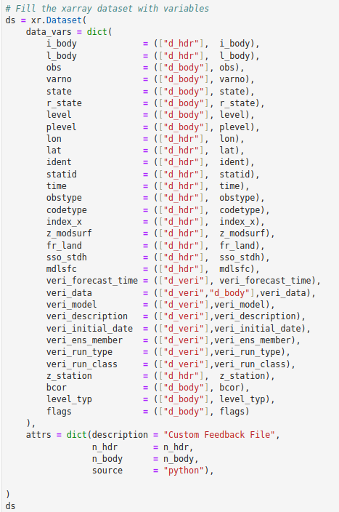
FFV2
Alternative for new observation/forecast data
FFV2 requires feedback files
Recommended way is to use MEC for production
New types of observations and/or forecasts are not easily implementable in MEC
Different approaches at DWD for easy production of feedback files without MEC
Most simple approach is based on pythons xarray
Jupyter notebook can be provided as template
Procedure
Load observations
Load predictions
Interpolate prediction to observation location
Write an xarray dataset with additional attributes (lon, lat, statid, …)
Save as netCDF
(Subproblem: filling existing feedback file with new forecasts)

Slide 5
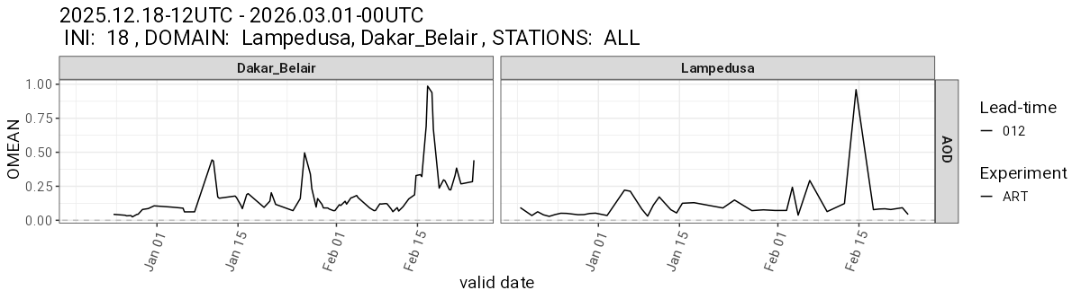
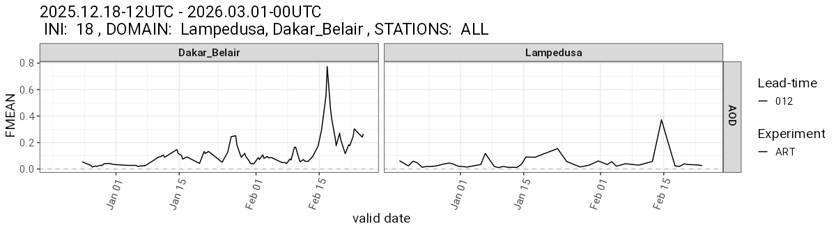
Example AOD
AERONET AOD observations are available only if cloud free and day-time
~400 stations globally but events are rare
Mean scores are not really interesting but at least some similarities of ICON-ART AOD with AERONET is there
Exercise to implement new observations in verification w.o. MEC
Hint: name new feedback files e.g. verSYNOP_areo.YYYYMMDDHH to see AOD scores together with SYNOP scores

Slide 6
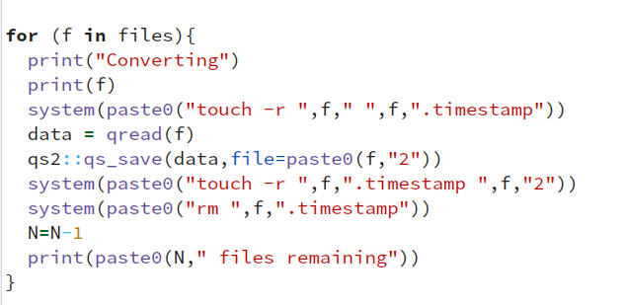
FFV2
Transition from qs to qs2
qs as score file format was introduced for data loading performance reasons
qs is no longer supported, removed from the CRAN repository and not supported with R >= 4.6
qs2 is offering the same functionality, however not backwards compatible
A current versions of FFV2 and shiny apps support both, qs and qs2
A FFV2 version no longer depending on qs is ready
  Git tag 1.5.0
A simple R script to convert qs files to qs2 can be provided
  i.e. a R version supporting both is needed
Shiny apps can be adopted easily by commenting out the import of the qs package
Rdata still is supported

Slide 7
FFV2
Smaller changes
Verification of RHi (rel. humidity over ice)
  RHi is calculated within FFV2 given T and RH exist
  Implemented for EPS & det, TEMP & AIREP
Some situations causing crashed in the categorical verification have been caught
Upper-air verification with binned vertical levels optionally allows to include data outside the bins
Verification against analysis at observation location
  Implemented for station based scores
Verification of mslp
  Simple conversion of PS to MSLP
  Scores nearly identical
  Helpful in case of a conditional/categorical verification

Slide 8
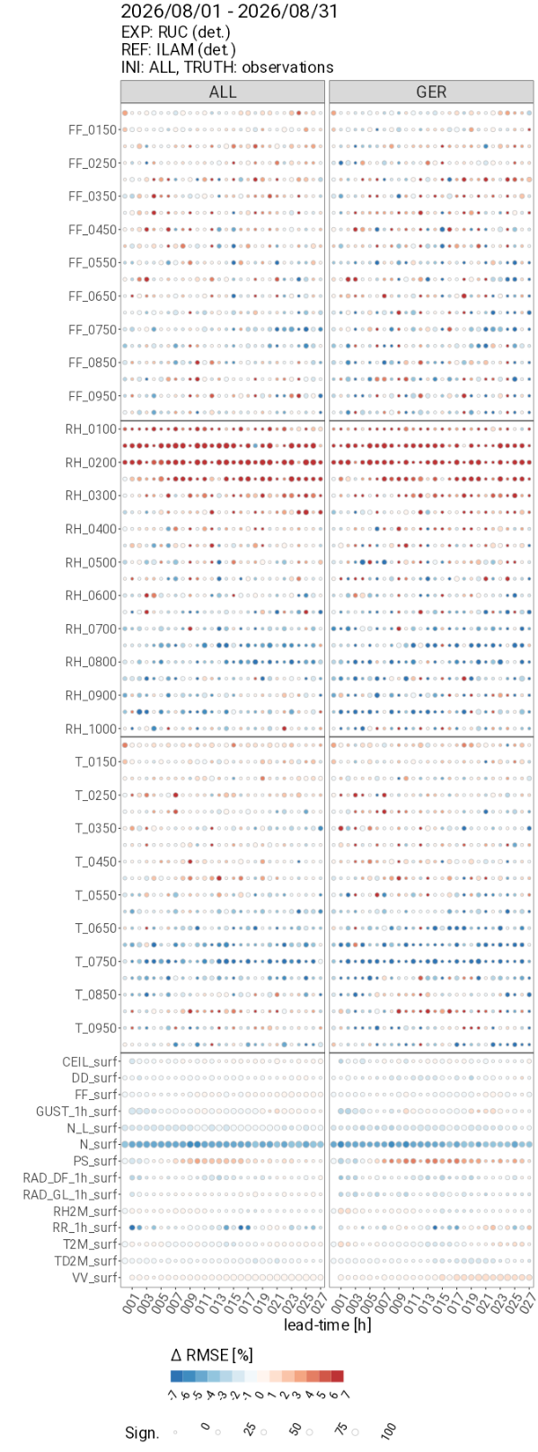
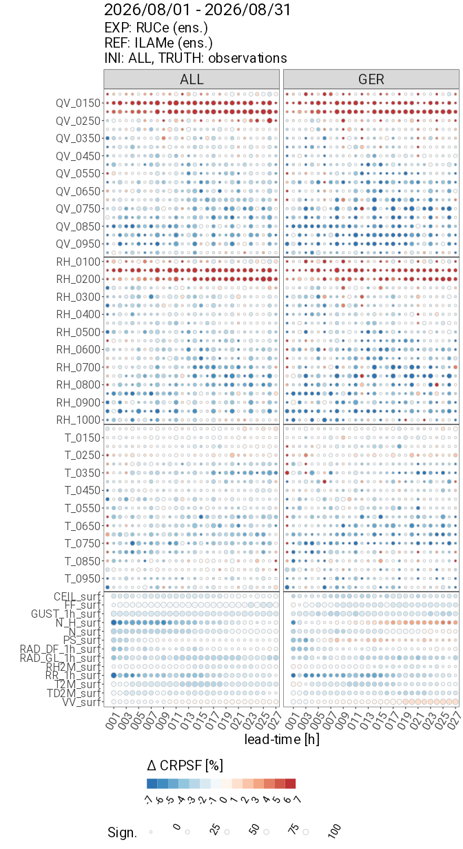
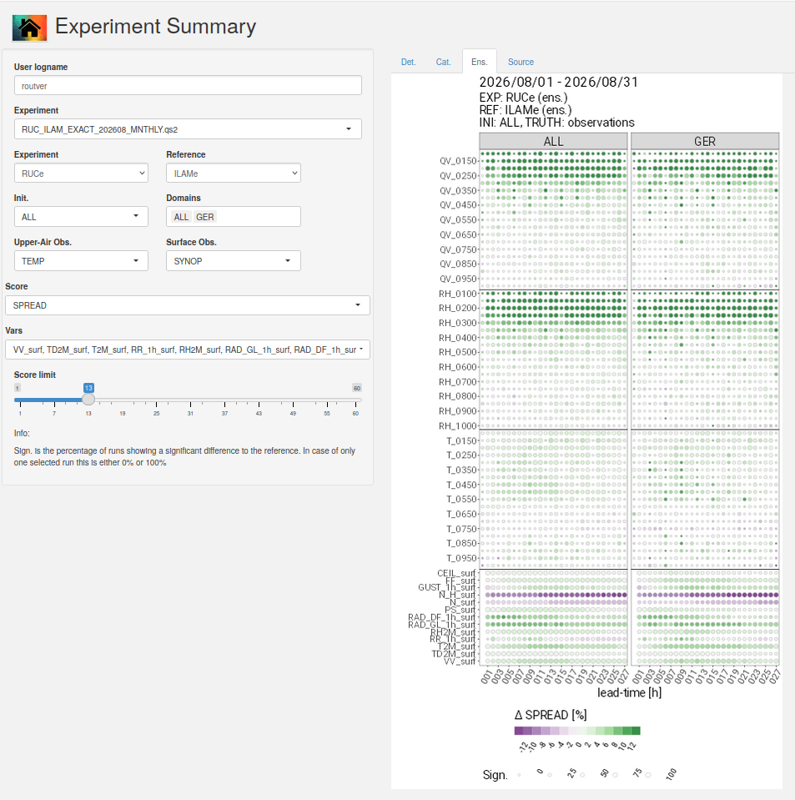
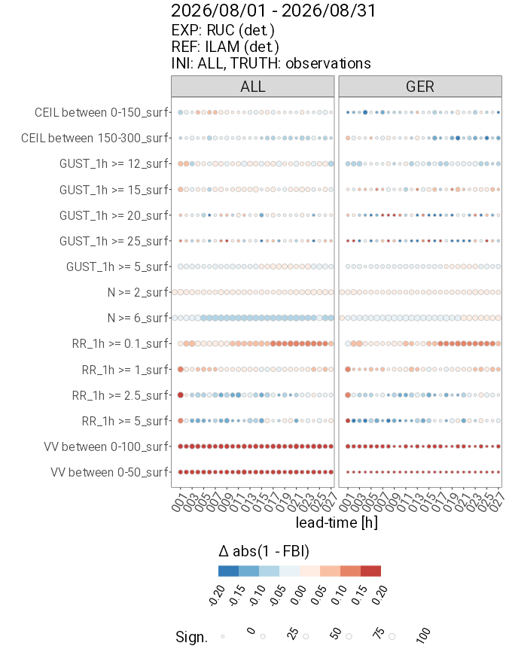
Shiny Apps
Score Card App
Work with .qs .qs2 and .Rdata score files
Revised categorical upper air score app
New ScoreCard app
  Shows upper air and surface scores at once
  Det. and EPS
  Blend in/out variables/levels
  Problematic with some older scores

Slide 9
Other Topics
Reanalysis
DREAM
  ICON, deterministic, 13km + 7km EU nest
  2010 - current
FORCE
  ICON-D2, deterministic, 2km
  2016-2025

Slide 10
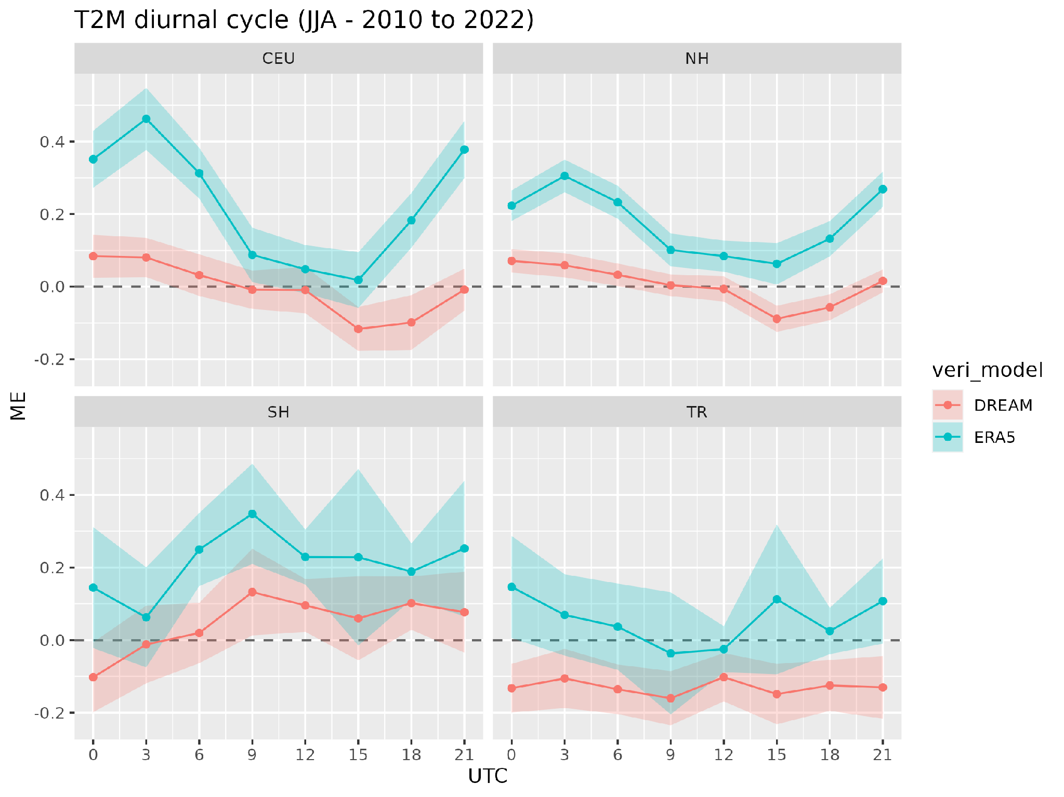
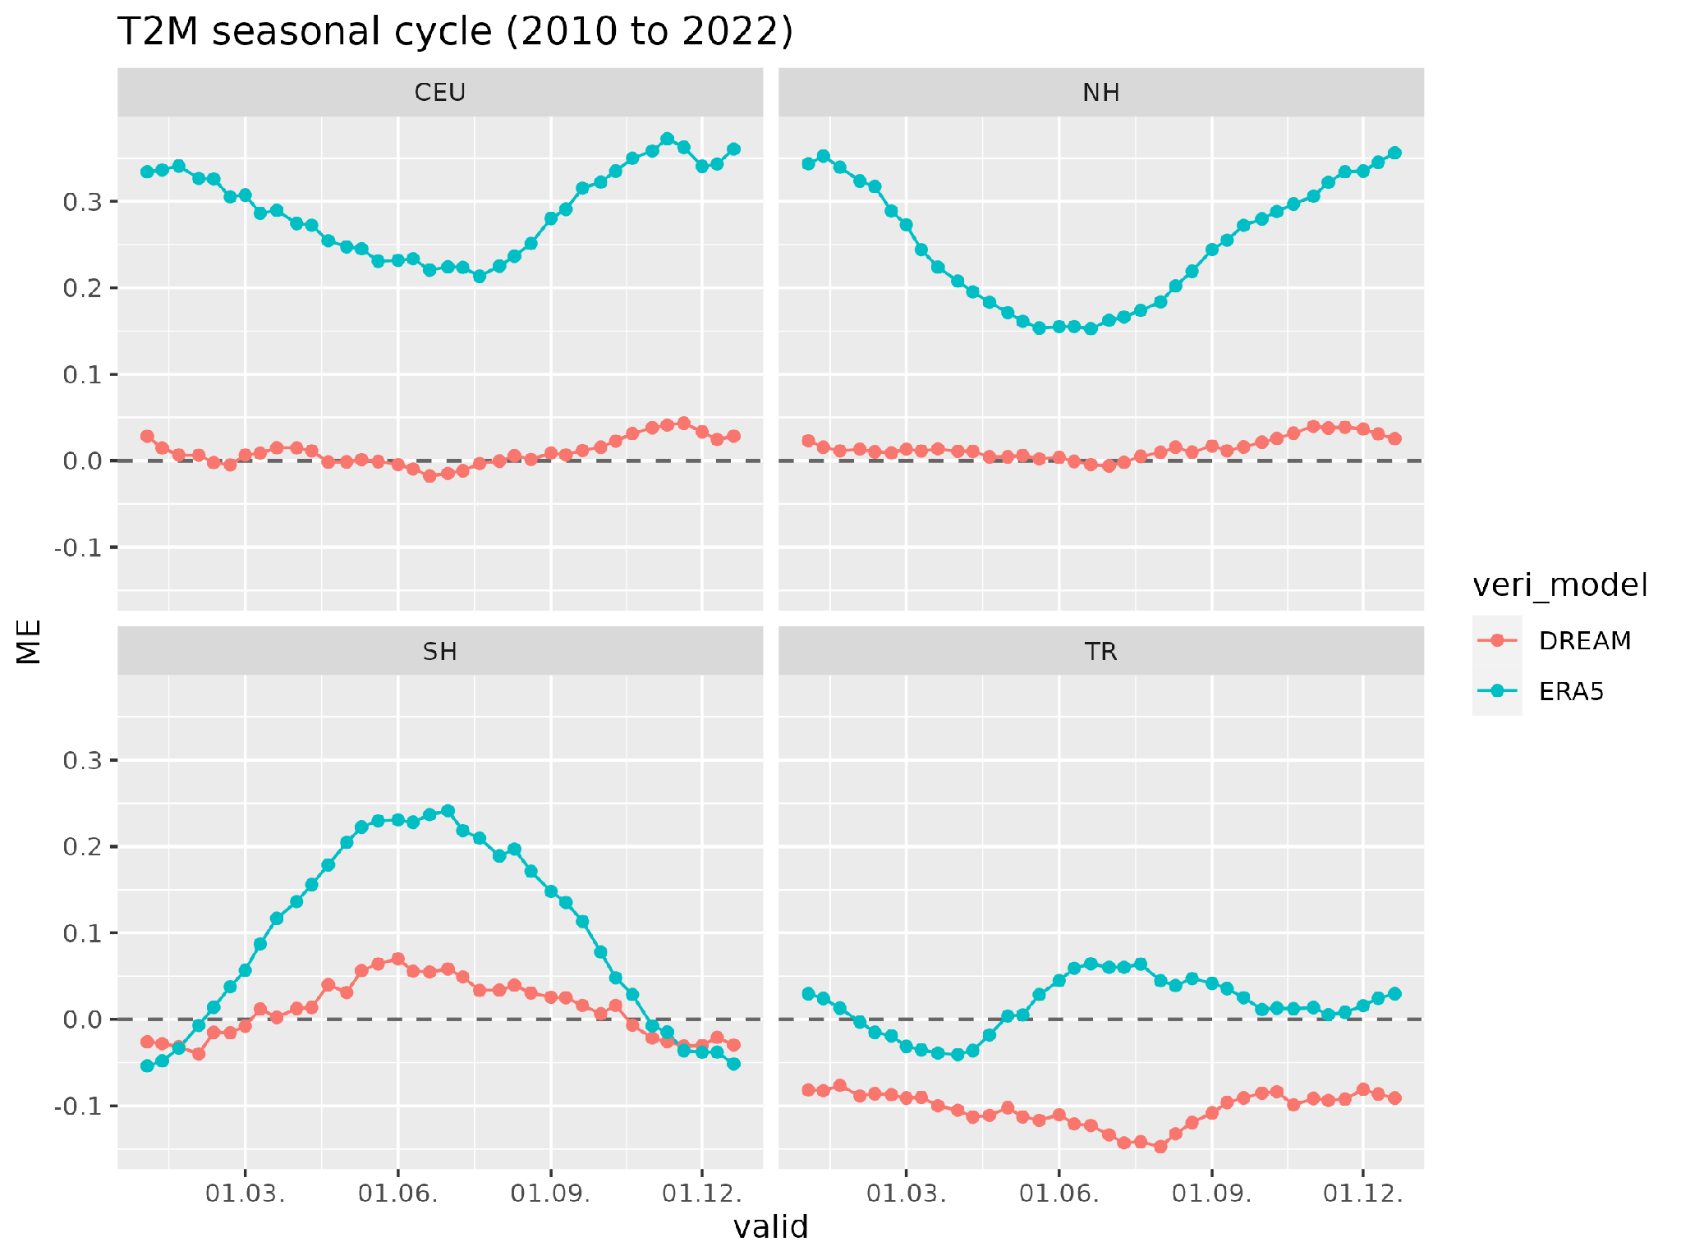
Other Topics
DREAM
Plots by Sabrina Wahl

Slide 11
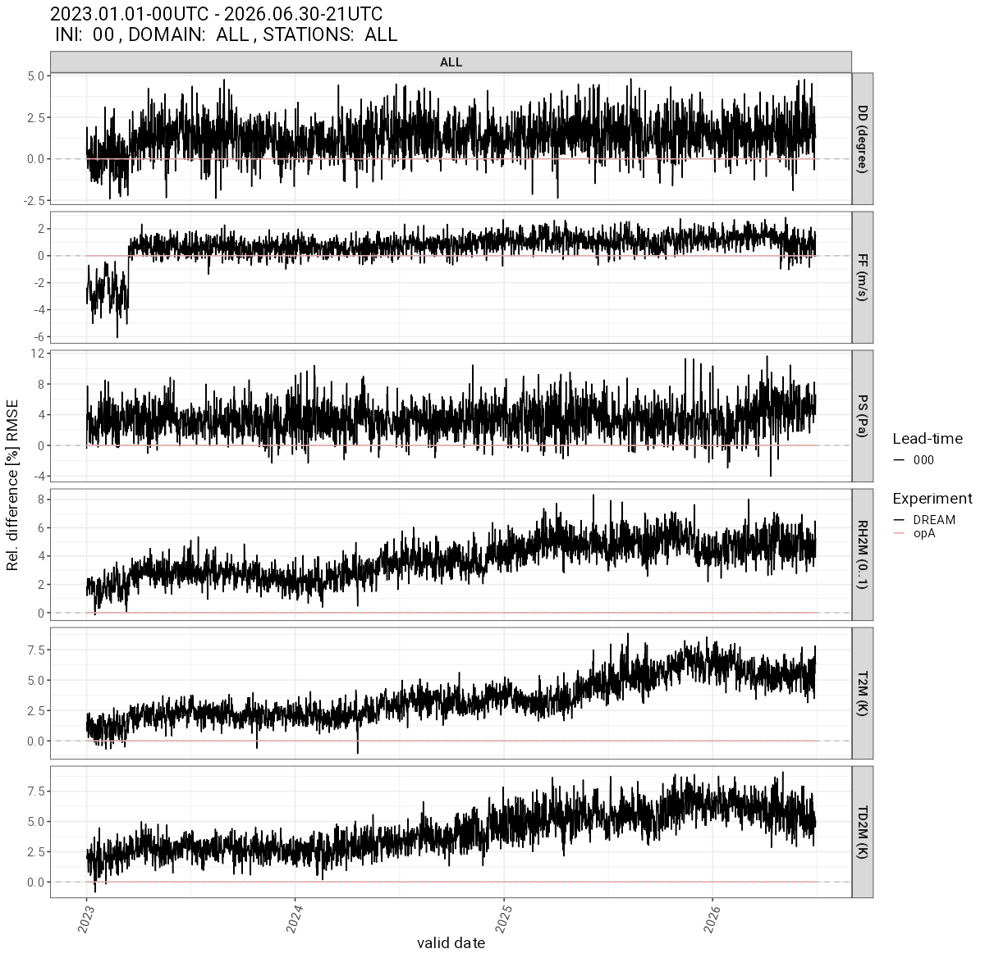
Other Topics
DREAM
RMSE comparison to operational ICON analysis
Slightly higher RMSEs of DREAM
Trend in some variables points to ongoing improvements of ICON
Plots by Sabrina Wahl

Slide 12
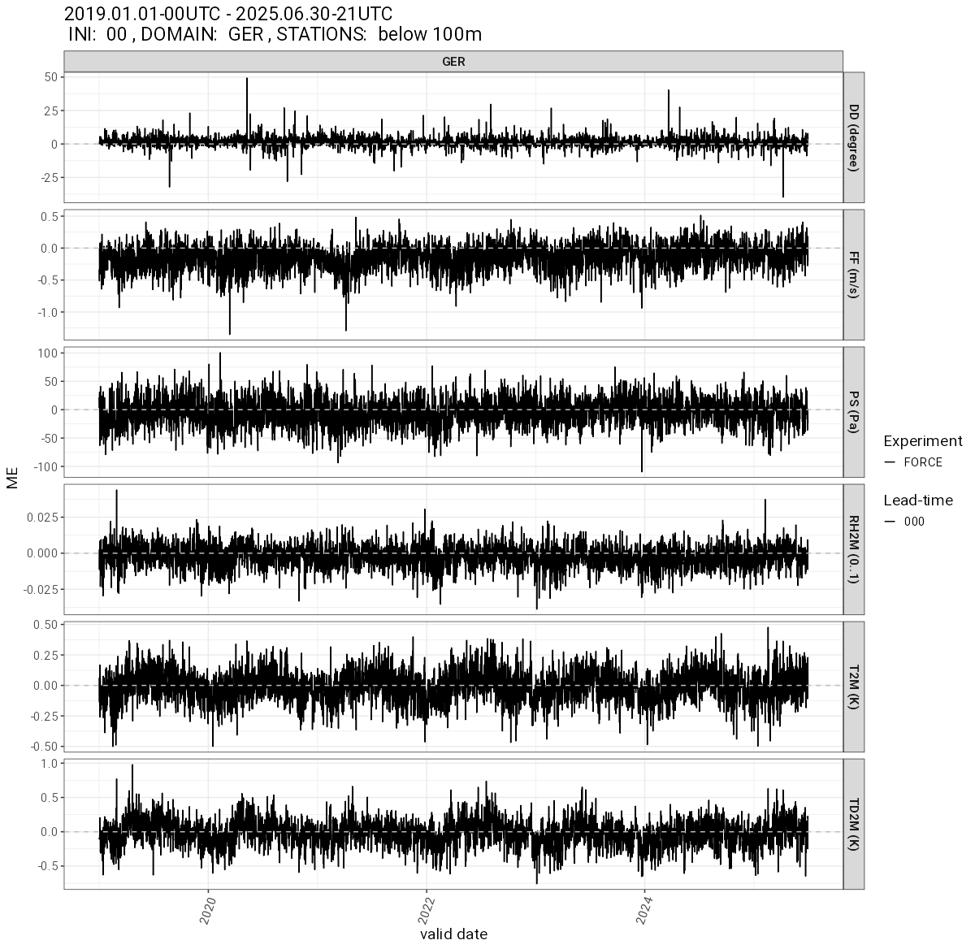
FORCE

Slide 13
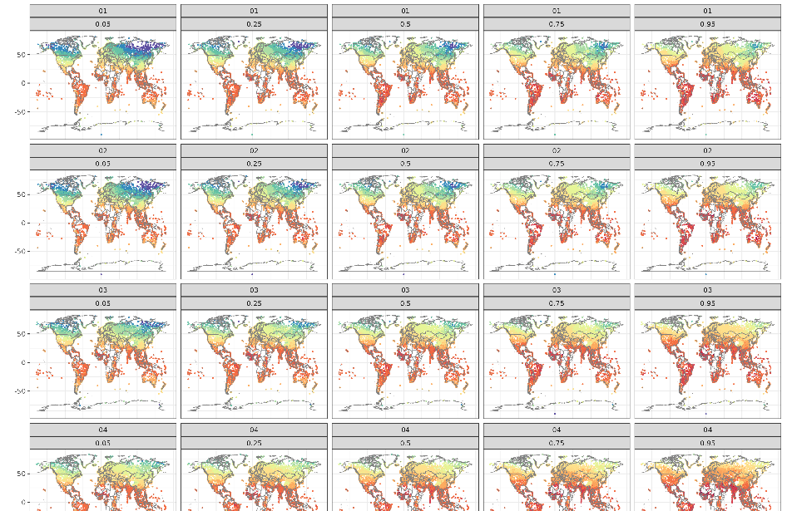
Q5
Q50
Q95
JAN
Obs from 12 years of DREAM feedback files
Monthly, station wise quantiles 0%..100%
Plot T2M
Useful for e.g. a quantile based categorical verification
FEB
MAR

Slide 14
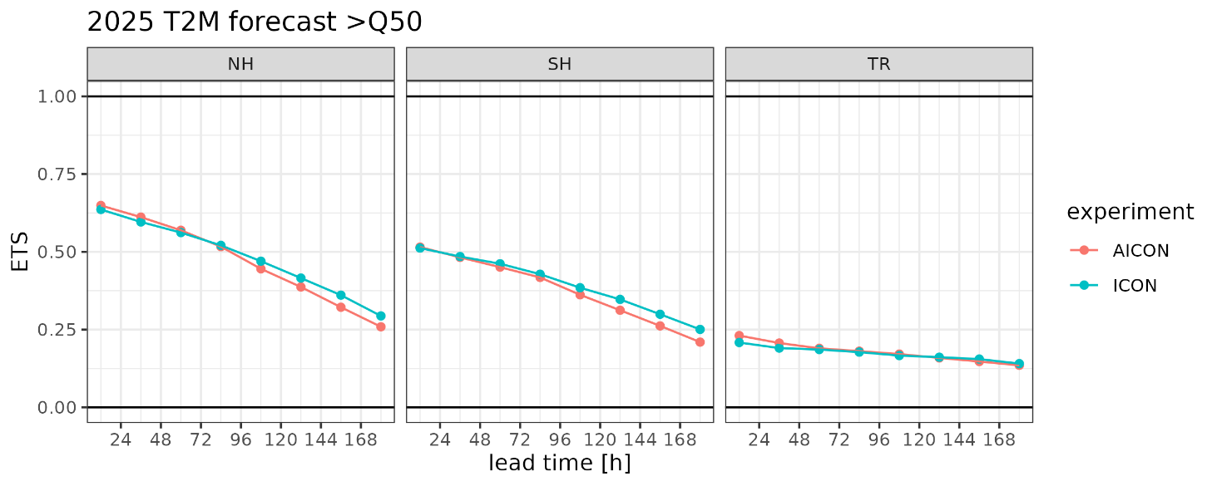
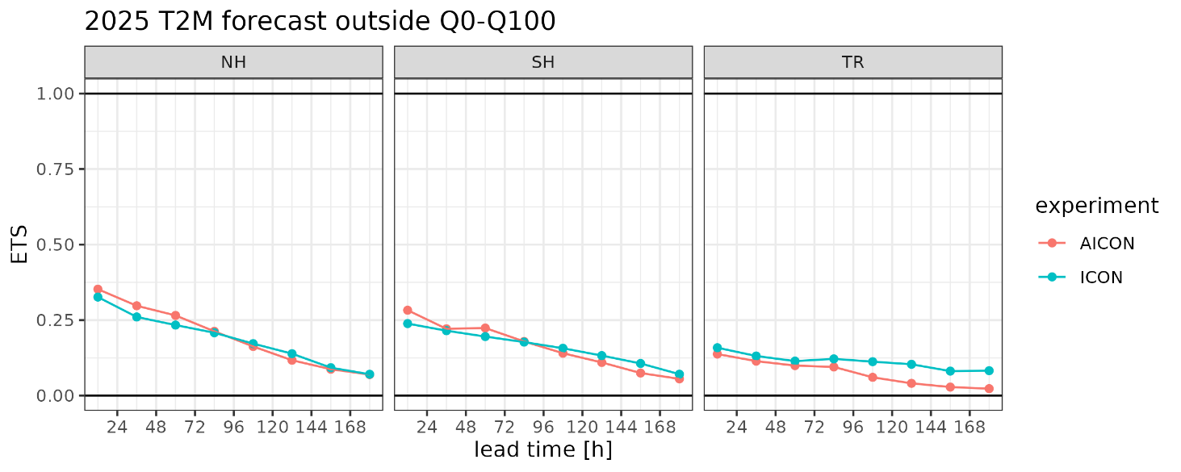
Fill contingency table for all events outside Q0 and Q100
How good is ICON/AICON in forecasting extreme (2010-2022) events?

