Slide 1
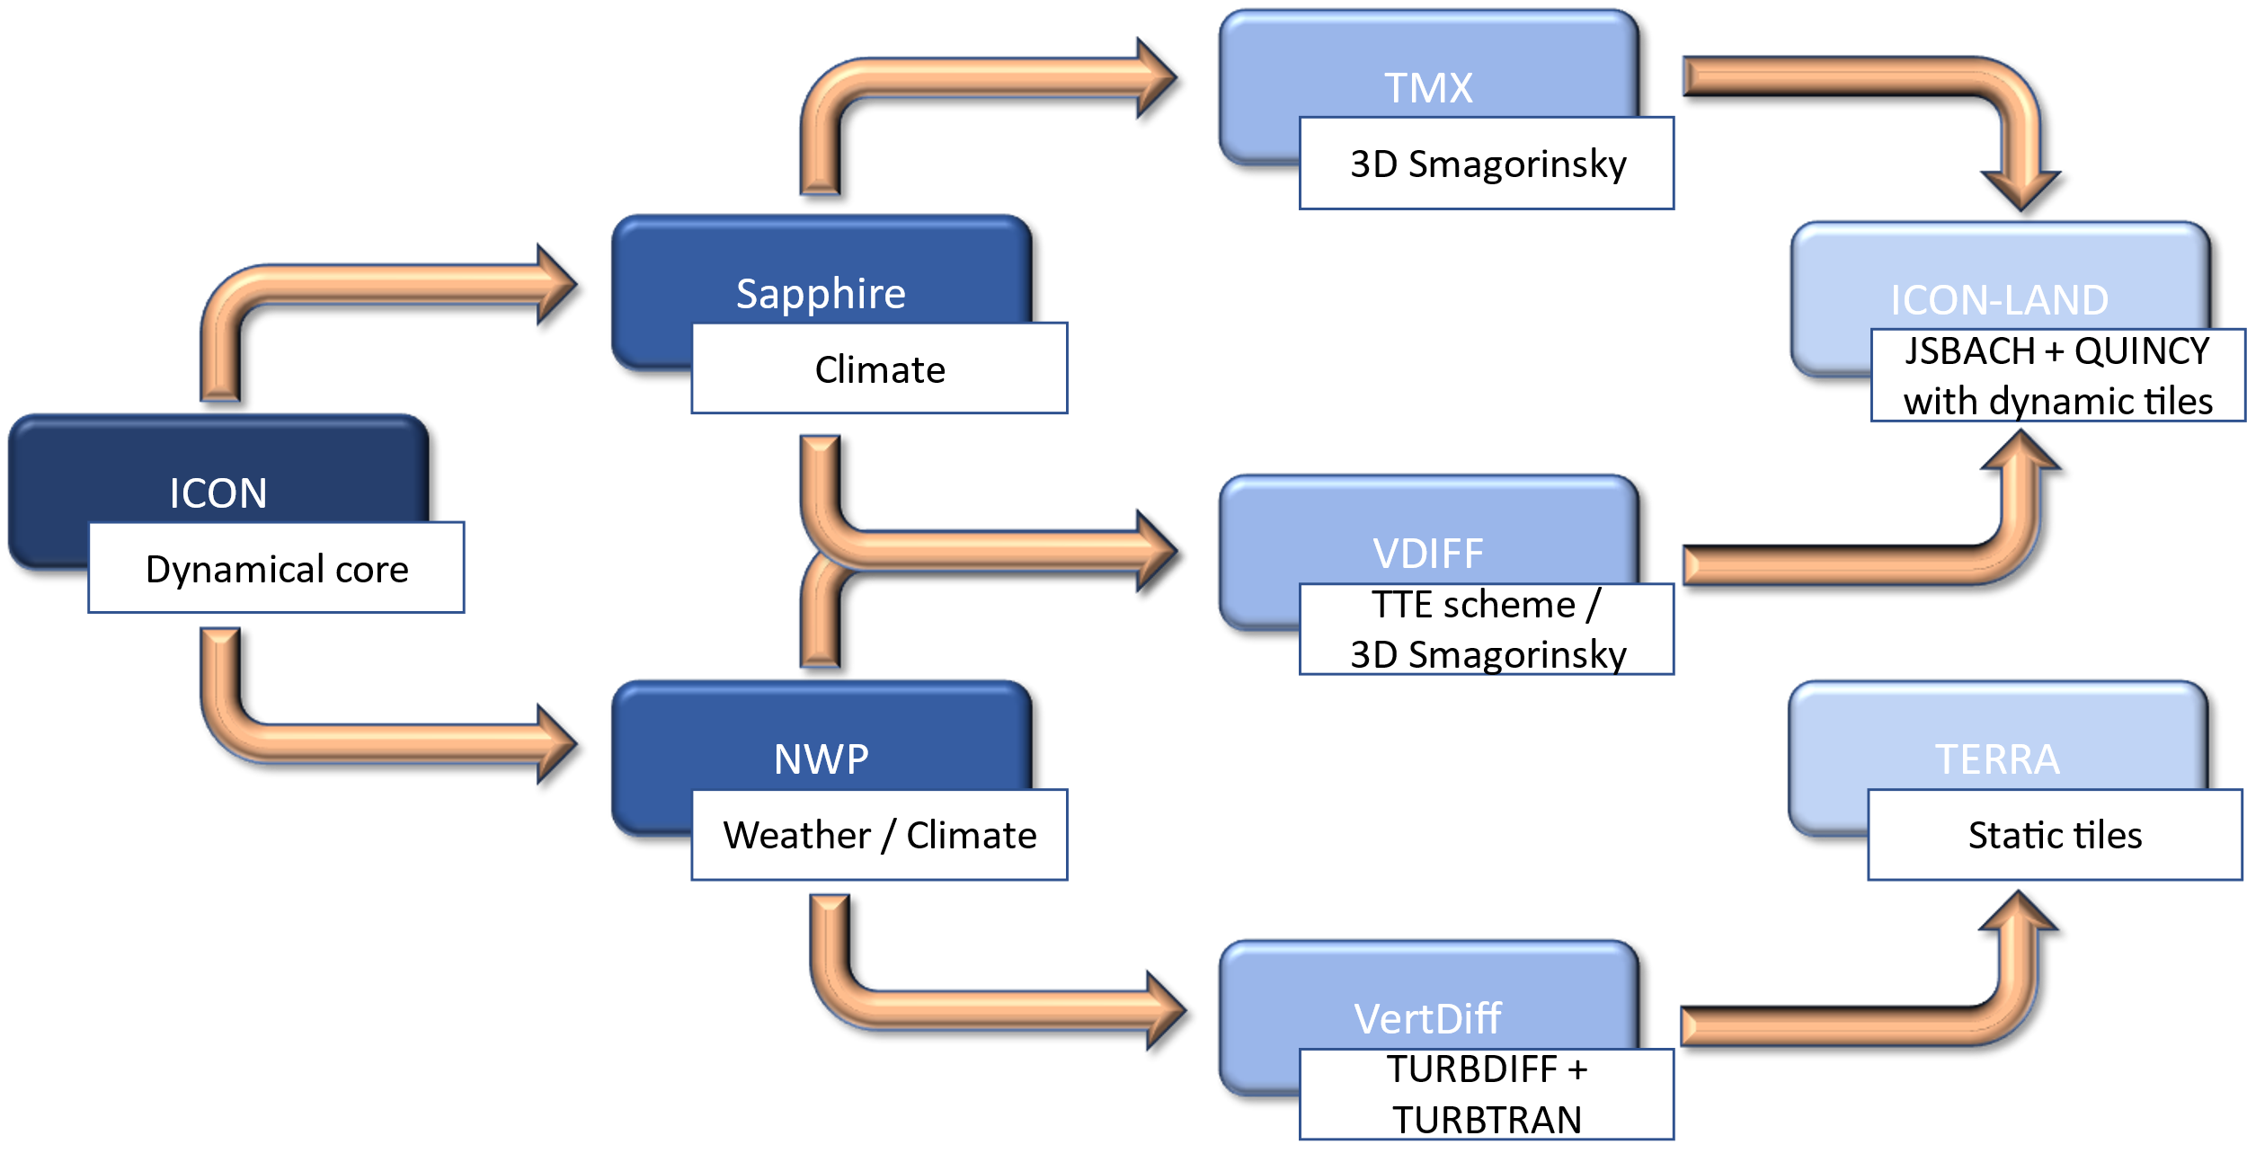
ICON’s atmosphere-land-coupling configurations
The zoo of turbulence models and land model interfaces in ICON:
  In ICON, several options for modelling the turbulence and the atmosphere-land interaction
  All configurations have their
  advantages and disadvantages
  Currently, the configurations are
  static, e.g., components cannot be
  exchanged

Slide 2
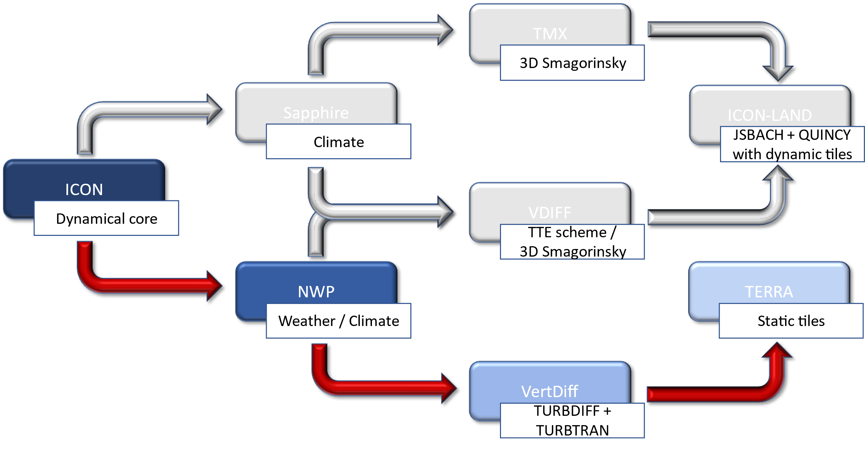
ICON’s atmosphere-land-coupling configurations
The zoo of turbulence models and land model interfaces in ICON:
  In ICON, several options for modelling the turbulence and the atmosphere-land interaction
  All configurations have their
  advantages and disadvantages
  Currently, the configurations are
  static, e.g., components cannot be
  exchanged
  Current configurations are:
    NWP configuration with VertDiff
    and TERRA

Slide 3
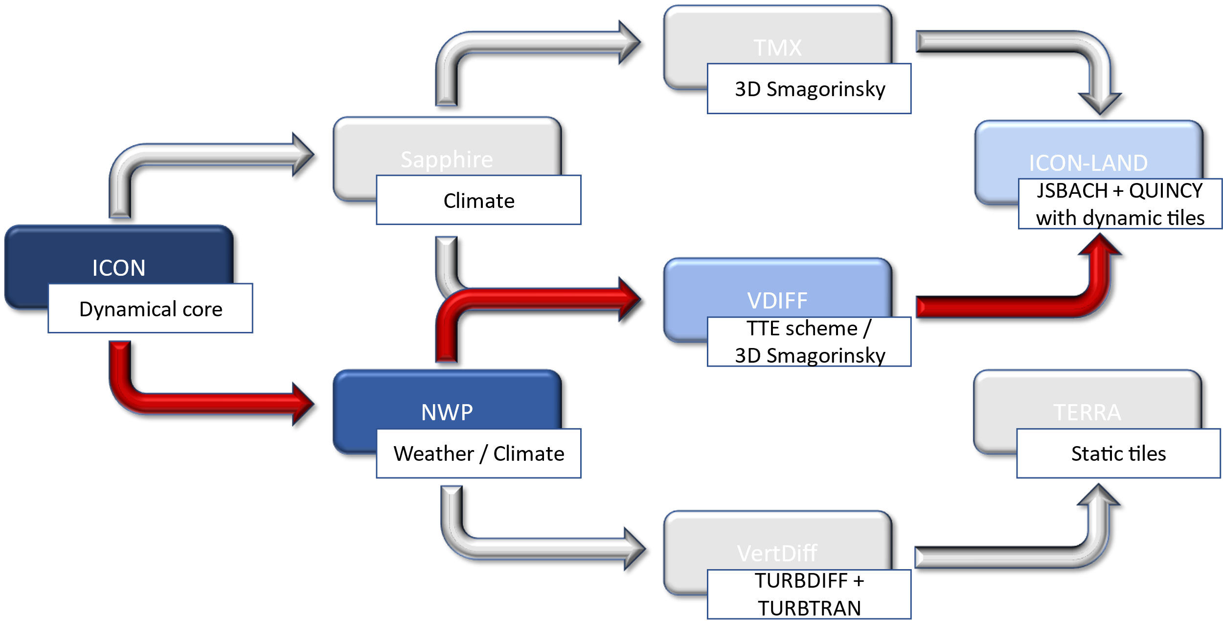
ICON’s atmosphere-land-coupling configurations
The zoo of turbulence models and land model interfaces in ICON:
  In ICON, several options for modelling the turbulence and the atmosphere-land interaction
  All configurations have their
  advantages and disadvantages
  Currently, the configurations are
  static, e.g., components cannot be
  exchanged
  Current configurations are:
    NWP configuration with VertDiff
    and TERRA
    Climate (XPP) configuration with VDIFF and ICON-LAND (JSBACH + QUINCY)

Slide 4
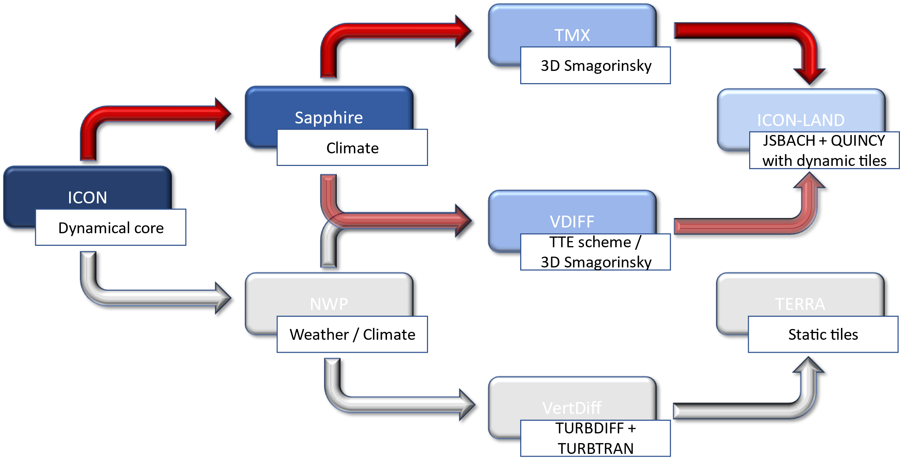
ICON’s atmosphere-land-coupling configurations
The zoo of turbulence models and land model interfaces in ICON:
  In ICON, several options for modelling the turbulence and the atmosphere-land interaction
  All configurations have their
  advantages and disadvantages
  Currently, the configurations are
  static, e.g., components cannot be
  exchanged
  Current configurations are:
    NWP configuration with VertDiff
    and TERRA
    Climate (XPP) configuration with VDIFF
    and ICON-LAND (JSBACH + QUINCY)
    Sapphire configuration (reduced physics) with TMX or VDIFF (deprecated) and ICON-LAND (JSBACH + QUINCY)

Slide 5
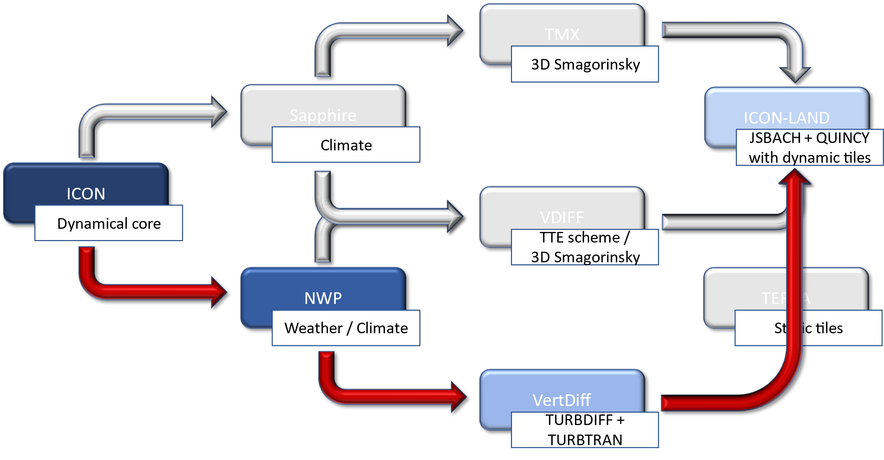
ICON’s atmosphere-land-coupling configurations
The zoo of turbulence models and land model interfaces in ICON:
  In ICON, several options for modelling the turbulence and the atmosphere-land interaction
  All configurations have their
  advantages and disadvantages
  Currently, the configurations are
  static, e.g., components cannot be
  exchanged
  Current configurations are:
    NWP configuration with VertDiff
    and TERRA
    Climate (XPP) configuration with VDIFF
    and ICON-LAND (JSBACH + QUINCY)
    Sapphire configuration (reduced physics) with TMX or VDIFF (deprecated) and ICON-LAND (JSBACH + QUINCY)
  In the future, further options to
  combine the different components
  will be available:
    NWP configuration with VertDiff and ICON-LAND

Slide 6
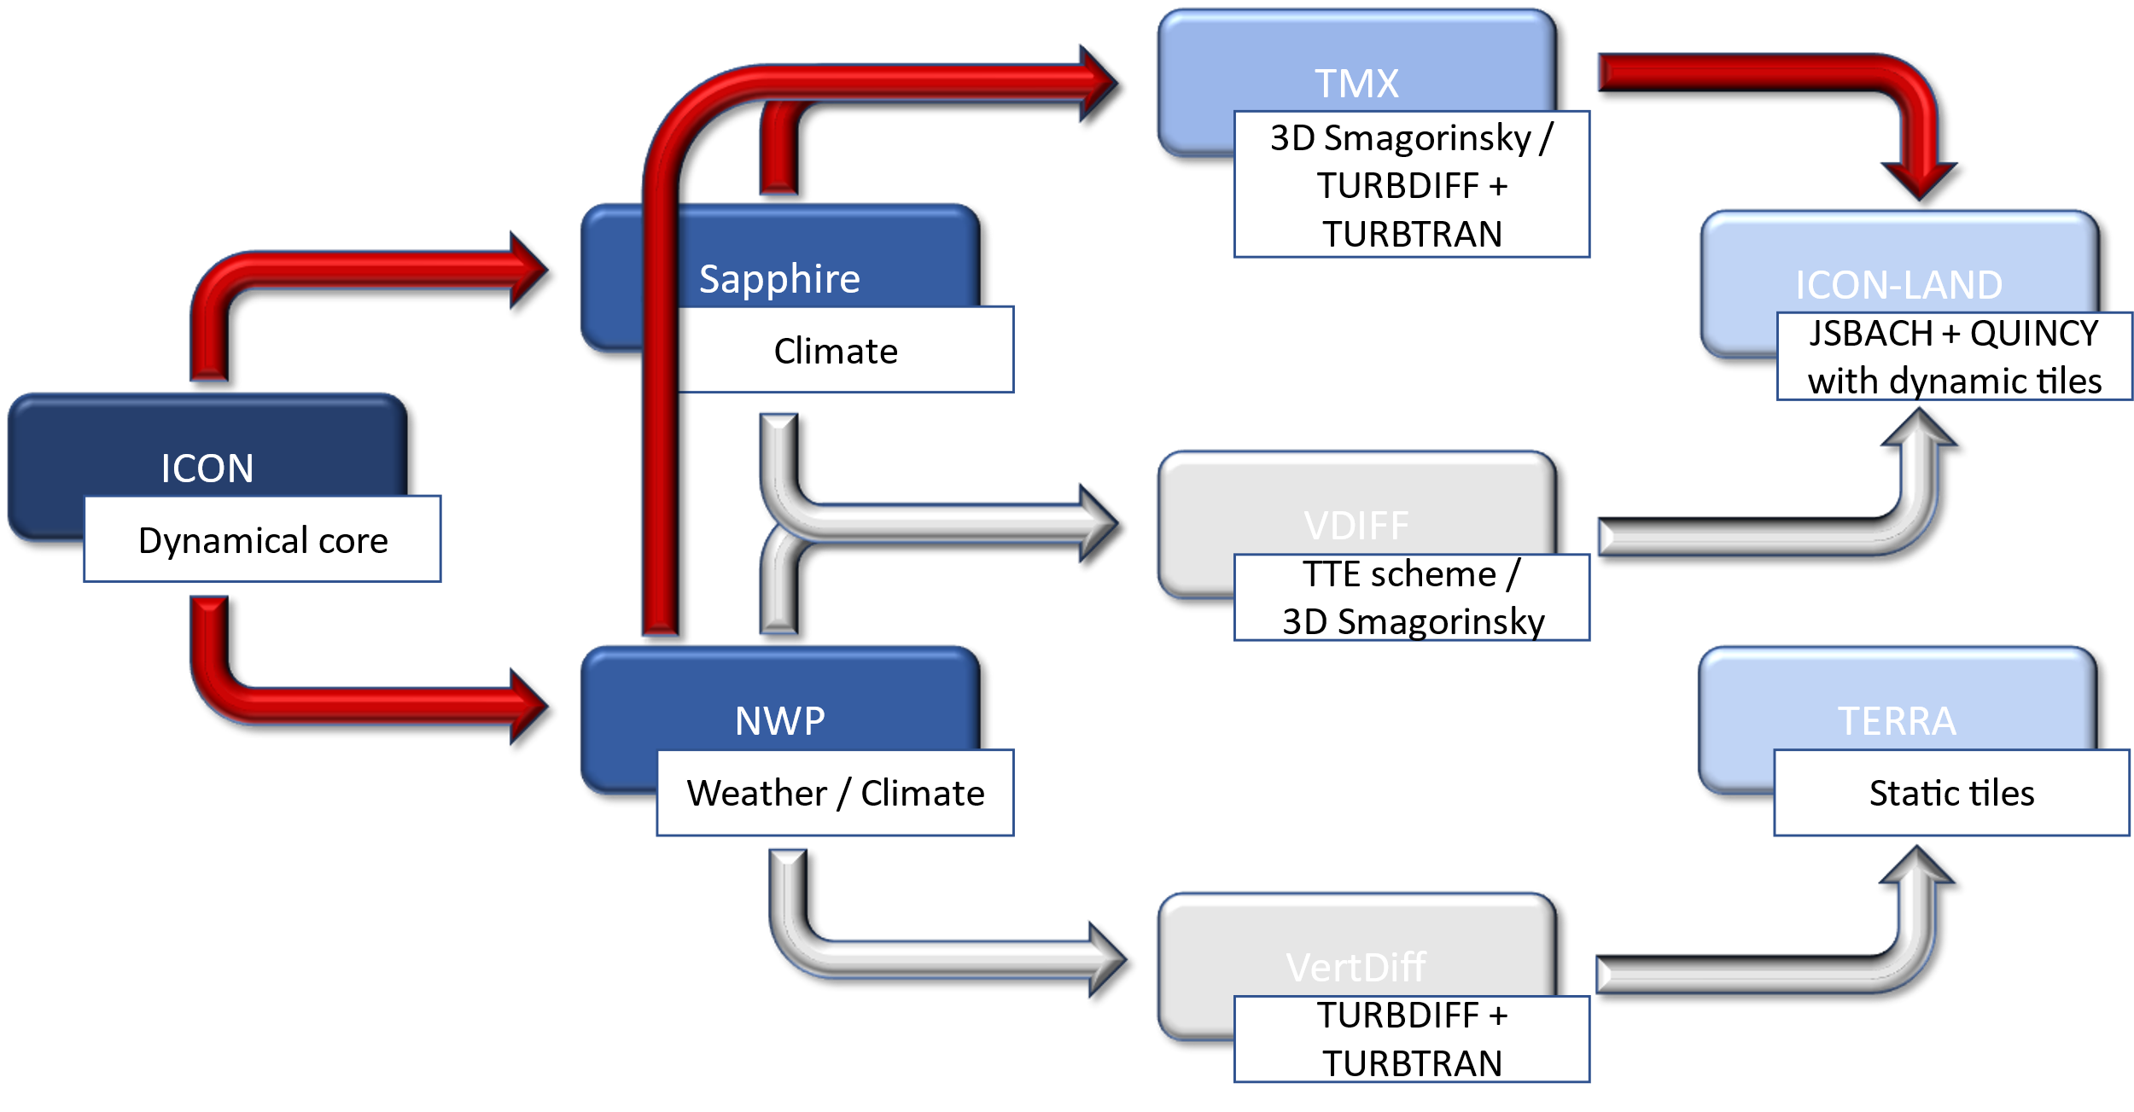
ICON’s atmosphere-land-coupling configurations
The zoo of turbulence models and land model interfaces in ICON:
  In ICON, several options for modelling the turbulence and the atmosphere-land interaction
  All configurations have their
  advantages and disadvantages
  Currently, the configurations are
  static, e.g., components cannot be
  exchanged
  Current configurations are:
    NWP configuration with VertDiff
    and TERRA
    Climate (XPP) configuration with VDIFF
    and ICON-LAND (JSBACH + QUINCY)
    Sapphire configuration (reduced physics) with
    TMX or VDIFF (deprecated) and ICON-LAND
    (JSBACH + QUINCY)
  In the future, further options to
  combine the different components
  will be available:
    NWP configuration with VertDiff and ICON-LAND
    Climate (XPP) or Sapphire configuration with TMX including TURBDIFF / TURBTRAN and ICON-LAND

Slide 7
ICON’s atmosphere-land-coupling configurations
Advantages: NWP configuration with VertDiff and
ICON-LAND
(currently implemented by Lukas Strebel, FE14):
  ICON-LAND is a land-surface model for Earth system modelling, jointly developed by the Max Planck Institute for Meteorology in Hamburg (JSBACH) and the Max Planck Institute for Biogeochemistry in Jena (QUINCY)
  It represents land-surface energy, water and carbon fluxes, including processes related to soil, vegetation and snow
  ICON-LAND offers a dynamic tile approach, allowing the fractional composition of vegetation/land-cover types within a grid cell to evolve over time
  Coupling JSBACH to the NWP configuration via VertDiff:
    Provides greater flexibility for experiments and model comparison
    Enables a direct comparison of TERRA and JSBACH within a well-tested NWP framework
    May help investigate and potentially reduce energy imbalances observed in climate simulations
    Equips the climate (XPP) configuration with a well-tested turbulence scheme
Advantages: Climate (XPP) or Sapphire configuration with TMX including TURBDIFF / TURBTRAN and ICON-LAND
(currently implemented by Moritz Waldmann, FE14):
  TMX (Turbulent MiXing) is the latest turbulence parametrization framework of the Max Planck Institute for Meteorology
  It was implemented as the successor of VDIFF
  By design, TMX has a clear separation between numerics and physics making it easily extendable
  It currently includes a 3D Smagorinsky scheme and a Louis-type
  scheme for near-surface processes
  Compared with VDIFF, atmosphere–land coupling is treated explicitly
  Integrating TURBDIFF / TURBTRAN into TMX:
    Increases flexibility in the choice of turbulence parametrization
    May help investigate stability issues associated with explicit atmosphere–land coupling
    Enables systematic investigation of how the turbulence parametrization affects atmosphere–land coupling
    Provides a clean interface for coupling TURBDIFF/TURBTRAN with ICON-LAND (JSBACH + QUINCY)

