Slide 1
A new diagnostic for PBL height
Navid Mouji, Rolf Zentek,
Jochen Förstner, Dmitrii Mironov

Slide 2




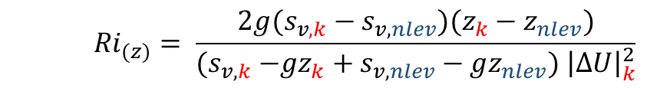
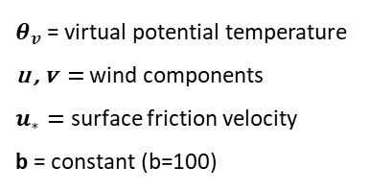
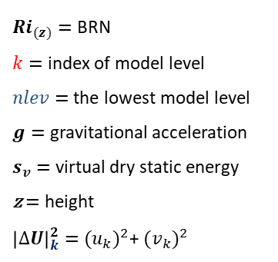
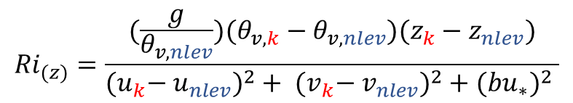
Bulk Richardson Number (Navid Mouji)
D-M.4.1
Provision of offline ICON mixing heights
${Ri}_{(z)}=$ BRN
$k=$ index of model level
$nlev$ = the lowest model level
$g=$ gravitational acceleration
$s_{v}=$ virtual dry static energy
z $=$ height
${\left|∆U\right|}_{k}^{2}=$ ${{(u}_{k})}^{2}$+ ${{(v}_{k})}^{2}$
Bulk Richardson Number
MH $=$ ${{Ri}_{(z)}=Ri}_{c}$ = 0.25
IFS CY47R3
(2021)
$${Ri}_{(z)}= \frac{2g(s_{v, k}−s_{v,nlev})(z_{k}−z_{nlev})}{{(s}_{v, k} −gz_{k}+s_{v, nlev}−gz_{nlev}) {\left|∆U\right|}_{k}^{2}}$$
What do the results look like?
$θ_{v}$= virtual potential temperature
u , v $=$ wind components
$u_{∗}=$ surface friction velocity
b = constant (b=100)
$${Ri}_{(z)}=\frac{(\frac{g}{θ_{v, nlev}})(θ_{v,k}−θ_{v, nlev})(z_{k}−z_{nlev})}{{{(u}_{k}− u_{nlev})}^{2}+ {{(v}_{k}− v_{nlev})}^{2}+{(bu_{∗})}^{2} }$$
Vogelezang & Holtslag (1996)

Slide 3
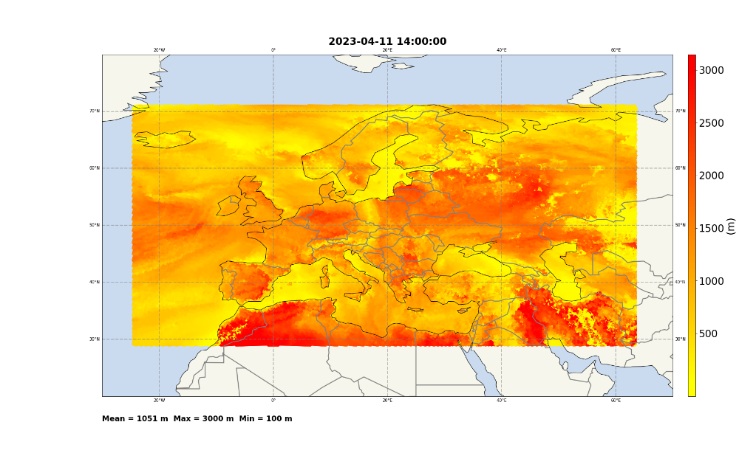
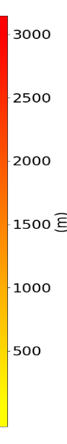
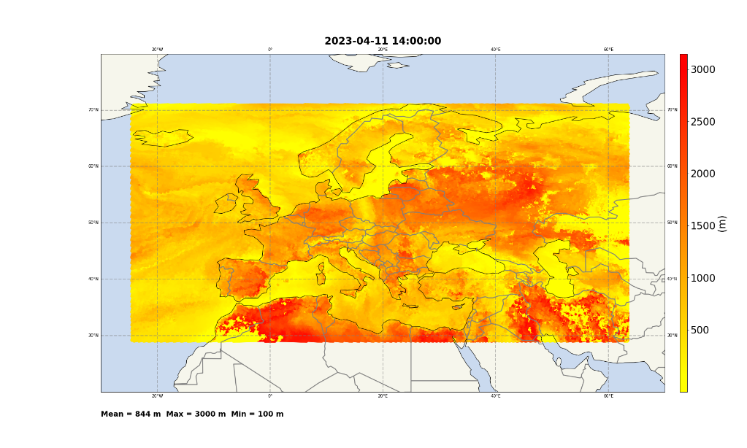

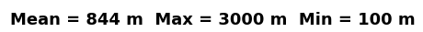


Bulk Richardson Number
D-M.4.1
Provision of offline ICON mixing heights
The results from IFS were higher than $θ_{v}$
Bulk Richardson Number
MH $=$ ${{Ri}_{(z)}=Ri}_{c}$ = 0.25
IFS
2023.04.11 at 14:00 UTC (ICON-EU domain)
$$θ_{v}$$
2023.04.11 at 14:00 UTC (ICON-EU domain)
20 W
0 W
20 E
40 E
60 E
20 W
0 W
20 E
40 E
60 E
70 N
70 N
70 N
70 N
60 N
60 N
60 N
60 N
50 N
50 N
50 N
50 N
40 N
40 N
40 N
40 N
30 N
30 N
30 N
30 N

Slide 4
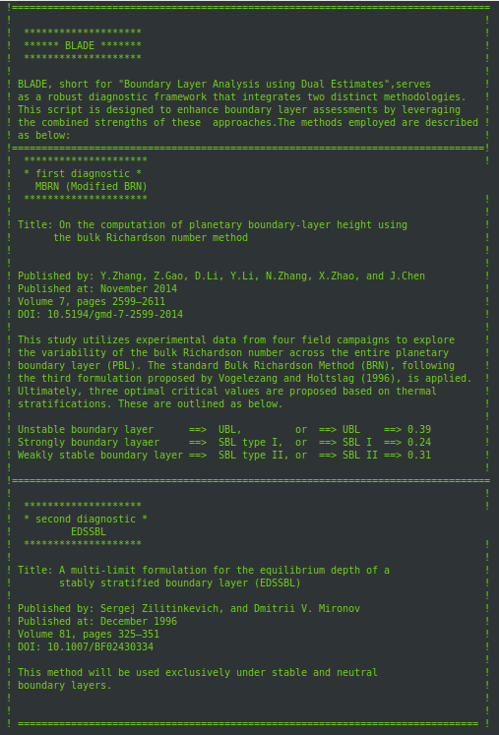

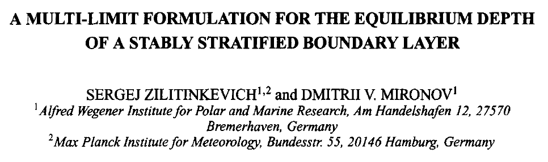
New Combined PBL Height Diagnostics
D-M.4.2
ICON-BLADE
(Boundary Layer Analysis using Dual Estimates)
ICON-BLADE is a dual diagnostic method capable of operating in convective, stable, and neutral boundary layers.
It combines a stability regime dependent BRN method with a multi-limit turbulence-based formulation for SBL and NBL.

Slide 5
New Combined PBL Height Diagnostics
ICON-BLADE (Boundary Layer Analysis using Dual Estimates)
  The main boundary layer diagnostic:
    This method, published by Zhang et al. (2014) in “On the computation of planetary boundary-layer height using the bulk Richardson number method” is originally based on the Bulk Richardson approach developed by Vogelezang and Holtslag (1996). It incorporates multiple critical Richardson numbers (Ric) tailored to different atmospheric boundary layer regimes: Ric = 0.39 for unstable boundary layer (UBL), Ric = 0.24 for strongly stable conditions (SBL I), and Ric = 0.31 for weakly stable conditions (SBL II).
  Stable and neutral boundary layer:
    This method is based on the paper “A Multi-Limit Formulation for the Equilibrium Depth of a Stably Stratified Boundary Layer” (EDSSBL) by Sergej Zilitinkevich and Dmitrii V. Mironov (1996) was employed to specifically address stable and neutral boundary layers.
vaisala.com

Slide 6
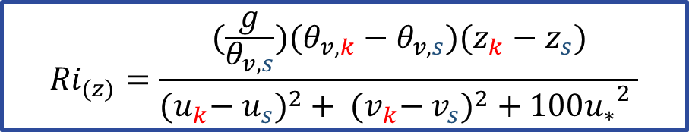
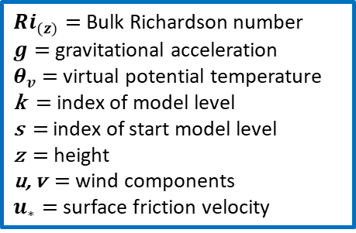
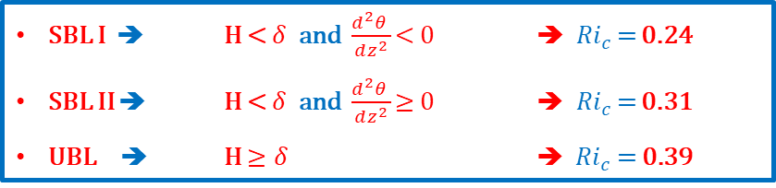
New Combined PBL Height Diagnostics
ICON-BLADE (Boundary Layer Analysis using Dual Estimates)
  The main boundary layer diagnostic:
${Ri}_{(z)}=$ Bulk Richardson number
$g=$ gravitational acceleration
$θ_{v}$= virtual potential temperature
k $=$ index of model level
s = index of start model level
z $=$ height
u, v $=$ wind components
$u_{∗}=$ surface friction velocity
$${Ri}_{(z)}=\frac{(\frac{g}{θ_{v, s}})(θ_{v,k}−θ_{v, s})(z_{k}−z_{s})}{{{(u}_{k}− u_{s})}^{2}+ {{(v}_{k}− v_{s})}^{2}+{100u_{∗}}^{2} }$$
Critica for stability regime:
SBL I ➔ H < $δ$ and $\frac{d^{2}θ }{dz^{2}}$ < 0 ➔ ${Ri}_{c}$ = 0.24
SBL II ➔ H < $δ$ and $\frac{d^{2}θ }{dz^{2}}$ $≥$0 ➔ ${Ri}_{c}$ = 0.31
UBL ➔ H $≥δ$ ➔ ${ Ri}_{c}$ = 0.39

Slide 7
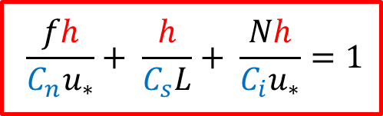

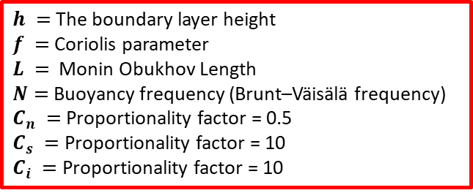
New Combined PBL Height Diagnostics
ICON-BLADE (Boundary Layer Analysis using Dual Estimates)
  The main boundary layer diagnostic:
${Ri}_{(z)}=$ Bulk Richardson number
$g=$ gravitational acceleration
$θ_{v}$= virtual potential temperature
k $=$ index of model level
s = index of start model level
z $=$ height
u, v $=$ wind components
$u_{∗}=$ surface friction velocity
$${Ri}_{(z)}=\frac{(\frac{g}{θ_{v, s}})(θ_{v,k}−θ_{v, s})(z_{k}−z_{s})}{{{(u}_{k}− u_{s})}^{2}+ {{(v}_{k}− v_{s})}^{2}+{100u_{∗}}^{2} }$$
  Stable and neutral boundary layer:
$h =$ The boundary layer height
$f =$ Coriolis parameter
$L =$ Monin Obukhov Length
$N=$ Buoyancy frequency (Brunt–Väisälä frequency)
$C_{n} =$ Proportionality factor = 0.5
$C_{s} =$Proportionality factor = 10
$C_{i} =$Proportionality factor = 10
$$\frac{fh}{C_{n}u_{∗}}+ \frac{h}{C_{s}L}+ \frac{Nh}{C_{i}u_{∗}}=1$$

Slide 8
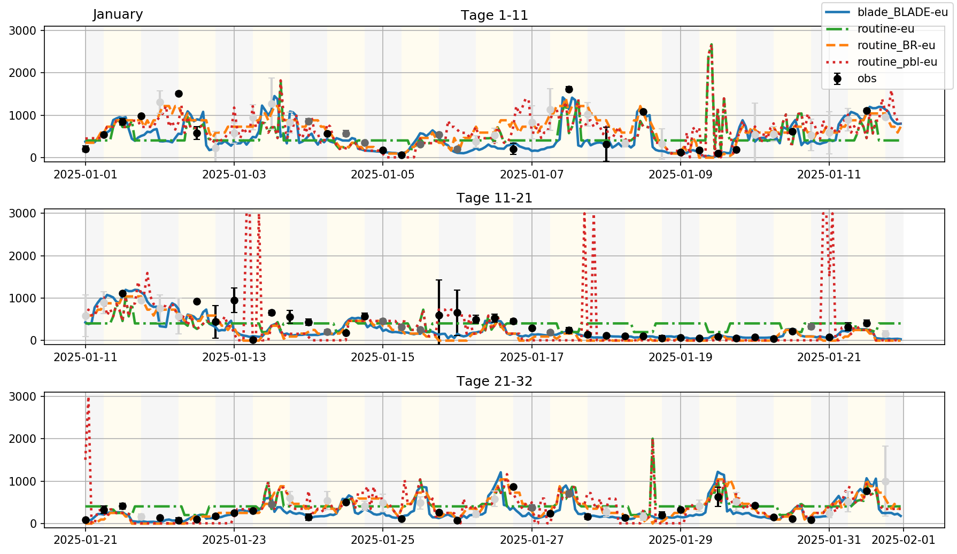
Comparison Lindenberg – Winter (Rolf Zentek)
BLADE
opendata
simple BR
extra

Slide 9
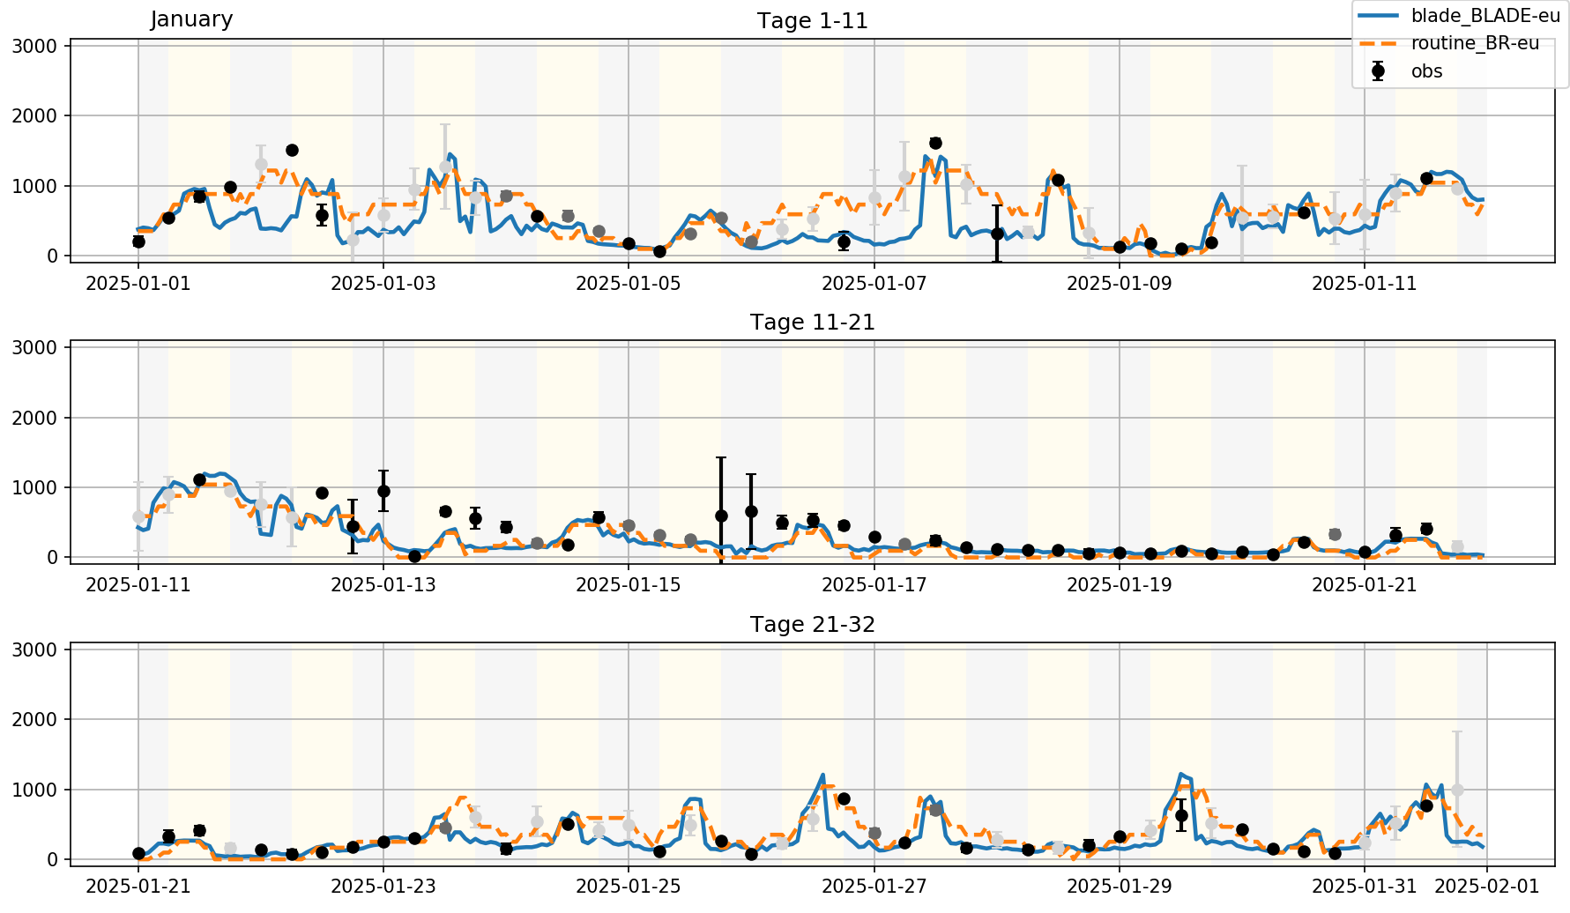
Comparison Lindenberg – Winter
BLADE
simple BR

Slide 10
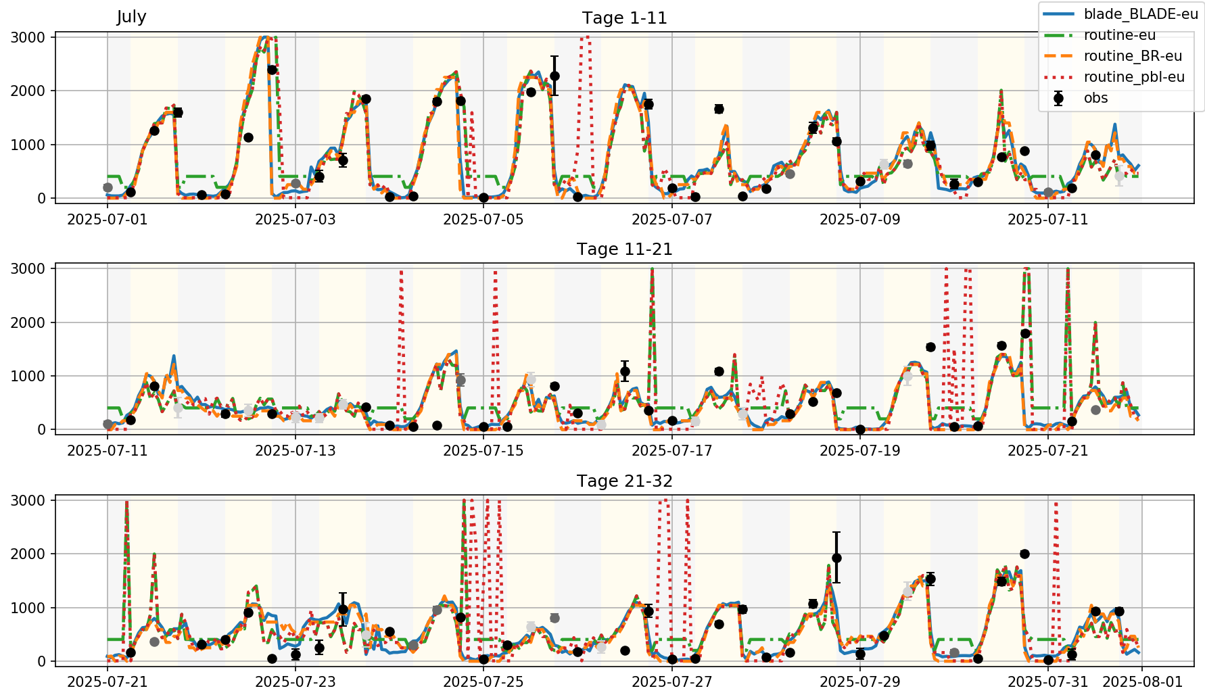
Comparison Lindenberg – Sommer
BLADE
opendata
simple BR
extra

Slide 11
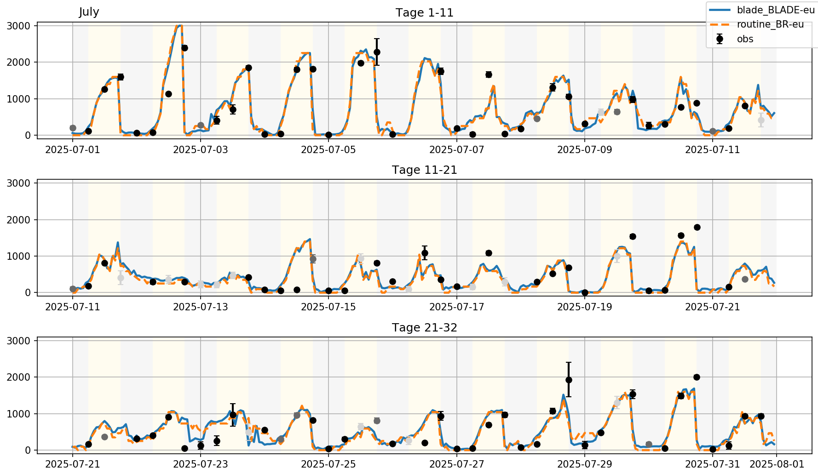
Comparison Lindenberg – Sommer
BLADE
simple BR

