Slide 1



The impact of ParFlow’s 3D subsurface hydrodynamics on ICON’ atmosphere
M. Waldmann, J. Weinkaemmerer, R. Schnur,
K. Georgen, S. Kollet, L. Schlemmer
Presented by
Jan-Peter Schulz

Slide 2
The impact of ParFlow’s 3D subsurface hydrodynamics
ICON-ParFlow coupling & simulation setup

Slide 3
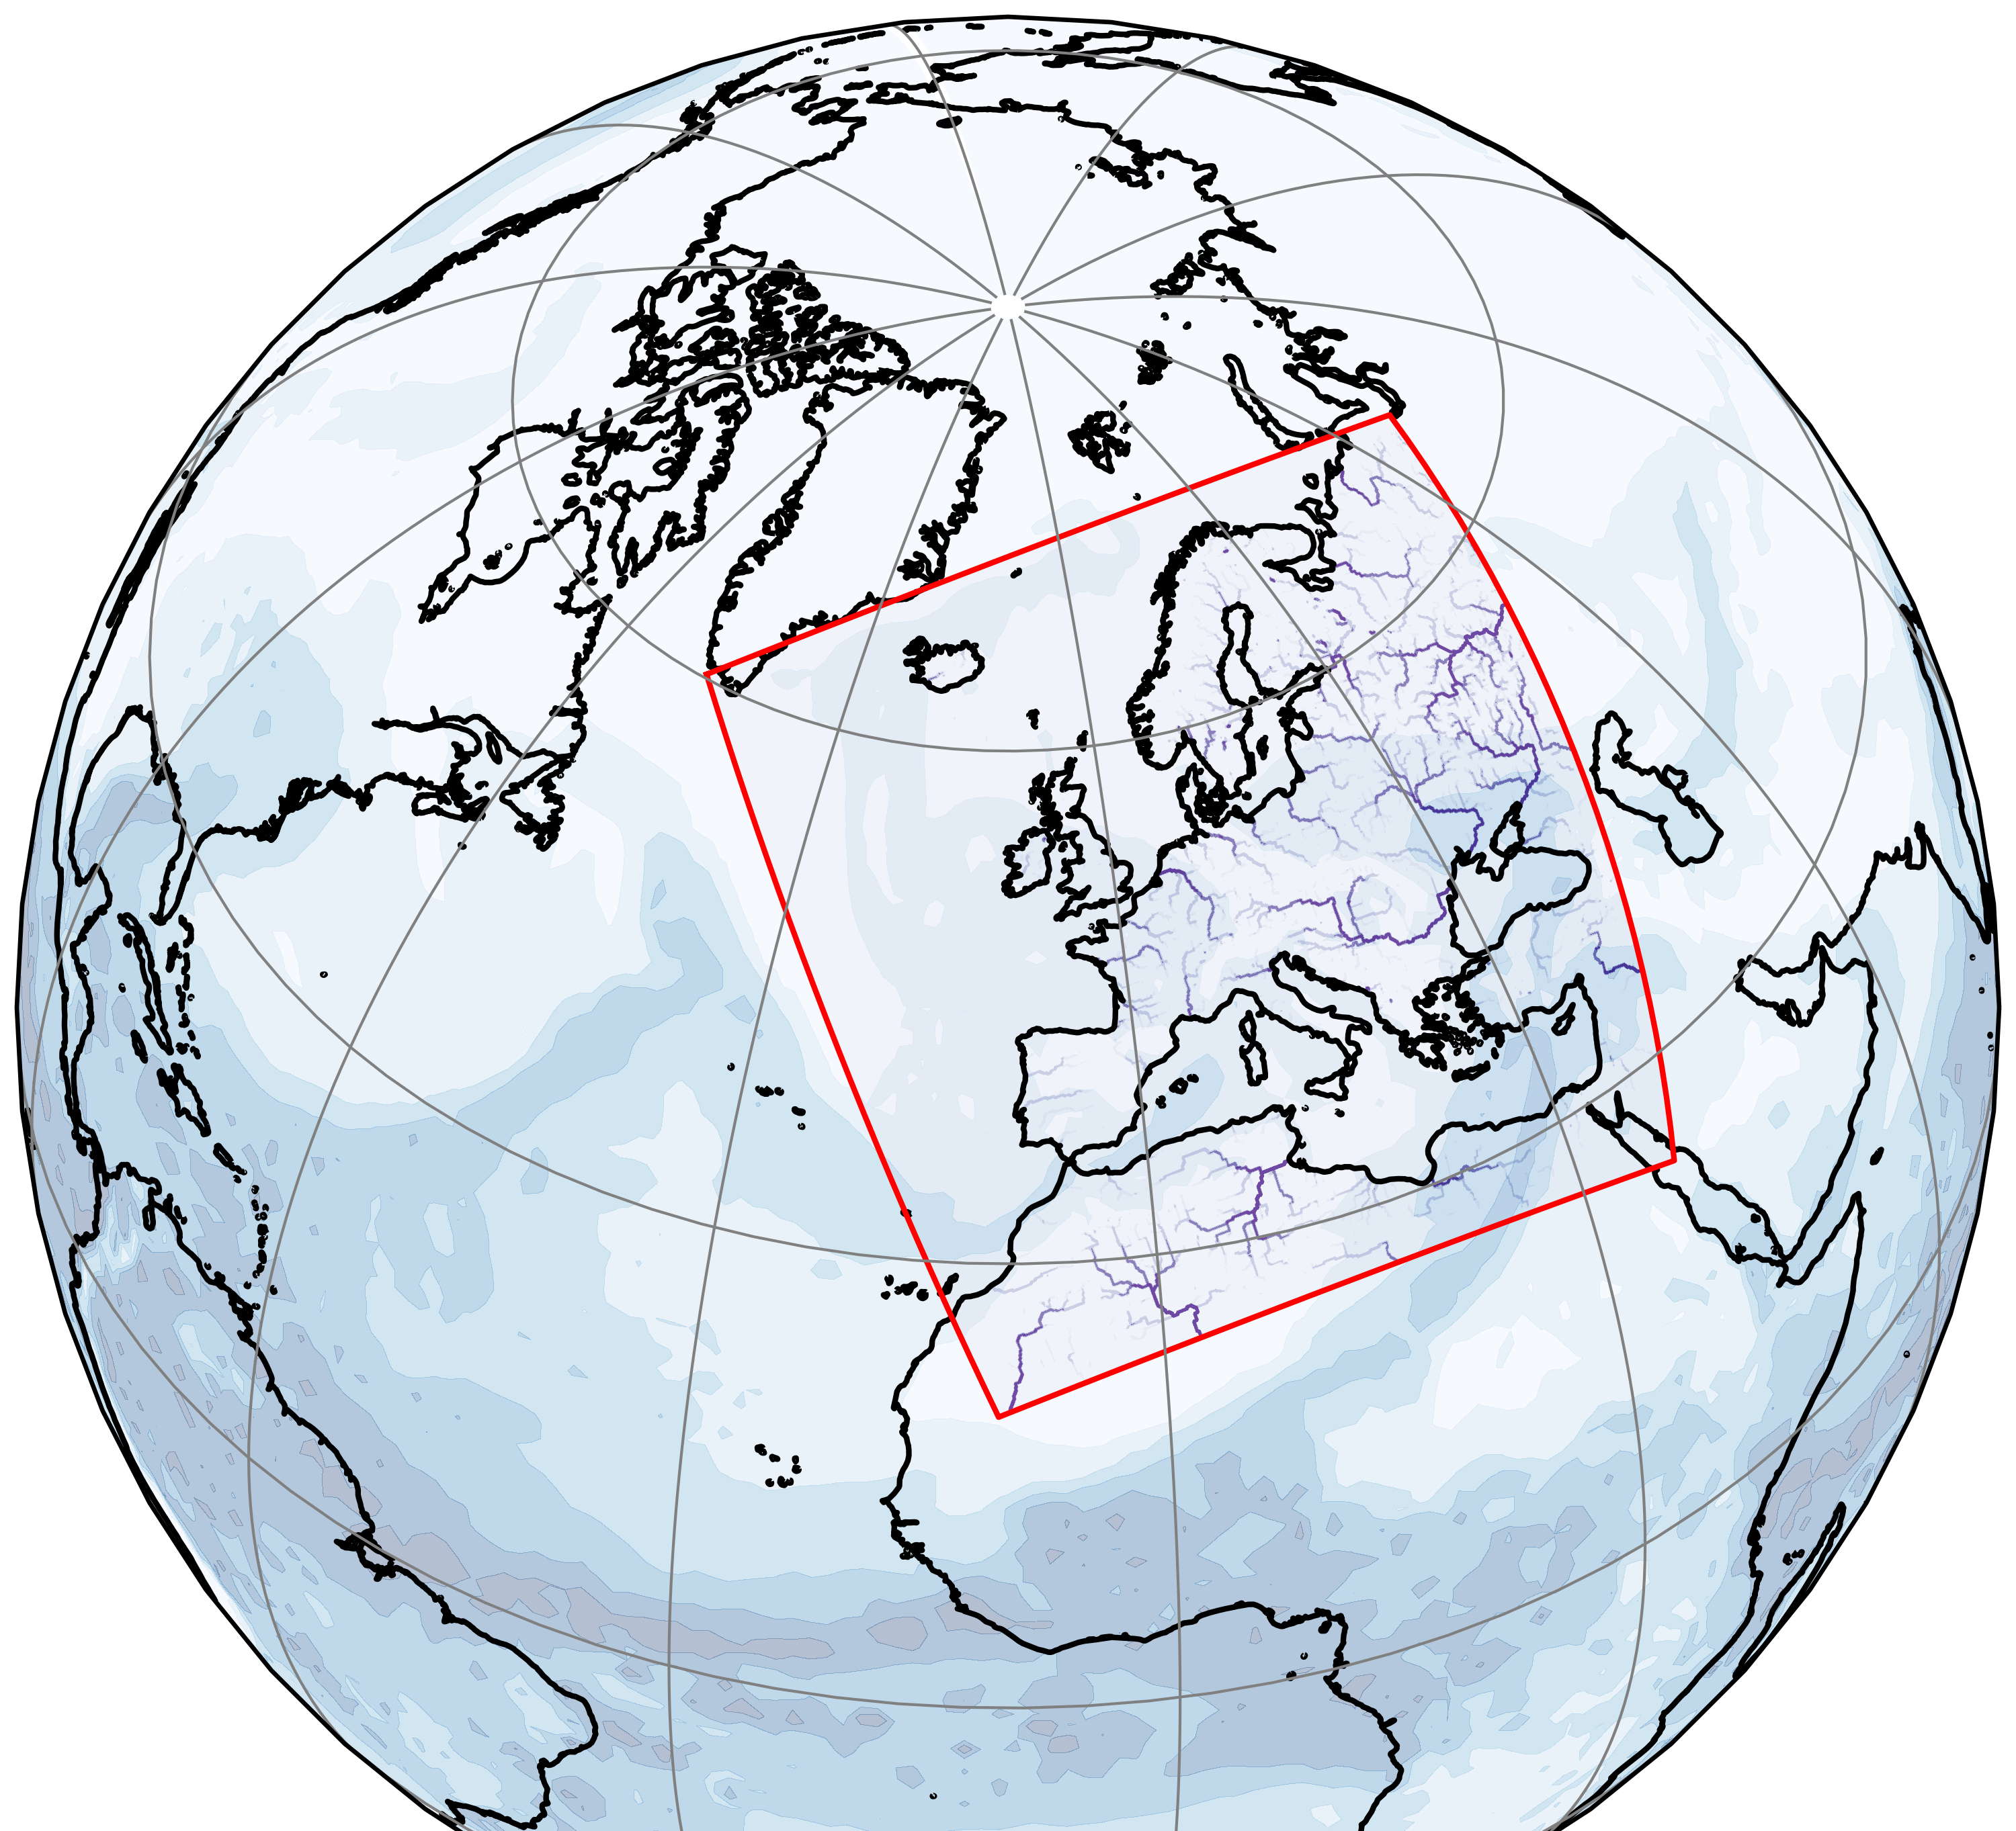
The impact of ParFlow’s 3D subsurface hydrodynamics
Technical details of the coupling:
  The coupling was implemented by Jan Weinkaemmerer (FZJ) in the WarmWorld project¹
  ParFlow² solves the 3D Richards equation for variably saturated subsurface water flow and a kinematic wave equation for surface run-off
  ParFlow is coupled to ICON-LAND (JSBACH) via YAC³
  The exchanged variables are the net water flux (P – ET) calculated by ICON-LAND and the soil water content (SWC) calculated by ParFlow
  Spatial interpolation of the exchanged fields (horizontally and vertically):
    ParFlow’s and ICON’s horizontal mesh differ (Cartesian vs. triangular mesh)
    ParFlow’s 15 soil layers cover a depth of 60m (thicknesses range 2cm - 18m)
    ICON-LAND’s 5 soil layers cover a depth of 10m (thicknesses range 6cm - 5m)
  Temporal interpolation of the exchanged fields
    ICON-LAND sends the temporally averaged net water flux (P – ET) to ParFlow
    ParFlow sends instantaneous soil water content to update ICON-LAND’s hydrology state in timesteps when it is active
    ICON-LAND uses its own hydrology scheme in timesteps when ParFlow is inactive
¹ Weinkaemmerer et al.: 10.22541/essoar.174241644.47338830/v1
² https://www.parflow.org
³ Hanke et al.: 10.5194/gmd-9-2755-2016
Fig. 1: Computational domain of the Limited Area Mode (LAM) simulation¹

Slide 4
The impact of ParFlow’s 3D subsurface hydrodynamics
Coupled simulation setup over Europe:
  Grid spacing: ∆x ≈ 3.25km for ICON (R3B9) & ∆x ≈ 3.0km for ParFlow
  Timestep: ∆t = 20s for ICON & ∆t = 3600s for ParFlow
  ICON configuration: Sapphire (Earth system modeling)
    Land model: ICON-LAND (JSBACH)
    Radiation: RRTMG (Radiative Transfer for Energetics)
    Turbulence: 3D Smagorinsky scheme
    No parameterization of atmospheric processes that can principally be resolved by the governing equations such as convection, subgrid-scale cloud cover, and orographic drag is used
  Spin-up of ParFlow for several years (ParFlow standalone)
  Two month of coupled spin-up (April and May 25)
  One month of production run (June 25)
  30 overlapping simulations in June 25, each lasting 48 hours
  Reinitialization of ICON’s atmosphere in each of the 30 simulation using an initialized analysis of DWD’s EU nest
  Restart of transient ICON-LAND run using the 24h restart file of the previous run
  Boundary conditions are extracted from DWD’s EU nest
  Reference run (ICON standalone) uses the same setup including 2 month of spin-up (April and May 25)
Coupled Spin-up
01.04. – 01.06.
Simulation 1
31.05. – 02.06.
Simulation 2
ICON-LAND restart + initialized analysis DWD
01.06. – 03.06.
Simulation 3
ICON-LAND restart + initialized analysis DWD
02.06. – 04.06.
Simulation 30
= Initialization phase
ICON-LAND restart + initialized analysis DWD
29.06. – 01.07.
= Output phase
ICON-LAND restart + initialized analysis DWD
Fig. 2: Overlapping simulation setup with reinitialization of ICON‘s atmosphere and restart of ICON-LAND

Slide 5
The impact of ParFlow’s 3D subsurface hydrodynamics
Influence of the orography

Slide 6
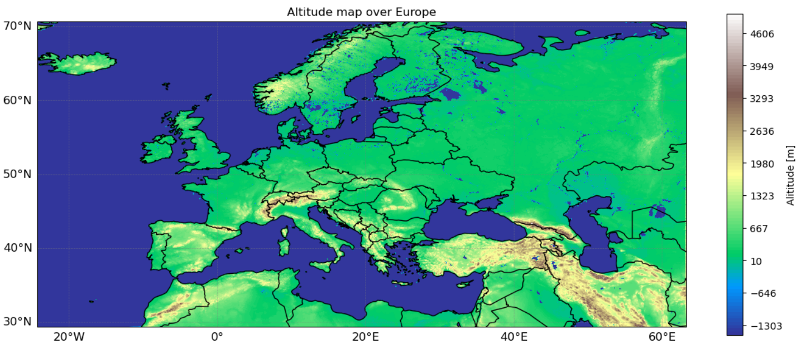
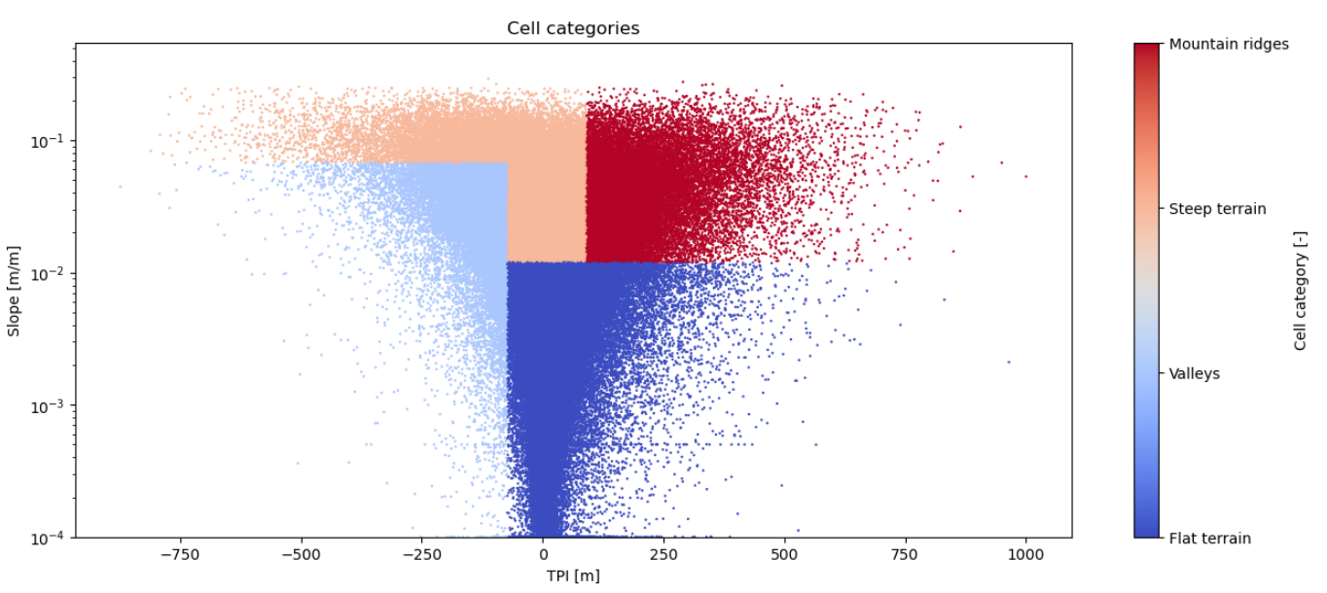
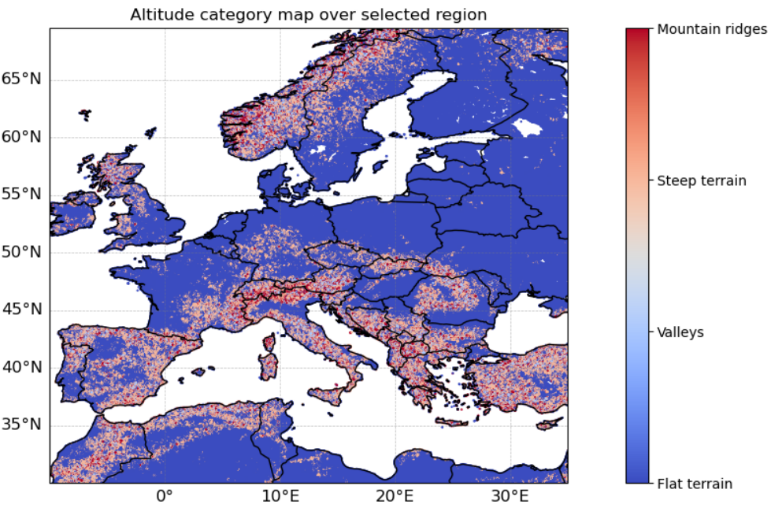
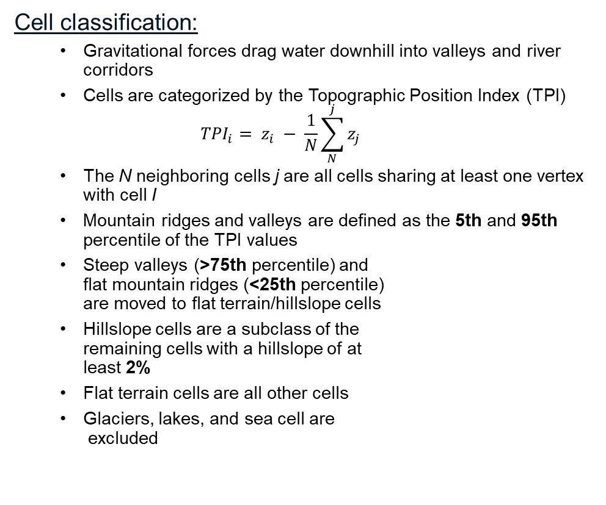
The impact of ParFlow’s 3D subsurface hydrodynamics
Cell classification:
  Gravitational forces drag water downhill into valleys and river corridors
  Cells are categorized by the Topographic Position Index (TPI)
  $${TPI}_{i}= z_{i} − \frac{1}{N}\sum_{N}^{j}{z_{j}}$$
  The N neighboring cells j are all cells sharing at least one vertex with cell I
  Mountain ridges and valleys are defined as the 5th and 95th percentile of the TPI values
  Steep valleys (>75th percentile) and
  flat mountain ridges (<25th percentile)
  are moved to flat terrain/hillslope cells
  Hillslope cells are a subclass of the
  remaining cells with a hillslope of at
  least 2%
  Flat terrain cells are all other cells
  Glaciers, lakes, and sea cell are
  excluded
Fig. 3: Surface elevation over Europe
Fig. 4: Cell categorization plotted over slope and TPI (l.) and on the map of Europe (r.)

Slide 7
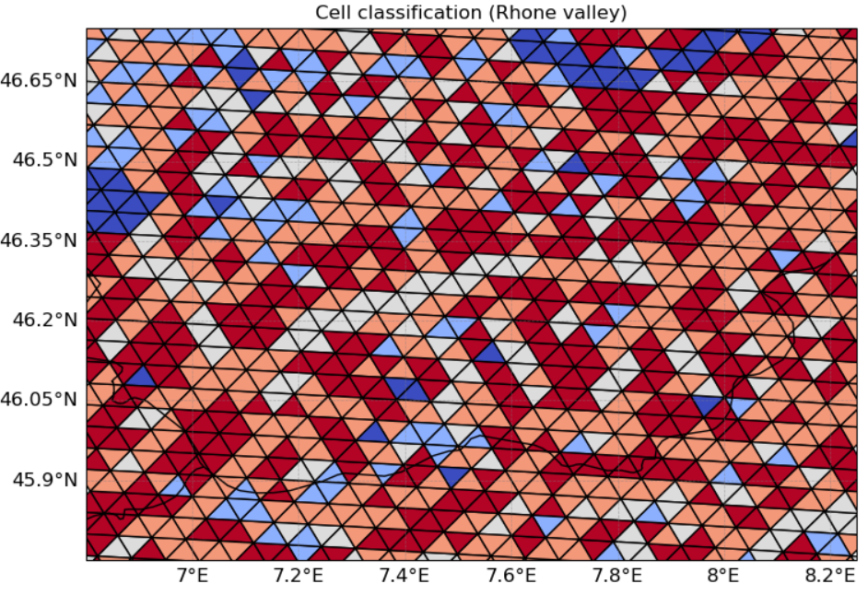
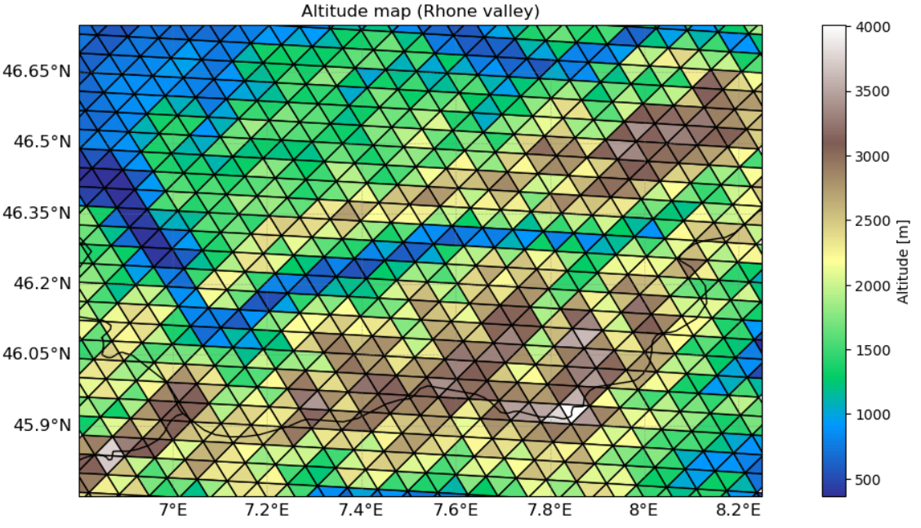
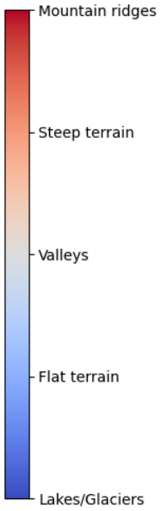
The impact of ParFlow’s 3D subsurface hydrodynamics
Fig. 5: Cell categorization (l.) and elevation (r.) plotted for the Rhone valley in Switzerland

Slide 8
The impact of ParFlow’s 3D subsurface hydrodynamics
Fig. 5: Cell categorization (l.) and elevation (r.) plotted for the Rhone valley in Switzerland

Slide 9
The impact of ParFlow’s 3D subsurface hydrodynamics
Fig. 5: Cell categorization (l.) and elevation (r.) plotted for the Rhone valley in Switzerland

Slide 10
The impact of ParFlow’s 3D subsurface hydrodynamics
Influence on the subsurface hydrology & near surface diagnostics

Slide 11
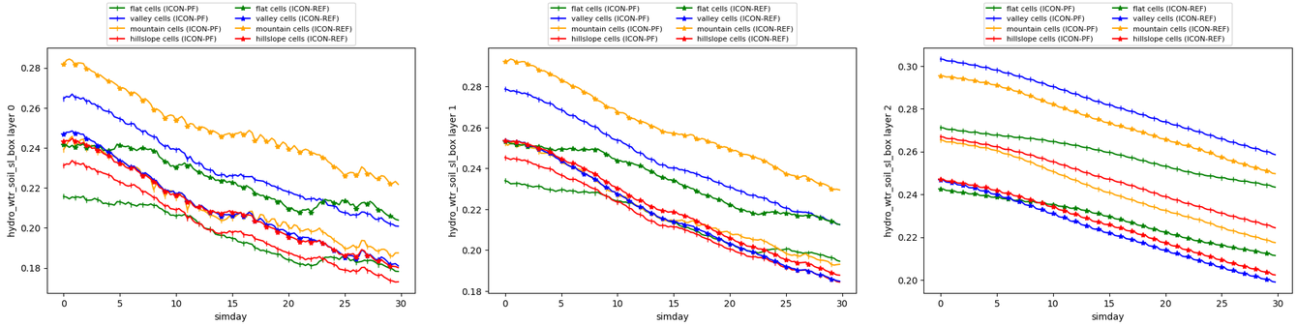
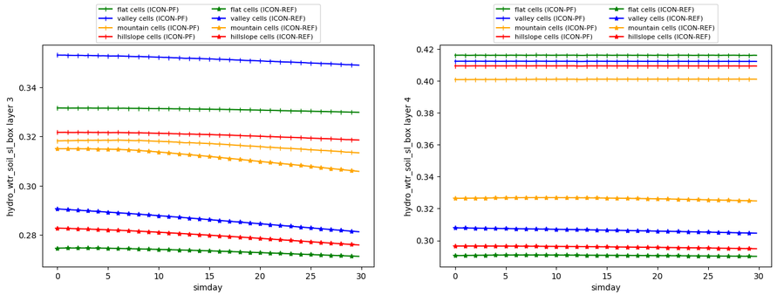
The impact of ParFlow’s 3D subsurface hydrodynamics
Fig. 6: Volumetric soil water content for all
5 layers of JSBACH
Average soil water content per category:
  Valley cells become moister in ICON-PF
  Mountain ridges become dryer in ICON-PF
  Flat terrain and hillslope cells are slightly dryer in ICON-PF
  The lower the layer the moister the soil, but the difference between uppermost and lowermost layer is larger in ICON-PF
  The soil water content in ICON-PF’s deep layer is more stable

Slide 12
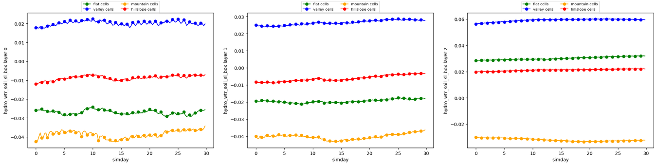
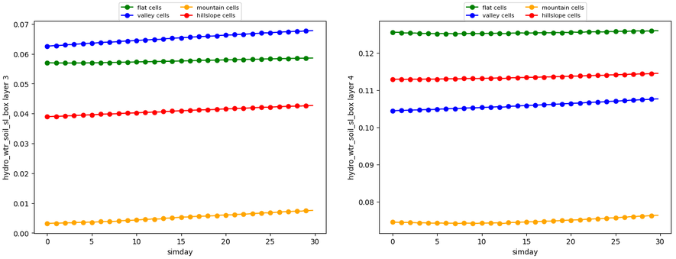
The impact of ParFlow’s 3D subsurface hydrodynamics
Fig. 7: Difference in vol. soil water content for all
5 layers of JSBACH
(ICON-PF– ICON-Ref)
Average soil water content per category:
  Valley cells become moister in ICON-PF
  Mountain ridges become dryer in ICON-PF
  Flat terrain and hillslope cells are slightly dryer in ICON-PF
  The lower the layer the moister the soil, but the difference between uppermost and lowermost layer is larger in ICON-PF
  The soil water content in ICON-PF’s deep layer is more stable

Slide 13
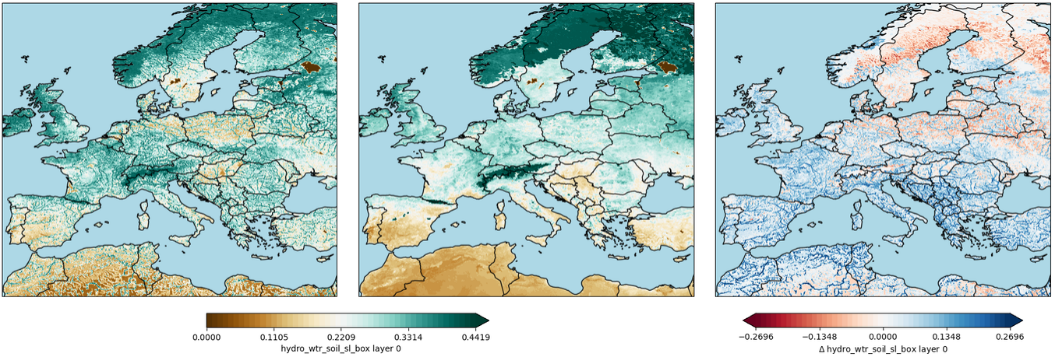
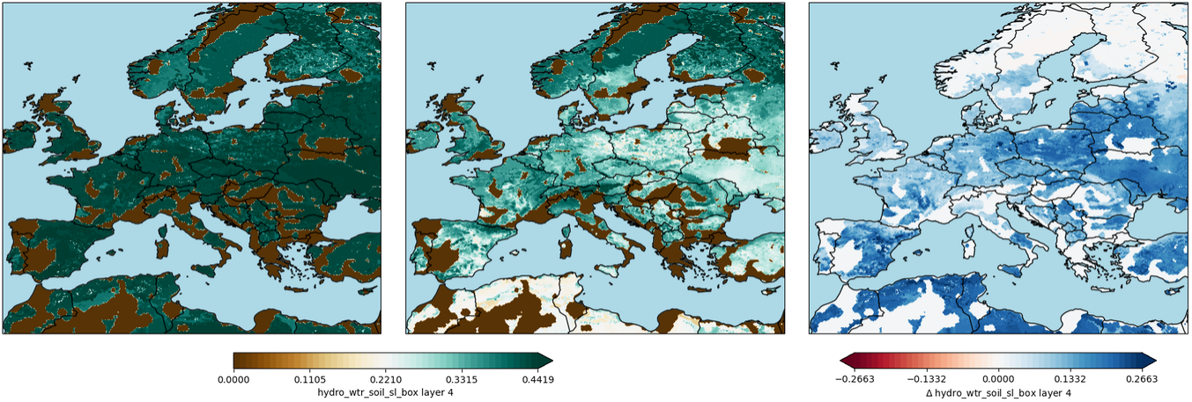
The impact of ParFlow’s 3D subsurface hydrodynamics
Soil water content distribution over Europe:
  The upper soil layer is drier in ICON-PF
    Especially Scandinavia, Poland, and north-east Germany are much drier
  ICON-PF produces a more heterogeneous soil water distribution
    The formation of river corridors is visible, in particular in dry regions
    Regions of complex orography show large soil water content gradients
  The lowermost soil layer is moister in ICON-PF
    Note that many cells are switched off due to the existence of bedrock
  The soil water content difference in the lowermost soil layer is driven by differences in the initial condition
Fig. 8: Volumetric soil water content distribution in soil layer 0 (u.) and 4 (b.) over Europe. The left figure shows ICON-PF, the middle plot shows ICON-Ref, and the one in the right shows their difference (ICON-PF – ICON-Ref)

Slide 14
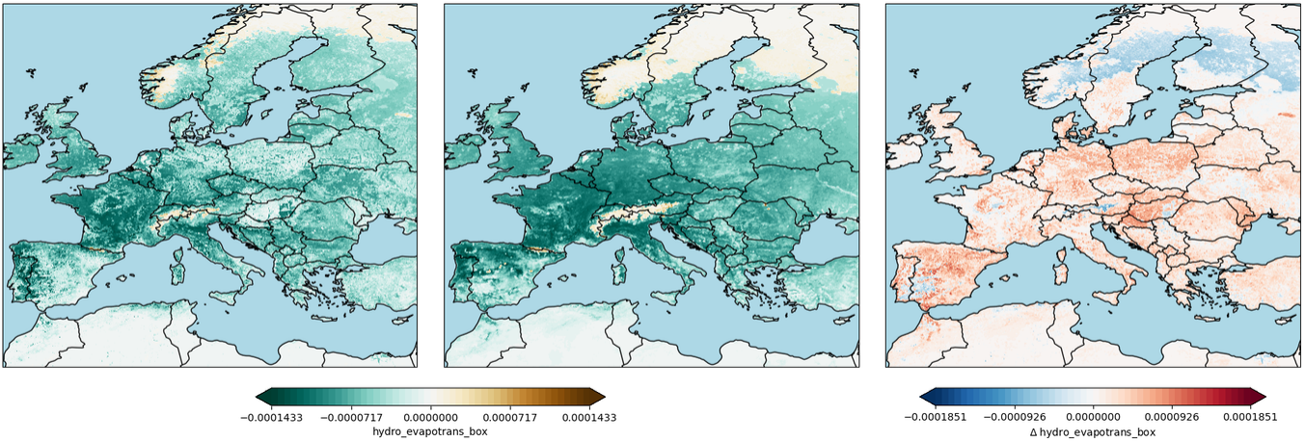
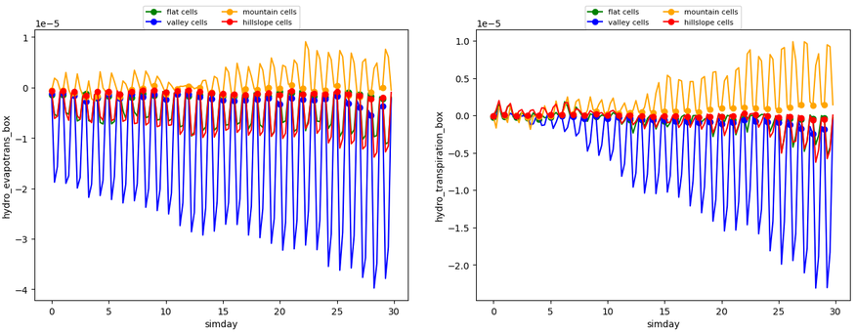
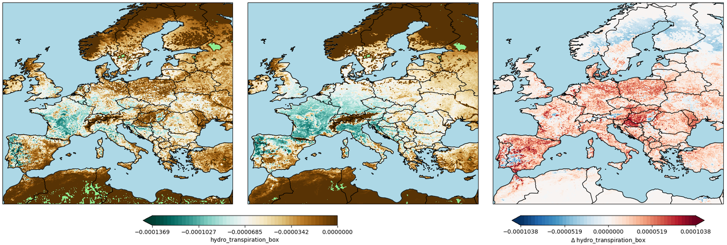
The impact of ParFlow’s 3D subsurface hydrodynamics
Evapotranspiration distribution over Europe:
  Evapotranspiration is stronger in valleys in ICON-PF
  Transpiration becomes stronger in ICON-PF in the second half of the month
  Evapotranspiration is reduced on mountain ridges in
  ICON-PF
Fig. 9: Evapotranspiration (u.) and transpiration (b.) distribution over Europe. The left figure shows ICON-PF, the middle plot shows ICON-Ref, and the one in the right shows their difference (ICON-PF – ICON-Ref)
Fig. 10: Evapotranspiration (l.) and transpiration (r.) difference spatially averaged for the cell categories. The left figure shows ICON-PF, the middle plot shows ICON-Ref, and the one in the right shows their difference (ICON-PF – ICON-Ref)

Slide 15
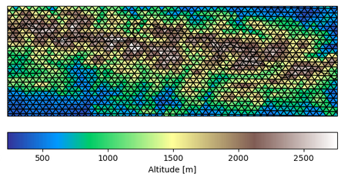
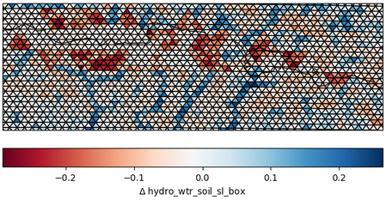
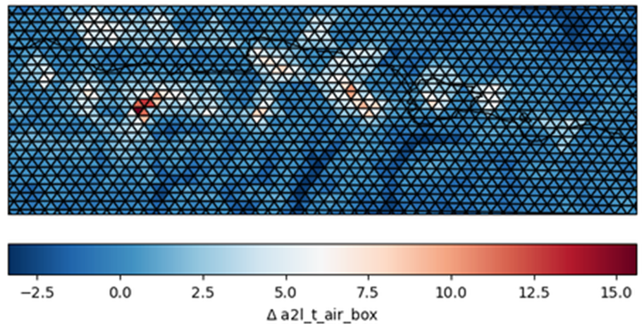
The impact of ParFlow’s 3D subsurface hydrodynamics
Soil water distribution over Pyrenees:
  The soil water content in the uppermost soil layer of valleys in the Pyrenees is larger in ICON-PF
  The larger soil water content increases evapotranspiration in the valleys
  Due to evapotranspiration, the energy partitioning in the valleys changes
    Latent heat fluxes increase
    Sensible heat fluxes decrease
  As a consequence, the near surface temperature decreases and the near surface humidity increases
Fig. 11: Surface elevation (u.), soil water content difference in the upper layer (b.l.) and 2m temperature difference (b.r.) are shown in the Pyrenees for each mesh triangle

Slide 16
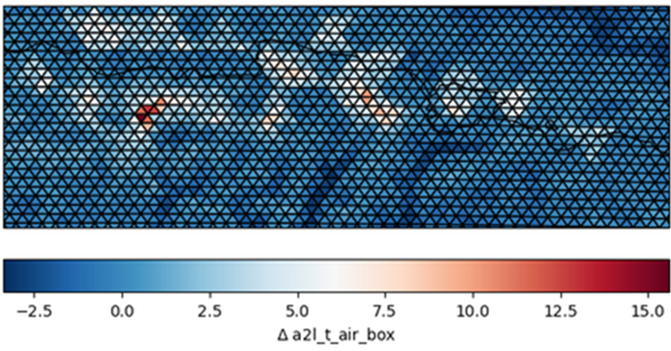
The impact of ParFlow’s 3D subsurface hydrodynamics
Soil water distribution over Pyrenees:
  The soil water content in the uppermost soil layer of valleys in the Pyrenees is larger in ICON-PF
  The larger soil water content increases evapotranspiration in the valleys
  Due to evapotranspiration, the energy partitioning in the valleys changes
    Latent heat fluxes increase
    Sensible heat fluxes decrease
  As a consequence, the near surface temperature decreases and the near surface humidity increases
Fig. 11: Surface elevation (u.), soil water content difference in the upper layer (b.l.) and 2m temperature difference (b.r.) are shown in the Pyrenees for each mesh triangle

Slide 17
The impact of ParFlow’s 3D subsurface hydrodynamics
Soil water distribution over Pyrenees:
  The soil water content in the uppermost soil layer of valleys in the Pyrenees is larger in ICON-PF
  The larger soil water content increases evapotranspiration in the valleys
  Due to evapotranspiration, the energy partitioning in the valleys changes
    Latent heat fluxes increase
    Sensible heat fluxes decrease
  As a consequence, the near surface temperature decreases and the near surface humidity increases
Fig. 11: Surface elevation (u.), soil water content difference in the upper layer (b.l.) and 2m temperature difference (b.r.) are shown in the Pyrenees for each mesh triangle

Slide 18
The impact of ParFlow’s 3D subsurface hydrodynamics
Summary:
  Using ParFlow heterogenizes the distribution of soil water content due to lateral water transport (subsurface + runoff)
    The soil in valley cells tend to become moister
    The soil in mountain ridge cells tend to become dryer
    In flat terrain, the differences are smaller but still visible
    When using ParFlow, rivers build naturally as a consequence of the local orography
  The differences in soil water content alter the surface fluxes
    The evapotranspiration in valley cells increases, especially in dry regions as the Pyrenees
    Mountain ridge cells show a shift of the energy partitioning from latent heat flux towards sensible heat flux
  The surface fluxes influence the state of the near-surface diagnostics
    The 2m temperature and humidity in valleys of the Pyrenees is reduced if the soil moister increases due to lateral water transport by ParFlow
  ParFlow’s influence on further atmospheric variables requires further investigation

