Slide 1
The Implementation of the Leonard-Terms: First Results
Daniela-C. Littmann, Matthias Raschendorfer, Alberto de Lozar, and the GLORI Team
Deutscher Wetterdienst (DWD), Offenbach am Main, Germany
14 September 2026

Slide 2


Content
1. Motivation
2. Theory and Model Setup
3. Preliminary Results
4. Summary
1
2
3
4

Slide 3

1. Motivation
1
1
2
3
4

Slide 4
State-of-Art
We see strong differences in the structure of heavy rain cells, which are not reflected in the monthly scores
During period of strong convection, strong vertical transport occur for finest resolution, but accumulated precipitation is higher at the coarsest resolution
The higher resolution may deplete CAPE more quickly due to more complex atmospheric circulations.
1
2
3
4

Slide 5
2. Theory and Model Setup
1
2
3
4

Slide 6
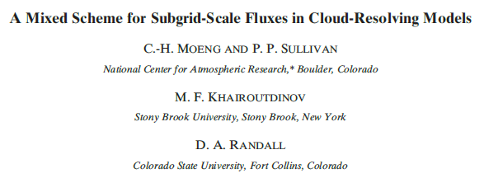
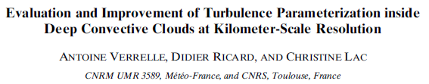
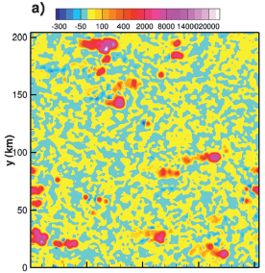
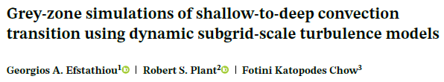
Introducing the Leonard Terms
Benchmark LES for deep convection:
„Counter gradients and a more realistic representation of cloud morphology and cellular organisation“
„More complex behaviour in the vertical moisture flux transport“
„… improves transition from shallow to deep convection.-.“
1
2
3
4
28th COSMO General Meeting, 14-18 September 2026
Notes:
Not favre averaged expression for compressible flows shown here
Represents part of the SG flux that can be explicetly computed from resolved fields when applying a filter
Unlike the reynolds term, which requires parametrization, the LT accounts for interactions of the resolved scales that fall just below the effective resolution of the model
RES: motions >= df, LT: dx <= motions <= df, SGS: motions <= dx
Example 500 m: df=4*dx=2km → RES >= 2km, 500m <= LT < 2km, SGS < 500m
It describes small scale interaction, larger than turbulence but smaller than effective resolution contribute to the flux

Slide 7
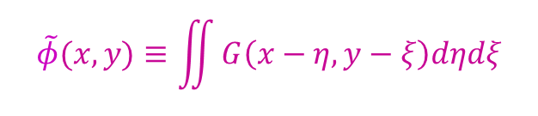




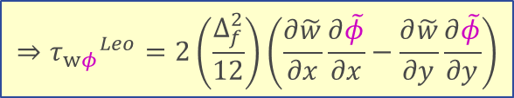


Schematic Derivation
subgrid $φ^{′′}$
resolved $\overline{φ}$
LES
NWP $∆x_{eff}$ $≅∆_{f}$
subfilter scale $φ^{′}$
filter scale $\tilde{φ}$
$$\tilde{φ}(x,y)≡\iint{G\left(x−η,y−ξ\right)dηdξ}$$
NWP
$$φ^{′}(x,y)=φ(x,y)−\tilde{φ}(x,y)$$
$$⇒{τ_{wφ}}^{Leo}=2\left(\frac{∆_{f}^{2}}{12}\right)\left(\frac{∂\tilde{w}}{∂x}\frac{∂\tilde{φ}}{∂x}−\frac{∂\tilde{w}}{∂y}\frac{∂\tilde{φ}}{∂y}\right)$$
Moeng et al. (2010)
1
2
3
4
7
28th COSMO General Meeting, 14-18 September 2026
Notes:
No new parametrisation, because the terms are expressed by the resolved scales
No double counting, because it is not a temporal correction, but a physical consistent spatial correction of the flux

Slide 8
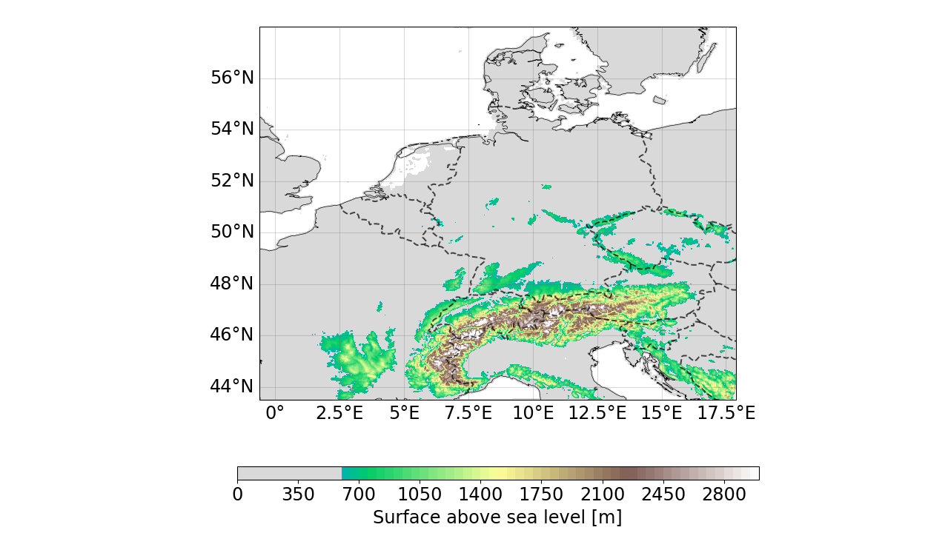

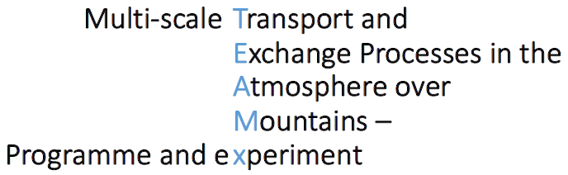
ICON-LAM Setup
Model top | 22 km
Vertical level | 65 full (66 half)
Hor. grid scale | 2km, 1km, 500m
LATBC (at start) | Forecast (ICON-EU)
∆x
Forecast start | 0 UTC
Duration | 36 UTC
2 km
1-way-Nesting
Model version icon-2026.04
2-moment microphysics (RUC Setup)
1 km
0.5 km
1
2
3
4
28th COSMO General Meeting, 14-18 September 2026
Notes:
Instead of the operational setup, use the RUC-setup, which was developed by the SINFONY project, predicting exrteme rain events over Germany:
Main difference: 2MMP
Additionally, restart every 12 h and duration 36 h

Slide 9
3. Preliminary Results
1
2
3
4
28th COSMO General Meeting, 14-18 September 2026

Slide 10
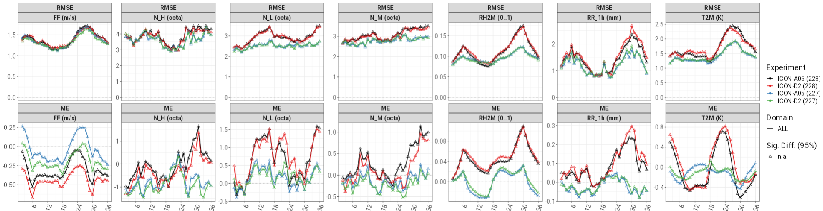
Verification
Initial time 12 UTC
∆x=0.5 km (leo)
Scores
∆x=2 km (leo)
∆x=0.5 km (ref)
∆x=2 km (ref)
Lead-time (h)
1
2
3
4
28th COSMO General Meeting, 14-18 September 2026

Slide 11
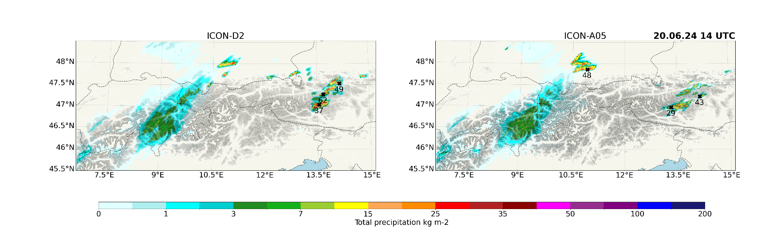
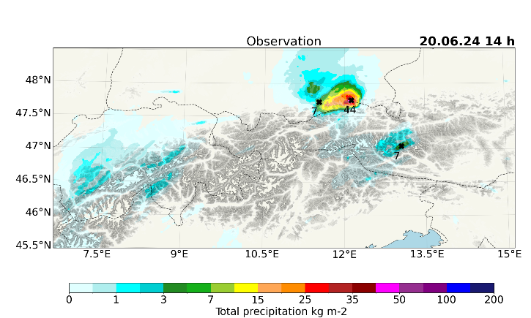
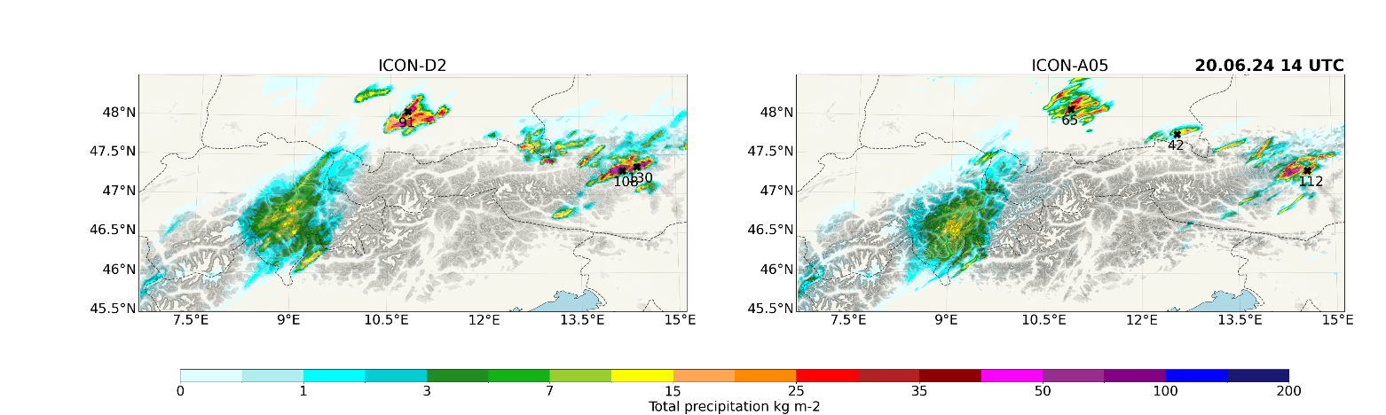
Total Precipitation
reference
leonard
1
2
3
4
28th COSMO General Meeting, 14-18 September 2026

Slide 12
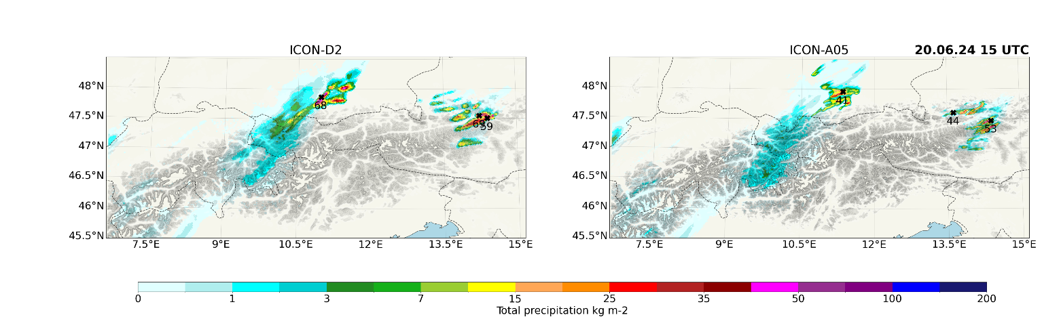
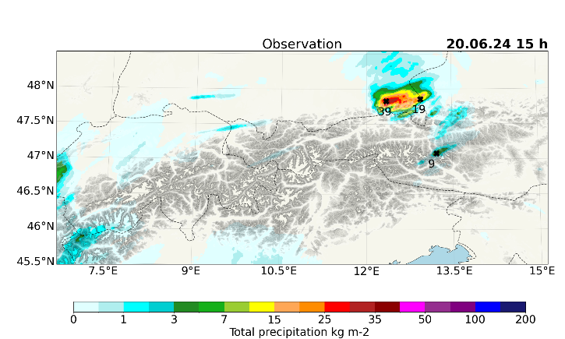
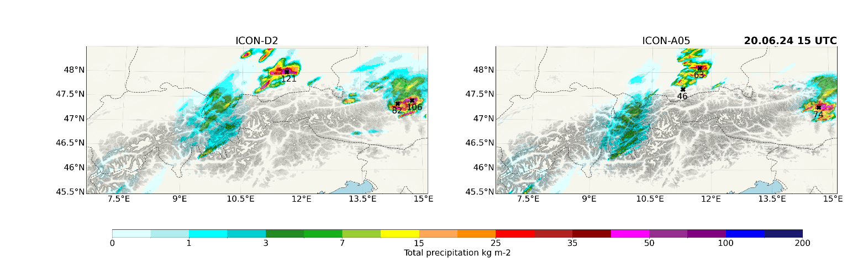
Total Precipitation
reference
leonard
1
2
3
4
28th COSMO General Meeting, 14-18 September 2026

Slide 13
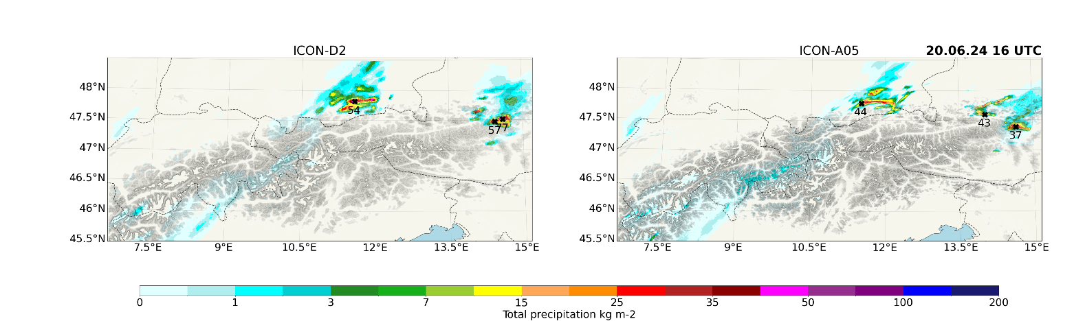
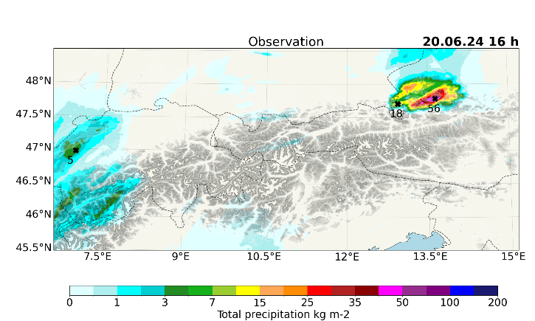
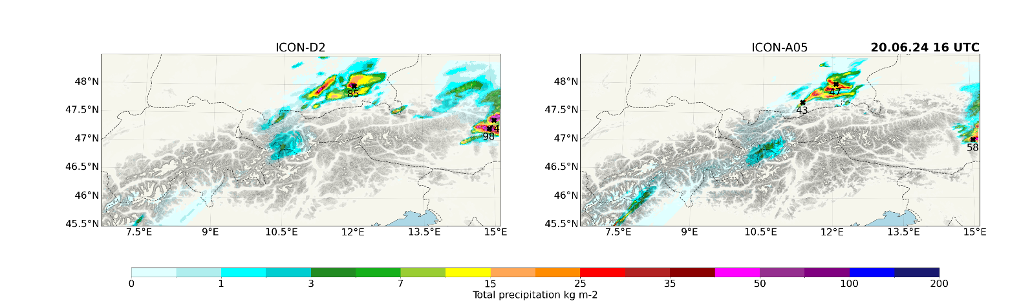
Total Precipitation
reference
leonard
1
2
3
4
28th COSMO General Meeting, 14-18 September 2026

Slide 14
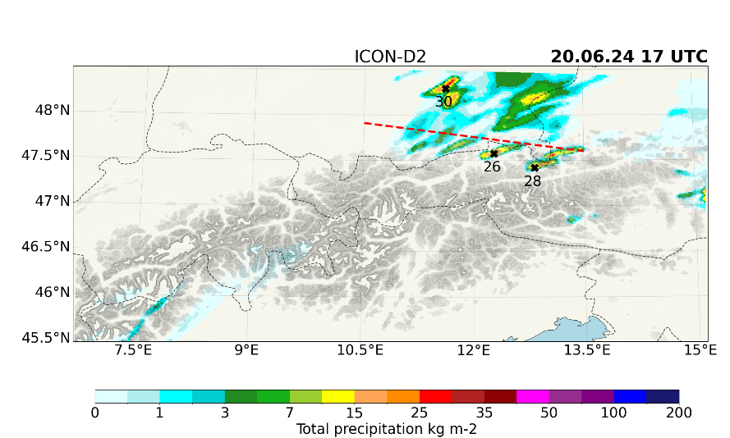
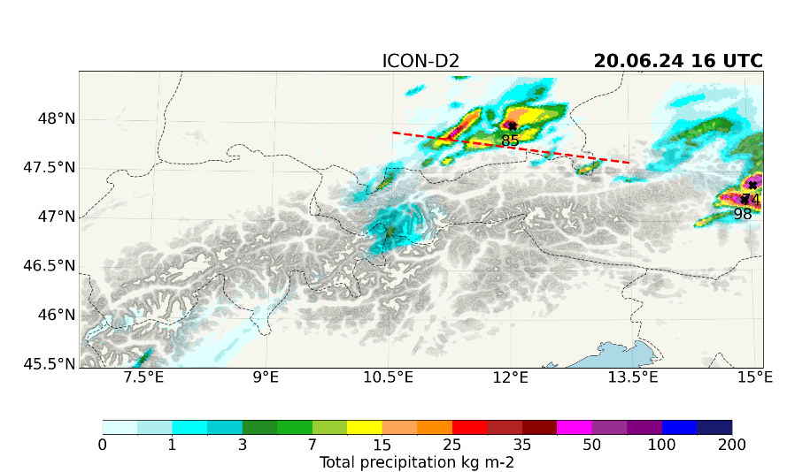
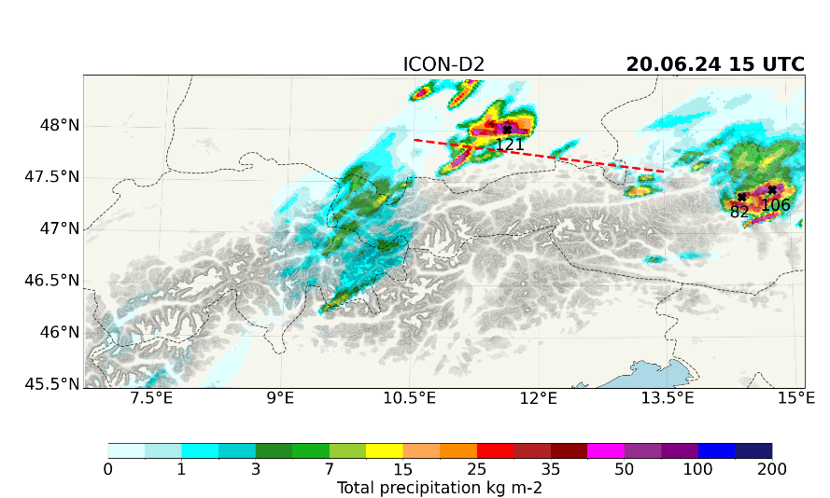
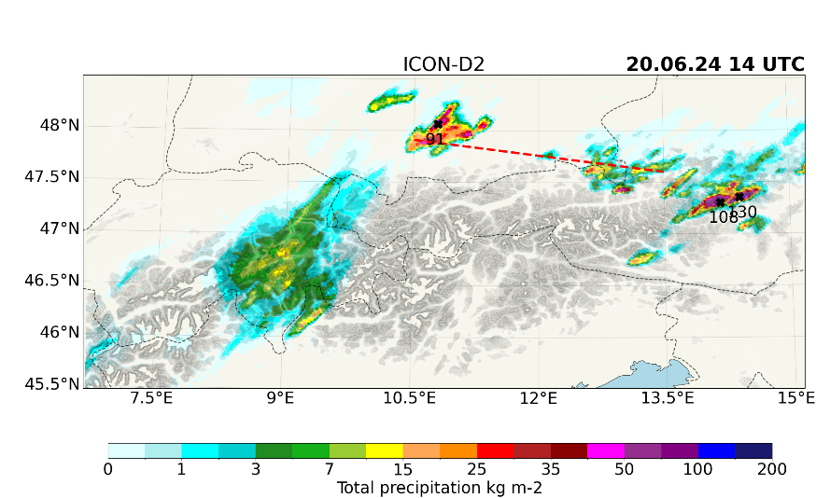
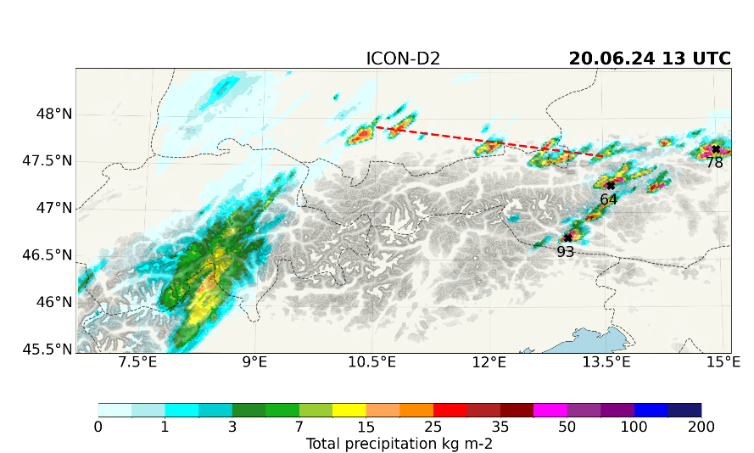
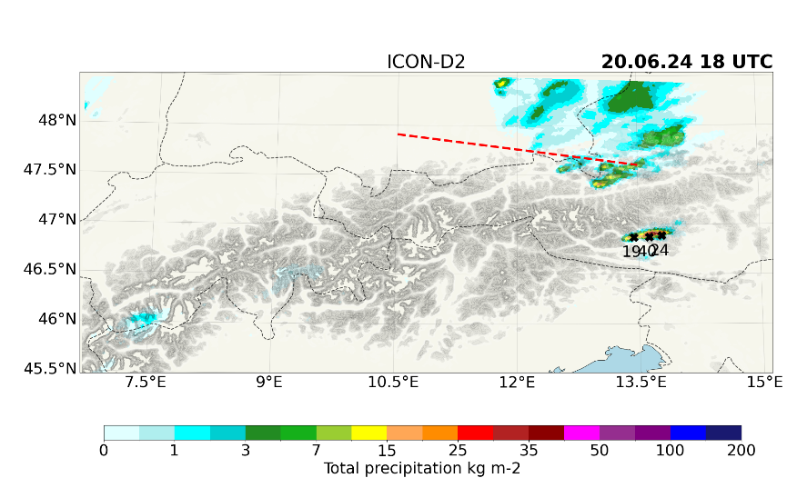
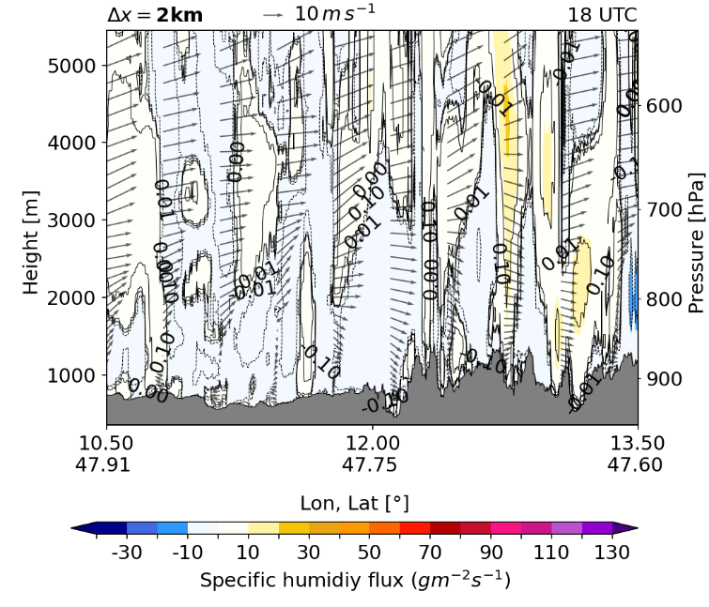
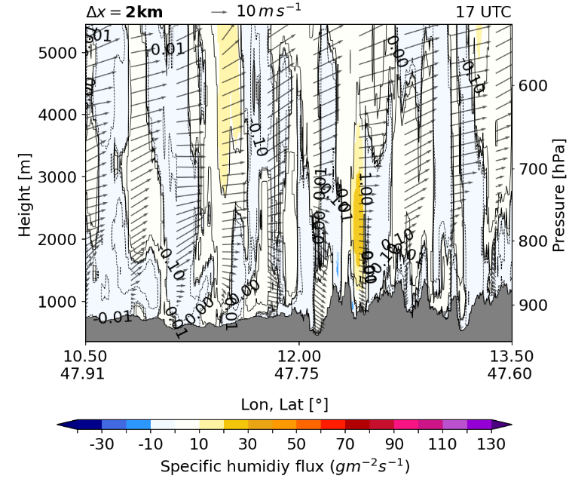
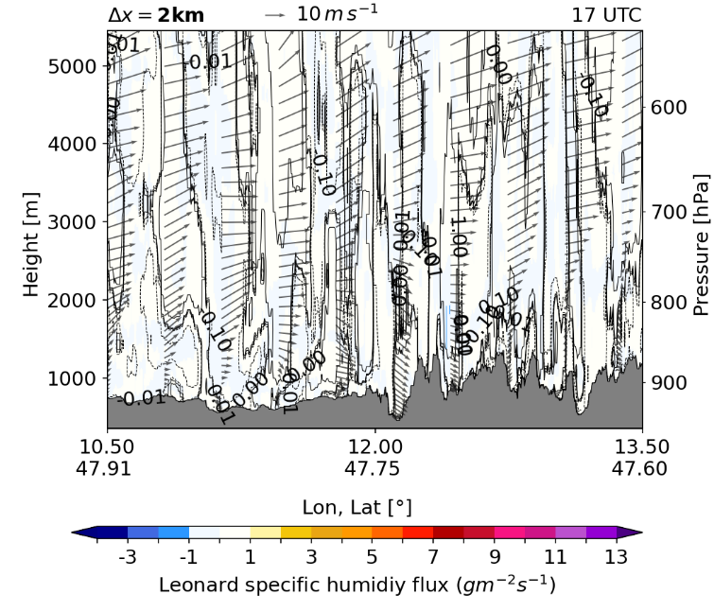
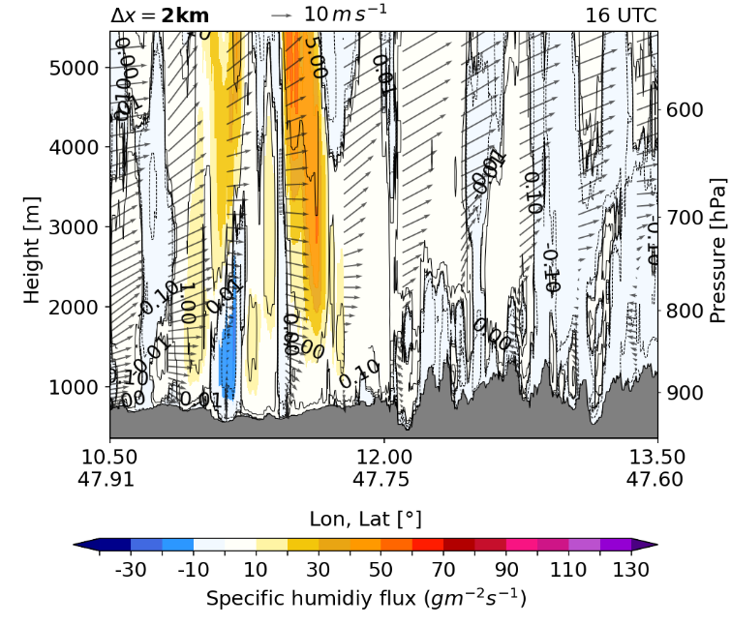
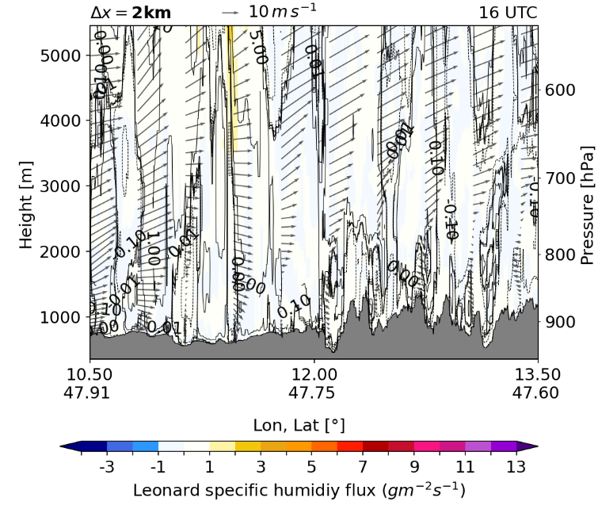
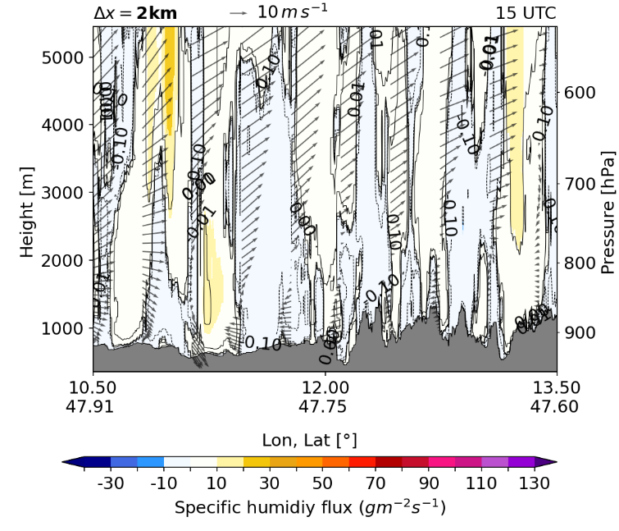
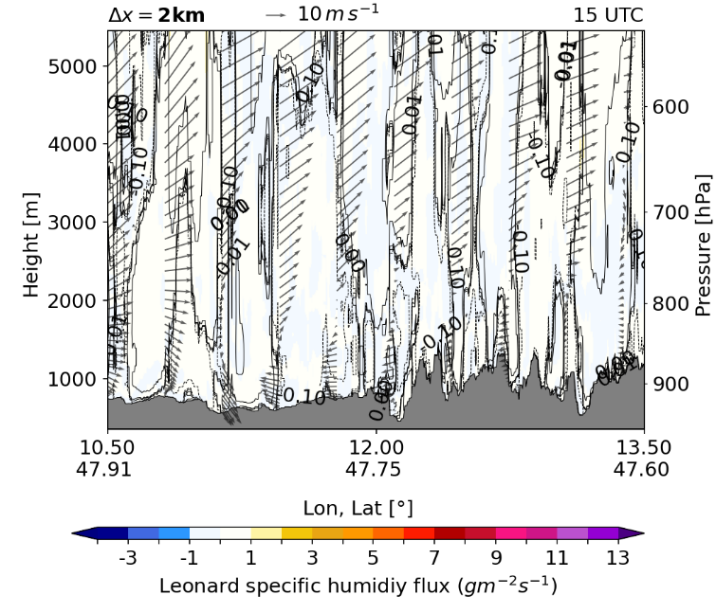
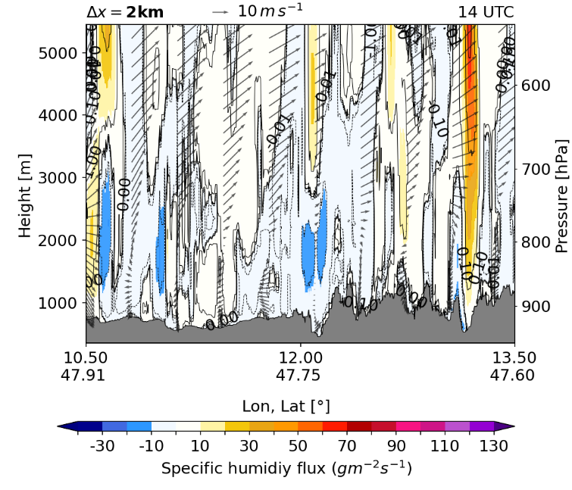
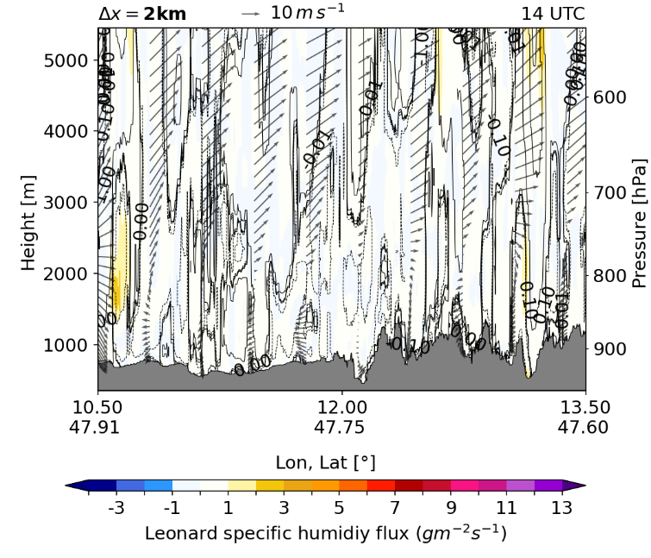
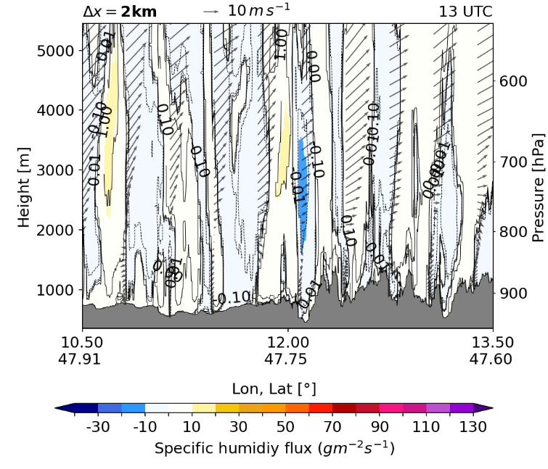
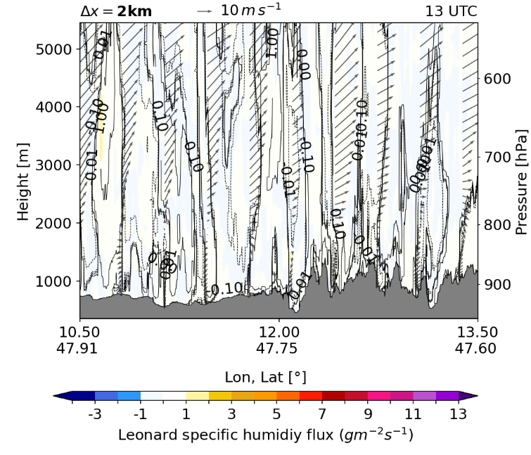
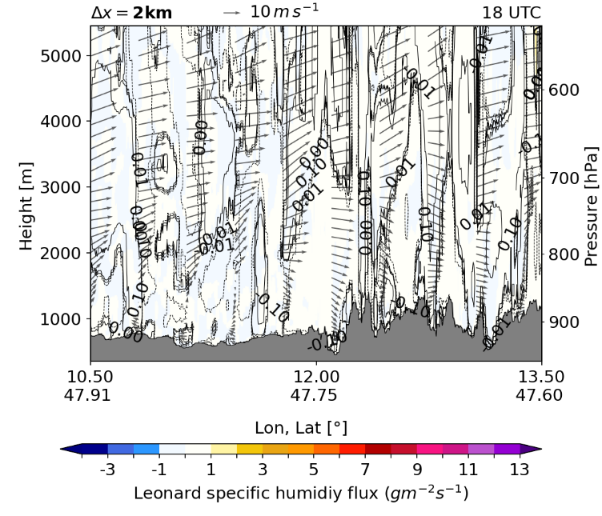
Leonard flux range

Slide 15
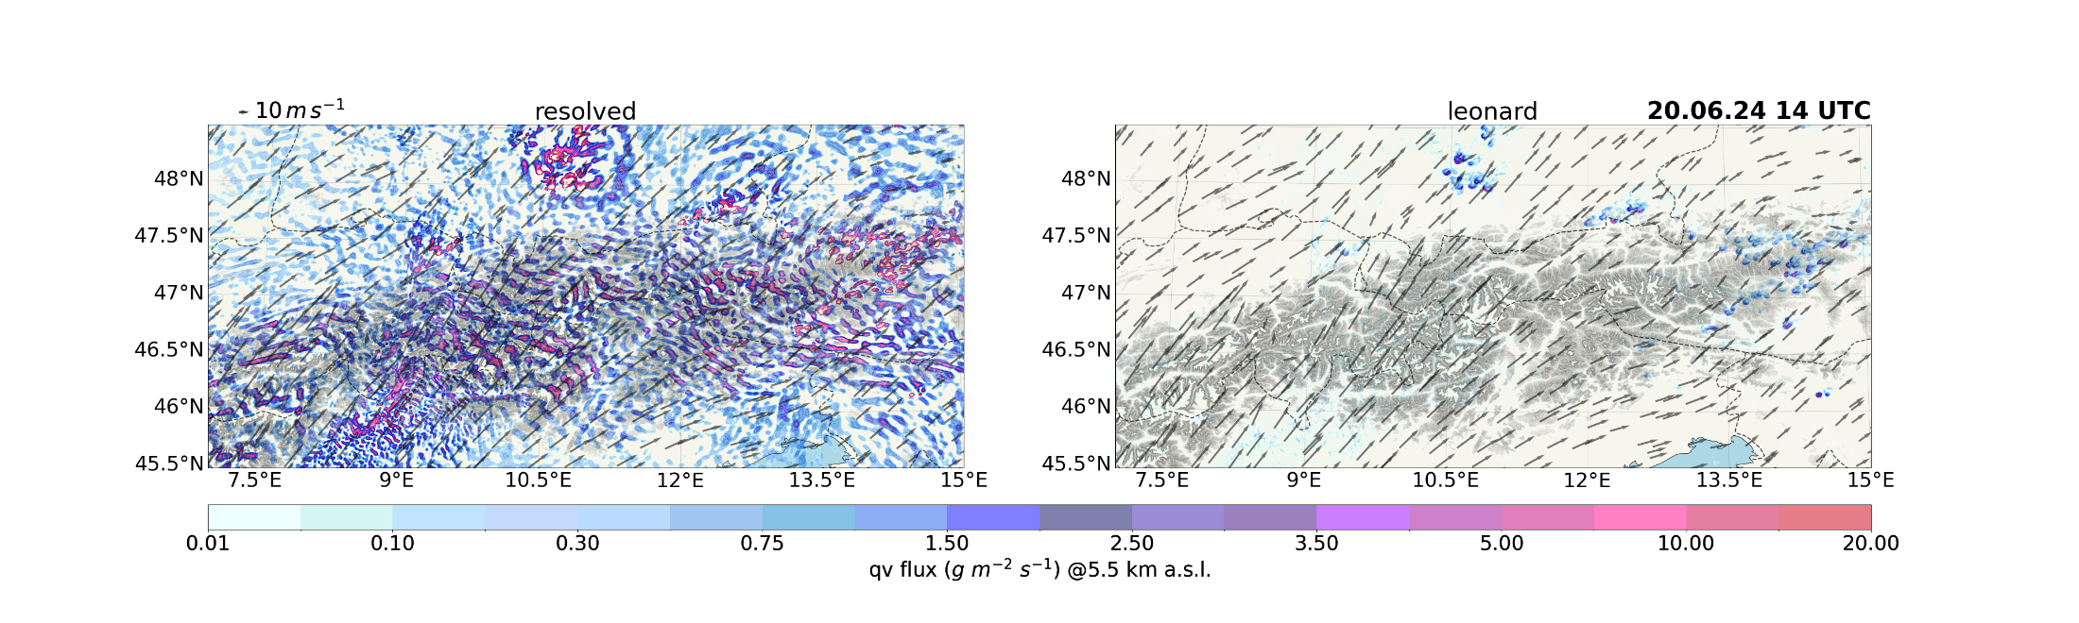
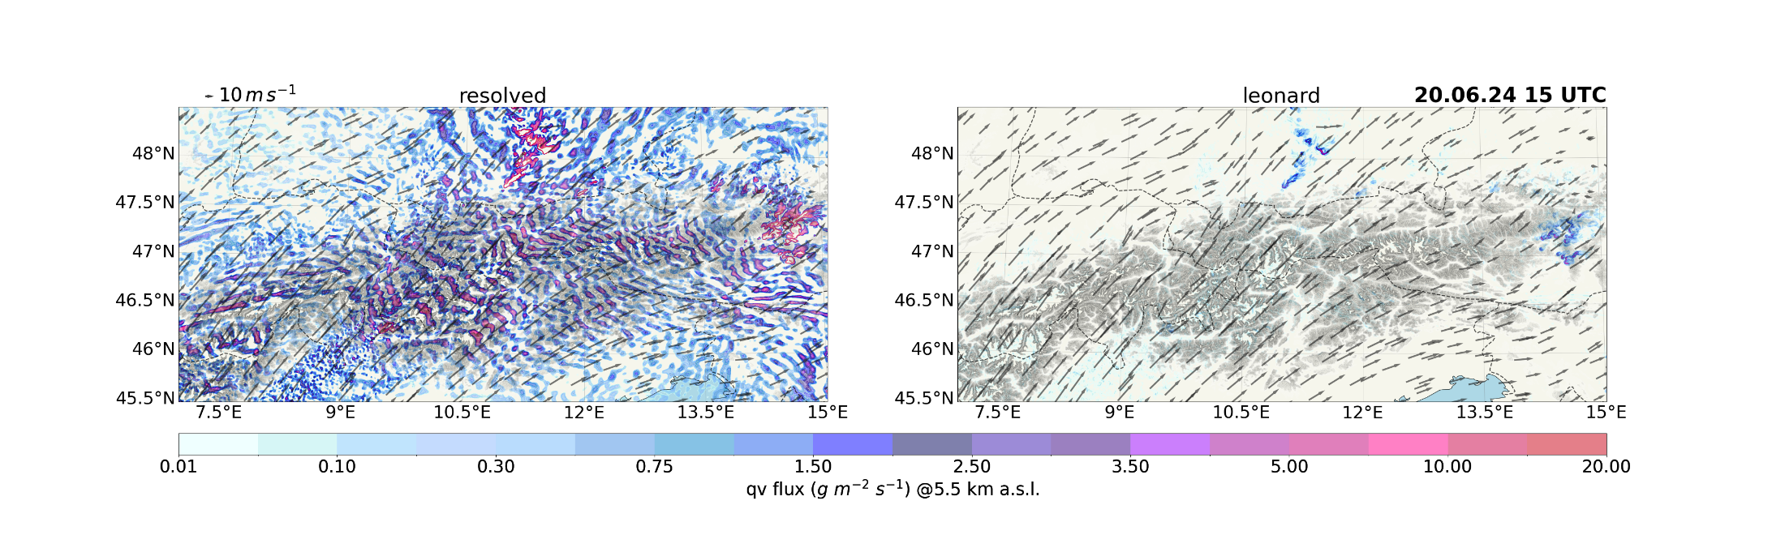
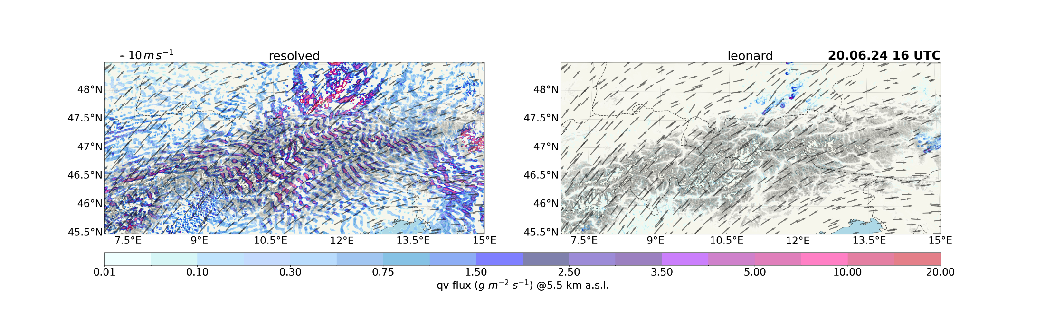
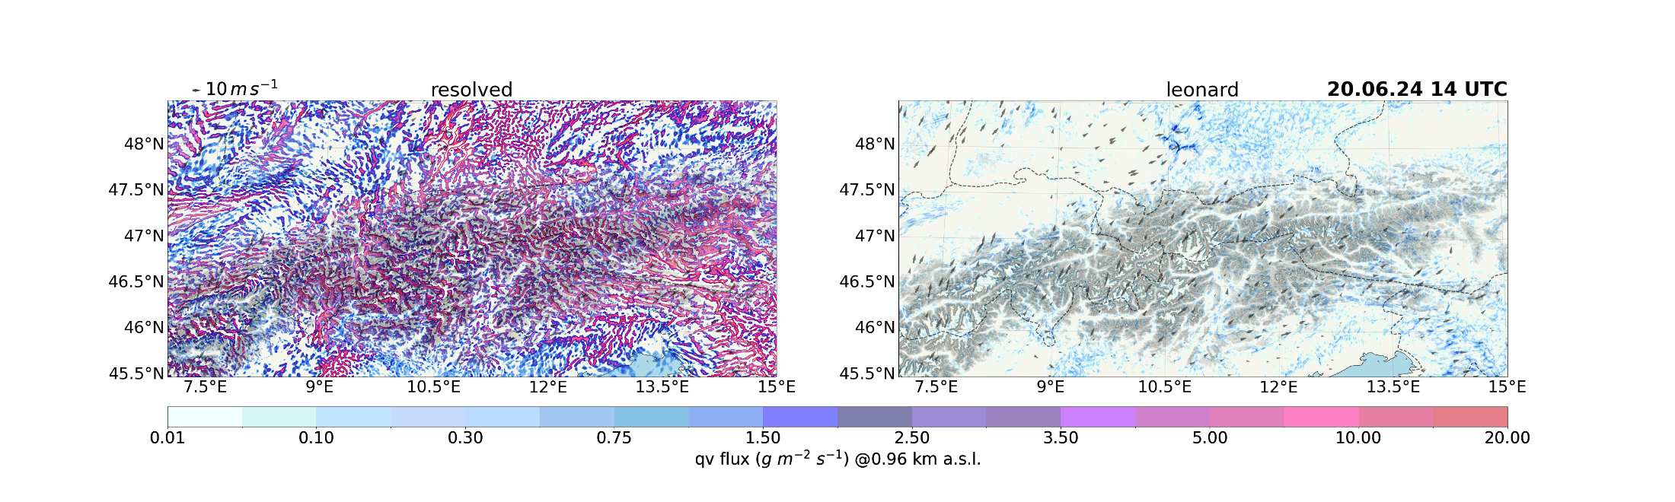
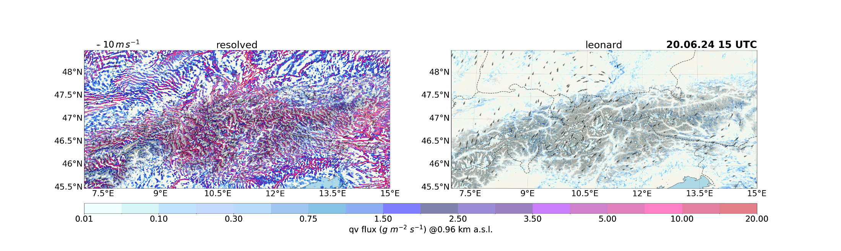
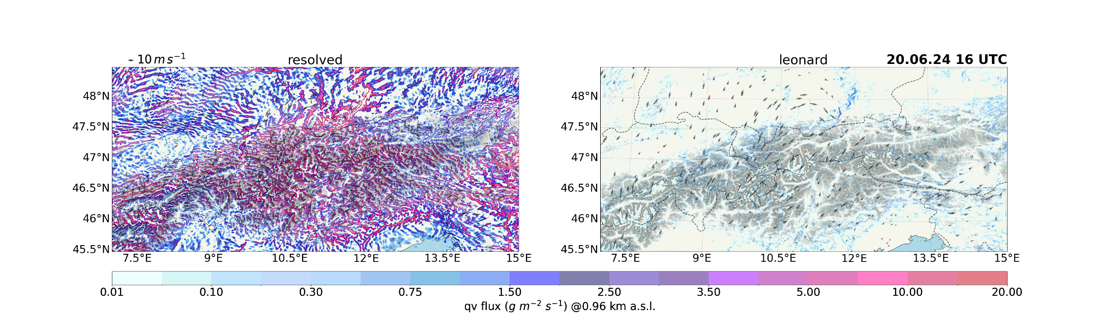
15

Slide 16
4. Summary
1
2
3
4
28th COSMO General Meeting, 14-18 September 2026

Slide 17
Summary
The Leonard terms were successfully implemented in ICON, and the model ran stable for a convective summer month in June 2024
Bias increases for Leonard fluxes with increasing lead-time
Accumulated precipitation is overestimated during periods of very strong convection. However, the magnitude of the Leonard fluxes are within a reasonable range
The Leonard terms will be included in the GLORI demonstrator (starting soon)
Work in progress!
1
2
3
4
28th COSMO General Meeting, 14-18 September 2026

Slide 18

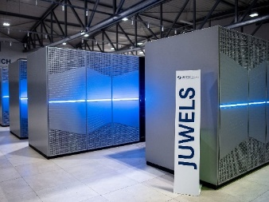


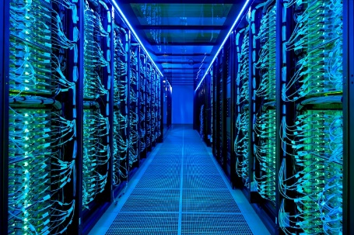
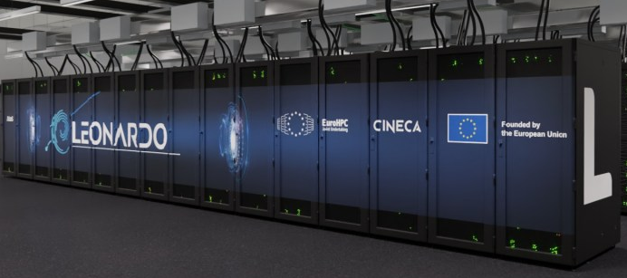

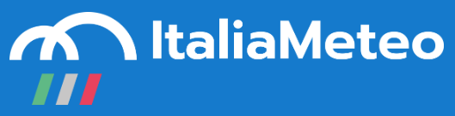

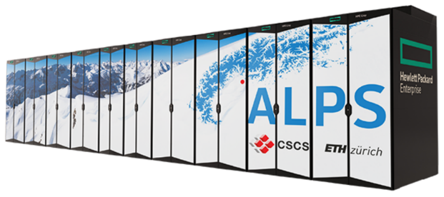
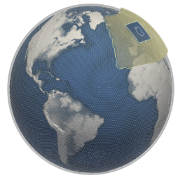



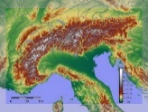


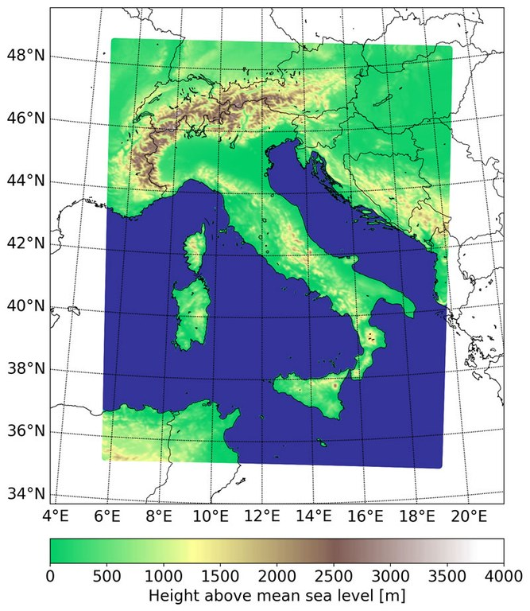


Partners and HPC system
References:
IDEA-S4S
1
2
3
4

Slide 19
Appendix
Derivation of the Leonard Terms
A
B
28th COSMO General Meeting, 14-18 September 2026

Slide 20







Derivation of the Leonard Terms
$$\tilde{φ}(x,y)≡\iint{G\left(x−η,y−ξ\right)dηdξ}$$
$$→G\left(x−η,y−ξ\right)=\frac{6}{π}\frac{1}{Δ_{f}^{2}}\exp\left(\frac{6{\left(x−η\right)}^{2}{\left(y−ξ\right)}^{2}}{∆_{f}^{2}}\right)$$
Filtered residual
$$φ^{′}\left(x,y\right)=φ\left(x,y\right)−\tilde{φ}\left(x,y\right)$$
Subfiltered residual
$$\tilde{⟹φ^{′}\left(x,y\right)}=\tilde{φ\left(x,y\right)−\tilde{φ}\left(x,y\right)=\tilde{φ}\left(x,y\right) −\tilde{\tilde{φ}\left(x,y\right) ≠0}}$$
Total subfilter flux:
$$τ_{wφ}=\overline{wφ}−\overline{w}\overline{φ}$$
$$\overline{wφ}= \overline{\tilde{w}\tilde{φ}}+\overline{\tilde{w}φ′}+\overline{w′\tilde{φ}}+\overline{w′φ′}$$
$$\overline{w}\overline{φ}=\overline{\tilde{w}}\overline{\tilde{φ}}+\overline{\tilde{w}}\overline{φ′}+\overline{w′}\overline{\tilde{φ}}+\overline{w′}\overline{φ′}$$
$$τ_{wφ}=\overline{\tilde{w}\tilde{φ}}+\overline{\tilde{w}}\overline{\tilde{φ}}+\overline{\tilde{w}φ^{′}}+\overline{w′\tilde{φ}}−\overline{\tilde{w}}\overline{φ^{′}}−\overline{w^{′}}\overline{\tilde{φ}}+\overline{w^{′}φ^{′}}−\overline{w′}\overline{φ′}$$
Leonard
Taylor expansion
Cross
Reynolds
$$⇛τ_{wφ}^{LEO}=2\left(\frac{Δ_{f}^{2}}{12}\right)\left(\frac{∂w}{∂x}\frac{∂φ}{∂x}+\frac{∂w}{∂y}\frac{∂φ}{∂y}\right)$$
Moeng et al. (2010)
A
28th COSMO General Meeting, 14-18 September 2026

