Slide 1
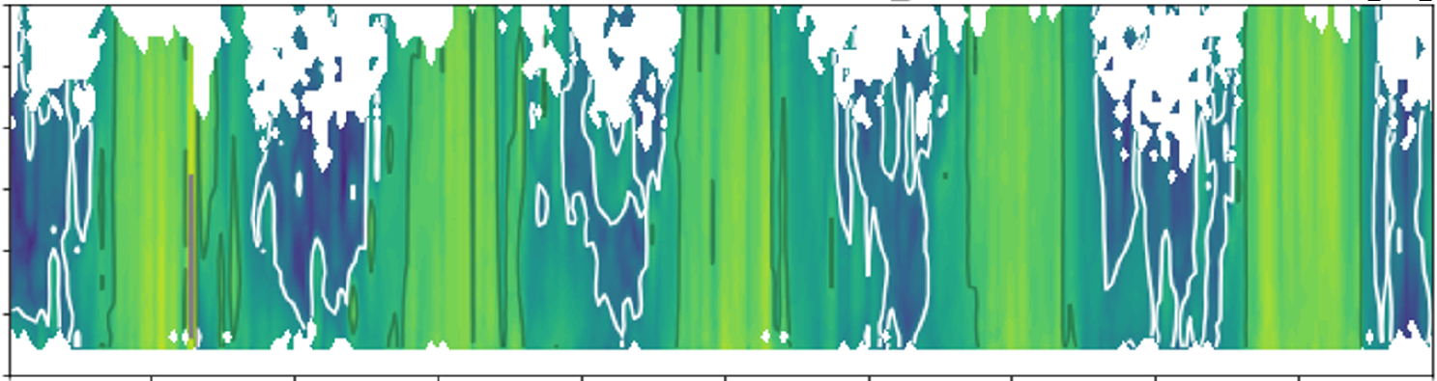
Evaluation of turbulence by Doppler lidar observations
Maike Ahlgrimm (DWD, HErZ), Eileen Päschke (DWD Lindenberg)
Notes:
Today I would like to show you how Doppler Lidar measurements using a particular retrieval can help us evaluate turbulence schemes in our models. This is joint work by myself and my colleague Eileen Paeschke from the German weather service.

Slide 2
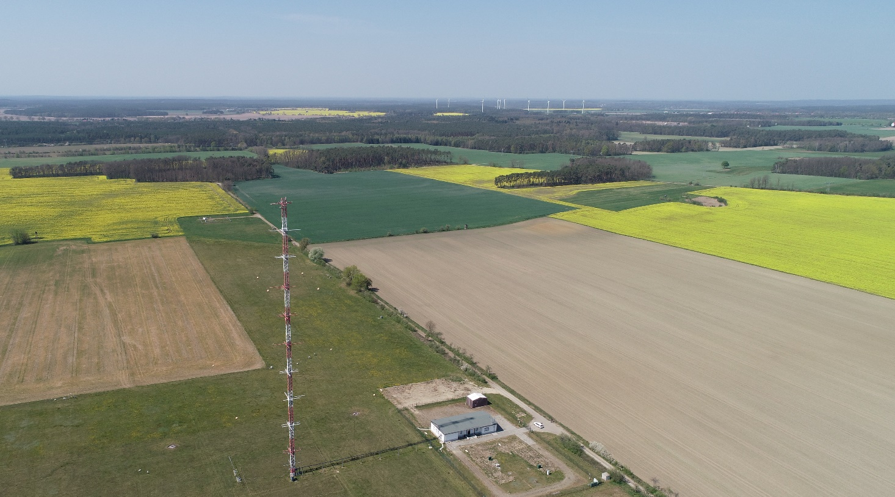
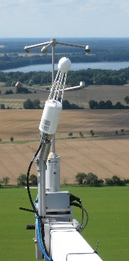
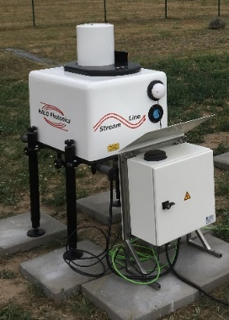

Doppler lidar retrieval
Smalikho & Banakh 2017, Päschke & Detring 2023 provide a retrieval method to simultaneously measure:
  winds
  turbulent kinetic energy (TKE)
  eddy dissipation rate (EDR)
  turbulent length scale (Lv)
  turbulent momentum transport
The Doppler lidar scan configuration involves:
  30min continuous scans for each retrieval
  35.3° elevation angle
    only the lowest ~600m of the ABL observed
    spatial area covered by scan approximately 1700m at 600m, 280m at 100m elevation
  TKE measured represents a joint temporal-spatial variability over a 30min period and a height-dependent scan circle area
up to 600 m
E. Päschke
99 m
v
v
Notes:
Smalikho and Banakh developed a retrieval in 2017, which was then further refined, to simultaneously measure turbulent properties that are typically predicted or parameterized by turbulence schemes, allowing a one to one comparison. What is special about this particular scan geometry is that at this elevation angle, the three components of the wind variance are weighted equally, to get a true absolute value of TKE, not just vertical velocity variance.
A drawback is that we can only measure in the lowest about 600m of the boundary layer.
And since the the measurement represents a joint temporal-spatial variability, we have to be a bit careful to account for an equivalent TKE from the model.

Slide 3
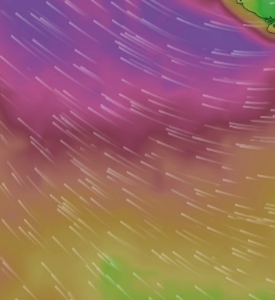
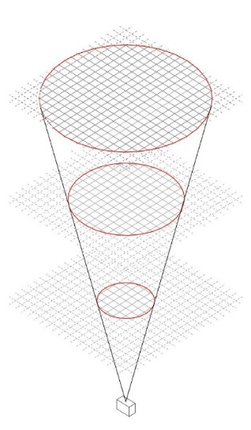
Grid-scale TKE diagnostic for a fair comparison with DL
ca. 1700m
2.1km
5min winds
+
DL scan cone
Coarse mesh size
Fine mesh size
temporal wind variance over 30min period only
online diagnostic every model time step
interpolation regular lat-lon mesh
horizontal averaging scale varies with height
frequent wind output (5min, 1min)
parameterized TKE from turbulence scheme represents only subgrid-scale (SGS) part
temporal fluctuations of grid-scale (GS) wind, and
horizontal fluctuations of GS winds within scan cone area contribute to GS TKE

Slide 4
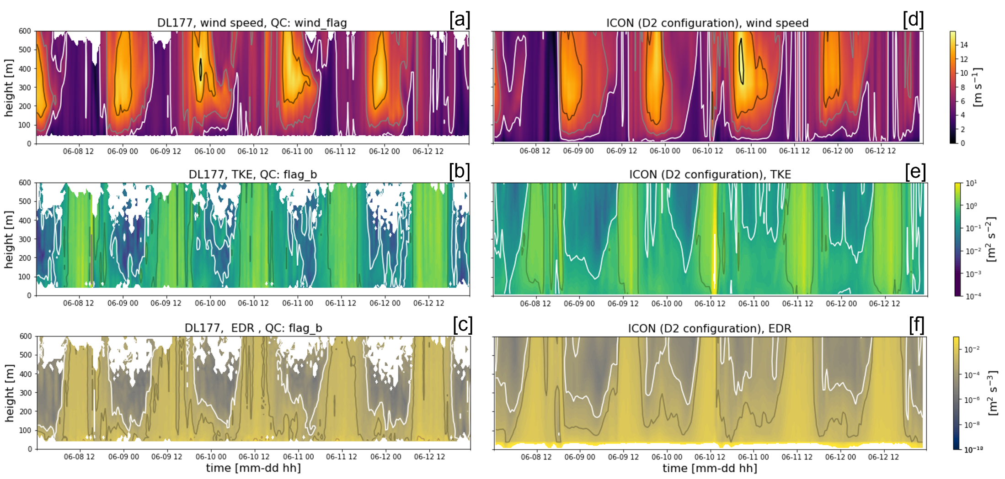
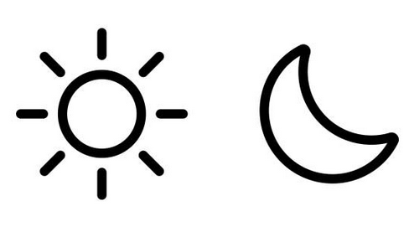
ICON D2 vs. DL
DL
ICON (2.1 km)
WIND
SPEED
TKE
EDR

Slide 5
ICON D2 vs. DL
LLJs at night
signatures of cold pools
discrepancies in stable near-surface layer
ICON (2.1 km)
DL
WIND
SPEED
TKE
EDR
*Mixed layer height
1e-4 m2 s-2

Slide 6
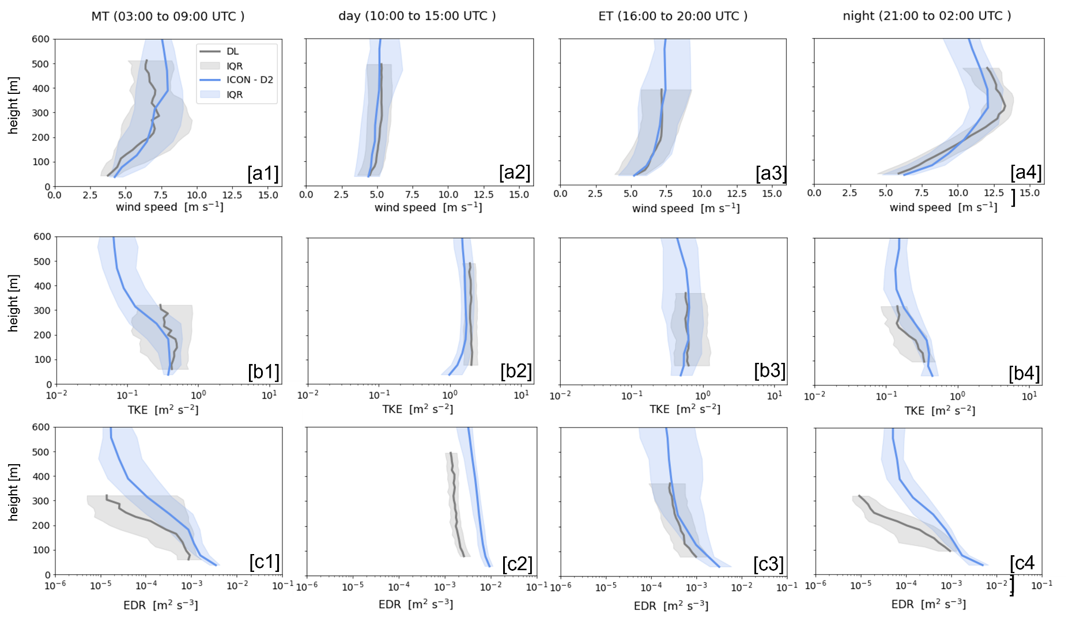
Profiles
morning transition
day
evening transition
night
daytime quite good
LLJ max wind speed underestimated
WIND
TKE
EDR

Slide 7
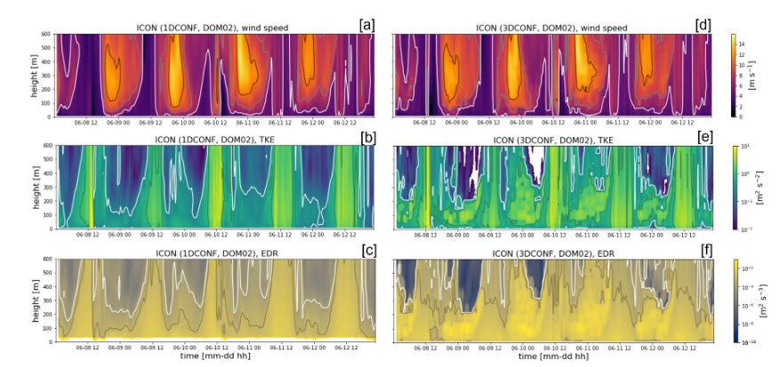
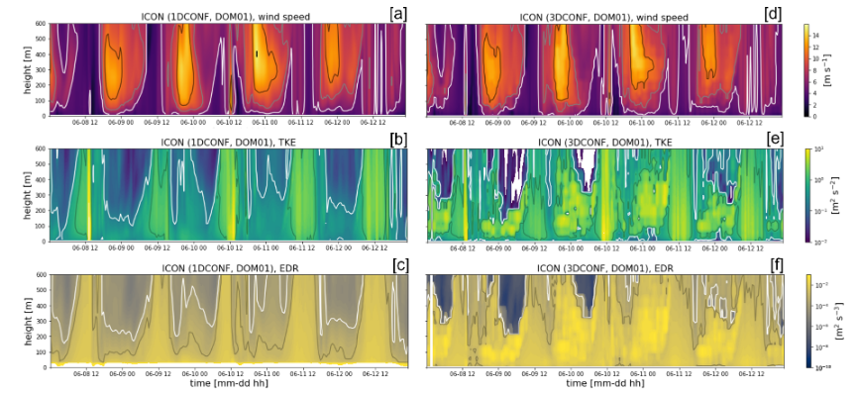
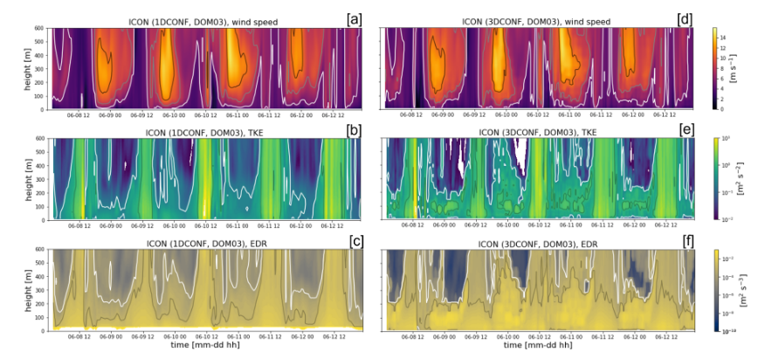
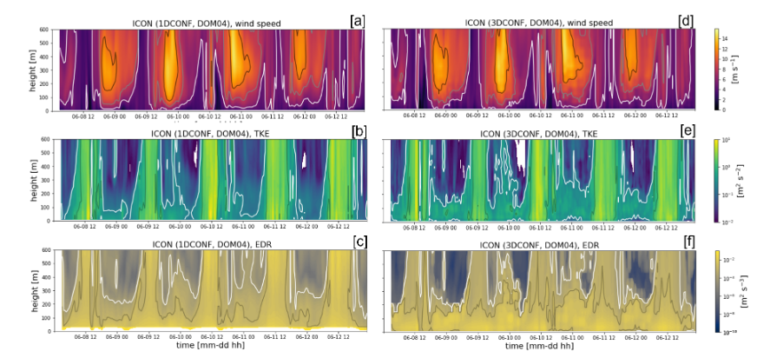
Impact of resolution
626m
313m
Wind speed, TKE and EDR patterns very consistent across resolutions
Wind magnitude resolution-independent
Total TKE magnitude decreasing slightly with finer mesh size
Wind
TKE
EDR
156m
78m

Slide 8
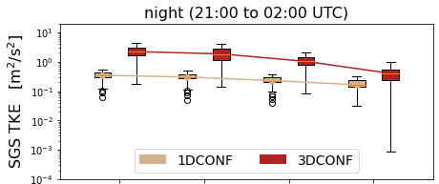
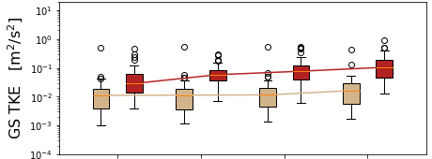
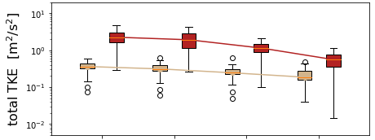
Scale partitioning of TKE
subgrid-scale TKE
decrease
Turbdiff
+
626m
313m
156m
78m
grid-scale TKE
slight increase
=
626m
313m
156m
78m
total TKE
decrease
626m
313m
156m
78m

Slide 9
Conclusion and further information
Doppler lidar retrieval provides good quality, self-consistent observations of winds, TKE, EDR and turbulent length scale in the lower ABL
Valuable tool to gain insights into specific aspects of the turbulence scheme
ICON‘s „Turbdiff“ scheme performs adequately down to 78m mesh size in terms of reproducings winds, but shows systematic errors representing low-level jets under stable conditions
Additional parameters: turbulent length scale, momentum transport
Interesting follow-on applications for wind energy, ABL height diagnostics based on EDR
  Päschke, E. and Ahlgrimm, M.: Turbulence Intensity from ICON: A study of the potential for Wind Energy Applications, EGU General Assembly 2026, Vienna, Austria, 3–8 May 2026, EGU26-9666, https://doi.org/10.5194/egusphere-egu26-9666, 2026. Mon, 04 May, 16:15–18:00 (CEST) Hall X4
  Baumgarten, K., Päschke, E., and Beyrich, F.: Evaluating the atmospheric boundary layer height from ceilometer and Doppler lidar: Divergent retrievals across methods and the question of what they truly represent, EGU General Assembly 2026, Vienna, Austria, 3–8 May 2026, EGU26-6622, https://doi.org/10.5194/egusphere-egu26-6622, 2026. Mon, 04 May, 16:15–18:00 (CEST) Hall X4 | X4.45

Slide 10
Outlook
Paper is now published in GMD: Ahlgrimm and Päschke, 2026, https://doi.org/10.5194/gmd-19-8385-2026
Finalize new turbulence diagnostics in model -> repeat systematic analysis of behaviour across resolutions
Compare Turbdiff, TKE-SV, 2TE schemes
Extend use of DL retrieval record (covers 2 years at Lindenberg), use observations from VITAL2 campaign (6 DL in Köln/Bonn/Aachen area, different retrieval algorithm)
IAFE position at Lindenberg to pursue investigation into best use of new DL network at DWD (primary function to measure wind profiles in BL for assimilation)

Slide 11
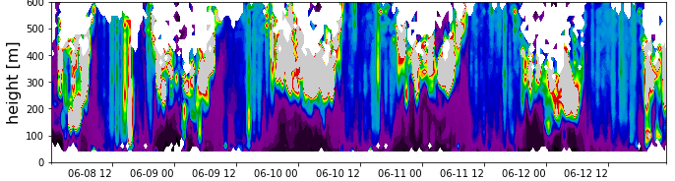
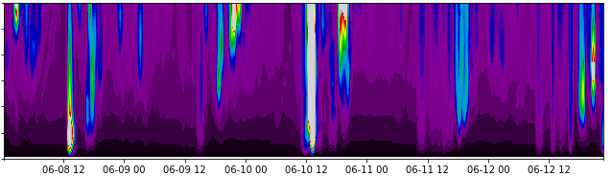
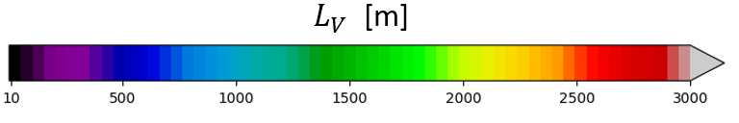
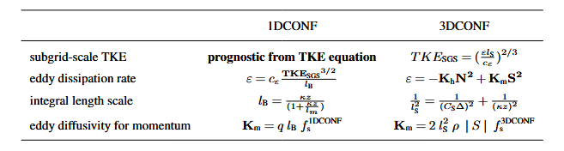


Turbulent length scale
$$Lv = c \frac{{TKE}^{3/2}}{EDR}$$
$Lv = c \frac{{(TKESGS+TKEGS)}^{3/2}}{cε {lB}^{−1}{ TKE}_{SGS}^{3/2}}$ ~ $\frac{c}{cε}$ $lB$ , $TKESGS≫TKEGS$
626m
L_{v}
Retrieved length scale Lv varies with time (and stability)
Equivalent derived length scale from Turbdiff is dominated by Blackadar formulation as f(mesh size, distance to ground)
TURBDIFF
SMAGORINSKY

Slide 12
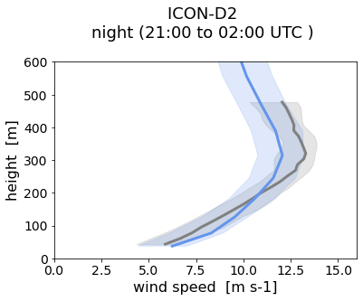
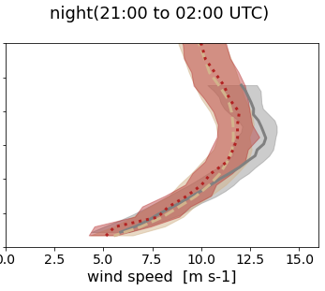
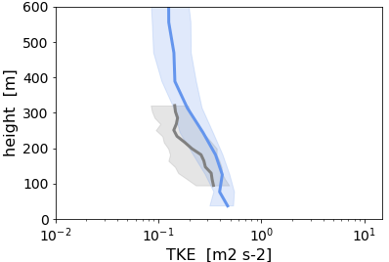
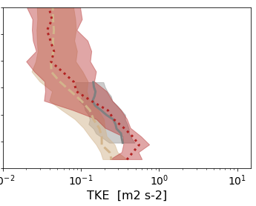
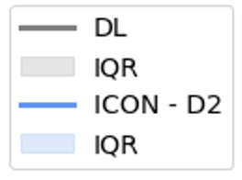
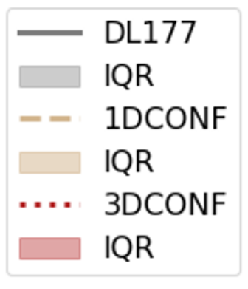
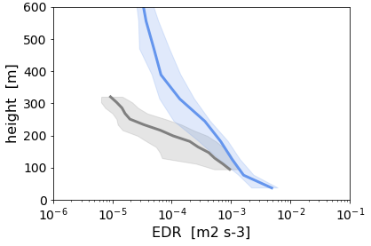
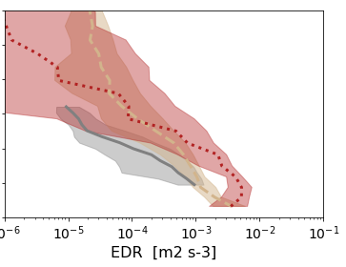
Higher resolution – same systematic errors
2.1km
78m
WIND
Why is decrease in total TKE not reflected in winds?
Missing feedback/link?
Same systematic errors in low-level jets persist for higher resolution
DL
TURBDIFF
DL
TURBDIFF
SMAGORINSKY
TKE
EDR

Slide 13
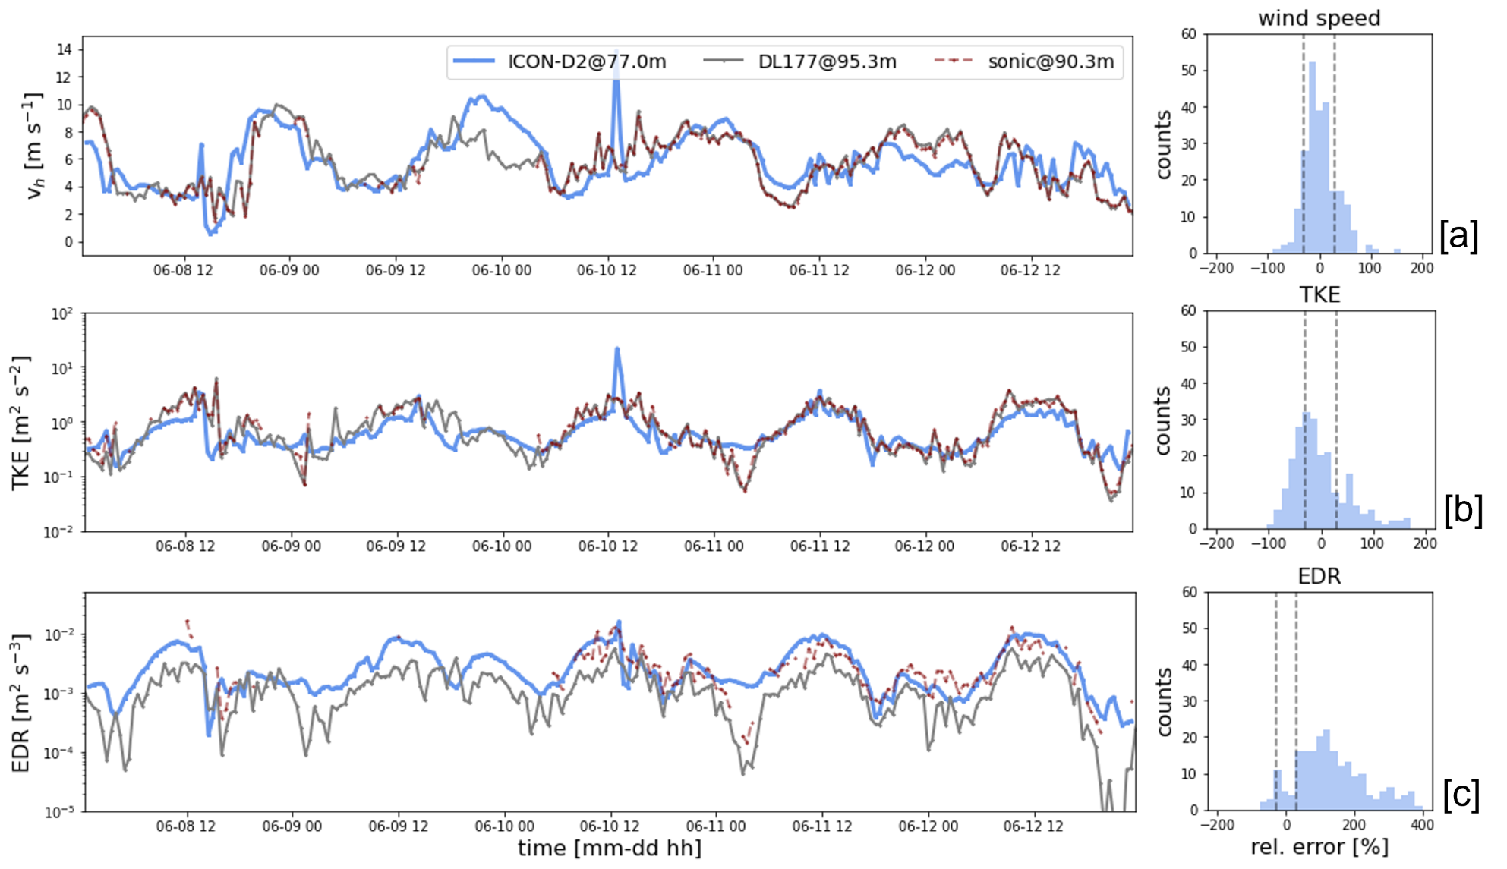
How reliable is DL turbulence retrieval?
Validation DL vs. sonic on Falkenberg mast
very!
WIND
very!
TKE
not as much
(DL underestimates)
EDR

Slide 14
Motivation and Goals
Motivation:
  Regional operational forecasts have increasingly finer resolution (D05 operational for a year now)
  Not always easy to demonstrate additional benefit
Questions:
  How well does operational Turbdiff scheme adapt to resolution?
  Can we demonstrate specific benefits of increased resolution?
  Can we identify limitations?
Experiments:
  Evaluate ICON across mesh sizes from 2.1km to 78m
  Use observations from Lindenberg (Falkenberg) for a five-day period in June 2023 with
    daytime convective boundary layer
    stable night-time conditions with low level jets

Slide 15
Summary
DL provide valuable, self-consistent data set of winds and turbulent properties. ~2.5 years at Lindenberg
ICON has systematic weaknesses related to the stable night-time ABL and low-level jets
ICON (with Turbdiff) is remarkably consistent across resolutions in terms of winds
Scale-partitioning of TKE across resolutions not bad, but room for improvement → how does that fit with winds?
Stability-independent turbulent length scales are a weakness
How good is ICON-DREAM, ICON-FORCE vs. operational forecast? TKE is parameter of interest for wind energy sector
Mixed-layer height derived directly from EDR → frequent, independent of residual layer, potentially better diagnostic than those based on thermodynamic profiles (Richardson number-based) → position at Lindenberg
DWD is building up DL network → potential for wider evaluation or possibly assimilation? Discussions on DL scan mode
Evaluate alternative turbulence schemes (TKE-SV, 2TE, Smagorinsky via TMX)
New on-line TKE diagnostic in master, calculates contribution to GS TKE from temporal wind fluctuations over specified period, calculates temporal average of SGS TKE over specified period
Outlook
Pre-print, in review: https://egusphere.copernicus.org/preprints/2026/egusphere-2025-6327/

