Slide 1
Some thoughts about the coupling of turbulence schemes with the Discontinuous Galerkin solver
COSMO GM, Rome
WG PHY meeting
14-17 Sept. 2026
Michael Baldauf (DWD)

Slide 2
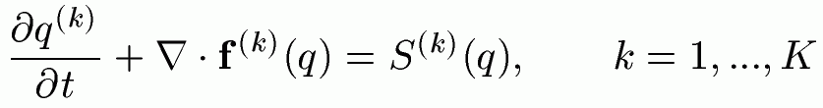

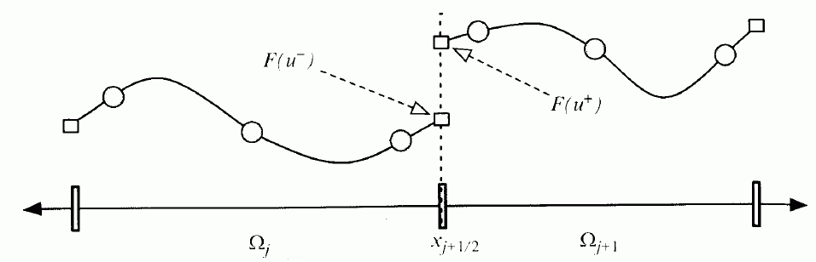
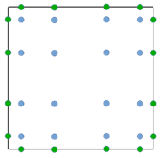
(Classical) Discontinuous Galerkin (DG) methods in a nutshell
e.g. Cockburn, Shu (1989) Math. Comput.
Cockburn et al. (1989) JCP
Textbooks:
Hesthaven, Warburton (2008)
Giraldo (2020)
1.) Finite-element representation
2.) Galerkin approach → weak formulation
3.) Finite-volume ingredient: numerical flux
From Nair et al. (2011) in ‚Numerical
techniques for global atm. models'
4.) Gaussian quadrature for the volume and surface integrals
→ ODE-system for q^{(k)}_{jl}(t)
5.) Use a time-integration scheme (Runge-Kutta, …)
M. Baldauf (DWD)
2

Slide 3
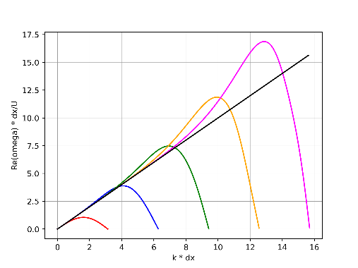
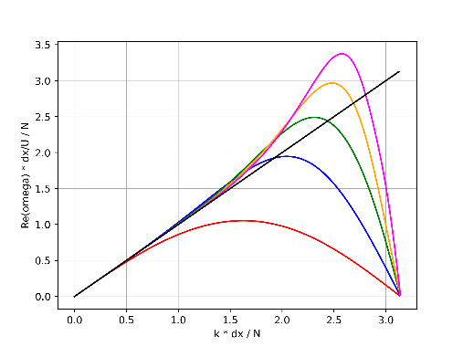
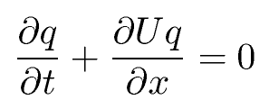
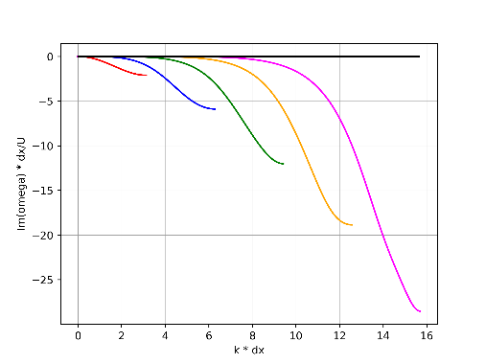
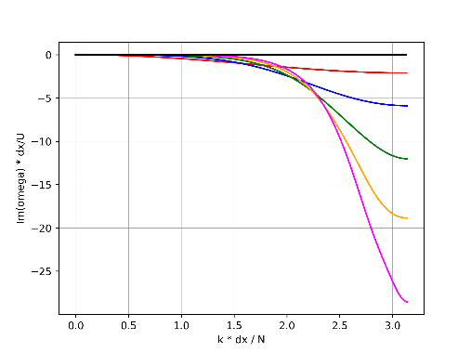
Why are DG methods increasingly used for turbulence modelling?
Higher oder DG is more
expensive → a fairer comparison
uses larger Δx ~ N:
Use the same Δx
for all orders:
Consider the
simple 1D advection equation:
Re ω
Re ω
→ Higher order methods
have much better
dispersion relations for
moderate wavenumbers,
even when using
coarser grids.
… and its numerical
dispersion relation ω(k) for different
DG discretization orders N=1, 2, …5
(spatial and temporal):
k
k/N
Especially DG methods:
erroneous behaviour at
very small length scales
is selectively
damped away
Im ω
Im ω
k
k/N
M. Baldauf (DWD)
3

Slide 4
Why does this DG stuff bothers in particular the turbulence developers?
A certain reorganization of the turbulence code necessary
Need to close new covarances due to other prognostic variables:
total energy vs. potential temperature
M. Baldauf (DWD)
4

Slide 5
DG and Parameterisations
General principle: spatial transport (advection, diffusion, sedimentation, …) should be treated in the DG scheme!
Otherwise we loose local conservation of the prognostic variables.
Note: local conservation is not just a convenient means to get global conservation.
In contrast, it is an essential prerequisite to get a numerical scheme that produces physically reliable solutions (correct phase speeds, …)
Box-models (e.g. cloud physics, chemistry/aerosol-packages):
are evaluated and deliver tendencies in every quadrature point
→ at the first place no adaptations necessary!
Nevertheless, the ‚classical‘ physics/dynamics-coupling questions remain:
overall time integration scheme? achieve non-negative variables, mass-consistency, …
M. Baldauf (DWD)
5

Slide 6
Building blocks for turbulence parameterizations (I)
Keep in mind: we want to conserve prognostic variables, therefore, instead of delivering only tendencies,
the turbulence parameterization mainly should deliver
fluxes f ^{(s)} (for explicit time integration)
or a flux coefficient matrix of the form H^{ss‘} ≡ δf ^{(s)} /δq^{(s‘)} (for implicit time integration)
or a combination of both (explicit / implicit)
This holds both for the prognostic variables (velocity/momentum, temperature/energy)
as for additional closure equations (TKE, variances, ..)
Note: don‘t bother with the time-integration itself; this takes place in a (hopefully) stable IMEX-RK scheme.
Therefore a turbulence parameterization should be separated into
the transport scheme i.e. the diffusion terms and additional transport
equations ← they are replaced by the DG scheme
the ‚pure‘ turbulence parameterization
M. Baldauf (DWD)
6

Slide 7
Building blocks for turbulence parameterizations (II)
To calculate these fluxes at a certain (quadrature) point r, the turbulence model gets
derivative variables at r from the dyn. core
(‚x-, y-, z-‘-derivatives of the prognostic variables ρ, M, E or ϑ=ρθ, ρ_{(s)}, …).
Use the chain rule to derive arbitrary other spatial derivatives of a variable ϕ = f(ρ, M, E, ρ_{(s)}).
In this ideal world, a turbulence modeler wouldn‘t need any grid information!
Problems to solve:
In ϕ = f(ρ, M, ϑ, q^{(s)}), the function f may contain non-differentiable Heaviside-functions
(i.e. ‚if-conditions‘) (?). Replace these by ‚relaxation expressions‘?
How to treat non-local closures? (smoothing operations, spatial integrations, …)
M. Baldauf (DWD)
7

Slide 8
Why does this DG stuff bothers in particular the turbulence developers?
A certain reorganization of the turbulence code necessary
Need to close new covarances due to other prognostic variables:
total energy vs. potential temperature
M. Baldauf (DWD)
8

Slide 9
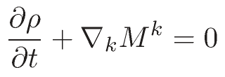

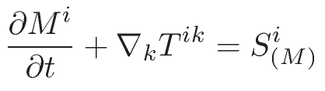
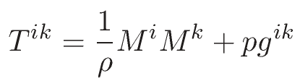


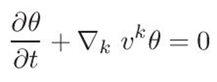

Euler equations (in covariant form)
Continuity eq.:
mass flux (= momentum density):
Momentum eq.:
momentum flux:
momentum source:
Energy budget eq.:
Variant 1: use density weighted potential temperature set ‚ρΘ‘
Variant 2: use total energy density set ‚E‘
p=p(θ)
E = E_{kin} + E_{pot} + E_{int}
p=p(E_{int})
In case of diffusion: T^{ik} → T^{ik} + T^{ik}_{diffus} , …
M. Baldauf (DWD)
9

Slide 10

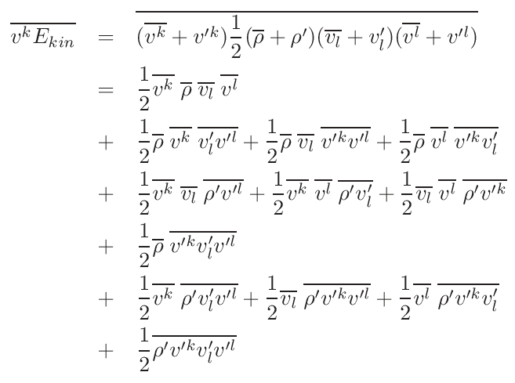
The choice of other/new prognostic variables requies the development of new closures
for their related covariances.
Can we circumvent this by expressing the new covariances by the ‚old‘ ones?
Examples:
M. Baldauf (DWD)
10

Slide 11
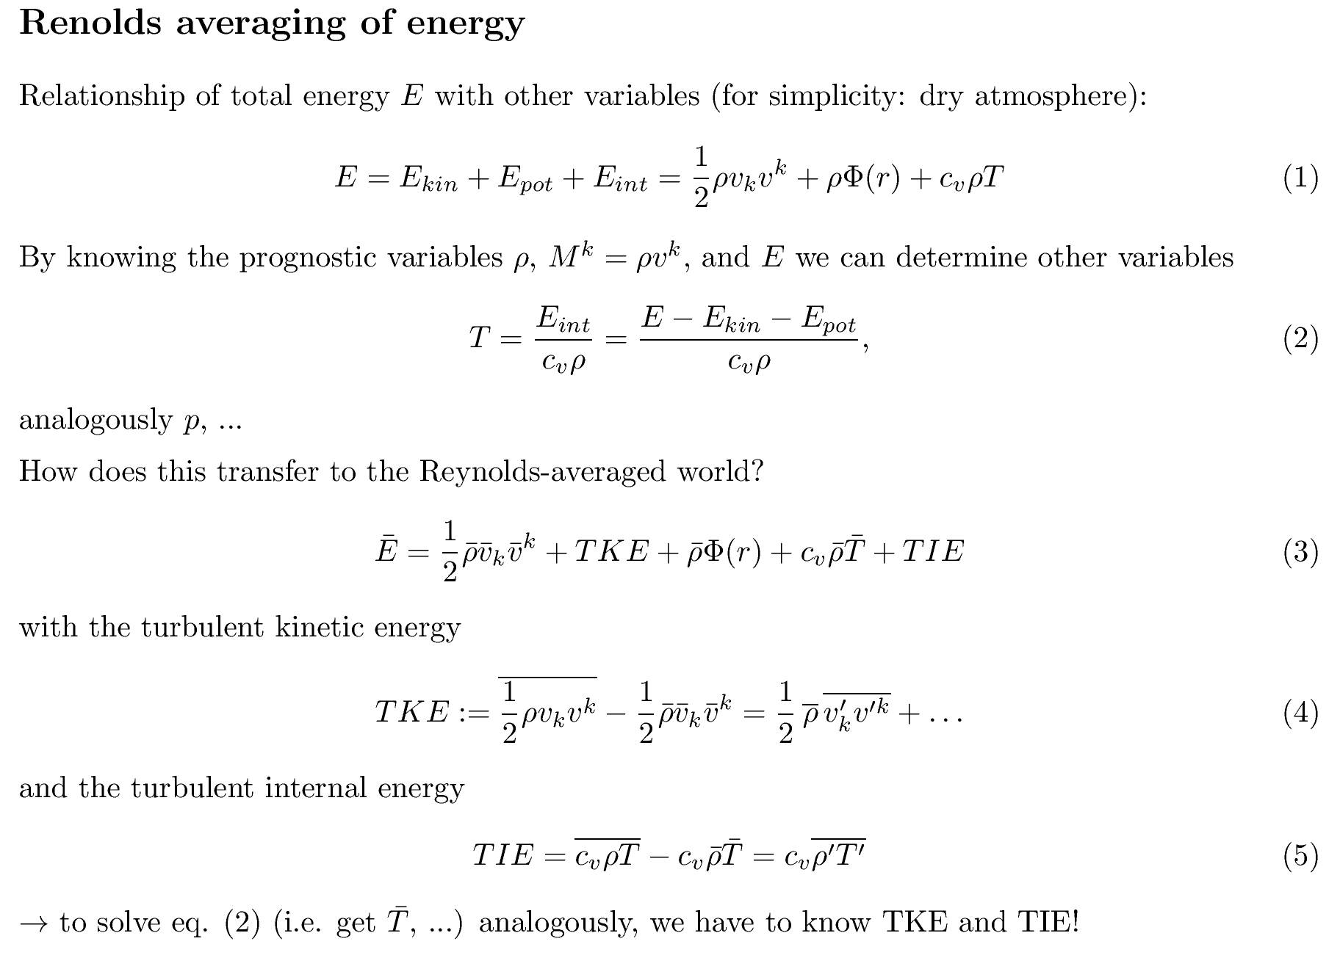
M. Baldauf (DWD)
11

Slide 12
Summary
Turbulence is tightly coupled to the dynamical core
Technical aspect:
  the wish for local conservation requires a separation of the turbulence model into a transport part (DG treatment) and a ‚pure‘ parameterization part
Scientific aspect: use of total energy E as prognostic variable is quite probable
  → instead of developing a new turbulence scheme, can we just express
  the new covariances by old ones (+ only a few additional covariances)?
  To get variables like T, p, … from E, we need TKE (ok) and TIE (?)
Extend all considerations for moisture and by moist transport equations
Similar considerations are in principle necessary for convection param., gravity wave param., …
However, the mid term plan is to couple them just as source terms (i.e. loosing some conservation properties)
M. Baldauf (DWD)
12

