Slide 1



On the Sensitivity of the “PYRCEL” version of ICON Model over Greece
Euripides Avgoustoglou, Hellenic National Meteorological Service (HNMS)
In Support and Collaboration with,
Harel Muskatel, Israel Meteorological Service (IMS)
Euripides Avgoustoglou, Hellenic National Meteotological Service, 28th COSMO GM , Rome-Italy, September 13-18, 2026
01

Slide 2
Motivation
Accurate rainfall simulation is essential for hydrological risk assessment and emergency response.
Aerosol climatologies strongly influence cloud microphysics and precipitation formation.
Vertical resolution affects the representation of convection, moisture transport, and storm structure.
The flexibility of ICON‑LAM allows systematic testing of different aerosol climatologies and vertical resolutions, making it an ideal framework for sensitivity studies.
Evaluating these sensitivities helps improve the reliability of numerical weather prediction during high‑impact events.
The introduction of a Deep Learning Emulator for pyrcel-Based Cloud Droplet Number Concentration .
Euripides Avgoustoglou, Hellenic National Meteotological Service, 28th COSMO GM , Rome-Italy, September 13-18, 2026
02

Slide 3
Model Set-up highlights
Horizontal grid: R2B10 ~ 2,5km (1621x1061 grid Lon/Lat points)
Model time step: dtime = 24 s
Convection parameterization scheme: inwp_convection = 1 (Tiedke)
Time interval for calling the convection parameterization scheme: dt_conv = 120 s
Time interval between successive lateral boundary condition updates: dtime_latbc = 10800 s
Time interval for calling the radiation scheme: dt_rad = 720 s
Minimum time scale for Rayleigh friction damping: efdt_min_raylfric = 7200 s
Time interval for calling the subgrid-scale orography (SSO) parameterization scheme: dt_sso = 120 s
Time interval for calling the gravity wave drag (GWD) parameterization scheme: dt_gwd = 360 s
Vertical Levels | Suitability | Notes
65 | ✅ Standard Reference | Common in operational ICON setups like ICON-D2
100 | ✅ Stronger vertical detail | Useful for high-resolution convection and cloud studies
130 | ✅ Excellent for upper-atmosphere studies | May require tuning of damping and physics schemes
Euripides Avgoustoglou, Hellenic National Meteotological Service, 28th COSMO GM , Rome-Italy, September 13-18, 2026
03

Slide 4
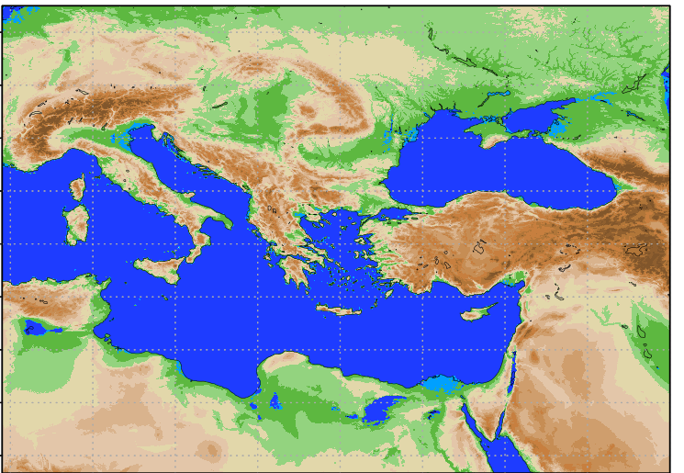
Model Domain
Euripides Avgoustoglou, Hellenic National Meteotological Service, 28th COSMO GM , Rome-Italy, September 13-18, 2026
04

Slide 5
DESIGNATION OF THE TESTED AEROSOL CLIMATOLOGIES
Default (DEF): Reference setup with Tegen aerosol climatology.
DeMott (DM): DeMott 2015 ice nucleation scheme is used.
IceOpt (ICE): New ice optical properties after Muskatel et al. (2020) including large hydrometeors in ecRAD.
Camsclim (CC): CAMS (Copernicus Atmosphere Monitoring Service) climatology used (instead of Tegen).
camsforc (CF): CAMS forecasted aerosols used (instead of Tegen).
camsclimSK (CCSK): CAMS climatology using Segal & Khain aerosol activation parameterization.
camsforcSK (CFSK): CAMS forecasted aerosols using Segal & Khain aerosol activation parameterization.
pyrcel_onnx_rev (PO): AI-emulator of the pyrcel model.
pyrcel_camsforc (PCF): AI-emulator of the pyrcel model using CAMS forecasted aerosols.
Euripides Avgoustoglou, Hellenic National Meteotological Service, 28th COSMO GM , Rome-Italy, September 13-18, 2026
05

Slide 6
Rationale
Greece presents an ideal case study for such an investigation due to its:
Complex Topography:
Mountainous terrain and coastal interactions influence vertical atmospheric processes like orographic lifting, boundary layer development, and convective activity.
Frequent Extreme Atmospheric Phenomena:
Greece experiences diverse meteorological events, including Mediterranean cyclones, heat-waves, and Saharan dust intrusions, all of which are sensitive to vertical resolution.
Model Uncertainty Reduction:
Assessing vertical level sensitivity can help identify optimal configurations for ICON-LAM, improving accuracy in temperature, wind, and precipitation profiles.
Regional Forecasting Applications:
Enhanced vertical resolution may improve short-term weather forecasting in Greece, benefiting sectors like agriculture, tourism, and disaster preparedness.
Contribution to Broader Scientific Goals:
Results can inform best practices for ICON-LAM deployment in other regions and refine parameterization schemes in limited-area models.
Euripides Avgoustoglou, Hellenic National Meteotological Service, 28th COSMO GM , Rome-Italy, September 13-18, 2026
06

Slide 7
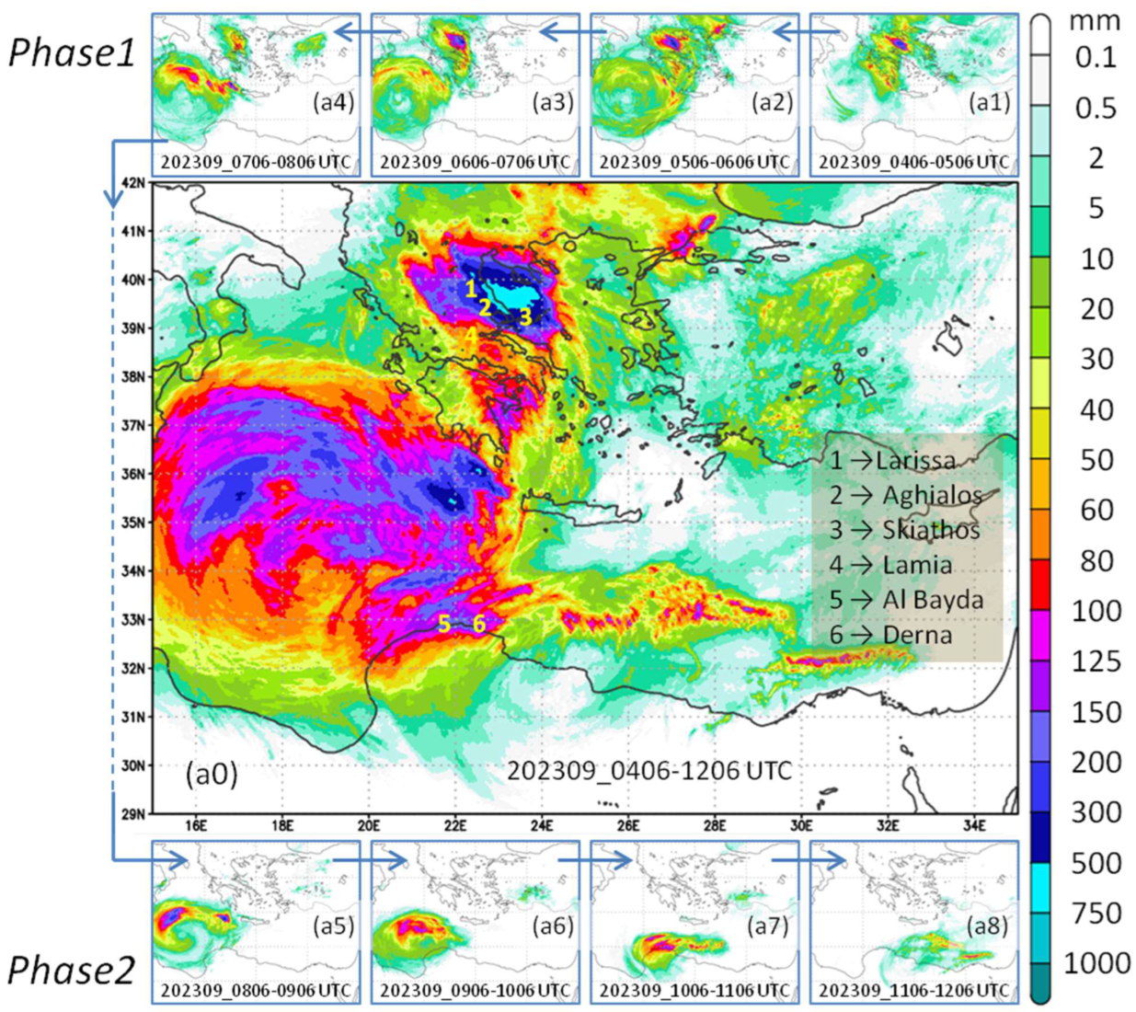
https://www.mdpi.com/2073-4433/16/9/1043
Extreme events like Storm ‘Daniel’ challenge the limits of numerical weather prediction, making it essential to understand how model configuration choices influence precipitation forecasts.
Euripides Avgoustoglou, Hellenic National Meteotological Service, 28th COSMO GM , Rome-Italy, September 13-18, 2026
07

Slide 8
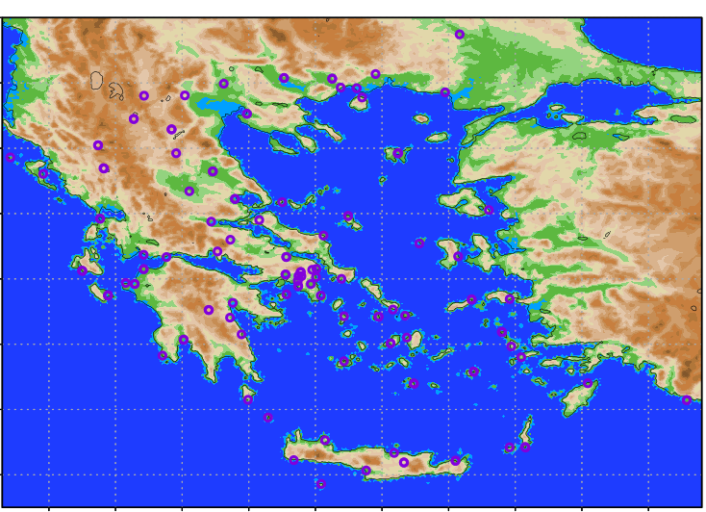
HNMS Station Positions
In the present work we are focused on a 48 ICON Model run starting at 20230905 00UTC
Euripides Avgoustoglou, Hellenic National Meteotological Service, 28th COSMO GM , Rome-Italy, September 13-18, 2026
08

Slide 9
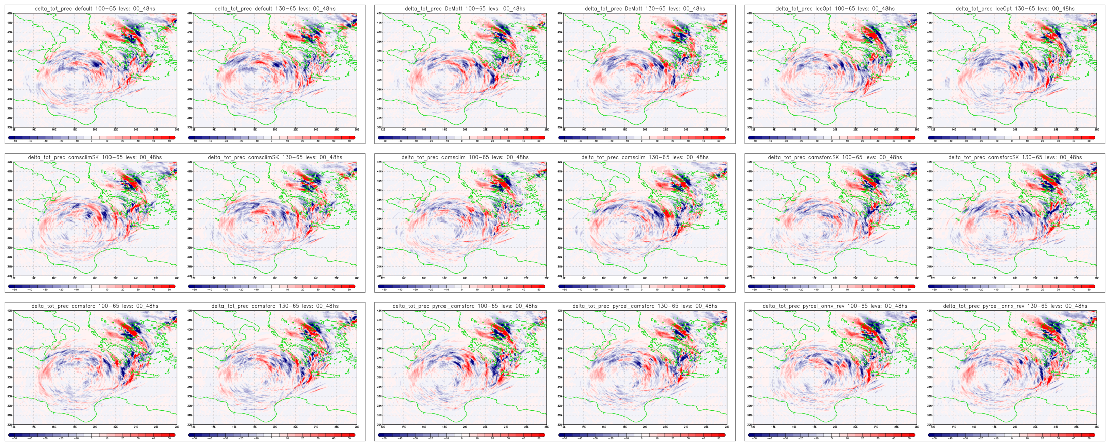
100/130 Level differences from 65 Level for all configurations
All differences display tha same trend but they are different in “details”
Euripides Avgoustoglou, Hellenic National Meteotological Service, 28th COSMO GM , Rome-Italy, September 13-18, 2026
09

Slide 10
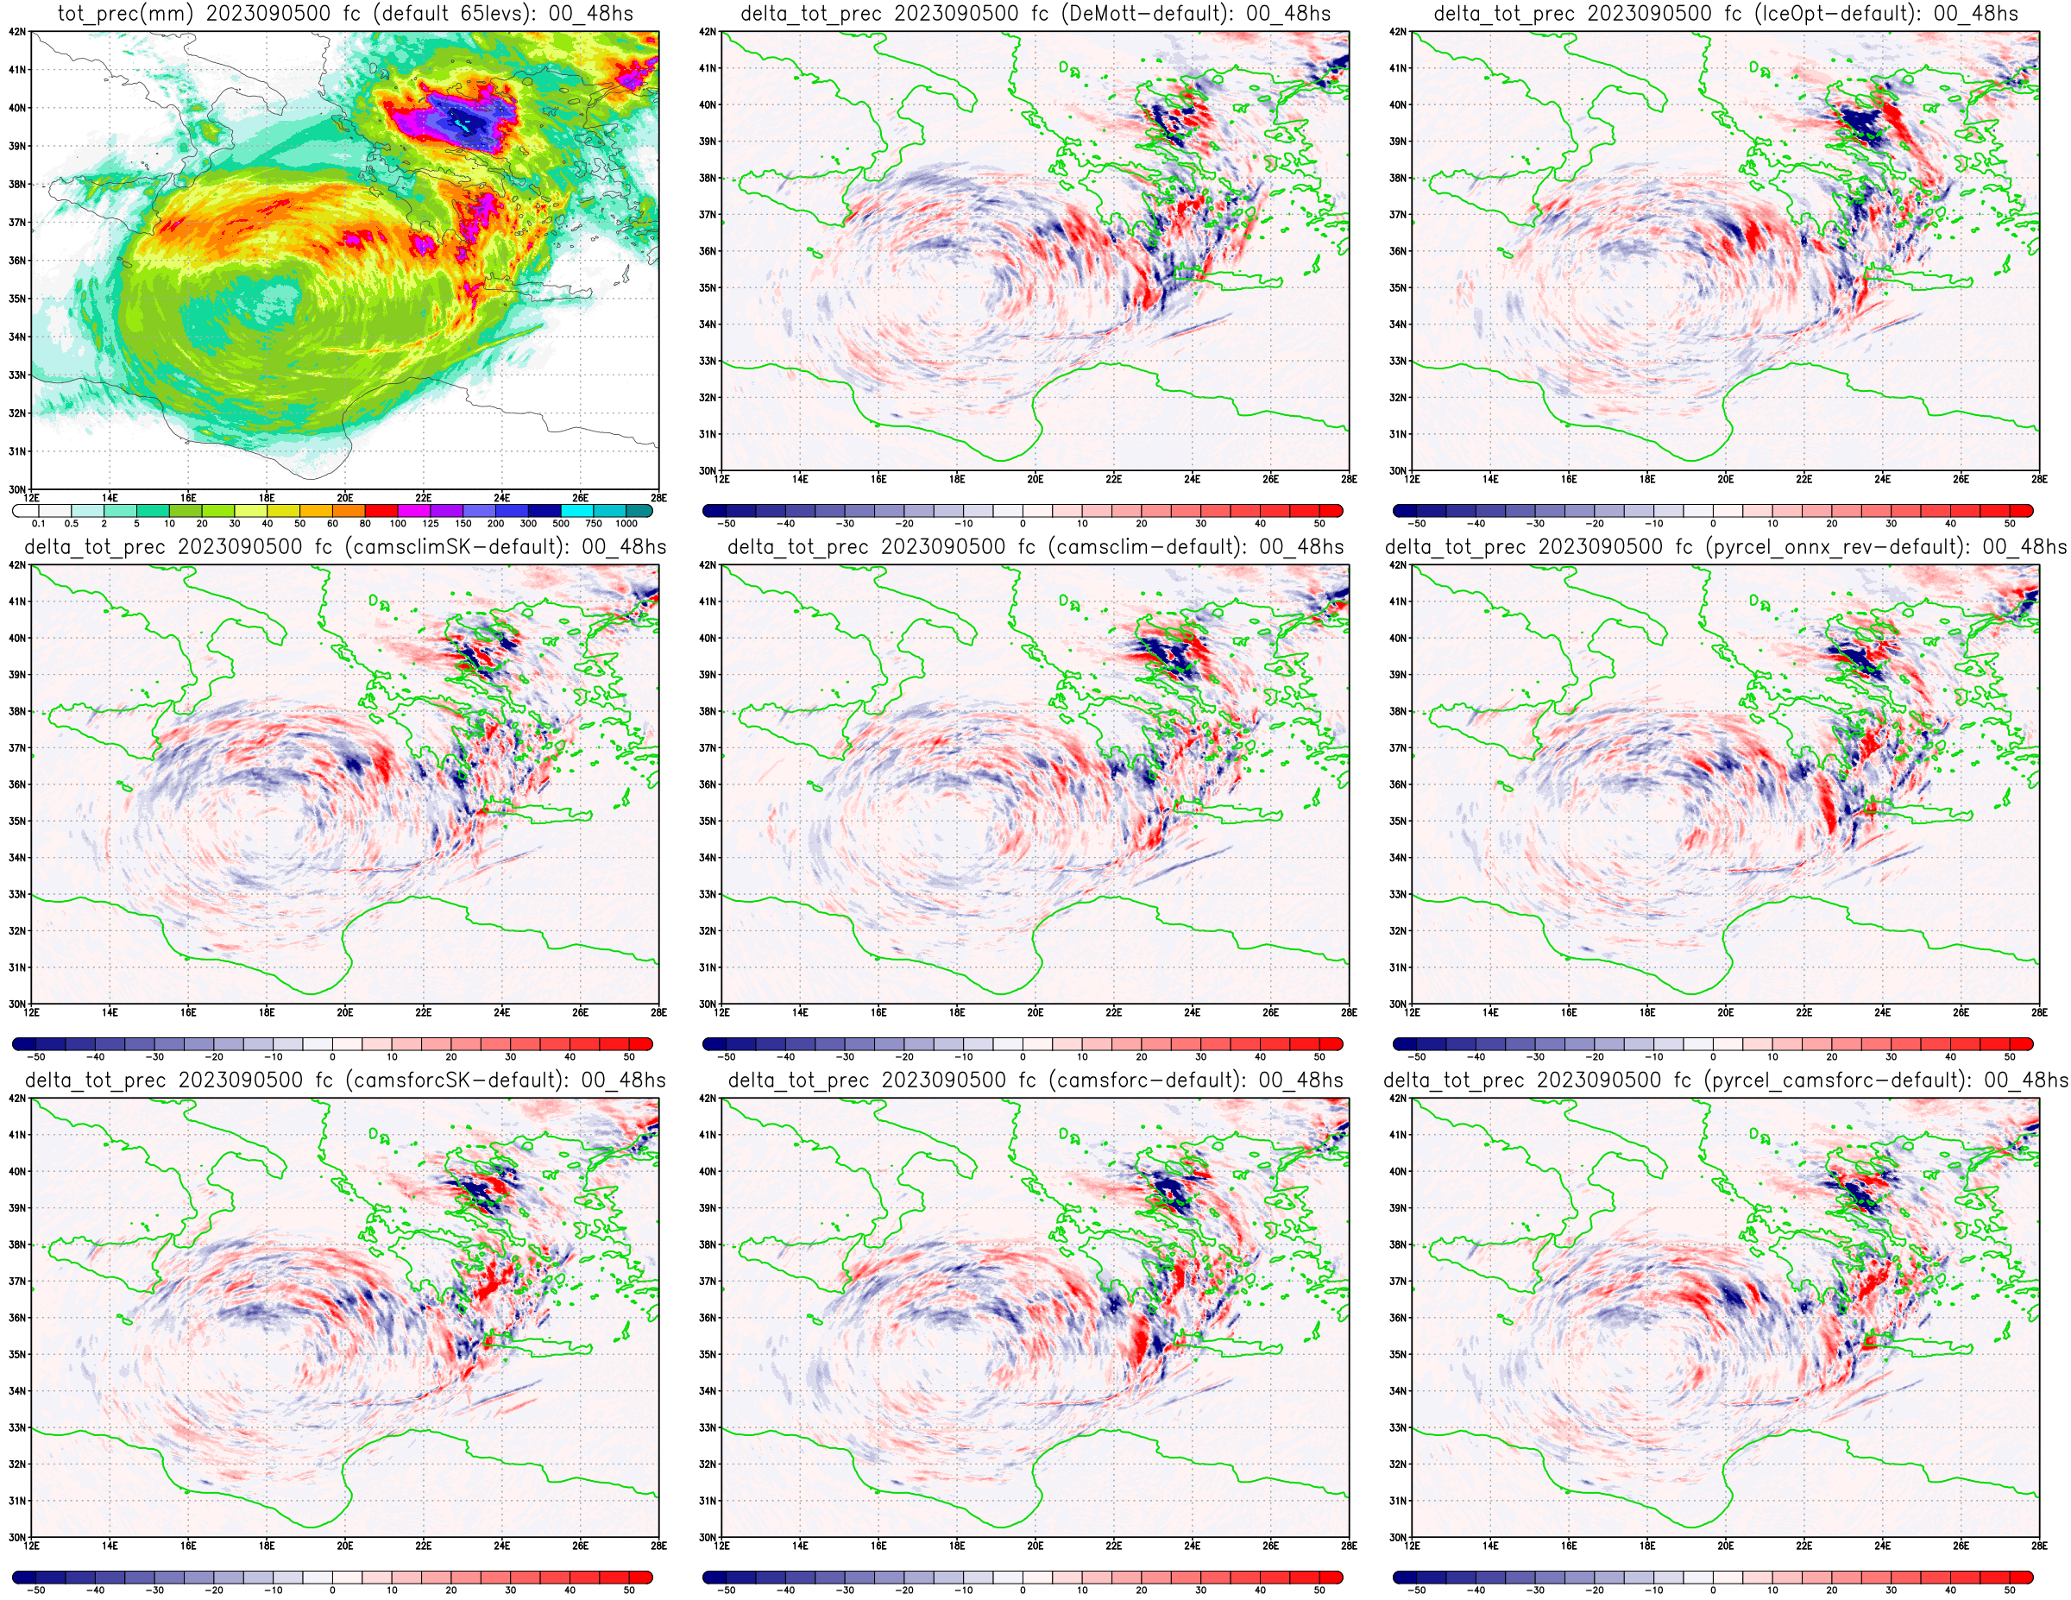
Euripides Avgoustoglou, Hellenic National Meteotological Service, 28th COSMO GM , Rome-Italy, September 13-18, 2026
10

Slide 11
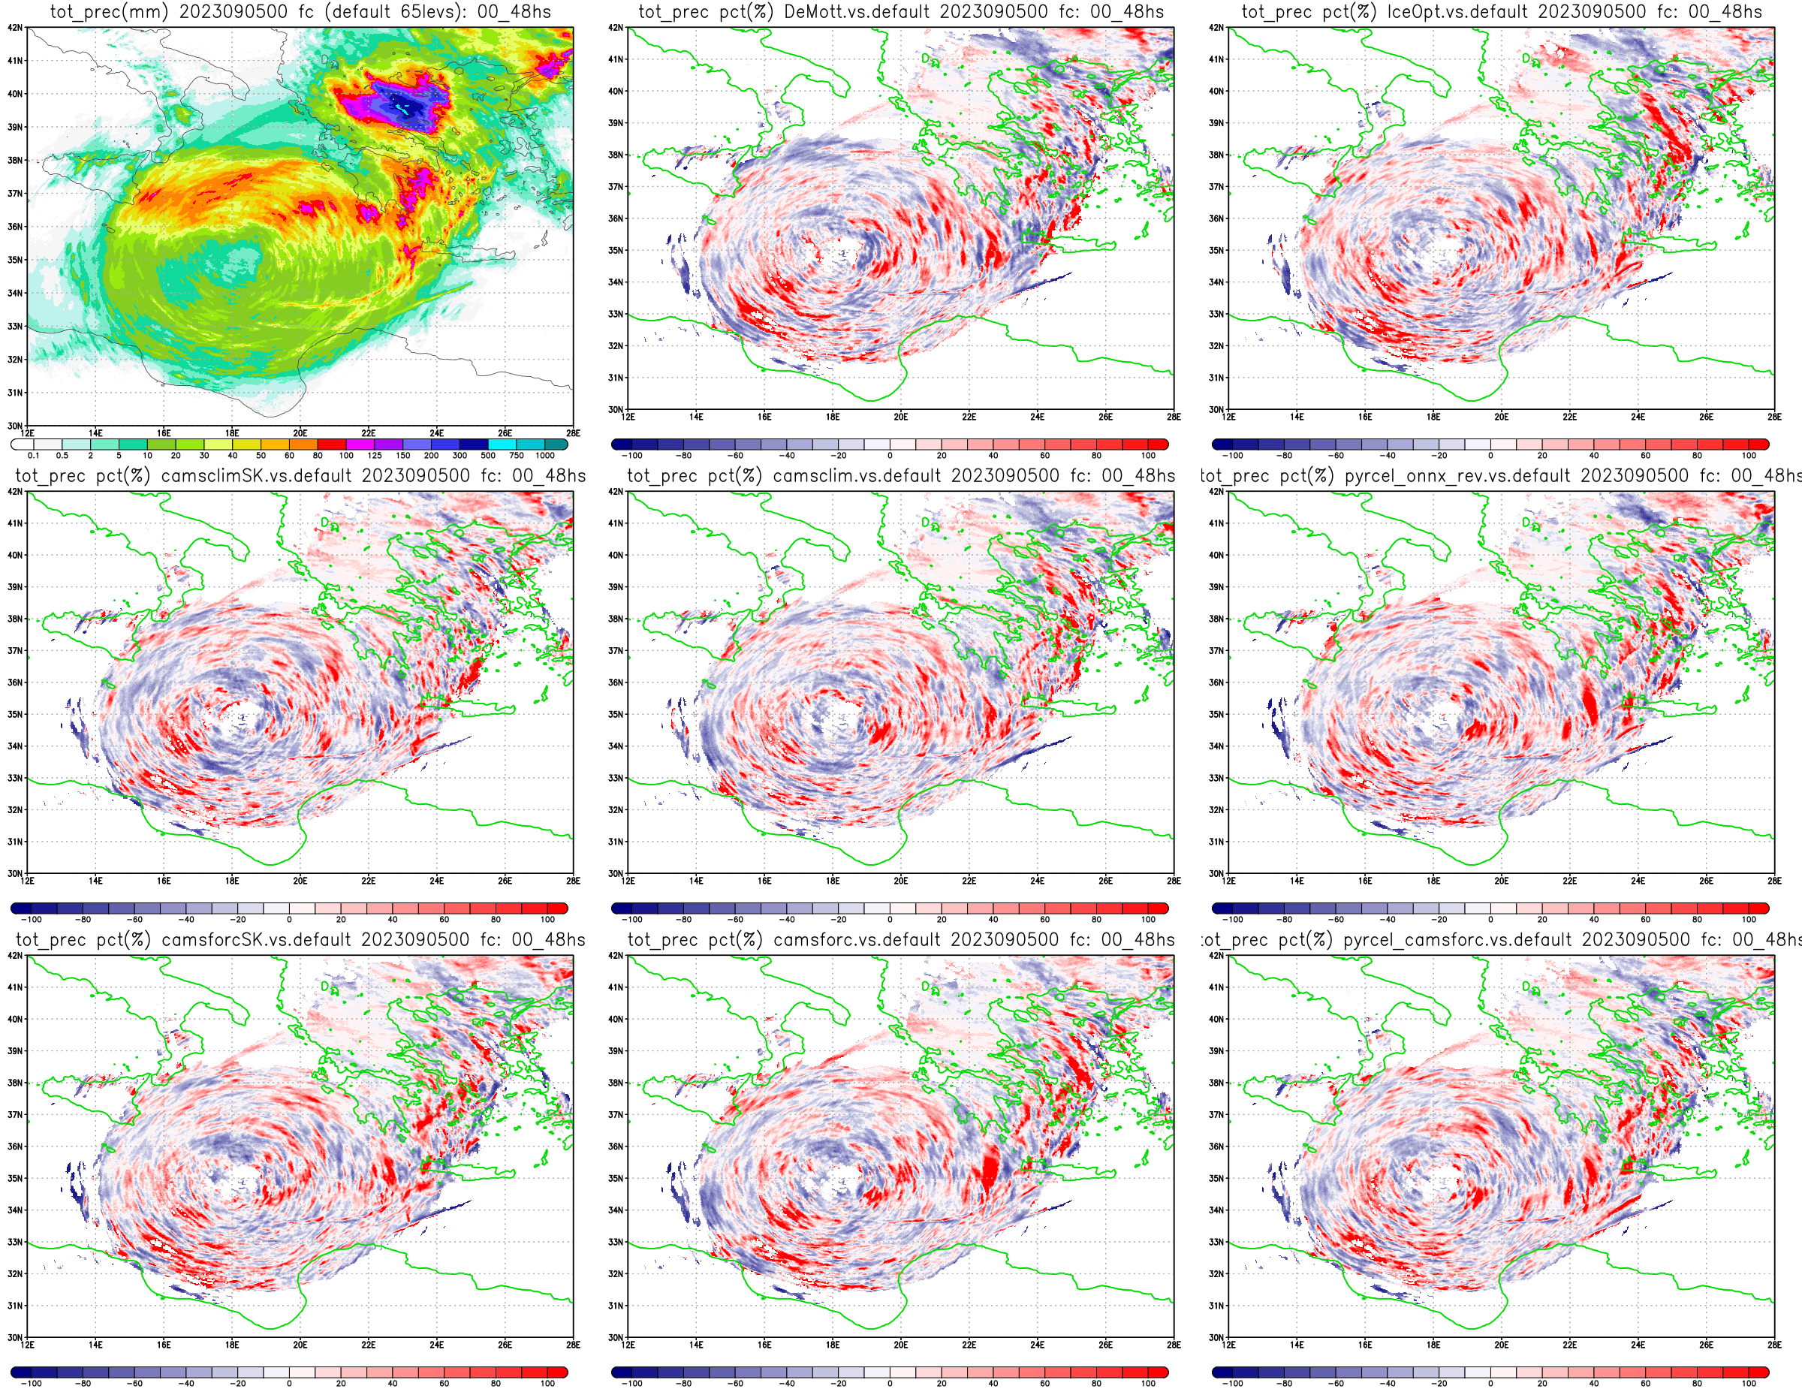
Euripides Avgoustoglou, Hellenic National Meteotological Service, 28th COSMO GM , Rome-Italy, September 13-18, 2026
10a

Slide 12
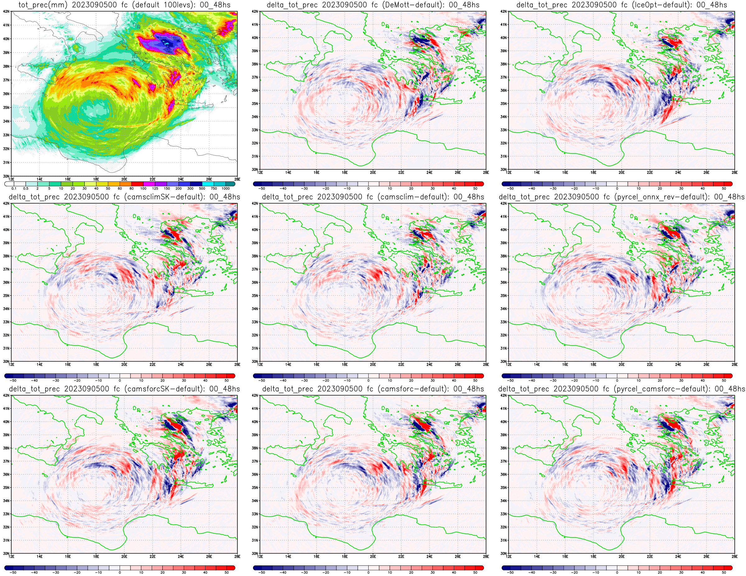
Euripides Avgoustoglou, Hellenic National Meteotological Service, 28th COSMO GM , Rome-Italy, September 13-18, 2026
11

Slide 13
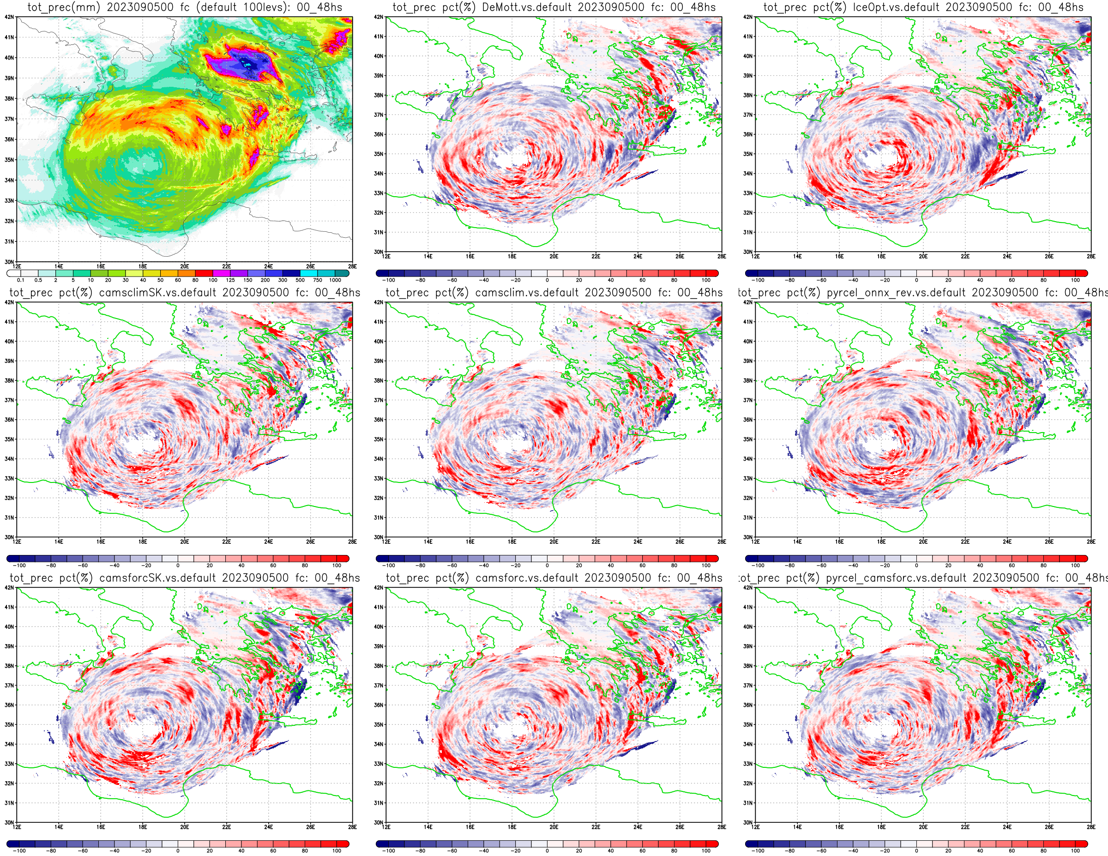
Euripides Avgoustoglou, Hellenic National Meteotological Service, 28th COSMO GM , Rome-Italy, September 13-18, 2026
11a

Slide 14
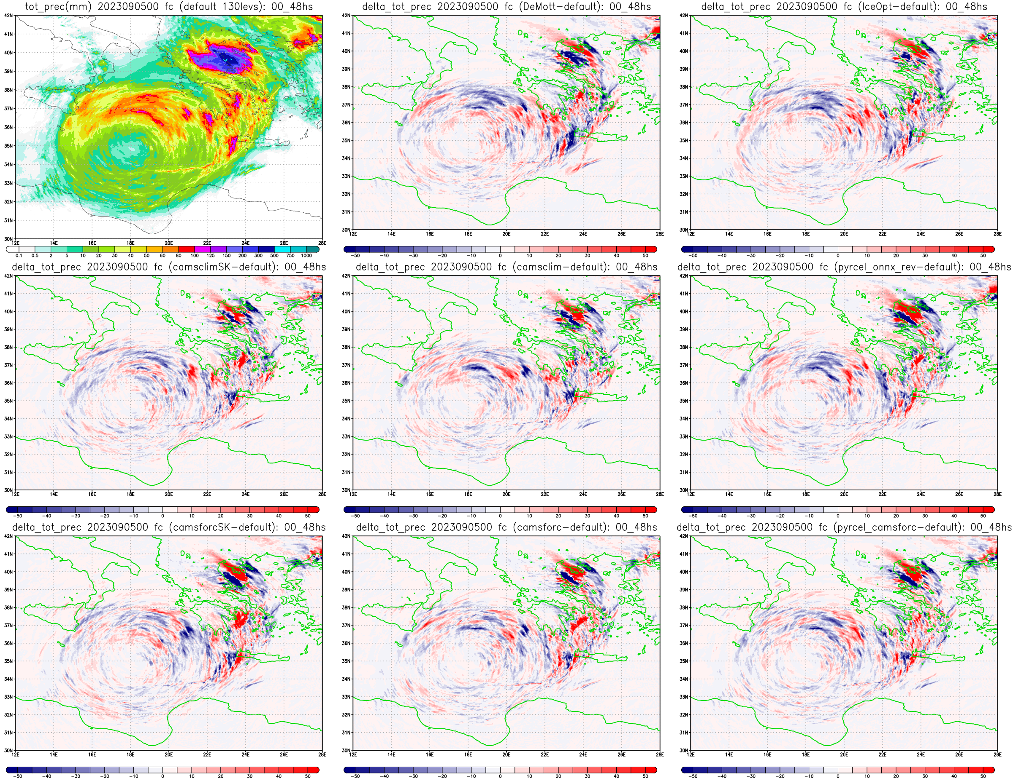
Euripides Avgoustoglou, Hellenic National Meteotological Service, 28th COSMO GM , Rome-Italy, September 13-18, 2026
12

Slide 15
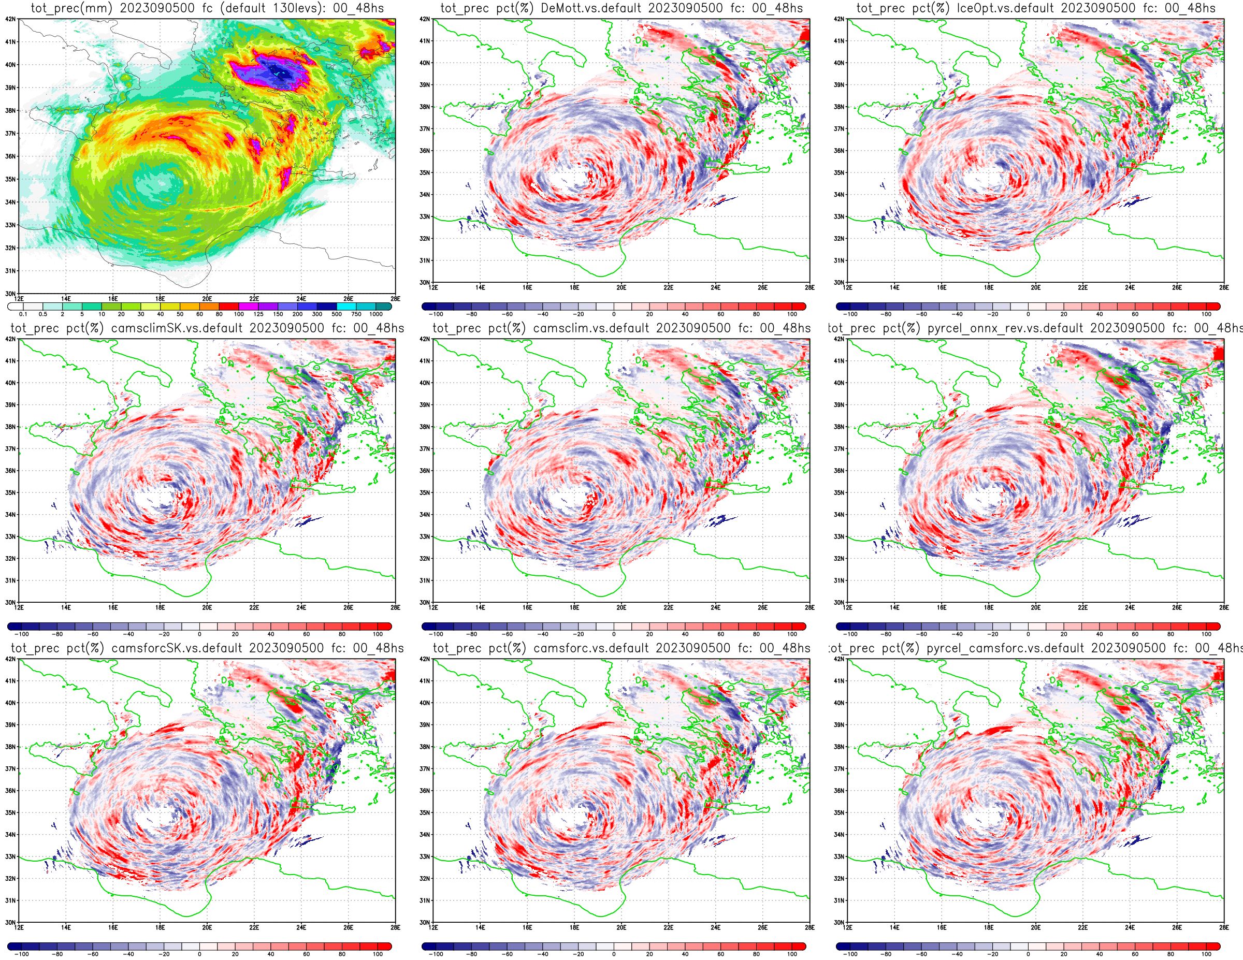
Euripides Avgoustoglou, Hellenic National Meteotological Service, 28th COSMO GM , Rome-Italy, September 13-18, 2026
12a

Slide 16
Euripides Avgoustoglou, Hellenic National Meteotological Service, 28th COSMO GM , Rome-Italy, September 13-18, 2026
13

Slide 17
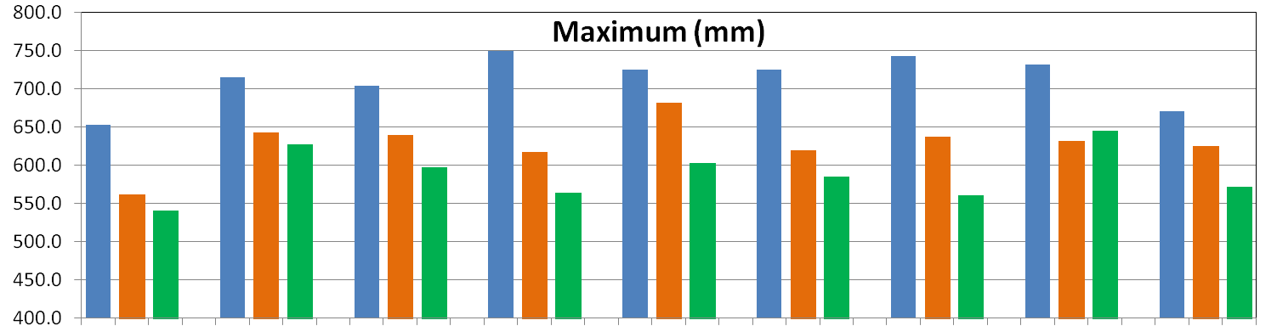
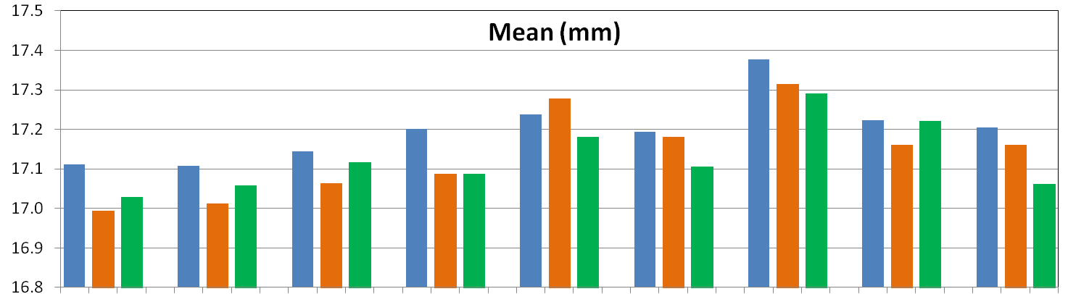
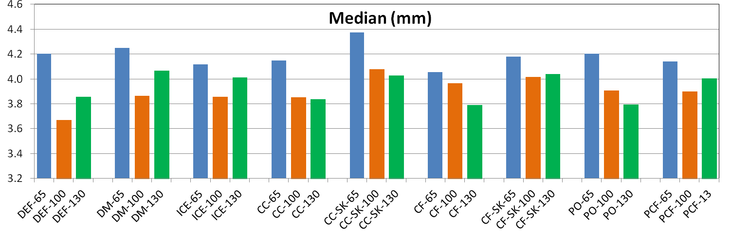
Euripides Avgoustoglou, Hellenic National Meteotological Service, 28th COSMO GM , Rome-Italy, September 13-18, 2026
14

Slide 18
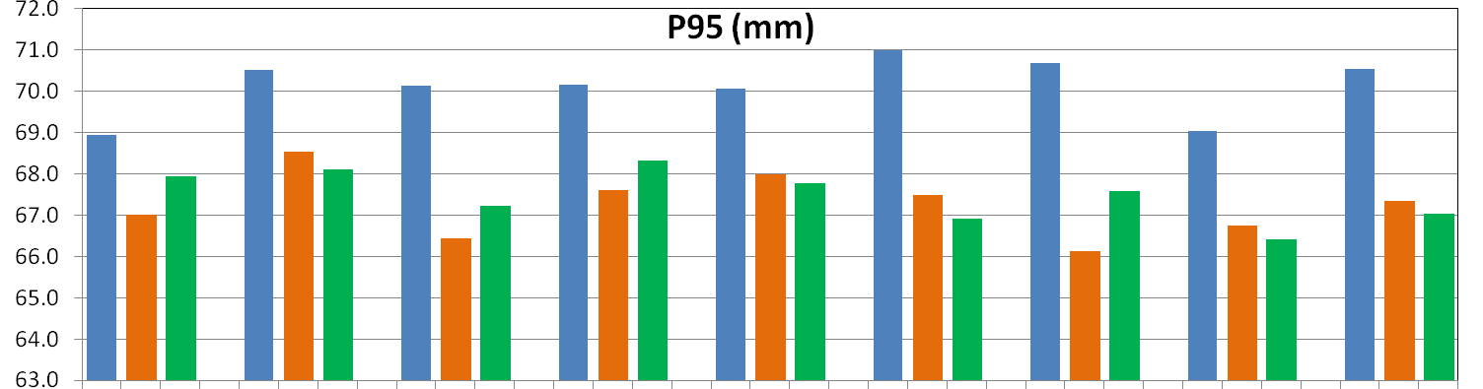
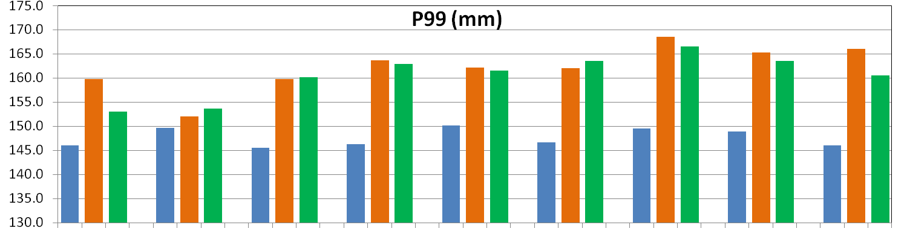
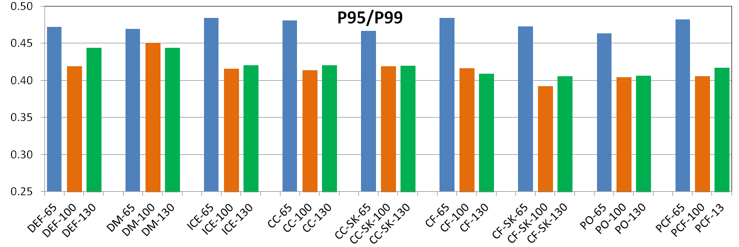
Euripides Avgoustoglou, Hellenic National Meteotological Service, 28th COSMO GM , Rome-Italy, September 13-18, 2026
15

Slide 19
Key Findings – Precipitation Sensitivity
Domain-mean precipitation is highly robust across all experiments (~17 mm), showing limited sensitivity in the overall precipitation amount.
The precipitation distribution is strongly skewed: median precipitation is only ~4 mm compared with ~17 mm for the mean, indicating rainfall concentration over a relatively small part of the domain.
Sensitivity increases toward the upper tail: P95 varies modestly (~66–71 mm), while P99 shows greater variability (~145–169 mm).
Maximum precipitation shows the strongest sensitivity, ranging from ~540 to ~750 mm (~39%), indicating substantial differences in localized rainfall extremes.
P95/P99 generally decreases from 65 to 100 levels, suggesting greater separation between heavy and extreme precipitation, although the response is not fully systematic.
Main conclusion: The experiments primarily influence the intensity and spatial concentration of precipitation extremes, rather than the overall domain precipitation.
Euripides Avgoustoglou, Hellenic National Meteotological Service, 28th COSMO GM , Rome-Italy, September 13-18, 2026
16

Slide 20
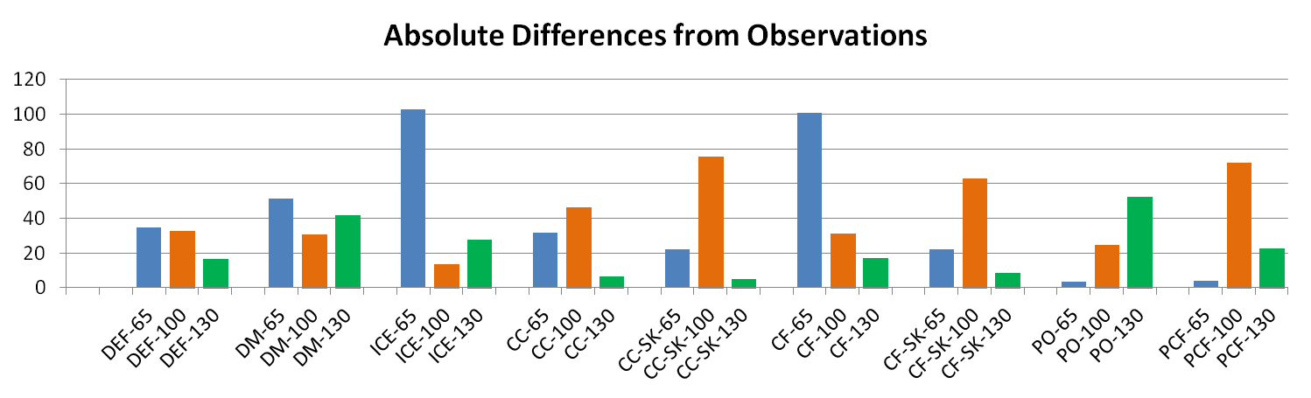
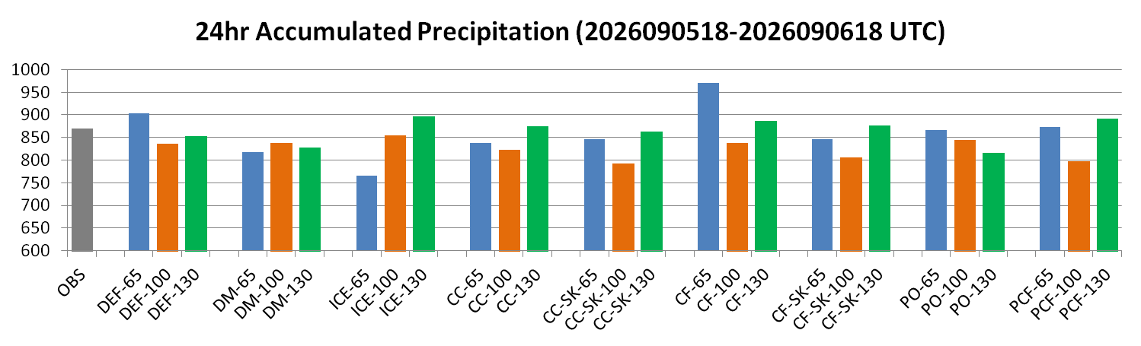
Comparison of total 24 hr accumulated preciptation over available stations
Euripides Avgoustoglou, Hellenic National Meteotological Service, 28th COSMO GM , Rome-Italy, September 13-18, 2026
17

Slide 21
Key Findings – Precipitation Sensitivity against Observations (mm)
Configuration | Best level | Error
Default | 130L | 16.8
DeMott | 100L | 30.9
IceOpt | 100L | 13.5
CAMS configurations | 130L | 5.2-17.2
Pyrcel configurations | 65L | 3.4-4.2
Observed total precipitation: 868.9
Best agreement with observations
pyrcel_onnx_rev – 65L: 865.5 → error 3.4 (0.39%)
pyrcel_camsforc – 65L: 873.1 → error 4.2 (0.48%)
camsclimSK – 130L: 863.7 → error 5.2 (0.59%)
camsclim – 130L: 875.4 → error 6.5 (0.75%)
The optimal resolution is configuration-dependent, likely reflecting interactions between vertical resolution and the representation of cloud microphysics, convection, and aerosol/forcing inputs.
Euripides Avgoustoglou, Hellenic National Meteotological Service, 28th COSMO GM , Rome-Italy, September 13-18, 2026
18

Slide 22
