Slide 1

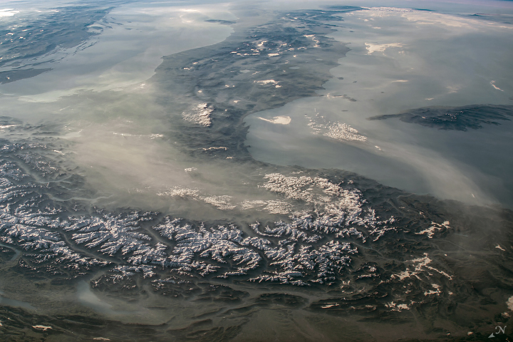
Cloud-Aerosols
Interactions in ICON
בס"ד
NASA
Harel Muskatel (IMS)
27th COSMO General Meeting, September 15, 2026

Slide 2


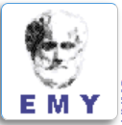

Aerosol-CLoud Interactions in ICON Model:
ACLIIM Priority Project
September 2024 - August 2027
Total planed FTEs : 6.1
Participants:
Harel Muskatel (IMS)
Pavel Khain (IMS)
Euripides Avgoustoglou (HNMS)
Daniel Rieger (DWD)
Alberto de Lozar (DWD)
Piero Serafini (CETEMPS)

Slide 3
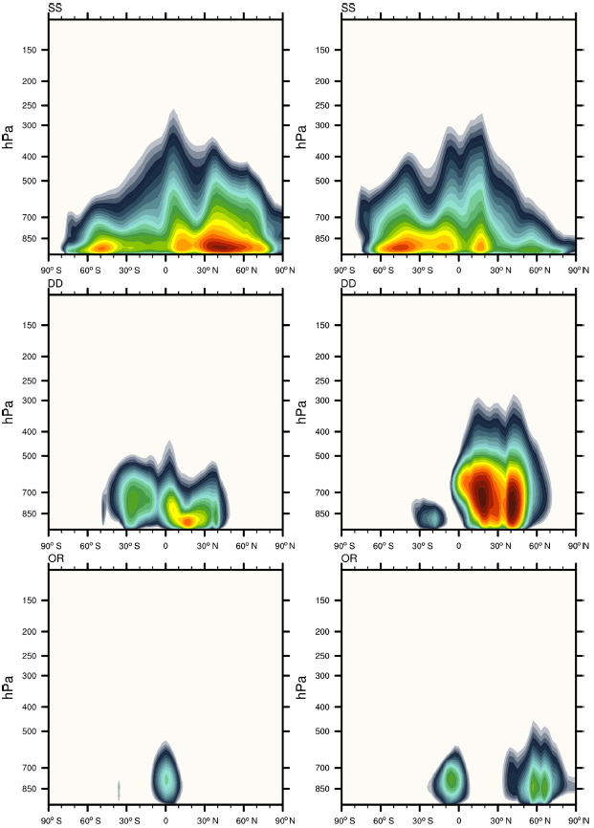
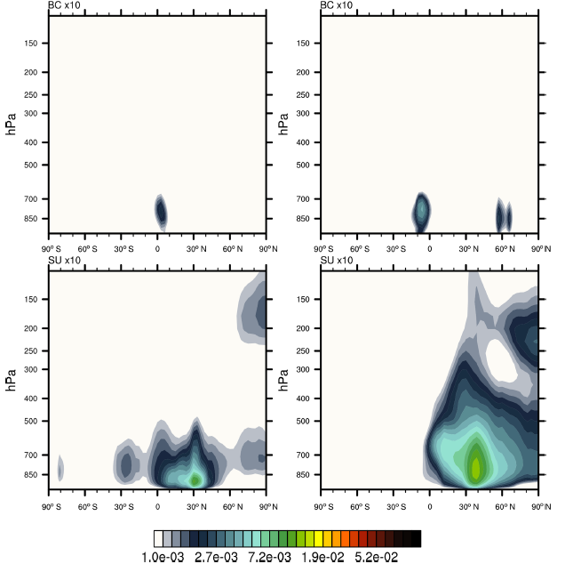
CAMS climatology - Zonal-mean layer-integrated mass profiles
Jan
Jul
SS
Jan
Jul
BC
DU
SU
OM
gr/m²
Bozzo et al. 2020

Slide 4
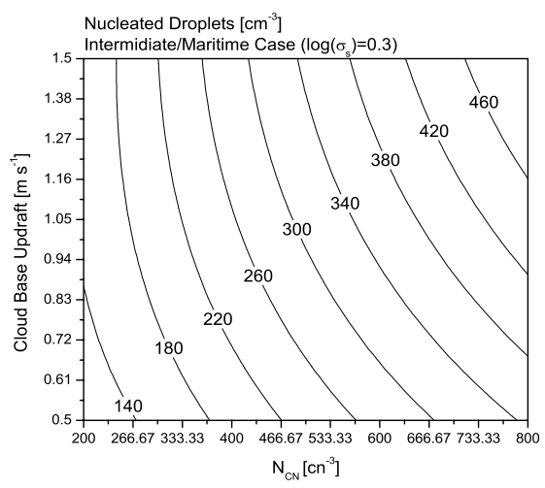

Segal & Khain cloud droplets activation scheme
  Calculation of CDNC from N_{CN} is estimated from Segal & Khain (2006)
  4D look-up table:
$$CDNC=f(n_{cn}, log(σ),r_{mod}{,w}_{CB})$$
Tegen CAMS climatology CAMS forecasted
Segal & Khain (2006)

Slide 5
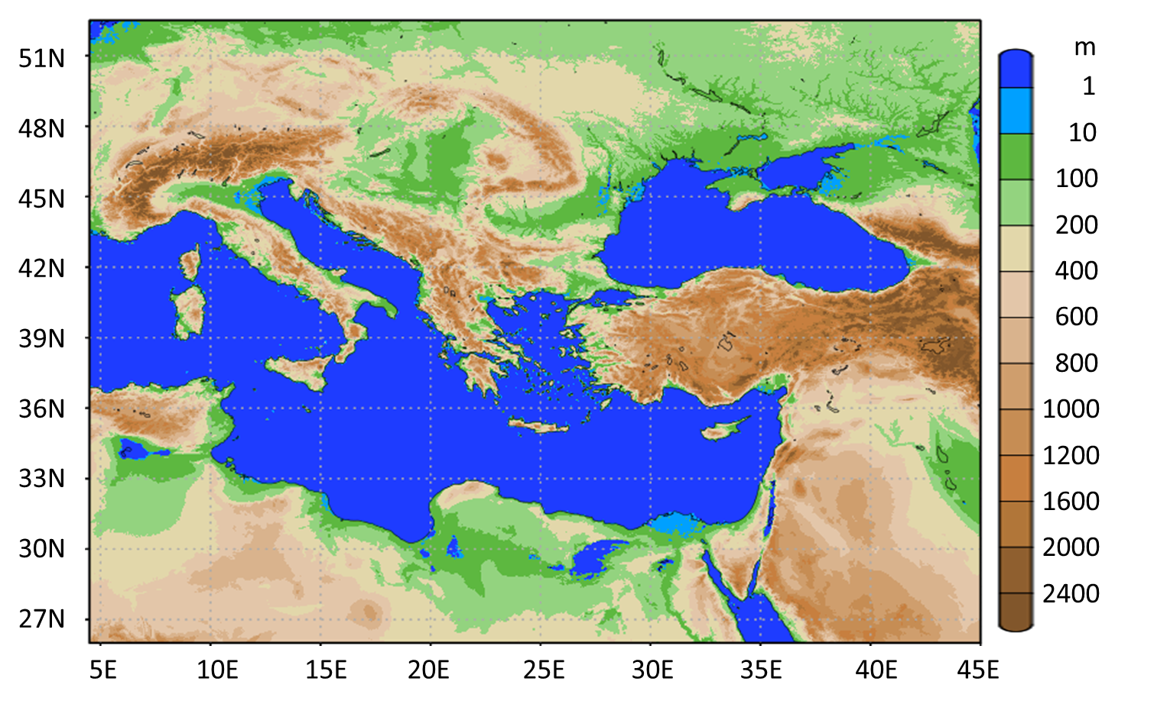
Test case – storm “Daniel”
Southeast Europe Domain (SEE)

Slide 6
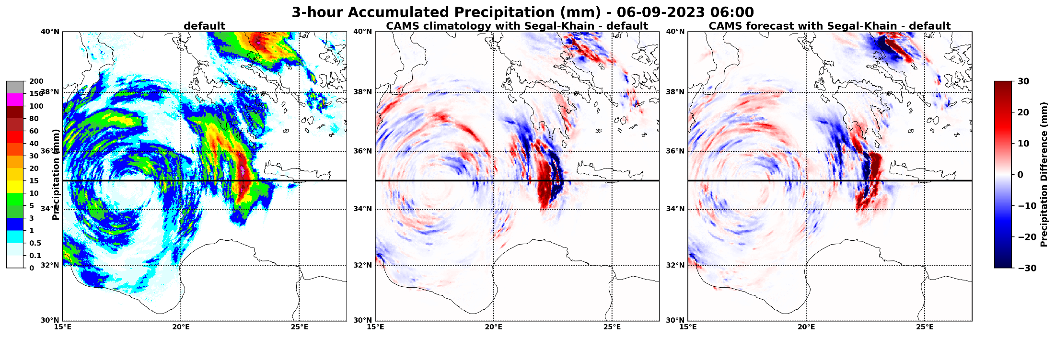
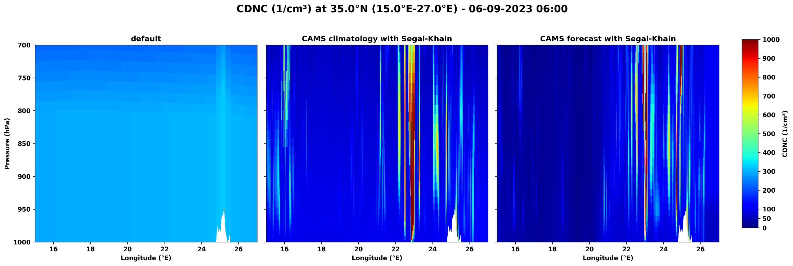
Snapshot analysis

Slide 7
Surface Radiation
Aerosols-Radiation:
CASM climatology
Aerosols-Radiation:
CASM climatology
Aerosols-Radiation:
CASM forecast

Slide 8

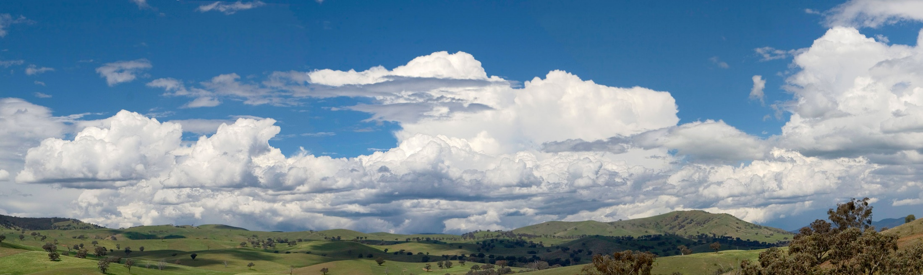
A Deep Learning Emulator for pyrcel-Based Cloud Droplet Number
Concentration in ICON
בס"ד
ACLIIM
Harel Muskatel (IMS), Daniel Rothenberg (Brightband), Mareike Burba (DWD) and Axel Seifert (DWD)
ICCARUS, March 17, 2026

Slide 9
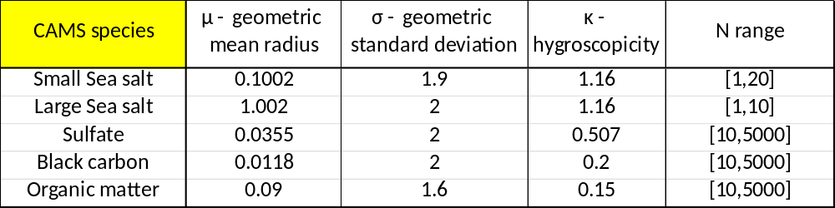
pyrcel: a Cloud Parcel Model
Adiabatic parcel model (Rothenberg & Wang, 2016) simulating cloud droplet formation and growth via condensation
Solves a coupled ODE system (temperature, water vapor, liquid water, supersaturation, and pressure) to predicts droplet activation by tracking supersaturation evolution as a balance between condensational heating and adiabatic cooling
Uses κ-Köhler theory to represent aerosol hygroscopicity with a single parameter
Supports arbitrary aerosol populations — any combination of size, number concentration, and hygroscopicity (internal/external mixtures)
Aerosol size distributions discretized from lognormal modes into sectional bins
    output: CDNC and S_{max}

Slide 10
pyrcel Data Base
T₀ → [ 237.0 K , 318.0 K ]
w → [ 0.02 m/s , 5.0 m/s ]
Small Sea salt N₁ → [ 5 , 20 ] Liu et al. 2012
Large Sea salt N₂ → [ 2 , 10 ] Liu et al. 2012
Sulfate N₃ → [ 10 , 5000 ] Kim et al. 2008
Black Carbon N₄ → [ 10 , 5000 ] Kim et al. 2008
Organic Matter N₅ → [ 10 , 5000 ] Kim et al. 2008
P₀ = 850 hPa
S₀ = 0.0
Total: 10.3 Million model runs

Slide 11
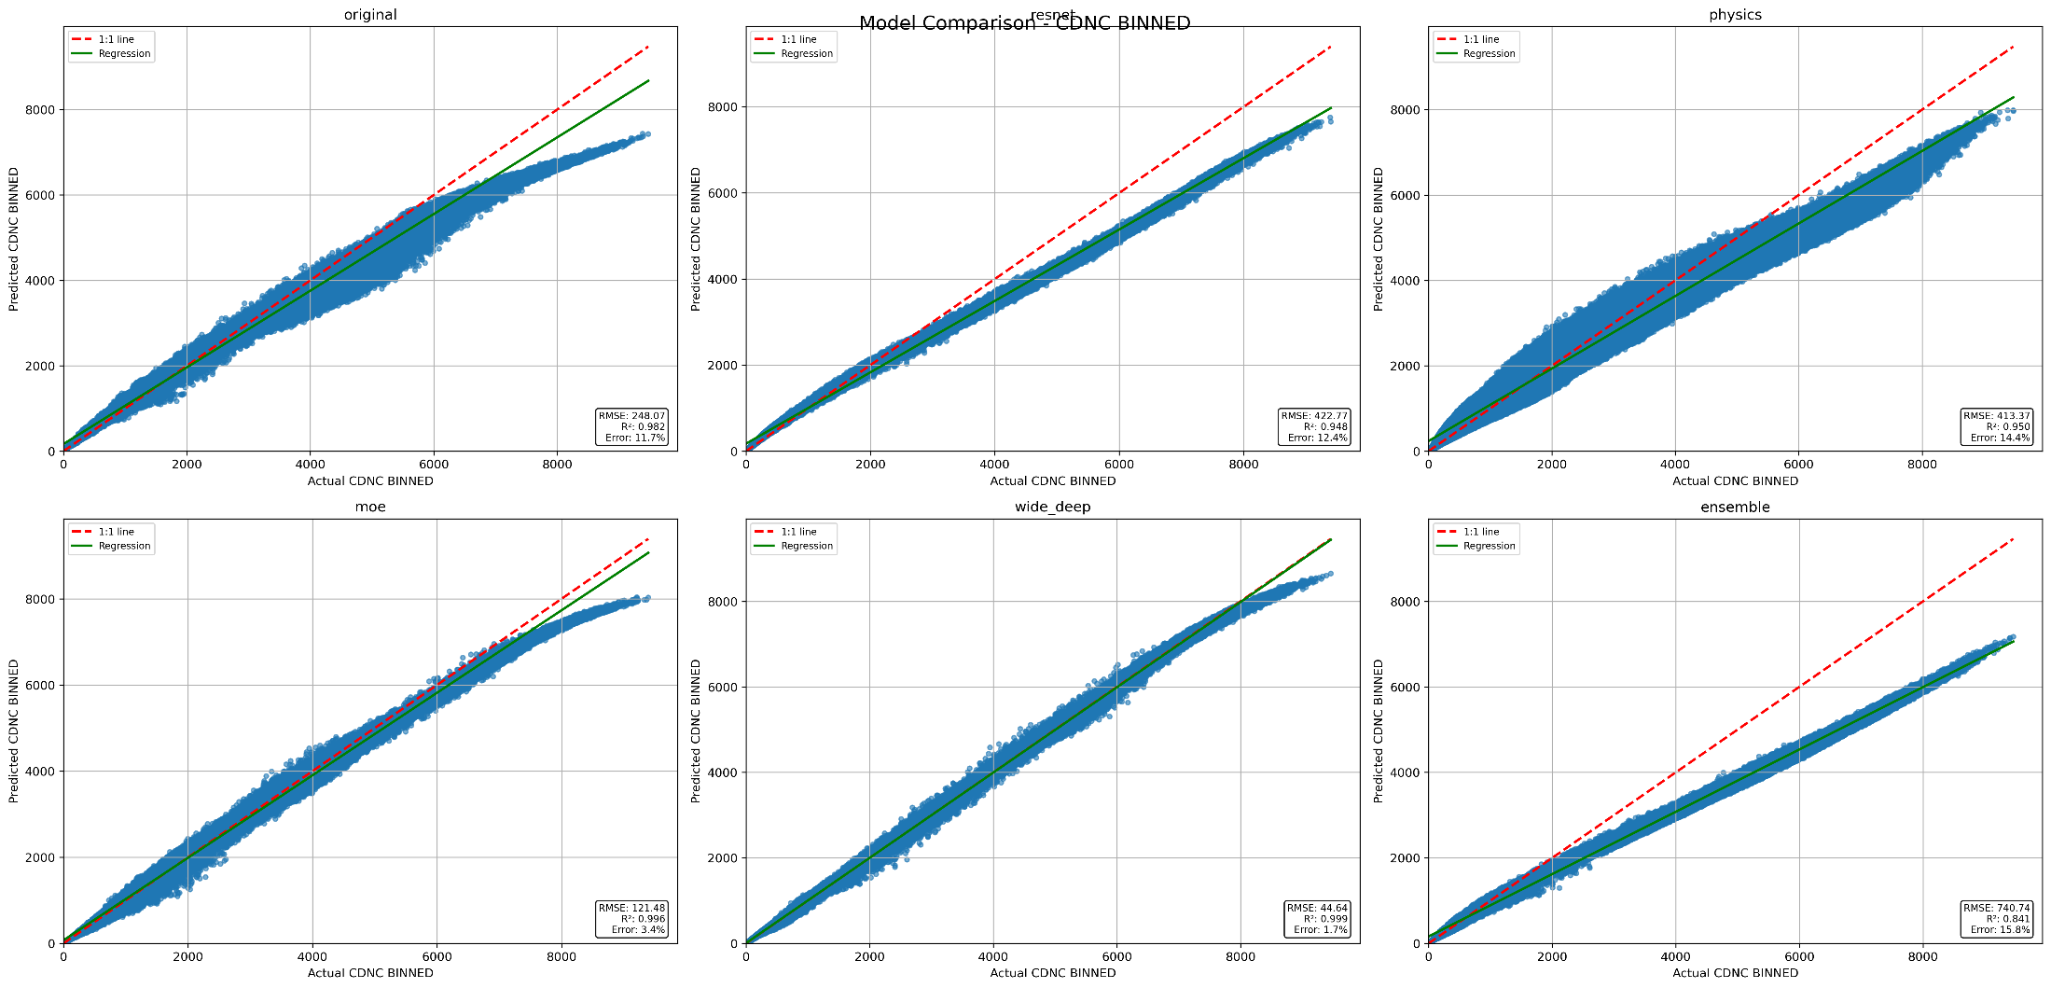
AI-pyrcel Emulator - Model Architectures
Bottleneck
resnet
Physics informed
11.7%
12.4%
14.4%
3.4%
1.4%
15.8%
moe
Wide & deep
endemble

Slide 12
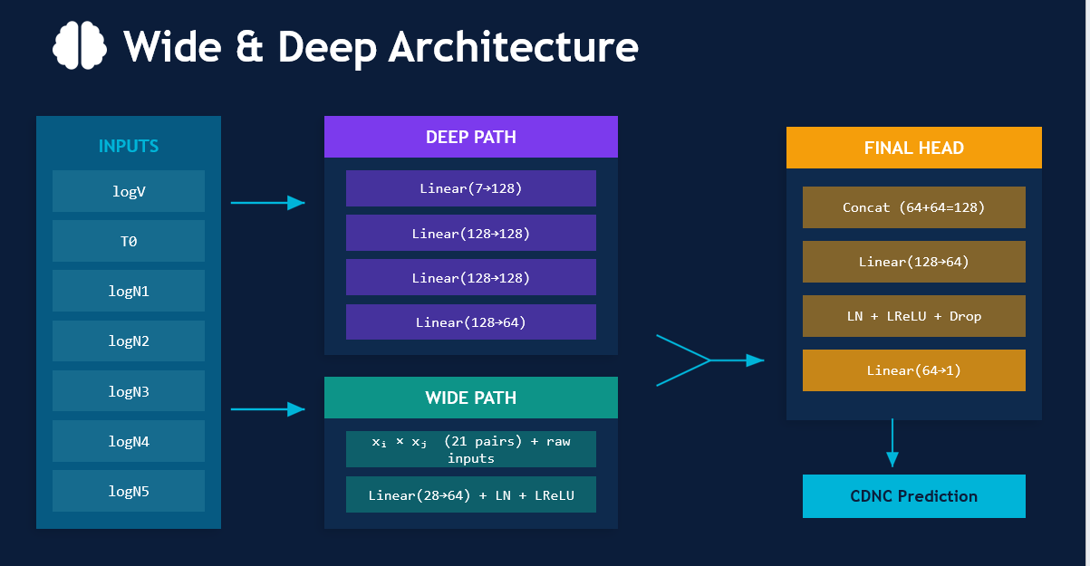
AI-pyrcel Emulator

Slide 13
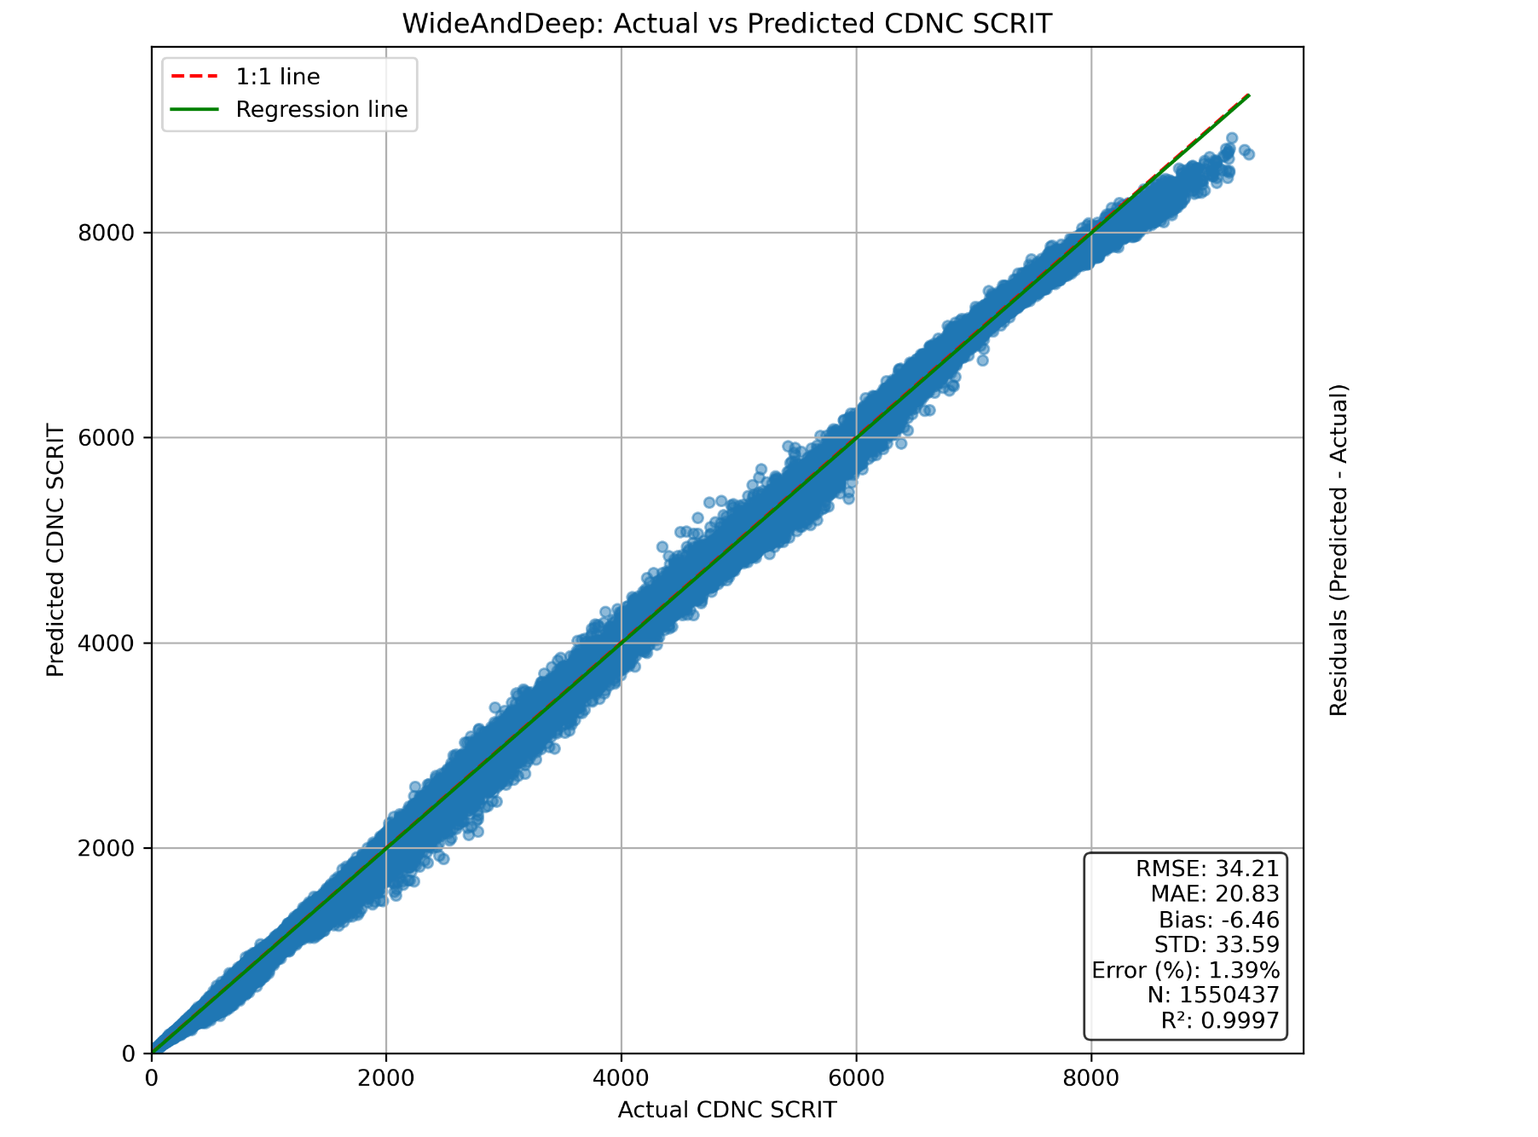
Wide and Deep architecture - inference
Mean Error = 1.4%

Slide 14
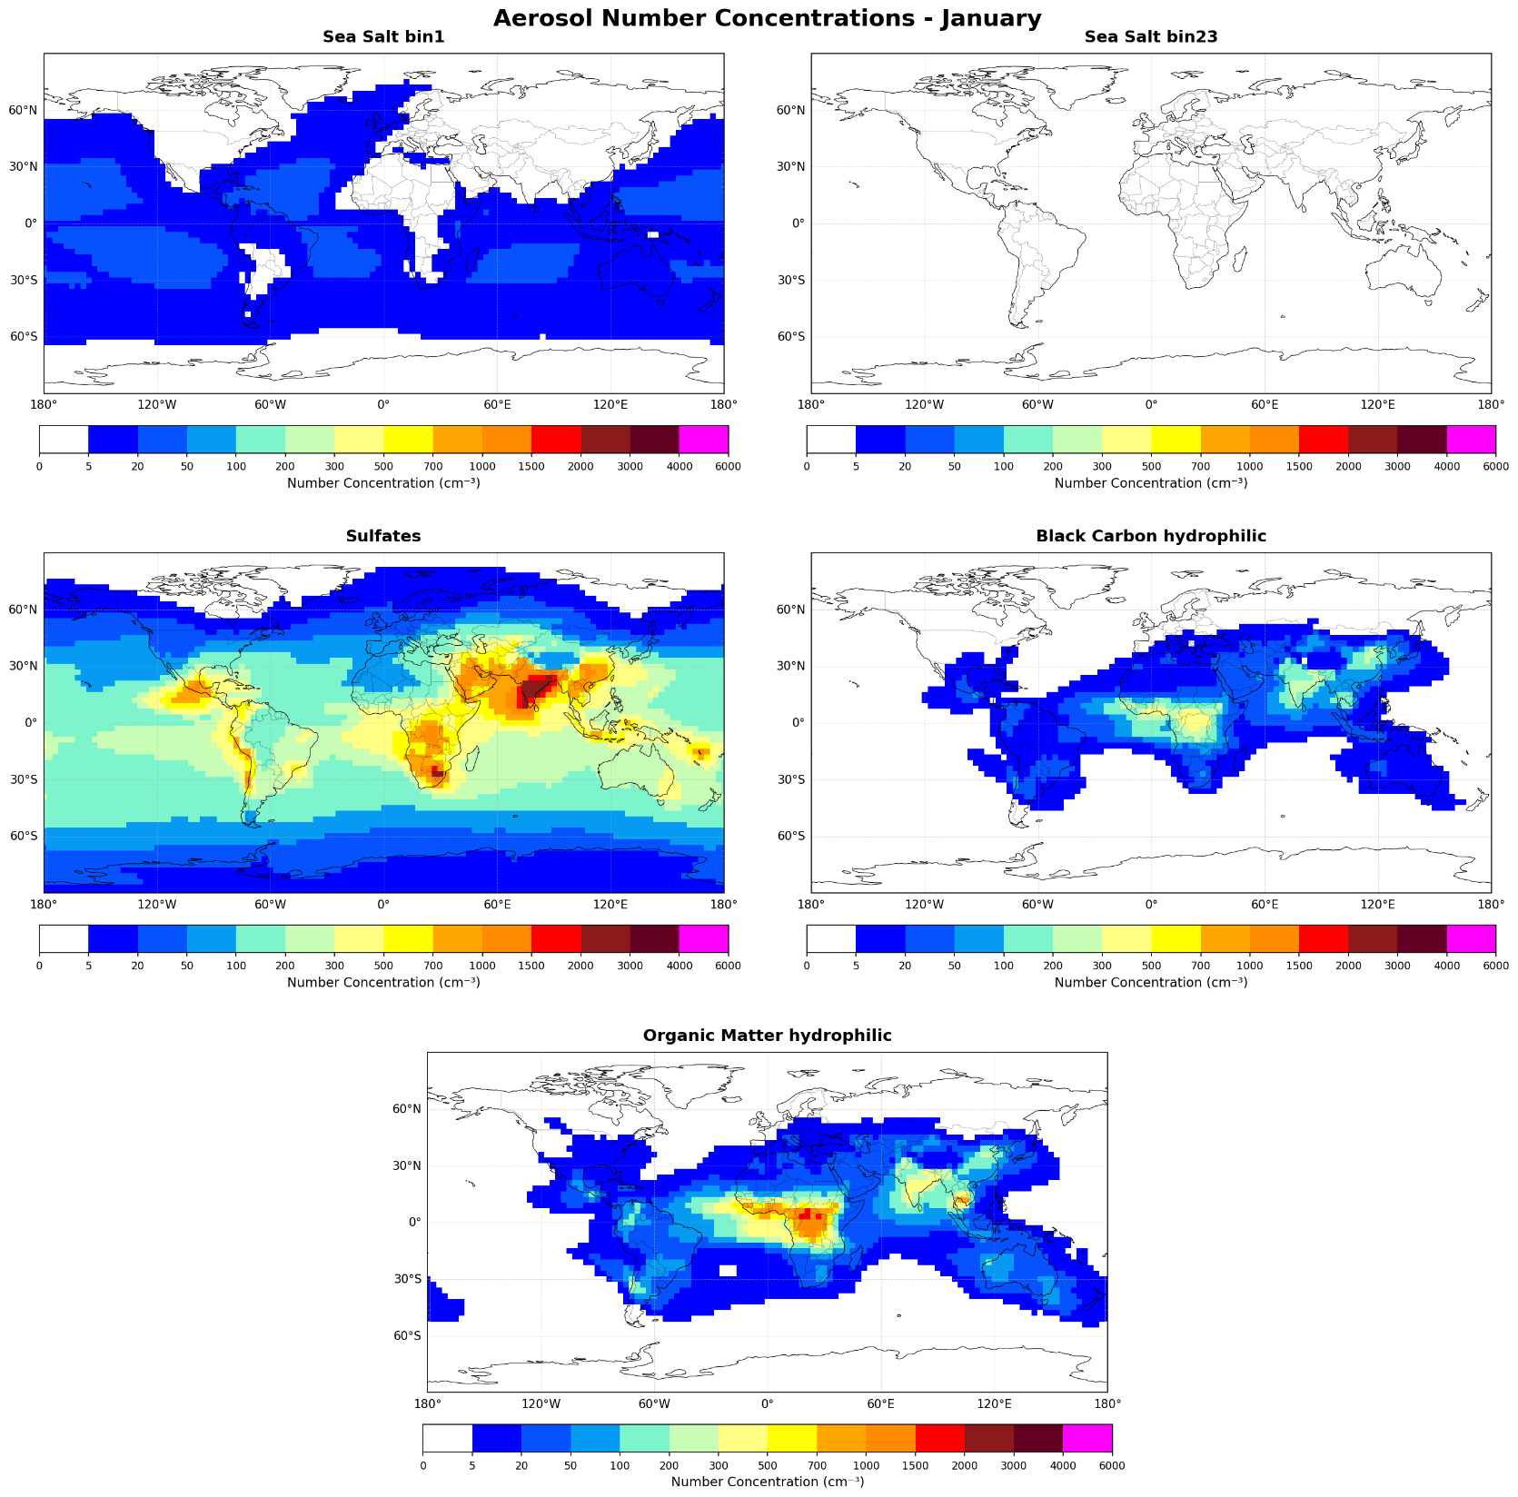
CAMS climatology – Number Concentrations at 850 hPa
SS small
SS big
SU
BC∙ (1/50)
January
OM

Slide 15
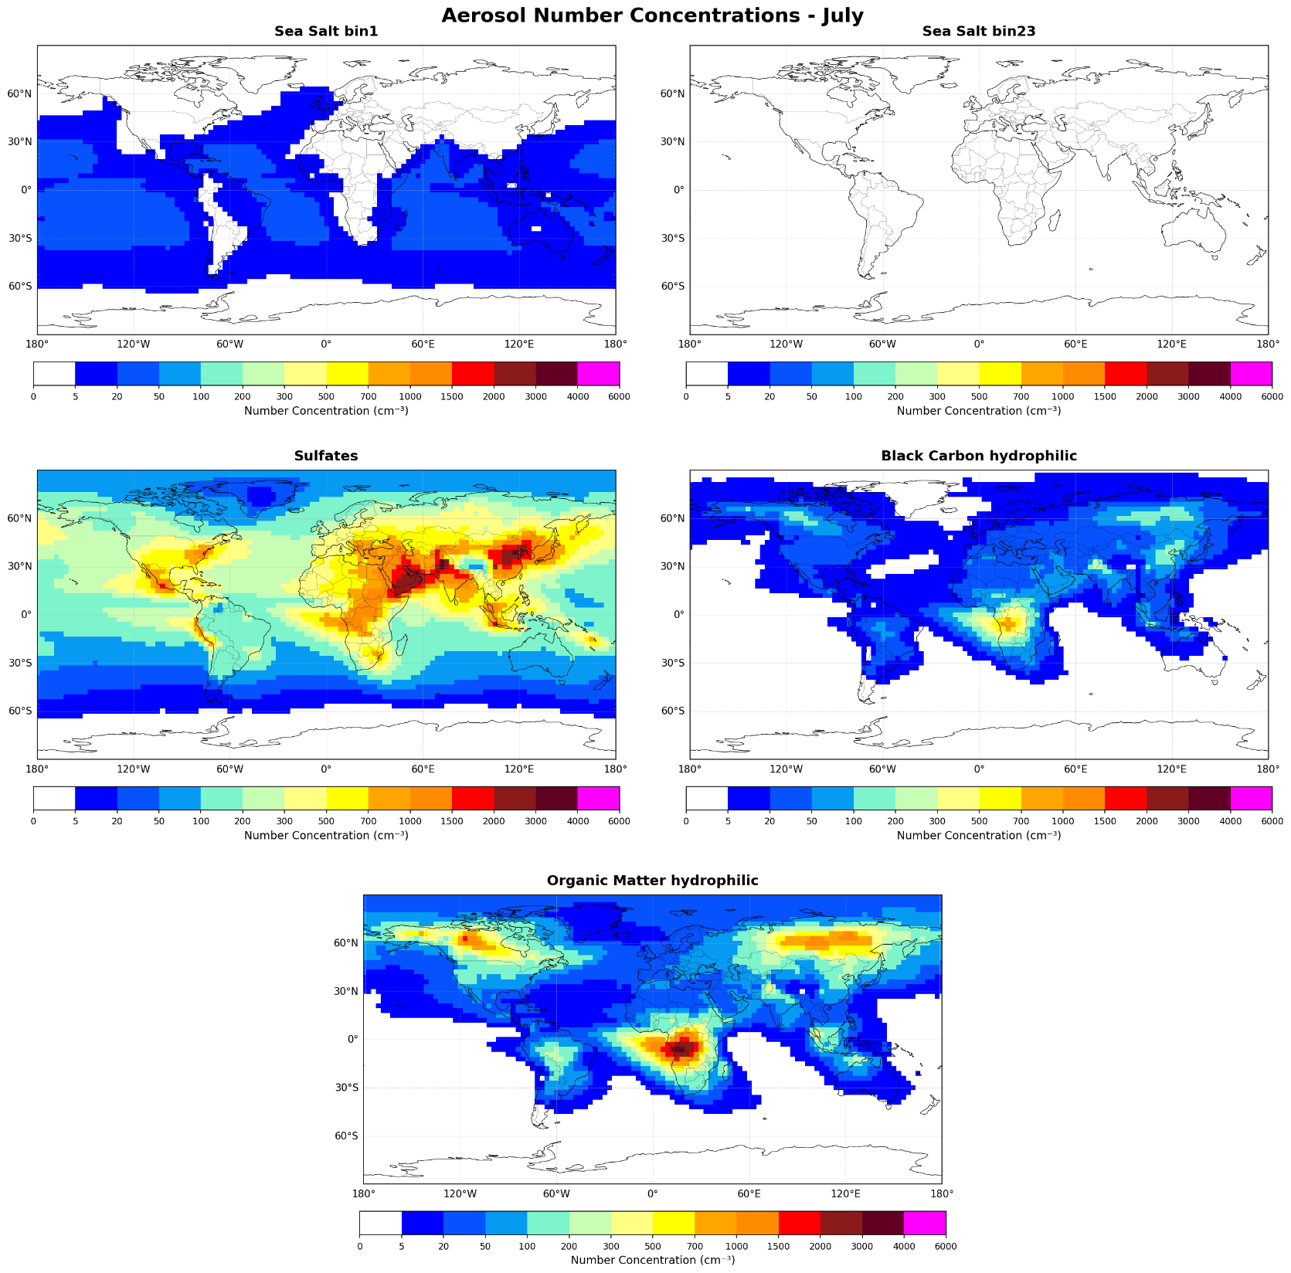
CAMS climatology – Number Concentrations at 850 hPa
SS small
SS big
SU
BC∙ (1/50)
July
OM

Slide 16
pyrcel-CAMS-AI-emulator 5D CDNC climatology
Vs.
MODIS 2D CDNC climatology

Slide 17
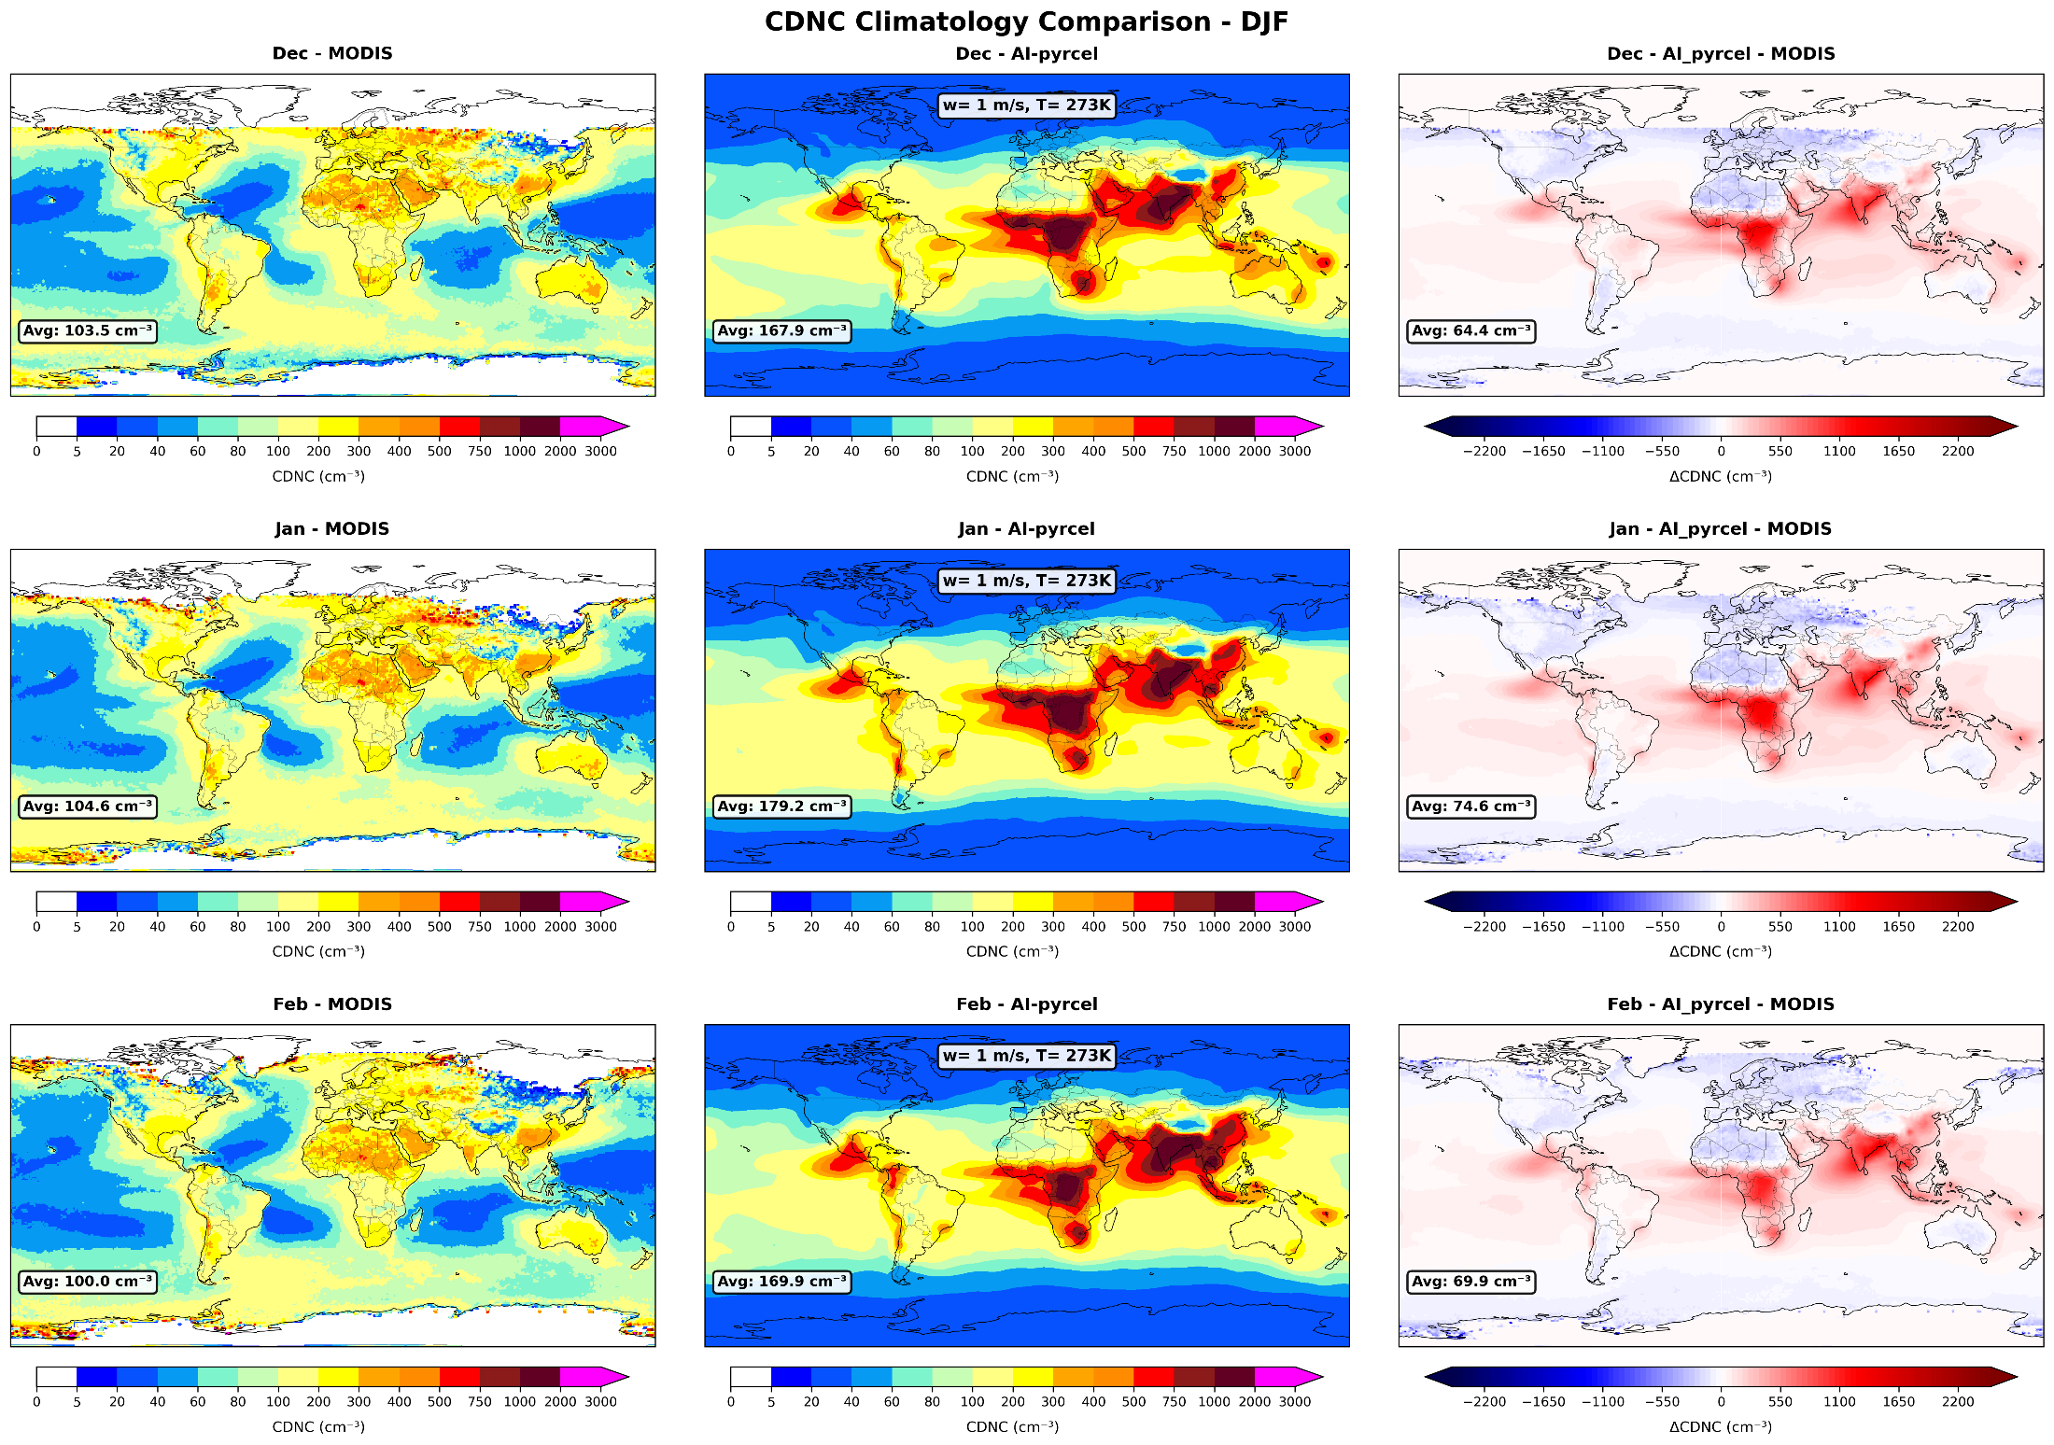
w = 1 m/s , T=273K

Slide 18
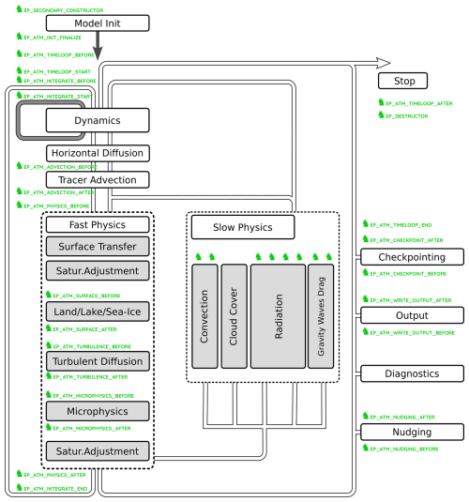
Running AI-pyrcel in ICON using ComIn interface
AI-pyrcel plug-in
Hartung, K., et al, 2025.

Slide 19
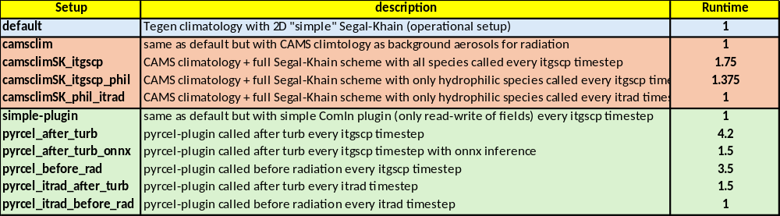
Running AI-pyrcel in ICON using ComIn interface
ONNX - Open Neural Network Exchange: standard file format for describing a trained neural network
Thanks: Florian Prill, Ronald Wirth, Nils-Arne Dreier

Slide 20

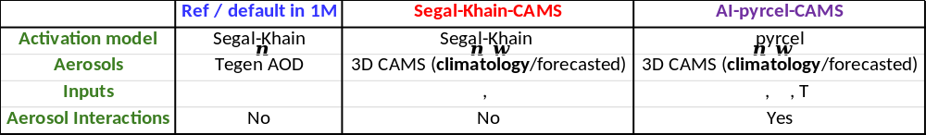
Test case – Daniel storm Model Setup

Slide 21
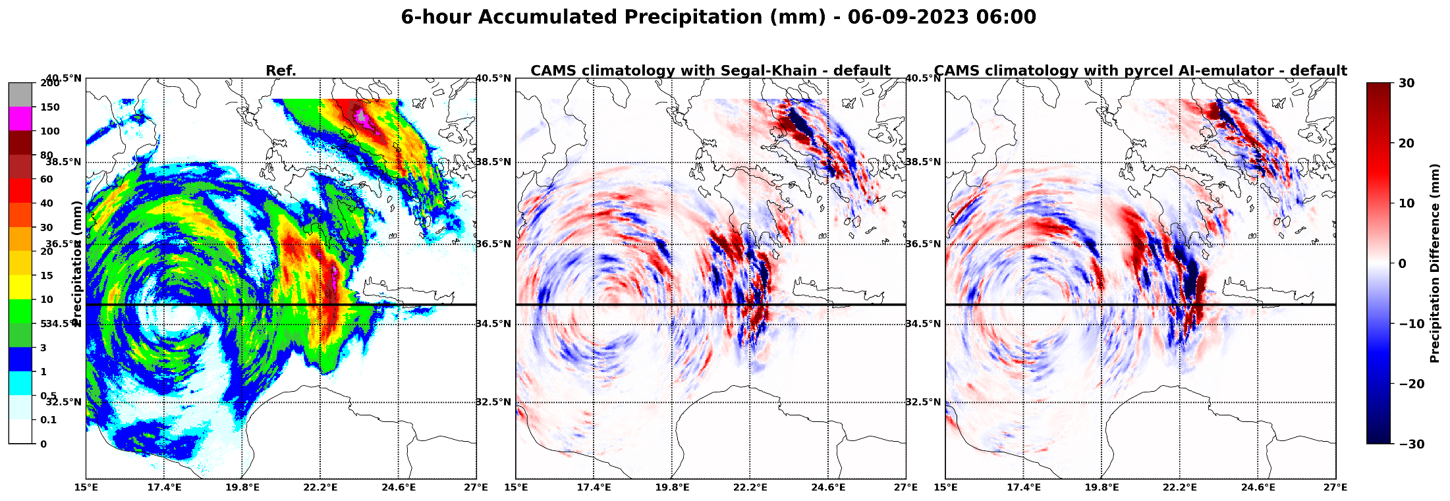
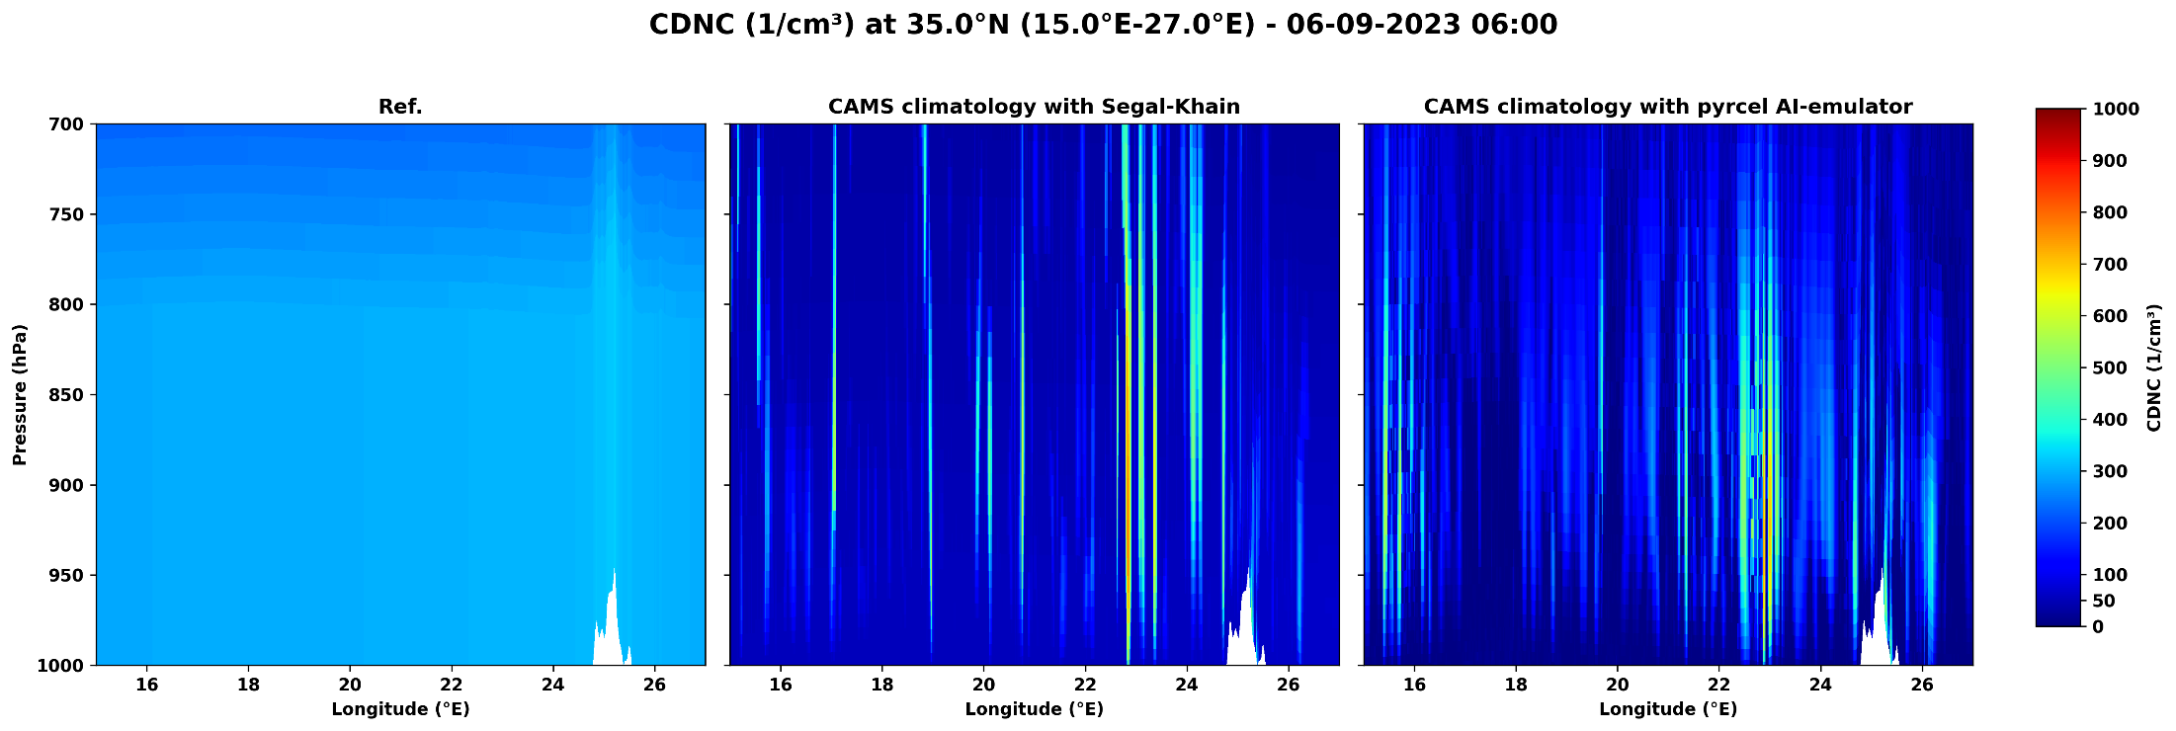
Snapshot analysis

Slide 22
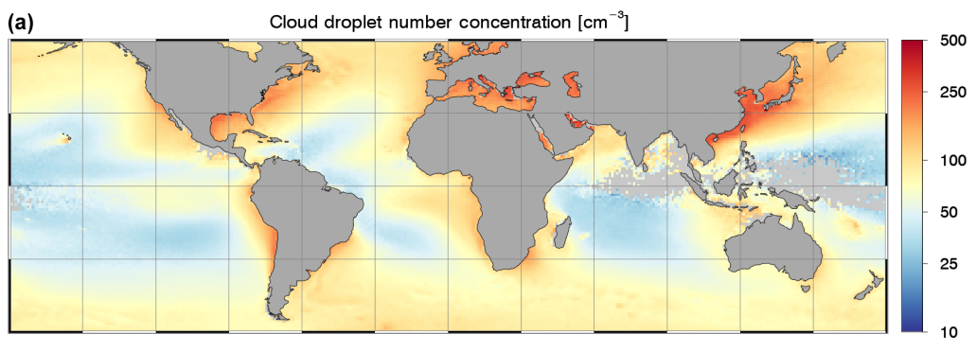
Comparisons to other datasets
1. MODIS climatology (done)
2. MODIS daily values 2000-2020 (Gryspeerdt et al., 2022)
Bennartz, R; Rausch, J (2017). ATMOSPHERIC CHEMISTRY AND PHYSICS, 17(16), 9815-9836.

Slide 23
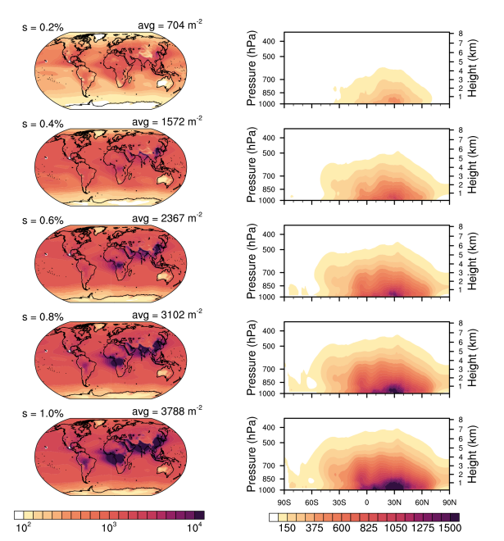
Comparisons to other datasets
3. CAMS reanalysis daily values 2003-2021 (Block et al., 2024)

Slide 24
ICON-ART-Dust-IMS
Thanks: Jochen Förstner, Sascha Brand, Uli Schaettler, Detlev Majewski

Slide 25
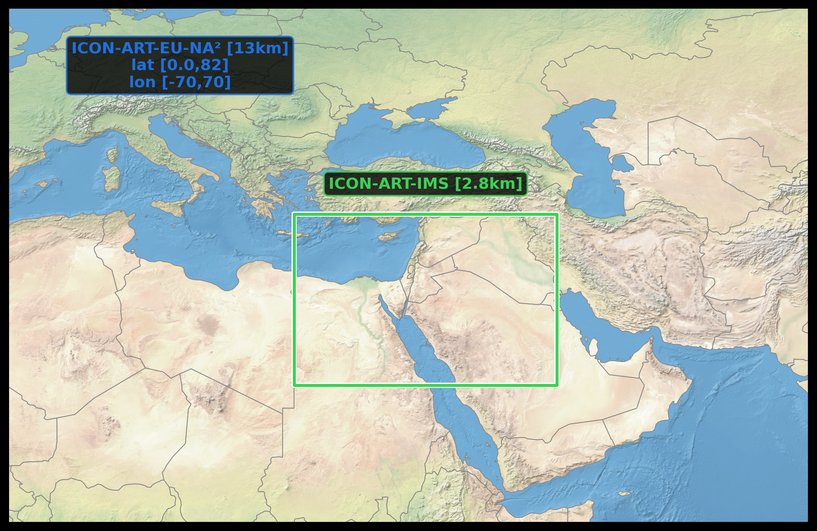
Model domain

Slide 26
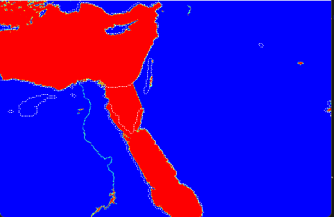
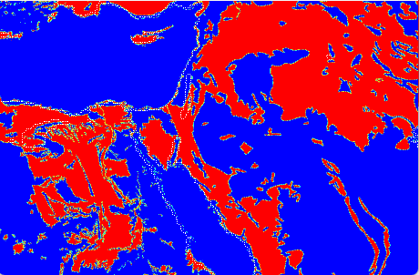
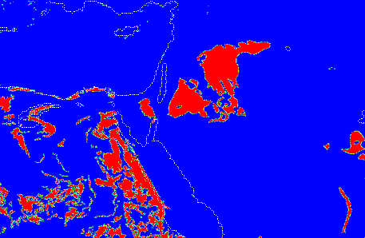
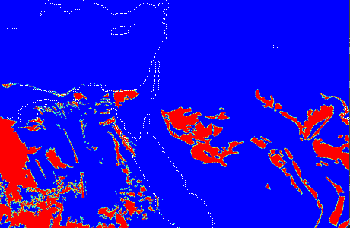
Sinai Peninsula Land
ICON_ART_IMS_DOM01_external_parameter.nc
UNDEF
Loam
Clay loam
Sand

Slide 27
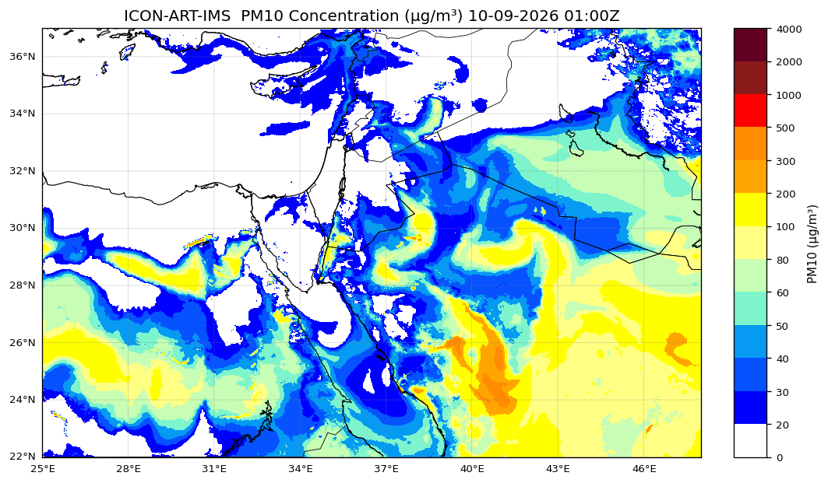
Example

Slide 28
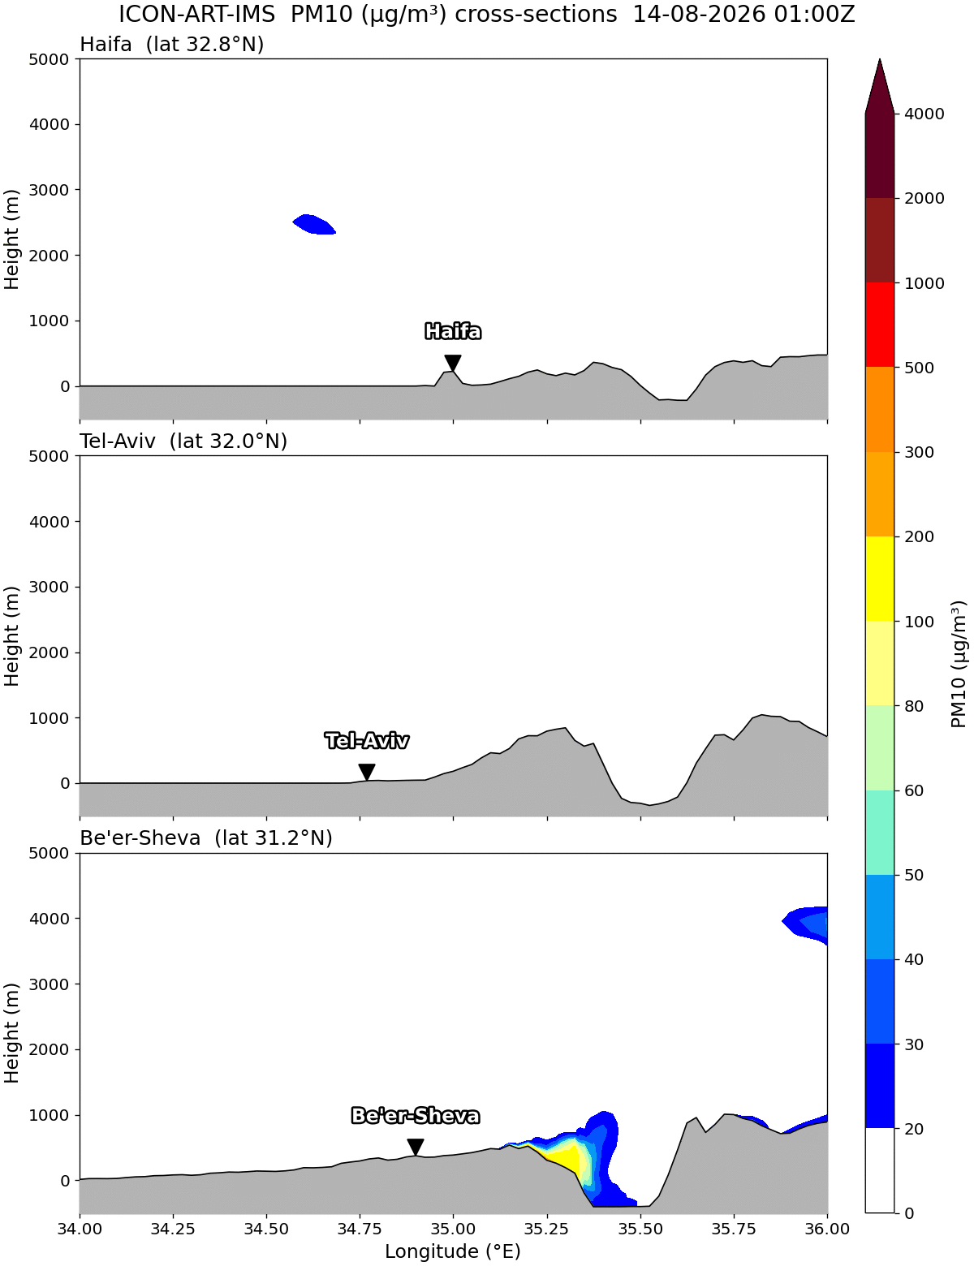
PM10 profiles

Slide 29
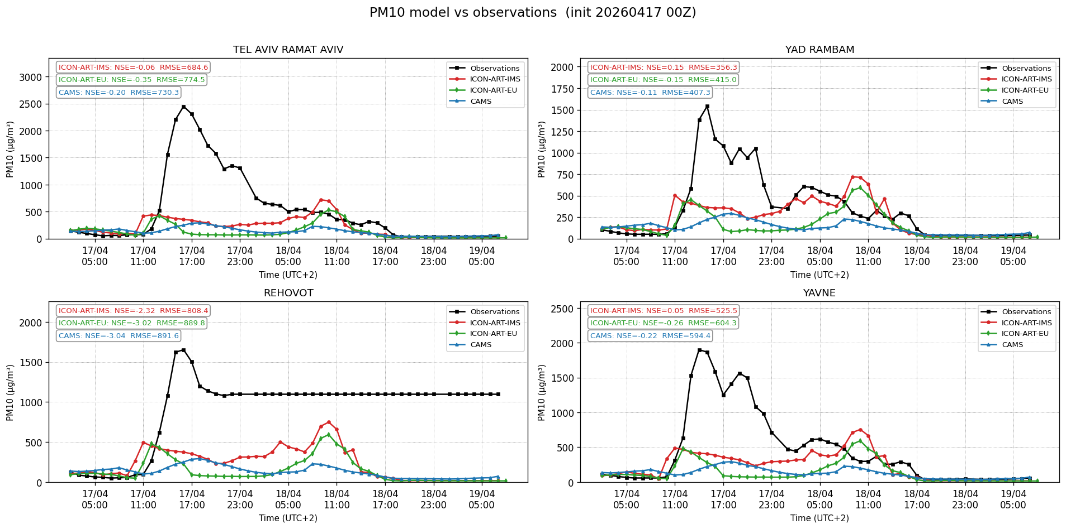
Verifications
17/04/2026 – 00Z RUN

Slide 30
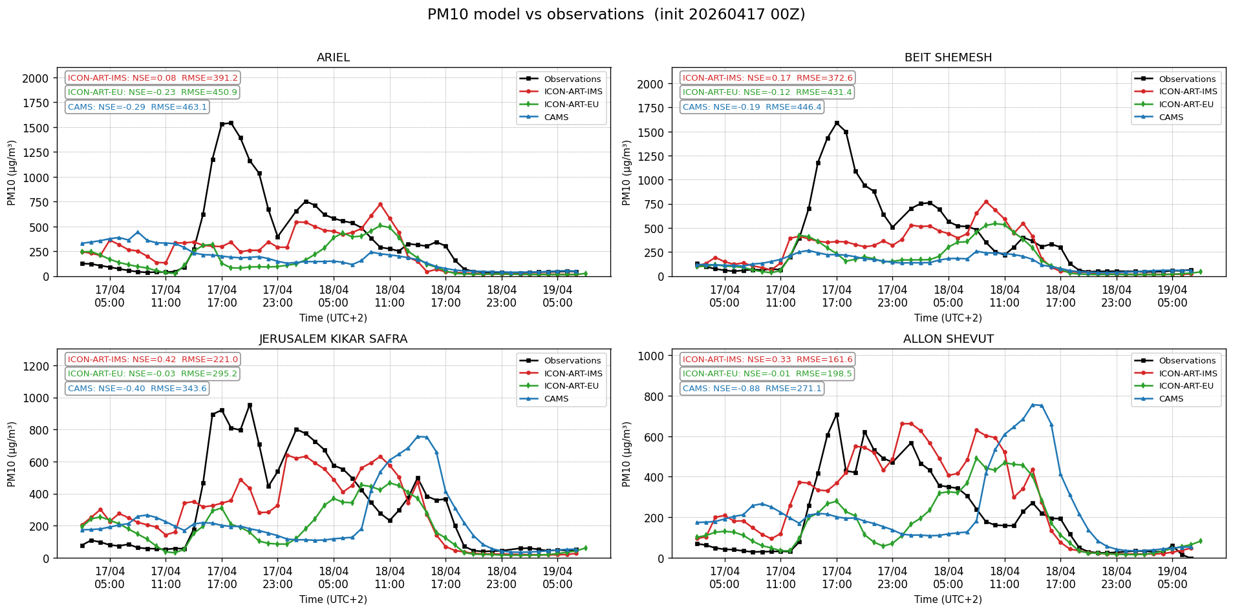
Verifications
17/04/2026 – 00Z RUN

Slide 31
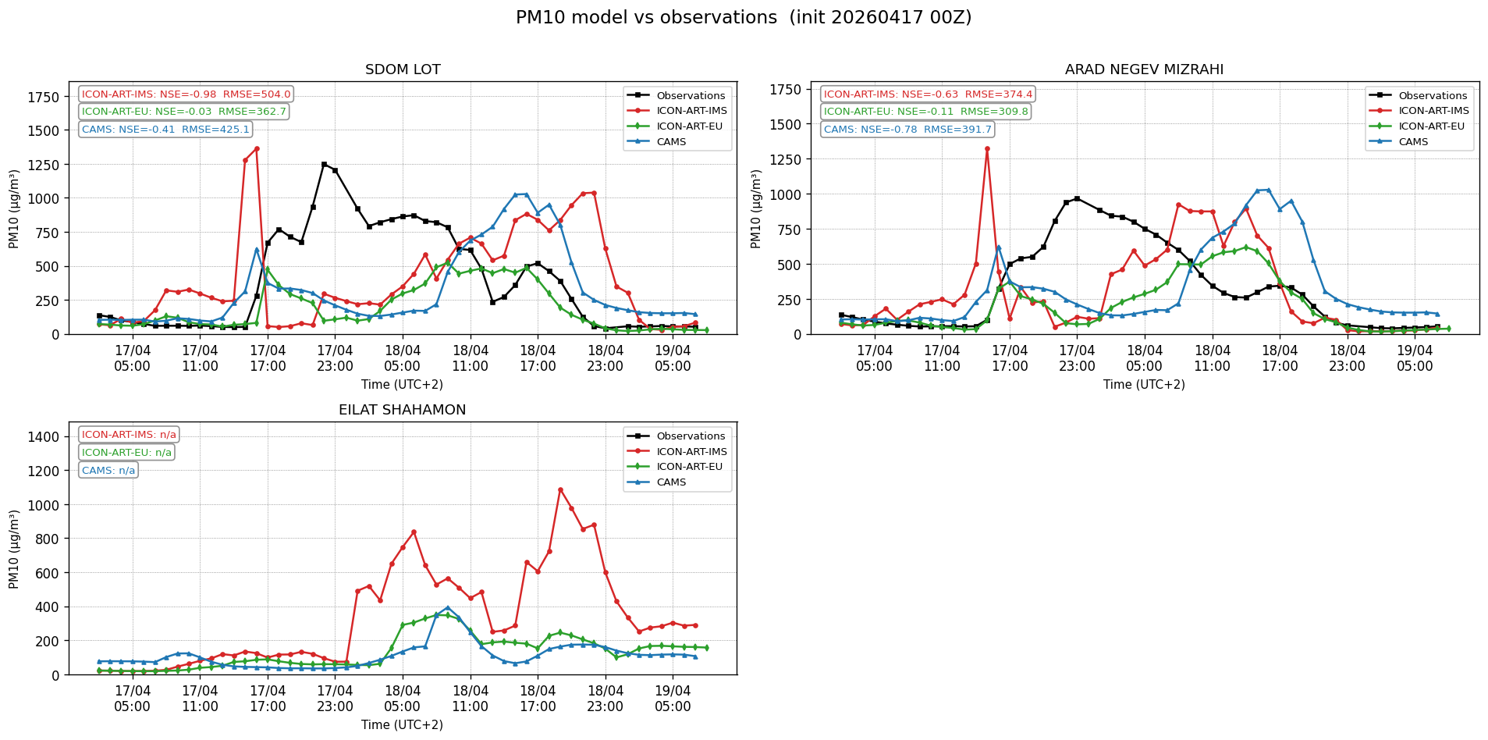
Verifications
17/04/2026 – 00Z RUN

Slide 32
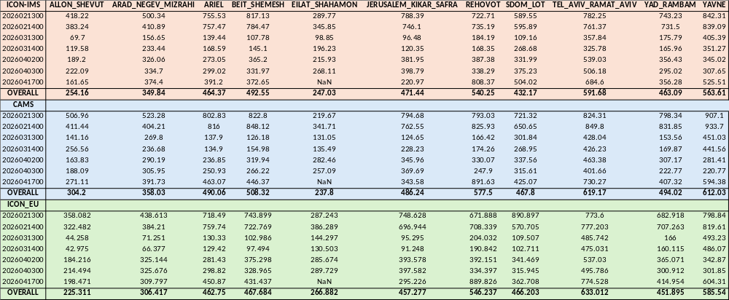
Verifications
==== Overall metrics (all dates, all stations) ====
ICON-ART-IMS : RMSE=458.61 bias=-194.76 (n=3909)
ICON-ART-EU : RMSE=461.45 bias=-240.96 (n=3909)
CAMS : RMSE=485.70 bias=-198.41 (n=3909)

Slide 33
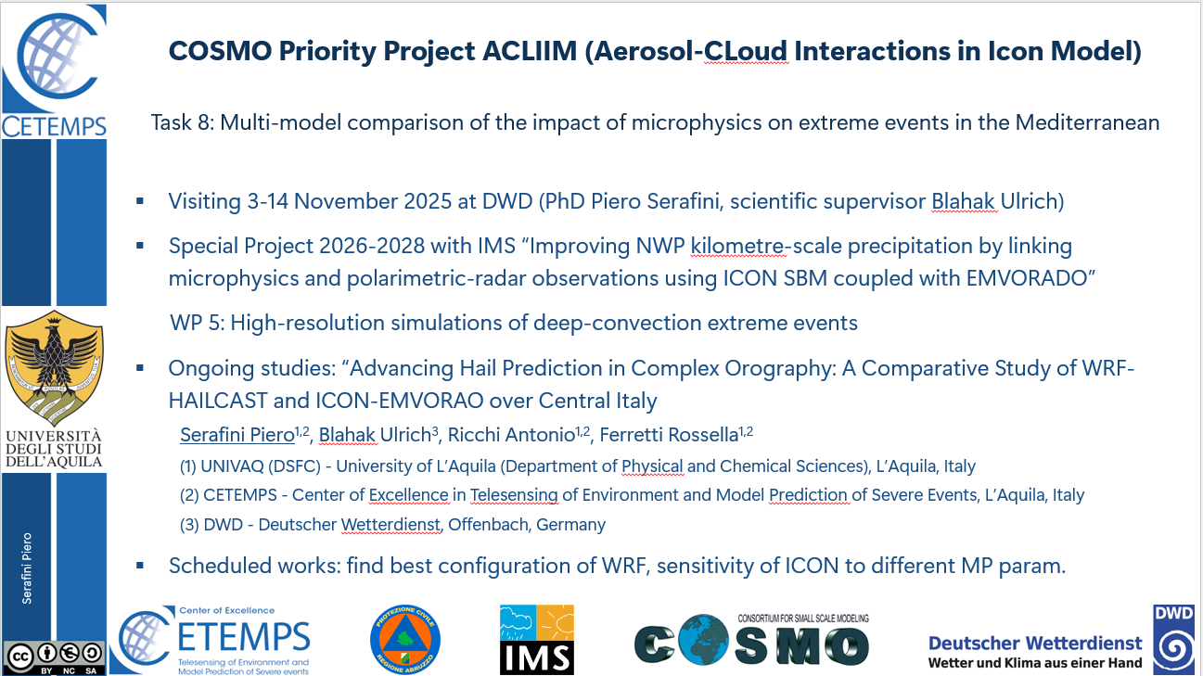

Slide 34
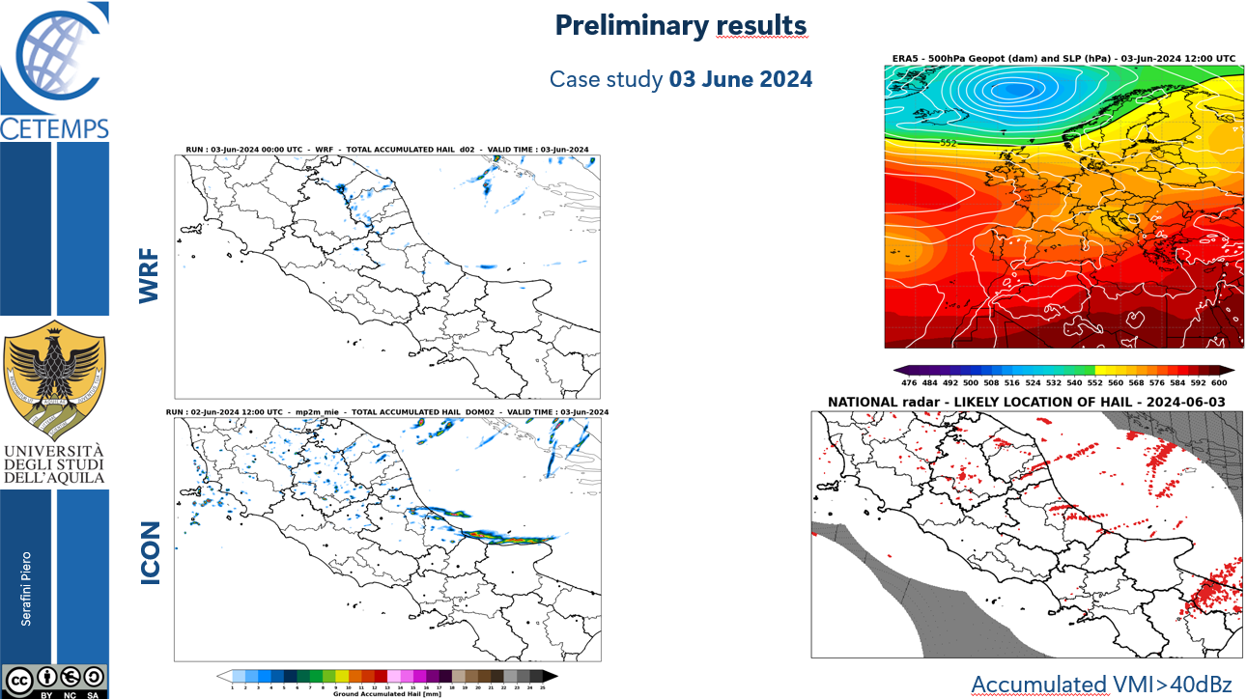

Slide 35
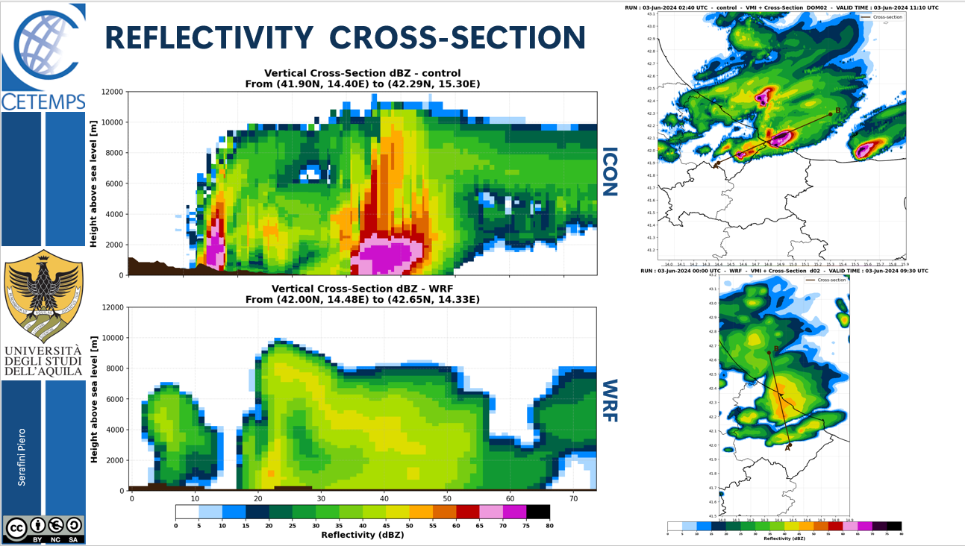

Slide 36
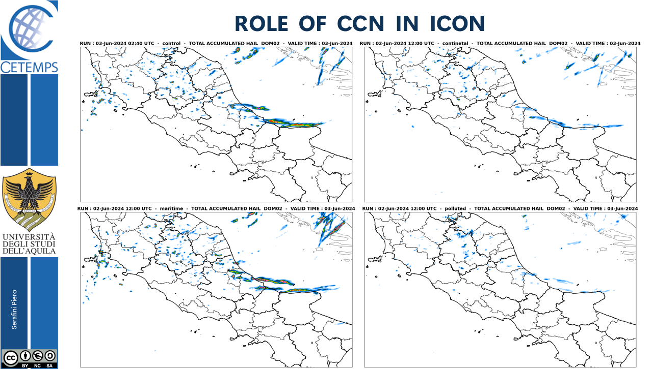

Slide 37
Thanks for your attention

