Slide 1
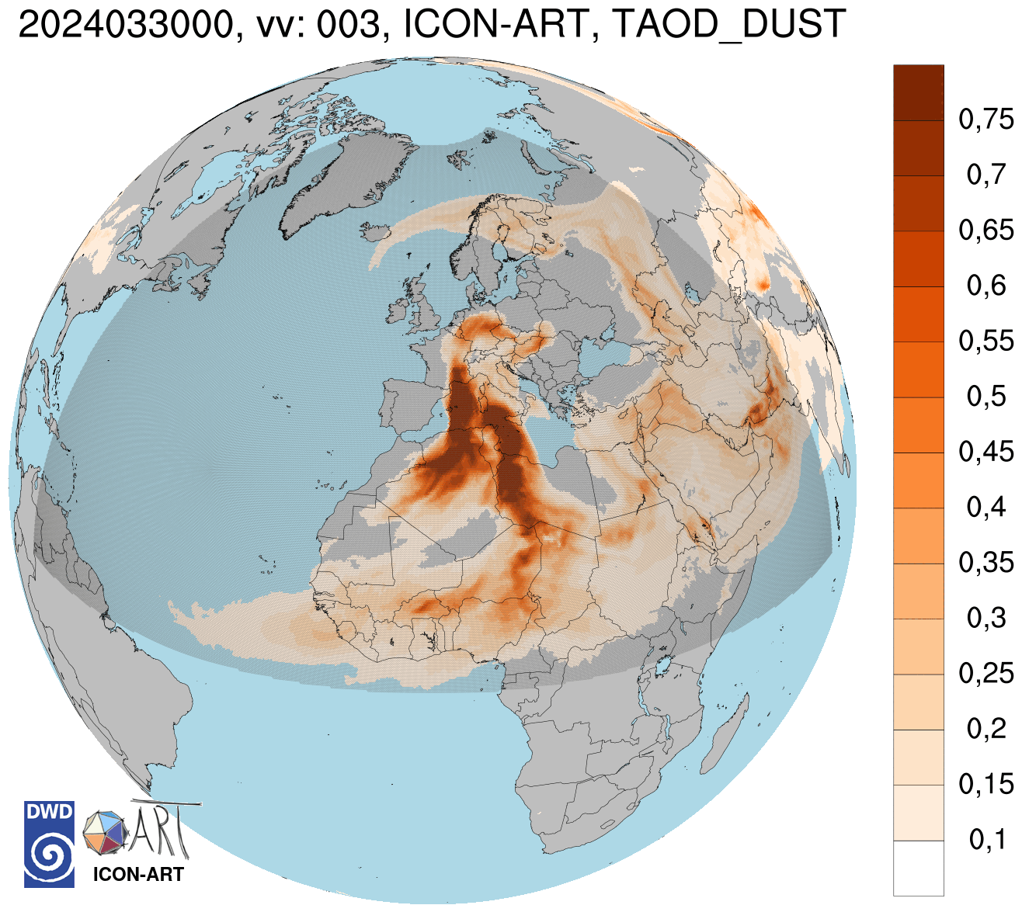
Dusty Cirrus and 2-Moment Ice Microphysics
Jochen Förstner,
Axel Seifert,
Leonhard Scheck,
Linda Schlemmer,
Felix Fundel, ARTists@KIT, …

Slide 2
Experiment Setup vs. ICON-ART Routine
with prognostic
2D-Aerosol
2-moment ice-microphysics (Köhler and Seifert 2015)
  Adds qni (ice particle number concentration) as prognostic variable
  Prediction of ice supersaturated (RH_{ice} > 100 %) regions for contrail avoidance
  (Hanst et al. 2025), D-KULT project
  External parameter data: use of MODIS cloud droplet number concentration
  Tuning of optical properties, sticking efficiency, cloud cover diagnostics for ice clouds
Heterogeneous ice nucleation using the INAS (Ice Nucleating Active Sites) approach (Ullrich et al. 2017)
Input: prognostic mineral dust number conc., mean surface area of mineral dust
“Dusty Cirrus” parameterization
EPS: perturbation of thresholds for prognostic mineral dust mass conc. and RH_{ice}
Enhanced dry deposition of mineral dust in non-source regions (e.g. over sea, snow, ice), counteracted by increased tuning parameter for dust emission.

Slide 3
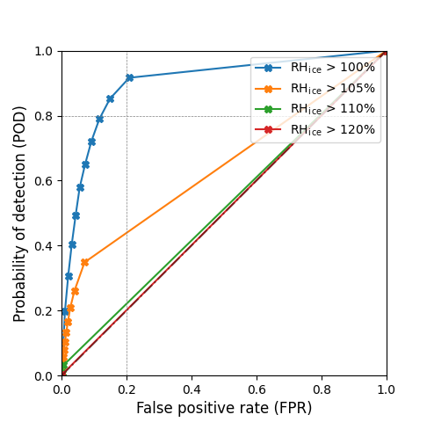
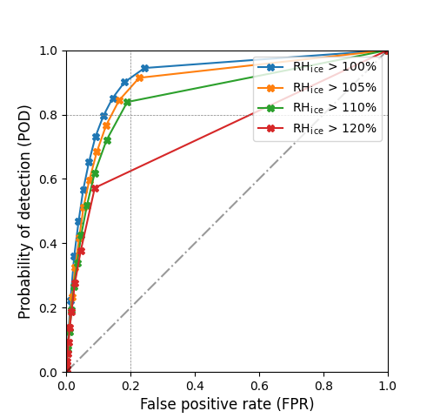
Prediction of ice supersaturated (RH_{ice} > 100 %) regions (Hanst et al. 2025) in April 2026
1-mom
2-mom

Slide 4
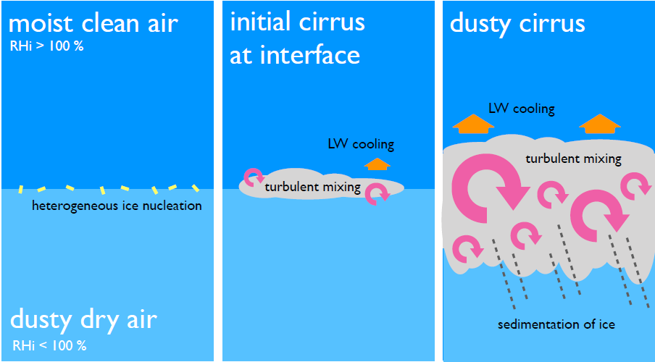
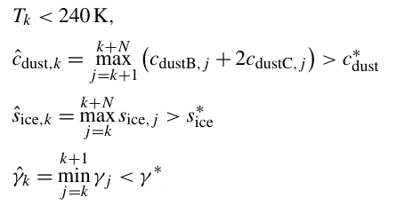
“Dusty Cirrus” Parameterization
Seifert et al., 2022:
Seifert, A., Bachmann, V., Filipitsch, F., Förstner, J., Grams, C., Hoshyaripour, G. A., Quinting, J., Rohde, A., Vogel, H., Wagner, A., and Vogel, B.: Aerosol-cloud-radiation interaction during Saharan dust episodes: The dusty cirrus puzzle, Atmos. Chem. Phys., 23, 6409–6430, 2023,
https://doi.org/10.5194/acp-23-6409-2023.
+1
N=4

Slide 5
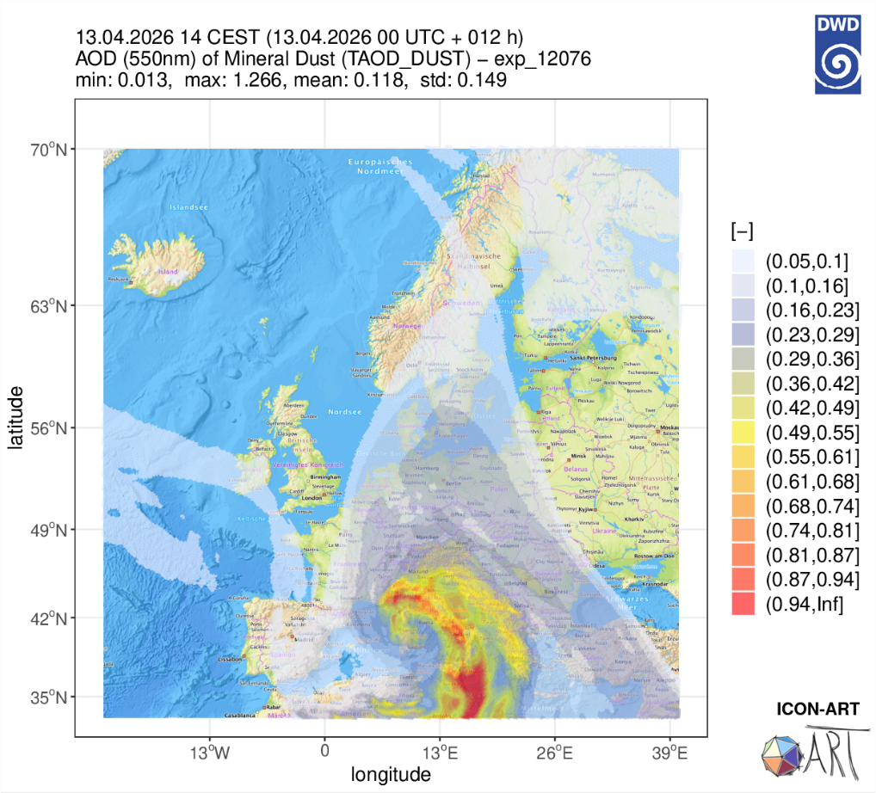
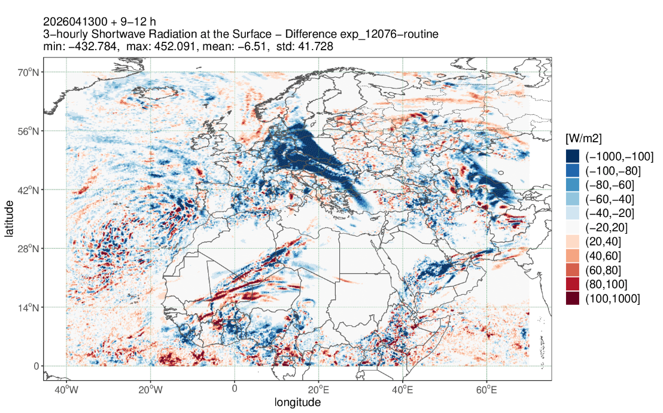
“Dusty Cirrus“ on 13 April 2026
Difference in 3-hourly shortwave radiation at the surface (exp_12076 – ICON-ART Routine)

Slide 6
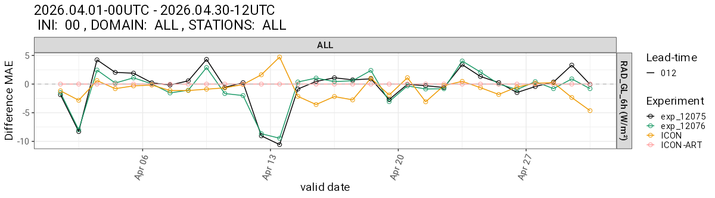
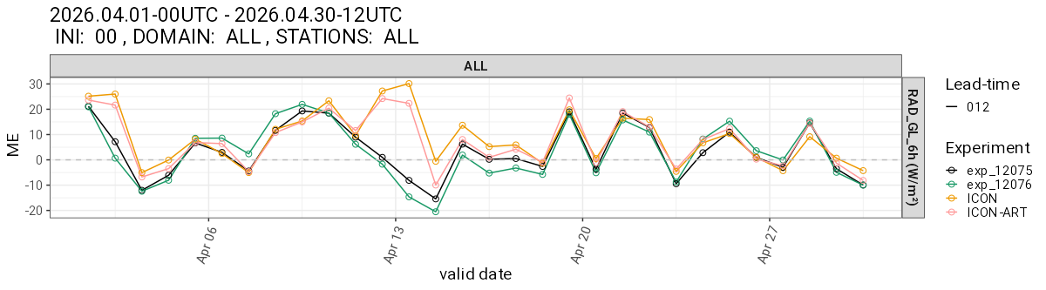
13 April 2026 – RAD_GL_6h MAE and ME
Difference MAE with respect to ICON-ART Routine
exp_12075:
without
prognostic
2D-Aerosol
exp_12076:
with
prognostic
2D-Aerosol
(operational:
2 Sep 2026)
… next talk by
Daniel Rieger
ME (Bias)

Slide 7
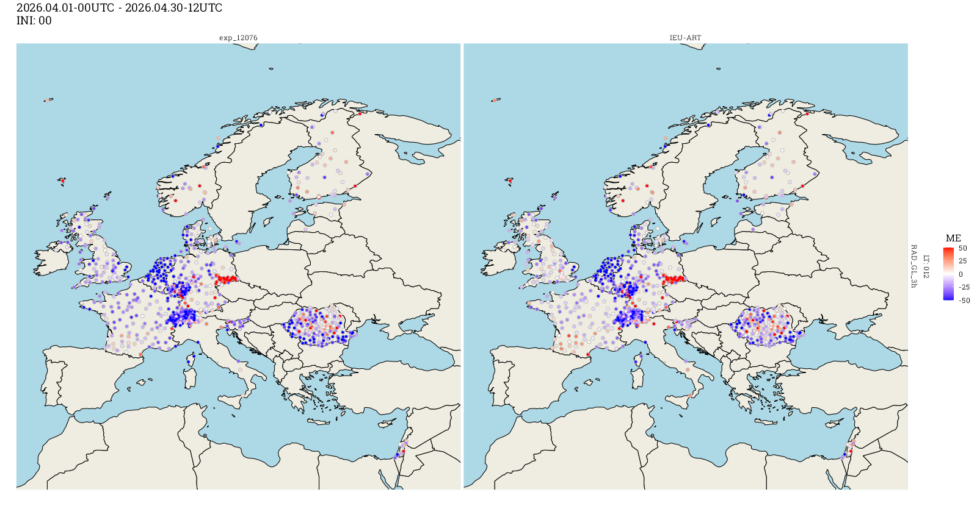
April 2026 – RAD_GL_3h ME (EU-NA² Nest)
exp_12076
ICON-ART Routine

Slide 8
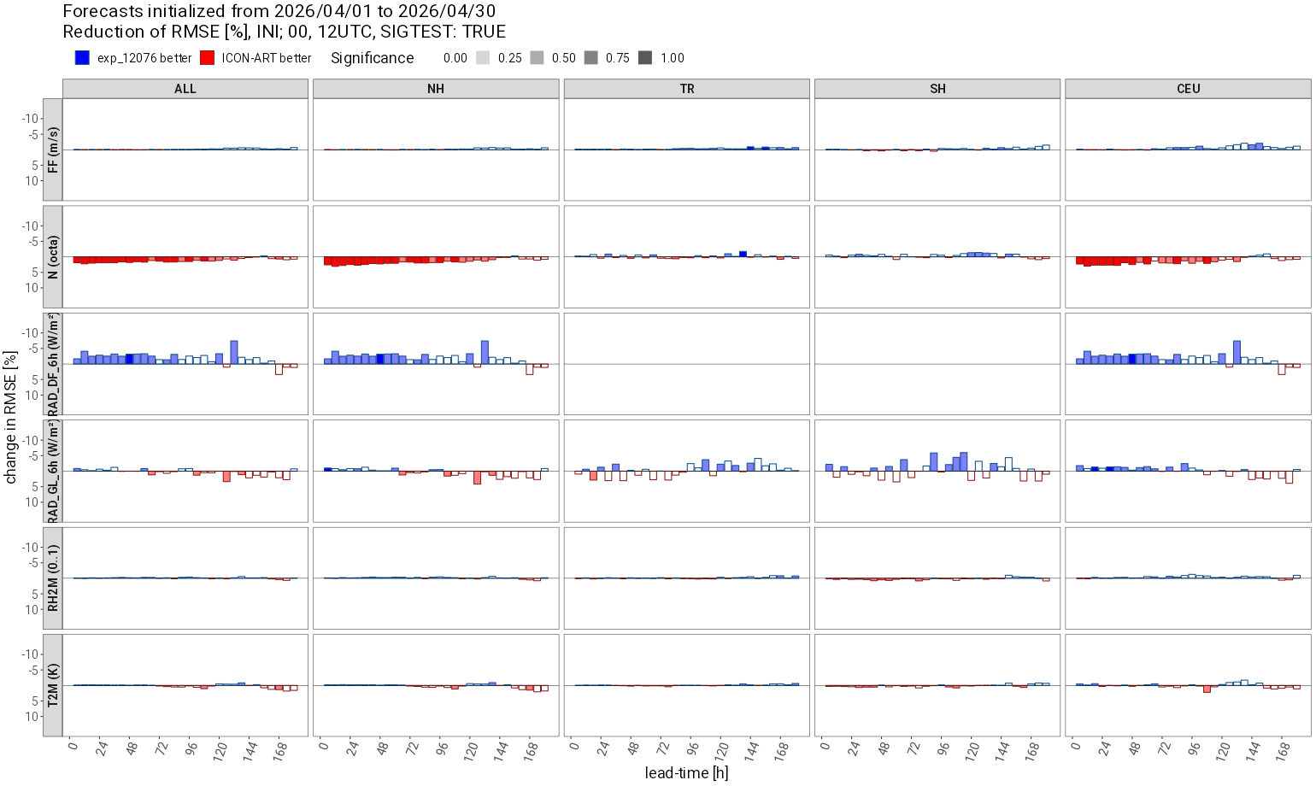
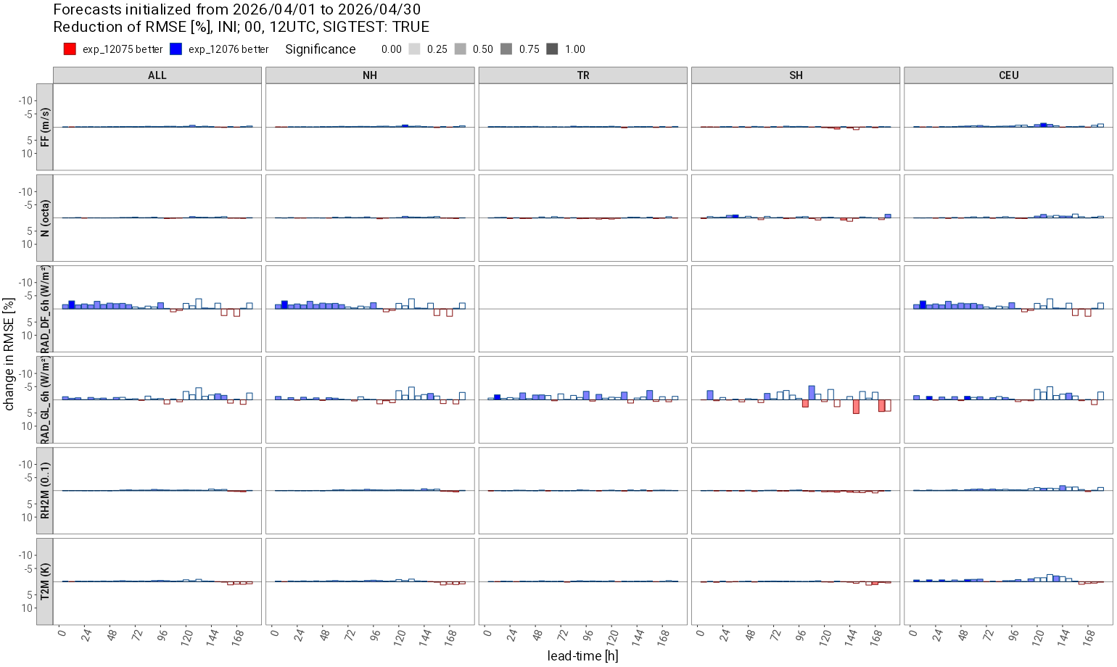
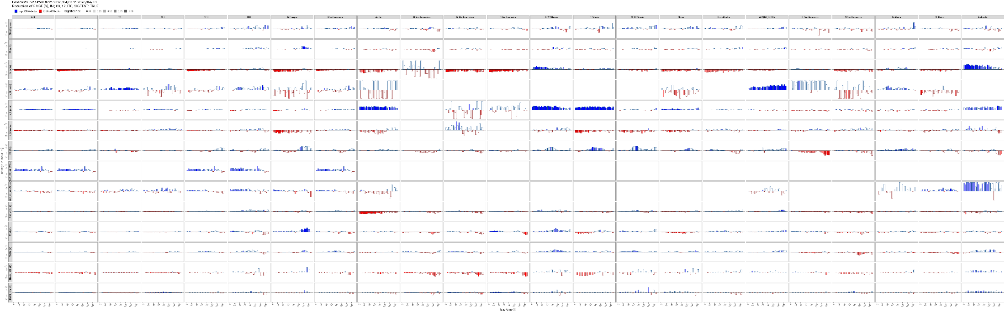
April 2026 – SYNOP Verification (Det.)
RMSE
vs. exp_12075
Variables
Domains
exp_12076 better ICON-ART Routine better

Slide 9
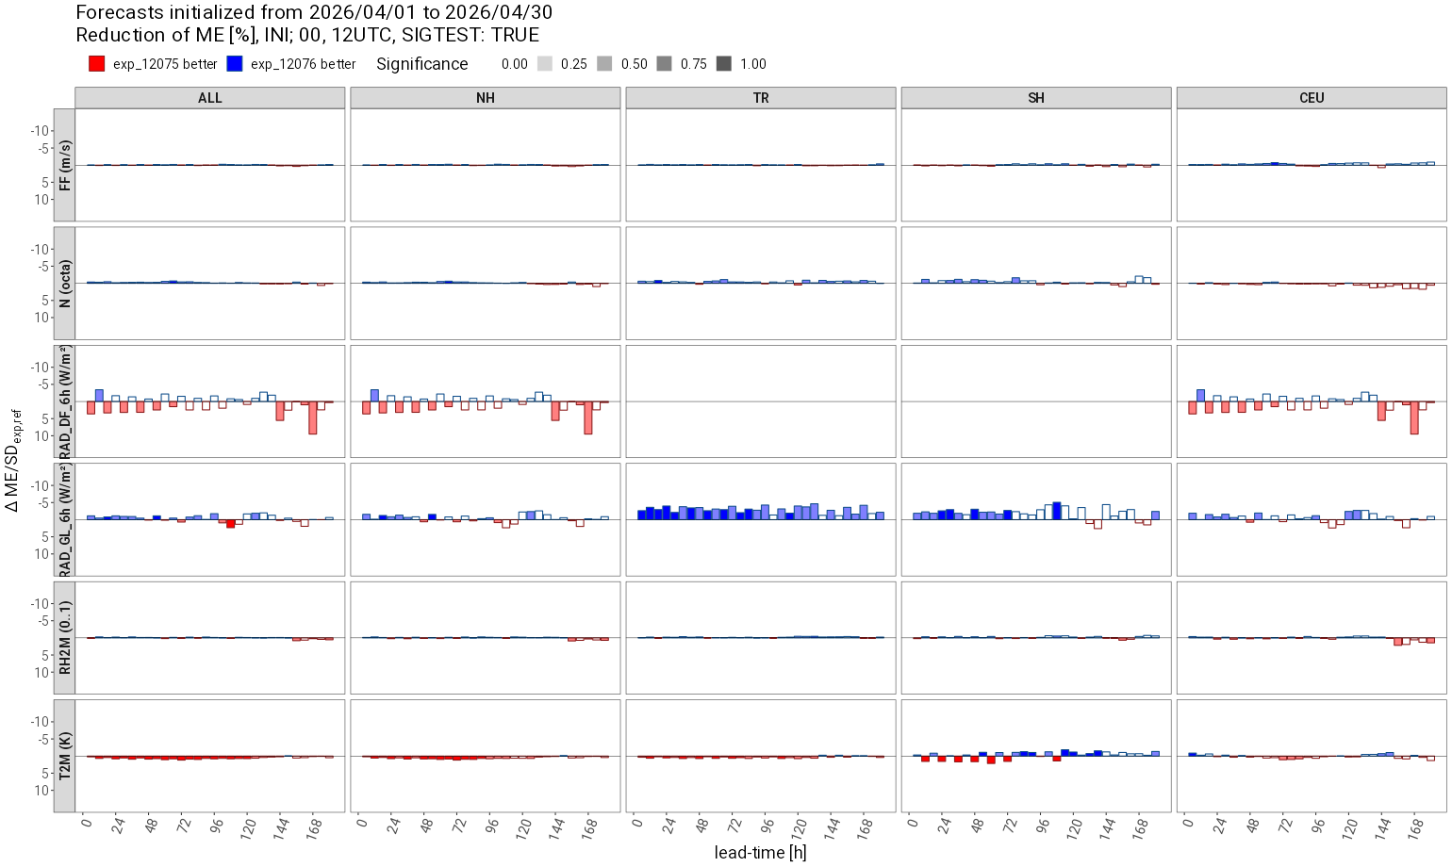
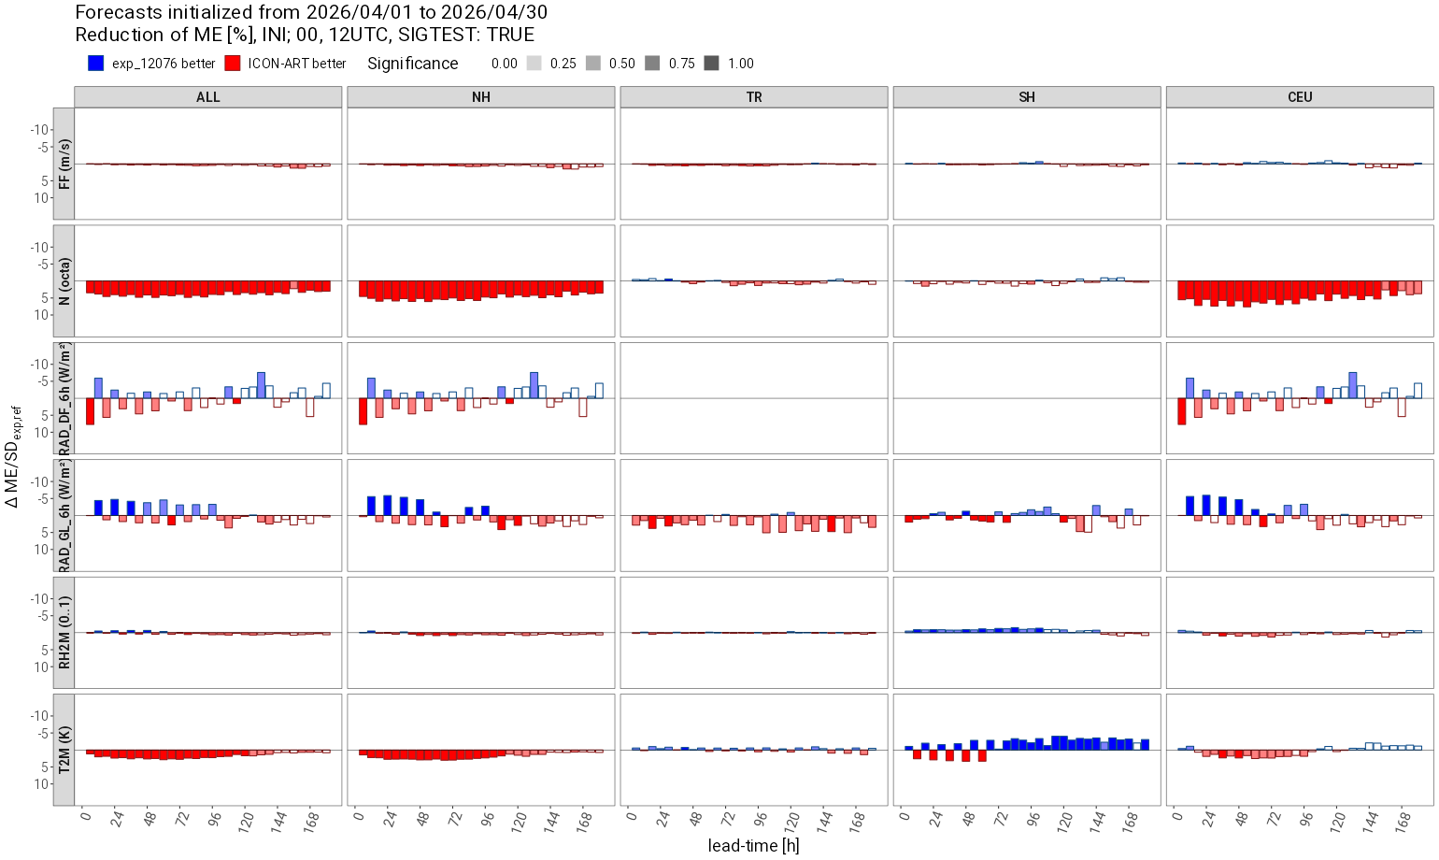
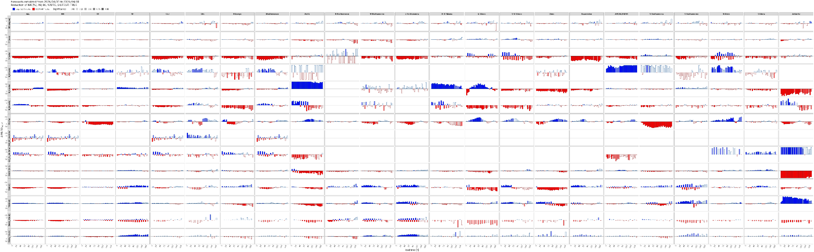
April 2026 – SYNOP Verification (Det.)
ME
vs. exp_12075
Variables
Domains
exp_12076 better ICON-ART Routine better

Slide 10
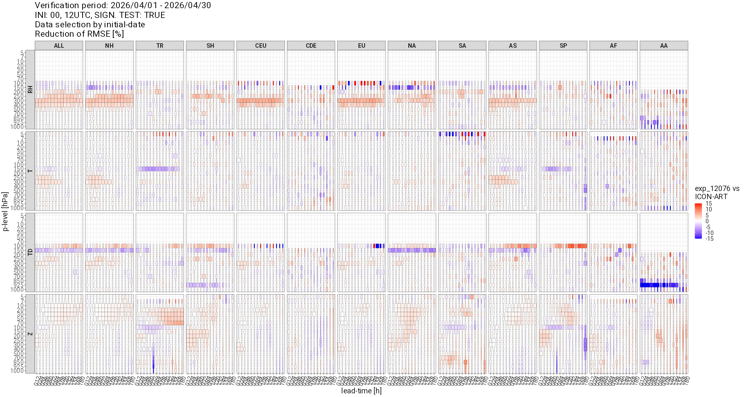
April 2026 – TEMP Verification (Det.)
exp_12076 better
ICON-ART
Routine better
RMSE

Slide 11
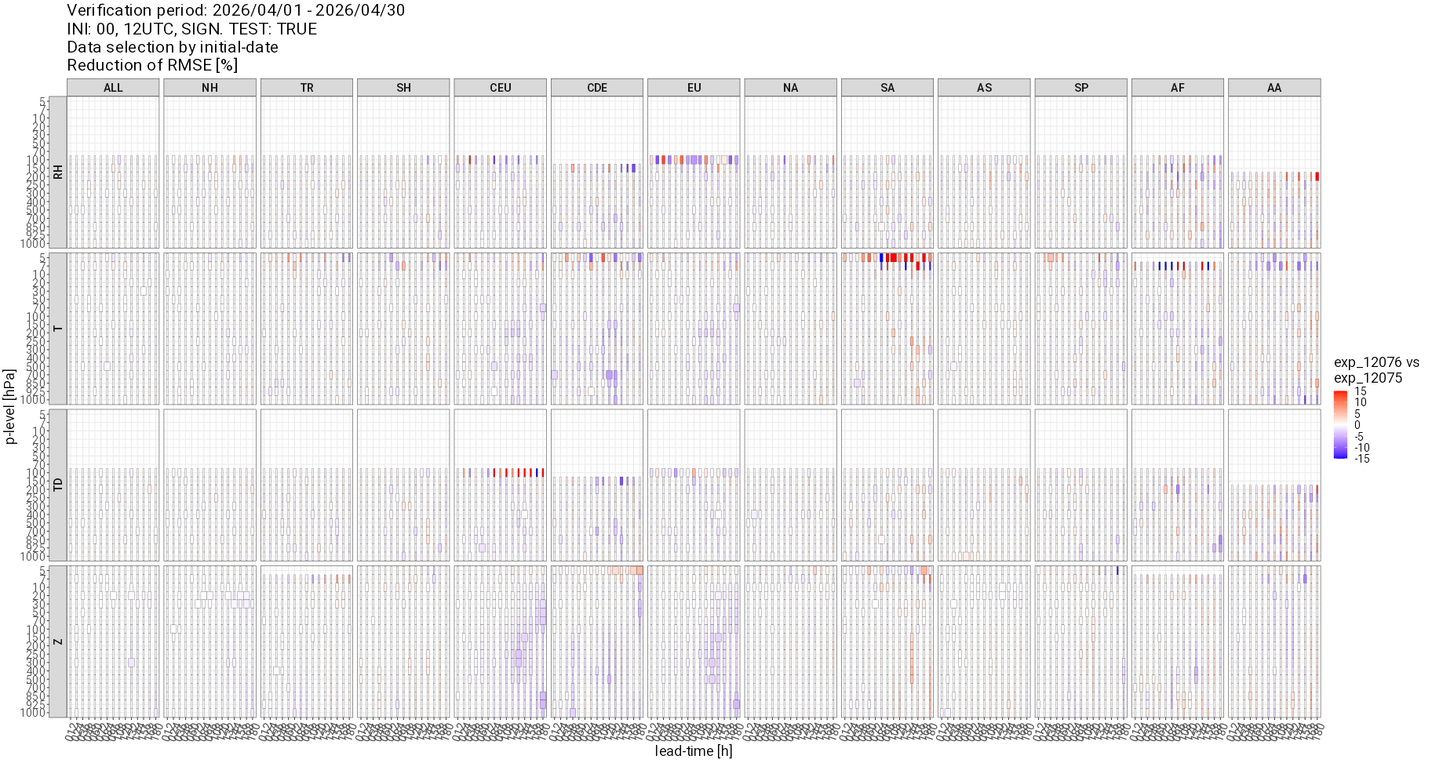
April 2026 – TEMP Verification (Det.)
exp_12076 better
exp_12075 better
RMSE

Slide 12
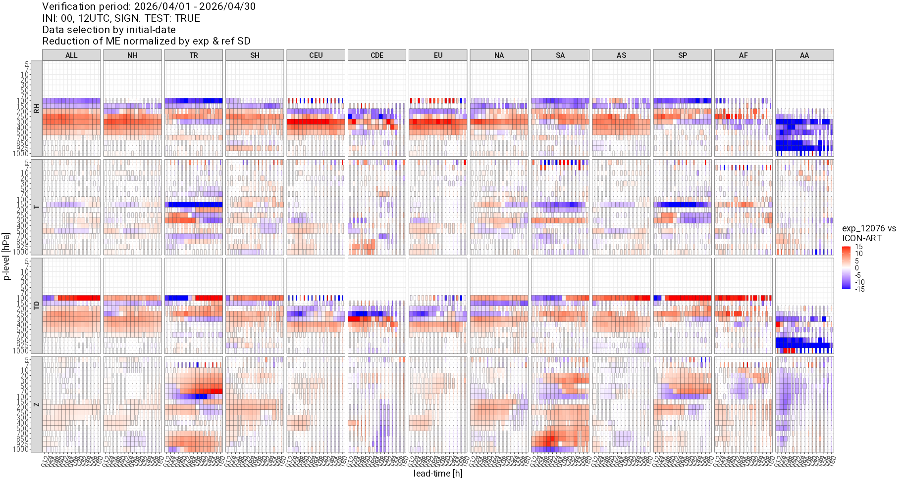
April 2026 – TEMP Verification (Det.)
exp_12076 better
ICON-ART
Routine better
ME

Slide 13
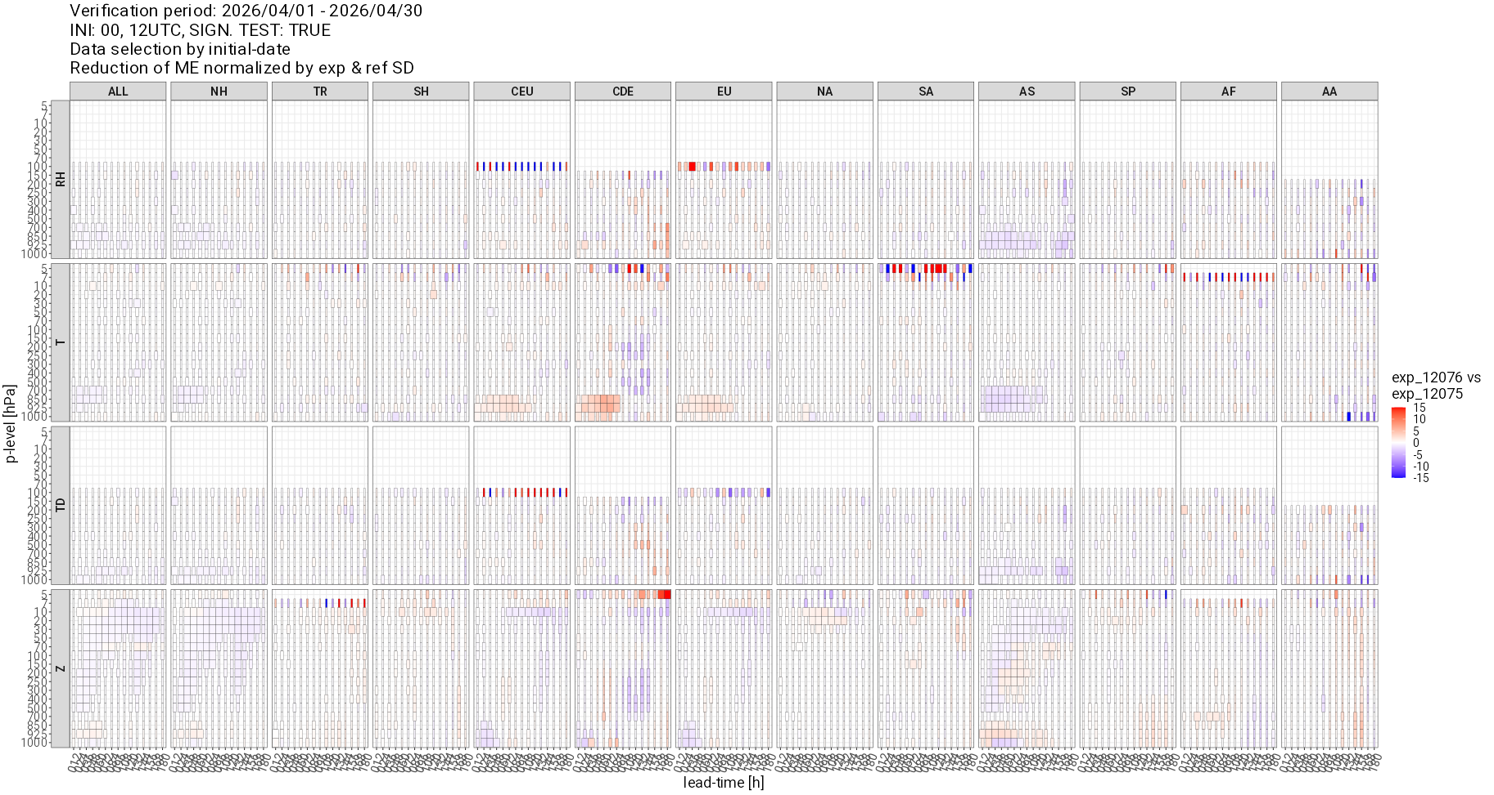
April 2026 – TEMP Verification (Det.)
exp_12076 better
exp_12075 better
ME

Slide 14
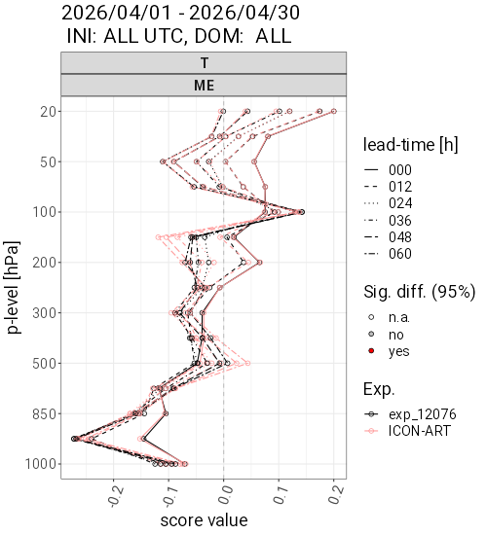
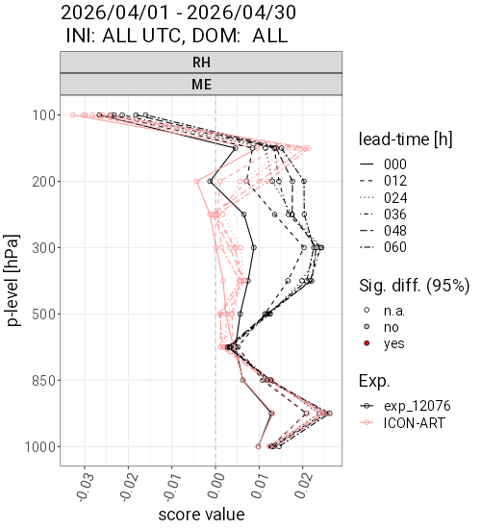
April 2026 – TEMP Verification

Slide 15
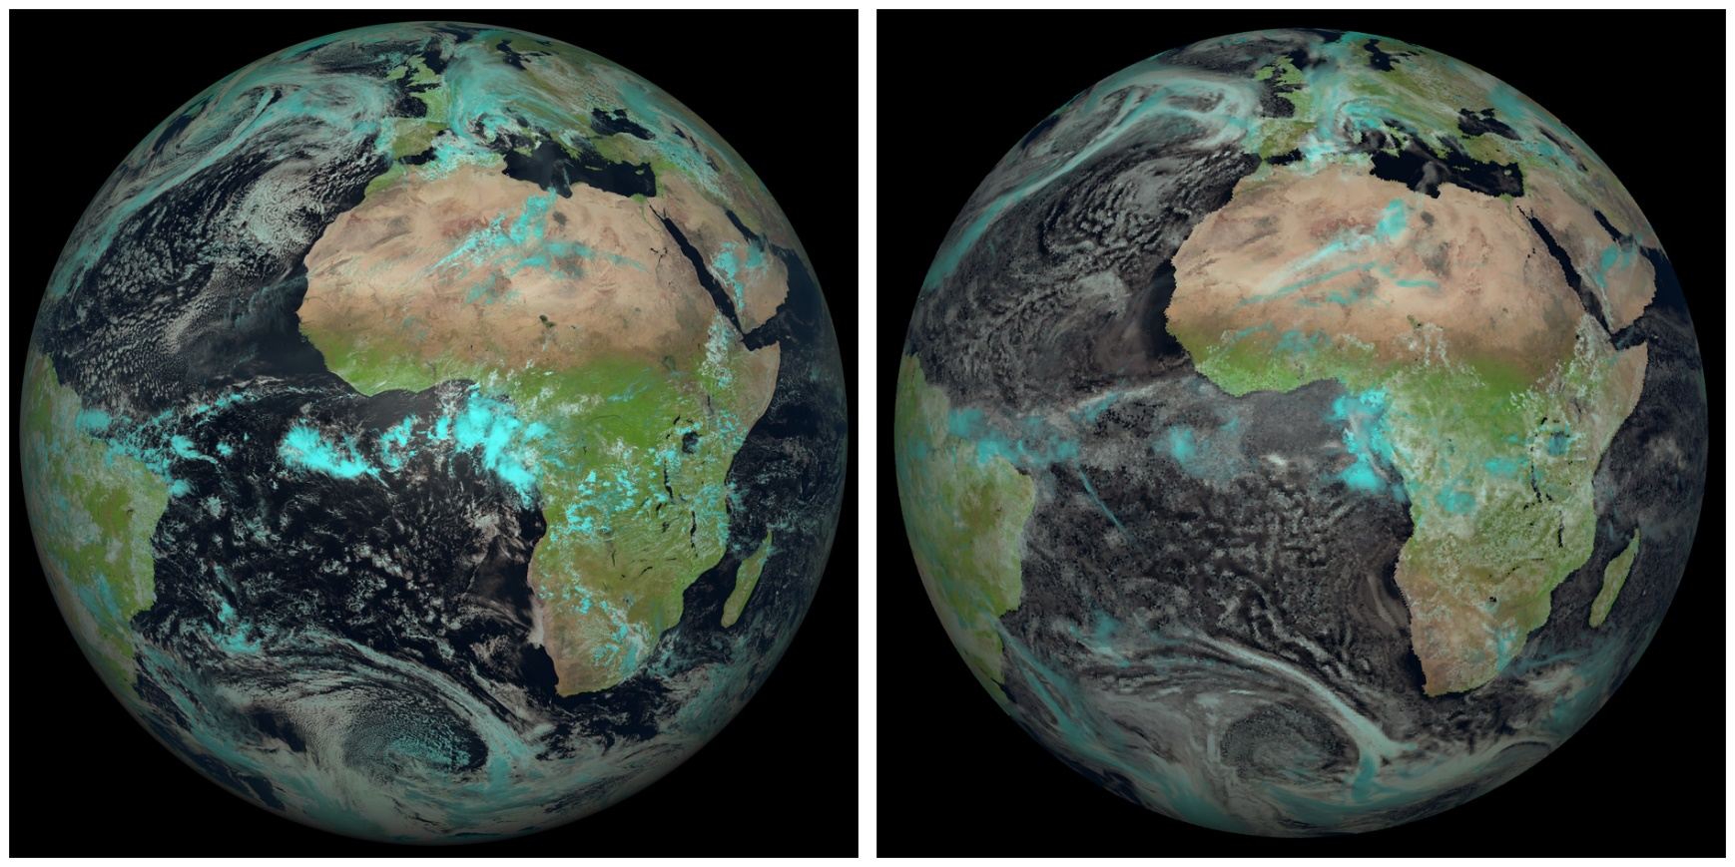
VISOP / MFASIS by Leonhard Scheck
13 April 2026 12 UTC
MTG-I FCI
ICON-ART Routine

Slide 16
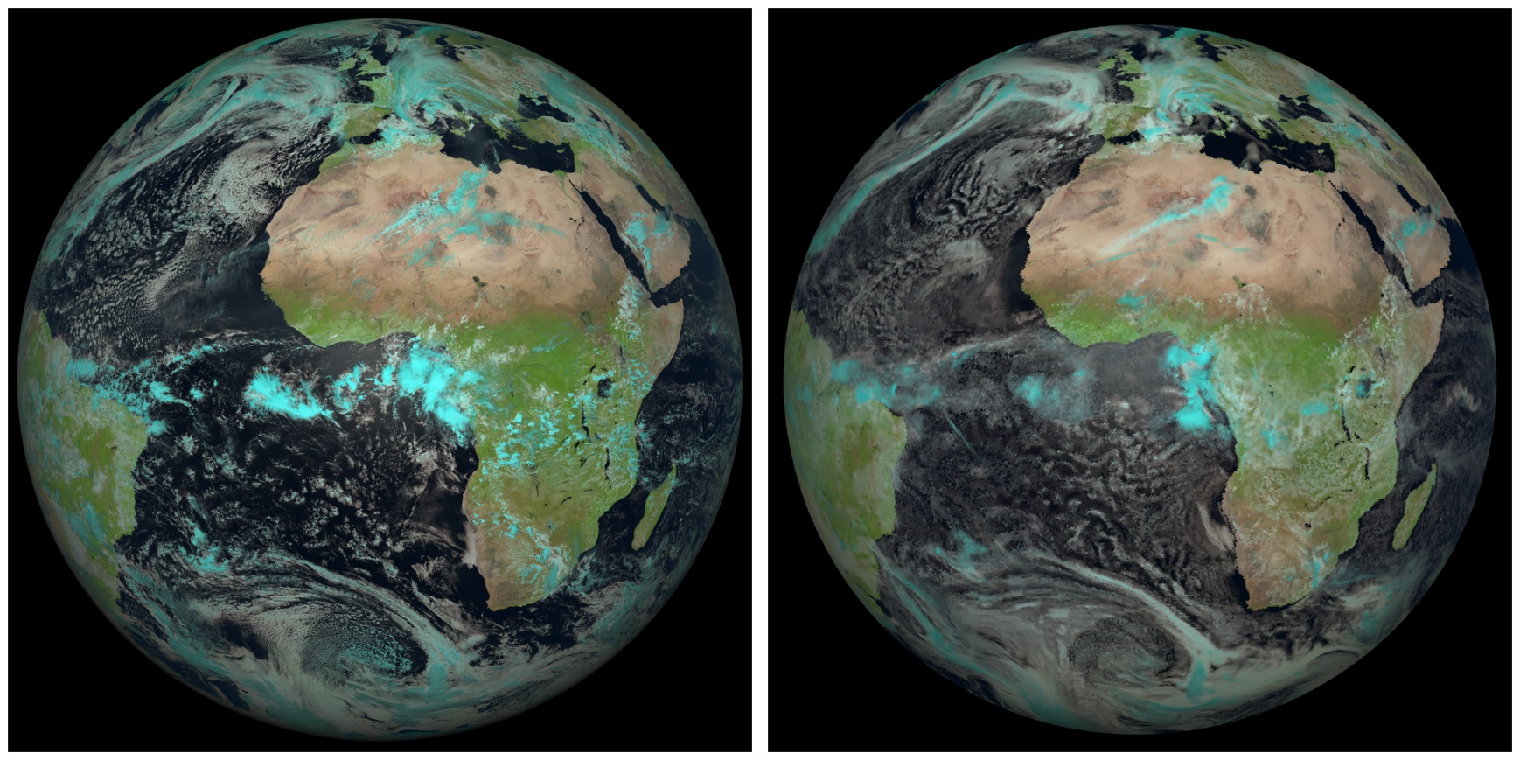
13 April 2026 12 UTC
MTG-I FCI
exp_12075 (without progn. 2D Aerosol)

Slide 17

13 April 2026 12 UTC
MTG-I FCI
exp_12076 (with progn. 2D Aerosol)

Slide 18
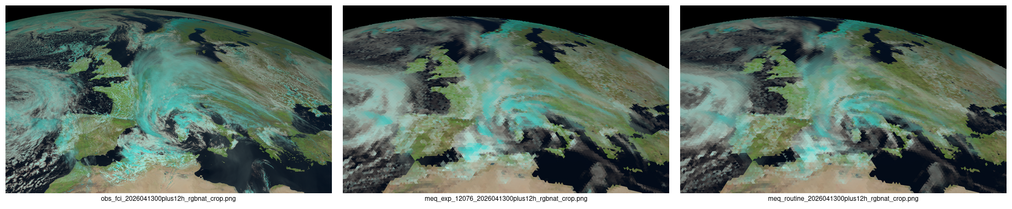
13 April 2026 12 UTC – natural color
Small, but noticeable difference.
MTG-I FCI (Flexible Combined Imager) ICON-ART exp_12076 ICON-ART Routine

Slide 19
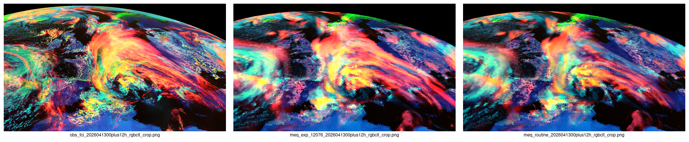
13 April 2026 12 UTC – cloud type
More red and yellow – that's good!
MTG-I FCI (Flexible Combined Imager) ICON-ART exp_12076 ICON-ART Routine

Slide 20
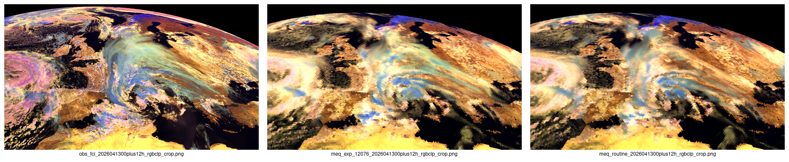
13 April 2026 12 UTC – cloud phase
Why not more blue?
MTG-I FCI (Flexible Combined Imager) ICON-ART exp_12076 ICON-ART Routine

Slide 21
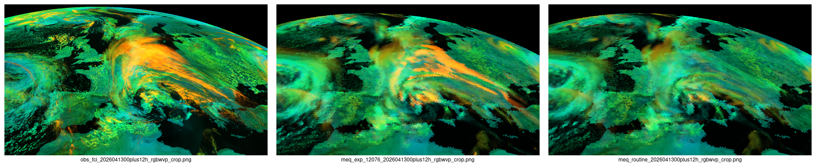
13 April 2026 12 UTC – cloud height (test)
More yellow (high clouds) – that's good!
MTG-I FCI (Flexible Combined Imager) ICON-ART exp_12076 ICON-ART Routine

Slide 22
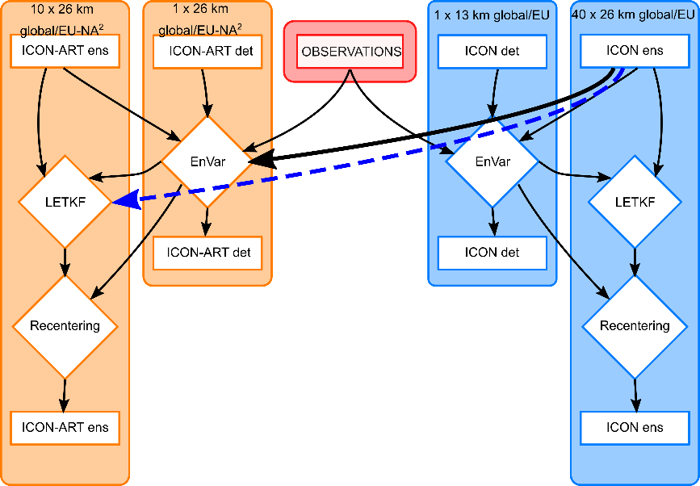
Outlook
Goal: Operationalize “Dusty Cirrus” parameterization together with 2-moment ice microphysics in ICON-ART part of DWD’s global NWP chain…
Benefits and improvements in key parameters for customers in the energy and aviation sectors vs. worsening scores for some other meteorological parameters.
Work on upcoming (planned: 6 October 2026)
R2B07_N08 configuration
(global: 20 km / nest: 10 km)
exp_12090
Further joint work on VISOP / MFASIS…
Tuning of optical properties, histograms

Slide 23
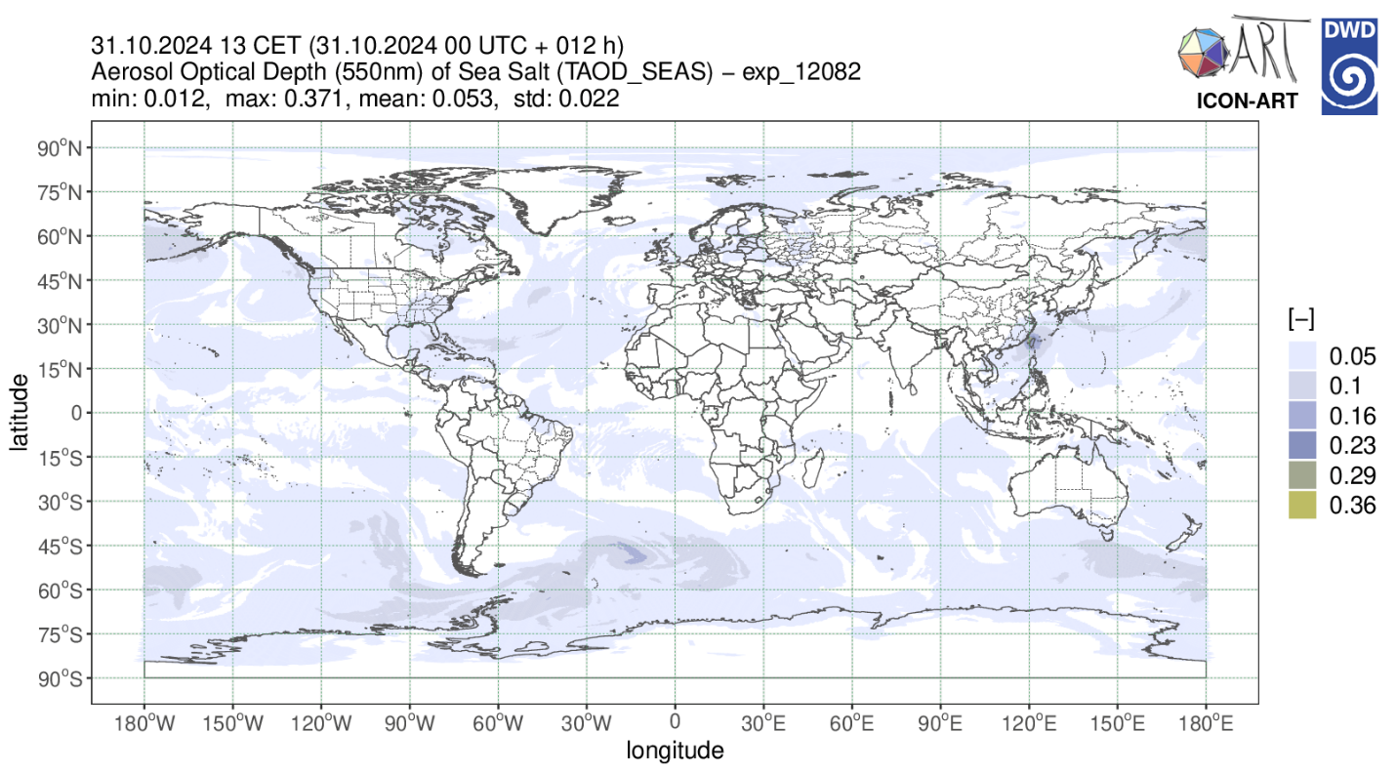
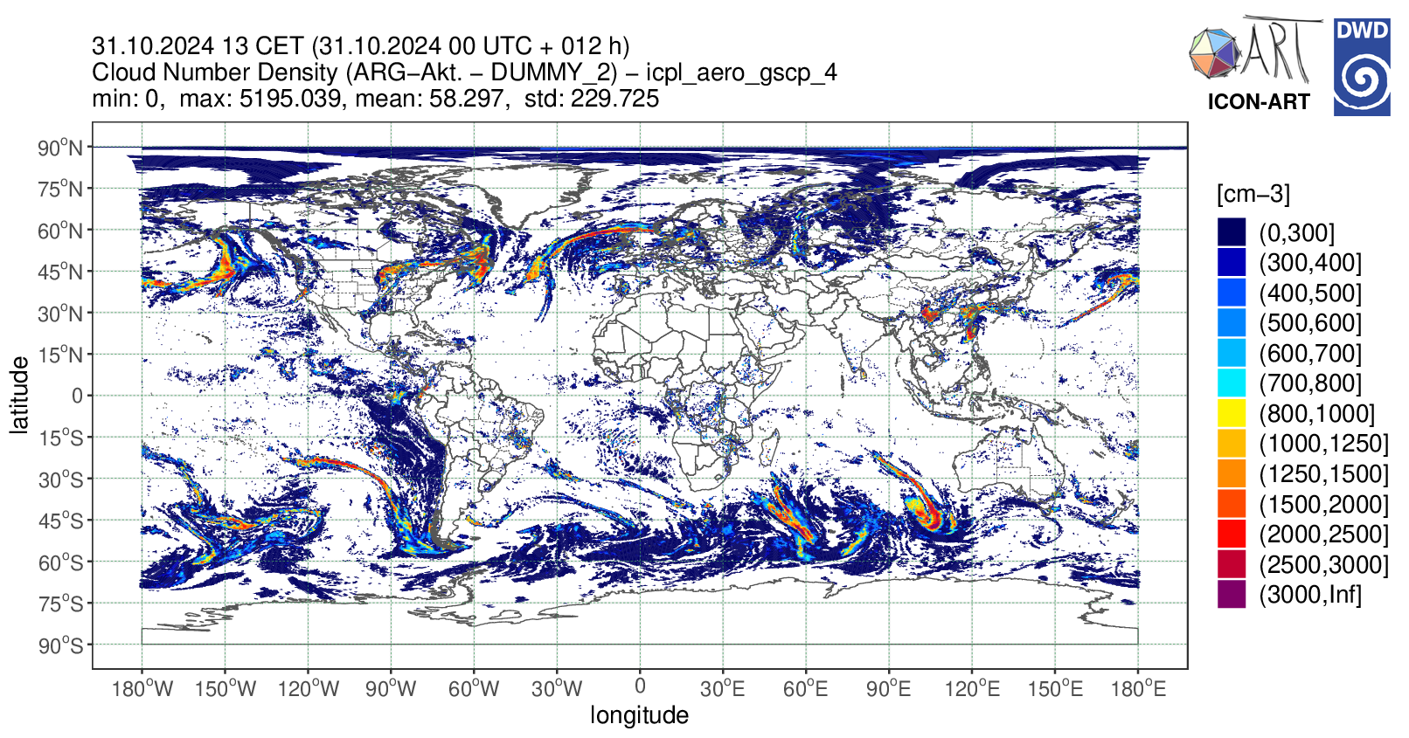
Teaser (all very preliminary…!)
Abdul-Razzak and Ghan (2000) Sea Salt Activation in a Global Setup
  based on development branch of Sascha Bierbauer at KIT
  work with
  Heike Vogel

Slide 24
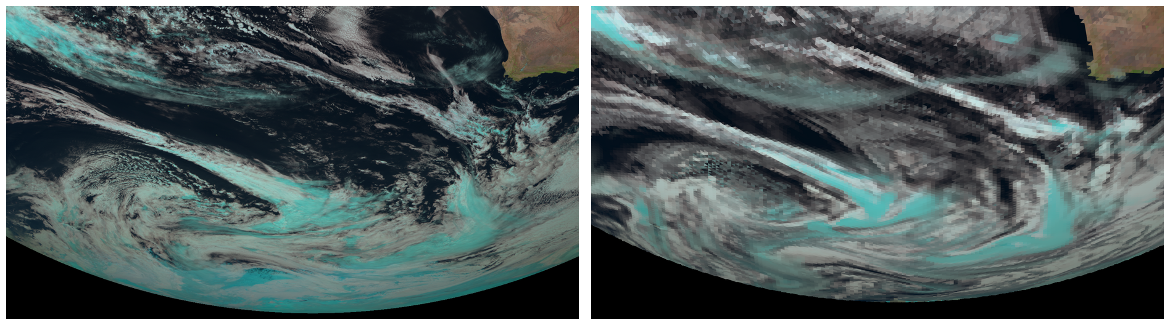
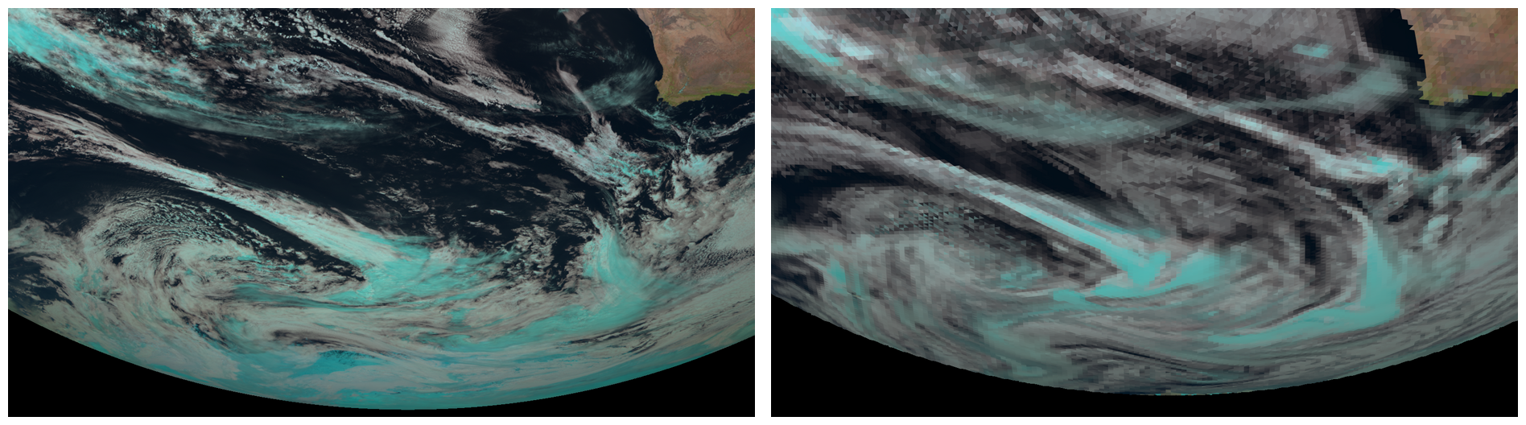
Teaser (all very preliminary…!)
Abdul-Razzak and Ghan (2000) Sea Salt Activation in a Global Setup
MSG SEVIRI ICON-ART with Segal-Khain (simple)
MSG SEVIRI ICON-ART and ARG-Act. for Sea Salt

Slide 26
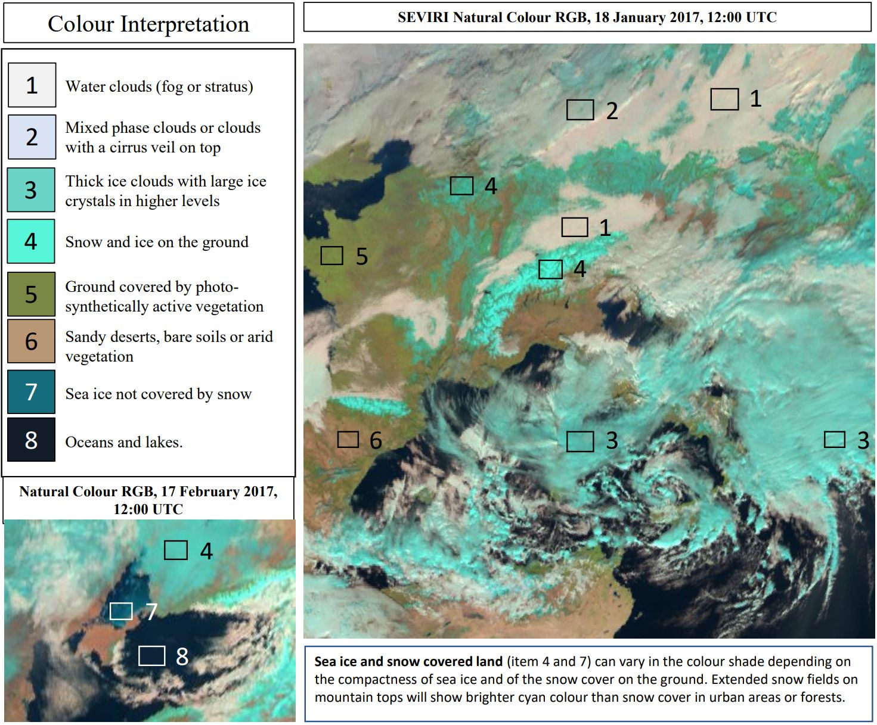
VISOP / MFASIS by Leonhard Scheck
http://oflxs464.dwd.de/~lscheck/visop
(Synthetic) Satellite Images
RGB Composites of different
MTG-I FCI Channels
EUMETSAT natural colour rgb-quick-guide

Slide 27
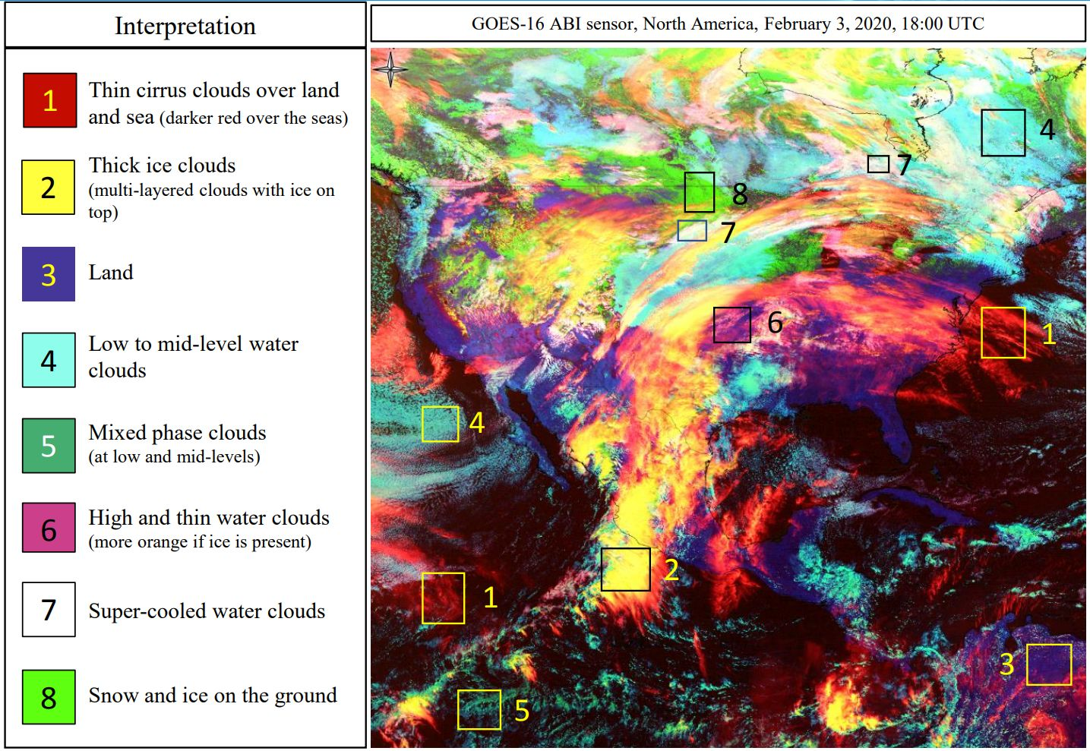
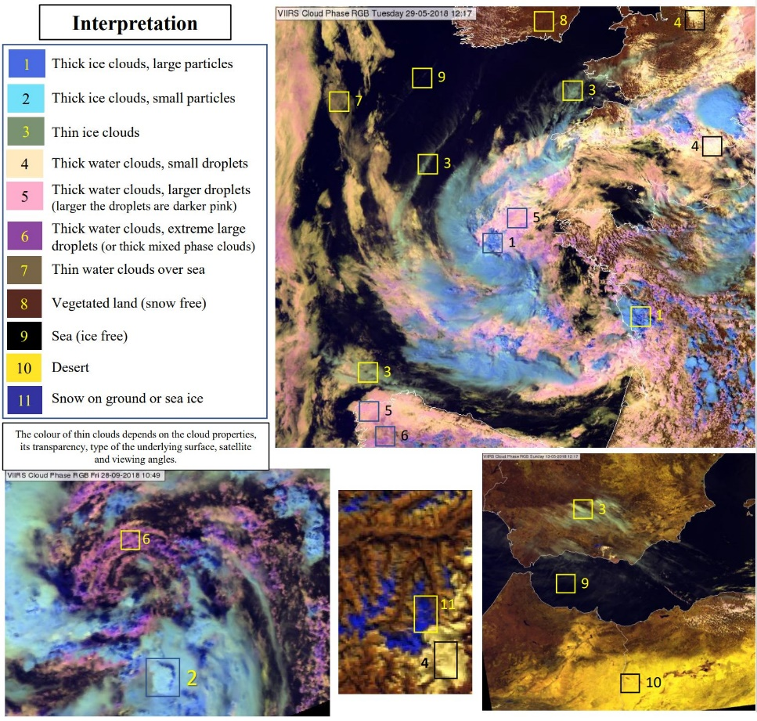
VISOP / MFASIS by Leonhard Scheck
cloud type
cloud phase

Slide 28
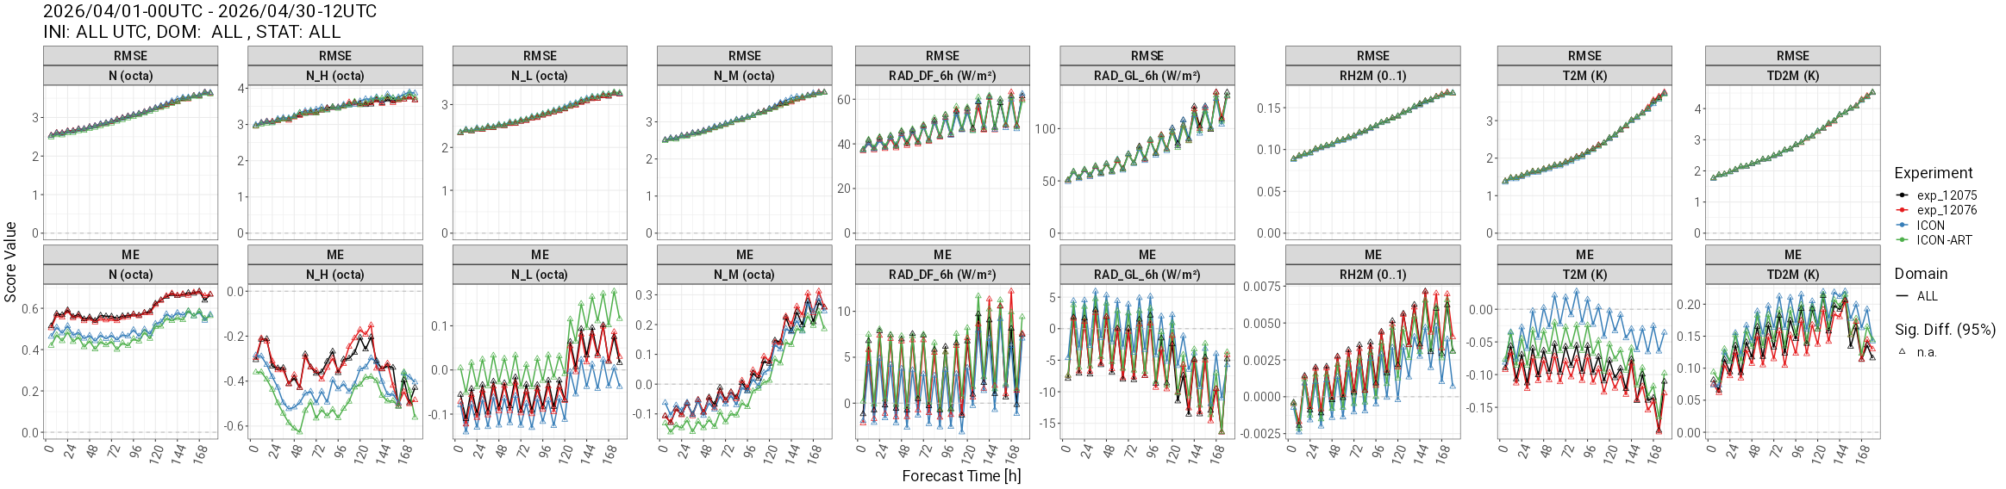
April 2026 – SYNOP Verification (Det.)

