Slide 1
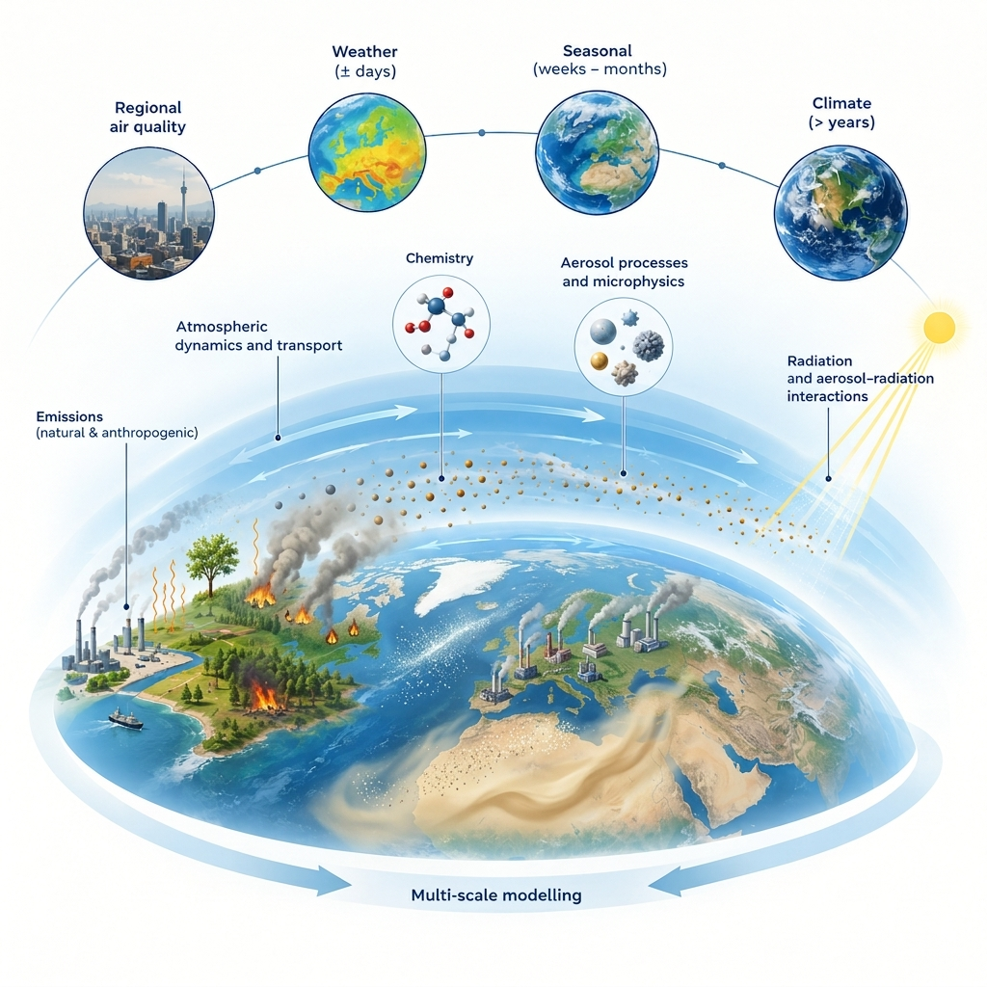

ICON-ART
Status & Highlights
Presented by: Ali Hoshyaripour
Contributions by S. Werchner, P. Kumar, T. Pak, S. Ghosh et al.
COSMO GM, Rome, September 2026

Slide 2
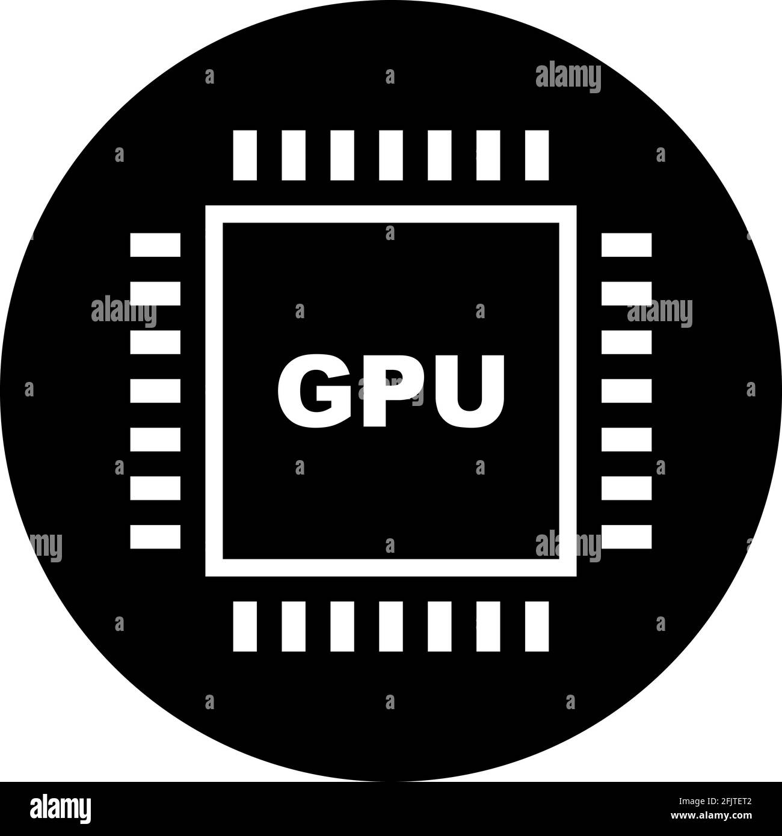
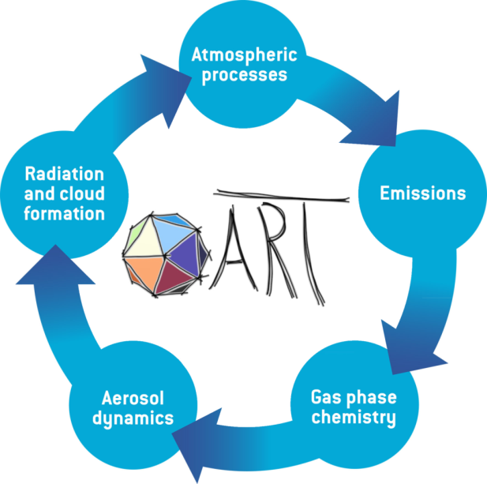


Our vision and mission for ICON-ART
Seamless from local AQ* to global CC** usable for operational NWP, climate and ESM
* Air Quality
** Climate-Chemistry
Notes:
Left: current status Multi-scale atmospheric composition modeling incl. interactions with radiation and clouds
Right: Our vision: make ART ready and computationally affordable for NWP, climate and ESM applications
To reach this goal we follow the following development paths in parallel:
Complete and maintain (ART)
Continuous development/maintenance of the code to include/enable new processes and parametrizations
Exascale-ready (ARTEX)
e.g. GPU porting of the code to prepare for heterogeneous HPC systems
Low-cost / AI-Based (ARTAI)
Development of ART AI to replace submodules and interactions with faster AI-based modules in a exascale-ready state 🡪 usable for NWP, Climate (CLM) and ESM applications

Slide 3

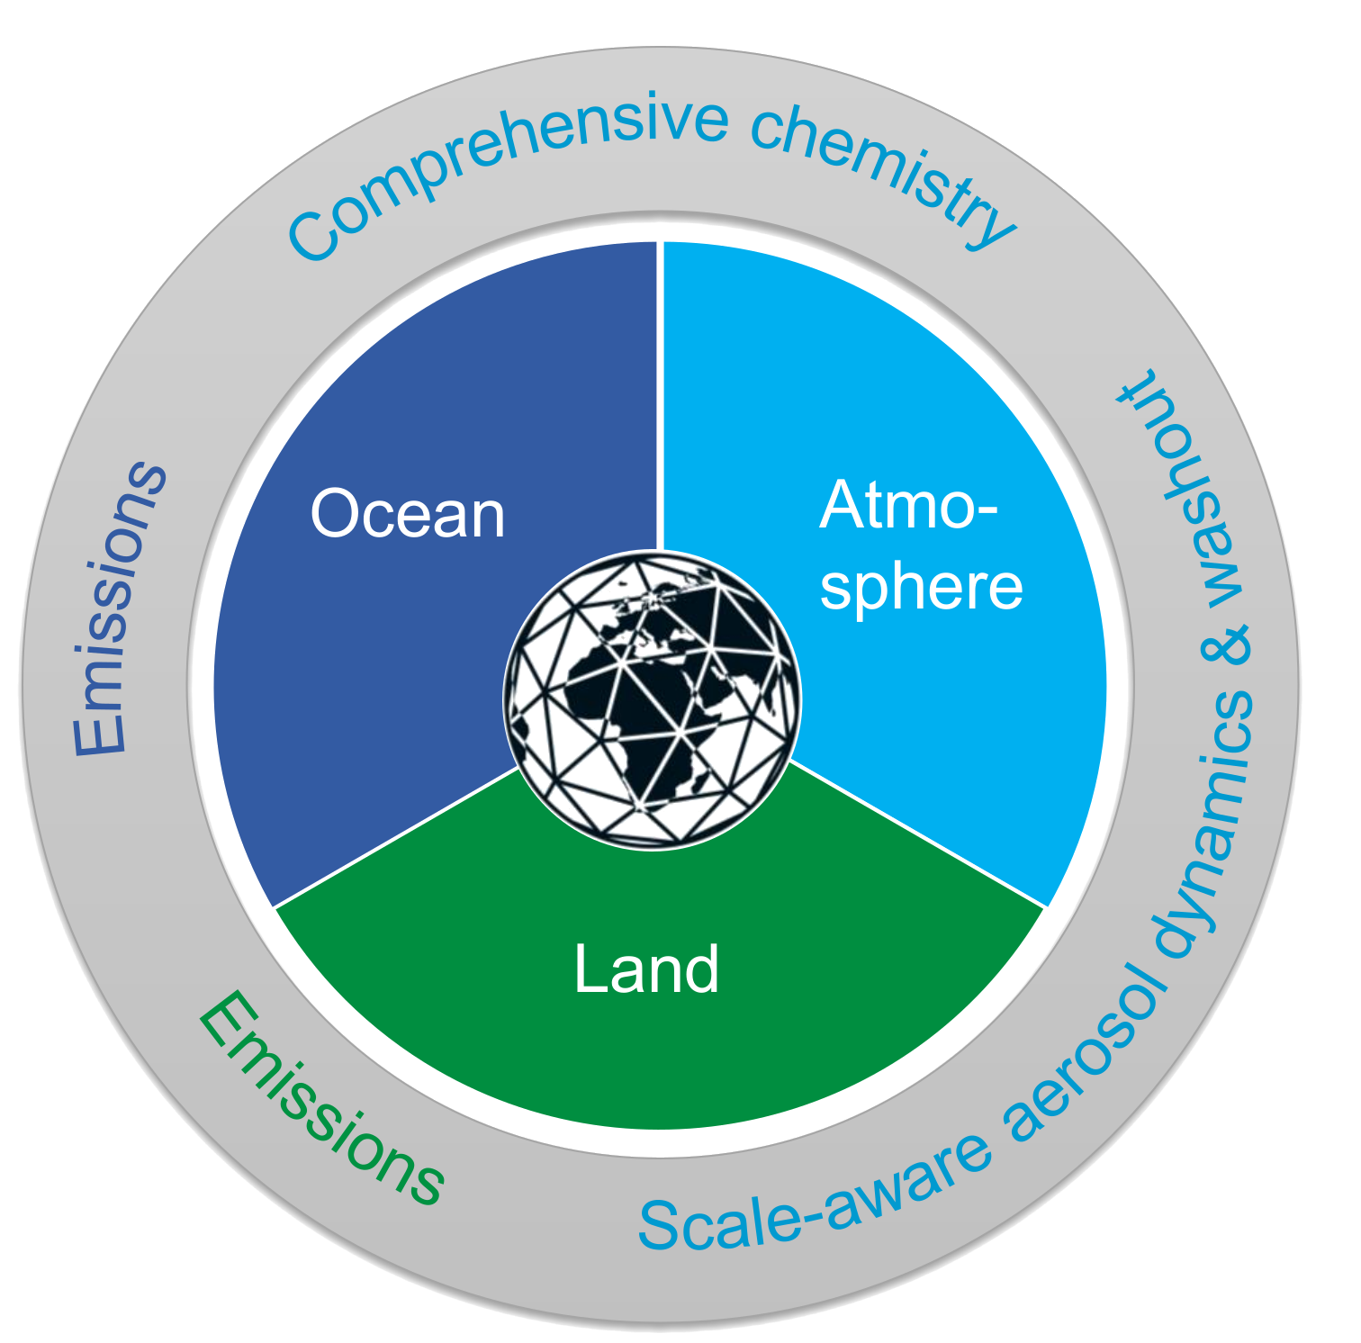
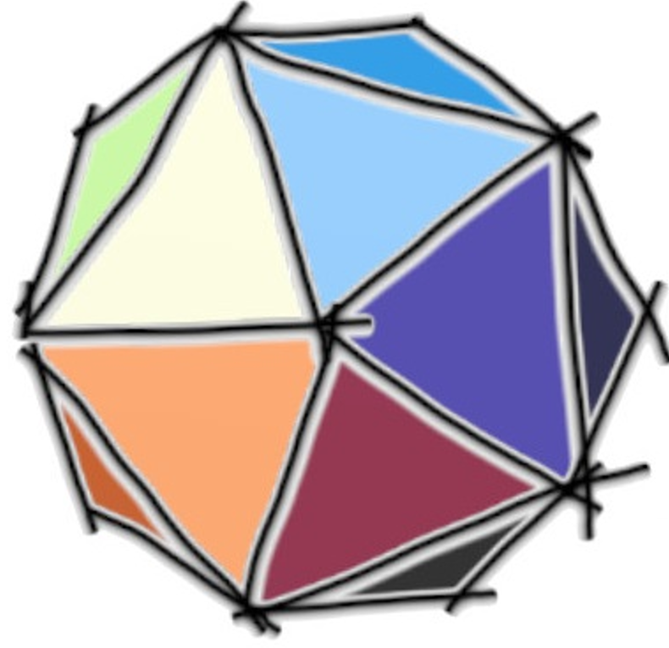
HErZ project (2023-2027)
Preparing ICON-ART for seasonal to decadal climate predictions in seamless regional to global model configurations → ICON-Seamless + ART = ICON-SmART
Emissions of natural aerosols and trace gases from fully coupled and interactive ocean and land modules
Comprehensive atmospheric chemistry (troposphere and stratosphere) → optimization and acceleration
ML-based and scale-aware aerosol dynamics and washout
Multi-year simulation with full chemistry and aerosol treatment

Slide 4
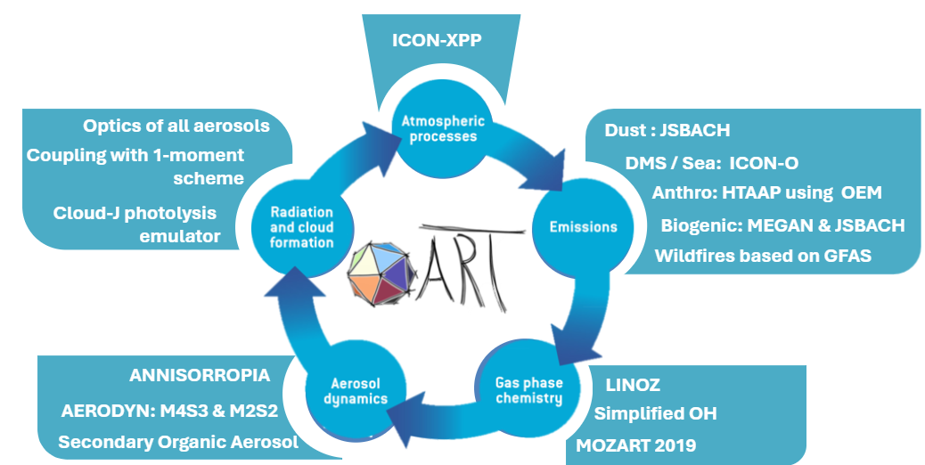
Targeted SmART configuration

Slide 5
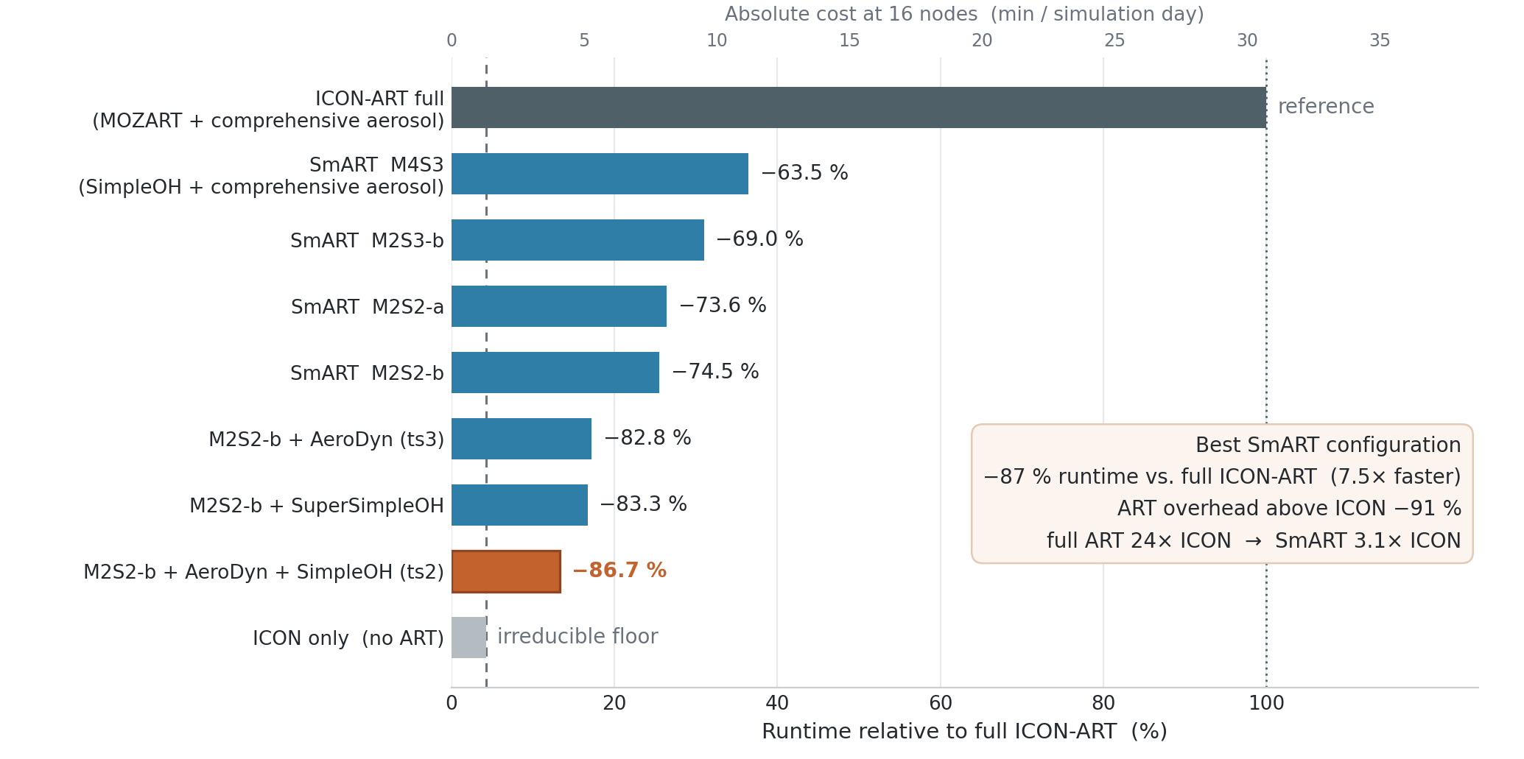
Cumulative efficiency gain of SmART over ART
Optimized part
Chemistry
Aerosol
Calls
Red. Grid?
We are not done yet!

Slide 6
ML compression of tracers for advection
Advection cost grows linearly with the number of tracers. Advect r latent tracers instead of m (r < m), keep the dynamical core unchanged.
m tracers
V
Encode
compress
Advect r < m
latent tracers
Decode
reconstruct
m tracers
V̂ ≈ V
Linear: NMF “superspecies”
Non-linear: Autoencoder
V ≈ W·H; projection B before, reconstruction W after advection
Non-negative, additive combinations of species
LOTOS-EUROS (Sturm et al., 2023): up to 75% compression, < 5% error, 30–50% faster advection
Neural encoder/decoder learns non-linear links between species
Softplus outputs keep latent and reconstructed tracers non-negative
Multi-head decoder: magnitude × non-zero mask; ICON-ART test 6 → 3 tracers
Requirements: no negative tracers · stable when applied every time step · mass conservation handled separately

Slide 7
Can we use these methods in ICON-ART?
  Total time taken
      Full model: 41.92s
      Reduced order: 33.32s
      Saving: 21%
  Expected, as ICON advect 5-7 hydrometeors + 6 dust species → 25% saving if ART species halfed
  8% used for ComIn call back
TRACER FROM ICON ONLY
Tai Pak

Slide 8
What’s failing now?
Decoder
      Physical admissible → Non-negative, mass conserving by design
      Single pass reconstruction produces high quality output at mid ranges, failing at extreme values
      Unstable over iterations
      Next steps:
      Rethink the ML tools and methods
      Adopt advection for gases and aerosols
Advection
Softplus (Non-zero)
X
Sigmoid
(classifier)
Tai Pak

Slide 9
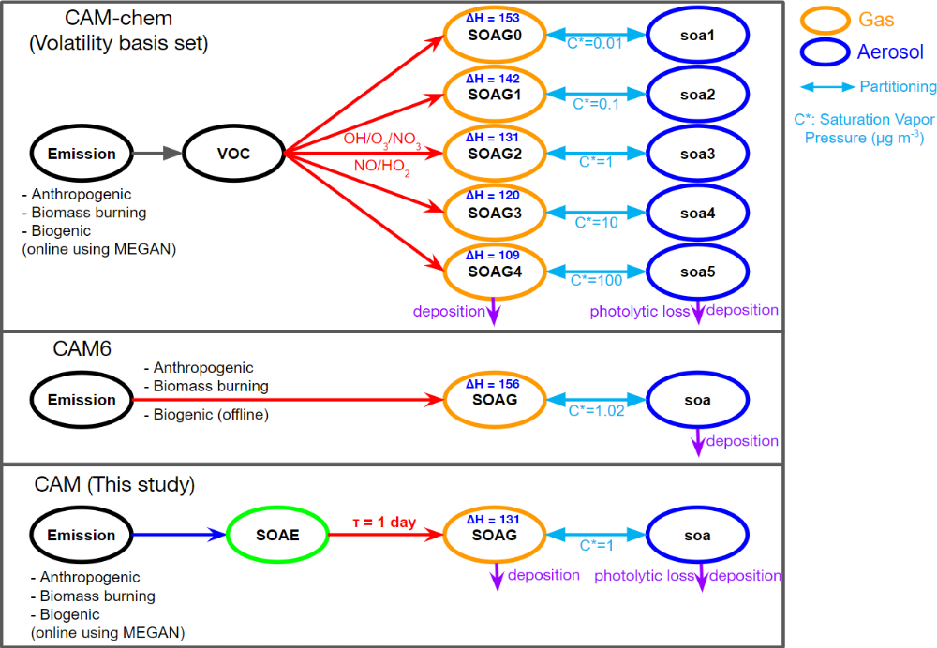
Secondary Organic Aerosols (SOA)
Detailed
Simplified
SOAE: consolidated VOC emissions estimated based on their yields
SOAG: less volatile tracer considering 1 day of e-folding lifetime of SOAE
Jo et al., 2023, Simplified parameterization of SOA, GMD.

Slide 10
SOA Precursors
VOC categories | MOZART | Biogenic (MEGAN) | Anthro (EDGAR) | Yield
ISOP | C5H8 | 1 - Isoprene | voc10 | 0.04
MT | C10H16 (parent monoterpene) | 2-9,13 - Monoterpenes | voc11 | 0.28
Sesquiterpenes |  | 10,11,12 - Sesquiterpenes |  | 0.64
Benzene |  |  | voc13 | 0.16
Xylenes |  |  | voc15 | 0.35
Toluene | TOLUENE |  | voc14 | 0.45
Aromatics | TOLUENE |  | voc17 | 0.35
IVOC | C3H6, C4H8 | 19 - Other VOC | voc8, voc12 | 0.41
SVOC | MEK | 15 - Acetone/Ketones | voc23 | 0.80
S. Ghosh& ICON-SmART team

Slide 11
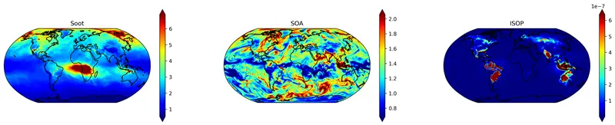
Concentration of soot/POA, SOA and Isoprene
The scheme runs table and the first results look promising.
Annual average of surface concentrations in 2020
Detailed tests and validation ongoing in a master thesis
S. Ghosh& ICON-SmART team

Slide 12
Model infrastructure
ComIn enteries realized within ART code → to be in OSR 2026.10
OpenACC porting is completed for the following modules:
  Pollen processes → in OSR since 2024
  Dust processes → to be in OSR 2026.10
  Online emission module → OSR 2026.04
C++/Kokkos porting in planning

Slide 13

ARTEX initiative: making ART EXascale-ready
ARTEX 1 | Harmonization (July-Sep 2026)
Standardize variables, units, precision, and naming
Establish explicit, argument-based interfaces
Document conventions and interface guidelines
ARTEX 2 | Aerosol Modularization (6 months)
Replace string-based dispatch in critical loops
Reduce cross-dependencies through clean interfaces
Centralize shared data and utilities
Enable isolated testing with lightweight drivers
ARTEX 3 | Chemistry Modularization (6 months)
        Apply modular interfaces to key chemistry processes
        Reduce inter-process coupling
        Consolidate guidelines for future C++/Kokkos and GPU

Slide 14
Sustainable Software and Community Building
Proposal submitted to ScienceServe of Helmholz
  standardizing namelist interfaces to make configuration modular, consistent, and self-documenting;
  establishing reusable, CI-integrated testing aligned with the wider ICON test infrastructure; and
  automating source-code documentation generation within CI.
ARTists Forum
  Online meeting of the ART user and developer community every 3 months
  Email list is icon-art-community@lists.kit.edu
  Joined forces to overcome the dry/wet air issue for tracers

Slide 15
OSR 2026.04 and OSR 2026.10
  Dust & biogenic coupled to JSBACH
  Sea Salt & DMS coupled to ICON-O
  OEM made GPU-ready
  Lumped BVOC tracers
  AI-based opitcs MieAI
  Updates in dusty cirrus
  New CCN activation
  OpenACC port of DUSTRAD experiment
  Fixes in CloudJ
  EUV photoionization and dissociation

