Slide 1
ICON-ART at CMCC: Status and Next Steps
Massimo Muraro, Oliver Carlo, Mario Raffa, Angelo Campanale, Alejandro Vichot Llano, Francesca Vittorioso, Paola Mercogliano

Slide 2








The Team
Massimo Muraro
Project lead and main developer of ICON-ART pipelines
Mario Raffa
Team lead at PRESTO
Alejandro Vichot Llano
Experienced modeller in ICON and support for ICON-ART
Paola Mercogliano
Principal Scientist and
head of REMHI Division
Oliver Carlo
Testing, debugging and simulations for ICON-ART
Angelo Campanale
Experienced modeller in ICON and Ocean Coupling
Francesca Vittorioso
Experience in chemistry transport modelling and satellite DA

Slide 3
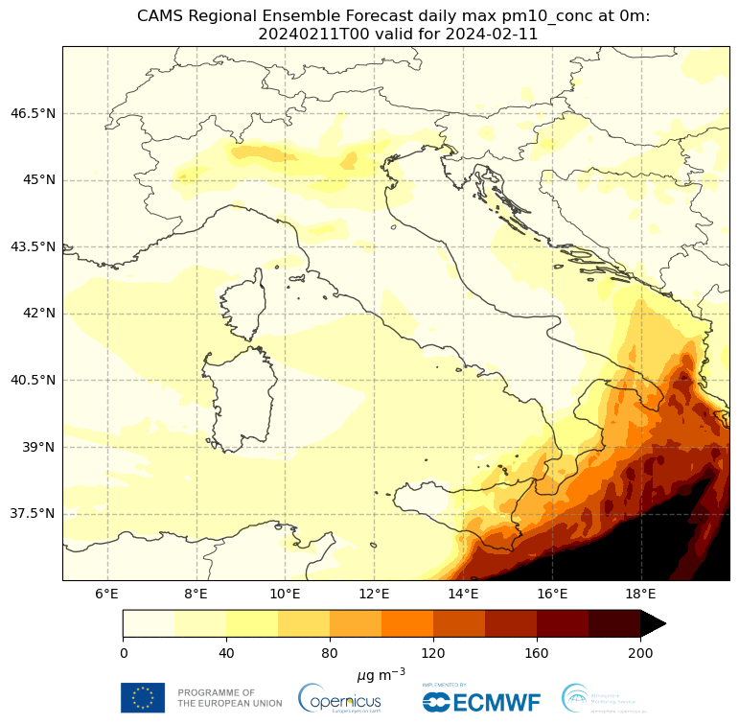
Project: RISING
Objective
Effect of air quality on health and weather – in Italy and beyond
Po Valley
Campania
Po Valley, nestled in between the Apennines to the south and the Alps to the North, is a flat plain valley that traps pollutants and changes local climate.
Centre of economic development and industries. A third of Italy’s population lives in this region.
Uniquely ‘humid subtropical’ climate (Cwa and Cfa Köppen Climate Classification)
Campania, home to the ‘land of fires’ (terra dei fuochi), caused due to the illegal local disposal and burning of toxic waste (heavy metals, sewage sludge, battery acids, asbestos, and radioactive waste).
Italy's 3rd-most populous region.
Alberti, P., 2022. The ‘land of fires’: epidemiological research and public health policy during the waste crisis in Campania, Italy. Heliyon, 8(12).
PM10 concentration levels over Italy
https://atmosphere.copernicus.eu/extreme-episode-particulate-matter-air-pollution-across-italys-po-valley
Main Activities
cams2art ★ NEW
CAMS EAC4 → IC + LBC
22 species: 11 gases + 11 aerosols, written in place
cams_to_art_iae
CAMS EAC4 dust → ART_IAE
3 bins → mass (DUSTA/B/C) + number
hwsd2_to_art ★ NEW
HWSD2 → ART_STY
14 texture fractions, Σ = 1 (+ SOILTYP)
cams2art · GHG
CAMS GHG → IC + LBC
CO₂ · CH₄ · N₂O as inert chemtracers
gfas2art
CAMS GFAS → ART_BCF
daily 0.1° fire fluxes + FRP, conservative
The target of CMCC activity is the climate scale: a long-term regional reanalysis in which air quality is simulated together with the weather, not added on top afterwards. The five input chains are the prerequisite for it — and on this we are looking for collaborations within the COSMO / ICON community.

Slide 4
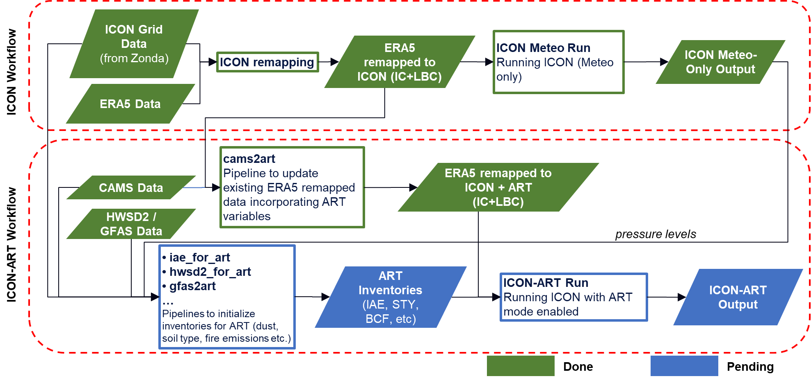
Workflow – ICON-ART LAM

Slide 5
cams2art: CAMS → ICON-ART pipeline for IC and LBC
Speciation + units + horizontal projection + vertical projection
CAMS (source)
Copernicus / ECMWF
EAC4 reanalysis + NRT forecast
Gases (CO, O3, NO2 ...) + aerosols (11 bins)
cams2art (the bridge)
Speciation + units
Horizontal + vertical projection
Sectional to Modal Representations*
Output IC + LBC, every 6 h (can be modified)
*Lu, J., & Bowman, F. M. (2004). Conversion of Multicomponent Aerosol Size Distributions from Sectional to Modal Representations. Aerosol Science and Technology, 38(4), 391–399. https://doi.org/10.1080/02786820490442842
ICON-ART (target)
DWD / MPI-M - on-line chemistry
Icosahedral grid + hybrid sigma-p
3D tracers (dusta, dustb, dustc, na_sol_acc, cl_sol_acc...)
The four discrepancies to reconcile
Aspect | CAMS | ICON-ART
Species names | aermr01, aermr02, aermr03 ... | dusta, dustb, dustc, na_sol_acc, cl_sol_acc...
Horizontal grid | regular lat/lon | icosahedral unstructured
Vertical coord. | isobaric levels (constant p) | hybrid sigma-pressure
Gas units | kg/kg | mol/mol (× M_air / M_species)
EAC4 sulphates | kg of sulphur / kg | kg of SO4 / kg (× 2.9963)
What ICON-ART needs
IC - initial 3D chemical state of the domain
LBC - boundary concentrations, every 6 h (can be modified)
Without IC+LBC: no long-range transport, no background.
Concentrations represented as modes
What CAMS provides
Tropospheric/stratospheric gases (CO, O3, NO, NO2, SO2, HCHO, CH4)
Aerosols in 11 size bins
5 families: dust(3) · salt(3) · BC(2) · OC(2) · SO4(1).
Concentrations represented as bins

Slide 6
cams_to_art_iae: initializing mineral dust for ICON-ART
The CAMS EAC4 mineral-dust state and the one required by ICON-ART are DIFFERENT representations of the same phenomenon → 5 mismatches → 5 cascaded transformations.
CAMS EAC4
• 3 MASS bins
• lat/lon ~0.75°
• ~25 fixed-p levels
• M only
ICON-ART
• 3 log-normal modes
• unstructured grid
• ~90 hybrid η levels
• M + N (2 moments)
①
②
③
④
⑤
Modal
matching
Horizontal
transport
Vertical
reprofiling
Number
from mass
ART_IAE
format
# | Transformation | What it does conceptually | Mismatch resolved
① | Modal matching | Associates each of the 3 truncated CAMS bins with the ICON-ART log-normal mode of best overlap; parameters (d_gn, σ_g, ρ) from modes_dustrad.xml (KIT) | Size distribution
② | Horizontal transport | (A) bilinear lat/lon CAMS → lat/lon ICON (to use ICON’s 3-D pressure in step ③); (B) CONSERVATIVE remap lat/lon → triangular (preserves ∫ M dA) | Horizontal grid
③ | Vertical reprofiling | From CAMS fixed plev to ICON hybrid η levels; interpolation in ln(p); above the top → constant, below the bottom → 0 | Vertical coordinate
④ | Number from mass | Reconstructs N from M assuming log-normal: N = M / [ (π/6)·ρ·d_gn³·exp(4.5·ln²σ_g) ] — third moment | Moments (1 → 2)
⑤ | ART_IAE conformity | CF-1.6 + clat/clon in radians + CDI_grid_type='unstructured' + uuidOfHGrid (fingerprint, checked on read) | Metadata

Slide 7
hwsd2_to_art: inventorying soil texture for ICON-ART
From HWSD2 soil texture to the ICON-ART dust scheme, after the M1..M5 revision
HWSD2 (source)
FAO/IIASA v2.0 - ~30'' raster + DB
29,538 SMUs, 58,405 D1 components
hwsd2_to_art (the bridge)
SMU → composition lookup (19 bands)
fr_* + hwsd_* + SOILTYP, ready for the remap
ICON-ART + TERRA_ML (target)
DWD/KIT - dust uplift scheme
u*_t per cell, DUSTA/B/C modes · T_soil
1. LOOKUP
2. GATHER
3. INVARIANT
4. REMAP + SOILTYP
Summary of Comparison
Indicator | HWSD v1.2 | HWSD2 with gap-fill | revised HWSD2
Mean sand fraction over land | 0.0764 | 0.0584 | 0.0778
Land cells with sand above zero | 14,720 | 9,205 | 22,233
Mean fraction with no texture | 0.0332 | 0.0325 | 0.0317
Effective number of classes per cell | 1.301 | 1.349 | 1.923
Soil-type codes present in the domain | 7 | 5 | 10
Dominant-class agreement with LUCAS | 39.81% | 39.50% | 41.63%
Mean absolute error against LUCAS | 1.208 | 1.160 | 1.048
From the DB to the
SMU → composition matrix
every D1 component
classified by the triangle
and weighted by SHARE
float32 matrix (N, 19)
From the pixel to
the composition
out = lookup[smu_id]
the row IS the composition
water/no data → row 0
Physical check of
the produced field
Σ fr_k(cell) ≡ 1
the 5 hwsd_* stay out
WARN if it drifts > 1e-3
On the ICON grid,
and for TERRA_ML
with remap (or nn)
SOILTYP from the candidate
with the largest area share
Why texture matters - dust emission scheme (Marticorena & Bergametti 1995)
F_dust = C · ρ_air / g · u*³ · ( 1 - u*_t² / u*² ) if u* > u*_t
Texture sets u*_t and the PSD partition into the DUSTA/DUSTB/DUSTC modes. The scheme is NON-LINEAR: what counts is the sandy TAIL of the distribution, not the mode.
What happens to a pixel - the decisive change is M2
before: one only
after (M2): composition
fr_loam = 1.00
fr_loam = 0.70 fr_sand = 0.30

Slide 8
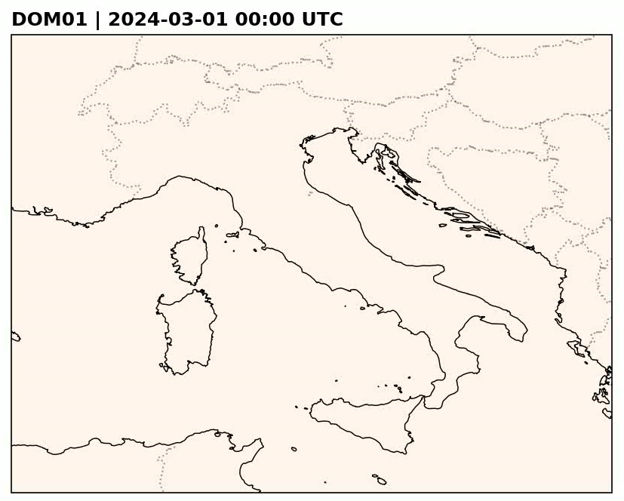
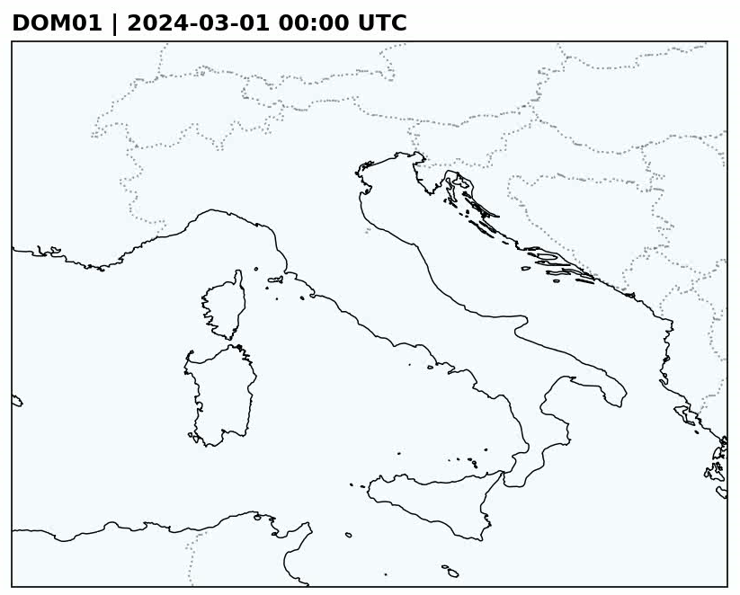
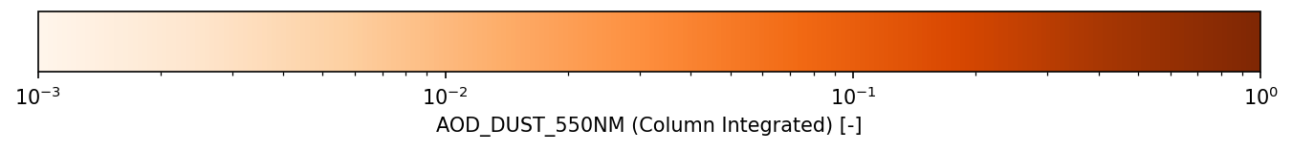
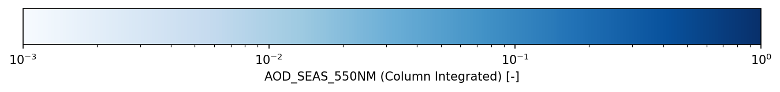
Aerosol Optical Depth – DUST and SEASALT – 550 nm

Slide 9
Status and Next Steps
READY
the five chains run end-to-end
VALIDATED
evidence, and the risks controlled
NEXT STEPS
what comes now, and what we share
▸ Written in place — the five chains fill the existing ICON-ART IC / LBC files: no parallel file, no meteorology–chemistry mismatch.
▸ Speciation, units, remapping — all upstream: bilinear + log(p) for concentrations, conservative remap for fluxes.
▸ 1-moment and 2-moment — dust, sea salt and soot feed the log-normal modes with mass and number.
▸ GHG beyond 2020 — the CAMS flux-inversion product replaces the standard one, which stops in 2020.
▸ hwsd2_to_art vs LUCAS / ESDAC (ICON Europe R5B7): dominant class 41.6 % vs 39.8 / 39.5; MAE 1.048 vs 1.208 / 1.160; 2.27 classes per cell vs 2.31 observed.
▸ Saharan dunes have no texture in HWSD2: left undefined, dust emission switches off right where the source is — restored by gap-fill.
▸ Failure is silent: ICON performs no dimensional check — the pipelines check what the model never checks.
▸ Full hindcast over the Euro-Mediterranean domain with all five inputs active — the first end-to-end test.
▸ Attribution runs: local vs advected dust toggled separately, to check the two stay distinguishable.
▸ Aerosol–radiation feedback quantified: how much dust and smoke dim the sun and change the forecast.
▸ Towards the community: pipelines consolidated into documented, portable tools to share with COSMO / ICON partners.
▸ For discussion at the STC: a common soil-texture reference and a shared validation protocol for ART inputs.

Slide 10



www.cmcc.it
massimo.muraro@cmcc.it
oliver.carlo@cmcc.it
CMCC - REMHI / PRESTO

