Slide 1
Operational development of EPS at IMGW
Andrzej Mazur, Tatiana Tabalchuk
LMM ZPN-COSMO IMGW-PIB

Slide 2
Contents
Concept and implementation of (TLE) ensembles, methods of description, and examples of results
Post-processing – variants and alternatives
Super(TL)ensemble
Summary

Slide 3
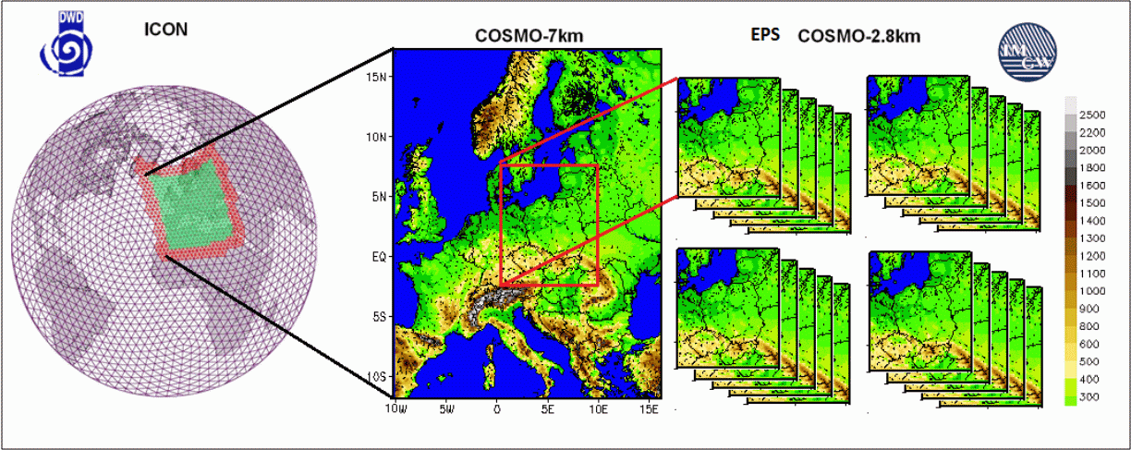
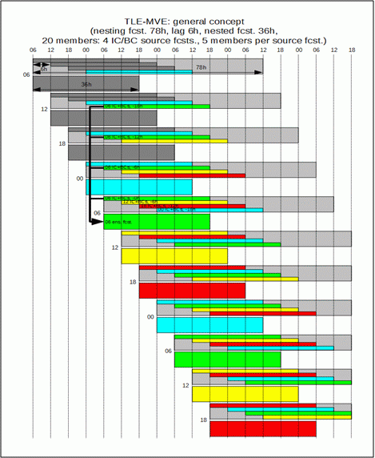
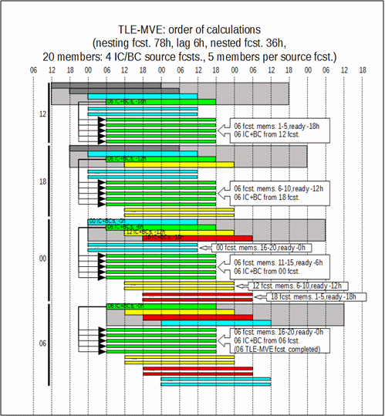
Concept and implementation

Slide 4
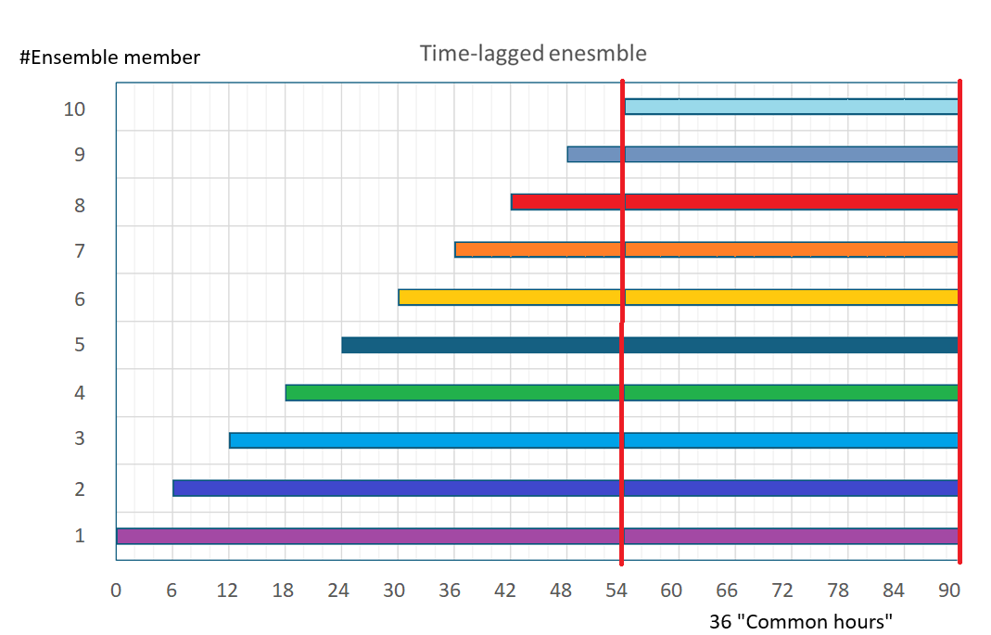
Concept and implementation v. 2.0 (2.1, 2.2, 2.3...)
To reduce computational cost, the MVE part has been omitted (just TLE).
(As above...) the number of elements has been reduced (to 10).
We have chosen appropriate "base" models (deterministic, but with a sufficiently long forecasting period).
All that was needed was to remember the earlier forecasts... and the ensemble(s) was ready.
All the issues related to post-processing and result visualization (calibration, mean calculations, etc.) remain.
The only question is whether the EPS defined in this way is appropriate/useful from a forecasting perspective.
VERIFIED: This time delay scheme indeed generates
the desired forecast spread.

Slide 5
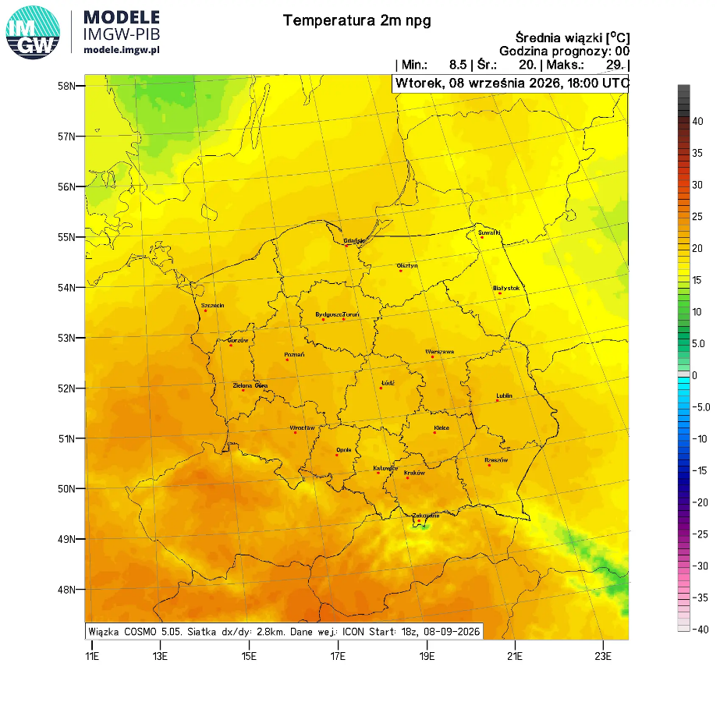
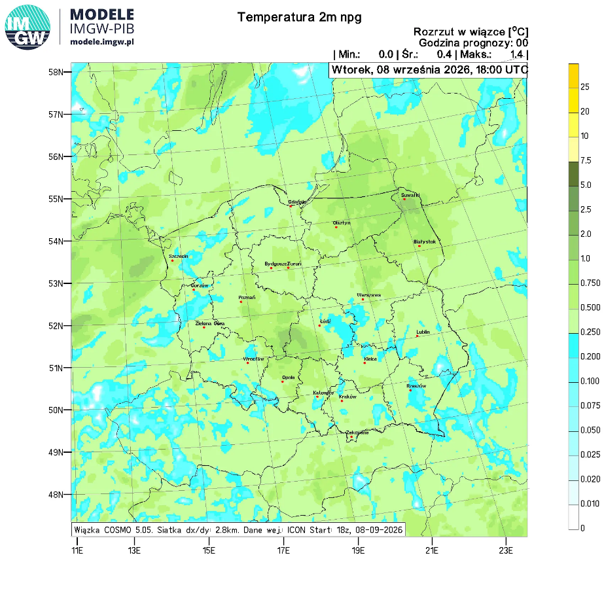
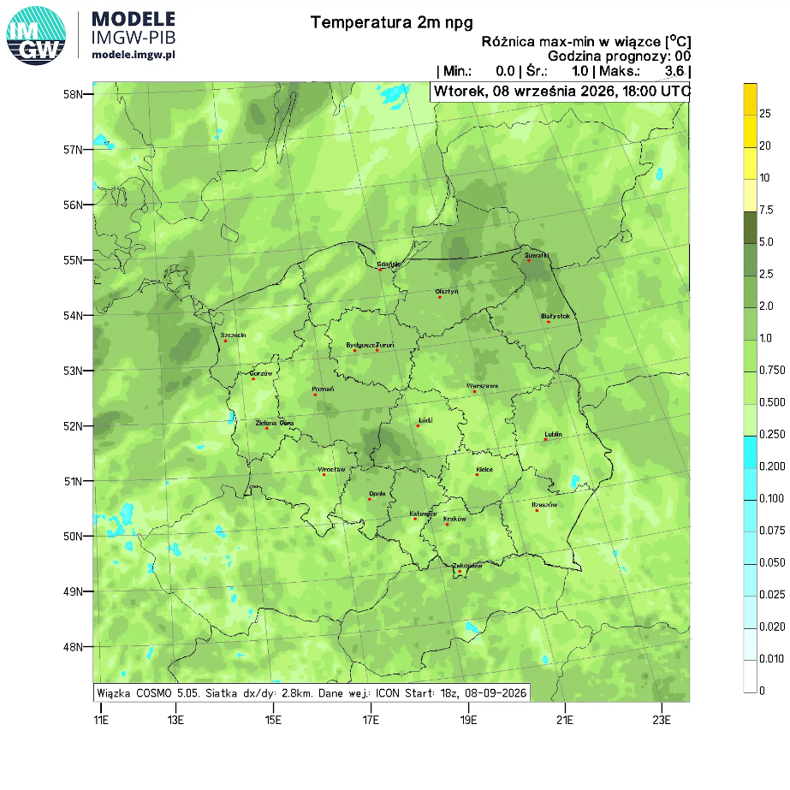
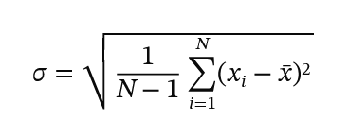
Methods of description of EPS results
Maps: mean values, spread, max-min difference, skill
Reminder:
mean means ensemble mean,
spread – standard deviation of forecasts from the mean EPS value,
skill – bias, |obs.-fcst.|; for EPS – |obs. – mean fcst.|
Why do I emphasize this formula?
Because changing the value of mean (using various methods – see subsequent slides) causes spread to change.

Slide 6
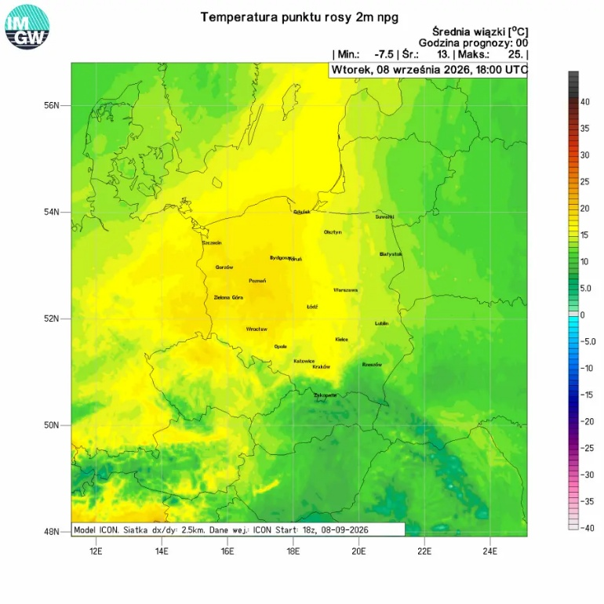
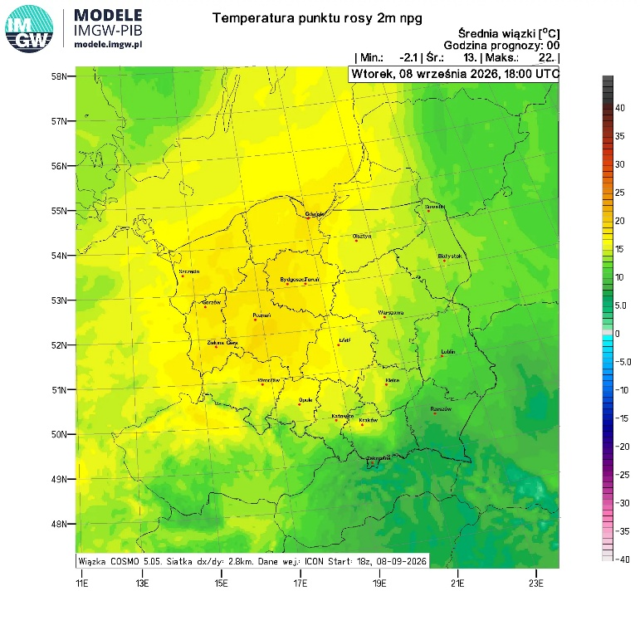
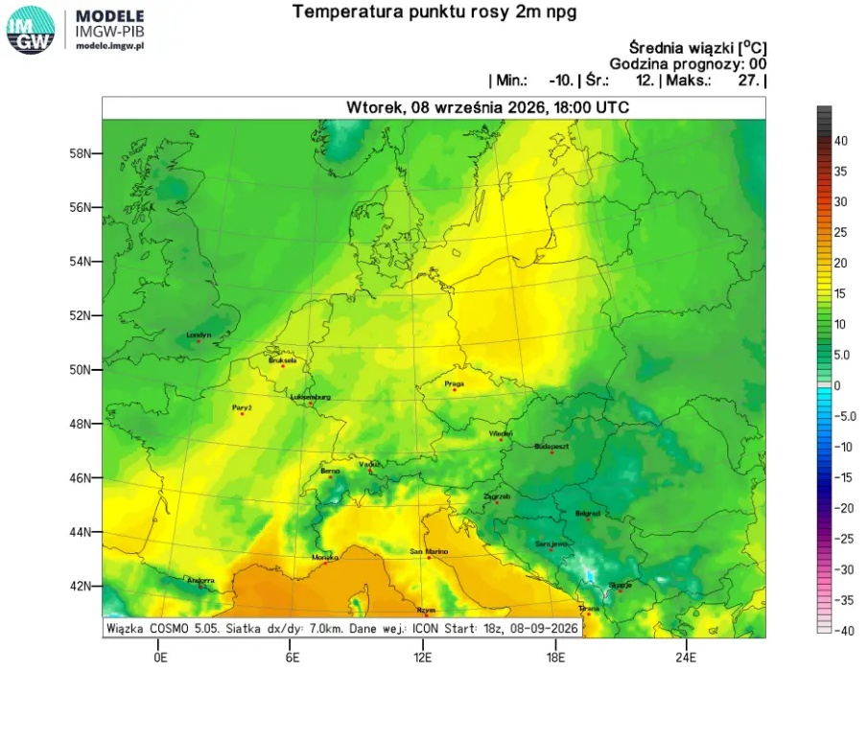
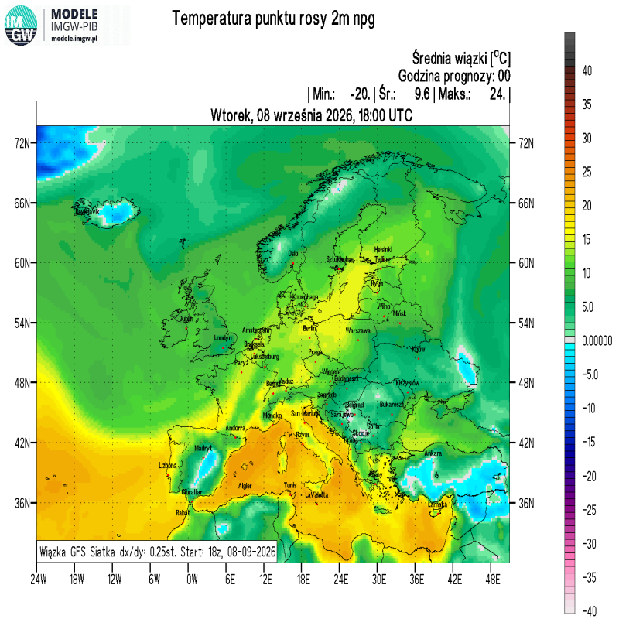
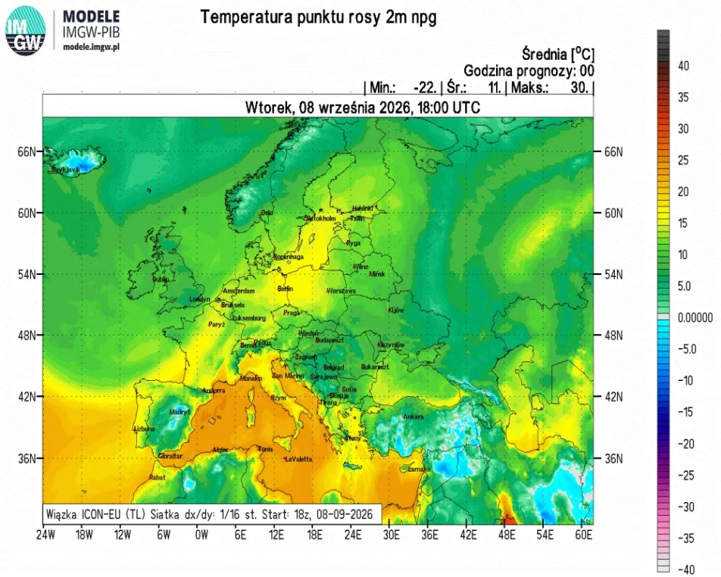
TD2M ICON 2.5
TD2M COSMO 2.8
TD2M COSMO 7.0
Ensemble means; COSMO 2.8 – TLE-MVE, others – TLE.
TD2M GFS
TD2M ICON-EU

Slide 7
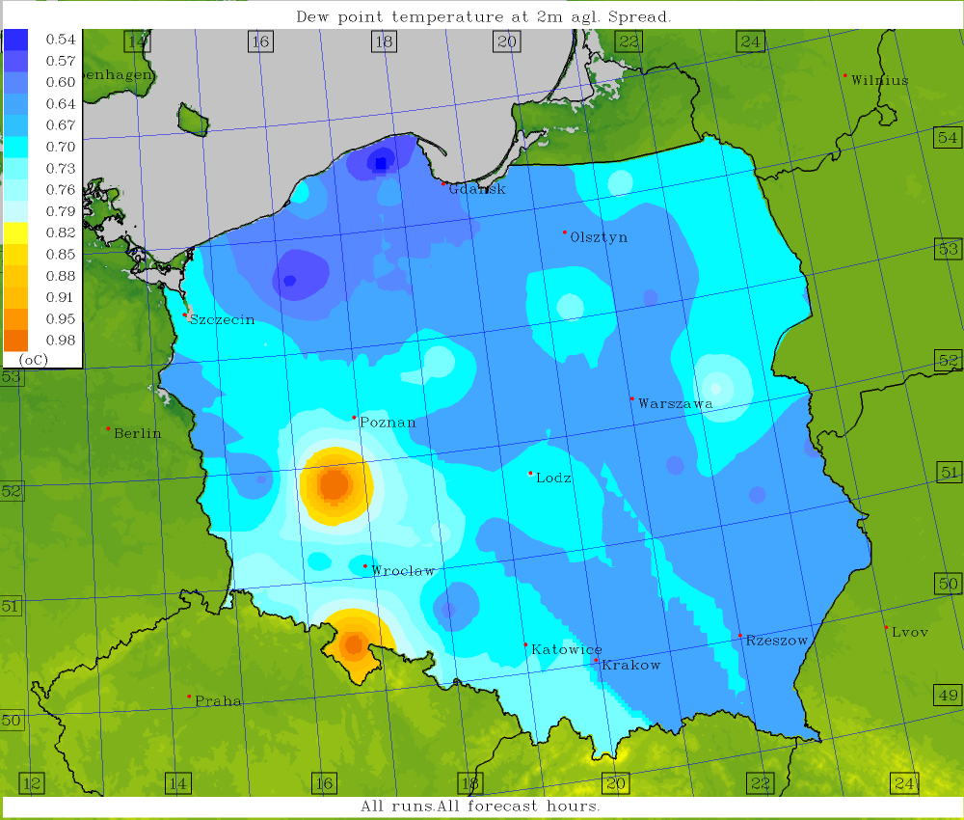
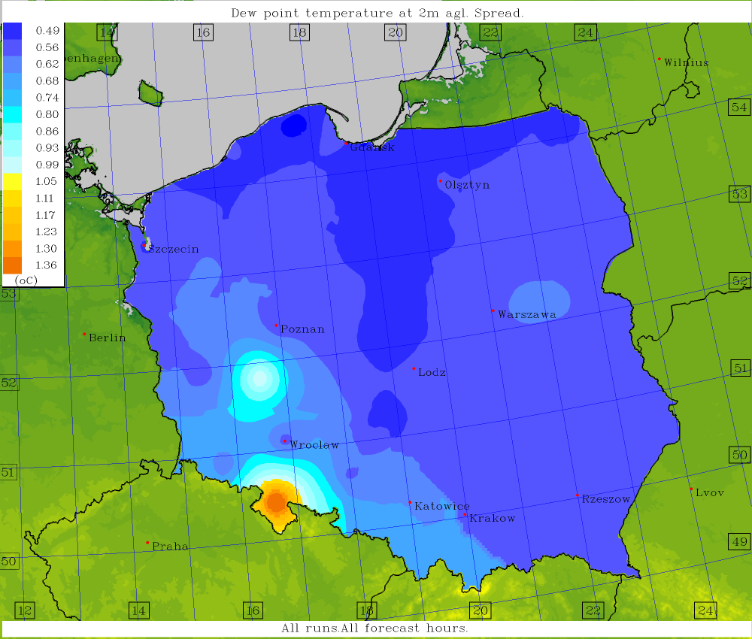
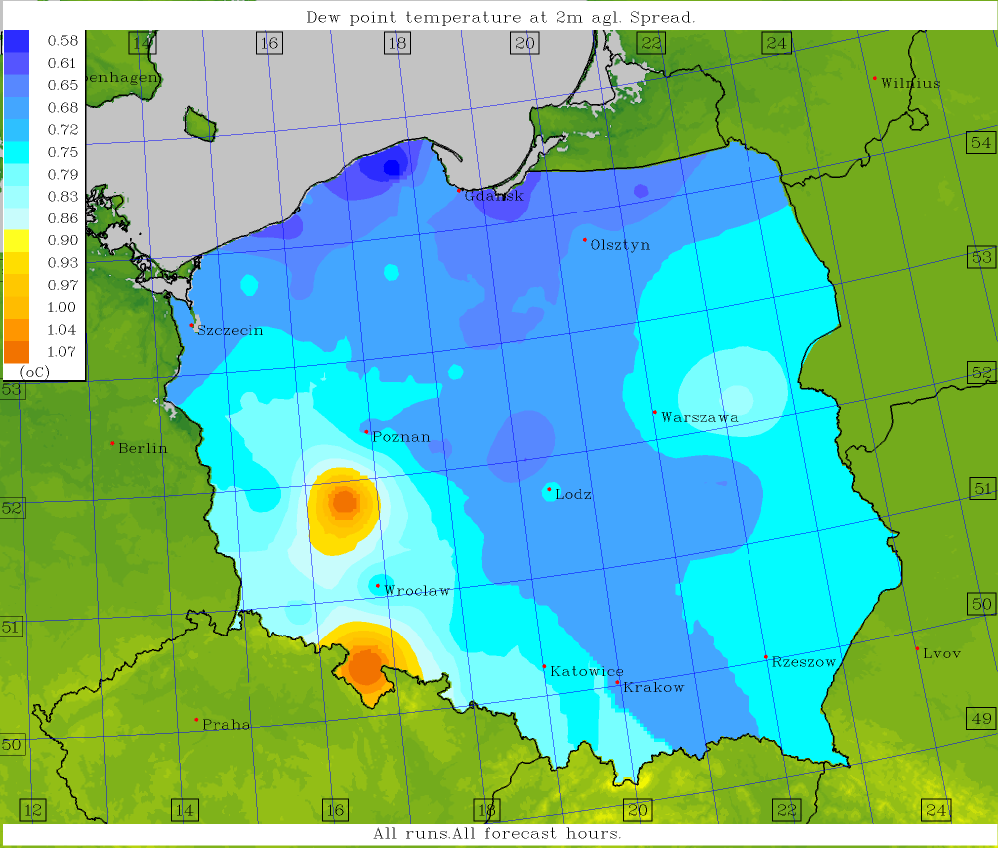
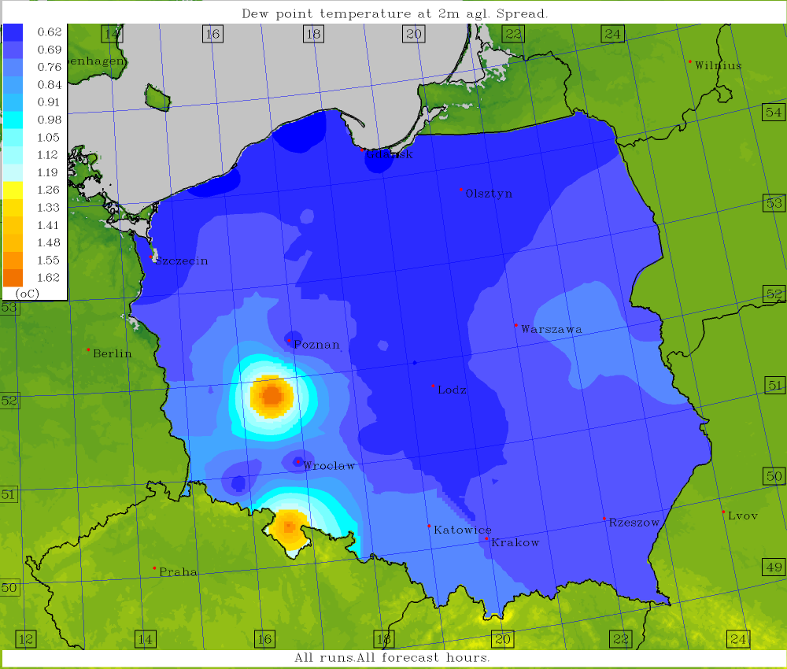
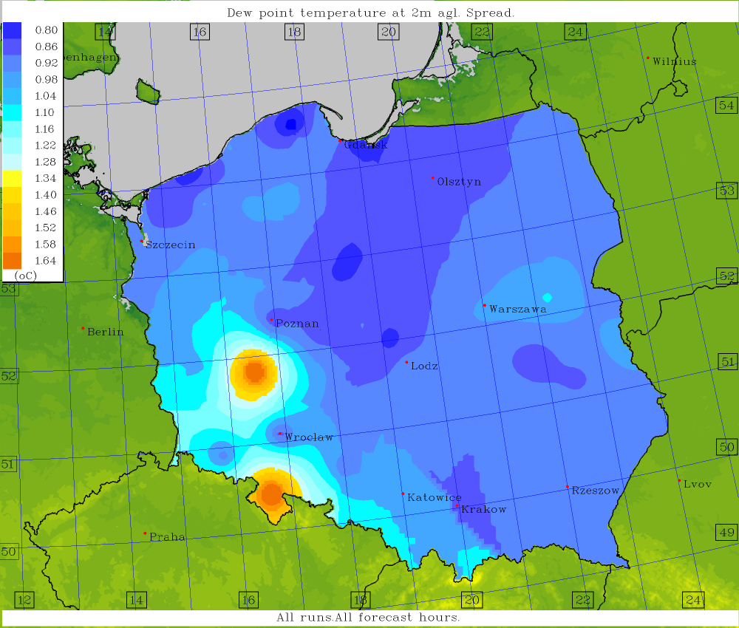
TD2M ICON 2.5
TD2M COSMO 2.8
TD2M COSMO 7.0
Ensemble spread; COSMO 2.8 – TLE-MVE, others – TLE.
TD2M GFS
TD2M ICON-EU

Slide 8
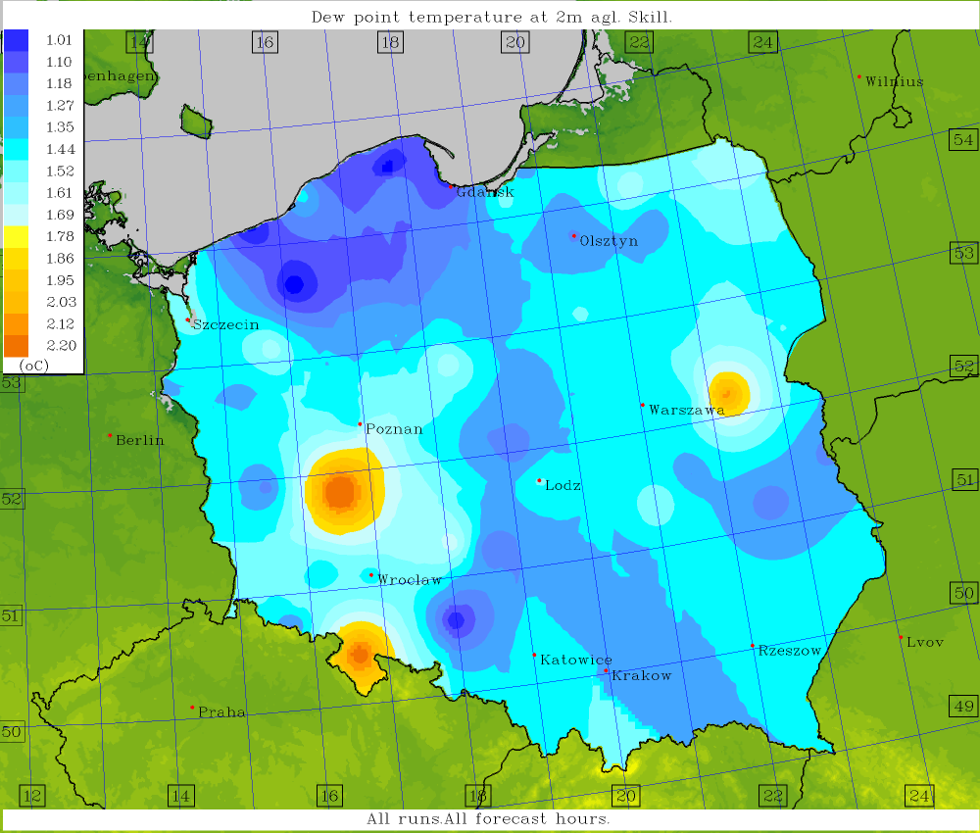
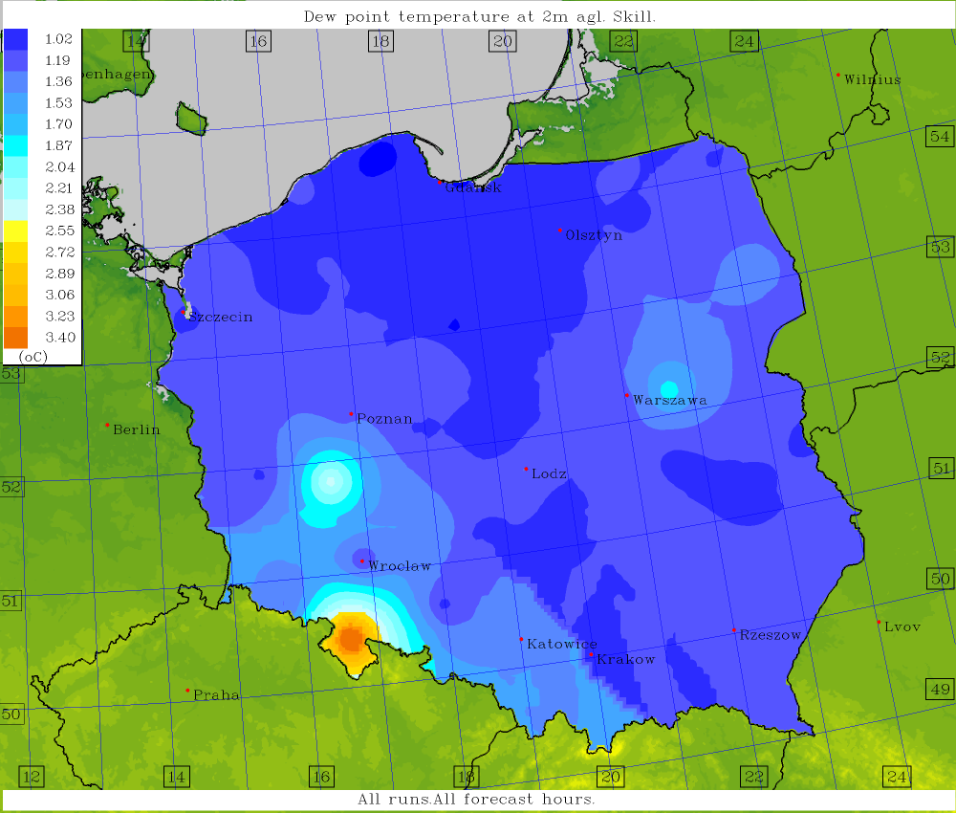
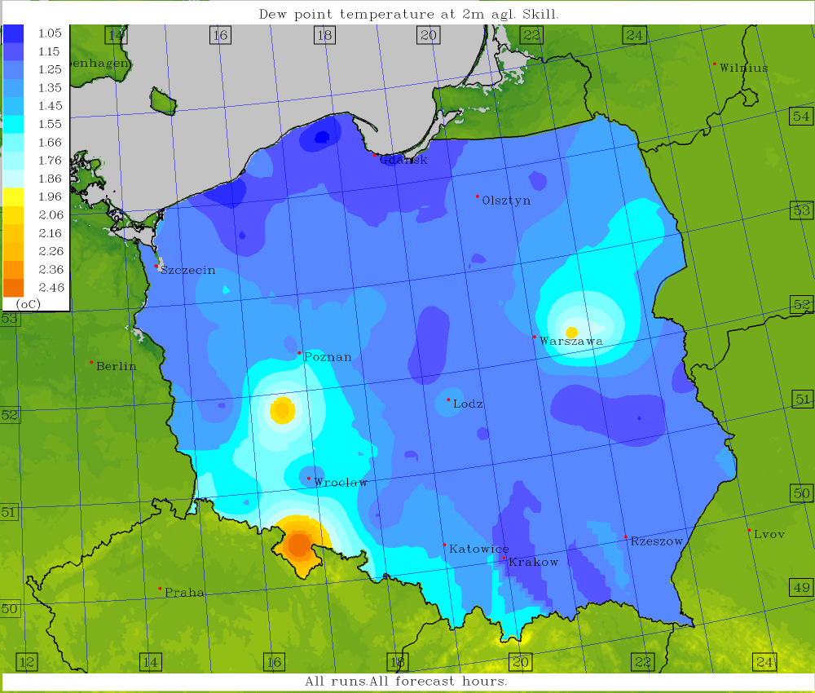
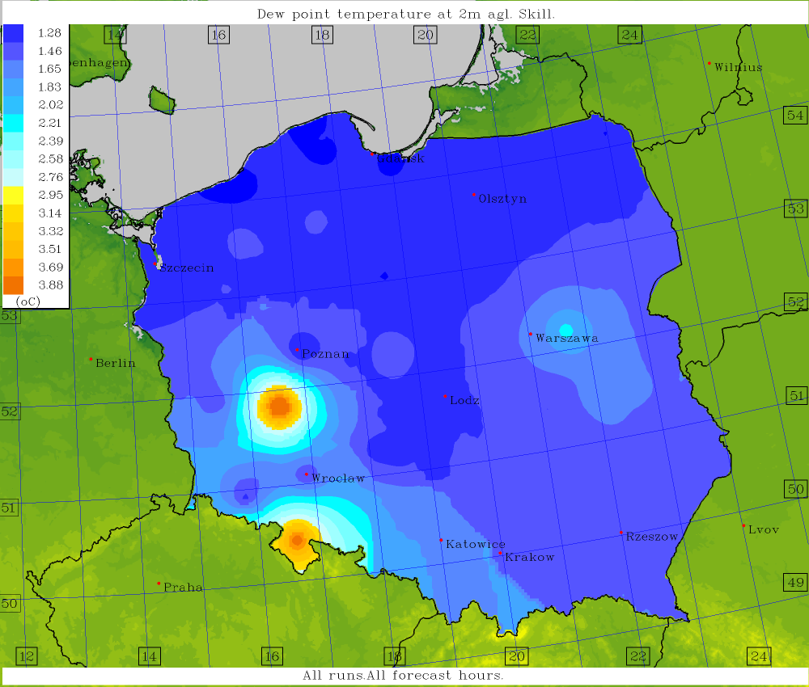
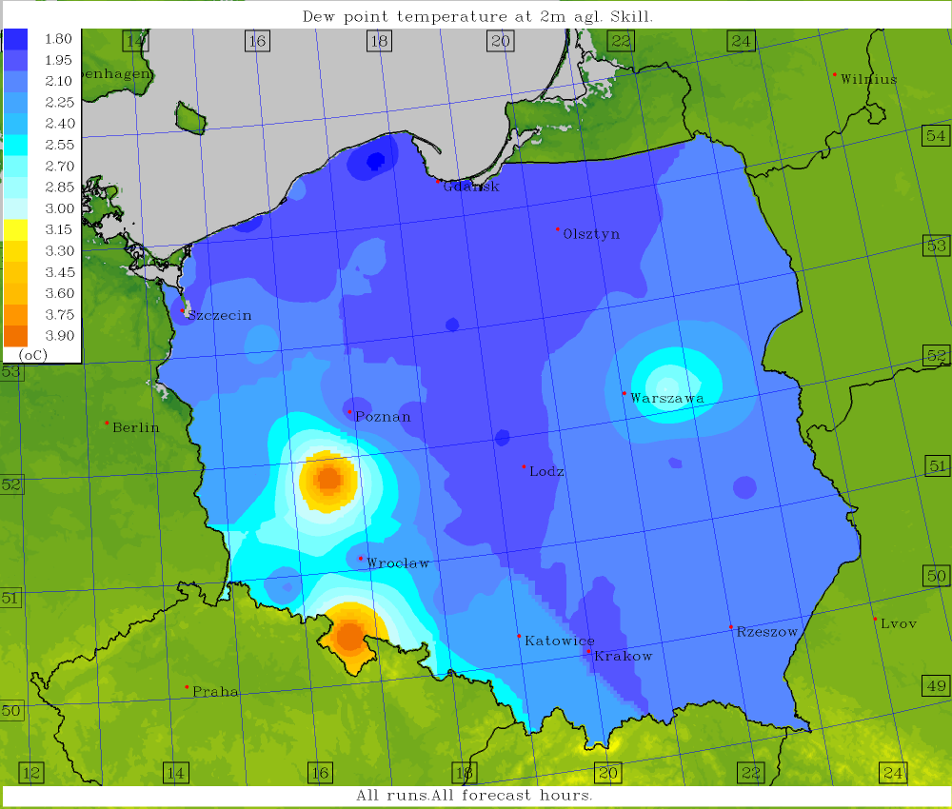
TD2M ICON 2.5
TD2M COSMO 2.8
TD2M COSMO 7.0
Ensemble skill; COSMO 2.8 – TLE-MVE, others – TLE.
TD2M GFS
TD2M ICON-EU

Slide 9
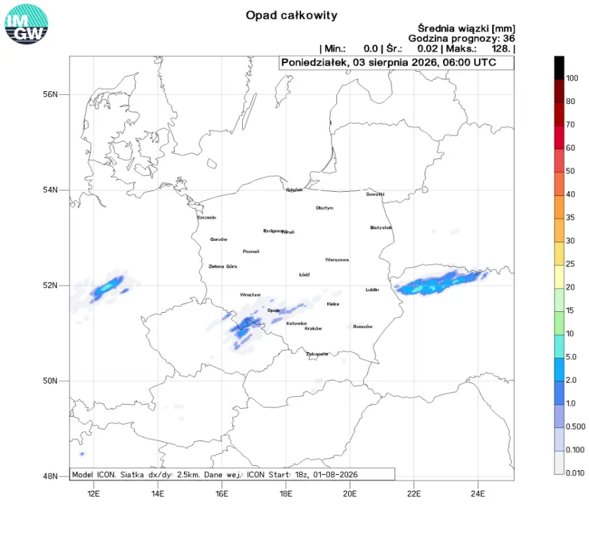
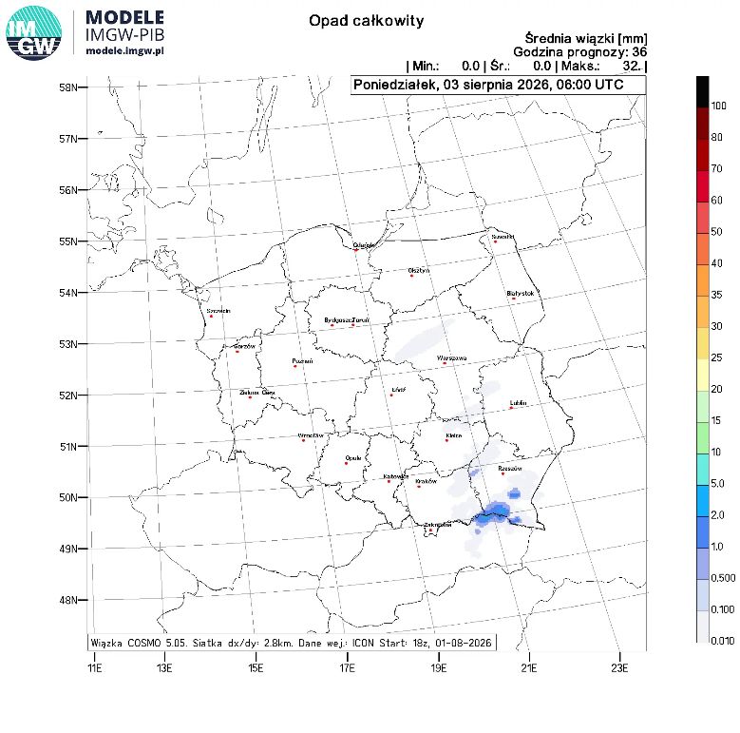
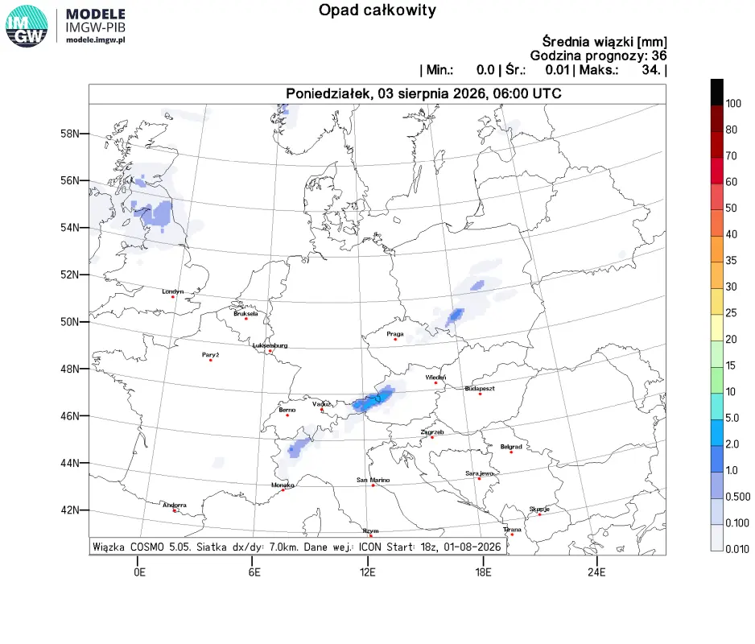
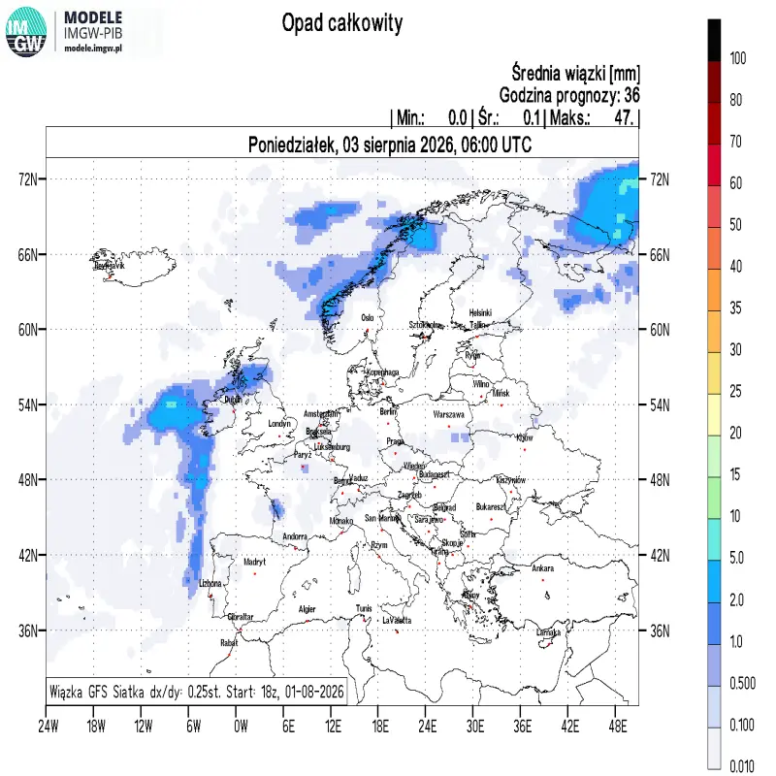
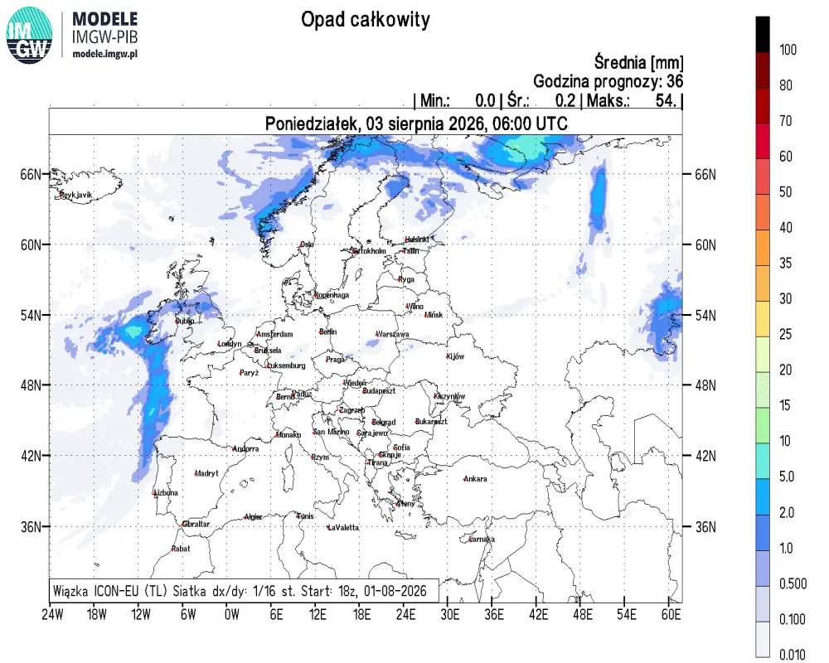
TOT_PREC ICON 2.5
TOT_PREC COSMO 2.8
TOT_PREC COSMO 7.0
Ensemble means; COSMO 2.8 – TLE-MVE, others – TLE.
TOT_PREC GFS
TOT_PREC ICON-EU

Slide 10
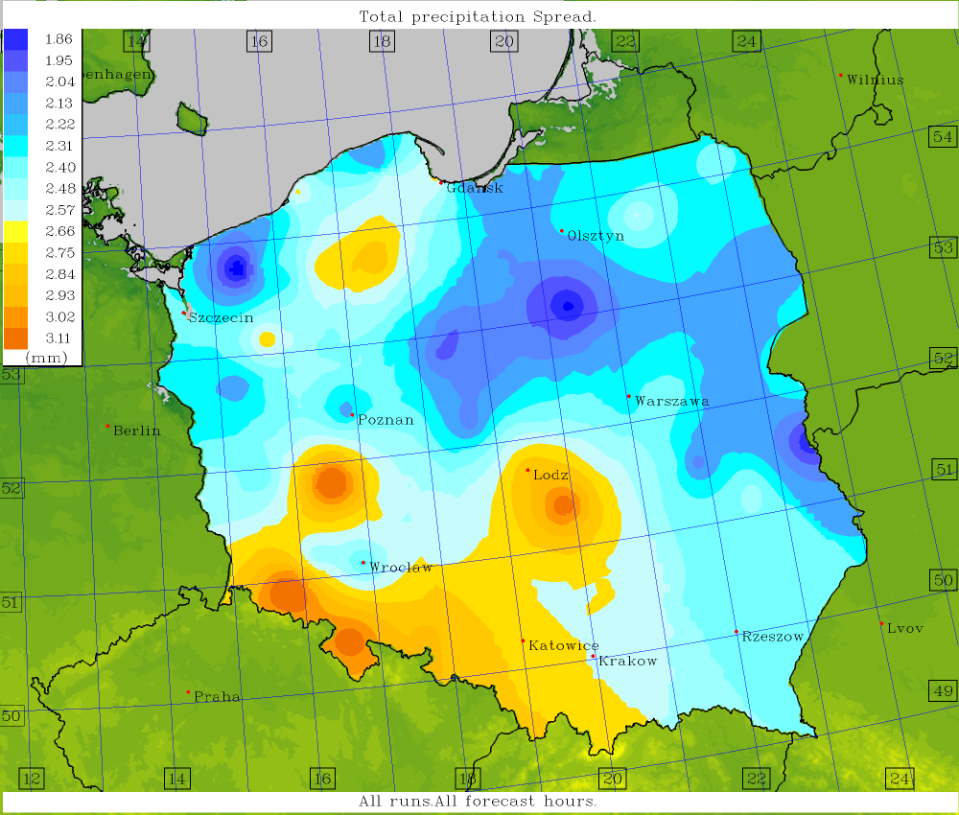
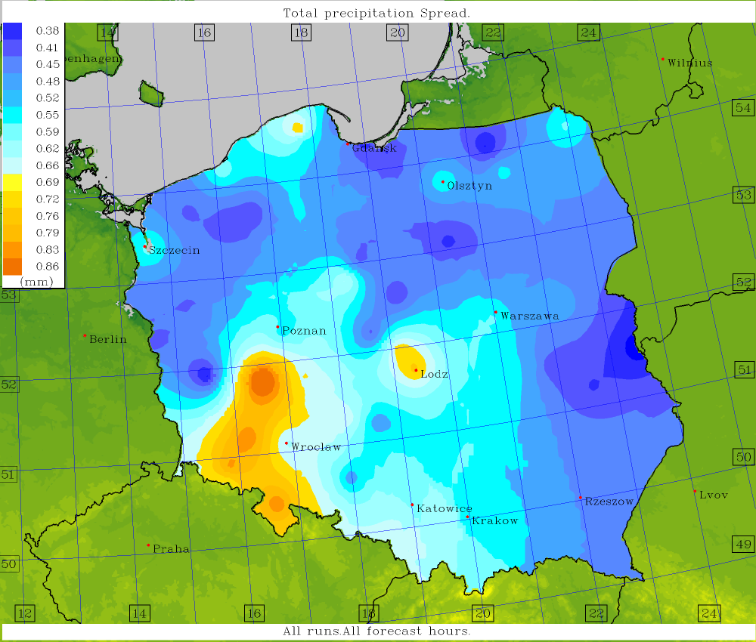
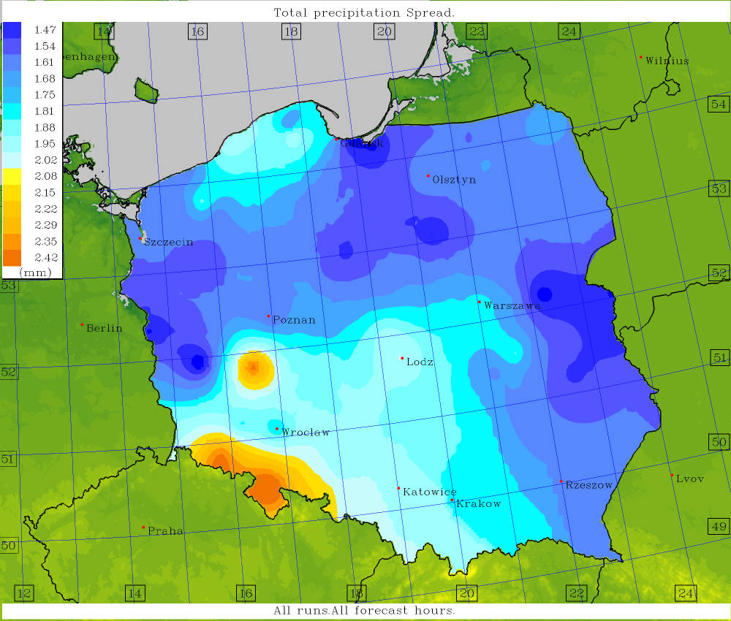
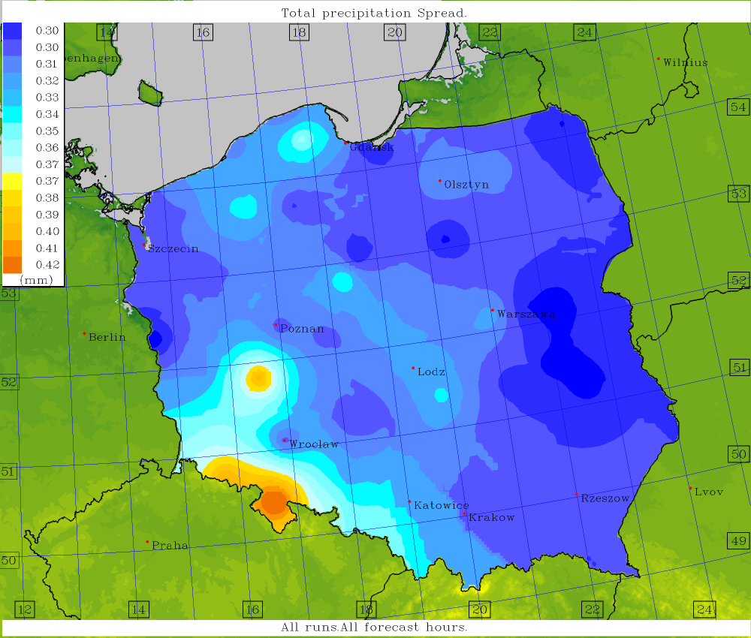
Tot.Prec. ICON 2.5
Tot.Prec. COSMO 2.8
Tot.Prec. COSMO 7.0
Ensemble spread; COSMO 2.8 – TLE-MVE, others – TLE.
Tot.Prec. GFS
Tot.Prec. ICON-EU

Slide 11
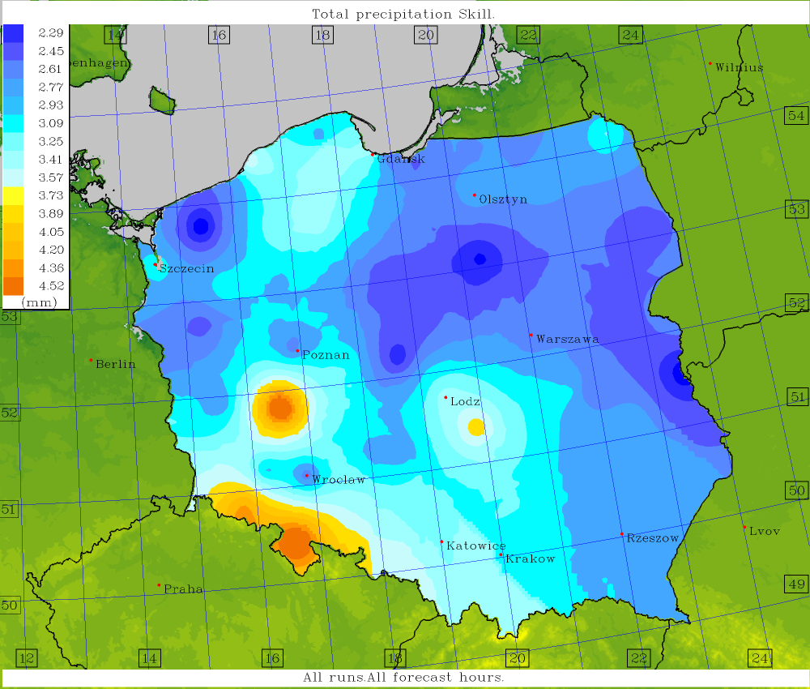
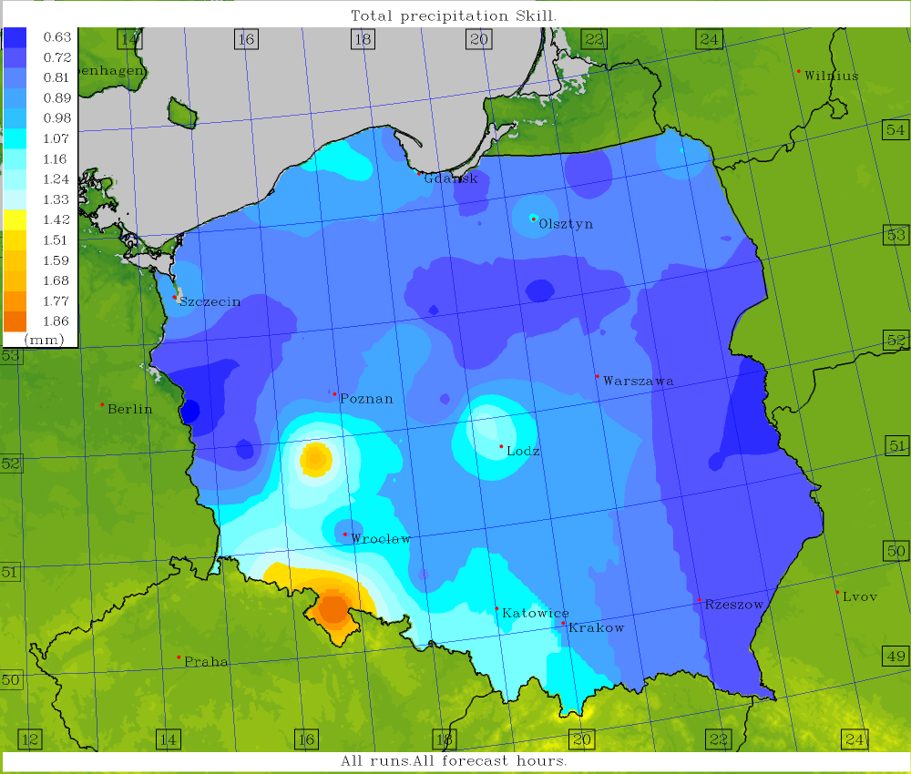
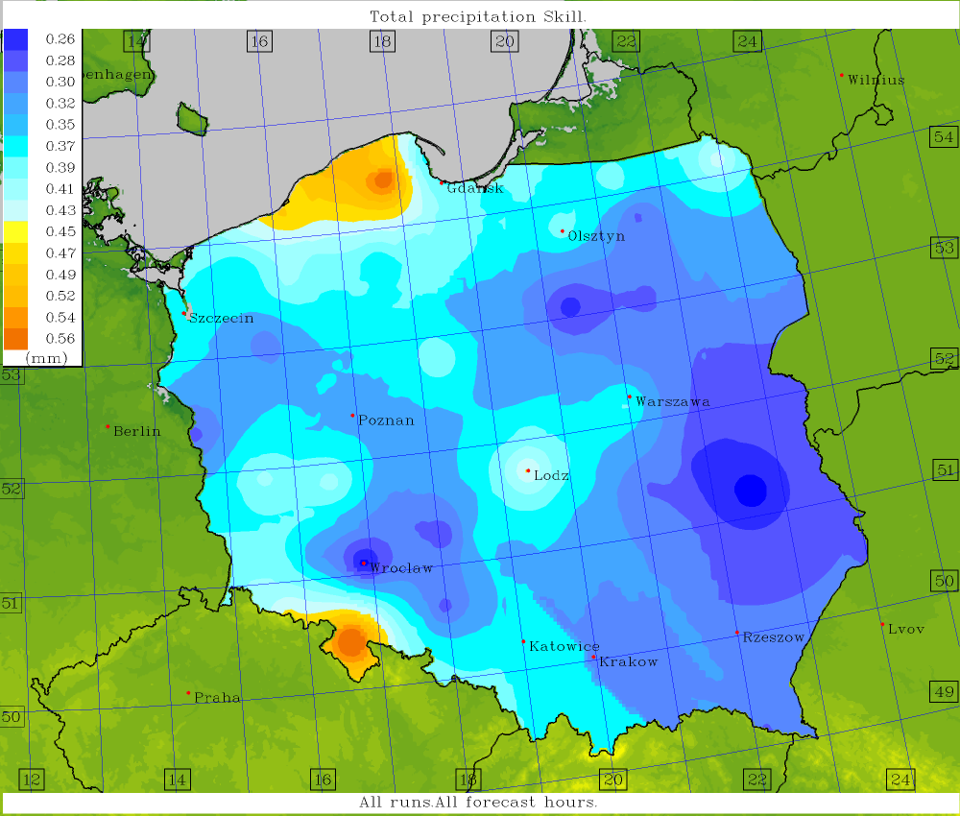
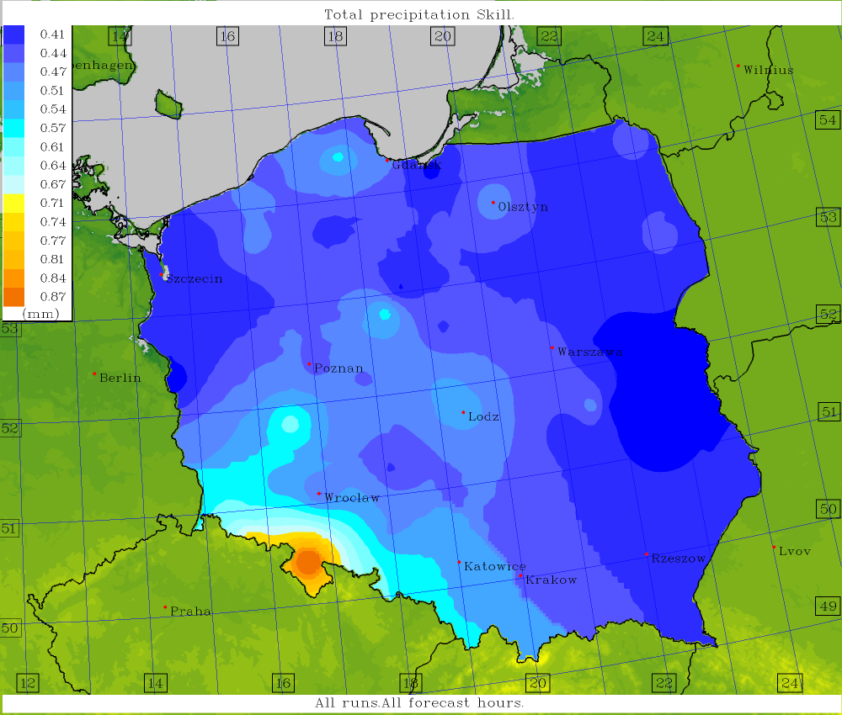
Tot.Prec. ICON 2.5
Tot.Prec. COSMO 2.8
Tot.Prec. COSMO 7.0
Ensemble skill; COSMO 2.8 – TLE-MVE, others – TLE.
Tot.Prec. GFS
Tot.Prec. ICON-EU

Slide 12
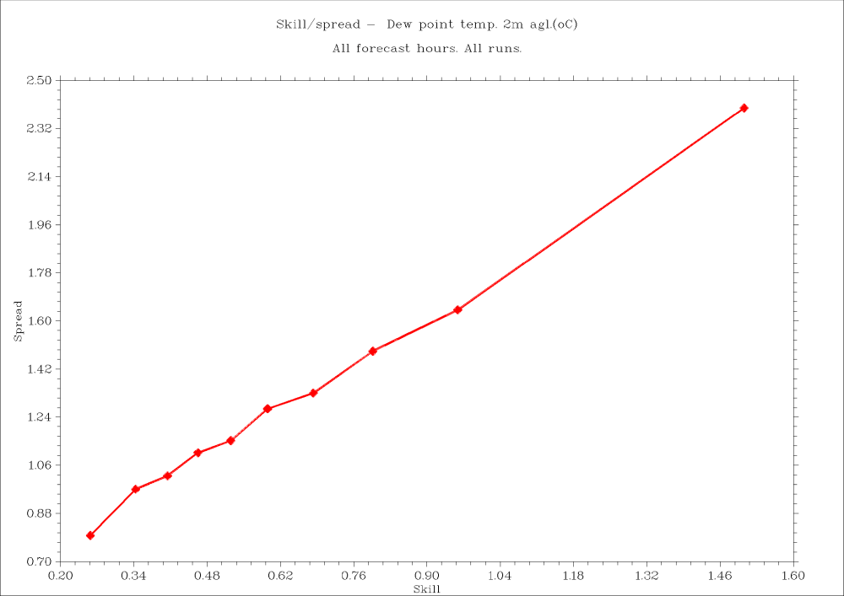
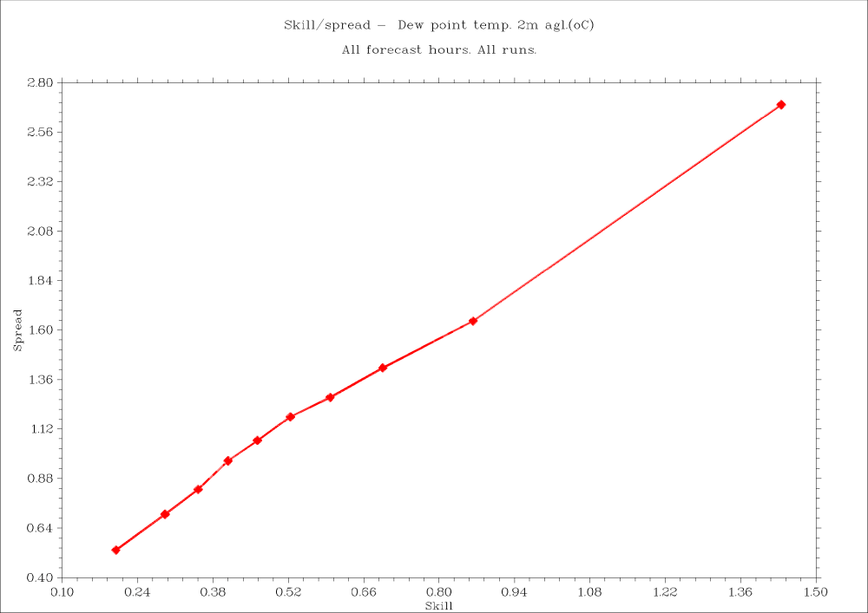

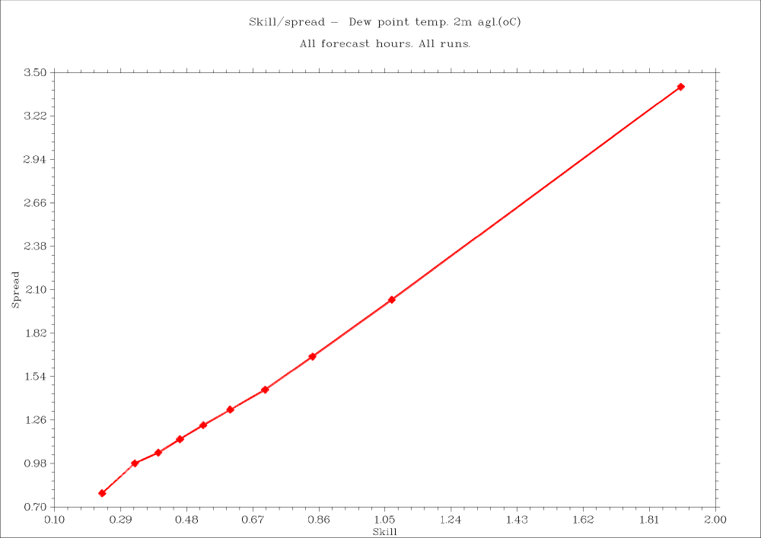
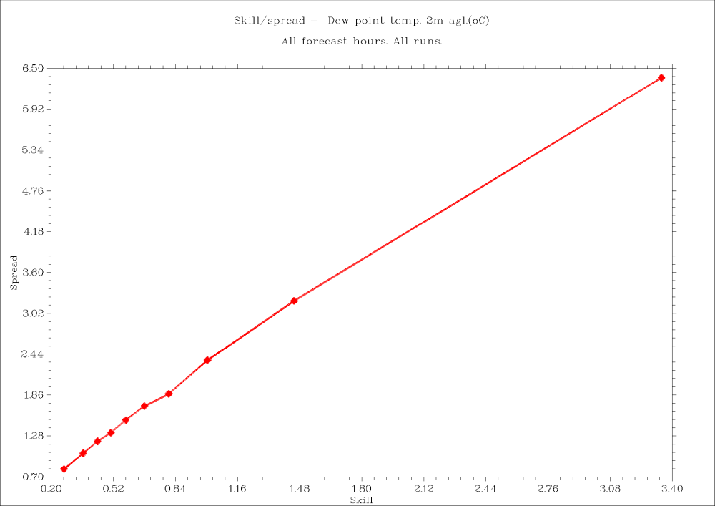
T2M ICON 2.5
T2M COSMO 2.8
T2M COSMO 7.0
Spread-Skill charts; COSMO 2.8 – TLE-MVE, others – TLE.
T2M GFS
T2M ICON-EU
Reminder: the Spread-Skill chart determines what fraction of the spread value a given skill has (or vice versa). Ideally, it should be a straight line, with the x-axis and y-axis being equal in length.

Slide 13
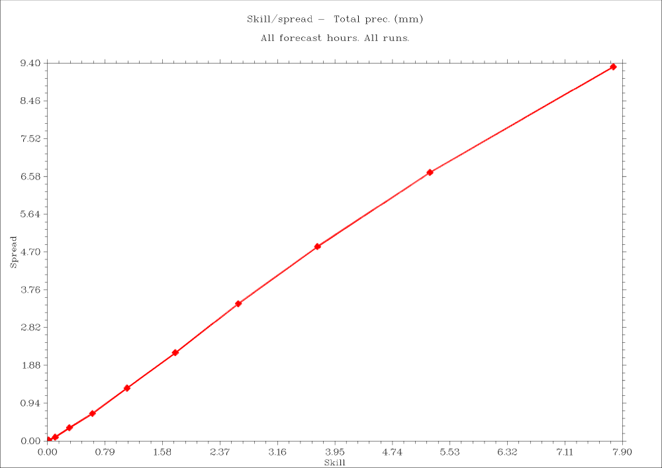
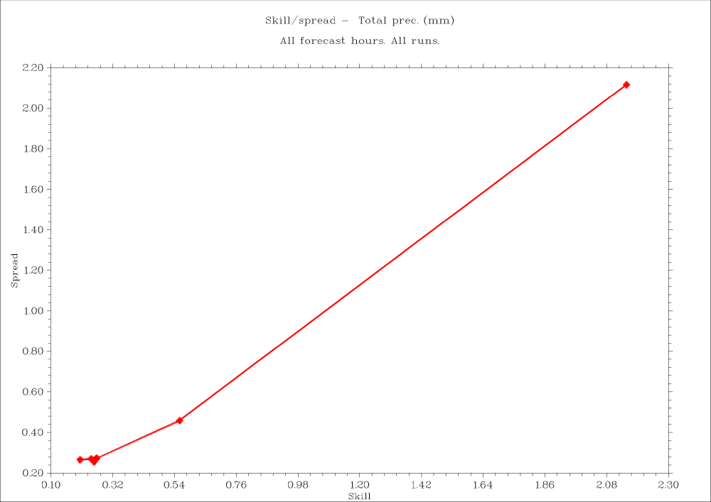

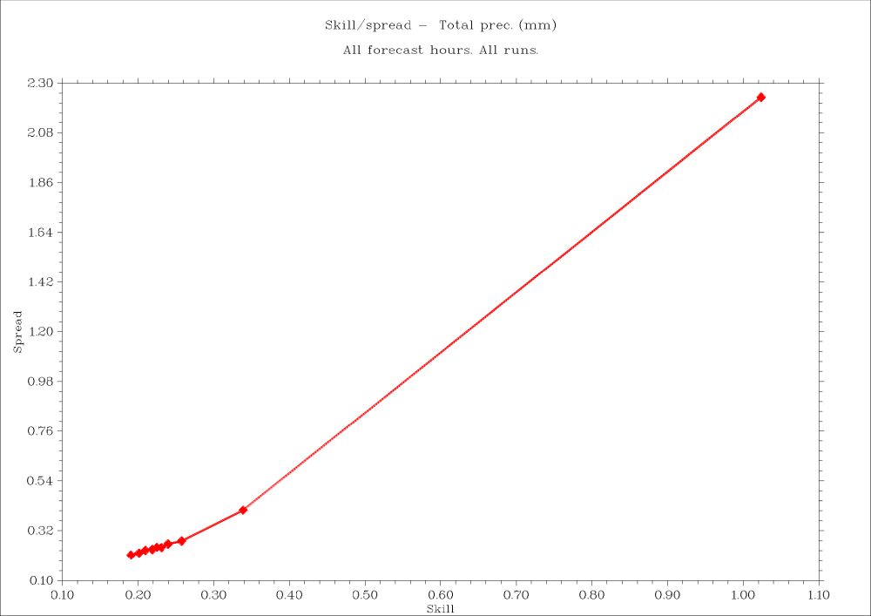
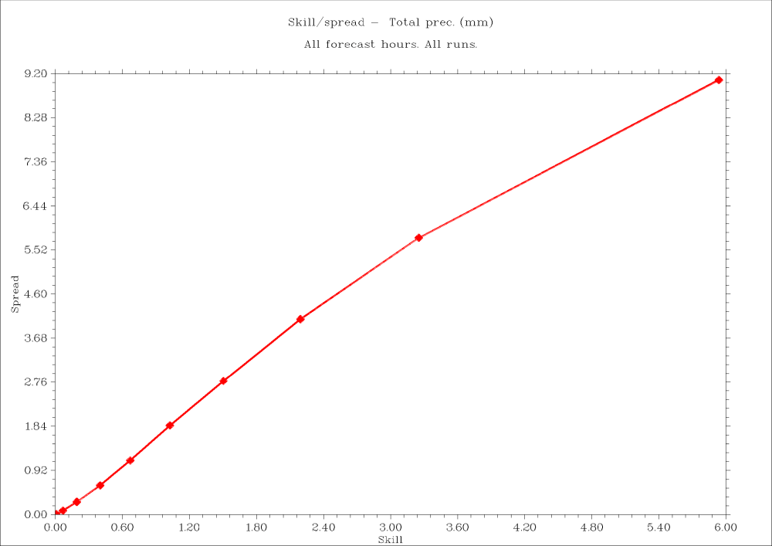
Tot.Prec. ICON 2.5
Tot.Prec. COSMO 2.8
Tot.Prec. COSMO 7.0
Spread-Skill charts; COSMO 2.8 – TLE-MVE, others – TLE.
Tot.Prec. GFS
Tot.Prec. ICON-EU

Slide 14
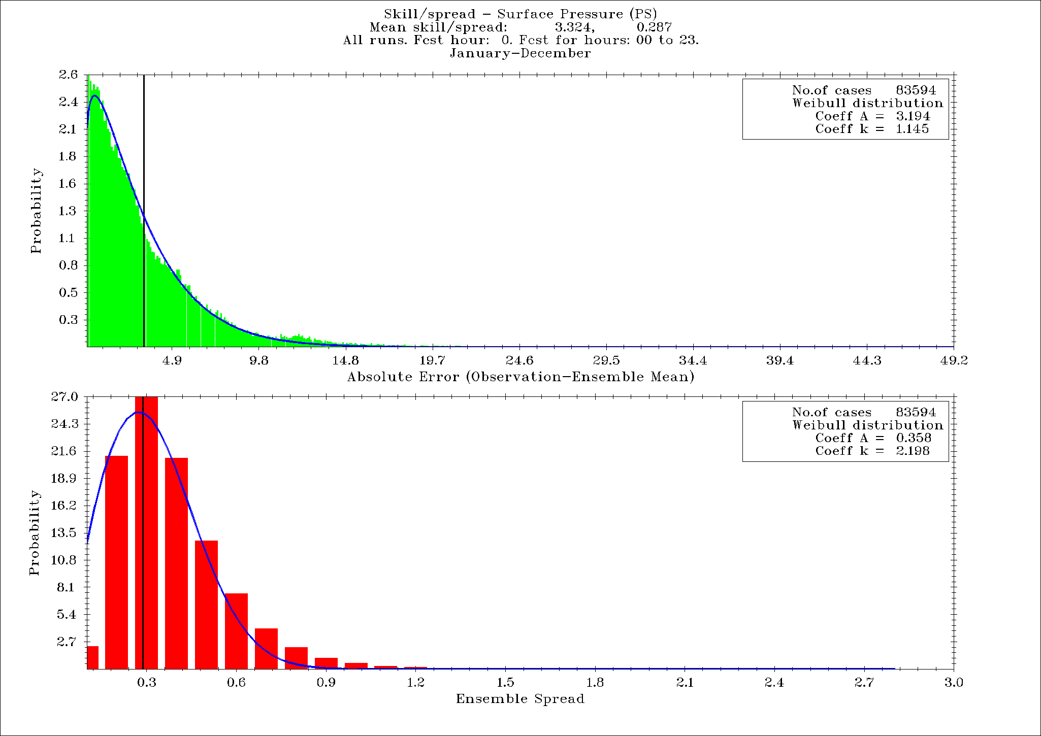
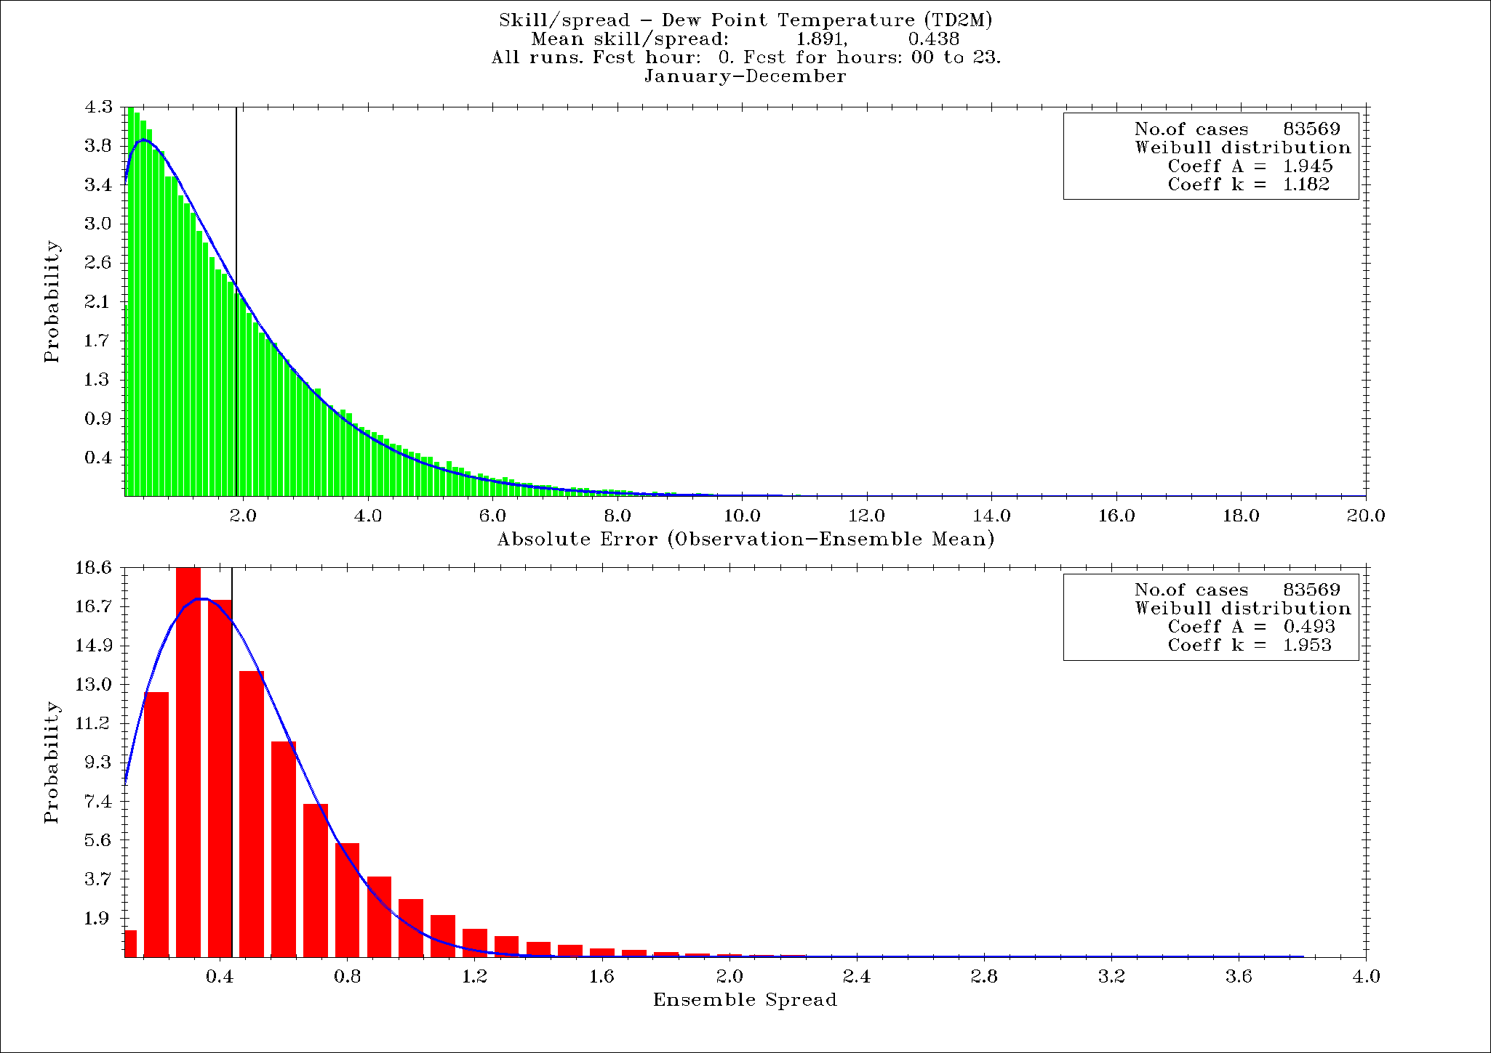
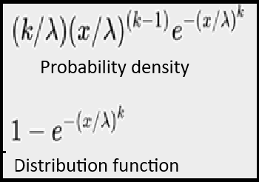
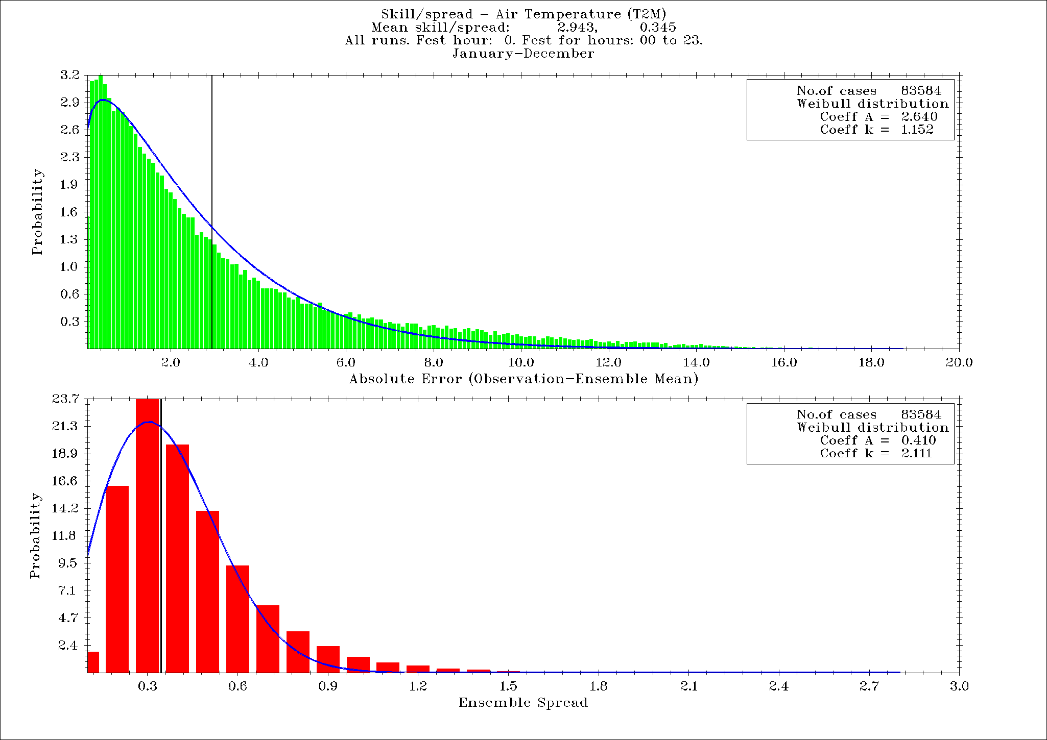
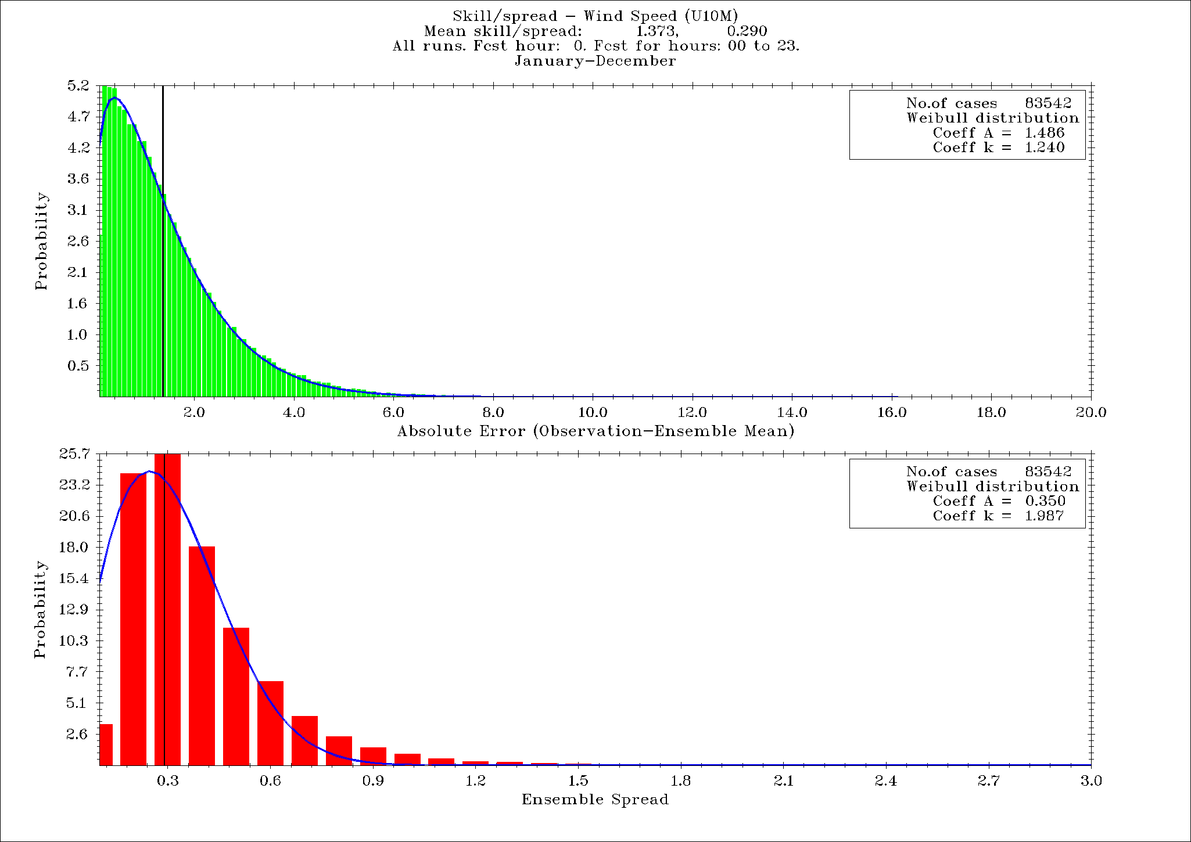
Methods of description (verification) of EPS results
Spread – Weibull distribution with a shape factor k~2,
Skill – a shape factor k ~1 – more like an exponential distribution
Sfc pressure
TD2M
T2M
U10M

Slide 15
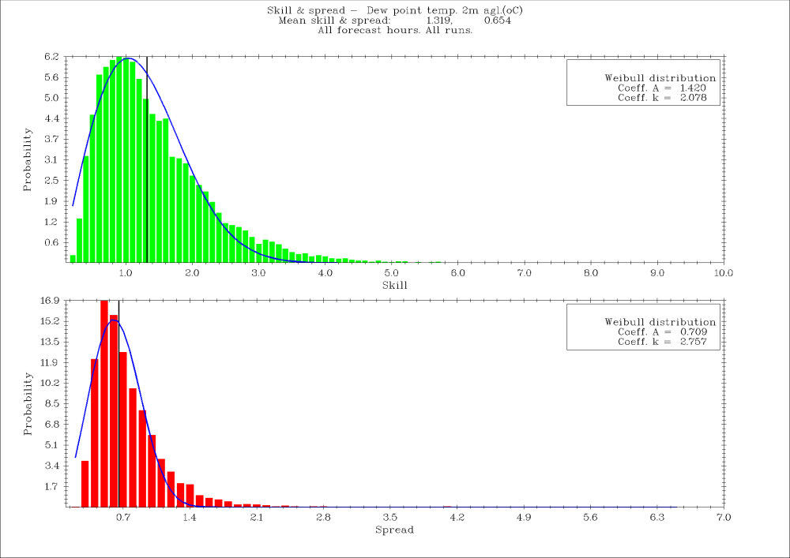




TD2M ICON 2.5
TD2M COSMO 2.8
TD2M COSMO 7.0
Histograms of skill and spread; COSMO 2.8 – TLE-MVE, others – TLE.
TD2M GFS
TD2M ICON-EU

Slide 16





TD2M ICON 2.5
TD2M COSMO 2.8
TD2M COSMO 7.0
Skill-to-spread histograms; COSMO 2.8 – TLE-MVE, others – TLE.
TD2M GFS
TD2M ICON-EU

Slide 17

Post-processing and verification – variants and alternatives
Weighted ensemble mean
y – corrected (calibrated) forecasts – new ensemble means
X – matrix of Direct Model Output and parameters,
β – weights – computed with linear regression
x_{ij} = x, [λ,φ,h]
x – T2M, U10M, TD2M, PS
λ,φ – geographical coordinates, h – orography
17

Slide 18


Post-processing and verification – variants and alternatives
Artificial Neural Network (ANN) – an alternative for linear regression

Slide 19
Post-processing – variants and alternatives
Setup:
23/22/20 neurons in an input layer – h + λ,φ + 20 members (for TLE 13/12/10, respectively)
5 neurons in a single hidden layer, corresponding to 4 TL-ICs/BCs blocks and spatial and temporal coordinates – 5th block
Each element is treated independently (temperature, wind speed, pressure, etc.).
Activation function – hyperbolic tangent (symmetrical relative to a point [0,0]).
Training – back-prop method.
Optymalization using gradient descent method.
19

Slide 20




TD2M ICON 2.5
T2DM COSMO 2.8
TD2M COSMO 7.0
Skills vs. ANN-based ensemble means; COSMO 2.8 – TLE-MVE, others – TLE.
TD2M GFS
TD2M ICON-EU

Slide 21




Skills vs. ensemble means, results of postprocessingu, TD2M, ICON 2.5km EPS
Standard mean Weighted mean Standard regression
Weighted mean (regression+geo.coords) Weighted mean (regression+orography) ANN-based mean

Slide 22
Concept and implementation v. 3.0 – Super(TL)Ensemble
All (or nearly all) of the previously mentioned EPSs can be combined into a so-called superensemble.
We take 20 members from the COSMO 2.8 EPS and 10 members each from the COSMO 7.0, GFS, and ICON EU EPSs.
This yields 50 ensemble members, with statistics based on a one-year period.
Since ICON-PL (2.5 km) has a shorter statistical record, it was not included in this set.
It is possible – as a test – to create a 60-member ensemble by including ICON-PL (2.5 km), although the statistics currently cover only six months.

Slide 23






Skills vs. ensemble means, results of postprocessing – TD2M, ”Superensemble”, 50 members
Standard mean Weighted mean Standard regression
Weighted mean (regression+geo.coords) Weighted mean (regression+orography) ANN-based mean

Slide 24






Spread-Skill charts; TD2M, ”Superensemble”, 50 members
Standard mean Weighted mean Standard regression
Weighted mean (regression+geo.coords) Weighted mean (regression+orography) ANN-based mean

Slide 25
Skills vs. ensemble means, results of postprocessing – TD2M, ”Superensemble”, 60 members
Standard mean Weighted mean Standard regression
Weighted mean (regression+geo.coords) Weighted mean (regression+orography) ANN-based mean

Slide 26






Spread-Skill charts; TD2M, ”Superensemble”, 60 members
Standard mean Weighted mean Standard regression
Weighted mean (regression+geo.coords) Weighted mean (regression+orography) ANN-based mean

Slide 27
Summary
The EPS approach, on the one hand, expresses caution, but on the other, it determines our confidence in the forecast results.
The average of a set of realizations has better "forecast skill" than individual forecasts.
The Time-Lagged Ensemble – according to the presented results – is just as well-formulated and produces results just as valuable as the „regular" EPS.
The super(TL)ensemble (especially the 60-member-version) appears to be an interesting subject for research in the near future.
Thank yor for your attention
#StandWithUkraine

