Slide 1

BRIDGE with moisture
WG DYN meeting, COSMO General meeting, online
07 October 2026
Michael Baldauf (DWD)
M. Baldauf (DWD)
1

Slide 2
Further steps towards moisture in BRIDGE
Implementation of the Kessler scheme (transfer from the ICON code)
by Sebastian Borchert (DWD)
Sedimentation now can be treated implicitly
in the case impl_update_freq>1 , sedimentation must partly be treated by the explicit step
→ to avoid possible instabilities, limit | v_{sedim, expl} | by a CFL crit.
Tracer diffusion can be treated vertically implicit (HEVI)
Non-negativity treatment of all ρ_{x} (and TKE) by linear rescaling (Zhang, Shu, 2010)
M. Baldauf (DWD)
2

Slide 3
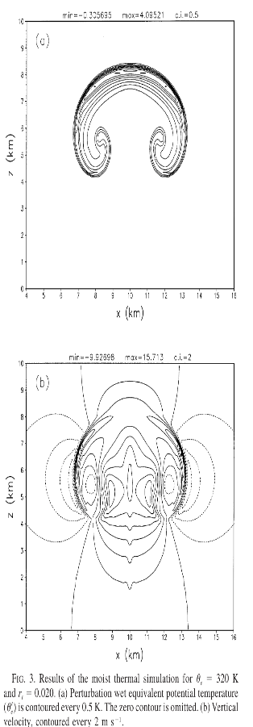
Bryan, Fritsch (2002) MWR test case
Set a warm bubble (+2 K) in an environment atmosphere with
dry case: pot. temp. Θ = 300 K, without moisture
moist case: equiv. pot. temp. Θ_{e} = 300 K, saturated atm.+clouds everywhere
dx=dz=100m
In both cases the w field should look quite similar (but not exactly identical)
Remarks:
the moist initialization procedure is complicated (iterations for the
environment state and the bubble needed)
the buoyancy term must probably be adapted (?)

Slide 4
Bryan, Fritsch (2002): dry test case
BRIDGE setup:
4th order DG (hrz. and vrt.), dx=400m, dz=400m
RK4, dt=0.05s

Slide 5
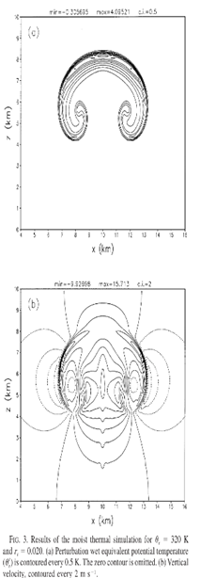
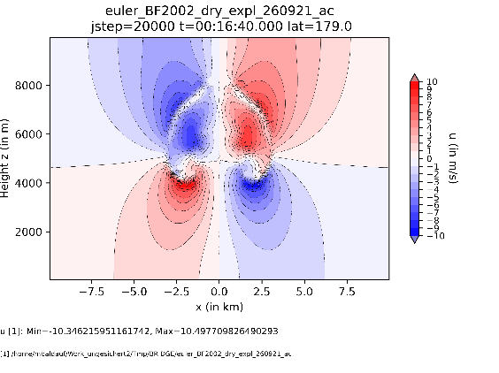
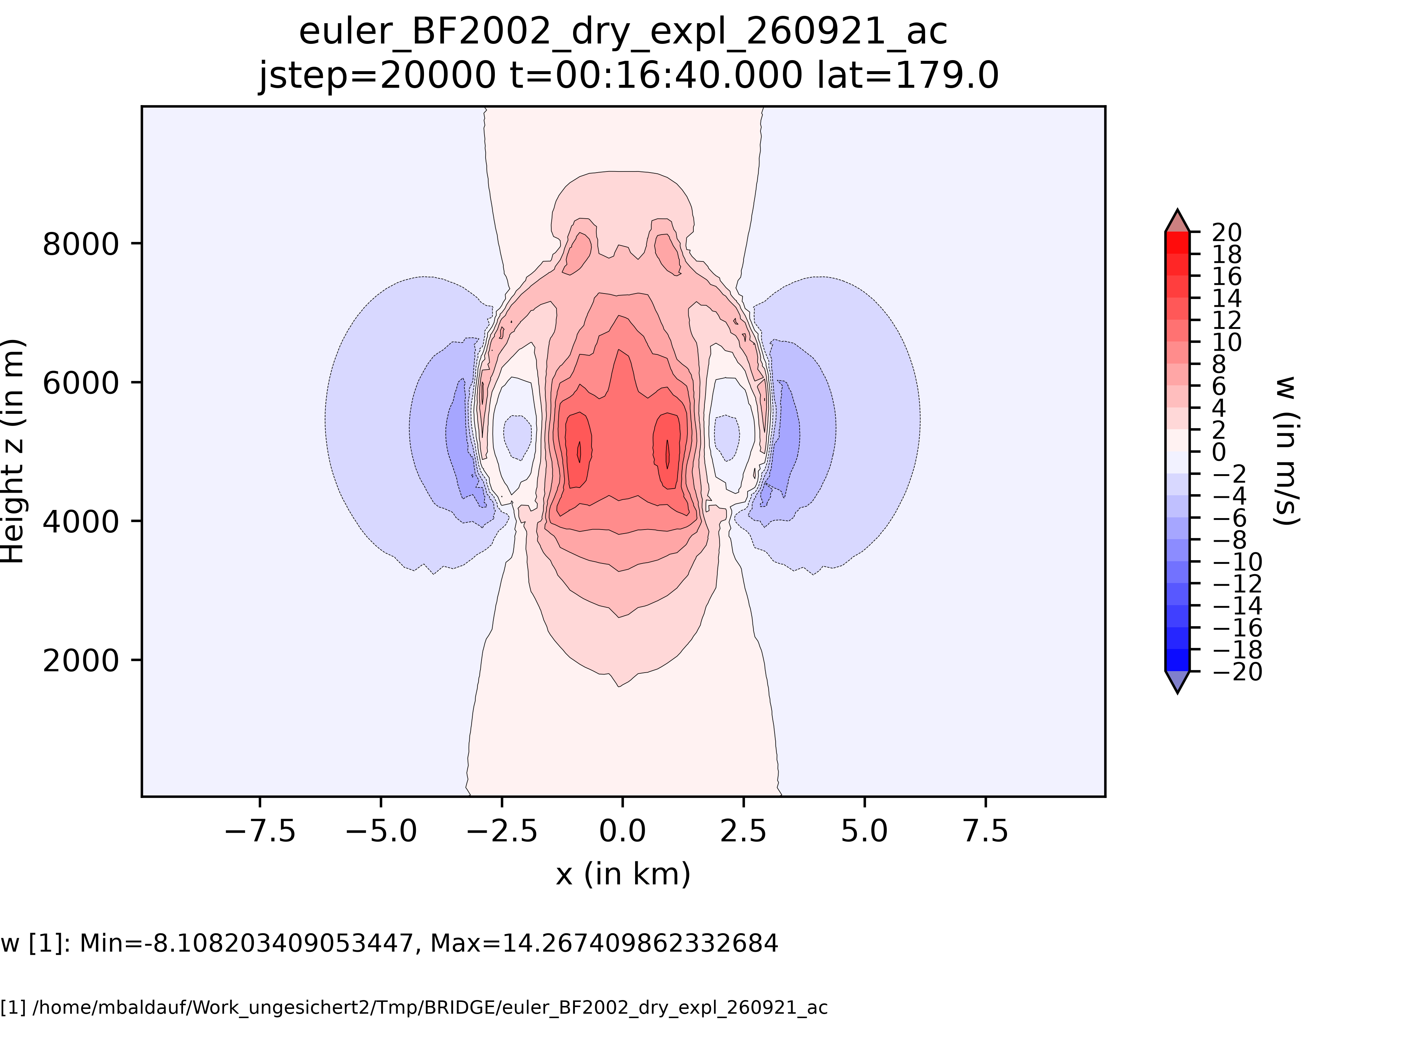
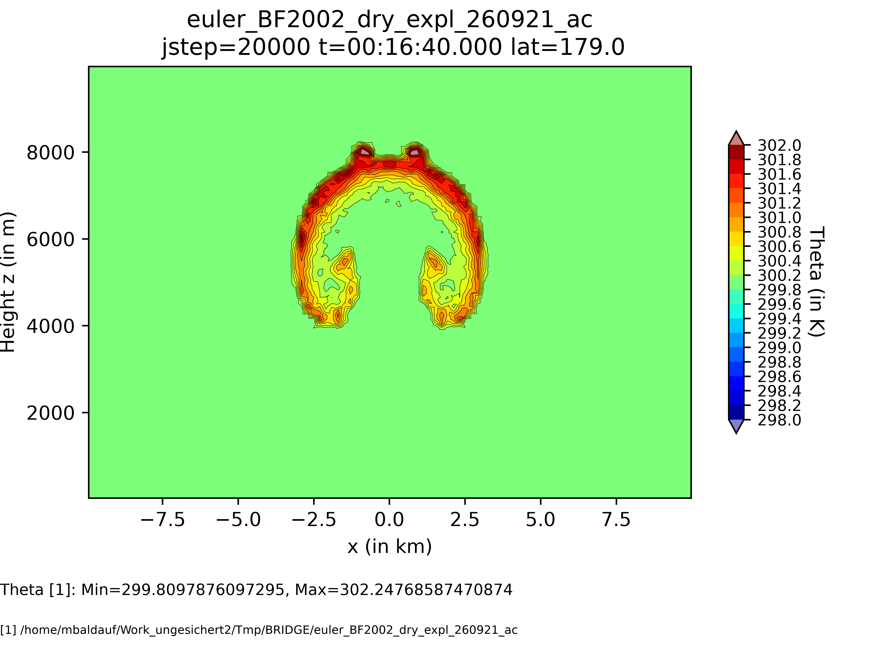
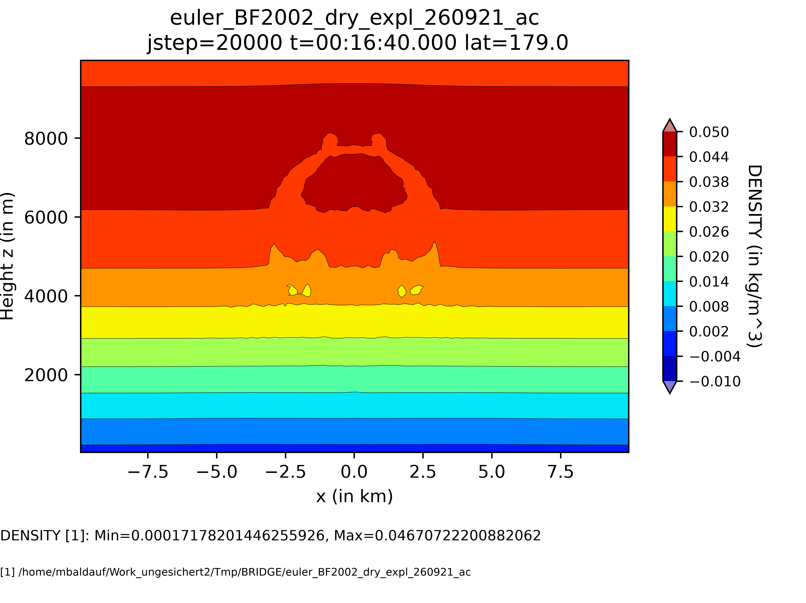
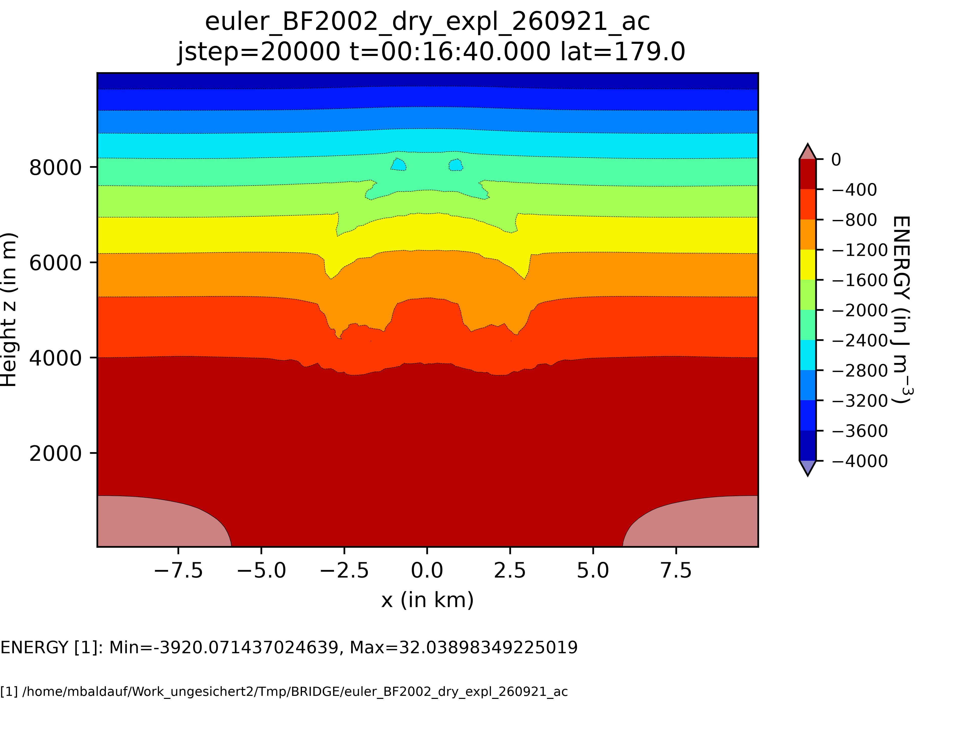
Bryan, Fritsch (2002) test, dry case: no diffusion, no filtering

Slide 6
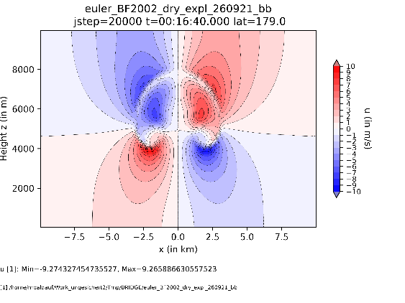

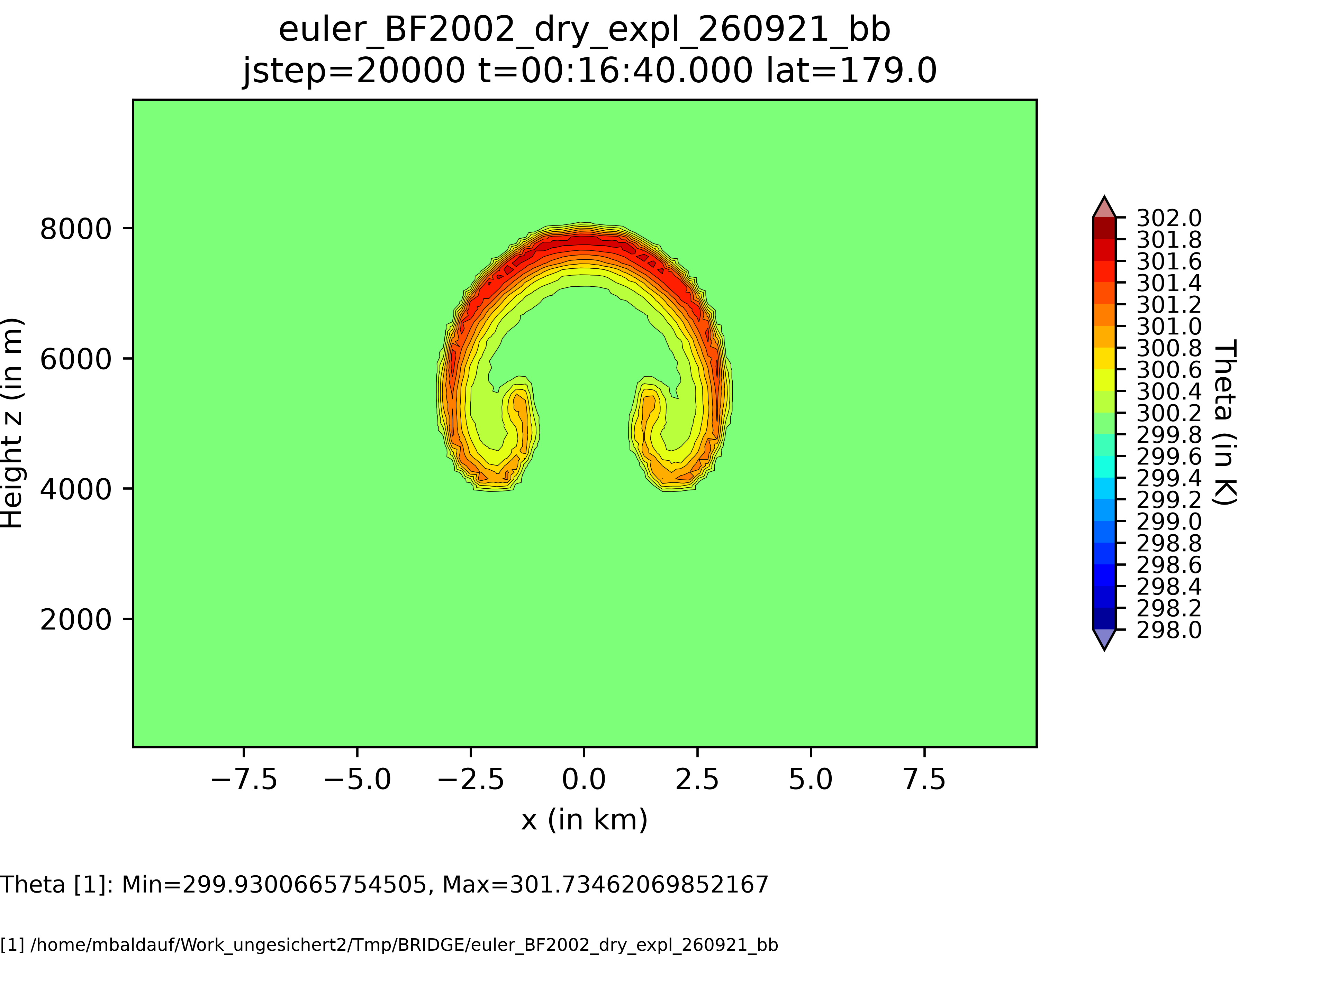


Bryan, Fritsch (2002) test, dry case: with diffusion K=10m²/s, no filtering

Slide 7
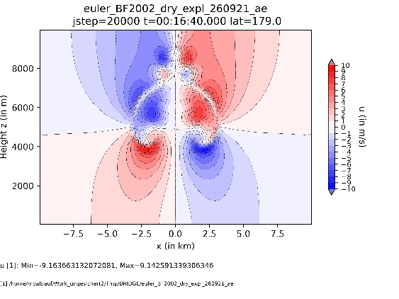
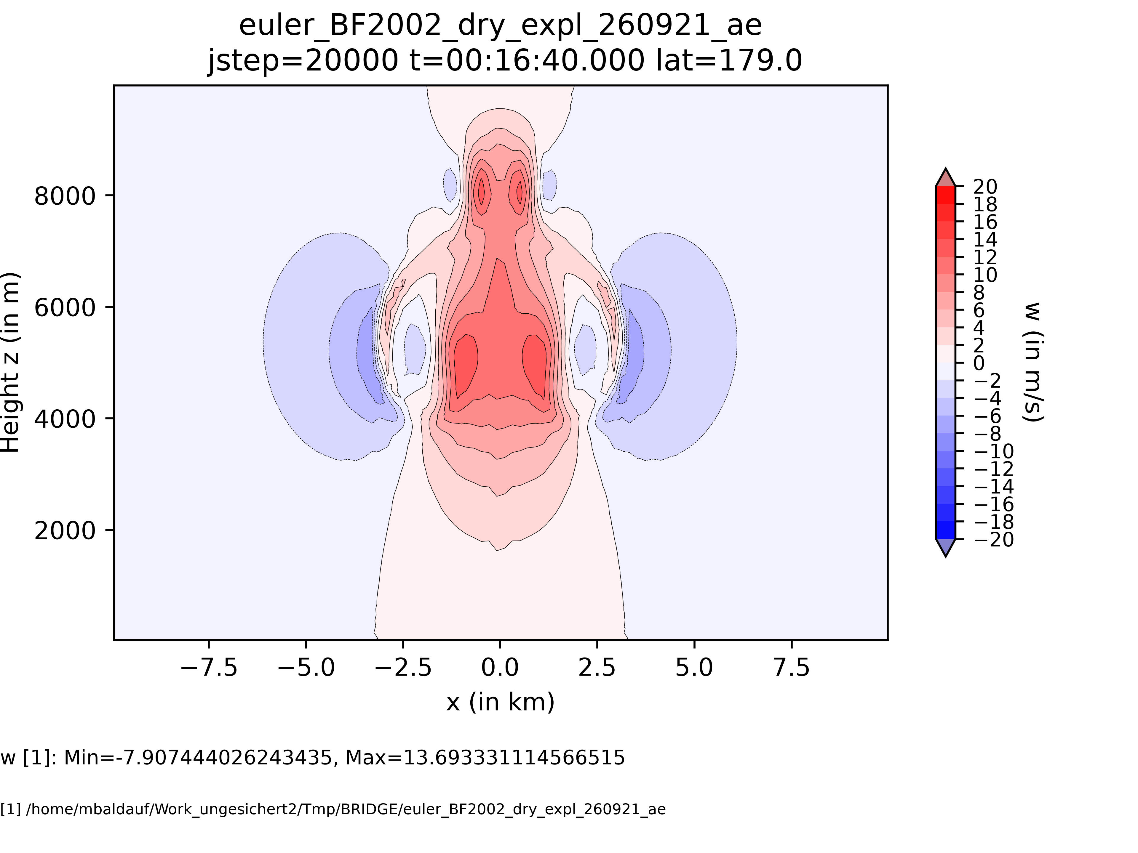
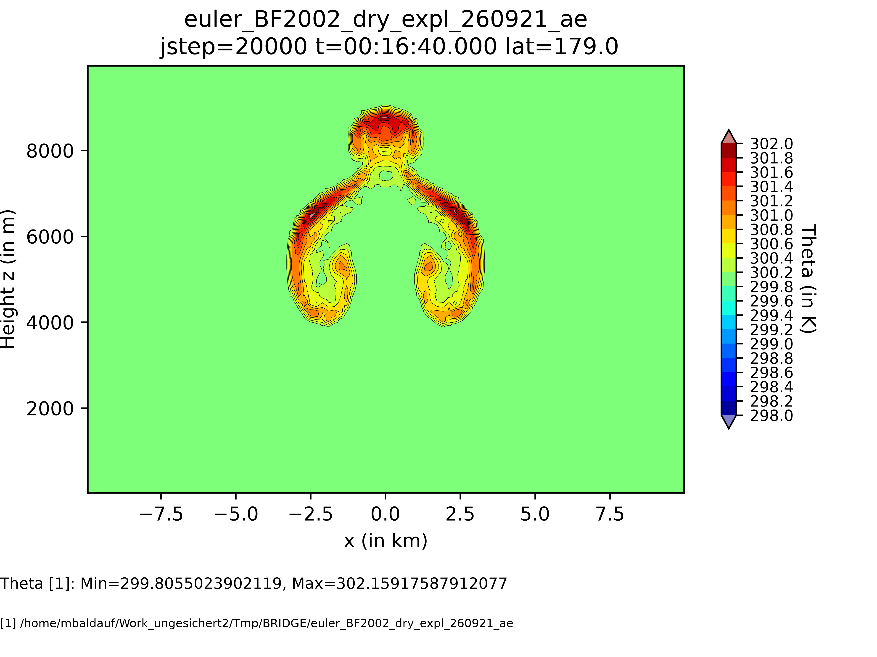

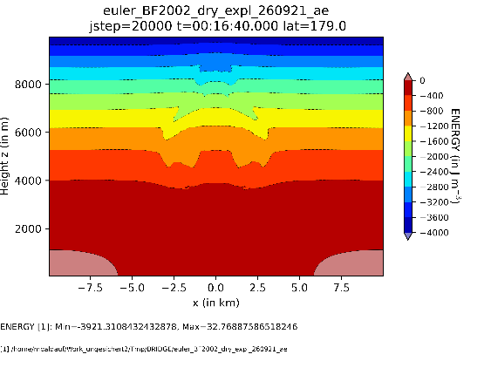
Bryan, Fritsch (2002) test, dry case: no diffusion, weak filtering
In this simulation,
filtering has a rather
detrimental effect!

Slide 8
Targeted diffusion by Persson, Peraire (2006) AIAA
Smoothness indicator (oscillatory sensor):
S := ( u-u, u-u ) / (u, u)
u: use the full DG expansion
u: truncate the DG expansion for the highest polynomial degree
Artificial viscosity:
K = 0 for S < S_{min}
K ~ S for S_{min} < S < S_{max}
K = K_{max} for S_{max} < S
Practically: use density or energy for u
S_{min} = 0.0001, S_{max} = 0.001

Slide 9
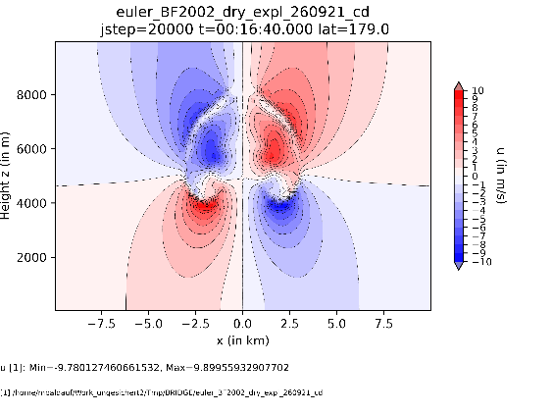

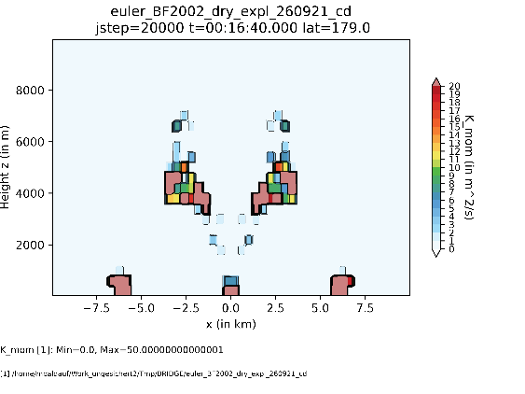
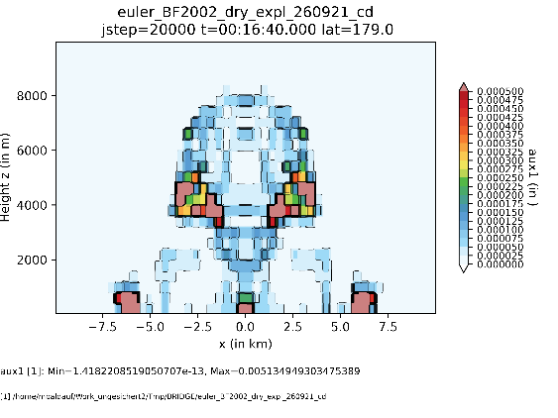
Bryan, Fritsch (2002) test, dry case: targeted diffusion, no filtering
K
osc.-sensor S
Targeted diffusion works,
but has here only a
minor effect

Slide 10
Bryan, Fritsch (2002): moist test case
BRIDGE setup:
4th order DG (hrz. and vrt.), dx=400m, dz=400m
RK4, dt=0.05s, ‚multieq‘ = no splitting

Slide 11
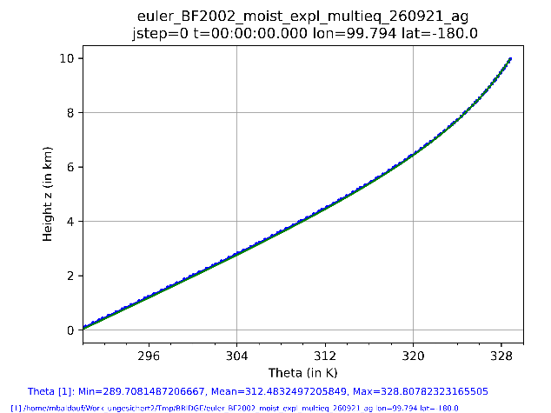
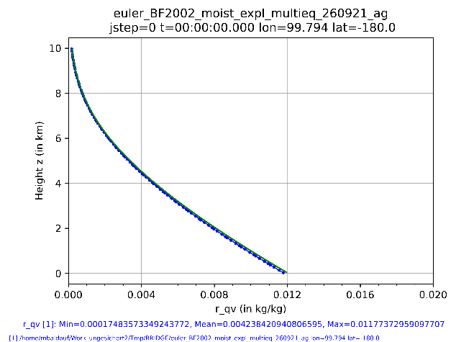
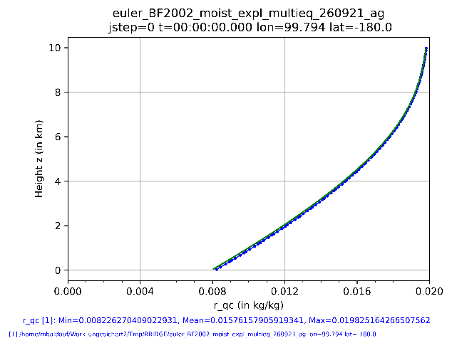
Bryan, Fritsch (2002) test, moist case, initialization
Vertical profile outside of the bubble
BRIDGE
G_Bryan_Initial_BF2002_case.F
Looks op

Slide 12
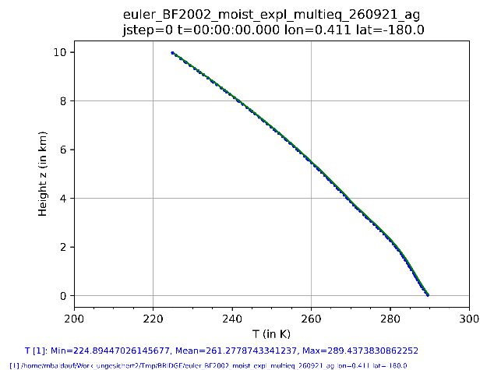
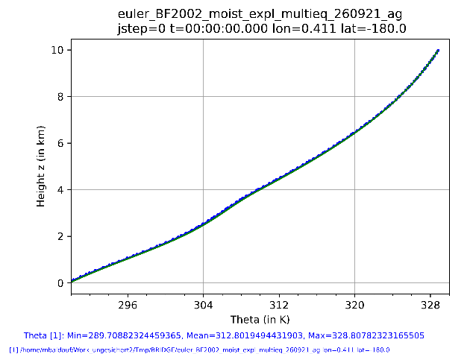
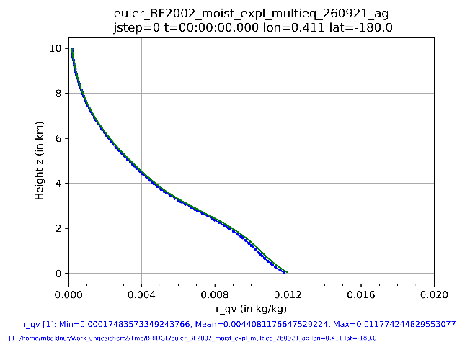
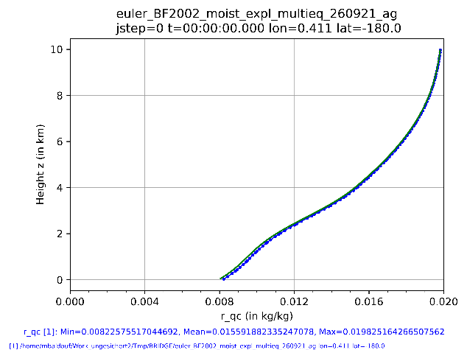
Bryan, Fritsch (2002) test, moist case, initialization
Vertical profile through the bubble
BRIDGE
G_Bryan_Initial_BF2002_case.F
Looks ok

Slide 13
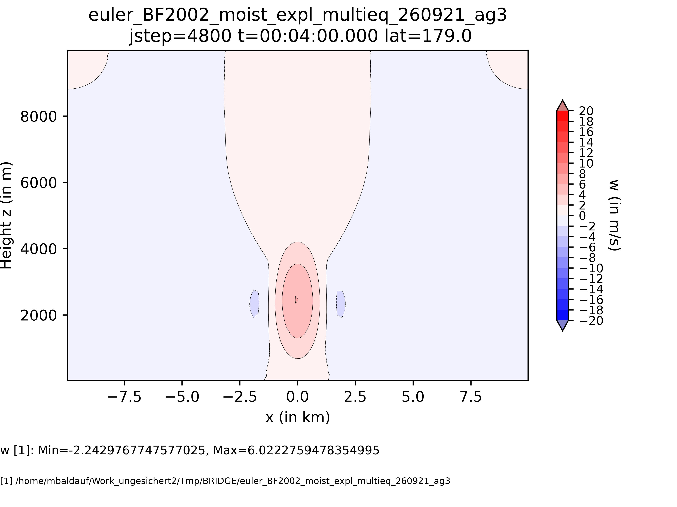
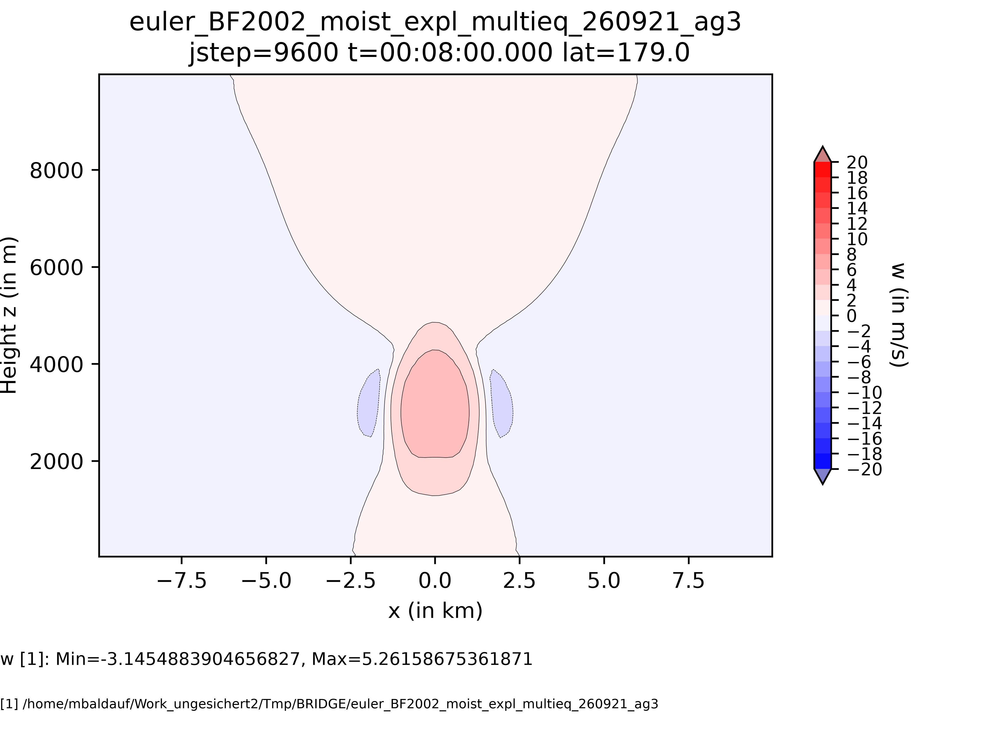
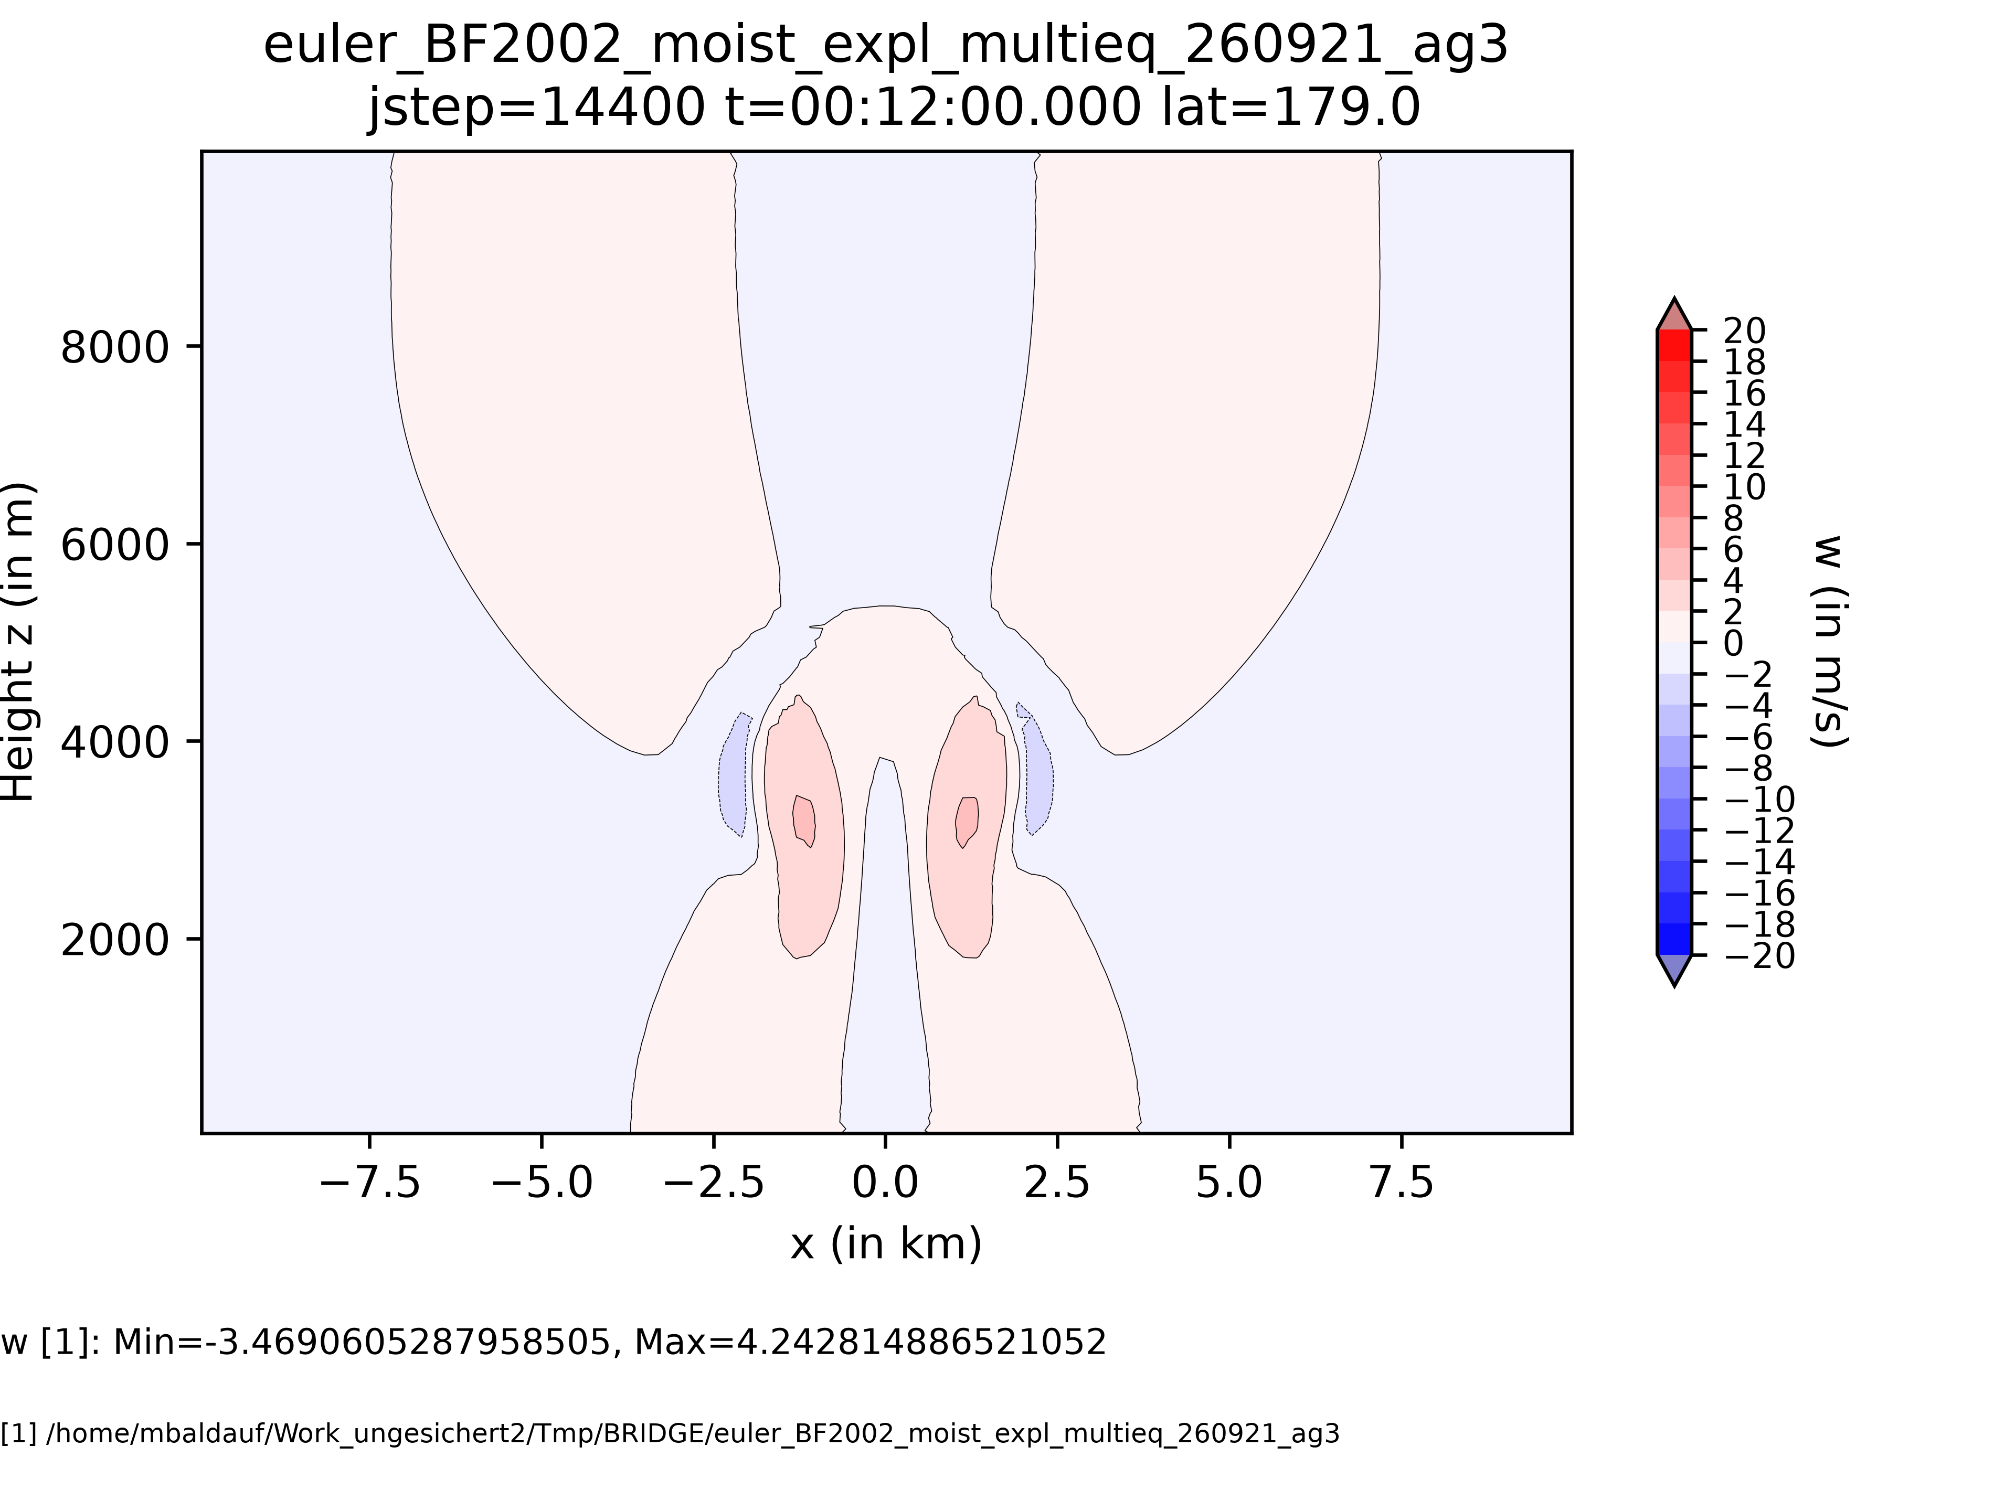
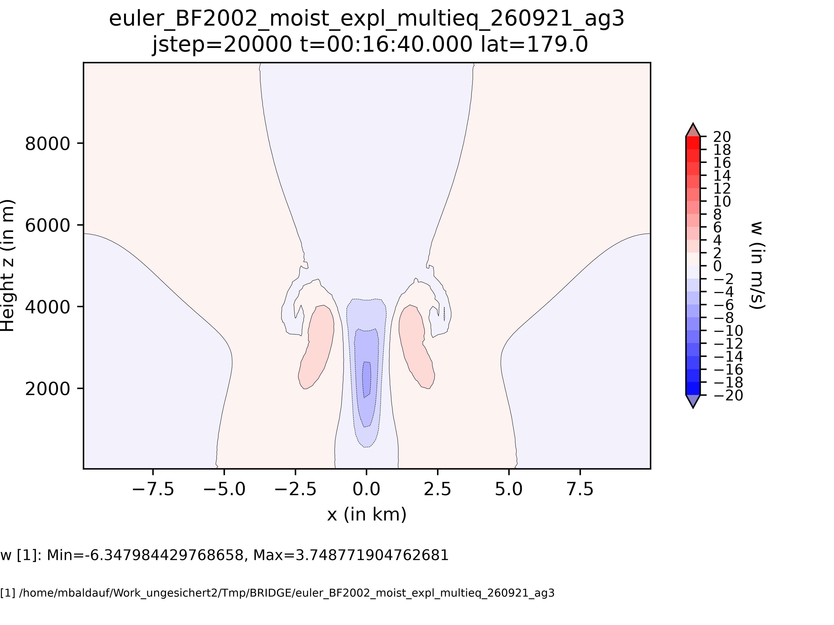
Bryan, Fritsch (2002) test, moist case
No similarity with
the dry case !
?

Slide 14
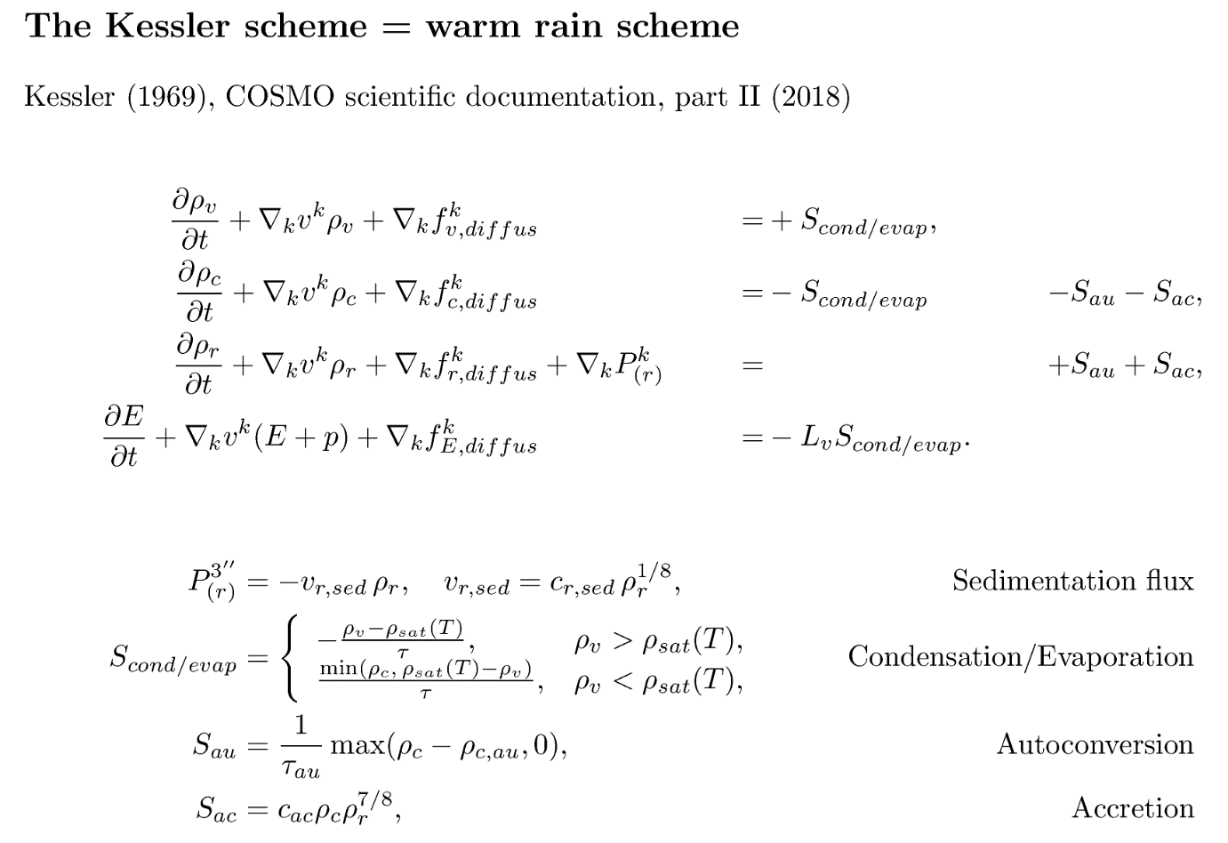
Non-negative prognostic
variables ρ_{v}, ρ_{c}, ρ_{r}
Flow with internal energy supply
advective transport with
potentially high CFL
nonlinear processes
M. Baldauf (DWD)
14

Slide 15
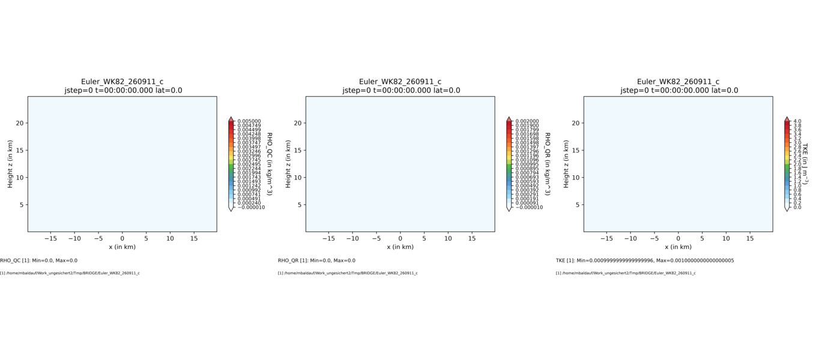
Moist setup by Weisman, Klemp (1982) MWR
200 x 16 grid cells, 40*40*25 km³, dt=0.5s, SSP3(3,3,2), Kessler microphysics + TKE scheme
ρ_{c}
ρ_{r}
TKE
M. Baldauf (DWD)
15

Slide 16
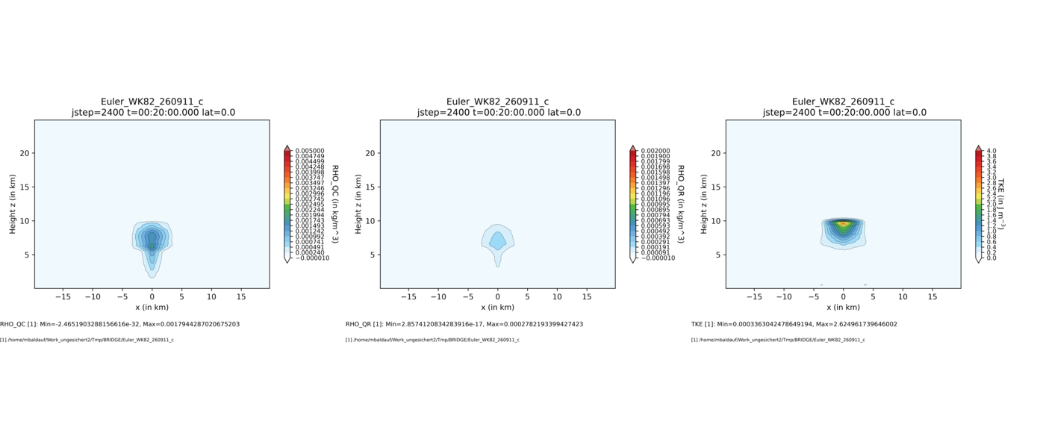
Moist setup by Weisman, Klemp (1982) MWR
200 x 16 grid cells, 40*40*25 km³, dt=0.5s, SSP3(3,3,2), Kessler microphysics + TKE scheme
ρ_{c}
ρ_{r}
TKE
M. Baldauf (DWD)
16

Slide 17
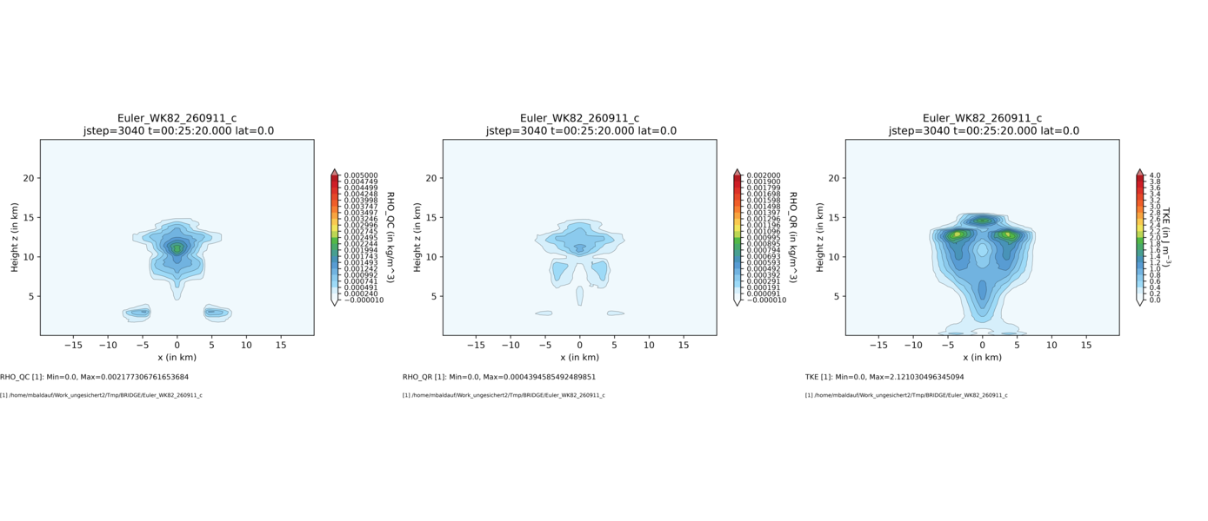
Moist setup by Weisman, Klemp (1982) MWR
200 x 16 grid cells, 40*40*25 km³, dt=0.5s, SSP3(3,3,2), Kessler microphysics + TKE scheme
ρ_{c}
ρ_{r}
TKE
M. Baldauf (DWD)
17

Slide 18
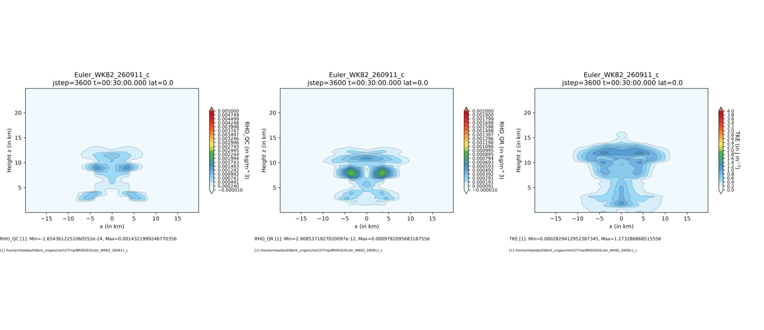
Moist setup by Weisman, Klemp (1982) MWR
200 x 16 grid cells, 40*40*25 km³, dt=0.5s, SSP3(3,3,2), Kessler microphysics + TKE scheme
ρ_{c}
ρ_{r}
TKE
M. Baldauf (DWD)
18

Slide 19
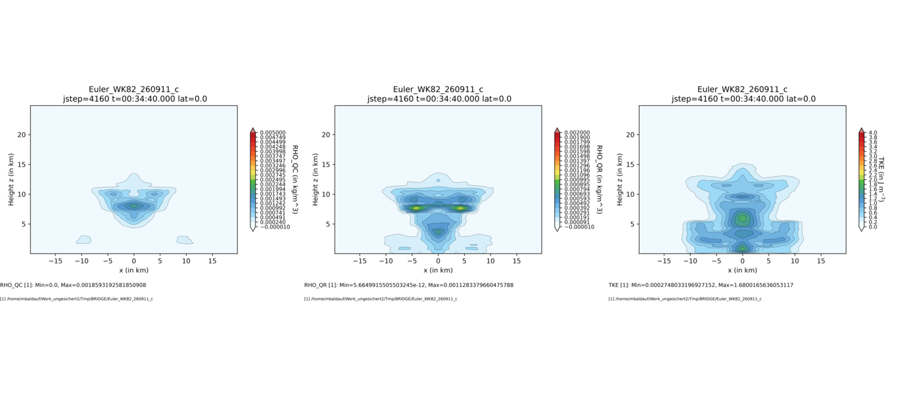
Moist setup by Weisman, Klemp (1982) MWR
200 x 16 grid cells, 40*40*25 km³, dt=0.5s, SSP3(3,3,2), Kessler microphysics + TKE scheme
ρ_{c}
ρ_{r}
TKE
M. Baldauf (DWD)
19

Slide 20
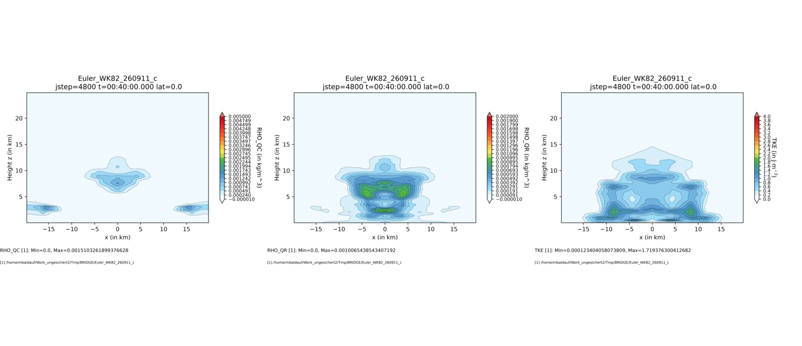
Moist setup by Weisman, Klemp (1982) MWR
200 x 16 grid cells, 40*40*25 km³, dt=0.5s, SSP3(3,3,2), Kessler microphysics + TKE scheme
ρ_{c}
ρ_{r}
TKE
M. Baldauf (DWD)
20

Slide 21
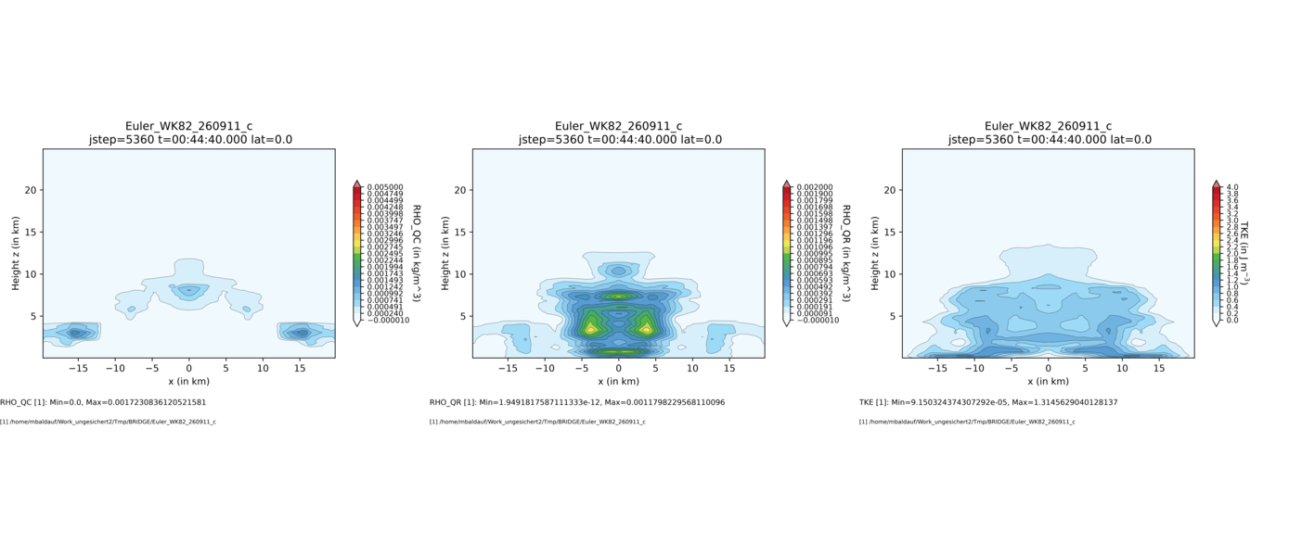
Moist setup by Weisman, Klemp (1982) MWR
200 x 16 grid cells, 40*40*25 km³, dt=0.5s, SSP3(3,3,2), Kessler microphysics + TKE scheme
ρ_{c}
ρ_{r}
TKE
M. Baldauf (DWD)
21

Slide 22
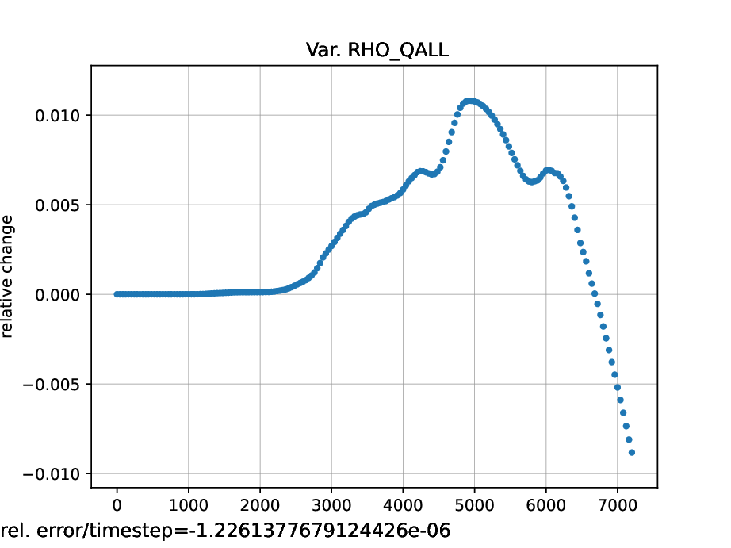
Moist setup by Weisman, Klemp (1982) MWR
200 x 16 grid cells, 40*40*25 km³, dt=0.5s, SSP3(3,3,2), Kessler microphysics + TKE scheme
Currently, an unphysical mass production of all moist variables occurs
Relative change of
∫ (ρ_{v} + ρ_{c}+ ρ_{r}) dV
Conservative non-negativity treatment by linear rescaling
of Zhang, Shu (2010) works correctly,
but cannot prevent total emptying of grid cells.
Probably flux limitation will help in the future…
Sedimentation (✓)
M. Baldauf (DWD)
22

Slide 23
A slightly more realistic simulation with BRIDGE …
‚Limited area‘ simulation with initial/boundary values taken from the
geostropic/hydrostatic balancing scheme
Nearly ICON-D2 area, R2B8 grid (dx~10km)
Orography on R2B10 (~2.5km), generated from R2B13 (~300m) ASTER data
DG 4th order SSP3(3,3,2) IMEX-RK-HEVI time integration
With TKE turbulence scheme
With Kessler scheme (artificial init. of q_{v} and a cloud layer around z ~ 5km)
M. Baldauf (DWD)
23

Slide 24
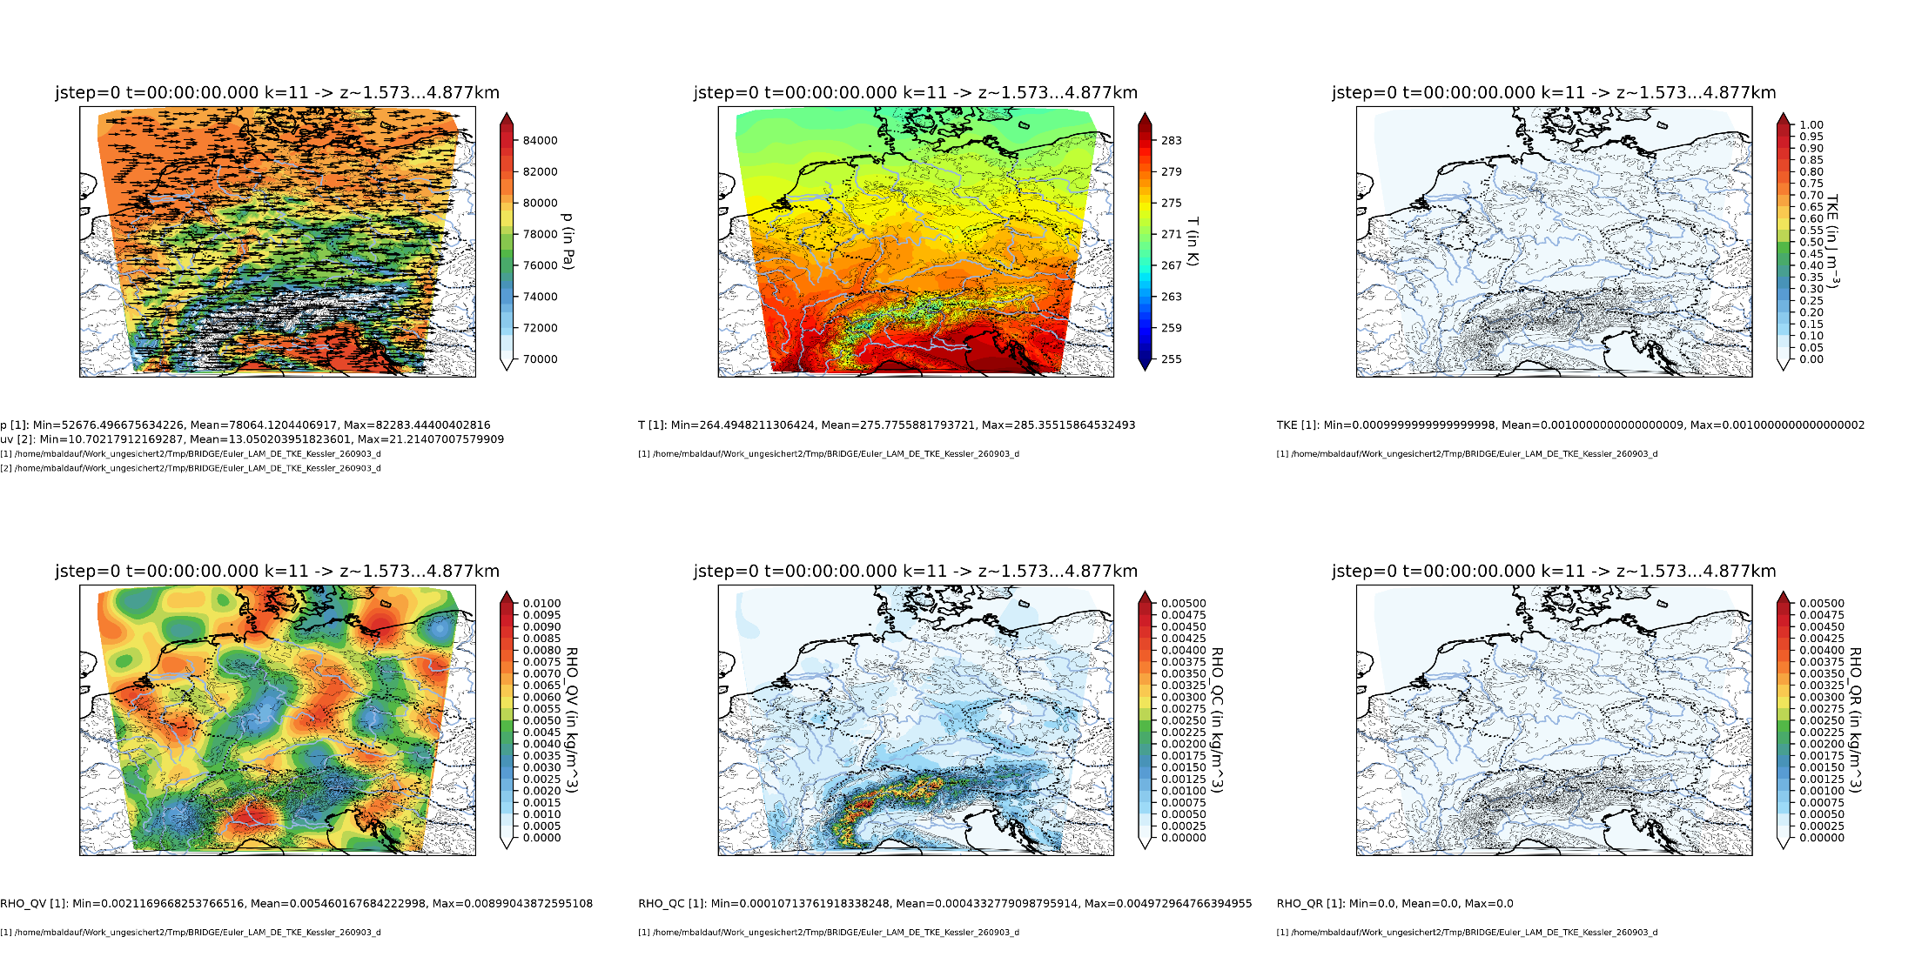
M. Baldauf (DWD)
24

Slide 25
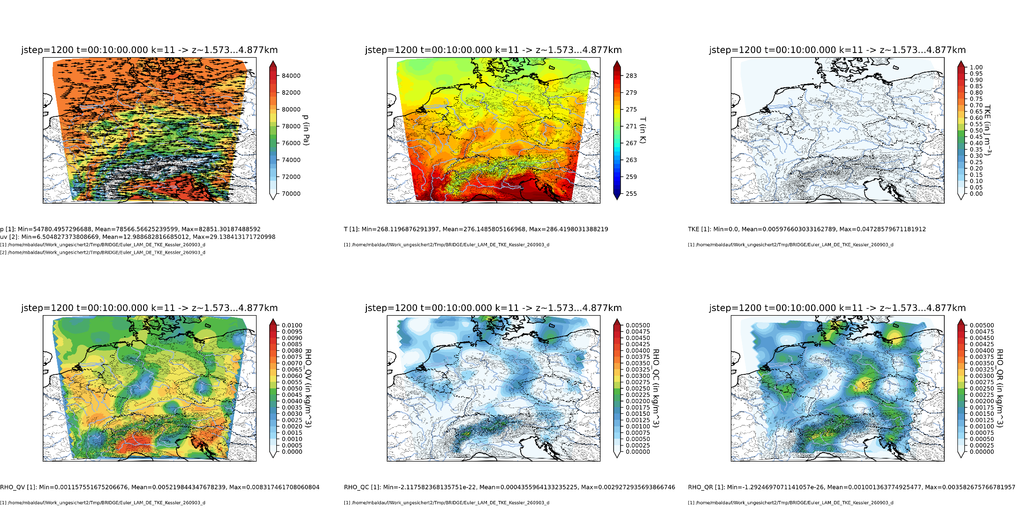
M. Baldauf (DWD)
25

Slide 26
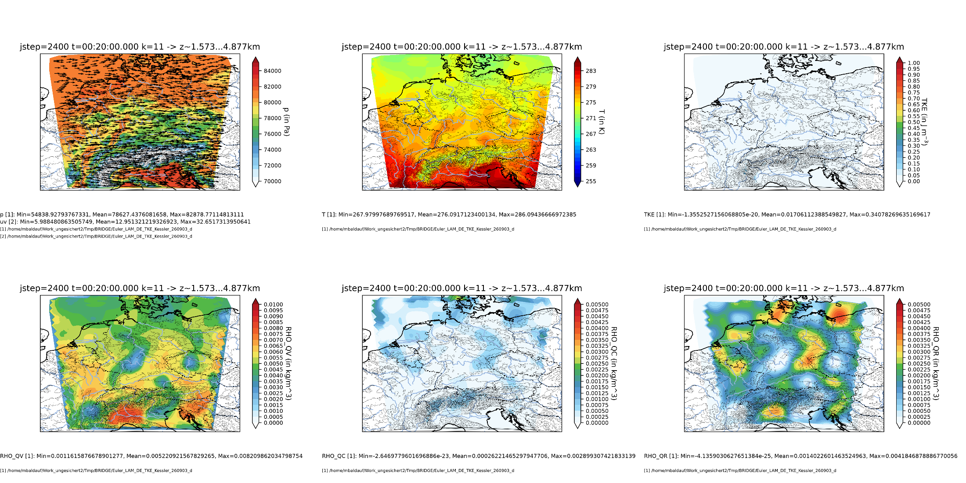
M. Baldauf (DWD)
26

Slide 27
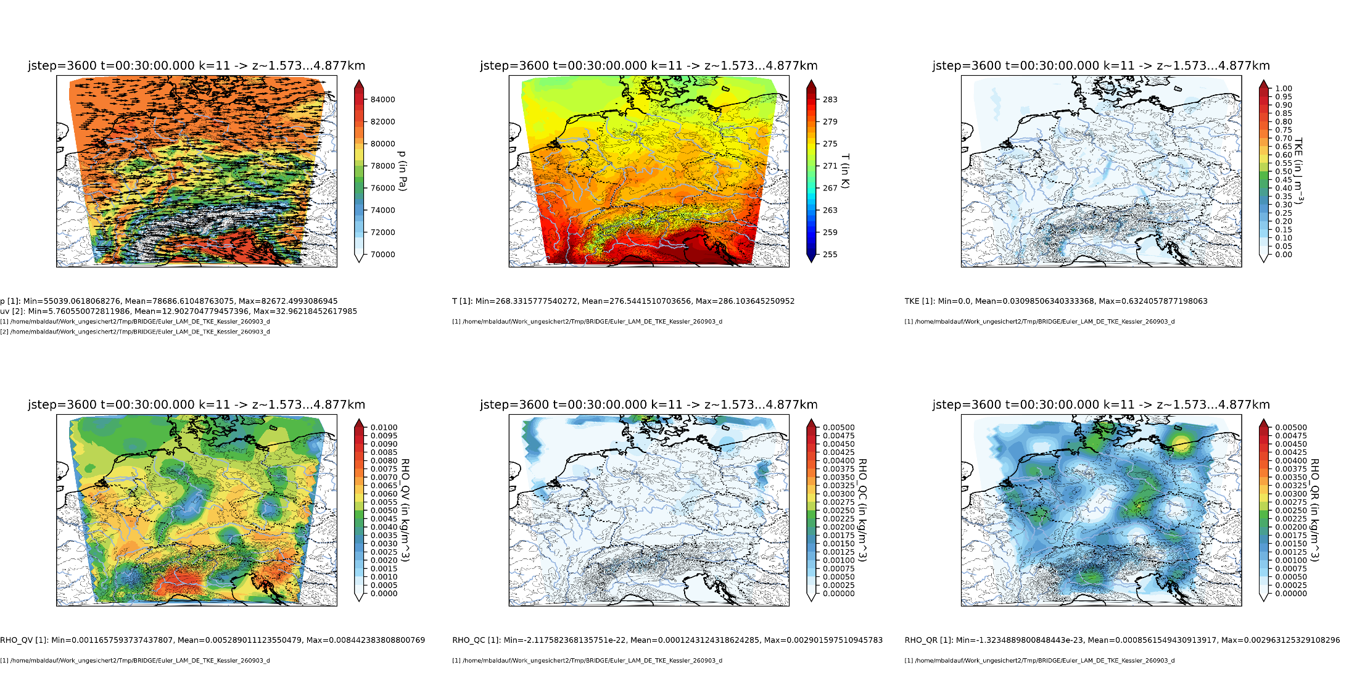
M. Baldauf (DWD)
27

Slide 28
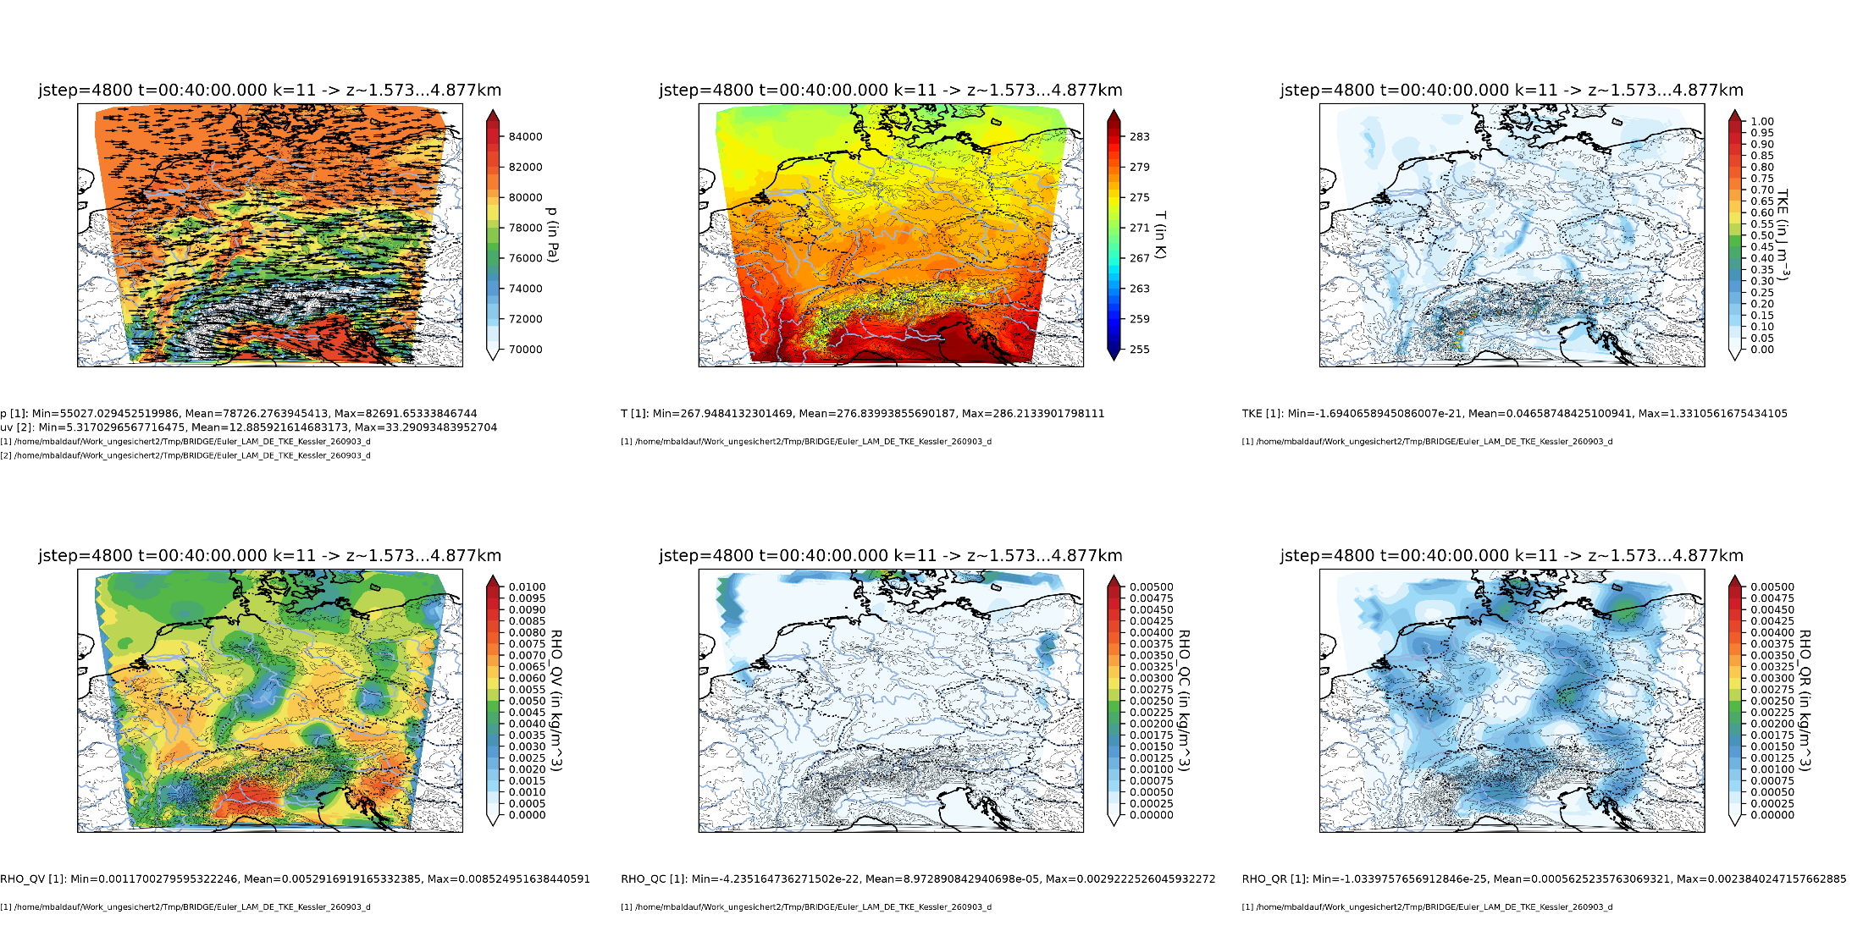
M. Baldauf (DWD)
28

Slide 29
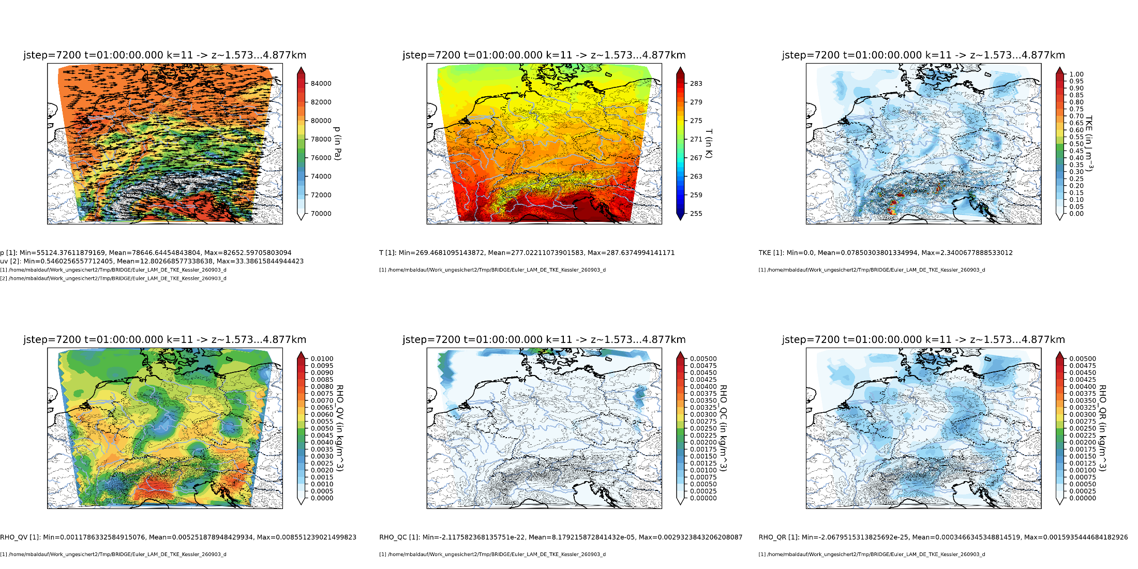
M. Baldauf (DWD)
29

Slide 30
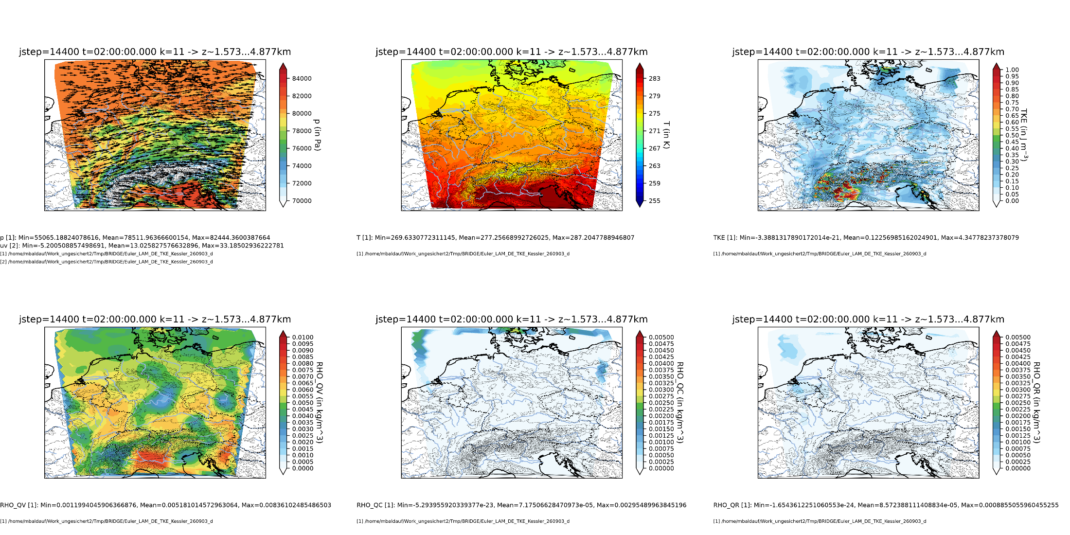
M. Baldauf (DWD)
30

Slide 31
M. Baldauf (DWD)
31

Slide 32
M. Baldauf (DWD)
32

Slide 33
M. Baldauf (DWD)
33

Slide 34
M. Baldauf (DWD)
34

Slide 35
M. Baldauf (DWD)
35

Slide 36
Project: ICON-DG: Gearing up the ICON Model with Smarter Discretizations
in the call ‚WarmWorld Module 4 Smarter‘ by German Ministry of Research and Educ. (BMBF)
Duration: 01.07.2024 - 30.06.2027
Project partners:
DLR Köln, Inst. for software technology, project leader: Benedict Geihe
Univ. Köln, Division of Mathematics, group Prof. Gregor Gassner, PhD: Philipp Baasch
DWD, M. Baldauf, BRIDGE group
Actual state:
Montoya, Rueda-Ramirez, Gassner (2026): Entropy stable discontinuous spectral element methods for the
spherical shallow water equations in covariant form, JCP
Philipp Baasch: recently, entropy stable flux found for the covariant Euler equations!
Andres Rueda-Ramirez, Oswald Knoth: steps for efficiency increase of HEVI schemes by twice application
of Schur complement technique
M. Baldauf (DWD)
36

Slide 37
Milestones of the BRIDGE-project (status Sept. 2025)
0. first version of a FE/DG framework available, MPI parallelized Q2/2021 ✓
1. shallow water equations on the sphere, explicit time integration (RK) Q3/2021 ✓
2. 3D Euler equations on the sphere, explicit time integration (RK) Q1/2022 ✓
2.b with 3D diffusion (+ a simple turbulence scheme) BR1/BR2 Q2/2022 ✓/
2.c grid refinement works Q2/2022 ✓
3. Euler equations, HEVI time integration (IMEX-RK) Q3/2022 ✓
3.b optimization of the vertically implicit solver (Schur compl.,...) Q4/2022 ✓
3.c with 3D diffusion (+ a simple turbulence scheme), HEVI Q1/2023 ✓
4. cloud microphysics (Kessler) + tracer advection (positive definit)
+ explicit sedimentation scheme Q4/2022 
4.b cloud microphysics (cloud ice, Graupel)
+ vertically implicit sedimentation scheme Q1/2023 !
5. HEVI diffusion on dt(fast phys.); physics-dynamics coupl./time integr. Q4/2023 ✓/
6. limited area (=use lateral BCs) version available Q1/2023 ✓/…
7.a vectorized version available Q2/2023 !
7.b GPU version Q1/2024 !
7.c general code optimization Q4/2024 
8. coupling of a one-equation turbulence + BL scheme Q2/2023 ✓
M. Baldauf (DWD)
37

Slide 38
Milestones of the BRIDGE-project (status Sept. 2026)
0. first version of a FE/DG framework available, MPI parallelized Q2/2021 ✓
1. shallow water equations on the sphere, explicit time integration (RK) Q3/2021 ✓
2. 3D Euler equations on the sphere, explicit time integration (RK) Q1/2022 ✓
2.b with 3D diffusion (+ a simple turbulence scheme) BR1/BR2 Q2/2022 ✓/
2.c grid refinement works Q2/2022 ✓
3. Euler equations, HEVI time integration (IMEX-RK) Q3/2022 ✓
3.b optimization of the vertically implicit solver (Schur compl.,...) Q4/2022 ✓
3.c with 3D diffusion (+ a simple turbulence scheme), HEVI Q1/2023 ✓
4. cloud microphysics (Kessler) + tracer advection (positive definit)
+ explicit sedimentation scheme Q4/2022 ✓
4.b cloud microphysics (cloud ice, Graupel) (Kessler)
+ vertically implicit sedimentation scheme Q1/2023 ✓/
5. HEVI diffusion on dt(fast phys.); physics-dynamics coupl./time integr. Q4/2023 ✓/
6. limited area (=use lateral BCs) version available Q1/2023 ✓
7.a vectorized version available Q2/2023 (!)
7.b GPU version Q1/2024 (!)
7.c general code optimization Q4/2024 
8. coupling of a one-equation turbulence + BL scheme Q2/2023 ✓
M. Baldauf (DWD)
38

Slide 39
Further steps in BRIDGE, the biggest working places:
Continue work on moist atmosphere (Kessler scheme with IMEX-RK)
  Conservation of non-negative moisture variables (implement flux limitation)
  is mass consistency still important in a higher order discretization scheme?
Improve efficiency for HEVI solver of moisture variables.
This is straightforward, because the implicit systems for the N_{q} moisture variables are decoupled
→ solve factor N_{q} more equations that are smaller by factor N_{q}.
Further inspection of time split schemes (dt_{phys}/dt_{dyn}> 1)
Further improvement of code efficiency (cache efficiency, …)
Implementation of entropy stable schemes (also kinetic energy
preserving schemes) ← Warmworld project
C++/Kokkos rewrite ? ← depends on the ICON dycore C++/Kokkos rewrite
End of the BRIDGE project
→ Decision about implementation of the BRIDGE code into ICON
M. Baldauf (DWD)
39

