Slide 1


Partial Analysis Increments (PAI)
Theoretical Advances and Case Study Applications
Arpae-SIMC
University of Bologna

Slide 2


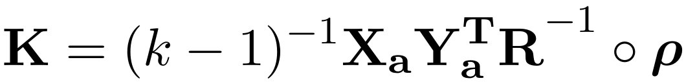
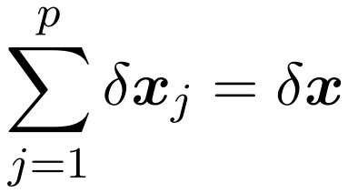
General formulation of PAI
Algorithm developed by Diefenbach et al., 2023. Estimates the 3D analysis increment δx_{j} attributed to each j^{th}-observation, using the Kalman gain (K) based on ensemble analysis perturbations.
Where Xa, Ya are the ensemble analysis perturbations in model and observation space, R the observation error covariance, ρ the localization matrix, k the number of ensemble members.​
Computable from standard LETKF output​ of KENDA!
Avoids expensive single-observation experiments​

Slide 3
General formulation of PAI
Partial analysis increment of control vector variables:
u, v, T, q, qr, qc, qg, qi
From analysis ensemble members (grib files)
From ekf files
This original formulation has been used in the experiments that Virginia will show later.

Slide 4
Two approximations in PAI
X_{a} is saved post-inflation, Y_{a} is saved pre-inflation
Y_{a} not stored entirely on each model grid point in ekf files.​
The analysis model equivalents for an observation are not stored for every grid point that is within the localisation cut-off radius of the observation, but only at the grid point that is closest to the nominal position of the observation. ​
​In PAI, the available Y_{a} at the grid point closest to the nominal observation location is used to compute K at nearby grid points up to the localisation length scale.​

Slide 5
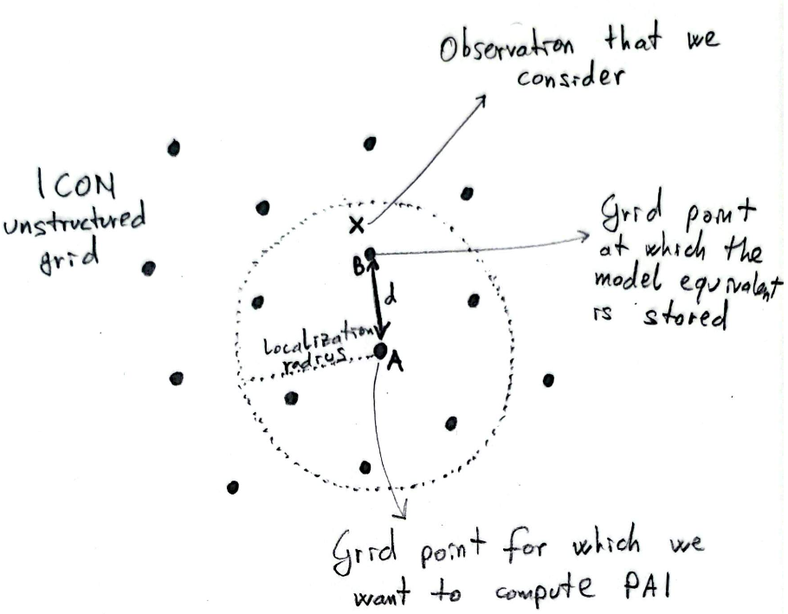

Two approximations in PAI
We have implemented a mathematically consistent correction of PAI to account for (multiplicative) covariance inflation and localization​ effect on Y_{a}

Slide 6
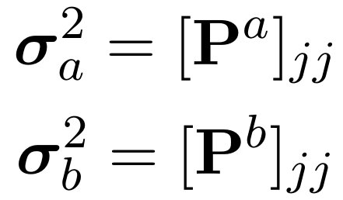
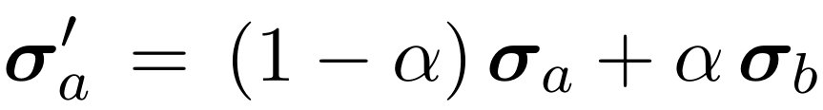
1) Account for posterior inflation effect
In our experiments we apply a Relaxation to Prior Spread (RTPS) for posterior covariance inflation:
Where σa and σb are pre-inflation analysis and background ensemble spread (vectors n × 1). ​
Pa, Pb are analysis and background error covariances matrices.​
Need to “deflate” X_{a} matrix!​
Saved after inflation
Saved before inflation

Slide 7

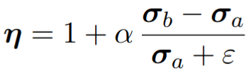


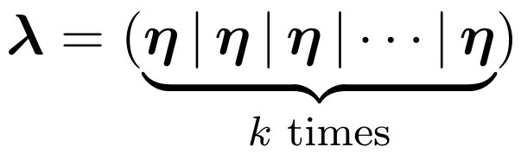
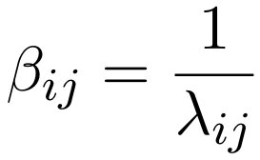
1) Account for posterior inflation effect
dropping min(100,...)
We can get an analytical formulation of η in terms of post-inflation spread by solving a simple quadratic equation (not shown for the interest of time).
Once we have the analytical formulation of η:​

Slide 8
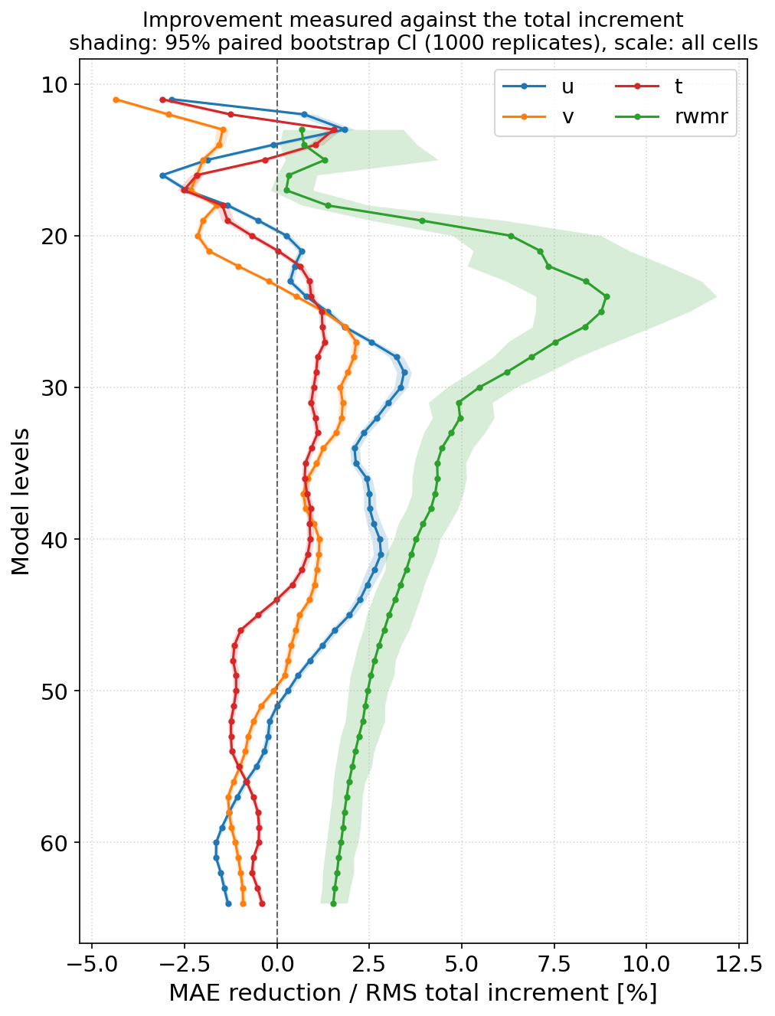
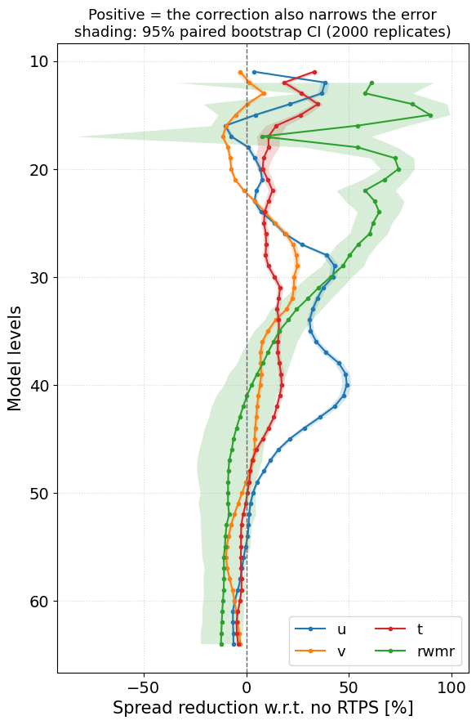
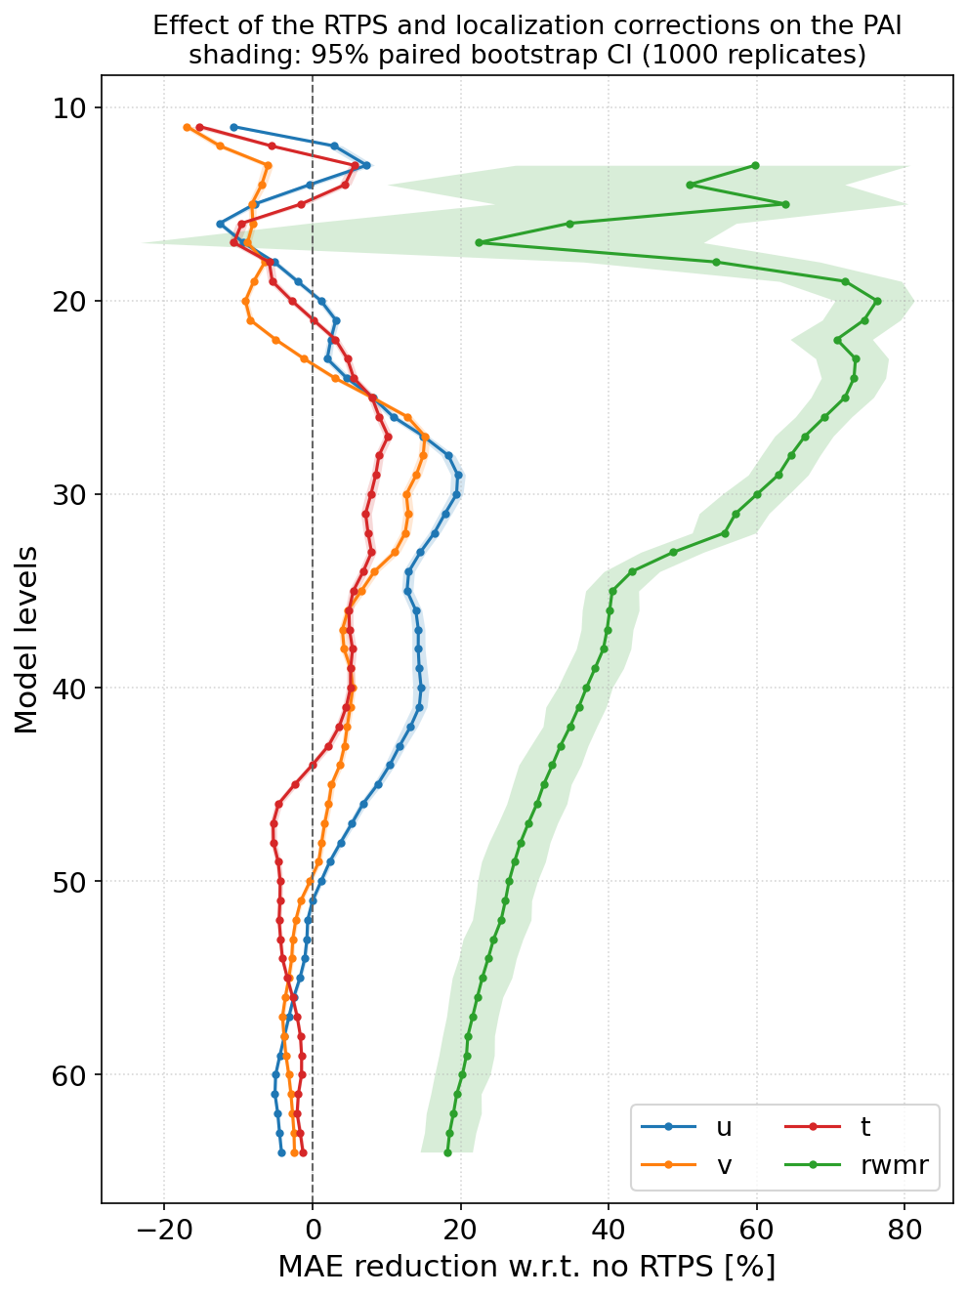

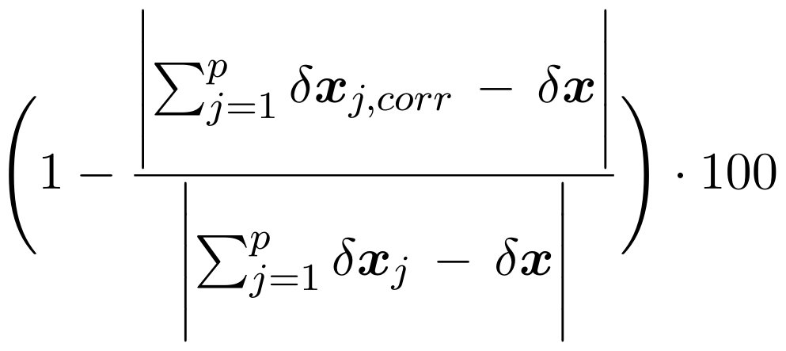
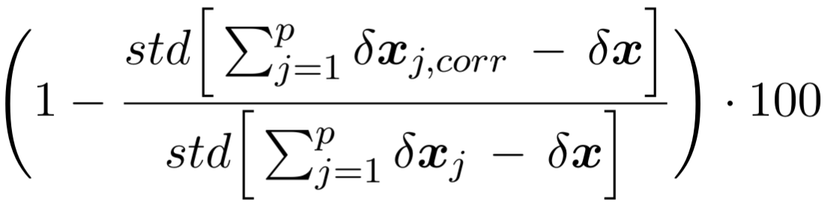
1) Account for posterior inflation effect
qr
qr
qr

Slide 9
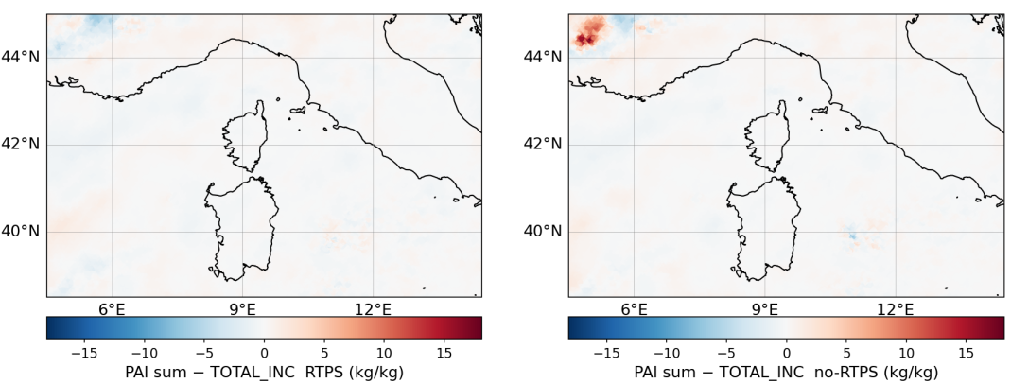
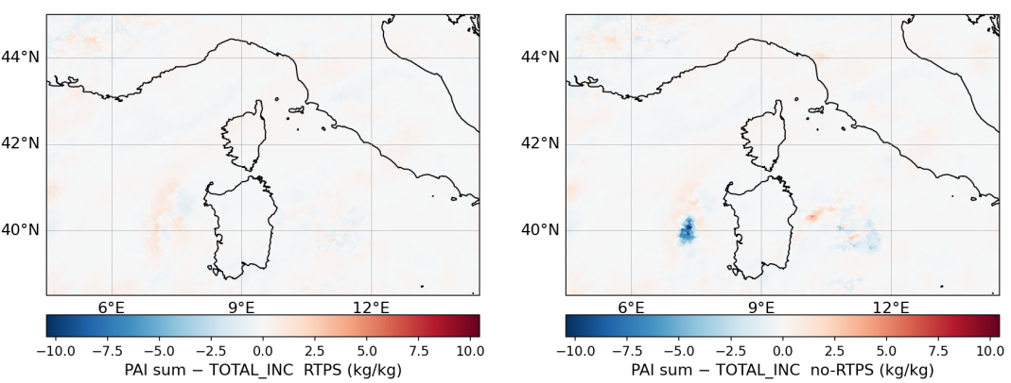
1) Account for posterior inflation effect
m/s
m/s
m/s
m/s

Slide 10

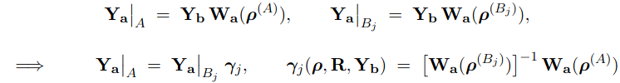
2) Account for localization effect on Y_{a}
We don’t have
We have
NB: j is the observation to be considered
expensive!

Slide 11


2) Account for localization effect on Y_{a}
Assumptions:
R is diagonal (verified);
ρ^{(Bj)}=1 (almost exact);
the local analysis in a grid point reduces to the assimilation of the single observation j (strongest assumption, realistic when observation density is lower)
Then, we can approximate the application of as a single scalar multiplication, by a factor:
Final PAI formulation with multiplicative inflation and localization
All from ekf files
Zero cost

Slide 12
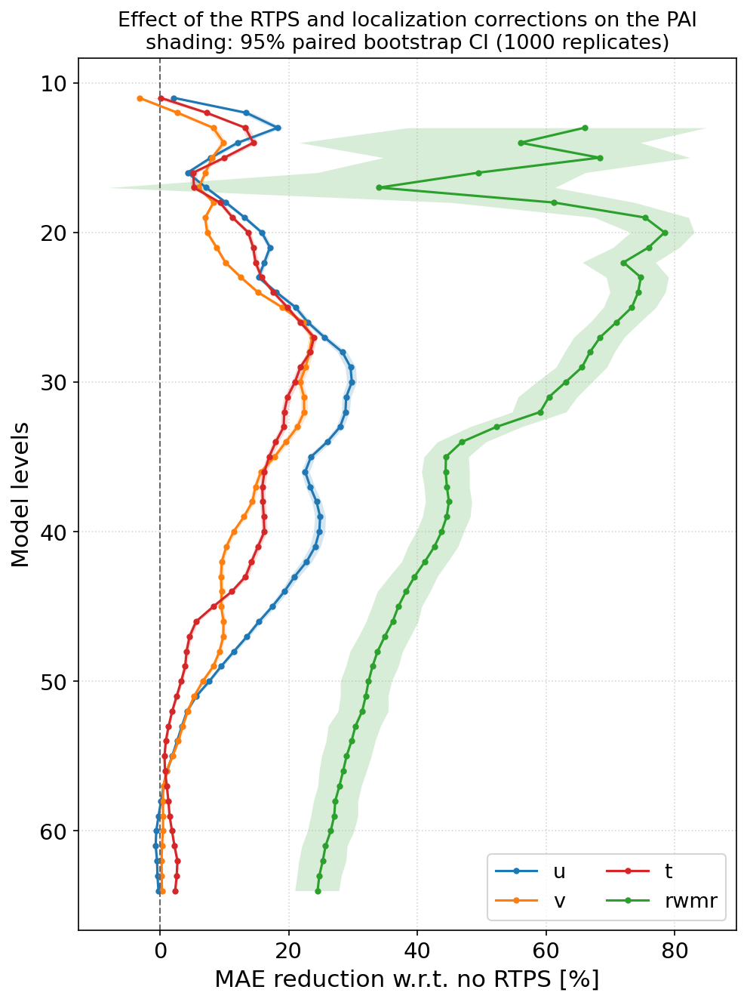
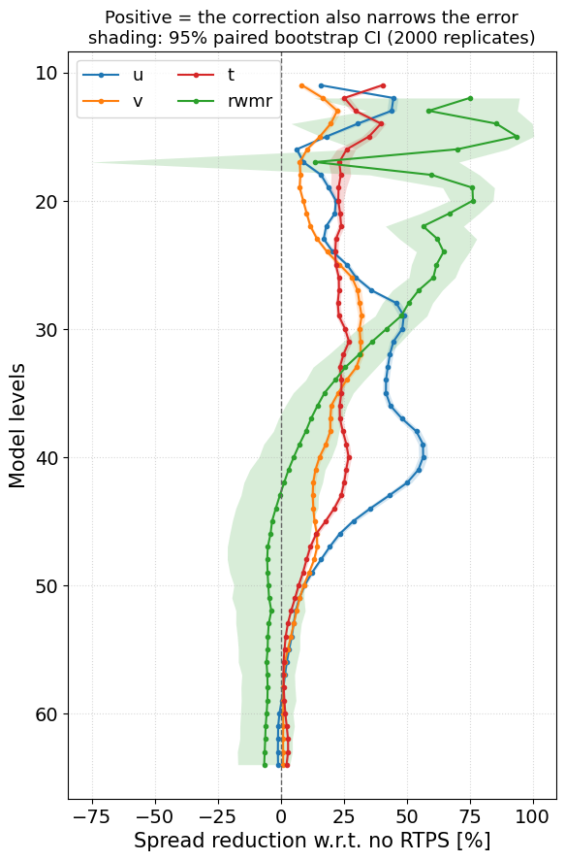
Final results with both corrections
qr
qr

Slide 13
Final notes
Applying the correction for multiplicative inflation and localization in PAI improves the agreement with the total LETKF increment for most variables.
The correction for inflation is valid only for RTPS and multiplicative inflation in general. Other methods (RTPP, additive inflation) need to be accounted in other ways.
The correction for localization can be applied more generally to all the systems using KENDA.
These corrections (and in particular inflation correction) are NOT valid for qv and qc variables: other adjustments are applied in KENDA post inflation (e.g. saturation adjustment), which are not simply invertible. For qv and qc we suggest at the moment to NOT apply these corrections and use the original PAI formulation.

Slide 14




Presented ad ERAD 2026
Quantifying the impact of weather radar observations in ICON-KENDA through the Partial Analysis Increments
Virginia Poli ⁽¹⁾, Thomas Gastaldo ⁽¹⁾, Marcello Grenzi ⁽²⁾,
Alberto Carrassi ⁽²⁾, Chiara Marsigli ⁽¹⁾
Arpae Emilia-Romagna, Bologna, Italy
University of Bologna, Bologna, Italy
Notes:
COPERTINA CON IMMAGINE

Slide 15
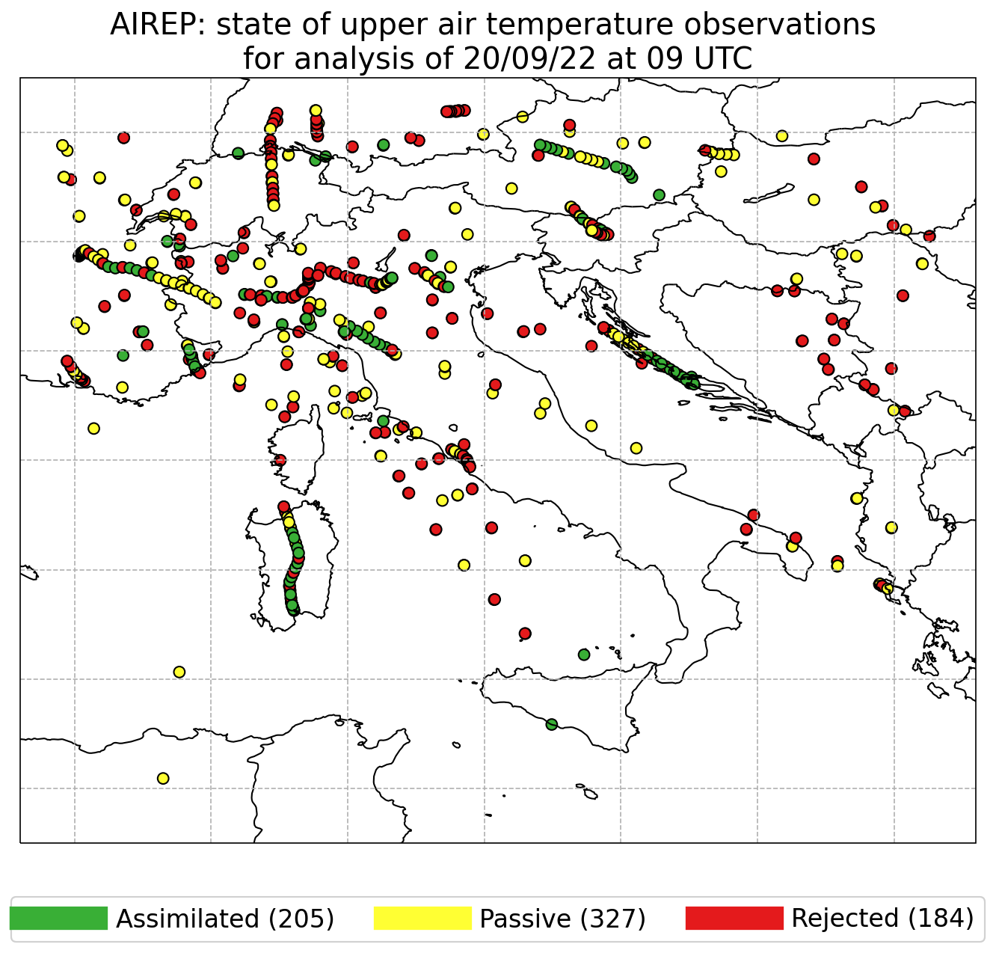
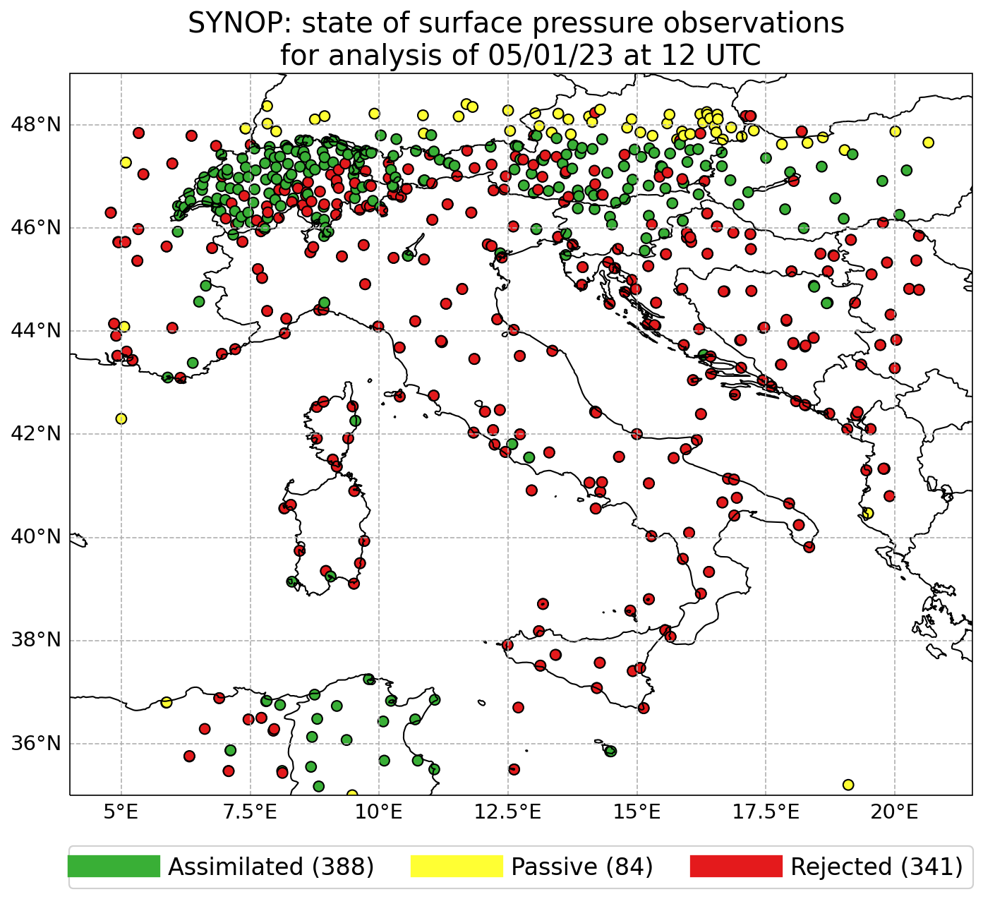
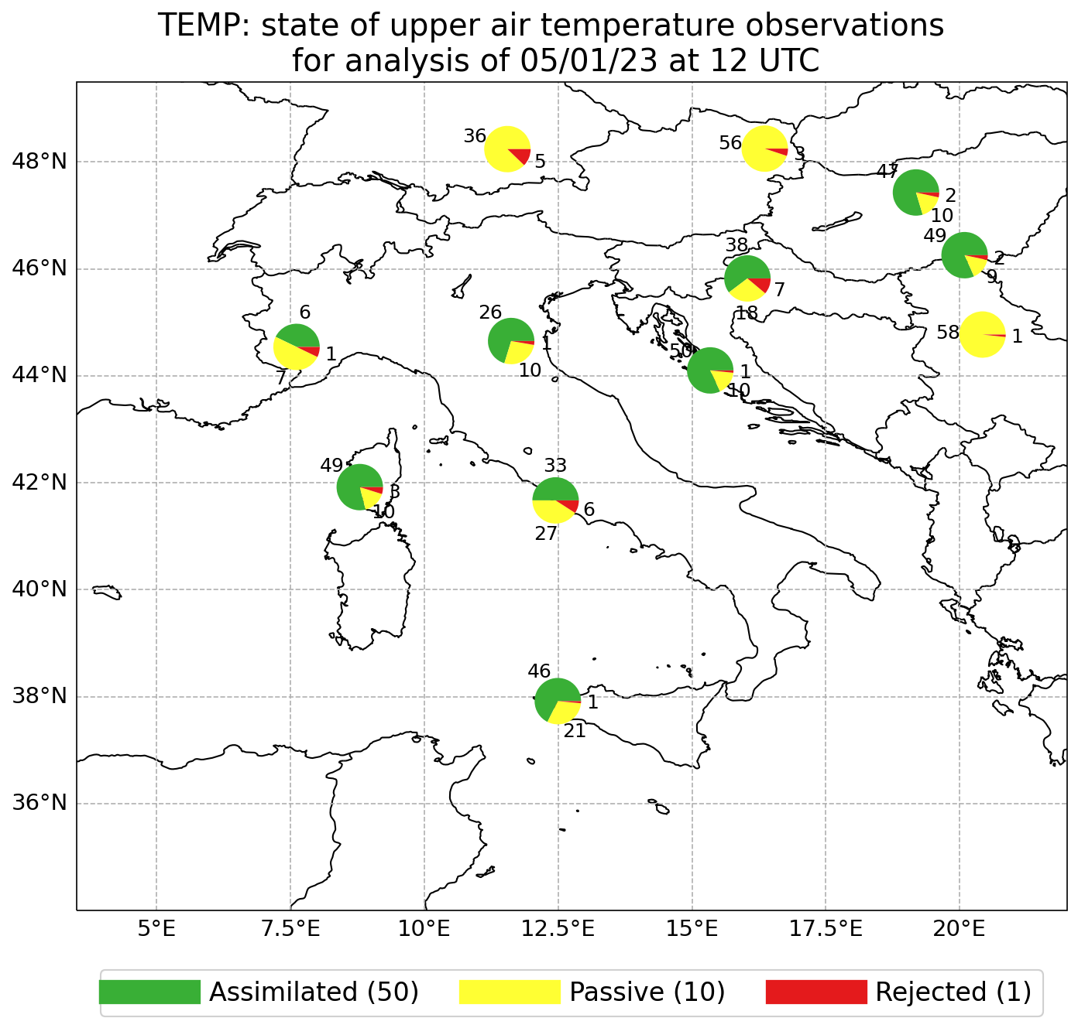
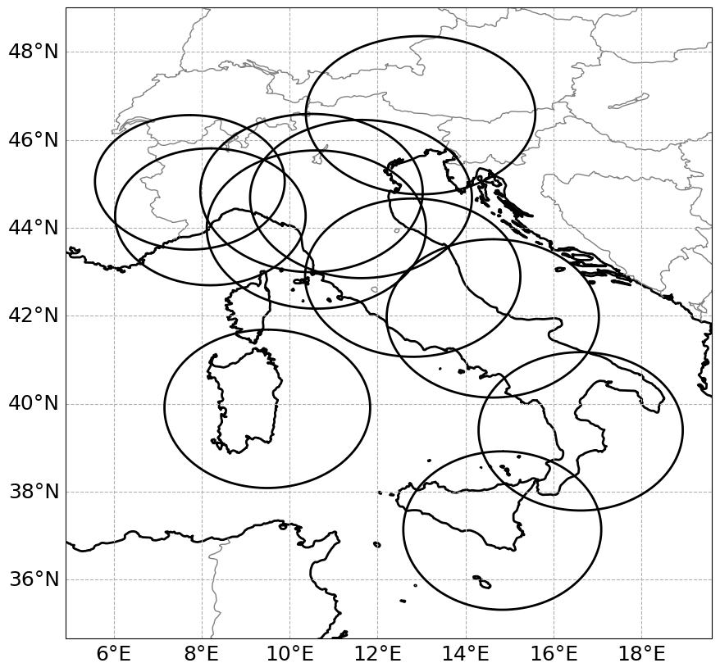
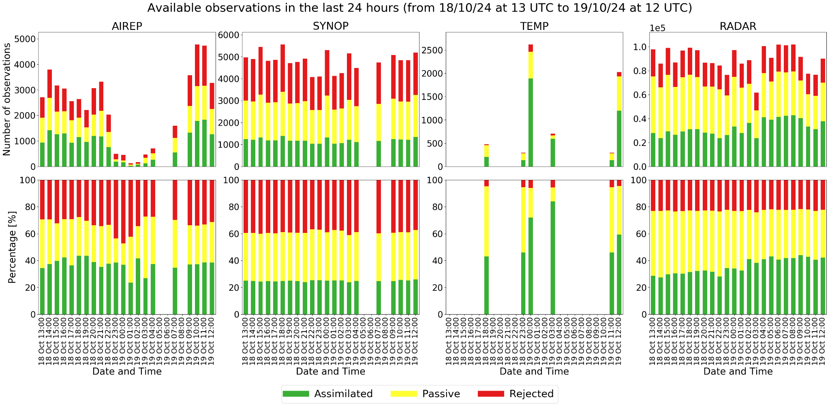
Data assimilation monitoring

Slide 16
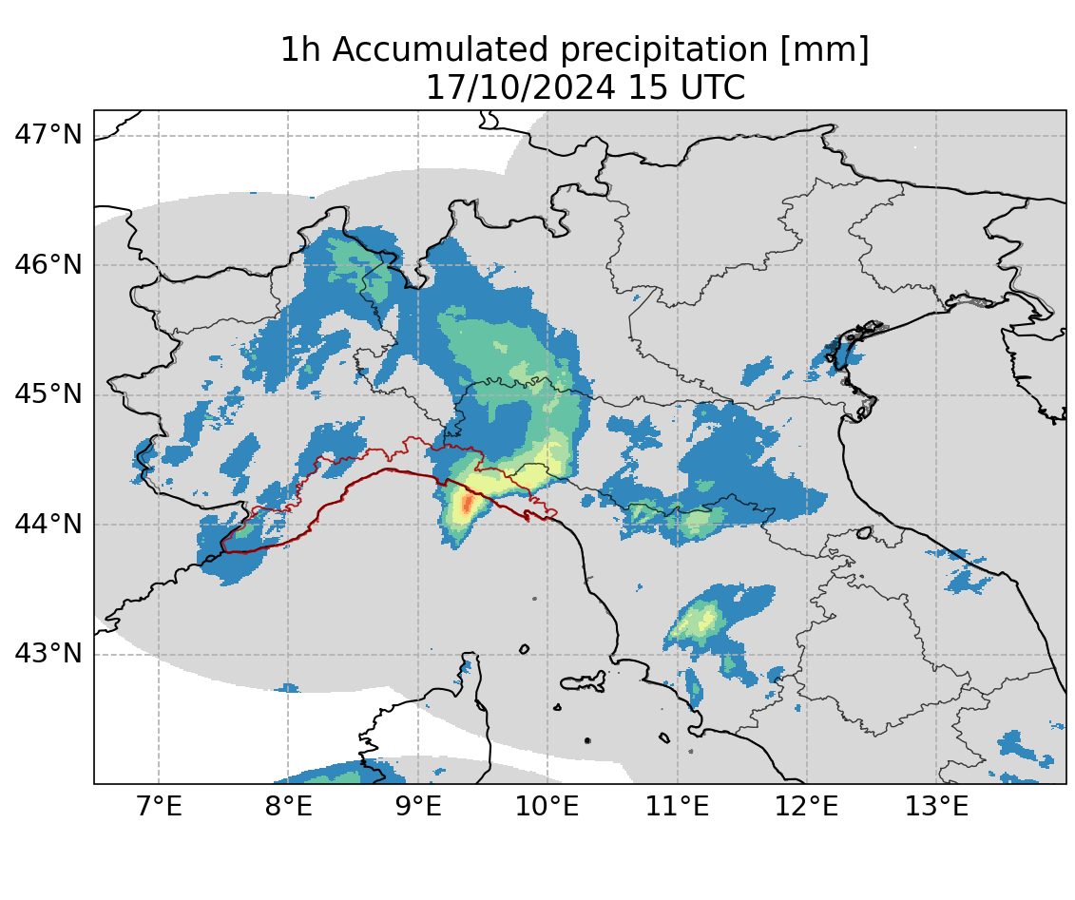
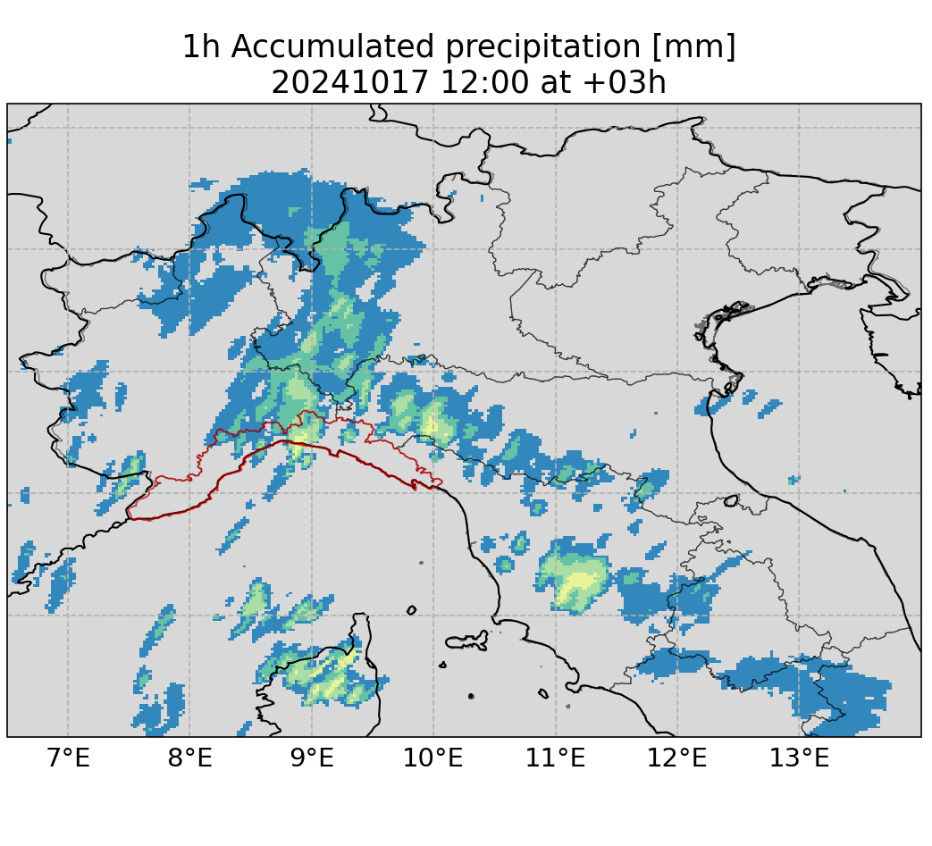
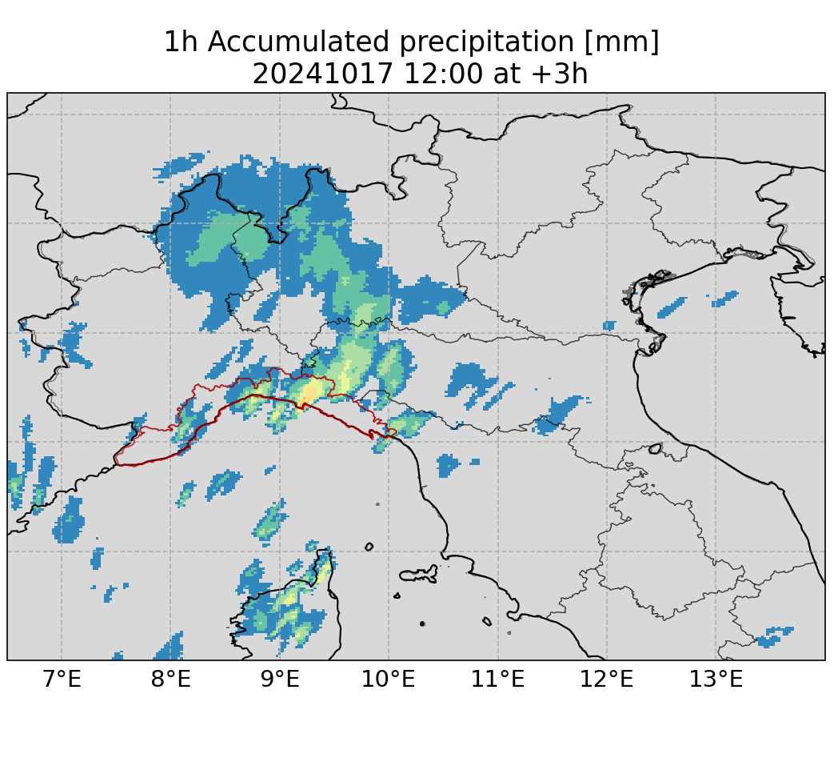
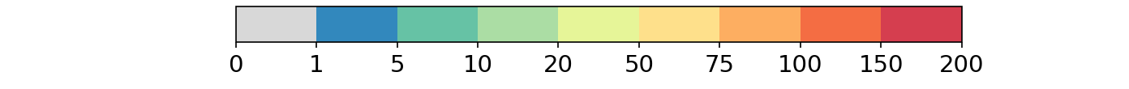
Case study: heavy precipitation over Liguria
observation
CONV
CONV+RADAR

Slide 17
PAI domain
observation
CONV
CONV+RADAR

Slide 18
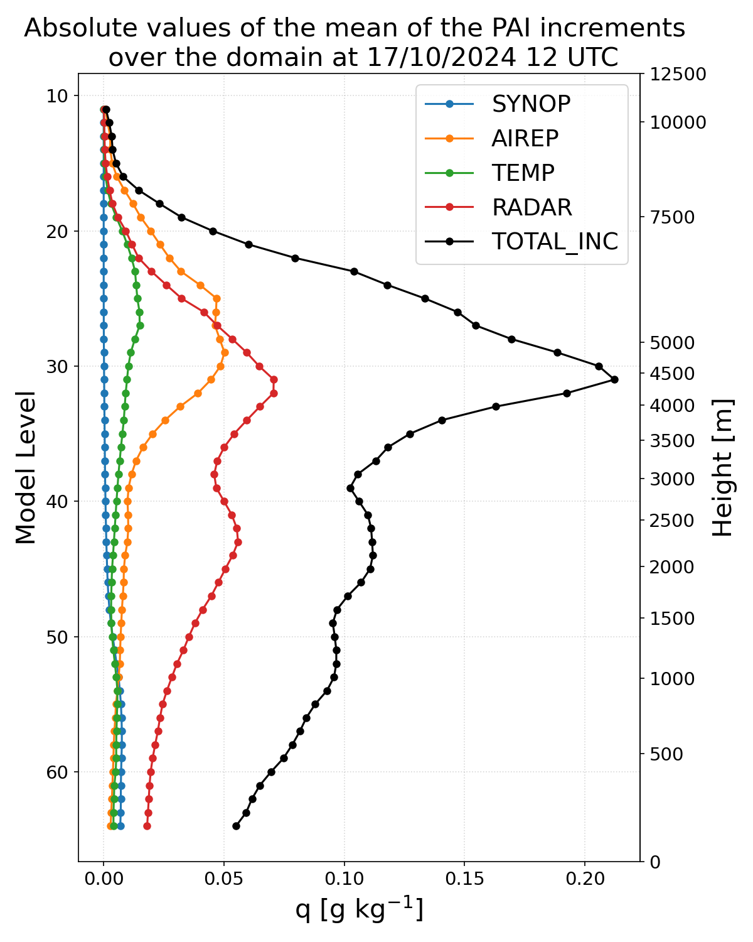
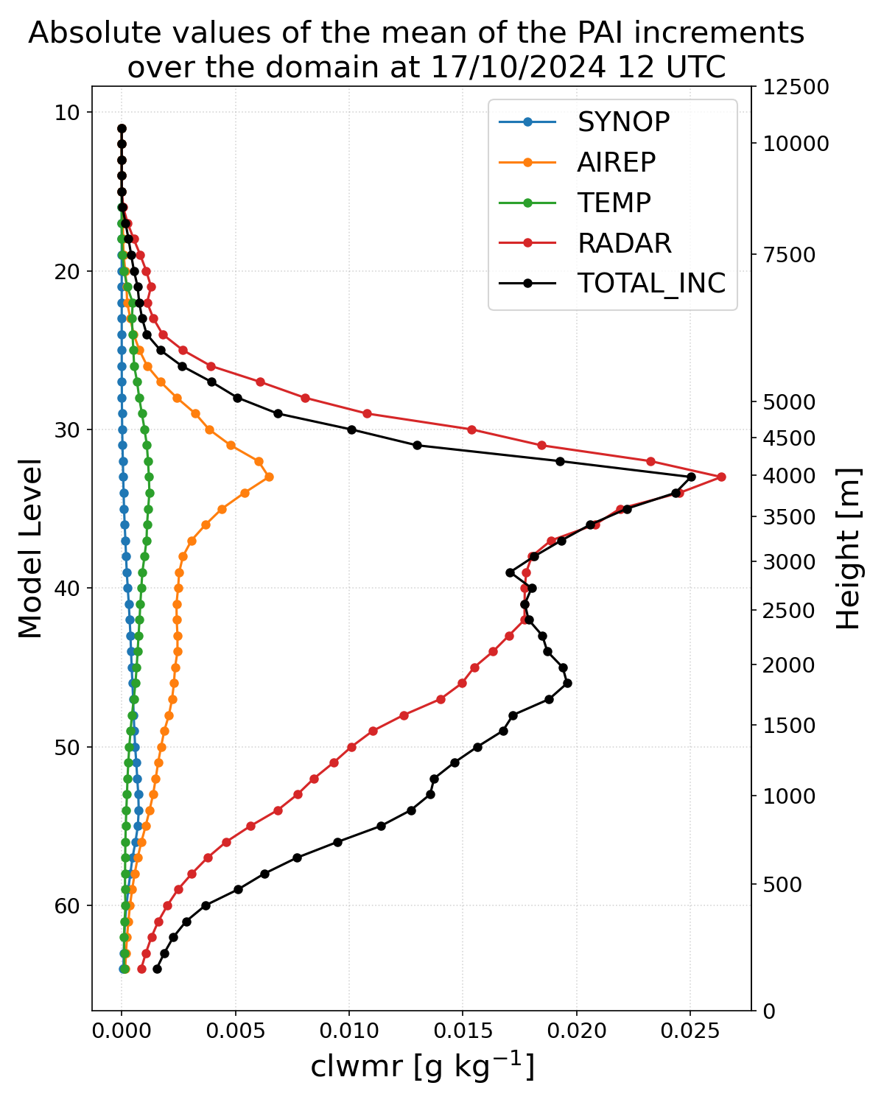
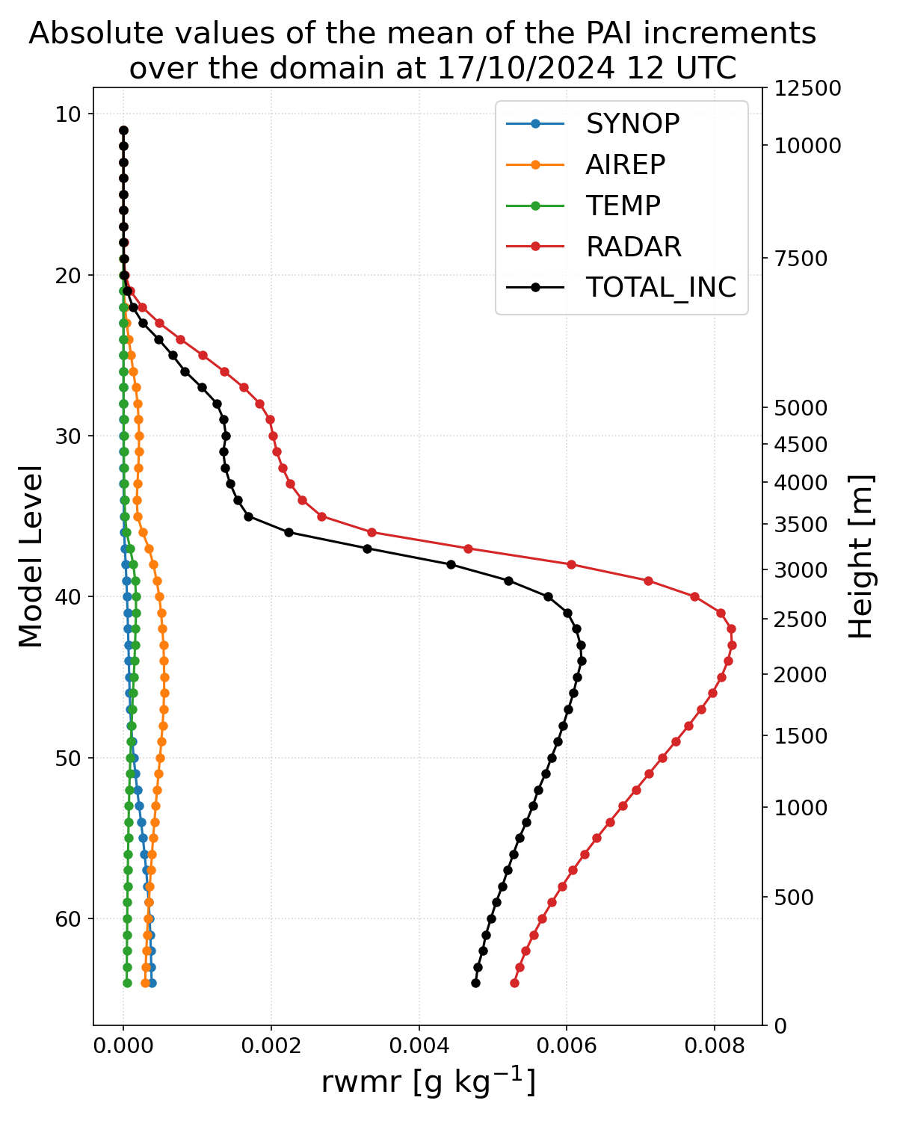
Mean of PAI over the domain
specific humidity
cloud water mixing ratio
rain water mixing ratio

Slide 19
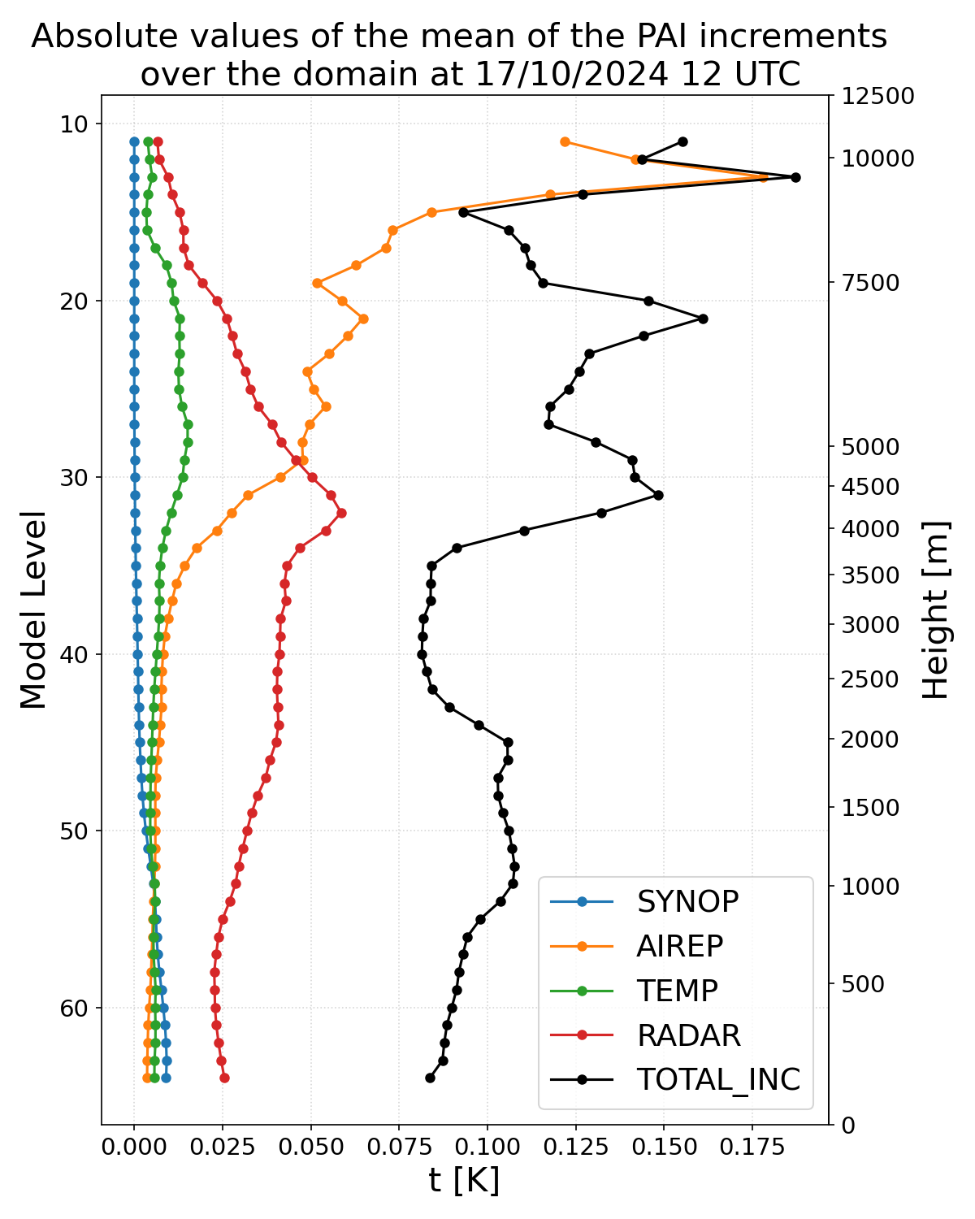
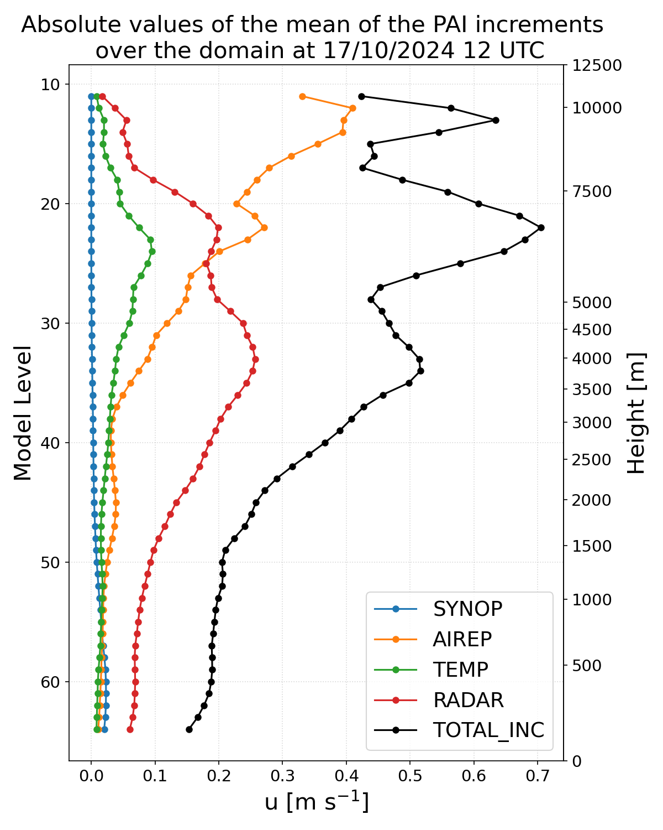
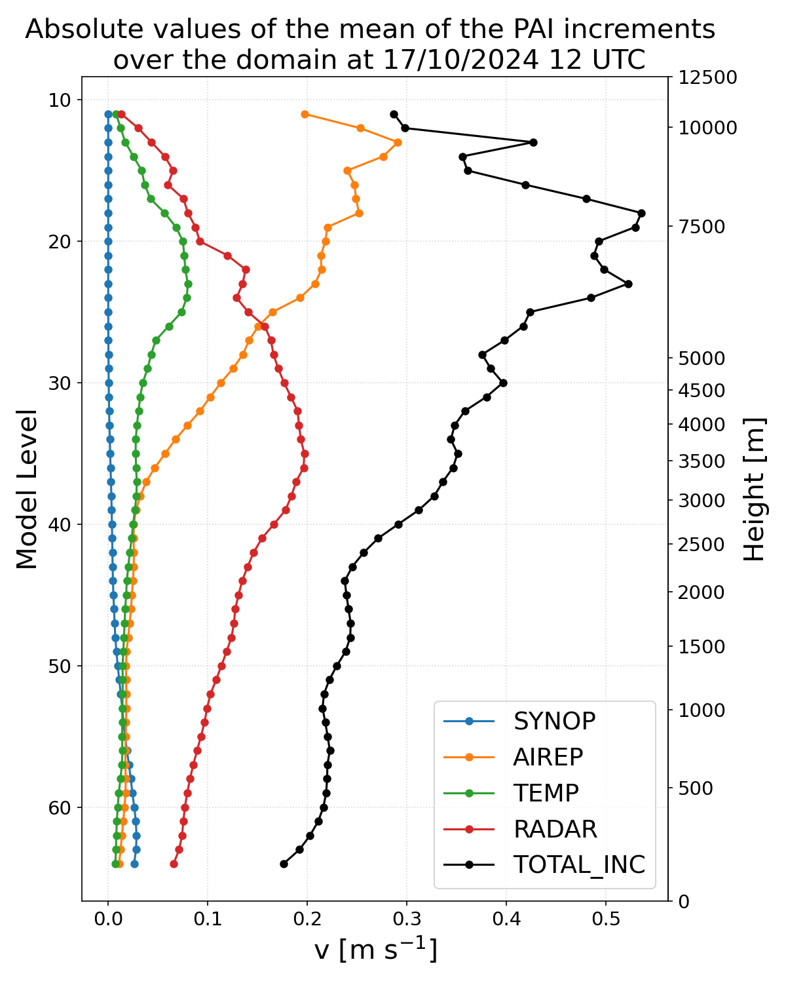
Mean of PAI over the domain
temperature
u-component wind velocity
v-component wind velocity

Slide 20
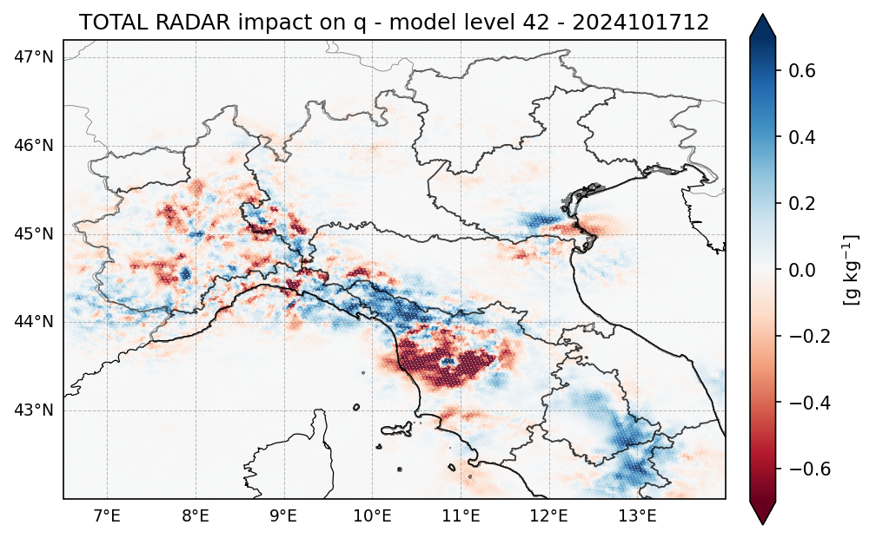
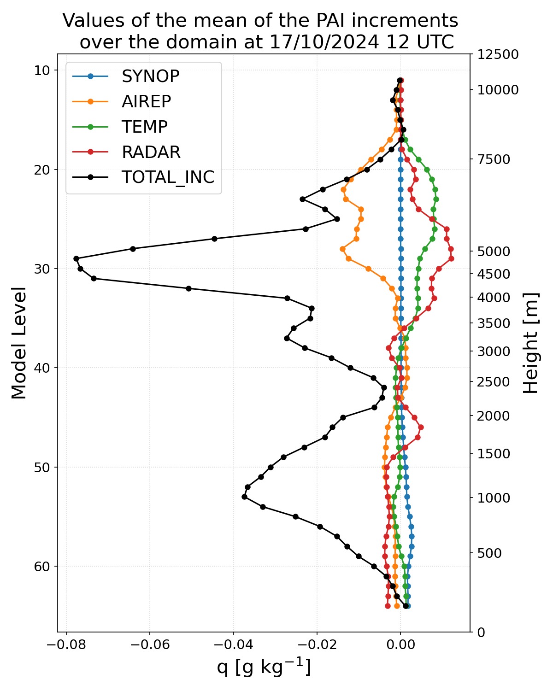
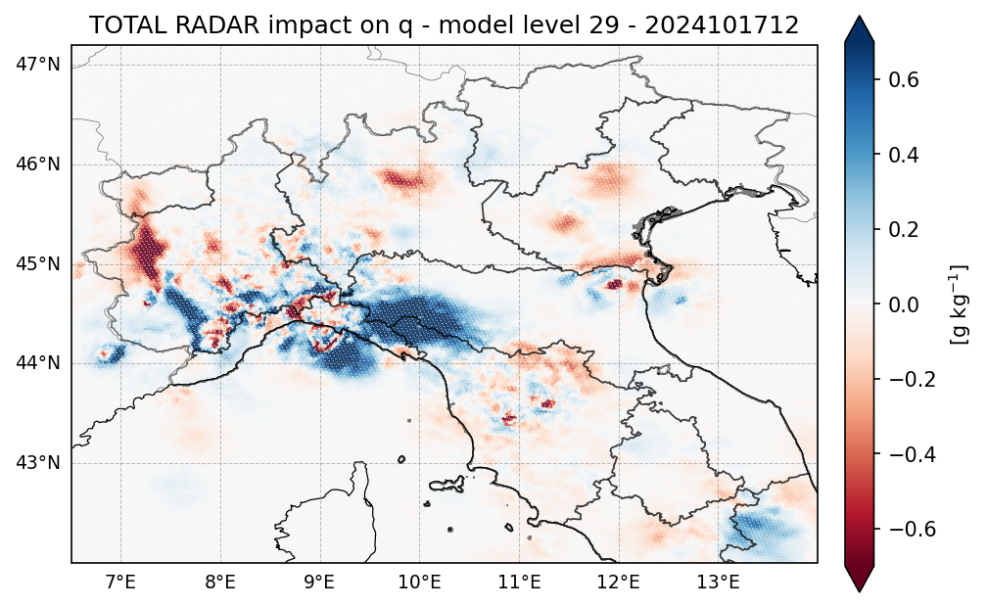
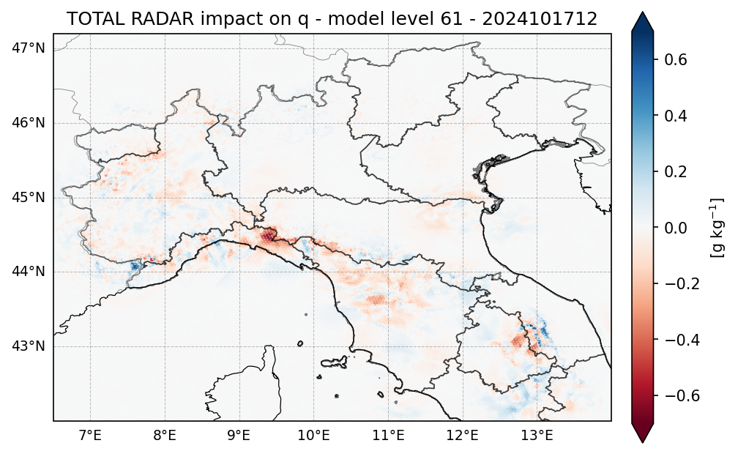
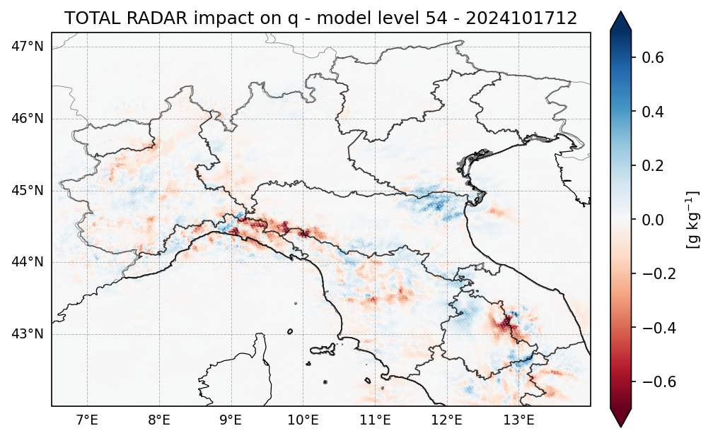
PAI across different levels within the domain
specific humidity

Slide 21
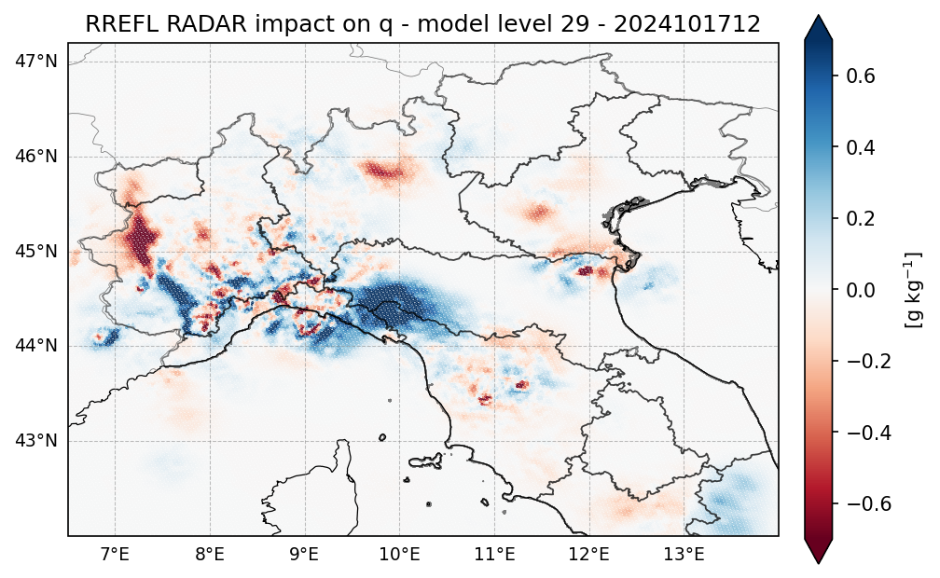
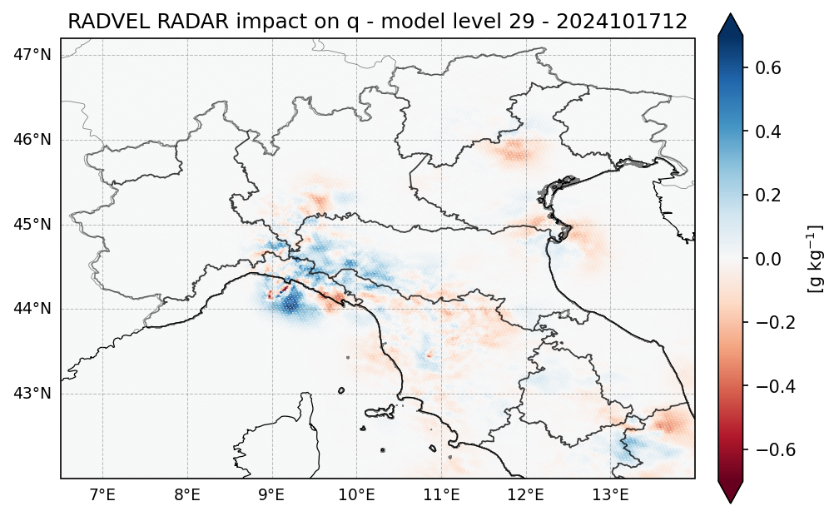
The radar impact on specific humidity

Slide 22
The radar impact on specific humidity

Slide 23
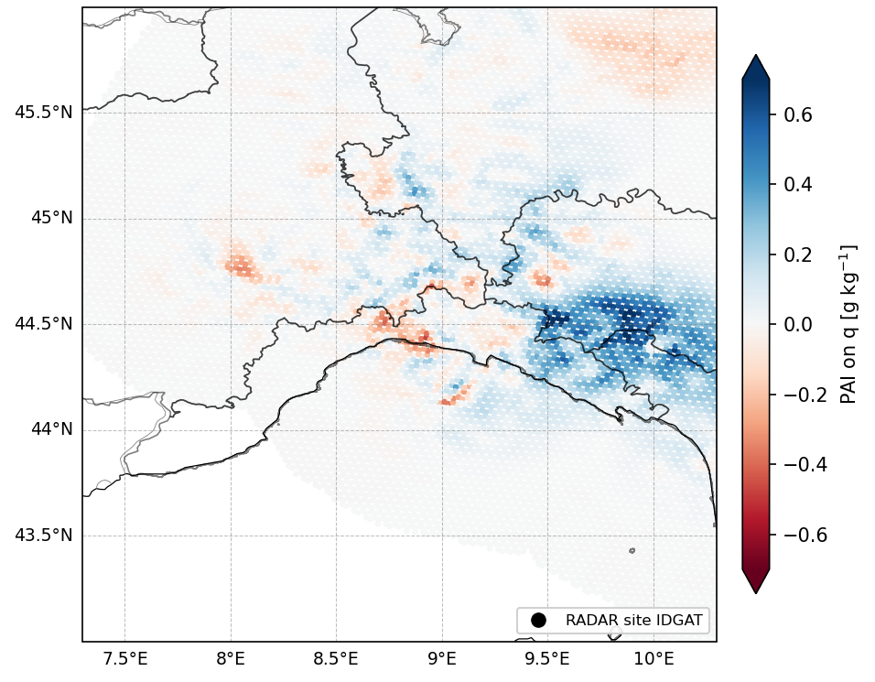
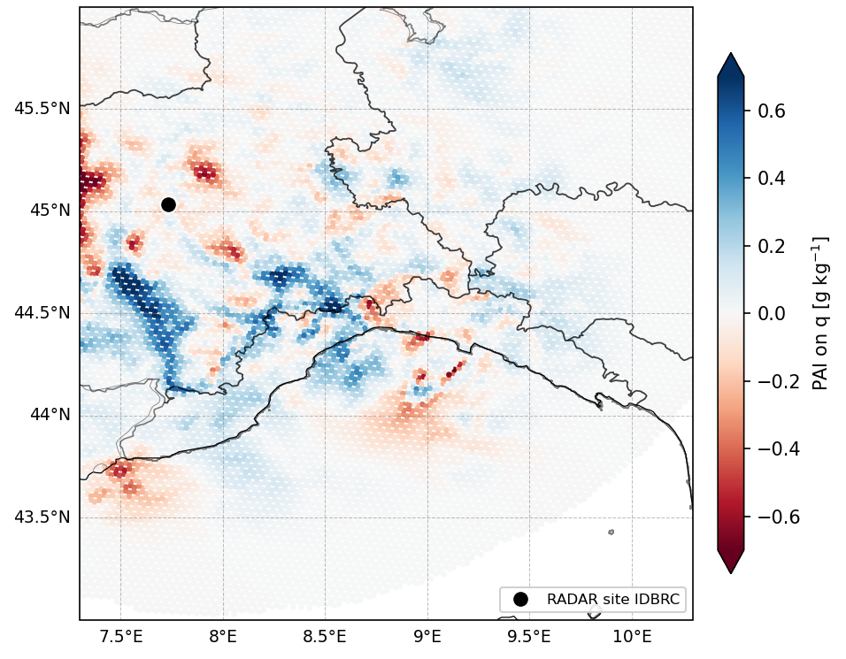
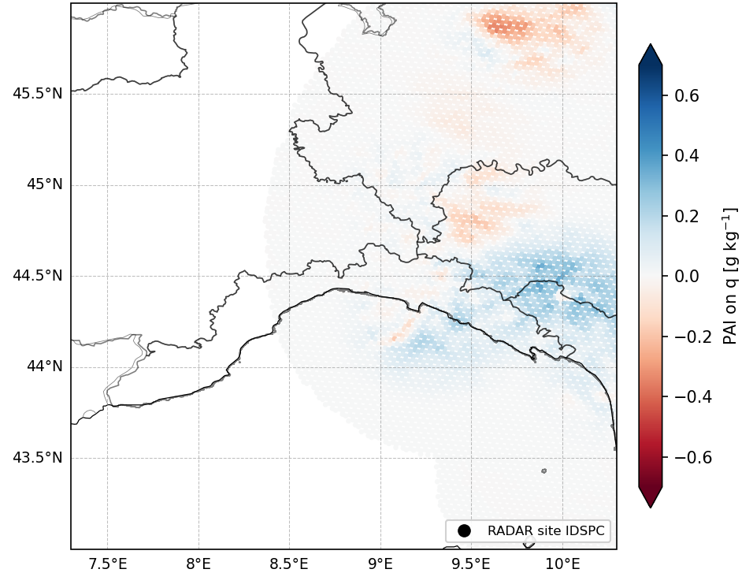
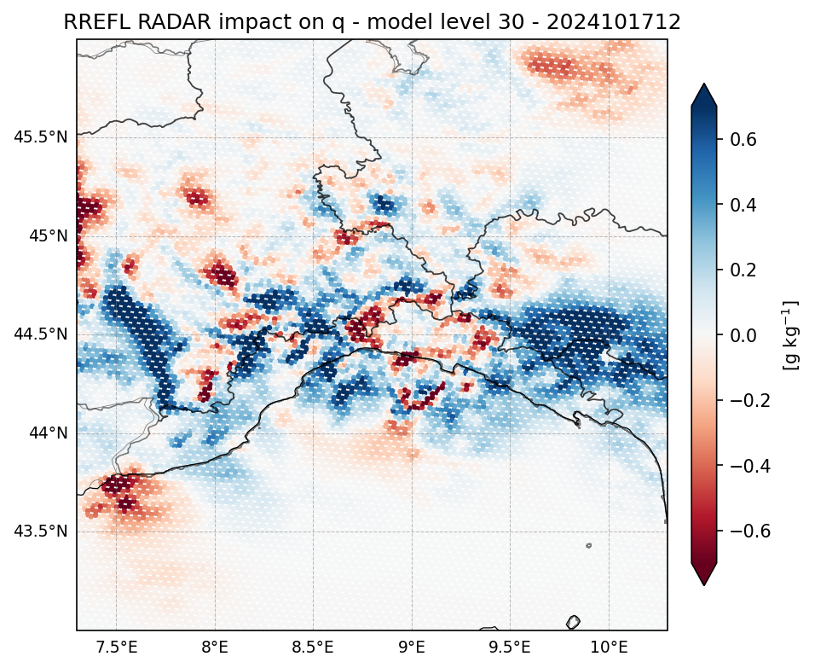
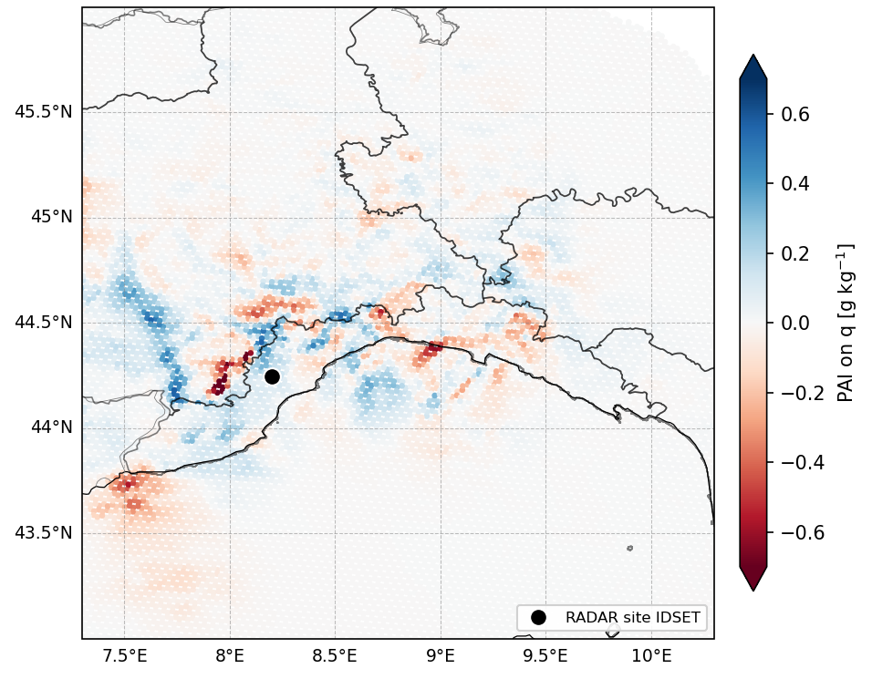
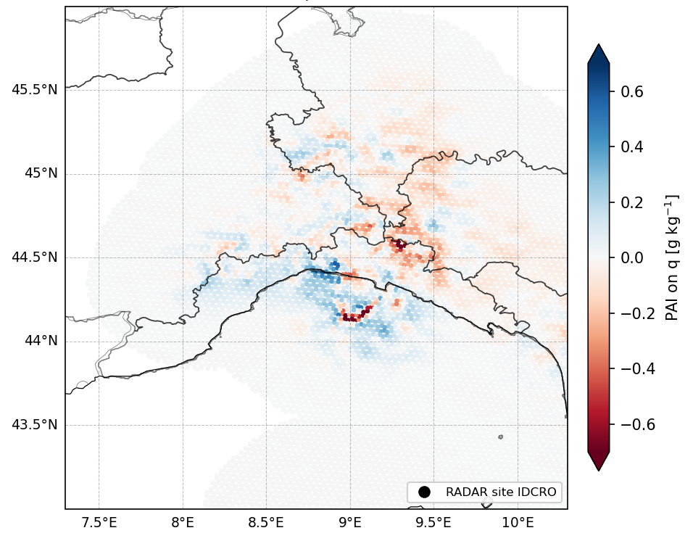
The radar impact
Gattatico
Bric
San Pietro Capofiume
Settepani
Crocione

Slide 24
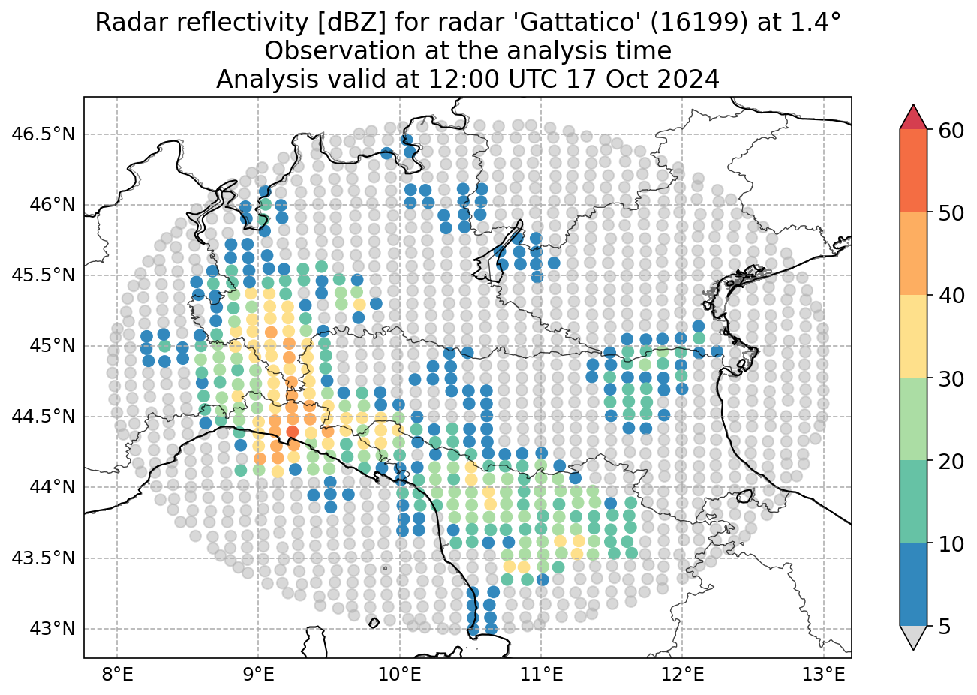
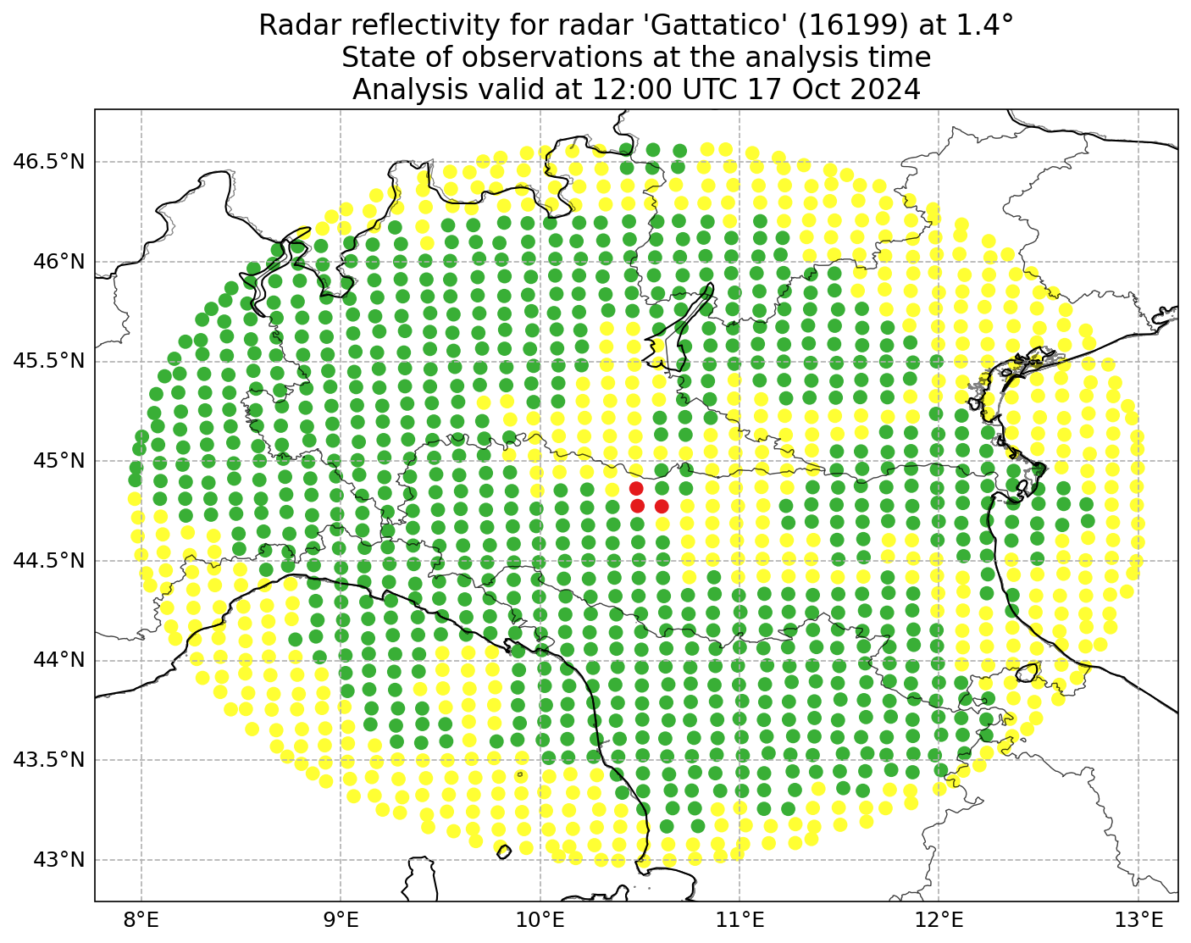
Gattatico radar

Slide 25
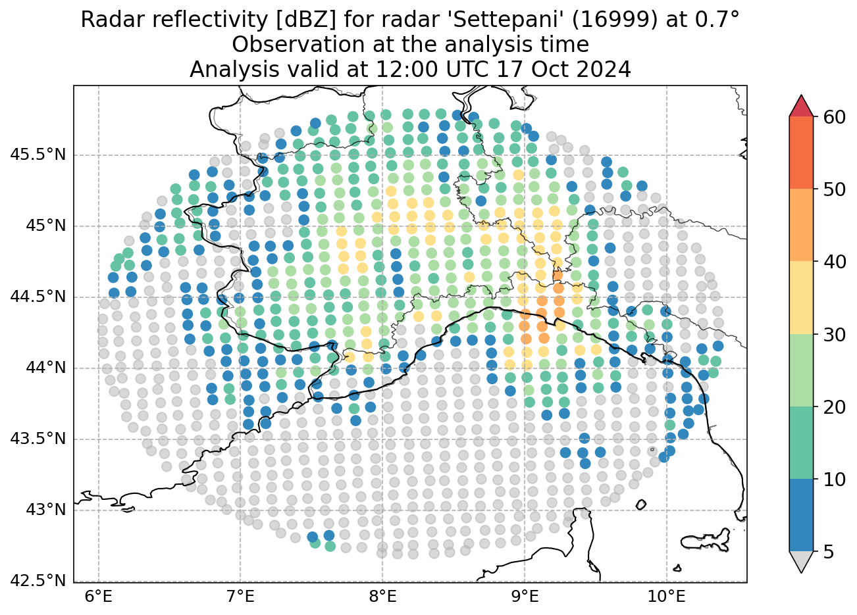
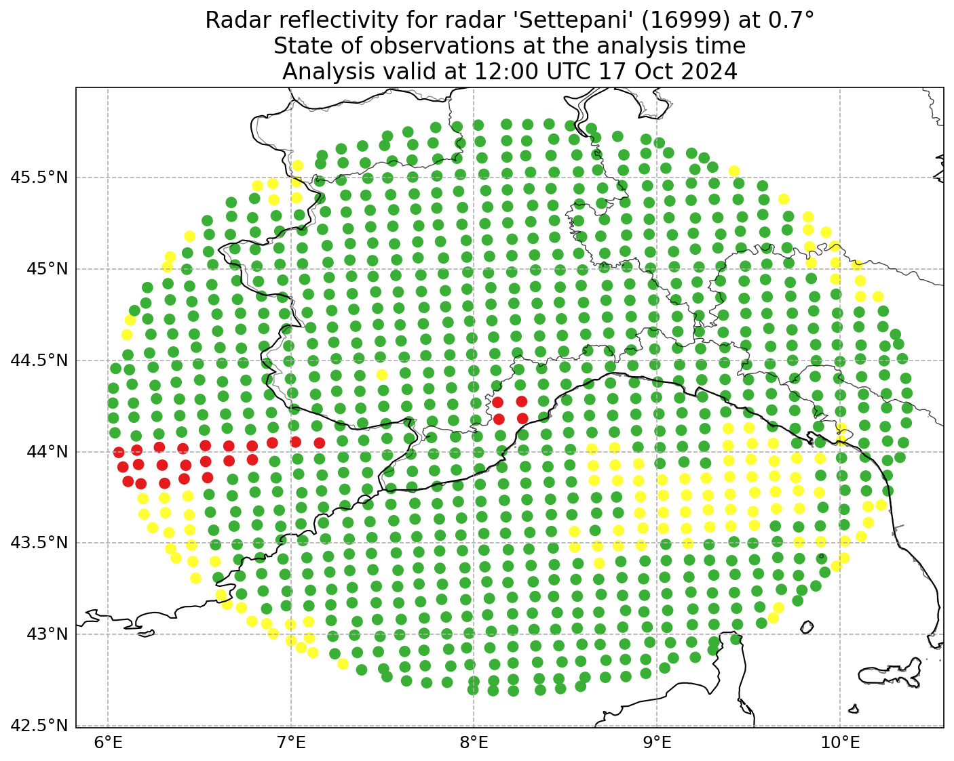
Settepani radar

Slide 26


Crocione radar

Slide 27
Conclusions
We introduced the calculation of Partial Analysis Increments (PAI), as defined by Diefenbach et al. (2023), and applied it to a case of heavy precipitation over Liguria:
We started by analysing the impact of all observations
We then assessed the different impact of radar observations
Building on these results, we went deeper to understand the behaviour of individual radar observations
We used PAI to analyse the influence of observations on different model variables, but it has other applications, such as:
Detecting detrimental observation influence: providing an indication of suboptimal data assimilation, related for example to spurious correlations or incorrect localisation settings
Optimising localisation: guiding modifications to assimilation settings (e.g., the vertical localisation scale)

