Slide 1

Rome, 14th September 2026
Alessandro FALCIONE
ICON-IT artificial low clouds over Sea of Sardinia
Valerio Cardinali, Lucio Torrisi
COSMO GM-2026, 14-18 September 2026 Rome, Italy

Slide 2


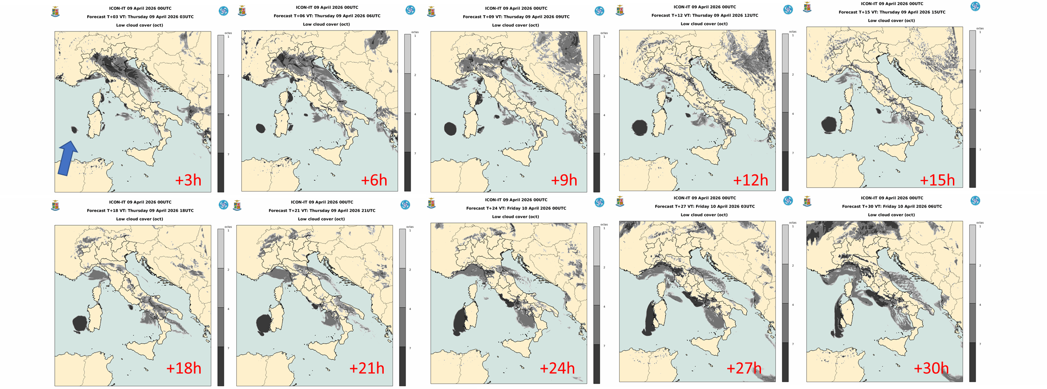


Sea of Sardinia: ICON-IT 20260409 00UTC FC
Artificial low clouds are produced over Sea of Sardinia in the ICON-IT (icon-nwp.2025.04-dwd-2.4)
forecasts of the 20260409 - 00 UTC run

Slide 3
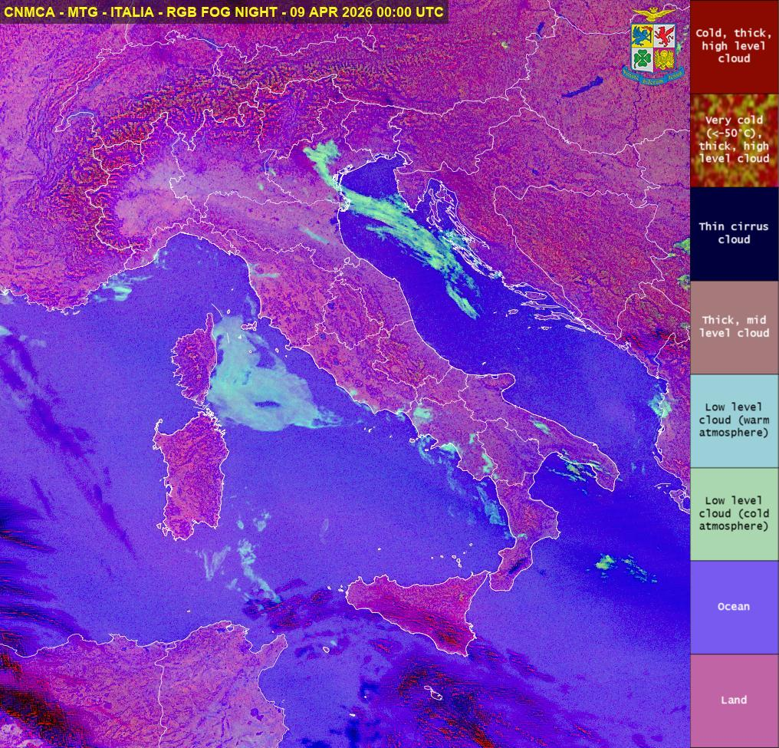
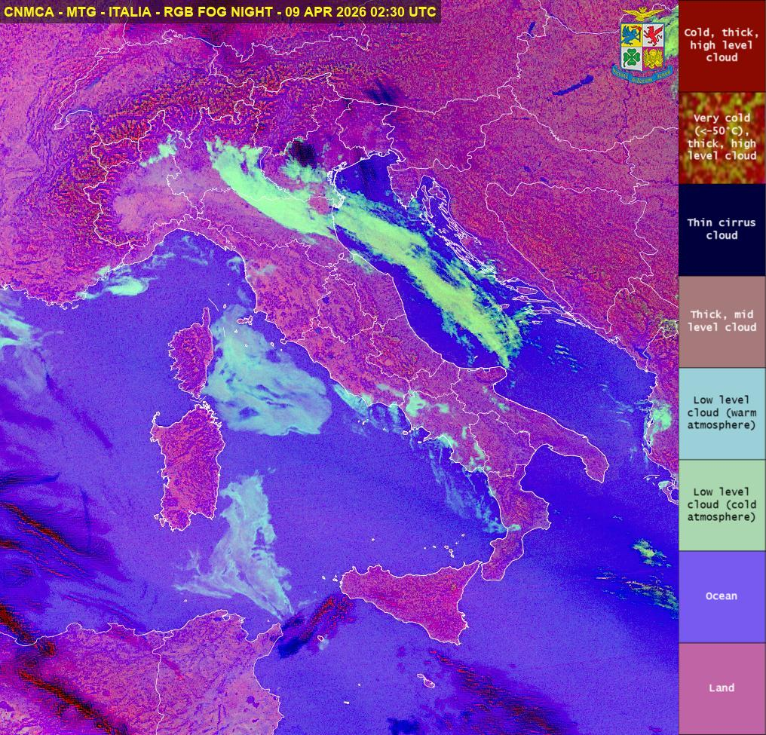
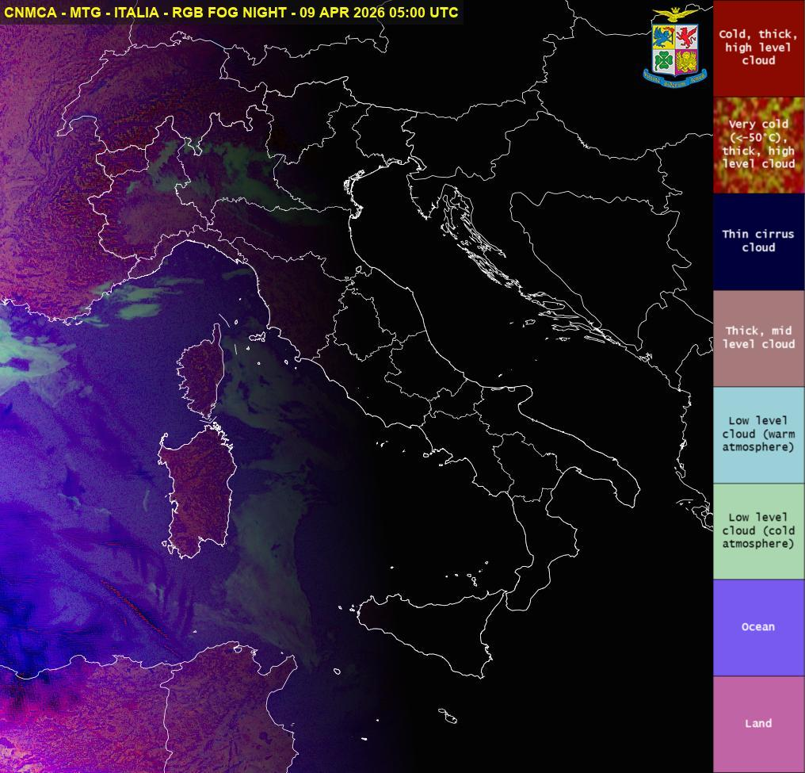
Sea of Sardinia: SAT 20260409
No low clouds are observed over sea of Sardinia in the first hours of 20260409
00:00 UTC 02:30UTC 05:00UTC

Slide 4
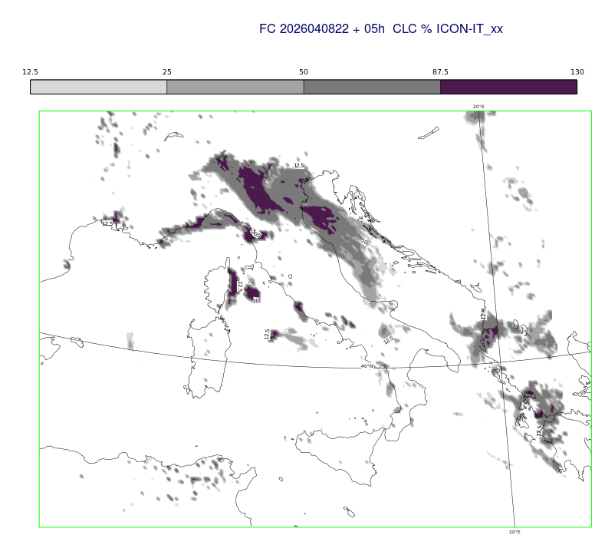
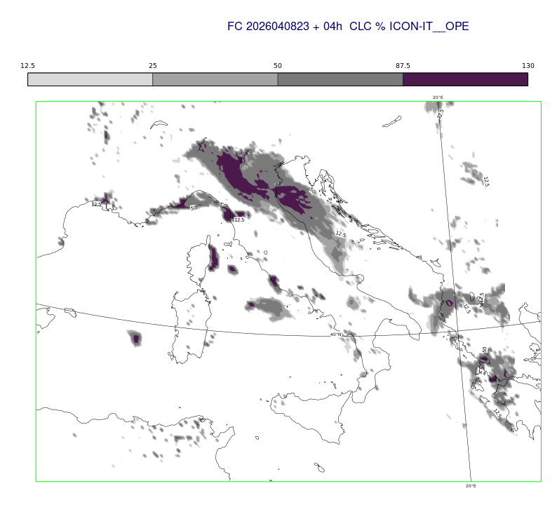
Sea of Sardinia: ICON-IT 20260408 22/23UTC FC
The artificial low clouds over sea of Sardinia are produced in 23 UTC run and not in the 22 UTC run. The problem is introduced during the initialization of 23 UTC run
Run 22UTC +5h
Run 23UTC +4h

Slide 5
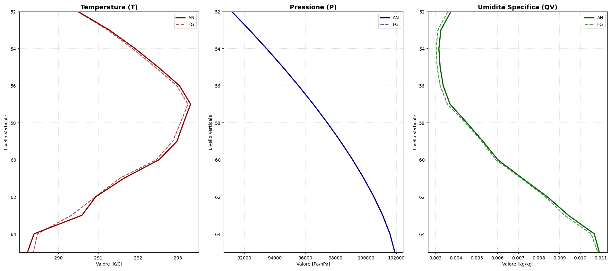
Sea of Sardinia: ICON-IT 20260408 23UTC AN
The problem is introduced during the initialization of 23 UTC run and it is related to the assimilation of RH TEMP
(in this experiment T, u, v, TEMP and all other observations are excluded).
It regards near surface model levels, where qv is increased and T is reduced due to 16546 TEMP influence. Deterministic FG and analysis (only RH TEMP) in the point: 39.5°N 7°E.

Slide 6
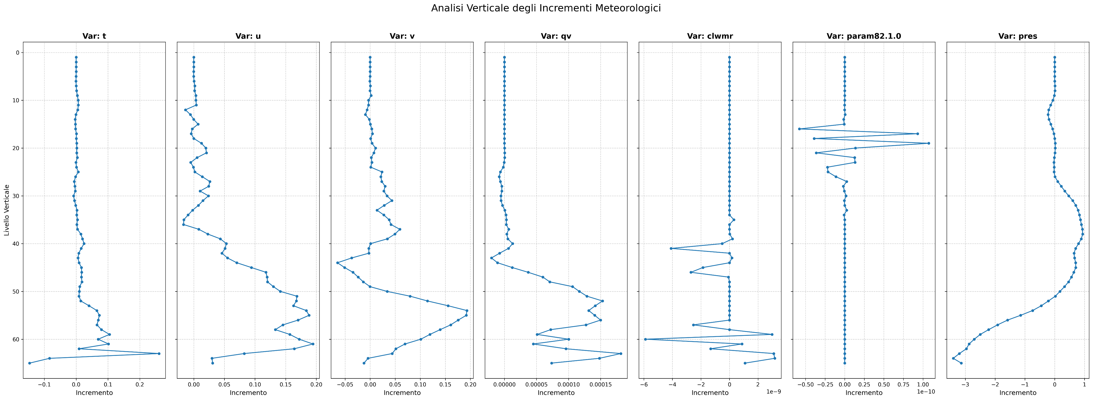
Sea of Sardinia: ICON-IT 20260408 23UTC AN-FG
The problem is introduced during the initialization of 23 UTC run.
It regards near surface model levels, where qv is increased and T is reduced due to 16546 TEMP influence.
Analysis increments (only RH TEMP) in the point: 39.5 N 7 E
T u v qv qc qi p

Slide 7

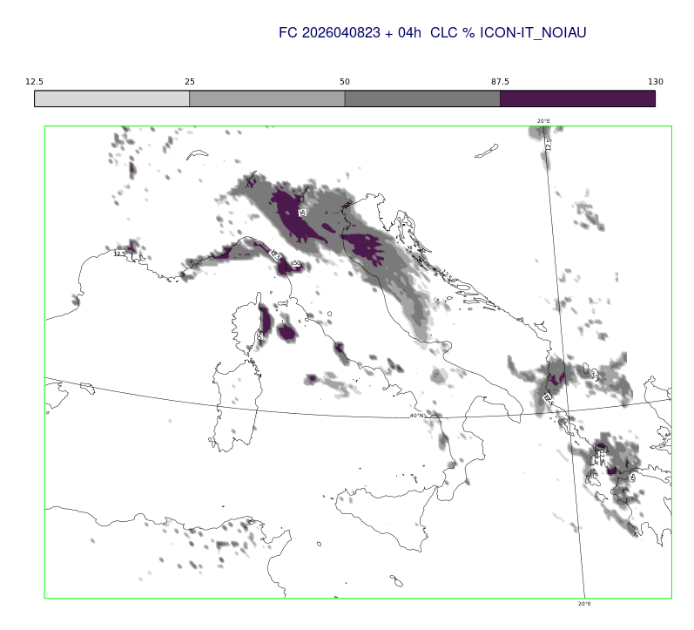
Sea of Sardinia: ICON-IT 20260408 23UTC FC
The artificial low clouds over sea of Sardinia (model levels: 64 and 65 – lowest one) are related to the use of the 23 UTC LETKF analysis
If LETKF analysis is not used in 23 UTC ICON run, the artificial low clouds do not develop
The artificial low cloud system is not forecast, if all observations, except for RH TEMP, are assimilated
The artificial low cloud system is produced, if only RH TEMP observations are assimilated
Run 23UTC +4h
Run 23UTC +4h
Only RH TEMP
assimilated
No use of analysis

Slide 8
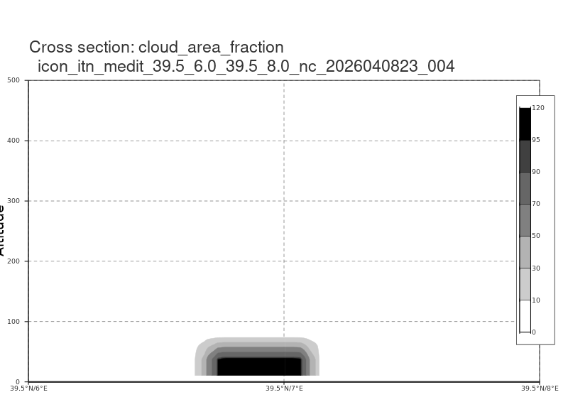
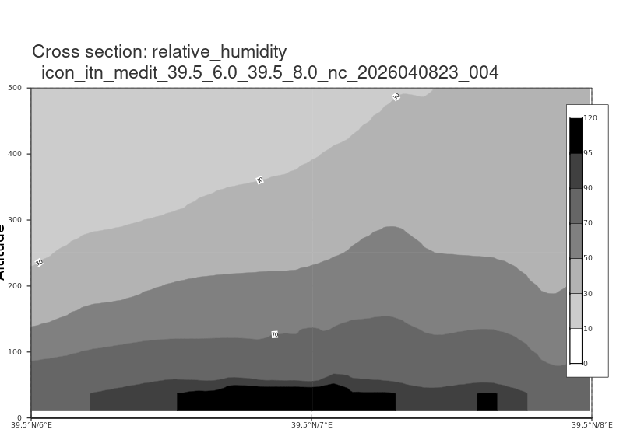
Sea of Sardinia: ICON-IT 20260408 23UTC FC
The artificial low clouds over sea of Sardinia are related to the assimilation of RH TEMP in 23 UTC analysis (Tuv TEMP and all other observations are excluded in this exp.).
It regards model levels: 64 and 65 – lowest one
Cross section between 39.5 N, 6.0 E and 39.5 N, 8.0 E
CLC
Run 23UTC +4h
RH
Run 23UTC +4h

Slide 9
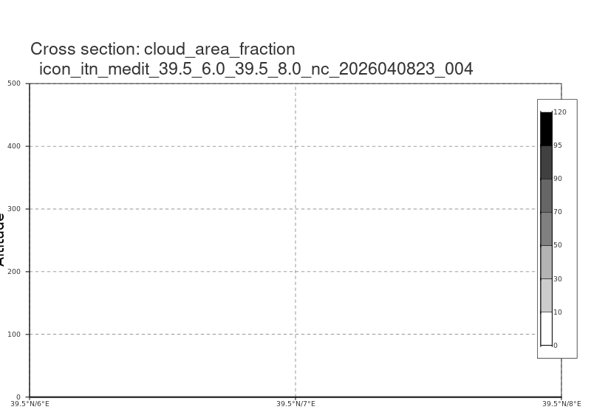
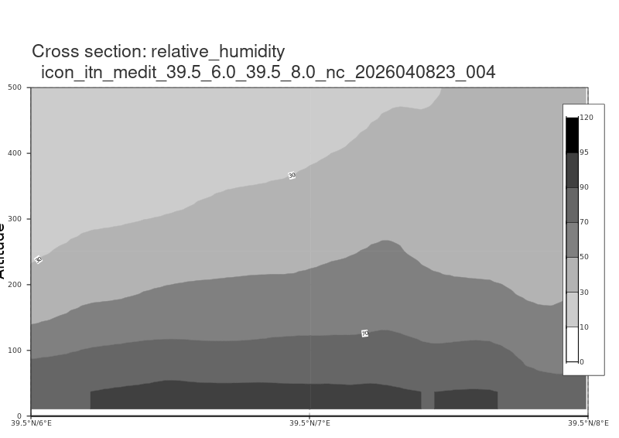
Sea of Sardinia: ICON-IT 20260408 23UTC FC
If LETKF analysis is not used in 23 UTC ICON run, the low clouds do not develope
Cross section between 39.5 N, 6.0 E and 39.5 N, 8.0 E
CLC
Run 23UTC +4h
RH
Run 23UTC +4h

Slide 10
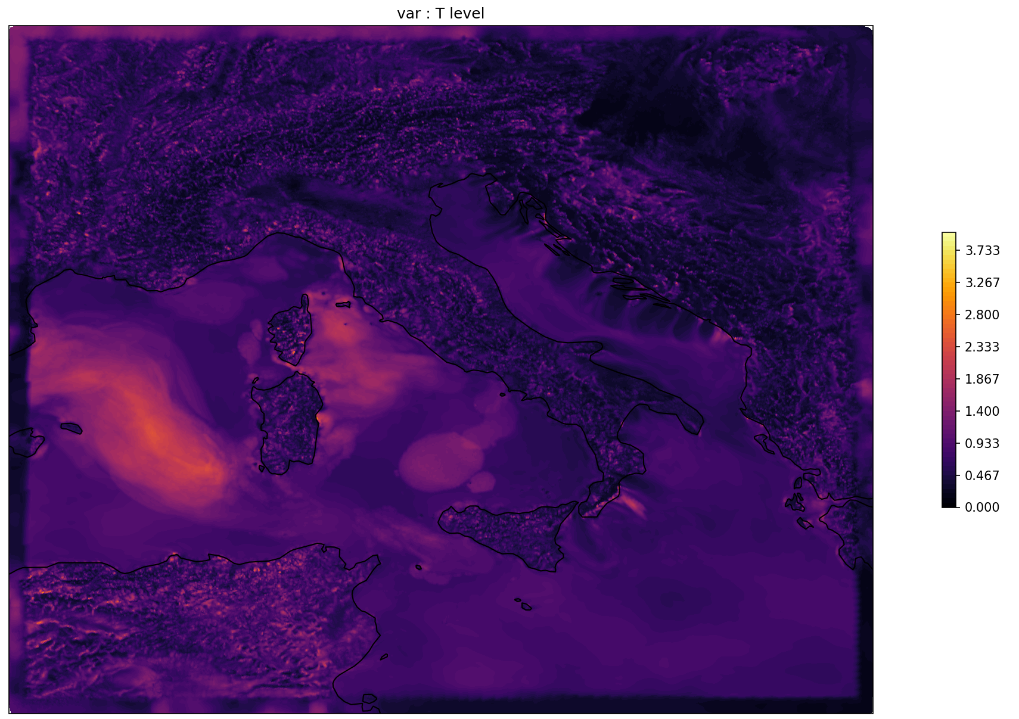
Sea of Sardinia: ICON-IT 20260408 22UTC + 1h FC
Spread of the ICON-IT first-guess ensemble for temperature in the lowest model level (65) used in the 23 UTC LETKF analysis
A large spread in the temperature (up to 3 K) at the lowest model level is present in the area where the artificial cloud appears
The spread for the low clouds (qc) shows the same structure as the spread for T
COSMO GM-2026, 14-18 September 2026 Rome, Italy

Slide 11
First summary
An artificial low cloud system over sea of Sardinia is produced in a few ICON-IT runs in the 64-65 model levels (near surface)
The artificial low cloud system is not forecasted, if all observations, except for RH TEMP, are assimilated
The artificial low cloud system is introduced by the LETKF analysis, because of the over fitting of RH TEMP observations in the area, where the artificial cloud appears
This over fitting is due to the large spread in temperature/humidity/clouds, present in the area, at the model levels near surface
The large spread in temperature could evolve due to interaction between radiation and clouds, if low clouds are present only in some members
The settings of the ensemble-perturbations (Stochastically Perturbed Parameterizations - SPP) in the assimilation cycle needs to be reviewed!

Slide 12
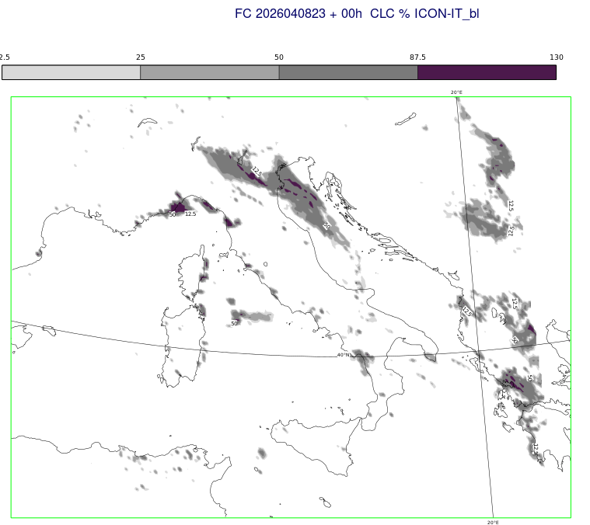

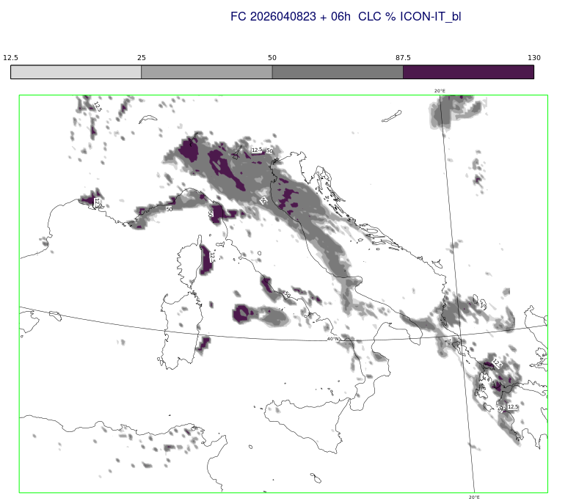
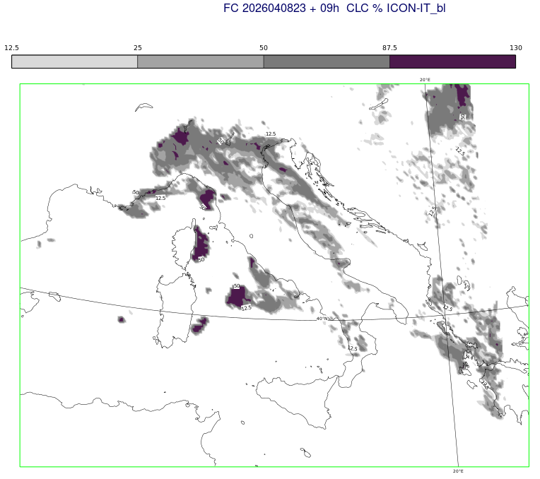
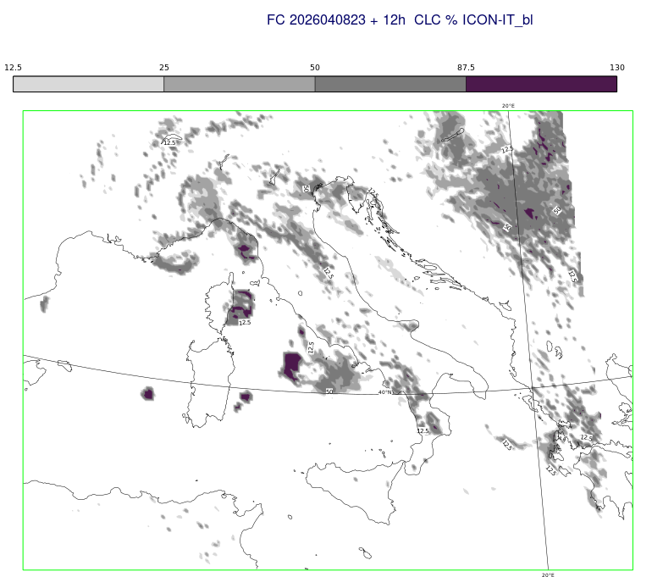
Sea of Sardinia: ICON-IT 20260408 23UTC FC
23:00 UTC 02:00UTC 05:00UTC
Some experiments were performed starting the assimilation cycle with the 20260408 23 UTC oper. analysis and changing one namelist parameter at time.
Namelist change:
Variability range for box width scale of
liquid clouds in cloud cover scheme
range_box_liq = 0
(instead of 0.01)
08:00 UTC 11:00UTC

Slide 13
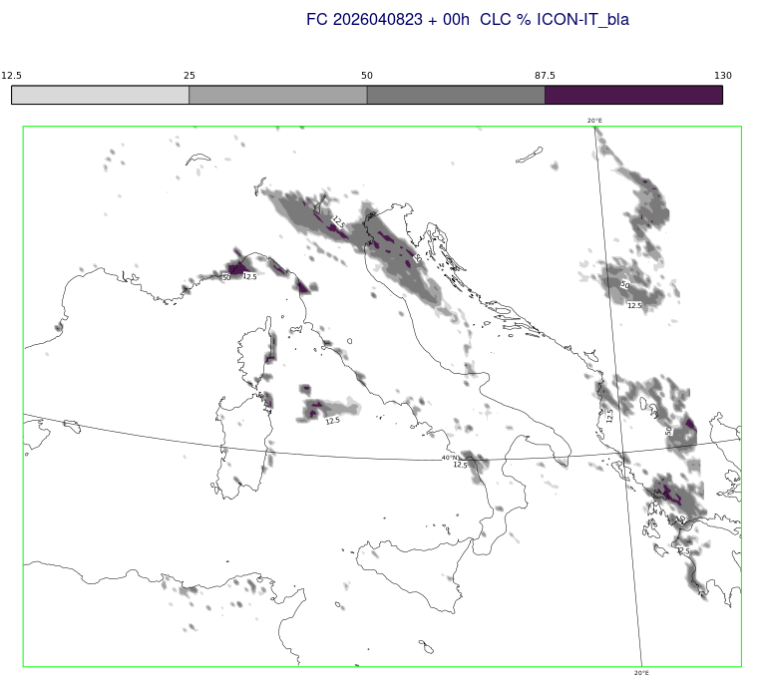
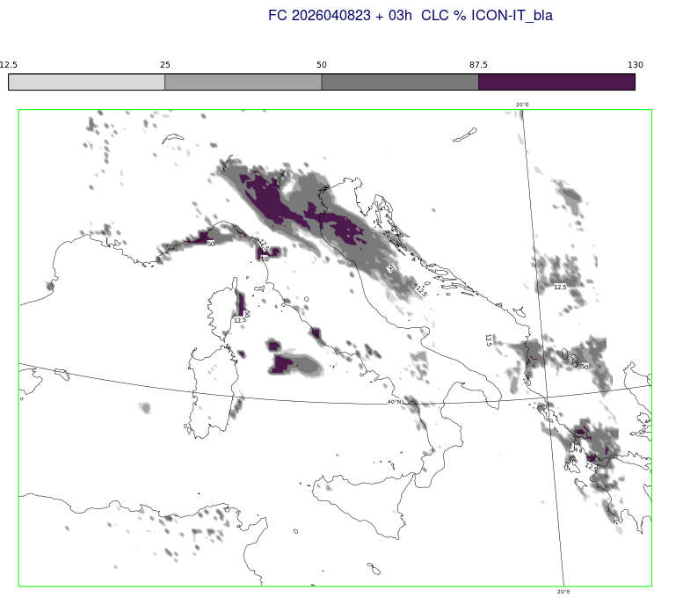
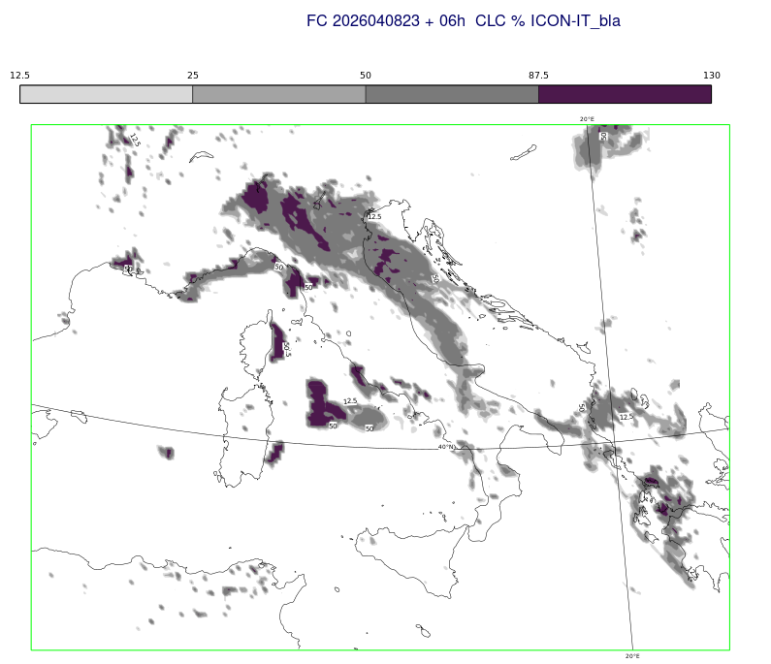
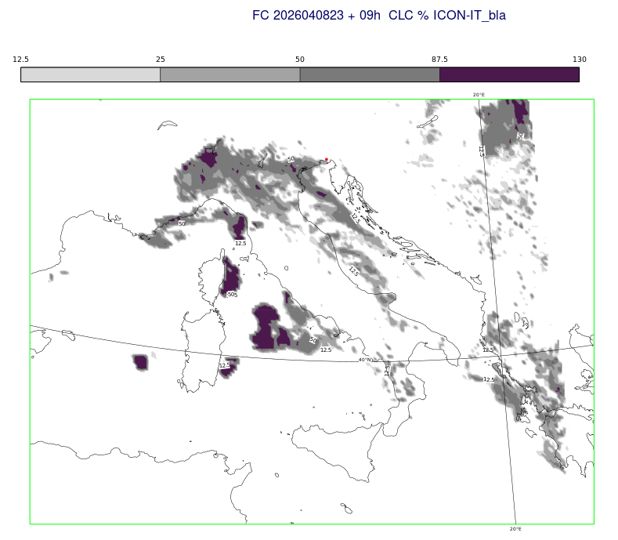
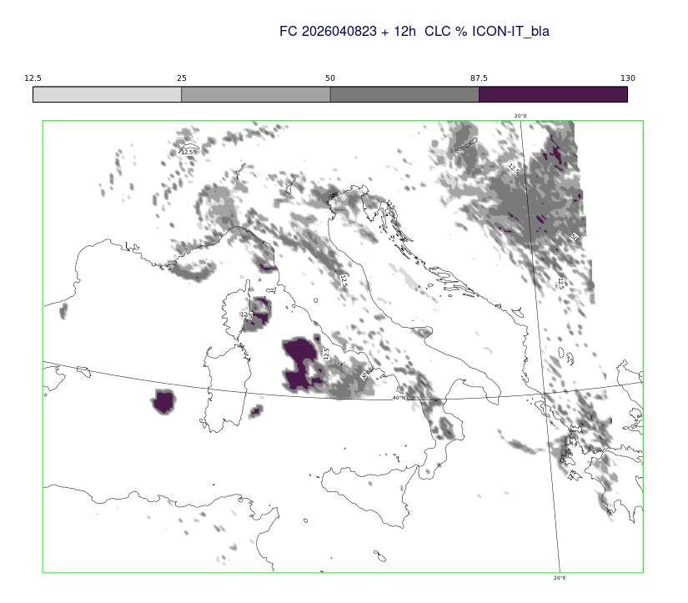
Sea of Sardinia: ICON-IT 20260408 23UTC FC
23:00 UTC 02:00UTC 05:00UTC
Namelist change:
Variability range for asymmetry factor for
sub-grid scale liquid cloud distribution
range_box_liq_asy = 0
(instead of 0.25)
08:00 UTC 11:00UTC

Slide 14
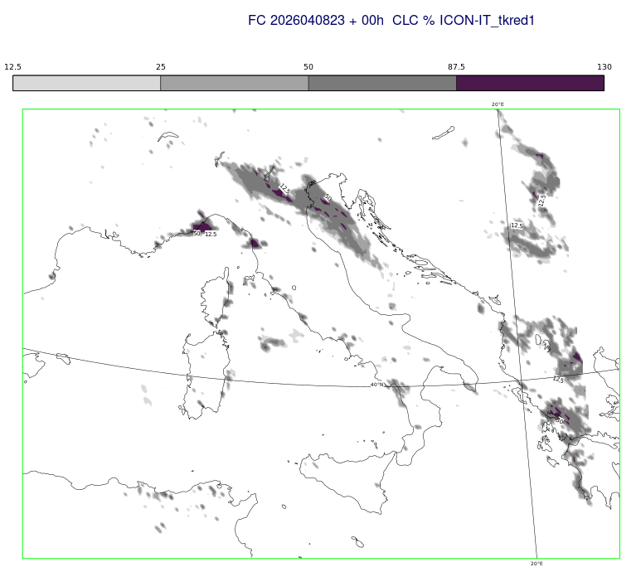

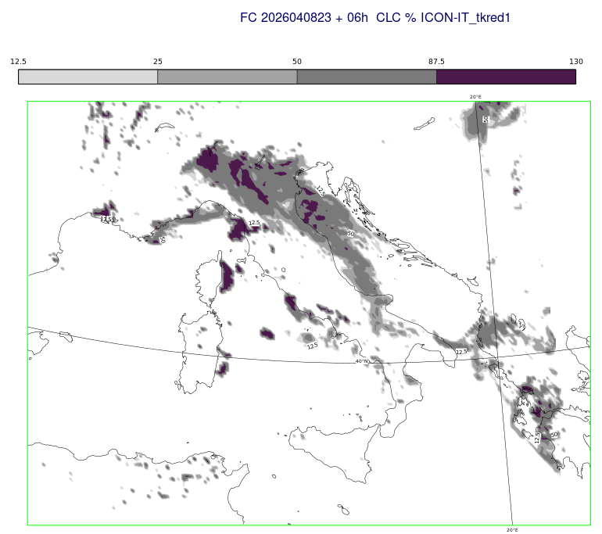
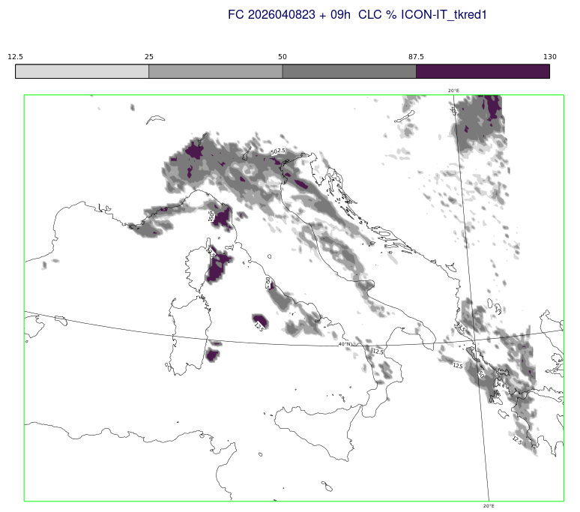
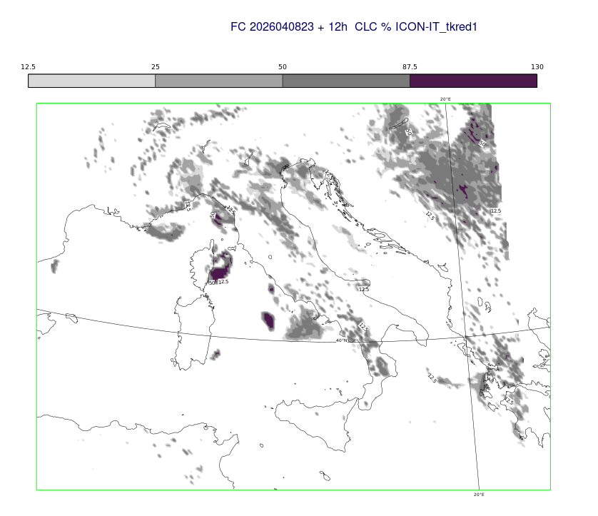
Sea of Sardinia: ICON-IT 20260408 23UTC FC
23:00 UTC 02:00UTC 05:00UTC
Namelist change:
Range for multiplicative change of reduction of minimum diffusion coeff. near the surface
range_tkred_sfc = 1 (instead of 4)
08:00 UTC 11:00UTC

Slide 15
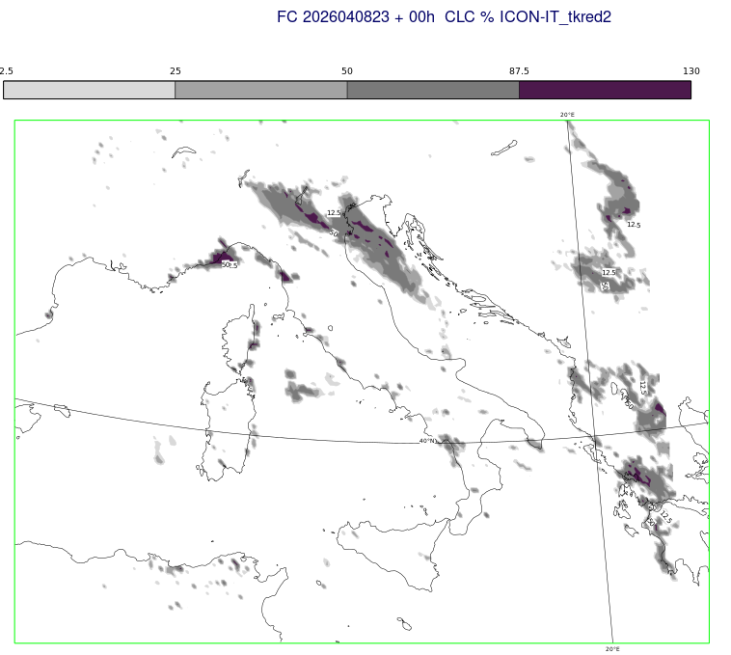

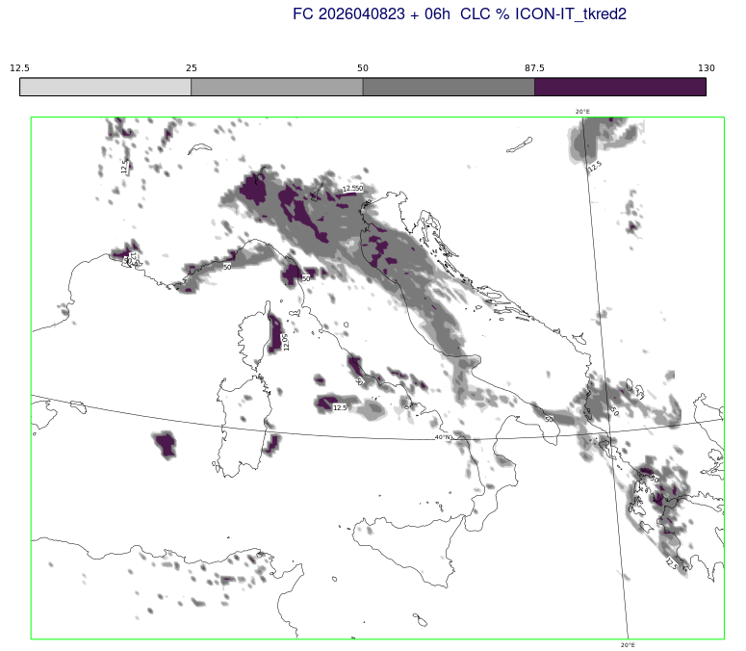
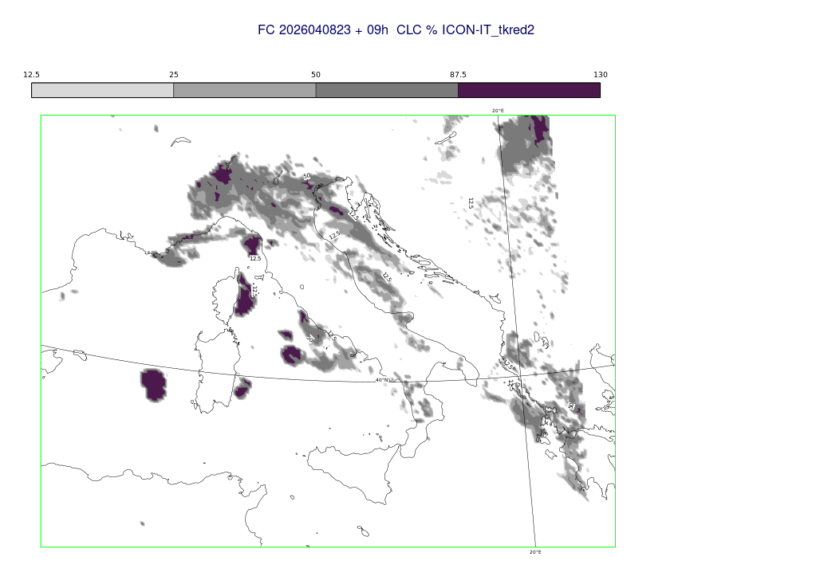
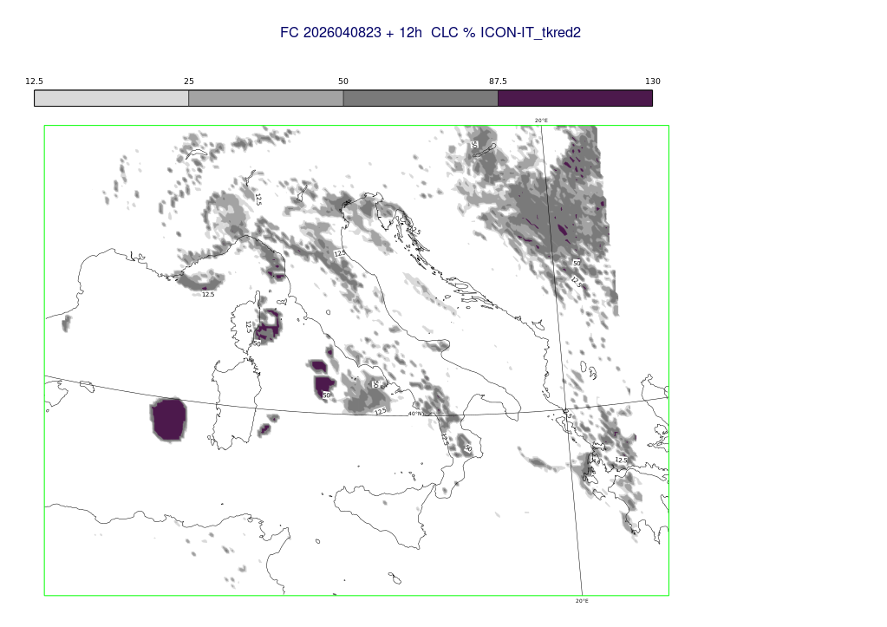
Sea of Sardinia: ICON-IT 20260408 23UTC FC
23:00 UTC 02:00UTC 05:00UTC
Namelist change:
Range for multiplicative change of reduction of minimum diffusion coeff. near the surface
range_tkred_sfc = 2 (instead of 4)
08:00 UTC 11:00UTC

Slide 16
Summary
An artificial low cloud system over sea of Sardinia is produced in the 20260408 23 UTC ICON-IT run in the 64-65 model levels (near surface)
Four experiments were performed starting the assimilation cycle with the 20260408 23 UTC oper. analysis and changing one ensemble perturbation namelist parameter at at time
The artificial low cloud system is not forecasted, only if range_tkred_sfc =1 (instead of 4) -> turn off the multiplicative change (perturbation) of reduction of minimum diffusion coefficients near the surface
The «problem» should be fixed by turning off the above mentioned perturbation over ice-free water (new namelist parameter: mask_tkred_water = T)

