Slide 1
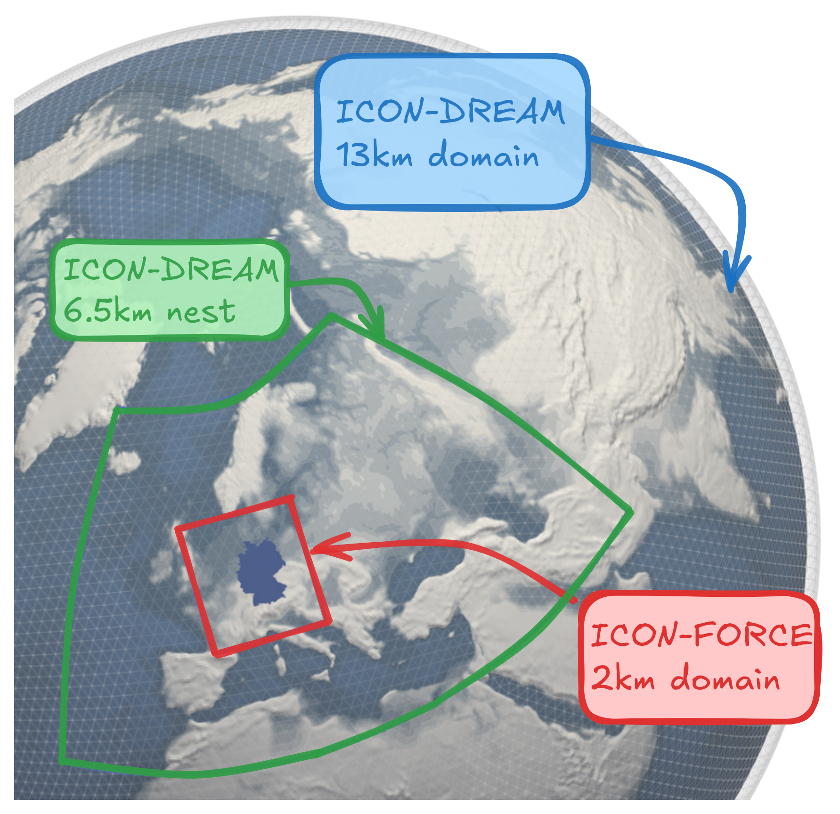
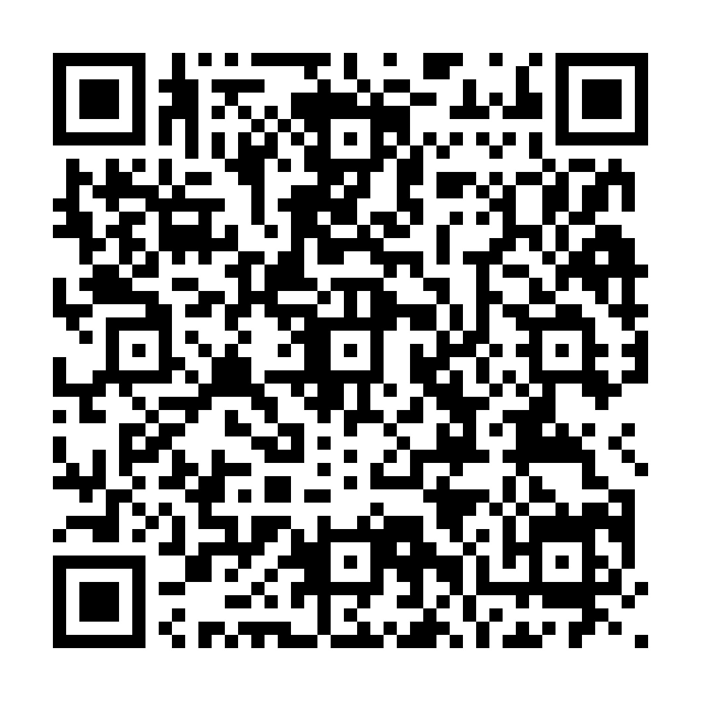
ICON Reanalyses – Status
ICON-DREAM v1
Near Real Time extension: last month with 6days lag
Subset of variables available at →
ICON-FORCE
Produced 2019-2025
Challenge to run 2016-2019: reprocessed Mode-s
ICON-FORCE-c
Produced 2019-2025
Waiting for FORCE (for now)
A. Valmassoi et al., A. Kelbch et al.
08.09.2026

Slide 2
ICON-DREAM v2 – developments
Extended period 1982-current
New features:
Include radiances assimilation: AMSU-A/B, MHS, ATMS, HIRS, MSU (thanks to Bill Bell for the CDRs);
If available, use CDRs (i.e. reprocesses observations)
Improve the ensemble representation
New snow DA – under testing
08.09.2026

