Slide 1

Andrzej Wyszogrodzki
PP APOCS
Subtask 4.4: Application of gridded RainGRS+ precipitation estimates for assimilation in NWP models (COSMO-RUC)
13-09-2026, COSMO GM 2026, PP APOCS

Slide 2
TASK: Application of gridded RainGRS+ precipitation estimates for assimilation in COSMO-RUC
Overview of COSMO-RUC system at IMGW-PIB
RainGRS+ devel. within PT EPOCS / PP APOCS
Status of implementation RainGRS+ to COSMO-RUC
Tuning and verification
Next steps for RUC development

Slide 3
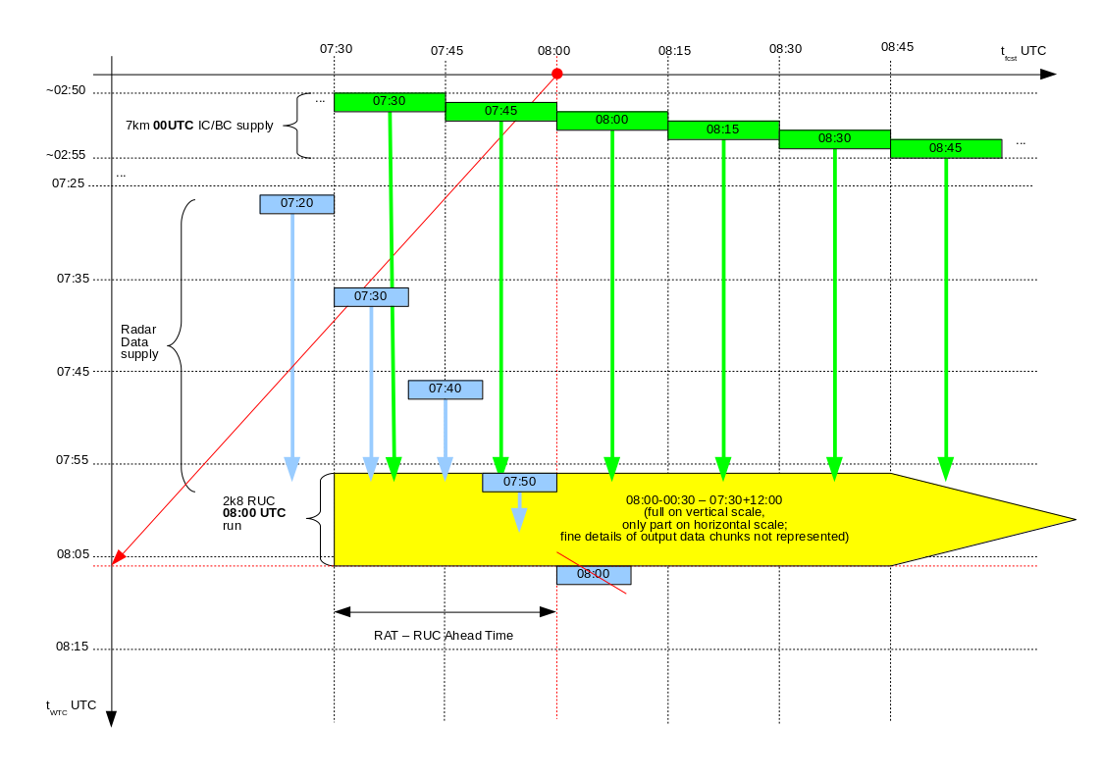
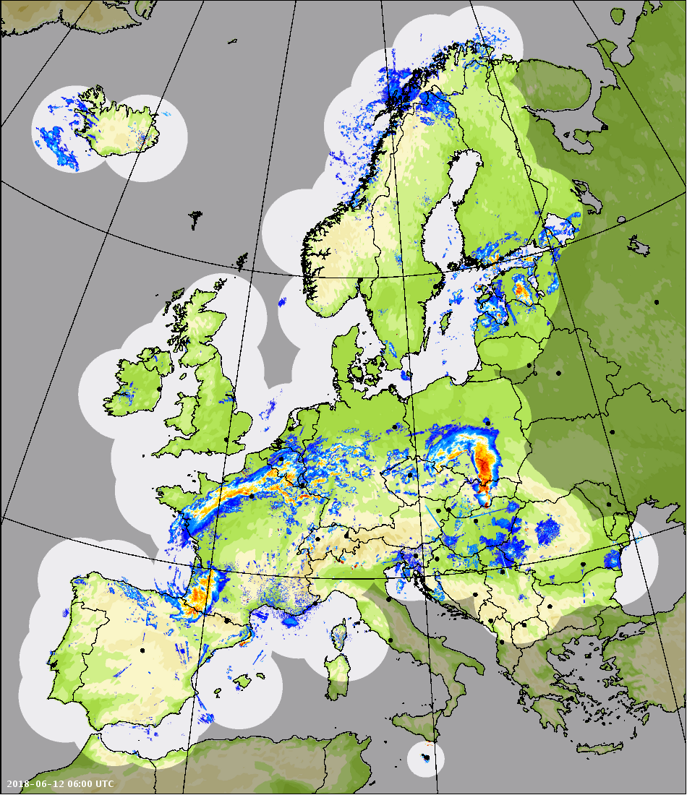
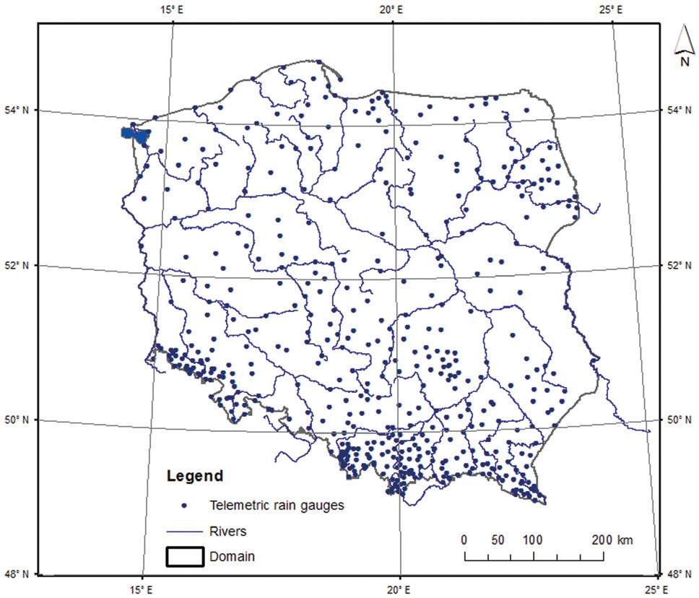
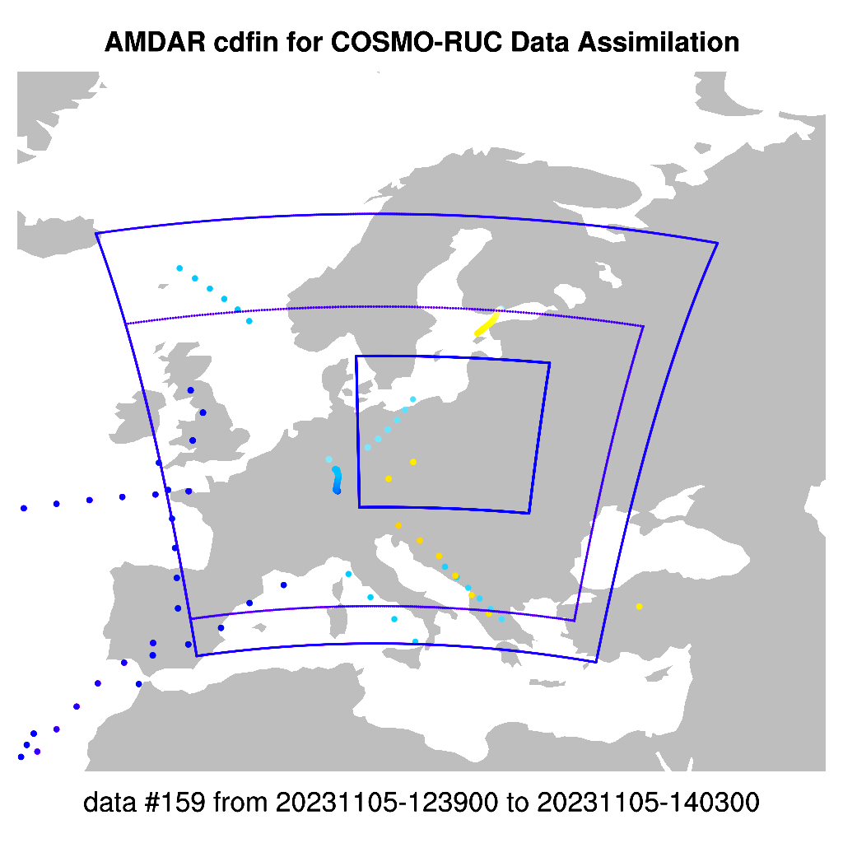
COSMO-RUC (Rapid Update Cycle) @ IMGW-PIB
Schematic RUC time /data flow
physical time →
Data Assimilation input
OPERA RADARS (SRI)​ 2km, 15 min
← forecast time
TELEMETRY (380 stations)
COSMO 2.8km: 1h data analysis + 3h free forecast
Cycles: start every 30 min (48 runs per day)
Data assimilation: telemetry, AMDAR, radar (LHN)
Support for: avaition, nowcasting, flash flood
Main modules for radar LHN:
  Converter OPERA HDF5 -> COSMO Grib1
  HDF5->BUFR (bufr-opera-mf-1.21), BUFR -> GRIB (dxc2grib)
  Remapping: OPERA 2km -> COSMO 2k8 domain / grid
AMDAR

Slide 4
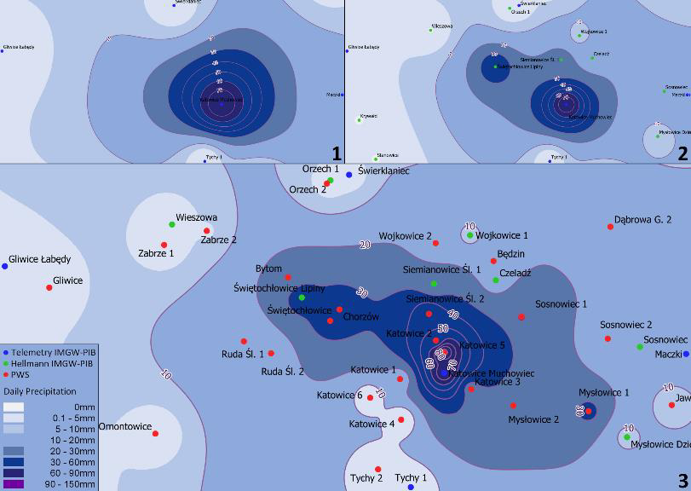
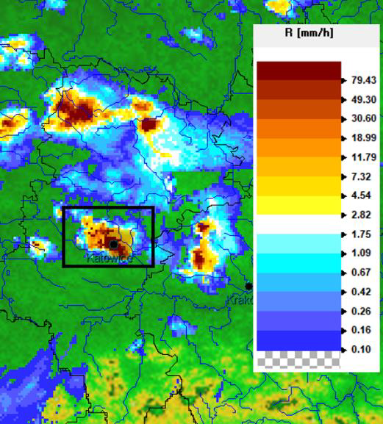
Spatial representation of precipitation field
Synoptic stations
Telemetric stations (Hellmanns)
RADAR rainfall intensity SRI
All stations including PWSs
ISSUES:
RainGRS OBJECTIVES:
quality of spatial precipitation field dependent on the number of gauge stations and spatial coverage / density of entire network
multi-source GRS precipitation fields
data quality control
weighted processing of precipitation inputs

Slide 5
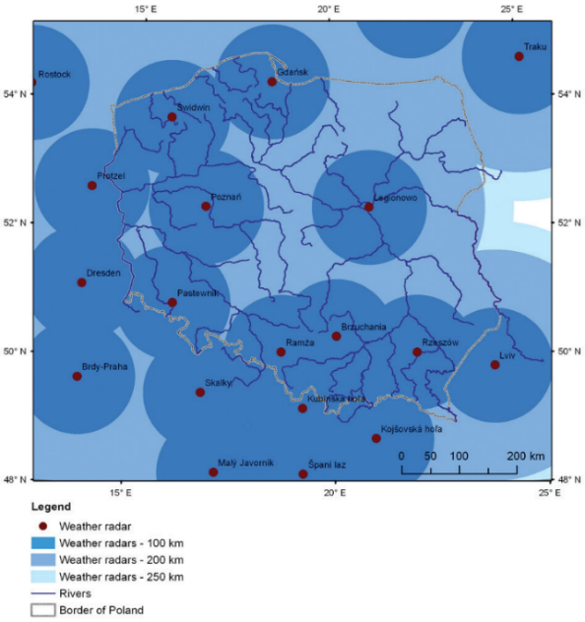
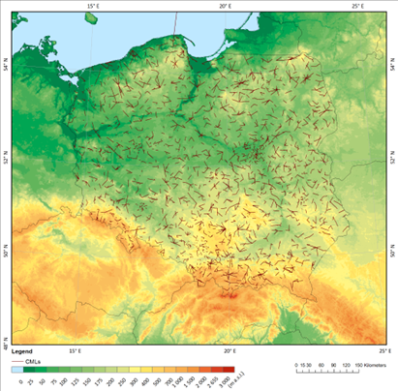
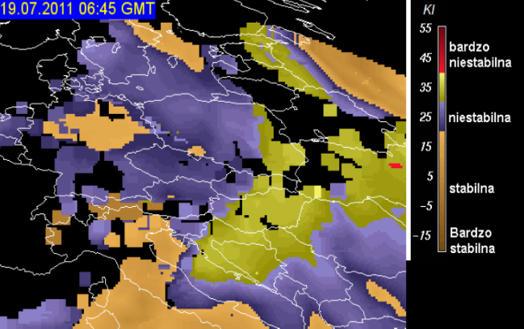
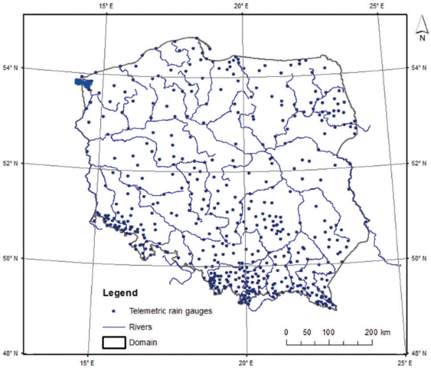
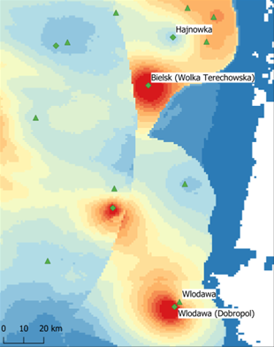
RainGRS / RainGRS+ composites
RainGRS (GAUGES, RADAR, SATELLIE)
operational configuration at IMGW-PIB
RainGRS+ (OPERA,PWS,CML)
extended version developed during PT EPOCS / PP APOCS
POLRAD+ NETWORK
METEOSAT SATELLITES
  COMMERCIAL MICROWAVE LINKS (CMLS)
NETWORK OF TELEMETRIC RAIN GAUGE STATIONS (491)
Doppler /dual-polarized radar data:
Poland (9) - POLRAD
Lithuania (2)
Ukraine (1)
Slovakia (4)
Czech Republic (2) Germany (4)
POLRAD + OPERA
Notes:
Commercial microwave links (CMLs)

Slide 6
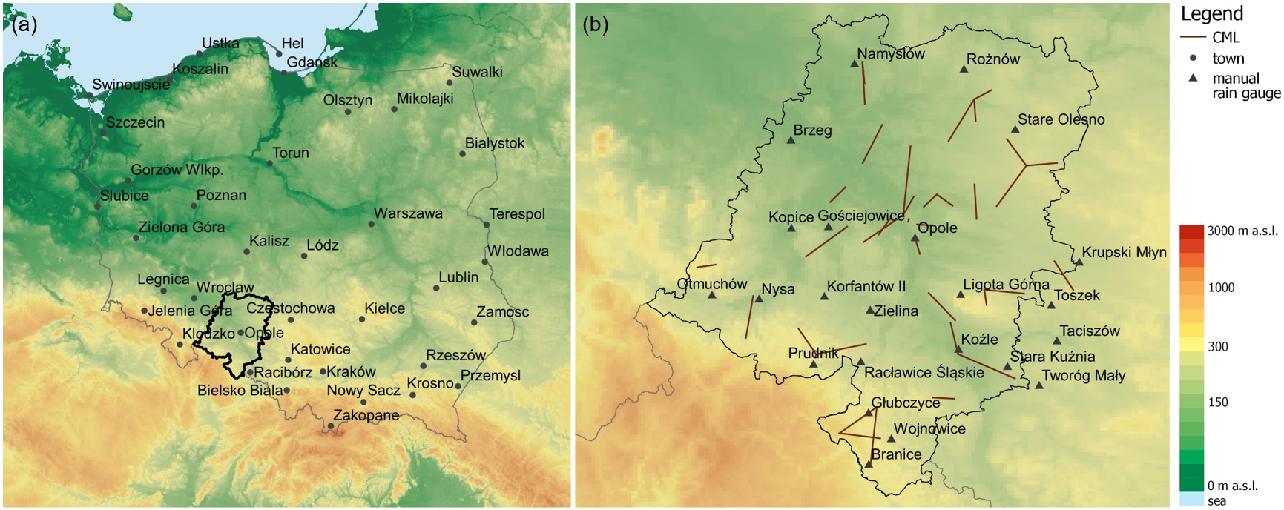
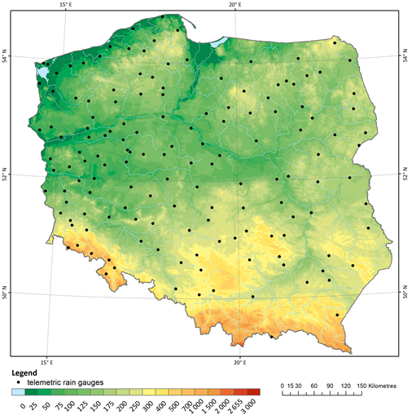
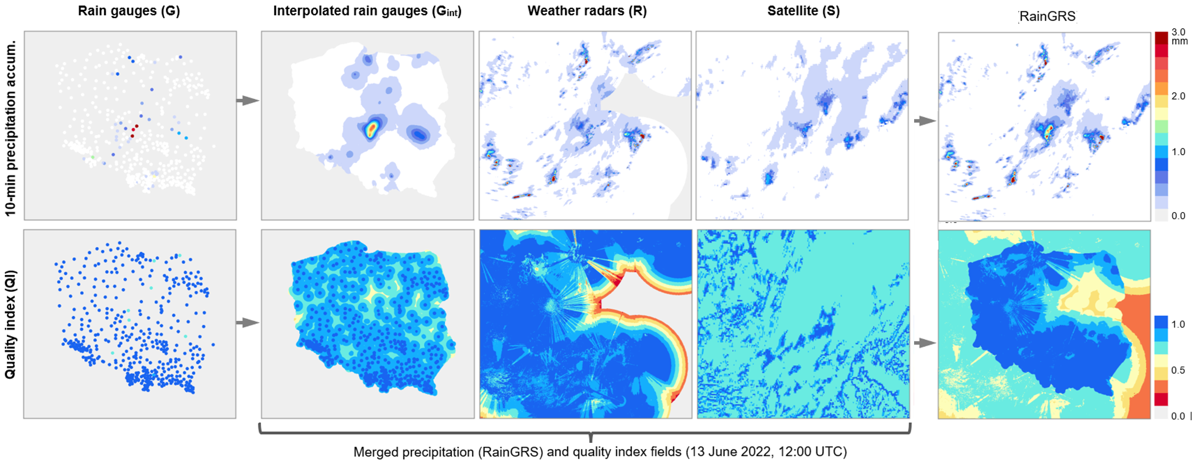
PT EPOCS / PP APOCS related tasks
PT EPOCS: 3.1 Processing different rainfall data sources -> RainGRS+ (COMPLETED)
CML location, Opole Voivodeship
Polish Forest State data
Quality based combination of input data:
  IMGW rain gauge network,
  POLRAD+ radar network
  Meteosat (NWC-SAF) precip estimates
  Commercial microwave links (CMLs)
  Polish Forest State rain gauges
Algorithm: a conditional merging (Sinclair and Pegram, 2005) modified by taking into account the quality information of the individual input data.

Slide 7
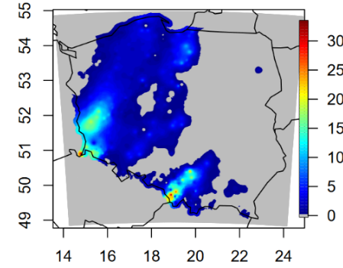
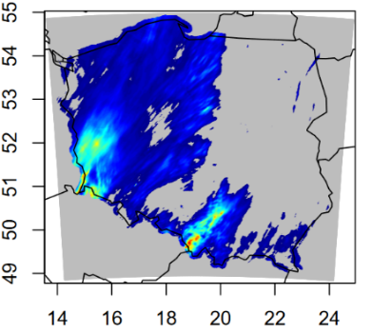
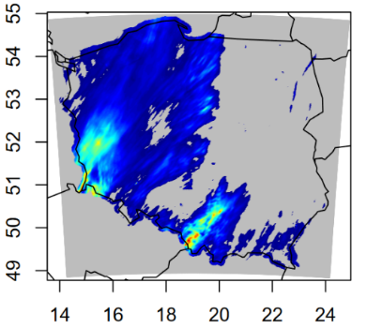
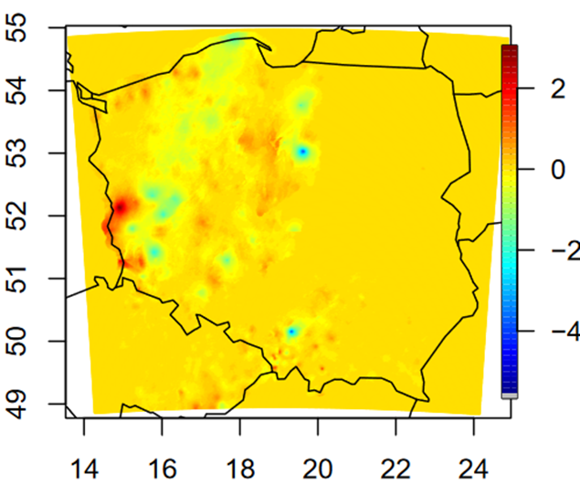
PT EPOCS / PP APOCS related tasks
PT EPOCS: 3.2 Reliability analysis of a gridded RainGRS+ high-resolution estimates of precipitation - case study 20230919 - 24h precipitation (COMPLETED)
Spatial and categorical verification over Poland and selected areas (24h precipitation)
Selected cases for period from 2023 -09-19 to 2023-10-01
Signal attenuation within CML sublinks determine different precipitation values
Rain GRS
Difference Rain GRS+ vs Rain GRS
Rain Gauges Hellmans
Rain GRS +
PP APOCS: 2.1 Adaptation of RainGaugeQC system to CML-based precipitation (ONGOING)
RainGaugeQC - quality control (QC) system of telemetric rain gauge data in real-time, using radar precipitation as auxiliary information
PP APOCS: 4.1 Improving RainGRS+ precipitation estimates by combining different types of data in more efficient and seamless manner (ONGOING)
Include OPERA composites: lower spatial resolution (~2km) and time frequency (15 min)
Combine radar data of different origins and quality control for a seamless merging

Slide 8
PP APOCS Subtask 4.4: Application of gridded RainGRS+ precipitation estimates for assimilation in COSMO-RUC
COMPLETED TASKS:
adaptation of RainGRS/RainGRS+ to COSMO 2k8 (domain / grid size)
generate converter GRS (HDF5) -> COSMO (GRIB1)
point verification: operational suite (m-files, shiny server)
ONGOING TASKS:
spatial verification (SAL): HARP operational suite (all IMGW-PIB models)
spatial verification (SAL/MODE): implement SpatialVx for case studies
data assimilation: LHN paramater tuning (max performance vs stability)
utilize quality precipitation estimates (QPE) for missing / poor quality data
collecting summertime convective cases for testing purposes

Slide 9
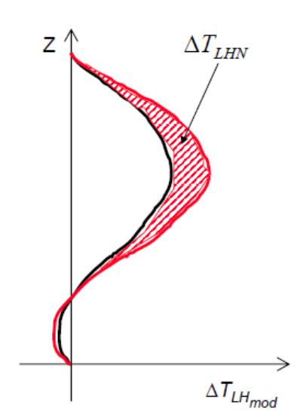
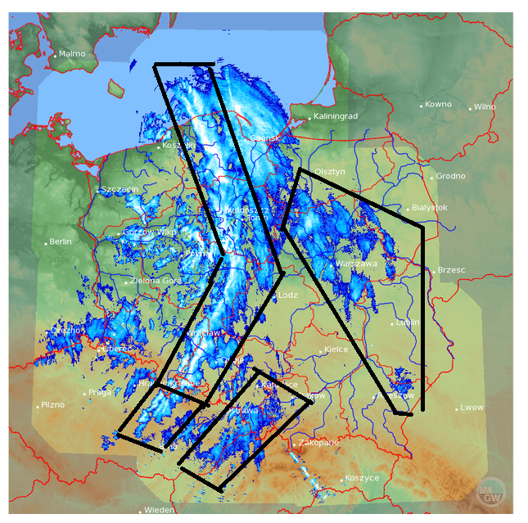
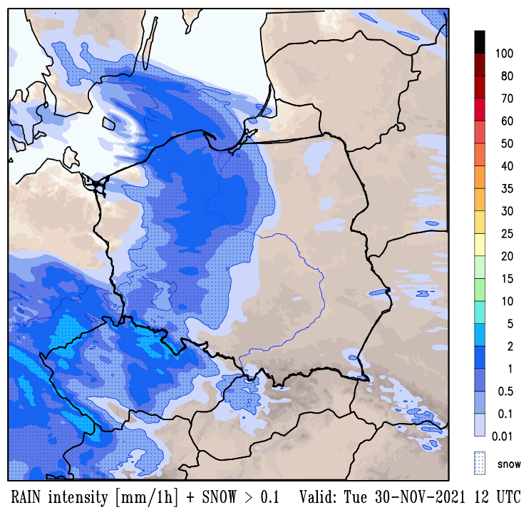
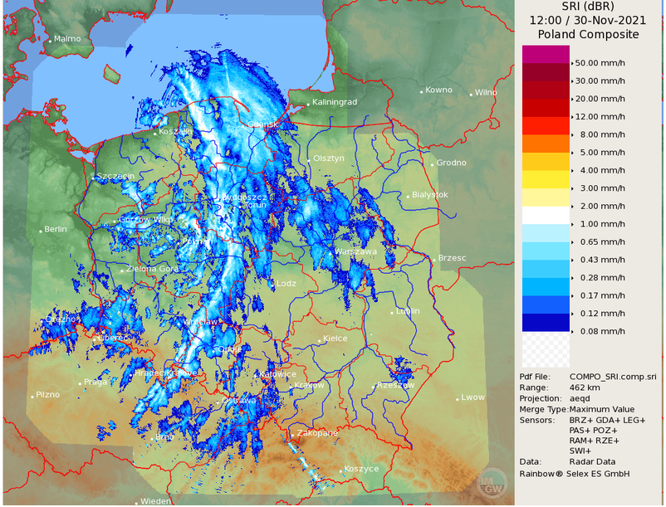
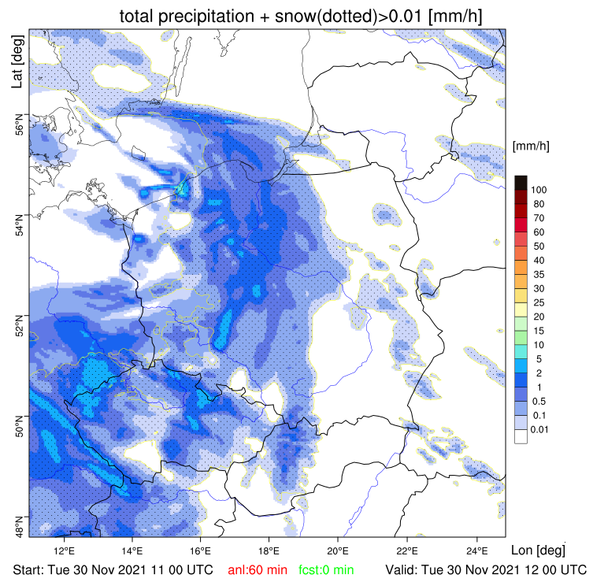
Tuning LHN parameters -> maximize RUC performance
Key tuning paramaters:
LHN-increments – incorporate positive heat rates
limiters to scaling factor – upper and lower
limiters to LHN-increments – preventing from instabilities
nearby grid points – enhancement for low precipitation rate
adjustment to specific humidity
vertical filtering – increments for profiles
horizontal filtering – incoming variables
vertically averaged precipitation flux
precipitation - feedback on the thermodynamic structure of the model
Observed precipitation at the right place and time => positive forecast adjustments
COSMO 2k8
RADAR SRI
COSMO 2k8 - RUC
ONGOING WORK: implementing spatial verification (SAL, MODE)

Slide 10
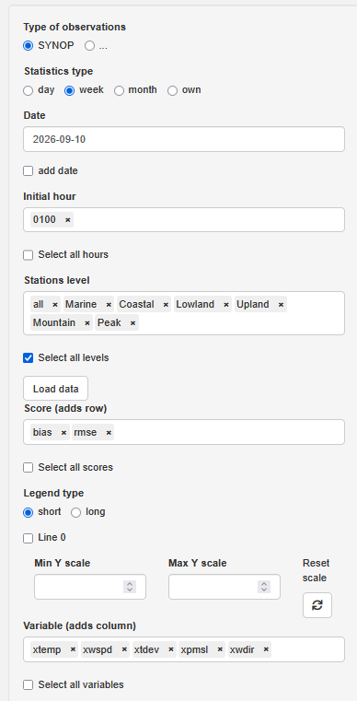
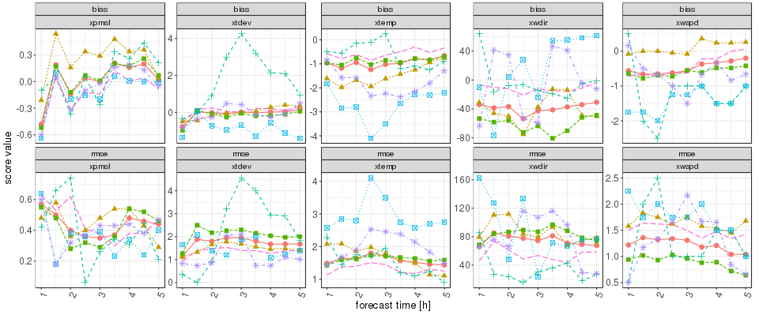
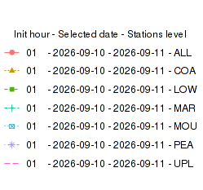
RUC verification
COMPLETED: SYNOP pointwise verification (m-files, shiny server)
EXAMPLE: RMSE/ BIAS verification for main fcst variables depending on the regional / geographical features (all, marine, coastal, lowland, upland, montains, high peaks)

Slide 11
NEXT steps for RUC development
2026:
COSMO-RUC tuning and objective verification (RainGRS vs RainGRS+)
Increase spatial resolution 2k8 -> 2k0
RainGRS+ operational implementation - substitute OPERA radar data
2027 +:
Transition COSMO -> ICON-LAM (2-mom microphysics, TERRA-URB)
Blending NWP with Nowcasting for seamless ultra-short-range forecasting

