Slide 1


Priority Project: APOCS Application of Personal Weather Station and Opportunistic Sensor Data CrowdSourcing
Greek stations data processing and quality control
Task 3.1
Dimitra Boucouvala
28th COSMO General Meeting, 2026

Slide 2
Priority Project: APOCS Application of Personal Weather Station and Opportunistic Sensor Data CrowdSourcing
Titanlib software:
Installation in our local machine.
Data Used:
OBS HNMS Network (restricted to non automated stations.
PWS data from National Observatory of Athens (NOA) and limited number of “amateur” stations in different formats
Test cases:
Several events around Greece over January 2023
Notes:
For the January 2023 test cases, six-hour precipitation observations from the HNMS network and PWS sources were used.
The HNMS observations were restricted to the non-automated stations used in this analysis and PWS observations provided additional spatial information.
The January MISH coefficients were applied consistently to all test cases.
The objective was to examine how the additional obs and the quality-control procedure affect the final gridded precipitation field.

Slide 3
Priority Project: APOCS Application of Personal Weather Station and Opportunistic Sensor Data CrowdSourcing
Data processing:
Reformatting and processing the dataset in order to get 6h precipitation for the whole month.
The data underwent quality control (by using the QC software). It was adapted for 6h precipitation values.
Notes:
Data was given in different formats and time steps.

Slide 4
Priority Project: APOCS Application of Personal Weather Station and Opportunistic Sensor Data CrowdSourcing
Quality Control parameters (winter configuration):
Buddy event check to detect 6h values >100mm over a radius of 40000km.
Buddy event check to detect null values among non null values (radius of 45000km)
Buddy check 20000 4 4 3.5 (radius, min_num, threshold, std_dev)
Buddy event check for null precipitation values for a smaller radius(1000km).
Procedure produced clean data.
Notes:
According to the software 3 buddy event checks and one buddy check were performed with adaptation of the

Slide 5
Priority Project: APOCS Application of Personal Weather Station and Opportunistic Sensor Data CrowdSourcing
Weather conditions
19-26 January winter weather across Greece broke a prolonged spell of unusually warm, sunny January weather.
The precipitation and weather patterns at the end of January featured:
Heavy Rains and Thunderstorms: Significant rainfall and localized storms impacted various parts of the country. On January 20 specifically, heavy rains and thunderstorms hit regions including western Greece (the northern Ionian Sea, Epirus, western Sterea, and western Peloponnese), central and eastern Macedonia, Thrace, and parts of the eastern Aegean islands and Dodecanese. These storms were occasionally accompanied by lightninsg, hail, and strong marine winds.
Mountain Snowfall: Colder air moving into the region brought snowfall to the mountainous and semi-mountainous areas of western Macedonia, Epirus, and western Sterea.
Notes:
The weather conditions in Greece was rainy for several days in the month especially around January 20th, with significant events especially over western Greece, and snowfall over mountains

Slide 6
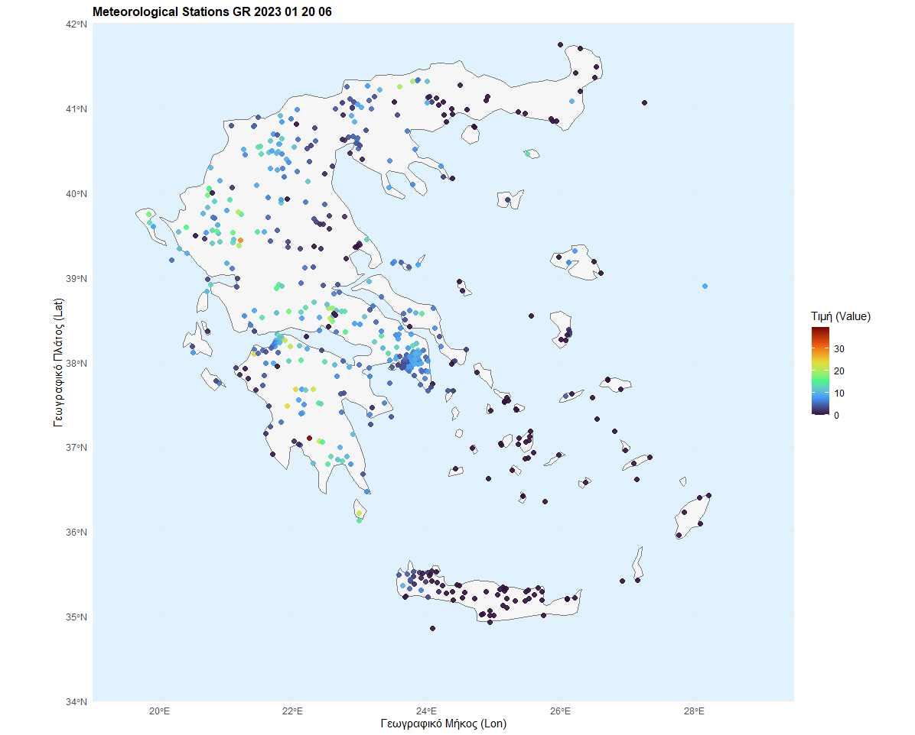
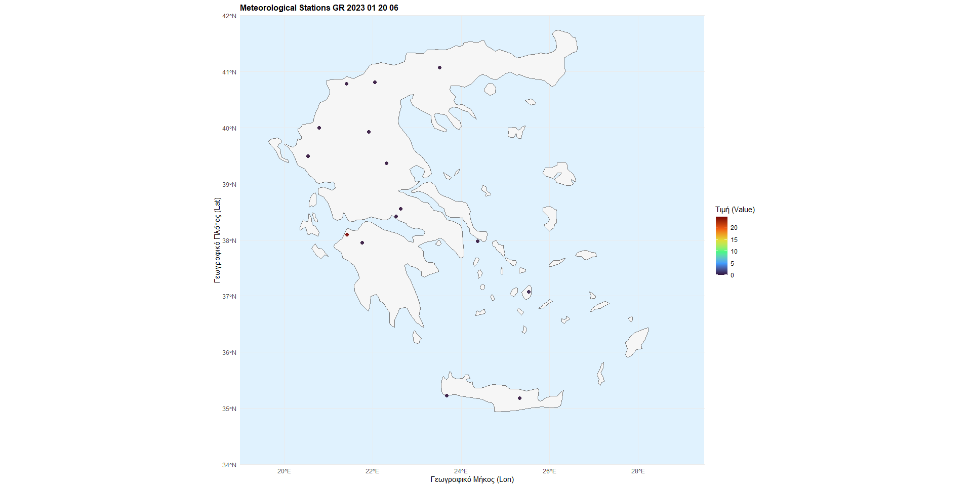
Priority Project: APOCS Application of Personal Weather Station and Opportunistic Sensor Data CrowdSourcing
20/1/2023 06 UTC 6h
Most stations were removed due to very small to zero values apart one in western Greece (25mm)

Slide 7
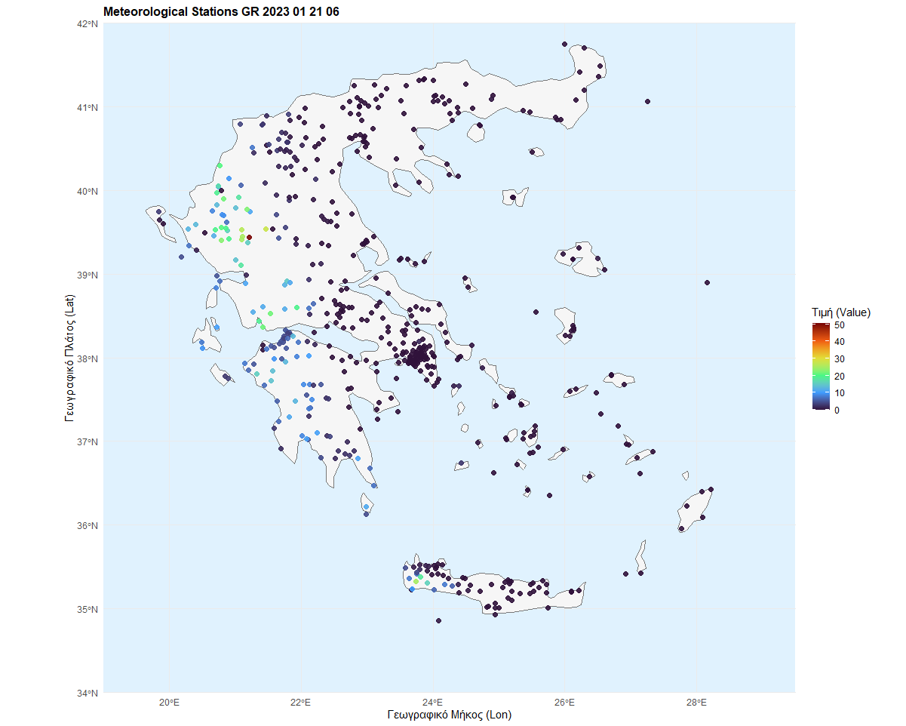

Priority Project: APOCS Application of Personal Weather Station and Opportunistic Sensor Data CrowdSourcing
21/1/2023 06 UTC
Most stations were removed due to zero values apart from one (51mm)

Slide 8
Priority Project: APOCS Application of Personal Weather Station and Opportunistic Sensor Data CrowdSourcing
The procedure can be applied to any dataset with qc parameters tuning according to weather conditions
Next step is gridded datasets production for the whole month (task 3.2).

