Slide 1



PP-APOCS
Elena Oberto¹, Francesco Uboldi¹, Massimo Milelli¹, Valeria Garbero², Tanguy Houget³
1 CIMA Foundation
2 ARPA Piemonte
3 PoliTO (Politecnico di Torino)
COSMO GM2026

Slide 2
SubTask 2.2: Titan lib applied to “not conventional” raingauge datasets.
TITAN LIBS (www.github.com/metno/titan) applied to precipitation data coming from the "official" network of stations of the Italian National Civil Department for QC, now we are going to apply also to "non-official" free networks, for instance “Meteonetwork”.
Deliverables: report on the tests performed, description of the useful algorithms
Participating scientists: Francesco Uboldi, Elena Oberto, Massimo Milelli (CIMA)
FTEs: 0.5, Dates: April 2026 - March 2027

Slide 3
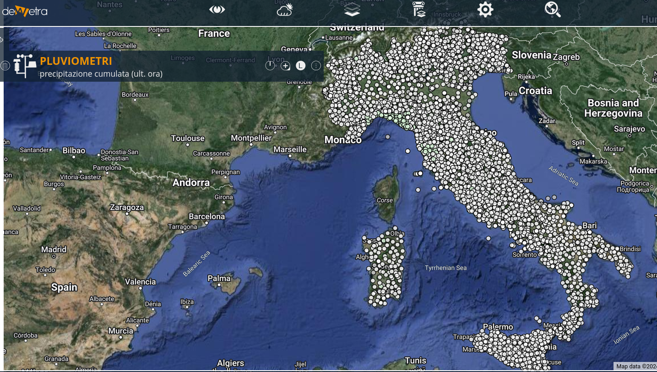
QC PRECIPITATION - A BRIEF RECAP: TITAN LIB APPLICATION
Titanlib range check (<0mm; >600mm) on hourly data
Completeness of daily values (rejected daily values if number of hours < 24)
Titanlib range check on daily data (>1000mm)
Titanlib isolation check (pre-operational fine tuning)
Titanlib sequential tests on daily data/seasonal data: buddy check and buddy
event check with several different configurations (depending on seasonal/weather configuration)
The buddy check: it compares an observation against its neighbours and flags outliers in a radius specified by the user.
The buddy check flags observations if the (absolute value of the) difference between the observations and the average of the neighbours normalized by the standard deviation in the circle is greater than a predefined threshold.
If the standard deviation of values in the neighbourhood is less than a chosen value, min_std, then a value of min_std is used instead.
min_std should be roughly equal to the standard deviation of the error of a typical observation. If it is too low, then too many observations will be flagged in areas where the variability is low.
The buddy event check: observations are converted into yes/no values of exceeding a specified threshold (event_threshold).
The threshold argument in this test is minimum fraction of other observations in the neighbourhood that must agree with the observation being inspected. If event_threshold=0.2 and threshold=0.25, then an observation exceeding 0.2 requires that at least 25% of the other observations within the radius also exceed 0.2. If an observation is less than 0.2, then 25% must also be below 0.2.
(thanks to U. Pellegrini for installing Titan lib and preparing R/bash scripts to run the QC)

Slide 4
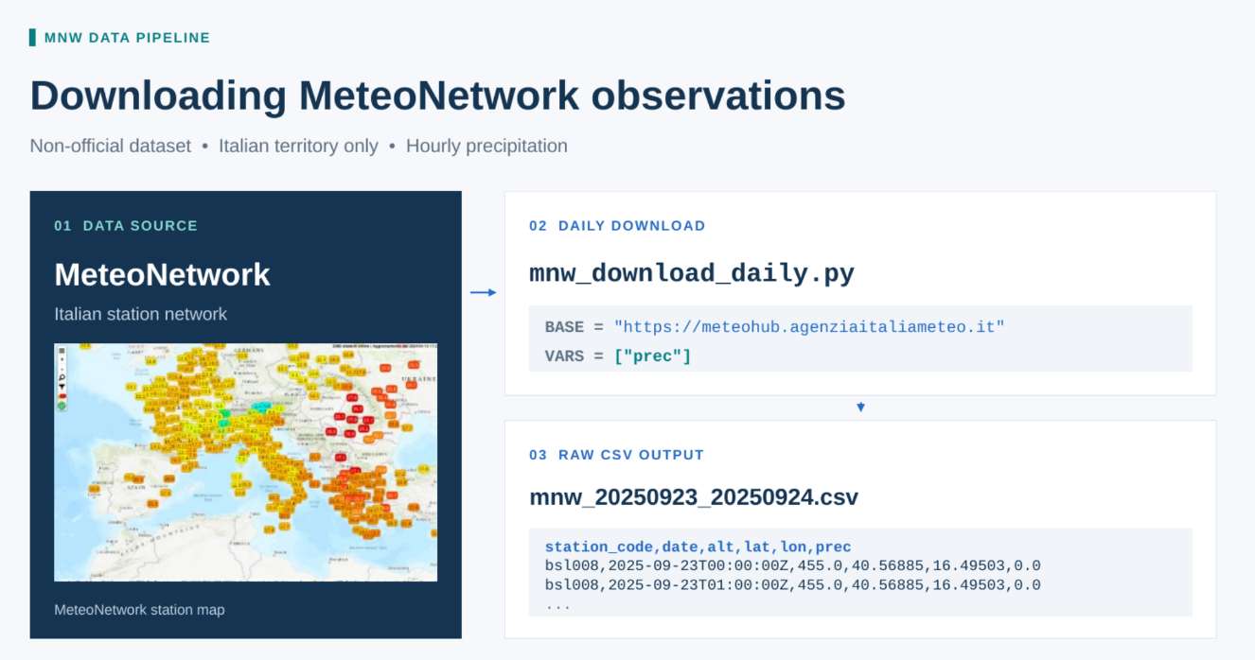

Slide 5
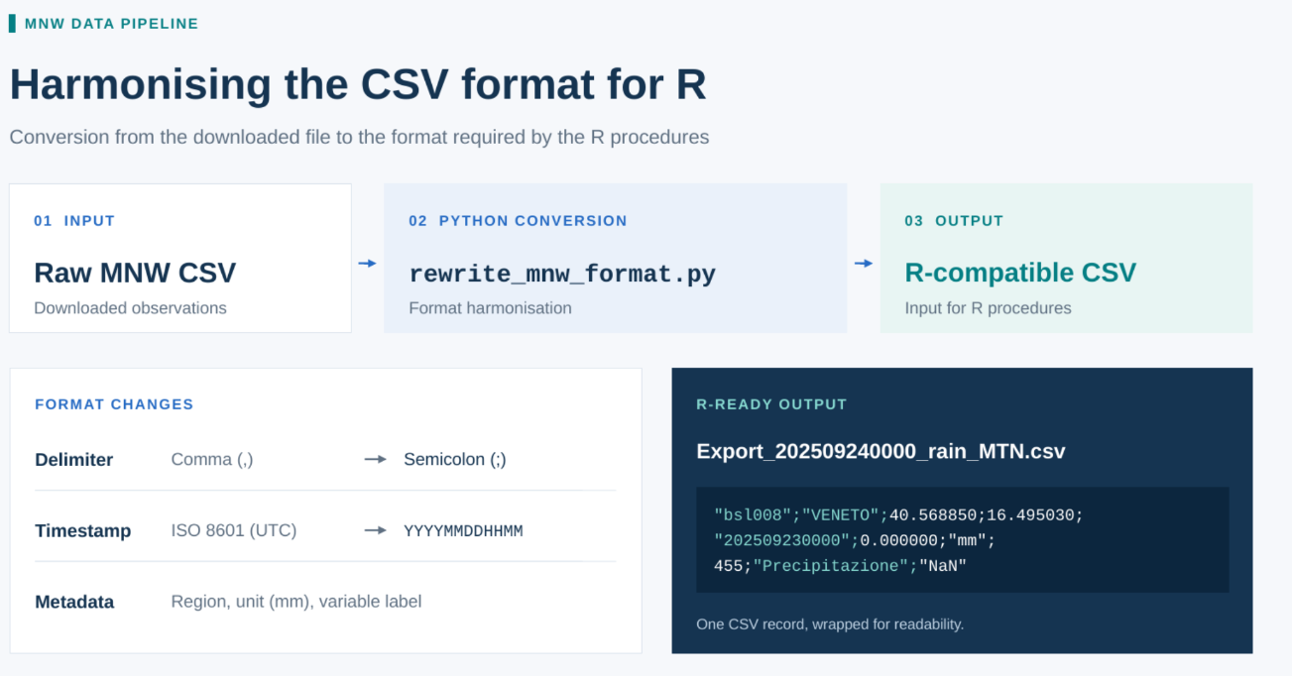

Slide 6
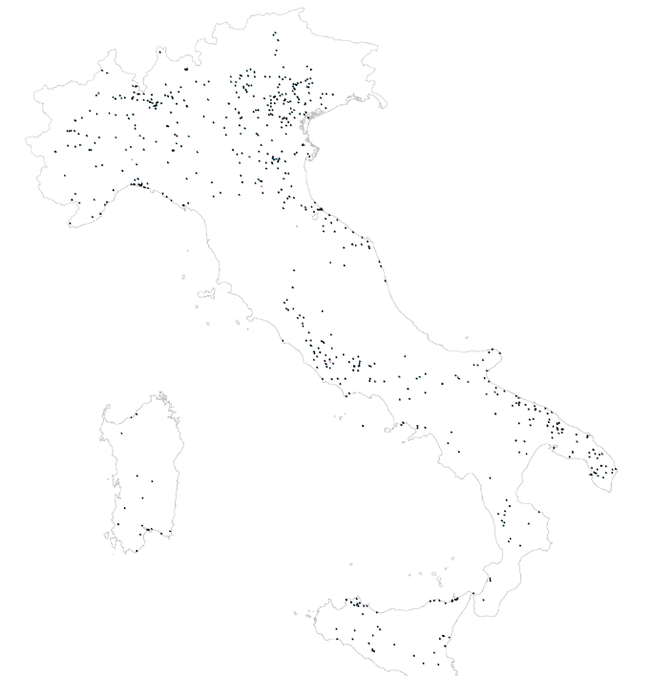
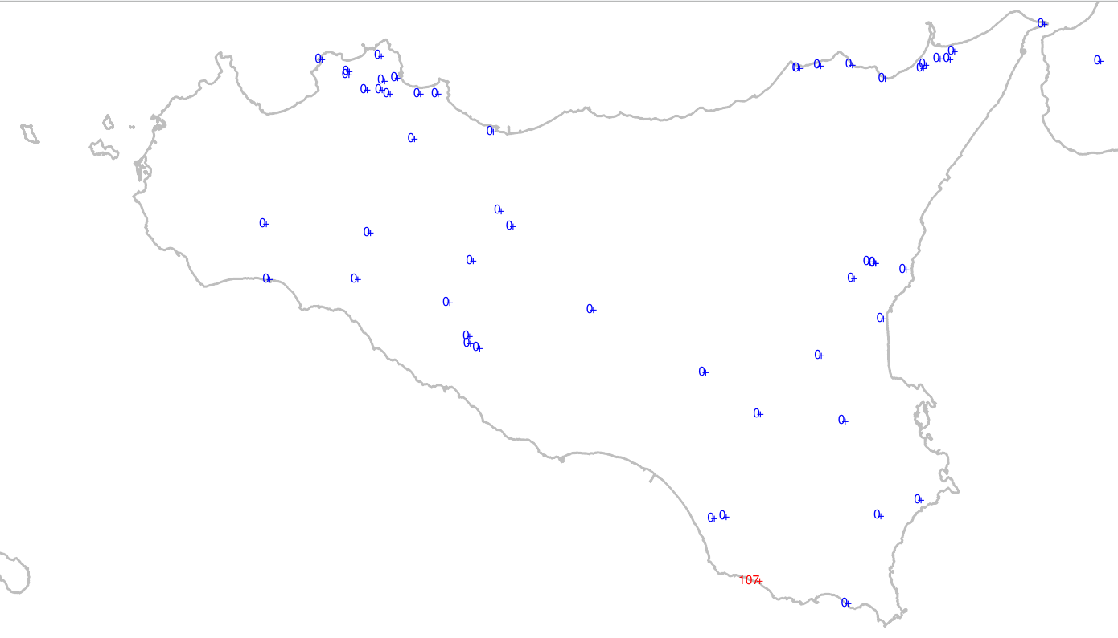
Buddy event
Removed: 7
Radius: 65 km
Buddy min: 8
Thres. Event: 0.1 mm
Thres. 1

Slide 7
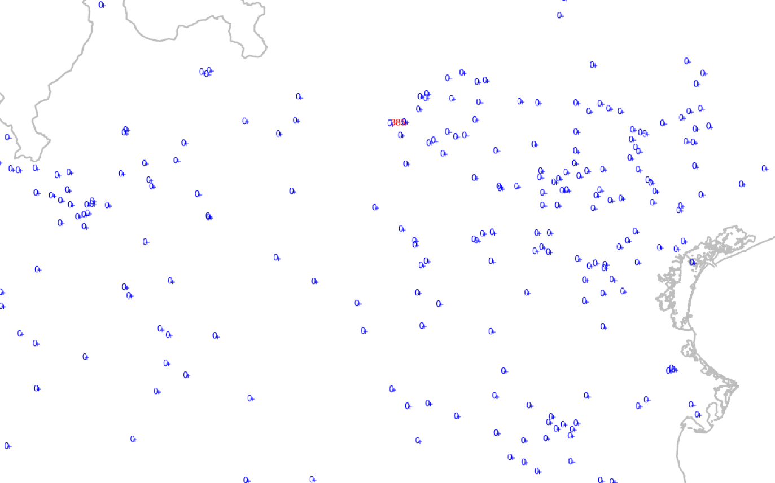
Buddy check
Removed: 1
Radius: 35 km
Buddy min: 4
Thres. : 12.5 mm
Dev. 8.5mm

Slide 8
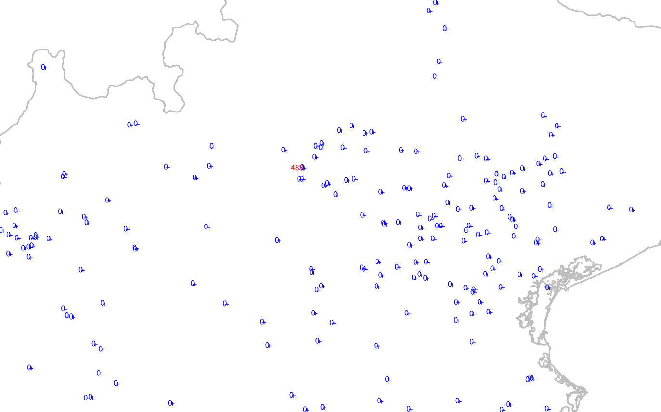
Buddy event
Removed: 1
Radius: 60 km
Buddy min: 8
Thres. event : 400 mm
Thres. 0.2%

Slide 9
SubTask 2.3: Quality control procedure for T2m and Rh2m
SCT R code have been applied to a temperature dataset from the "official" network of stations of the Italian National Civil Department. Additionally, it has been also applied to RH official dataset for the quality control.
A new quality control procedure will then be developed in Python specifically for NetAtmo data
The next step will be to implement and apply the different QC techniques (Titan lib,R code and Python script) to the "non-official" networks of “Meteonetwork” and “Netatmo”.
Deliverables: report on tests performed, description of the useful algorithms
Participating scientists: Francesco Uboldi, Elena Oberto, Massimo Milelli (CIMA), Valeria Garbero (Arpa Piemonte), Tanguy Houget (Politecnico di Torino) FTEs: 0.3 (CIMA), 0.1 (ArpaP), 0.1 (PoliTo). Dates: April 2025 - March 2026

Slide 10


OI, BF and SCT
The background estimate for temperature (T) and dew point (TD) is calculated at each observation site using nearby stations within 30 km for T and 50–60 km for TD. The observation under test is excluded from this computation. A vertical gradient is derived via least-squares from neighboring station values and elevations, allowing all nearby data to be adjusted to the target elevation. The median of these adjusted values is used as the background field BF, offering robustness against outliers. In the BF check, each observation is compared with its background field (BF) value using two thresholds: a large one (T: 6 °C, TD: 12 °C) and a small one (T: 1 °C, TD: 1 °C). Observations differing from the BF by more than the large threshold are classified as gross errors (GE) and discarded, and the ones differing from BF for less than the small threshold are directly validated, without undergoing other tests.
The Optimal Interpolation OI minimizes the mean square error of the analysis:
yº: observations, y^{b}: background, yª: analysis, S: background error correlation matrix, R=ε²I observation error correlation matrix
The leave-one-out Cross Validation analysis is calculated and used in the Spatial Consistency Test SCT:
σo²: observation error variance, T²: test threshold
F. Uboldi, C. Lussana and M. Salvati, 2008. Three-dimensional spatial interpolation of surface meteorological observations from high-resolution local networks. Meteorological Applications, 15, 331-345, DOI:10.1002/met.76
C Lussana, F Uboldi and M Salvati, 2010. A spatial consistency test for surface observations from mesoscale meteorological networks. Q. J. R. Meteorol. Soc., 136, 1075–1088, https://doi.org/10.1002/qj.622

Slide 11
Updates on Quality Control procedure for T2m and Rh2m
QC R scripts are applied to temperature (T) and relative humidity (RH) observations from the official network of stations of the Italian National Civil Department.
METADATA CHECK
“Multiple” stations: a) same time series, different coordinates; b) same location, (very) different data:
Multiple stations are rejected for monthly model verification;
Variability of difference from model estimate proved to be a valid approach, it can be used in case-studies to find the correct station (not all ambiguities can always be solved)
OBSERVATION TEST SEQUENCE
RANGE and MISSING DATUM tests are performed first.
PERSISTENCE check (temperature only): in a station data series, observations not varying more than a minimum interval (0.09°C) in a given time interval (8 hours) are rejected.
Preliminary FEWOBS check: station data series with less than a given fraction of data are rejected
BF (Background Field) check
SCT (Spatial Consistency Test)
Final FEWOBS check: FEWOBS test is repeated to account for rejections due to BF check or SCT

Slide 12




Approach to Quality Control of Wind observations
A QC procedure for wind observations is under development
Wind observations are few, about 1/3 of temperature observations
Wind is a vector, wind observation is a couple: incoming direction an speed (vector magnitude) that can be converted in Cartesian components U (Eastward) and V (Northward)
Weak speed is often associated to uncertainty on direction
Analysis (OI) of Cartesian components U,V implicitly tends to reduce speed
SCT can be seen as a check on the squared difference between observed value and CV-analysis:
For wind, the squared magnitude of the vector difference is used to formulate the SCT:
BF for wind is obtained as a preliminary large-scale OI analysis
The prior observation-to-background error ratio for wind is assumed to decrease with observed wind speed.
The test threshold also vary with speed: more permissive when observed winds are strong with respect to CV analysis, more restrictive for weak observed winds. Work is under way to tune test parameters.

Slide 13
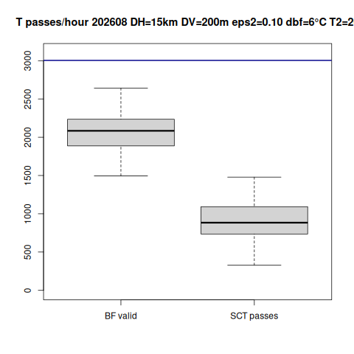
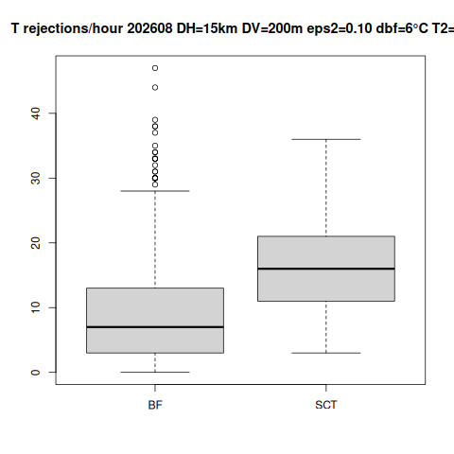
Number of temperature observations validated by the BF check and accepted by the SCT (left-hand plot), and number of observations rejected by the BF check and by the SCT (right-hand plot), per hour, August 2026

Slide 14
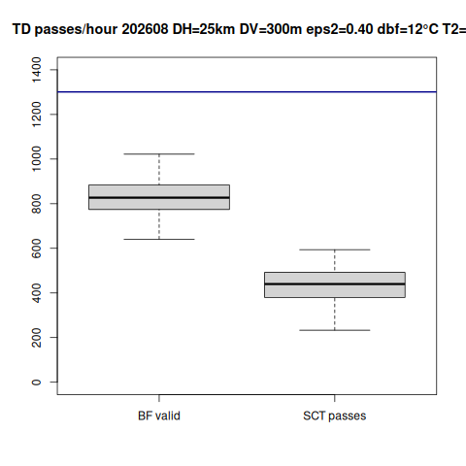
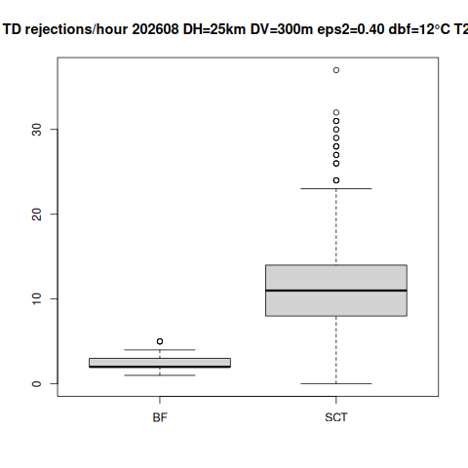
Number of TD observations validated by the BF check and accepted by the SCT (left-hand plot), and number of observations rejected by the BF check and by the SCT (right-hand plot), per hour, August 2026

Slide 15
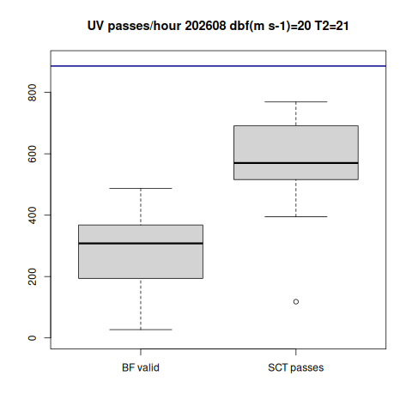
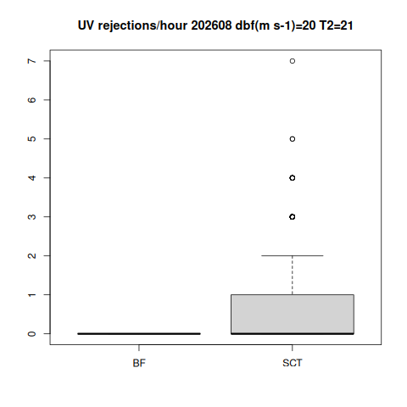
Number of WIND observations validated by the BF check and accepted by the SCT (left-hand plot), and number of observations rejected by the BF check and by the SCT (right-hand plot), per hour, August 2026

Slide 16
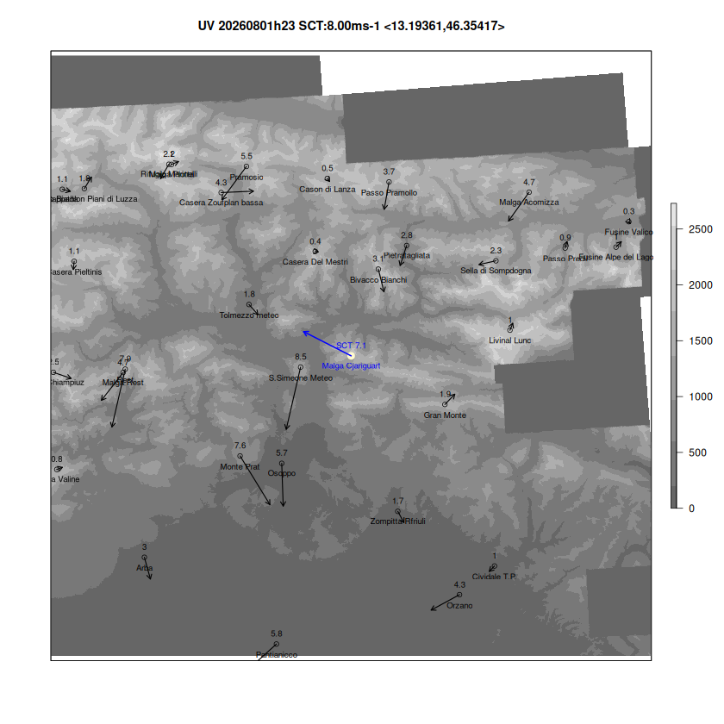
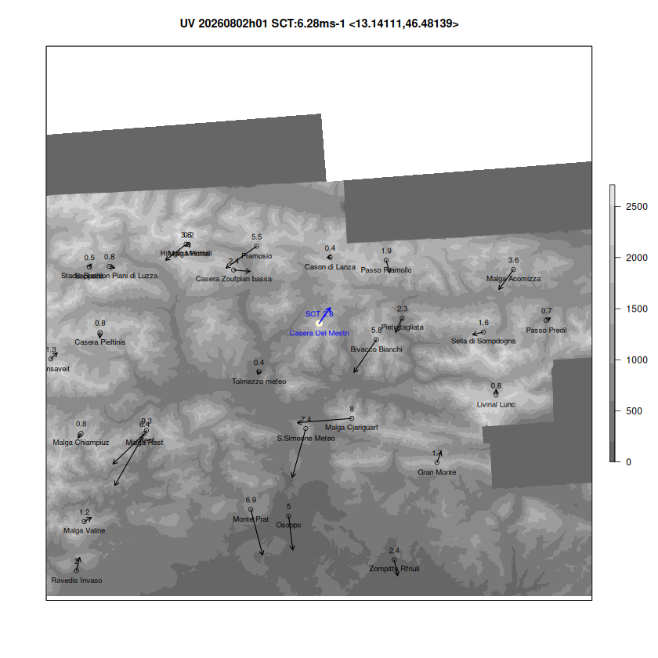
WIND QC Arrows represent observed wind vectors

Slide 17
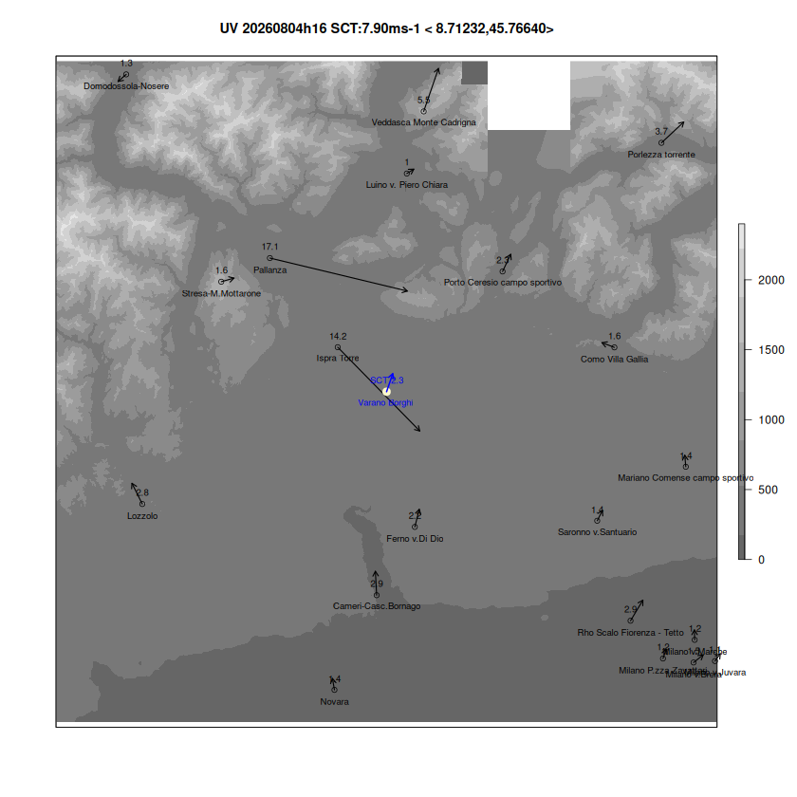
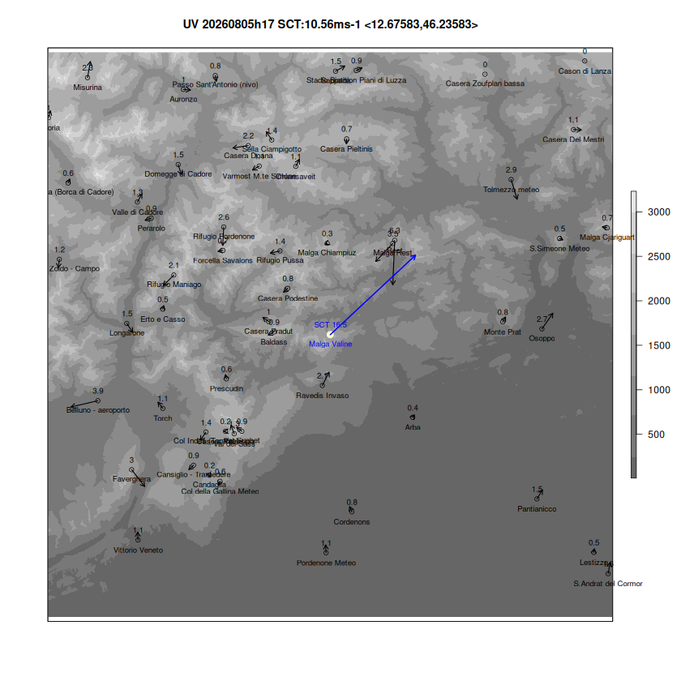
WIND QC Arrows represent observed wind vectors

Slide 18
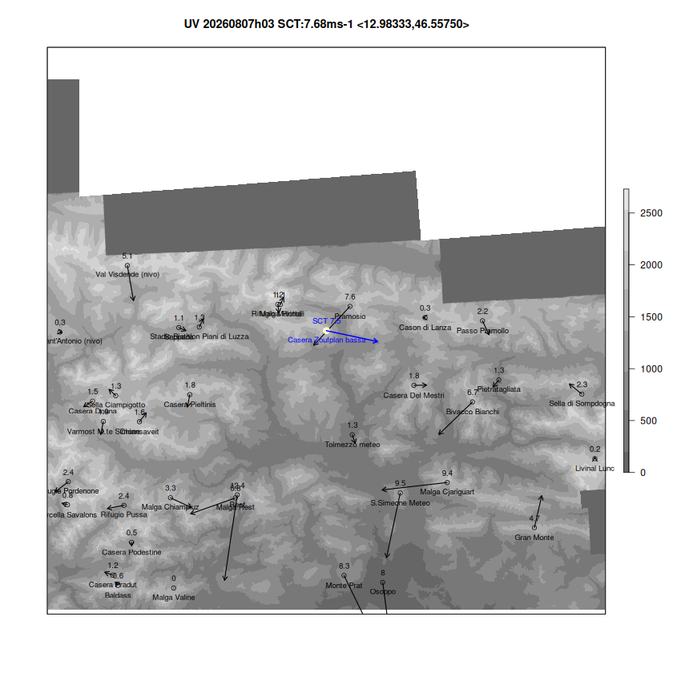
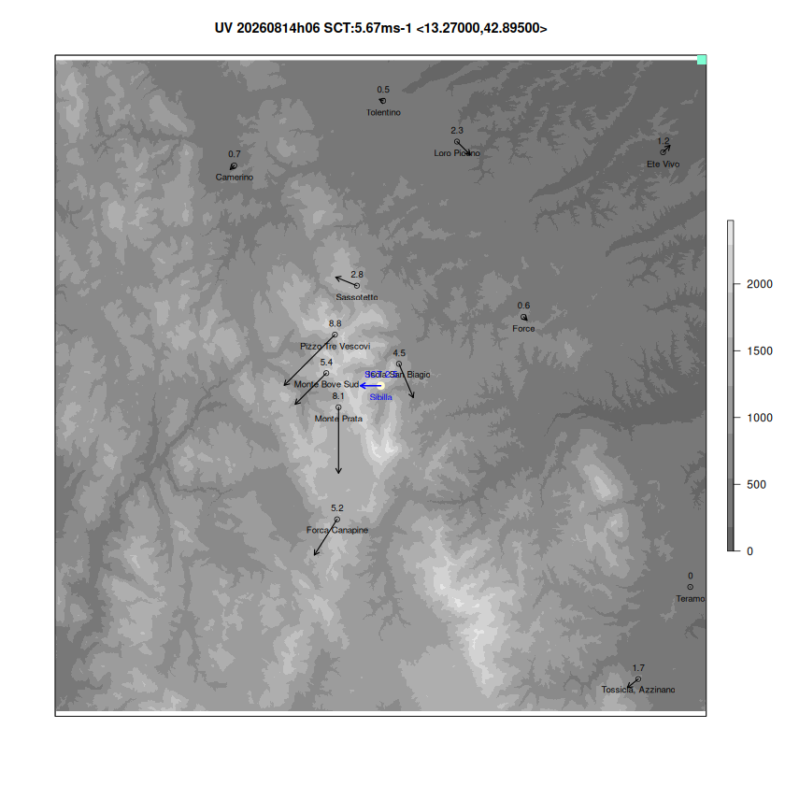
WIND QC Arrows represent observed wind vectors

Slide 19
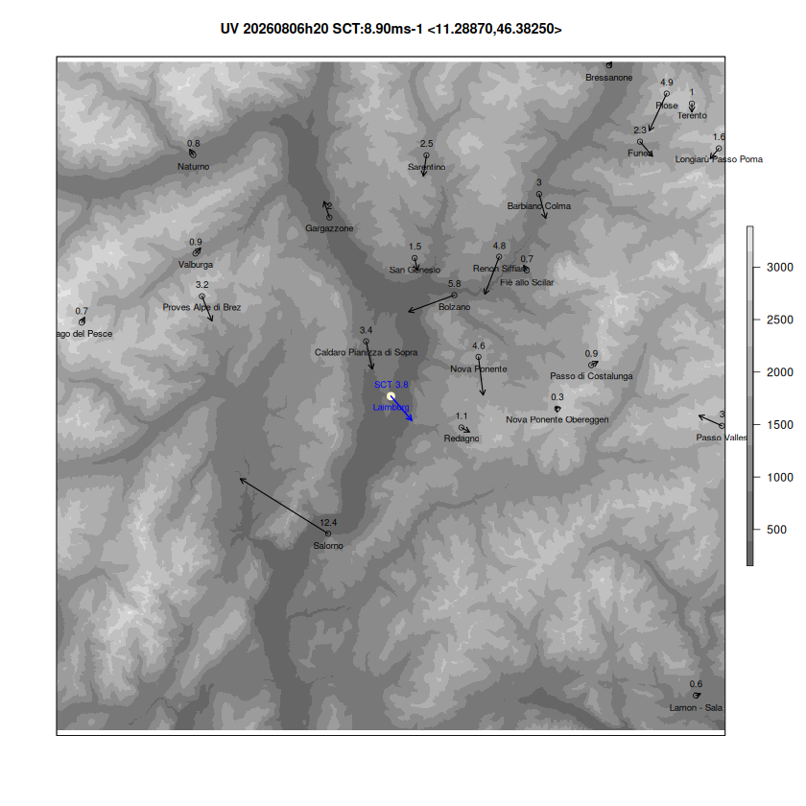
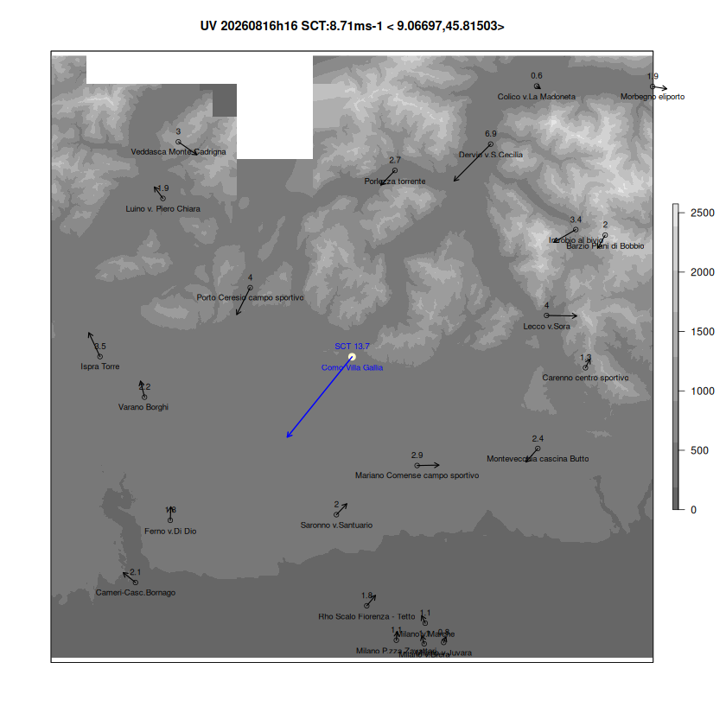
WIND QC Some representativeness errors may be flagged

Slide 20
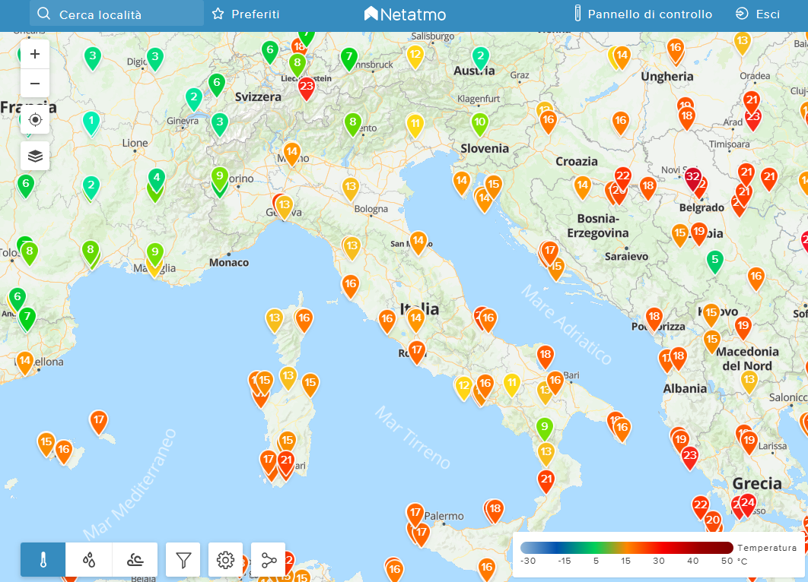

SubTask 2.3: Quality control procedure for T2m and Rh2m​
Citizen weather stations (CWS), i.e., privately-owned weather stations whose owners share their data publicly via the internet, have become increasingly popular and can be highly valuable in areas where traditional measurement networks are sparse but
rigorous quality control (QC) of CWS data is essential prior to any application
Netatmo CWS (https://weathermap.netatmo.com/)
A new quality control procedure has been developed in Python specifically for NetAtmo temperature data:
a median-based method (Napoly et al.), which uses the median behaviour of the crowdsourced data itself as a reference
A python script to download NetAtmo data via API has also been developed

Slide 21



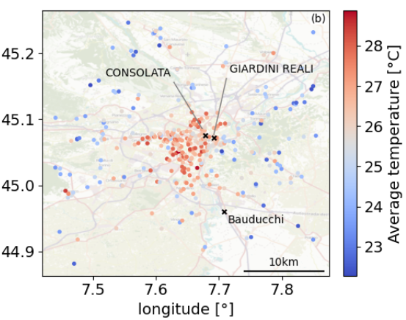

SubTask 2.3: Quality control procedure for T2m and Rh2m​
The new quality control procedure has been applied to CWS data from NetaAtmo
and compared with other different QC tecniques such as CrowQC+, and others
To evaluate the advantages and disadvantages of each technique
To assess the limitations and potential of the CWS datasets and determine whether temperature (and relative humidity) data could be valuable for scientific applications, such as assimilation and urban heat island studies

Slide 22
A new Napoly-based Quality Control (QC) procedure
M0 – initialization: removes stations containing only NaN values across all timestamps
M1 – location-based filtering: removes stations sharing identical coordinates (lon, lat) or moving stations
M2/M3 – statistical outlier detection: detects temperature outliers every 5 minutes using robust z-scores and removes stations with more than M3_DENSITY_THR% of flagged data
M4 – correlation analysis: removes stations with Pearson correlation coefficients below CORRELATION_THR when compared to the spatial mean temperature
O2 – hourly data sufficiency: removes measurements from station-hours where missing data exceeds O1_THR in an hour
O3 – monthly data sufficiency: removes station-months where missing data exceeds O2_THR in a month
Limitations of the method
it does not consider contextual metadata of individual measurements (e.g., altitude), which may explain variability between stations
it does not exploit spatial correlations between nearby stations, which could help detect outliers

Slide 23
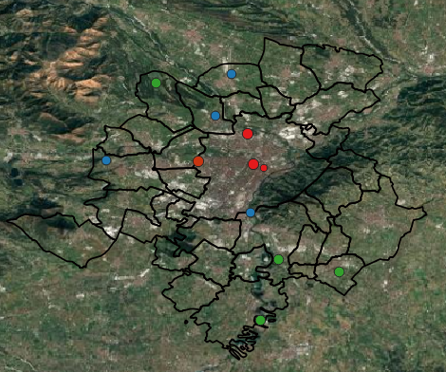
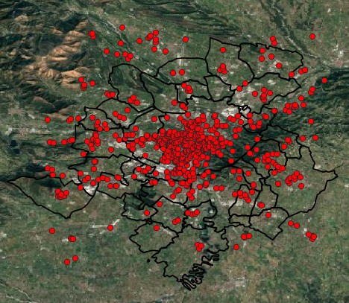
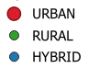
A new Napoly-based Quality Control (QC) procedure
Turin and surroundings
Official ARPA meteorological network
Netatmo Citizen Weather Stations (CWS) network
denser but accurate..?
Contextual uncertainty due to placements
622 stations
in JJA2026
12 stations
Notes:
The model validation was carried out using temperature data from both the official Arpa meteorological network and the NetAtmo Citizen Weather Network.
The NetAtmo network is significantly denser, with nearly 600 stations compared to just 12 official stations.
But can we consider these measurements reliable?
NetAtmo observations are certainly affected by higher errors, the so-called contextual uncertainty, which arises from improper sensor placement (e.g., too close to walls, exposed to direct sunlight, or sheltered areas), leading to inaccurate temperature readings.

Slide 24
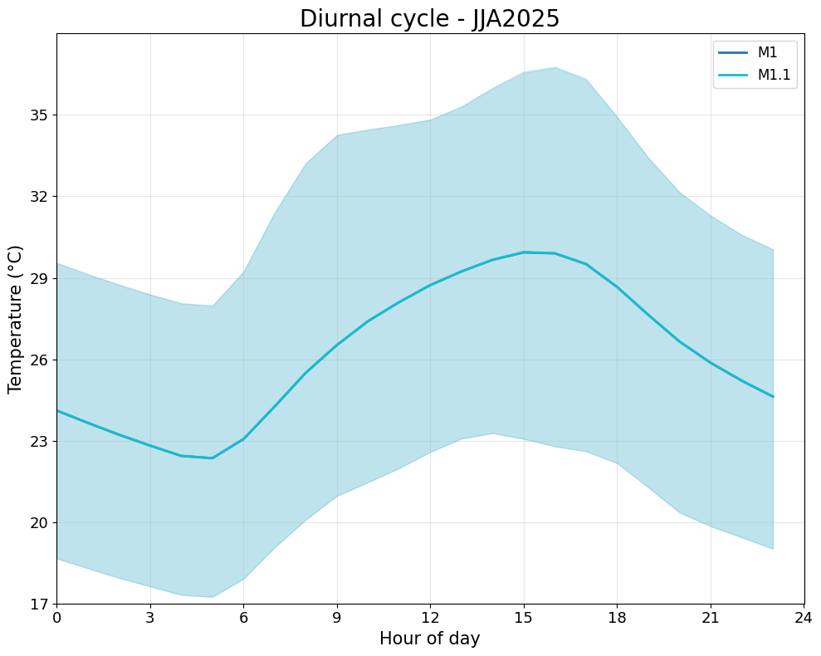
A new Napoly-based Quality Control (QC) procedure: JJA 2026
M0 – initialization: removes stations containing only NaN values across all timestamps
M1 – location-based filtering: removes stations sharing identical coordinates (lon, lat)
M1.1 – location-based filtering: removes moving stations
+++ Napoly output statistics ++
Raw data: 1373998 values, 622 stations
QC level m0: 94.5 % of raw data,
606 stations
QC level m1: 88.6 % of raw data,
569 stations
QC level m1.1: 86.9 % of raw data,
558 stations ++++++++++++++++++++++++++++++++++
After M1.1 QC level are removed 64 stations and 13% of raw data →
no significant effect on diurnal cycle of hourly temperature

Slide 25
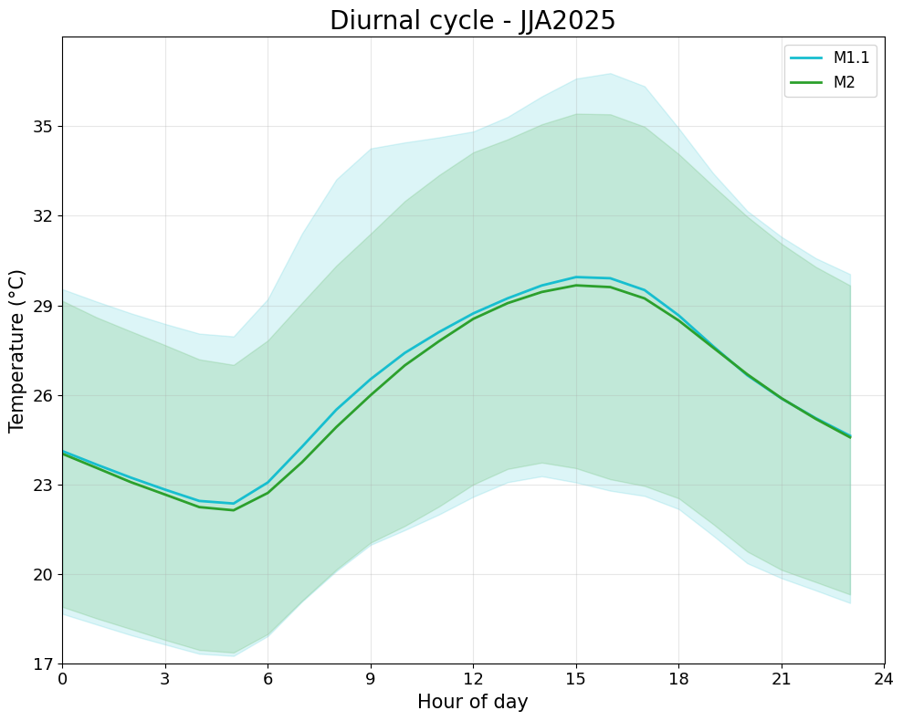
A new Napoly-based Quality Control (QC) procedure: JJA 2026
M2 – statistical outlier detection: detects temperature outliers every 5 minutes using robust z-scores
+++ Napoly output statistics ++ +++++++++++++++++++++++++++++++
QC level m2: 77.8 % of raw data, 556 stations +++++++++++++++++++++++++++++++
M2 removes 9% of values across nearly the whole network (only 2 stations lost), mainly cutting daytime high-temperature outliers — consistent with filtering out sun-exposure artifacts rather than faulty stations

Slide 26
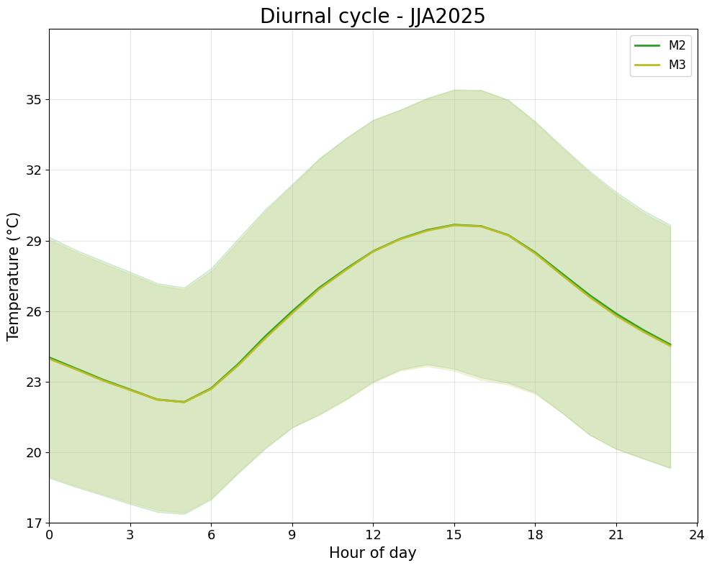
A new Napoly-based Quality Control (QC) procedure: JJA 2026
M3 – statistical outlier detection: removes stations with more than M3_DENSITY_THR=20% of flagged data
+++ Napoly output statistics ++ +++++++++++++++++++++++++++++++
QC level m3: 69.70 % of raw data, 534 stations +++++++++++++++++++++++++++++++
M3 applies a per-station data validity threshold (>0.8 coverage), removing 22 stations with insufficient temporal completeness — not based on temperature plausibility →
unchanged diurnal cycle since this is a coverage filter, not a value filter

Slide 27
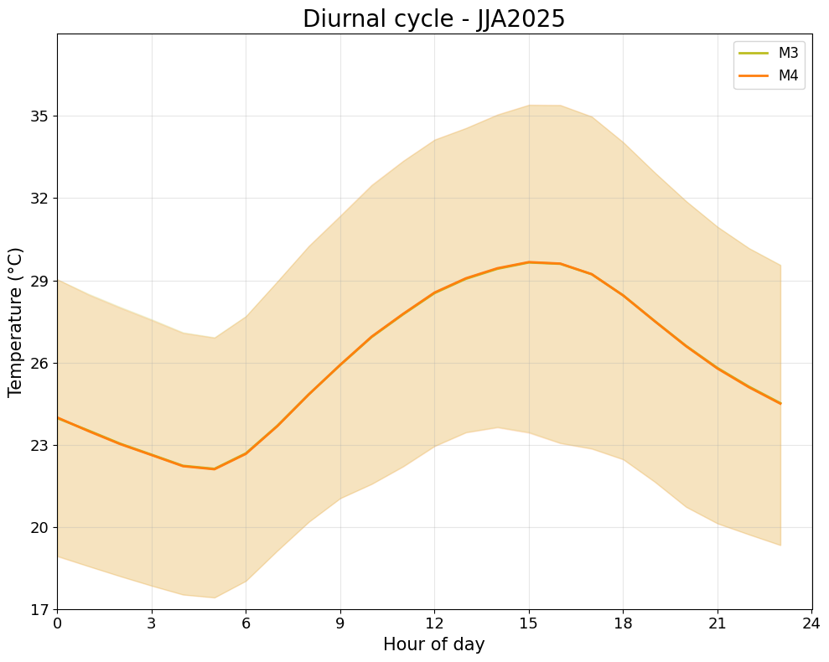
A new Napoly-based Quality Control (QC) procedure: JJA 2026
M4 – correlation analysis: removes stations with Pearson correlation coefficients below CORRELATION_THR=0.9 when compared to the spatial mean temperature
+++ Napoly output statistics ++ +++++++++++++++++++++++++++++++
QC level m4: 68.75 % of raw data, 499 stations +++++++++++++++++++++++++++++++
M4 removes 35 stations with Pearson correlation <0.9 vs. the spatial mean but only 1.4% of values — these were low-volume, spatially incoherent sensors → this spatial consistency filter does not alter the aggregate climate signal

Slide 28
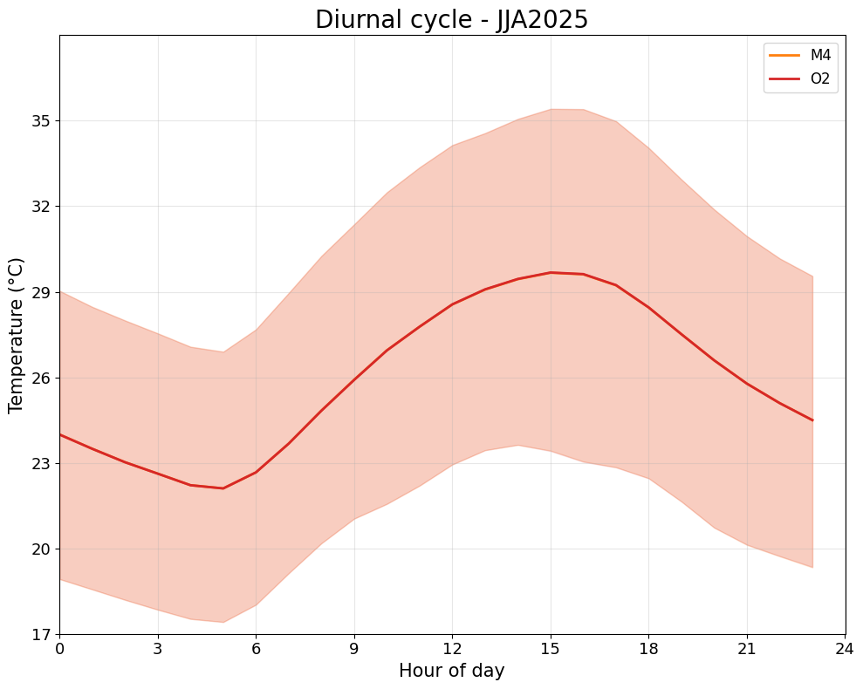
A new Napoly-based Quality Control (QC) procedure: JJA 2026
O1 – hourly data sufficiency: removes measurements from station-hours where missing data exceeds O2_THR=0.7 in an hour
+++ Napoly output statistics ++ +++++++++++++++++++++++++++++++
QC level o2: 68.05 % of raw data, 499 stations +++++++++++++++++++++++++++++++
O2 removes only 0.7% of values and zero stations — daily coverage filtering has virtually no effect on the aggregate diurnal cycle

Slide 29
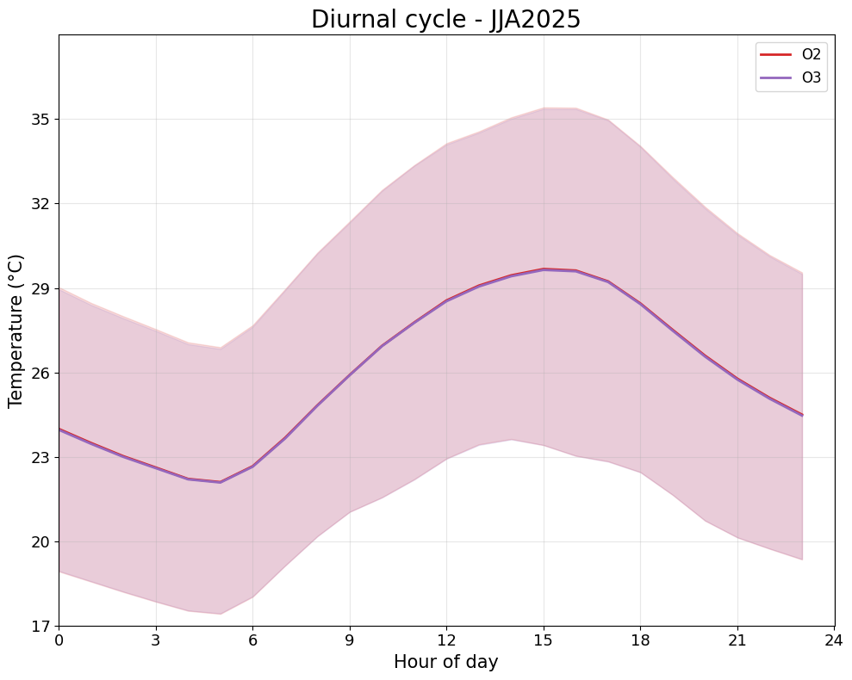
A new Napoly-based Quality Control (QC) procedure: JJA 2026
O3 – monthly data sufficiency: removes station-months where missing data exceeds O3_THR=0.7 in a month
+++ Napoly output statistics ++ +++++++++++++++++++++++++++++++
QC level o3: 61.25 % of raw data, 406 stations +++++++++++++++++++++++++++++++
O3 removes station-months with >70% missing data, dropping 93 stations (-18.6%) → unchanged aggregate diurnal cycle — confirming this is a temporal-completeness filter, not a value-based one.

Slide 30
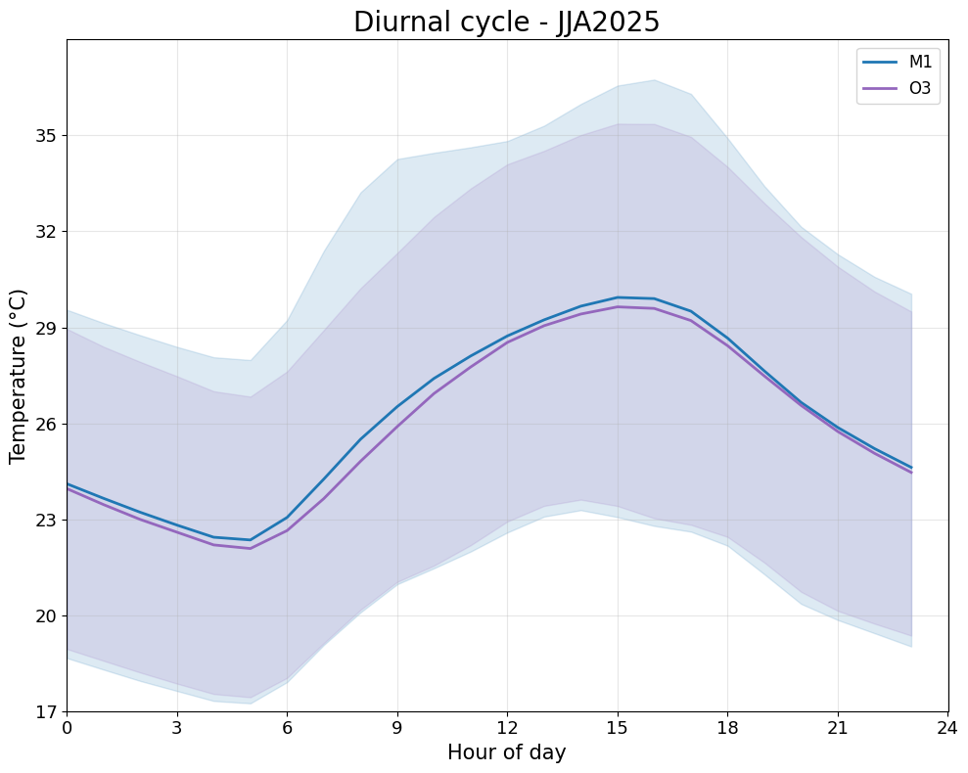
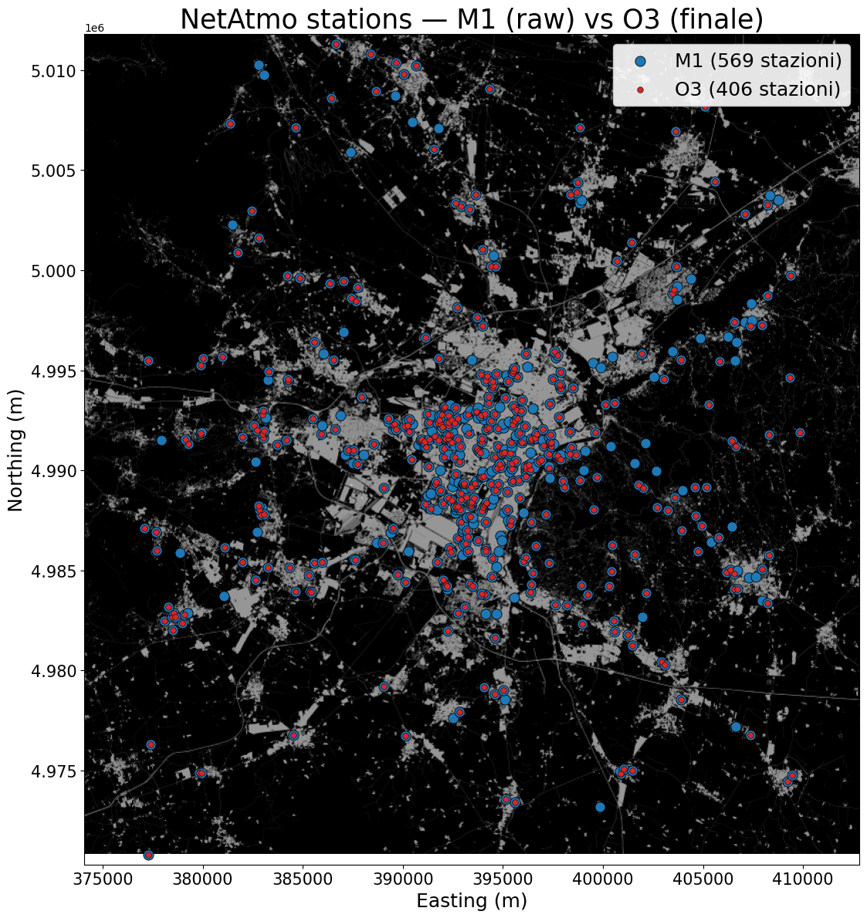
A new Napoly-based Quality Control (QC) procedure: JJA 2026
M2 QC level drives the largest changes in the Netatmo mean temperature signal by removing daytime warm outliers
O3 QC level results in the greatest station loss and and is highly sensitive to the
to the monthly coverage threshold (406 stations for O3_THR = 0.7 versus 371 for O3_THR = 0.8), while having only a marginal impact on the mean Netatmo temperature signal.

Slide 31
CrowdQC+ Quality Control (QC) procedure
M0 – initialization: removes stations containing only NaN values across all timestamps
M1 – location-based filtering: removes stations sharing identical coordinates (lon, lat)
M2/M3 – statistical outlier detection: detects temperature outliers every 5 minutes using robust z-scores and removes stations with more than m3_cutOff% of flagged data
M4 – correlation analysis: removes stations with Pearson correlation coefficients below m4_cutOff when compared to the spatial median temperature
M5 – spatial buddy check: identifies anomalous stations by comparing each against the neighbors using a robust z-score approach
O2 – hourly data sufficiency: removes measurements from station-hours where missing data exceeds m1_cutOff% in an hour
O3 – monthly data sufficiency: removes station-months where missing data exceeds m2_cutOff%
m5_radius = 3000
m5_heightCorrection = TRUE/FALSE
m5_check_elevation = TRUE/FALSE
m5_max_elev_diff = 100
m5_keep_isolated = TRUE
m2_heightCorrection = TRUE/FALSE
m2_lapse_rate = 0.0065

Slide 32
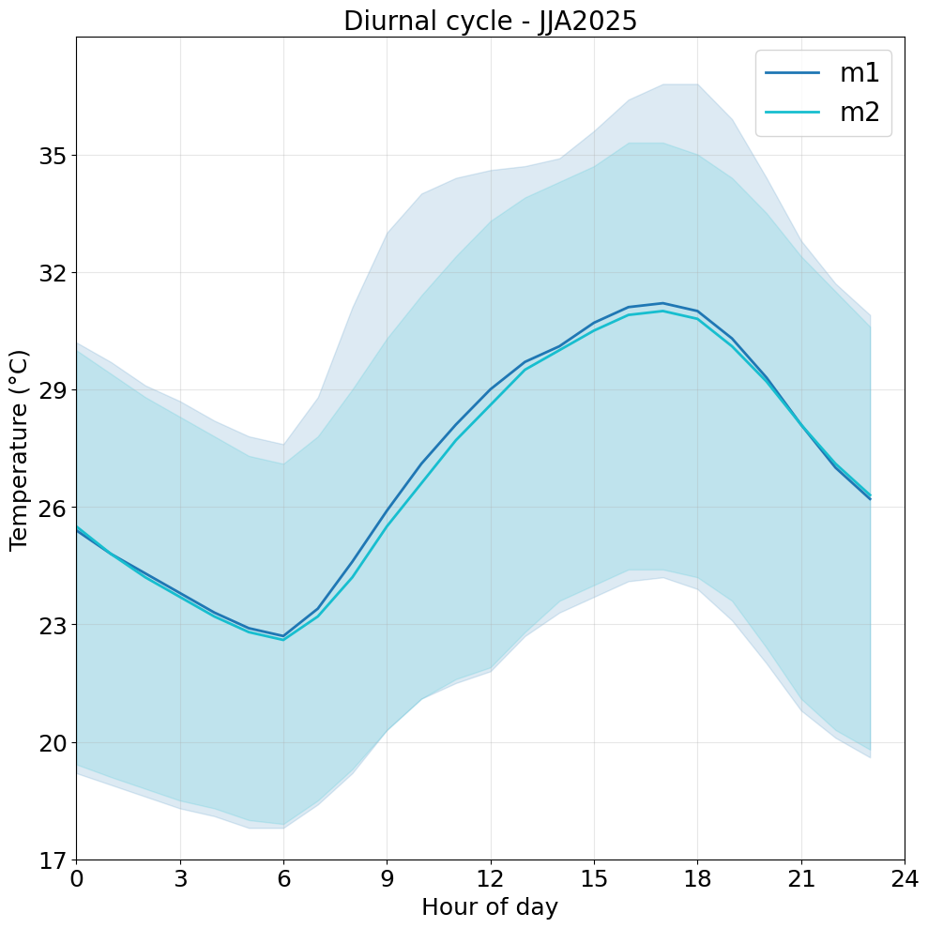
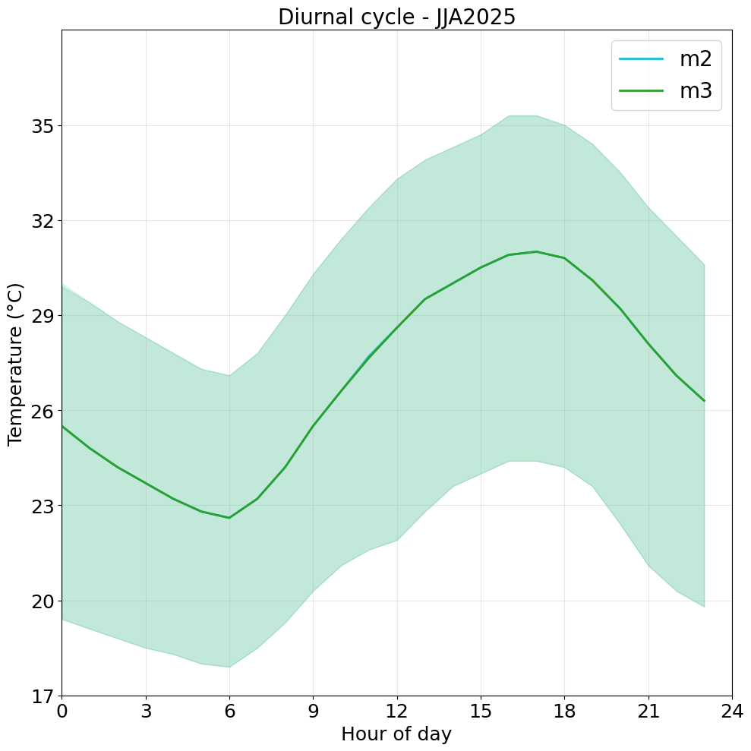

m2 QC level drives the largest changes in the Netatmo mean temperature signal by removing daytime warm outliers
m3 and m4 QC levels removes respectively 8 and 20 stations without altering the diurnal mean cycle
+++CrowdQC+ output statistics + +++++++++
Raw data: 4856242 values, 562 stations
QC level m1: 86.42 % of raw data, 523 stations
QC level m2: 78.53 % of raw data, 522 stations
QC level m3: 78.40 % of raw data, 514 stations
QC level m4: 76.48 % of raw data, 495 stations

Slide 33
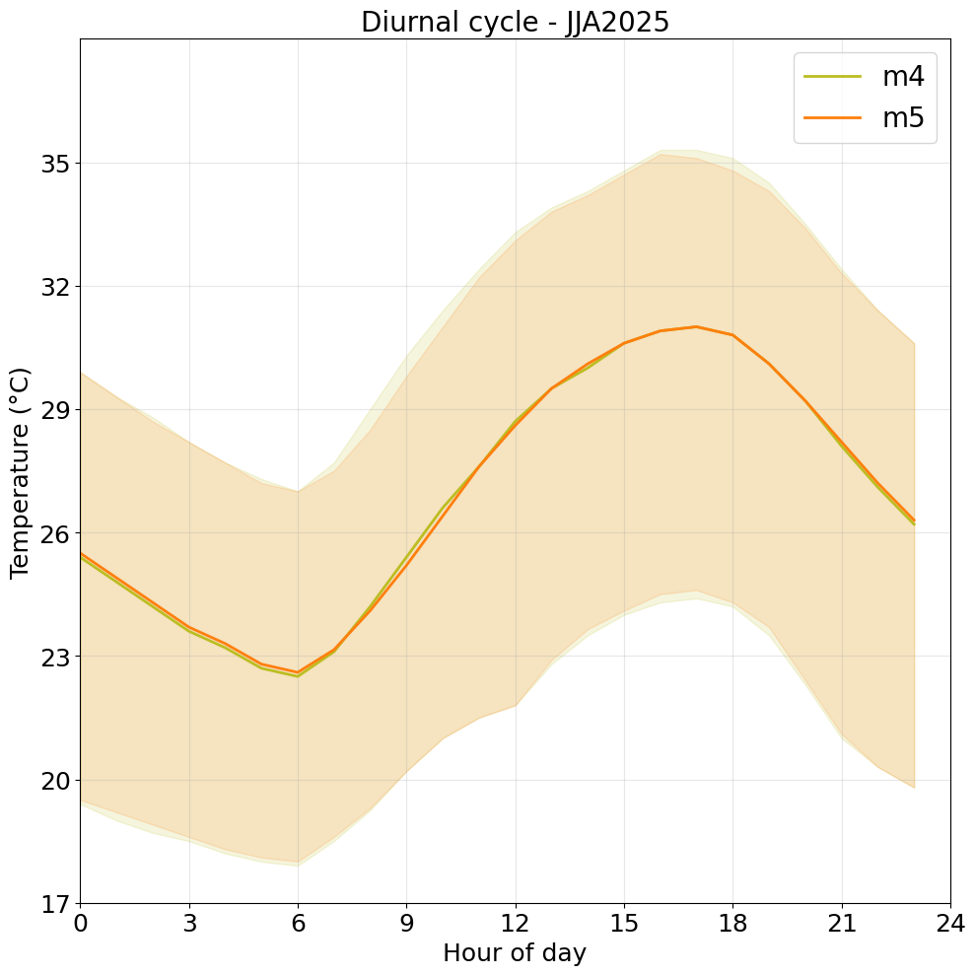
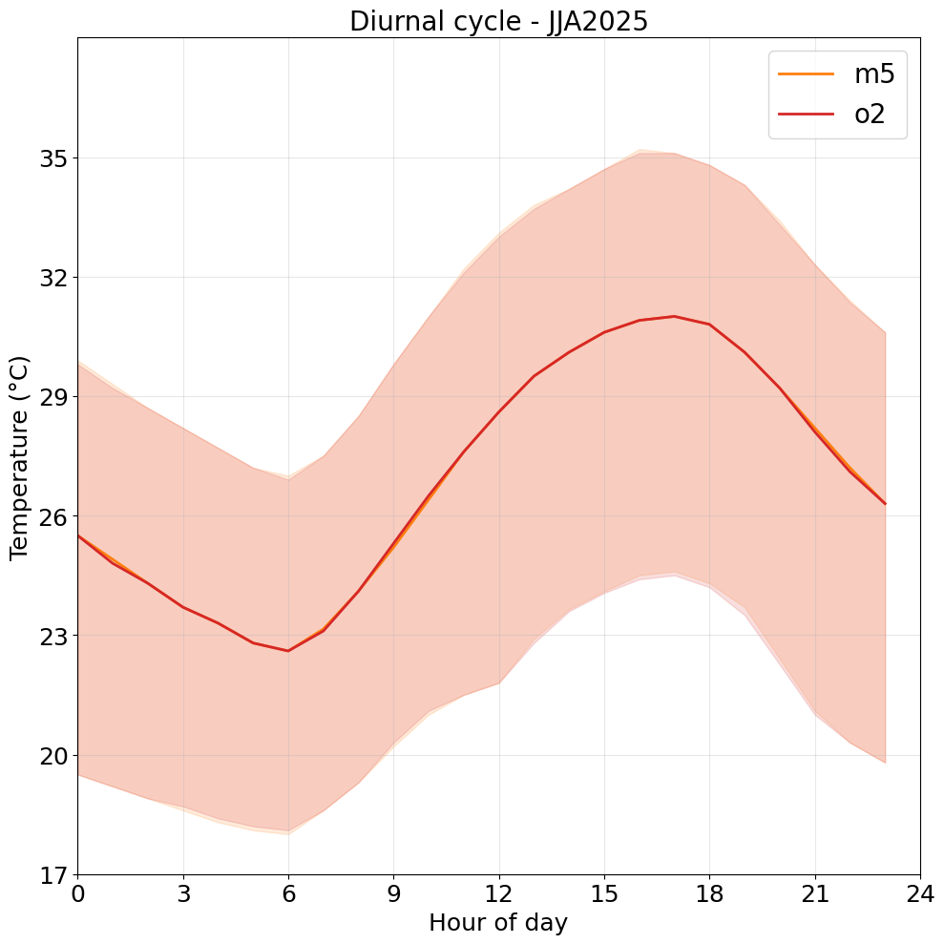
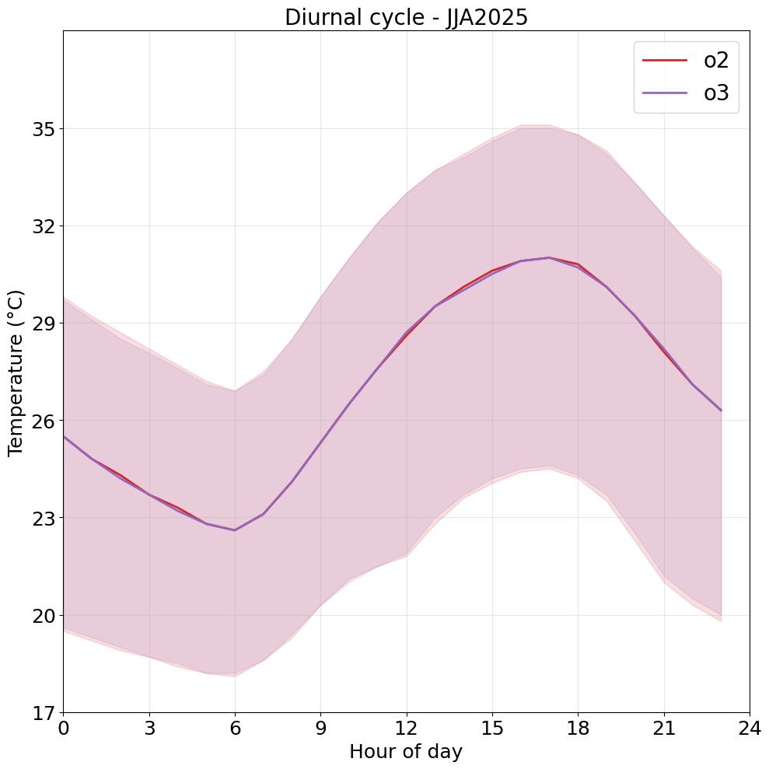
+++ CrowdQC+ output statistics +++
QC level m5: 484 stations
QC level o2: 477 stations
QC level o3: 375 stations
M2 QC level drives the largest changes in the Netatmo mean temperature signal by removing daytime warm outliers
O3 QC level results in the greatest station loss

Slide 34
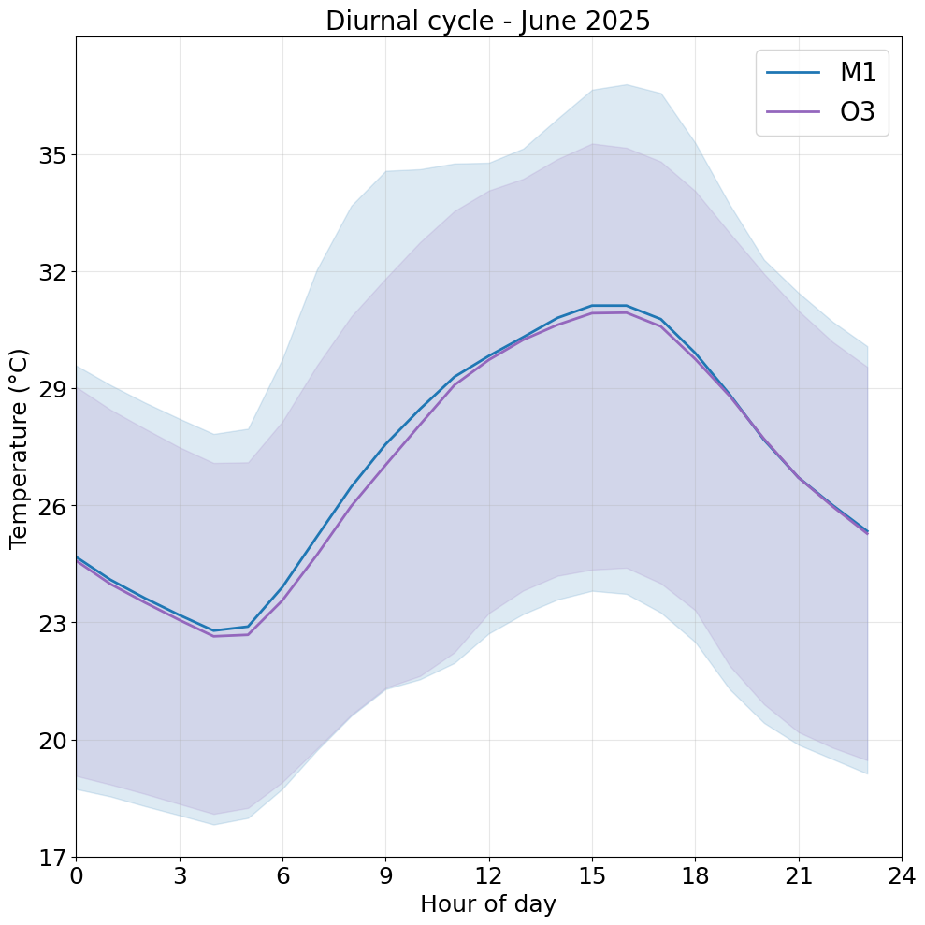
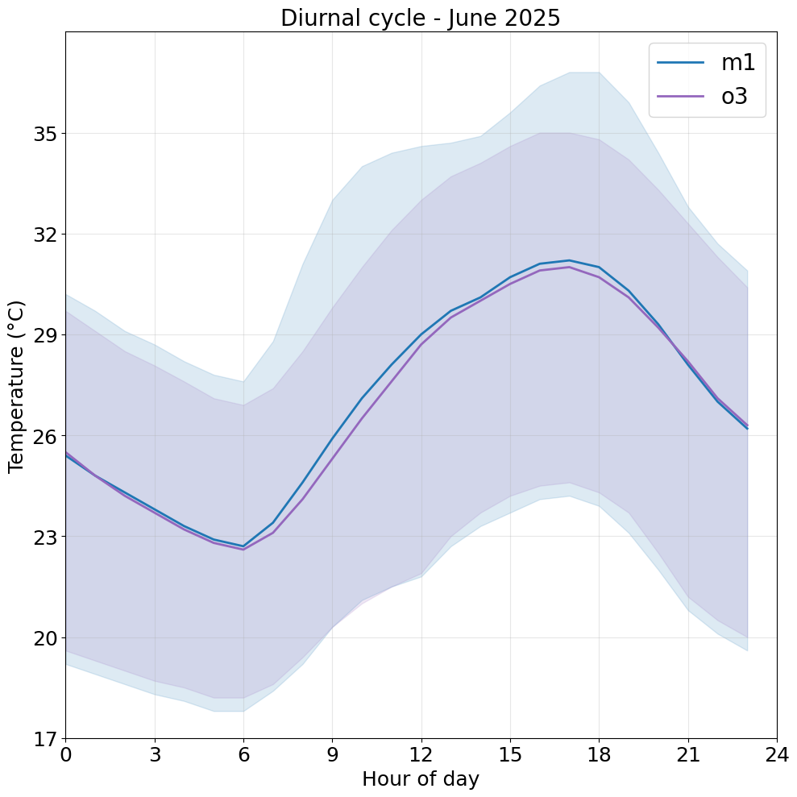
Napoly-based vs CrowdQC+ Quality Control (QC) procedure
Napoly-based
CrowdQC+
406 stations
375 stations
The QC procedures have very similar results but.. high sensitivity to the parameters! Other experiments to obtain the best configuration

Slide 35
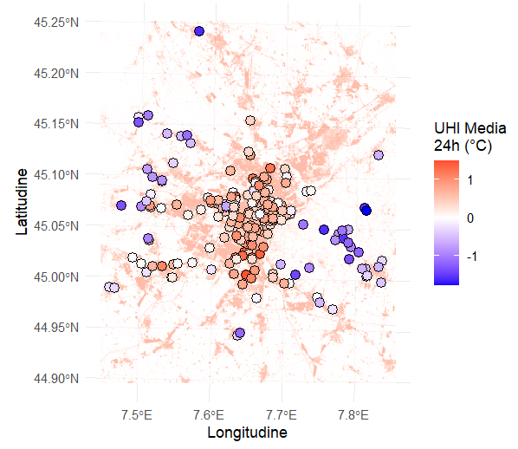
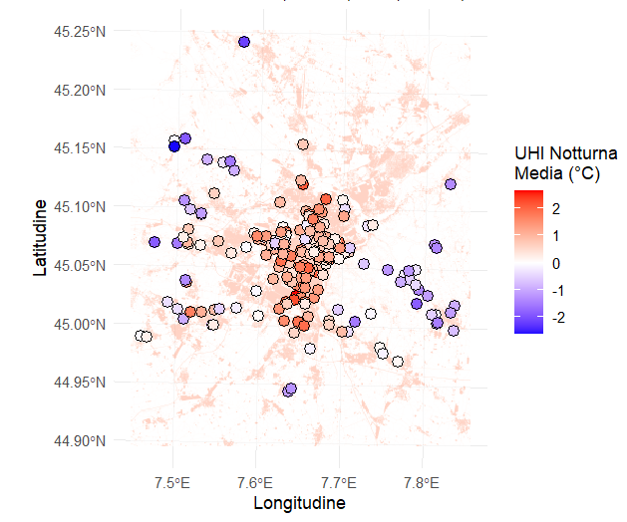
Urban Heat Island (UHI) Map of Turin – JJA 2025
Urban Heat Island Map –
NetAtmo stations
Night Urban Heat Island Map –
NetAtmo stations

Slide 36
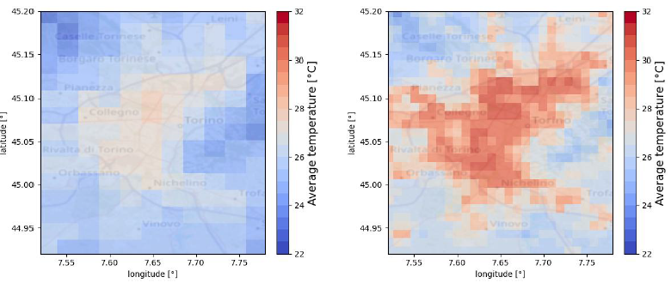
Subtask 4.3: Application of PWS to NWP model verification in urban areas
​
In the frame of the subtask, the quality-controlled Netatmo temperature data were used to investigate the urban heat island effect in Turin
by comparing the results with the official meteorological network
by comparing the results with ICON simulations over Turin and surroundings
ICON-2I run by ARPAE
@2km resolution
ICON in hindcast mode
@1km resolution
Air temperature at 22h over the period from 22 to 29-06-2025

Slide 37
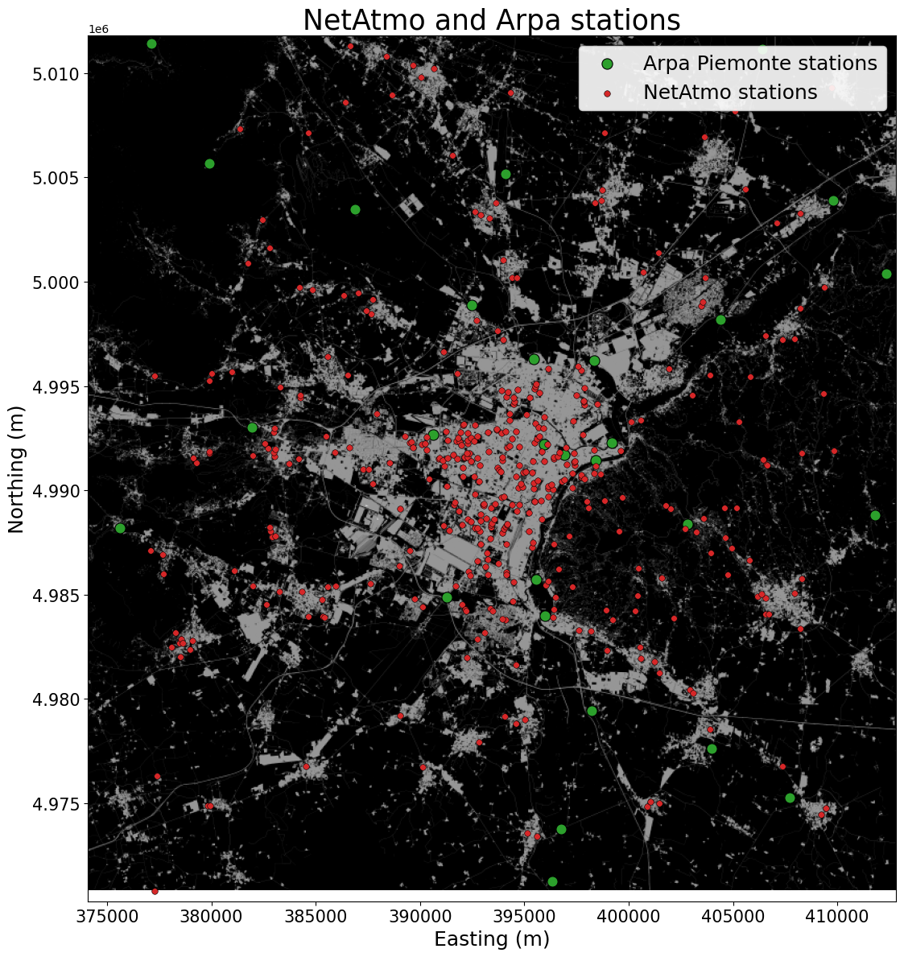
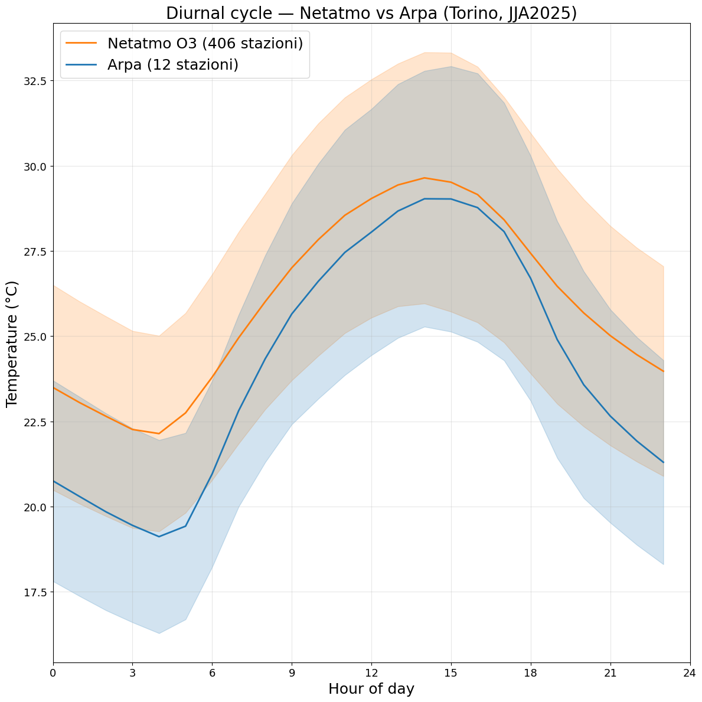
NetAtmo and Arpa stations: JJA 2026
NetAtmo stations are warmer than official ones: still an effect of erroneus placement or may reflect microscale effects? NetAtmo often placed in urbanized context

Slide 38
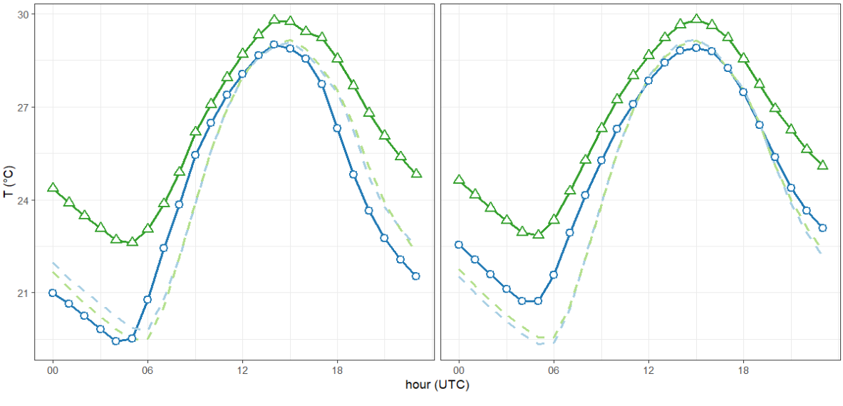
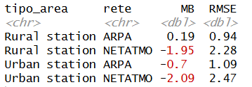
NetAtmo and Arpa data vs ICON-2I forecast : JJA 2025
RURAL STATIONS
URBAN STATIONS
NetAtmo obs
Stations are classified as urban or rural according to the ECOCLIMAP Local Climate Zone (LCZ) classification.
NetAtmo obs
ARPA obs
ARPA obs
ICON-2I
@NetAtmo
ICON-2I
@NetAtmo
ICON-2I @ARPA
ICON-2I @ARPA
NetAtmo observations are warmer than ARPA
ICON-2I cannot capture micro-scale spatial variability

Slide 39
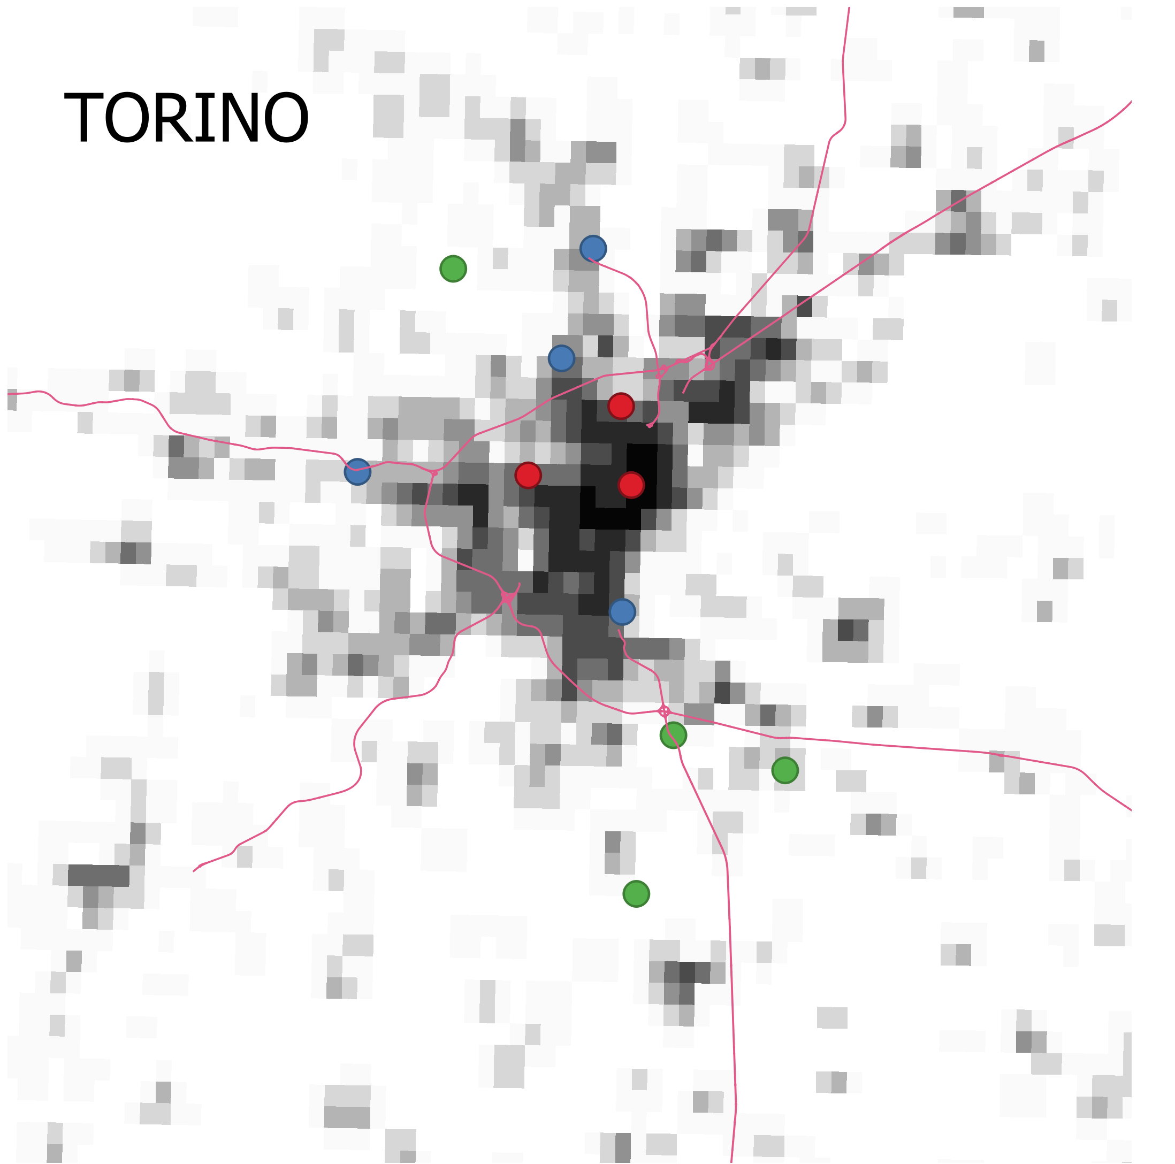
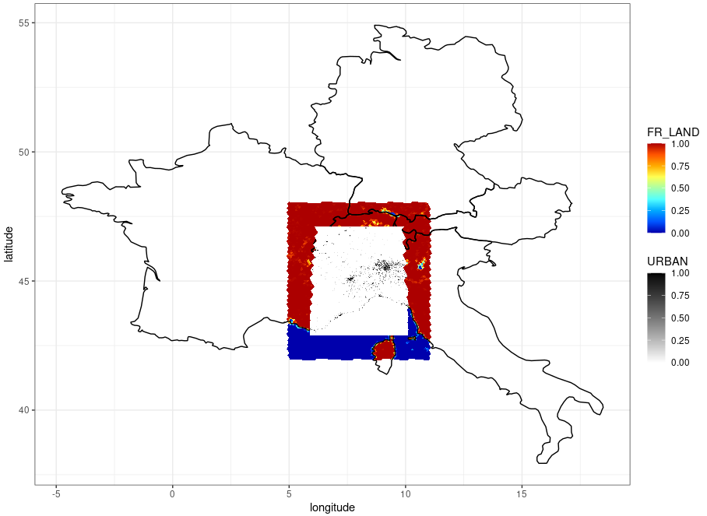

NetAtmo and Arpa data vs ICO+TERRA_URB
22-29 June 2025 heatwave over Turin
ICBC from ICON-EU analysis
at 7 km resolution (R03B08)
ICON-2I namelist
External parameters:
GLOBCOVER landuse classification (2009)
ICON-LAM domain
@ 1 km resolution
AHF seasonal cycle
Notes:
I performed simulations at 1 km resolution in hindcast mode, focusing on a heatwave event over Turin in June 2022, using initial and boundary conditions from ICON.
The simulation domain covers Piedmont, in northwestern Italy, with a focus on the city of Turin.
I tested ICON in three different configurations:
ref0: without the urban parameterization (TERRA_URB),
exp0 and exp1: with the urban scheme activated,
exp: including a seasonal cycle for the Anthropogenic Heat Flux (AHF).

Slide 40






NetAtmo and Arpa data vs ICON+TERRA_URB
Arpa
TERRA_URB successfully reproduces the UHI effect
NetAtmo
Not able to capture micro-scale spatial variability

