Slide 1


Priority Project: APOCS
Application of Personal Weather Station and Opportunistic Sensor Data CrowdSourcing
TASK 3: Adaptation of private/citizen datasets for verification purposes over Greece
SubTask 3.2: Climatology based Interpolation methodology of precipitation data from various sources
Flora Gofa, HNMS
A verification procedure must be based on equally realistic and detailed observations as high-resolution model forecasts Precipitation observations from “official” and “unofficial” networks together with remote sensing data can only increase the accuracy of the “true” location of rainfall events.
An approach to create precipitation gridded datasets for areas with complex terrain as Greece, which is based on an interpolation method that uses long climate data series to determine the geographical characteristics that this parameter is best correlated with, as well as remote sensing estimates as background information to cover the areas where observations are insufficient.
The methodology will be applied on the datasets that are resulted from SubTask 3.1, with the addition of H-SAF precipitation estimates mainly to over sea areas that ground observations are not available.
High resolution forecasts in ~km scale produce realistic spatial structures for precipitation.
Objective evaluation in a process that has a prerequisite detailed representation of the «reality».
Obs availability: insufficient in-situ measurements from HNMS network, use of PWS can enhance the spatial precipitation info, which is necessary for generation of gridded fields
Greek terrain is characterized by steep slopes in mainland and large areas covered by water, all important factors for rainfall formation and demanding in terms of appropriate representativity in measurements
Notes:
The aim was to create a detailed and realistic precipitation observation field over Greece for the verification of high-resolution forecasts.
The main challenge is the limited density of conventional observations, especially over complex terrain.
By combining conventional obs with PWS data we can improve the spatial representation of preci.
MISH is used to transform these point observations into a gridded precipitation field suitable for comparison with model forecasts.

Slide 2
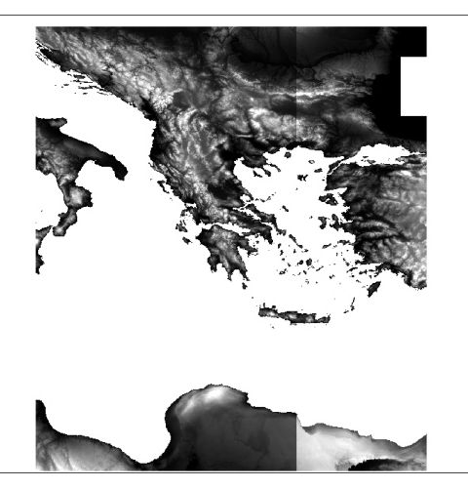
Interpolation
Analysis
Software (MISH)
QC Crowdsourced+Official Network precipitation data +
(monthly, daily, hourly)
HOMOGENIZED CLIMATE DATA SERIES
Background data
Model
0.0083333 deg
Monthly
Statistical
Parameters
Interpol
0.5’ ή 0.0083 deg
Shuttle Radar Topography Mission
TOPOGRAPHY 90x90m
(digital surface model DEM/NASA
20 GEOPHYSICAL PARAMETERS:
15 AURELHY + latitude+ % Land/sea
+ Distance Sea + Altitude
+ Incoming Solar Radiation
Gridded Obs
Meteorological Interpolation based on Surface Homogenized Data
(Szentimrey & Bihari, 2007)
Notes:
MISH is a meteorological interpolation method based on long-term homogenized climate data series.
The long-term series are used to estimate the statistical parameters that control the interpolation.
For this application the obs data are quality controlled before interpolation, while topographic and other geophysical information is also used.
The target grid has a resolution of 0.0083 degrees.

Slide 3
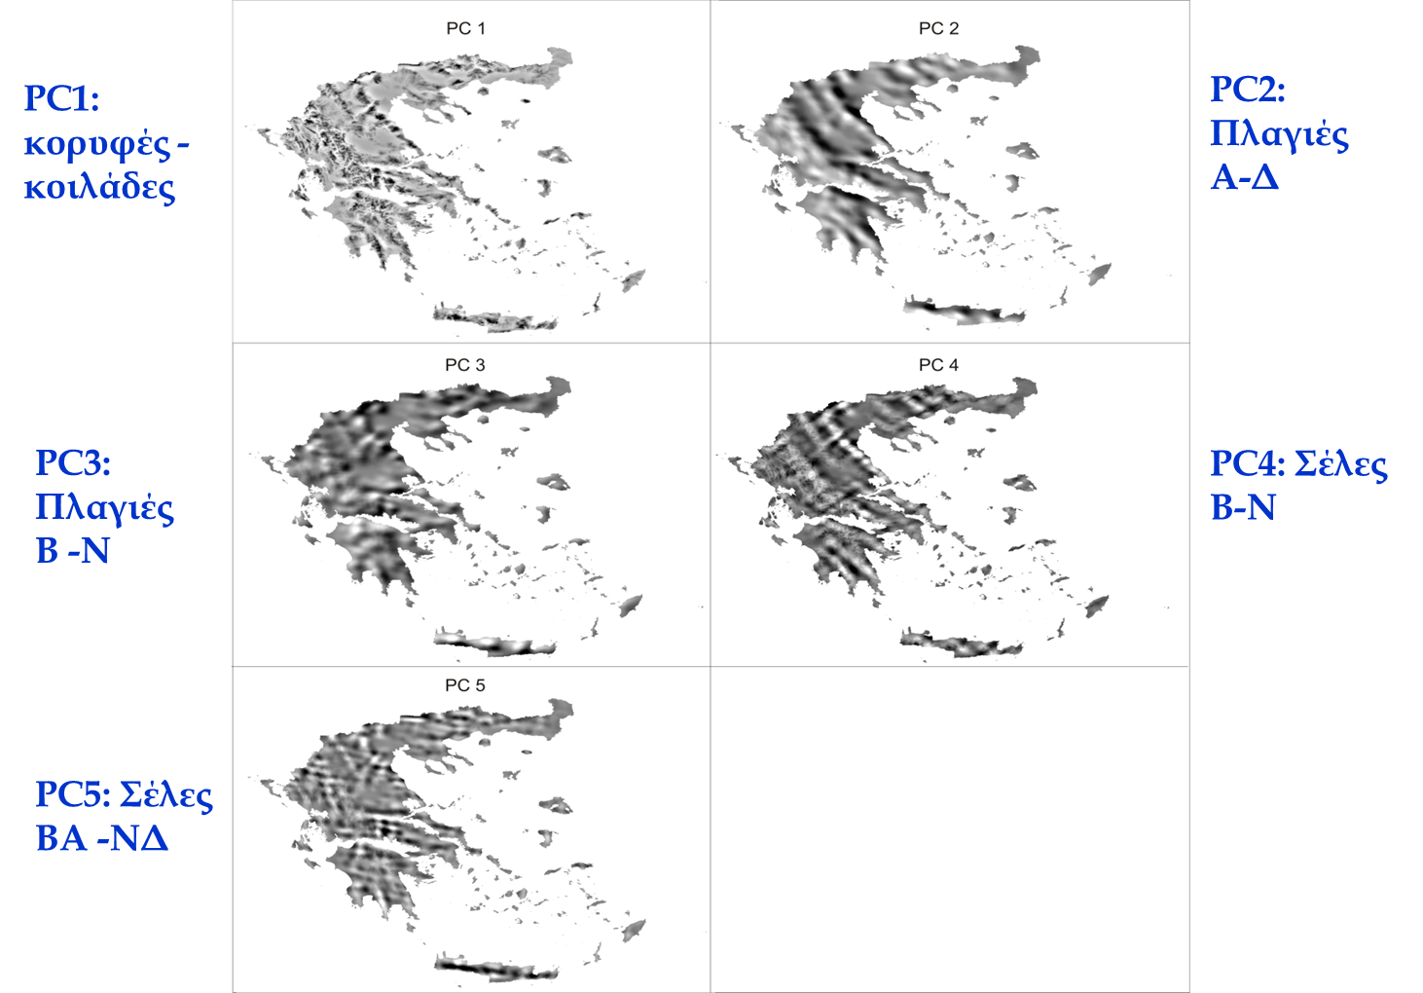
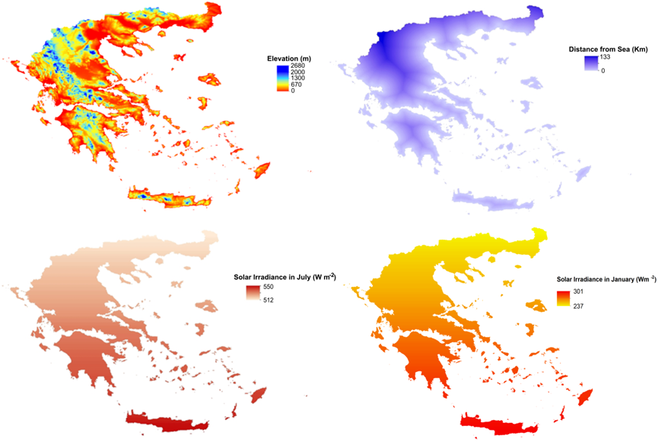
Geophysical Parameters
Aurelhy
Principle Components
Peaks-valleys
Slopes
E-W
Distance Coast
Slopes
N-S
Saddles
N-S
Topography
Additional Parameters
Saddles
NE-SW
Solar Rad.
Solar Rad.
Notes:
The key idea is that precipitation is not controlled only by distance between stations.
Its spatial distribution is also related to geographical and topographical characteristics such as altitude, slopes and terrain structure.
MISH identifies the geophysical parameters that are most strongly related to precipitation for each month.
This allows the interpolation to account for the strong spatial variability of precipitation over the complex Greek terrain.

Slide 4
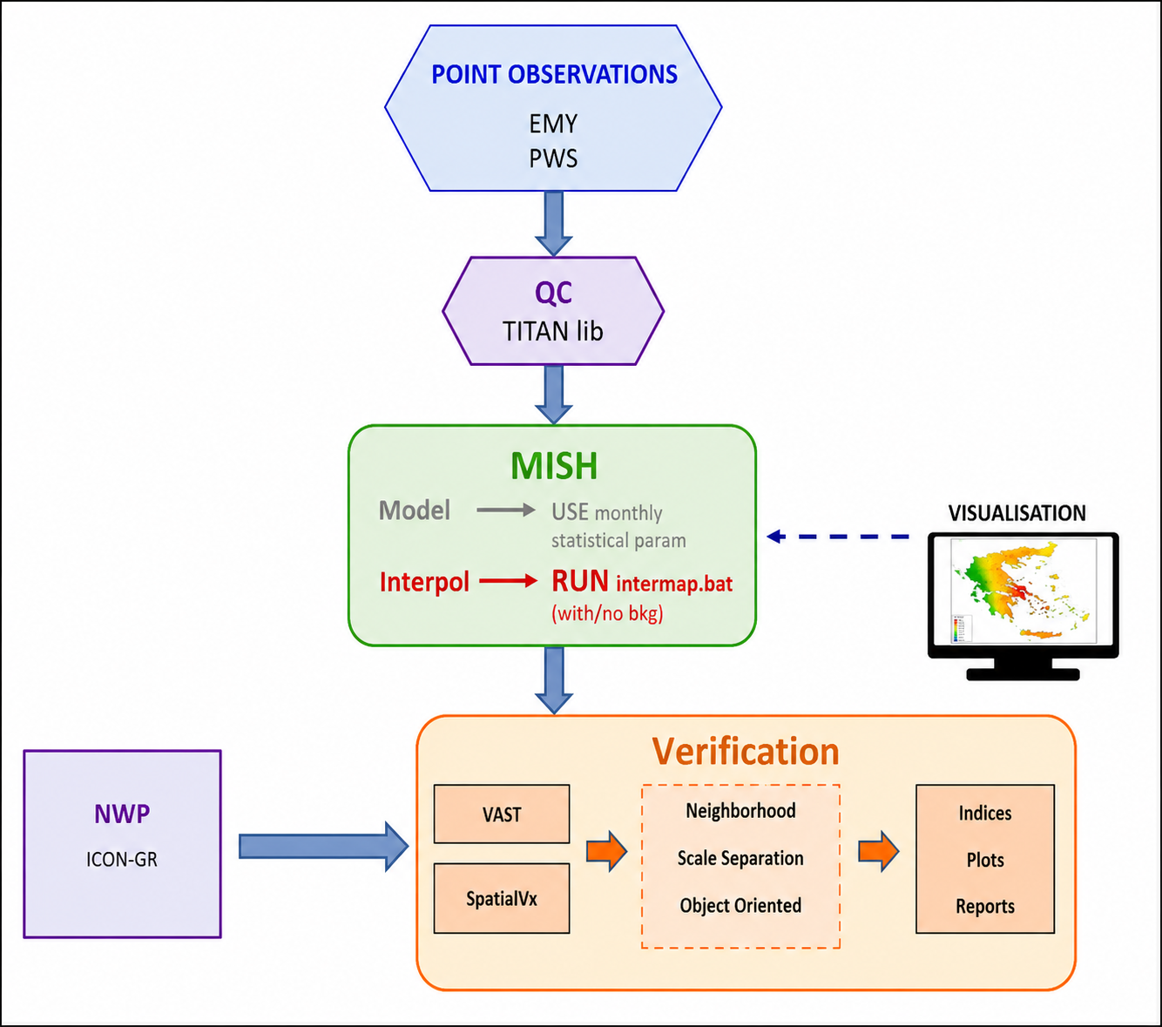
TASK 3.1
TASK 3.2
TASK 4.2
Notes:
The workflow is divided into three connected steps.
Task 3.1 provides the quality-controlled observation datasets including the additional crowdsourced obs.
Task 3.2 uses these obs to produce the gridded precipitation analysis with MISH.
The resulting gridded observations are then used in Task 4.2 for spatial verification of precipitation forecasts.

Slide 5
Priority Project: APOCS Application of Personal Weather Station and Opportunistic Sensor Data CrowdSourcing
Data Used:
OBS HNMS Network (restricted to non automated stations
PWS data from NOA and limited number of “amateur” stations
6h preci
Test cases:
Several events around Greece over January 2023
MISH month of January coefficients used
Notes:
For the January 2023 test cases, six-hour precipitation observations from the HNMS network and PWS sources were used.
The HNMS observations were restricted to the non-automated stations used in this analysis and PWS observations provided additional spatial information.
The January MISH coefficients were applied consistently to all test cases.
The objective was to examine how the additional obs and the quality-control procedure affect the final gridded precipitation field.

Slide 6
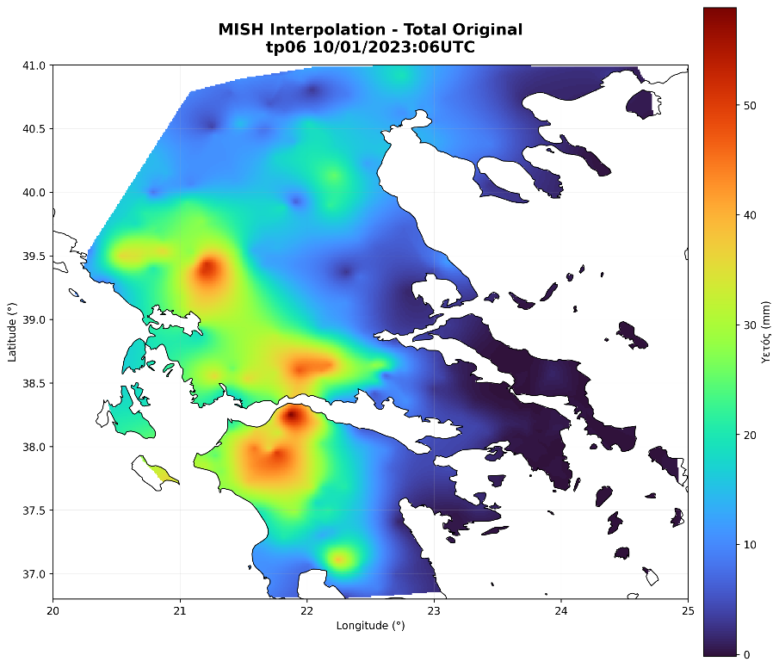
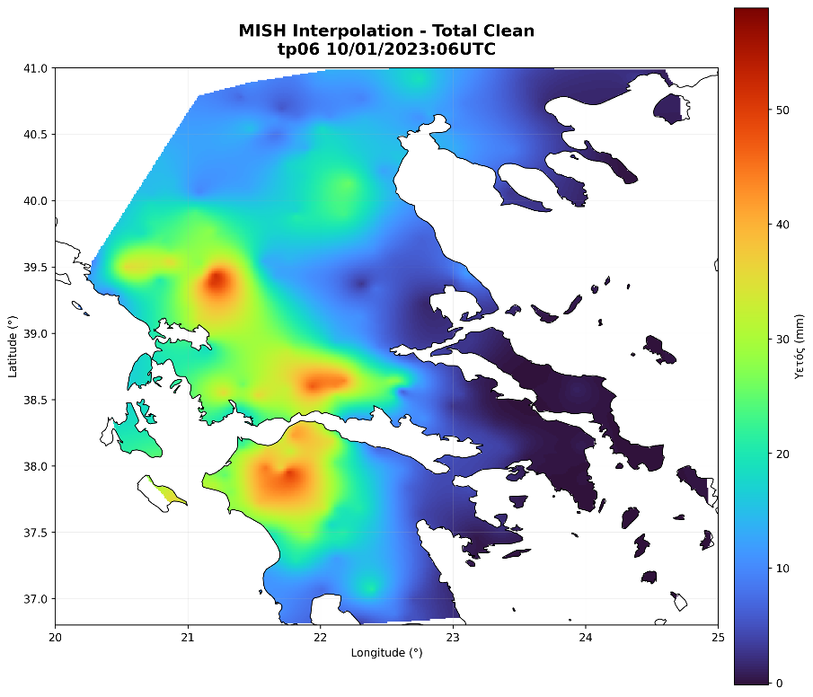
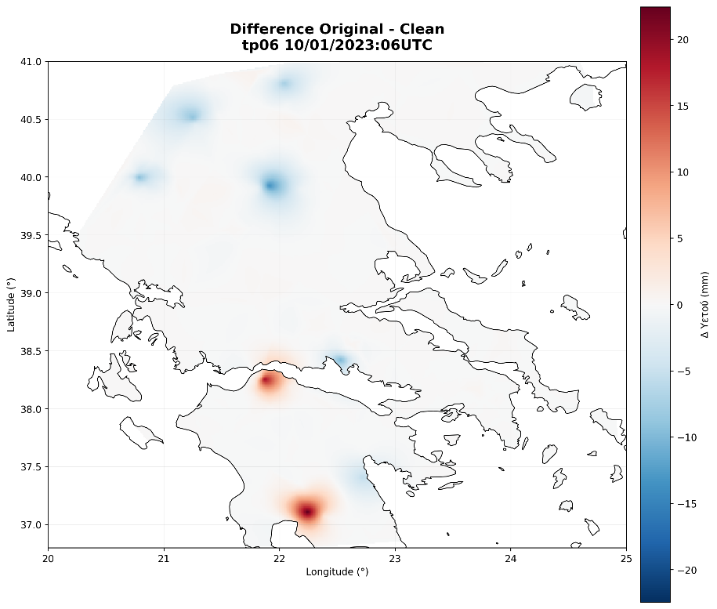
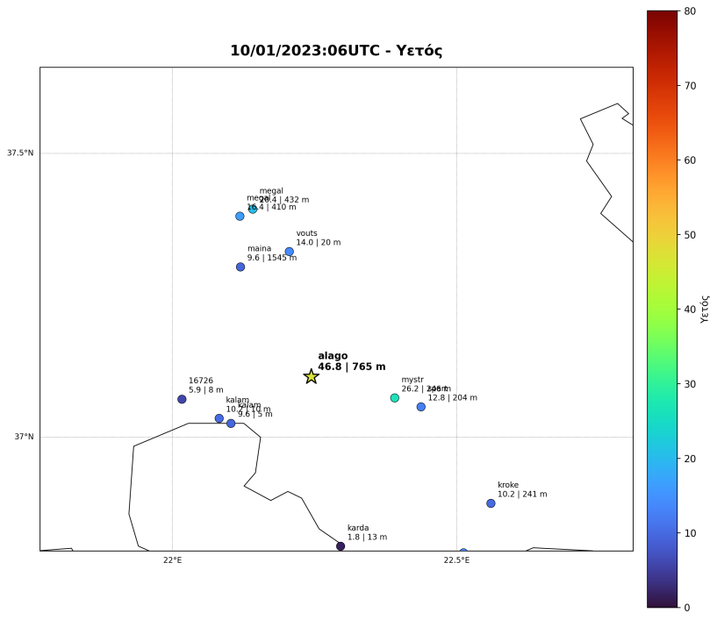
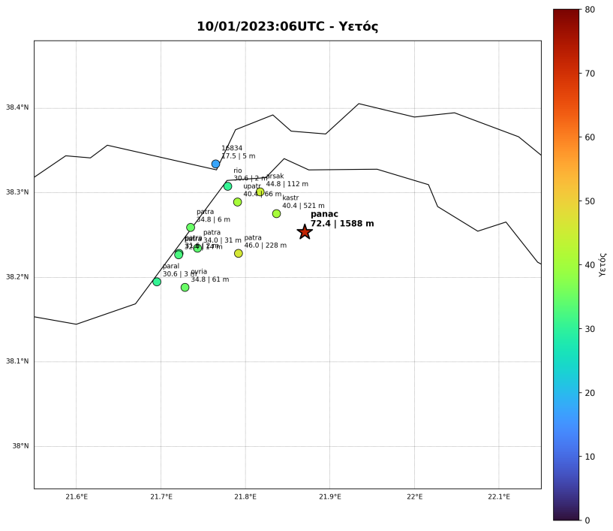
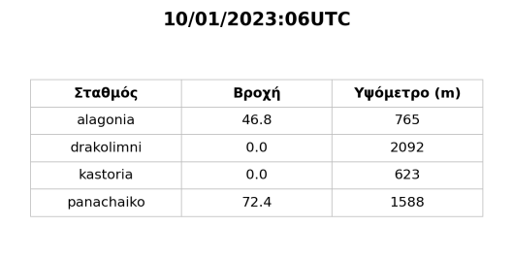
Priority Project: APOCS Application of Personal Weather Station and Opportunistic Sensor Data CrowdSourcing
Performed Analysis MISH: 10.01.2023 06UTC
Notes:
This case corresponds to 10 January 2023 at 06 UTC.
The Original (up left) and Clean (up middle) observation sets were compared before interpolation to identify stations removed by quality control (in the table).
Then created the Original (up left) and Clean (up middle) interpolated gridded observation fields as well as the differences. The isolated high preci observations can have a strong local influence on an interpolated field.
The comparison therefore provides a direct check of how the QC step affects the precipitation analysis (check diff field).

Slide 7
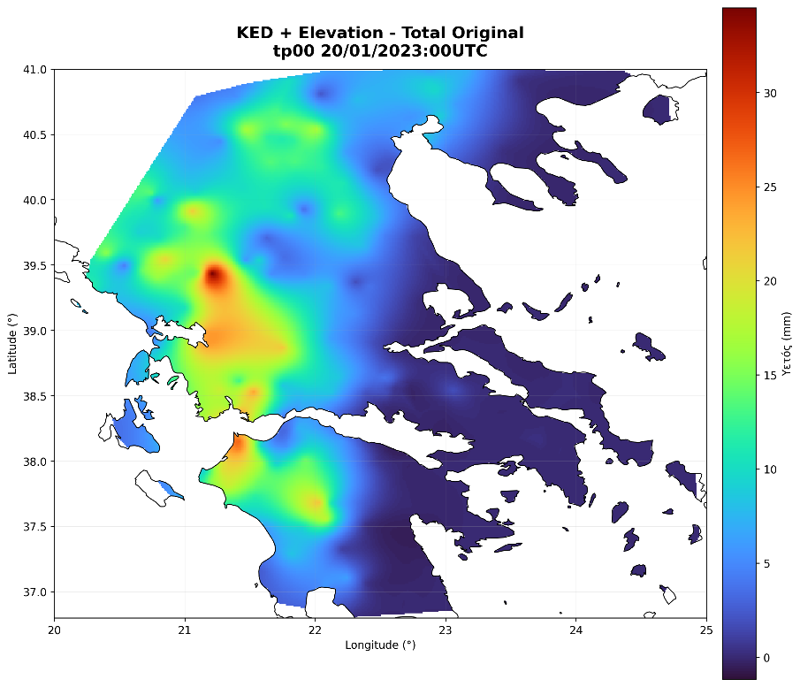
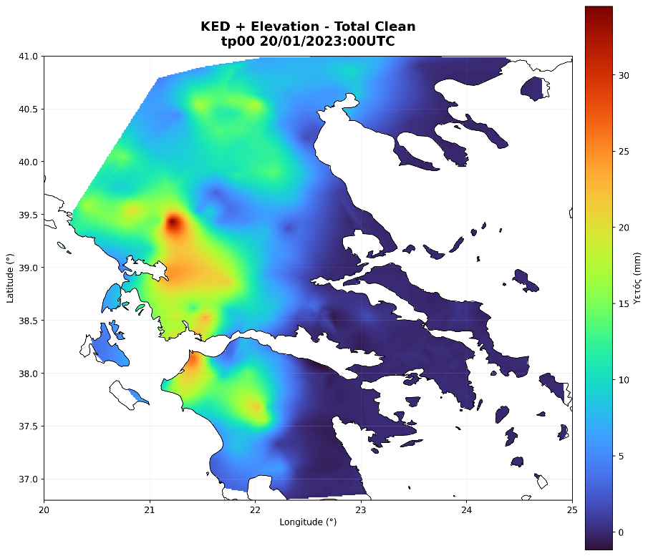
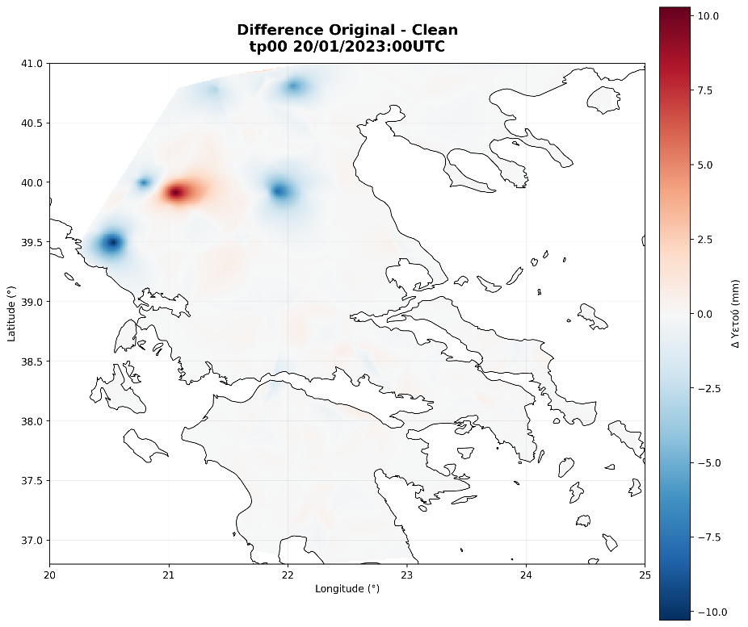
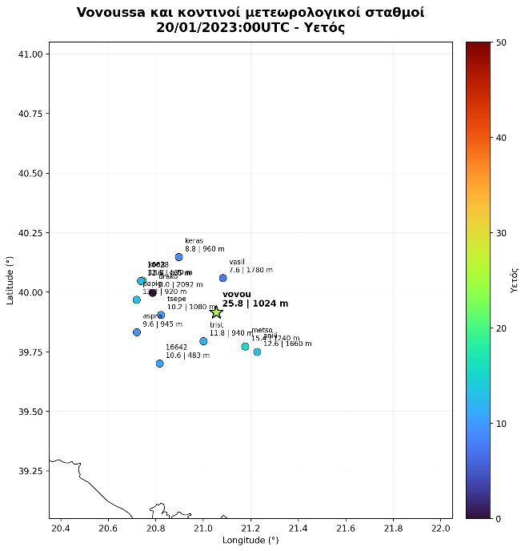
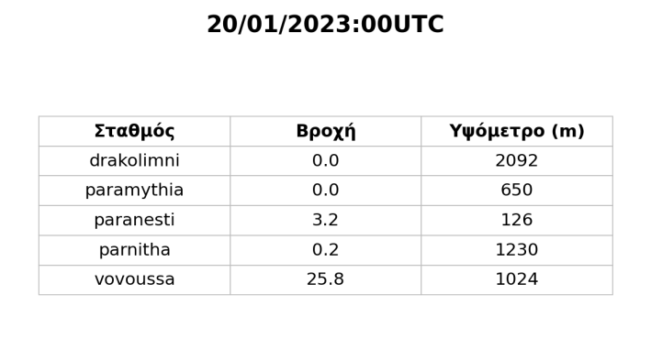
Priority Project: APOCS Application of Personal Weather Station and Opportunistic Sensor Data CrowdSourcing
Performed Analysis MISH: 20.01.2023 00UTC
Notes:
This case corresponds to 20 January 2023 at 00 UTC.
the Original and Clean datasets were examined before applying the interpolation so that changes in the station network could be separated from changes introduced by the interpolation method.
This case has fewer outliers and overall smaller 6h preci amounts but local differences still exist in the interpolated fields

Slide 8
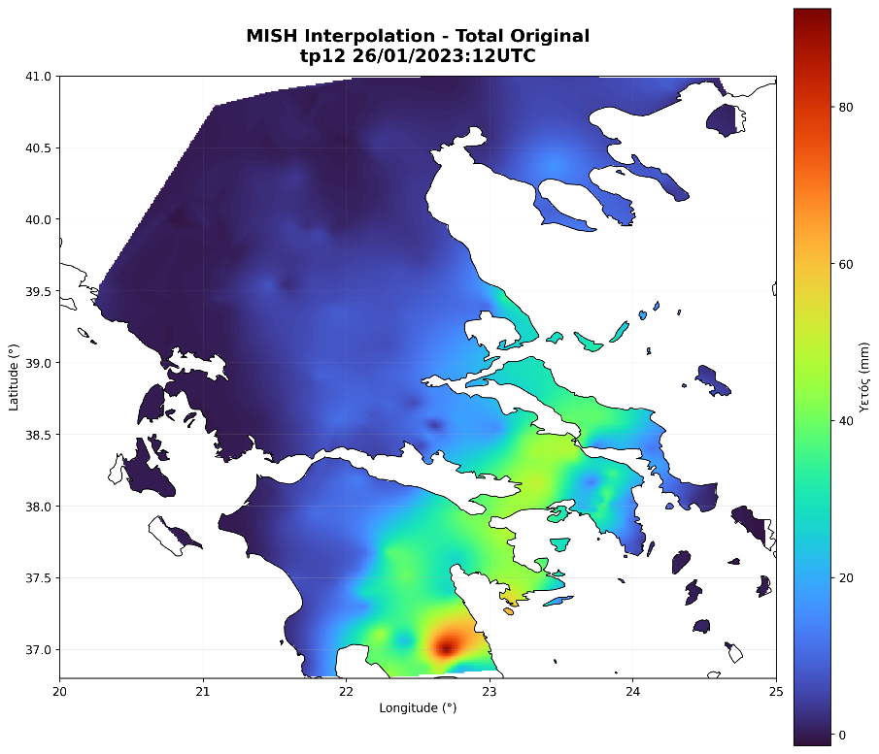

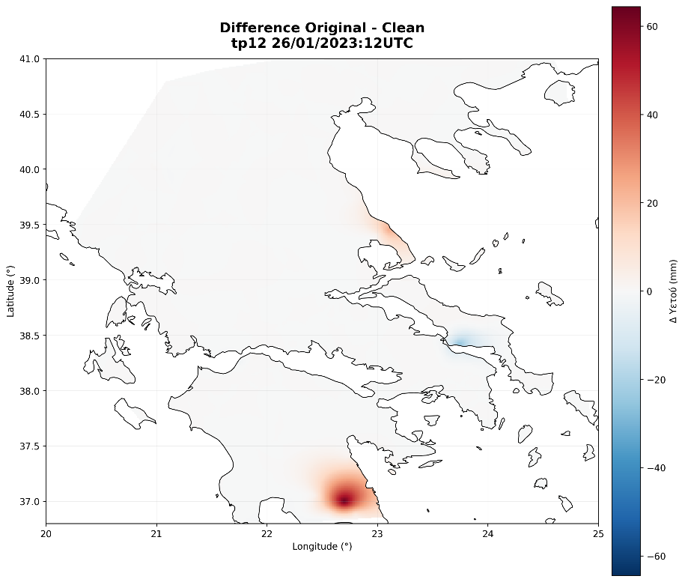
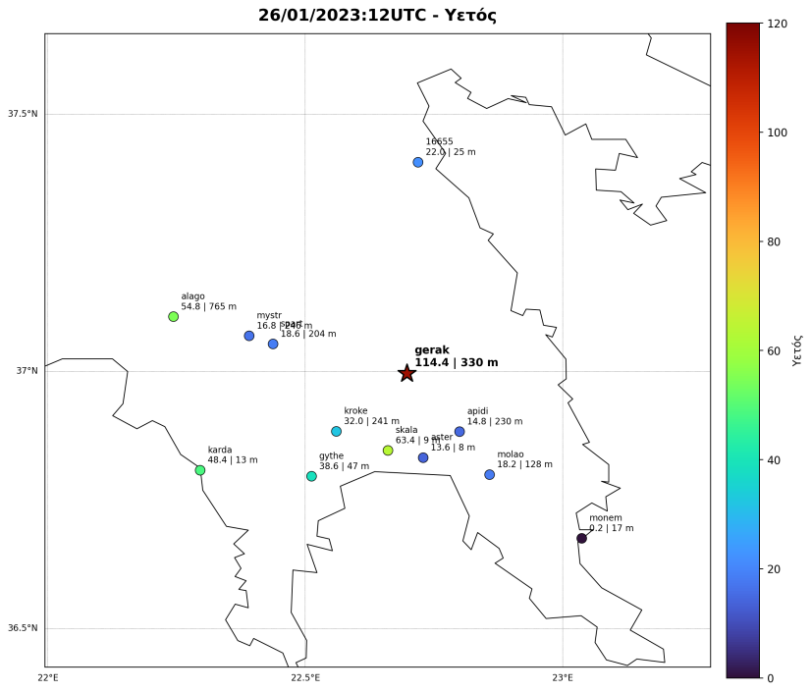
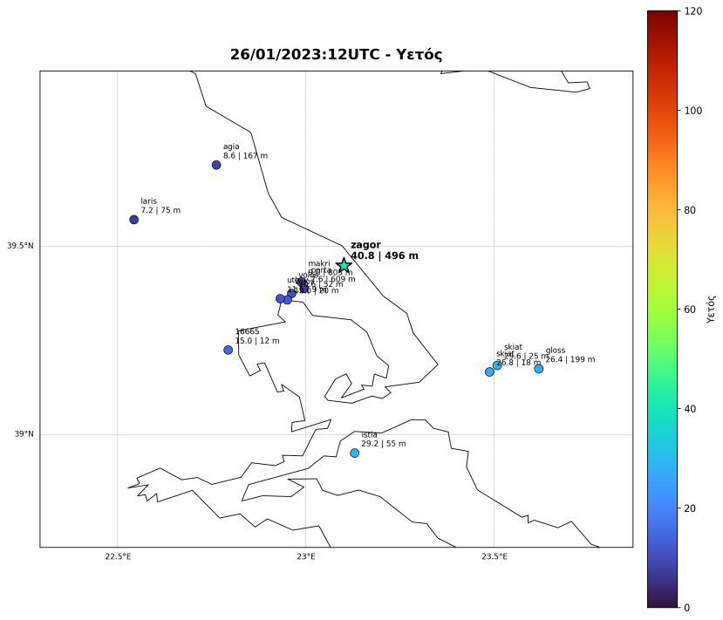
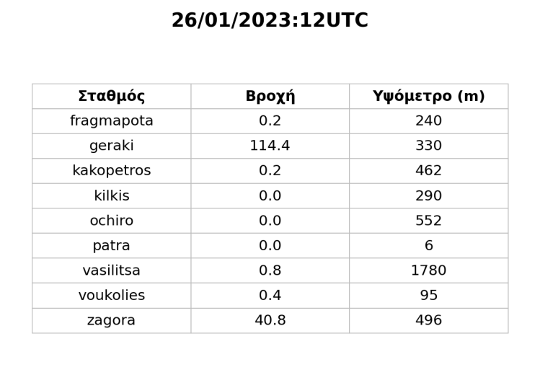
Priority Project: APOCS Application of Personal Weather Station and Opportunistic Sensor Data CrowdSourcing
Performed Analysis MISH: 26.01.2023 12UTC
Notes:
This case corresponds to 26 January 2023 at 12 UTC.
The comparison showed that the main differences between the Original and Clean analyses were associated with a small number of stations, rather than with a general change in the network.
Two particularly important observations removed were Geraki 114.4 mm and Zagora 40.8 mm.
The maps of the surrounding stations are useful for assessing whether these high values are consistent with the local preci pattern and therefore whether their removal can significantly affect the interpolation.

Slide 9
Priority Project: APOCS
Application of Personal Weather Station and Opportunistic Sensor Data CrowdSourcing
TASK 3: Adaptation of private/citizen datasets for verification purposes over Greece
SubTask 4.2: Spatial verification techniques based on gridded precipitation obs enhanced with crowdsource data
Spatial verification methodologies are subsequently applied to certain convective events that accentuate the relative skill of high resolution forecasts in revealing characteristics in the precipitation patterns such as structure and intensity that can be applied with equally detailed gridded observation fields.
Participants: Flora Gofa, Dimitra Boucouvala, HNMS
DELAYED – To be completed by Feb 2027
Notes:
The next step is to use the gridded precipitation observations for spatial verification of high-resolution model forecasts.
Spatial verification requires obs and forecasts on comparable grids and benefits from realistic representation of the obs preci structure.
This Task is delayed.

