Slide 1
25th COSMO GM
2-5 September 2024 Offenbach - Germany
Hellenic National Meteorological Service
Current Status and Future Plans
Panagiotis Skrimizeas – Euripides Avgoustoglou
Additional contributions by Theodore Andreadis, Dimitra Boukouvala and Flora Gofa

Slide 2
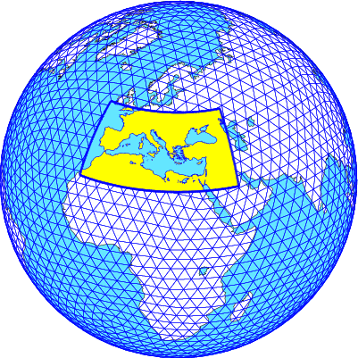
Current status
ICON operational
The model setup
ICON runs twice a day (00 and 12UTC)
Runs performed at ECMWF
Analysis and boundary conditions from IFS
Resolution: ≈ 2.4Km
Forecast range: 72 hours
Area covered is south Europe, Black Sea,
Mediterranean and north African coast
Hourly output of three types (model, pressure and height levels)
No assimilation or any preproc performed

Slide 3
Current status
ICON operational

Slide 4
Ongoing projects

Slide 5
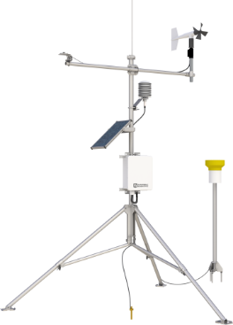
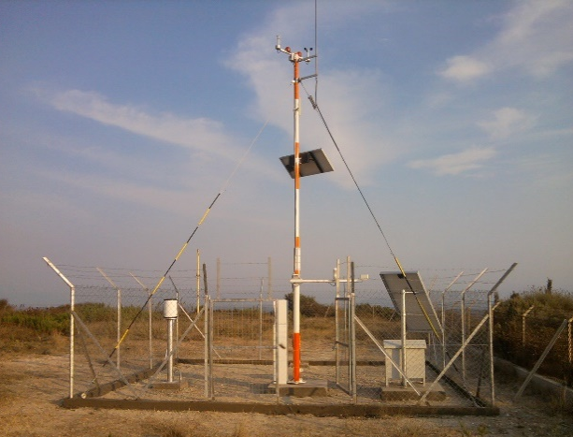
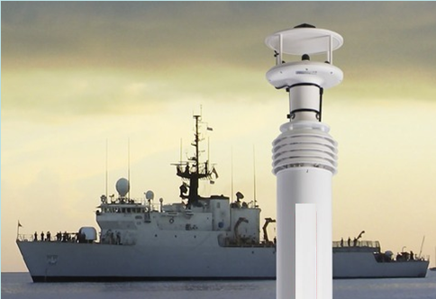
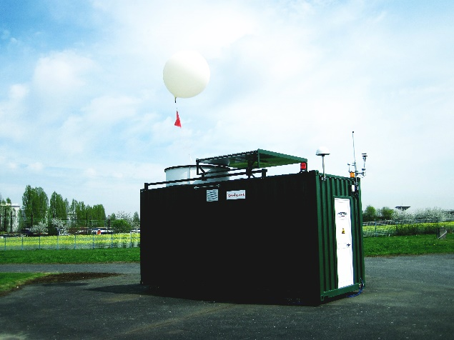
1st PROJECT
1st Project: Upgrade and Extension of Surface & Upper Air Observation network
50 Automatic Weather Stations (AWS)
30 Environmental AWS (E-AWS)
10 Portable AWS (P-AWS)
10 Shipboard AWS (S-AWS)
3 Automatic Radiosonde Systems (ARS)
Notes:
(Δ–4)
In more details….
The first part with the surface observation network upgrade includes the installation of 50 Automatic Weather Stations systems consisted of the most essential sensors, 30 Environmental AWS consisted of some more peculiar sensors, 10 shipboard AWS (S-AWS), 10 portable (P-AWS) and 3 fully automatic sounding systems (ARS).

Slide 6
1st PROJECT
1st Project: Upgrade and Extension of Surface & Upper Air Observation network
50 Automatic Weather Stations (AWS)
30 Environmental AWS (E-AWS)
10 Portable AWS (P-AWS)
10 Shipboard AWS (S-AWS)
3 Automatic Radiosonde Systems (ARS)
The implementation of the network with the installation of the new met stations is in progress.
Fully operational by the end of the year.
Notes:
(Δ–4)
In more details….
The first part with the surface observation network upgrade includes the installation of 50 Automatic Weather Stations systems consisted of the most essential sensors, 30 Environmental AWS consisted of some more peculiar sensors, 10 shipboard AWS (S-AWS), 10 portable (P-AWS) and 3 fully automatic sounding systems (ARS).

Slide 7
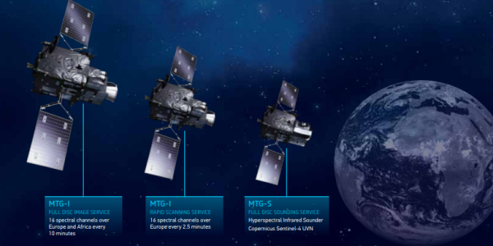
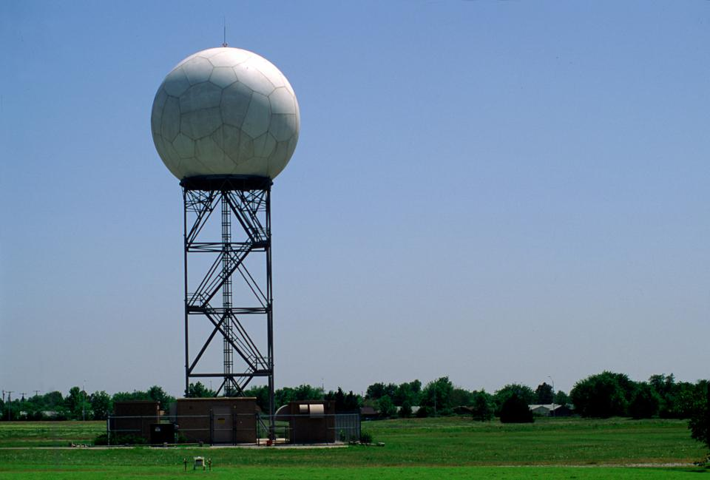
2nd PROJECT
2st Project: Implementation of a Nowcasting system for severe weather and for supporting Civil Protection Authority
1st phase includes:
30 automatic stations for Radar calibration,
two MTG-compatible satellite data acquisition and processing stations, and
a network of 12 lightning sensors.
Notes:
(Δ–8)
The second modernization project with the title of “Implementation of a nowcasting system for severe weather and for supporting Hellenic Civil Protection Authority” includes the upgrade and spatial expansion of our radar network covering the entire Hellenic territory with at least 10 new C-band dual polarization systems, the upgrade of our satellite receiving stations to be compatible with the new generation of EUMETSAT satellites MTG and METOP SG, the upgrade of our lightning detection network and the development of a Nowcasting system focusing on severe weather. The system will be able to produce warnings automatically which after a quality control from the on duty forecasters will be sent to civil protection services and then to public. The budget of the project is around 50 million euros and has a scheduling of at least 5 years.

Slide 8
2nd PROJECT
2st Project: Implementation of a Nowcasting system for severe weather and for supporting Civil Protection Authority
1st phase includes:
30automatic stations for Radar calibration,
two MTG-compatible satellite data acquisition and processing stations, and
a network of 12 lightning sensors.
The implementation is expected to start before the end of this year.
Notes:
(Δ–8)
The second modernization project with the title of “Implementation of a nowcasting system for severe weather and for supporting Hellenic Civil Protection Authority” includes the upgrade and spatial expansion of our radar network covering the entire Hellenic territory with at least 10 new C-band dual polarization systems, the upgrade of our satellite receiving stations to be compatible with the new generation of EUMETSAT satellites MTG and METOP SG, the upgrade of our lightning detection network and the development of a Nowcasting system focusing on severe weather. The system will be able to produce warnings automatically which after a quality control from the on duty forecasters will be sent to civil protection services and then to public. The budget of the project is around 50 million euros and has a scheduling of at least 5 years.

Slide 9
2nd PROJECT
2st Project: Implementation of a Nowcasting system for severe weather and for supporting Civil Protection Authority
2nd phase includes:
New network of 7 – 10 Radar C-band Dual Pol Magnetron, and
The infrastructure for a Nowcasting System
Notes:
(Δ–8)
The second modernization project with the title of “Implementation of a nowcasting system for severe weather and for supporting Hellenic Civil Protection Authority” includes the upgrade and spatial expansion of our radar network covering the entire Hellenic territory with at least 10 new C-band dual polarization systems, the upgrade of our satellite receiving stations to be compatible with the new generation of EUMETSAT satellites MTG and METOP SG, the upgrade of our lightning detection network and the development of a Nowcasting system focusing on severe weather. The system will be able to produce warnings automatically which after a quality control from the on duty forecasters will be sent to civil protection services and then to public. The budget of the project is around 50 million euros and has a scheduling of at least 5 years.

Slide 10
2nd PROJECT
2st Project: Implementation of a Nowcasting system for severe weather and for supporting Civil Protection Authority
2nd phase includes:
New network of 7 – 10 Radar C-band Dual Pol Magnetron, and
The infrastructure for a Nowcasting System
The implementation is expected to start in the 1st half of 2025.
Notes:
(Δ–8)
The second modernization project with the title of “Implementation of a nowcasting system for severe weather and for supporting Hellenic Civil Protection Authority” includes the upgrade and spatial expansion of our radar network covering the entire Hellenic territory with at least 10 new C-band dual polarization systems, the upgrade of our satellite receiving stations to be compatible with the new generation of EUMETSAT satellites MTG and METOP SG, the upgrade of our lightning detection network and the development of a Nowcasting system focusing on severe weather. The system will be able to produce warnings automatically which after a quality control from the on duty forecasters will be sent to civil protection services and then to public. The budget of the project is around 50 million euros and has a scheduling of at least 5 years.

Slide 11
3rd PROJECT
3rd Project: Procurement of a new HPC, and
Data Center upgrade.
Notes:
(Δ–8)
The second modernization project with the title of “Implementation of a nowcasting system for severe weather and for supporting Hellenic Civil Protection Authority” includes the upgrade and spatial expansion of our radar network covering the entire Hellenic territory with at least 10 new C-band dual polarization systems, the upgrade of our satellite receiving stations to be compatible with the new generation of EUMETSAT satellites MTG and METOP SG, the upgrade of our lightning detection network and the development of a Nowcasting system focusing on severe weather. The system will be able to produce warnings automatically which after a quality control from the on duty forecasters will be sent to civil protection services and then to public. The budget of the project is around 50 million euros and has a scheduling of at least 5 years.

Slide 12
3rd PROJECT
3rd Project: Procurement of a new HPC, and
Data Center upgrade.
The procurement process will start in 2025
Notes:
(Δ–8)
The second modernization project with the title of “Implementation of a nowcasting system for severe weather and for supporting Hellenic Civil Protection Authority” includes the upgrade and spatial expansion of our radar network covering the entire Hellenic territory with at least 10 new C-band dual polarization systems, the upgrade of our satellite receiving stations to be compatible with the new generation of EUMETSAT satellites MTG and METOP SG, the upgrade of our lightning detection network and the development of a Nowcasting system focusing on severe weather. The system will be able to produce warnings automatically which after a quality control from the on duty forecasters will be sent to civil protection services and then to public. The budget of the project is around 50 million euros and has a scheduling of at least 5 years.

Slide 13
Ongoing activities
Increase the model run to 4 times a day.
Implementation of Data Assimilation.
Implementation of nesting technique over Greece on a resolution of ~1 km.

Slide 14
Support activities
ICON model output is used operationally by Civil Protection to produce the Fire Risk Assessment Map.
The predictive maps of the WBGT (Wet Bulb Globe Temperature) index produced by the ICON model are used by the Ministry of Labour and Social Affairs to implement measures to protect workers, especially during heat waves.

Slide 15
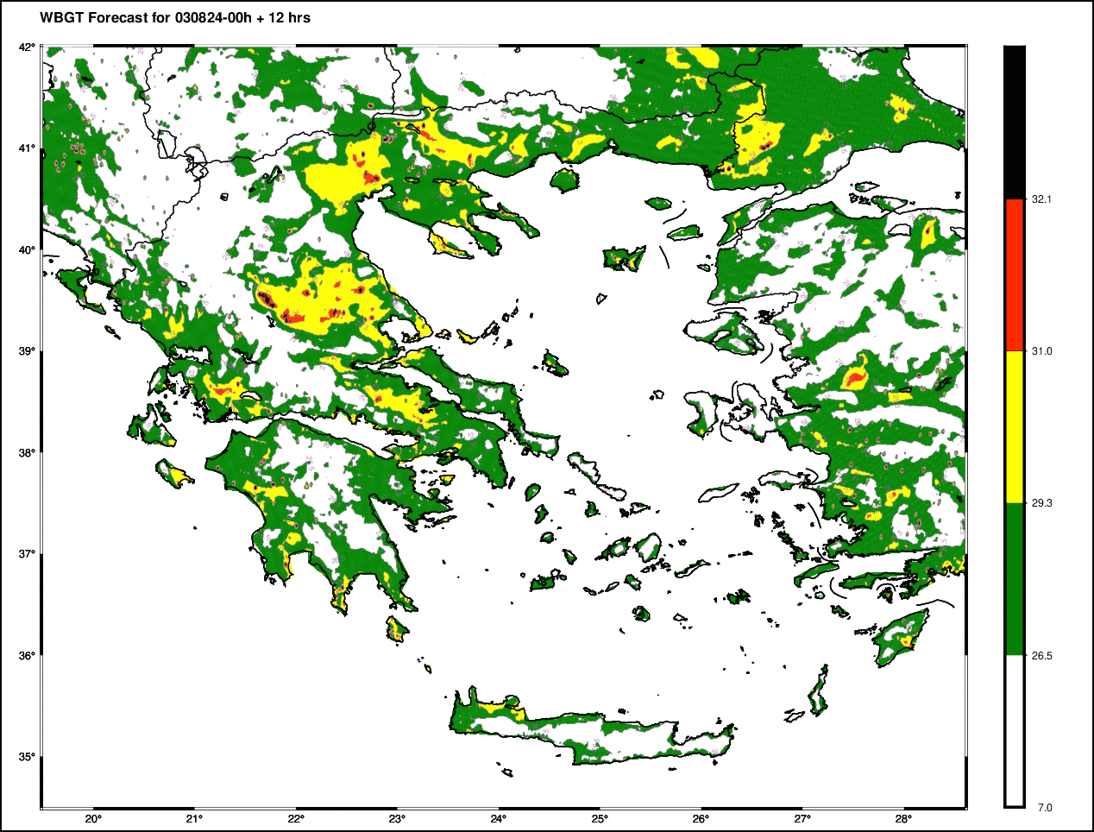
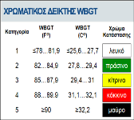
Βioclimatic indices forecasts at HNMS
Human response to thermal environment
Indices: Wind Chill (UTCI), Heat Stress (WBGT)
Methods: Dedicated software based on ICON-GR forecasts utilizing 2mT, RH, radiation, Windsp, etc.
Operations: Daily hourly forecasts for certain periods of the year that determining weather parameters can affect human activities and health
End-Users: Municipalities of most populated areas, Ministry of Labor, Port Authorities, Industrial Zones, Ministry of Tourism, etc.
Perspectives: In preparation of first european legislation for occupation in heat stress conditions based on WBGT forecasts, to protect the health and productivity of workers.

Slide 16
HNMS Verification Highlight
Scores for continuous parameters for Greek domain SON23
ICON-GR2.5
IFS-ECMWF
RMSE
ME
2m Temperature
is overestimated at night
by ICON-GR
Wind speed
Better scores for ICON-GR

Slide 17
TAF verification software development
Can be applied to a dataset of TAFs and METARs of all available airports within a time window (month or season) and gives an indication on the forecast quality of wind , visibility and events such as RA/TSRA
Compares metar and TAF wind speed and direction for every forecast hour according to
user specified thresholds .
The output gives the percentage of correct and incorrect wind forecasts for all TAFs included in the Verification.
Every PROB40/PROB30 TEMPO for events such as RA /TSRA /SN is verified according to the events occurrence within the time window of the forecast period and it is considered as HIT, MISS or FALSE ALARM.
Categorical scores are given for all the TEMPO RA/TSRA etc predictions for all TAFS included in the verification.
The software is being now tested with data and will be used for monitoring the aeronautical forecasts quality

Slide 18
Research Highlight
Implementation of COSMO model in the Evaluation of Eumetsat Aeolus Project
COSMO Model was used in hindcast mode forced with IFS Analysis with and without Aeolus assimilated data for the case of Medicane “Ianos”.
The results regarding precipitation threat scores over Greek synoptic stations displayed a preponderance of the forcing with Aeolus assimilated data.
A relevant peer reviewed publication is available in open access from MDPI Water journal and further investigation for eleven more test cases spanned over 2020 fairly supports this trend.
Associated links:
https://www.eumetsat.int/eps-aeolus
https://en.wikipedia.org/wiki/Cyclone_Ianos
https://www.mdpi.com/2073-4441/15/21/3820

Slide 19
25th COSMO GM
2-5 September 2024 Offenbach - Germany
Hellenic National Meteorological Service
Current Status and Future Plans
Thank you for your attention

