Slide 1
SCA Report for ICON-NWP
Ulrich Schättler
ICON Gatekeeper (in charge for COSMO)

Slide 2
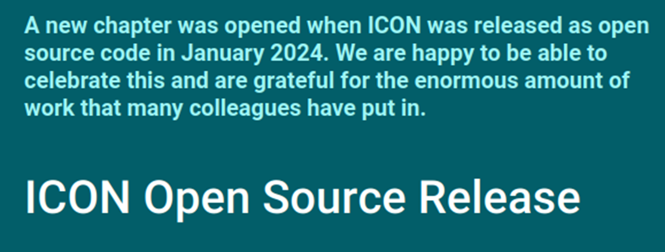
ICON now is Open Source

Slide 3
Where to find ICON and Related Informations
https://icon-model.org New webpage with basic information on ICON and the download link:
Going to „ICON-Model ⇒ Release Download“, which is a publicly availabe gitlab page
https://gitlab.dkrz.de/icon/icon-model
From here you can download a tar-ball (go to „Code“ ⇒ „Download source code“)
You can also download directly with git:
git clone git@gitlab.dkrz.de:icon/icon-model.git
git clone https://gitlab.dkrz.de/icon/icon-model.git
https://docs.icon-model.org/
Still under construction, should be publicly available soon.

Slide 4
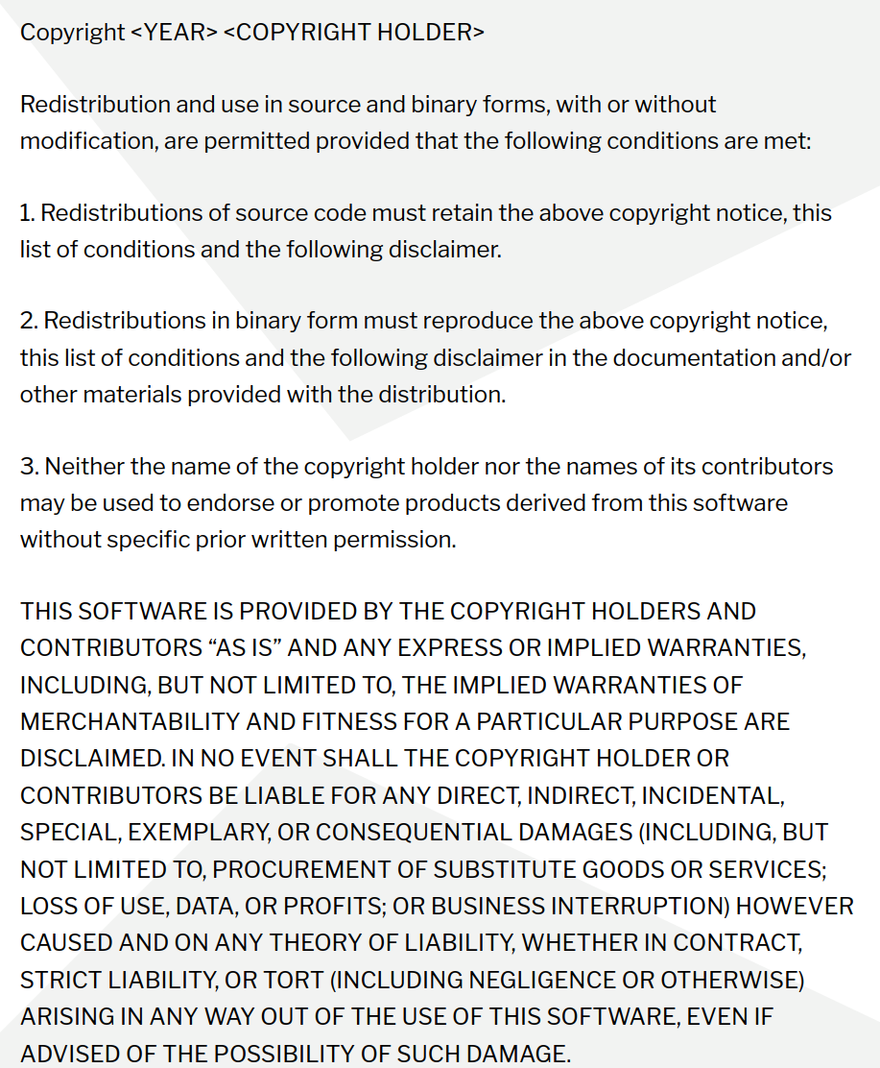
The W-Questions
What is Open Source?
Open Source software can be used, investigated, modified, and enhanced by everybody.
It can be downloaded for free.
Why Open Source?
Enables the greatest possible scientific dissemination.
Project funding from the EU (for example) requires that software developed by the project is Open Source.
Reduces amount of administrative work to issue special licenses to partners.
Which Open Source?
ICON is now licensed under BSD-3C permissive license.

Slide 5
HowTo Open Source?
Preliminary work:
A working group AGIL (Arbeitsgruppe ICON Lizenz) elaborated 10 recommendations for an Open Source License (for about a year).
Florian Prill and Daniel Reinert inspected ICON to identify parts of code which have not been written by ICON developers. E.g. Tiedtke-Bechtold Convection (ECMWF), RRTM in all flavors (AER), etc.
Work on the ICON repository: From October on colleagues from all ICON partners took care of necessary modifications in the repository. This work was organized by Florian Prill and Uli Schättler.
Every file in the source code directories was modified to replace the old license header by a new one.
For external code it was ensured that proper permissive open source licences are available.
Also files in other parts of the repository need a proper license: run-scripts, pictures, pdf-files, data,…

Slide 6
Consequences for Developers
If you contribute code to ICON, you have to agree that it is published under the BSD-3C license.
For colleagues working for ICON partners this is guaranteed by the ICON partner.
Also the COSMO STC agreed that code contributed by COSMO colleagues will be published under BSD-3C.
You cannot add code which has no permissive open source license.

Slide 7
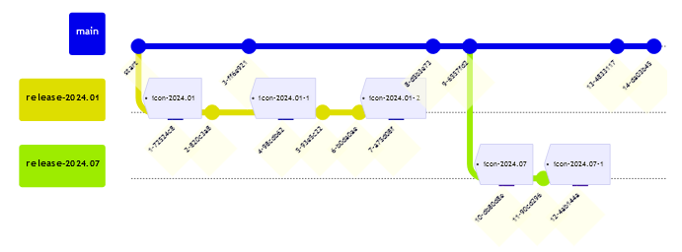
Release Names
Old: icon-2.6.7 also with patch level icon-x.y.z.n, e.g. icon-2.6.5.1
New: icon-2024.01 also with patch level icon-yyyy.mm-n, e.g. icon-2024.01-1
On icon/icon.git: Note: There is no icon-x.y.z-rc any more!
© Florian Prill
Branch Tag

Slide 8
Use Cases
These are publicly available test cases:
Whoever downloads and installs ICON should be able to test it with special (recommended) configurations.
Recommended means: we only support these configurations!
For NWP we provide a global (R02B06, 40 km) and a local (R19B07, ICON-D2) case.
Available from (once the docs-pages are available)
https://docs.icon-model.org/how_to_run/recommended_config/recommended_config.html
These pages lead you to the DKRZ Swiftbrowser, from where you can download the tar-balls:
https://swiftbrowser.dkrz.de/public/dkrz_4d992e1b-f237-4258-a2bc-138ca6a1cf59/icon-model-use-cases/

Slide 9
Latest ICON Releases

Slide 10
Two Releases Since Last COSMO GM
release-2024.01 (formerly known as Release Candidate 2.6.7)
Work on this release candidate started on 09.02.2023!
It was released on 15.01.2024 as the first ICON Open Source version, now named release-2024.01.
release-2024.07
This release will be tested with the NWP Testsuite in the next months.
ICON changes relevant for ICON-NWP have been shown yesterday already by Günther.
Upcoming release: release-2024.10
Feature freeze for this release starts at 25. September!

Slide 11
(Detailed) Informations on the Content of the Releases
Informations can be found in
The file RELEASE_NOTES.md of the open source releases.
CAMS climatological aerosol as an option for ecRad radiation
Disadvantage: Just the title is given.
The Protocol of Release Commits: https://gitlab.dkrz.de/icon/wiki/-/wikis/Protocol-of-Release-Commits (and subpages).
CAMS climatological aerosol as an option for ecRad radiation (icon!783)
Advantage: this protocol contains links to the corresponding merge requests with more informations.
Disadvantage: Only accessible, if you have a DKRZ account. Very often you have to go to sub pages.

Slide 12
DWD ICON Tools
Version 2.6.0 available since 15 May 2024.
Many fixes and consolidations
Support for lat-lon grids in python bindings
Bug fix for spherical area
icondelaunay: close grid file as soon as it is no longer needed
Use at your own risk!
DWD does not support the ICON Tools officially
Colleagues in Romania are willing to take a look, if something goes wrong.

Slide 13
License and Support Issues

Slide 14
Status of ICON Licensees
Running ICON: UAE, Oman (preoperational), Brazil (Navy)
Contracts also signed by: Kirgistan, Lesotho, Nigeria,Turkmenistan, Yemen, Zimbabwe
Contracts already sent to: Botswana, Brazil (INMET), Tanzania.
Possible paying countries (still in negotiation): Bahrain, Colombia, Panama

Slide 15
COSMO Money 2024 and Beyond (Using World Bank Data)
Country | 2024 |  | 2025
 | GDPpc¹ | Fee | GDPpc² | Fee
Botswana | Still COSMO | 20,000 | 7,249.8 | 10,300
Brazil (INMET) | Still COSMO | 20,000 | 10,043.6 | 15,900
Brazil (Navy) | 8,917.7 | 13,700 | 10,043.6³ | 15,900
Oman | 16,439.3 | 20,000 | 23,295.3 | 20,000
Turkmenistan | 8,792.5 | 13,400 | 8,792.5 | 13,400
UAE | 36,284.6 | 20,000 | 52,976.8 | 20,000
 |  | 107,100 |  | 95,500
GDPpc taken from https://data.worldbank.org/indicator/NY.GDP.PCAP.CD (August 2023)
GDPpc taken from https://data.worldbank.org/indicator/NY.GDP.PCAP.CD (26.08.2024)
If we really want to raise the fee, we have to send a written notice until end of September!

Slide 16
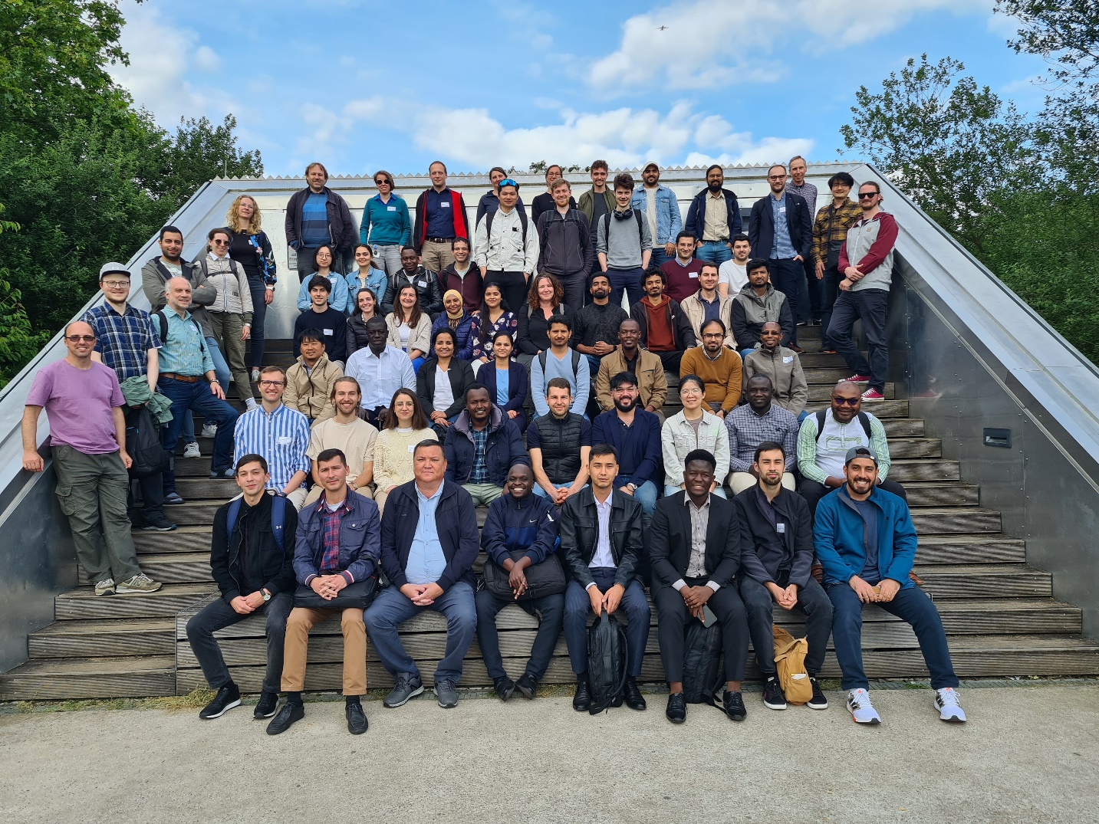
NWP Model Training
Took place from 10.-14. June at DWD Headquarters (conference area) in 3 different groups.
85 registered participants, 5 excused before the Training started. But only 60 participants present!
MetServices: 19 participants (+ 2 from DWD accepted at short notice): but 31 registrations!
Theoretical lessons (morning) and practical exercises (afternoon).
Practical exercises for MetServices again on ECMWF‘s HPC in Bologna.

Slide 17
Time Table for MetServices
Slighly modified timetable:
Added presentation on verification.
Added presentation and exercise for scheduler ecFlow. But time was too short.
Challenges:
How to fit all material in one week?
More participants have no (good) knowledge in Linux and shell scripts.

Slide 18
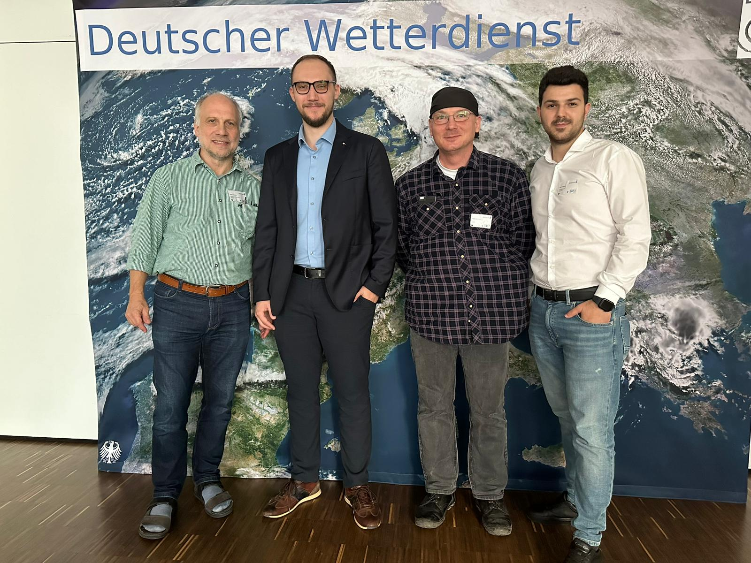
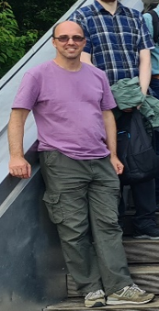
The Tutor Team
Preparation of the exercises again was a joint COSMO development!
4 Videoconferences between January and May.
Colleagues involved:
DWD: Daniel Rieger, Uli Schättler (General Info, Installation)
IMGW: Witold Interewicz (Preprocessing, Grid Generator Web Interface)
NMA: Stefan Dinicila, Stefan Gabrian (ICON-LAM; Visualization, Verification)
DWD: Sascha Brand (ecFlow)

Slide 19
NWP Model Training: Summary
Joint COSMO development of the exercises: GREAT SUCCESS!
Material available for everybody, who wants to do a Training.
Scheduler and Verification included now:
At least in a „basic state“. Have to be elaborated.
Perhaps need some more time for the Training?
Sascha is working on an ecFlow based operational setup.
Next Step: Encourage partners to install and test ICON.
I think we have to push them!
We have to see, how much support is necessary.

Slide 20
Other Support Activities
Organized an online workshop for Central Asia to give information on ICON-LAM and the migration from COSMO to ICON-LAM. Held on 01.12.24
Turkmenistan is back in business with the COSMO-Model. 3 colleagues participated to the NWP Training.
Kirgistan signed the ICON license (already before 01.12.24); 2 colleagues participated to the NWP Training
The Request Tracker is online and we already got one ticket from UAE:
ICON consistently overestimates forecasted rainfall amounts.

Slide 21
„ICON Consistently Overestimates Forecasted Rainfall Amounts“
Forecast from 16.07.2024 00 UTC for 15 UTC
There have been more events in early Summer.
After reporting that in WG 6 Meeting on Monday, several partners said, that this is also the case for their domain.
See also National Reports from yesterday.
Is it time for a task force?

Slide 22
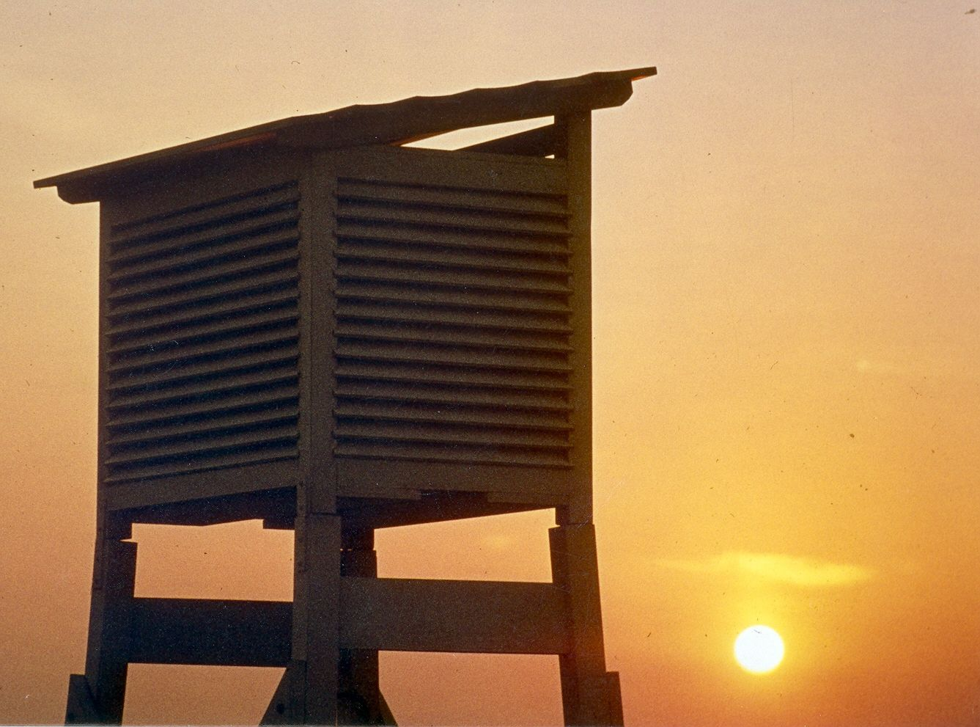
It is difficult
to predict
especially
the future.
And we have
only just begun…

