Slide 1
26th COSMO General Meeting
2-5 September 2024
STC report
Panagiotis Skrimizeas
Chairman of COSMO Steering Committee (STC)

Slide 2
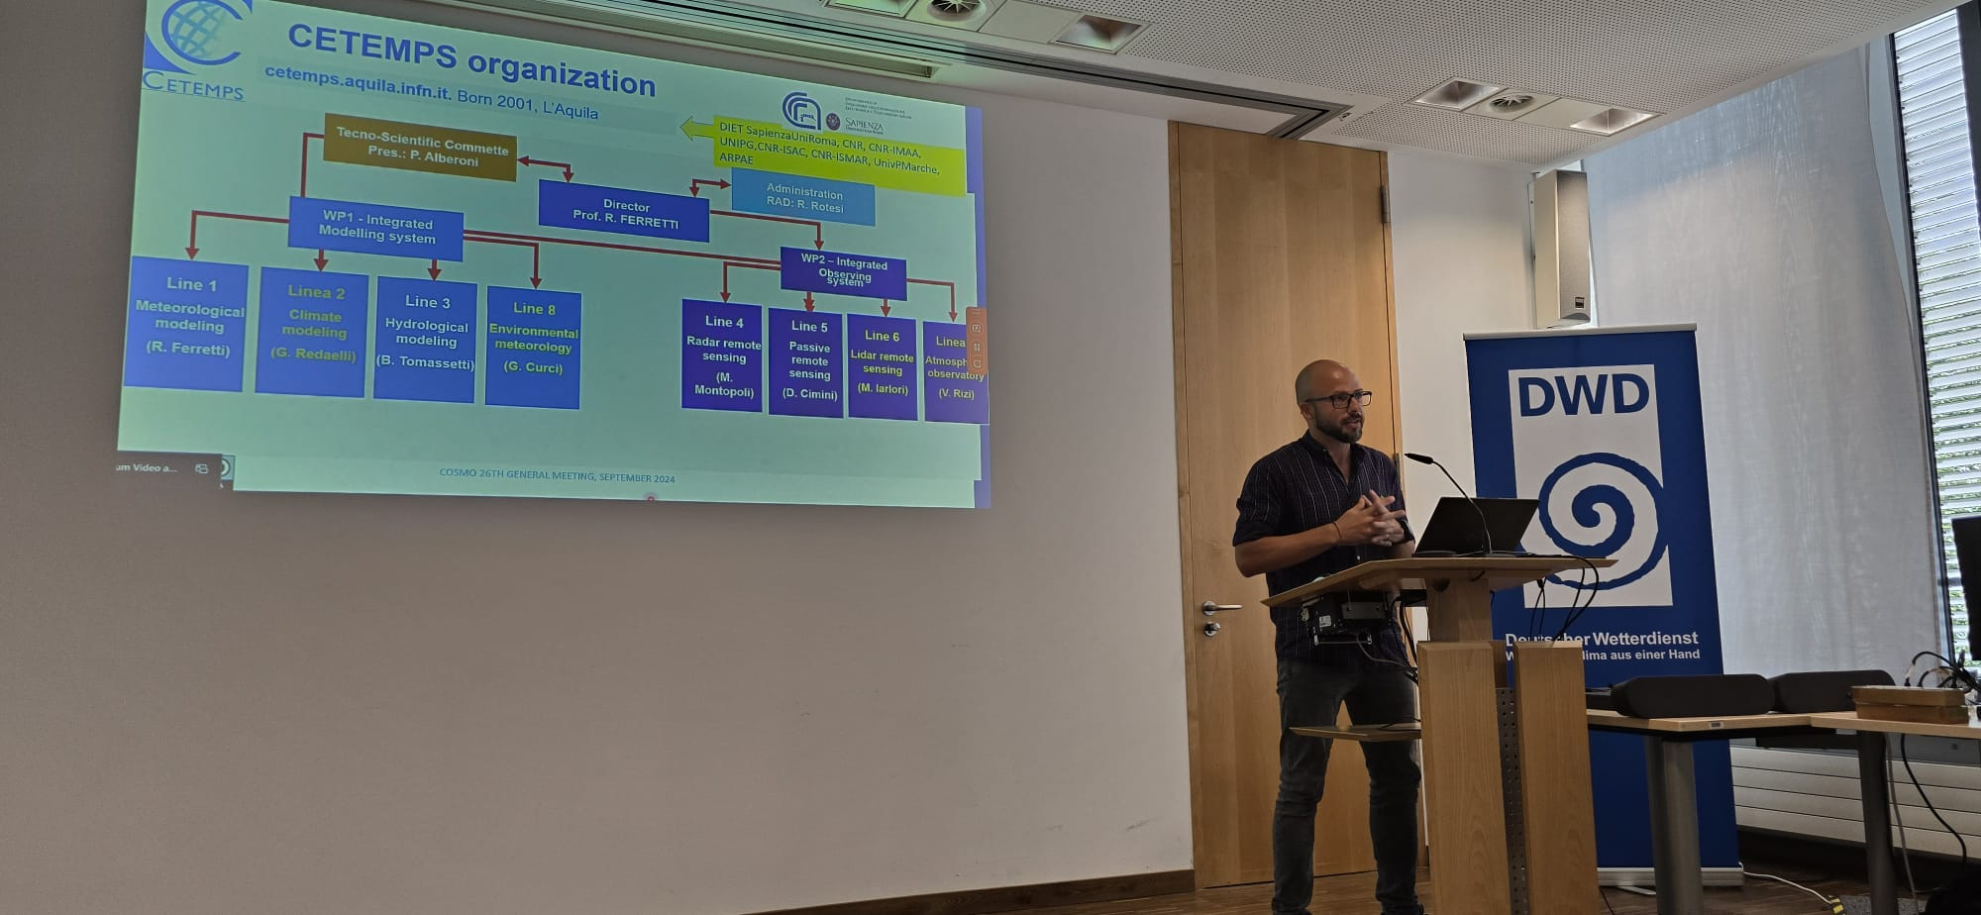
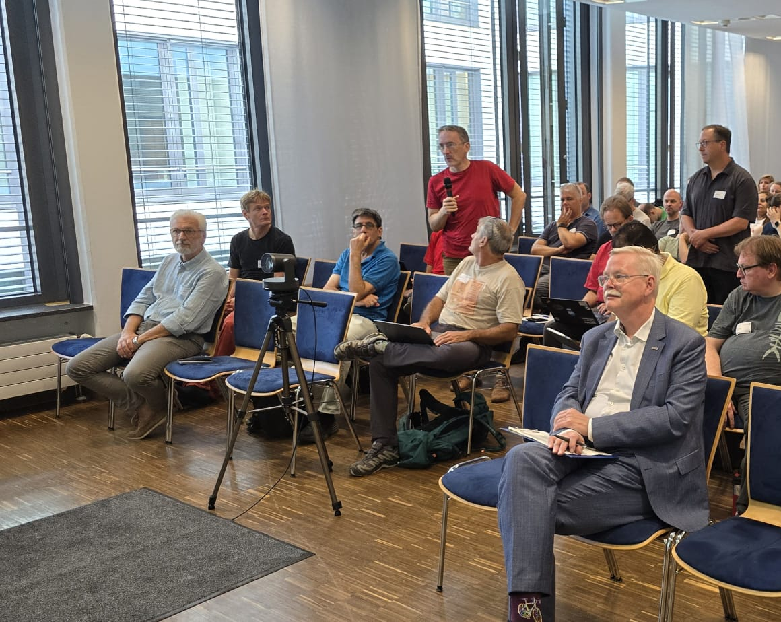
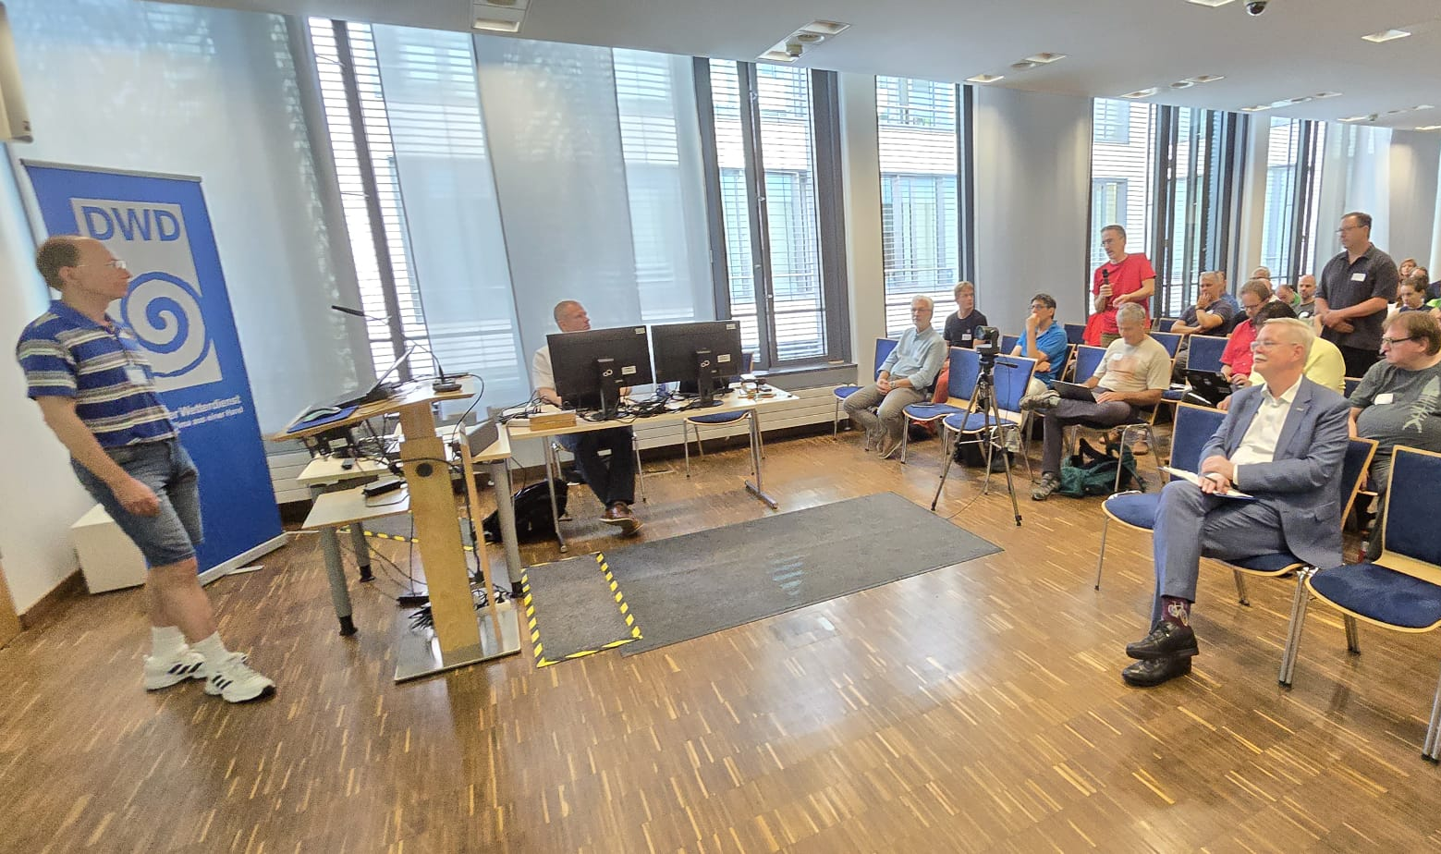
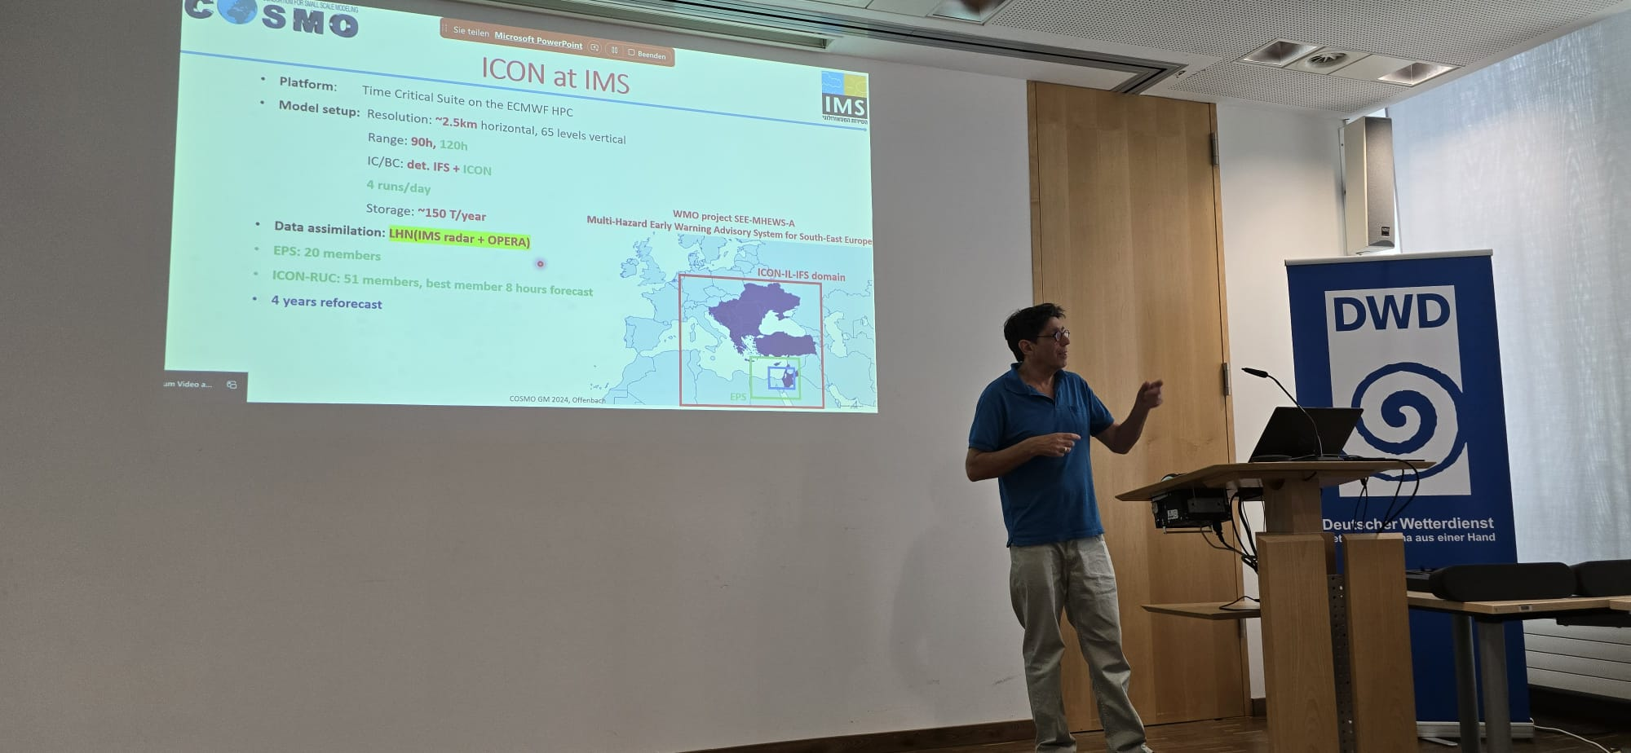

Slide 3
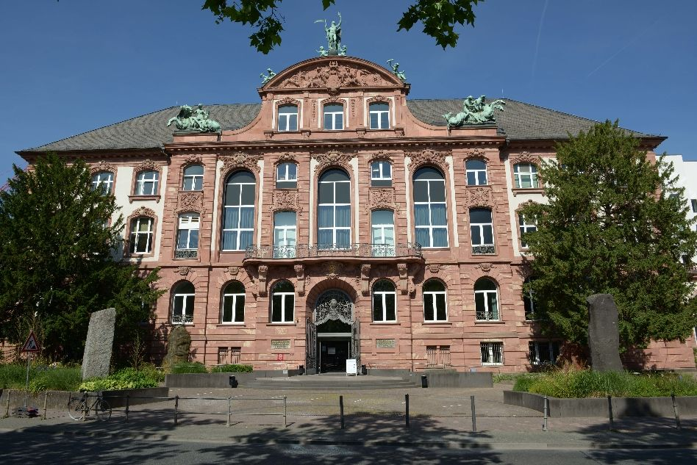
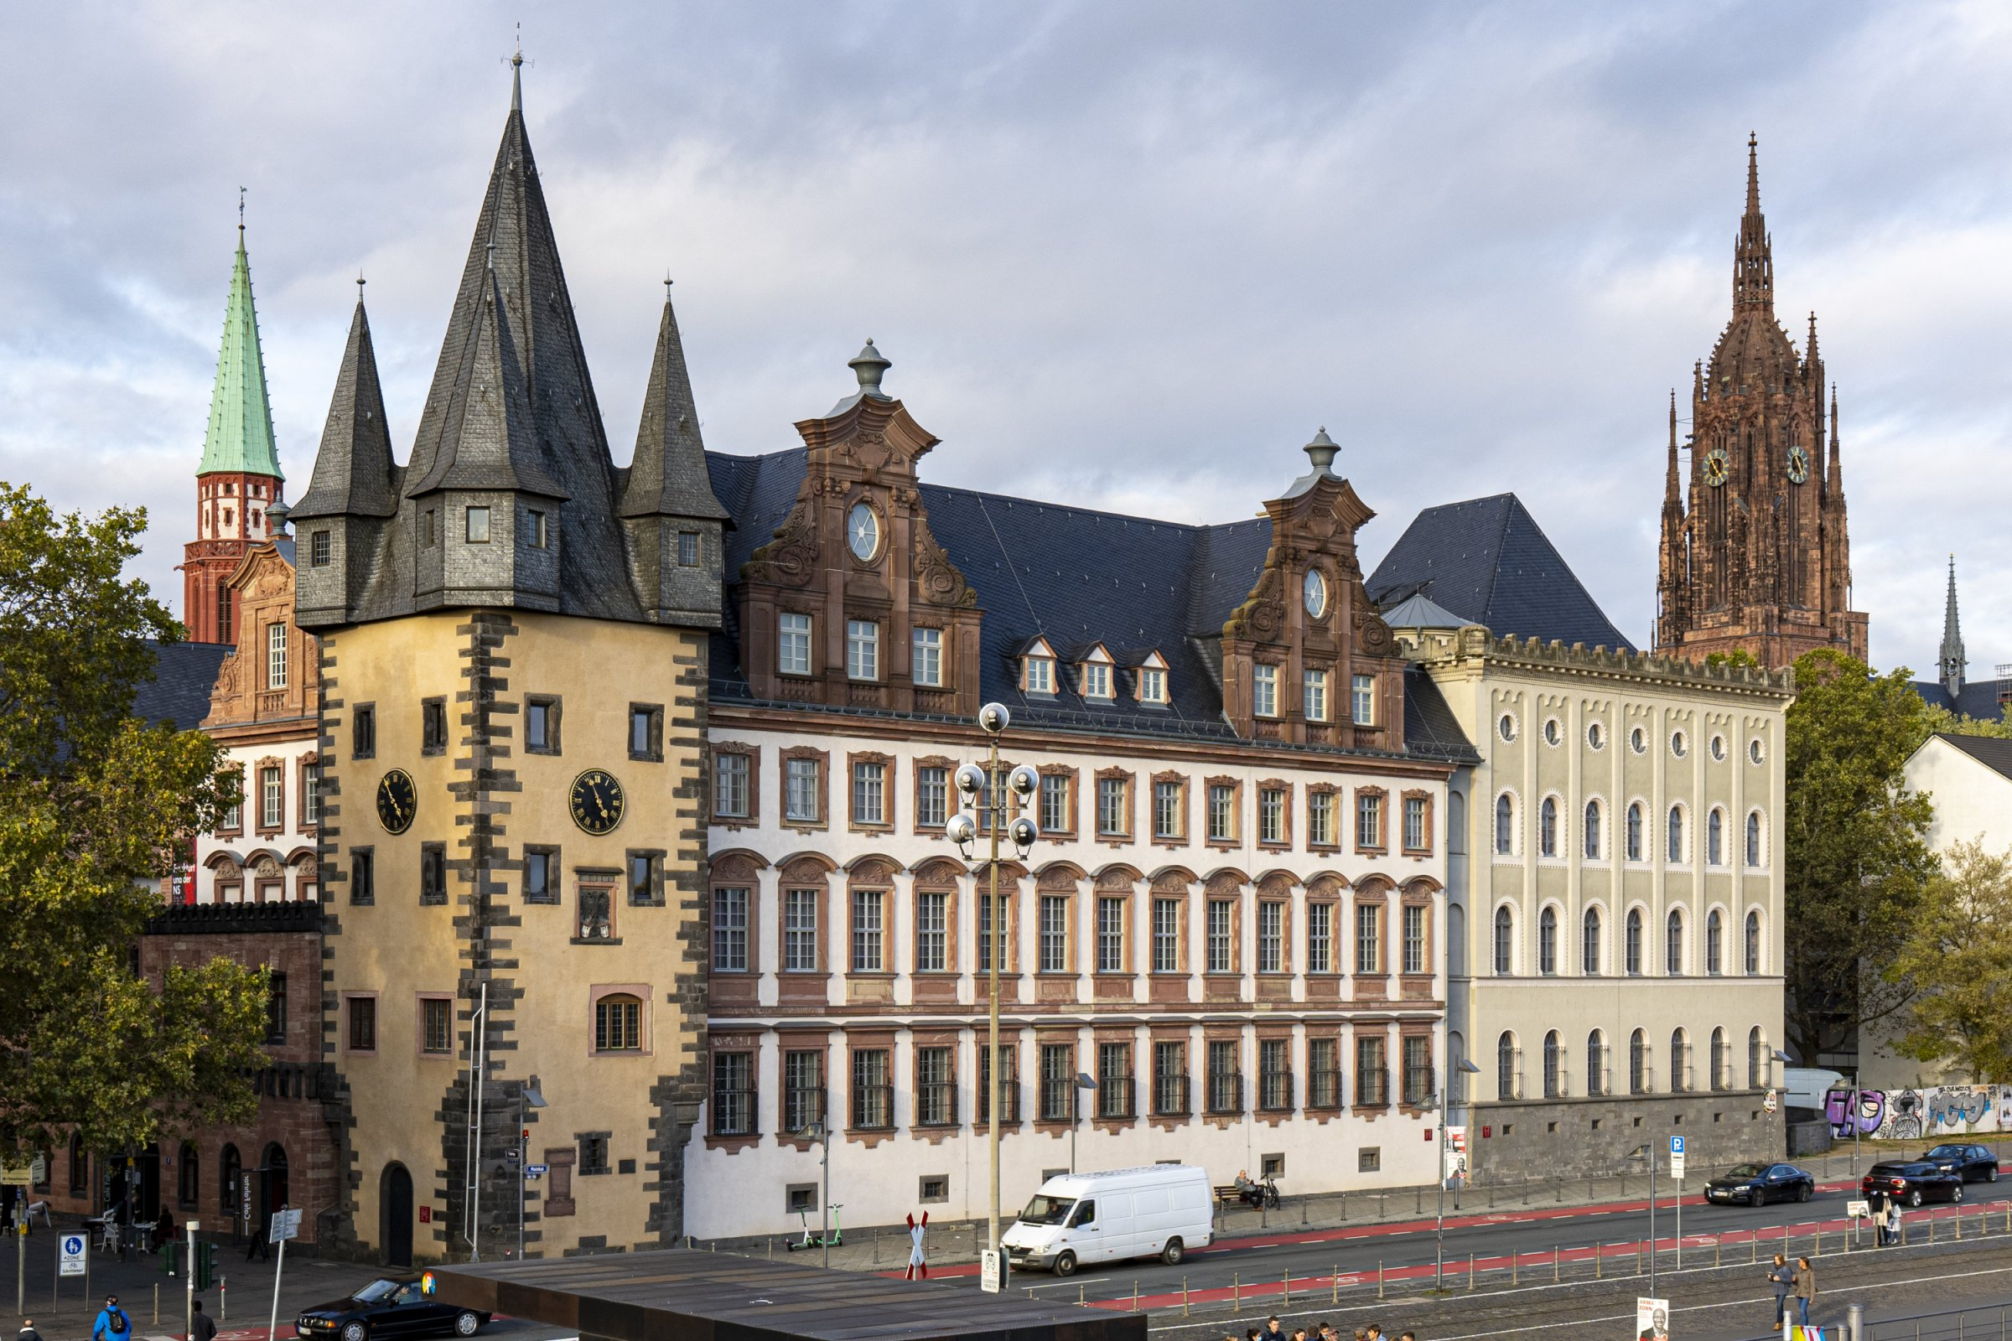
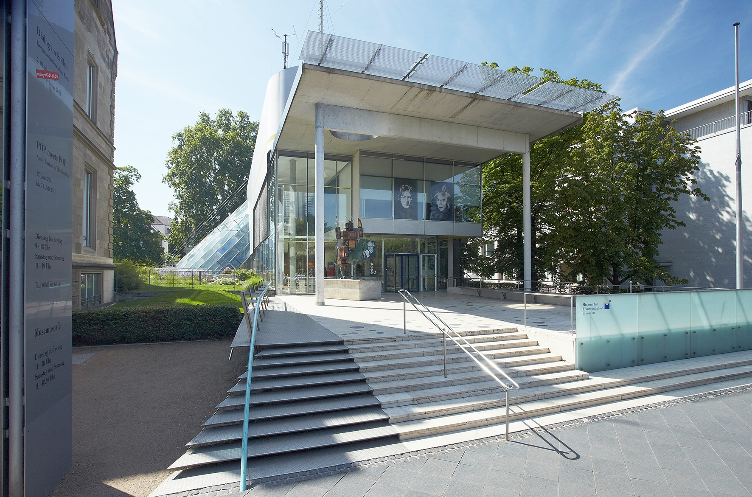
Senckenberg Museum
Historical Museum
Museum of Communication

Slide 4
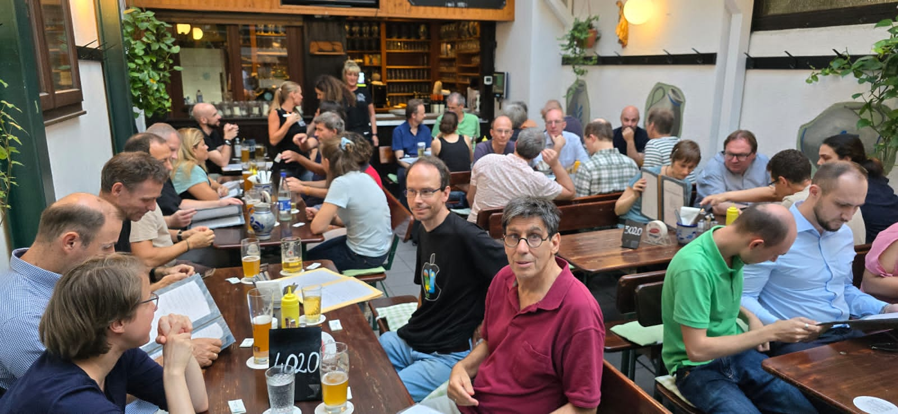
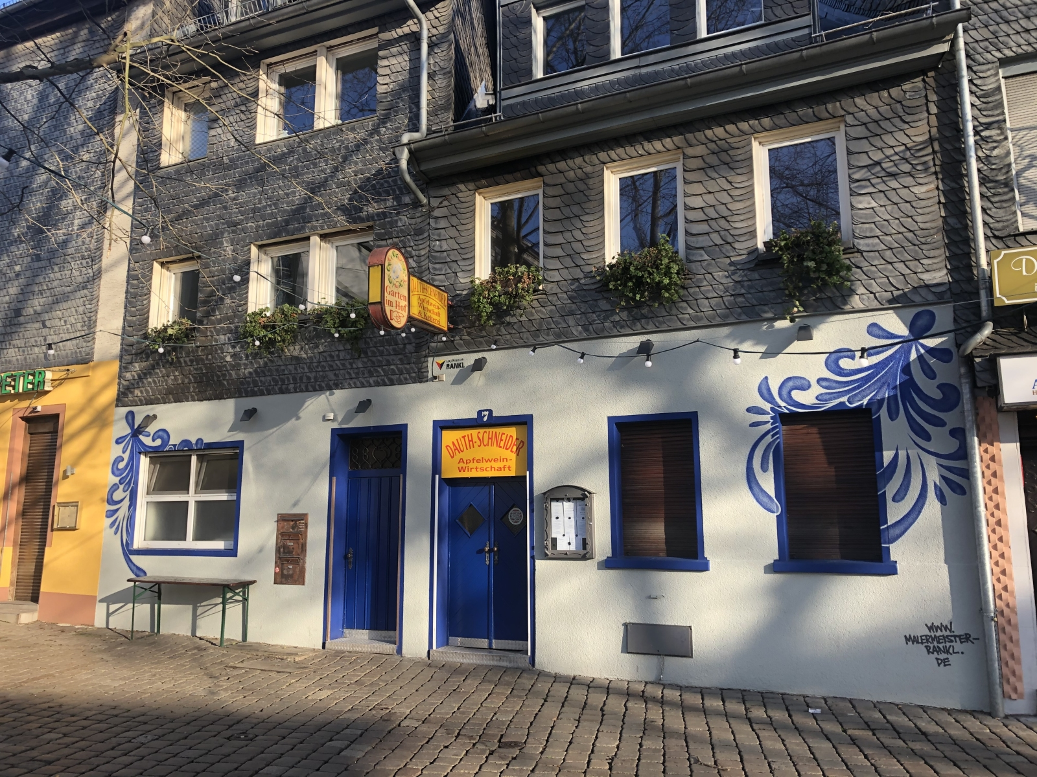
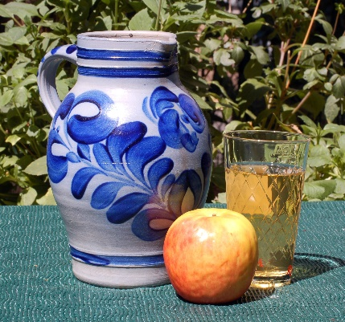
Apfelweinwirtschaft Dauth-Schneider

Slide 5
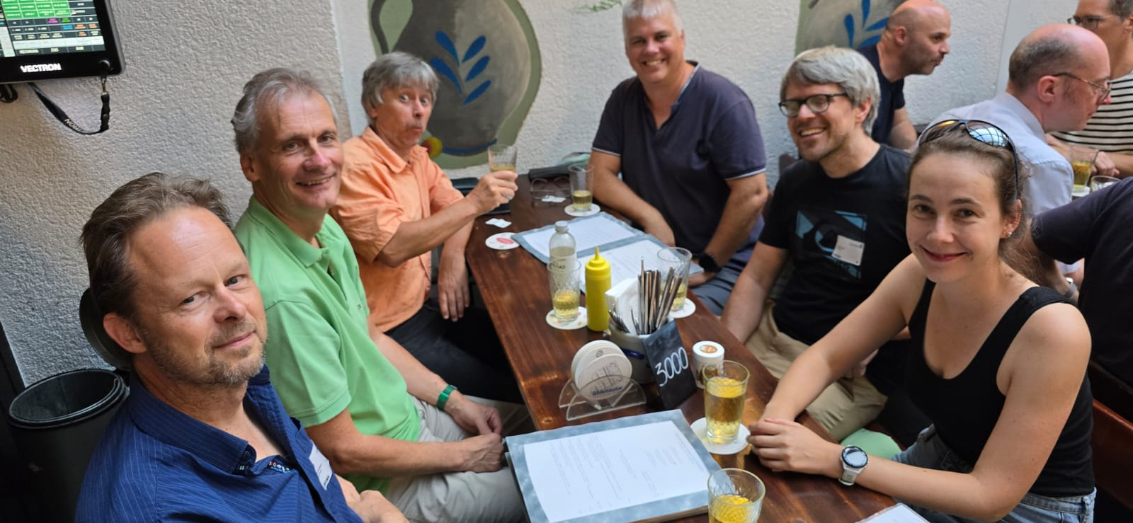
Apfelweinwirtschaft Dauth-Schneider

Slide 6
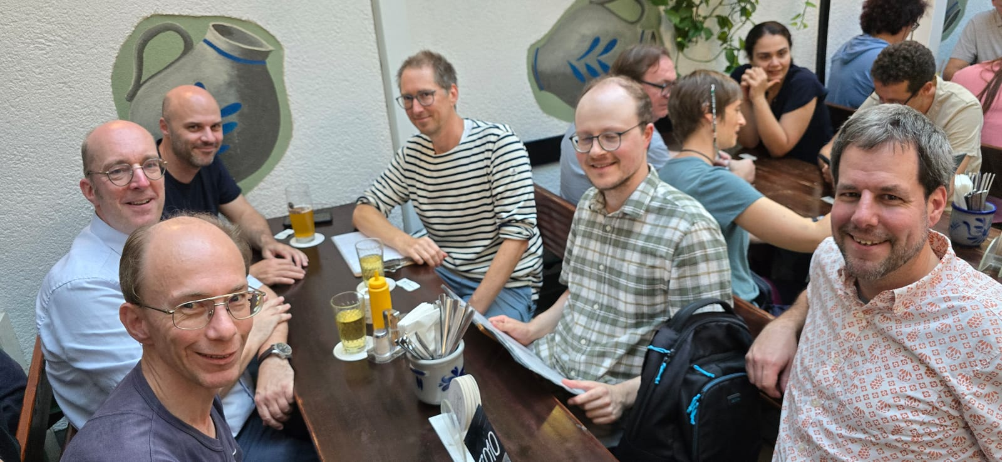
Apfelweinwirtschaft Dauth-Schneider

Slide 7
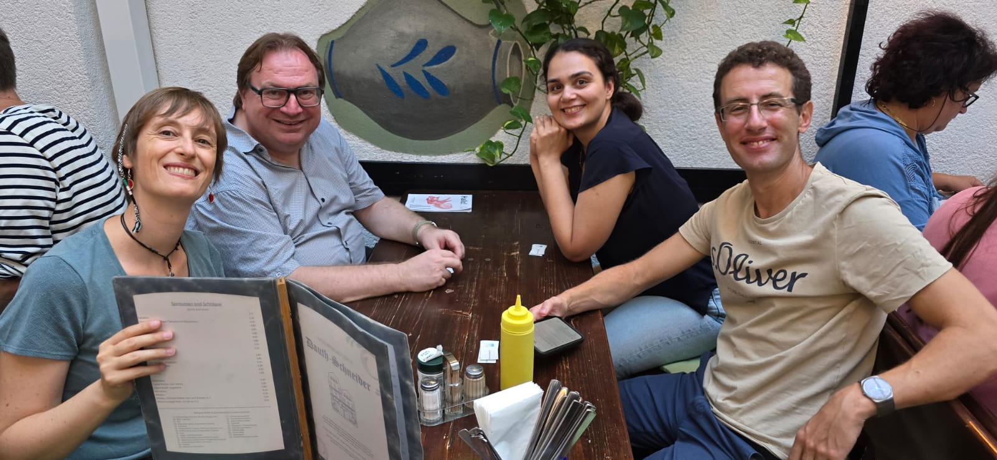
Apfelweinwirtschaft Dauth-Schneider

Slide 8
Apfelweinwirtschaft Dauth-Schneider

Slide 9
Topics from 54th STC
2 – 3 September 2025

Slide 10
27th COSMO General Meeting
September 2025

Slide 11
52nd STC meeting (11-12 September 2023, Gdansk)
The STC re-emphasized its position to continue to build and strengthen the COSMO Consortium as the consortium of NHMS’ employing ICON for operational NWP.
The STC recognize the need for change of COSMO and to strengthen its relationship with ICON, since the landscape has changed significantly since the definition of COSMO’s governance and organizational structure.

Slide 12
New WG structure
STC meeting
2-3 September 2024
WG DA ‚Data Assimilation‘ (WG1) Christoph Schraff (DWD)
WG DYN ‘Dynamics and Numerics’ (WG2) Michael Baldauf (DWD)
WG PHY ‘Physics’ (WG3a & 3b) Jean-Marie Bettems (MeteoSwiss) Harel Muskatel (IMS)
WG V/A ‘Verification and Applications’ (WG4 & 5) Flora Gofa (HNMS) Andrzej Mazur (IMGW-PIB)
WG S/I ‚Support and Infrastructure (WG6) Massimo Milelli (CIMA)
WG EPS ‚Predict. and Ensemble Meth.‘ (WG7) Chiara Marsigli (DWD, APRPAe)

Slide 13
