Slide 1
WG PHYS : soil & surface (WG3b)
Terra developments ICON-LAND and JSBach (ICON seamless) Consolidation of surface-atmosphere transfer (ConSAT) Snow model (NIX) → Sascha Urban model (PP CITTA’) → Jan-Peter

Slide 2
TERRA

Slide 3
TERRA developments
Fixes to water balance (Roland Wirth, Martin Köhler)
Coupled runs Atmosphere – TERRA – HD – OCEAN conserve mass well (new buildbot test for water conservation (1e-11), 2.5 cm/10 years)

Slide 4
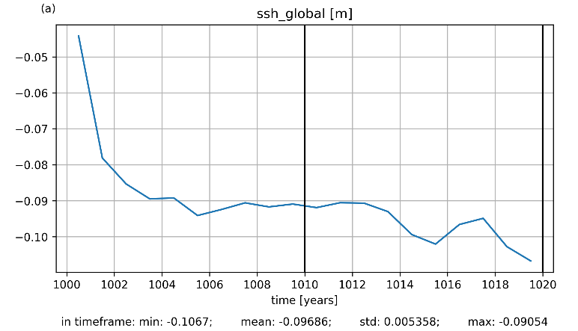
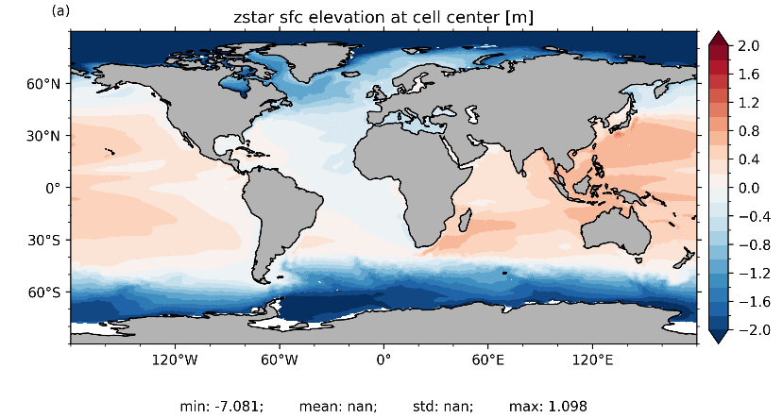
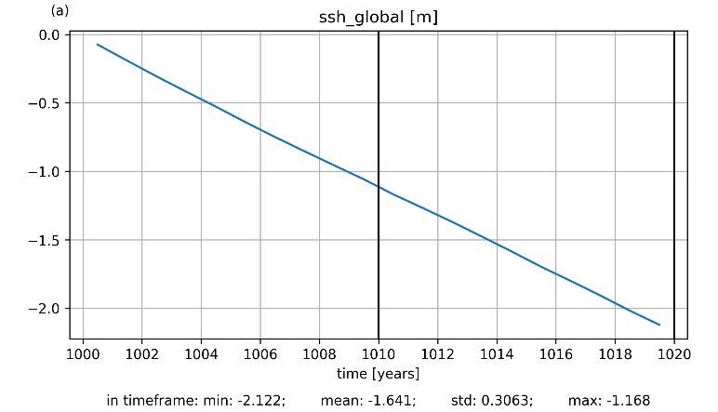
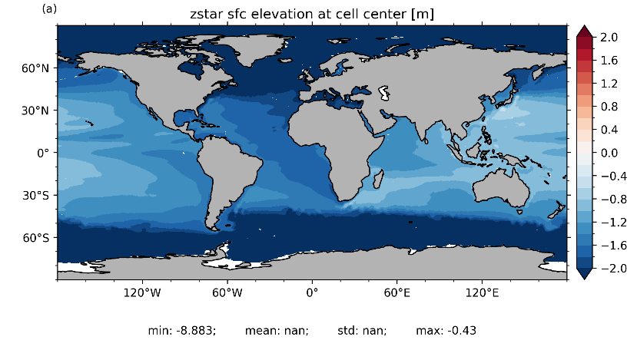
Hydrological discharge (HD), impact on sea surface
- 2.5cm/10y
with
HD-model
- 1.1m/10y
without
HD-model
Martin Köhler
Small remaining water conservation inconsistency in TERRA

Slide 5
TERRA developments
Inclusion of HiHydroSoil v2.0 (Jürgen Helmert) (global map of soil hydraulic properties at 250m resolution)
Modifications to TERRA
Processing of data in Extpar
See https://www.futurewater.eu/projects/hihydrosoil/

Slide 6
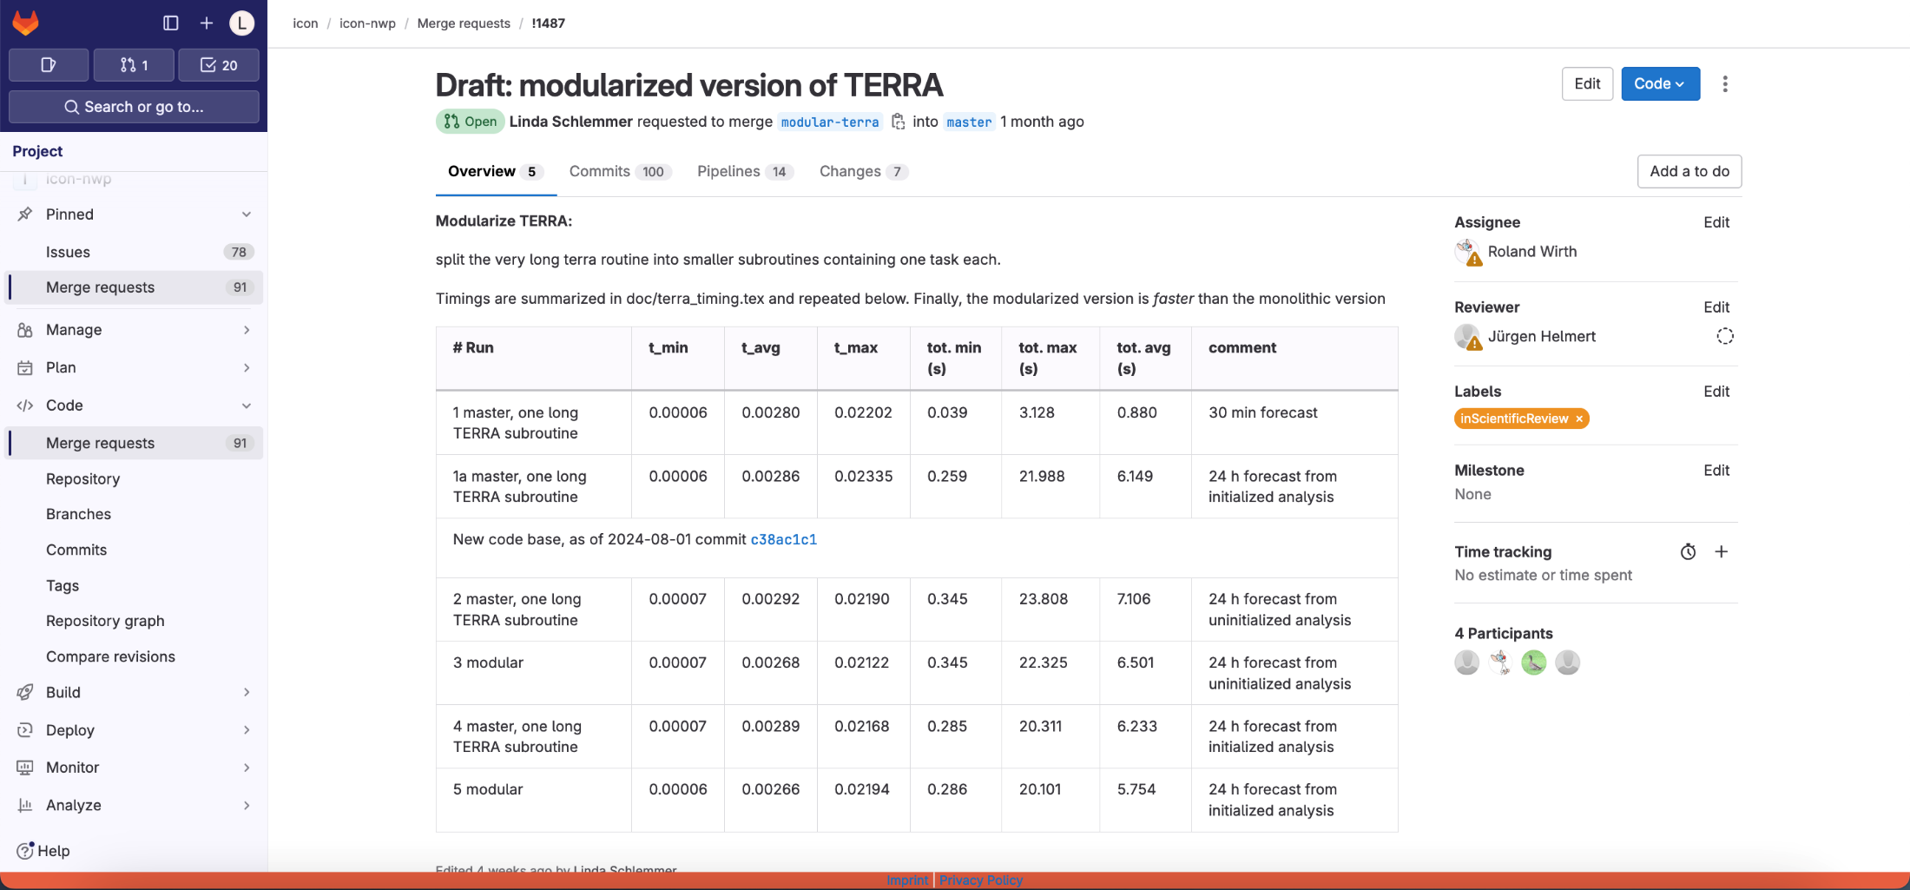
TERRA modularization
Merge request in progress (some buildbot tests still failing)
https://gitlab.dkrz.de/icon/icon-nwp/-/merge_requests/1487
Code restructuring, „identical“ results, 5-10% faster
Which further TERRA developments that are in progress must be migrated?

Slide 7
Surface analysis, developments
New Surface analysis
Snow – tests are running
SST – work in progress
T_{2m} – work in progress

Slide 8
ICON-LAND

Slide 9
ICON-LAND (ICON-XPP configuration)
Coupling of HD model via YAC completed (Trang v. Pham, Roland Wirth)
Tuning
Work on using tmx (turbulent diffusion – land coupling infrastructure) in progress (Moritz Waldmann, WarmWorld)

Slide 10
ICON-LAND (ICON-XPP configuration)
CERISE (ICON-LAND)
New snow analysis applied
Time-dependent ESA-CCI land cover used

Slide 11
ConSAT

Slide 12
Consolidation of the Surface-to-Atmosphere Transfer (ConSAT)
Tasks 2 to 5: Terra-related development
Better physical representation of the roughness cover (canopy) in the tiled model
Implicit equilibrium treatment of surface processes
Related overall revision of TERRA, the coupling of snow and dynamical snow-tiling
Facing the challenges of increased time steps and a more complete physical representation of surface-processes
According to the concept: ISUP (in combination with a GBLA)
Concern modules sfc_terra, turb_transfer (turbtran), and including ICON interfaces and utility routines
Principal contributor: Matthias Raschendorfer
Other thematically involved people: Jürgen Helmert, Jan-Peter Schulz, Ekaterina Maschulskaja, Günther Zängl, Martin Köhler, Roland Wirth, Moritz Waldmann, Contributors to the COSMO PP/PTs: CITTA, SAINT and ICON-projects: ICON_land/seamless/c
Matthias Raschendorfer
COSMO-GM WG3ab Offenbach 2024

Slide 13
Status of ConSAT-development related to TERRA (ICON branch mrsurf )
Task 2: Major revision of surface-layer processes towards an implicit treatment of surface temperature
To facilitate the implicit coupling of a fractional snow-cover and of a land-use roughness (canopy)
To remove the current numerical instability at large time steps
Task 2.1: New set-up of implicitly coupled heat equations
Task 2.2: Adaptations to an implicit treatment
Forming of dew/rime and water-phase transitions of precipitation at the surface
Evaporation of interception water or of the snow-cover
Calculation of sn-fraction and of updates for dynamical sn-tiles
Snow-smoothing of surface roughness
Various now detrimental limitations related to the former explicit treatment
Other model parts, which are so far based on the assumption Tg = T_B1
pending
SL snow-melting
→ No significant impact in most cases, but no oscillations of NS variables at large time steps: artificial flux-limiter is not needed anymore!
→ Previous extra-code for a multi-layer snow treatment removed: preparation for a new multi-layer snow implementation (task 3)
Matthias Raschendorfer
COSMO-GM WG3ab Offenbach 2024

Slide 14
Status of ConSAT-development related to TERRA (ICON branch mrsurf )
Task 3: Add a correctly coupled multi-layers (ML) snow-treatment
Task 3.1: Extension of the single coupled linear system of heat equations in Terra by
ML approach for the snow-cover
Being reducible to the SL approach
Task 3.2: Implementation of a particular ML snow-hydrology
pending
Task 4: Include all water-phase transitions into the implicit temperature treatment
pending
pending
Task 5: Implementation of a sophisticated canopy treatment
Not yet transferred in ICON
Matthias Raschendorfer
COSMO-GM WG3ab Offenbach 2024

Slide 15
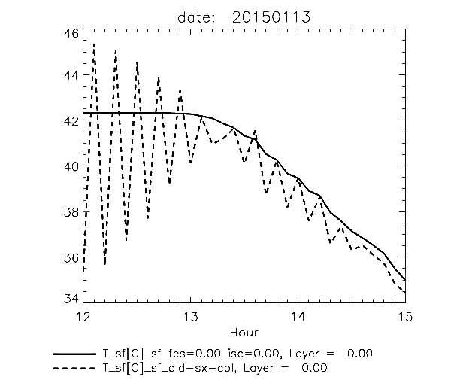
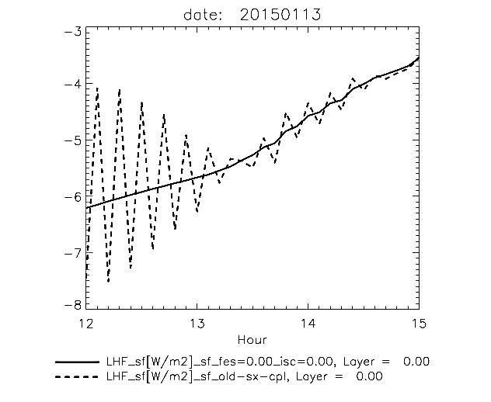
Test-grid-point Kenia (+33.71_+7.89) :
After-noon situation; tropical hot with strong radiation forcing
3 hour ICON-global test-run (R2B6, dt=6min) with
implicit defaults of the new development version of SAT-formulation (mainly TERRA)
emulation of so far operational explicit surface coupling only for a special grid-point
T_sf
LHF_sf
new-sx-cpl (Ifb=1 ; itv=1)
new-sx-cpl (Ifb=1 ; itv=1)
Oscillations almost completely eliminated, even without the operational flux-limiter in TERRA!
Matthias Raschendorfer
COSMO-GM WG3ab Offenbach 2024

Slide 16
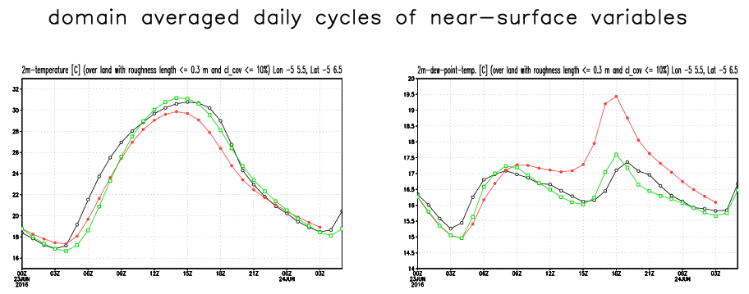
Task 5: Implementation of a sophisticated canopy treatment
by a treating an additional heat budget of a cover-layer above the sf soil (consisting of R-elements from land-use), which is
Mass-carrying
Semi-transparent
Layered with, a profile of surface temperatures and an adapted resistance coupling for sensible and latent heat transfer
Through adopting an existing prototype in a COSMO test-version as an extension of the ‘mrsurf’ development
Skin-layer equilibrium => heat budget of cover layer
pending
T_{C} according to cover heat budget.
T_{B} from flux equilibrium at B.
T_{C} and T_{B} implicitly coupled to soil-temperatures .
Resistances between δ-surfaces X and Y from TURBTRAN/TURDIFF.
n cover layers including the surface of the dense soil (n=0) are connected by long-wave radiation interaction and atmospheric sensible heat exchange
Only a part of the inner surfaces is connected to the Atmosphere by a resistance chain, the other part is for the inter- surface exchange
Matthias Raschendorfer
COSMO-GM WG3ab Offenbach 2024

Slide 17
The puzzle

Slide 18
The puzzle
(ICON master) CITTA’ and new external parameters for land use
(ICON private) NIX and modularized TERRA
(ICON private) NIX and ConSAT treatment of the heat equation
(ICON private) NIX and dynamical snow tile
(ICON private and COSMO) ConSAT and modularized TERRA
(ICON private and COSMO) Piecewise transfer of ConSAT developments into ICON master
…
jean-marie.bettems@meteoswiss.ch, COSMO GM 2024, Offenbach 18

Slide 19
NIX CITTA’

