Slide 1
Overview WG DYN ‘dynamics and numerics’
(formerly WG2) -
Actual status of the BRIDGE project
COSMO General Meeting, Offenbach
02-05. Sept. 2024
Michael Baldauf (DWD)
M. Baldauf (DWD)
1

Slide 2
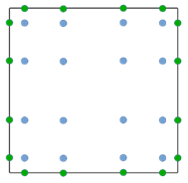
Discontinuous Galerkin (DG) methods in a nutshell
e.g. Cockburn, Shu (1989) Math. Comput.
Cockburn et al. (1989) JCP
Hesthaven, Warburton (2008)
1.) Finite-element representation
2.) Galerkin approach → weak formulation
From Nair et al. (2011) in ‚Numerical
techniques for global atm. models'
3.) Finite-volume ingredient: numerical flux
4.) Gaussian quadrature for the volume and surface integrals
→ ODE-system for q^{(k)}_{jl}(t)
5.) Use a time-integration scheme (Runge-Kutta, …)
M. Baldauf (DWD)
2

Slide 3
Discontinuous Galerkin (DG) methods in a nutshell
e.g. Cockburn, Shu (1989) Math. Comput.
Cockburn et al. (1989) JCP
Hesthaven, Warburton (2008)
1.) Finite-element representation
higher order discretization ✓
2.) Galerkin approach → weak formulation
From Nair et al. (2011) in ‚Numerical
techniques for global atm. models'
works on unstructured grids ✓
Local conservation ✓
3.) Finite-volume ingredient: numerical flux
allows explicit time integration ✓
4.) Gaussian quadrature for the volume and surface integrals
→ ODE-system for q^{(k)}_{jl}(t)
allows massive parallelisation ✓
5.) Use a time-integration scheme (Runge-Kutta, …)
high computational intensity ✓
M. Baldauf (DWD)
3

Slide 4
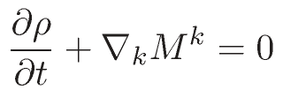
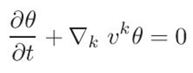
Euler equations (in covariant form)
Continuity eq.:
Momentum eq.:
Energy budget eq.:
Variant 1: use density weighted potential temperature
Variant 2: use total energy density
p=p(θ)
E = E_{kin} + E_{pot} + E_{int}
p=p(E_{int})
In case of diffusion: T^{ik} → T^{ik} + T^{ik}_{diffus} , …
M. Baldauf (DWD)
4
M. Baldauf (DWD)

Slide 5
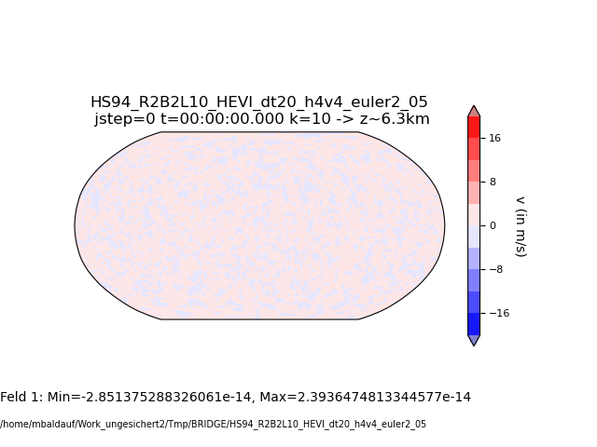
Held, Suarez (1994) test = ‚poor mans climate run‘
Only solve the pure Euler equations (no diffusion, no microphysics, …),
but add height and latitude dependent relaxation terms on the rhs of the momentum and energy equations.
Stabilization by standard exponential filtering
necessary.
M. Baldauf (DWD)
5

Slide 6
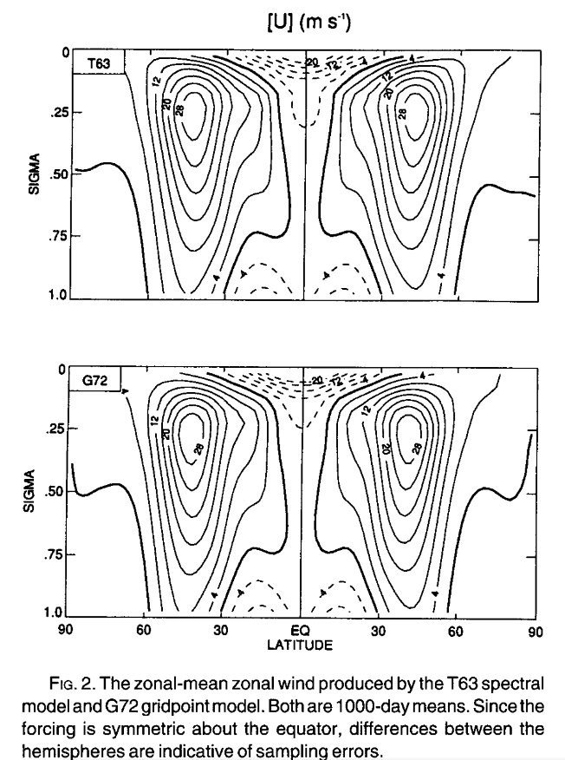
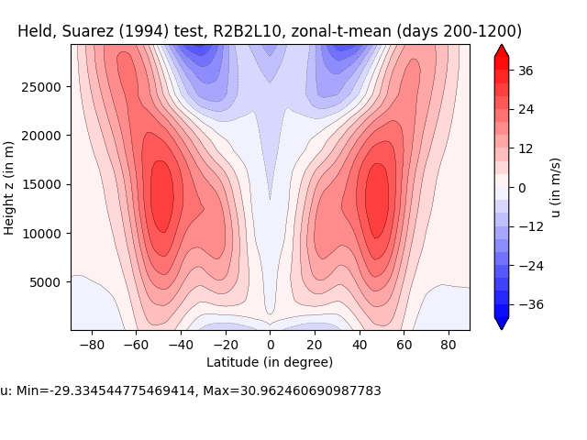
Held, Suarez (1994) test = ‚poor mans climate run‘
Init.: Jab., Will. (2006)
Init.: v=0, T=250K
From Held, Suarez (1994)
M. Baldauf (DWD)
6
BRIDGE

Slide 7
Using real orography data
Our DG scheme needs in every (horizontal) quadrature point (i.e. in the cells and on hfaces):
Orography h_{oro}
First horizontal derivatives of h_{oro} for transformation matrices and the metric tensor g_{ij}
Second horizontal derivatives of h_{oro} for Christoffel symbols Γ ^{i}_{jk} (mainly needed in the diffusion operator)
Until now, we have used only analytically given orography and their derivatives and just calculated it in every point we needed.
We need a more general approach to deal with real orography data…
M. Baldauf (DWD)
7

Slide 8
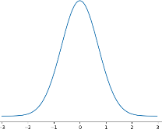
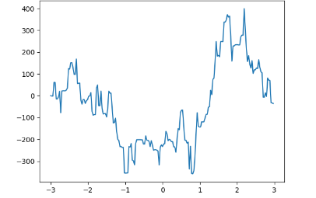
How to treat orography?
Numerically via terrain-following coordinates (ICON, COSMO-model, …)
New: preprocessor for orography (pre_pr_oro.py): goal: generate filtered orogr. + 1st + 2nd derivatives (consistently!)
scipy: kd-tree, 2D-interpolation unstruct. -> regular, integrations (on tangential planes)
pre_pr_oro.py is ‚embarassingy‘ parallelized
EXTPAR delivers the ultra-highly resolved orography data (runs into memory problems ☹)
Maybe also of interest for current ICON?
(Baldauf, 2021, JCP)
x²
x¹
h(ξ) =
maybe fractal orography
M. Baldauf (DWD)
8

Slide 9
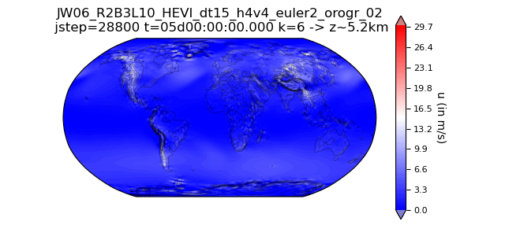
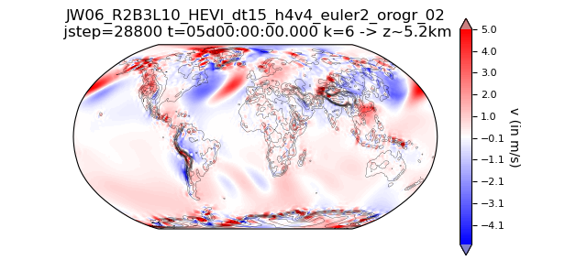
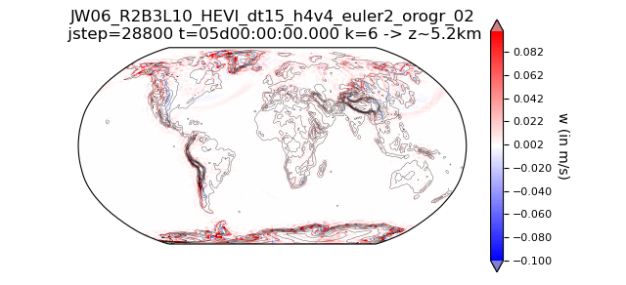
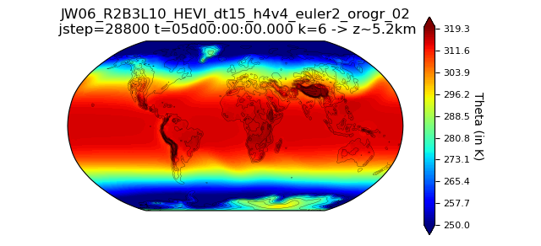
Jablonowski, Williamson (2006) test setup but with real orography (and constant diffusion), R2B3L10
u
v
w
Θ
Use a preprocessor (pre_pr_oro.py) to calculate 1st + 2nd derivatives of orography (from a highly resolved EXTPAR output (fractal) orography field)
M. Baldauf (DWD)
9

Slide 10
Project: ICON-DG: Gearing up the ICON Model with Smarter Discretizations
in the call ‚WarmWorld Module 4 Smarter‘ by German Ministry of Research and Educ. (BMBF)
has been accepted.
Duration: 01.07.2024 - 30.06.2027
Project partners:
DLR Köln, Inst. for software technology, project leader: Johannes Markert
Univ. Köln, Division of Mathematics, group Prof. Gregor Gassner postdoc: Tristan Montoya
DWD, M. Baldauf, BRIDGE group
Goal: develop further stabilization of DG schemes by designing entropy stable / entropy conserving schemes (=obeying 2nd law of thermodynamics) especially for the prismatic grid cells used in ICON / BRIDGE with HEVI and horiz. flux transformations. → ‚Next Generation DG methods‘
e.g. Gassner, Winters (2021) Front. Phys.
M. Baldauf (DWD)
10

Slide 11
Discontinuous Galerkin (DG) methods in a nutshell
e.g. Cockburn, Shu (1989) Math. Comput.
Cockburn et al. (1989) JCP
Hesthaven, Warburton (2008)
1.) Finite-element representation
via Integration by parts
2.) Galerkin approach → weak formulation
From Nair et al. (2011) in ‚Numerical
techniques for global atm. models'
Discrete analogon:
summation by parts
→ also allows derivation of stability statements.
3.) Finite-volume ingredient: numerical flux
4.) Gaussian quadrature for the volume and surface integrals
→ ODE-system for q^{(k)}_{jl}(t)
5.) Use a time-integration scheme (Runge-Kutta, …)
M. Baldauf (DWD)
11

Slide 12
Project: ICON-DG: Gearing up the ICON Model with Smarter Discretizations
in the call ‚WarmWorld Module 4 Smarter‘ by German Ministry of Research and Educ. (BMBF)
has been accepted.
Duration: 01.07.2024 - 30.06.2027
Project partners:
DLR Köln, Inst. for software technology, project leader: Johannes Markert
Univ. Köln, Division of Mathematics, group Prof. Gregor Gassner postdoc: Tristan Montoya
DWD, M. Baldauf, BRIDGE group
Goal: develop further stabilization of DG schemes by designing entropy stable / entropy conserving schemes (=obeying 2nd law of thermodynamics) especially for the prismatic grid cells used in ICON / BRIDGE with HEVI and horiz. flux transformations. → ‚Next Generation DG methods‘
e.g. Gassner, Winters (2021) Front. Phys.
M. Baldauf (DWD)
12

Slide 13
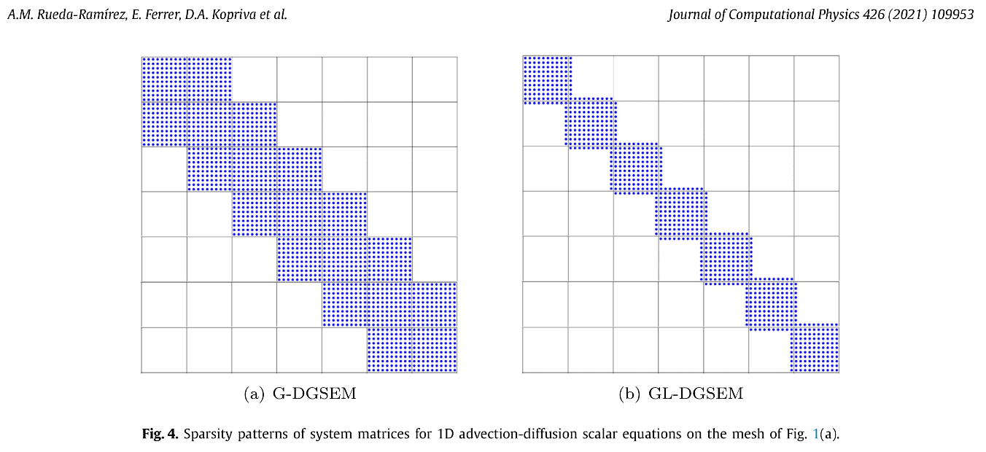
F. Prill
Optimization of the HEVI solver by Schur complement
Andrés M. Rueda-Ramírez et al. (2021) JCP: A statically condensed discontinuous Galerkin spectral element method …
This method (using Gauss-Lobatto quadratures in the vertical) improves efficiency of the BRIDGE HEVI solver up to 30% (for a 4th order DG scheme treating diffusion, too)!
M. Baldauf (DWD)
13

Slide 14
DG discretization of the TKE-equation
A very first implementation of a TKE equation (leading to a one-equation turbulence closure) together with a very simple ‚transfer scheme‘ (just a log.-wall law) has been done. This work is done just
to give an example, how more complicated turbulence models using extra transport equations can be implemented in and coupled to the DG solver
Check usefulness of the code design
M. Baldauf (DWD)
14

Slide 15
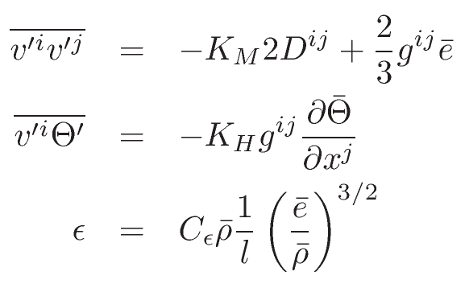
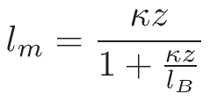
Example: Turbulence closure by a one-equation TKE model
Density of the turbulent kinetic energy (TKE density):
TKE equation:
Parameterizations:
Diffusion coefficients:
Mixing lengths (here only neutral case):
BCs from a simplified ‚transfer scheme‘ (wall law) for neutral stratification:
u* from
→ in z=0: u‘w‘=u*², v=0 and e = cρ u*²
Note: it is not the purpose of this implementation to have a ‚good‘ turbulence parameterization, but to have the main ingredients that must be considered for a DG treatment!
M. Baldauf (DWD)
15

Slide 16
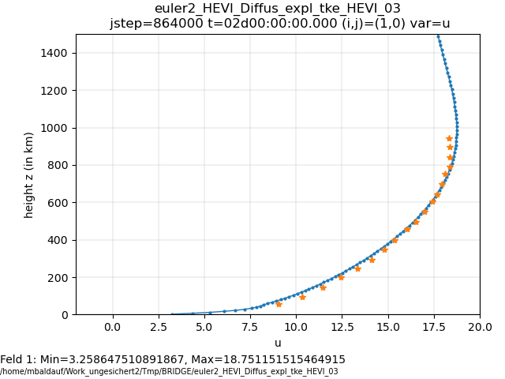
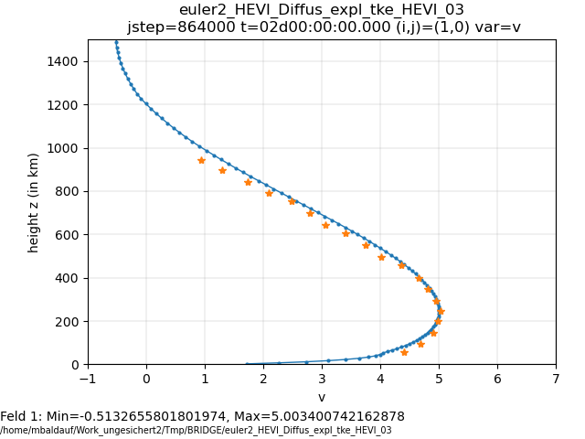
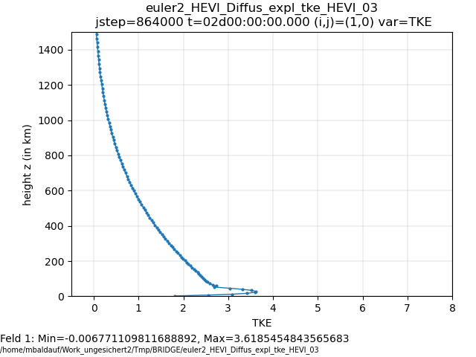
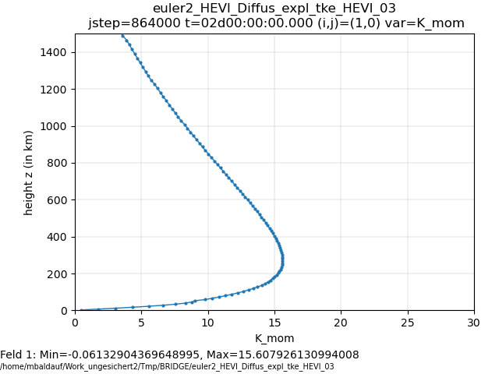
Euler equations + TKE-turbulence model
Simulation of the ‚Leipzig wind profile‘ (from 1931!) u_{g}=17.5 m/s, z₀=0.3m, l_{B}=40m
(u, v obs. data from Detering, Etling (1985))
u
v
Now TKE diffusion is solved vertically implicit.
Apart from a (simple) linearisation, this could mainly be achieved by code reorganisation.
TKE
K_{M}
Observed:
u* ~ 0.65 m/s
Simulated: u* ~ 0.667m/s
M. Baldauf (DWD)
16
Notes:
HEVI-Diffusion der TKE-Gl.: im wesentlichen nur code-Organisation (nutze equation Klassen!)

Slide 17
Object oriented code design in BRIDGE: equation classes
t_equation_base
<<abstract>>
init()
init_var()
flux_expl()
flux_expl_hface()
source_term_expl()
t_eq_adv2D
t_eq_euler
flux_impl_x3()
source_term_impl()
…
t_eq_euler2
flux_impl_x3()
source_term_impl()
…
t_eq_adv3D
t_eq_tracer_micro
t_eq_shw
Sub equation
classes
Master equation classes
t_eq_tke
M. Baldauf (DWD)
17

Slide 18
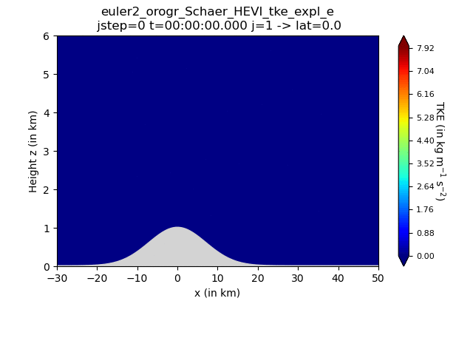
Example of a boundary layer separation behind a mountain; Euler equations + TKE turbulence model:
u₀=10m/s, N=const
Δx=4 km
z₀=0.3m
M. Baldauf (DWD)
18

Slide 19
Limited area modelling (LAM-mode)
1.) Treat lateral boundaries
Enhance the grid data structures (mo_model_domain: extensions in t_triangulation, ..): identify and enumerate boundary edges and nudging zone cells (in an MPI parallelized environment, possibly with local refinement) ✓
Implement lateral boundary conditions (weak DG approach): Dirichlet conditions with prescribed boundary values ✓
Apply nudging zone: additional, explicitly treated, relaxation source terms ✓
Environment: torus grid generator torus_gridgen.py now can generate rectangly shaped triangle LAM grids, too. ✓
2.) Interpolate boundary values from a coarser model run this step is postponed to the ICON implementation of BRIDGE
1
1
1
1
2
2
2
3
3
3
M. Baldauf (DWD)
19

Slide 20
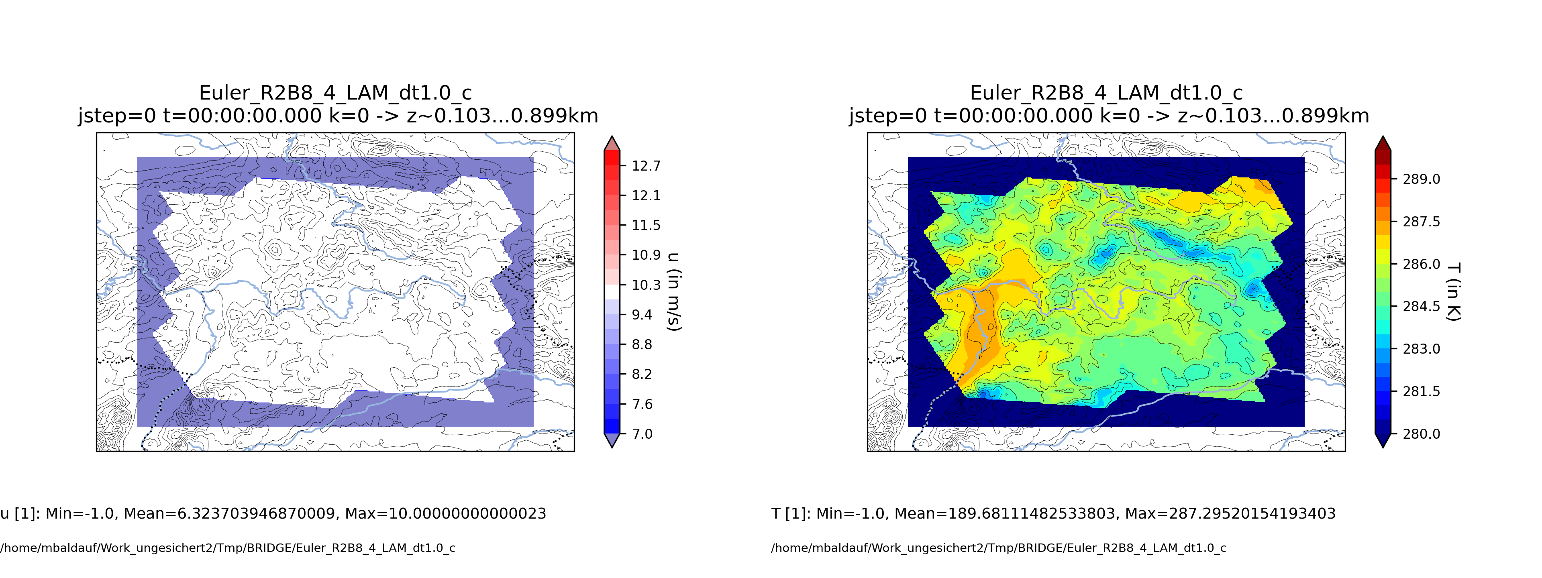
Example of a ‚LAM‘-run: area central Germany (around Offenbach ☺), R2B8 (~10km)-LAM grid
Constant inflow (u,v)=(10,10) m/s, N=0.01 1/s
pre_pr_oro.py: orography on R2B10, (~2.5km) generated from R2B13 (~300m) ASTER data
M. Baldauf (DWD)
20

Slide 21
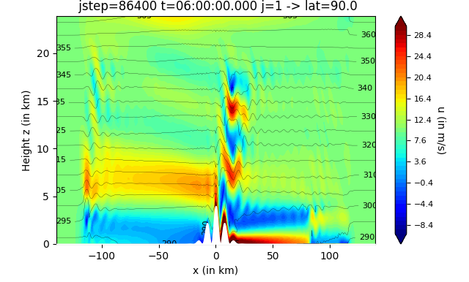
Flow over mountains with steep slopes and vertical grid stretching
Schaer et al. (2002) MWR, test case 5b: U₀=10m/s, N=0.01 1/s, but a=10km
H_{oro}= 4000m,
α_{max} = 58°
Δx=4 km; vertical grid stretching: Δz_{min}~46m, Δz_{max}~736m, z_{lowest QP}~10.3m
HEVI-DG simulation (4th order) remains stable even for steeper slopes! (Baldauf, 2021)
to avoid instability by strong gravity wave breaking, vertically implicit diffusion with K=100 m²/s was used
M. Baldauf (DWD)
21

Slide 22
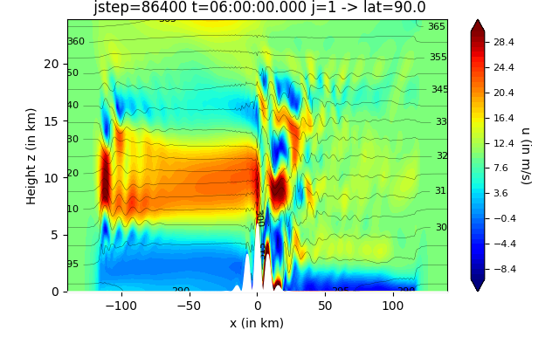
Flow over mountains with steep slopes and vertical grid stretching
Schaer et al. (2002) MWR, test case 5b: U₀=10m/s, N=0.01 1/s, but a=10km
H_{oro}= 6000m,
α_{max} = 67°
Δx=4 km; vertical grid stretching: Δz_{min}~46m, Δz_{max}~736m, z_{lowest QP}~10.3m
HEVI-DG simulation (4th order) remains stable even for steeper slopes! (Baldauf, 2021)
to avoid instability by strong gravity wave breaking, vertically implicit diffusion with K=100 m²/s was used
M. Baldauf (DWD)
22

Slide 23
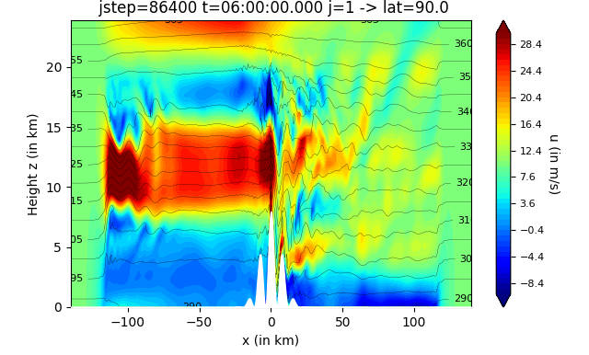
Flow over mountains with steep slopes and vertical grid stretching
Schaer et al. (2002) MWR, test case 5b: U₀=10m/s, N=0.01 1/s, but a=10km
H_{oro}= 8000m,
α_{max} = 72°
Δx=4 km; vertical grid stretching: Δz_{min}~46m, Δz_{max}~736m, z_{lowest QP}~10.3m
HEVI-DG simulation (4th order) remains stable even for steeper slopes! (Baldauf, 2021)
to avoid instability by strong gravity wave breaking, vertically implicit diffusion with K=100 m²/s was used
M. Baldauf (DWD)
23

Slide 24
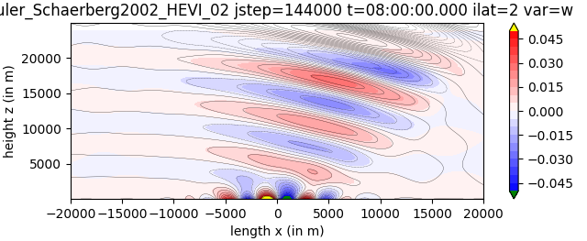
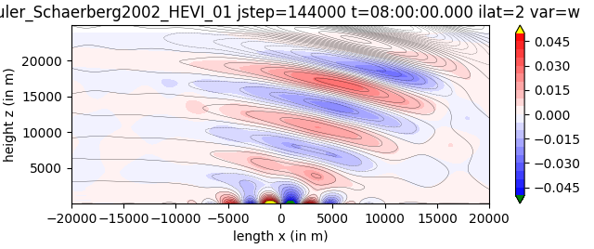
Linear flow over mountains
Schaer et al. (2002) MWR, test case 5b: U₀=10m/s, N=0.01 1/s, a=5 km
Inflow conditions
U=10m/s
→ Slightly improve similarity with the analytic solution (back lines)
Periodic BCs
M. Baldauf (DWD)
24

Slide 25
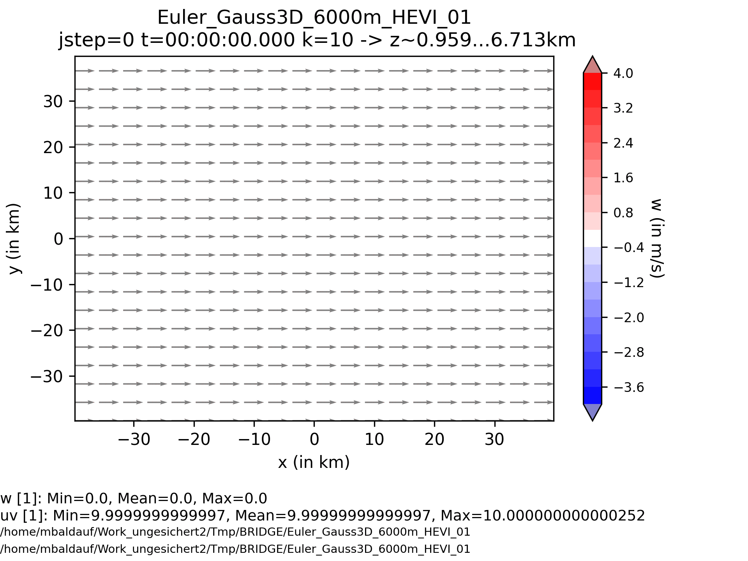
Flow over a mountain with fixed inflow conditions
Generation of a Karman vortex street
U=10 m/s
N=0.01 1/s
max h_{oro} = 6000m
Δx=Δy=2 km
M. Baldauf (DWD)
25

Slide 26
Physics-dynamics coupling
Goal: analogous to ICON, calculate Euler dynamics on a ‚dynamics time step‘ dt_{dyn} whereas (fast) physics (diffusion terms, microphysics, turbulence) uses a larger time step dt_{phys}
Idea: use Strang-splitting, e.g with the sequence DDDPDDD in every (physics) time step, i.e. dt_{phys} = 6 * dt_{dyn} Remember: Strang splitting is of overall 2nd order, if the single processes are of 2nd order. This is guaranteed via Runge-Kutta-time integration in every process (implicit steps in parameterizations?)
Example ‚falling bubble‘ test: diffusion (via Bassi, Rebay (1997) ‚BR1‘ scheme) on the fast physics time step → roughly halves the wall clock time
Namelist-param. t_config_timestepping::time_integration_scheme_couple="split2"
Use two instances of t_timestep_imex (allows e.g. different time integration schemes SSP3(4,3,3) for Euler and SSP(3,3,2) for diffusion
M. Baldauf (DWD)
26

Slide 27
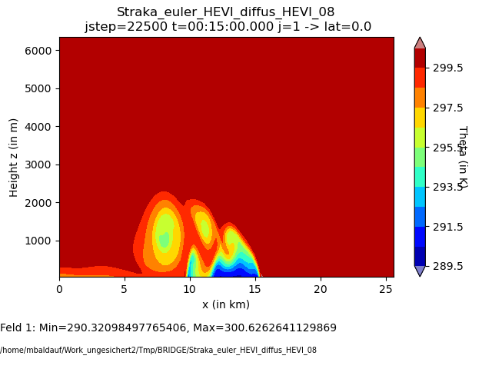
Physics-dynamics coupling: example falling bubble test (Straka et al., 1993)
NEW:
dt(diffusion) = 6 * dt(Euler):
Euler + Diffusion both use dt(Euler)
dx=dz=400m, dt(Euler)=0.04s
M. Baldauf (DWD)
27

Slide 28
Other topics in ‚COSMO year‘ 2024
Revision of boundary conditions in the HEVI solver; free-skip conditions with diffusion: ➔ global conservation of density, momentum and energy: rel. change ~ 10⁻¹⁷ / time step
Restart capability available (F. Prill)
HEVI-Diffusion for ‚euler2‘-Gln. (ρ, ρv, E), too (← Linearisations) COSMO-meetings, presentations 2024
WG DYN (WG2) meeting during ICCARUS 2024 and COSMO GM 2024
Discussion about BRIDGE during WG3a meeting at ICCARUS 2024 (couping of turbulence)
presentations at the 5th ‚Math. Of the Weather‘ workshop‘ in Bad Orb, Oct. 2024, and the SRNWP/EWGLAM meeting
M. Baldauf (DWD)
28

Slide 29
The BRIDGE project (Basic Research for ICON with DG Extension)
BRIDGE is an informal project at DWD, started ~ mid 2020
Staff: M. Baldauf, F. Prill, D. Reinert
Goals:
develop a prototype for a Discontinuous Galerkin (DG) discretization of the 3D Euler equations (‚DG-HEVI on the sphere‘)
together with a minimal set of physical parameterizations
using ICON infrastructure (parallelisation via YAXT, I/O, ...)
more object-orientation and use of standard software (e.g. YAC coupler, ...)
→ BRIDGE is an intermediate step to a full–fledged ICON implementation.
Later on (starting ~2024), the BRIDGE code will serve as a code base for the final ICON-DG model.
At the moment a dramatic paradigm change takes place:
AI/ML development sucks off people since ~end of last year.
M. Baldauf (DWD)
29
29

Slide 30
Milestones of the BRIDGE-project (status Sept. 2023)
0. first version of a FE/DG framework available, MPI parallelized Q2/2021 ✓
1. shallow water equations on the sphere, explicit time integration (RK) Q3/2021 ✓
2. 3D Euler equations on the sphere, explicit time integration (RK) Q1/2022 ✓
2.b with 3D diffusion (+ a simple turbulence scheme) BR1/BR2 Q2/2022 ✓/
2.c grid refinement works Q2/2022 ✓
3. Euler equations, HEVI time integration (IMEX-RK) Q3/2022 ✓
3.b optimization of the vertically implicit solver (Schur compl.,...) Q4/2022 ✓/... 3.c with 3D diffusion (+ a simple turbulence scheme), HEVI Q1/2023 ✓
4. cloud microphysics (Kessler) + tracer advection (positive definit)
+ explicit sedimentation scheme Q4/2022  !
4.b cloud microphysics (cloud ice, Graupel) + vertically implicit sedimentation scheme Q1/2023 4.c HEVI diffusion on physics time step; overall time integration Q4/2023
5. limited area version available Q1/2023
5.b vectorized version available Q2/2023
5.c GPU version Q1/2024
6. coupling of a full fledged turbulence + BL scheme Q2/2023 
M. Baldauf (DWD)
30

Slide 31
Milestones of the BRIDGE-project (status Sept. 2024)
0. first version of a FE/DG framework available, MPI parallelized Q2/2021 ✓
1. shallow water equations on the sphere, explicit time integration (RK) Q3/2021 ✓
2. 3D Euler equations on the sphere, explicit time integration (RK) Q1/2022 ✓
2.b with 3D diffusion (+ a simple turbulence scheme) BR1/BR2 Q2/2022 ✓/
2.c grid refinement works Q2/2022 ✓
3. Euler equations, HEVI time integration (IMEX-RK) Q3/2022 ✓
3.b optimization of the vertically implicit solver (Schur compl.,...) Q4/2022 ✓
3.c with 3D diffusion (+ a simple turbulence scheme), HEVI Q1/2023 ✓
4. cloud microphysics (Kessler) + tracer advection (positive definit)
+ explicit sedimentation scheme Q4/2022  !
4.b cloud microphysics (cloud ice, Graupel) + vertically implicit sedimentation scheme Q1/2023 ! 5. HEVI diffusion on dt(fast phys.); physics-dynamics coupl./time integr. Q4/2023 ✓/
6. limited area (=use lateral BCs) version available Q1/2023 ✓/…
7.a vectorized version available Q2/2023
7.b GPU version Q1/2024
7.c general code optimization Q4/2024 !
8. coupling of a one-equation turbulence + BL scheme Q2/2023 ✓
M. Baldauf (DWD)
31

